Slide 1
Taylor Ch 2:
Projectiles (and drag) and, basic ODE math.

Slide 2
Classify this ODE:
y’’ = sin(x) y
1st order, nonlinear
1st order, linear
2nd order, nonlinear
2nd order, linear
E) None of these
Notes:
Phys 2210 Fa’12 SJP Lecture #3
I cleaned this up, see next slide.

Slide 3
Classify this ODE:
y’’(x) = sin(x) y(x)
1st order, nonlinear
1st order, linear
2nd order, nonlinear
2nd order, linear
E) None of these
Notes:
Phys 2210 Sp’12 SJP Lecture #3
Using previous version, 3, 0, 25, [[72]], 0. And the year before, 2, 6, 10, [[82]], 0
(See previous slide for discussion – I changed the notation after class)
I added the notation (x) for y’’ and y after giving the question in class, because I think it should be there.
The discussion was as it should be – is this linear or not? (It doesn’t have to be linear in x, it needs to be linear in y) I claim this is 2nd order, linear (because no functions of y)
Idea from: M. Dubson, A. Marino, M. Betterton

Slide 4
Classify this ODE:
y’’ + x²y + 1 =0
Linear (not Homogeneous)
Homogeneous (not Linear)
Linear and Homogeneous
Nonlinear and Inhomogeneous
Notes:
Phys 2210 Sp’12 SJP Lecture #3. I animated the slides so they could decide it all on their own first.
[[93]], 1,1, 4, 0
Last year: [[90]], 0, 8, 2, 0
All seems good – discussion was heated, but didn’t take them long, they’ve got this.
I claim linear (it’s y that matters, not x), and non homogenous due to the +1.
Idea from: M. Dubson, A. Marino, M. Betterton

Slide 5
Classify this ODE:
y’’(t) + ty(t) + 1 =0
Linear (not Homogeneous)
Homogeneous (not Linear)
Linear and Homogeneous
Nonlinear and Inhomogeneous
Notes:
Didn’t bother…
Same as last. I cleaim linear (it’s y that matters, not x), and non homogenous due to the +1.
Idea from: M. Dubson, A. Marino, M. Betterton

Slide 6
Classify this ODE:
y’’(t) = (t+1)y(t)
Linear (not Homogeneous)
Homogeneous (not Linear)
Linear and Homogeneous
Nonlinear and Inhomogeneous
Notes:
Didn’t bother
C) I claim linear (it’s y that matters, not x), and homogenous
Idea from: M. Dubson, A. Marino, M. Betterton

Slide 7
Classify this ODE:
y’ = sin(y) +1
Linear (not Homogeneous)
Homogeneous (not Linear)
Linear and Homogeneous
Nonlinear and Inhomogeneous
Notes:
Phys 2210 Sp’12 SJP Lecture #3
We didn’t click, but I had them shout out their opniions. That worked fine. Someone shouted “separable”, which is a nice observation.
I claim D, nonlinear, inhomogeneous (nonlinear because of the sin(y)
Idea from: M. Dubson, A. Marino, M. Betterton

Slide 8
Is this ODE homogeneous?
y’’ = (x+1)y
Yes
No
???
Notes:
Phys 2210 Sp’12 SJP Lecture #3
Again, no click, but they shouted it out. The “homogenous” question generated a quick discussion, but they quickly settled on yes, it’s homogeneous. (The extra term is +y, no problem)
I claim yes, this is 2nd order, linear, homogeneous
Idea from: M. Dubson, A. Marino, M. Betterton

Slide 9
Consider the ODE: dN/dt – kN = 0
with k>0 and N(t=0)=N₀>0.
How does N(t) behave as t➔∞?
N(t) decays to zero
N(t) approaches a constant value
N(t) stays constant the whole time
N(t) diverges (approaches ∞)
Not enough info given!
Notes:
Phys 2210 SP’12 SJP Lecture #3
Apparently I forgot to have them click- In Sp ‘11 it was 0, 0, 0, [[98]]], 2
I let them work this out at their desks, gave about 5 minutes. It’s good. Many did it qualitatively, but I pushed them to solve it analytically. Good discussion. I asked them about a physical system this represents – one tried “Newton’s cooling” (close, though that one doesn’t have k>0), and another came up with population. I asked WHY dN/dt would be proportional to N in that case, got some good answers from students.
Good to compare this to dN/dt = k (which gives different solution, linear!)
There’s lots here, we didn’t quite have time (I didn’t do the separation of variables solution for them, they seemed to intuit it or remember it. MANY thought the answer was N(t) = e^kt, they weren’t thinking about the normalization. (I asked them if they could do e^kt + c, which some of them were claiming.)
D) This gives the growing exponential solution.
Idea from: L. Carr

Slide 10
The magnetic force on a particle (charge q, velocity v) is F = q v x B.
If q>0, v(t=0) = +v₀ î, and B(x,y,z) = B₀ ĵ, how does the particle move?
straight line motion
circular orbit in xy plane
circular orbit in yz plane
circular orbit in xz plane
helical motion
Notes:
Answer is D. I skipped magnetism.

Slide 11
In the last problem, suppose v now has a component in the B direction (ĵ), and a perp. component (î). It starts in the y=0 plane and crosses the y=y_{final} plane at time T. If you increase only the initial perpendicular component of v, what happens to the “passage time” T.?
T is independent of v_{perp}
T increases as v_{perp} increases
T decreases as v_{perp} increases
Notes:
I Skipped this topic.
A) The component of v parallel to B “carries it” along the helix, this is what determines this passage time. The perpendicular component of v0 will change the radius of the circles it makes parallel to the xz plane, (although in fact not the period of that either). But this is irrelevant to the question.

Slide 12
The magnetic force on a particle (charge q, velocity v) is F = q v x B.
If q>0, v(t=0) = +v₀ î, and B(x,y,z) = B₀ î, how does the particle move?
straight line motion
circular orbit in xy plane
circular orbit in yz plane
circular orbit in xz plane
helical motion
Notes:
I skipped this topic.
A) This V is parallel to B, so there is no magnetic force.

Slide 13
In a homework problem, a student derives a formula for position.
The problem involves gravity and a “drag force” F= -cv,
where v is speed. They get a term that looks like
Is there any way to tell if they made a mistake, without carefully looking over all their work?
Yes, I see a nice check
There probably is but I’m not seeing the “trick”
With a formula this messy, the only way to check is to redo the work (or compare with someone else, or the book, or google it, or …)
Notes:
Phys 2210 Sp ‘12 SJP Lect #4
Preclass question. [[62]], 34, 2
This is a big improvement over last year’s version. (see next slide, now hidden)
We wanted to start emphasizing what physicists mean by “checking” (to many students, that just means “do it again carefully”, nothing more!) This is the first of many such activities, we may need more!
Units are “easy to spot” here (since cv is a force, cv/g is manifestly not unitless). I pointed out that y = yinit*ln(…) looks good, what could be the problem? Lots of students saw it, for those who didn’t it was a good “pitch” about a useful checking mechanism in homeworks)
I briefly mentioned that there are other checks. For instance, I don’t even know what this QUESTION was, I’m just looking at an answer, and units told me it must be wrong. They also point to my possible mistake (I bet I dropped an “m”!) But what about if v_init=0? That’s a different kind of check, a limit. Here, it says that y=y_init log(1) = 0, so y =0 INDEPENDENT OF Y(initial). That could be a clue that something is seriously wrong. (Although, now I need to know the problem, there are problems were that might be reasonable, but others where it might be preposterous)
Sense-making/checking is a “physicists” skill that we may need to be quite explicit about. We have evidence that it only comes along VERY SLOWLY if we don’t address it directly like this.

Slide 14
In a Phys 1110 exam, a student produced the following solution.
- Is the final solution correct?
- If NOT, does that mean the initial equation must have been wrong?
- If NOT, and assuming the initial equation is NOT wrong,
find the error using
dimensional analysis.
Notes:
From Joe Redish
(The error is that omega = v/R, not v^2/R)
This didn’t work so well, people spotted the physics error, rather than using dimensions as a check. It focused their attention in ways I didn’t find productive.

Slide 15
Which of these ODEs for y(t) are separable?
i) ii)
iii)
none
i & ii
ii & iii
i & iii
all
Notes:
Phys 2210 Sp ‘12 SJP Lecture #4
0, 5, [[95]], 0, 0
Sp ‘11: 2, 2, [[85]], 0, 10
I claim ii and iii by inspection. (I separated them on the board, asked students what to do next. Pointed out that for ii, the integral might not look trivial. That’s ok, it’s “solved in principle” at this point, even if perhaps not analytically)
It’s hard to PROVE that i cannot be separated, I just tried, and failed, and couldn’t see how to do so.
Students seem to be doing well on this!
Idea from: M. Dubson, A. Marino, M. Betterton

Slide 16
Classify this ODE:
1st order, nonlinear
1st order, linear
2nd order, nonlinear
2nd order, linear
E) None of these
Notes:
Phys 2210 Sp ‘12 SJP, Lect #4
[[91]], 9,0,0,0 (last year, end of Lect #3, 100% correct!)
No issue that “v^2” might make them think it’s second order!
Perhaps it would be better next time not to have 1st vs 2nd order, see next slide for a new idea.
Pointed out that this is one of the (rare!) nonlinear equations we will deal with this term – soon!
I claim 1st order nonlinear. (It is, however, separable)

Slide 17
Classify this ODE:
linear, homogeneous
Nonlinear, homogeneous
linear, inhomogeneous
Nonlinear, inhomogeneous
To think about: What order is it? Is it separable, or not?
Notes:
Maybe try this version! (See prev slide for more comments, haven’t tried this version yet)
No issue that “v^2” might make them think it’s second order! Pointed out that this is one of the (rare!) nonlinear equations we will deal with this term – soon!
I claim nonlinear, inhomogeneous, separable. In this case, “separable” is really all we care about, it’s easy to solve!

Slide 18
Classify this ODE:
y’(x) + P(x) y(x) = Q(x)
Order?
Linear?
Homogeneous?
Separable?
Notes:
Phys 2210 Sp ‘12 SJP Lect #4.
Let them call it out. It’s a very generic 1st order linear ODE. Last year I worked out details of the solution, this year I did not (though I did show it to them, see next slide). The point is not to derive the solution (I don’t see the importance of that right here and now, seems like a distraction), but rather that they should know that there IS a straightforward procedure. This is a VERY GENERIC ODE, and if they see one of this form (linear, 1st order) in their life, it’s not that they need to remember the solution – but that they should be confident that they can flip open BOAS and find it!!

Slide 19
Classify this ODE:
y’(x) + P(x) y(x) = Q(x)
1st order, linear,
NOT homogeneous (because of Q(x))
NOT separable.
Still, there IS a general solution
(with one undetermined coefficient,
as befits a 1st order linear ODE!)
Notes:
Phys 2210 Sp ‘12 SJP Lect #4.
See comments on previous slide. I didn’t work out the details.
I did point out the “basic trick”. First solve the homogeneous version where Q(x)=0. That separates, it’s easy!
Given that, we can often then add in a particular solution, and we’ve got the full/general solution. A nice idea, but we’ll come back to it later when we need it, no need to harp on the details now.

Slide 20
Consider the equation dv/dt = -k v,
where v is velocity, t is time, and k is a constant.
What motion does this describe?
a mass on a spring
a mass in free-fall
a moving mass with a drag force
a moving mass with a driving force
something else entirely!
Notes:
Phys 2210 Sp ‘12 SJP Lect #4
9, 1, [[88]], 1, 0 (last year, 6,2, [89], 0, 2)
I phrased it like a jeopardy question. The answer id dv/dt = -kv. What is the question!
Maybe too easy? I no longer think so. It’s a nice intro question for this topic. They did fine but the discussion was robust. What I did next was to say “OK, what IS the right ODE for A? For B? Some knew it, and they’re all very CLOSE to –kv (A is –kx, B is –k)
Idea from: L. Carr

Slide 21
Suppose you solve an ODE for a particle’s motion, and find
x(t) = c(t-t₀) What can you conclude?
This particle is responding to a constant force
This particle is free (zero force)
This particle is responding to a time varying force
???
Notes:
Skipped this year.
Last year:
8, [85], 2,4,0
Discussion around this was of the “math is in a sense the easy part: it’s the connection of physics to math,and math back to physics, that is what is interesting”. This wasn’t hard for them, but the discussion was surprisingly energetic. And, there was some discussion about “visualizing the motion” which was precisely what I wanted
B. Inspired by a Lincoln Carr question

Slide 22
Suppose you solve an ODE for a particle’s motion, and find x(t) = bt².
What can you conclude?
This particle is responding to a constant force
This particle is free (zero force)
This particle is responding to a time varying force
???
Notes:
Skipped
A) Inspired by a Lincoln Carr question

Slide 23
Suppose you solve an ODE for a particle’s motion, and find :
What can you conclude?
This particle is responding to a constant force
This particle is free (zero force)
This particle is responding to a time varying force
???
Notes:
Skipped
C) (Take two derivatives!) by a Lincoln Carr question

Slide 24
For an object of “diameter D”,
f_{linear}=bv=βDv
f_{quad} = cv² = (1/2)c₀ A ρ_{air} v²
For a sphere in air, f_{quad}/f_{linear}≈(1600 s/m²) Dv
Which form of drag dominates
most microbiology contexts?
linear
quadratic
??
Notes:
Phys 2210 Sp ‘12 SJP Lecture #4.
[[95], 5
No problem. They have already thought about this for our “preflight” question too, I think.
Naive answer: For diameters on order of sub mm, and speeds at or below 1 m/s, linear. (But, there are obviously lots of exceptions, e.g. high speeds)
S. Pollock

Slide 25
For an object of “diameter D”,
f_{linear}=bv=βD
f_{quad} = cv² = (1/2)c₀ A ρ_{air} v²
For a sphere in air, f_{quad}/f_{linear}≈(1600 s/m²) Dv
Which form of drag dominates
most sports events?
linear
quadratic
??
Notes:
Didn’t have time, but talked about it.
Answer: For diameters on order of mm or higher, and velocity on order of m/s or higher, fquad is larger. So in our lives, quadratic typically dominates.(Too bad, since linear is easier to solve :-(

Slide 26
Where are you now?
Done with page 1
Done with page 2
Done with page 3
If you are done with page 3, try these:
Like in section IIc, find the terminal velocity of an object of mass m when air drag force is...
1) ...quadratic with respect to speed (c₁ = 0, c₂ ≠ 0)
2) ...a combo of both linear and quadratic terms (c₁ ≠ 0, c₂ ≠ 0)
Finally, if you still have time, find an expression for v(t) from part I. (You sketched this qualitatively in IB).
You will need to solve an ODE!
Notes:
Phys 2210 Sp ‘12 SJP
We spent 35 minutes on the Tutorial Activity 2TtVDF-RP_CUmodified_final from Ambrose/Maine.
Another 10 minutes would get more finished, but this was fine - it went great.
The clicker question was helpful – about every 10 minutes I asked them to click in, and then briefly pulled class together to discuss that page. This kept everyone more or less together. (I talked about questions when more than 2/3 of the class was past that page.) At the very end of class, I asked them to click in again, and the vote was
0, 33, 62. So, 2/3 were DONE, and 1/3 were on the last page. I think that’s about perfect. The “filler question” above was keeping everyone busy. (Last year I only saw a couple groups work on it)
The very last question is ambiguous about linear vs quadratic, if they asked I told them to do linear.
Note that the “sign” question (page 3, part II, question B) is pretty universally WRONG, some students want to flip the sign of the mg term (!) and many students want to flip the sign of the c1 v term. I did NOT “resolve” this for them, we’ll do that next class, but I did alert them to the fact that it’s subtle and important, and they should think about it before next class!

Slide 27
An object falling in air satisfies the ODE (from Newton’s 2nd law):
The equation has three dimension-ful parameters (m, g, b)
Use those three dimensionful parameters to create “Natural” scales of mass (M₀), length (L₀), and time (T₀)
b) Using these three natural scales, create a natural scale for velocity (V₀)
Notes:
From Joe Redish

Slide 28
An object falling in air satisfies the ODE (from Newton’s 2nd law):
The equation has three dimension-ful parameters (m, g, b)
Use those three dimensionful parameters to create “Natural” scales of mass (M₀), length (L₀), and time (T₀)
b) Using these three natural scales, create a natural scale for velocity (V₀)
c) Define a dimensionless velocity V by the equation V=v/V₀,
and rewrite the original ODE as an equation for V instead.
(This equation should contain NO parameters with dimensions, except where you have combinations of quantities that manifestly look dimensionless)
Notes:
From Joe Redish
I skipped it, but it’s worth considering talking about!

Slide 29
Suppose you solve an ODE (Newton’s law!) for a particle’s motion, and find
x(t) = c(t-t₀) (where c is a constant)
What can you conclude?
This particle is responding to a constant force
This particle is free (zero force)
This particle is responding to a time varying force
???
Notes:
Phys 2210, Sp12 SJP Lecture #5
19, [[72]], 7, 2,
Last year:
8, [85], 2,4,0
Answer is B. I didn’t solicit reasons for A, the first person to speak gave the nice physical interpretation (visualizing an object moving with constant speed, so no force). I used this to discuss the “math-physics connection”, that we can just take two derivatives mathematically, and find F = m d^2x/dt^2=0, but it’s also nice to do as the student did, to “visualize the motion” and help make sense of the math.
Last year: Discussion around this was of the “math is in a sense the easy part: it’s the connection of physics to math,and math back to physics, that is what is interesting”. This wasn’t hard for them, but the discussion was surprisingly energetic. And, there was some discussion about “visualizing the motion” which was precisely what I wanted
Inspired by a Lincoln Carr question.

Slide 30
Drag force is:
Consider a mass moving UP
(Let’s define DOWN as the +y direction )
Which eq’n of motion is correct?
v (moving up)
mg
f_{drag}
+y
Notes:
Phys 2210, Sp12 SJP Lecture #5
I did this silently first, and had NOT yet animated the force arrows. It was largely split among all 4 options. I didn’t stop the vote to record it, but then I animated the drag arrows and let them talk to their neighbors. The vote shifted to what you see
5, [[53]], 6, 36,0
Last year, it was a preclass question and was 2, [[34]], 15, 49, 0
I showed them this, and then moved to the next slide to let them revote.
(We give a Maine Tutorial on this last time)
Answer is B: The term which likely confuses students is the –bv_y one, because it looks like you want all “positive” (i.e. downward) terms on the right. That’s TRUE, and –bv_y IS positive in this case! (Because, v_y is negative if it’s moving up)
One direct way to see this is that the y component of {\vec v} is always v_y.
Although students typically get the linear term’s sign wrong, it is the quadratic term which in fact is the odball, because IT is the one whose explicit sign flips if the velocity turns around..
S. Pollock

Slide 31
Drag force is:
Consider a mass moving UP
(Let’s define DOWN as the +y direction )
Which eq’n of motion is correct?
v (moving up)
mg
f_{drag}
+y
Notes:
Phys 2210, Sp12 SJP Lecture #5
[[88]] for B, 12% for D.
I pretty much walked them through the critical idea- that you should ask yourself what vy’s sign is, and then see if you get the right result. (See comments on previous slide for other discussion points)

Slide 32
Drag force is
(Let’s define DOWN as the +y direction )
While moving up, the correct expression is:
v
mg
f_{drag}
+y
Notes:
Phys 2210, Sp12 SJP Lecture #5
Just setting up (animating) for next slide:

Slide 33
Drag force is
(Still define DOWN as the +y direction )
While moving up, the correct expression was:
f_{drag}
If the object is now moving DOWN,
which term(s) in that equation will change sign?
mg (only)
the linear term (only)
the quadratic one (only)
more than one term changes sign
NONE of the terms changes sign.
mg
v
+y
Notes:
Phys 2210, Sp12 SJP Lecture #5
0, 4, [[93]], 3, 0
Good followup, to make sure they’re ok. Looks good.
Sp 11: silent was 0, 15, [[65]], 17, 4, then after discussion for 2 min, it was 0, 0, [[93]], 0, 7
Comments from Sp’ 11: Despite having just explained the previous one, this is clearly a difficult idea for them. Have to be clear, vy is the “y component” of velocity, a signed quantity (it is not the magnitude of anything)

Slide 34
Drag force is
Back to moving up, the correct expression was:
+y
But, let’s now define UP as the +y direction )
v
Which term(s) in that equation will change sign?
mg (only)
the linear term (only)
the quadratic one (only)
more than one term changes sign
NONE of the terms changes sign.
mg
f_{drag}
Notes:
Phys 2210, Sp12 SJP Lecture #5
2, 2, 5, [[92]], 0
And, another followup. The problem here is that although they largely correctly vote D, you don’t know if they have the RIGHT pair in mind! I had them shout it out term by term (what do you think about mg, yes or no? Etc) it seemed fine.

Slide 35
Assuming you have two solid spheres made of the same material, but one has a larger diameter. When dropped in air, which one will reach the higher terminal velocity, the bigger one or the smaller one?
The bigger one
The smaller one
both are the same
???
Notes:
Phys 2210, Sp12 SJP Lecture #5
[48], 45, 6, 0,0
SP ‘11, we got [[64]], 36, 0,0,0
This was also a preflight question. The problem is tricky. Vterm = mg/b (linear) or Sqrt[mg/c] (quadratic)
b goes like size, and c grows like size^2.
So, larger size drives DOWN the terminal velocity due to the denominator, but the mass in the numerator grows like size^3, and so in either case wins, So the answer is A. (Elephants have a big vterm, ants survive!) See next slide
Comments fro Sp ‘11: I had the formulas up on the board, explicitly rewritten to include the dimensions, e.g. in the quadratic case, vt = Sqrt[mg/c] = Sqrt[mg/ (0.5 c_d rho_medium D^2],
but had not mentioned explicitly the “size scaling” of mass.
During the discussion I began by emphasizing that this is everyone’s intuition (in general) before taking any physics classes. Talked about ants/fluff “drifting down”, and people (elephants) plummeting.
The formal crux is the “hidden” cubic growth of mass with diameter which beats the explicit diameter dependence in the formulas
S. Pollock

Slide 36
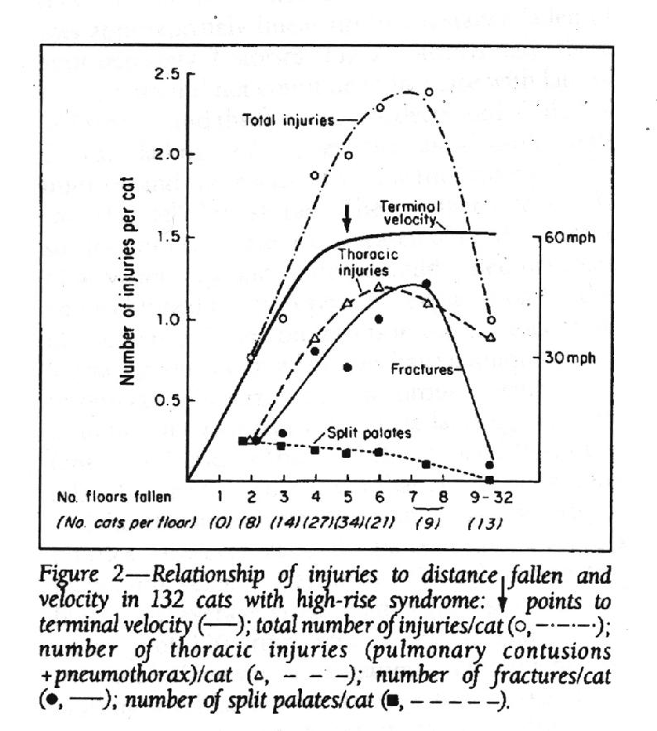
vt=100 km/h
Journal of the American Veterinary Medical Association, 1978
Notes:
Phys 2210, Sp12 SJP Lecture #5
Just some humor. The black curve is vterm vs height, the red curve is “cat injuries” vs “height of fall”. They track each other!
The turnover in cat injuries is a good question to ask the class – (I presume cats need some distance to get themselves properly oriented, at which point they relax some, and also probably “splay” which increases drag).
Don’t try this experiment! ☺
Comments from Sp 11:
Just a fun followup – black curve is theoretical final velocity of a cat falling the given number of stories. (Vt = 60 mph) The red curve is veterinary injuries – apparently, they grow with height of the ap’t to a point, than drop again (presumably because AFTER reaching terminal velocity, the cat has a chance to stabilize and perhaps even flatten out, and get slightly LESS injured)
(It’s just for fun, the class erupted in laughter at this. )
See
http://en.wikipedia.org/wiki/Cat_righting_reflex
http://www.straightdope.com/columns/read/1143/do-cats-always-land-unharmed-on-their-feet-no-matter-how-far-they-fall

Slide 37
The solution to the equation describing an object falling from rest with linear air drag was
Which figure best shows this sol’n?
t
A
v
B
v
t
t
v
C
D
v
t
E) Other/???
Notes:
Phys 2210, Sp12 SJP Lecture #5
Note: It’s worth mentioning this assumes “up is +y-hat”. (I had the ODE on the board).
[[63]], 31, 5, 2, 0
Sp ‘11: [[80]], 18, 0, 0, 2
Seems awfully easy, but I think it’s very much worth the time. I animated it and had them sketch first. The A/B dispute is largely about signs, if vterm is negative you could plausibly think that v is correct. (But my conventions, and the choice of “up is plus” makes A the unambiguous correct answer)
It’s worth discussing the SLOPE at the origin, and also the limiting behavior (value) for v(t) at small and large t.
Comments from Sp ‘11: discussion was healthy, we/they talked about limits and slope. “B” is correct for Taylor’s sign conventions, but my own lecture (and lecture notes) I switched to “up is plus”, so that’s why “A” is correct.
Idea from: M. Dubson, A. Marino, M. Betterton

Slide 38
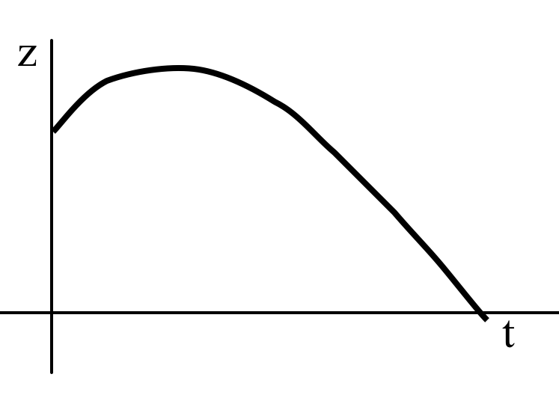
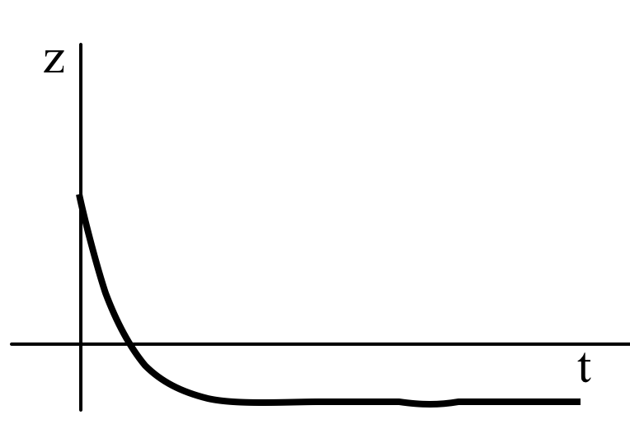
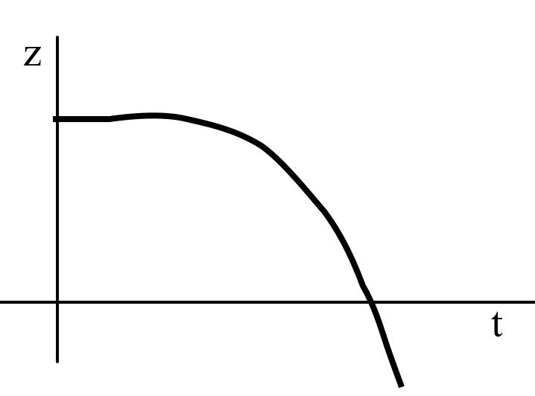
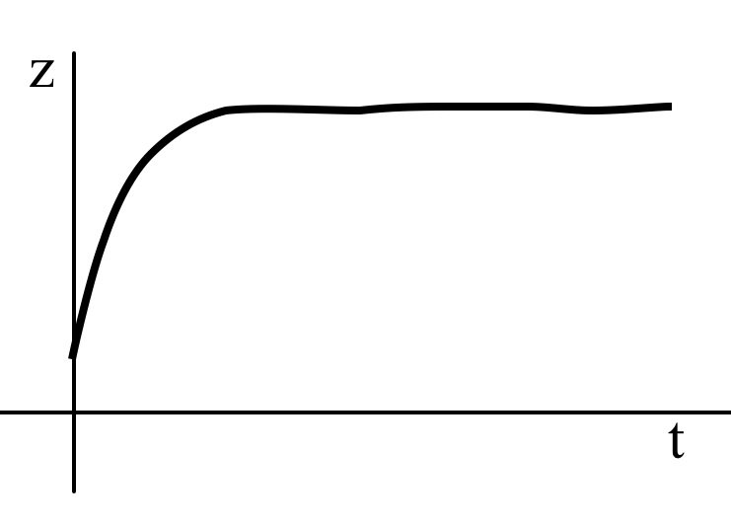
The solution to the eq’n describing an object falling from rest from h>0 with linear air drag was
Which figure best shows height, y(t)?
A
B
t
t
E) Other/???
C
D
t
t
E) Other/???
Notes:
Phys 2210, Sp12 SJP Lecture #5
0,8,[[69]], 11, 12
Sp ‘11: 0, 15, [[65]], 4, 17
**Figures need to be cleaned up, improved. E.g. Label axis y, not z, and fix C so it really is correct.**
Some students were confused about whether there was “ground” (making D correct, at least, if the ground was soft, as one person suggested). Good discussion about shape at origin (again, figure is poor, it’s meant to be parabolic at the origin, but I agree with a student that the sketch is a little TOO flat for too long, making C a little dubious. Should probably generate real plots on MMA for this slide)
Answer: C. At t=0, it starts at height h>0. It has initial slope 0 so the graph starts flat, but initial acceleration will be –g, so concave down. It picks up speed, and accelerates but asympotically reaches terminal speed, at which point the graph is a straight line with downward slope (value –vterm)
Comments from Sp ‘11: I told them rather than doing the integral, to just think about the physics. There was some discussion about “where is the ground”. (Far away)
The “E” voters told me they either didn’t think “C” had turned “straight line” at the end, and another told me they thought it looked TOO flat (no 2nd deriv visible?) at the origin.
Idea from: M. Dubson, A. Marino, M. Betterton

Slide 39
Which of these two plots seems more realistic for a tennis ball trajectory, comparing (in each graph) the path with (purple), and without (blue), drag.
A
B
C) Neither of these is remotely correct!
Notes:
No time. Skipped
With linear drag, one can explicitly show that y(x) matches the ideal case for both the x and x^2 terms, then here is a “cubic” correction. So the two graphs start off with the same slope and curvature at first, like graph A. (For quadratic drag, I am not sure how to show this analytically, but the Phet simulation shows pretty clearly that it always looks like A for realistic cases!

Slide 40
With quadratic air drag, v(t)=v₀/(1+t/ )
where =m/(cv₀), and c=(1/2)c₀ A ρ_{air.}
(For a human on a bike, c is of order .2 in SI units)
Roughly how long does it take for a cyclist on the flats to drift down from v₀=10 m/s (22 mi/hr) to ~1 m/s?
a couple seconds
a couple minutes
a couple hours
none of these is even close.
Can you confirm that c is about 0.2? (c₀ is ~1 for non-aerodynamic things, and ~.1 for very- aerodynamic things.
In real life, the answer is shorter than this formula
would imply. Why?
Notes:
No time, skipped.
For c0=0.5, and an area of about (1/2 m)*(1 m), and rho = 1.3, c is about 0.2 N/(m/s)^2. = 0.2 kg/m
So tau = (60 kg)/(.2 * 10 m/s) is of order 30 seconds.
for 1+t/Tau to reduce you by 10, you need 10 Tau’s, or 5 minutes. Seems a little long
As v gets small, linear drag enters (and will exceed the quadratic drag, making the drop exponentially fast rather than inversely with time
Rolling friction also matters, especially at slow speeds!

Slide 41
A tennis ball is hit directly upwards with initial speed v₀. Compare the time T to reach the top (height H) to the time and height in an ideal (vacuum) world.
T>T_{vacuum}, H≈H_{vacuum}
T>T_{vacuum}, H<H_{vacuum}
T≈T_{vacuum}, H<H_{vacuum}
T<T_{vacuum}, H<H_{vacuum}
Some other combination!!
Notes:
Phys 2210, Sp12 SJP Lecture #5
0, 11, 24, [[65]], 0
Sp 11: 0, 16, 9, [[70]], 5
Point out that I don’t even bother with H>Hvacuum, who would vote for that?
Got some decent discussion about why some students liked A. The argument was that with friction, it moves slower, and “moving slower” means “takes longer”! (Another student pointed out that it won’t go as high, though. True… so, does that CANCEL OUT the effect? How do you know that “takes longer” loses to “doesn’t go as high”.
Next slide (animation, though I did it on board), can help.
All the way up, there’s an extra downward force. So, at all times, the speed is LESS than it would have been in vacuum.
So a plot of v(t) vs t is always BELOW the “straight line” vacuum case.
That means it reaches the top (v=0) earlier,
and the area under the curve (height) is smaller. (This argument is in the text) The answer is unambigous, and independent of details (including linear or quadratic drag, value of v0, etc)
Students spontaneously brought up these points. But, there was a lot of confusion about how you would PROVE this result, even for the 70% who guessed it. (Taylor solves it graphically, Fig 2.11) See next slide.

Slide 42
A tennis ball is hit directly upwards with initial speed v₀. Compare the time T to reach the top (height H) to the time and height in an ideal (vacuum) world.
T>T_{vacuum}, H≈H_{vacuum}
T>T_{vacuum}, H<H_{vacuum}
T≈T_{vacuum}, H<H_{vacuum}
T<T_{vacuum}, H<H_{vacuum}
Some other combination!!
v(t)
t
Notes:
All the way up, there’s an extra downward force. So, at all times, the speed is LESS than it would have been in vacuum.
So a plot of v(t) vs t is always BELOW the “straight line” vacuum case.
That means it reaches the top (v=0) earlier,
and the area under the curve (height) is smaller.

Slide 43
The solution to the equation describing an object falling from rest with quadratic air drag was
Which figure best shows this sol’n?
t
A
v
B
v
t
t
v
C
D
v
t
E) Other/???
Notes:
Phys 2210, Sp12 SJP Lecture #5
[[84]], 9, 7, 0, 0
Still some residual questions about sign conventions, and the problem doesn’t clearly state it (though the minus sign out front and the fact that all PREVIOUS questions had up as +y should have helped?)
I reviewed hyperbolics first, and wrote this solution, and suggested that although they can think of the definition of tanh mathematically, they can also use their physical intutions. (And thus make some SENSE of what tanh must look like).
Good chance to talk about behaviour of sinh, cosh, and tanh for x=0 and x large here.

Slide 44
An object is launched directly upwards with initial speed v₀.
Compare the time t₁ to reach the top
to the time t₂ to return back to the starting height.
t₁>t₂
t₁=t₂
t₁<t₂
Answer depends on whether v₀ exceeds v_{t} or not.
Notes:
Skipped.

Slide 45
If you add linear drag, what happens (qualitatively) to the horizontal range of a projectile (with angle fixed)? Why?
Notes:
Skipped

Slide 46
The solution to the eq’n describing an object thrown up from h>0 with linear air drag was
Which figure best shows height, z(t)?
A
B
t
t
E) Other/???
C
D
t
t
E) Other/???

Slide 47
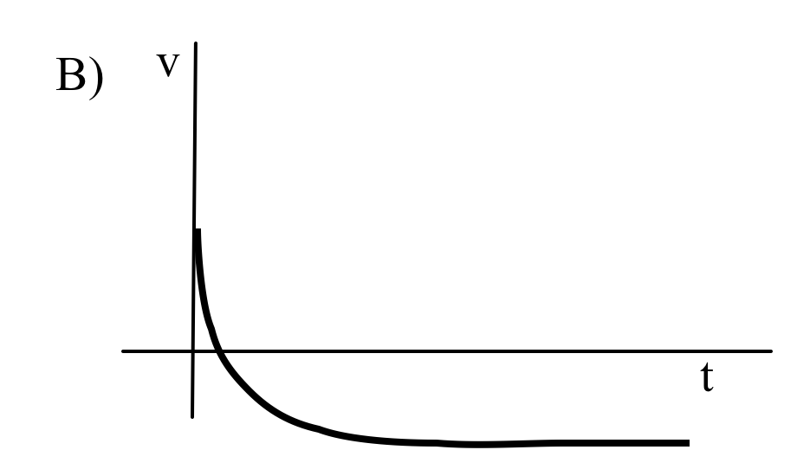
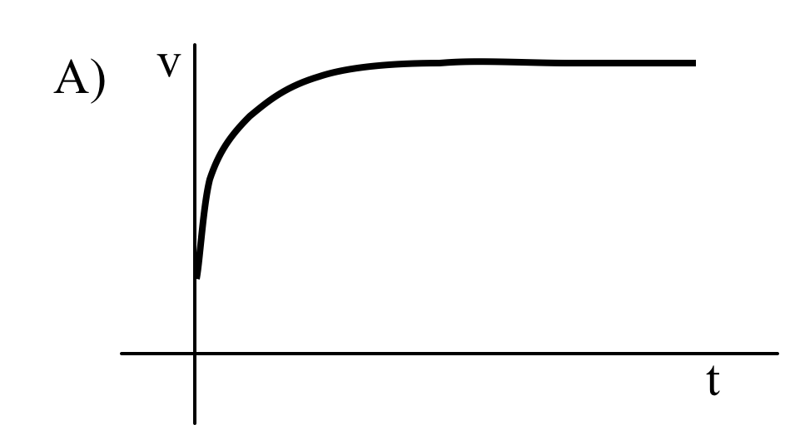
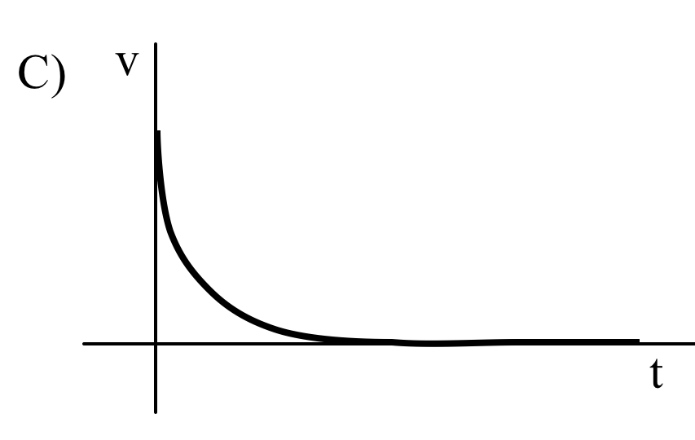
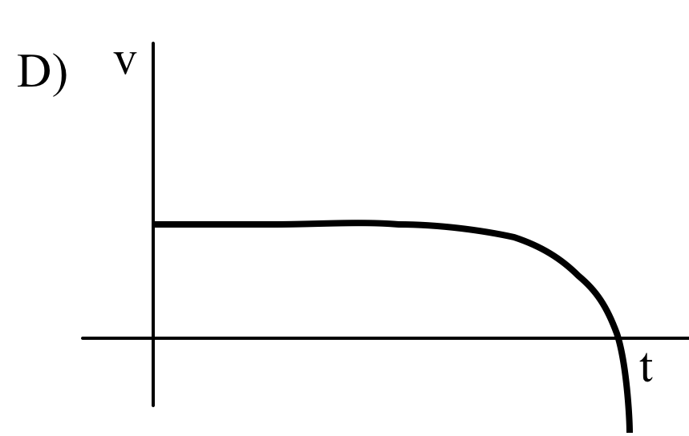
The solution for an object moving horizontally with linear air drag was
Which figure best shows this sol’n?
A
B
E) Other/???
C
D

Slide 48
If you add linear drag,
what happens (qualitatively) to the horizontal range of a projectile (with angle and v₀ fixed)?
It goes down (because of the horizontal drag)
It goes up (because it’s in the air longer!)
It could go either way, depending… (the two reasons above make it ambiguous)
Notes:
Phys 2210 Sp ‘12 SJP Lecture 6
[[90]], 8, 2
Students had gotten this wrong on the first homework (making argument C, even the grader wondered about this!) No problem at this point. I pointed out that a force diagram on the moving projectile shows you that its acceleration vector cannot take it “up above” the zero-drag curve.

Slide 49
f(x)
Notes:
Phys 2210 Sp ‘12 SJP Lecture 6
This plot is what I used for discussing Taylor series. I have a MMA workbbok (4MMA_Taylor_examples) to go along with this sequence of clicker questions, afterwards.

Slide 50
f(x)
x₁
If we expand f(x) around point x₁ in a Taylor series,
f(x) =a₀+a₁ (x-x₁)+a₂ (x-x₁)²+...
What is your best guess for the signs of a₀ and a₁?
a₀ is +, a₁ is + B) a₀ is +, a₁ is –
a₀ is -, a₁ is + D) a₀ is -, a₁ is –
E) Other! (Something is 0, or it’s unclear)
Notes:
Phys 2210 Sp ‘12 SJP Lecture 6
2, [[97]], 2, Sp ‘11 we had 8, [[83]], 2, 6, 0
No problems with this, “in the abstract” they’re doing fine with it. We did discuss the “a2 =0” story here (there was a little dispute in the class until they settled on it), and thus adding in the a2 term adds nothing, it doesn’t contribute.
Comments from Sp ‘11:
Pretty straightforward, the discussion was quick, students were able to articulate the reasoning. I gave a long spiel before this, deriving the Taylor series, but also talking about what it means and is used for. (The idea of find f NEAR a point about which you know a lot, and the idea of expanding in simple functions, and the idea of convergence, and...) Talked through an intuitive understanding about the meaning of the coefficients as derivatives, of “modeling” the function locally as linear, or quadratic...
S. Pollock, from an idea of Andrew Boudreaux, Warren Christianson, and later the U. Maine PER Lab.

Slide 51
f(x)
x₁
If we expand f(x) around point x₁ in a Taylor series,
f(x) =a₀+a₁ (x-x₁)+a₂ (x-x₁)²+...
What is your best guess for the signs of a₀ and a₁?
a₀ is +, a₁ is + B) a₀ is +, a₁ is –
a₀ is -, a₁ is + D) a₀ is -, a₁ is –
E) Other! (Something is 0, or it’s unclear)
Notes:
Phys 2210 Sp ‘12 SJP Lecture 6
Didn’t bother to click, but I had them shout these out. Here it’s the a1 term that vanishes.
Sp ‘11 it was 0, 0, 2, 7, [[89]]
S. Pollock, from an idea of Andrew Boudreaux, Warren Christianson, and later the U. Maine PER Lab.

Slide 52
f(x)
x₁
If we expand f(x) around point x₁ in a Taylor series,
f(x) =a₀+a₁ (x-x₁)+a₂ (x-x₁)²+...
What is your best guess for the signs of a₀ and a₁?
a₀ is +, a₁ is + B) a₀ is +, a₁ is –
a₀ is -, a₁ is + D) a₀ is -, a₁ is –
E) Other! (Something is 0, or it’s unclear)
Notes:
Phys 2210 Sp ‘12 SJP Lecture 6
Again, had them shout it out, “what is a0?” “what’s a1”?
Answer is E, (0 and +)
S. Pollock, from an idea of Andrew Boudreaux, Warren Christianson, and later the U. Maine PER Lab.

Slide 53
f(x)
x₁
If we expand f(x) around point x₁ in a Taylor series,
f(x) =a₀+a₁ (x-x₁)+a₂ (x-x₁)²+...
What is your best guess for the sign of a₂?
A) +(?) B) -(?) C) 0 (?)
D) ????? How could we possibly tell this without a formula?
Notes:
(See above, we’ve already discussed this)
Sp ‘11 we voted, it was 8, 0, [[90]], 0, 2 . (. I told them the “?” sign meant “approximately, or best guess” (I told them that there IS a correct answer, since I generated it in MMA. Maybe that helped?)

Slide 54
f(x)
x₁
If we expand f(x) around point x₁ in a Taylor series,
f(x) =a₀+a₁ (x-x₁)+a₂ (x-x₁)²+...
What is your best guess for the sign of a₂?
A) +(?) B) -(?) C) 0 (?)
D) ????? How could we possibly tell this without a formula?
Notes:
Skipped. Last year I had them shout it out.

Slide 55
f(x)
x₁
If we expand f(x) around point x₁ in a Taylor series,
f(x) =a₀+a₁ (x-x₁)+a₂ (x-x₁)²+...
What is your best guess for the sign of a₂?
A) +(?) B) -(?) C) 0 (?)
D) ????? How could we possibly tell this without a formula?
Notes:
Didn’t bother. Last year (sp ‘11) I had them shout it out. There was a bit of disagreement/confusion, it might be decent to ask. (It’s still A, positive here – we’re still a long way from the inflection point).
Commen from Sp ‘11: I liked this string of questions, but they were a little too simple for my class. Next time around I’d make them tougher, chop a couple, move on to the next step (which is finding f(1+epsilon), e.g.) And, I’d make THEM do more work – the activity on the next slide was good, I think.
S. Pollock, from an idea of Andrew Boudreaux, Warren Christianson, and later the U. Maine PER Lab.

Slide 56
f(x)
x₁
Taylor expand about x1, to “zeroth”, “first”, and “second” orders. In each case, SKETCH (on top of the real curve) what your
“Taylor approximation” looks like
If time – try it about the BOTTOM point of the curve, or the first zero crossing…
Notes:
Phys 2210 Sp ‘12 SJP Lecture 6
Whiteboard activity!
This activity took about 5 minutes. It’s a little confusing, but they quickly got it – I want them to “copy” this sketch into their notes, then on top, maybe dashed, sketch the APPROXIMATE function f(x) you get if you Taylor expanded about x1 to zeroth order (just the constant term) What would that function look like? Then do it again including up to the 1st order (linear) term. Then once more, draw the approximation to this function if you include 0, 1, and 2nd order terms.
Point of discussion: for x1, adding the quadratic term does NOTHING.
For x2, adding the linear term does nothing.
I have a mathematica notebook (4MMA_Taylor_examples) which, near the bottom, can DO this for you. (You have to change the value of “n” in the ts[x, n, x1] function and re-evaluate). It’s VERY effective, I think, especially nice when e.g. you change n from 1 to 2 here, and nothing changes! I then jump to 25, it fits nicely except the VERY end, which is cool.

Slide 57
f(x)
x₂
x₁
x₃
Taylor expand about x1, to “zeroth”, “first”, and “second” orders. In each case, SKETCH (on top of the real curve) what your
“Taylor approximation” looks like
Repeat for the other two points.
Notes:
This was the original version used in Sp 11, you might use it after they’ve started to clarify the wording at the bottom of the previous slide.

Slide 58
f(x)=cos(x).
If x₀=0, will the full Maclaurin series expansion produce the exact value for cos(3π)=-1?
A) Yes
B) No, not even close
C) Close, but not exact
x₀=0
x=3π
Notes:
Phys 2210 Sp ‘12 SJP Lecture 6
[[82]], 2, 17 (Sp ‘11 we had [[94]], 2, 4)
They did pretty well, this year there was less issue about “approximate vs exact” because I emphasized I meant the FULL series, going off to infinity.
After this question, I pointed out that 3pi is close to 10. So the zeroth order approx is +1 (for an answer that’s supposed to be -1). Not so great. So we go out to the next one, and subtract (3 pi)^2/2, which like like 50, so our next guess is -24!! Not doing so hot. It takes quite a few terms for the factorial downstairs to kick in and make us converge.
I claim yes, the full series produces the exact answer (it’s analytic). However, if you truncate (as shown in black), then of course it’s approximate (and in this case, not even close)
Comments from Sp 11: Unfortunately (?) I had JUST showed them in MMA how adding terms expands the range of convergence – I think if I had done this first it would have been more mixed (?) I emphasized the point that Taylor series works even when (x-x1) is not SMALL, as long as f(x) is analytic.
Idea from: M. Dubson, M. Betterton

Slide 59
Consider f(x), composed of an infinite series of semicircles.
If x₀=0, will the Maclaurin series expansion produce the correct value for f(3R)=0?
X=3R
x₀=0
A) Yes
B) No, not even close
C) Close, but not exact
R
Notes:
Phys 2210 Sp ‘12 SJP Lecture 6
26, [[57]], 16.
Sp ‘11 the result was 13, [[55]], 30, 0, 2
Didn’t have quite enough time on this one, it’s a fun question, and there were a variety of questions (e.g, some were worried about the infinite slope at x=R, some wondered if it matters that you have to write this “piecewise” (the answer is, yes!) Some wondered if there WAS a formula to take derivatives of (I’d say yes, it’s Sqrt[R^2-x^2]
I claim no, not even close. This series is not analytic (not continuous derivatives at the “joins”), how could the series “know” what I did when I reached the end of the first semicircle?
Comments from Sp 11: This one generated very good discussion, and we spent some time in class talking it through. I got students to discuss their reasoning, and the conversation was healthy. One student pointed out that it’s nonanalytic, but we pushed on this a bit. One student said the problem was the infinite slope at x=R, so I pointed out that our series is Maclaurin, we’re only taking derivatives at x=0 where it’s perfectly smooth. So, does it MATTER that there’s a bad derivative at x=R? This generated more discussion. One student said that it looks like a cosine, almost, so it should be “close but not exact”. Here I introduced the idea (below) that the function at x=0 doesn’t “know” anything about what I choose to do at x=R. The student really liked that. Then I pointed out that at x=R, where the derivative blows up, makes me guess (but I’m not sure) that the series might not CONVERGE any more. (No reason it has to) So, the series might not even converge at all at x=4R, let alone “converging to a wrong value”. (I’m not sure, but am guessing that the infinite slope at x=R will make the series blow up past there, but haven’t thought it through)
Idea from: M. Dubson, M. Betterton

Slide 60
Consider f(x), which is a quarter-circle joining two straight lines. Near x=0:
discontinuity?
A) f(x) is discontin. at x=0
B) f’(x) is discontin. at x=0
C) f’’(x) is discontin. at x=0
D) Some higher deriv is discontin. at x=0
E) f and all higher derivs are continuous at x=0.
R
Notes:
Skipped,
Idea from: M. Dubson, M. Betterton

Slide 61
Where are you now?
Done with page 1
Done with page 2
Done with page 3
If you are done with page 3, try these:
Rewrite your code to solve for v[t] for an object falling with quadratic drag force.
(You used NDSolve to do this for the falling penny - now you know, roughly what NDSolve was doing!)
Notes:
Phys 2210 Sp ‘12 SJP Lecture 6
We spent 35 minutes on the Tutorial Activity. It went great! This was “mma_loops.pdf”, and I made an associated file, 4Mathematica_class_activity” (printed and distributed) and “4_MMA_loop_sample.nb” which they could download and run in MMA.) At the end, 1/3 were still working on page 3, almost 2/3 were done. It went well, seems worthwhile.
Lots of good questions about numerics, programming – a few students stuck on lower level issues (like shift-return, or capital letters, or using the text simple for “>” rather than the “>” key)

Slide 62
Does the Taylor Series expansion
cos(θ) = 1 - θ²/2! + θ⁴/4! + ...
apply for θ measured in
A) degrees
B) radians
C) either
D) neither
Notes:
No time! Gotta be B, though.

Slide 63
What are the first few terms of the Taylor Series expansion for e^{x} (about x=0)?
D)
E) Something else!!
Notes:
Phys 2210 Sp ‘12 SJP (Lect #7)
0,0,[[96]], 4, 0
Preclass question - emphasis here is on a) memorizing the “common Taylor formulas” and also b) how do you rederive it if you need to? Briefly discussed “radius of convergence” (infinite), but still, in general, such series expansions converge rapidly when x<<1.

Slide 64
What is the start of the Taylor series expansion for , if x is small?
While you’re at it…. What’s the NEXT term?
Notes:
Phys 2210 Sp12 SJP Lecture #7
5, 3, 2, [[87]], 3
Many knew the binomial expansion by heart and mentioned it. I put that on the board as part of the solution, but also worked it out from scratch. A student asked what x0 was, what are we expanding around? (So, I pointed out that “if x is small” is the code phrase! If we wanted to expand around x=1, we would need x-1 small… One student wanted to know if we could just expand Sqrt[x], so I threw it back at the class (they focused on the issues of Sqrt[negative numbers] near the origin, but I pointed out that even ignoring that, f’(0) = ½ 1/sqrt[x] blows up at x=0.
Finally, a student was worried about the “plus or minus” implicit in square roots – our convention here is that the symbol means the positive root (if is real and >-1, anyway!)
D) The next term is (1/2)(-1/2)/2! x^2 = -x^2/8

Slide 65
What is the next term in the binomial expansion for ?
Something else
Notes:
n(n-1)/2! = ½(-1/2) /2 = -1/8, so it’s E, not D, sign is wrong.

Slide 66
Which of these two plots seems more realistic for a tennis ball trajectory, comparing (in each graph) the path with (purple), and without (blue), drag.
A
B
C) Neither of these is remotely correct!
Notes:
Phys 2210 Sp ‘12 SJP (Lect #7)
[[82]], 15, 3
We had not yet derived the expansion, only the analytic formula was on the board. So it’s more of a “guess”, although we pointed out in discussion that B doesn’t have the right SLOPE at the origin, it should still be vy0/vx0 there. (One student wanted to argue that maybe it is, it’s hard to tell, maybe you can’t see that the slopes in B DO match at the origin because drag is so big it turns over quickly. I pointed out that it’s a tennis ball, so this is not the “molasses limit!” )
With linear drag, one can explicitly show that y(x) matches the ideal case for both the x and x^2 terms, then here is a “cubic” correction. So the two graphs start off with the same slope and curvature at first, like graph A. (For quadratic drag, I am not sure how to show this analytically, but the Phet simulation shows pretty clearly that it always looks like A for realistic cases!)
I worked out the expansion, and pointed out that the leading (linear) term y = vy0 x / vx0 is beautiful – I asked them what it represents, and someone came up with “no gravity, no drag” limit. Yes! The NEXT term has some nice cancellations, drag disappears. It’s exactly what you’d get with no drag. And, it’s negative, that’s gravity pulling the ball down. It’s the third order term that’s “friction” pulling the curve even further down, and the minus sign (explicit from the Taylor formula) again makes physical sense!

