Slide 1
Taylor Chapter 3: Momentum

Slide 2
Taylor adds up the forces on all bits of a body with N pieces. If all forces are internal, he gets
If you wrote out all the terms in this double sum, how many would there be?
N
N²
N(N-1)
N!
Other/not really sure
Notes:
Phys 2210 Sp ‘12 SJP (Lect #7)
2, 0, [[97]], 2, 0
Sp ‘11 Lecture #7 Pre-class question 2,2,[79] 17, 0
‘12 notes: Easier than I thought, but I had already written out the sum explicitly on the board! (Writing out all the terms, organizing them in a visually compelling way, 0 + F12 + F13 + … + F1N on one line, then F21 + 0 + F23 + … on the next line, and so on. So that made it pretty trivial for them. This notation is NOT so easy for these students, I think it’s worth taking the time to make it “concrete” for them on this first pass.
Older notes:
This one wasn’t too challenging, but a number of student indicated (before class in preflight, and during this question) that they were uncomfortable with the notation, not sure what the “double sum” meant. Just a few, but enough to make this worth going over in class. I basically wrote out the sum on the board as N rows, with N-1 columns, concretizing by writing out the subscripts. Shouldn’t have to do this again, but for the first time they’ve seen it, it seemed worthwhile.
Answer is C, there are N terms in the outer sum, and N-1 in the inner sum (we don’t count F of point object on itself)
S. Pollock

Slide 3
(Assume below that N-II is an experimental fact)
We just showed that we can then use N-III to derive the law of conservation of momentum for systems of particles. Is the converse true? i.e.:
If the law of conservation of total momentum of a system (of two particles) holds, can you derive that it MUST be the case that F₁₂=-F₂₁?
Yes
No
Maybe one could, but I can’t...
Notes:
(Didn’t do this in class)
I claim the answer is A,at least I think this works... the way I would do it is to consider a subsystem which consists JUST of the two particles 1 and 2. If the law of conservation of momentum holds, then when Fnet, external =0, we have Pdot=0 = F12 + F21, and this F12=-F21.
(Or, am I missing something?)
S. Pollock

Slide 4
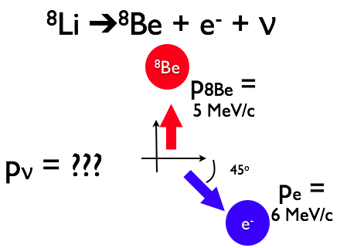
A ⁸Li nucleus at rest undergoes β decay transforming it to ⁸Be, an e⁻ and an (anti-)neutrino. The ⁸Be has |p|=5 MeV/c at 90º,
the e⁻ has |p|= 6 MeV/c at 315º, what is p_{ν}?
Use the form (p_{x},p_{y})
(4.2, 4.2)
(-5,0)
(-5,-1)
(-4.2, 0.8)
(-4.2, -0.8)
MeV/c
Notes:
Phys 2210 Sp ‘12 SJP (Lect #7)
(I told them cos(45) = .7 so they don’t need a calculator)
3, 3, 0, 11, [[83]]
SJP, Sp ‘11 Lecture #7 0,0,2,7,[91]
They did ok, there was a lot of discussion, I think some were a little confused about signs, others about the main idea here, but it’s good as an example of the use of conservation of momentum.
Older notes:
Although the final result was very strong, I felt this was a worthwhile problem. It took them awhile (4 minutes!) and there was a lot of noise/discussion in the class for much of that time. There was some discussion about the notation (what I meant by the ordered pairs) so I have cleaned that up here.
I spent time to discuss a lot of the notation – explained the physics (neutron in Li 8, which is 3 p + 5 n, thus neutron rich, beta decays, i.e. turns into proton + electron (conserving charge) + neutrino. How do we know? This CT was basically done, and p is not conserved without an invisible particle! Also mentioned/asked them how one measures p (someone remembered curvature of tracks in B field), and discussed the units of p = MeV/c. Also showed next slide, just for fun. (Pauli’s letter)
Question from A. Marino

Slide 5
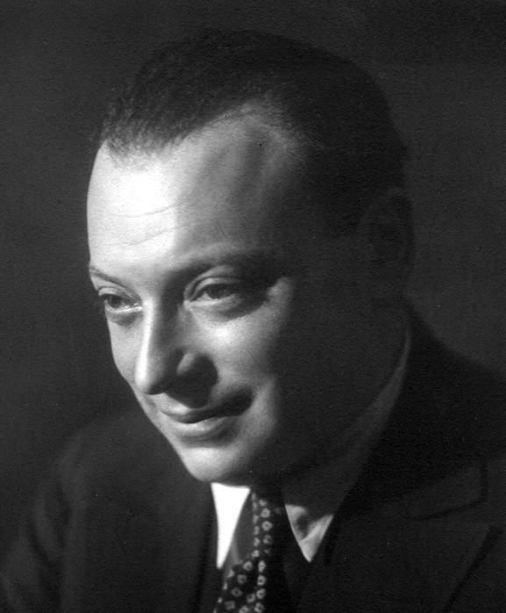
Pauli’s Desperate Remedy
Dec. 4, 1930
Dear Radioactive Ladies and Gentlemen:
...I have hit upon a desperate remedy.. I admit that my remedy may appear to have a small a priori probability because neutrons, if they exist, would probably have long ago been seen, However, only those who wager can win...
Unfortunately I cannot personally appear in Tübingen, since I am indispensable here on account of a ball taking place in Zürich....,Your devoted servant,
W. Pauli [Translation from Physics Today, Sept. 1978]
Notes:
Phys 2210 Sp ‘12 SJP (Lect #7)
Just fun…
(Students appreciated the last line – he missed the conference to go to a ball! )
Thanks to A. Marino

Slide 6
If you push horizontally (briefly!) on the bottom end of a long, rigid rod of mass m (floating in space), what does the rod initially do?
Rotates in place, but the CM doesn’t move
Accelerates to the right, with a_{CM}<F/m
Accelerates to the right, with a_{CM}=F/m
Other/not sure/depends...
F(external)
Notes:
Phys 2210 Sp ‘12 SJP (Lect #7)
11, 30, [[56], 3, 0 first time
Then, some lecture on R_CM and Newton’s law F(net, ext) = ma_CM
3, 8, [[88]], 0, 2 second pass.
SJP, Sp ‘11 Lecture #7 5,41, [52],2,0
I left it (without discussion, just showed the histogram!) and did my “lecture” on R(cm), ending up with Newton’s law (above). Then, re-asked this question. Now
0, 11, [89],0,0
This generated a lot of discussion. It comes from the UW group. Some students insisted that the CM doesn’t move (so they were having a hard time reconciling that with Newton’s law!) Some thought that some of the force gets “used up”, one was bothered by the fact that if you hit it at the bottom, or at the center, that I’m claiming we get the same acceleration of the cm, when it seemed “obvious” to him that the latter case would accelerate it more. I introduced some discussion about how the energy story is DIFFERENT (you can “use up” some of the work into rotational kinetic energy), and discussed what’s different (the force acts over a longer distance when the rod “gives way” at the bottom). I pointed out the race of a spool that unwinds and one that doesn’t as an analogous situation, (it’s a tie!) that helped some, but a few are still struggling with this idea.
I flicked a pencil on the desk to show that the cm certainly does accelerate, it’s DEFINITELY not answer A, at least!
Good long conversation. In the end, “which part of Newton’s law, Fnet = ma_cm, don’t you believe?” is the quip to leave them with!
Answer: C. (Which part of Newton’s law do the students not understand? This is glib – this problem generates lots of argument in Phys 1110 –some students seem to think this force is “partly used up” to create rotation, or something... Some even think it will ALL go into rotation, and nothing into CM acceleration! This latter belief is easy to counter-demonstrate by flicking a pen sitting on the desk, by they way. It will spin, but also very clearly flies away from you)
Older notes:
Lots of questions! Does it rotate? What about conservation of energy? What about ‘elasticity’ effects e.g. when you hit a ball on center vs off center, it definitely doesn’t go as far in the latter case. (One student was certain that B must be right, based on real life experience - I pointed out that this was an instantaneous question, and we talked about the difficulty of *maintaining* a constant force off center like this, because the bottom of the rod “runs away” faster than the CM!)
Seems like a keeper!
Based on UWash Tutorials

Slide 7
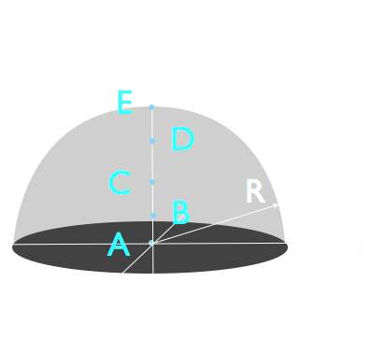
Consider a solid hemisphere of uniform density with a radius R. Where is the center of mass?
z=0
0<z<R/2
z=R/2
R/2<z<R
z=R
Notes:
Phys 2210 Sp ‘12 SJP (Lect #7)
2, [[97]], 0, 2, 0
SJP, Sp ‘11 Lecture #7
0,[98],0,2,0
No problem, good intuitions. A morale booster after that last question! And, we will compute this (or something like it) on homework, so it’s good to remind them that they “know the answer” qualitatively in the midst of what proves to be hard computation for them.
Older notes: Quick, no issues, seems rather too easy. I used it to lead into my formal derivation/calculation of integral(r dm)
Idea from: M. Dubson, M. Betterton, A. Marino

Slide 8
Consider a flat “equilateral triangle”. Where is the CM?
Precisely at the point i
A little ABOVE point i
A little BELOW point i
i
Notes:
Phys 2210 Sp ‘12 SJP (Lect #7)
[[98]], 2, 0
I’m surprised it’s so easy, given the answer to the previous one is that CM is “closer to the thick end”, but they had good reasoning and brought up the symmetry arguments spontaneously.
I brought in a funny shaped board which you can hang and find the CM (and then balance from that point on your finger), which was appreciated.
Older notes:
SJP, Sp ‘11 Lecture #7
. Hands indicated good consensus for A, though I bet some would vote otherwise. Used this to talk about “symmetry arguments”, (and how one might, in practice, FIND the CM experimentally, by hanging an object) I was very explicit in my discussion to talk about HOW the symmetry argument goes, not just hand waving, but finding matching dm chunks with equal but opposite x values, to argue R(CM) must lie on the bisector line here. (And, tilting ones head, ANY bisector line)
S. Pollock

Slide 9
The dark shaded portion of this rigid body is a different material from the light shaded portion.
The object is hanging from the black “pivot point”, and is in balance and stationary. (Ignore friction!)
Compare the mass of the shaded and unshaded portions:
M(shaded) > M(unshaded)
M(shaded) = M(unshaded)
M(shaded) < M(unshaded)
Not enough info!
To think about: Where is the CM of this object?
Notes:
Phys 2210 Sp ‘12 SJP (Lect #7)
[[43]], 20, 18, 18
SJP, Sp ‘11 Lecture #8
[36], 36, 24, 4
What a great question! From UW, there is lots of debate. I got students to discuss reasons for A (several different ways, including torque, One student thought of this as a “2 point mass system”, followed by an
invocation of what we had just derived, that R_CM is located closer to the heavier of two masses.
I think some students want the “center of mass” to be the CENTER, i.e. equal masses on both sides (!?)
I also think the “tipping down and right” may be responsible for some of the “C” answers (?)
Older notes:
This question comes straight from the McDermott freshman Tutorial instructor’s guide. It generate *lots* of good discussion and argument.
Answer A) The CM sits where the black dot is (or perhaps just below it, but the black dot seems plausible) The CM is located closer to the larger masses – so M(shaded) is larger. Or, consider torques about the CM (which must =0, since it’s in balance) There is M(shaded) * small lever arm which equals M(unshaded)* large lever arm, so again, M(shaded) must be larger.
Students had great discussions. Most quickly argued that CM is on (or near) the pivot point, and we talked only briefly first about that. Then, some thought M(unshaded) is greater simply because it’s “tipped down”. Some thought the masses should be equal, simply because they thought CM MEANS mass must be the same on both sides of the CM point.
From Uwash Tutorials

Slide 10
Which of the three quantities: R_{CM}, v_{CM} (=dR_{CM}/dt), or a_{CM} (= d²R_{CM}/dt²)
depends on the location of your choice of origin?
All three depend
R_{CM}, v_{CM} depend (but a_{CM} does not)
R_{CM} depends (but v_{CM} and a_{CM} do not)
NONE of them depend
Something else/not sure...
Notes:
Phys 2210 Sp ‘12 SJP (Lect #7)
(rushed, at very end of class, no discussion) I have since changed the wording to add “on the location of”, which wasn’t there when they voted.
18, 0, [[67]], 15, 0 with only a bit more than half the class voting. Must Repeat it again next class….
SJP, Sp ‘11 Lecture #8 7,2,[70], 17, 4
Preclass question to start lecture. (Review of last time) Had definition of Rcm on board.
Answer: C. (At least, that was my intent – I just had in mind “choice of origin” meaning a simple shift of location of the origin) This question was Ana Maria Rey’s suggestion, and proved to generate very nice discussion. The discussion comments and questions raised were thoughtful. One student wanted to know if “choice of origin” could include rotating or inverting the origin. Another wanted to know if “choice of origin” included shifting to a noninertial reference frame. One believed that v DOES depend on origin, or at least *could*, but wasn’t able to clearly articulate why.
S. Pollock and AM Rey

Slide 11
Which of the three quantities: R_{CM}, v_{CM} (=dR_{CM}/dt), or a_{CM} (= d²R_{CM}/dt²)
depends on your choice of origin? (By “choice” I just mean location. Assume the new origin is still at rest)
All three depend
R_{CM}, v_{CM} depend (but a_{CM} does not)
R_{CM} depends (but v_{CM} and a_{CM} do not)
NONE of them depend
Something else/not sure… To think about: How would your answer change if the new coordinate system did move with respect to you? And, what if it was non-inertial?
Notes:
Phys 2210 Sp12 SJP Lect #8
Preclass (repeat from last time, with clarification added to top)
15, 7, [[69,]] 10, 0
SJP, Sp ‘11 Lecture #8
7,2,[70], 17, 4
Preclass question to start lecture. (Review of last time) Had definition of Rcm on board.
(See last class for other comments)
Good discussion, some students thought R_cm was independ of origin, so I picked an object on the table, walked to one corner, asked them “what’s R_cm”? Then, walked to a different spot, asked it again. That helped! For velocity INDEPENDENCE, couple students argued “in words”, but it was handwavy. I went to board and drew R(one frame), R(primed frame), and R0 (connecting those origins), and had them come up with the proper vector relationship. Then, with that on the board, I asked how we get to velocity (take d/dt), and suddenly it seemed clear to many that dR/dt = dR’/dt, since dR0/dt = 0. We briefly discussed what if the frame is moving, and ended with the “big idea” that Newton’s law will thus be totally independent of your choice of frame (as long as its inertial)
This is a nice “big concept” to talk about, and will hook in to later clicker questions today about relating velocity in different frames (for the rocket story) students had a decent intuitive understanding of why
S. Pollock and AM Rey

Slide 12
In the last homework question for this week, you wrote a “for loop” to solve Newton’s law for a mass on a spring, and you had to choose a time step, dt.
Would making dt even smaller be a good thing, or a bad thing?
Yes, the smaller the better!
No, the bigger the better!
It’s complicated, there are tradeoffs!
Notes:
Phys 2210 Sp12 SJP Lect #8
19, 3, 76
This was a followup to a homework problem where they solved Newton’s law with Euler’s method. We argued that “smaller is better” for accuracy, but it costs (in time, and memory the way we did it) and so it’s complicated. Sometimes, if you have a complex or rich ODE to solve numerically, you might WANT to “explore” with big time steps to get a rough picture of what’s going on, before you “zoom in” on a region of interest with smaller time steps (and more time and memory required at that point)
Steven Pollock and Danny Caballero

Slide 13
When computing r_{CM} of a “uniform half hockey puck”, what is dm for the small chunk shown?
(ρ is constant, and the puck thickness is T)
dm=
r
ϕ
T
Notes:
Phys 2210 Sp12 SJP Lect #8
0,3, 15, 41, [[41]]
This is a little mean, the answer is E (it’s missing the “r” in r dr dphi) The discussion was good, though, and this kind of “E is mean” question doesn’t really seem to be a bad thing, it’s pushing them to pay attention.
The “thickness” was something that garnered some questions and discussion. (rho is a volume density, so you need it for units, it arises from the integration over dz, which you COULD explicitly include, or you can just notice that “nothing is happening” in this integral so it just gives you T)
Steven Pollock

Slide 14
When computing r_{CM} of a “uniform half hockey puck”, what is dm for the small chunk shown?
(ρ is constant, and the puck thickness is T)
r dϕ
dr
r
ϕ
Notes:
Phys 2210 Sp12 SJP Lect #8
Just to summarize/clarify, since the answer to the previous one was “none of the above”. Note that I filled in the figure with the two sides, to make the area more obviously r dr dphi.
Steven Pollock

Slide 15
When computing y_{CM}
what should we put in for y?
r dϕ
dr
r
ϕ
Notes:
Phys 2210 Sp12 SJP Lect #8
6, 2, [[92]], 2, 0
They did fine, but I think it’s worthwhile, there was discussion. Students are often confused about why you can’t just “pull out the y”, they don’t all see that y is itself dependent on the integration variables. At this point, we are all set up do compute y_cm, and I separately compute M as a triple integral (to show how that goes). We then discuss various things like why x_cm comes out zero (you can argue it by symmetry, but with the integral set up as we now have it with these last two clicker questions, you can ALSO see it mathematically, from the phi integration, nice)
I had questions about the “triple integral” notation, which was a good catch. Because in the previous slide I effectively DID the z integration (to ge the factor of T), this really could be a DOUBLE integral over r and phi only on this slide. It was a nice observation, I think it’s ok to leave the slides and let the students think about/notice this, but you might also choose to change it…
Steven Pollock

Slide 16
r _{you/dock}
r _{you/boat}
Dock
CM boat
r _{boat/dock}
You are walking on a flat-bottomed rowboat. Which formula correctly relates position vectors?
Notation: r_{a/b} is “position of a with respect to b.”
r_{you/dock}= r_{you/boat} + r_{boat/dock}
r_{you/dock}= r_{you/boat} - r_{boat/dock}
r_{you/dock}= -r_{you/boat} + r_{boat/dock}
r_{you/dock}= -r_{you/boat} - r_{boat/dock}
Other/not sure
Notes:
Phys 2210 Sp12 SJP Lect #8
[[94]], 5, 2,
SJP, Sp ‘11 Lecture #8 [[93[] 2 0 4 0
We’re heading to the rocket equation, and students have a lot of difficulty with signs on the velocity relationships, so I decide to build it up with this sequence of slides. It works ok – the scores start off perfect and get worse and worse, but this provides an anchor (and a NOTATIONAL tool to help figure out ambiguities) which, I hope at least, will help them. (But, we are finding they do not stick to this, and revert to intuitions rather than a rigorous approach when the question becomes less “obvious”)
Here you want to point out that the PICTURE can answer the question for you, but the NOTATION can also answer it for you, once you get the hang of it. (ra/c = ra/b + rb/c) I also added an “ant crawling across my head” and pointed out that it’s super easy to get the relationships right if you think of this notation!
Older notes:
Answer: A) By inspection of the figure. But we want to push on the fact that it can be done by use of math notation, NOT just “inspection”. (For velocities, e.g., that becomes more helpful)
This question, and the two following, were *explicitly designed* to be quick and easy. I wanted them to get the answer right, right away, on their own, so that they would realize that *with this notation*, it’s easy and quick to get all the signs right, without ambiguity. Didn’t take a lot of class time, used this to set up next question.
The bad news is that it didn’t work very well (see rocket problem discussion below). This sequence might work, but requires a little more scaffolding!
S. Pollock

Slide 17
Dock
CM boat
You are walking on a flat-bottomed rowboat. Which formula correctly relates velocities?
Notation: v_{a/b} is “velocity of a with respect to b.”
v_{you/dock}= v_{you/boat} + v_{boat/dock}
v_{you/dock}= v_{you/boat} - v_{boat/dock}
v_{you/dock}= -v_{you/boat} + v_{boat/dock}
v_{you/dock}= -v_{you/boat} - v_{boat/dock}
Other/not sure
Notes:
Phys 2210 Sp12 SJP Lect #8
[[83]], 5, 8, 0, 5
SJP, Sp ‘11 Lecture #8 [91] 9 0 0 0
Interesting, just taking a derivative drops the score by 10%. I tried to emphasize that the previous slide (which was written up on the board when this one went up) tells you the answer, no need to second guess, or “work it out”, the previous slide tells you this one immediately!
I had a cart demo, and walked across it, to try to further make sense of the result: vme/cart + vcart/wall = v me/wall, it makes total sense!
(One student noted that it’s not relativistically correct. True!)
Older notes:
Answer A) There was some discussion in the room at first, and so I asked them if they could use the previous result to get this one quickly, easily, unambiguously, and WITHOUT trying to visualize carefully all the vectors involved. Indeed it was very quick (<1 min), and students were prompt to point out it’s just d/dt of the previous question. I emphasized the power of this notation. (Noted that one or two MORE got this one wrong than the previous one – it’s *safest* to use this notation, at the very least to check yourself) I pointed out that this is a vector equation (more on that to come) and is absolutely unambiguous, in fact it’s coordinate independent. I pointed out that you could extend this (v(bug w.r.t carpet + carpet w.r.t flatbed truck + truck w.r.t highway + highway w.r.t. center of earth = v(bug wrt center of earth)
S. Pollock

Slide 18
Dock
CM boat
v_{you/dock}= v_{you/boat} + v_{boat/dock}
(In general, v _{a/c} = v_{a/b} + v_{b/c})
If you are walking in the boat at what feels to you to be your normal walking pace, v₀, WHICH of the above symbols equals v₀? A) v_{you/dock} B) v_{you/boat} C) v_{boat/dock}
D) NONE of these...
Notes:
Phys 2210 Sp12 SJP Lect #8
8 [[89]], 3, 0,0
SJP, Sp ‘11 Lecture #8 2,[98],0,0,0
This is a “ground”, let’s make sure we’re on the same page. You might think this was trivial or obvious, and largely it is, but it seems critical to point out that the lovely and powerful “v_a/b” notation which ensures you get signs right without having to think hard is NOT what we normally use, so you must be able to “translate” back and forth. (We’re heading to rockets, this seemed like a useful last practice before the new context)
Older comments:
Answer: *As intended*, this was quick and easy for them. I wrote the conclusion on the board, and did a quick demo (walking across a “skateboard”) to show that v(you/room) IS your normal speed, but v(you/room) is SLOWER, because the skateboard recoils backwards.
This string was all meant to set up the rocket equation. (Next) (This whole sequence of 3 questions took in total 5 minutes of class time)
I showed a great video of this,
video_vectorAddition_1minto130_then_300.mp4
which I extracted from
http://www.youtube.com/watch?v=yPHoUbCNPX8&feature=player_embedded#at=28
Its very humorous, worth showing!
S. Pollock

Slide 19
Dock
CM boat
You are walking on a flat-bottomed rowboat. v_{you/dock}= v_{you/boat} + v_{boat/dock}
or
v = v₀ + v_{boat}
Notes:
Review

Slide 20
v_{fuel}
v
A rocket travels with velocity v with respect to an (inertial) NASA observer.
It ejects fuel at velocity v_{exh} in its own reference frame. Which formula correctly relates these two velocities with the velocity v_{fuel} of a chunk of ejected fuel with respect to an (inertial) NASA observer?
v = v_{fuel} + v_{exh}
v = v_{fuel} - v_{exh}
v = -v_{fuel} + v_{exh}
v = -v_{fuel} - v_{exh}
E) Other/not sure??
Notes:
Phys 2210 Sp12 SJP Lect #8
25, [[24]], 22, 27, 2
After some collective discussion (see below), we re-voted, the new distribution was
13,[[ 63]], 16, 8, 0
Older: SJP, Sp ‘11 Lecture #8 5 [43] 25 27 0
This(first pass) is the most even distribution I’ve ever gotten! It’s a great followup to the last sequence, a little mean because I’ve “shuffled up” the order of the terms so it does NOT match the previous slide. I let them work for ~2 minutes on this. Then showed this distribution, it got a big laugh! What I did next was to go back to the board and write “va/c = va/b + v b/c”. That’s ALWAYS true, with all + signs. Now, think about re-writing the symbols on this slide in this way (I did thistogether with the class), so e.g “v” here is really “v rocket/NASA” and vfuel is really “v fuel/NASA” and finally vexhaust is really “v fuel/rocket”. With THAT notation, I asked them to rearrange the terms to get a formula with all plus signs that is immediately and manifestly correct, and then re-arrange to match up to the ordering in this slide. In another 2 minutes they were now 2/3 correct.
This is the formula from the text, except that the text uses “vexh” to refer to the SPEED of the exhaust, rather than the vector. This introduces another sign – that’s the next slides. But first, I showed a video, see
video_vectorAddition_1minto130_then_300.mp4
Start at 1 min, go to 1:30, then skip to 3:00. It’s *very* funny, and very appropriate. Have the students connect the results from the video to the symbols and equations in this clicker question!
I also pointed out that these are VECTORS. The v_exh is going to be “leftwards” in this situation, the “v” is rightwards, but v_fuel is… ambiguous! (For small v and big v_exh, vfuel will point leftwards. If v is big and v_exh is smaller, vfuel will point RIGHTwards. This is funny, that’s what the video helps with… but whatever the situation, the EQUATION on this page is correct and universal, no fudging required!)
Older notes: Answer: B). Best to think of v(fuel/NASA) = v(fuel/rocket) + v(rocket/NASA) = v(exh)+v, and then solve for v to see where that minus sign arises.
This was the “punchline” of the previous 3 questions, and alas, they did not do the job I had intended them to do! I had considered writing this in the same form as I did above: namely v(fuel) = v(exh) + v, with the various signs, but I feared I would get the “false positive” effect, of everyone blindly voting “the same” as the previous 3 questions and getting it right without understanding.
I intentionally drew v(fuel) to the left, (that’s only correct for v<vexh), the formal answer here DOES NOT CHANGE if I draw that arrow the other way. But, this did seem to impact a lot of students, that left arrow apparently *invited* throwing in minus signs on the fuel term!
I *did* point out to them that this one was trickier, and the best way to check/convince themselves was to write it out in the notation that they had just learned. But, many were trying to visualize, wave their hands, shift frames in their head...Interestingly, almost NONE feel for the simple “follow the pattern”, so they were *trying* to work this out, but basically getting all possible combinations of signs!
Apparently, this needs a little more time, maybe *make* them write this out in the v a/b notation first, and THEN ask this question.
S. Pollock

Slide 21
v_{fuel}
v
A rocket travels with velocity v with respect to an (inertial) NASA observer.
It ejects fuel at velocity v_{exh} in its own reference frame. Which formula correctly relates these two velocities with the velocity v_{fuel} of a chunk of ejected fuel with respect to an (inertial) NASA observer?
v = v_{fuel} + v_{exh}
v = v_{fuel} - v_{exh}
v = -v_{fuel} + v_{exh}
v = -v_{fuel} - v_{exh}
E) Other/not sure??
Be careful, work it out:
use the last result
V_{a/c}= v_{a/b} + v_{b/c}
to check!?)
Notes:
Phys 2210 Sp12 SJP Lect #8
(I added the “be careful’ note AFTER giving this, not sure if it will help, but might be worth a try? Or, just do the revote after some discussion, that might also be just as effective)
25, [[24]], 22, 27, 2
After some collective discussion (see below), we re-voted, the new distribution was
13,[[ 63]], 16, 8, 0
Older: SJP, Sp ‘11 Lecture #8 5 [43] 25 27 0
This(first pass) is the most even distribution I’ve ever gotten! It’s a great followup to the last sequence, a little mean because I’ve “shuffled up” the order of the terms so it does NOT match the previous slide. I let them work for ~2 minutes on this. Then showed this distribution, it got a big laugh! What I did next was to go back to the board and write “va/c = va/b + v b/c”. That’s ALWAYS true, with all + signs. Now, think about re-writing the symbols on this slide in this way (I did this together with the class), so e.g “v” here is really “v rocket/NASA” and vfuel is really “v fuel/NASA” and finally vexhaust is really “v fuel/rocket”. With THAT notation, I asked them to rearrange the terms to get a formula with all plus signs that is immediately and manifestly correct, and then re-arrange to match up to the ordering in this slide. In another 2 minutes they were now 2/3 correct.
This is the formula from the text, except that the text uses “vexh” to refer to the SPEED of the exhaust, rather than the vector. This introduces another sign – that’s the next slides. But first, I showed a video, see
video_vectorAddition_1minto130_then_300.mp4
Start at 1 min, go to 1:30, then skip to 3:00. It’s very fun and very appropriate. Have the students connect the results from the video to the symbols and equations in this clicker question!
I also pointed out that these are VECTORS. The v_exh is going to be “leftwards” in this situation, the “v” is rightwards, but v_fuel is… ambiguous! (For small v and big v_exh, vfuel will point leftwards. If v is big and v_exh is smaller, vfuel will point RIGHTwards. This is funny, that’s what the video helps with… but whatever the situation, the EQUATION on this page is correct and universal, no fudging required!)
Older notes: Answer: B). Best to think of v(fuel/NASA) = v(fuel/rocket) + v(rocket/NASA) = v(exh)+v, and then solve for v to see where that minus sign arises.
This was the “punchline” of the previous 3 questions, and alas, they did not do the job I had intended them to do! I had considered writing this in the same form as I did above: namely v(fuel) = v(exh) + v, with the various signs, but I feared I would get the “false positive” effect, of everyone blindly voting “the same” as the previous 3 questions and getting it right without understanding.
I intentionally drew v(fuel) to the left, (that’s only correct for v<vexh), the formal answer here DOES NOT CHANGE if I draw that arrow the other way. But, this did seem to impact a lot of students, that left arrow apparently *invited* throwing in minus signs on the fuel term!
I *did* point out to them that this one was trickier, and the best way to check/convince themselves was to write it out in the notation that they had just learned. But, many were trying to visualize, wave their hands, shift frames in their head...Interestingly, almost NONE fell for the simple “follow the pattern”, so they were *trying* to work this out, but basically getting all possible combinations of signs!
Apparently, this needs a little more time, maybe *make* them write this out in the v a/b notation first, and THEN ask this question.
S. Pollock

Slide 22
v_{fuel}
v
A rocket travels with velocity v with respect to an (inertial) NASA observer.
It ejects fuel at velocity v_{exh} in its own reference frame. Which formula correctly relates these two velocities with the velocity v_{fuel} of a chunk of ejected fuel with respect to an (inertial) NASA observer?
v_{fuel} = v_{exh} + v
v_{fuel} = v_{exh} - v
v_{fuel} = -v_{exh} + v
v_{fuel} = -v_{exh} - v
E) Other/not sure??
Notes:
Skipped in lect #8, but this is the equation where the “ordering” matches up with what we on earlier slides,
Vfuel/Nasa = vfuel/rocket + vrocket/Nasa, answer A.
(I asked it as the starting question next class) :
Phys 2210 SJP Sp 12 Lect #9
[[66]], 13, 19, 1, 0
This was a “review” slide, set up to be *easier* than the one we had last class, since there are no minus signs this time.
Vfuel/Nasa = vfuel/rocket + vrocket/Nasa, answer A.
See notes/comments on earlier slide sequence.
S. Pollock

Slide 23
v_{fuel}
v
v_{fuel/NASA}= v_{fuel/rocket} + v_{rocket/NASA}
In other words, v_{fuel} = v_{exh} + v
Notes:
Phys 2210 Sp12 SJP Lect #8
Review. This was my explanation. They *did* seem happy with it, (but hard to say) Generated some questions about minus signs
S. Pollock

Slide 24
v_{fuel}
v
v_{fuel} = v_{exh} + v
What happens when you take the x component?
v_{fuel,x} = v_{exh,x} + v_{x} (No problems yet)
But, be careful when writing in terms of magnitudes!
v_{fuel,x} = -|v_{exh}| + v (Because v_{exh} is leftward)
Notes:
Phys 2210 Sp12 SJP Lect #8
Just a note of caution, and a connection to the notation in the textbook. It’s important, and hard for them, they want to “throw in minus signs” arbitrarily, I want to teach them that SOMETIMES we do that (e.g. when an absolute value appears, you probably have to CHOOSE the sign depending on the details of the problem) but when the expression involves vectors, you have no choice in the matter, and furthermore, don’t really need to think about “special cases”.
Older notes:
This was my followup just to discuss the fact that minus signs are ONLY added by hand when terms have absolute values, but the vector equations (and their components) you mustn’t start tossing in minuses.
Might want to turn it into a clicker question, but it was feeling like I was flogging a dead horse by this point!
I DID animate this slide, and asked the class if there were any minus signs introduced when you take the x component. That generated *lots* of comments, some “yes” and some “no”, so I’m sure a clicker question on this COULD be fruitful.
S. Pollock

Slide 25
You have TWO medicine balls on a cart, and toss the first. Your speed will increase by Δv₁.
Now you’re moving, and you toss #2 (in the same way). How does the second increase in speed, Δv₂,
compare to the first one?
Δv₂ = Δv₁
Δv₂ > Δv₁
Δv₂ < Δv₁
??
Notes:
Phys 2210 SJP Sp 12 Lect #9
(Came back to this lecture AFTER the main rocket discussion, as review)
5, [[95]] 0, 0, 0
The rocket equation is on the board (in a form with, and without, dt in the denominator). Didn’t seem to be any problem, I heard good reasoning.
S. Pollock

Slide 26
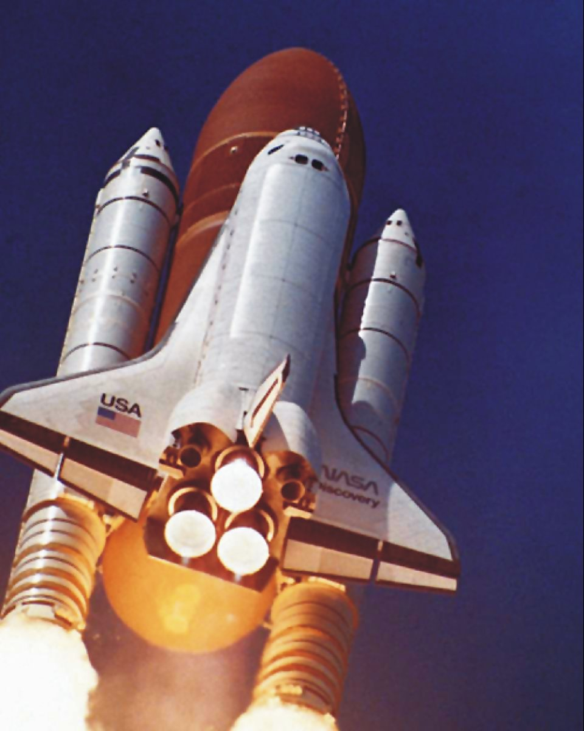
Liquid fuel tank
Orbiter vehicle
2 solid rocket
booster (SRB’s)
3 Space Shuttle Main Engines (liquid propellant)
Notes:
Phys 2210 Sp12 SJP Lect #8
Lots to “chat” about this slide, students seem very interested in these details. I have a video that goes with this (no time today, will show next class). See my lecture notes for some numbers.
video_STS-131_Space ShuttleDiscovery.mp4
(You can start about 30 seconds before launch, and run about 2 minutes).
At about T=+40 there’s a nice comment, that the thrust is reduced, and she explains that it’s to reduce stress. Shortly after, she mentions that its because the shuttle is moving through the region of “maximum dynamic pressure”. This is a great rollback – air drag is cv^2, and c is proportional to air density. As the shuttle rises, density is dropping, but v is climbing. There’s a tradeoff, with a maximum pressure from this drag at about this time in the launch (so presumably they throttle back to prevent v from rising more rapidly than rho is dropping!) It doesn’t last long, just a few seconds in this video, but nice connection to the topic of the previous week!
I brought in a CO2 fire extinguisher and launched myself across the room for fun, students loved this.
Video I extracted from
http://www.youtube.com/watch?v=_NeCvBCZbC8
(Slide and vide thanks to Prof. Alysia Marino)
I have more notes with some numbers in my lecture notes.

Slide 27
Solid Rocket Boosters
Notes:
Shuttle launch (2 min)
http://www.youtube.com/watch?v=_NeCvBCZbC8
SRB drop: start at 2:15
http://www.youtube.com/watch?v=vPQvTgD2quQ

Slide 28
Which of the three quantities: τ (torque), L (angular momentum), or
p (linear momentum)
depends on your choice of origin?
All three depend
τ depends (but L and p do not)
L depends (but τ and p do not)
NONE of them depend
Something else/not sure...
Notes:
Phys 2210 SJP Sp 12 Lect #9
I wrote torque = rxF and L = rxp on board, then asked this.
21, 12, 26, 18, [[24]]
SJP, Sp ‘11 Lecture #8 15, 9, 9, 17, [51]
Slightly mean, E is the answer (I would claim that p does NOT depend on the location of your choice of origin, since v does not), but both L = rxp and torque = rxF DO depend on r . We had a good long discussion about this, students came up with good reasoning. One argued that p is independent of origin (from last class), so L DOES depend on origin, but then he argued that, just as p was independent of origin because it’s a d/dt, then similarly torque should be independent of origin because it’s also a d/dt, this time of L. Another student responded, pointing out that that d/dt involves a chain rule, and one of the terms still has an r in it.
One student pointed to torque = rxF on the board and said that r in that equation must be (is defined to be) “r from the center of rotation”, so torque does NOT depend on the location of your choice of origin. Interesting! I hadn’t heard this expressed before, but they were interpreting torque as “defined” to be around an axis of rotation, not the origin. This is of course what happens in essentially all freshman problems, so maybe not such a surprise. This was a good chance to clarify that rxF means literally that, that torque is referred to an origin. (I invoked the “bike rolling along” example from lecture one, and pointed out that you can consider torques about any point you like, and in fact picking a point at ground level might simplify the analysis of certain problems!)
In the end, I walk through the next couple of slides before coming back to wrap this one up.
Older notes:
Answer E: torque and L depend, p does not.
This generated quite a lot of discussion, and prompted the review of torque and L and right hand rule. It cycled back to the question that started today’s lecture (same thing about R, v, and a (CM)) This time I clearly defined “choice of origin” as JUST the location of the origin (so, same axes, orientation, inertial, etc). Some confusion about L, and directions, so this prompted a nice review. I also pointed out in the case of a straight line motion, accelerating in that line, that I could pick one axis where it has NO L (and no torque!) and another where it has (increasing) L, and non-zero torque, so the torque equation is different from the force equation (F is F, independent of choice of origin)
S. Pollock

Slide 29
A point-like object travels in a straight line at constant speed.
Does this object have any angular momentum?
Yes
No
It depends….
Notes:
Phys 2210 SJP Sp 12 Lect #9
7,7, [[85]], 0
We “acted this out”, then drew it on the board, and students seemed to quickly catch on that rxp can have different signs, or be zero, in this case.

Slide 30
A point-like object travels in a straight line at constant speed.
What can you say about dL/dt?
It’s zero
It’s not zero
It depends….
Notes:
Phys 2210 SJP Sp 12 Lect #9
[[36]], 7, 57
This is interesting. Because the last one was “it depends”, and we had already discussed the slide (two before) that in general, torque depends on the choice of origin, it sure seemed reasonable that the majority would vote for “it depends”. But I claim it does not, in this special case ANY origin will get dL/dt=0, because F=0 (constant speed!) means torque=0, no matter where your origin is. We then drew the picture and noted that rxp is constant, because although “r” is indeed changing, the cross product gives you back the perpendicular part of r, which is NOT changing as the particle moves. So even explicitly thinking about d/dt (rxp) gives us zero here.

Slide 31
The vector A is in the xy plane. B is parallel to the z-axis. Which is true about P =A x B?
P is perpendicular to the xy plane
P lies in the xy plane
Px=0
Py=0
None of the above is always true.
Notes:
Skipping this in ‘12.
Notes from ‘11:
SJP, Sp ‘11 Lecture #8
13, [80], 2, 0, 4
Ended class with this, no time to discuss, but seems solid (in a very short time, < 1 minute!)

Slide 32
Given a particle with mass m, velocity , , and , what is ?
zero
a non-zero scalar
a vector, parallel to p
a vector, perpendicular to p
Need more info!
Notes:
Didn’t get to this either semester.

Slide 33
Given a planet with mass m, velocity , , and
Is L conserved?
Sun
Yes
No
Depends on your choice of origin!
A
B
Notes:
Phys 2210 SJP Sp 12 Lect #9
91, 4,[4]]
Well, I got surprised by this one myself. I wrote it just before class, and assumed the answer was A) Yes (as did 91% of my class), because the force is in the (–) r direction, so the cross product vanishes. This is the trap that I mentioned two slides earlier, you do not HAVE to choose the origin to be the “center of rotation!”
Someone pointed out that if you choose as your origin some place OTHER than the sun, then the force on the planet is NOT in line with the radius from the origin, and thus there IS a torque, and L is NOT conserved. Only if you choose your origin to be the sun is L conserved.
Afterwards, we debated whether this is still true when the sun is finite mass, so it “wobbles” in its own elliptical orbit. So you CANNOT choose the sun to be the origin at all times, that’s not an inertial frame! Still, I quickly convinced myself that if your origin is the CM, then the sun is always on one side, and the planet on the other, so r and F are still “antiparallel” and thus in the CM frame, dL/dt =0 at all times.
Another student wanted to know about “decaying orbits” (but there we have another force, so no reason to assume dL/dt=0)

Slide 34
Given a planet with mass m, velocity , , and (which is conserved – do you see why?):
Compare the planet’s speed at points A and B:
Sun
Faster at A
Faster at B
Same
Depends on whether the orbit is CW or CCW
A
B
Notes:
Phys 2210 SJP Sp 12 Lect #9
(No time, but we discussed it, and students who talked out loud were doing fine on this one)
Older notes:
SJP, Sp ‘11 Lecture #9
Didn’t click, just talked about it. (No problem for them)
I had a related discussion here– first I asked (preflight question) how Taylor’s argument that torque=0 implies that the earth’s orbit is planar. So then I asked what about if you observed the earth’s orbit from the center of the Galaxy. Would the torque about THAT origin be zero? (There was lots of discussion, and debate, before deciding rxF is not zero about a non-solar origin) Then, given that torque is not zero, does that mean that the earth’s orbit is NOT planar as viewed from that new origin? here again, lots of discussion and debate, before consensus arose that if the earth’s orbit is planar, it’s planar, as seen by any other (inertial) observer.

