Slide 1
Energy

Slide 2
Did you start reading Ch 4 for today?
Yup, 4.1 and 4.2
Sort of... parts of it
No, but I plan to (after the exam!)
No, I tend to just read what I have to for solving homework problems
(None of these – something else best describes my answer here)
Notes:
Phys 2210 SJP Sp 12 Lect #10
33, 30, 19, 11, 6
Sp 11 was similar, 35 and 35 on A and B.

Slide 3
When I do read for class, I usually
Read the Taylor assignment (only)
Read the online lecture notes (only)
Both the above!
Mix of the above (but not really both, usually)
Other: none of the above really describes my answer.
Notes:
Skipped in ‘12
SJP, Sp ‘11 Lecture #9
50% A, 25% D.

Slide 4
In which of the following situations is
nonzero net work done on the specified object?
I- A book is pushed across a table at constant speed
II- A car goes around a corner at a constant 30 mph
III- An acorn is falling from a tree (still near the top)
i only B) ii only C) iii only
D) i and iii only E) Other/not sure
Notes:
Phys 2210 Sp12 SJP Lect 10
Before class: 6, 12, [[36]], 26, 20
After formal discussion of work energy theorem: 1, 4, [[82]], 4, 7
Older results:
Phys 2210 SP11 SJP, 4,2,25, [35], 33 before lecture
0,0,[83], 7, 11 approximately 15 minutes later (after formal lecture.)
Older notes:
I clarified to the class that these situations are meant to be “real world”. (To trigger thoughts/concerns of friction, etc) But later, I backtracked, and said “consider these objects to be “pointlike”, please”.
On the first round, I asked what they meant by their “E” vote, and several said “both II and III” . But I didn’t solicit explanations or discussion – I asked this first before any formal discussion of work. We didn’t have a class discussion about it until after I did my lecture on work, calculation of work, *net* work, and the work-energy theorem.
Afterwards, the discussion centered on whether frictional forces change the answer (still some confusion about “net”), and whether the “rounding the corner” changed anything – some worry about changing velocity. I asked them why I had specified “near the top” for the acorn (to avoid the situation of terminal velocity).
Note that if you think of these objects as non-pointlike, which they are, it gets subtler. The work-energy theorem really only applies to points.( So, we had no dicsussion what, if anything, changes if e.g. the book heats up., I just stayed away from this)

Slide 5
An acorn is falling from a tree (still near the top)
What is the SIGN of the work done on the acorn by gravity over a short time interval?
+ B) - C) 0
D) It depends on your choice of coordinate system.
Notes:
New question we just made up for next year, based on student discussion. (They were confused about this!)

Slide 6
Done with page 1
Done with p. 2
Done with page 3
D All done!
When you’re done, try this:
A pretzel is dipped in chocolate.
Its shape is a quarter circle (R=2 cm)
(Straight from the origin to (2,0), a circular arc to (0,2), and straight back to the origin)
The linear chocolate density is λ=c(x² + y²), where c = 3 g/cm³.
How much chocolate is on a pretzel?
Notes:
Phys 2210 Sp12 SJP Lect 10
This was for Tutorial activity 5line_integral_activity_mod.pdf
It’s a good activity, we gave them ~20 minutes, and in the end the clicks here were 6, 56, 18, 21
So, 40% have finished. We interrupted after about 10 minutes to talk through page 1.
We are modifying it a little more based on the timing, to try to make it more of a 20 minute activity.

Slide 7
Done with page 1 (pretzels), got it!
Done with p. 1 (but not so confident)
Done with page 2 (E field), got it!
Done with p. 2 (but not so confident)
Notes:
From an older version of the Tutorial:
SJP, Sp ‘11 Lecture #9
31, 45, 7, 10
This was in response to my in-class activity (p. 1 of which comes from OSU: )
5line_integral_activity.docx
I gave them 15 minutes – this was enough time for page 1, but not really enough for page 2!
The activity was great – I had just done one line integral for them, and then set them loose on this, told them to follow their instincts, “use what they know”. Some figured out “ways around” doing the integrals, but most were setting them up and thinking about e.g. the polar story.
I brought chocolate ☺

Slide 8
How was last Thursday’s test for you?
A) Way too hard - no fair!
B) Hard, but fair
C) Seemed reasonable.
D) Easy/fair enough, thanks!
E) Almost too easy, really should make it harder next time!
Notes:
Phys 2210 Sp 12 SJP
2, 29 59. 8. 2 Seems just fine!

Slide 9
Consider the vector field , where E₀ is a constant, and consider the closed square path L shown.
What can you say about the line integral ?
A) It is positive
B) It is negative
C) It is zero
D) It cannot be determined from the information given!
Notes:
Phys 2210 Sp 12 SJP L#11
0, 2, [[97]], 2, 0
No problems here. One student didn’t know the “circle on the integral” notation. Students responded with “it’s a conservative field” “the curl of a constant is zero”, and also “line integral on top and bottom cancel, and on right and left are zero”, all good answers.
S. Pollock

Slide 10
Notes:
Phys 2210 Sp 12 SJP L#11
Whiteboard activity:
Asked them to sketch this. This is quick, no big problems, but worthwhile and a setup for what’s coming.
We also rewrote it in polar coordinates, as rvector or r rhat. (The latter is still an issue for many!

Slide 11
B=(0, Sqrt[8])
A=(-2,-2)
Notes:
Phys 2210 Sp 12 SJP L#11
Review from last class’ Tutorial activity. Task is “Since we just argued the work is path independent, pick a path and tell me why you picked it”
About half picked the “circular path” (so that f dot dr is zero every step of the way). They explained how they know A and B lie on such a circle (both are Sqrt[8] from origin) Be careful to emphasize that this is a special case, no reason for it to come out zero (! Don’t want them thinking ALL line integrals are zero in conservative fields!!)
Roughly the other half picked the path “straight to origin, then up”. We discussed how this would turn into an integral of “r dr”, which is r^2/2, so why does this come out ZERO? (Someone pointed out that it’s negative to the origin, and positive the rest of the trip, so it balances).
Finally, one student wanted to do the straight line from A to B. So I went to the board and DID the integral for that path – it’s easy enough. (Integrate x dx + y dy, each is simple.)
S. Pollock and D. Cabellero

Slide 12
When doing line integrals in cartesian (2D), we start from
and thus use
whenever evaluating work done by F:
In plane-polar coordinates,
What should we use for dr?
Notes:
Phys 2210 Sp 12 SJP L#11
11, 0, 14, 13, [[62]]
Last year, we did not have option D above, so E (then D) was correct : Sp 11: 19, 45, 17, [[19]]]
Decent performance, we talked about reasons why people might be tempted with A, C, and D
(A is sort of obvious, but what if you go around a circle?
C turns out to be the “familiar” d(area) element, this suckered a good 9 students! Talked about units…
Last year answer B captured 45% of the class!!?
D is very tempting too, it’s directly analogous to dr in Cartesian, (dx ihat + dy yhat). Asked them “what’s manifestly wrong with the second term” and got “units” from some. (Had to discuss units of radians, there was some confusion about that)
Finally talk about E. One student justified E right away by appealing to our earlier calculation of v = dr/dt (from lecture #2 or #3, and it was on last week’s exam of course).
For me, a good picture is valuable here. Draw an r vector at angle theta. Then, draw a little d(vec r) arrow leading away (in the +rhat, +phihat direction for convenience). Point out that this “change” vector could be written (dx, dy), but in polar coordinates, look closely. It’s definitely “dr” outwards, but what about “tangentially”, in the phihat direction? Draw the picture from the origin, that arc length is r dphi. Some students seemed to really like this.
An essential point to emphasize is that this formula is universal. If you are in polar coordinates, this is dr. Path doesn’t matter! The path will come in at the NEXT step. After you’ve dotted with F, and have some scalar integrals, THEN you may (or may not) need to parametrize the path.

Slide 13
B=(0, Sqrt[8])
A=(-2,-2)
Notes:
Phys 2210 Sp 12 SJP L#11
Go back to the last example and do it more formally around the circular path, using results from last slide (Here, the dphi term vanishes due to the dot product of r(vector) with phi-hat, make sure they see why! (Rhat and phihat are always orthogonal). Then, ask them about “rhat dot rhat”, not everyone knows that, but many do. Finally, you get that you are integrating r dr, around a circle of fixed r=Sqrt[8]. And, what’s dr for this path? Ah, it’s zero… (So this recapitulates the earlier examples, this time with polar coordinates)

Slide 14
Notes:
Phys 2210 Sp 12 SJP L#11
Whiteboard activity: Sketch this field!
Let them sweat this out for awhile. I gave about 4 minutes. It’s hard, very few got it. Many had radial plots, or phi-hat plots, but it’s neither. (This was ALSO one part of the Tutorial activity from last class, but few got to it, it was near the end)

Slide 15
A=(-3,-3)
B=(3,-3)
Notes:
Phys 2210 Sp 12 SJP L#11
Treat this like the previous one. Ask about the curl – lots think it DOES have a curl. Sometimes you get fooled, the pinwheels don’t turn here! Really, I must do the cross product to check, it comes out zero (I did this in detail for them) So it’s conservative – what path do you like? Many wanted “straight line”, so we DID it. F dot dr becomes y dx + x dy. On the straight horizontal path, dy=0, so that simplifies away. And y = -3 all the way, so THAT simplifies, it’s just -3 * 6.
Sweet!
Here, there were two “favorite path”. (Diagonal in to origin, then back out, was also some students’ choice)

Slide 16
A pretzel is dipped in chocolate.
Its shape is a quarter circle (R=2 cm)
(Straight from the origin to (2,0), a circular arc to (0,2), and straight back to the origin)
The linear chocolate density is λ=c(x² + y²), where c = 3 g/cm³.
How much chocolate is on a pretzel?
Notes:
Phys 2210 Sp 12 SJP L#11
This was for Tutorial activity 5line_integral_activity_mod.pdf
NO TIME, I skipped it. Too bad!
It’s a good activity, last year we gave them ~20 minutes, and in the end the clicks here were 6, 56, 18, 21
So, 40% finished. We interrupted after about 10 minutes to talk through page 1.
We are modifying it a little more based on the timing, to try to make it more of a 20 minute activity.

Slide 17
Consider an Electric field given by .
Compute the work done on a charge +q as it moves around that same "pretzel" path, in the CCW direction.
(Is this E field conservative?)
Notes:
Skipped in ‘12.

Slide 18
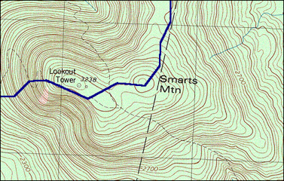
Notes:
Phys 2210 Sp 12 SJP L#11
Do the Maine Tutorial activity 6TtCFP_Tutorial
.

Slide 19
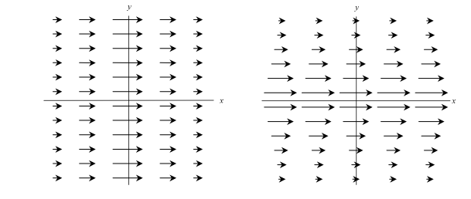
Click A when done with p. 1, etc. If you finish early .....
Do you agree or disagree with the following statements?
“For a conservative force, the magnitude of the force is related to potential energy. The larger the potential energy, the larger the magnitude of the force.”
2) “For a conservative force, the magnitude of the force is related to potential energy. For any equipotential contour line, the magnitude of the force must be the same at every point along that contour.”
Can you come up with equipotential lines for the 2 force fields below?
Notes:
Phys 2210 Sp 12 SJP L#11
Spent 22 minutes on the Maine Tutorial activity 6TtCFP_Tutorial
Class quickly spread out in pace – this was a hard one to coordinate. Some whipped through it, others struggled on page one for much of the time (I’m not sure why!) We had many good questions.
Issues include “which way is the force” (straight down, or “down the hill”?)
How can speed be same for boulders falling the same height when the TIME is not the same. (And for one group, WHY is the speed the same, how do you know?)
What is the definition of (partial) dU/dx?
Why is it positive if the function increases to the right, and not ambiguous in sign?
Which way does the gradient point? (Parallel to slope? Up the slope? Down the slope?)
Why/is there a minus sign in F=-grad(U).
One fast group was done so quickly I posed the challenge to them that in fact F(net) is NOT –grad U in this case (see notes on the Tutorial file itself for more on this). For most, though, they were puzzling nicely over the issues.
Spent about 5 collective class minutes at end discussing these 2 puzzles – got students to come up with counterexamples to each. (The Tutorial itself is the counterexample to 2, all three points are at the same height). The point one of my students raised is not to confuse potential with “rate of change of potential”. Precisely
(Question idea from Lincoln Carr, Mines)

Slide 20
y
Consider an infinitesimal “step” directed radially inward, toward the origin as shown. In spherical coordinates, the correct expression for dr is:
x
Notes:
Phys 2210 Sp 12 SJP L#11
[[61]], 39, 0
Last year it was [26] 63, 12
My answer is A) This can be *very* challenging for students (it still is for me) but it’s correct.
The answer is staring at you, at the bottom of the slide! (Although, I animated it, so it wasn’t showing. But I had written dr = dr rhat + r dpi phat on the board earlier)
If you are moving in the dr direction, then dr is just dr rhat. Always! That’s what dr is (see earlier clicker question) The sign will be taken care of by the limits of integration: in effect, if you are integrating “in” as shown, dr will itself prove to be a signed, negative quantity. If you *stick in* an extra minus sign like in B, you will double count and get the wrong result.
dr is ALWAYS dx ihat + dy jhat in cartesian, and dr rhat + etc in spherical, no exceptions!
Consider a "pie-shaped" integral of this same vector function. Argue (without proof here) that the full loop integral should vanish, and in this way simply show that you do NOT want to introduce that extra minus sign..) that seemed to help some students (?)
NOTES From last year Sp ‘11:
If students are still in doubt, perhaps have them consider, e.g, the integral to find “Potential energy of a charge in the Coulomb potential”
U(r)-U(infinity) =- Integral (from infinity to r) [ kQ/r^2 rhat] dot [dr rhat]
Note that I am putting in the overall outside minus sign as we always do, this is the *definitiion* of Delta PE = - integral (field dot dr)
Note that the lower limit on the integral is infinty, that’s where I’m calling U=0, that’s where we start from.
Finally, and key to this concept test, note that even though I am integrating IN from infinity, I.e. “inwards”, exactly as shown in the picture here, I nevertheless insist on making dr = +dr rhat, as answer A in this concept tests says. No minus sign there, or we’re hosed!
So you get –kq (-1/r)| (evaluated from infinity to r) The new, extra – sign came from integrating 1/r^2.
= +kq/r | upper limit r, lower limit infinity] = +kq/r, as we know it should be.

Slide 21
Do you agree or disagree with the following statements?
“For a conservative force, the magnitude of the force is related to potential energy. The larger the potential energy, the larger the magnitude of the force.”
2) “For a conservative force, the magnitude of the force is related to potential energy. For any equipotential contour line, the magnitude of the force must be the same at every point along that contour.”
Agree with 1 and 2
Agree only with 1
Agree only with 2
Disagree with both
Notes:
(These questions were asked after the main Tutorial, skipped in ’12.
In ‘11:
SJP, Sp ‘11 Lecture #12
2, 6, 17, [74]
This was our “review” (start of class) question on the day after the Tutorial. Students did pretty well, there was some good feedback from the students. One pointed out the the force on his potential doesn’t change as he lifts it (thus, 1 is false) Ana pointed out that although 2 is false, you might be fooled if you think if simple cases (like, equipotentials for gravity from a point or spherical mass)
Question based on Maine Tutorial

Slide 22
Which of the following are conservative forces?
I- friction (velocity independent, like μN)
II- Gravity (non-uniform case, e.g. in astronomy)
III- the normal force (between two solid, frictionless objects)
i only B) ii only C) iii only
D) i and ii only E) Other/not sure
Notes:
Phys 2210 Sp 12 SJP L#11
4, [[58]], 15, 7, 16
No time – (we handed back exams), so need to discuss next class again. (See next slide!)
Answer: B, only gravity, of these three. “Non-uniform” doesn’t matter, gravity is still conservative.
Friction in I is velocity independent (like, e.g, sliding friction) but it IS still manifestly path dependent.
III is not dissipative, it does no work, but is still not conservative, because it is not a function of position alone)
S. Pollock

Slide 23
Which of the following are conservative forces?
I- friction (velocity independent, like μN)
II- Gravity (non-uniform case, e.g. in astronomy)
III- the normal force (between two solid, frictionless objects)
i only B) ii only C) iii only
D) i and ii only E) Other/not sure
Notes:
Phys 2210 Sp 12 SJP Lect #12
(repeated from end of last class, start of this lecture)
8, [[58]], 7, 5, 22 (almost the same distribution as Tuesday!)
Last year it was 2, [86], 0, 2, 9 Not sure why the big change this time.
Answer: B, only gravity, of these three. “Non-uniform” doesn’t matter, gravity is still conservative.
Friction in I is velocity independent (like, e.g, sliding friction) but it IS still manifestly path dependent.
III is not dissipative, it does no work, but is still not conservative, because it is not a function of position alone)
Older comments:
Why, for instance, is a velocity INdependent friction force non-conservative? (Students can voice their explanation for this pretty clearly)
And similarly, why isn’t the normal force conservative, when after all it does NO work on any path (so it IS path independent!)

Slide 24
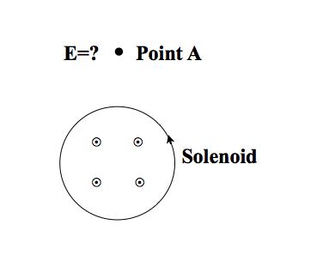
Consider the E-field at Point A, just outside a solenoid, which has a B-field that is increasing with time. Does this E-field produce a conservative force?
(Hint: Consider the motion of positive charge in a wire loop that passes through point A.)
Yes, it produces a conservative force
No, it is not conservative
Notes:
Skipped

Slide 25
Last Class:
A. Work
Line integral along a specific path
1
O Q
B. Conservative Forces
1. F(r)
2. Work independent of the path
C. Tutorial
Concepts: Equipotential surface, PE,Gradient, Force
Motivation: Force is proportional to gradient of PE but opposite direction
Notes:
Skipped in ‘12, this was from Prof. Rey’s ‘11 lecture.

Slide 26
This Class:
Rigorous definition of potential energy U(r)
Formal derivation of the relation between force and potential energy
Given U find F
Given F find U
Rigorous understanding of conservative forces.
Notes:
Skipped in ‘12, this was from Prof. Rey’s ‘11 lecture.

Slide 27
A charge q sits in an electric field E = E₀ i.
What is the potential energy U(r)?
(Assume U(0)=0)
Something else!
Notes:
Phys 2210 Sp 12 SJP Lect #12
2, 9, 21, [[68]], 0
Last year: 2, 4, 10, [81], 2
Animated slide, let them work a bit on it before revealing the answers.
A couple fell for the “vector” answers, it was good to point out that U must be a scalar. The sign issue didn’t catch many, but here too, it was good to hear student voices about why you know it should be D. (draw a picture on the board with the force arrows, and then “high PE, low PE” on left and right) A student next to me was worried about whether the answer depended on the sign of q, perhaps worth having the rest of the class think about!
S. Pollock

Slide 28

http://wn.com/Wile_E_Coyote
http://www.youtube.com/watch?v=Jnj8mc04r9E&noredirect=1
Notes:
http://www.youtube.com/watch?v=Jnj8mc04r9E&noredirect=1
Animated slide links to Road runner cartoon.
Start it as :31 seconds. Just humorous

Slide 29
Consider the contour plot of a function u(x,y), where the central contour corresponds to the largest value of u.
Which way does u point, at point 1?
A
D
B
1.
C
E) Other/???
Can you explain why?
Notes:
Phys 2210 Sp 12 SJP Lect #12
Silent: 0, 32, 2, [[67]], 0
Let them talk: 0, 15, 0, [[85]], 0
You must clearly state that the central contour is larger u, some students didn’t catch that.
Despite the Tutorial last class, there is still some confusion whether gradient points “up the hill” or “down the hill”.
I use this to reiterate F = -grad(U). I wrote out grad u = partial u /partial x, partial u/partial y, and we discussed WHY du/dx is NEGATIVE in this picture at point 1 (take a small step to the right, u goes down)
S. Pollock

Slide 30
What is the potential energy of M in
terms of φ? (Take U=0 at φ=0)
A)MgRcosφ
B)MgR(cos(φ)-1)
C)MgRsin(φ)
D)MgR(1-cos(φ))
E) MgR(1-sin(φ))
R
ϕ
M
Notes:
Phys 2210 Sp 12 SJP Lect #12
Note: I had already derived U(grav) = mg*height earlier in class,
0, 14, 8, [[78]], 0 (but, in our version, option A was MgRphi. This didn’t get any votes, so we’ve changed the question after class to what you see above now)
Sp ‘11: 0, 4, 19,[ 69], 8
The room was noisy on this. I animated the slide, and made them work on it for ~2 minutes before putting up any choices to click on. This is good, it pushes them to not just “choose among the answers”, but start to derive it. You can talk about limits (when phi=0, it better give 0) and sign (when phi>0, it should be positive).
Some students were trying to set up a line integral in those first two minutes. I had already derived U(grav) = mg*height earlier in class, so this was a good place to point out that you don’t have to re-integrate over and over again, once you know the functional form of potential energy, you’re done!
Brief discussion with some students about why the Tension force doesn’t mess anything up or add its own potential energy (it’s not conservative, but also does no work!)

Slide 31
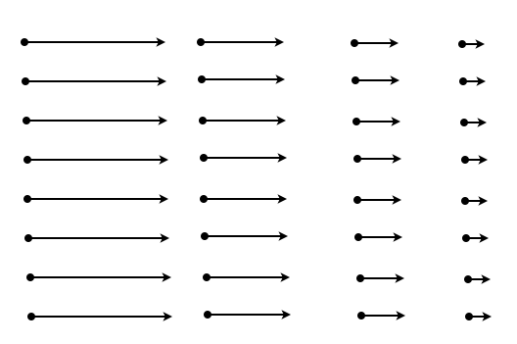
What is the curl (∇xF) of this vector field, F?
= 0 everywhere
≠ 0 everywhere
=0 in some places
Not enough info to decide
Notes:
Phys 2210 Sp 12 SJP Lect #12
Didn’t click, we did this AFTER a mathematica “walkthrough” activity, (see curl_SJP_Mod_forclass.nb)
and everyone seemed on board.

Slide 32
What is the curl (∇xF) of this vector field, F?
= 0 everywhere
≠ 0 everywhere
=0 in some places
Not enough info to decide
Notes:
Phys 2210 Sp 12 SJP Lect #12
6 [[77]], 17, 0,
This field is (-y,x). Its curl is constant (2 khat) everywhere . Some students were confused about the origin, thought maybe its curl vanished there. We talked about the case where the vectors get smaller and smaller (*I talked, mostly*), I think that went by too fast and wasn’t what we needed to be doing right here.

Slide 33
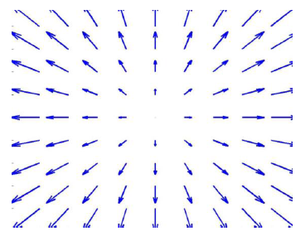
Can you come up with equipotential lines for the 3 force fields below?
Draw it if possible
Notes:
Phys 2210 Sp 12 SJP Lect #12
End of class, just gave them a few minutes for this. The middle one is the fun one, it has nonzero curl and there ARE no equipotential lines. We had already discussed the right one while doing the MMA activity.
Notes from Sp ‘11: We did this as a blackboard/class activity. (Three groups up front, each working on one of these) It worked very well!
The one in the middle is impossible, but many students want to draw “wavy lines”. It was nice to see them correct themselves as they talked about it. Many students wanted to do it “in their heads”, I was very insistent they really DRAW the answer, in part because that leads them to think about the density of equipotentials, not just their location. The group dealing with the third case missed this, but then corrected themselves. One group nicely pointed out (for fig 1) that they FIRST thoughty about whether this was conservative (by thinking about loops), and only THEN trying to draw equipotentials.

Slide 34
What is the curl (∇xF) of this vector field, F?
= 0 everywhere B) ≠ 0 everywhere
C) =0 in some places D) Not enough info to decide
Notes:
No time in ‘12.
Notes from ‘11: Followup to previous – we didn’t click, just had them think/discuss. It worked better than I had anticipated, it was framed as “youreally know the answer from our discussion of the previous activity, but can you convince yourself by the “paddlewheel” imagery?”, and then just gave them a few minutes to think about it.
We had a nice conversation/discussion that arose when someone noted that the paddlewheel wouldn’t turn along the y=0 line!

Slide 35
Now think about line integrals about various loops, to convince yourself they are always 0 in the “curl-free” cases.
Notes:
Skipped in ‘12
Notes from SJP, Sp ‘11 Lecture #12
Followup to previous – this led to a nice continuing discussion about the middle case. E.g, students noted that SOME integrals DO still give zero, and wanted to know if that had some significance? (One suggested maybe if you restricted the motion, say to follow y=0, then maybe you COULD define a potential?)

Slide 36
Discussion questions:
- Why is there a minus sign in F = -dU/dx?
- What is the physical meaning of the zero of
potential energy?
Notes:
Phys 2210 Sp 12 SJP Lect #12
Ended class with this, as “rhetorical” questions.
(Question idea from Lincoln Carr, Mines)

Slide 37
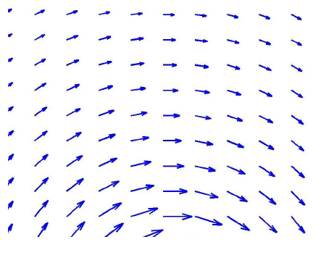
What is the curl (∇xF) of this vector field, F?
= 0 everywhere
≠ 0 everywhere
=0 in some places
Not enough info to decide
Notes:
Phys 2210 Sp 12 SJP Lect #12
we discussed it.
At first glance it looks simple, nonzero. There’s “obviously” a curl here. But it’s subtle. The field is very clearly F = f(r)phihat.
IF this field happens to be the magical field with f(r) ~ 1/r, then the curl of that function actually vanishes EVERYWHERE except the origin (where it has a singlularity). Physically, if you draw a little loop, the 1/r dependence means that the “longer outer leg” will cancel out the “shorter inner leg” exactly in any small “pie shaped” loop that runs anywhere EXCEPT around the origin. If f(r) does not drop off like 1/r, however, the cancellation is not exact, and you WILL have nonzero curl everywhere. So, the simple answer is B, but perhaps you should vote D, unless you’re able to decide by careful inspection whether this picture happens to be the magic case or not!

Slide 38
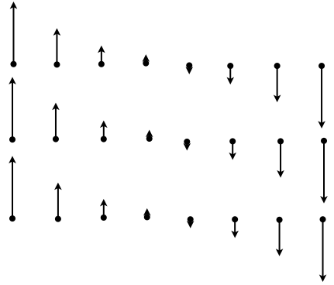
What is the curl (∇xF) of this vector field, F?
= 0 everywhere B) ≠ 0 everywhere
C) =0 in some places D) Not enough info to decide
Notes:
Didn’t bother in ‘12:
Notes from ‘11:
SJP, Sp ‘11 Lecture #13
2, [73], 25
This was the “preclass” question, to check up on last class. I did not hear why so many students (1/4 of the class! thought it was =0 in “some places”. One student thought maybe near the middle line, because the field was zero there... We had a good discussion here, though – I asked for HOW they knew, and I heard from one student about “dropping a pinwheel”, from another about integrating around a loop, another just said it *looked* like it had a clockwise “rotation” to it. The one thing I didn’t hear (and therefore did at the board), was just how to CALCULATE it. (I had them shout out a formula for the field, and got a few “-x yhat”’s, and went from there).
(When one student suggested the loop, I showed the next slide)
A) Looks like –x jhat, so the curl is –khat.

Slide 39
What is the curl (∇xF) of this vector field, F?
= 0 everywhere B) ≠ 0 everywhere
C) =0 in some places D) Not enough info to decide
Notes:
Looks like –x jhat, so the curl is –khat.

Slide 40
Consider the Coloumb force from a + charge on a positive test charge. Is this a conservative force?
Yes
No
???
Notes:
Didn’t bother.

Slide 41
Consider the three closed paths 1, 2, and 3 in some vector field F, where paths 2 and 3 cover the larger path 1 as shown. What can you say about the 3 path integrals?
1
3
2

Slide 42
Consider the contour plot of a function f(x,y), where the central contour corresponds to the largest value of f. What is the sign of the directional derivative of f(x,y) at point 3, in the direction of the unit vector n (shown by the arrow)?
n
3.
1.
A) >0
B) <0
C) =0
D) ???
2.
Notes:
Didn’t do this, though we did talk about the idea of “directional derivative” in answering a student question

Slide 43
Consider the contour plot of potential energy u(x,y).
Point 1 is somewhere on the u=0 contour.
Can we conclude F(r₁)=0?
Point 1 sits on the u(x,y)=0 contour
Yes, it must be true
It might be true, it depends!
It cannot be true
I still don’t see how we can say
anything about the vector F,
given only information about
the scalar function u
1.
Notes:
Phys 2210 Sp 12 SJP Lect #13
Preclass, 5, [[80]], 15, 0
It’s a wee bit of a trick – if you assume the contours are steadily decreasing (or increasing), then the answer would be C. But if you don’t know (and you don’t), then it COULD be true if 0 is a “local extremum” contour.
Nice, ( few were fooled!) Got several students to articulate the fact that I have not labeled contours, so you don’t know if they “turn around” at 1, making 1 a local extremum after all. I then labeled them (so it was +1 on the contour just inside, and -1 on the contour just outside), and then reasked (no click) – many student agreed verbally that now the answer “cannot be true”.
I use this question to reiterate F = -grad(U). I wrote out grad u = partial u /partial x, partial u/partial y. Also discussed the arbitrary nature of u=0 location. Also discussed point D (even though nobody voted for it). It is a little magical that you only NEED “one bit” of info at every point, to figure out the “2 bits” associated with the vector field. (My reasoning is that, knowing that F is conservative CONSTRAINS that vector field, you do NOT have “total freedom” for the vector to be *whatever*, at any point!)
S. Pollock

Slide 44
Consider the contour plot of potential energy u(x,y).
Point 1 is at an “extremum”, and u(1) is nonzero.
Can we conclude F(r₁)=0?
This is the u(x,y)=0 contour
Yes, it must be true
It might be true, it depends!
It cannot be true
I still don’t see how we can say
anything about the vector F,
given only information about
the scalar function u
1.
Notes:
Phys 2210 Sp 12 SJP Lect #12
Silent: 55, 27, 18, 0, 0
Let them talk: [[78]], 12, 8, 2
There’s no ambiguity here (I think), F=0 there.
Here I used this to review the formula dU = (grad U) dot (dr). (I wrote dU = (grad U) and got people to call out how to “finish the equation”, to get a scalar). We then talked about the analogy to a 1-D graph where, at an extremum, df/dx=0. Extrema are “flat” locally!)
One student wanted to know if we couldn’t invent some “mathematically pathological” function U which has a maximum that is somehow delta-function like, so that it’s NOT flat, and F is NOT zero. I had to wave my hands and argue that delta functions are approximations but not really “physics”, if this represents a physical potential energy, I cannot think of how to get a physical force which is anything but zero.
S. Pollock

Slide 45
What is the curl (∇xF) of this vector field, F?
= 0 everywhere B) ≠ 0 everywhere
C) =0 in some places D) Not enough info to decide
Check yourself! Invent a formula for F,
and take its curl.
Notes:
Phys 2210 Sp 12 SJP Lect #13
7, [[89]], 2, 2, 0
In Sp ‘11: 2, [[73]], 25,0
I passed out whiteboards, and had them do the activity at the bottom of the question: guess a functional form, take the curl and check yourself!
Looks to me (and most of the class) like –x jhat, whould work, so the curl is –khat. (A constant).
This all took just about 3 minutes, and seemed worthwhile. There were sign issues, people discussed if it could be –x^2 ihat (signs don’t work out!)
This also helped set the stage for the next question.
Comments from Sp11:
I did not hear why so many students (1/4 of the class! thought it was =0 in “some places”. One student thought maybe near the middle line, because the field was zero there... We had a good discussion here, though – I asked for HOW they knew, and I heard from one student about “dropping a pinwheel”, from another about integrating around a loop, another just said it *looked* like it had a clockwise “rotation” to it. The one thing I didn’t hear (and therefore did at the board), was just how to CALCULATE it. (I had them shout out a formula for the field, and got a few “-x yhat”’s, and went from there).
(When one student suggested the loop, I showed the next slide)
S. Pollock

Slide 46
What is the sign of the line integral
around the red line path shown?
= 0 B) >0 C) <0
D) Not enough info to decide
Notes:
Phys 2210 Sp 12 SJP Lect #13
Started silent, it was about 67% correct, with the rest split evenly across =0 and <0.
Then, talking to each other: 2, [[81]], 14, 3
Most students in the end correctly argued that the contribution is + on BOTH lef and right sides, and zero on top or bottom, giving a positive contribution. When I pushed for the connection to the curl, there was largely silence, so I think it was good to go through the “Stokes” story, and relate this integral to the (here, uniform, negative) curl.
This is a good place/opportunity to bring up the Stoke’s convention about sign of area, (the “right hand rule” for line integrals). We’re not going deeply into the math of stoke’s this term, but this was a good refresher (and, hooks in with a homework problem they just handed in which had some sign issues about integrating around a loop.
About 20% of the class argued that if you integral B dot dl “the other way”, you conclude the current must be flowing the other way (!!) )
Steven Pollock

Slide 47
Last class: the following are basically all equivalent!
F(r) is a conservative force
Notes:
Phys 2210 Sp 12 SJP Lect #13
(See comments on next slide)

Slide 48
Last class: the following are basically all equivalent!
F(r) is a conservative force
PE is well defined
is path independent
Notes:
Phys 2210 Sp 12 SJP Lect #13
I spent a few minutes going over this, trying to get students to ask questions. It’s a good review, but my class was mostly silent. Danny C pointed out that the last line really needs to be “for ALL closed loops”.
When nobody could think of a question or comment, I asked them how many could tell me how the last line relates to the one before it. Very few raised their hands – so, I think I am not getting questions but that doesn’t mean they understand! I talked through Stoke’s Theorem once more, (including the subtle but important point, related to Danny’s comment, that just because an integral vanishes, doesn’t mean the integrand vanishes. Only if ALL/ANY integrals of your integrand vanish, THEN you can conclude the integrand is zero!)
S. Pollock

Slide 49
If the force F(r,t) is explicitly time dependent, mechanical energy is not conserved.
Which of the equations below (which were all used in our PROOF that energy is conserved for conservative Forces) is incorrect in this case?
Notes:
We decided not to go here.

Slide 50
Of the four labeled points, at which is the force = 0 ?
i only B) ii only
C) ii & iv only D) ii, iii and iv only
E) Some other combination!
U(x)
i
ii
iii
iv
x
Notes:
Phys 2210 Sp 12 SJP Lect #13
3, 2, 5, [[89]], 2
SP 11: 5, 2, 2, [91], 0
No problems here. I used this as a starting off point to define equilibrium, then stable and unstable, saddle points (iv looks like a “shallow minimum rather than a saddle, perhaps I should change that!)
Sp 11 comments:
A couple of students thought U=0 means F=0, that was nice to talk about (even though it’s only 5%)
I talked about the condition for stability (U’’>0) with this slide.

Slide 51
Fig 4.12 of Taylor shows PE of H in an HCl molecule.
If the mechanical energy, E, is shown (dashed), what’s the best description of the motion of the H atom?
Trapped, at r=a B) Oscillates around r=b
C) Unbound, the H “escapes” D) Other/????
U(r)
E>0
a
b
r
Notes:
Phys 2210 Sp 12 SJP Lect #13
Sp ‘12: Silent: 5 52, [[44]]
After discussion, 8, 30, [[61]], 2
Sp 11: 4, 28, [67]
I “animated” this slide, and them them talk to their neighbor for a good minute before I showed them options A-D.
I started by talking about the physics (Cl- attracting H+, and then why would you get a repulsive force for small r, what’s the physics?)
I pointed out that they should think of this as truly 1D - “constrained to live on a line” . (Much later, during discussion I came back and had them think about the true 3D problem where U depends only on r, but the particles can orbit too!)
We had already talked about “turning points before doing this CT, and how you can “read off” kinetic energy from this picture. The discussion was muted, until I suggested we think about a hydrogen starting at large r, either heading OUT (or, after that, IN), and this year the argument for answer C came quickly – there’s no turning point (unless it’s heading in), but either way it runs away forever.
Had to point out that “oscillate” means repeated oscillation, not a single “bounce”.
One student was a little surprised, and wondered if this means that you have to have “low energy” to bind an H+ to a Cl-.
Sp 11 additional comments:
This was a good conversation: one student clearly articulated that if you start at a, you move right (F = -dU/dx pushes outwards), but past b, there is a NEGATIVE force, so he thought that meant it should turn around, thus arguing for B. So, we had a good conversation, another student came up with the argument that KE>0 so it “runs away” and never turns around.
I also heard students talking about how it “comes in, bounces, and leaves, so that’s an oscillation”.
I used this slide also to talk about initial/boundary conditions, and that you cannot FULLY answer “what is the motion” with just the information given.

Slide 52
Given the plot below (with E>0)
Sketch a plot of KE(r) vs r on your whiteboard.
What does this tell you about the motion?
U(r)
E>0
a
b
r
Notes:
FOLLOWUP WHITEBOARD IDEA FROM LAST QUESTION:
What if we leave the picture up and say, on your whiteboard sketch a graph of KE(r) vs r
I think this would reveal some interesting ideas!

Slide 53
Fig 4.12 of Taylor shows PE of H in an HCl molecule.
If the energy, E, is shown (dashed), what’s the best description of the motion of the H?
Trapped, at r=a B) Trapped, at a OR c
C) Unbound, H “escapes” D) Oscillates around r=b
E) Other/???
U(x)
a
b
c
r
E<0
Notes:
Phys 2210 Sp 12 SJP Lect #13
Didn’t bother to click, but we had a nice discussion. I pushed into the “3D” world, and asked if you could have a stable orbit with the energy shown and r=b (circular, steady orbit). This is a puzzle, the answer is no, if r=b, then F=0, but you can’t have a stable circular orbit with no centripetal force! The class caught on, and students argued that there must be some value of r between b and c where it would work. (Less than c, because at c it’s not moving, and must head towards a!)

Slide 54
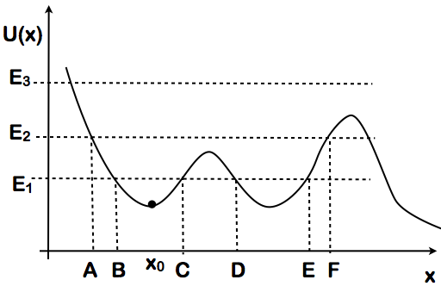
Which statements are true about a particle located at x_{o}?
I- If it has energy E_{1,} it can move between B and E
II- If it has energy E₂ it is bounded between A&F, it cannot escape
III- A particle with E₃ is unbounded
All
II only
III only
I&II
II&III
Notes:
Phys 2210 Sp12 SJP L#14 (start of class, review from last time)
5, 3, 2, 2, [[89]]
Sp 11: 2, 13, 0, 2, [82]
This leads to a review/discussion of notation (turning points, stability). I added the “Sketch” question, we had them do this on whiteboards. Most were ok, nobody realized v could be negative, and some were confused about what happens at large x.
Notes from Sp11: The students who voted “II only” said that they thought E3 was bounded *on the left* so that’s why they didn’t vote for E. (Semantics, and good to get out in the clear!) (Mentioned tunneling for non-classical particals on I)

Slide 55
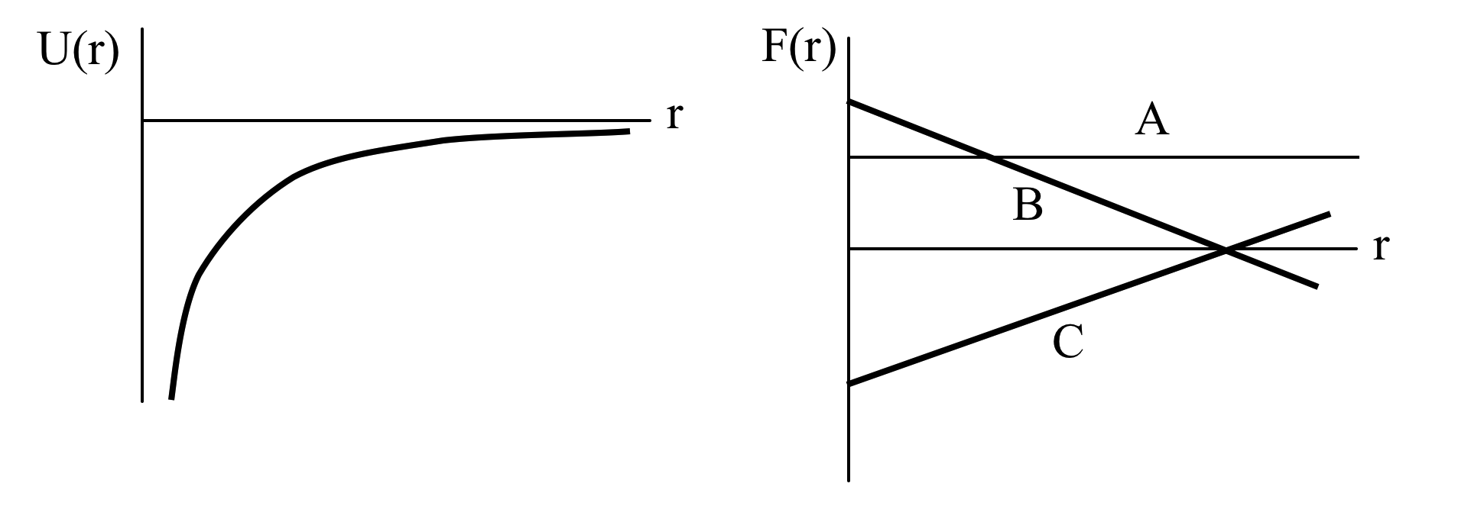
The potential energy of a test mass is shown as a function of distance from the origin U(r) ~ - 1 / r.
Which graph shows the corresponding force as a function of distance?
D) None of these!
Notes:
Didn’t Bother

Slide 56
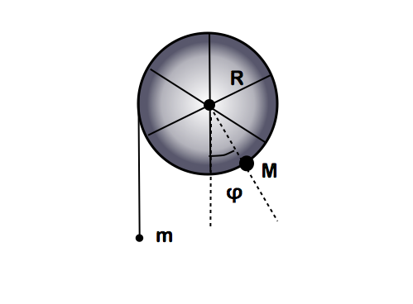
Consider this massless frictionless wheel.
M is attached to the side, while m hangs from a string wrapped around the wheel.
What is the potential energy of m in terms of φ?
+mgφ
-mgφ
+mgRφ
-mgRφ
Something else, there’s
got to be some trig!
Notes:
Phys 2210 Sp 12 SJP Lect #13
3, 2, 15, [[75]], 5
Since we had whiteboards out, this was an all-class activity. I set it up (I have a physical demo that works very nicely, called “angular acceleration machine”) Students took a good few minutes working on this and the next part – most managed to get this one just fine, the sign issue needed to be discussed (and we also discussed the “zero of U” issue, they seemed good with it)

Slide 57
What is the potential energy of M in terms of φ?
MgRcos(φ)
MgRsin(φ)
MgR(cos(φ)-1)
MgR(1-cos(φ))
Something else!
Notes:
Phys 2210 Sp 12 SJP Lect #13
3, 0, 5, [[92]], 0
They’ve seen this question before, it’s the same! They seemed fine with this. We did have a good discussion about the difference between A and C (just a constant!) but both get the sign of cos(phi) wrong!
After this pair of questions, we’re set up to calculate equilibrium and stability (and then demonstrate it!)

Slide 58
A square object of edge length b is perched on top of a stationary cylinder of radius R, as shown. The square can roll without slipping on the surface of the cylinder. The cylinder is fixed and cannot move. Is the square in stable equilibrium?
b
R
A) Yes, the equilibrium is always stable
B) No, the equilibrium is always unstable
C) The equilibrium is always neutral
D) The nature of the equilibrium depends
on the relative size of b and R
Notes:
Skipped this.

Slide 59
A particle oscillates in a one-dimensional potential.
How many (which?) of the following properties guarantee simple harmonic motion?
i) The period T is independent of the amplitude A
ii) The potential U(x)~x²
iii) The force F=–kx (Hooke’s law)
iv) The position is sinusoidal in time: x=Asin(wt+a)
A) only 1 of these properties guarantees simple harmonic motion
B) exactly 2 properties guarantee simple harmonic motion
C) exactly 3 properties guarantee simple harmonic motion
D) all (any one of these guarantees simple harmonic motion)
Notes:
Skipped.

Slide 60
A particle oscillates in a potential well which is not a simple
U(x) ~ x² harmonic well.
The well U(x) can be written as a Taylor series expansion about the equilibrium point x₀ (at which dU/dx vanishes) :
The higher derivatives U'' and U''' are nonzero at x = x₀.
In the limit of very small oscillations, that is, in the limit of , what can you say about this potential well?
A) The well definitely becomes harmonic..
B) The well definitely becomes anharmonic.
C) Whether the well becomes harmonic or anharmonic depends on the function U(x). )
Notes:
Skipped.
From M. Betterton. (?)

Slide 61
A particle is oscillating, back and forth with amplitude A, in a potential well .
Notice that, compared to the harmonic x² potential, the anharmonic x⁴ potential has a flatter bottom and steeper sides. When the amplitude of oscillation is increased, what happens to the period T of the oscillation for the anharmonic x⁴ potential?
U(x)
x⁴
x²
x
A) period T increases, as A increases
B) period T decreases, as A increases
C) period T remains constant, as A increases
Notes:
Skipped
From M. Betterton. (?)

Slide 62
Summary:
1-D systems, U(x) yields F(x)=-dU/dx
Equilibrium when U’(x)=0
Stable Equilibrium if U’’(x)>0
Plots of U(x) vs x give us immediate information
(about binding, motion, v(x), v(t), equilibrium, ...)
Notes:
Phys 2210 Sp 12 SJP Lect #13
(Skipped, Ran out of time, did it in Lecture 14 as review)

