Slide 1
Oscillations
Notes:
Phys 2210 Sp 12 SJP L16

Slide 2
How many initial conditions are required
to fully determine the general solution
to a 2nd order linear differential equation?
Notes:
Phys 2210 Sp 12 SJP L16
Students are quick on this one. But, I solved the x’’ = -k/m x (by guess and check), and we talked about whether omega = Sqrt[k/m] we put in our solution (A cos(omega t)) is one of the parameters determined by initial conditions (it certainly is not!)

Slide 3
Since cos(ωt) and cos(-ωt) are both solutions of
can we express the general solution as
x(t)=C₁cos(ωt) + C₂cos(-ωt) ?
yes
no
???/depends
Notes:
Phys 2210 Sp 12 SJP L16
40 [[54]], 6, 0, 0
Sp ‘11: 55, [45] 0
Just a fun little question. We had just explicitly shown cos(omega t) works, and I quickly showed that cos(-omega t) does too, so then asked this. This leads to a nice discussion of linear dependence, and the need for two independent solutions. (I also briefly mention the Wronskian check method, but don’t have them practice it)
Notes from ‘11: I explicitly showed that cos(omega t) is a solution to this ODE just BEFORE giving this CT.
Note that the majority got this wrong! It was a nice discussion. Since 55 “looked correct”, I asked for an explanation of A, and got a nice one: the ODE is linear, so if you have two solutions, then a linear combination of them is also a solution”. This is 100% correct, and I agree with the student, but then MANY hands shot up. The counter arguer stated that it’s true that this y(t) is a solution, but it’s not general, because cos(x)=cos(-x), so you can combine C1+C2, it’s just ONE constant, really, not two. So we’re missing the other solution (which the student point out was sin)

Slide 4
Richard Feynman’s notebook (Age 14)
Notes:
Phys 2210 Sp 12 SJP L16
Got this slide from A. Marino/D. Caballero. Just fun, intro to complex numbers.

Slide 5
For a simple harmonic oscillator (mass on a spring), what happens to the period of motion if the spring constant is increased?
Increases
decreases
unchanged
It depends!
Notes:
Phys 2210 Sp 12 Lecture 17
Sp 12: 11, [[85]], 2, 2
(It was about 77% preclass, then I talked for a minute about formulas, then encouraged revote.)
Sp ‘11: 0, [98], 2,0,0
I’m not sure why so many voted for increases, couldn’t get anyone to speak up about it. The formula omega = Sqrt[k/m] and T = 2 pi/omega was on the board when they revoted. Neither had been discussed or was on the board before the first vote.

Slide 6
For SHM, what happens to the period of motion if the mass is increased by 4?
Increases by 2x
Increases by 4x
unchanged
Decreases by 2x
Decreases by 4x
Notes:
Phys 2210 Sp 12 Lecture 17
[[93]], 3, 0, 3, 0
This is easy after discussion of the previous one. (I did a little demo for them)

Slide 7
For the previous situation, what happens to the period of motion if the initial displacement is increased by 4?
Increases by 2x
Increases by 4x
unchanged
Decreases by 2x
Decreases by 4x
Notes:
Phys 2210 Sp 12 Lecture 17
Didn’t bother clicking, but they called it out. I challenged the class, isn’t this odd, that it goes 4 times as far in the same time? I got several “but the initial force is larger” responses. But it’s still rather magical, how does it come out COMPLETELY independent of the amplitude? Pointed out that for a pendulum, it is NOT exactly independent, only approximately (which is a good thing for grandfather clocks, and why you need small amplitude motion on such a clock)

Slide 8
Complex Numbers
Notes:
They all claim to “know” complex numbers. And it’s sort of true, but they need a lot of review, they don’t know them well, and they really don’t seem to have a good sense of complex numbers as represented in the complex plane.

Slide 9
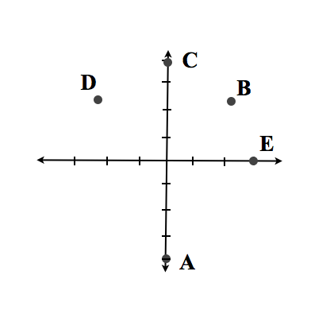
Which point below best represents 4e^{i3π/4} on the complex plane?
Challenge question: Keeping the general form Ae^{i θ}, do any OTHER values of θ represent the SAME complex number as this? (If so, how many?)
Notes:
Phys 2210 Sp 12 Lecture 17
Sp ’12: 13, 13, 10, [[64], 0
I was disappointed so asked them to talk to their neighbors (before I explained anything), result became
2, 7, 2, [[88]], 2, good!
Sp ‘11 (clicker failure, estimate: 8, 10, 6, [[75]], 0
I had introduced Euler, showed how to plot a+bi in the complex plane, showed that this is equivalent to Aexp[I theta] on the board. I had a sketch up there, of a+bi, with the hypotenuse A = Sqrt[a^2+b^2] and angle theta = tan^-1(b/a). Then gave them this one, and it was NOT universally correct. I find this interesting, it’s apparently new to just “see” how to plot a point in the complex plane for them.
What I could not figure out is what the source of the problem on the first pass is. Do they really think that “3 pi/4” points DOWN (answer A)? Or that it’s in the 1st quadrant (answer B)? Is this the nature of their difficulty, or are they just lost/guessing? Their discussion with neighbors definitely helped a lot. Then I shifted to whiteboards, where things went very well. (see next one)
Sp ‘11 comments:
Surprised me, thought this was a gimme - so I realized I needed to spend just another minute discussing this representation of complex numbers. We had already talked about Euler’s theorem, but it still hadn’t sunk in.
From A. Marino

Slide 10
On a white board, draw points showing
i) e ^{i π/6}
ii) e ^{i π/3}
iii) e ^{i π/3} e ^{i π/6}
iv) e ^{i π/3} / e ^{i π/6}
Click A) only when you’re done, please.
Notes:
Phys 2210 Sp 12 Lecture 17
Simple whiteboard activity, only takes a few minutes, but gets them thinking about NOT “computing” the real and imaginary parts, but rather just “seeing” from the polar form where the point is in the complex plane. This slide also gets them thinking about “rotations” in the plane as what multiplication or division means.
Might want to add a clicker question at the bottom to let you know when they’re done with it, though.
S. Pollock and D. Caballero

Slide 11
Consider two complex numbers, z₁ and z₂.
The dotted circle shows the unit circle, where |z|=1.
Im z
Im z
z₁
z₂
Re z
Re z
Notes:
Phys 2210 Sp 12 Lecture 17
Followup to the whiteboard (previous slide). Put this up when ~1/2 the class was done. See next slide for rest.

Slide 12

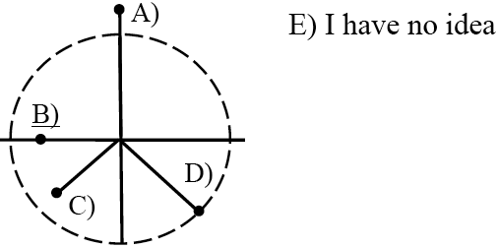
Consider two complex numbers, z₁ and z₂.
The dotted circle shows the unit circle, where |z|=1.
Im z
Im z
z₁
z₂
π/4
Re z
Re z
Which shows the product z₁z₂ ?
Notes:
Phys 2210 Sp 12 Lecture 17
Sp ;12: 5,[[ 90]], 5, 0,0
Sp ’11: 8, [[71]], 18, 0, 2
Just a reminder/focus on how to multiply complex numbers, and to picture that as a “rotation” in the complex plane. Looks like the whiteboard activity preceding this helped, comparing with Sp ’11
From A. Marino (?)

Slide 13
What is 1/(1+i) in “polar” form?
e^{i π/4}
e^{-i π/4}
0.5 e^{i π/4}
0.5 e ^{-iπ/4}
Something else!
Notes:
Phys 2210 Sp 11 Lecture 17
Sp ‘12: 2, 16, 0, 46, [[36]]
(Last year I gave a harder version, Sp ‘11 result was only 30% correct. )
Note that this is a little mean, the correct coefficient is 1/Sqrt[2], not ½, so E is correct. Might not want to do that next time, especially since A garners no votes.
There are two obvious “paths” here,
Write 1 = 1e^i0 and (1+i) = Sqrt[2] e^(I pi/4), and divide, using the method/logic of the previous slide.
“Rationalize” by multiplying numerator and denominator by 1-i.
I did both with the class, discussing WHY you rationalize. Some students are still confused, how do I “see” that 1+I = Sqrt[2]e^(I pi/4)? I drew it out on the board (complex plane diagram), I think this helped.
They’re still slow/struggling, even though last class they all said they “know” complex numbers! It’s clearly worth taking a little time to review. I have more review q’s on homework due in 2 days.
S. Pollock

Slide 14
What is (1+i)²/(1-i)
e^{i π/4}
Sqrt[2] e^{i π/4}
e^{i 3π/4}
Sqrt[2]e^{i 3π/4}
Something else!
Notes:
Did this last year, seems unneccessarily complicated for this point in the lecture.

Slide 15
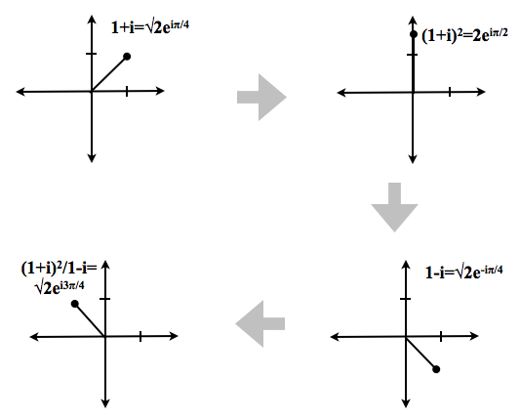
What is (1+i)²/(1-i)
Notes:
From A. Marino (?)

Slide 16
What is (1+i)²/(1-i)
Notes:
From A. Marino (?)

Slide 17
What is (1+i)²/(1-i)
Notes:
From A. Marino (?)

Slide 18
What is (1+i)²/(1-i)
Notes:
From A. Marino (?)

Slide 19
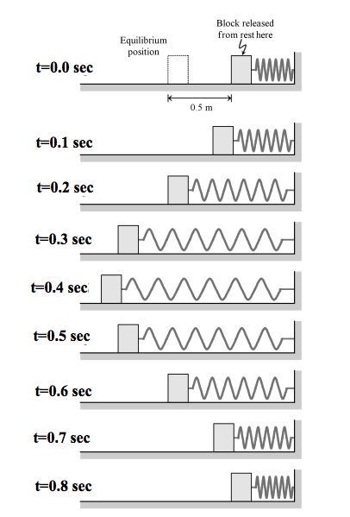
Based on the pictures what is the period of motion of the block?
.2 s
.4 s
.6 s
.8 s
None of these/
not enough info!
Notes:
No time
(From Maine/Ambrose Intermediate MechanicsTutorials)

Slide 20
A mass m oscillates at the end of a spring (constant k)
It moves between x=.1 m to x=.5 m.
The block is at x=0.3 m at t=0 sec, moves out to x=0.5 m and returns to x=0.3 m at t=2 sec.
Write the motion in the form x(t)=x₀+Acos(ωt+φ), and find numerical values for x₀, A, ω, and φ
If you’re done:
Write the motion in the form x(t)=x’₀+A’sin(ω’t+φ’), and find numerical values for x’₀, A’, ω’, and φ’
Notes:
SJP Sp ‘12 Lecture #18
This year we did this with whiteboards, spent a good 5 minutes on it. It’s a good activity. This time I first connected the motion to the physical (demo) mass in the room, and this seemed to help mitigate what the physical meaning of x0 is. Student this term were quick to get x0 and A, spent some time on omega (there were a variety of answers, including 2 Pi, 4 Pi, 8 Pi, Pi/2, … (Some arising from thinking T=2 sec, others from not correctly using omega = 2 Pi/T, …) The tough one seems to be phase, I saw MOSTLY pi/2 or –pi/2, some +/- signs, and some 0’s, (The +/- is NOT correct, we sketched this on the board, I did each one separately, and we realized that +pi/2 generates –sin, not +sin, inconsistent with the story on the slide. I also used this to remind them of the trig identity for cos(a-b). Afterwards, Danny pointed out the “take a derivative” trick (see notes from last year, below) to get that it is –pi/2, not +pi/2.
SJP, Sp ‘11 Lecture #17
We spent a lot of class time on this, at least 5 minutes. I had two groups at the board, and everyone working at their seats. The groups at the board struggled – they struggled with understanding what x0 meant, they struggled to come up with omega (without k or m), they even debated if A was 0.2 or 0.4 There was a LOT of trouble with phi – one group up front thought it was 0, but then realized this was inconsistent and wanted to toss their entire answer (which had correct x0, A, and omega). When I got them to come up with “pi/2”, I asked if it was + or -, and again, big class discussion, many said “it doesn’t matter”.
Equilibrium: x0=.3
A = 0.2 by inspection
omega = 2pi/T = 2pi/4 sec
phi is tricky. At t=0, we’re at x0, so cos(phi)=0. That lets phi = +/- pi/2.
To decide, take a deriv, v = -Aw sin(wt+phi), and at t=0, v=-Aw sin(phi).
Since our problem has v(0)>0, phi must be –pi/2.
That’s right, Acos(wt-pi/2) = Asin(wt), which is more “obviously” correct here!

Slide 21
Oscillators have x_{i}(t)=A_{i}cos(ω_{i}t+φ_{i}) (for i=1, 2)
Which parameters are different?
What is the difference between φ₁ and φ₂?
Which is slightly larger (more positive?)
A) φ₁ B) φ₂
Notes:
Phys 2210 Sp 12 Lecture 17
[[71]], 29,
Before the discussion, I asked “which is leading, red or black”? MOST students called out red, but some called out black – visually, the black curve looks “ahead”, but of course the red curve peaks a little EARLIER so it “winning the race”. This is the lingo, red is leading, black is lagging.
Discussion went well, students point out “cos(x-delta) shifts the curve to the RIGHT”, and another pointed out that “cos(w t + d) reaches a peak FIRST, if d>0”.
SP ‘11: 38, [62] (order /notation was different in last year’s version,I had cos(wt –d) and no colors)
Sp 11 comments: Students are still confused about this. You peak when wt-d=0, or t=d/w. So, if your d is more positive, you peak a little later. Looks like osc 2 has the slightly more bigger delta. (I had to go over this several times, even a very good student was struggling with it)

Slide 22
What is the general solution to the ODE
where ω is some (known) constant?
Is there any OTHER general form for this solution? How many are there? How many might there be?
Notes:
Phys 2210 SJP SP 12 Lecture 18 (preclass)
Sp 12: 0, , 4, [[73]], 18
Sort of just for fun and review. A student argued that C is ok, just “redundant”. I would argue that C is somewhat silly, just like suggesting A cos + B cos + C sin + D sin is also “fully general”.

Slide 23
Neglecting all damping, and considering just 1D motion, what is the angular frequency at which this mass will oscillate? (The mass is at the equilibrium position for both springs at the point shown)
k
2k
m
Sqrt[k/m]
Sqrt[1.5 k/m]
Sqrt[3k/m]
Sqrt[5k/m]
Something else!
Notes:
Phys 2210 SJP SP 12 Lecture 18
Sp ‘12: 33, 9, [[56]], 0, 2
From Joe Redish
SJP, Sp ‘11 Lecture #17
24, 7, [67], 2,0
This is a nice problem, it triggers some sort of “balancing” intuition, and requires a systematic approach to be sure to get it right.
I had them talk me through “how do you proceed”, got many “draw a free body diagram”, “write down the ODE”
Here, the forces when you displace it by “x” both point in the SAME direction, on is kx, the other is 2kx, thus 3kx is the total.
From E. Redish.

Slide 24
Phase Space

Slide 25
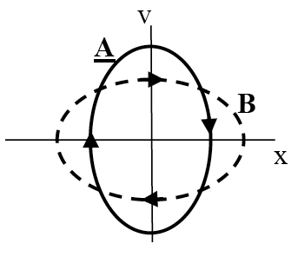
If you finish early, click in on this question:
Phase paths A and B both describe a harmonic oscillator with the same mass m. Which path describes the system with a bigger spring constant k?
C) Other/undetermined…
2) How does a phase space diagram change, if you start it with a bigger initial stretch?
3) How does a phase space diagram change, if the phase “δ” in x(t)=Acos(ωt-δ) changes?
Notes:
Phys 2210 SJP SP 12 Lecture 18
Sp ‘12: [[88]], 12
We spent about 20 minutes on the Maine Tutorial, 7TtPhase-SHM_ADM.doc and wrapped up with this question. It was a good discussion, students had interesting ideas, and there was ongoing debate even after I had “b/a = omega” (where b and a represent the v and x intercepts), which is derived in the Tutorial, on the board.
One student argued that this figure was impossible, because “curve B obviously has higher energy because it goes out farther, and yet curve A goes up to higher v, so IT has higher energy.” He convinced himself that both curves should have the same x-extent. I asked the class what they thought – which curve represents more energy. This generated more debate, with some insisting that “larger stretch must mean more energy”. (But of course k is NOT the same for the two figures, as implied by the question). Indeed, given that m is the same, the v intercept tells us that curve A has the larger energy. (And larger k)
The second pair of questions proved to be very good conversation starters too, we had a good long class discussion. 2 was easy, 3 was harder. Someone thought (like last year) that this would “shift the whole ellipse sideways” (?) So, we had a good discussion about that.
(From Maine/Ambrose Tutorials)

Slide 26
Phase paths A and B both describe a harmonic oscillator with the same mass m. Which path describes the system with a bigger spring constant k?
C) both are (or at least could be!) the same
D) Not enough info/???
Notes:
Phys 2210 SJP SP 12 Lecture 18
Sp 12 (see prev slide)
Sp 11: [[95], 3, 3
No problem, but worth asking. The discussion was good, and the student who explained it made the nice physical argument that bigger k means “stiffer”, so it goes faster without going as far.
(Fa ’10 - this one was given RIGHT after the Tutorial but before the previous review slide and it was a much more mixed result)
(From Maine/Ambrose Tutorials)

Slide 27
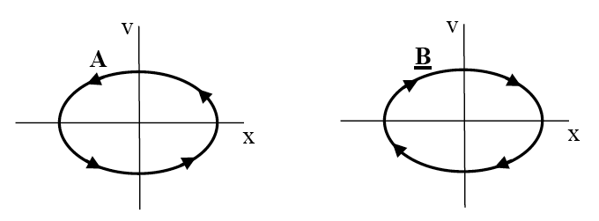
Phase paths A & B below attempt to describe the mass-on-a-spring simple harmonic oscillator.
Which path is physically possible?
C) both are possible
D) neither is possible
Notes:
Phys 2210 SJP SP 12 Lecture 18
(Didn’t click on this in Sp 12, but discussed it)
Sp ‘11: 2, [59], 35
Sp 11: This was a review from last time (when we did the Tutorial on phase space). Since the answer split indicated that A was the one they weren’t sure about, I asked for people to explain to me what the problem might be with A. One student discussed the issue when x is max (but v is going from negative to positive??) and another pointed out the issue when x=0, and v is positive, but x is becoming more negative. It’s a good conversation starter, I think.

Slide 28
v
b
x
a
1) How does the phase space diagram change,
if you start it with a bigger initial stretch?
2) How does the phase space diagram change, if the phase “δ” in x(t)=Acos(ωt-δ) changes?
Notes:
Phys 2210 SJP SP 12 Lecture 18
From Sp ‘11:
Review, I animated this. I didn’t do 1 and 2 as clicker questions, just gave them ~1 minute (each) to talk with their neighbors, and then asked for class discussion. This went very well. 1 seemed easy, there was strong and quick consensus. (Nobody raised the possibility that it “stretches wider”) Students pointed out that bigger stretch means bigger energy, so “the whole think scales up” (which is almost but not 100% identical to how I was thinking, merely that omega is fixed and sets b/a, so bigger a makes a bigger “similar” ellipse)
But 2 generated a lot of discussion. 1 student said w stays the same so the SHAPE is the same, but it must “shift sideways”. Another said it makes no difference at all (which is true if you think of this as a shape, rather than the trajectory of a point). I would argue that delta is telling you where on the curve you start, so the overall ellipse is the same, but the starting point depends on delta. I thought this slide was very worthwhile review.

Slide 29
For the phase space trajectory of a simple harmonic oscillator,
give a physical interpretation of the fact that:
- the trajectory crosses the horizontal (x) axis
at right angles.
- the trajectory crosses the vertical (v) axes
at right angles.
v
x
Notes:
Phys 2210 SJP SP 12 Lecture 18
No clicks, very healthy discussion.
Sp ‘11 comments: Again, no clicking, just discussion. I told them I wanted it quick, and gave them ~1 minute. I got very nice, clear explanations for both, students were able to articulate it well. (E.g, at the top, x=0 so you’re at equilibrium, there is no force, and thus speed must be constant there). One student tried to explain the crossing of the x axis by stating that there, v=0 at the endpoint. So I pointed out that the ellipse could (conceivably) be tipped, so maybe it crosses through the x axis with a slope. But another student quickly countered, at the extremum of x, velocity is zero, which means x is not instantaneously changing, so it must be vertical.

Slide 30
2D Harmonic motion

Slide 31
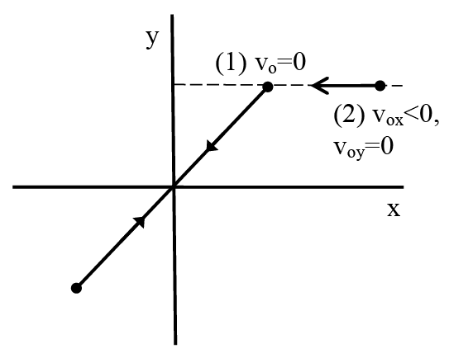
Compare the motion of a 2D harmonic oscillator with two different sets of initial conditions. In case (1) the particle is released from rest and oscillates along the path shown. In case (2) the particle starts with a larger x position and with a negative x component of the velocity.
What can you say about the amplitude of the x and y motion?
A_{x1}>A_{x2}, A_{y1}>A_{y2}
A_{x1}<A_{x2}, A_{y1}=A_{y2}
A_{x1}=A_{x2,} A_{y1}>A_{y2}
A_{x1}<A_{x2,} A_{y1}<A_{y2}
A_{x1}=A_{x2}, A_{y1}=A_{y2}
Notes:
Phys 2210 SJP SP 12 Lecture 18
0, [[98]], 2, 0, 0
Sp ’11: 0, [95], 0, 5,0
SP 11 comments:
No problem at all here. I had just given a quick lecture about 2D HO, with equations on the board for x and y(t) in the form Acos(wt-delta). They were quick and almost all correct on this one.( It did take a moment for them to “process” the question, I think, the notation is a little ugly and it’s wordy)

Slide 32
Compare the motion of a 2D harmonic oscillator with two different sets of initial conditions. In case (1) the particle is released from rest and oscillates along the path shown. In case (2) the particle starts with a larger x position and with a negative x component of the velocity.
What can you say about the frequency of the x and y motion?
ω_{x1}>ω_{x2}, ω_{y1}>ω_{y2}
ω_{x1}<ω_{x2}, ω_{y1}=ω_{y2}
ω_{x1}=ω_{x2,} ω_{y1}>ω_{y2}
ω_{x1}<ω_{x2,} ω_{y1}<ω_{y2}
ω_{x1}=ω_{x2}, ω_{y1}=ω_{y2}
Notes:
Phys 2210 SJP SP 12 Lecture 18
(Similar to last year, we discussed it). Also briefly discussed the fact that the diagonal line indicates wx = wy here as well.
Sp ‘11 comments: Didn’t click, but asked it. Many shouted out both are “equal”.

Slide 33
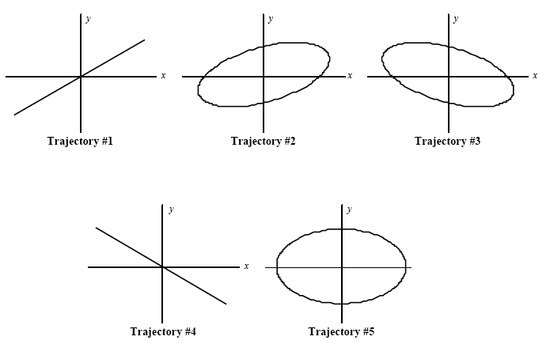
Which of the below trajectories most closely resembles case 2 in the last question, where v_{y0}=0 and v_{x0}<0 at the release point?
C
A
B
D
E
Notes:
Skipped

Slide 34
Shown below are several trajectories for a 2D oscillator. For which one is δ=0?
Notes:
(No time in ‘12. In ‘11 didn’t click, but talked it through. Many in class spontaneously shouted out tilted line. Must be careful not to confuse this representation with “phase space” that we just covered! )

Slide 35
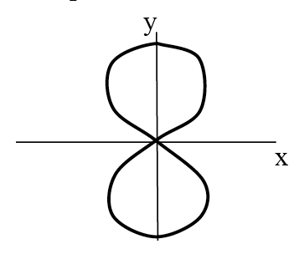
A 2D oscillator traces out the following path in the xy-plane.
What can you say about the frequencies of the x and y motion?
ω_{x} = 4ω_{y}
ω_{x} = 2ω_{y}
ω_{x} = ω_{y}
ω_{x} = 0.5 ω_{y}
ω_{x} =0.25 ω_{y}
35
Notes:
Phys 2210 SJP SP 12 Lecture 18
4, [[75]], 0, 21, 0
Sp ‘11: 0, [61], 10, 20, 10
It’s easy to get “backwards”, good conversations, must figured it out, it requires care. See comments below, the Mathematica notebook was a big hit!
Sp 11 comments: I had several students clearly explain it by “walking through” the curve, pointing out that x goes through a FULL cycle in the time y goes through a half cycle. I think this one is tricky, I have to think hard about it myself, and it’s certainly easy to get “D” if you’re just a little sloppy/quick.
I used this as an excuse to pull up my Mathematica Lissajous code, and walked them through it. When I got to the case of wx=2 wy, I reminded them of this figure, then let MMA produce its picture – it looks TOTALLY different (because the figure here has an interesting phase combination, you need the cos functions to in fact be sin functions in order to get the (0,0) point. I then let MMA “animate” the changing of phi, and you can see it rotate into this form (from a parabolic form)
I thought this ordering, having them think about the curve/concept test, THEN see MMA, then wrestle with why it was different from this slide, worked well. Good discussion and reactions (and everyone likes Lissajous figures!)

Slide 36
A 2D oscillator traces out the following path in the xy-plane.
What can you say about the Amplitudes of the x and y motion?
A_{x} > A_{y}
A_{x} ≈ A_{y}
A_{x} < A_{y}
36
Notes:
Phys 2210 SJP SP 12 Lecture 18
Skipped this term
Sp ‘11: Didn’t click, but asked it. Seemed to generate quick and correct responses through the room.

Slide 37
Consider a super ball which bounces up and down on super concrete. After the ball is dropped from an initial height h, it bounces with no dissipation and executes an infinite number of bounces back to height h.
Is the motion of the ball in z simple harmonic motion?
yes
no
???
Notes:
skipped

Slide 38
Damped oscillations

Slide 39
An oscillator is released from rest at x=+.1 m,
and undergoes ideal SHM.
If a small damping term is added, how does |F_{net}| differ from the ideal situation when the mass is on its way from +.1 m to the origin?
Slightly larger than the undamped case.
Slightly smaller than the undamped case
The same as the undamped case
It varies (and thus none of the above is correct)
The answer depends on how big the damping is.
Hint: Draw a free body diagram!
Notes:
Phys 2210 Spring 2012 Lecture 19 SJP
Sp ‘12; 14, [[83]], 0, 2, 2
Sp 11: 11, [84], 0, 5
Solution is drawn on next slide. I didn’t really hear much by way of student voices on this one, but one student just said “drag counters the spring force”.
I asked them how many had drawn a FBD, and only one person raised their hand! (Both terms)
I discussed “D”, because it DOES “vary” with speed, it’s just that even so, answer B is still correct.
S. Pollock

Slide 40
the mass is on its way from +.1 m to the origin...
F=-kx
F=-bv
v
x=0
x
x=.1 m
Notes:
Phys 2210 Spring 2012 Lecture 19 SJP
Animated to facilitate discussion of the FBD

Slide 41
The ODE for damped simple harmonic motion is:
What are the signs of the constants α and β?
α,β>0
α,β<0
α<0, β>0
α>0, β<0
Depends!
41
Notes:
Phys 2210 Spring 2012 Lecture 19 SJP
(I had them do it silently first, results did not change much, except the “B and C” results had been about 1/3 of the class, and they went away)
Sp ‘12: [[38]], 3, 5, 53, 3
Last year I didn’t click. This result surprised me! Although all of them had the right sign for alpha, the majority got the sign of beta wrong. I had x’’ + (k/m) x = 0 and its solution on the board (and had discussed it before we got to this question). So, no big surprise that they got alpha right.
While the clicker question was going I wrote “F = ma = mx’’, with F = -kx “ on the board. I thought this would help them, but I think they were “intuiting” the answer and just putting in a minus sign for friction without thinking of how this ODE arises from Newton II.
Glad I asked it, I think this may stick better!
S. Pollock

Slide 42
A mass on a spring has a small damping term added. What happens to the period of oscillation?
Slightly larger than the undamped case.
Slightly smaller than the undamped case
The same as the undamped case
Notes:
Phys 2210 Spring 2012 Lecture 19 SJP
Sp ‘12: [[40]], 11, 49 (silent)
[[37]], 4, 58, 2 (No improvement, maybe even got worse, except here too B largely gone!)
Sp 11’: [43], 11, 45 (silent)
[55], 5, 40 (after 1 more minute of loud discussion) Not much change, though B has largely vanished.
Conversation in ‘12 was almost IDENTICAL to that in ‘11:
I heard lots of student comments about this. One said that it’s going slower due to drag, so it should take longer (building on a previous CT). Another responded that yes, it goes slower, but the amplitude is dropping, so it has less far to go, so those should cancel out, giving the SAME frequency as before. (answer C) A student rebutted with the example of the extreme case (lots of drag, it will take forever even to do just a half period) (Which the previous student had to concede was a good point ☺ Another then said that “frequency = Sqrt[k/m], which has nothing to do with damping constant”, so again, it should be C. A fifth student said that solving the auxiliary equation gives a new omega = Sqrt[omega_0^2-beta^2] which IS a little smaller. (Another student said that if damping is “small”, this effect is negligible, so “C” should be the correct answer. Which has some validity, although I would say “slightly largrr” is fundamentally different than “same” when in fact it really is “slightly larger” )
At this point, I worked out that math on the board, making the meta-point that in physics you can’t always answer conceptual questions without calculating! Summarized the relation to the previous question, and moved on.
Excellent discussion, I had thought this would be easy after the previous ones, but it generated very strong discussion.
S. Pollock

Slide 43
What are the roots of the auxiliary equation D² + D - 2 = 0 ?
1 and 2
1 and -2
-1 and 2
-1 and -2
Other/not sure...
Notes:
Phys 2210 Spring 2012 Lecture 19 SJP
3, [[78]], 16, 3
Note that the only mistakes are mostly just overall signs. Just a little quick practice, and clarifying that the roots become the exponents in the solution.
I took the opportunity to go BACKWARDS from this auxiliary equation to the starting ODE, and asked them why it was NOT the ODE for damped HM. (the sign of the -2 term is unphysical for an oscillator, students noticed that) But of course our METHOD is more general, it works for any 2nd order lineary homogeneous ODE with constant coefficients.
B) (D+2)(D-1)=0

Slide 44
What are the roots of the auxiliary equation for y’’(t) +y(t) = 0 ?
1 and -1
1 and 0
just 1
just i
i and -i
Notes:
Phys 2210 Spring 2012 Lecture 19 SJP
Showed this, then decided to just jump right to the next one, it’s better.
S. Pollock

Slide 45
What are the roots of the auxiliary equation y’’(t) +ω²y(t) = 0 ?
ω and -ω
ω and 0
just ω
just iω
iω and -iω
Notes:
Phys 2210 Spring 2012 Lecture 19 SJP
5, 0, 2, 3, [[90]]
At first, about 30% of the class was voting A. During their discussion this shifted, till they all got those “i’s right. I pointed out that they can sensemake, this is the SHM equation we started class with, we know the solution, it’s nice to see this METHOD gives it back to us.
(One student argued that D is ok if you let omega be either positive or negative. I wanted to insist that you should explicitly indicate there are 2 linearly independent solutions/roots)
S. Pollock

Slide 46
Are e^{iωt} and cos(ωt) linearly independent?
yes
no
It depends on omega
???
Notes:
Skipped in ‘12 and ‘11

Slide 47
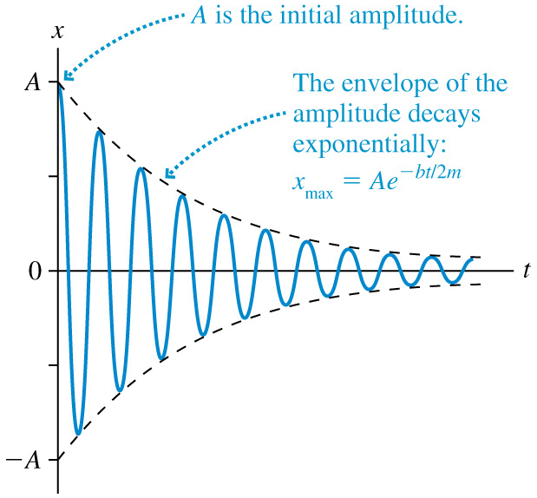

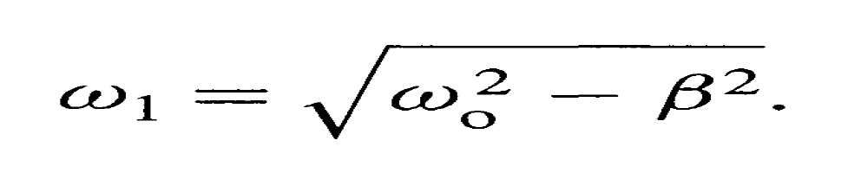
Underdamped Oscillations
An underdamped oscillation with β<ω₀ :
Note that damping reduces the oscillation frequency.
Notes:
Phys 2210 Spring 2012 Lecture 19 SJP
Nice slide to summarize, I had gotten to all this on the board already.
From Ana Marie Rey.

Slide 48

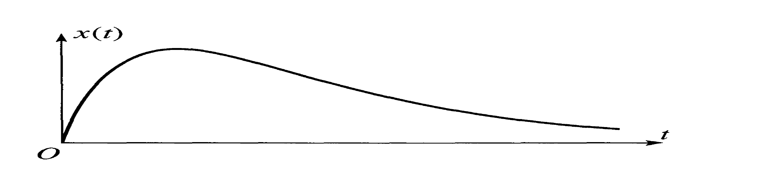

Overdamped Oscillations
An overdamped oscillation with β>ω₀ :
Notes:
Phys 2210 Spring 2012 Lecture 19 SJP
From AMR.
Again, nice slide to summarize, I had the roots but this saved me from having to rewrite it on the board. Note the pulling out of the minus sign, this requires some attention. I asked the students, “are both exponents negative, or could the first one involve a “cancellation” and end up giving you a net + behaviour. The answer is no, it was good to hear them argue for it) I then asked, at large times, which of the two terms dominates. This was also a good discussion, and there was some disagreement. (The answer is written, it’s the C1 term that survives.)
Finally, talked about “very overdamped”, pointed out that the nomenclature is confusing. Many of them in the preflight thought “overdamped” should bring you to the origin QUICKLY. This slide shows that’s not true, overdamping makes the decay parameter SMALLER. It is not that overdamping brings x to 0 quicker, it’s that it brings v (speed) to 0 quicker!) That seemed to help a few students understand why overdamping can mean a long time to return (like a spring/mollasses system)
Slide from A. Rey

Slide 49


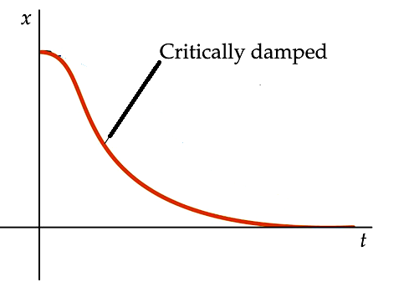
Critically damped Oscillations
A critically damped oscillation with β=ω₀ :
Notes:
Phys 2210 Spring 2012 Lecture 19 SJP
Went through this quickly, had to discuss the novel story here that there’s only one root, so we need another linearly independent function. (Pointed out that t exp[-beta t] does NOT solve the ODE if beta is not equal to omega0!)
Slide from A. Rey

Slide 50
A mass on a spring has a small damping term added. When it passes through x=0, which is correct?
The mass is instantaneously speeding up
The mass is instantaneously slowing down
The mass is at a maximum speed (and is thus neither speeding up nor slowing down
The answer depends on which WAY it is passing through the origin.
Notes:
(Moved into next slide, but could be separate if you have time)

Slide 51
An oscillator has a small damping term added.
We release it from rest.
Where do you think v_{max} first occurs?
Just BEFORE reaching x=0
Just AFTER reaching x=0
Precisely when x=0
???
HINT: At the instant it passes through x=0, is it speeding up, slowing down, or at a max speed?
Does this help?
Notes:
Phys 2210 Spring 2012 Lecture 19 SJP
[[54]], 0, 46,
Running out of time, I wanted to do the Tutorial, but this one is helpful for that Tutorial!
I forgot to animate the hint. Didn’t have as much time as last year, too bad.
Still, it was a very good discussion, and we heard some interesting arguments. One student made a compelling case that AT the origin you are already slowing down (i.e. he invented the hint idea)
Then a student tried an energy argument, at x=0 PE is still minimum (friction is not entering into PE) which he claimed argued for C. Another student rebutted, (although the argument was not convincing to the first speaker.)
Answer is A) ) At release, it is certainly speeding up (there’s only F=-kx), but by the time it gets to x=0, it must already be slowing down (because there’s only damping at x=0). So we must have already PASSED the moment when we switch from speeding up to slowing down. That moment we passed, where we switch from speeding to slowing, is the place where vmax occurred.
Notes from Sp 11: [77], 2, 21 (however, it was about 60% correct when I showed the hint, with about 1 minute of discussion after that)
Good, loud discussion, for several minutes.
Answer is A) ) At release, it is certainly speeding up (there’s only F=-kx), but by the time it gets to x=0, it must already be slowing down (because there’s only damping at x=0). So we must have already PASSED the moment when we switch from speeding up to slowing down. That moment we passed, where we switch from speeding to slowing, is the place where vmax occurred.
I sketched x(t) and v(t), and discussed this at the board.
A student was puzzled about this one, and said that he “could see the math, but not the physics”. I tried the following argument: at first, ONLY the spring force acts (v=0 at first), and it speeds up. As it goes faster, friction increases. At some point, friction BALANCES the spring force, and THIS is the moment when vmax occurs, because F=0. But, we’re not at x=0 yet, because the spring is still pulling us, if it is to balance drag. So, we go just a little FURTHER to reach the zero point. This student really seemed to lighten up, so apparently that argument helped him!

Slide 52
F=-kx
F=-bv
v
x=0
x
x=.1 m
Notes:
Phys 2210 Spring 2012 Lecture 19 SJP
Can use this to point out that –kx is getting smaller and smaller and approaching 0 at x=0.
-bv starts out zero and gets bigger and bigger.
At some point BEFORE reaching x=0, they MUST balance, and at that point, F=0, so it’s NOT speeding up any more!

Slide 53
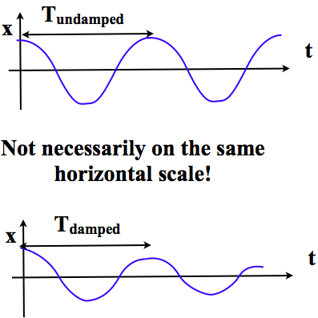
For a damped oscillator, how does the the period between successive maxima compare to the undamped case?
(Assume k and m are the same)
same
damped is
bigger
undamped
is bigger
53
Notes:
(Skipped)

Slide 54
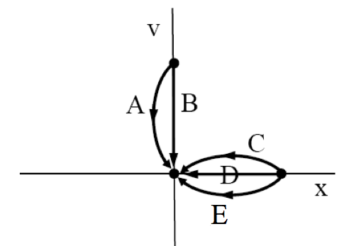
Which phase path below best describes overdamped motion for a harmonic oscillator released from rest?
Challenge question: How does your answer change if the oscillator is “critically damped”?
Notes:
Phys 2210 Spring 2012 Lecture 19 SJP
Sp ‘12:
0,0,4,4, [[93]]
Notes from Sp 11’: 7,0,7,5, [80] (Asked at end of class, after tutorial)
I only had ~20 minutes for the intermediate mechanics Tutorial on phase space for damped oscillators. Needed at least 5 minutes more, maybe 10. No time for discussion. 9TtPhase-DHM-REPmod
Sp ‘11 notes:
We did the intermediate mechanics tutorial on phase space for damped oscillators, and I left this up on the board for them to click on only after they were done (so I knew when they finished). We spent about 30 minutes on that Tutorial. Many students knew the answer to this one right away, even before the Tutosrial. We ended class with it. I asked them what was wrong with A and B (doesn’t start at rest), then a student volunteered that C had the same issues as previous question: x is decreasing while v is positive?? I added that D has v=0 while x is decreasing, also inconsistent.

Slide 55
What kind of damping behavior should the shock absorbers in your car have, for the most comfortable ride?
No damping is best
under-damping
critical damping
over-damping
55
Notes:
Phys 2210 Sp 12 SJP Lecture 20
0, 11, [[68]], 21, 0
Just fun, one student argued that “over-damping” would be better, since you might not want the velocity to drop so rapidly (since you would feel that as acceleration or even jerk). I’m not sure, he might be right on this! We also talked about screen doors (similar story, more clear that you want critical damping, to minimize time to let the flies in!)

Slide 56
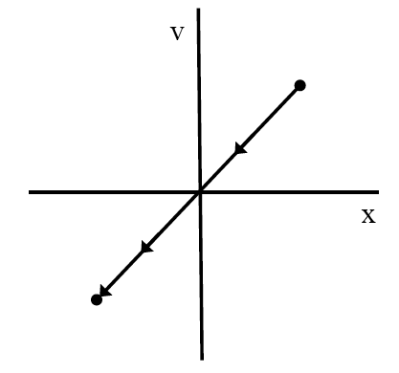
What kind of oscillator motion does this
phase space diagram describe?
overdamped
underdamped
critically damped
undamped (ideal SHM)
??? (not possible?)
Notes:
Phys 2210 Sp 12 SJP Lecture 20
6,3,15, 6, [[70]]
Notes from ‘11:
7, 12, 7, 23, [51]
Good discussion. One student pointed out that initial point is nonsense (positive x, decreasing, yet v is positive). The student was able to articulate this very well.
Another student said that at the point x=0, v=0, so it should stop there. I pointed out that a dropped object, dropped from x=0 with v=0, doesn’t just sit there, it just takes an instant for v to “build up”. The student was clearly still thinking/concerned about this, as he asked me later about it, pointing out that my gravity example would NOT result in a straight line phase space plot at the origin (he was quite correct!!)
Bottom line is that this picture is totally nonsense for many reasons, and is certainly not harmonic (which will make an arc, or ellipse, or...)
I asked them if this picture “reminded” them of anything from last class, and indeed, a student pointed out that the 2-D y vs x diagram can look like this. I agreed, that was sort of the idea here – the picture is the same, but the y-axis is totally different, and this is simply not an oscillator diagram at all. (or any kind of valid phase space diagram!)

Slide 57
Which phase path below best describes overdamped motion for a harmonic oscillator released from rest?
Challenge question: How does your answer change if the oscillator is “critically damped”?
Notes:
Phys 2210 Sp 12 SJP Lecture 20
(Just discussed, we already clicked, and score was high last time)
Notes from Sp 11’: 7,0,7,5, [80] (Asked at end of class, after tutorial)
We did the intermediate mechanics tutorial on phase space for damped oscillators, and I left this up on the board for them to click on only after they were done (so I knew when they finished). We spent about 30 minutes on that Tutorial. Many students knew the answer to this one right away, even before the Tutorial. We ended class with it. I asked them what was wrong with A and B (doesn’t start at rest), then a student volunteered that C had the same issues as previous question: x is decreasing while v is positive?? I added that D has v=0 while x is decreasing, also inconsistent.

Slide 58
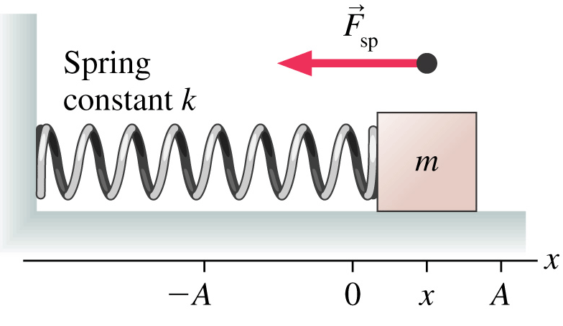
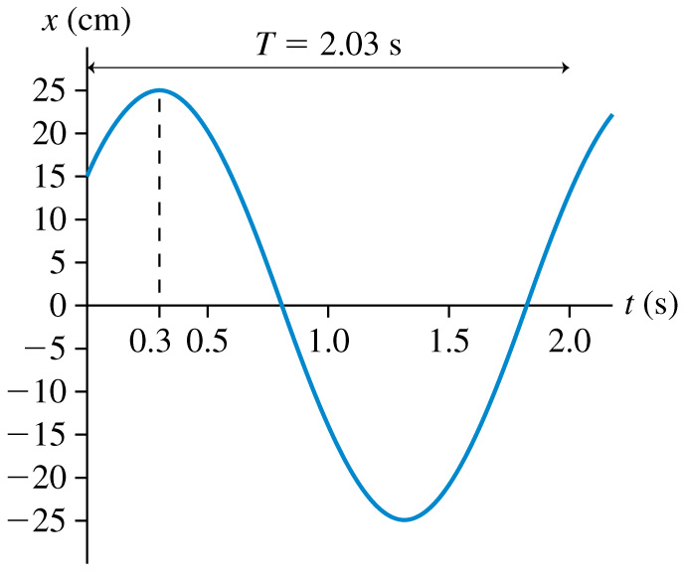
Important concepts
Angular frequency
Frequency:
Position:
Velocity:
Acceleration:
No friction implies conservation of mechanical energy
Energy:
Notes:
Phys 2210 Sp 12 SJP Lecture 20
(Review notes – very quick)

Slide 59
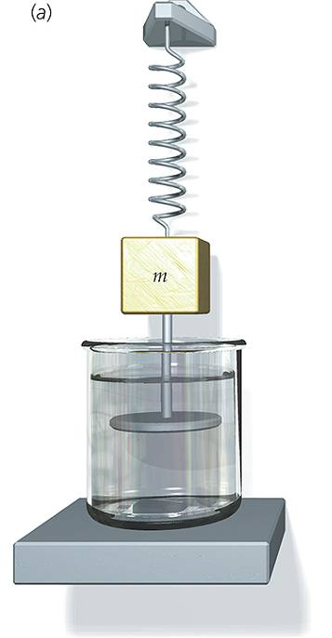
Damped Oscillations
Notes:
Phys 2210 Sp 12 SJP Lecture 20
Skipped
(Review notes, - I used them in a later lecture instead!)

Slide 60
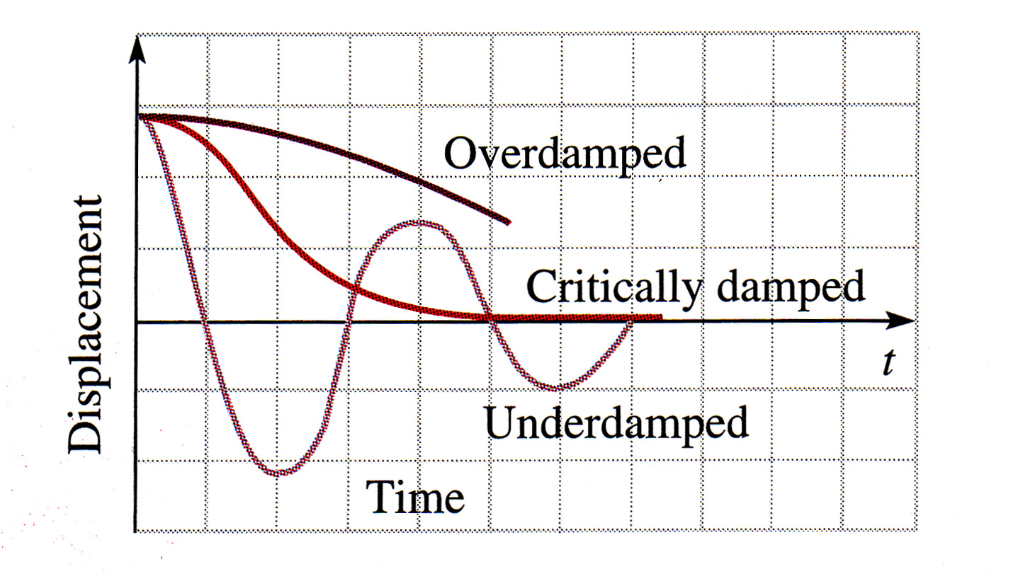
Damped oscillations
Notes:
Phys 2210 Sp 12 SJP Lecture 20
(Skipped)
(Review notes, very quick) All these slides together were about 4 minutes.

Slide 61
What kind of motion does this phase path describe?
v
x
overdamped
underdamped
critically damped
impossible to tell
This motion is impossible
Notes:
Phys 2210 Sp 12 SJP Lecture 20
No time. It is not impossible to “add energy” (though, it won’t happen for a damped oscillator!)

Slide 62
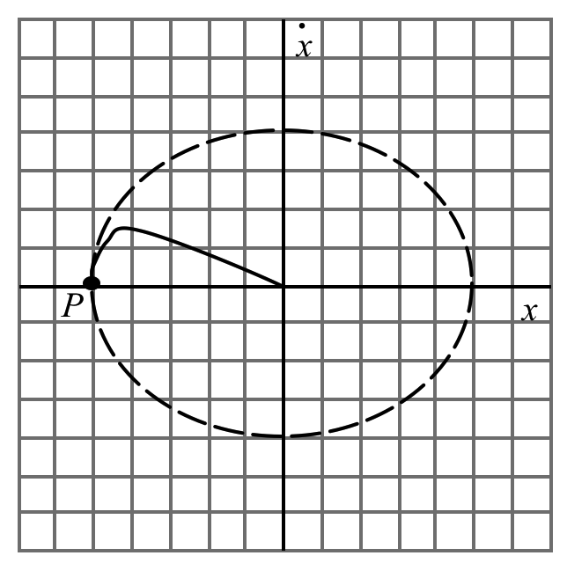
This phase space plot (the solid line that starts at P and ends at the origin) represents what system?
A) undamped B) under-damped C) critically damped
D) over-damped E) Not enough info to decide!!
Notes:
Phys 2210 Sp 12 SJP Lecture 20
No time, comes from Maine/Ambrose Tutorials

Slide 63
This phase space plot (the solid line that starts at P and ends at the origin) represents what system?
A) undamped B) under-damped C) critically damped
D) over-damped E) Not enough info to decide!!
Notes:
Phys 2210 Sp 12 SJP Lecture 20
No time, comes from Maine/Ambrose Tutorials

Slide 64
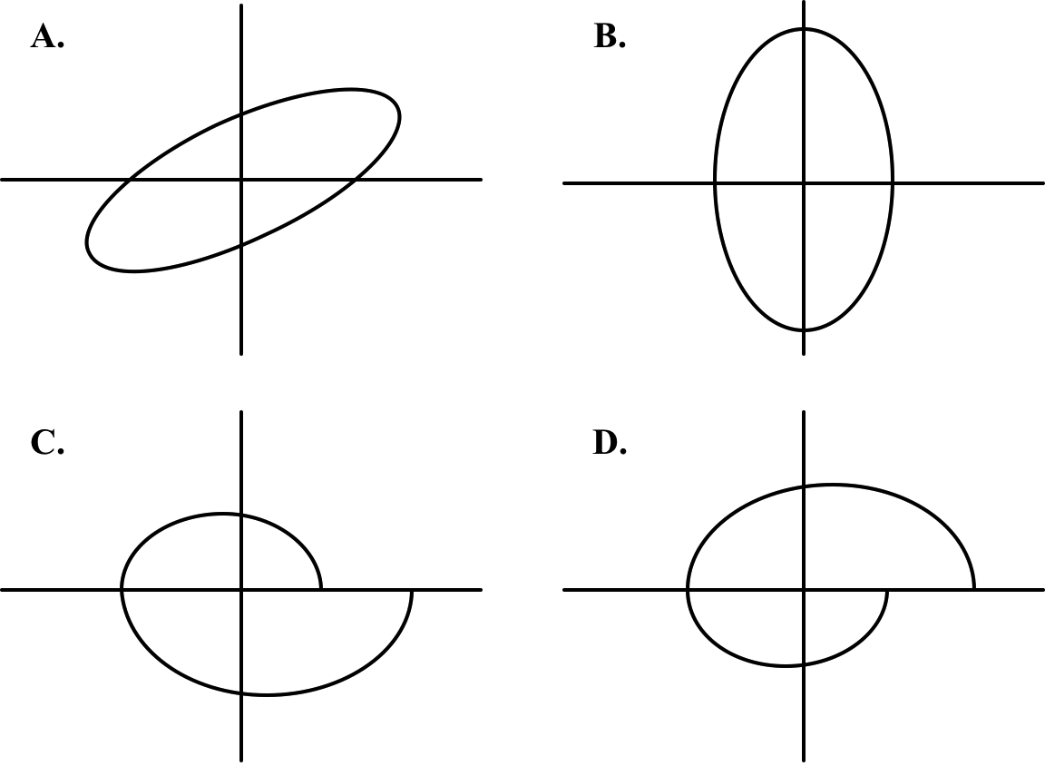
Which could be the phase space diagram for
one full period of an underdamped 1D oscillator?
v
v
x
x
v
v
x
x
E) None of these, or MORE than 1!!
Notes:
Phys 2210 Sp 12 SJP Lecture 20
No time. A is impossible (crossing x with 0 velocity, but x is changing!)
C could be ok if you go around it CW
D is no good for an underdamped oscillator. If you go CCW, then v>0 at top but x is moving left. If you go CW, then energy is feeding into this damped system?

Slide 65
Given the differential equation for an RLC circuit, which quantity is analagous to the damping term in a mechanical oscillator?
R, resistance
L, inductance
C, capacitance
Q, charge
t, time
Challenge question: What do the other two electrical quantities “correspond to” in the mechanical system?
Notes:
Phys 2210 Sp 12 SJP Lecture 20
Did not click, just discussed. It’s nice to point out that “the same math” leads to useful analogies, you can THINK of the inductor as “inertia”. We discussed that big C means “floppy spring” in this analogy. I’m making the meta-point that they can solve large classes of problems now, even ones that don’t look explicitly like “mass on spring”.
Of course, this version of the question is too easy, “resistance = damping” is so instinctive, they don’t really have to think very hard….

Slide 66
http://vnatsci.ltu.edu/s_schneider/physlets/main/osc_damped_driven.shtml
Notes:
Phys 2210 Sp 12 SJP Lecture 20

Slide 67
How was Midterm 2 for you?
A) Too hard and/or long - no fair!
B) Hard, but fair
C) Long, but fair
D) Seemed reasonable.
E) I had such a nice break, I can’t remember that far back…
Notes:
Phys 2210 Sp ‘12 Lecture #21 SJP
20, 41, 2, 24, 13
Interesting, last year there was no “no fair’s”, 50% “hard but fair”, and 37% “reasonable”.

Slide 68
The density of a spherical object is ρ(r)=c/r²
(out to radius R, then 0 beyond that)
This means the total mass of this object is
M =
Notes:
Phys 2210 Sp ‘12 Lecture #21 SJP
Silent: 9, 40, 25, 25, 2
After discussion: 0, 33, 2, 63, 2
A little exam review, older material!
The shift during discussion moved everyone away form answers with the variable r in it, but still some confusion – the point here is that M is NOT rho V!! That’s only true if rho is constant. A lot of students made this error in the exam. Discussion was good, students pointed out all the key ideas (answer can’t depend on r, answer B assumes that rho is it’s “value at the edge” everywhere, M=rho V only if rho is constant (or, is the mean rho)

Slide 69
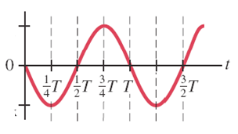
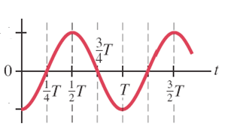
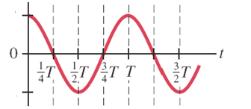
Quick Review after the break
If a spring is pulled and released from rest, the plots shown below correspond to:
I
I: velocity, II:position, III:acceleration
B) I: position, II:velocity, III:acceleration
I: acceleration, II:velocity, III:position
I: velocity, II:acceleration, III:position
I do not have enough information!
II
III
Notes:
Phys 2210 Sp ‘12 Lecture #21 SJP
2, 3, 3, [[85]], 7
Last year: [92% correct] xxx
No problem for the students. (This was review after spring break).
I took away a little bit of info that had been present last year (where we set x0>0), and the discussion was largely about how to decide the signs. We got both answers from students: that v’ should tell us the sign of a, and that x’ should tell us the sign of v (so, looking just past t=0)

Slide 70
Underdamped Oscillations
An underdamped oscillation with β<ω₀ :
Note that damping reduces the oscillation frequency.
Notes:
Phys 2210 Sp ‘12 Lecture #21 SJP
(Review notes, very quick)

Slide 71
Overdamped Oscillations
An overdamped oscillation with β>ω₀ :
Notes:
Phys 2210 Sp ‘12 Lecture #21 SJP
(Review notes, very quick)

Slide 72
Critically damped Oscillations
A critically damped oscillation with β=ω₀ :
Notes:
Phys 2210 Sp ‘12 Lecture #21 SJP
(Review notes, very quick)

Slide 73
Damped oscillations
Notes:
Phys 2210 Sp ‘12 Lecture #21 SJP
(Review notes, very quick) All these slides together were about 4 minutes.

Slide 74
Driven oscillations

Slide 75
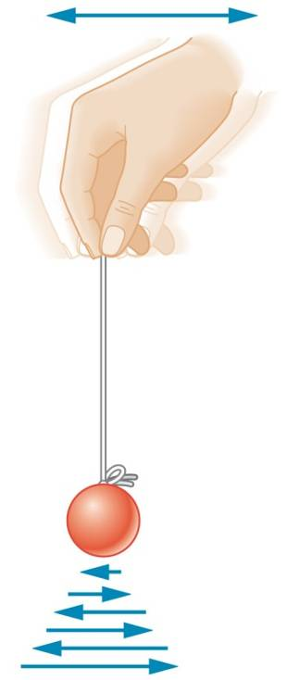
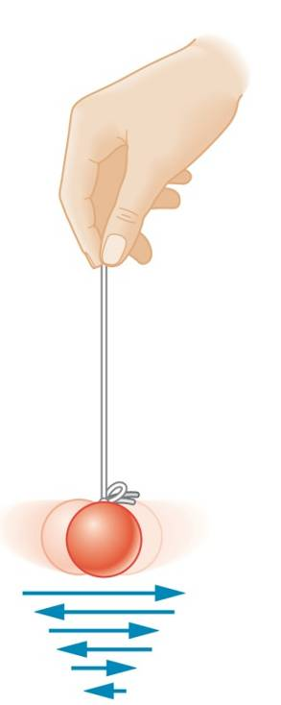
This class
Driven Oscillations & Resonance
Notes:
Phys 2210 Sp ‘12 Lecture #21 SJP

Slide 76

Driven oscillators and Resonance:
Emission & absorption of light
Lasers
Tuning of radio and television sets
Mobile phones
Microwave communications
Machine, building and bridge design
Musical instruments
Medicine
– nuclear magnetic resonance
magnetic resonance imaging
– x-rays
– hearing
Nuclear magnetic Resonance Scan
Notes:
Phys 2210 Sp ‘12 Lecture #21 SJP
Slide from A. M. Rey

Slide 77
What is a particular solution to the equation
y’’+4y’-12y=5 ?
y=e^{5t}
y=-5/12
y=-a 5/12
y= a e^{2t} +b e^{-6t} +5
Something else
General solution is thus y= a e^{2t} +b e^{-6t} - 5/12
Notes:
Phys 2210 Sp ‘12 Lecture #21 SJP
0, 88, 2, 10, 0
Sp ‘11: 25,[47], 8, 19
Last year we had not explained how to do the solution yet, only sketched out the idea of homogenous + particular solutions, and that you can “guess” y_p. Same was largely true this year – we had a nice discussion of why C is not “making it more general” but in fact making it WRONG. And, we discussed that D is the right approach for a general solution (except the +5 isn’t right) I animated the “general solution” at the bottom which helped round out the problem
Last year: Half the class got this. It seemed a little quiet in the room. I didn’t hear any reasons for A, but it got ¼ of the votes. There was a defense of D, as the general solution – but that’s not what we’re asking for here. (I suppose one could argue that it IS also a particular solution, technically... well, if we had gotten the constant at the end right. But as it stands, it’s just plain wrong)
This clicker question seemed worthwhile doing: after the solution was stated/discussed, a number of students around me seemed to sort of slap their heads, they got it – for x_p, you just need to find something that works!
M. Rey

Slide 78
What might you try for a particular solution to
y’’+4y’+6y=3e^{2t} ?
How about = 4e^{2it}?
How about = f₀cos(2t)?
Notes:
Phys 2210 Sp ‘12 Lecture #21 SJP
Nice followup to previous one, we discussed these one by one (the slide is animated). The class was responding nicely, people seemed to get the basic idea.
The last one, cos(2t) generated nice discussion. One student suggested trying Acos(2t) but another student pointed out that doesn’t work, then we heard Acos(2t)+Bsin(2t) (which is ok, if you pick A and B right, but is a bit of a pain). Another suggesting solving e^(2it) and taking the real part, which is the trick I was after! I spend some time explaining/discussing this further, because it’s a bit subtle. The same student then asked about what the imaginary part “tells you”, he seemed bothered that when we solve e^2it and then take the real part, we’re tossing away info. We are! I suggested that we have solved two problems for the price of one – both the “cos” driver and the “sin” driver, and you could toss away the real part if you only cared about the latter.
S. Pollock

Slide 79
Consider the following equation
x’’+16x=9 sin(5 t), x(0)=0, x’(0)=0
The solution is given by
x(t)=c₁ cos(4 t)+ c₂ sin(4t) - sin(5 t)
A.
x(t)=5/4 sin(4t) - sin(5 t)
B.
x(t)= cos(4t)- cos(5 t)
C.
D. I do not know
Notes:
Phys 2210 Sp ‘12 Lecture #21 SJP
21, [[61]], 7, 11, 0
S ‘11: 31, [49], 18
2012: We had decent discussion. I animated this, and let them start working on whiteboards. After about a minute or 2, I revealed these choices and suggested they stop “deriving” and move into “choosing mode”, i.e. look at these solutions, see if any look like where they were heading, and picking the one they like best. We had a good discussion – a student pointed out that A is the general solution (but doesn’t solve the initial conditions) – exactly right! And C is better than it looks, it has the right behaviour for x(0) and x’(0) (that took a moment of discussion/thinking for the class to see!) it also has a reasonable homogeneous portion, only the particular solution is bad.
We then went on to talk about how damping modifies the solution (Someone shouted out that you’d get a damping term - I asked the class which term in the correct answer gets the damping, or is both? This was a great segue to “steady state” vs transient behaviour, which is where the Tutorial goes)
Last year: The room was mostly quiet, it didn’t generate student conversations. But the discussion afterwards was worthwhile. A student defended A, it looked like the general solution to them. Ana pointed out that we have boundary conditions, so the solution is determined! Then a student argued that it must be B, because C didn’t satisfy the bound. cond’s. But it does, it was chosen so x(0)=x’(0)=0! So, this drew out another student comment that you still need to satisfy the ODE, and that cos(5t) term isn’t going to do the trick.
Seemed worthwhile, even though there wasn’t great discussion (?)
From A. M. Rey

Slide 80
Done with page 1
Done with page 2
Done with page 3
Done with the puzzle below
Puzzle: Taylor p. 189 says
Suppose one oscillator is ideal, with amplitude 0.5 m.
Another is lightly damped, and driven, so that by t=0 a (resonant) steady-state amplitude of 0.5 m is reached.
Which graph is which?
Notes:
Phys 2210 Sp ‘12 L21 SJP
We did the Tutorial 10TtFHM.docx . Not enough time today, so continued next class.
On the blackboard, before starting the Tutorial, I wrote the ODE x’’ + 2b x’ + w0^2 x = f0 exp[I w t]
Then, I wrote x(t) = x(homog) + x(part), with x(part) = Aexp[I w t]. This is all stuff we’ve done in class.
Then I plugged in x(part) to get A(-w^2 + 2 beta I w + w0^2) = f0.
Briefly discussed the logic: solve this for A, we have our answer! And at large times, x(part) is it.
This is where we begin the Tutorial:
It’s a good, hard Tutorial, we gave them 25+ minutes, and at the end, 50% said “done with p1”, 40% said “done with p. 2”, 10% said “done with the whole thing”. We are going to return to it on Thursday.
Student issues in the Tutorial included struggling with steady-state vs transient behaviour, interpreting x(t) (many think it will “interfere” with F(t) in some way, or vary with time, or vanish if you’re off resonance…)

Slide 81
What is the most general form of the solution of the ODE u’’+4u=e^{t} ?
u=C₁e^{2t} + C₂e^{-2t} + C₃e^{t}
u=Acos(2t-δ) + C₃e^{t}
u=C₁e^{2t} + C₂e^{-2t} + (1/5)e^{t}
u=Acos(2t-δ) + (1/5)e^{t}
Something else!???
81

Slide 82
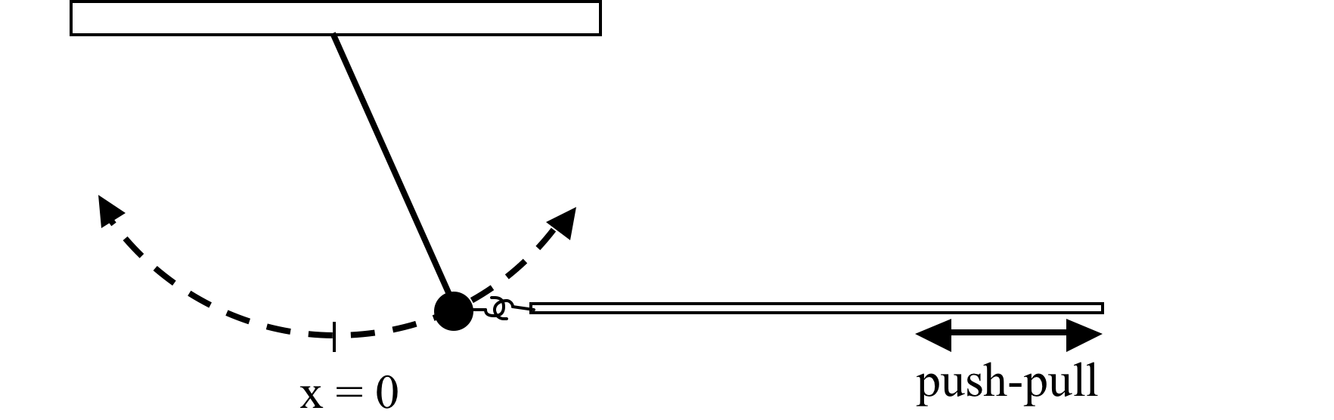
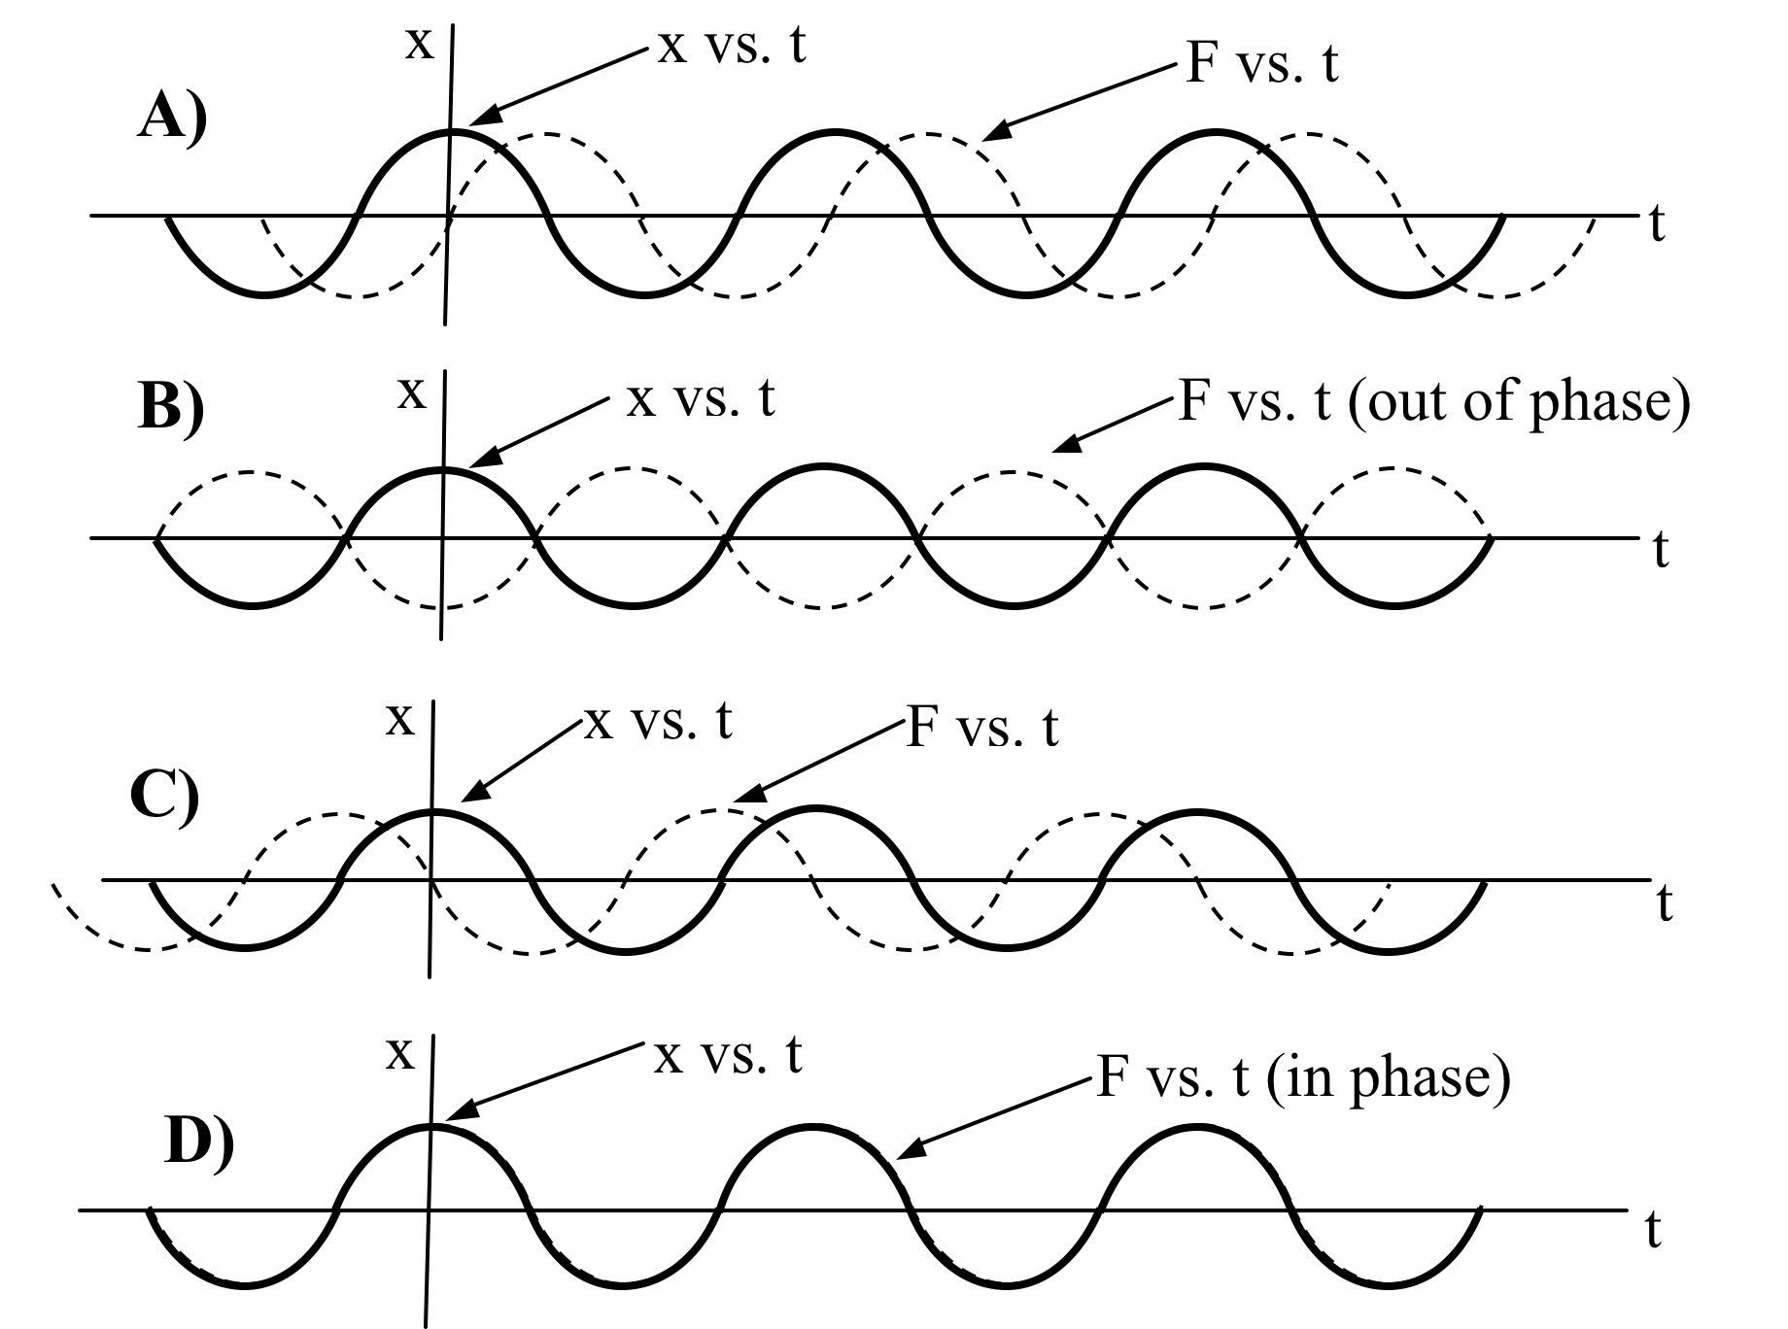
A person is pushing and pulling on a pendulum with a long rod. Rightward is the positive direction for both the force on the pendulum and the position x of the pendulum mass
To maximize the amplitude of the pendulum, how should the phase of the driving force be related to the phase of the position of the pendulum?
Notes:
Phys 2210 Sp ‘12 Lecture #21 SJP
This was up while we did the Tutorial last year, but we did not vote on it.

Slide 83
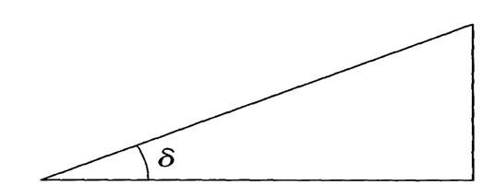
The phase angle δ in this triangle is
B
A
A.
B.
C.
D. More than one is correct
D. None of these are correct
Notes:
We skipped this one, just talked about it on the board without fussing with the ambiguity here (A and B are fine, making D correct)

Slide 84
Consider the general solution for a damped, driven oscillator:
Which term dominates for large t?
term A
term B
term C
D) Depends on the particular values of the constants
E) More than one of these!
Challenge questions: Which term(s) matters most at small t?
Which term “goes away” first?
84
Notes:
SJP, Sp ‘12 Lecture #22
Preclass: 16, 5, [[73]], 2, 4
Then some discussion, and then let them re-discuss: 4, 0 [[91]], 5
Last year we didn’t discuss this, but it’s nice. It reviews the formalism, and lets you clearly look at the full solution, thinking about WHY the particular solution is “left behind”.
There was discussion/questions from the class about what happens when beta<wo (so the first 2 terms become complex), and also whether you might get “runaway” and have term A end up dominating at large times due to the positive exponent. (We’d discussed this before, but it got lost for a few students)
I also spent time asking them about the physical interpretation of “A” in this formula, and also of “delta” – where does that come from? The oscillatorformula is f0 cos(w t) for this one (some students thought that delta just took into account an oscillator that itself had a phase) Both of these are hard for the students, they are not seeing that the resulting steady state motion is *steady* at the *driving frequency*, and A is the steady-state amplitude of the response to the choice of w.

Slide 85
A person is pushing and pulling on a pendulum with a long rod. Rightward is the positive direction for both the force on the pendulum and the position x of the pendulum mass
To maximize the amplitude of the pendulum, how should the phase of the driving force be related to the phase of the position of the pendulum?
Notes:
SJP, Sp ‘12 Lecture #22
2, 7, [[84]], 5, 2
We gave them 25 *more* minutes for the Tutorial 10TtFHM.docx , and had the “followup” activity 11_TutorialTfFHM_followup
for those who were done. Most finished this time, and this clicker question implies that many got the outcome.
Student explained the physics nicely, they visualized answer C as saying that you “push forward” when the object is moving forward (i.e. F and v are in phase!) and you “push backward” when the object is moving backward. (I keep visualizing the kid on the swing, and this becomes very physically obvious.)
(This was up while we did the Tutorial last year, but we did not vote on it.)

Slide 86
Consider the amplitude
In the limit as ω goes to infinity, A
A. Goes to zero
B. Approaches a nonzero constant
C. Goes to infinity
D. I don’t know!
Notes:
SJP, Sp ‘12 Lecture #22
[[98]], 2
Sp ‘11: [96],3,
Although they all get it, I like it. What I ask of them is to look at it mathematically, but also *physically* (a student explained that you change direction of push before it has any chance to respond) I also asked which of the two terms in the denominator dominate, and interestingly some students weren’t sure. Basic stuff, good to review!
Comments last year: Clearly too easy of a question (it’s a “setup” for the sketch in 2 slides), might not need to click on this. One thing that was nice was when we asked for the explanation, one student pointed out the physics – that if you try to oscillate something super fast, it has no time before it turns around, so it can’t really move anywhere, it just “buzzes” in place.

Slide 87
Consider the amplitude
In the limit of no damping, A
A. Goes to zero
B. Approaches a constant
C. Goes to infinity
D. I don’t know!
Notes:
SJP, Sp ‘12 Lecture #22
5, 43, 31, [[21]]
Sp ‘11: 12,60,19,[9]
This is really a trick question, and it worked fine. The “correct” answer has to be “I don’t know” – depending on what omega is, the answer could be A, B, or C! The students around me had a good discussion, one thought physically that if beta goes to zero “there’s nothing to damp it, so A should go to infinity”. Another pointed out that the FORMULA says A goes to a constant. Another responded after the histogram showed up, but he was assuming that w=w0 from the previous question, and thus that it goes to infinity. I think in the end the message worked. (In ‘12, someone asked during the question, “is omega = omega0 or not” and I said “I don’t know, it could be anything, which may have helped boost the number realizing the “trick”)

Slide 88
What is the shape of
A)
B)
ω
ω
C)
D)
ω
ω
E) None of these looks at all correct?!
Notes:
SJP, Sp ‘12 Lecture #22
[[90]], 3, 2, 2, 3
‘11: [86], 5, 5, 4 (?)
(I have changed the image from what we gave in class) B is a sigmoid, C is 1-that with different coefficients.
Next time we need to add a symmetric curve, that will get more distraction!
I was a little surprised that this wasn’t even higher (given the previous two questions), but 86% is still very high. One student near me thought that the curve for A looked “cleaner” than the others, so that had to be the answer. One student articulated the reasoning *based* on the limits from the previous slides.
The behaviour at omega=0 is a little surprising, in ‘12 I had explicit questions about it, and again when I asked students what happens to A as omega-> 0, there was a bit of confusion in the class.

Slide 89
What is the shape of
A)
B)
ω
ω
C)
D)
ω
ω
E) None of these looks at all correct?!
Notes:
SJP, Sp ‘12 Lecture #22
NOTE: I changed figure D AFTER class (see prev slide for the version I gave this time)
I think this will be a strong temptation and will force the discussion of what happens at w0->0 better, probably worth a try next year.
[[90]], 3, 2, 2, 3
‘11: [86], 5, 5, 4 (?)
B is a sigmoid, C is 1-that with different coefficients. D is the correct curve multiplied by w0, to force it to 0 at the origin. (wrong)
I was a little surprised that this wasn’t even higher (given the previous two questions), but 86% is still very high. One student near me thought that the curve for A looked “cleaner” than the others, so that had to be the answer. One student articulated the reasoning *based* on the limits from the previous slides.
The behaviour at omega=0 is a little surprising, in ‘12 I had explicit questions about it, and again when I asked students what happens to A as omega-> 0, there was a bit of confusion in the class.

Slide 90
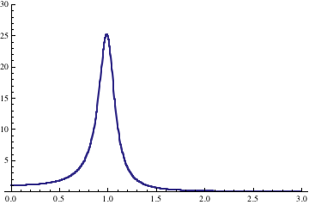
If you have a damped, driven oscillator, and you increase damping, β, (leaving everything else fixed) what happens to the curve shown?
Fixed ω!
ω₀
It shifts to the LEFT, and the max value increases.
It shifts to the LEFT, and the max value decreases.
It shifts to the RIGHT, and the max value increases.
It shifts to the RIGHT, and the max value decreases.
Other/not sure/???
Notes:
SJP, Sp ‘12 Lecture #22
2, 36, 0, 8, [[54]]
‘11: 0, 62, 4, 17, [17]
A little mean to have two in one day where the answer is basically “other”, but here it is again. If you are plotting versus w0, the peak is at w0=w, independent of beta. So the max value does decrease, but it doesn’t shift at all.
I heard various arguments and reasons, but *suspect* the main reason that B was so popular was that this was the answer to a similar preflight question, which asked them to read the book which states that the peak of a resonance is shifted to the left a little bit when there is damping. (But that’s versus w, with w0 held fixed!) I did hear some students trying to argue this one out, making vague arguments about “when there is more damping, you need a [higher] or [lower] frequency to compensate”. I couldn’t quite decipher their logic...
This is a good (and hard) little question – the solution path is mathematical (at least for me), and we may want to encourage students to COMPUTE the answer rather than always searching for a vague explanation. (?)

Slide 91
If you have a damped, driven oscillator, and you increase damping, β, (leaving everything else fixed) what happens to the curve shown?
Fixed ω₀
ω
It shifts to the LEFT, and the max value increases.
It shifts to the LEFT, and the max value decreases.
It shifts to the RIGHT, and the max value increases.
It shifts to the RIGHT, and the max value decreases.
Other/not sure/???
Notes:
SJP, Sp ‘12 Lecture #22
Didn’t have time to vote in ‘12, we just discussed it.
In ‘11: 2, [64], 0, 1, 23
Back to the earlier question, but this time the one they read about in the book. We didn’t hear from the 23% who voted E, so I don’t know what they were thinking, next round I would really push harder to find out what the issue is.

Slide 92
Given the differential equation for an RLC circuit, which quantity is analagous to the inertial (mass) term in a mechanical oscillator?
R, resistance
L, inductance
C, capacitance
Challenge question: What are the other two quantities analagous to ?
Notes:
SJP, Sp ‘12 Lecture #23
Preclass: 4, [[91]], 6,
Just for fun, we’ve really already asked this, although I discussed a little more about the “math” and “physics” analogies, trying to get across the idea that “same math” yields “same solutions”, even for very different physical contexts, and this can yield INSIGHTS into the physics of an unfamiliar system (like an RLC circuit for them). Here, the “inertia” is from Lenz’ law, inductors don’t “like” to change current just like masses don’t like to change velocity.
S. Pollock

Slide 93
What is ω₀?
C
1/C
1/Sqrt[C]
1/LC
1/Sqrt[LC]
Notes:
SJP, Sp ‘12 Lecture #23
Silent: 0, 5, 22, 10, 63
Discussion: 0,0,0,0,[[100]]
(Big applause for that one) It’s a followup to the previous one, you must make the math “analogous” before extracting results, in this case dividing through by L.
2011: Didn’t click, no time, just talked through it. But I think it would be worth clicking on this one. It’s nice to point out the physics here – this goes back to the question two slides ago, when you vary w0 at fixed w, resonance is when you tune your radio capacitor (e.g.) to get w0=w, and you pick up THAT station. (Student in front of me thought that was very cool!) \
S. Pollock

Slide 94
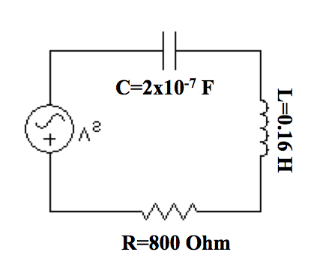
If we attach an AC voltage source to the circuit shown below, for what frequency do we get the maximum charge flowing through the circuit?
C=30 pF
L=100 nH
R=1 Ω
Notes:
SJP, Sp ‘12 Lecture #23
‘11 comments: (Pretty much identical in ‘12, takes a good few minutes!)
I didn’t make this a clicker question, but took a good ~3 minutes or more on it. I had reviewed the math/formalism already, and asked them to work out the numbers. I encouraged them to pull out a pencil and get a NUMBER. I thought it would be quick (esp since we had reviewed this circuit last class), but some were quite stuck, others had the idea but weren’t sure of numbers or units. Some were intimidated by the numbers. I kept interrupting and stepping through bits – e.g. “what’s the central physics idea” (resonance), “what are “p” and “n” again?” (Some weren’t sure!), “do you need to remember what exactly a “F”(Farad) or “H (Henry)” is? (No, just that they are consistent SI) As more progressed, I told them to convert their answer to Hz, and then figure out the PHYSICS here, what common object/circuit could this represent? I asked for the formula for w0, and got “1/Sqrt[LC]” shouted out. Worked that out at the board, then asked if I multiply or divide by 2pi to get f. (You’d think this would be trivial by now, but it took a moment to start getting unanimity) The numbers work out to about 1E8 Hz, I asked “so, what’s the physics, what do you know that resonates at this frequency”? Again, mostly silence, till someone came up with “FM radio station, 100 MHZ!”
S. Pollock

Slide 95
Our particular solution is :
with
So
At resonance, this means the phase between x and F is:
0
90°
180°
Infinite
Undefined/???
Notes:
SJP, Sp ‘12 Lecture #23
0, [[92]], 3, 5, 0
This rolls back to the Tutorial from last (2) classes, they know the answer is 90, we talked through other limits (like omega=0, where we have already intuitively argued that phase should vanish) and omega -> infinity. The latter is a little subtle, you have to think about why tan^-1(-0) is 180 and not 0).
S. Pollock

Slide 96
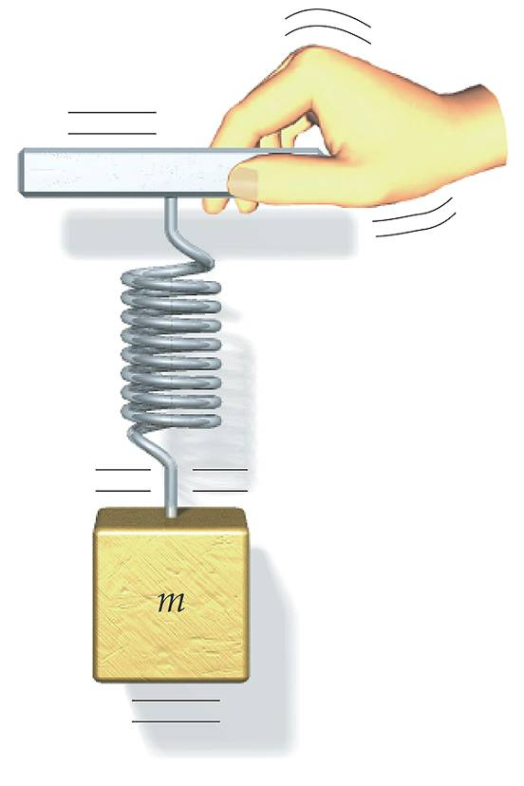
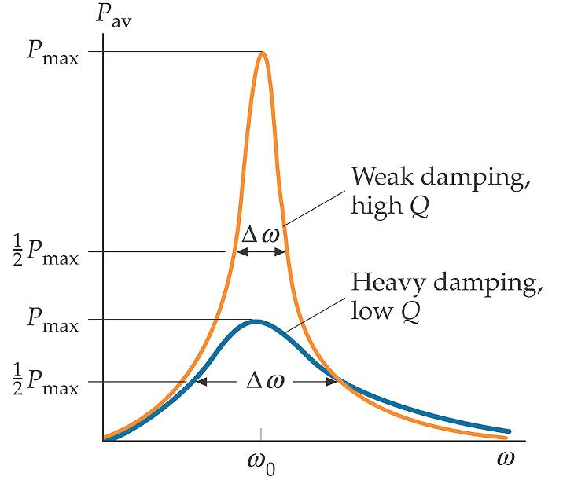
Driven Oscillations & Resonance
The Q-factor characterizes the sharpness of the peak
Q=ω₀/2β (proportional to τ/T)
Notes:
SJP, Sp ‘12 Lecture #23
(Slide to introduce Q – it’s a definition, we did some sensemaking, showed how the definition leads to the proportionality shown in this slide, and how to think about it, Q measures “how many cycles before you die off”)
Slide from A. M Rey

Slide 97
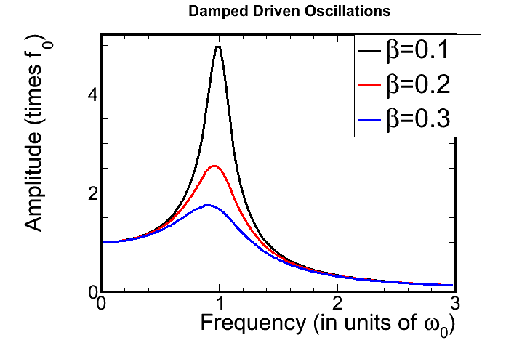
Notes:
Skipped in ‘12.
Slide from A. M Rey

Slide 98
Driven Oscillations & Resonance
The Q-factor Q=ω₀/2β (proportional to τ/T)
characterizes the sharpness of the peak
What is the (very) approximate Q of the simple harmonic oscillator shown in front of class?
A) much less than 1 B) of order 1 C) Much greater than 1
Notes:
SJP, Sp ‘12 Lecture #23
I had a mass on a spring in front of class, it probably bobbed 50-100 times before significantly dieing off. (So, Q=100)
2012: Didn’t click, just had a discussion. It’s fun, played it like an auction (“I got Q=100, going once, anyone want a higher Q? How about a lower Q”) For the mass and spring I have, I think it’s a couple hundred – went on to discuss examples of even higher Q (like quartz crystal in my watch) and then higher still (10^15 for atomic clocks). One student wondered why, in such a large Q, you don’t store an ENORMOUS amount of energy on resonance – we then talked about the LIMITS of the approximations we’re making (our ODE assumes linear spring force, for instance!)
2011: 2,5, [93] (preclass)
I did talk them through this (preclass) slide before I collected votes.
Despite the high score, I think it’s a good review question, and provoked some discussion. I asked them for numerical estimates, and they ranged from 10 to 1000. I asked them how to justify this number – it was NOT clear that many of them could articulate what exactly they were looking for or “counting”, they were not thinking of it as tau/T = “number of cycles before losing 1/e of amplitude” (One student just said “look at the rate of change of amplitude”, which is hard to quantify when watching a high Q object like this)
Slide from A. M Rey

Slide 99
What is the approximate Q of the simple harmonic oscillator shown in class?
1
100
10000
.01
.0001
Notes:
Changed this to previous slide

Slide 100
Can you break a wine glass with a human voice if the person sings at precisely the resonance frequency of the glass?
A) Sure. I could do it
A highly trained opera singer might be able to do it.
No. Humans can’t possibly sing loudly enough or precisely enough at the right frequency. This is just an urban legend.
Myth Busters video http://dsc.discovery.com/videos/mythbusters-adam-savage-on-breaking-glass.html
Notes:
SJP, Sp ‘12 Lecture #23
2012: 11, 72, 15
2011: 25, 57, 18
Just for fun.
I thought it was a myth myself, but the video shows the answer is B! Quite humorous, but you need to skip to the good part, it’s a long video.
Here’s a 1 minute version: (I saved the file, it’s available in our curricular materials.
video_Adam Savage on Breaking Glass.mp4
Myth Busters video http://video.google.com/videoplay?docid=7765557442856739526#
http://www.youtube.com/watch?v=I4jdGf3RzCs
556 Hz, 105 dB.

