Slide 1
Fourier series
Notes:
Phys 2210 Sp 12 SJP L16

Slide 2
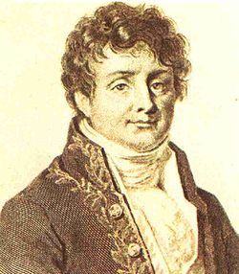
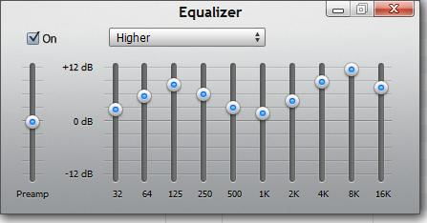
Fourier Series
PDEs
Acoustics & Music
Optics & diffraction
Geophysics
Signal processing
Statistics
Cryptography
...
Notes:
SJP, Sp ‘12 Lecture #23
I took a while to talk through this slide. I began with the series formula, talked about how remarkable it is, bit of history (1807 paper, on heat flow, and he postulated without proof that period functions could be expanded in sin/cos series, uniquely). Discussed that only nw appears (not e.g. 1.3 w), and why (periodicity). Sketched the idea, gave as example pushing on a swing (not a pure cos)
Compared and contrasted with Taylor expansion
Also pointed out that you can “fourier expand” in OTHER basis functions – we’ll come back to this.
Walked through the list, giving a few examples or comments about each. (For signal processing and cryptography, emphasized the idea that instead of talking about a function, we can instead talk about this list of numbers, the coefficients).
S. Pollock

Slide 3
How many of the following are even functions?
I: x II: sin(x) III: sin²(x) IV: cos²(x)
None
Exactly one of them
Two of them
Three of them
All four of them!
Notes:
SJP, Sp ‘12 Lecture #23
2012: silent: 0, 8, [[83]], 8, 0
2011: 0, 10, [81], 10, 0
I asked if everyone know what even and odd functions were. I said “raise your hand if you’re not totally familiar with this” None went up. So, asked this as “individual” question. The vote was about 67% correct so I encouraged them to talk, and it went up to 80% correct. While the question was still up, I walked through e(x) = e(-x), but o(x) = -o(-x) idea on the board.

Slide 4
How many of the following are even functions?
I: 3x²-2x⁴ II: -cos(x) III: tan(x) IV: e^{2x}
None
Exactly one of them
Two of them
Three of them
All four of them!
Notes:
SJP, Sp ‘12 Lecture #23
2012: 0, 19, [[70]], 2, 0
2011:
2, 20, [66], 9, 2 (silent, 1 minute)
0, 8, [90], 3, 0 (talking, 1 more minute)
After the last, I said “let’s just make sure everyone is really on board”. Sure enough on their own, several of these tripped them up. We talked through all 4, the minus signs and odd numbers thrown in there were confusing some of them. Several could not articulate what e^2x was, finally someone said “neither” and explained it.

Slide 5
How would you classify this function?
t
A) Odd B) Even C) Neither
Notes:
No time. Kind of cute, it’s neither, not sure what they would have said.

Slide 6
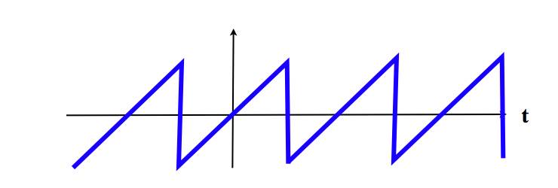
What can you predict about the a’s and b’s for this f(t)?
f(t)
All terms are non-zero B) The a’s are all zero
C) The b’s are all zero D) a’s are all 0, except a₀
E) More than one of the above (or none, or ???)
Notes:
SJP, Sp ’12 Lecture 24
7, [[76]], 0, 11, 5
Sp 11: 0, [86], 8,0,6
This year we had not really talked much about this, this was “preclass” and we have not yet done the Tutorial. The vote was more “E” until they began talking to one another.
Sp11 comments:
A student asked me what would happen if this was shifted up. I posed it back to the class (and they mostly called out D) I then asked what would happen if you shifted the time origin a bit (that was good, people got that sin’s and cos’s would appear) Finallty, I asked if there is any simple change in coordinate system I can make to get “C” to be the answer? This prompted some good discussion (the answer is no, this function is not even around any t=0 point)
Used in this lecture too: Mathematica notebook.
Dubson’s sim http://www.colorado.edu/physics/phet/dev/resonance/
Raven lite.

Slide 7
When you finish P. 3 of the Tutorial, click in:
What can you say about the a’s and b’s for this f(t)?
f(t)
t
All terms are non-zero B) The a’s are all zero
C) The b’s are all zero D) a’s are all 0, except a₀
E) More than one of the above, or, not enough info...
Notes:
SJP, Sp ’12 Lecture 24
3, [[62]], 22, 5, 8
Sp 11: 0, [79], 2, 5, 14
Tutorial is 12_Tutorial-Fourier, gave about 25 minutes.
This year we’re getting more “b’s are all zero”, not sure where that came from. In the discussion, the voices that came out all had clear answers.
Tutorial goes well, about 45 students were done with 3 pages at 25 minutes (out of about 55 in the room today)
Used this as the “are you done with the Tutorial” question. (Sp ‘11: Tutorial took ~25 minutes, most but not all finished)
I didn’t get a chance to find out why 14% voted E.

Slide 8

What can you say about the a’s and b’s for this f(t)?
f(t)
t
All terms are non-zero B) The a’s are all zero
C) The b’s are all zero D) a’s are all 0, except a₀
E) More than one of the above!
Notes:
SJP, Sp ’12 Lecture 24
Didn’t click, just used this to point out that a0 is “special”, and shifts the curve up.

Slide 9
Given an odd (periodic) function f(t),
Notes:
SJP, Sp ’12 Lecture 24
For next time, I plan to FIRST give the fourier formula without proof, work a couple of examples, then take a little interlude to talk about orthogonality and Fourier’s trick.

Slide 10
Given an odd (periodic) function f(t),
I claim (proof coming!) it’s easy enough to compute all these b_{n}’s:
Notes:
SJP, Sp ’12 Lecture 24

Slide 11
If f(t) is neither even nor odd, it’s still easy:
Notes:
SJP, Sp ’12 Lecture 24

Slide 12
For the curve below (which I assume repeats over and over), what is ω?
1
2
π
2π
Something else!
Notes:
SJP, Sp ‘12 Lecture #25
2, 0, [[94]], 2, 2
No problems – this serves as a reminder, and shows why I like T=2 (makes formulas simpler) Also leads to upcoming discussions of what to do if function is NOT periodic. (Either MAKE it periodic and just focus on one period, or else you’ll need to use Fourier transforms, which we get to later)
This is really a setup for the next pair of questions.

Slide 13
Let’s zoom in.
Can you guess anything more about the Fourier series?
Notes:
SJP, Sp ‘12 Lecture #25
Nice discussion, students called out bn=0 (symmetry), then someone noted a0=0 (discuss, average is zero) then someone noticed a1=2, although there was some dispute since the function is a bit bigger than 2 at the top. Nice discussion, students seemed to realize we don’t necessarily want to “match” the function at the origin, the higher terms might correct for this discrepancy.
At this point the room got quiet, which led to the next slide:

Slide 14
Does this help? (The blue dashed curve is 2Cos πt.)
Notes:
SJP, Sp ‘12 Lecture #25
Continuing – drawing this picture helped them see that a1=2 is indeed a good “fit”, and this figure really helps them see what the next term should be. (It is 0.4 Cos[4 w t], I did it in MMA). I drew the Cos[4 w t] figure on the board, made several mistakes and they helped me get it right (e.g. I drew a Sin, not a Cos, and I got the period wrong till they fixed me) This worked great! We’re intuiting the meaning of the terms, seeing how you can “shape” a curve, nice lead in to computing the terms as we do next with the Mathematica notebook.

Slide 15
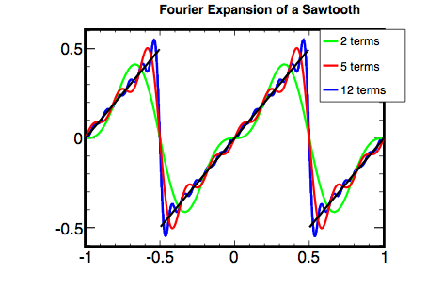
Notes:
SJP, Sp ‘12 Lecture #25
Showed my mathematica code (13Fourierseries_forclass), walked through it in considerable detail. Talked about which terms are zero, and which are not. Discussed how MMA cannot simplify “sin n pi” (if it doesn’t know that n is an integer). We walked through two examples – this one (shown above) and (first) the +1, -1 square signal.(Worth discussing that that function by itself is NOT periodic, but I choose to “repeat” it.) I sketched on the board to show why every other term in that latter one vanishes. And, we talked about Gibbs (which generated quite a few questions)

Slide 16
RECAP: Any odd periodic f(t) can be written as:
where
But why? Where does this formula for b_{n} come from?
It’s “Fourier’s trick”!
Notes:
SJP, Sp ’12 Lecture 24
THOUGHTS FOR NEXT YEAR: This is a good sequence of ppts, but is very abstract. I think I did it too soon last year! Rather than *deriving* the Fourier formulas (and proving fourier’s trick works), I think next time I would first give the formulas for a’s and b’s as givens, DO some nice examples (use MMA, talking them through it), and then come BACK to this set of ppts. (This is how these ppts are now set up. We’ll see if it helps0
It’s abstract, but potentially useful. (Many students seemed to get what follows, others were deer-in-headlights. )
I might put what’s on this slide on the board, and remind them that the upcoming slides are a “story” which will allow us to understand and DERIVE Fourier’s trick, so we can remember it and generalize it to new circumstances later.
_____________________
Notes from ‘11: I had a long lecture, following these powerpoints, walking through a way of thinking about the Fourier series as analogous to vector decomposition in an orthonormal basis. See the next string of slides, this took a lot of class time, I went through it slowly, the slides are animated. I had THEM generate guesses and discuss at every animation point.
Here, we’re simplifying to odd functions (to keep notation simple), so just sin’s. I “interpreted” the bn’s here in a musical sense, as foreshadowing of where we’re headed. (Each b tells you “how much” of a given overtone some sound has in it)

Slide 17
Fourier’s trick:
Thinking of functions as a bit like vectors…

Slide 18
Vectors, in terms of a set of basis vectors:
Inner product, or “dot product”:
To find one numerical component of v:
Notes:
SJP, Sp ’12 Lecture 24
So here, spent awhile making sure they were comfy with the formula, including the “ehat” notation. Talked about how ehat could be i,j,k, or r, theta, phi, or whatever.
Reminded them of how we interpret vi, how much a vector “points in the ei direction”. Drew this on the board.
For the last one, I gave them a chance to come up with v dot eihat. Many did NOT, they were somewhat stumped, but some did. One thought it should be “v cos(theta)”, so we discussed that that seemed to be treating “i” like “ihat”, not as a generic symbol that could represent ANY direction.

Slide 19
Can you see any parallels?
Notes:
SJP, Sp ’12 Lecture 24
Summarizing last slide, and now, talking through the parallels. THINKING of the fourier sum as analogous to the equation above it. So the “sin functions” play the role of “unit vectors”, a subset of functions from which you can “build” any general one. Just like vectors.
Thoughts for future: We’re not making any VISUAL clues here – perhaps a picture of a vector, so they can SEE the vi’s.

Slide 20
Inner product, or “dot product” of vectors:
If you had to make an intuitive stab at what might be the analogous inner product of functions, c(t) and d(t),
what might you try? (Think about the large n limit?)
Notes:
SJP, Sp ’12 Lecture 24
Talked first about letting n get bigger than 3. (String theorists have n=10. Why not 100, or infinite number?)
Gave them some time on this. Again, many were stumped about what I was after, but they talked, and at least a few did come up with it. Perhaps from the reading, or past experience?

Slide 21
Inner product, or “dot product” of vectors:
If you had to make an intuitive stab at what might be the analogous inner product of functions, c(t) and d(t),
what might you try? (Think about the large n limit?)
How about:
??
Notes:
SJP, Sp ’12 Lecture 24
We talked about whether/what the limits of integration should be, and what/whether we need a constant out front. (The UNITS don’t match the formula at the top of the page if you integrate over time without a “1/T” out front.)

Slide 22
What can you say about
0 B) positive C) negative D) depends
E) I would really need to compute it...
Notes:
SJP, Sp ’12 Lecture 24
[[97, 0, 0, 0, 3
Last year: [95],3,0,0,3
No problem, but they discussed it, and I got them to discuss their reasoning. In this simple case, symmetry arguments make it easy,

Slide 23
If m>1, what can you guess about
always 0 B) sometimes 0 C)???
Notes:
SJP, Sp ’12 Lecture 24
[[46]], [54]]
Last year: [90], 10, 0,0,0
(I did tell them we assume m is an integer here!)
This term was a total split, I clearly hinted that the “m=3 case” might be different. We had a good and long discussion, but I realized that this one really is NOT something you can easily “see” intuitively. They made lots of arguments about cancellation, but I don’t think they are rigorous for the m=3 case. You just have to do the integral! Once again, I sketched the derivation (which was an optional homework this year)
Note: the very first line of the Mathematica file:
13_fourier_series_for_class.nb
Plots up Sin[x], Sin[nx], and their product, so you can SEE how the orthogonality works out. (When n is 2, or 4, etc, it’s fairly “obvious” by symmetry arguments. But e.g. when n=3, I still find the cancellation that arises just a wee bit magical, and NOT something I can “handwave to zero”, I do need to do the integral!)
Last year: They’re doing fine. When I asked why some weren’t sure this was “always”, the issue of odd m came up. I concur, that’s harder to intuit. So I sketched how you would DERIVE this (on the board, using Euler’s theorem for the sin’s.

Slide 24
Summary (not proven by previous questions,
but easy enough to just do the integral and show this!)
Notes:
SJP, Sp ’12 Lecture 24
So at this point I’m emphasizing that this is how we think about the “inner product of functions”. A student asked me how I interpret this, because they think of the dot product of vectors as “how much a vector points in the other vector’s direction”. I liked that, and pointed out that this is called an “overlap integral”. Pointed out that two identical function have perfect overlap. So this was good, deepening the analogy.

Slide 25
Orthogonality of basis vectors:
What does ...
suggest to you, then?
Notes:
SJP, Sp ’12 Lecture 24
Talked them through this – I had pretty much just TOLD them what it suggested, but still it was good to have students say the words, that our “sin functions” are playing to role of ORTHOGONAL basis functions.

Slide 26
Orthonormality of basis vectors:
Notes:
SJP, Sp ’12 Lecture 24
I’m glad I animated the Kronecker delta – I asked how many had seen it, and almost none had, this is new! So, we’re adding some “cognitive load”here, but this is a good intro. I took my time, kept asking them about the delta (e.g. in the 2nd equation, it’s animated, so I made the class predict the form of the delta before I showed it)

Slide 27
Vectors, in terms of a set of basis vectors:
To find one numerical component:
Functions, in terms of basis functions
To find one numerical component:
(??)
Notes:
SJP, Sp ’12 Lecture 24
And again, at the bottom, big pause to have THEM generate it. (It happened to be on the board, but that was fine). This seemed to be working, people talked me through it and got it. I pointed out what we’ve done here – they can now GENERATE the formula at the bottom of the page (next year in the middle of an E&M exam) without a crib sheet, just by thinking this way, in analogy to the familiar formula at the top of the page.
The question marks at the end indicate we’ve proven nothing yet, this is conjecture by analogy.
So what’s next? Let’s DERIVE it… That’s Fourier’s trick

Slide 28
Vectors, in terms of a set of basis vectors:
To find one numerical component: Fourier’s trick
Notes:
SJP, Sp ’12 Lecture 24
Walked through very slowly, had THEM predict each step. I described the IDEA of Fourier’s trick at the start, then walked through. Got them to note that we had our Kronecker delta. Paused at the end for the next clicker question.

Slide 29
Notes:
SJP, Sp ’12 Lecture 24
7, 20,[[64]], 5, 3
Last year: 3, 10, [82], 5, 0
Very glad I did this, good practice in this notation. We had a nice discussion about why C is right, and B is wrong, even though “i=j”. Talked about dummy index. Talked through a specific example and pointed out what that sum really MEANS, effectively writing it out...
This is where I got to in Sp ’12 at the end of class, not the best place to stop, we’re nearing a punch line but not there yet.

Slide 30
D’oh!
Notes:
SJP, Sp ‘12 Lecture #25
Reminded them that we just completed the last step of this proof, and then emphasized that they *already know this answer very well*. So, step back see the forest for the trees, what was the idea of Fourier’s trick, what did it do for us. Someone asked why we went through this agony to get such a simple/known outcome, and others immediately realized that we could use it for the Fourier series too.

Slide 31
To find one component: Fourier’s trick again
“Dot” both sides with a “basis vector” of your choice:
Notes:
SJP, Sp ‘12 Lecture #25
Ran through this in analogy to the previous case, and had THEM call out what the trick should look like, what the “dot product” should look like, what we are doing. This is a little nasty to do on powerpoint, but it seemed to work well, we went through it slowly. E.g. the last animation, I had them predict what the “integral of the sum” is...

Slide 32
Notes:
SJP, Sp ‘12 Lecture #25
Class seemed to have no trouble generating the 2nd line. Pause for clicker question, it was quick

Slide 33
Notes:
SJP, Sp ‘12 Lecture #25
100% correct, got a little round of applause! I predicted this, but glad that the shift in notation didn’t stump a single person.
(Same result in Sp ‘11)

Slide 34
Notes:
SJP, Sp ‘12 Lecture #25
Finishing up the proof of the equation which had been given (like magic) in the last class, and had been on the board the whole time.
Pause to summarize and wrap up. If they got lost in this “analogy to vectors” story, reassure them it’s fine. The formula on this slide, Fourier’s formula for the b’s, is enough for now.
But the idea of Fourier’s trick will return in many guises. They’ll see this all again multiple times (E&M, QM for sure)

Slide 35
This Fourier sum is used for functions f(t) with period
T=2π/ω, which means f(t+T)=f(t) (for all times t)
What can you say about the periodicity
of the function sin(nωt) ...
It has period T = 2π/(nω), but NOT T = 2π/ω
It has period T = 2π/ω, but NOT T = 2π/(nω)
It has period T = 2π/ω, and ALSO T = 2π/(nω)
It has NEITHER period (not T = 2π/ω, not T = 2π/nω)
Notes:
(Did not get to this one)

Slide 36
We have 3 weeks of class (20% of the term!) left.
Still to come:
Dirac delta function, PDEs, and Fourier transforms
If we have time after that, how would you like to wrap up the term? More useful math-y stuff like e.g.
Special functions (“Bessel Functions”
and/or “Legendre Polynomials”)
or more physics-y stuff like...
B) Non-inertial reference frames (fictitious forces,
like centrifugal and Coriolis)
C) I have something else in mind (that I think the whole class would benefit from!)
D) I think Prof Rey and Pollock should choose!
Notes:
SJP, Sp ‘11 Lecture #25
30, 59, 5,5,0
Didn’t bother with this in Sp ‘12, we were a lecture behind so I didn’t do any of it!

Slide 37
Given this little “impulse” f(t) (height 1/τ, duration τ),
In the limit τ ➔0, what is
1/τ
τ
0 B) 1 C) ∞
D) Finite but not necessarily 1 E) ??
Challenge: Sketch f(t) in this limit.
Notes:
SJP, Sp ‘12 Lecture #25
5, [[93]], 0, 2, 0
Last year: 15, [78],2,2,2
This year I set it up a little more clearly/explicitly.
This was my intro to the delta function. I asked where the 0 answers came from. One said that in the limit that tau->0, the integration region vanishes, and therefore the integral must vanish.( I speculated that if you didn’t quite realize the intent (that the height scale as 1/tau) that you could indeed get 0). I did not hear a reason for C, D, or E.

Slide 38
The oscillator response to a step function is
What is the behavior at large t? x goes to...
Notes:
No time

Slide 39
What is the value of
Notes:
SJP, Sp ‘12 Lecture #25
0, 3, [[88]], 9, 0
Last year 0,0,[100], 0, 0
This came immediately after lecture on the delta function (defined as limit, discussed integral, discussed integral of f(x) so the formula (integral[f(x)delta(x-a) dx] = f(a) was on board.) In 2012 this formula was NOT yet on the board, I wanted them to come up with the idea for themselves, and they (largely) did! I think I prefer thisnew ordering.
2011: Silently, this was about 85% correct, so I told them to talk to their neighbor because ~5 people in the room had it wrong. And, in 30 seconds we got to 100% correct (which one student pointed out looks rather like a delta function histogram ☺

Slide 40
What is the value of
Notes:
SJP, Sp ‘12 Lecture #25
Just had them shout this out. (A,0), no problem

Slide 41
What is the value of
Notes:
SJP, Sp ‘12 Lecture #25
Had them shout this out. (B, 1) Lots of participation, no apparent issues (we discussed the fact that the limit doesn’t matter as long as the delta function’s zero is “spanned”)

Slide 42
What is the value of
Notes:
2012: I had NOT discussed the issue of the limits this year, did some hand raising, and got about 1/5 of the class voting for 4. But as soon as I pointed out the limits, and pointed to the graphical representation on the board, I saw some head slaps. So I think this is also effective! Maybe just let them click.
2011: Shouted this one out. (A,0) Class is doing fine, far as I can tell.I heard one or two “4”’s, but mostly, lots of students noted the issue here, that we did not span x=-2.

Slide 43
What is the value of
Notes:
SJP, Sp ‘11 Lecture #25
Shouted this one out. (C, 4)
(Just follows up/confirms the previous one, not worrying about the limit issue)

Slide 44
What is the value of
Notes:
SJP, Sp ‘11 Lecture #25
2011: 0,0,[69],28,3
No time to click in 2012.
This one generated good discussion. (The one person voting “different” wondered if it vanished, but he couldn’t articulate why he thought that). Lots of argument for negative 4, due to the sign flip in the delta function. I talked about our pictorial “limit” definition of the delta function as a limit of even functions, so that delta(x)=delta(-x), and thus the 2-x could just as well be x-2. I also argued that the delta function and x^2 are both intrinsically positive functions. (Our discussion of “even vs odd” was good, and someone pointed out that delta(x)=-delta(x) is true, at least, for all x away from 0. But another pointed out that the integral of odd functions vanishes, whereas the integral of delta clearly does not, so it cannot be odd!)

Slide 45
Notes:
SJP, Sp ‘11 Lecture #25
(quick this year, we had already “derived” this in an early CT, no time to delve in or vote)
I animated this slide, and asked all students to write down the integral at the top in their notebook. Many did, and then I pointed out that this is just a change of dummy index from what we already had on the board. I also pointed out this notation is perhaps how they will see the delta function in the future...

Slide 46
Recall that
What are the UNITS of (where t is seconds)
Notes:
(Sp ‘12 no time!)
SJP, Sp ‘11 Lecture #25
16, [49], 32, 0, 3
Then on to the question itself. They were definitely struggling with this, so I walked through the example on the board without any f(t), just integral delta(t)dt = 1, and got them to argue the answer. I then went back to my original drawing of the limiting process, where the height was 1/tau, and that made several students go “ahh”. (See next slide for an animation)

Slide 47
1/τ
τ
Notes:
SJP, Sp ‘12 Lecture #25

Slide 48
PDEs
Partial Differential Equations
Notes:
SJP, Sp ‘11 Lecture #26
(Long intro, discussing need for, and character of, PDE’s, including many of the more common ones. See notes, I get them to call out their “favorite” PDE’s, including Schrodinger, wave equation, this year I got “heat equation”, and Laplace’s equation. I talk through all of them, little sense/making sketching where they come from (like, wave equation is just “F=ma” for a mass on a springy-string) I also discuss the generalization from 1D to 2 or 3D by converting d^2/dx^2 to del^2, explaining why that notation. For the wave equation, and the diffusion equation, I try to justify that “spatial variation leads to time variation, and vice versa”, just again trying to make sense of it, so they aren’t total black boxes.
Also like to talk about difference with ODE’s, in that you need to know the BC’s right up front, you can’t even write a “general solution” to a PDE without knowing something about the boundaries in most cases.
Note some commonalities and differences in the PDEs on the board, (e.g. Schrodinger and diffusion have very similar “look” to them, 2 spatial derivs = 1 temporal deriv), and indeed lots of common math in solutions.
I then focus in on heat equation. Discuss “physics” of the unit-ful coefficient in the equation, (make sense of what information it contains, big constant -> strong “diffusion” of heat) Talk about steady state, get them to realize that dT/dt can vanish when things stablize over time. Make a concrete example, e.g. in one dimension, a rod with temperature baths on the edges to talk more concretely. We’re going to “derive” (at least heuristically) the diffusion equation for temperature, starting from basic intuitions and by introducing H(x,t), “joules/sec”, heat flow. (See lecture notes, I tried to make this a very interactive lecture, see also next powerpoints)
(At end of all this, I get back to Laplace’s equation, point out its equivalent for voltage in E&M. )

Slide 49
What is the general solution to
Y’’(y)-k²Y(y)=0
(where k is some real nonzero constant)
Y(y)=A e^{ky}+Be^{-ky}
Y(y)=Ae^{-ky}cos(ky-δ)
Y(y)=Acos(ky)
Y(y)=Acos(ky)+Bsin(ky)
None of these or MORE than one!
Notes:
SJP, Sp ‘11 Lecture #26
[[56]], 4, 2, 18, 20
Sp 11’: [65],0,3,3,30
Start of class question. Many voted E because they thought A and D were both ok. I worked it out in detail, to try to convince them that A is correct, and C/D are NOT, they don’t solve the ODE. (The fact that C is not fully general makes it doubly wrong). Signs matter, exponentials are quite different functions than sin/cos’s!

Slide 50
What is the general solution to
X’’(x)+k²X(x)=0
X(x)=A e^{kx}+Be^{-kx}
X(x)=Ae^{-kx}cos(kx-δ)
X(x)=Acos(kx)
X(x)=Acos(kx)+Bsin(kx)
None of these or MORE than one!
Notes:
(Skipped – but we discussed it. I asked them, on the previous slide, what you have to change to get the sin’s and cos’s solution)

Slide 51
I’m interested in deriving
Where does this come from? And what is α?
Let’s start by thinking about H(x,t), heat flow at x:
H(x,t) = “Joules/sec (of thermal energy) passing to the right
through position x”
T_{H}
T_{C}
What does H(x,t) depend on?
Notes:
The following sequence of slides may take up too much time, possibly unneeded. But, I felt uncomfortable simply HANDING them Laplace’s equation with no motivation, no specific example or derivation. So I thought this would take them through one example, and might serve as a justification of why we might care about PDEs and also one example of where they come from.
(New slide, untested, to use next year)
I’m expecting temperature to be obvious enough! (But, is it both? Average? Difference? And what else, which dimensions matter? How about materials?) Just brainstorming here, next slide(s) will get into the functional dependences.

Slide 52
H(x,t) = Joules/sec (of thermal energy) passing to the right
What does H(x,t) depend on?
Probably boundary temperatures! But, how?
T_{H}
T_{C}
H ~ (T_{H}+T_{C})/2
H ~ T_{H} - T_{C} (=ΔT)
Both but not in such a simple way!
Neither/???
Notes:
(New slide, untested, to use next year)
Answer is B

Slide 53
H(x,t) = Joules/sec (of thermal energy) passing to the right
What does H(x,t) depend on?
Perhaps Δx? But, how?
T_{H}
dx
T_{C}
H ~ ΔT Δx
H ~ ΔT/Δx
Might be more complicated, nonlinear?
I don’t think it should depend on Δx.
Notes:
(New slide, untested, to use next year)
Answer is B

Slide 54
H(x,t) = Joules/sec (of thermal energy) passing to the right
What does H(x,t) depend on?
We have concluded (so far)
A
T_{H}
dx
T_{C}
x
Are we done?
Notes:
(New slide, untested, to use next year)
Units aren’t right! Animate other things that might matter…

Slide 55
Heat flow (H = Joules passing by/sec):
How does the prop constant depend on the area , A?
linearly
~ some other positive power of A
inversely
~ some negative power of A
It should be independent of area!
Notes:
SJP, Sp ‘11 Lecture #26
Forgot to click on this, just discussed it.
Sp ‘11: [81], 8, 3, 3, 5
I presented this in the middle of this derivation, when I had gotten to the formula shown (which I had THEM generate, by asking what H should/could depend on. I got T, then delta T, then delta x, then 1/delta x... ) The previous slide sequence now takes care of this.
They argued about this one – the debate (which I pushed on) seemed to center on how you decide the “power” of A. (I argued that if you have one window that loses heat, and then you add an IDENTICAL window beside it, won’t each one lose the same amount of heat, thus doubling (exactly) the heat flow...

Slide 56
Thermal heat flow H(x,t) has units (J passing)/sec
A
dx
x
If you have H(x,t) entering on the left, and
H(x+dx,t) exiting on the right,
what is the energy building up inside, in time dt?
H(x,dt)-H(x+dx,dt)
H(x+dx,t+dt)-H(x,t)
(H(x,t)-H(x+dx,t))dt
(H(x+dx,t)-H(x,t))/dt
Something else?! (Signs, units, factor of A, ...?)
Notes:
SJP, Sp ‘11 Lecture #25
9,3 [[83]], 5
‘11 92% correct, but different distractors
This wasn’t hard for them, but I think it made the next step of the derivation “theirs”. I asked them, given this result, what the effect of that energy buildup would be, and there was some confusion until people started suggesting temperature rise... (This year the idea had already come up)

Slide 57
T₁
T₂
x₁
x₂
In steady state, in 1-D: solve for T(x)
Notes:
SJP, Sp ‘11 Lecture #26
Leading up to this question: Discuss steady state, so we have motivated and written/explained Laplace’s equation. (I.e. the time derivative has vanished)
This is a whiteboard activity. I want a formula. It’s hard for them, not because of the math, but because they can’t see that this is a simple math problem!
Gave them a few minutes to do this, in groups. Many are deeply stumped, but group by group I point out that in steady state, dT/dt=0, and it’s just 1D, this is an ORDINARY ODE. Most seemed to make good progress, with many finishing in ~5 minutes.
I’m looking for a straight line solution!
Can talk about how in general, solutions to Laplace are “smooth connections” from one boundary to the other, no local min or max.

Slide 58
When solving T(x,y)=0, separation of variables says: try T(x,y) = X(x) Y(y)
Just for practice, invent some function T(x,y) that is manifestly of this form. (Don’t worry about whether it satisfies Laplace's equation, just make up some function!) What is your X(x) here? What is Y(y)?
ii) Just to compare, invent some function T(x,y) that is definitely NOT of this form.
Challenge questions:
Did your answer in i) satisfy Laplace’s eqn?
Could our method (separation of variables) ever FIND your function in part ii above?
Notes:
SJP, Sp ‘11 Lecture #26
Leading up to this: Motivate and write/explain Laplace’s equation in 2D, write and discuss separated form.
Gave them a few minutes to do this, in groups, we treated it as a “mini Tutorial”. Good results. I had people call out their answers and I wrote them on the board. We got to discuss some of the interesting issues, like
e.g. T(x,y) = cx is in “category i”, with Y(y)=1 (or a constant)
We evaluated del^2 of various answers they had called out – some (like xy) did satisfy Laplace’s eqn, some did not.
They didn’t really seem to get Challenge 2,*I’m after the idea that you can linearly superpose solutions to get more complex solutions) but I led them to it on the board. One answer was e.g. sin(xy), another was “ax+by”. The former will NOT arise from our method, but here is where I pointed out that linearity of Laplace allows us to linearly combine solutions, so we WILL “generate” ax + by, not directly of the form X(x)Y(y), but a linear combo of such functions that still satisfies Laplace. This was the point I was after.
Someone then asked me if I could categorize all functions that we can and cannot “find”. I didn’t know the answer, but pointed out an interesting case, T(x,y) = 1/Sqrt[x^2+y^2]. This is manifestly NOT of the “separable form in X(x)Y(y)”, but if you think polar, it’s 1/r, which IS separable in r, theta. I pointed out that del^2 of this is zero (pulled out a textbook and took del^2 in spherical coordinates). So here is a solution that won’t “pop out” if we work in Cartesian coords, but it IS a valid solution. This is part of the point – separation of variables does NOT give a general solution, it only works in certain cases – the method’s success depends on your boundary conditions!

Slide 59
When solving T(x,y)=0, separation of variables says try T(x,y) = X(x) Y(y). We arrived at the equation
f(x) + g(y) = 0
for some complicated f(x) and g(y)
Invent some function f(x) and some other function g(y) that satisfies this equation.
Challenge question: In 3-D, the method of separation of variables would have gotten you to f(x)+g(y)+h(z)=0. Generalize your “invented solution” to this case.
Notes:
SJP, Sp ‘11 Lecture #26
Leading to this: Plugged separated form in to Laplace, divided by XY, separated to get to something that looks like f(x) + g(y). Then posed the above.
The class didn’t take long to converg on f(x) = c, g(y)=-c. One student suggested f(x)=sin(kx), g(y) = -sin(ky) – he was thinking (he told me later) of vaguely remembered solution for X(x) or Y(y) from E&M.
(In 2012 the same thing happened, this time with e^(ikx) and e^(kx). )
This was good – I got to discuss the central idea that you CANNOT have a function of x and a function of y adding to zero *for all x and y*. Took a bit of time to discuss this in detail.

Slide 60
When solving T(x,y)=0, separation of variables says try T(x,y) = X(x) Y(y). We arrived at
Write down the general solution to both of these ODEs!
Challenge: Is there any deep ambiguity about your
solution?
Notes:
SJP, Sp ‘11 Lecture #26
Leading to this: Write down the 2 ODEs for them, with x equation = +c.
They had solved one of these in the preclass question, so I quickly got people to call out the answer. We had a nice discussion about the “ambiguity”, which here meant whether c has to be positive, i.e. can the X(x) solution be sin/cos instead of exponential. (Answer: your boundary conditions may tell you!)
When I wrote Y(y) it started out as a function of x, just sloppy board work, but pointed out how careful you have to be about this!
Student pointed out that exp[Sqrt[c]x], my solution for X(x), COULD be sin/cos if c was negative. I agreed, we’re just trying to keep notation simple, so the notation on the page is sort of implying positive c. The point is that if X(x) is sinusoidal, Y(y) has to be exponential, and vice versa. (Here, I also pointed out the other ambiguity – c could be 0, and we get a different kind of solution!)
This led to the paper Tutorial, 14sepofVar.doc
which took about 15 minutes. They took awhile on question 1, many seemed reticent to conclude that the exponential solution forces X(x)=0 if you go through 0 at two points. Interestingly, someone had brought this up JUST before the Tutorial, pointing out that my exponential X(x) solution on the board could only pass through zero once. So I framed it this way with the groups – they were proving this!

Slide 61
In part B of the Tutorial, you have
f(x) = Csin(kx) + D cos(kx),
with boundary conditions f(0)=f(L)=0.
Is the f(x) you found at the end unique?
Yes, we found it.
Sort of – we found the solution, but it involves one completely undetermined parameter
No, there are two very different solutions, and we couldn’t choose!
No, there are infinitely many solutions, and we couldn’t choose!
No, there are infinitely many solutions, each of which has a completely undetermined parameter!
Notes:
SJP, Sp ‘11 Lecture #26
. This was up during the paper Tutorial, to indicate they had finished. 14sepofVar.doc
10,22, 7, 34, 27
I personally think the answer is E, but didn’t fuss about it, nor count it. This is wrapping up Tutorial - write out the solution f_n(x) =A_nsin(n Pi x/L) So, there are infinitely many solutions (one for each n), and each has a “parameter” A_n which could still be anything. That’s why I like E. We had discussion about whether “0” was very different, and they were not all clear on the idea that n is still up to us. Others didn’t want to say that sin(n pi x/a) is “different” than sin(m pi x/a), I drew these on the board to emphasize that they are certainly very different functions. (And, orthogonal!)
After Tutorial, Do next 2 CT’s, then work through the infinitely tall case, use y (infinite) dimension to chose the sign, and solve problem. Discuss BC at base generically, but don’t solve it yet.

Slide 62
__________________________________________
Question for you: Given the ODE,
Which of these does the sign of “c” tell you?
Whether the solution is sines rather than cosines.
Whether the sol’n is sinusoidal vs exponential.
It specifies a boundary condition
None of these/something else!
Notes:
SJP Phys 2210 Sp12 L27
2, [[88]], 5, 5
Just a preclass review/ warmup. I encouraged them to chat with their neighbors because at first it was only about 75% correct! This got rid of a couple of “A” answers. Someone said “but, if c is negative, you get complex exponentials, which are still exponential, right?” So then I realized there is some language ambiguity here, what I MEANT by “exponential” is “real exponential”, and so I would consider exp[i w t] to be “sinusoidal”. I think this was a reasonable conversation to have.

Slide 63
Last class we got to a situation where we had two totally unknown/unspecified functions a(x) and b(y),
All we knew was that (for all x and all y)
a(x) + b(y) = 0
What can you conclude about these functions?
Really not much to conclude (except b(y)=-a(x) ! )
Impossible, it’s never possible to solve this equation!
The only possible solution is the trivial one,
a(x)=b(y)=0
a(x) must be a constant, and b(y)= -that constant.
I conclude something else, not listed!
Notes:
SJP Phys 2210 Sp12 L27
3, 2, 0, [[95], 0
Another review/recap.
Leading to this: Plugged separated form in to Laplace, divided by XY, separated to get to something that looks like f(x) + g(y). Then posed the above. This is review from last class. I let them think quietly, animated the solutions.
We had some discussion about whether a(x)=b(y)=0 is really trivial, since in our case, it really means X’’(x)=Y’’(y)=0, and those have NONtrivial solutions (linear functions, multiplied). This was a great point, I’m glad it came up.

Slide 64
When solving T(x,y)=0, separation of variables says try T(x,y) = X(x) Y(y). We arrived at
Write down the general solution to both of these ODEs!
Challenge: Is there any ambiguity about your solution?
Notes:
SJP Phys 2210 Sp12 L27
Leading to this: Write down the 2 ODEs for them, with x equation = +c.
Did this on whiteboards. I pretty much had the answer on the board already, due to the questions on the previous concept test, but it was good. The “ambiguity” became the focus of attention, many still did not realize that they could allow c to be either sign.
We had a nice question, when I had written X(x)=A exp[Sqrt[c] x] + B exp[- Sqrt[c] x], and sin’s/cos’s for Y(y), someone said “no ambiguity, if c is negative, then these ARE still the correct solutions, X(x) just has complex arguments in the exponents and becomes sinusoidal) This is correct, so it’s a bit of a notation/convenience issue. Another student pushed on this – why fuss about there being “two choices”, when this ONE solution is truly general. I’m arguing that boundary conditions are likely to push us towards saying “c should really be +” or “c should really be –”, and whichever it is, I would prefer to write functional forms that “look” like what they imply (so, the one with sin and cos should be oscillatory, with real arguments) These are good points, and don’t seem to detract from the story, so I think it’s productive.
Last year:
They had solved one of these in the preclass question, so I quickly got people to call out the answer. We had a nice discussion about the “ambiguity”, which here meant whether c has to be positive, i.e. can the X(x) solution be sin/cos instead of exponential. (Answer: your boundary conditions may tell you!)
When I wrote Y(y) it started out as a function of x, just sloppy board work, but pointed out how careful you have to be about this! Some students on the whiteboards write it as a function of t, again, sloppy and worth pointing out!
Student pointed out that exp[Sqrt[c]x], my solution for X(x), COULD be sin/cos if c was negative. I agreed, we’re just trying to keep notation simple, so the notation on the page is sort of implying positive c. The point is that if X(x) is sinusoidal, Y(y) has to be exponential, and vice versa. (Here, I also pointed out the other ambiguity – c could be 0, and we get a different kind of solution!)

Slide 65
Rectangular plate, with temperature fixed at edges:
T=0
y=H
T=0
T=0
y=0
x=0
T=t(x)
x=L
Written mathematically, the left edge tells us T(0,y)=0.
Write down analogous formulas for the other 3 edges.
These are the boundary conditions for our problem
Notes:
SJP Phys 2210 Sp12 L27
I just wanted them to write T(L,0)=0, T(x,H)=0, and T(x,0)=t(x). Didn’t take long, and I think it may have been useful just to clarify how to write our BC’s.
This year this came BEFORE the Tutorial, so I didn’t start by making the argument that x has to be sinusoidal, that’s what they are going to be figuring out.
Last year this came AFTER the tutorial: From here, I argued we really want X(x) to be sinusoidal (because of the Tutorial, we *can’t* use the exponential solution for X(x), without geting T(x,y)=0 everywhere, which is no good).
Then, I wrote it all out (with A, B, C, D coeffiicients, and Sqrt[c] in front of x or y), and started applying these BC’s one by one.

Slide 66
In part B of the Tutorial, you are looking for X(x)
(we’re calling if f(x) here), f(x) = Csin(kx) + D cos(kx),
with boundary conditions f(0)=f(L)=0.
Is the f(x) you found at the end unique?
Yes, we found it.
Sort of – we found the solution, but it involves one completely undetermined parameter
No, there are two very different solutions, and we couldn’t choose!
No, there are infinitely many solutions, and we couldn’t choose!
No, there are infinitely many solutions, each of which has a completely undetermined parameter!
Notes:
SJ:P Phys 2210 Sp12 L27
This was up during the paper Tutorial, to indicate they had finished. 14SepofVar.doc
8, 22, 0, 35, 35
Sp ’11:10,22, 7, 34, 27
Tutorial takes at least 15 minutes. Maybe 20. They took awhile on question 1, many seemed reticent to conclude that the exponential solution forces X(x)=0 if you go through 0 at two points Last year, Interestingly, someone had brought this up JUST before the Tutorial, pointing out that my exponential X(x) solution on the board could only pass through zero once. So I framed it this way with the groups – they were proving this!
I personally think the answer is E, but didn’t fuss about it, nor count it. This is wrapping up Tutorial - write out the solution f_n(x) =A_nsin(n Pi x/L) So, there are infinitely many solutions (one for each n), and each has a “parameter” A_n which could still be anything. That’s why I like E. We had discussion about whether “0” was very different, and they were not all clear on the idea that n is still up to us. Others didn’t want to say that sin(n pi x/a) is “different” than sin(m pi x/a), I drew these on the board to emphasize that they are certainly very different functions. (And, orthogonal!)
After Tutorial, Do next 2 CT’s, then work through the infinitely tall case, use y (infinite) dimension to chose the sign, and solve problem. Discuss BC at base generically, but don’t solve it yet.

Slide 67
Semi-infinite plate,
with temp fixed at edges:
T➔0
T=0
T=0
y=0
x=0
T=f(x)
x=L
When using separation of variables, so T(x,y)=X(x)Y(y),
which variable (x or y) has the sinusoidal solution?
X(x) B) Y(y) C) Either, it doesn’t matter
D) NEITHER, the method won’t work here
E) ???
Notes:
SJP Phys 2210 Sp12 L27
Did not click this year, just asked.
[95],0,5,0,0, very quick. (1 minute)
Just a small variation to make sure they were with me. I might consider swapping so that it’s Y(y) that gets the sinusoid next time around, but I think this was ok.
___________
Last year I went on with more clicker questions, trying to get students to figure out each step in the general procedure of solving a problem like this, but next time, I think I would at this point do a fairly straight “lecture” which goes through the entire problem(outlined in this slide) step by step from start to finish, so students have a working template/model to start to make sense of. I found that working from the abstract (piece by piece) towards the concrete final story was hard for them – too many pieces!
We will then go through it AGAIN for the “finite, square” plate case, and there is a sequence of clicker questions to follow which steps through it. I think that might work better building on a firmer (more concrete, “presented”) base, but we’ll have to try it out and see.

Slide 68
We are solving T(x,y)=0, with boundary conditions:
T(x,y)=0 for the left and and right side, and “top” (at ∞)
T(0,y)=0, T(L,y)=0, T(x,∞)=0.
The fourth boundary is T(x,0) = f(x)
What can we conclude about our solution X(x)?
Cannot contain sin(ky) term
Cannot contain cos(ky) term
May contain both sin(ky) and cos(ky) terms
Must contain both sin(ky) and cos(ky) terms
Must contain both e^{-ky} and e^{+ky} terms
Notes:
(skipped)

Slide 69
We are solving T(x,y)=0, with boundary conditions:
T(x,y)=0 for the left and and right side, and “top” (at ∞)
T(0,y)=0, T(L,y)=0, T(x,∞)=0.
The fourth boundary is T(x,0) = f(x)
What can we conclude about our solution Y(y)?
Cannot contain e^{-ky} term
Cannot contain e^{+ky} term
Cannot contain either e^{-ky} or e^{+ky} terms
Must contain both e^{-ky} and e^{+ky} terms
???
Notes:
SJP Phys 2210 Sp12 L27
0, 97, 2, 2, 0
Quicky, just pointing out that one by one, BC’s are simplifying/limiting our solution.
Last year: Skipped, I claim the answer is B, can’t let T grow arbitrarily at large y.

Slide 70
Using 3 out of 4 boundaries, we have found
T_{n}(x,y) = A_{n}sin(n π x/L) e^{-nπ y/L}
Question: Is
ALSO a solution of Laplace’s equation?
A) Yes B) No C) ????
Notes:
SJP Phys 2210 Sp12 L27
[[98]], 2, 0
Just seemed worth pointing out, they did not take long and it wasn’t hard. But, generated questions. Like, “is this solution still separated”. (I would say no, but it’s part of the METHOD of separation of variables)

Slide 71
Using 3 out of 4 boundaries, we have found
T_{n}(x,y) = A_{n}sin(n π x/L) e^{-nπ y/L}
Using the bottom boundary, T(x,0)=f(x), we can
compute all the An’s:
In terms of these (known) constants, what then
is the complete final answer for T(x,y)?
Notes:
SJP, Sp ‘11 Lecture #26
I did this for them on the board at the end of class. Wrote it all out in detail (combining the coefficients from A sin(n pi x/) with D exp[- n Pi y/L). Pointed out A and D can combine to form one constant, also noted that the thing next to y is still the negative of the thing next to x (this is important, it’s the Sqrt[separation constant])
We spent some time collectively remembering the formula for An. I got them to shout it out – some discussion of limits of integration, and even more about the coefficient out front. (I went through the case where f(x) = sin (m pi x/L) to “derive” it!)

Slide 72
Using 3 out of 4 boundaries, we have found
Using the bottom (4th) boundary, T(x,0)=f(x),
Mr. Fourier tells us how to compute all the An’s:
And we’re done!
Notes:
SJP Phys 2210 Sp12 L27
This year: Pretty much just walked through this. At the end, one student was loudly confused, what have we done? I was glad they asked this – I’d forgotten how confusing what we have just done is. We have a *formula* for T(x,y), temperature EVERYWHERE, given ONLY information about T at the edges. That’s the big story here. And that formula is completely determined (the A’s are themselves fixed by the formula given). Yes, it’s complicated, it’s an infinite sum, and each term needs you to do an integral. But in principle we have SOLVED this particular problem.
Another student wanted to know about negative n, or zero n. (See below, good question too. Negative n is “double counting”, because the sin function is odd, so you really don’t get anything new by adding in negative n terms. Ditto n=0, you add zero, it’s nothing new either)
Last year: I did this for them on the board at the end of class. Wrote it all out in detail (combining the coefficients from A sin(n pi x/) with D exp[- n Pi y/L). Pointed out A and D can combine to form one constant, also noted that the thing next to y is still the negative of the thing next to x (this is important, it’s the Sqrt[separation constant])
We spent some time collectively remembering the formula for An. I got them to shout it out – some discussion of limits of integration, and even more about the coefficient out front. (I went through the case where f(x) = sin (m pi x/L) to “derive” it!)

Slide 73
T➔0
Using all 4 boundaries, we have found
where
Now suppose f(x) on the bottom boundary is
T(x,0)=f(x) = 3sin(5 π x/L)
What is the complete final answer for T(x,y)?
0
0
3sin(5π x/L)
Notes:
SJP Phys 2210 Sp12 L27
This year: I gave them a good few minutes, we had a good discussion. Many seemed to get it, but those who didn’t remember the “orthogonality” trick were pretty much spinning their wheels. When one student clearly called out the orthogonality story, we came to consensus that only A5 survives, but then I asked what A5 should be… there was a LOT of discussion, with many different answers. But when you write it out, and then go to y=0, it suddenly becomes painfully clear, no integration required…
Last year:
We did this quickly at the end. I got several to shout out the correct answer, but not sure if everyone got it.

Slide 74
Rectangular plate, with temperature fixed at edges:
T=0
y=H
T=0
T=t(y)
y=0
x=0
T=0
x=L
When using separation of variables, so T(x,y)=X(x)Y(y),
which variable (x or y) has the sinusoidal solution?
X(x) B) Y(y) C) Either, it doesn’t matter
D) NEITHER, the method won’t work here
E) ???
Notes:
SJP Phys 2210 Sp12 L27
2, [[93]], 0, 5, 0
No problems at this stage (near the end of class)
Last year: Preclassquestion. 8,[86], 0 5,0
This served as a review from last time – I redid the whole story (Start with Laplace, separate, plug back in, divide out T(x,y), argue that the two ODEs you get must each be of the form X’’(x)/X(x)=c (with opposite signs), basically the whole thing to get to this. Then, reminded them from the Tutorial last class that exponential functions can’t give you zero twice.

Slide 75
Trial solution: T(x,y)=(Ae^{kx}+Be^{-kx})(Ccos(ky)+Dsin(ky))
T=0
y=H
Applying the boundary condition T=0 at
i) y=0 and ii) y=H gives
(in order!)
T=0
T=t(y)
y=0
i) k=n π/H, ii) A=-B
i) k=n π/L, ii) D=0
i) A=-B, ii) k=n π/H
i) D=0, ii) k=n π/L
E) Something else!!
x=0
T=0
x=L
Notes:
SJP Phys 2210 Sp12 L27
8, 2, 37, 31, [[22]]
Last year: 10,0,26,10,[54]
(Next slide has solution).
This year we were running low on time, but there was a lot of debate. Talking through it there were many groans, but they were not generating the result on their own. (Though of course it is mean to have “none of the above” as an answer!)
Note that this is animated – I gave them ~30 seconds or more to start before I showed my answer choices, and strongly encouraged them to work together.
Interesting that this had only 54% correct, and that e.g. C was so tempting. Despite the last class’ Tutorial, this is clearly still new and hard for them.
Again, I just used this as a setup to walk through (review) of procedure from last class – go ahead and plug in y=0 (Do it on the board!) follow your nose, must conclude C=0. (Discuss why can NOT conclude A=B=0!) Similarly, plug in y=H, yielding kH=n Pi (and again, why NOT D=0)

Slide 76
Trial solution: T(x,y)=(Ae^{kx}+Be^{-kx})(Ccos(ky)+Dsin(ky))
T=0
y=H
Applying the boundary condition T=0 at
i) y=0 and ii) y=H gives
(in order!)
T=0
T=t(y)
y=0
i) k=n π/H, ii) A=-B
i) k=n π/L, ii) D=0
i) A=-B, ii) k=n π/H
i) D=0, ii) k=n π/L
E) Something else!!
x=0
T=0
x=L
i) C=0 ii) k = nπ/H
Notes:
SJP Phys 2210 Sp12 L27

Slide 77
Trial solution: T(x,y)=(Ae^{kx}+Be^{-kx})(Ccos(ky)+Dsin(ky))
T=0
y=H
Applying the boundary condition T=0 at
i) y=0 and ii) y=H gives
(in order!)
T=0
T=t(y)
y=0
i) A=-B, ii) k=n π/H
i) D=0, ii) k=n π/H
i) C=0, ii) k=n π/H
i) C=0, ii) k=n π/L
E) Something else!!
x=0
T=0
x=L
Notes:
SJP, Sp ‘12 Lecture #28
Preclass question
7, 3, [[83]],5,2
Variant (slightly harder) Sp 11: 10,0,26,10,[54]
This was a followup to last class (this time the answer WAS one of the ones available).
They have just turned in a HW on this (which they struggled on, because we were just slightly behind in terms of lecturing on this material) We talked about why people voted for A=-B (pretty clear, they’re applying the BC on x=0) And, by writing the formula on the board and plugging in y=0, it becomes more obvious why C=0 rather than D=0.
The students are still struggling with the basic idea, I think – that we are working our way through BC’s to try to restrict the form of our solution, so that it satisfies ALL BC’s.

Slide 78
Trial solution: T_{n}(x,y)=(A_{n}e^{nπx/H}+B_{n}e^{-nπx/H})(sin nπy/H)
y=H
T=0
Applying the boundary condition T(0,y)=0 gives...
T=0
T=t(y)
A_{n}=0
B_{n}=0
A_{n}=B_{n}
A_{n}=-B_{n}
Something entirely different!
T=0
x=L
Notes:
SJP, Sp ‘12 Lecture #28
3, 0, 0, [97,0
Sp 11: 0,3,0, [97], 0.
I spent some time explaining why I had added the subscript “n” to the equation, and pointed out that the coefficient of x is the same as that of y. Talked about why – asked them “what happens if you take d^2/dx^2 of this equation, got them to shout out “k^2 times what you start with” or something equivalent [n^2 pi^2 / H^2 is better here] Ditto with d^2/dy^2, trying to emphasize that it satisfies Laplace, but only because the “k”’s are the SAME.
I also walked through what happens to this Tn if y=0 and H) emphasizing that it is constructed to satisfy the upper and lower BC already.
Good that they did so well after the last one. (Note that this is animated, again I gave them ~30 seconds to start working on their own on paper before showing any clicker choices.)

Slide 79
Recalling sinh(x)=½(e^{x}-e^{-x)}
Trial solution: T_{n} (x,y)=A_{n}sinh(nπx/H)sin(nπy/H)
y=H
T=0
Applying the boundary condition T(L,y)=t(y)
does what for us...
T=0
T=t(y)
Determines (one) A_{n}
Shows us the method of separation of v’bles failed in this instance
Requires us to sum over n before looking for A_{n}’s
Something entirely different/not sure/...
T=0
x=L
Notes:
SJP, Sp ‘12 Lecture #28
0, 2, [[84], 14,
Sp 11: 18,0,[69],13
And again, gave them time to work on their own, but less, since my answers are a little obscure. During the discussion, I insisted that we talk about what is *tempting* about answer B. Got a good clear response (it would be TRUE if we insisted on the pure, separated form at the top of the page, unless our t(y) was coincidentally a pure sin(n pi y/H) function)
Took this opportunity to talk about linearity of Del^2, walked them through that Sum(Tn) still satisfies Laplace, as well as the BC’s on top, left, and bottom.
This year I had students thinking that we FIRST find An and then sum, but I think this misses the point. No, a single term does not and can not solve the right BC for a generic t(y), we NEED the full sum, and only then can we apply Fourier ideas to figure out the various An’s

Slide 80
Trial solution:
What is the correct formula to find the A_{n}’s?
y=H
T=0
T=0
T=t(y)
T=0
x=L
Notes:
SJP, Sp ‘12 Lecture #28
2, 18, 11, 48, [[21]]
SP 11: 3,3,5,82,[8]
This is mean! The answer is E (next slides walk them through it). D is “best”, but forgets about that sinh factor.
The fact that some% voted A –C implies that we might *still* need more review of the Fourier series idea, but I think we’re doing ok (even though 92% got it wrong :-( This was simply tricky, especially the way I presented it (I talked them through the answers implying that one of them was right!)
The discussion here was quite good – they were arguing about the H’s and L’s issue productively, and by and large seemed to work it out. I heard good arguments from the front row, at least.
At this point I go to the board, review the fourier sin series story, make the connection, and work out the correct answer (I have it on ppt next slide, but chose to do it at the board – the story proves to be subtle for students!)

Slide 81
Trial solution:
Right b’dry:
y=H
T=0
T=0
T=t(y)
T=0
x=L
Notes:
SJP, Sp ‘12 Lecture #28
(See previous slide, and following slides. My point here was, don’t skip steps, walk through the calculation slowly, carefully, and clearly)
What we KNOW is if t(y) = Sum[bn sin(n pi y/H)], then we can use Fourier’s trick to write down a formula for bn. That’s “old news”. But we do NOT quite have that, at least not as shown at the top of this page. There’s that extra “sinh” term, so we need to be careful.

Slide 82
Right b’dry:
y=H
T=0
T=0
T=t(y)
Which means
T=0
x=L
Notes:
SJP, Sp ‘12 Lecture #28
Just working out previous slide – I did this all on the black board instead this year
I spent a moment justifying/explaining the b_n formula, because it’s not IDENTICAL to what we had before. Before, we had t(y) as an odd function with period T, and then the factor out front was 2/T and we integrated –T/2 to +T/2. So you need to think about this a bit. (One way is to imagine a fictitious function which is like our t(y) but “extended” to –H, in the “odd function” manner, and integrating it from –H to +H and multiplying by 2/(2H). But then we can argue that we can safely just integrate halfway, by doubling the answer, and getting back to the formula given here. It’s subtle, I think students are content with just being “told the formula”, but it’s a slight cheat, since this situation is slightly different than before.

Slide 83
Solution (!!) :
with:
y=H
T=0
T=0
T=t(y)
T=0
x=L
Notes:
SJP, Sp ‘12 Lecture #27.
Here it is, the final answer. I spent a little time discussing the fact that, yes, you must do an infinite number of integrals (one for each n) to solve this problem! But, if you can do it “generically”, you’re good. I also acknowledged that some people feel a little unsatisfied with “series” answers, but that this is powerful, and gives a good *approximation* (pointed out that the An’s often get smaller with n, so a finite # of terms is often all you need)
Also need to emphasize that many students get the “An” formula and think THAT is the “final answer”, but what we are after is not A_n, it’s T(x,y). An is part of that, but don’t forget that it’s just an element, the “amount” of each term.

Slide 84
Solution (!!) :
with:
y=H
T=0
If e.g.
t(y)=100° (a constant)...
T=0
T=100
T=0
x=L
Notes:
SJP, Sp ‘12 Lecture #28
Used this to take them to file 15_Sep_variables.nb, my mathematica notebook that solves this problem (I set L=1 and H=2, and walked them through it, using this slide as a “template” for my solution)
We first predicted what it SHOULD look like, before looking at the code, several students were very quick to describe the function (including a contour approach)
Here I discuss the “smoothness” of solutions of Laplace’s equation, and we also finally addressed the bizarre story at the two corners where T=0 and T=100 at the same place! It’s a model, we allow “discontinuities” as approximations to some real setup where the transition might be rapid. (The MMA notebook shows the consequence – Gibb’s phenomenon at the corners)

Slide 85
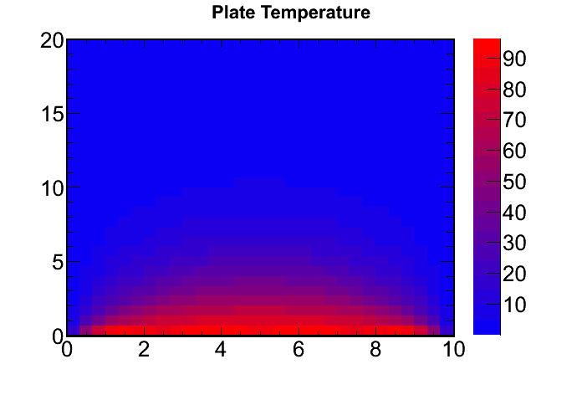
T=0
T=0
T=0
T=100
Notes:
Skipped

Slide 86
y=H
T=0
T=g(x)
y=H
T=0
T=0
T=f(y)
T=0
T=0
x=L
T=0
x=L
How would you find T₂(x,y)?
Notes:
SJP, Sp ‘12 Lecture #28
I asked this rhetorically. Argued that this WAS their homework problem, and they SHOULD go back to square 1, and do the WHOLE procedure from start to finish. BUT, given this formula, there is a quick way, tilt your head! Got students to call out “swap x and y”, and then “also H and L”. Lots of them came up with this, I gave them about 30 seconds to think.

Slide 87
y=H
T=0
T=g(x)
y=H
T=0
T=0
T=f(y)
T=0
T=0
x=L
T=0
x=L
Notes:
SJP, Sp ‘12 Lecture #28.
Just talked it through, pointing out x<-> y and L <-> H (and f <-> g)

Slide 88
y=H
T=0
T=0
y=H
T=0
T=h(y)
T=f(y)
T=0
T=0
x=L
T=0
x=L
How would you find T₃(x,y)?
Notes:
SJP, Sp ‘12 Lecture #28
Again, asked this of the whole class. This stumped them more than the last one. Took awhile, I got “try -T1”, which we talked about. I got “swap sinh for cosh” and “flip the sign”. Finally, someone suggested the correct answer. I pointed out that this sort of “trick” is a great way to think – use symmetry, the PHYSICS is identical, just the coordinate system is changing.

Slide 89
y=H
T=0
T=0
y=H
T=0
T=h(y)
T=f(y)
T=0
T=0
x=L
T=0
x=L
Just swap x with (L-x) (!)
Notes:
SJP, Sp ‘12 Lecture #28
(Answer to last one. I walked carefully through the eq’n, pointing out there is only ONE little spot to fix up!)

Slide 90
y=H
T=0
T=g(x)
y=H
T=0
T=0
T=f(y)
T=0
T=0
T=0
x=L
x=L
y=H
T=g(x)
How would you
find T₄(x,y)?
T=0
T=f(y)
T=0
x=L
Notes:
SJP, Sp ‘12 Lecture #28
And again, asked this to the class. This time, many students said “go back to square one”. But there’s a problem, you can’t! The method really fails (which direction gets sin and cos, for instance?) I pointed this out and asked if anyone could see a clever method, a “trick”. One student suggested adding to T1 and T2, which led to next slide.

Slide 91
y=H
T=0
T=g(x)
y=H
T=0
T=0
T=f(y)
T=0
x=L
x=L
T=0
T=0
y=H
T=g(x)
Would this work?
T₄(x,y) = T₁(x,y) + T₂(x,y)
T=0
T=f(y)
sweet!
No, it messes up Laplace’s eqn
No, it messes up Bound conditions
Other/??
T=0
x=L
Notes:
SJP, Sp ‘12 Lecture #28.
[[75]], 3, 22,0
Last year: [97],3,0,0
Good! Still, I had people explain WHY it doesn’t “mess up Laplace” (linearity) and why it correctly gets the boundary conditions.

Slide 92
y=H
T=g(x)
T=j(y)
T=f(y)
T=h(x)
x=L
We have solved this!
Notes:
SJP, Sp ‘12 Lecture #28
I’m not sure I realized this before teaching this class, but the previous slide shows the general method to solve this. you do NOT start from scratch, you solve the “0,0,0,f(y)” problem, then construct the other 3 by simple symmetry arguments, and then add them. So we HAVE solved the general 2-D Cartesian Laplace’s problem with BC’s on the edges. (Pointed out that when we started, separation of Variables looked very tentative, it felt like it might only work in very special, maybe contrived cases like the “0,0,0, f(y)” case, but now we see that ALL problems of this type are solved!
In ‘12, a student asked “how about 3D”, so we spent some time going through this. I asked them what changes in the PDE (add a d^2/dz^2). I asked them what they might try for separation of variables (got lots of “multiply by Z(z)” shout outs). We talked about how when you do this you’ll get THREE functions of different v’bles adding to 0, so each must be a constant, so yes, we have 3 ODEs each of which is familiar. Then I asked if they think this would solve the box with “0,0,0,0,0,f(x,y)” problem, and they all concluded sure, one even said “two of the v’bles will be sin/cos to get the 0->0 right, and the third will have to be exponentials”. Bingo. And again, superposition with symmetry says we can solve the arbitrary “T given on a cube” problem.
I took this opportunity to go back to the beginning and talk generically (and briefly) about what happens if the boundary is a circle (look up del^2 in polar coords!) or if you are in 3D (walked through this in a bit of detail – pointed out that you have 2 independent separation constants, etc).

Slide 93
Fourier Transforms
Notes:
SJP, Sp ‘11 Lecture #28

Slide 94
If f(t) is periodic (period T), then we can write it
as a Fourier series:
What is the formula for c_{n}?
Notes:
SJP, Sp ‘12 Lecture #28.
4, 4, 0, [[85]], 7
Sp 11: 0,0,7,[86],7
Just gave this to set up the discussion of Fourier, they seem to know this by now.
I asked the student who voted E why, and one replied that he thought D was off by a factor of 2. Might add that next time, though it’s a little hard for them to figure it out (I explained my own trick – just let f(t)=e^{+i m omega t), and the integral becomes “T”, giving cm=1, as it must. )
Also pointed out that units say there must be a 1/T outside.

Slide 95
Fourier Series
Fourier Transforms
Notes:
SJP, Sp ‘12 Lecture #28.
(Had ~15 minutes to start to introduce FT’s, motivation, the idea, some places it gets used) This slide is animated – I spent some time reviewing Fourier series on the board, reminded them of this exponential form (they had done that for homework, which helps!) Pointed out once again my interpretation of the cn’s, “how much of each frequency” is represented. Talked about the “spectrum” of frequencies, nw0, drew those on a number line. Then asked them what happens if T gets larger, if the period is longer?
Got them to shout out that our omegas (n omega0) get smaller, though not many realized they also get closer together. I wanted them to generate the idea of the integral... Not sure how well this worked. But in ‘12, MANY students shouted out that as T-> infinity, I should replace the sum with an integral. Leading to next slide:

Slide 96
Fourier Series
Fourier Transforms
dx
dt
dω
Nothing is needed, just
Something else/not sure
Notes:
SJP, Sp ‘12 Lecture #28
‘12: 0, 27, [[72]], 0, 0
‘11: 0,24,[76],0,0
In ‘12 a student shouted out on previous slide I was missing a domega, so that led nicely to this. I told them anyone who leaves out the “d(something)” should be slapped! But, what’s the physics, what are we summing over?
Interesting, 25 or so % wanted dt. Talked about “dummy variables”, and that we are “summing over frequencies”... Should return to this in next class. (ran out of time here in ‘12)

Slide 97
(period T = 2π/ω₀)
Fourier Series
(limit as T gets long)
Fourier Transforms
dx
dt
dω
Nothing is needed, just
Something else/not sure
Notes:
SJP, Sp ‘12 Lecture #29
Pre class question to start off (we asked it last class)
0, 18, [[81]], 0, 2
I asked them to talk it over some more, that it was a split between B and C, and they revoted 18/[[82]] on B/C, no real change!
Sp ‘11: this was 0,24,[76],0,0
Interesting, 25% wanted dt.
Talked about MATH “dummy variables”, and alsoPHYSICS that we are “summing over frequencies”...Either way, you want d omega.

Slide 98
Fourier Series
Fourier Transforms
Notes:
SJP, Sp ‘12 Lecture #29.
19, [[68]], 0, 14, 0
Sp ‘11, done as review after having gone over it previous class: 5,[78], 5, 10,2
Again, discussed the “dummy variable” aspect, but also the role that n played for series, and that “n omega” is now representing “the frequency of some wave”, and we are summing over this.
Notes from variant in ‘11:
I reminded them first of the “spectrum” of omegas in the series, the interpretation of the cn’s as “strength of frequency n omega0”, and what happens to the spectrum when T gets large. This is totally a review from last class, which felt a little rushed. (Given the distribution, it seemed worth redoing – solid, but not unanimous.)
I allowed them to explain what was *wrong* with the wrong ones. Talked about the presence of “n” which is needed to characterize frequency in the series, but isn’t needed in the integral. And, again, about the “dummy variable”. (More students seemed to understand the idea this time, and one explained it nicely to the class who normally doesn’t talk)

Slide 99
Fourier Series
Fourier Transforms
Notes:
SJP, Sp ‘12 Lecture #29.
Summary, review of where we are, try to SEE the significance of g(omega), it’s “how much of each pure frequency do you need”.
Also, you can “undo” or solve for these amplitudes (cn or g(w)) by taking an OVERLAP, essentially the same thing!
Finally, briefly discuss the 1/2Pi (which is partly convention, but UNITS tell us that you cannot have a 1/T out there – which is good, since T -> Infinity)

Slide 100
g(ω) is the Fourier Transform of f(t)
f(t) is the inverse Fourier Transform of g(ω)
Notes:
SJP, Sp ‘12 Lecture #29.
Spent a little time just talking about how I think about these “pairs”. Again, took the time to talk about the 1/2pi convention issues (and got the symmetric form on the board) Again emphasized my interpretation of f as “a sum of sins”
And, the “partnership” of f and g, and how the inverse is very nearly the same as the FT.
Just as the “cn’s” encode information about f(t), so too g(omega) “encodes” information. We talked briefly about quantum mechanics, and how knowing spatial information or momentum information is equivalent (but mathematically looks very different)

Slide 101
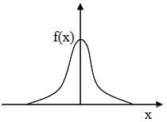
Consider the function
What can you say about the integral
f(t)
It is …
zero
non-zero and pure real
non-zero and pure imaginary
non-zero and complex
t
50
Notes:
SJP, Sp ‘12 Lecture #29
0, [[44], 16, 40
Last year: , [56], 0, 40
This year Lect 29 is the “review test”, so we had run out of time here. Not as much time as last year, and no whiteboards, hence the slightly worse results.
Last year: This proved to be a good question – I gave them a lot of time (over 3 minutes), and group by group suggested they try using Euler on the e^{-i omega t) term and then thinking “symmetry”. Some saw it, many didn’t, but they seemed ready for the answer when I worked it out on the board. However, the next question proved that they hadn’t fully gotten the idea here!
(from 3310, M. Dubson)
101

Slide 102
We are planning to hold a help session the Monday of final exam week (5/7/12). This is the day before our final exam. We’d like to know when it would make sense to hold it. Please select the time that works best for you.
10am-Noon
2pm-4pm
4pm-6pm
D) I probably wouldn’t attend anyway
E) Some other time works best for me.
Notes:
MENTION THAT FINAL WILL BE HARDER THAN POSTTEST ?!
Also that final will be in THIS room.
And they have one more day for Danny’s survey.

Slide 103
If f(t) is given in the picture, it's easy enough to evaluate
Give it a shot!
After you find a formula, is it...
real and even
real and odd
complex
Not sure how to do this...
Notes:
SJP, Sp ‘12 Lecture #30.
[[43]], 41, 15, 2
Last year: [61] 24, 15
Again gave lots of time (4-5 minutes for this) Made sure everyone really tried to work it out. Emphasizing the point that this abstract looking formula is not so hard (here) Many did get it, and some of the 24% voting B did so because they saw the “sin(omega T)” in their answer and thought sin has to be odd. We had to segue to talk about odd and even functions (and prove that e*o is odd, and o*o is even)
This is the “HeavysidePi[t/(2 T0)] function in Mathematica, I believe.

Slide 104
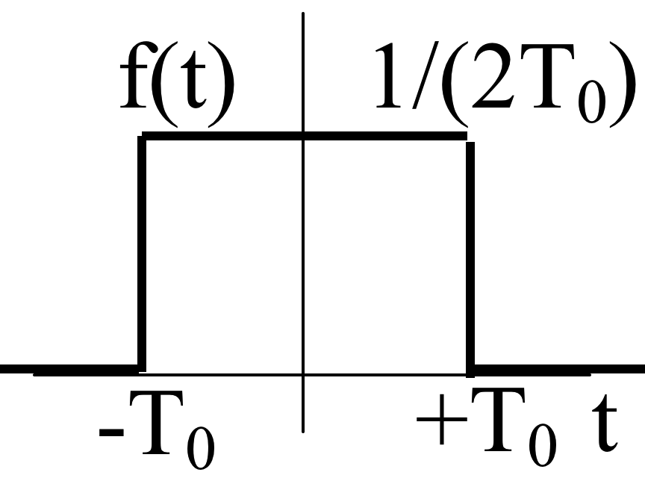
If f(t) is given in the picture,
What is
0 B) infinite C) 1/2π D) 1/(2πωT₀)
E) something else/not defined/not sure...
Notes:
SJP, Sp ‘12 Lecture #30.
0, 4, [[76]], 6, 15
Last year: 5,2,[86], 5,2
This was fast. They know L’hopital’s rule, (so I reminded them to also think of the Taylor expansion of sin, and did it quite explicitly on the board. ) I also looked at the *next order term*, which L’hopital doesn’t tell you about, so we could see that the function “curves down” near but not exactly at w=0.

Slide 105
If f(t) is given in the picture,
What is
What is
0 B) infinite C) 1/2π D) 1/(2πωT₀)
E) something else/not defined/not sure...
Notes:
SJP, Sp ‘12 Lecture #30.
(Did not vote this year. Some discussion about whether it’s “not defined”, since sin(w t) does NOT have a limit as omega -> inifinity.
Sp ‘11: [95],2, 0, 0, 2
Again, very fast. Set up for next slide (sketch)

Slide 106
If f(t) is given in the picture,
Describe and sketch g(ω)
Challenge: What changes if T₀ is very SMALL?
How about if T₀ is very LARGE?
Notes:
SJP, Sp ‘12 Lecture #30.
Gave them a few minutes on this. Most got it, some didn’t notice the oscillations. Some only sketch it for positive omega. I went to the board and led the discussion of limits, pointed out general feature of Fourier Transforms. (Including the inverse “width” story)

Slide 107
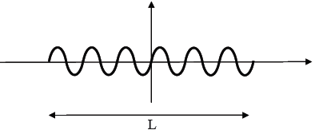
Consider the function f(x) which is a sin wave of length L.
Which statement is closest to the truth?
f(x) has a single well-defined wavelength
f(x) is made up of a range of wavelengths
42
Notes:
SJP, Sp ‘12 Lecture #30.
17, [[83]]
CORRECT ANSWER: B
This was well set up from my lead in (previous slides and example), and leads to great examples to talk about like listening to a short tape of a singer, or even the fact that most drums have ill-defined “pitch”. (It’s not that you don’t have time to hear it, it’s that a broad range of frequencies are present). Talked briefly about physics of your cochlea, that you are fourier transforming sound on the fly.
After this, I had a quick demo: brought in a laser pointer, we discussed what the “spectrum” of the light is (someone called out ‘delta function’, pointed out that the pulse has a finite length in time, so it must have SOME spread in “color”, and rolled back to the short laser pulse laser idea : , that VERY short (fsec) pulses will only have a few cycles in them, and thus also do not have well-defined color.

Slide 108
What is the Fourier transform of a Dirac delta function,
f(t)=δ(t)?
0
∞
1
1/2π
e^{-iω}
Notes:
SJP, Sp ‘12 Lecture #30.
0, 6, 0, [[93]], 2
Last year:
2, 7, 5, [86], 0
Had to remind some of them about the delta function, which made this a nice review of that. And, it connects well with the previous activity. Continue the talk here about physics - e.g. that a short “clap” sound has no clear pitch, and that a short laser pulse is built up out of many frequencies, here we’re just going to a limit. (A student asked me to talk it through more – the answer is 1/2pi, it’s a constant, the SAME g(w) for all w, so you need equal amounts of all frequencies…

Slide 109
What is the Fourier transform of a Dirac delta function,
f(t)=δ(t-t₀)?
E) Something else...
Notes:
SJP, Sp ‘12 Lecture #30.
Had them call it out, LOTS said D. Talked about the idea here – this f(t) is not even (or odd), and thus g does come out complex. The phase of g(w) is important, it contains the information of “where” the pulse is located! We’re emphasizing that knowing g(omega) tells you things, and is tightly linked to f(t).

Slide 110
The Fourier transform of
is
Sketch this function
Notes:
SJP, Sp ‘12 Lecture #30.
Too little time for this, but had people call it out. Many seemed to be with me, but not enough time to assess if there were issues throughout the room. Emphasized again the inverse nature of widths, and connected to Quantum mechanics and the uncertainy principle. Many students did NOT seem to know that the “width” of the gaussian is sigma.

Slide 111
What is the standard deviation of
which is the Fourier transform of
1
σ
σ²
1/σ
1/σ²
Notes:
SJP, Sp ‘11 Lecture #28.
No time, just talked it through.

Slide 112
Compared to the original function f(t), the Fourier transform function g(ω)
Contains additional information
Contains the same amount of information
Contains less information
It depends
Notes:
SJP, Sp ‘12 Lecture #30.
Ended with this, it’s brief and fun idea. I then followed my lecture notes (quickly and casually) to suggest how light going through slits “fourier transforms” into the spatial distribution on the wall (so narrow slits -> wider spots on the wall), and then shone my laser pointer through a couple of gratings, first a “regular” one, then a funny one that makes a shape (I had a star or dollar sign one) Point is that you can inverse fourier transform the image you WANT, and then generate a grating that Produces that pattern!

Slide 113
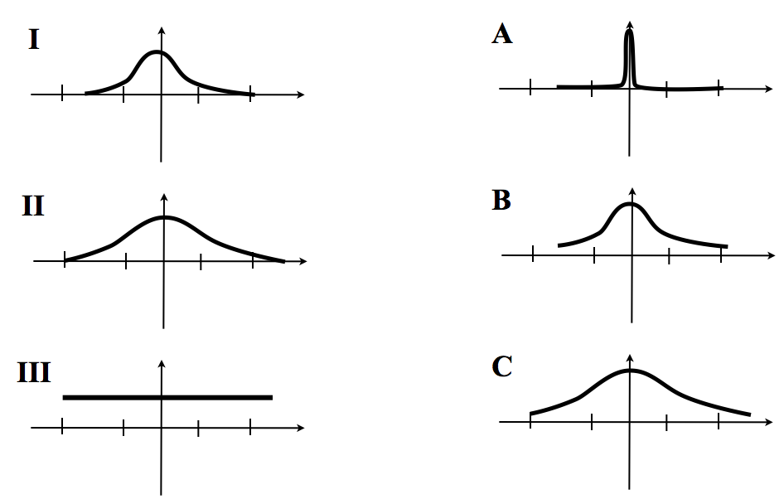
Match the function (on the left)
to its Fourier transform (on the right)
Notes:
Skipped.

Slide 114
Solving Laplace’s Equation:
If separation of variables doesn’t work, could use “Relaxation method”
Notes:
SJP, Sp ‘12 Lecture #30.
Quick (<10 minute) run through, just for fun.

Slide 115
Solving Laplace’s Equation:
A handy theorem about any solution of this eq’n:
The average value of T (averaged over any sphere)
Equals the value of T at the center of that sphere.
Notes:
SJP, Sp ‘12 Lecture #30.

Slide 116
Solving Laplace’s Equation:
T=5
T=5
Notes:
SJP, Sp ‘12 Lecture #30.
Slide sequence from Alysia Marino.

Slide 117
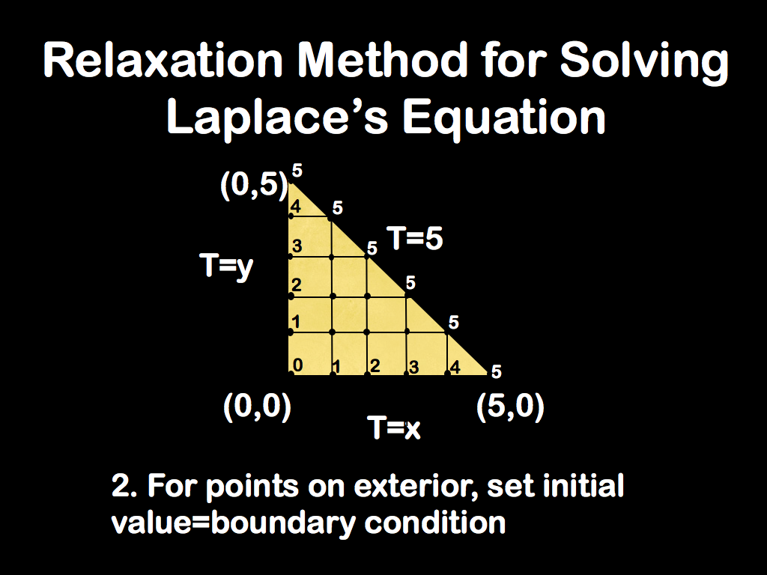
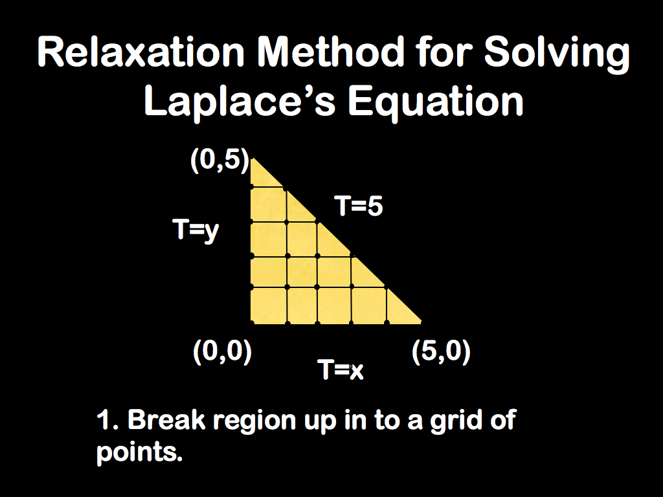
Solving Laplace’s Equation:
T=5
Notes:
SJP, Sp ‘12 Lecture #30.

Slide 118
Solving Laplace’s Equation:
T=5
Notes:
SJP, Sp ‘12 Lecture #30.

Slide 119
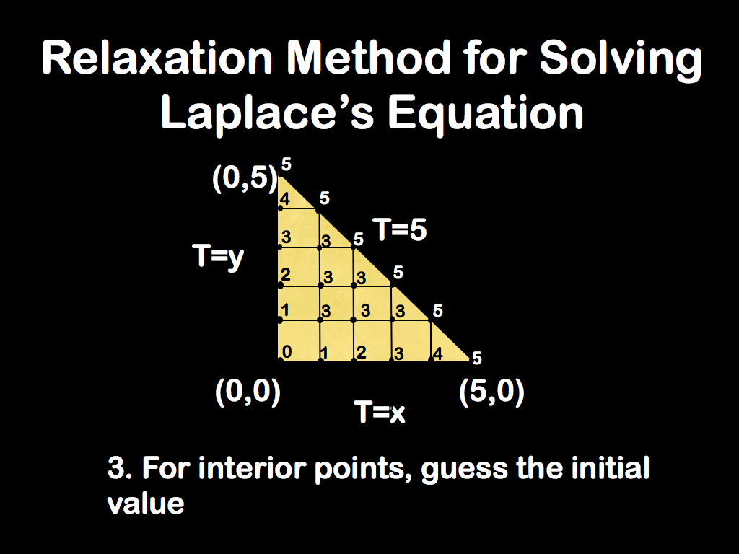
Notes:
SJP, Sp ‘12 Lecture #30.

Slide 120
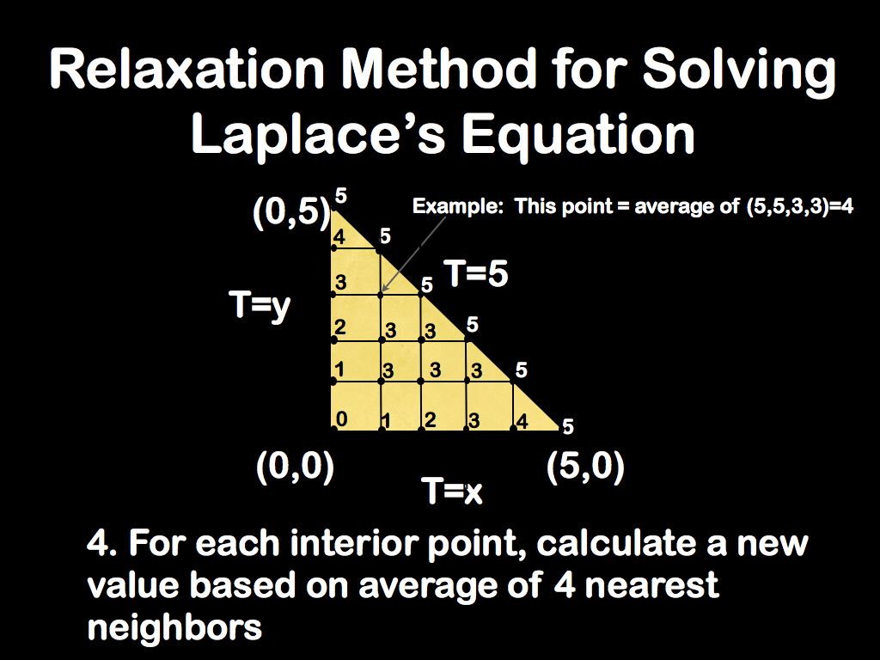

Slide 121
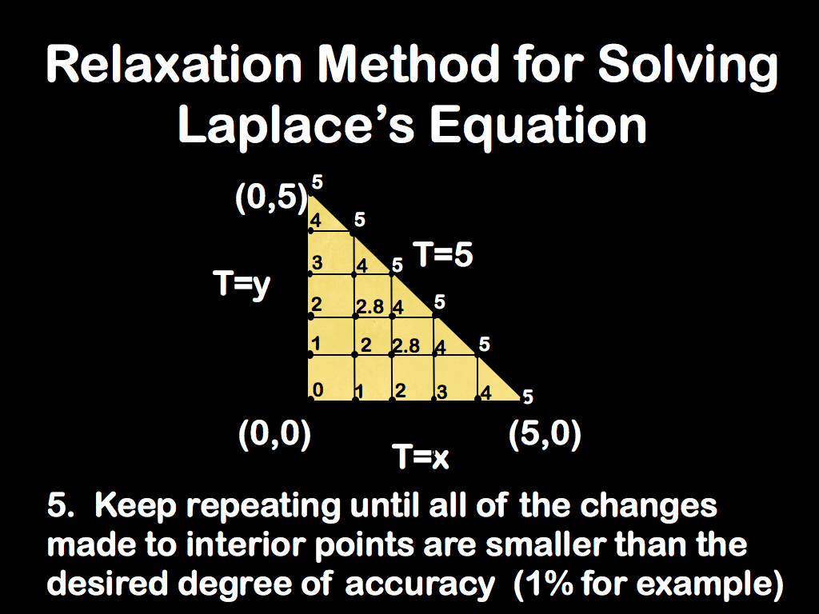
Notes:
SJP, Sp ‘12 Lecture #30.

