Slide 1
Some exam review questions
(for first midterm)

Slide 2
Which term gets the minus sign?
E) None, or more
than 1 of these!
Notes:
Phys 2210 Sp12 SJP Lect 10
6, [[83]], 0, 2, 10
(Answer is B, the “centripetal force”) We briefly discussed the other signs here , and the physics of the terms.

Slide 3
Suppose you solve an ODE for a particle’s motion, and find x(t) = bt².
What can you conclude?
This particle is responding to a time varying force
This particle is responding to a constant force
This particle is free (zero force)
???
Notes:
Phys 2210 Sp12 SJP Lect 10
3, [[97]], 0,0,0
No issues here, the course is all about F=ma!
B IInspired by a Lincoln Carr question

Slide 4
Classify this ODE:
y’’(t) = (t+1)² y(t)
Linear (not Homogeneous)
Homogeneous (not Linear)
Linear and Homogeneous
Nonlinear and Inhomogeneous
Notes:
Phys 2210 Sp12 SJP Lect 10
10, 7 [[81]], 1, 0
We discussed *why* it’s linear, and homogeneous, this seems fine. I asked them “is it separable” and they all shouted “yes”! But I’m not so sure (indeed, I think not) – this is a second order ODE, and I don’t know how I would “separate” it!!? ( I don’t ASK if it’s separable when it’s not first order)
C) I claim linear (it’s y that matters, not x), and homogenous

Slide 5
Classify this ODE:
y’’(t) + ty(t) + 1 =0
Linear (not Homogeneous)
Homogeneous (not Linear)
Linear and Homogeneous
Nonlinear and Inhomogeneous
Notes:
Didn’t bother…
Same as last. I cleaim linear (it’s y that matters, not x), and non homogenous due to the +1.

Slide 6
A downward falling mass feels a drag force
. (Up is the + direction)
Which eq’n of motion is correct?
v
+y
F_{drag}
mg
Notes:
Phys 2210 Sp12 SJP Lect 10
91, 0, 7, 1, 0
Gravity is down, so –g
Drag is up (because it’s “falling”), so +kv^2.
Animated slide so they had to work on it first.
We discussed what would change if it was linear drag (then, it’s –kv.) Also discussed how I would rewrite that linear case in terms of SPEED
Then it would be +k|v|… if it’s moving down

Slide 7
If you push forwards on a lower spoke as shown, the bike moves
A) Left B) right C) no motion D) ??
F(external)
Notes:
Phys 2210 Sp 12 SJP
Outcomes Sp11: [24] 62 15
Sp12: 20, 55 22 4
Nice! Physics is not a democracy. This one could have had a much longer followup discussion, but we ran out of time. (No time at all in Sp12!~)
Too bad. I brought in a bike (!) and did the demo, I think that’s a great touch.
Some questions about “how hard are you pushing”, “is friction negligible”, etc. I had half a dozen students come up after class to discuss this further, and try it out themsleves.
I think one needs to be careful with this question, especially when used in lecture #1. It looks simple, but turns out to be quite difficult. Students will argue, and many will be convinced that your force “turns the wheel CW” (and thus, moves the bike backwards). This is wrong, see below.
I have seen students feeling uncomfortable about looking stupid or not being able to do freshman physics, and getting worred about their ability in this course right off the bat. So, it should be framed properly as a puzzler –( perhaps an argument for why clicker questions ARE useful even in advanced mechanics! ) I have seen physicists blow this question, at least if they answer too quickly.
It moves left (forward).
Argument #1: Consider torques about the bottom of the front wheel. (I like that point because it’s “stationary”, at least for instant, assuming of course the rubber tire is not “skidding”) Then the friction force is irrelevant, the external force makes a CCW torque, and that implies the wheel and/or bike moves to the left (forward) This is all you need, and you needn’t consider friction.
Argument #2: Suppose for a moment you think the answer is “no motion”. Newton II would REQUIRE that the frictional force on the tire(s) be equal and opposite F(external). But that’s a problem, because then the TORQUE around the hub, caused by the friction, would EXCEED the torque around the hub caused by the external force (due to the larger moment arm), and that would imply the wheel starts to rotate CCW around the hub, contradicting your assumption of no motion.
If you assume the “to the right” answer, it’s the same but even worse. Now the friction must EXCEED the external force (to generate a net rightwards force on the bike as a whole), making the friction torque larger still, meaning even more so that the wheel rotates CCW (contradicting the assumption of rightwards motion).
Just try it, it works beautifully. The closer to the hub you push, the stronger/easier is the effect to see. In the limit that you push RIGHT at the very bottom of the spoke, it fails: if you push gently the bike sits there, and if you push hard it skids (to the left)
Result was 65% B! (And, 24% A, 12% C)

Slide 8
If you push backwards on the bottom pedal of a fixed-gear bike as shown,
the bike moves
A) Left B) right C) no motion D) ??
F(external)
Notes:
Phys 2210 Sp 12 SJP Didn’t get this.
Answer is *very* surprising for many students (the bike goes backwards) Try it!
I put this question up for them to think about, but didn’t vote, and most left without engaging with it. A couple students came up after class and debated it for a long time.

Slide 9
With quadratic air drag, v(t)=v₀/(1+t/ )
where =m/(cv₀), and c=(1/2)c₀ A ρ_{air.}
(For a human on a bike, c is of order .2 in SI units)
Roughly how long does it take for a cyclist on the flats to drift down from v₀=10 m/s (22 mi/hr) to ~1 m/s?
a couple seconds
a couple minutes
a couple hours
none of these is even close.
Can you confirm that c is about 0.2? (c₀ is ~1 for non-aerodynamic things, and ~.1 for very- aerodynamic things.
In real life, the answer is shorter than this formula
would imply. Why?
Notes:
For c0=0.5, and an area of about (1/2 m)*(1 m), and rho = 1.3, c is about 0.2 N/(m/s)^2. = 0.2 kg/m
So tau = (60 kg)/(.2 * 10 m/s) is of order 30 seconds.
for 1+t/Tau to reduce you by 10, you need 10 Tau’s, or 5 minutes. Seems a little long
As v gets small, linear drag enters (and will exceed the quadratic drag, making the drop exponentially fast rather than inversely with time
Rolling friction also matters, especially at slow speeds!

Slide 10
The solution for an object moving horizontally with linear air drag was
Sketch this solution (for v, and then x(t))
Notes:
Ended class with this, did not solve for them

Slide 11
An object moves with a “square-root” drag force:
When dropped, what terminal speed will it reach?
(To think about: is this the SAME as terminal velocity?)
Notes:
No time!

Slide 12
Does the Taylor Series expansion
cos(θ) = 1 - θ²/2! + θ⁴/4! + ...
apply for θ measured in
A) degrees
B) radians
C) either
D) neither
Notes:
No time!
From Sp 11: 4 [85] 10 0
There was not much discussion, but we talked about how degrees are “out” because they have units, radians are unitless and therefore the power series only has meaning if theta is in rads. (Pointed out that the series has to give a different result if you plug in the number 90, or the number Pi/2, on the right!)
Idea from: M. Dubson, M. Betterton, A. Marino

Slide 13
Consider the three closed paths 1, 2, and 3 in some vector field F, where paths 2 and 3 cover the larger path 1 as shown. What can you say about the 3 line integrals?
1
3
2

Slide 14
When doing line integrals in cartesian (2D), we use
What should we use when in plane-polar coordinates?
Notes:
Phys 2210 Sp12 SJP Lect 10
(Did not get to this!)

Slide 15
Consider the vector field , where E₀ is a constant, and consider the closed square path L shown.
What can you say about the line integral ?
A) It is positive
B) It is negative
C) It is zero
D) It cannot be determined from the information given!

Slide 16
Which of the following are conservative forces?
i- friction
ii- Gravity
iii- the normal force
i only B) ii only C) iii only
D) i and ii only E) Other/not sure
Notes:
Answer: B, only gravity, of these three. “Non-uniform” doesn’t matter, gravity is still conservative.
Friction in I is velocity independent (like, e.g, sliding friction) but it IS still manifestly path dependent.
III shouldn’t give them any troubles at all. It might be more interesting/challing to make III be “the Normal force “ (which is not dissipative, it does not work, but is still not conservative, because it is not a function of position alone)

Slide 17
Which of the following are conservative forces?
I- friction (velocity independent)
II- Gravity (non-uniform)
III- linear air drag
i only B) ii only C) iii only
D) i and ii only E) Other/not sure

Slide 18
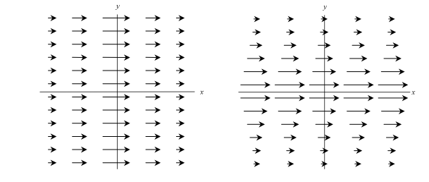
If you finish early .....
Do you agree or disagree with the following statements?
“For a conservative force, the magnitude of the force is related to potential energy. The larger the potential energy, the larger the magnitude of the force.”
2) “For a conservative force, the magnitude of the force is related to potential energy. For any equipotential contour line, the magnitude of the force must be the same at every point along that contour.”
Can you come up with equipotential lines for the 2 force fields below?

Slide 19
y
Consider an infinitesimal path element dL directed radially inward, toward the origin as shown. In spherical coordinates, the correct expression for dL is:
x

Slide 20
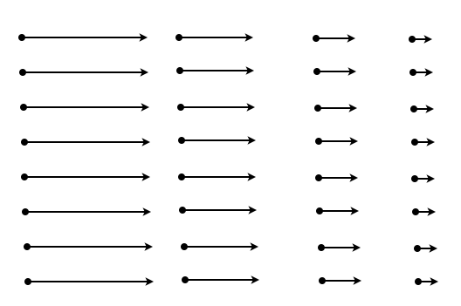
What is the curl (∇xF) of this vector field, F?
= 0 everywhere
≠ 0 everywhere
=0 in some places
Not enough info to decide

Slide 21
What is the curl (∇xF) of this vector field, F?
= 0 everywhere
≠ 0 everywhere
=0 in some places
Not enough info to decide
Notes:
This field is (-y,x). Its curl is constant (2 khat) everywhere

Slide 22
When doing line integrals in cartesian, we use
What should we use
when in spherical coordinates?

Slide 23
A charge q sits in an electric field E = ,
what is the potential energy U(r)?
Something else!

Slide 24
Some exam review questions
(for second midterm)

Slide 25
The binomial expansion is:
2.16
Does this mean that, for z<<a, we can write
Correct, but only to leading order, it will fall apart in the next term
It’s fine, it’s correct to all orders, it’s the binomial expansion!
Utterly false, even to leading order.
Notes:
Phys 2210 Sp 12 SJP Lecture 20
15, 12, [[73]]
This is just a nice review of Taylor series and our method of expanding when one quantity is larger than another. Got students to call out what we SHOULD do. One student discussed how nonsensical the expansion shown is, consider when z EQUALS 0, and you have 1/a = a^2 ?!

Slide 26
The hollow spherical shell has mass density ρ,
inner radius a, outer radius 2a, total mass M
What is the gravitational force on m
at point P?
3a
2a
P
a
GMm/a²
GMm/3a²
GMm/9a²
Something else entirely!
Notes:
Phys 2210 Sp 12 SJP Lecture 20
3, 6, [[88]], 3, 0
Provide opportunity for review of Gauss’ law. Doesn’t seem to be any big issue here (but, we’re still not 100%!)
(One student pointed out the correct answer is D, since “force” is a vector, not a number. They are correct, though that’s not what I was after… )

Slide 27
The hollow spherical shell has mass density ρ,
inner radius a, outer radius b.
How does the gravitational potential
ϕ depend on r, for r>b?
b
a
~r
~r²
~r ⁻¹
~r ⁻²
Something else entirely!
Notes:
Phys 2210 Sp 12 SJP Lecture 20
Skipped

Slide 28
The hollow sphere has mass density ρ,
inner radius a, outer radius b.
How does the gravitational potential
ϕ depend on r, for r<a?
b
~r
~r²
~r ⁻¹
~r ⁻²
Something else entirely!
a
Notes:
Phys 2210 Sp 12 SJP Lecture 20
9,0,9,4,[[78]]
I animated this to let them work on it first. F=0 in there, so U= constant (no gradient). I asked if U=0 in the middle, it was split opinion, so we discussed the graph of U(r) vs r (this was good, lots of callouts from class). I pointed out continuity of U, (asked them WHY this is the case, wanted to get to F = -grad(U) means discontinuity in U means/requires infinite force)
Good question

Slide 29
Consider a thin cylindrical shell with uniform mass per unit area σ.
If we want to find the gravitational field at an arbitrary point on the z-axis, can we simply use Gauss’ law?
z
r
Yes, this problem has nice cylindrical symmetry
No, Gauss’ law is valid but not helpful here
No, Gauss’ law is invalid in this case.
Notes:
Phys 2210 Sp 12 SJP Lecture 20
6, [[91]], 3
There was still some confusion/discussion here, although the vote was strong in the end. Some students were arguing that “cylindrical symmetry gives g pointing straight towards the origin” (which is correct), but from this they thought the answer was a. The *procedure* of Gauss’ law is not firm with everyone yet, or the idea that you can only solve for g(r) this way if you can pull it out of the integral.
As for the 2 votes for “Gauss’ law is invalid”, I pointed out it’s even true for relativistically moving masses!.

Slide 30
Consider a thin cylindrical shell with uniform mass per unit area σ.
What is |dg| at the origin due to the small patch of mass shown?
dθ
dz
z
Gσdz dθ/r²
Gσdz dθ/(r²+z²)
Gσdz rdθ/r²
Gσdz rdθ/(r²+z²)
Something else!
O
r
Notes:
Phys 2210 Sp 12 SJP Lecture 20
0, 2, 3, [[89]], 7
This ended class – they did fine, were able to articulate why the r appears in r dr dtheta and why the denominator was r^2+z^2 (though, I got quite a few “clarifying” questions about the setup while it was going.

Slide 31
Consider a thin cylindrical shell with uniform mass per unit area σ.
What is |dg| at the origin due to the small patch of mass shown?
dθ
dz
z
Gσdz dθ/r²
Gσdz dθ/(r²+z²)
Gσdz rdθ/r²
Gσdz rdθ/(r²+z²)
Something else!
O
r

Slide 32
What is your opinion about these claims?
For a conservative force, the magnitude of the force is related to potential energy, so….
“The larger the potential energy, the larger the magnitude of the force.”
2) “For any equipotential contour line, the magnitude of the force must be the same at every point along that contour.”
Agree with 1 and 2
Agree only with 1
Agree only with 2
Disagree with both
Notes:
Phys 2210 Sp 12 SJP Lecture 20
No time

Slide 33
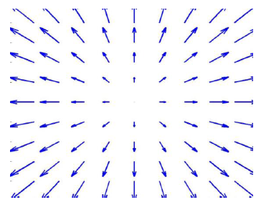
Can you come up with equipotential lines for the 3 force fields below?
Draw it if possible
Notes:
Phys 2210 Sp 12 SJP Lecture 20
No time
Notes from Sp ‘11: We did this as a blackboard/class activity. (Three groups up front, each working on one of these) It worked very well!
The one in the middle is impossible, but many students want to draw “wavy lines”. It was nice to see them correct themselves as they talked about it. Many students wanted to do it “in their heads”, I was very insistent they really DRAW the answer, in part because that leads them to think about the density of equipotentials, not just their location. The group dealing with the third case missed this, but then corrected themselves. One group nicely pointed out (for fig 1) that they FIRST thoughty about whether this was conservative (by thinking about loops), and only THEN trying to draw equipotentials.

Slide 34
F=(-y, -x²)
Is this force field conservative? A) Y, B) N, C) ?
Notes:
Phys 2210 Sp 12 SJP Lecture 20
No time

Slide 35
An object moves with a “square-root” drag force:
When dropped, what terminal speed will it reach?
(To think about: is this the SAME as terminal velocity?)
Notes:
No time!

Slide 36
v_{fuel}
v
A rocket travels with velocity v with respect to an (inertial) NASA observer.
It ejects fuel at velocity v_{exh} in its own reference frame.
Which formula correctly relates these two velocities with the velocity v_{fuel} of a chunk of ejected fuel with respect to an (inertial) NASA observer?
v_{fuel} = v_{exh} + v
v_{fuel} = v_{exh} - v
v_{fuel} = -v_{exh} + v
v_{fuel} = -v_{exh} - v
E) Other/not sure??
Notes:
Phys 2210 Sp 12 SJP Lecture 20
No time!
Phys 2210 SJP Sp 12
[[66]], 13, 19, 1, 0
This was a “review” slide, set up to be *easier* than the one we had last class, since there are no minus signs this time.
Vfuel/Nasa = vfuel/rocket + vrocket/Nasa, answer A.
See notes/comments on earlier slide sequence.

Slide 37
Consider the three closed paths 1, 2, and 3 in some vector field F, where paths 2 and 3 cover the larger path 1 as shown.
What can you say about the 3 line integrals?
1
3
2
Notes:
Phys 2210 Sp 12 SJP Lecture 20
NO TIME

Slide 38
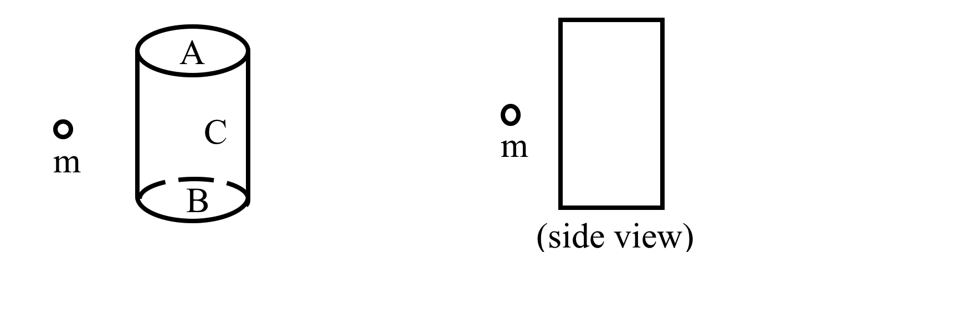
A point mass m is near a closed cylindrical gaussian surface. The closed surface consists of the flat end caps (labeled A and B) and the curved barrel surface (C). What is the sign of through surface C?
A) + B) - C) zero D) ????
(the direction of the surface vector is the direction of the outward normal.)
Notes:
Phys 2210 Sp 12 SJP Lecture 20
NO TIME
Inspired by UW Tutorial

Slide 39
A point mass m is near a closed cylindrical gaussian surface. The closed surface consists of the flat end caps (labeled A and B) and the curved barrel surface (C). What is the sign of through surface C?
A) + B) - C) zero D) ????
(the direction of the surface vector is the direction of the outward normal.)
Notes:
Phys 2210 Sp 12 SJP Lecture 20
No time
Inspired by UW Tutorial

Slide 40
A particle oscillates in a 1-D potential.
How many (which?) of the following properties guarantee SHM?
i) Period T is independent of the amplitude A
ii) Potential U(x)~x²
iii) Force F= –kx (Hooke’s law)
iv) Position is sinusoidal in time: x=Acos(wt-δ)
A) only 1 of these properties guarantees SHM
B) exactly 2 properties guarantee SHM
C) exactly 3 properties guarantee SHM
D) all (any one of these guarantees SHM)
Notes:
No time

Slide 41
Consider a super ball which bounces up and down on super concrete. After the ball is dropped from an initial height h, it bounces with no dissipation and executes an infinite number of bounces back to height h.
Is the motion of the ball in z simple harmonic motion?
yes
no
???
Notes:
No time

Slide 42
Some exam review questions
(FINAL EXAM )

Slide 43
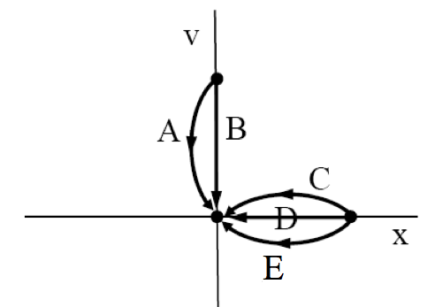
Which phase path below best describes overdamped motion for a harmonic oscillator released from rest?
Challenge question: How does your answer change if the oscillator is “critically damped”?
Notes:
SJP, Sp ‘12 Lecture #30.
Quick exam review
2, 0, 8, 2, [[88]]
Quick discussion, no problems apparent here.
Notes from Sp 11’: 7,0,7,5, [80] (Asked at end of class, after tutorial)
We did the intermediate mechanics tutorial on phase space for damped oscillators, and I left this up on the board for them to click on only after they were done (so I knew when they finished). We spent about 30 minutes on that Tutorial. Many students knew the answer to this one right away, even before the Tutorial. We ended class with it. I asked them what was wrong with A and B (doesn’t start at rest), then a student volunteered that C had the same issues as previous question: x is decreasing while v is positive?? I added that D has v=0 while x is decreasing, also inconsistent.

Slide 44
Which of the following are conservative forces?
i- Gravity from nonspherical planets
ii- the normal force
i only B) ii only C) both
D) Neither E) it depends
Notes:
Answer: B, only gravity, of these three. “Non-uniform” doesn’t matter, gravity is still conservative.
Friction in I is velocity independent (like, e.g, sliding friction) but it IS still manifestly path dependent.
III shouldn’t give them any troubles at all. It might be more interesting/challing to make III be “the Normal force “ (which is not dissipative, it does not work, but is still not conservative, because it is not a function of position alone)

Slide 45
In cylindrical coordinates, what is the correct volume element, dV = ?
dr dΦ dz
r dr dΦ dz
r² dr dΦ dz
sinΦ dr dΦ dz
r sinΦ dr dΦ dz
ρ
z
z
y
φ
x
Notes:
SJP, Sp ‘12 Lecture #30.
Quick exam review
0, [[67]], 2, 4, 27
Earlier in term: Responses were 6, [66], 2, 2, 23.
Then I showed next slide, and voted again.
Answer: It’s B, because (see next slide) the inside/outside edge is r dphi.
S. Pollock

Slide 46
In cylindrical coordinates, what is the correct volume element, dV = ?
ρ
dr dΦ dz
r dr dΦ dz
r² dr dΦ dz
sinΦ dr dΦ dz
r sinΦ dr dΦ dz
z
δρ
δζ
ρδφ
φ
y
x
Notes:
SJP, Sp ‘12 Lecture #30.
Quick exam review
Did not revote, this is the “explanation slide”
0 [96] 2 0 2
The picture of course gives it away. Talked about UNITS, and also tried to motivate the one interesting side in this figure, rho dphi. The point is that one need not memorize such formulas, but “think them through” when you need them.
S. Pollock

Slide 47
What is the most general form of the solution of the ODE u’’(t)+4u(t)=e^{t} ?
u=C₁e^{2t} + C₂e^{-2t} + C₃e^{t}
u=Acos(2t-δ) + C₃e^{t}
u=C₁e^{2t} + C₂e^{-2t} + (1/5)e^{t}
u=Acos(2t-δ) + (1/5)e^{t}
Something else!???
47
Notes:
SJP, Sp ‘12 Lecture #30.
Quick exam review
15, 6, 15, [[46]], 17
Good review question, there’s something tempting in all the answers, it was good to have them call out what’s wrong with each (no i’s in exponential in A and C, A has too many undetermined coeffs. Ask them what WOULD you need to change to get A or C to be more correct, they call out change 4 to -4, which is correct for exponentials, but does change that 1/5 constant. One student didn’t notice the delta and thought we were missing the sin’s. One student thought that the answer HAD to be written in terms of exp[+/- 2 I t].

Slide 48
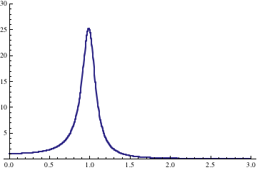
If you have a damped, driven oscillator, and you increase damping, β, (leaving everything else fixed) what happens to the curve shown?
Fixed ω₀
ω
It shifts to the LEFT, and the max value increases.
It shifts to the LEFT, and the max value decreases.
It shifts to the RIGHT, and the max value increases.
It shifts to the RIGHT, and the max value decreases.
Other/not sure/???
Notes:
SJP, Sp ‘12 Lecture #30.
Quick exam review
2, [[62]], 0, 21, 14
Ran out of time –
Didn’t have time to vote in ‘12, we just discussed it.
2, [64], 0, 1, 23
Back to the earlier question, but this time the one they read about in the book. We didn’t hear from the 23% who voted E, so I don’t know what they were thinking, next round I would really push harder to find out what the issue is.

Slide 49
When you finish P. 3 of the Tutorial, click in:
What can you say about the a’s and b’s for this f(t)?
t
All terms are non-zero B) The a’s are all zero
C) The b’s are all zero D) a’s are all 0, except a₀
E) More than one of the above, or, not enough info...
Notes:
SJP, Sp ‘12 Lecture #30.
No time.
0, [79], 2, 5, 14
Used this as the “are you done with the Tutorial” question. (Tutorial took ~25 minutes, most but not all finished)
I didn’t get a chance to find out why 14% voted E.

Slide 50
What is the general solution to
Y’’(y)-k²Y(y)=0
(where k is some real nonzero constant)
Y(y)=A e^{ky}+Be^{-ky}
Y(y)=Ae^{-ky}cos(ky-δ)
Y(y)=Acos(ky)
Y(y)=Acos(ky)+Bsin(ky)
None of these or MORE than one!
Notes:
SJP, Sp ‘12 Lecture #30.
No time.
[[56]], 4, 2, 18, 20
Sp 11’: [65],0,3,3,30
Start of class question. Many voted E because they thought A and D were both ok. I worked it out in detail, to try to convince them that A is correct, and C/D are NOT, they don’t solve the ODE. (The fact that C is not fully general makes it doubly wrong). Signs matter, exponentials are quite different functions than sin/cos’s!

Slide 51
What is the general solution to
X’’(x)+k²X(x)=0
X(x)=A e^{kx}+Be^{-kx}
X(x)=Ae^{-kx}cos(kx-δ)
X(x)=Acos(kx)
X(x)=Acos(kx)+Bsin(kx)
None of these or MORE than one!
Notes:
SJP, Sp ‘12 Lecture #30.
No time.

Slide 52
Rectangular plate, with temperature fixed at edges:
T=0
y=H
T=0
T=0
y=0
x=0
T=t(x)
x=L
When using separation of variables, so T(x,y)=X(x)Y(y),
which variable (x or y) has the sinusoidal solution?
X(x) B) Y(y) C) Either, it doesn’t matter
D) NEITHER, the method won’t work here
E) ???
Notes:
SJP, Sp ‘12 Lecture #30.
No time.

Slide 53
Does the Taylor Series expansion
cos(θ) = 1 - θ²/2! + θ⁴/4! + ...
apply for θ measured in
A) degrees
B) radians
C) either
D) neither
Notes:
SJP, Sp ‘12 Lecture #30.
No time.
From Sp 11: 4 [85] 10 0
There was not much discussion, but we talked about how degrees are “out” because they have units, radians are unitless and therefore the power series only has meaning if theta is in rads. (Pointed out that the series has to give a different result if you plug in the number 90, or the number Pi/2, on the right!)
Idea from: M. Dubson, M. Betterton, A. Marino

