Slide 1
POTENTIAL

Slide 2
Class Activities: Potential (slide 1)

Slide 3
Class Activities: Potential (slide 2)

Slide 4
Today: Voltage or “Electric Potential”
The 1120 version:
Voltage V = kq/r from a point charge
Voltage = potential energy/charge
ΔV is “path independent”
E = -dV/dr
Notes:
USED IN: Spring 2013 (Pollock)
LECTURE NUMBER: 8 (intro to voltage)
Today’s lecture I decided to try “powerpointing” due to our lousy blackboard situation.
Review, this seemed helpful. Spent just a few minutes on it. Point out the funny language, potential is NOT potential energy!
WRITTEN BY: Steven Pollock

Slide 5
Potential and E-field
= external work done on charge to move it
Notes:
USED IN: Spring 2013 (Pollock)
LECTURE NUMBER: 8 (intro to voltage)
This slide was my “motivation for the definition”. It’s physical. qV is “work done”, you pay for it, it’s real! I walked through the critical point that if *I* (the external agent) am the one moving test q around, I am doing –F(electric), so that – sign is critical to get the EXTERNAL work.
WRITTEN BY: Steven Pollock

Slide 6
Potential and E-field
The fact that V is well defined arises from
Which is exactly the same as (!)
Notes:
USED IN: Spring 2013 (Pollock)
LECTURE NUMBER: 8 (intro to voltage)
Part of the formal introduction,
Slide is animated. FIRST I argue (remind, did not prove!) that “del” (gradient) inverts line integrals, and vice versa. So one of the two top formulas follows from the other.
Someone asked about this: is it always true, for any functions? I started to say, sure, it’s *math*, so far E and V could just be “A” and “B”, arbitrary functions. Then I hedged and said “well, as always, they must be well-behaved in the usual mathematical ways, no pathological functions please”. And finally I said, you know, this will turn out to be super important coming up very soon: Clearly E in physics is… physical, it should be finite. So in fact that PHYSICAL constraint on E suggests that V better NEVER be discontinuous (otherwise, del will blow up and give an unphysical E). So we ARE going to find that voltage is always continuous everywhere, and this will help us solve problems! It was a nice “foreshadowing” (we’ll talk about it more next lecture)
The next part is motivation to review/discuss Curl, and Stoke’s theorem. At this point, I have not explained or proven why curl(E) is zero, or why the 2 statements are the same, but I promise I would get to BOTH of those soon. Right here, instead, I mrerely wanted to argue that IF the line integral around a loop vanishes, then the non-closed integral in the definition is independent of path choice. (A picture on the board and splitting the loop integral up into two parts, then “reversing” one of them, is all that is needed here)
Student comment: They thought V was NOT “well defined” (they knew about arbitrary constant). Nice, I pointed out that that’s built in to the choice of origin here. So, THIS formula has no ambiguity (given an origin), the ambiguity is that I can pick any origin I want. I used that to point out that FROM THIS FORMULA (at the top), Delta V is independent of the origin, and there’s your voltmeter!
WRITTEN BY: Steven Pollock

Slide 7
Potential and E-field
One way to find V(r) (given charges):
Notes:
USED IN: Spring 2013 (Pollock)
LECTURE NUMBER: 8 (intro to voltage)
Here, I am arguing that the definition at the top and the “conclusion “ (that E is –grad(V)) sort of look circular. And they sort of ARE unless you have some OTHER way to find V.
The formula at the bottom looks formal, and I point that out. The next slide helps “make sense” of what it’s saying
WRITTEN BY: Steven Pollock

Slide 8
One way to find V(r) (given charges):
Voltage V = kq/r from a point charge !
Notes:
USED IN: Spring 2013 (Pollock)
LECTURE NUMBER: 8 (intro to voltage)
Here I am taking the “ugly looking” formal formula and moving them in two steps to what it MEANS, where it comes from – it’s what they already know from intro physics.
WRITTEN BY: Steven Pollock

Slide 9
So, what does
Have to do with
And why is that the same as
Notes:
USED IN: Spring 2013 (Pollock)
LECTURE NUMBER: 8 (intro to voltage)
Returning to my promise to explain the math connection (Stoke’s theorem). I DEFINE curl to be limit (area ->0) circulation/unit area. And then define circulation.
Some brief discussion of the vector nature of curl (circulation AROUND an axis)
Some brief discussion of the signs (right hand rule for which way to integrate)
WRITTEN BY: Steven Pollock

Slide 10
Fundamental theorem:
Divergence theorem:
Stoke’s (or “curl”) theorem:
Notes:
USED IN: Spring 2013 (Pollock)
LECTURE NUMBER: 8 (intro to voltage)
This is largely review, walk through it again, and get THEM to call out the animated right hand sides before they show up.
Use my definition (prev slide) of what curl means to “prove” Stoke’s theorem (by summing up the little circulations to get the big circulation).
This theorem answers my previous question: If curl(E)=0, then line integral of E is always zero, and vice versa. Still haven’t shown/proven WHY curl(E) =0 (that’s coming next), but if it is,
Then we have now shown why curl(E)=0 implies voltage is well defined.
But proof or no proof, Curl(E) IS=0 in statics, A Maxwell equation, put it up on the board!
WRITTEN BY: Steven Pollock

Slide 11
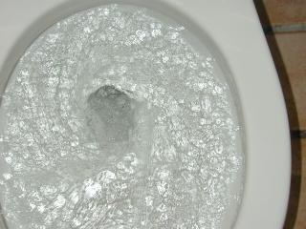
Common vortex
Notes:
USED IN: Fall 2009 (Schibli) Spring 2013 (Pollock)
LECTURE NUMBER: 8 (intro to voltage)
Discussion: We’re trying to develop intuition for Stoke’s theorem and curl. Here I argue that the fish “knows” there is a circulation. That’s ALL it knows. By Stoke’s theorem, however, the fish perhaps also intuits “don’t explore the central region”, because it already knows there is a nonzero curl (a vortex) SOMEWHERE in there!
Nice comic relief here with the final animation.
Credit: Thomas Schibli

Slide 12
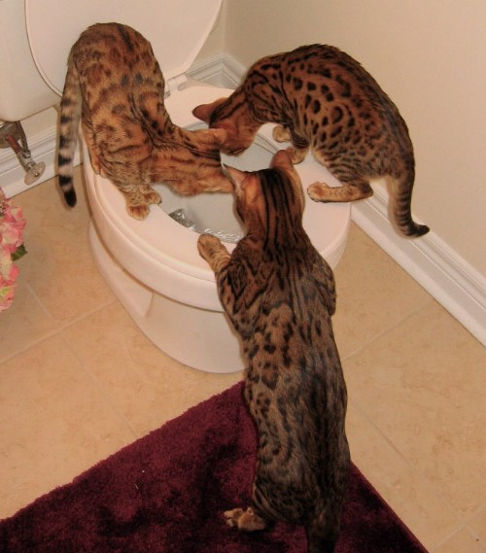
Feline Vortex
Notes:
USED IN: Fall 2009 (Schibli) Spring 2013 (pollock0
Very cute, just gratuitous comic relief.
Credit: Thomas Schibli
12

Slide 13
What is the curl of this vector field, V in the region shown below?
1.8
non-zero everywhere
Zero at some points, non-zero others
zero curl everywhere shown
Notes:
CORRECT ANSWER: A
USED IN: Spring 2013 (Pollock)
LECTURE NUMBER: 8 (intro to voltage)
STUDENT RESPONSES: [80]], 13, 7, 0, 0
This one is easy – I try to distract them by pointing out the red region is NOT at the origin (where there is OBVIOUSLY a curl).
INSTRUCTOR NOTES : Non-zero everywhere. This is still very intuitive for the students, here finally is a clicker question which is NOT counterintuitive!
I use the next slide to “prove” it (go to the board and find the circulation, in detail, take the limit as the loop vanishes, work out that it is c*(r+dr) dphi on the top, 0 on the 2 sides, and –cr dphi on the bottom, leaving circulation = c dr dphi, so curl = circulation/area = c/r
Also, reminder/discussion of the sign, right hand rule suggests tis is a positive (z-component) curl
Also, it’s not a CONSTANT curl – far away from origin, no curl. Near the origin, INFINITE curl! (Agres with the picture, already in the red box there is not MUCH curl)
WRITTEN BY: Steven Pollock
13

Slide 14
What is the curl of this vector field, V in the region shown below?
1.8
non-zero everywhere
Zero at some points, non-zero others
zero curl everywhere shown
Notes:
USED IN: Spring 2013 (Pollock)
LECTURE NUMBER: 8 (intro to voltage)
I drew this on the board and worked out the circulation in gory detail (see prev slide)
14

Slide 15
What is the curl of this vector field, V in the region shown below?
1.8
Notes:
USED IN: Spring 2013 (Pollock)
LECTURE NUMBER: 8 (intro to voltage)
And finally, just do the math. Walk them through it, it’s not nearly as bad as it looks (and fun to see “c/s” pop out again!)
A student asked the question of whether we would always find fields that either have NO curl, or curl EVERYWHERE like this. This was great, I talked about B fields, curl can be zero JUST where currents are. Then I walked through the “V = 1/s phi_hat” example (just like this one, but dying off) and showing from the math that then the curl WOULD be zero everywhere except the origin. (It’s the one “magic field” that does this). So, didn’t do those (hidden) clicker questions, but we got to talk about it.
One point to make: fields that LOOK “curly” may or may not have curl. You must work it out! (Next couple of slides I show curl(E_static=0), then show a dipole field which may LOOK “curvy” but it’s not “curly”!)
15

Slide 16
Why is
Notes:
USED IN: Spring 2013 (Pollock)
LECTURE NUMBER: 8 (intro to voltage)
There are many ways to see this. Griffiths uses explicit line integral, and then Stoke’s.
My lectures notes “do it” using curly R formula for E, and just taking derivatives.
Here, yet another way, just do it on Coulomb directly (see next slide)

Slide 17
1.8
0!
Notes:
USED IN: Spring 2013 (Pollock)
LECTURE NUMBER: 8 (intro to voltage)
Once again, do it! Here, using spherical coordinates, it is quick to see all terms vanish (no v_phi, no v(theta), and v_r does not depend on phi or theta.
Then draw the Coulomb field, it’s OBVIOUSLY not “curly” if there’s just one charge. But here’s the beautiful thing:
This was true for ONE charge, but superposition immediately says that adding multiple charges can’t ever give you a curl.
After this, draw the dipole field of a +/- charge, it looks “curvy”, but it is NOT curly!
17

Slide 18
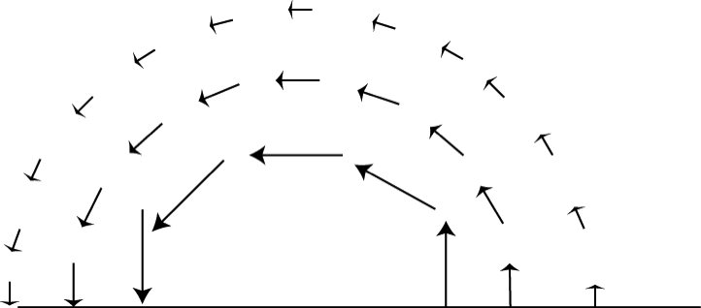
What is the curl of this vector field, in the red region shown below?
1.8
non-zero everywhere in the box
Non-zero at a limited set of points
zero curl everywhere shown
We need a formula to decide for sure
Notes:
Sp08: Skipped, but could be a good one. (I think the answer is D, since it depends on whether it goes *exactly* as 1/r! From this crude a picture, you can’t tell for sure, but it is certainly consistent with the possibility of C, so I think both would be good answers )
18

Slide 19
What is the curl of this vector field, in the red region shown below?
1.8
non-zero everywhere in the box
Non-zero at a limited set of points
zero curl everywhere shown
Notes:
Sp08: Skipped, although I was asked about it spontaneously so talked it through. Here, given the formula, curl is zero everywhere except origin.
19

Slide 20
What is the curl of this vector field, in the red region shown below?
1.8
non-zero everywhere in the box
Non-zero at a limited set of points
zero curl everywhere shown
Notes:
Easy to work out. See above, I did this because of a student question.
20

Slide 21
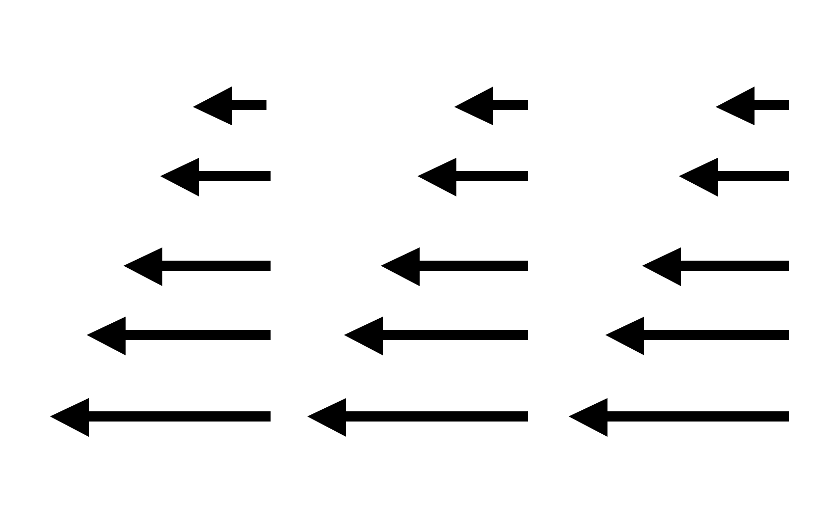
Which of the following could be a static physical E-field in a small region?
2.43b/1.7b
I
II
Only I B) Only II
C) Both D) Neither
E) Cannot answer without further info
Notes:
21
CORRECT ANSWER: B
USED IN: Fall 2008 (Dubson) and Spring 2008 and ‘13 (Pollock)
LECTURE NUMBER: Dubson (Week 3, Lecture 6). Pollock (Lecture 8).
STUDENT RESPONSES: 0% [[91%]] 6% 4% 0% (FALL 2008)
50% correct (SPRING 2008)
0 [[95]], 0, 5%, 0 (Sp ’13)
INSTRUCTOR NOTES: Answer is B (I is forbidden by curl)
Used at start of class. In ‘08 50% correct. Good discussion, which was not merely about “seeing the curl” but also we discussed the field in II wrt Gauss law. (So, some students said II was no good because it has a nonzero divergence, thinking “small region” must have rho=0.) We also got into a nice discussion when I argued that there MUST be charge in region II, since div is clearly 0 (which turns out not to be correct - a student pointed out that this is the field as you approach a negative line charge on the left. So we had to talk about the 3-D *assumptions* I was implicitly making. Another student wanted to argue (incorrectly) this was the field if you have two SHEETS on either side, with low sigma on the right, and high negative sigma on the left. So that made a nice review conversation too. -SJP
Remarkably similar conversations in Sp ‘13! I did not get to hear from the few students who thought “Neither”.
WRITTEN BY: Steven Pollock (CU-Boulder)

Slide 22
Notes:
No real time for this, rushed!

Slide 23
(with )
It is also true that where

Slide 24
(with )
It is also true that where

Slide 25
(with )
It is also true that where
Question: is the following mathematically ok?
Yes B) No C) ???
Notes:
NO TIME in 2013.
CORRECT ANSWER: A
USED IN: Spring 2008 (Pollock)
LECTURE NUMBER: 7
STUDENT RESPONSES: [[57%]] 43% 0% 0% 0%
INSTRUCTOR NOTES: Pretty much split A and B! (I sort of guided the confusion, suggesting that, who knows, maybe this is one of those “integration by parts” situations that means you need a second surface term when you try to slide the Del around.) Anyway - I think this was a really good one - good discussion, this kind of formal operation is still hard for them *especially* given their confusions about what curly R means… Answer is yes, the gradient has nothing to do with the “prime” variables, this is fine (and the key step in our derivation of voltage) -SJP
WRITTEN BY: Steven Pollock (CU-Boulder)

Slide 26
Notes:
Skipped. Summary?

Slide 27
Could the following electrostatic field possibly exist in a finite region of space that contains no charges? (A, and c are constants with appropriate units)
2.43
A) Sure, why not?
B) No way
C) Not enough info to decide
Notes:
Skipped
CORRECT ANSWER: B
USED IN:
LECTURE NUMBER: 7 SKIPPED
STUDENT RESPONSES:
INSTRUCTOR NOTES:. Good conversation starter, regarding units, and div must be zero if we’re in a charge free region, and curl must be zero…
Answer is no, because Del dot E is not zero. (Curl is ok) Of course, this doesn't require them to TAKE the curl, since div already says it's no good... so if the operation of taking the curl is what you WANT to focus on, you will have to adapt the question. -SJP
Previously gave this question with a choice of E fields and asked which was physically possible -- took too much time (50% correct).
WRITTEN BY: Steven Pollock (CU-Boulder)
27

Slide 28
Which of the following electrostatic fields could exist in a finite region of space that contains no charges?
2.43
A)
B)
C)
D)
None of these
Notes:
Skipped
28

Slide 29
Given a sphere with uniform surface charge density σ what can you say about the potential V inside this sphere? (Assume as usual, V(∞)=0)
2.45
V=0 everywhere inside
V = non-zero constant everywhere inside
C) V must vary with position, but is zero at the center.
D) None of these.
Notes:
Skipped in ‘13
CORRECT ANSWER: B
USED IN: Spring 2008 (Pollock), Fall 2009 (Schibli)
LECTURE NUMBER: 9
STUDENT RESPONSES: 17% [[ 67%]] 17% 0% 0% (SPRING 2008)
23% [[ 73%]] 5% 0% 0% (FALL 2009)
INSTRUCTOR NOTES: Used this as the “lead in” question start of class. 2/3 got it, lots argued for A (which I also heard during office hours) but several also argued for C. Not sure if the confusion was just misreading the problem (thinking of it as a solid sphere), but I got *asked* about that during the question, and was extremely clear that this was supposed to be JUST A SHELL of charges with nothing inside. (SO, I just now edited the problem to say “and no other charges anywhere else”, we’ll see if that helps?) Although as usual, leaving in ambiguities sometimes makes for more fruitful and active discussions/arguments!) -SJP
WRITTEN BY: Steven Pollock (CU-Boulder)

Slide 30
Why is in electrostatics?
Because
Because E is a conservative field
Because the potential between two points is independent of the path
All of the above
NONE of the above - it's not true!
Notes:
Skipped
CORRECT ANSWER: D
USED IN: Fall 2008 (Dubson) and Spring 2008 (Pollock)
LECTURE NUMBER: Dubson (Week 3, Lecture 6). Pollock (Lecture 7).
STUDENT RESPONSES: 6% 6% 9% [[79%]] 0% (FALL 2008)
9% 9% 14% [[55%]] 14% (SPRING 2008)
INSTRUCTOR NOTES: . I used it as a “start of class” clicker question, before covering this material, so it was sort of a “reading question” 57% chose d) I then came back to it later in the lecture (though we didn’t re-vote) to talk through points a, b, and c…-SJP
WRITTEN BY: Steven Pollock (CU-Boulder)

Slide 31
A uniformly charged ring, in the xy plane, centered on the origin, has radius a and total charge Q. V(r = ∞) = 0.
What is the voltage at z on the z-axis?
z
a
Notes:
CORRECT ANSWER: C
USED IN: Fall 2008 (Dubson), Sp 2013 (Pollock)
LECTURE: Dubson (Week 3, Lecture 7)Pollock (2013) (Week 4, Lecture 9) (Pre-class question)
STUDENT RESPONSES: 0% 4% [[90%]] 6% 0% (FALL 2008)
0% 19%, [[69%]] 6%, 6% Sp ‘13
INSTRUCTOR NOTES:
Given the high success from Dubson’s students, and the simple question, I thought this would be quick. But, students did NOT all get it, they were making some sort of “Gauss law says this acts like a point at the origin argument” (Maybe?) I used this to review curly R, (see next slide),
(One student was struggling with how to go from the integral of lambda dl to Q, he was introducting 2 Pi, not seeing that the integral IS Q. )
WRITTEN BY: Mike Dubson (CU-Boulder)

Slide 32
A uniformly charged ring, in the xy plane, centered on the origin, has radius a and total charge Q. V(r = ∞) = 0.
What is the voltage at z on the z-axis?
z
a
dq
Notes:
Animated, this helps explain the previous answer.

Slide 33
Summary:
Def of potential:
How do you compute it:
What good is it?
Where did it come from?
Which by Stoke’s theorem is
mathematically equivalent to:
Notes:
LECTURE: Pollock (Week 4, Lecture 9)
Took some time on this. Students were confused about the first two equations, one did not realize that “dr” is NOT d^3r, so thought the top two equations were the exact same thing (and thus, was confused why it’s 1/R instead of 1/R^2)
Reminded them of the “hidden” element of curl(E)=0 buried in the definition of V, and the fact that the computation formula is only valid if the charges are localized (and we are setting V(infinity)=0)

Slide 34
Tutorial
Please click the letter below when you START working on the following parts:
I’m now starting (click right away!)
I’m starting ii
I’m starting iii
I’m starting the 2nd page
DONE!

Slide 35
Tutorial
When you are DONE, click in:
What is the slope of V(r) at the origin?
Positive
Negative
Zero
It depends!
Be prepared to explain/defend your answer!
Notes:
For use with Tutorial 3 (in-class), “Electric Potential”
CORRECT ANSWER: C
USED IN: Spring 2013 (Pollock),
LECTURE NUMBER: Pollock (Lecture 9 in 13)
STUDENT RESPONSES: 4% 15% [[81%]] 0% 0%(Sp 13
Instructor Notes:
See Tutorial. E is given, it’s the field for a uniformly charged solid sphere. Then they use that to figure out the voltage, sketch it, and then redo it with a different choice of “zero”.
I walked the class through page 1 at the board (for ~10 minutes!) then gave ANOTHER 10 minutes for the 2nd page (sketching and sense-making)

Slide 36
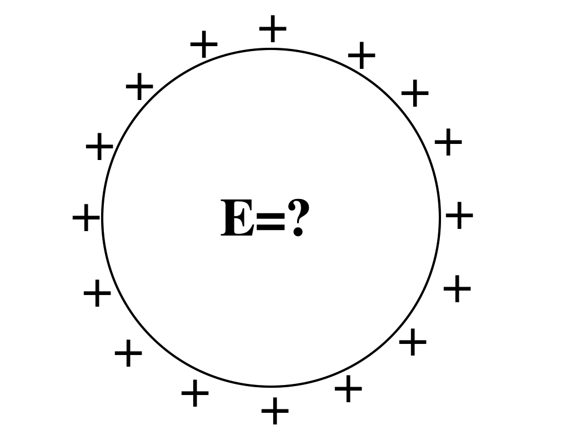
2.26
A spherical shell has a uniform positive charge density on its surface. (There are no other charges around)
What is the electric field inside the sphere?
A: E=0 everywhere inside
B: E is non-zero everywhere in the sphere
C: E=0 only at the very center, but non-zero elsewhere inside the sphere.
D: Not enough info given
Notes:
36
CORRECT ANSWER: A
USED IN: Fall 2008 (Dubson) and Spring 2008 (Pollock)
LECTURE NUMBER: Dubson (Week 3, Lecture 7). Pollock (Lecture 8).
STUDENT RESPONSES: [[92%]] 8% 0% 0% 0% (FALL 2008)
[[ 91%]] 0% 9% 0% 0% (SPRING 2008)
INSTRUCTOR NOTES: L8,Used as lead in to “continuity/boundary conditions”. 91% correct, but still worth making sure they know WHY E=0 everywhere, that is, can they articulate the symmetry argument (that E must be radial) from which Gauss’ law gives the answer. (Many seem to think if flux is zero, then E is zero, so they can get the right answer for inadequate reasoning!) -SJP
WRITTEN BY: Steven Pollock (CU-Boulder), from a freshman question by M. Dubson

Slide 37
Could this be a plot of |E|(r)? Or V(r)? (for SOME physical situation?)
2.44
A) Could be E(r), or V(r)
B) Could be E(r), but can't be V(r)
C) Can't be E(r), could be V(r)
D) Can't be either E) ???
Notes:
CORRECT ANSWER: B
USED IN: Fall 2008 (Dubson) and Spring 2008 and 13 (Pollock), Fall 2009 (Schibli)
LECTURE NUMBER: Dubson (Week 3, Lecture 7). Pollock (Lecture 8 in 2008, Lecture 9 in 13) Schibli
STUDENT RESPONSES: 31% [[57%]] 12% 0% 0% (FALL 2008)
27% [[73%]] 0% 0% 0% (SPRING 2008)
7% [[93%]] 12% 0% 0% (FALL 2009)
6, [[89]], 2, 4, 0 (Spring ‘2013)
INSTRUCTOR NOTES: 73% correct. (I preceded it by 2.26, which made the E part easier, since they had just, 10 minutes earlier, SEEN this E field!) Nice discussion possibilities, we had some good arguments brought out about WHY we know V(r) can not be discontinuous.
My answer is B, E can jump, but V cannot, in physical situations -SJP
WRITTEN BY: Steven Pollock (CU-Boulder)

Slide 38
The voltage is zero at a point in space.
You can conclude that :
The E-field is zero at that point.
B) The E-field is non-zero at that point
C) You can conclude nothing at all about the E-field at that point
Notes:
CORRECT ANSWER: C
USED IN: Fall 2008 (Dubson), Fall 2009 (Schibli)
LECTURE NUMBER: Dubson (Week 3, Lecture 7) Schibli. No time in Sp 13, just discussed (Lecture 9)
STUDENT RESPONSES: 10% 0% [[90%]] 0% 0% (FALL 2008)
30% 0% [[70%]] 0% 0% (FALL 2009)
INSTRUCTOR NOTES:
WRITTEN BY: Mike Dubson (CU-Boulder)

Slide 39
The voltage is constant everywhere along a line in space.
V=constant
You can conclude that :
A) The E-field has constant magnitude along that line.
B) The E-field is zero along that line.
C) You can conclude nothing at all about the magnitude of E along that line.
Notes:
CORRECT ANSWER: C
USED IN: Fall 2008 (Dubson)
LECTURE NUMBER: Dubson (Week 3, Lecture 7 and Week 3, Lecture 8) . No time in Sp 13, just discussed (Lecture 9)
STUDENT RESPONSES: 18% 10% [[73%]] 0% 0% (FALL 2008: Week 3, Lecture 7)
11% 2% [[87%]] 0% 0% (FALL 2008: Week 3, Lecture 8)
INSTRUCTOR NOTES:
WRITTEN BY: Mike Dubson (CU-Boulder)

Slide 40
Consider an infinitesimal path element dL directed radially inward, toward the origin as shown.
y
In spherical coordinates, the correct expression for dL is:
x
Notes:
Skipped in ‘13, talked about it at board.
CORRECT ANSWER: A
USED IN: Fall 2008 (Dubson)
LECTURE: Dubson (Week 3, Lecture 6 and Week 3, Lecture 7)
STUDENT RESPONSES: [[6%]] 85% 6% 4% 0% (FALL 2008: Week 3, Lecture 6)
[[95%]] 5% 0% 0% 0% (FALL 2008: Week 3, Lecture 7)
INSTRUCTOR NOTES: This is kind of subtle, hard for students. B is very tempting because the arrow “points” in the –r direction. But the answer is animated on the slide, dL is always dr rhat, period, and the minus sign you feel you want will “come out” in a case like the one shown due to the limits of integration, starting at large r and ending at smaller r…If you put it into dL, you’ll get an EXTRA minus sign, B is wrong.
WRITTEN BY: Mike Dubson (CU-Boulder)

Slide 41
Given a spherical SHELL with uniform surface charge density σ (no other charges anywhere else) what can you say about the potential V inside this sphere? (Assume as usual, V(∞)=0)
2.45
V=0 everywhere inside
V = non-zero constant everywhere inside
C) V must vary with position, but is zero at the center.
D) Could be A OR B!
E) None of these, it’s something else!
Notes:
CORRECT ANSWER: B
USED IN: Spring 2008 and 13 (Pollock), Fall 2009 (Schibli)
LECTURE NUMBER: 9 (10 in 2013)
STUDENT RESPONSES: 17% [[ 67%]] 17% 0% 0% (SPRING 2008)
23% [[ 73%]] 5% 0% 0% (FALL 2009)
10. [[65]] 6. 17 2(Sp ‘13) preclass. (I added a new option this year, D = could be A or B! This proved to be an ok distractor)
Then, I wrote the formula for V on the board (asking them about the limits of integration, being clear that we must start from infinity), and sketched E(r) which they all seem to know. Then revote: new vote is
5, [[87]], 4, 4, 0 (Sp ‘13)
INSTRUCTOR NOTES: Used this as the “lead in” question start of class. 2/3 got it, lots argued for A (0 inside which I also heard during office hours) but several also argued for C. Not sure if the confusion was just misreading the problem (thinking of it as a solid sphere), but I got *asked* about that during the question, and was extremely clear that this was supposed to be JUST A SHELL of charges with nothing inside. (SO, I just now edited the problem to say “and no other charges anywhere else”, we’ll see if that helps?) Although as usual, leaving in ambiguities sometimes makes for more fruitful and active discussions/arguments!) -SJP
In 2013, the ambiguities were very explicitly discussed ahead of time, the difficulty remains. Students are confused about why/when they can “set” V=0 somewhere. Talked about the PHYSICS of this, how strange it would be to say a particle has zero potential energy inside when, if you release it, it would drift to the edge but then accelerate off to infinity. (Where it again has zero PE by definition!)
The point is that although V=0 satisfies grad(V)=0, it does not satisfy our “boundary condition” at infinity! Good lead in to what’s coming.
WRITTEN BY: Steven Pollock (CU-Boulder)

Slide 42
We usually choose V(r → ∞) ≡ 0 when calculating the potential of a point charge to be V(r) = +κq/r. How does the potential V(r) change if we choose our reference point to be V(R)=0 where R is closer to +q than r.
SC-4
+q
R
r
∞
A V(r) is positive but smaller than kq/r
B V(r) is positive but larger than kq/r
C V(r) is negative
D V(r) doesn’t change (V is independent of choice of reference)
Notes:
42
Skipped in ‘13
CORRECT ANSWER: C
USED IN: Spring 2009 (Kinney),
LECTURE NUMBER: Kinney (Week 3, Lecture 8)
STUDENT RESPONSES: 16% 2% [[78%]] 4% 0% (FALL 2009)
INSTRUCTOR NOTES: A good question - we ended with this. I heard great student reasoning on this, both in the direction of how to calculate potential differences, and using work-related arguments. The answer is “C” because V(r) has to be less than V(R). You can use the analogy of changing “sea level” to explain this.
---- height of Estes Park
---- height of Boulder
--- sea level
Change the reference point from sea level to Estes Park and now the height of Boulder is negative.
WRITTEN BY: Stephanie Chasteen (CU-Boulder)

Slide 43
+Q
+Q
A
B
Two isolated spherical shells of charge, labeled A and B, are far apart and each has charge Q. Sphere B is bigger than sphere A. Which shell has higher voltage? [V(r=∞) = 0]
A) Sphere A B) Sphere B
C) Both have same voltage.
Notes:
Skipped in ‘13
CORRECT ANSWER: A
USED IN: Fall 2008 (Dubson), Fall 2009 (Schibli)
LECTURE NUMBER: Dubson (Week 3, Lecture 8) Schibli
STUDENT RESPONSES: [[66%]] 6% 28% 0% 0% (FALL 2008)
[[55%]] 2% 43% 0% 0% (FALL 2009)
INSTRUCTOR NOTES:
WRITTEN BY: Mike Dubson (CU-Boulder)

Slide 44
Why is in electrostatics?
2.46
Because
Because E is a conservative field
Because the potential (voltage) between two points is independent of the path
All of the above
NONE of the above - it's not true!
Notes:
44
Skipped in ‘13
CORRECT ANSWER: D
USED IN: Fall 2008 (Dubson) and Spring 2008 (Pollock)
LECTURE NUMBER: Dubson (Week 3, Lecture 6). Pollock (Lecture 7).
STUDENT RESPONSES: 6% 6% 9% [[79%]] 0% (FALL 2008)
9% 9% 14% [[55%]] 14% (SPRING 2008)
INSTRUCTOR NOTES: . I used it as a “start of class” clicker question, before covering this material, so it was sort of a “reading question” 57% chose d) I then came back to it later in the lecture (though we didn’t re-vote) to talk through points a, b, and c…-SJP
WRITTEN BY: Steven Pollock (CU-Boulder)

Slide 45
V
A parallel plate capacitor is attached to a battery which maintains a constant voltage difference V between the capacitor plates. While the battery is attached, the plates are pulled apart. The electrostatic energy stored in the capacitor
A) increases
B) decreases
C) stays constant.
Notes:
Skipped in ‘13. (more on this idea in next section of clicker questions too, on energy)
CORRECT ANSWER: B
USED IN: Fall 2008 (Dubson)
LECTURE: Dubson (Week 4, Lecture 11)
STUDENT RESPONSES: 50% [[30%]] 20% 0% 0% (FALL 2008)
INSTRUCTOR NOTES:
WRITTEN BY: Mike Dubson (CU-Boulder)

