Slide 1
METHOD OF IMAGES
Notes:
-SJP
WRITTEN BY: Steven Pollock (CU-Boulder)

Slide 2
Class Activities: Method of Images

Slide 3
Whiteboard:
Calculate voltage (everywhere in space!) for 2 equal/opposite point charges a distance “d” above and below the origin. Where is V(r)=0?
Notes:
2008: This worked really well
Lots of struggles to do it, many writing kq/d instead of kq/r
And some trouble writing script-r, as per usual
I didn’t see a lot of people get to the final solution of V=0
This followed clicker 3.7 which was then very powerful because it looked just like that one
Someone brought up that it doesn’t look like the same situation below the plane, which was good
Could have written up the two situations on the board to show the exact situations being compared
There were lots of “a-hahs” from the audience during this.
But later a woman asked a question that seemed that she didn’t understand that the conducting plane situation was the same as two charges

Slide 4
A point charge +Q sits above a very large grounded conducting slab.
What is E(r) for other points above the slab?
3.7
Simple Coulomb’s law:
B) Something more complicated
+Q
r
z
y
x
Notes:
CORRECT ANSWER: B
USED IN: Fall 2008 (Dubson: Week 5, Lecture 13 and Week 5, Lecture 14) and Spring 2008 and 13 (Pollock), Fall 2009 (Schibli)
LECTURE NUMBER: Dubson (Week 5, Lecture 13). Pollock (Lecture 13, Lect 14 in ‘13). Schibli
STUDENT RESPONSES: 24% [[76%]] 0% 0% 0% (FALL 2008: Week 5, Lecture 13)
2% [[98%]] 0% 0% 0% (FALL 2008: Week 5, Lecture 14)
n/a (SPRING 2008)
38% [[62%]] 0% 0% 0% (FALL 2009)
23%, [[75%}], 2, 0, 0, (Sp ‘13)
INSTRUCTOR NOTES:
(Problem was, I had just showed a sim of this situation, so they had just SEEN the answer!).
http://www.falstad.com/emstatic/ Setup “charge + plane” Answer is B, it looks like a dipole field. (Note that simple coulomb would generate E's that are NOT perpendicular to the surface everywhere, clearly an immediate no-no. -SJP
WRITTEN BY: Steven Pollock (CU-Boulder)

Slide 5
Infinite grounded conducting slab
Notes:
From Charles Baily:
Used in Spring 2013
(The slide is nicely animated!)
To give a concrete example of how we exploit this, consider an infinitely long and wide conducting slab that extends everywhere in the xy-plane, and has been grounded at zero potential. If we bring a charge +Q close to the surface of the conductor, we know that the potential can't be just that of a point charge located at a distance d from the surface. The free charge in the conductor will respond to the external electric field and electrons will move about the surface until equilibrium has been established, and the surface of the conductor is again at constant potential, as it must be in electrostatics.
At this point we really don't know anything about how this induced charge is distributed on the surface, so we can't use our usual technique of integrating over the charge distribution to get the potential everywhere above the conducting surface.

Slide 6
Boundary Conditions:
(grounded)
Notes:
From Charles Baily:
Used in Spring 2013
What we do know are the boundary conditions on the potential, which we need to state in order to completely specify the problem. There are two boundaries in this situation, one is far away, where the potential goes to zero. The other is at the surface of the conductor, where the potential is also zero because its grounded.
BUT WHAT IF, instead of trying to solve this problem, we solve a different problem, where we replace the conducting slab with what we'll call an "image charge" Q-prime, located at a distance d-prime below the xy-plane. But for this problem we don't want to use just any charge – we want to choose an amount that will make the electric potential satisfy the same boundary conditions as the previous problem. We'll see that this can happen when the "image charge" is truly like a mirror reflection of the physical charge – and this shouldn't be so surprising if we recall that a mirror is really just a flat conducting plane with a plate of glass over it.
The question is: Why should you believe the two situations have anything to do with one another?

Slide 7
Calculate voltage V(r) (everywhere in space!) for 2 equal/opposite point charges a distance “d” above and below the origin.
Where is V(r)=0?
(If you’re done early, figure out Ex, Ey, and Ez from this voltage, and evaluate (simplify) AT the plane z=0)
Notes:
Activity (done at desks, in pairs)
Used in Sp 2008, and Spring 2013
This worked really well
Lots of struggles to do it, many writing kq/d instead of kq/r
And some trouble writing script-r, as per usual
I didn’t see a lot of people get to the final solution of V=0
This followed clicker 3.7 which was then very powerful because it looked just like that one
Someone brought up that it doesn’t look like the same situation below the plane, which was good
Could have written up the two situations on the board to show the exact situations being compared
There were lots of “a-hahs” from the audience during this.
But later a woman asked a question that seemed that she didn’t understand that the conducting plane situation was the same as two charges

Slide 8
Boundary Conditions:
(grounded)
Notes:
From Charles Baily:
Used in Spring 2013
(Animates, nicely! This is good to see the connection between the “image” problem and the conductor problem. )
What we do know are the boundary conditions on the potential, which we need to state in order to completely specify the problem. There are two boundaries in this situation, one is far away, where the potential goes to zero. The other is at the surface of the conductor, where the potential is also zero because its grounded.
BUT WHAT IF, instead of trying to solve this problem, we solve a different problem, where we replace the conducting slab with what we'll call an "image charge" Q-prime, located at a distance d-prime below the xy-plane. But for this problem we don't want to use just any charge – we want to choose an amount that will make the electric potential satisfy the same boundary conditions as the previous problem. We'll see that this can happen when the "image charge" is truly like a mirror reflection of the physical charge – and this shouldn't be so surprising if we recall that a mirror is really just a flat conducting plane with a plate of glass over it.
The question is: Why should you believe the two situations have anything to do with one another?

Slide 9
Boundary Conditions:
(grounded)
“Image Charge”
Notes:
From Charles Baily:
Used in Spring 2013
We'll see that this can happen when the "image charge" is truly like a mirror reflection of the physical charge – and this shouldn't be so surprising if we recall that a mirror is really just a flat conducting plane with a plate of glass over it. The question is: Why should you believe the two situations have anything to do with one another?

Slide 10
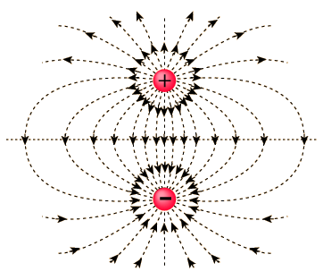
Notes:
From Charles Baily:
Used in Spring 2013
Animates, very nicely! (You cannot see it until you present it, but this slide is very helpful, because hidden behind the bottom half is the “dipole” field as well)
If we look at the field of a dipole, where Q-prime is equal to minus-Q, and they're separated by a distance 2d, we notice that there's a reflection symmetry across the xy-plane.
We can connect it back to our original situation by putting the conducting slab back in, and we can already see that the field lines satisfy some of our expectations for the field. Notice that the electric field lines all intersect with the conducting surface at right angles, which is exactly what we would expect for an equipotential – there's no component of the electric field that's parallel to the surface. Notice also that the field lines are more spread out as we get farther from the origin – and it makes sense that there'd be more induced surface charge directly below our point charge, and less and less as we go farther out.

Slide 11
Method of Images
Poisson’s Equation
Last Class: Uniqueness Theorem
If: &
& If: on the boundaries
Then: everywhere
(within the boundaries)
Notes:
From Charles Baily:
Used in Spring 2013
I’ll begin where I presumably would have left off in the previous class, which is proving the Uniqueness Theorem for solutions to Poisson's Equation. This is actually quite easy to prove, but today we'd like to talk about how we can exploit the Uniqueness Theorem to find solutions for the electric potential in situations involving conductors with the right kinds of symmetry.
Before we do that, let's just remind ourselves what the Uniqueness Theorem says. Simply stated, IF we have two solutions to Poisson's Equation for the same charge distribution, Phi-A and Phi-B; and IF the two solutions satisfy the same boundary conditions (meaning they're equal to each other everywhere on the boundary), then the two functions are exactly equal to each other, everywhere in the region contained by the boundary.
The practical implications are enormous, because it means that it doesn't matter how we find our solution – we could guess it from our knowledge of mathematical functions, or it could come to us in a dream in the middle of the night – if it satisfies Poisson's Equation and it satisfies the boundary conditions – then not only is it A solution to the problem, it's THE one and only solution. In other words, once we have a solution, then we can stop looking for others because they just don't exist.

Slide 12
Boundary Conditions:
(grounded)
Uniqueness Theorem
Notes:
From Charles Baily:
Used in Spring 2013
So, we say that the potential in the region above the xy-plane is just the sum of the potentials from two point charges, one charge that's physically real, and the other that's been introduced as a mathematical convenience. We've tried to physically motivate why this should be the correct solution. Mathematically speaking, it satisfies Poisson's Equation for the same charge density above the xy-plane, it satisfies the boundary conditions by construction, so the Uniqueness Theorem tells us that, even if you don't like how we found it, there's no other possible solution.
This is a brilliant trick for sure, and I think it's worth taking a moment to talk about who it was that came up with it in the first place.

Slide 13
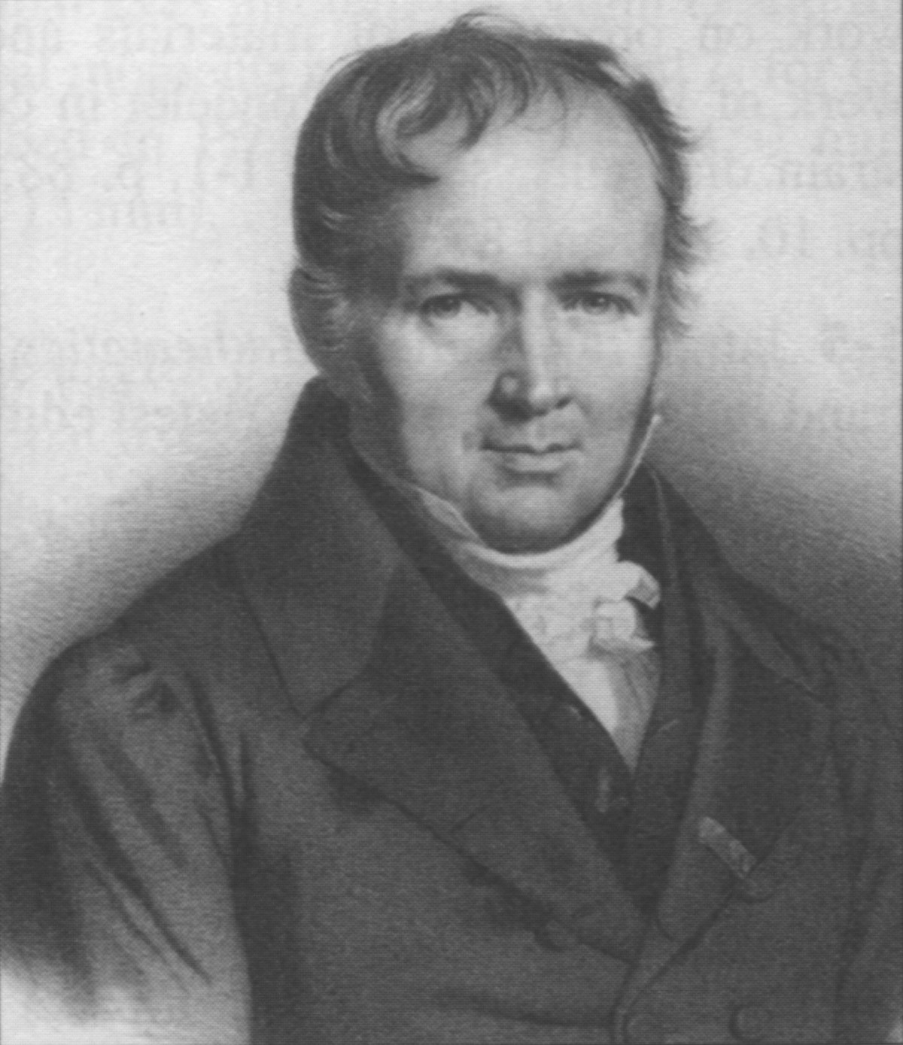
Method of Images
Siméon Denis
Poisson
1781-1840
Notes:
From Charles Baily:
Used in Spring 2013
The seeds for it originally came from Poisson himself, who was interested in finding how charge distributed itself on the surfaces of two nearby conducting spheres.

Slide 14
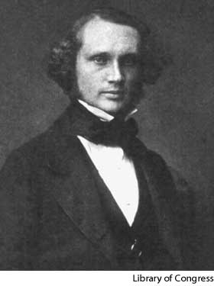
Method of Images
William Thomson
(Lord Kelvin)
1824-1907
Notes:
From Charles Baily:
Used in Spring 2013
But apparently it took a physicist to recognize that what all these mathematicians were doing was equivalent to placing an image charge inside the conducting surface, and then removing the conductor from the picture entirely. This was William Thomson, who later became Lord Kelvin, but was only 21 when we wrote about this in 1845. But Kelvin was working in terms of forces and fields…

Slide 15
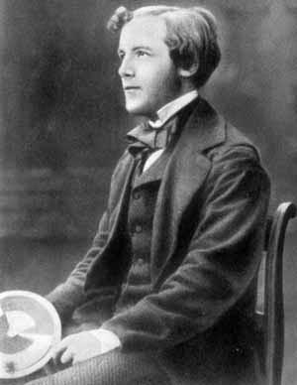
Method of Images
James Clerk
Maxwell
1831-1879
“Treatise on Electricity and Magnetism”
1873, Vol. 1, Ch. XI (p. 245-283, 3rd Ed.)
Notes:
From Charles Baily:
Used in Spring 2013
…and it was James Clerk Maxwell who fully developed the method in terms of an electric potential. He devoted an entire 40 pages to the technique in his "Treatise on Electricity and Magnetism," first published in 1873. So, it seems that one way or another we have Scotland to thank for this one!

Slide 16
Boundary Conditions:
(grounded)
Notes:
From Charles Baily:
Going back to our original problem, if we want to find the electric potential everywhere above the xy-plane, we should first write down the potential due to the individual charges.
In the first case, we have the potential due to the physical charge +Q. Notice that I'm using cylindrical coordinates just to simplify the expression, and that r-prime simply has length d and points in the z-hat direction, so there's a minus sign here in the denominator.
The potential due to the image charge looks almost the same. Since we're illustrating a method, let's keep it general for now, and write down the potential due to a charge Q-prime located at the point minus-d in the z-hat direction. Notice that now there is a plus sign in the denominator, and that there's nothing in this term that's going to make the field diverge above the xy-plane.

Slide 17
Boundary Conditions:
(grounded)
Notes:
Note that we already had this on the board from the whiteboard activity earlier!
From Charles Baily:
Used in Spring 2013
The total potential is therefore the sum of the two. We now have the final solution. We really can't simplify the expression any further, because the denominators are not the same. Now that we have the final solution, we could easily find the electric field by taking the gradient of the potential. We could also find the charge density induced on the surface of the conductor by applying Gauss' Law. And if we integrated up the charge density we would find that it totals to –Q, as I'm sure you can convince yourself it must. All of these would be suitable for homework problems, so let's instead use our time here to engage in a little more sense-making.

Slide 18
A point charge +Q sits above a very large grounded conducting slab. What is the electric force on this charge?
3.8
0 B)
C)
D) Something more complicated
+Q
d
z
y
x
Notes:
CORRECT ANSWER: B
USED IN: Fall 2008 (Dubson) and Spring 2008 and 13 (Pollock),
LECTURE NUMBER: Dubson (Week 5, Lecture 14). Pollock (Lecture 13, Lecture 14 in 2013).
STUDENT RESPONSES: 0% [[80%]] 18% 2% 0% (FALL 2008)
14% [[68%]] 14% 5% 0% (SPRING 2008)
2, [[79]]], 17, 0, 2 (Sp 2013)
INSTRUCTOR NOTES: 2008: Pollock ended with this. No time to discuss,maybe could start next class with it. (70% are voting for B, but I think it'll still be worth talking about) (I just discussed it L14, did not revote)
Answer is B, the image charge is 2D away, and the potential (and thus the field) at Q is *exactly* the same as you would have had if there had been an image charge there, -SJP
WRITTEN BY: Steven Pollock (CU-Boulder)

Slide 19
A point charge +Q sits above a very large grounded conducting slab. What's the energy of this system?
3.8b
B) Something else.
+Q
d
z
y
x
Notes:
CORRECT ANSWER: B
USED IN: Spring 2008 (Pollock),
LECTURE NUMBER: 14
STUDENT RESPONSES: 50% [[50%]] 0% 0% 0%
INSTRUCTOR NOTES: . Split vote, 50-50. Good discussions and arguments. (Main arguments I heard for A: everything else is the same, so should energy. Or, the integral of E dot dL is the same from infinity (or from the plate) to the charge...)
Answer is B, something else, This formula is two times too *large*. (Lots of explanations, see Griffiths, including the E^2 is zero for half the universe means there's half the stored energy of the "image" situation, or (my favorite), as you move +Q in from infinity, the image charge is NOT fixed at d below the plate, it's always FARTHER, so you do less work (negative) as you move Q in. -SJP
WRITTEN BY: Steven Pollock (CU-Boulder)

Slide 20
Notes:
Second Explanation – There is energy in the fields, and we can see that if the first expression is the energy in the fields of a dipole, then the physical situation only has half the volume of space containing electric field lines. So, we'd expect that there's half as much energy in the fields.
If there aren't any questions about this, I'd like to use my remaining time to tell you something about my education research, and how this has influenced my approach to teaching physics at all levels of instruction.

Slide 21
Two ∞ grounded conducting slabs meet at right angles. How many image charges are needed to solve for V(r)?
3.9
one
B) two
C) three
D) more than three
E) Method of images won't work here
+Q
r
Notes:
CORRECT ANSWER: C
USED IN: Spring 2008 (Pollock)
LECTURE NUMBER: 14
STUDENT RESPONSES: 18% 5% [[41%]] 0% 36%
INSTRUCTOR NOTES: Can be done with whiteboards. Lots of good discussion on this one, some got it, but most did not. Some wanted just ONE -Q “diagonally down”, others wanted JUST the two partners (missing the third one, +Q in lower left quadrant) Very good tool to talk about the principles of the method. Answer C, three. -Q to the left. -Q below, and the "image of those images" +Q in the -x, -y quadrant, to ensure V=0 everywhere. -SJP
WRITTEN BY: Steven Pollock (CU-Boulder)

Slide 22
On paper (don’t forget your name!) in your own words (by yourself):
What is the idea behind the method of images? What does it accomplish?
What is its relation to the uniqueness theorem?

Slide 23
Could we use the method of images
for THIS problem? Find V(r) everywhere z>0,
Given these two charges above a (grounded,
infinite, conducting) plane?
Yes, it requires 1 “image charge”
Yes, it requires 2 images
Yes, more than 2 image charge
No, this problem can NOT be solved using the “trick” of image charges…
Notes:
CORRECT ANSWER: B
USED IN: Spring 2013 (Pollock)
LECTURE NUMBER: 15 (review)
STUDENT RESPONSES: 11, [[67]], 11, 11, 0 (Sp ‘13)
INSTRUCTOR NOTES:
Straightforward: the solution is animated. It sets V=0 everywhere on the plane, and at +infinity.
Reminder: This solves for V(z>0) only!
Students did ok on this, I’m glad I asked it. It also shows that although this method is limited, there ARE a lot of problems it can solve (one student asked, what if we had a continuous distribution of charges out there instead of a bunch of points, and the class decided together that sure, we could solve that with this exact same method. It does require the “infinite grounded plane”, or a grounded sphere, or cylinder though, and we do need to know the distribution of the remaining charges!
-SJP
WRITTEN BY: Steven Pollock (CU-Boulder)

Slide 24
Could we use the method of images
for THIS problem? Find V(r) everywhere z>0,
Given these two charges above a (grounded,
infinite, conducting) plane?
Notes:
Animation for the previous question.

