Slide 1
MULTIPOLE EXPANSION
Notes:
-SJP
WRITTEN BY: Steven Pollock (CU-Boulder)

Slide 2
Class Activities: Multipole

Slide 3
Dipole moment - off center
MD6.1
The dipole moment,
+q
r₁
d
x
r₂
-q
Notes:
USED IN: Sp 2013
LECTURE NUMBER: 20
Introduction to the dipole moment

Slide 4
Dipole moment - off center
MD6.1
+q
d
-q
r₁
y
r₂
x
Notes:
CORRECT ANSWER: A
USED IN: Fall 2008 (Dubson) SP 2013 (Pollock)
LECTURE: Week 7? Pollock Lecture 20
STUDENT RESPONSES: [[91]],2, 2, 4, 0 (Sp 13)
INSTRUCTOR NOTES: Following the previous slide, this was a little too trivial, but it was fine to have them think through what changes when the dipole is tilted and moved away from the origin. (We’re heading towards “coordinate free” representations)
WRITTEN BY: Mike Dubson (CU-Boulder)

Slide 5
A small dipole (dipole moment p=qd) points in the z direction.
We have derived
3.22a
Which of the following is correct (and "coordinate free")?
A) B)
C) D)
E) None of these
Notes:
CORRECT ANSWER: A
USED IN: Fall 2008 (Dubson) and Spring 2008 and 13 (Pollock)
LECTURE NUMBER: Dubson (Week 7, Lecture 20). Pollock (2013, Lec 20)
STUDENT RESPONSES: [[67%]] 2% 31% 0% 0% (FALL 2008)
[[56]], 4, 40, 0,0 (SPRING 2013)
INSTRUCTOR NOTES: SJP did not originally think this is an interesting question.
Dubson: Student discussion centered on units. There was only one answer that had the right units, it would be good to have another answer that had right units so there would be more distracting distractors.
Pollock ‘13: My students also focused on units. I decided that’s ok! It’s quick, and a review, and the poor performance is suggesting that students are still at this late part of the term struggling with notation, and what “r-hat” means. I ended class with it (so, didn’t have a lot of time), but it also serves as a decent way to introduce the “final formula” for the dipole potential. (And, to talk about what I mean by “coordinate free”, which is a really novel concept for them. I doubt they get it yet!)
WRITTEN BY: Steven Pollock (CU-Boulder)

Slide 6
An ideal dipole (tiny dipole moment p=qd) points in the z direction.
We have derived
3.22b
Sketch this E field...
(What would change if the dipole
separation d was not so tiny?)
Notes:
This became an in-class Tutorial activity in 2013, “6a”. See also later in this file.
CORRECT ANSWER: n/a
USED IN: Spring 2008 (Pollock)
LECTURE NUMBER: 20
STUDENT RESPONSES: n/a
INSTRUCTOR NOTES: Stephanie used this as a whiteboard activity. -SJP
WRITTEN BY: Steven Pollock (CU-Boulder)

Slide 7
3.22b
Sketch this E field…
Notes:
CORRECT ANSWER: n/a
USED IN: Spring 2008 (Pollock), and Sp 13
LECTURE NUMBER: 20 (21 in ‘13)
STUDENT RESPONSES: n/a
INSTRUCTOR NOTES: Stephanie used this as a whiteboard activity.
I wrote it up (see “Tutorial 6a – Dipole Field” word doc) and let them wrestle for ~4-5 minutes in small groups on their own. This is VERY HARD, although they largely succeeded on +/- z axis (although the –z axis generates some sign issues) and +/- x axis (although again, the –x axis generates lots of questions, it is NOT theta=3 pi/2, since theta stops at Pi, instead you let phi “wrap you around”, but this E field is manifestly azimuthally symmetric.
I used this as a lead in to the sketch of the dipole field. Only a few students realized that this WAS the dipole field. Right after this activity, I derived this E formula from the voltage.
-SJP
WRITTEN BY: Steven Pollock (CU-Boulder)

Slide 8
For a dipole at the origin pointing in the z-direction, we have derived
MD6 - 2
z
+
For the dipole p = q d shown, what does the formula predict for the direction of E(r=0)?
d
x
-
Down B) Up C) some other direction
D) The formula doesn't apply.
Notes:
CORRECT ANSWER: D
USED IN: Fall 2008 (Dubson)
LECTURE NUMBER: Dubson (Week 7, Lecture 20) (Did not click in ‘13, but mentioned it)
STUDENT RESPONSES: 10% 5% 2% [[83%]] 0% (FALL 2008)
INSTRUCTOR NOTES: This is a similar question to the whiteboard question (previous) but modified to be a clicker question.
In ‘13, a student came up with this as a spontaneous question. We did not click, but talked about it. Part of the point is “it doesn’t matter”, this formula should not be applied for small r, it’s associated with the *large r* approximation.
WRITTEN BY: Steven Pollock (CU-Boulder), modified by Mike Dubson

Slide 9
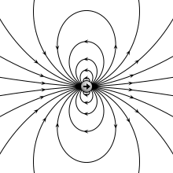

Notes:
http://upload.wikimedia.org/wikipedia/commons/a/aa/VFPt_dipole_animation_electric.gif
It’s animated, moves from point to finite dipole!
I believe it is “distorted”.

Slide 10
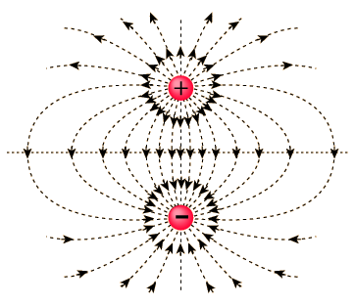

Slide 11
An ideal dipole (tiny dipole moment p=qd) points in the z direction.
We have derived
3.22b
(What would change if the dipole
separation d was not so tiny?)
Notes:
Lead in to next figure

Slide 12
Notes:
It’s an animated gif! Click the arrow to make it go.
http://upload.wikimedia.org/wikipedia/commons/a/aa/VFPt_dipole_animation_electric.gif

Slide 13
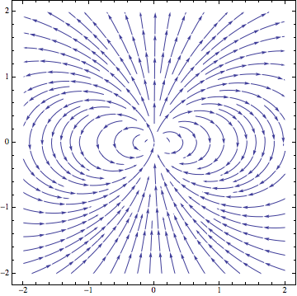
StreamPlot[
{(3*x*y)/(Sqrt[x^2 + y^2])^5, (2*y*y – x*x)/(Sqrt[x^2 + y^2])^5},
{x, -2, 2}, {y, -2, 2}]
Notes:
Sp ‘13: I had a figure from the web last class and a student questioned whether it had been “stretched”, so this time I wrote the code myself
It generated some questions – mostly about why I used cartesian coordinates, and whether there are other MMA functions besides “StreamPlot” to use here (it’s subtle, field lines are NOT well defined, like equipotentials are!)
Note also the numerical breakdown near the origin.

Slide 14
Griffiths argues that the force on a dipole in an E field is:
3.23
If the dipole p points in the z direction, what direction is the force?
Also in the z direction
B) perpendicular to z
C) it could point in any direction
Notes:
I punted this in ‘13 for time (though we revisit the math for Magnetic dipoles later, so still cover it)
CORRECT ANSWER: C
USED IN: Spring 2008 (Pollock), Fall 2009 (Schibli)
LECTURE NUMBER: 21
STUDENT RESPONSES: 17% 0% [[83%]] 0% 0% (SPRING 2008)
36% 15% [[38%]] 10% 0% (FALL 2009)
INSTRUCTOR NOTES: Start of class. Lot got it right (85%), but many were quite confused about the logic. Common issues: Some seemed to think “E” in the formula is the E FROM the dipole. Others were confused about what p dot del means (and whether del also operates on p in this formula) And the scalar nature of p dot Del was also confusing some. Answer: If p = pz zhat, then F = pz d/dz (Ex,ey,ez) So, depending on the details of E, this could have any or all components, the answer is C. -SJP
WRITTEN BY: Steven Pollock (CU-Boulder)

Slide 15
Griffiths argues that the force on a dipole in an E field is:
3.24
If the dipole p points in the z direction, what can you say about E if I tell you the force is in the x direction?
E simply points in the x direction
B) Ez must depend on x
C) Ez must depend on z
D) Ex must depend on x
E) Ex must depend on z
Notes:
I punted this in ‘13 for time (though we revisit the math for Magnetic dipoles later, so still cover it)
CORRECT ANSWER: E
USED IN: Fall 2009 (Schibli)
LECTURE NUMBER: ?
STUDENT RESPONSES:
0% 10% 32% 2% [[56%]] (FALL 2009)
INSTRUCTOR NOTES: I felt the discussion from the previous one was good enough.
Answer: If p = pz zhat, then F = pz d/dz (Ex,ey,ez)
To have an x component, we need a nonzero d(Ex)/dz. So I claim it's E. -SJP
WRITTEN BY: Steven Pollock (CU-Boulder)

Slide 16
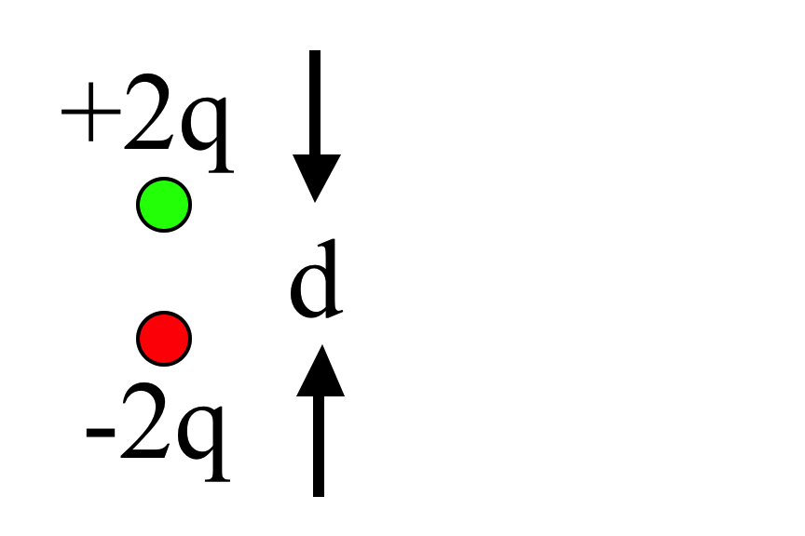
What is the magnitude of the dipole moment of this charge distribution?
3.27
qd
B) 2qd
C) 3qd
D) 4qd
E) It's not determined
(To think about: How does V(r) behave as |r| gets large?)
Notes:
CORRECT ANSWER: B
USED IN: Sp 2013 as start of class
LECTURE NUMBER: 21
STUDENT RESPONSES: 2, [[59]], 0 37, 2 (Sp ’13)
INSTRUCTOR NOTES: Answer here is 2qd, origin is irrelevant. Far away, V = 2 qd cos(theta) / 4 pi e0 r^2
Of course, the common student distractor is 4qd, it’s helpful to go through this “from scratch” to see why it’s 2, not 4.
-SJP
WRITTEN BY: Steven Pollock (CU-Boulder)

Slide 17
Dipole moment - off center
MD6.1
+2q
What is the dipole moment of this system? (Note: it is NOT overall neutral!)
d
0
-q
x
Notes:
CORRECT ANSWER: B
USED IN: Sp 2013 LECTURE NUMBER: 21
STUDENT RESPONSES: 2, [[70]], 25 0, 4 (2013)
INSTRUCTOR NOTES
This builds on the previous CT. Students did better, although the “3/2” answer (which is correct for the NEXT CT with origin at the center) was appearing.
This question generated lots of good questions about what the dipole moment “means”, what its sign tells you… One student was distressed that somehow the –q wasn’t participating here, (it could have had any charge without affecting the answer, which struck them as odd). Where we’re headed is that if q(tot) is not zero, the dipole moment does NOT have intrinsic meaning independent of the choice of coordinate system.
-SJP
WRITTEN BY: Steven Pollock (CU-Boulder)

Slide 18
Dipole moment - off center
MD6.1
+2q
What is the dipole moment of this system? (Note: same as last question, just shifted in z!)
d/2
r₁
d
0
x
r₂
d/2
-q
Notes:
CORRECT ANSWER: B
USED IN: Sp 2013 LECTURE NUMBER: 21
STUDENT RESPONSES: 0, 0, [100] 0,0
INSTRUCTOR NOTES
I told them not to guess, but to calculate, and they could do this. This led me to the formal proof on the board that shows that p is only independent of origin if Q_tot=0.
-SJP
WRITTEN BY: Steven Pollock (CU-Boulder)

Slide 19
MD6 - 3
For a collection of point charges, the dipole moment is defined as
Consider the two charges, +2q and –q, shown.
Which statement is true?
A) The dipole moment is independent of the origin.
B) The dipole moment depends on the position of the origin.
C) The dipole moment is zero.
D) The dipole moment is undefined.
+2q
y
r₁
d
-q
r₂
x
Notes:
CORRECT ANSWER: B
USED IN: Fall 2008 (Dubson)
LECTURE: Week 7?
STUDENT RESPONSES: 75% [[25%]] 3% 0% 0% (FALL 2009)
INSTRUCTOR NOTES:
WRITTEN BY: Mike Dubson (CU-Boulder)
Can’t find student data on this question, not sure if it was asked.

Slide 20
You have a physical dipole, +q and -q a finite distance d apart.
When can you use the expression:
3.22c
A) This is an exact expression everywhere.
B) It's valid for large r
C) It's valid for small r
D) ?
Notes:
20
CORRECT ANSWER: B
USED IN: Fall 2008 (Dubson) and Spring 2008 and 13 (Pollock)
LECTURE NUMBER: Dubson (Week 7, Lecture 20). Pollock (Lecture 20, 21 in ‘13).
STUDENT RESPONSES: 5% [[93%]] 0% 0% 2% (FALL 2008)
8% [[77%]] 15% 0% 0% (SPRING 2008)
7, [[64]], 29, 0,0 (Sp ‘13)
INSTRUCTOR NOTES: Used by SVC. 75% voted for B.
My answer: B A physical dipole is NOT an ideal dipole,
this expression is only correct in the limit r gets large compared to d.
In 2013 we had a lot of votes for “small r”. I’m not sure where this was coming from, and could not get students to articulate their reasoning.
One point of discussion was “what large r means” (large compared to what? It’s a great question, and the answer here is “d”)
-SJP
WRITTEN BY: Steven Pollock (CU-Boulder)

Slide 21
You have a physical dipole, +q and -q, a finite distance d apart.
When can you use the expression
3.22
d
A) This is an exact expression everywhere.
B) It's valid for large r
C) It's valid for small r
D) ?
Notes:
21
CORRECT ANSWER: A
USED IN: Fall 2008 (Dubson)
LECTURE NUMBER: Dubson (Week 7, Lecture 20). Pollock (Skipped in 08, used in ‘13, lecture 21).
STUDENT RESPONSES: [[69%]] 26% 5% 0% 0% (FALL 2008)
n/a (SPRING 2008)
[[72]], 19, 9, 0, 0 (Sp ‘13)
INSTRUCTOR NOTES: This is an exact expression everywhere, of course. (At least, in electrostatics)
Interesting that even following the previous ones, students are falling for “valid for large r”. The “big idea” of the multipole expansion is still unclear to them, I think. I’m glad we asked this.
-SJP
WRITTEN BY: Steven Pollock (CU-Boulder)

Slide 22
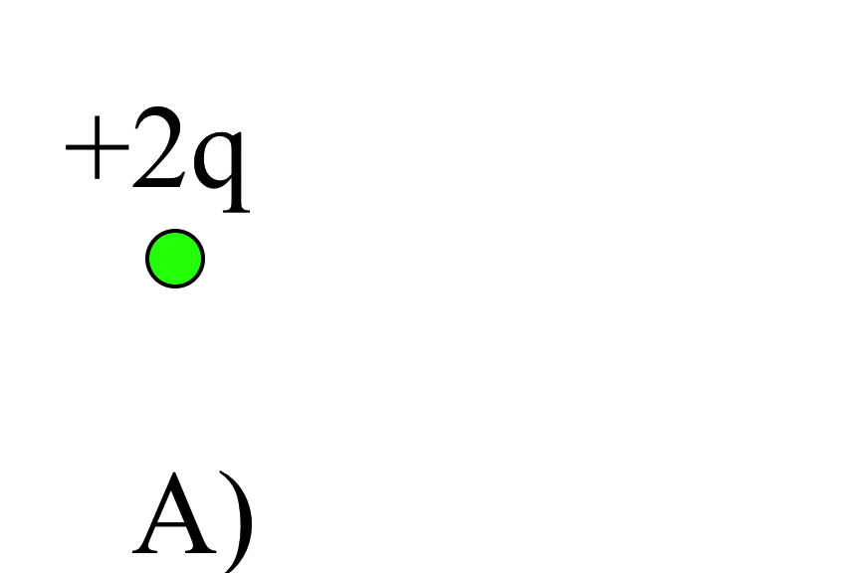
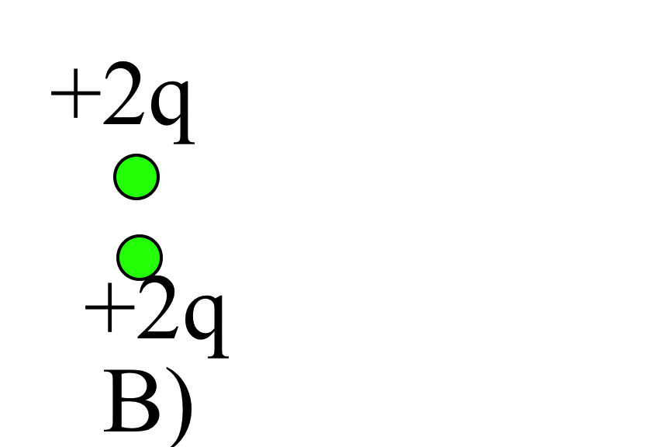
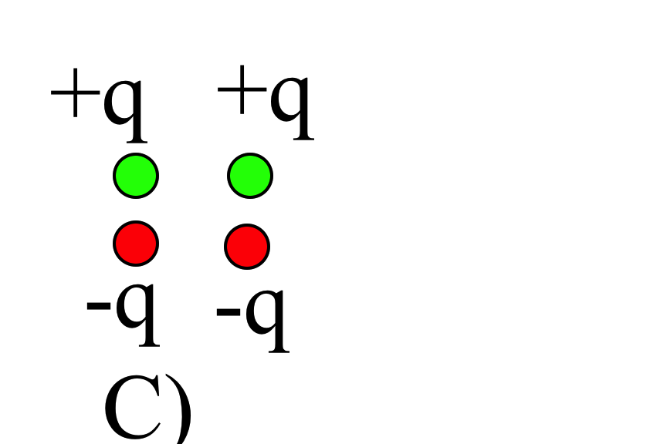
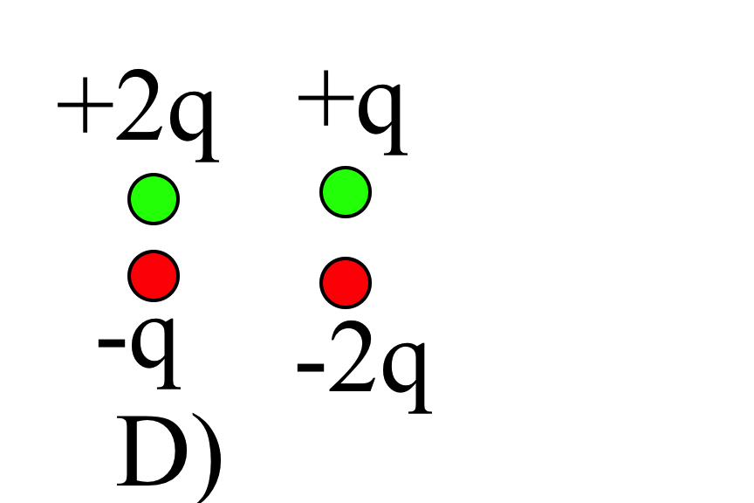
Which charge distributions below produce a potential which looks like C/r² when you are far away?
3.25
E) None of these, or more than one of these!
(Note: for any which you did not select, how DO they behave at large r?)
Notes:
CORRECT ANSWER: E
USED IN: Fall 2008 (Dubson) and Spring 2008 and 13(Pollock), Fall 2009 (Schibli)
LECTURE NUMBER: Dubson (Week 7, Lecture 20 and Week 8, Lecture 21). Pollock (Lecture 21).
STUDENT RESPONSES: 0% 2% 5% 0% [[93%]] (FALL 2008: Week 7, Lecture 20)
0% 0% 14% 2% [[83%]] (FALL 2008: Week 8, Lecture 21)
5% 0% 26% 0% [[68%]] (SPRING 2008)
0% 10% 32% 2% [[56%]] (FALL 2009)
4,4,14,7, [71]] (Sp 13)
INSTRUCTOR NOTES: 26% think C only (they did not spot D, apparently). B Generates good discussion about the ambiguity of the dipole moment when Q(net) is not zero. D generated good questions about how you would actually compute the dipole moment (and whether the origin should matter here!)
Answer: E) More than one of these. Both C and D have zero net charge, (so they can't be monopole), but both have a net dipole moment (pointing up the page)
Note that B is NOT a dipole, so we'll have to see if people who voted "more than one" are ALSO thinking about B!
One student was puzzling about how exactly to figure out the dipole moment of D. (Thinking of “left and right” bits separately you would get straight up + straight up = straight up, but thinking of the two crossed “diagonal” pairs, they are unequal in strength, so it would be tilted. The latter is correct, the former is problematic because the individual dipoles are NOT pure dipoles, and thus origin dependent. Just work it out, add up the sum of qi ri, starting at any origin you like! The answer IS tilted. This latter bit is a subtle point, good for some students, perhaps not for whole-class discussion.)
–SJP
WRITTEN BY: Steven Pollock (CU-Boulder)

Slide 23
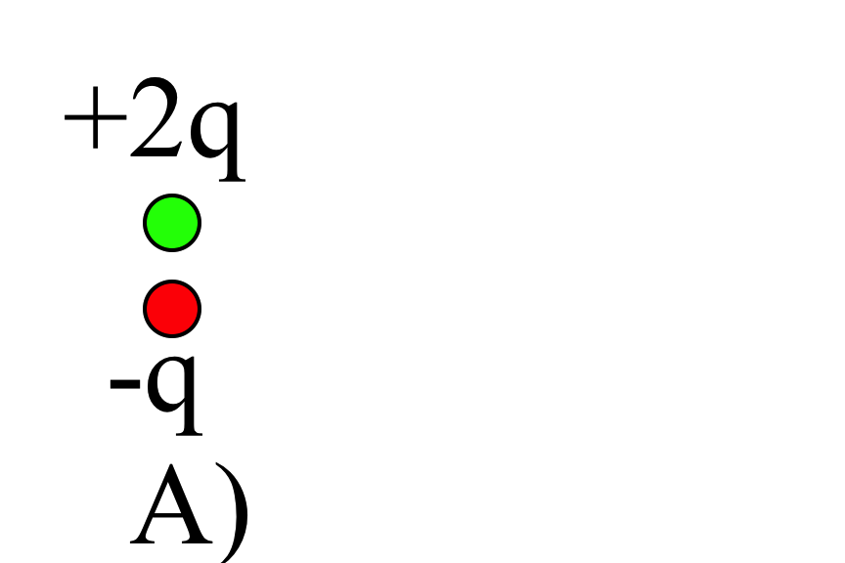
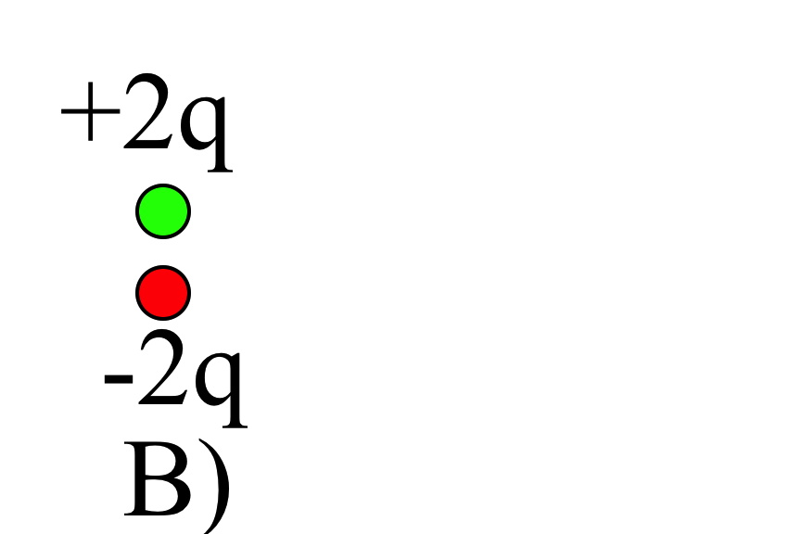
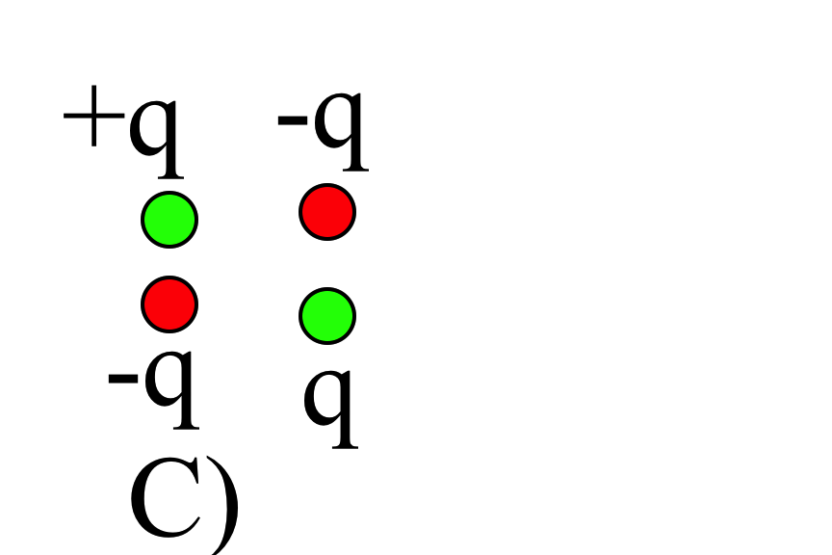
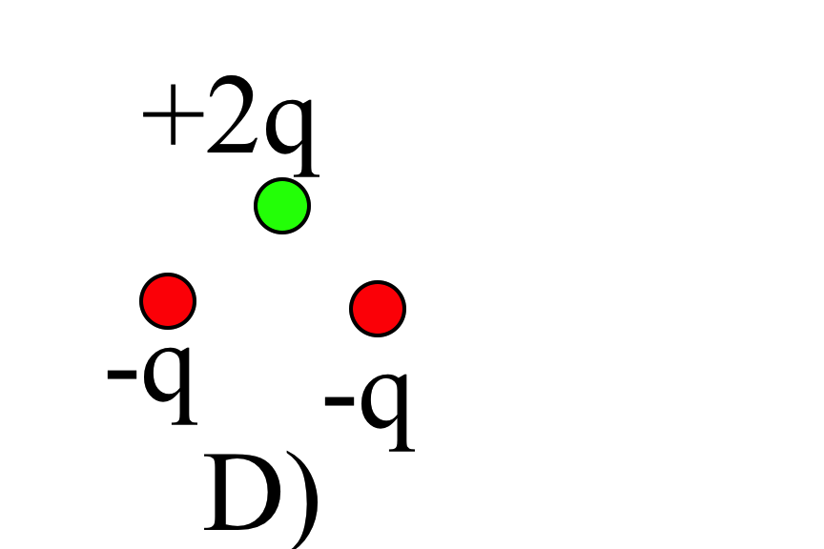
Which charge distributions below produce a potential which looks like C/r² when you are far away?
3.26
E) None of these, or more than one of these!
(Note: for any which you did not select, how DO they behave at large r?)
Notes:
CORRECT ANSWER: E
USED IN: Spring 2008 and 13 (Pollock) (skipped by Dubson), Fall 2009 (Schibli)
LECTURE NUMBER: 21
STUDENT RESPONSES: 0% 17% 0% 0% [[83%]] (SPRING 2009)
0% 8% 0% 2% [[90%]] (FALL 2009)
0, 14, 0, 0, [[86]] (Sp 13)
INSTRUCTOR NOTES: 83%. (All wrong votes went for B, so they were not spotting D) Here again the discussion of how you compute/prove that the dipole moment IS zero for C was helpful.
Answer: A is no good, it has net charge. B is dipole all right. C is pure quadrupole!. D is also a dipole, it has zero net charge, and the total dipole is very clearly up...
So the answer must be E.
The pure quadrupole was novel, and generated some questions and discussion. (You can “add up dipole moment in pairs”)
-SJP
WRITTEN BY: Steven Pollock (CU-Boulder)

Slide 24
In terms of the multipole expansion
V(r) = V(mono) + V(dip) + V(quad) + … the following charge distribution has the form:
3.29
= +q
= - q
A) V(r) = V(mono) + V(dip) + higher order terms
B) V(r) = V(dip) + higher order terms
C) V(r) = V(dip)
D) V(r)=only higher order terms than dipole
E) No higher terms, V(r)=0 for this one.
Notes:
CORRECT ANSWER: D
USED IN: Fall 2008 (Dubson) and Spring 2008 (Pollock)
LECTURE NUMBER: Dubson (Week 8, Lecture 21). Pollock (Skipped).
STUDENT RESPONSES: 2% 13% 7% [[60%]] 18% (FALL 2008)
n/a (SPRING 2008)
INSTRUCTOR NOTES: Pollock skipped in interest of time, but it’s a decent question.
I'll vote D. Made by LA. . Clearly qnet=0. Looks, pairwise, like p (dipole moment) =0 also. But, clearly SOME field, so it must be higher order terms.... -SJP
WRITTEN BY: Ward Handley (CU-Boulder)

Slide 25
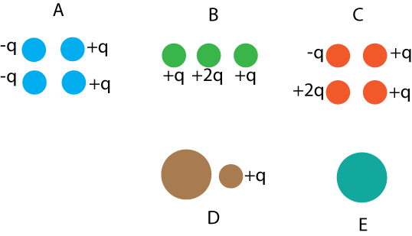
In which situation is the dipole term the leading non-zero contribution to the potential?
3.28
A) A and C
B) B and D
C) only E
D) A and E
E) Some other combo
Notes:
CORRECT ANSWER: D
USED IN: Sp ‘13
LECTURE NUMBER: 21 (review/start of class question)
STUDENT RESPONSES: 13, 0, 2, [[75]], 10
INSTRUCTOR NOTES: A has zero net charge, but dipole moment to the right, so it's good.
B, C, D all have net charge, no good; E is a classic (ideal) dipole! So d, A&E looks good to me.
Some people didn’t see the +rho0 (which doesn’t show up so well when projected), but I talked through D and E in words before closing the vote.
-SJP
WRITTEN BY: Stephanie Chasteen (CU-Boulder)

Slide 26


Electric properties of matter
No flies were harmed in the process
Notes:
CORRECT ANSWER:
USED IN: Fall 2009 (Schibli)
LECTURE NUMBER:
STUDENT RESPONSES:
INSTRUCTOR NOTES: Start E field in materials with this one. It’s animated…no need to click, just wait for it.
WRITTEN BY: Thomas Schibli (CU-Boulder)
26

Slide 27

What is the direction of the dipole moment of the blue sphere?
the dipole moment is zero (or is ill defined)
Notes:
27
Skipped in ‘13
CORRECT ANSWER: E
USED IN: Fall 2008 (Dubson) and Spring 2008 (Pollock)
LECTURE NUMBER: Dubson (Week 7, Lecture 19). Pollock (Skipped).
STUDENT RESPONSES: 15% 9% 4% 11% [[62%]] (FALL 2008)
n/a (SPRING 2008)
INSTRUCTOR NOTES: Answer: E) This dipole moment is zero. (And, it has net charge, too, so technically, it is ill defined; I was assuming with respect to the given origin!) -SJP
WRITTEN BY: Steven Pollock (CU-Boulder)

Slide 28
Notes:
Sp ‘13, Lecture 22, SJP
I did a Tutorial (#6, “Multipole”) based on this problem, so used the following powerpoints to walk the class through the solution (so they could focus on the task at hand more quickly)

Slide 29
Notes:
Sp ‘13, Lecture 22, SJP
I did a Tutorial based on this problem, so used the following powerpoints to walk the class through the solution (so they could focus on the task at hand more quickly)

Slide 30
Notes:
Sp ‘13, Lecture 22, SJP
I did a Tutorial based on this problem, so used the following powerpoints to walk the class through the solution (so they could focus on the task at hand more quickly)

Slide 31
Notes:
Sp ‘13, Lecture 22, SJP
I did a Tutorial based on this problem, so used the following powerpoints to walk the class through the solution (so they could focus on the task at hand more quickly)

Slide 32
Let me know how far along you are:
DONE with page 1
DONE with page 2
DONE with page 3!
Notes:
Sp ‘13, Lecture 22, SJP
Tutorial . I gave them about 8 minutes, then gathered them together to get the class past the “what region is this valid in” question. Then gave them perhaps another 5-10 minutes. This got to the distribution
30% done with page 1
43% done with page 2
27% done with page 3
This is where I called it. I then worked through the whole problem also briefly discussing the issues from page 3.

Slide 33
On paper (don’t forget your name!) in your own words (by yourself):
What is the idea behind the multipole expansion? What does it accomplish?
In what limits/cases is it useful?
Notes:
CORRECT ANSWER: n/a
USED IN: Spring 2008 (Pollock)
LECTURE NUMBER: 21?
STUDENT RESPONSES: n/a
INSTRUCTOR NOTES: Took <5 minutes of class time. -SJP
WRITTEN BY: Steven Pollock (CU-Boulder)

