Slide 1
Magnetic fields, B
- Features
- Force
- Sources
Notes:
Lecture 28, 2013

Slide 2
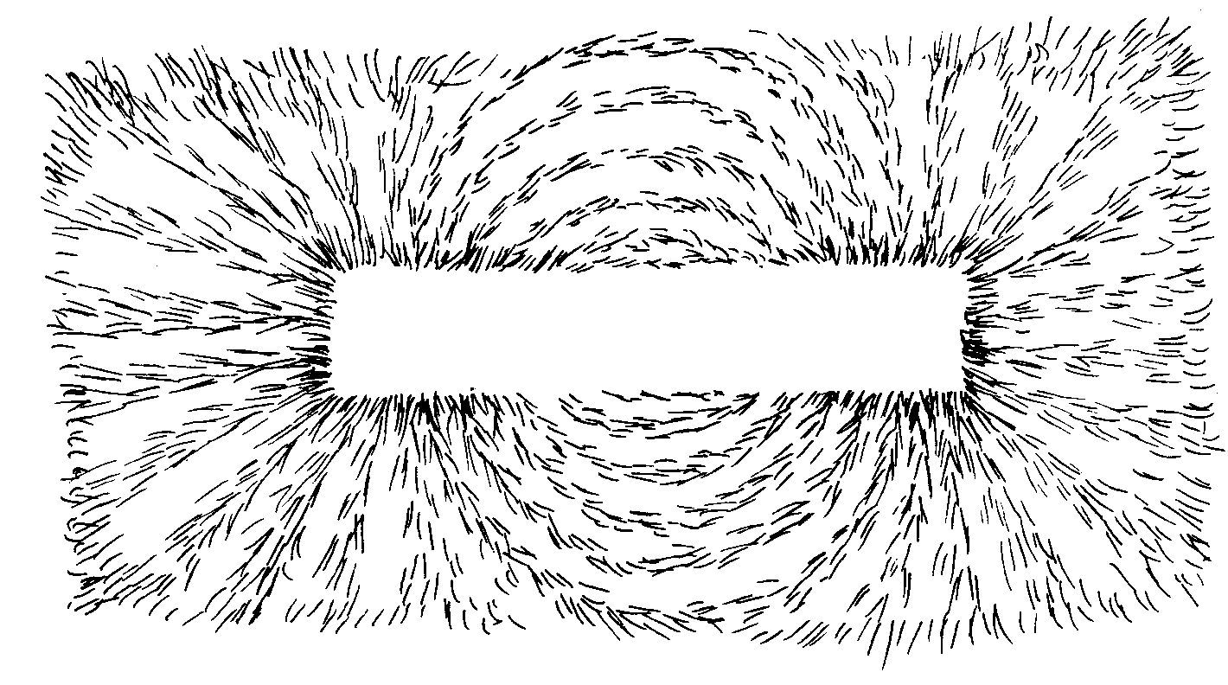
filings
Notes:
Lecture 28, 2013

Slide 3
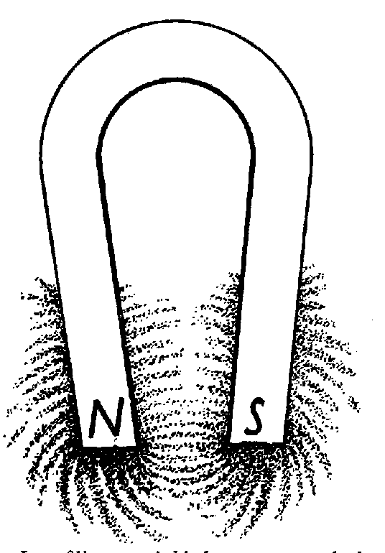
Notes:
Lecture 28, 2013

Slide 4
LORENTZ FORCE
Notes:
WRITTEN BY: Steven Pollock (CU-Boulder)

Slide 5
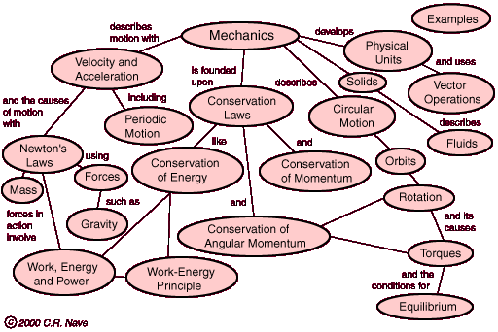
Notes:
CORRECT ANSWER:
USED IN: Fall 2009 (Schibli)
LECTURE NUMBER:
STUDENT RESPONSES:
INSTRUCTOR NOTES:
WRITTEN BY: Thomas Schibli (CU-Boulder)

Slide 6
Chapter 3 and 4 Concept Map
Make a concept map showing the relationship between the following quantities and concepts:
Electric Field E
Voltage V
Displacement D
Polarization P
Charge Density ρ
Permittivity ε₀
Bound Charge Density ρ_{b}
Laplace’s equation
Multipole expansion
Uniqueness theorem
Method of Images
Dipole moment
If you have time you can include:
Linear Dielectric
Poisson’s Equation
Susceptibility χ_{e}
Relative Permittivity ε
Notes:
CORRECT ANSWER:
USED IN: Fall 2009 (Schibli)
LECTURE NUMBER:
STUDENT RESPONSES:
INSTRUCTOR NOTES:
WRITTEN BY: Thomas Schibli (CU-Boulder)

Slide 7
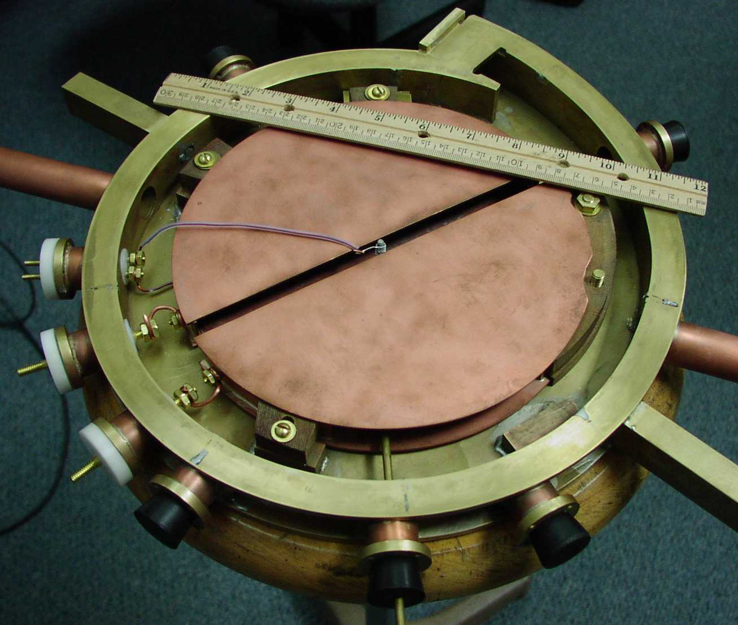
Cyclotron (undergraduate project @ Knox College)
Notes:
CORRECT ANSWER:
USED IN: Fall 2009 (Schibli)
LECTURE NUMBER:
STUDENT RESPONSES:
INSTRUCTOR NOTES:
WRITTEN BY: Thomas Schibli (CU-Boulder)

Slide 8
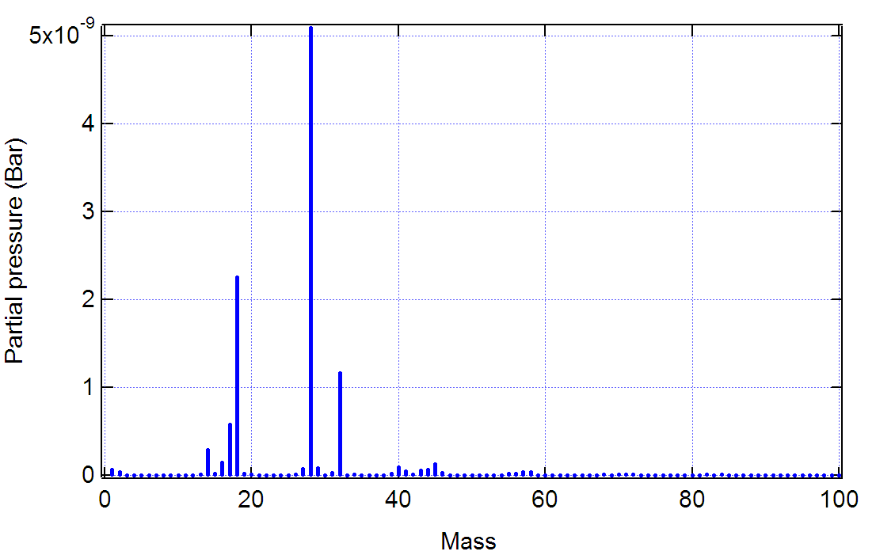
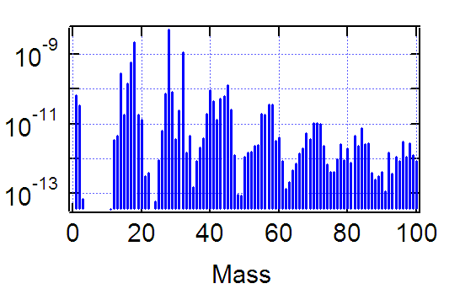
Mass spectrometer
N₂
H₂O
O₂
H
H₂
Ar
Hydro-carbons (oils)
Notes:
CORRECT ANSWER:
USED IN: Fall 2009 (Schibli)
LECTURE NUMBER:
STUDENT RESPONSES:
INSTRUCTOR NOTES:
WRITTEN BY: Thomas Schibli (CU-Boulder)

Slide 9
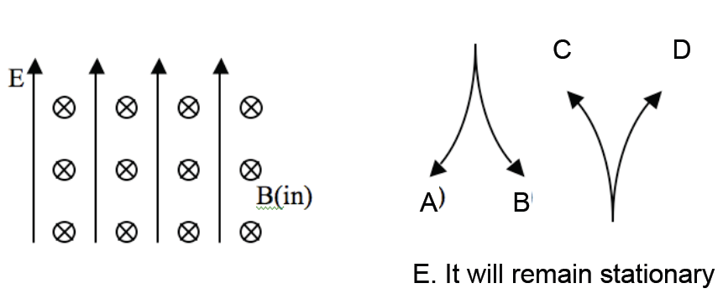
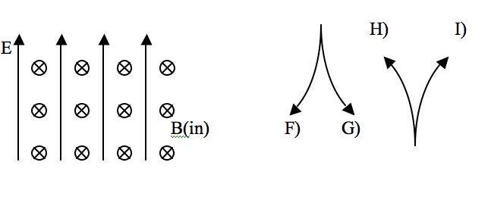
A proton (q=+e) is released from rest in a uniform E and uniform B. E points up, B points into the page. Which of the paths will the proton initially follow?
C
D
A
B
E. It will remain stationary
(To think about: what happens after longer times?)
Notes:
CORRECT ANSWER: C
USED IN: Spring 2008 and 13 (Pollock), Fall 2009 (Schibli)
LECTURE NUMBER: Dubson (Week 10, Lecture 24), Pollock (Lecture 28)
STUDENT RESPONSES: 9% 2% [[85%]] 2% 2% (FALL 2008)
0% 0% [[94%]] 6% 0% (SPRING 2008)
0% 2% [[93%]] 5% 0% (FALL 2009)
5, 5, 81, 10, 0 Sp ‘13
INSTRUCTOR NOTES: 94% correct, it's an 1120 (freshman) question. From Dubson -SJP See also http://mathworld.wolfram.com/Cycloid.html
(Next slide)
WRITTEN BY: Mike Dubson (CU-Boulder)

Slide 10
Cycloid
z
x
Source: Wofram Research, Inc.
Notes:
CORRECT ANSWER:
USED IN: Fall 2009 (Schibli) Sp 2013 (Pollock)
LECTURE NUMBER: 28
STUDENT RESPONSES:
INSTRUCTOR NOTES: http://mathworld.wolfram.com/Cycloid.html
WRITTEN BY: Thomas Schibli (CU-Boulder)

Slide 11
A + charged particle moving up (speed v) enters a region with uniform B (left) and uniform E (into page). What’s the direction of F_{net} on the particle, at the instant it enters the region?
5.1
To the left
Into the page
Out of the page
No net force
Not enough information
Notes:
11
From Singh
Showed and discussed in 2013, didn’t bother to vote.

Slide 12
A proton (speed v) enters a region of uniform B. v makes an angle θ with B. What is the subsequent path of the proton?
5.3
A) Helical
B) Straight line
C) Circular motion, ⊥ page.
(plane of circle is ⊥ B)
D) Circular motion ⊥ page. (plane of circle at angle θ w.r.t. B)
E) Impossible. v should always be ⊥ B
Notes:
12
CORRECT ANSWER: A
USED IN: Spring 2008 and ‘13 (Pollock)
LECTURE NUMBER: 28 (29 in ‘13)
STUDENT RESPONSES: [[72%]] 0% 17% 11% 0% (sp ‘08)
[[50]], 5, 24, 18, 3 then some discussion, then [74]], 0, 21, 3, 3, (Sp ‘13)
INSTRUCTOR NOTES: 72% correct with a few votes for C and D. This also didn't seem very challenging, though the diagram is helpful to talk about helical orbits.
-SJP
WRITTEN BY: ?? Not sure about this: Chandralekha Singh. Improving students' understanding of magnetism, C. Singh,Proceedings of the Annual Conference of the American Society forEngineering Education (ASEE), AC 2008-90, 1-16, (2008): http://www.asee.org/conferences/v2Search.cfm

Slide 13
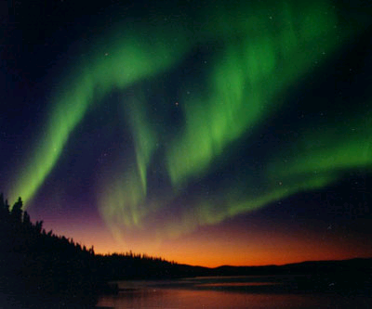
Notes:
Lect 29, Sp 2013
Followup to previous clicker question

Slide 14
Notes:
Lect 29, Sp 2013
Just for fun

Slide 15
A wire loop in a B field has a current I. The B-field is localized, it’s only in the hatched region, roughly zero elsewhere. Which way is I flowing to hold the mass in place?
5.4
B (into page, uniform)
L
CW
B) CCW
C) You cannot “levitate” like this!
I
m
Notes:
CORRECT ANSWER: A
USED IN: Spring 2013 (Pollock)
LECTURE NUMBER: Pollock (29)
STUDENT RESPONSES [90]], 10, 0, 0, 0 (SP ‘13)
INSTRUCTOR NOTES: I threw this in as a freshman physics review. I added the explicit mention that the B-field is spacially localized, this was confusing my students, and some were arguing C at first since they thought B was uniform EVERYWHERE. But even with this correction, there was a much bigger split between A and B than I expected, I prodded them to talk with their neighbors and that largely solved most problems.
. -SJP
WRITTEN BY: Steven Pollock (CU-Boulder)

Slide 16
A wire loop in a B field has a current I. The mass is "levitated" by the magnetic force F_{mag}=ILB. If you increase the current , does the magnetic force do positive work on the mass?
5.4
B (into page, uniform)
Yes
B) No
L
I
m
Notes:
CORRECT ANSWER: B
USED IN: Fall 2008 (Dubson), Spring 2008 and 13 (Pollock)
LECTURE NUMBER: Dubson (Week 10, Lecture 24), Pollock (29)
STUDENT RESPONSES: 10% [[90%]] 0% 0% 0% (FALL 2008)
43% [[57%]] 0% 0% 0% (SPRING 2008)
13%, [[87]], 0,0,0 (Sp ‘13)
INSTRUCTOR NOTES: This was just about 50-50. My answer is B, no, the B field does not do work. The energy input is coming from the battery or EMF or whatever drives up the current.
The analogy of Griffiths is to think of an object sliding up a frictionless ramp, pushed by a purely horizontal external force. Focus on the Normal force. It does NO WORK, but on the other hand, the only upward force on the block comes from that normal force. So the Normal force (like B here) Is the force which makes the block rise, but it is NOT the force doing any work.
(Think also of the car story - friction from the ground on the tires is what provides Fnet external to accelerate you - but it is NOT doing + work on the car. The KE of the car is coming from gasoline potential energy!)
One student remembered a Haiku she had written:
It is Saturday Night
And like a magnetic field
I will do no work
Griffiths has some good discussion about this, it’s very slippery and subtle. -SJP
WRITTEN BY: Steven Pollock (CU-Boulder)

