Slide 1
CURRENTS & CHARGE CONTINUITY
Notes:
WRITTEN BY: Steven Pollock (CU-Boulder)

Slide 2
Class Activities: current (1)

Slide 3
Class Activities: Current (2)

Slide 4
Current through a Wire
A student argues that the current through a wire flows throughout its volume, you:
Agree, resistance is inversely proportional to cross sectional area, not circumference
Disagree, it must flow only on the surface of the wire because the negative charges repel each other
Agree for different reasons
Disagree for different reasons
Notes:
4
CORRECT ANSWER: A or C
USED IN:
LECTURE NUMBER: Skipped
STUDENT RESPONSES: (But it could be interesting, we did talk about this idea in class some!)
Proto question from Ward Handley, our LA. Ans: A or C (e.g. net charge is neutral) -SJP
INSTRUCTOR NOTES:
WRITTEN BY: Ward Handley (CU-Boulder)

Slide 5
Positive ions flow right through a liquid, negative ions flow left.
The spatial density and speed of both ions types are identical.
Is there a net current through the liquid?
5.5
Yes, to the right
B) Yes, to the left
C) No
D) Not enough information given
Notes:
CORRECT ANSWER: A
USED IN: Fall 2008 (Dubson), Spring 2008 (Pollock), Fall 2009 (Schibli)
LECTURE NUMBER: Dubson (Week 10, Lecture 24), Pollock (29)
STUDENT RESPONSES: [[96%]] 0% 2% 2% 0% (FALL 2008)
[[ 87%]] 0% 13% 0% 0% (SPRING 2008)
[[79%]] 0% 21% 0% 0% (FALL 2009)
[[75]], 0, 23, 3, 0 (Sp ‘13)
INSTRUCTOR NOTES: 87% correct, not difficult, but it also went quite quickly. I had I = nqv on the board, which helped!
One student asked “what if both particles flow in the SAME direction”, of course that represents ZERO net current (think of neutral atoms moving to the right – it’s equal mix of + and – moving in the same drection, no current though)
-SJP
WRITTEN BY: Steven Pollock (CU-Boulder)

Slide 6
Current I flows down a wire (length L) with a square cross section (side a)
If it is uniformly distributed over the entire wire area, what is the magnitude of the volume current density J?
5.7
A) B)
C) D)
E) None of the above !
Notes:
CORRECT ANSWER: A
USED IN: Spring 2008 and 13 (Pollock), Fall 2009 (Schibli)
LECTURE NUMBER: 29 (30 in ’13)
STUDENT RESPONSES: [[87%]] 0% 0% 13% 0% (SPRING 2008)
[[71%]] 3% 0% 26% 0% (FALL 2009)
[[76]], 17, 2, 2, 4 (Sp ‘13)
INSTRUCTOR NOTES: 87% on this one. This is too easy! The only confusion was the 2 students who wanted D.
(Correct answer is A, pretty trivial) I would skip this - but there WAS a very good conversation that came out of this one, which was about whether current WOULD be uniformly distributed over the area. (The student thought the like charges would repel). So this gave an opportunity to talk about the model of a wire as electrically neutral, but two “fluids” on top of each other (with the electrons mobile). So that in reality this IS a decent picture of charge flow in a wire, I think. -SJP
WRITTEN BY: Steven Pollock (CU-Boulder)
6

Slide 7
Current I flows down a wire (length L) with a square cross section (side a)
If it is uniformly distributed over the outer surfaces only, what is the magnitude of the surface current density K?
5.6
A) B)
C) D)
E) None of the above
Notes:
CORRECT ANSWER: C
USED IN: Fall 2008 (Dubson), Spring 2008 and 13 (Pollock), Fall 2009 (Schibli)
LECTURE NUMBER: Dubson (Week 10, Lecture 25), Pollock (29, 30 in ‘13)
STUDENT RESPONSES: 20% 2% [[78%]] 0% 0% (FALL 2008)
0% 7% [[93%]] 0% 0% (SPRING 2008)
0% 5% [[92%]] 3% 0% (FALL 2009)
2, 16, [[82]], 0, 0 (Sp ‘13)
INSTRUCTOR NOTES: , 93% correct. No problems (only mistake was few who went for B). Very easy for them (good!)
We had some good physics discussion about whether charges WOULD distribute evenly over the outer surface (not on a conductor, I wouldn’t think, for a variety of reasons. But you could “paint” them on the wire and then drag the wire, I suppose. Or coat a nonconducting wire with a thin layer of conductor?). -SJP
WRITTEN BY: Steven Pollock (CU-Boulder)
7

Slide 8
A "ribbon" (width a) of surface current flows (with surface current density K)
Right next to it is a second identical ribbon of current.
Viewed collectively, what is the new total surface current density?
5.8
K
a
Notes:
CORRECT ANSWER: n/a
USED IN: Spring 2008 (Pollock)
LECTURE NUMBER: 29
STUDENT RESPONSES: n/a
INSTRUCTOR NOTES: “Animated” question is on next one! -SJP
WRITTEN BY: Steven Pollock (CU-Boulder)

Slide 9
A "ribbon" (width a) of surface current flows (with surface current density K)
Right next to it is a second identical ribbon of current.
Viewed collectively, what is the new total surface current density?
5.8
A) K
B) 2K
C) K/2
D) Something else
a
Notes:
CORRECT ANSWER: A
USED IN: Fall 2008 (Dubson), Spring 2008 and 13 (Pollock), Fall 2009 (Schibli)
LECTURE NUMBER: Dubson (Week, 10, Lecture 24), Pollock (29, 30 in ‘13)
STUDENT RESPONSES: [[96%]] 2% 2% 0% 0% (FALL 2008)
[[87%]] 0% 13% 0% 0% (SPRING 2008)
[[92%]] 6% 3% 0% 0% (FALL 2009)
[[75]], 5, 20, 0, 0, (Sp ‘13)
INSTRUCTOR NOTES: 87% correct. Couple went for K/2, because they thought I had increased the length without increasing the current. It’s an easy problem, but I think helps hammer in the MEANING of K. (Current doubled here, but K is what it is). -SJP
WRITTEN BY: Steven Pollock (CU-Boulder)

Slide 10
A "ribbon" (width a) with uniform surface current density K passes through a uniform magnetic field B_{ext}. Only the length b along the ribbon is in the field. What is the magnitude of the force on the ribbon?
ERK5-1
KB
aKB
abKB
bKB/a
KB/(ab)
B_{ext}
a
K
b
Notes:
CORRECT ANSWER: C
USED IN: Fall 2008 (Dubson), Fall 2009 (Schibli)
LECTURE NUMBER: Dubson (Week, 10, Lecture 24), Pollock (29)
STUDENT RESPONSES: 0% 22% [[75%]] 3% 0% (FALL 2009)
0, 17, [[78]], 2, 4 (Sp ‘13)
INSTRUCTOR NOTES: My answer: C. F_magn = int(K x B)da
In ‘13 I animated the slide, and gave them a good few minutes to GENERATE the formula before giving them the choice to pick.
Some brief quick review of direction, and the PHYSICS of why it is proportional to b (which was the bulk of the mistakes, some people went for B) I thought of TWO strips, end to end; each feels the same force, so doubling the length doubles the total force, hence the linearity. Mathematically, it comes from integrating over “da”, but I find that less compelling somehow… -SJP

Slide 11
Charge Conservation
5.10
Which of the following is a statement of charge conservation?
Notes:
11
CORRECT ANSWER: D
USED IN: Fall 2008 (Dubson), Spring 2008 and ‘13 (Pollock), Fall 2009 (Schibli)
LECTURE NUMBER: Dubson (Week 10, Lecture 25), Pollock (30)
See next slide
In ‘2013, I did it differently. I found the integral form of charge conservation, then gave them this “blank” slide and gave them a good few minutes to try to work out the answer, in terms of J. I gave progressively more and more hints, talked about using the divergence theorem (one student tried to apply divergence theorem “backwards” getting a div(rho)!)
WRITTEN BY: Steven Pollock (CU-Boulder)

Slide 12
Charge Conservation
5.10
Which of the following is a statement of charge conservation?
A)
B)
C)
D)
E) Not sure
Notes:
12
CORRECT ANSWER: D
USED IN: Fall 2008 (Dubson), Spring 2008 (Pollock), Fall 2009 (Schibli)
LECTURE NUMBER: Dubson (Week 10, Lecture 25), Pollock (30)
STUDENT RESPONSES: 2% 7% 17% [[72%]] 2% (FALL 2008)
0% 0% 6% [[ 94%]] 0% (SPRING 2008)
0% 5% 3% [[92%]] 0% (FALL 2009)
8, 10, 2, [[75]],6 (Sp ‘13)
INSTRUCTOR NOTES: 94% correct. I asked it again on the *last* day of class, they did worse! (50% correct!). This was the first day back after spring break, wanted to see if they remembered what we had covered 10 days ago!
In ‘13 we had not talked about it before break, so this was their first pass.
-SJP
WRITTEN BY: Steven Pollock (CU-Boulder)

Slide 13
Charge Conservation
5.10
Which of the following is a statement of charge conservation?
A)
B)
C)
D)
E) Not sure
Notes:
13
CORRECT ANSWER: B (I changed the order or responses from last time, used to be D was correct)
USED IN: Fall 2008 (Dubson), Spring 2008 (Pollock), Fall 2009 (Schibli)
LECTURE NUMBER: Dubson (Week 10, Lecture 25), Pollock (30)
STUDENT RESPONSES: 2% 7% 17% [[72%]] 2% (FALL 2008)
0% 0% 6% [[ 94%]] 0% (SPRING 2008)
0% 5% 3% [[92%]] 0% (FALL 2009)
8, 10, 2, [[75]],6 (Sp ’13 lecture 30) Start of Lecture 31: 6, [[79], 8,4,4 (not so great as I’d like)
INSTRUCTOR NOTES: 94% correct. I asked it again on the *last* day of class, they did worse! (50% correct!). This was the first day back after spring break, wanted to see if they remembered what we had covered 10 days ago!
In ‘13 we had not talked about it before break, so this was their first pass.
I reviewed it the next class, the ones who came late to class did much worse on it, perhaps they skipped the previous lecture?!
-SJP
WRITTEN BY: Steven Pollock (CU-Boulder)

Slide 14
Is the total net charge in the universe conserved? How about the total mass?
Charge is conserved; total mass is conserved
Charge is conserved; total mass is not conserved
Charge is not conserved; total mass is conserved
Charge is not conserved; total mass is not conserved
Dude! How should I know?
Notes:
CORRECT ANSWER: B
USED IN: Fall 2009 (Schibli)
LECTURE NUMBER:
STUDENT RESPONSES: 24% [[68%]] 5% 0% 3% (FALL 2009)
INSTRUCTOR NOTES:
WRITTEN BY: Thomas Schibli (CU-Boulder)

Slide 15
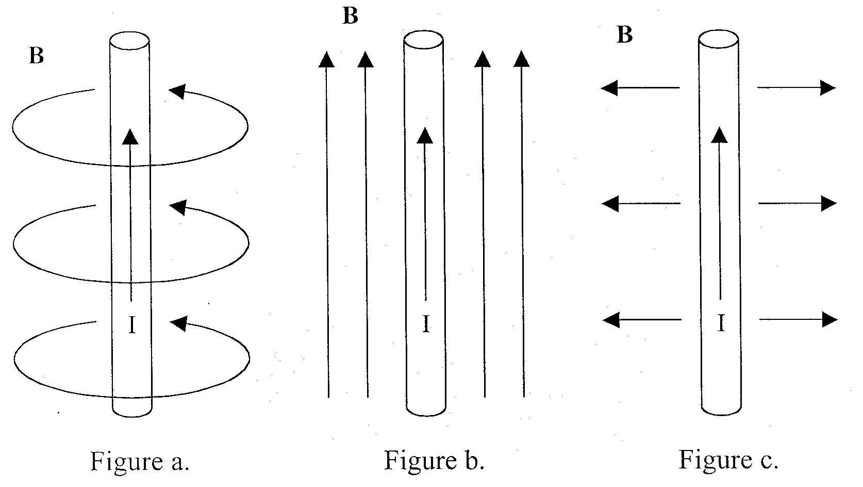
Until now, you have been told that magnetic fields loop around a current carrying wire. But how do you know that there are no other components? Show (mathematically) which of the below B-field components are/not possible.
Notes:
This comes later, Ampere’s law!
CORRECT ANSWER:
USED IN: Fall 2009 (Schibli)
LECTURE NUMBER:
STUDENT RESPONSES:
INSTRUCTOR NOTES: This whiteboard activity can be helpful to do before the tutorial on Ampere’s law.
WRITTEN BY: Thomas Schibli (CU-Boulder)

Slide 16
Discussion
Why does B follow the right hand rule? Is it contained in Ampere’s Law?
When you find the B field for a point in space near a long current carrying wire, what *could* B depend on? Given the form of Biot-Savart law, what would you GUESS?
Notes:
CORRECT ANSWER: N/A
USED IN: Spring 2008 (Pollock)
LECTURE NUMBER: 30
STUDENT RESPONSES:
INSTRUCTOR NOTES: Didn't do the first, but we did have discussions about the second.
mu0 I / some distance. What distance IS there? Can it depend on z? phi? what direction must it point?
WRITTEN BY: Steven Pollock (CU-Boulder)

