Slide 1
BIOT SAVART LAW
Notes:
WRITTEN BY: Steven Pollock (CU-Boulder)

Slide 2
Class Activities: Biot Savart

Slide 3
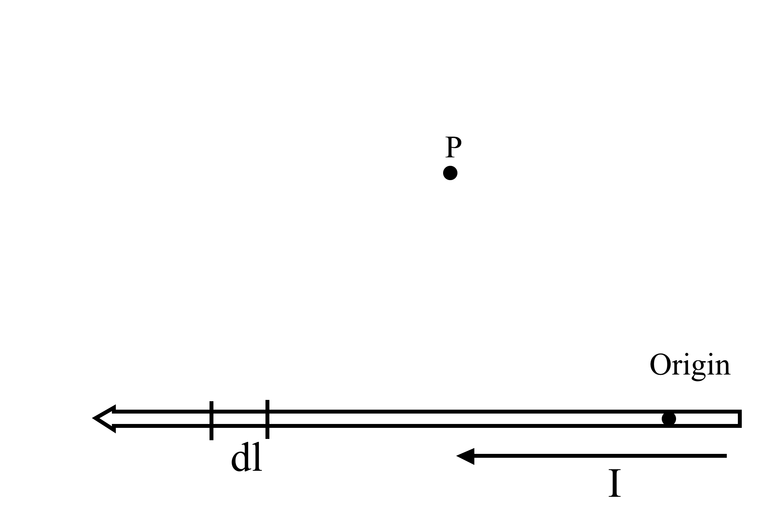
To find the magnetic field B at P due to a current-carrying wire we use the Biot-Savart law,
5.11
In the figure, with “dl” shown, what is ?
Notes:
3
CORRECT ANSWER: n/a
USED IN: Spring 2008 (Pollock) and ‘13
LECTURE NUMBER: 30
STUDENT RESPONSES: n/a
INSTRUCTOR NOTES: See next slide -SJP
WRITTEN BY: Steven Pollock (CU-Boulder)

Slide 4
To find the magnetic field B at P due to a current-carrying wire we use the Biot-Savart law,
5.11
In the figure, with “dl” shown, which purple vector best represents ?
E) None of these!
Notes:
4
CORRECT ANSWER: A
USED IN: Fall 2008 (Dubson), Spring 2008 (Pollock)
LECTURE NUMBER: Dubson (Week 10, Lecture 25), Pollock (30, 31 in ‘13)
STUDENT RESPONSES: [[96%]] 0% 2% 0% 2% (FALL 2008)
[[100%]] 0% 0% 0% 0% (SPRING 2008)
[[94]], 0, 4, 0, 4 (Sp ‘13)
INSTRUCTOR NOTES: 100% correct in SP08, silent. Guess they know this! Answer is A, from the source, to the target point.
Nice review, even though it’s not hard for them. I animated curly R = r-r’, but they also seemed to know this.
-SJP
WRITTEN BY: Steven Pollock (CU-Boulder)

Slide 5
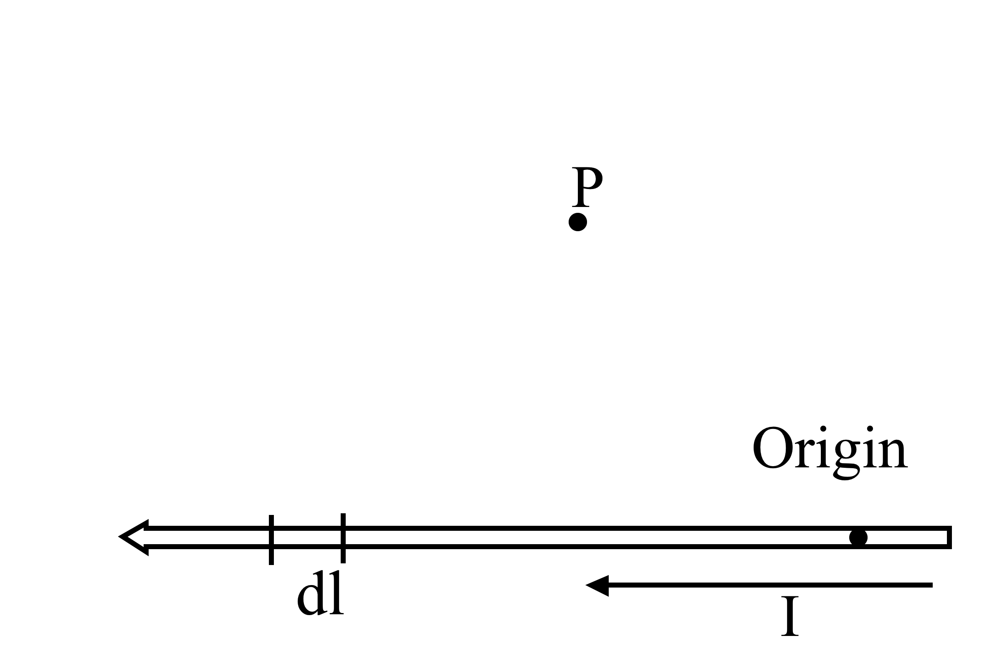
To find the magnetic field B at P due to a current-carrying wire we use the Biot-Savart law,
5.12
What is the direction of the infinitesimal contribution dB(P) created by current in dl?
Up the page
Directly away from dl
(in the plane of the page)
Into the page
Out of the page
Some other direction
Notes:
5
CORRECT ANSWER: C
USED IN: Fall 2008 (Dubson),Spring 2008 (Pollock), Fall 2009 (Schibli)
LECTURE NUMBER: Dubson (Week 10, Lecture 25), Pollock (30, 31 ‘in 13)
STUDENT RESPONSES: 2% 0% [[96%]] 0% 2% (FALL 2008)
0% 0% [[ 94%]] 0% 6% (SPRING 2008)
0% 0% [[95%]] 3% 3% (FALL 2009)
4, 2, [[94]], 0, 0 (Sp ‘13)
INSTRUCTOR NOTES: 94% correct, (1 vote for E) Silent. Guess they know this too!
No problems here – nice to then connect back to the old Phys 2 “B field wraps around a wire like your right hand”, this agrees with that.
Also nice to point out/ask if it matters whether dl was to the left or to the right of point P. (doesn’t matter, this is important, means we can pull “direction” out of the integral!)
-SJP
WRITTEN BY: Steven Pollock (CU-Boulder)

Slide 6
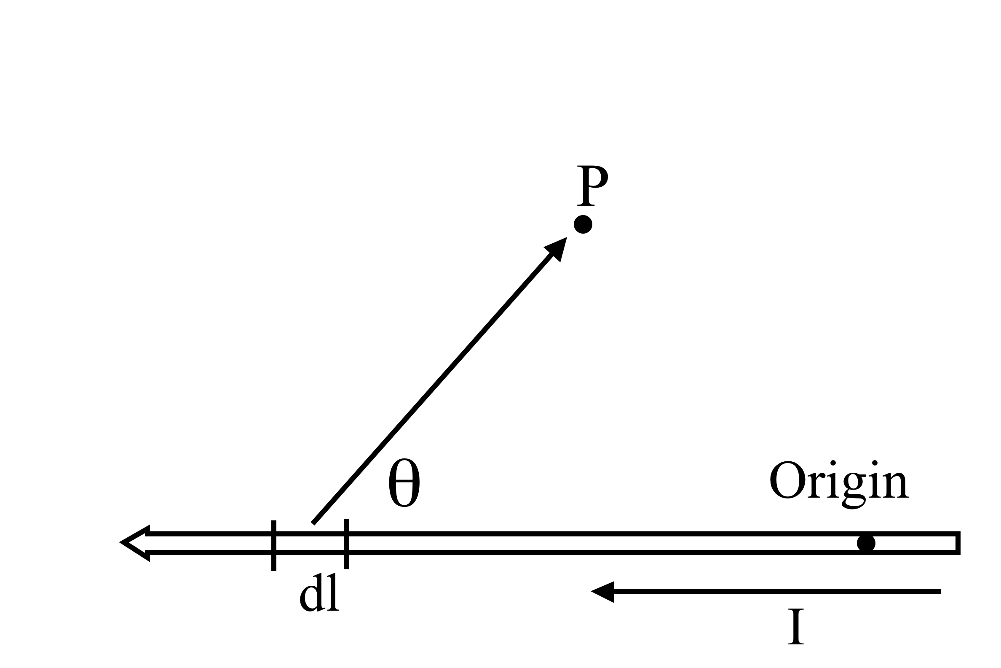
To find the magnetic field B due to a current-carrying wire, below, we use the Biot-Savart law,
5.13
What is the magnitude of
?
Notes:
6
USED IN: Fall 2008 (Dubson), Spring 2008 (Pollock), Fall 2009 (Schibli)
LECTURE NUMBER: Dubson (Week 10, Lecture 25), Pollock (30)
STUDENT RESPONSES:
INSTRUCTOR NOTES:
Animated, let them think first.
WRITTEN BY: Steven Pollock (CU-Boulder)

Slide 7
To find the magnetic field B due to a current-carrying wire, below, we use the Biot-Savart law,
5.13
What is the magnitude of
?
b)
d) e) something else!
(And, what's here, given that P = (x,y,z)?)
Notes:
7
CORRECT ANSWER: A
USED IN: Fall 2008 (Dubson), Spring 2008 (Pollock), Fall 2009 (Schibli)
LECTURE NUMBER: Dubson (Week 10, Lecture 25), Pollock (30, 31 in ‘13)
STUDENT RESPONSES: [[66%]] 9% 26% 0% 0% (FALL 2008)
[[31%]] 13% 25% 31% 0% (SPRING 2008)
[[64%]] 18% 15% 3% 0% (FALL 2009)
[[53]], 23, 17, 6, 2 (Sp ‘13)
INSTRUCTOR NOTES: Answers were all over the board, each answer! Note - because of the near perfect previous two, Just to throw them off a little :-) I clearly warned them: look carefully at definition of theta here! It's NOT the angle you would "expect" if computing the usual dl R sin(theta) rule for a cross product. And, also reminded them that Rhat/R^2 = R(vec)/R^3 was something we used w. Coulomb's law. Given all that.... what's the answer? (from Stephanie) Answer: A.
Example 5.5 in Griffihs. Make 'em write down Curly R here, too! -SJP
WRITTEN BY: Steven Pollock (CU-Boulder)

Slide 8
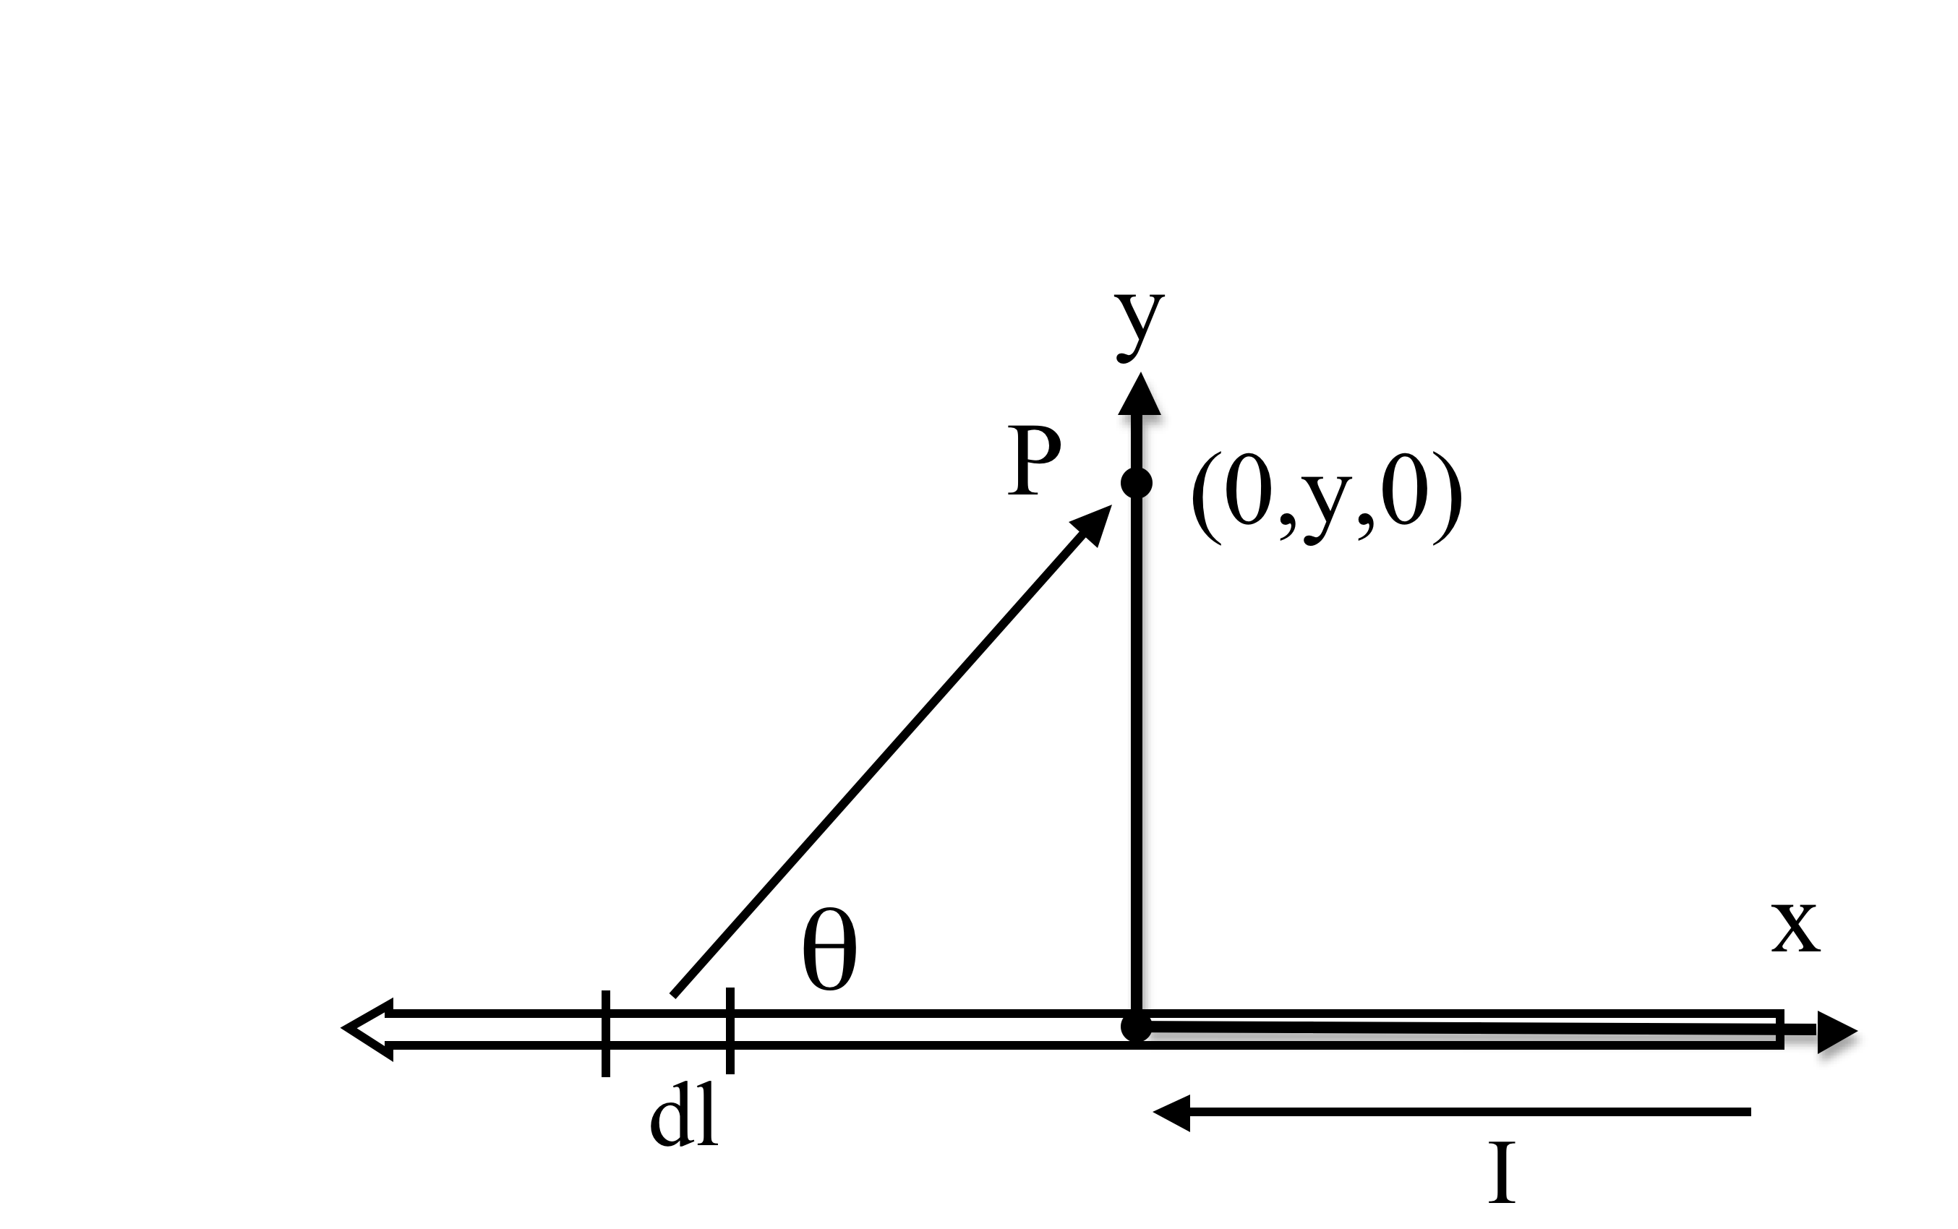
To find the magnetic field B due to a current-carrying wire, below, we use the Biot-Savart law,
5.13m
What is the value of
I ?
(What's here, given that P = (0,y,0)?)
Notes:
8
USED IN: Spring 2013 (Pollock),
LECTURE NUMBER: Pollock (31)
STUDENT RESPONSES:
INSTRUCTOR NOTES:
Animated, let them think first.
WRITTEN BY: Steven Pollock (CU-Boulder)

Slide 9
To find the magnetic field B due to a current-carrying wire, below, we use the Biot-Savart law,
5.13m
What is the value of
I ?
b)
c) d) e) Other!
Notes:
9
CORRECT ANSWER: D
USED IN: Fall 2008 (Dubson), Spring 2008 (Pollock)
LECTURE NUMBER: Dubson (Week 10, Lecture 25), Pollock (30, 31 in ‘13)
STUDENT RESPONSES: (Missing data from earlier terms?)
21, 2, 2, [[65]], 10 (Sp ‘13)
INSTRUCTOR NOTES: Note the funny choice of coord system (usually the wire would be z, but it’s my call!)
I animated it so they could come up with curly R BEFORE showing these choices.
In 2013, most of the debate was about that sign (the minus sign arises because z is out of the page, B is into the page)
The y/Sqrt[x’^2+y^2] is simply the sin(theta) from the previous slide. (I had written the answer to that one up on the board)
-SJP
WRITTEN BY: Steven Pollock (CU-Boulder)

Slide 10
What is B at the point shown?
5.14
A)
B)
C)
D)
E) None of these
s
I
I
(What direction
does it point?)
Notes:
CORRECT ANSWER: C
USED IN: Fall 2008 (Dubson), Spring 2008 and ‘13 (Pollock), Fall 2009 (Schibli)
LECTURE NUMBER: Dubson (Week 11, Lecture 27), Pollock (30), 31 in ‘13
STUDENT RESPONSES: 7% 30% [[43%]] 17% 2% (FALL 08)
0% 13% [[88%]] 0% 0% (SPRING 08)
0% 10% [[88%]] 2% 0% (FALL 2009)
8, 25, [[67]], 0,0, (Sp ‘13)
INSTRUCTOR NOTES: . 88% correct, no problems at all. (Got 2 votes for B)
Small discussion about whether it *matters* where exactly the blue dot is. If e.g. you "ignore" the lower segment of I, does a semi-infinite wire produce the same B field everywhere? One student was confused about this, at least... (Again in ‘13, and it was a very strong student)
We had to discuss the “symmetry” argument, it’s a little subtle, that the right half and left half give the SAME contribution, but would not if the blue dot was off to the side.
-SJP
WRITTEN BY: Steven Pollock (CU-Boulder)

Slide 11
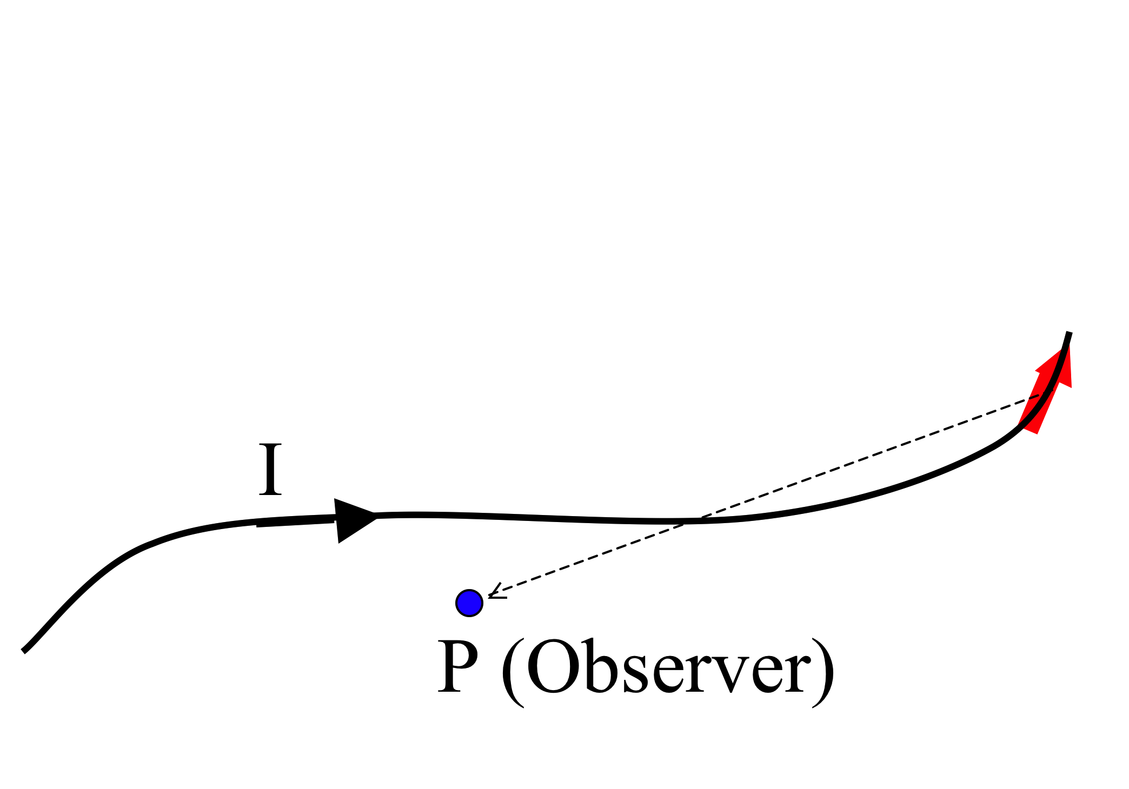
What do you expect for direction of B(P)?
5.16
com
How about direction of dB(P) generated JUST by the segment of current dl in red?
A) B(p) in plane of page, ditto for dB(P, by red)
B) B(p) into page, dB(P, by red) into page
C) B(p) into page, dB(P, by red) out of page
D) B(p) complicated - has mult component (not ⊥ or || to page), ditto for dB(P, by red)
E) Something else!!
Notes:
11
CORRECT ANSWER: C
USED IN: Fall 2008 (Dubson), Spring 2008 (Pollock), Fall 2009 (Schibli)
LECTURE NUMBER: Dubson (Week 10, Lecture 25), Pollock (31)
STUDENT RESPONSES: 0% 2% [[91%]] 6% 0% (FALL 08)
0% 13% [[88%]] 0% 0% (SPRIING 08)
0% 8% [[92%]] 0% 0% (FALL 2009)
4, 14, [[69]], 12, 2 (Sp ‘13)
INSTRUCTOR NOTES: L31 start. 88% correct. No problems - 1 student wanted to know how I got the dB part of it. Discussion included fact that E could be correct (what if wire comes out of page just past the edge of the picture, for instance!) 1/R^2 issues.
-SJP
WRITTEN BY: Steven Pollock (CU-Boulder)

Slide 12
I have two very long, parallel wires each carrying a current I₁ and I₂, respectively. In which direction is the force on the wire with the current I₂?
Up
Down
Right
Left
Into or out of the page
I₁
I₂
(How would your answer change if you reverse the direction of both currents?)
Notes:
CORRECT ANSWER: D
USED IN: Fall 2009 (Schibli) Sp 2013 (Pollock)
LECTURE NUMBER: 31 in 2013
STUDENT RESPONSES: 0% 0% 21% [[79%]] 0% (FALL 2009)
2, 0, 36, [[62]], 0, (S0 ‘13)
INSTRUCTOR NOTES: This is “freshman physics”, but a good review, and there was a *lot* of discussion (it was 50/50 for the first minute, and only started swinging near the end) I then derived the formula, and talked about applications (e.g. stresses in MRI machines that make them so noisY)
-SJP
WRITTEN BY: Steven Pollock (CU-Boulder)

Slide 13
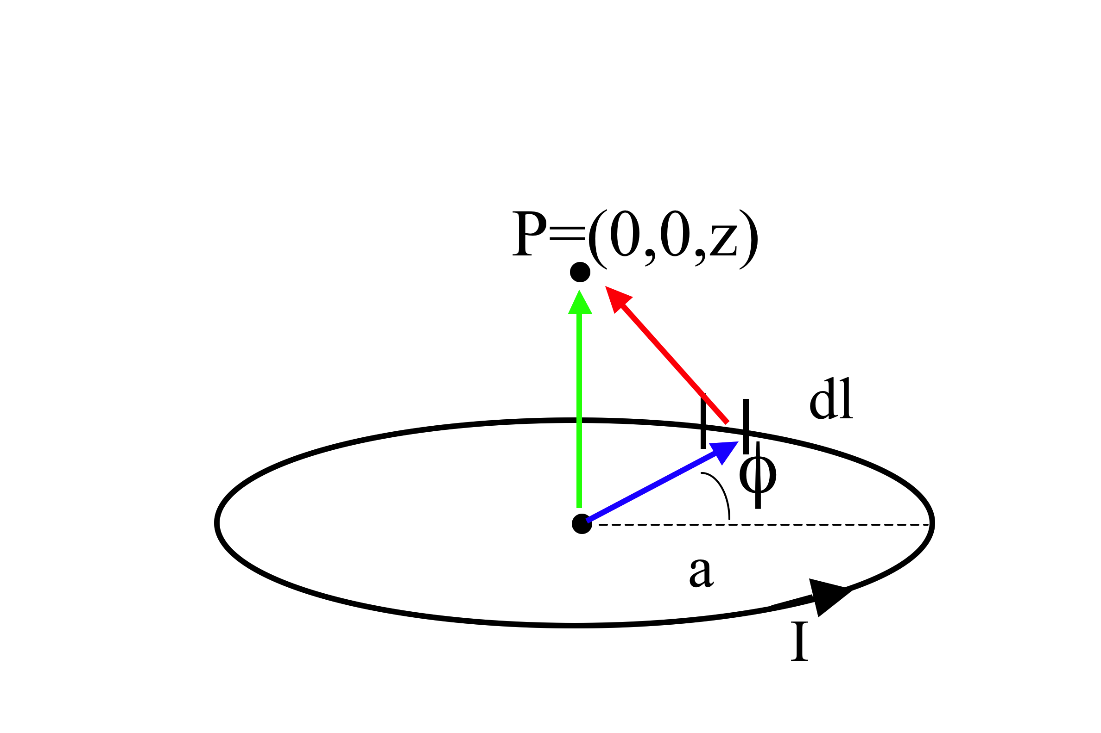
To find the magnetic field B due to a current-carrying loop, we use the Biot-Savart law,
5.15
What is the magnitude of ?
A) B)
D)
E) Something quite different!
(Which colored arrow is ? r? r’? )
Notes:
13
CORRECT ANSWER: D
USED IN: Fall 2008 (Dubson), Spring 2008 (Pollock), Fall 2009 (Schibli)
LECTURE NUMBER: Dubson (Week 10, Lecture 25), Pollock (31, 32 in ‘13)
STUDENT RESPONSES: 2% 0% 20% [[74%]] 4% (FALL 08)
0% 0% 38% [[63%]] 0% (SPRING 2008)
0% 0% 5% [[65%]] 30% (FALL 2009)
0 0 44 [[42]], 14 (Sp ‘13)
INSTRUCTOR NOTES: C got 40% of the votes. They were a little confused about what the angle was between dl and curly R (I had a simple "prop" to show it) -SJP
WRITTEN BY: Steven Pollock (CU-Boulder)

Slide 14
To find the magnetic field B due to a current-carrying loop, we use the Biot-Savart law,
5.15b
What is dB_{z} (the contribution to the vertical component of B from this dl segment?)
A) B)
D)
E) Something quite different!
Notes:
14
CORRECT ANSWER: A
USED IN: Spring 2008 and 13 (Pollock), Fall 2009 (Schibli)
LECTURE NUMBER: 31 (32 in ‘13)
STUDENT RESPONSES: [[ 75%]] 0% 25% 0% 0% (SPIRNG 2008)
[[ 72%]] 0% 28% 0% 0% (FALL 2009)
14, 0, [[83]], 2, 0 (Sp 13)
INSTRUCTOR NOTES: 25% voted for C (almost all in ‘13!) . It's easy to mix up which angle you're taking the cos of to get this. We discussed limit z-> 0 (a student brought it up) as one argument. Another asked if z-> infinity helps you decide (but I pointed out that both A and C are well behaved and go to zero in that limit - though A goes as 1/z^3, which is what it SHOULD be for a dipole!) -SJP
WRITTEN BY: Steven Pollock (CU-Boulder)

Slide 15
Consider the B-field a distance z from a current sheet in the z = 0 plane:
MD10-1
The B-field has
y-component only
z-component only
y and z-components
x, y, and z-components
Other
z
y
K
x
Notes:
CORRECT ANSWER: A
USED IN: Fall 2008 (Dubson) Sp 2013 (Pollock)
LECTURE NUMBER: Dubson (Week 10, Lecture 26, 1st try, Week 10, Lecture 26, 2nd try) (L 32 in SJP ‘13)
STUDENT RESPONSES: [[60%]] 10% 30% 0% 0% (1st try)
[[46%]] 18% 31% 5% 0% (2nd try)
[[82]], 9, 9, 0, 0 (Sp ‘13)
INSTRUCTOR NOTES:
Students are figuring this out by superposition of known field around wires, which is fine.
We also discussed the x, y, and z *dependence* of the answer, which is worth talking about. (the z dependence is not obvious by symmetry. Though, once you know the field points purely in the –y direction, I would argue that you cannot then have any z dependence, because that would create a curl out there in empty space! -SJP
WRITTEN BY: Mike Dubson (CU-Boulder)
15

Slide 16
Here is the integral expression for the B-field a distance z from a current sheet in the z = 0 plane:
MD10-1
z
The B-field has
y-component only
z-component only
y and z-components
x, y, and z-components
y
K
x
Notes:
CORRECT ANSWER: A
USED IN: Fall 2008 (Dubson)
LECTURE NUMBER: Dubson (Week 10, Lecture 26, 1st try, Week 10, Lecture 26, 2nd try)
STUDENT RESPONSES: [[60%]] 10% 30% 0% 0% (1st try)
[[46%]] 18% 31% 5% 0% (2nd try)
INSTRUCTOR NOTES:
WRITTEN BY: Mike Dubson (CU-Boulder)
16

