Slide 1
DIVERGENCE & CURL OF B; STOKES THEOREM
Notes:
WRITTEN BY: Steven Pollock (CU-Boulder)

Slide 2
Class Activities: Stokes’ Thm, Div, Curl. Ampere. (1)

Slide 3
Class Activities: Stokes’ Thm, Div, Curl, Ampere (2)

Slide 4
Amperian loop analysis:
Consider the infinite uniform current sheet K flowing in the x direction.
I. Which variables (x, y, z) can B depend on?
II. Which vector components (B_{x}, B_{y}, B_{z}) can be non-zero?
Give your reasoning for each variable and component.
III. What loop would you use to find B? Why?
Notes:
CORRECT ANSWER:
USED IN: Fall 2009 (Schibli)
LECTURE NUMBER:
STUDENT RESPONSES:
INSTRUCTOR NOTES:
WRITTEN BY: Thomas Schibli (CU-Boulder)

Slide 5
MD11-3
A large cube of volume V is made up of many smaller cubes. Each smaller cube (labeled with index i) has volume v_{i}, so that
The flux of the vector field F over small cube i is
If we add up all the fluxes over all the little cubes
will this equal the flux over the big cube ?
Yes B) No
C) Depends on the vector field F
Notes:
CORRECT ANSWER: A
USED IN: Fall 2008 (Dubson)
LECTURE NUMBER: Dubson (Week 11, Lecture 28)
STUDENT RESPONSES:
[[77%]] 21% 2% 0% 0%
INSTRUCTOR NOTES:
WRITTEN BY: Mike Dubson (CU-Boulder)

Slide 6
MD11-1
Stoke's Theorem says that for a surface S bounded by a perimeter L, any vector field B obeys
S
L
Does Stoke's Theorem apply for any surface S bounded by a perimeter L, even one such as this balloon-shaped surface S :
Yes
B) No
C) Sometimes
S
L
Notes:
CORRECT ANSWER: A
USED IN: Fall 2008 (Dubson)
LECTURE NUMBER: Dubson (Week 11, Lecture 27)
STUDENT RESPONSES: [[82%]] 16% 2% 0% 0%
INSTRUCTOR NOTES:
WRITTEN BY: Mike Dubson (CU-Boulder)

Slide 7
Choose all of the following Maxwell’s equations for electrostatics and magnetostatics that need to be changed if magnetic charges exist:
(I) the one related to
(II) the one related to
(III) the one related to
(I) only
(II) only
(III) only
(I) and (II) only
(I) and (III) only
Notes:
CORRECT ANSWER: E
USED IN: Spring 2008 (Pollock)
LECTURE NUMBER: Skipped
STUDENT RESPONSES: n/a
INSTRUCTOR NOTES: Skipped (but I talked a bit about it in class, and it's a homework extra credit prob). -SJP
WRITTEN BY: Chandralekha Singh. Improving students' understanding of magnetism, C. Singh,Proceedings of the Annual Conference of the American Society forEngineering Education (ASEE), AC 2008-90, 1-16, (2008): http://www.asee.org/conferences/v2Search.cfm

Slide 8
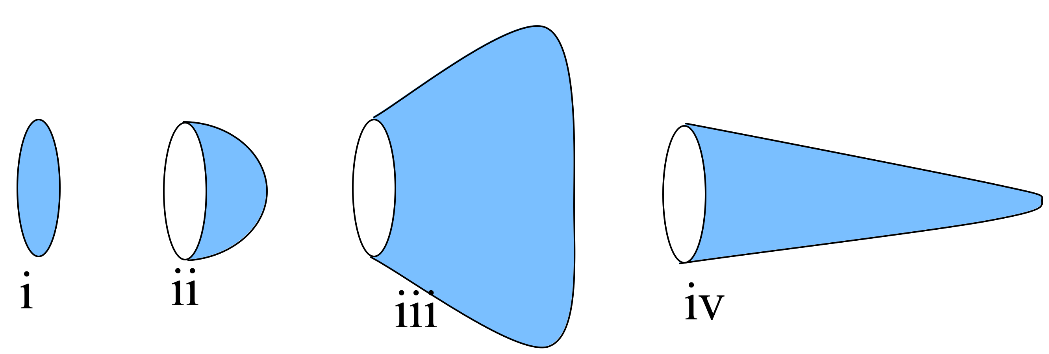
Stoke’s Theorem: line v. surface integral
5.16
Rank order (over blue surfaces) where J is uniform, going left to right:
A) iii > iv > ii > i
B) iii > i > ii > iv
C) i > ii > iii > iv
D) Something else!!
E) Not enough info given!!
Notes:
8
CORRECT ANSWER: D
USED IN: Fall 2008 (Dubson), Spring 2008 and 13 (Pollock), Fall 2009 (Schibli)
LECTURE NUMBER: Dubson (Week 11, Lecture 28, 1st try, Week 11, Lecture 29, 2nd try), Pollock (31) (32 in ‘13)
STUDENT RESPONSES: 4% 0% 7% [[89%]] 0% 1st try (FALL 08)
5% 0% 5% [[91%]] 0% 2nd try (FALL 08)
0% 6% 6% [[88%]] 0% (SPRING 08)
17% 0% 0% [[60%]] 23% (FALL 2009)
19, 7, 12, [[60]], 2 (Sp ‘13)
INSTRUCTOR NOTES: I thought it would be harder, D got 90% of the votes, and nobody had anything to argue except "all the same". In the discussion, though, we talked about "how do you know", and discussed what "current through" means (and e.g. how some extra current does enter case iii, but then re-exits). I also pointed out integral B dot dl around the entrance loop would be the same... Ans D: a = b = c = d
I picked A distractor to be “largest area to smallest area” (visually?)
I picked B distractor to be “most perpendicular to least perpendicular”??
I picked C distractor to be “most area towards the left” ?? -SJP
WRITTEN BY: Ward Handley, adapted by Steve Pollock (CU-Boulder)

Slide 9
The figure shows a static magnetic field in a region of space. Could this region of space be “empty”?
1.4
Yes, it could be empty space (with currents somewhere off to the sides creating it)
No, there must be static charges (ρ) in there.
No, there must be a current density (J) in the plane of the page in this (boxed) region
No, there must be a current density (J) perpendicular to the plane of the page in this region.
Other/???
Notes:
CORRECT ANSWER: D
USED IN: Spring 2012 (Pollock)
LECTURE NUMBER: 33 in 2013
STUDENT RESPONSES: 28, 7 22 [41], 2 (Sp ‘13, preclass) Then brief discussion (pointed out that Ampere’s law is local): 5, 0, 16, [[79]], 0
Part of the issue here was that we haven’t really covered Ampere’s law directly in detail, but many students were having some “locality” issue: they felt that you could have a curl caused by current somewhere else! I heard a lot of people talking about this.
INSTRUCTOR NOTES:
Written by:SJP

Slide 10
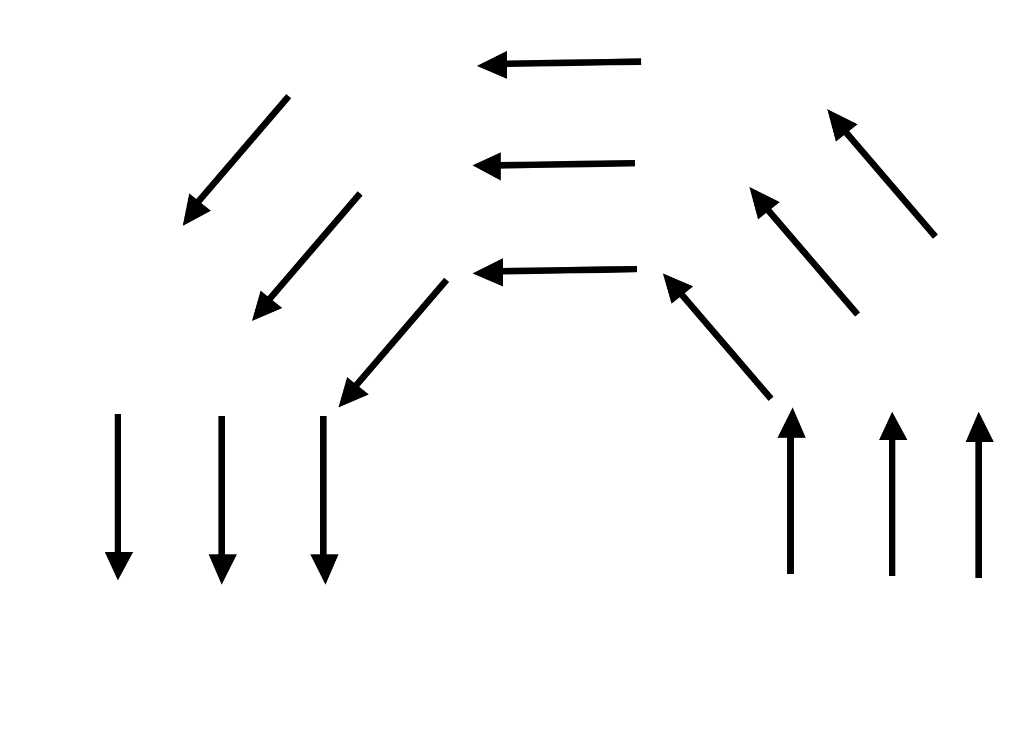
ONLY CLICK AFTER YOU FINISH p.2, part iib:
If the arrows represent a B field (note that |B| is the same everywhere), is there a nonzero J (perpendicular to the page) in the dashed region?
5.17a
Yes
No
Need more information to decide
Notes:
Used with Tutorial?? (Which one?)
CORRECT ANSWER: A
USED IN: Spring 2008 and 13 (Pollock), Fall 2009 (Schibli)
LECTURE NUMBER: 33
STUDENT RESPONSES: [[26%]] 58% 16% 0% 0% (SPRING 2008)
[[42%]] 54% 4% 0% 0% (FALL 2009)
[83]] 13, 0, 2, 2 (Sp ‘13)
INSTRUCTOR NOTES: 25% A, 60% for B, rest for C. Good discussion, lots of ways to think about this. "Paddlewheel" argument, use front flyleaf to take curl of B0 phihat, or the next slide... Answer is A, yes. If I consider the loop (which appears in the next slide), the line integral around the loop is manifestly NOT zero (B has same magnitude everywhere, but length is bigger on the outer path). Nonzero line integral means I(enclosed) must be nonzero. -SJP
WRITTEN BY: Steven Pollock (CU-Boulder)

Slide 11
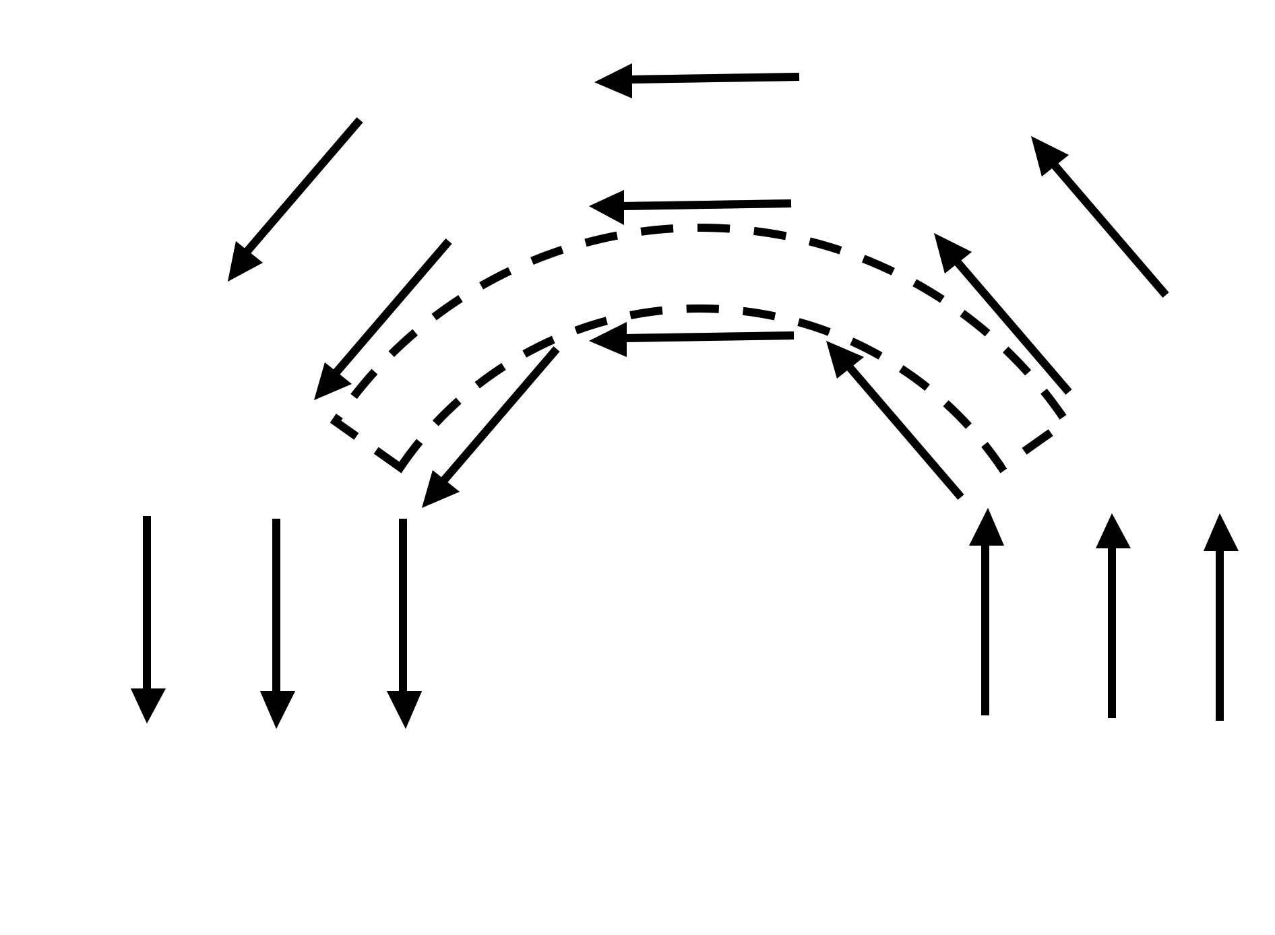
If the arrows represent a B field (note that |B| is the same everywhere), is there a nonzero J (perpendicular to the page) in the dashed region?
5.17b
Yes
No
Need more information to decide
Notes:
CORRECT ANSWER: A
USED IN: Fall 2008 (Dubson), Fall 2009 (Schibli)
LECTURE NUMBER: Dubson (Week 11, Lecture 28) (Skipped in Sp08)
STUDENT RESPONSES: [[74%]] 26% 0% 0% 0%
INSTRUCTOR NOTES: Answer is A, yes. If I consider the loop (which appears), the line integral around the loop is manifestly NOT zero (B has same magnitude everywhere, but length is bigger on the outer path). Nonzero line integral means I(enclosed) must be nonzero. -SJP
WRITTEN BY: Steven Pollock (CU-Boulder)

Slide 12
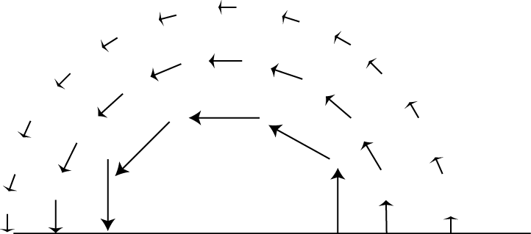
If the arrows represent a B field, is there a J (perpendicular to the page) in the dashed region?
5.17c
Yes
No
Need more information to decide
Notes:
CORRECT ANSWER: C
USED IN:
LECTURE NUMBER: Skipped
STUDENT RESPONSES: n/a
INSTRUCTOR NOTES: No time. Answer is C. If the field drops EXACTLY as 1/s (which it looks like it might, from the picture, but I can’t tell for sure), then that’s a curl free field! (Curl looks like 1/s d/ds (s B_phi)), so if B is azimuthal but goes exactly like 1/s, then it has no curl) So it’s hard to tell - the picture is compatible with e.g. a current running into the page just in a wire at the “center of those circles”, which would mean J is localized and is ZERO in the red-dashed region.
On the other hand, if the dependence is anything BUT 1/s, then -SJP
WRITTEN BY: Steven Pollock (CU-Boulder)

Slide 13
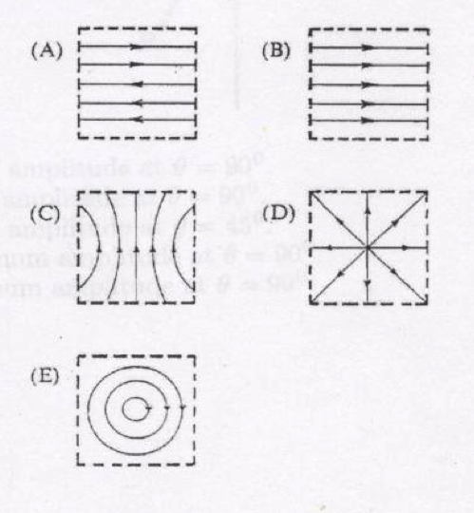
Pick a sketch showing B field lines that violate one of Maxwell’s equations within the region bounded by dashed lines.
5.18
(What currents would be needed to generate the others?)
Notes:
Skipped in 13
CORRECT ANSWER: D
USED IN: Fall 2008 (Dubson), Spring 2008 (Pollock)
LECTURE NUMBER: Dubson (Week 11, Lecture 28), Pollock (33)
STUDENT RESPONSES: 0% 4% 0% [[96%]] 0% (FALL 08)
0% 0% 6% [[94%]] 0% (SPRING 08)
INSTRUCTOR NOTES: Start of class. 94% got it. (I told them "if more than one violates Maxwell, pick the one which offends you the most") C got one vote. Although it's clearly easy for them, it was useful to discuss e.g. what CURRENT was needed for A (someone thought two magnets off to the sides could do it) C might be possible with currents only outside the region (probably need more info). E is fun because they thought it was the field from a wire, but it's not (field is not dropping off like 1/r) So, lots to talk about. I’m going to argue that D is the ONLY one which is not possible. (Magnetic monopole). A could occur if you have a sheet of charge around the top/middle heading away from you, E requires a wire heading away from you. -SJP
WRITTEN BY: Chandralekha Singh. Improving students' understanding of magnetism, C. Singh,Proceedings of the Annual Conference of the American Society forEngineering Education (ASEE), AC 2008-90, 1-16, (2008): http://www.asee.org/conferences/v2Search.cfm
13

Slide 14
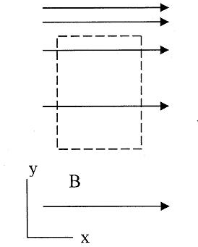
The magnetic field in a certain region is given by
(C is a positive constant) Consider the imaginary loop shown. What can you say about the electric current passing through the loop?
5.19
must be zero
must be nonzero
Not enough info
Notes:
Skipped in ‘13
CORRECT ANSWER: B
USED IN: Fall 2008 (Dubson), Spring 2008 (Pollock), Fall 2009 (Schibli)
LECTURE NUMBER: Dubson (Week 11, Lecture 29), Pollock (32)
STUDENT RESPONSES: 0% [[98%]] 2% 0% 0% (FALL 08)
53% [[47%]] 0% 0% 0% (SPRING 08)
34% [[66%]] 0% 0% 0% (FALL 2009)
INSTRUCTOR NOTES: (Also asked them for the sign/direction of the current, if it’s nonzero.)
Almost perfect 50/50 split between A and B IN SP08 (There was some confusion about “what causes what” - student wanted to know where would the current from from, does the B field produce it?? Interesting!)
Not sure why so many voted A, some didn’t notice the contributions on the top and bottom of the loop, some were confusing these arrows with E arrows. A very good student wanted to know if I_through is the same as “flux”. It’s interting, “J dotdA” is flux , it’s the flux of the electric CURRENT density, but we had been using flux in this class for flux of a field (E or, soon, B). Anyway, this was a good discussion, about notation and the difference between CURRENT and E field, which it turned out he was confused about (and I think is still a difficulty for some students).
Correct answer is B, the curl of this B is -A zhat, so there is a uniform J INTO the page. Can also integrate around that loop, and note the upper line contributes more than the lower, so integral is nonzero, so nonzero current enters. -SJP
WRITTEN BY: Mike Dubson (CU-Boulder)

Slide 15
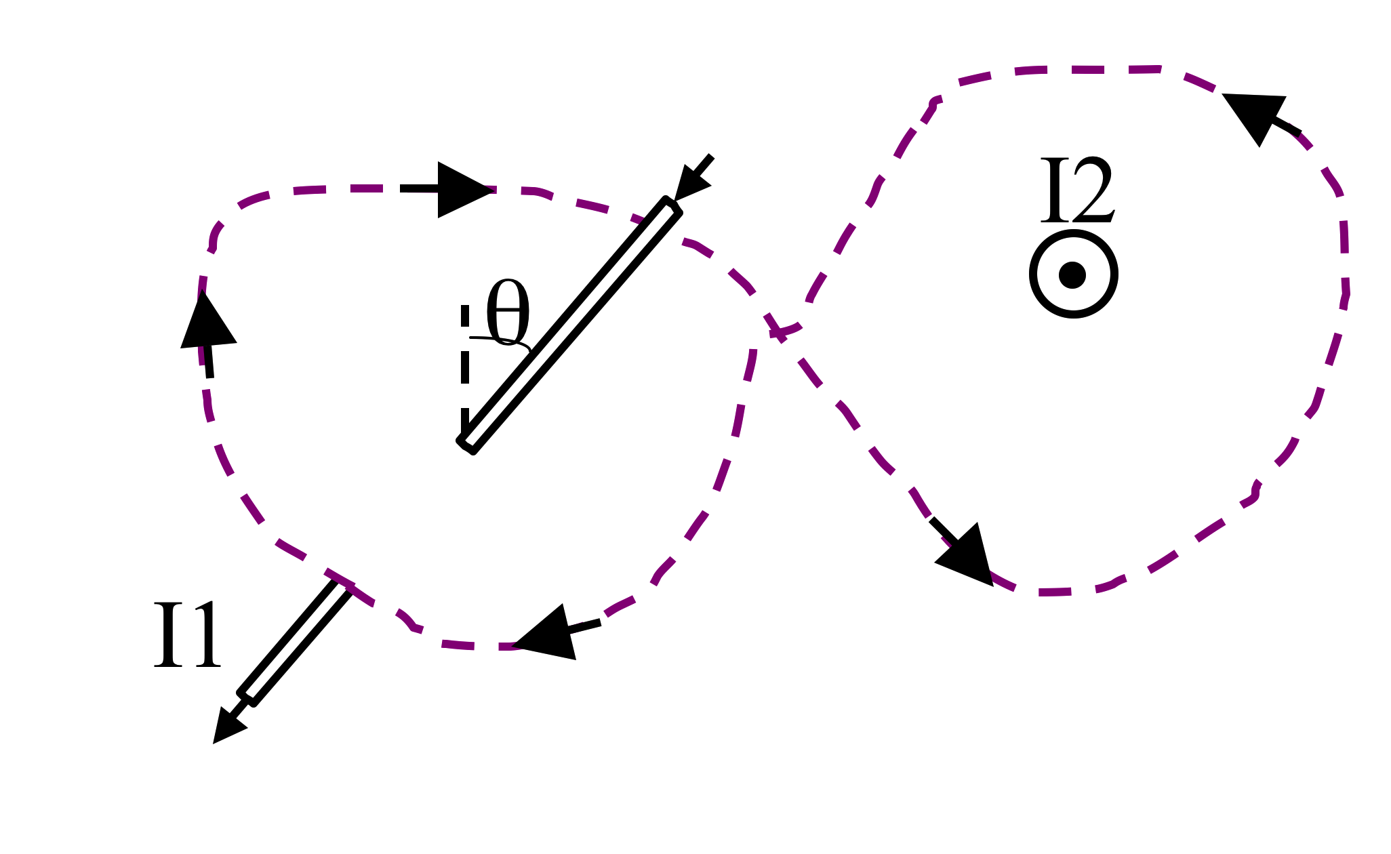
What is around this purple (dashed) Amperian loop?
5.22
μ₀ (|I₂ | +|I₁ |) B) μ₀ (|I₂|-|I₁|)
C) μ₀ (| I₂ | + | I₁ | sinθ) D) μ₀ (| I₂ | - | I₁ | sinθ)
E) μ₀ (| I₂ | + | I₁ | cosθ)
Notes:
CORRECT ANSWER: A (I changed E from “Something else” to this…
USED IN: Fall 2008 (Dubson), Spring 2008 (Pollock), Fall 2009 (Schibli)
LECTURE NUMBER: Dubson (Week 11, Lecture 29), Pollock (32, 34 in ‘13)
STUDENT RESPONSES: [[83%]] 11% 6% 0% 0% (FALL 08)
[[53%]] 7% 7% 20% 13% (SPRING 08)
[[60%]] 9% 11% 20% 0% (FALL 2009)
[[51]] 49, 0,0,0 (Sp ‘13) The vote was much more split, but I started discussing it and talked about the angle issue, so then it swept to “50/50” regarding the sign issue…
INSTRUCTOR NOTES: 53% voted for A. Very long discussion. The *sign* issue was one thing which required some talking, but what caught me by surprise was how many thought that there should be a sin(theta) or actually, many voted for E because they wanted a cos(theta).
The argument of one student was interesting: go back to a simple loop with a current poking through the center, but tilted at angle theta. Then, he said, think of that current as having an “inward component” given by I1 cos(theta), and a “sideways component” given by I1 sin(theta). Only the “inward component” should contribute to the integral of B dot dl, so.... the integral should be reduced by cos(theta!) It’s a nice argument, and I had to think awhile to realize a flaw - the B field at any given point on the circle would have to be modified from the “mu0 I / 2 pi r) because “r” (the distance to the center of the circle) will no longer be equal to “the distance to the wire”. This should be the “closest distance”.
Answer is A. Both currents point in the same direction based on the RHR. (Think of starting with both currents up, and then “giving a half twist” to one half). Ampere’s law just includes “I(through)” -SJP
In 2013 there was a new element to this discussion (which went for a LONG time), which sort of amounted to “why would you care about this”? (i.e. in what context would you need to do such an integral? Which I don’t have a great answer to – it’s practicing conventions)
WRITTEN BY: Steven Pollock (CU-Boulder). Inspired by Reay et al's AJP article. AJP 73 (2005) P. 554

Slide 16
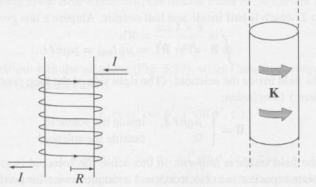
A solenoid has a total of N windings over a distance of L meters. We "idealize" by treating this as a surface current running around the surface.
What is K?
5.20
I B) NI C) I/L D) I N/L
E) Something else...
Notes:
CORRECT ANSWER: D
USED IN: Fall 2008 (Dubson), Spring 2008 (Pollock), Fall 2009 (Schibli)
LECTURE NUMBER: Dubson (Week 11, Lecture 29), Pollock (33, 34 in ‘13)
STUDENT RESPONSES: 0% 17% 2% [[76%]] 4% (FALL 08)
0% 5% 5% [[89%]] 0% (SPRING 08)
0% 24% 2% [[74%]] 0% (FALL 2009)
0, 28, 4, [[62]], 6 (Sp ‘13)
INSTRUCTOR NOTES: 89% correct. I thought this might generate mistakes, but I'm glad they know what K means.
Discussion around this was fruitful - in particular, I pointed out that in the IDEAL solenoid, current is pure azimuthal (so e.g. there will be ZERO field outside). But in REAL solenoid with a pitch, there is a "residual" current I running up the page, and so there will be a (small) field outside just like you'd get for a single vertical wire with I. It's a subtlety, but worth talking about I think. (One student suggested winding "back" with the opposite pitch, a nice idea!)
I think some of the votes for B are confusing N with “number density”.
-SJP
WRITTEN BY: Steven Pollock (CU-Boulder). Image from Griffiths.

Slide 17
MD11-3
z
An infinite solenoid with surface current density K is oriented along the z-axis. Apply Ampere's Law to the rectangular imaginary loop in the yz plane shown. What does this tell you about Bz, the z-component of the B-field outside the solenoid?
K
Bz is constant outside
Bz is zero outside
Bz is not constant outside
It tells you nothing about Bz
Notes:
CORRECT ANSWER: A
USED IN: Fall 2008 (Dubson), Fall 2009 (Schibli)
LECTURE NUMBER: Dubson (Week 11, Lecture 29)
STUDENT RESPONSES: [[35%]] 41% 4% 20% 0% (FALL 2008)
[[24%]] 45% 5% 26% 0% (FALL 2009)
[[64]], 21, 2, 13 (Sp ‘13), but I left the vote open while discussing it, before that the distribution was very spread out.
INSTRUCTOR NOTES: I had DONE this loop the previous class, there were lots of ideas, including the idea that it tells you nothing because the integral is zero, and many thought that it would tell you B=0 because the integral is zero (!!, not because of the boundary condition at infinity)
WRITTEN BY: Mike Dubson (CU-Boulder)
17

Slide 18
MD11-3
z
An infinite solenoid with surface current density K is oriented along the z-axis. Apply Ampere's Law to the rectangular imaginary loop in the yz plane shown.
We can safely assume that B(s→∞)=0. What does this tell you about the B-field outside the solenoid?
K
|B| is a small non-zero constant outside
|B| is zero outside
|B| is not constant outside
We still don’t know anything about |B|
Notes:
CORRECT ANSWER: B
USED IN: Fall 2009 (Schibli)
LECTURE NUMBER:
STUDENT RESPONSES: 2% [[93%]] 2% 2% 0% (FALL 2009)
INSTRUCTOR NOTES:
WRITTEN BY: Thomas Schibli (CU-Boulder)
I skipped this in ‘13, but we talked about it.
18

Slide 19
Infinite Solenoid
5.23
Loop 1
Loop 2


Loop 3
In the case of the infinite solenoid we used loop 1 to argue that the B-field outside is zero. Then we used loop 2 to find the B-field inside. What would loop 3 show?
The B-field inside is zero
It does not tell us anything about the B-field
Something else
Notes:
CORRECT ANSWER: C
USED IN: Spring 2008 (Pollock)
LECTURE NUMBER: 33
STUDENT RESPONSES: 0% 32% [[68%]] 0% 0%
INSTRUCTOR NOTES: 33% went for "B, tells us nothing". But I argue it does tell you something. One student pointed out that if loop 3 is "symmetric about the middle", it really just tells you the simpler fact that B is "symmetric" about the midline. You need to be sure loop 3 is NOT symmetric about the middle (e.g. shift it up) to find out that B is uniform in there.
Ans (C), IT shows that the B-field inside is constant, but not necessarily zero. Loop 1 leads to the argument that it is zero because the B-field is constant, and B -->0 as r--> infinity. -SJP
(Didn’t click in ‘13, but discussed. It’s good)
WRITTEN BY: Ward Handley (CU-Boulder)

Slide 20
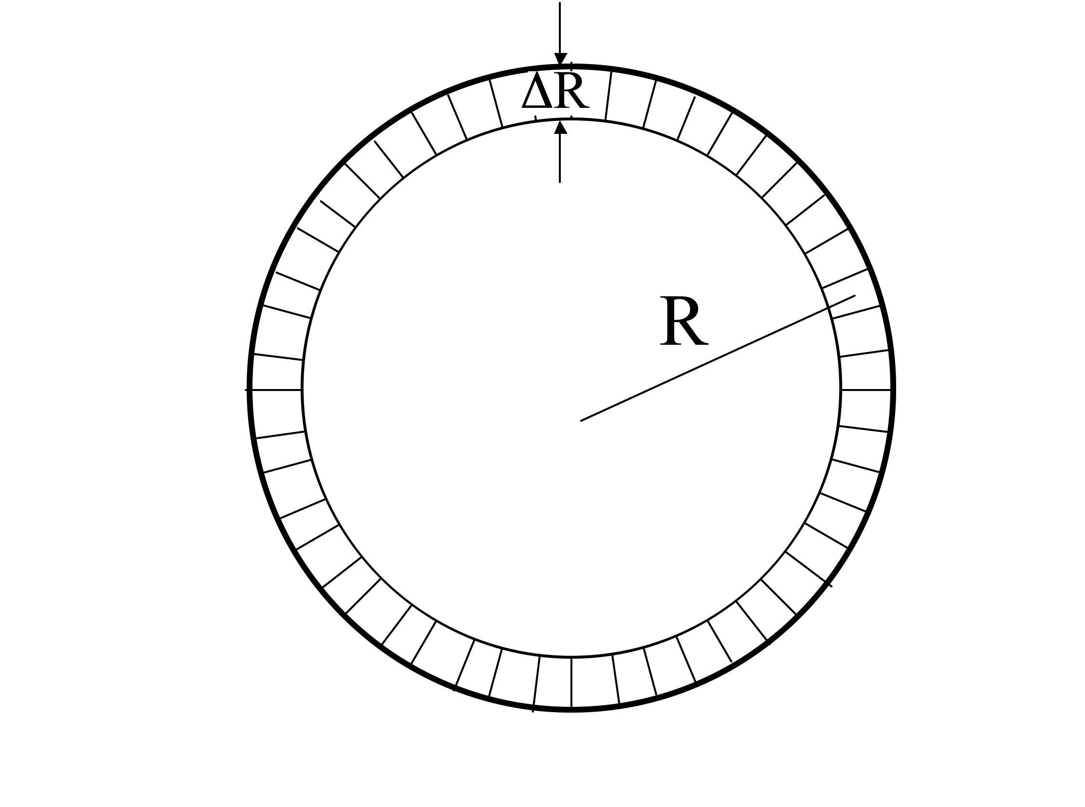
A thin toroid has (average) radius R and a total of N windings with current I.
We "idealize" this as a surface current running around the surface.
What is K, approximately?
5.21a
I/R B) I/(2 π R)
C) NI/R D) NI/(2 π R)
E) Something else
Notes:
Skipped for time in ‘13
CORRECT ANSWER: D
USED IN: Fall 2008 (Dubson), Fall 2009 (Schibli)
LECTURE NUMBER: Dubson (Week 12, Lecture 30)
STUDENT RESPONSES: 0% 16% 9% [[57%]] 18% (FALL 2008)
0% 3% 3% [[92%]] 3% (FALL 2009)
INSTRUCTOR NOTES:
Skipped in 2013
WRITTEN BY: Steven Pollock (CU-Boulder)

Slide 21

What direction do you expect the B field to point?
5.21b
Azimuthally
Radially
C) In the z direction
(perp. to page)
D) Loops around the rim
E) Mix of the above...
Notes:
CORRECT ANSWER: A
USED IN: Fall 2009 (Schibli)
LECTURE NUMBER:
STUDENT RESPONSES: n/a
[[78%]] 0% 6% 11% 6% (FALL 2009)
INSTRUCTOR NOTES: -SJP
Skipped in ‘13, but discussed.
WRITTEN BY: Steven Pollock (CU-Boulder)

Slide 22
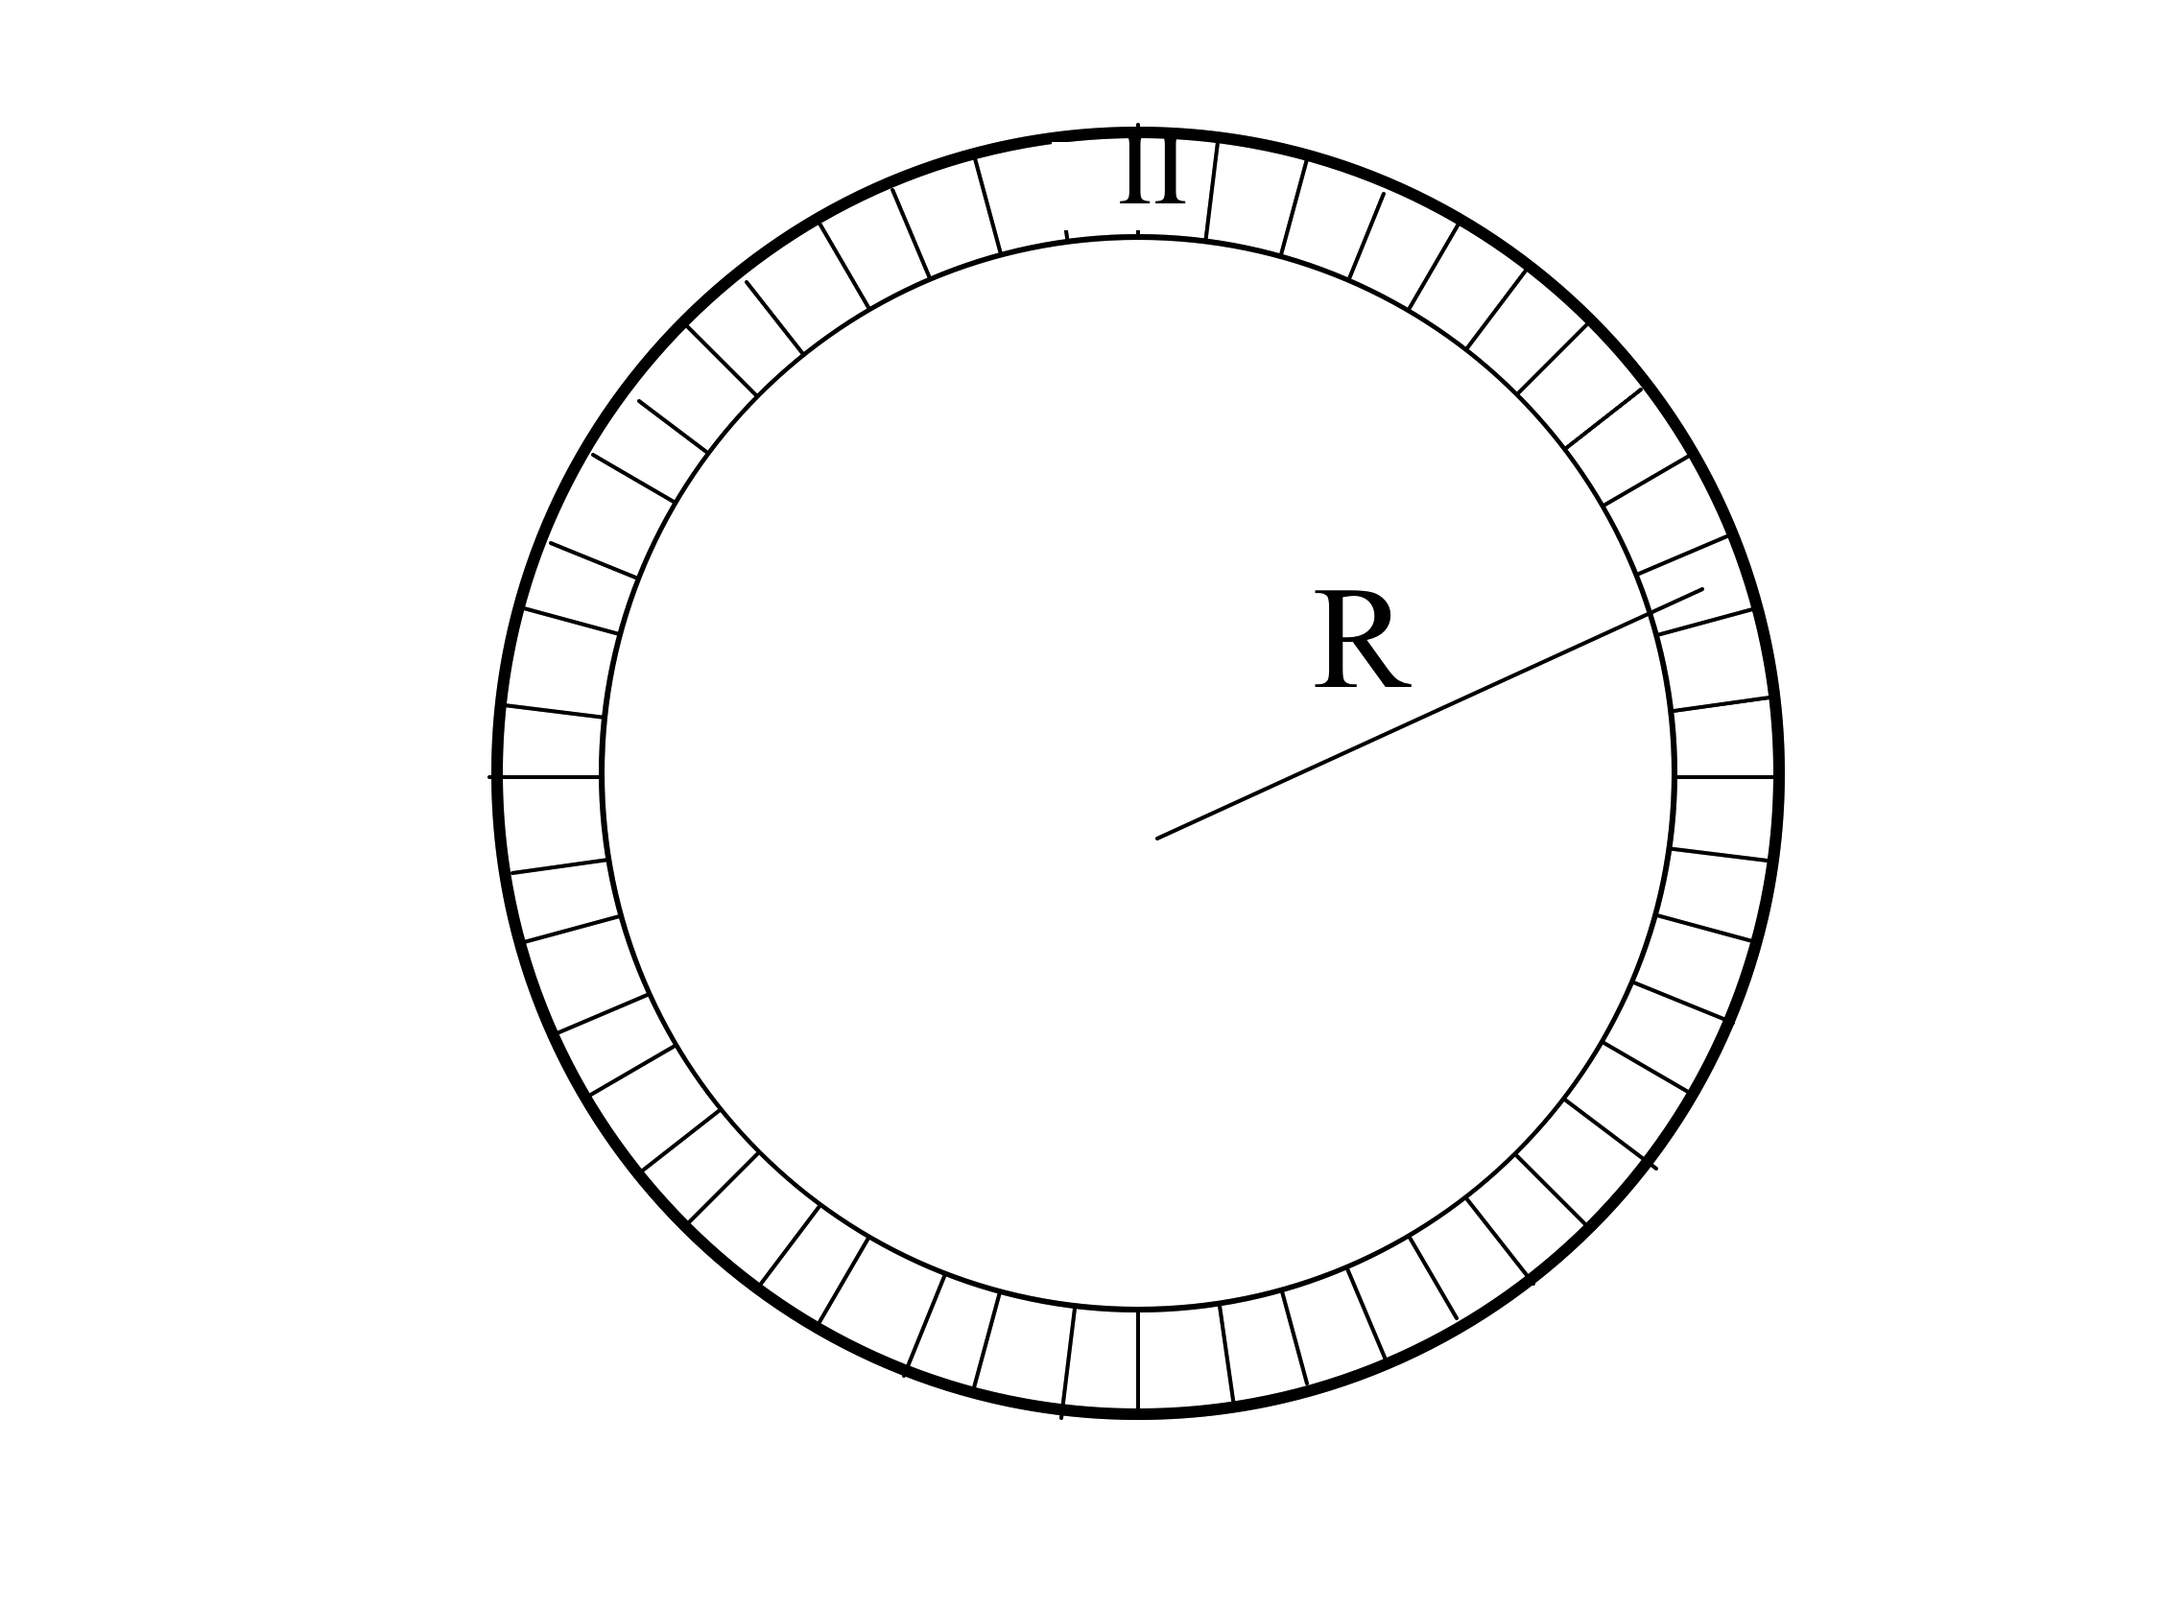
What Amperian loop would you draw to find B “inside” the Torus (region II)
5.21c
Large “azimuthal” loop
B) Smallish loop from
region II to outside
(where B=0)
C) Small loop in region II
D) Like A, but perp to page
E) Something entirely different
Notes:
CORRECT ANSWER: A
USED IN: Spring 2008 (Pollock), Fall 2009 (Schibli)
LECTURE NUMBER: 34
STUDENT RESPONSES: [[75%]] 13% 6% 0% 6% (SPRING 2008)
[[67%]] 3% 25% 0% 6% (FALL 2009)
[[52]], 31, 8, 8, 2 (Sp ‘13)
INSTRUCTOR NOTES: (Used as review/pre-class question for L34) 75% correct.Note that it is "animated", but in the end I didn't use that feature since I used it as the start of class question. Answer is A, B field runs around just like loop A. -SJP
WRITTEN BY: Steven Pollock (CU-Boulder)

Slide 23
Which Amperian loop would you draw to learn something useful about B anywhere?
K
z
x
Notes:
Review question for discussion (used in Final lecture, Spring 2013, SJP)

Slide 24
Which Amperian loops are useful to learn about B(x,y,z) somewhere?
Notes:
Followup to previous one: use as review in final lecture, Spring 2013, SJP
Good discussion points.
(I argue A *is* useful, it can be used to teach us that the B field does not diminish with distance from the sheet (once we have used symmetry to argue that it can only have a z component out there)
(And of course B is also useful to figure out B explicitly)

Slide 25
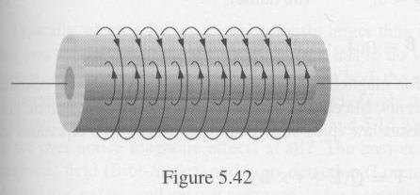
Two long coaxial solenoids each carry current I but in opposite directions.
The inner solenoid (radius a) has n1 turns per unit length, and the outer one (radius b) has n2.
5.21
d
Find B (i) inside the solenoid, (ii) between them, and (iii) outside both.
Notes:
25
CORRECT ANSWER:
USED IN:
LECTURE NUMBER: Skipped
STUDENT RESPONSES: n/a
INSTRUCTOR NOTES: Whiteboard activity. Looks *great*, but I didn't take time for it!
“We monitor the communication and discussion of this problem by doing it in class instead of having it as a HW (and then when one person gets it everyone else copies it). Those learning in groups will not benefit from this. -SJP
WRITTEN BY: Griffiths (problem 5.15.)

Slide 26
An electron is moving in a straight line with constant speed v. What approach would you choose to calculate the B-field generated by this electron?
v
e⁻
Biot-Savart
Ampere’s law
Either of the above.
Neither of the above.
Notes:
CORRECT ANSWER: D
USED IN: Fall 2009 (Schibli)
LECTURE NUMBER: 31
STUDENT RESPONSES: 15% 31% 10% 44% [[0%]] (FALL 2009)
INSTRUCTOR NOTES: You might want to modify this to make sure students do not think of Ampere’s law as the Maxwell-Ampere equation.
WRITTEN BY: Thomas Schibli (CU-Boulder)
I did not click on this in 2013, but we discussed it, it’s nice. And, generated some interesting questions, including whether Biot-Savart is a “good approximation” (which it is if v<<c, I think) -SJP
26

Slide 27
BOUNDARY CONDITIONS
Notes:
In 2013 this came a little later.
WRITTEN BY: Steven Pollock (CU-Boulder)

Slide 28
Choose boundary conditions
5.28
When you are done with p. 1:
Choose all of the following statements that are implied if for any/all closed surfaces
(I)
(II)
(III)
A) (I) only
B) (II) only
C) (III) only
D) (I) and (II) only
E) (I) and (III) only
Notes:
CORRECT ANSWER: D
USED IN: Spring 2008 and 13 (Pollock), Fall 2009 (Schibli)
LECTURE NUMBER: 36 (and again in 37 in 13) SJP
STUDENT RESPONSES: 11% 6% 39% [[28%]] 17% (SPRING 2008)
3% 13% 8% [[77%]] 0% (FALL 2009)
0, 24, 10, [[62]], 3 (Sp ‘13), End of class, not all voted. Start of class: 4, 4, 2, 7, [[82]]
INSTRUCTOR NOTES: Start of class with this. I did it silently first, and they were all over the map. (Correct answer D had 28%). Then I let them talk to their neighbors, D moved to 50% (and C and E were equally represented). I'm voting for I and also III, which gives D. –SJP
WRITTEN BY: Chandralekha Singh. Improving students' understanding of magnetism, C. Singh,Proceedings of the Annual Conference of the American Society forEngineering Education (ASEE), AC 2008-90, 1-16, (2008): http://www.asee.org/conferences/v2Search.cfm
28

Slide 29
I have a boundary sheet, and would like to learn about the change (or continuity!) of B(parallel) across the boundary.
6.11
B(above)
B//(above)
Am I going to need to know about
A)
B)
C) ???
Notes:
CORRECT ANSWER: A
USED IN: Fall 2008 (Dubson) and Spring 2008 and 13 (Pollock)
LECTURE NUMBER: Dubson (Week 14, Lecture 39). Pollock (Lecture 40, 37 in ‘13).
STUDENT RESPONSES: [[42%]] 58% 0% 0% 0% (FALL 2008)
[[63%]] 37% 0% 0% 0% (SPRING 2008)
[[88]], 13, 0, 0, 0 (Sp ‘13)
INSTRUCTOR NOTES: Nice one! 60/40 split, good discussion, they woke up for this one. Some students see this by now, but others still don't know this "game". It was productive to have THEM construct the argument, think about stokes theorem, (and divergence theorem/H perp came up, so I skipped next one, that's fine). A winner.
ANSWER is A, you need to construct a short Amperian loop, and use Stoke's theorem to argue that the line integral (which tells you about H// above - H//below) must be determined by the area integral of the curl. In this case, that would be the area integral of J(free), which will only be nonzero if there is a delta function, i.e. a surface free current on the sheet. Also good to talk about DIRECTIONS, since "H//" is really still a 2-D vector. (See Griffiths, the discontinuity is given by K(free) cross n hat.
In ‘Sp ‘13 this happened DURING an in-class tutorial that targeted exactly this idea, and I had clearly outlined that the divergence of B gives you info on B_perp, so no surprise it was a stronger outcome (not sure why it was not 100%, in fact!)
-SJP
WRITTEN BY: Steven Pollock (CU-Boulder)

Slide 30
If B=B₀ in the +x direction just RIGHT of the sheet, what can you say about B just LEFT of the sheet?
+x direction
-x direction
+z direction
-z direction
Something else!
B₀
K
z
x
Notes:
Used as review question in Final lecture, Spring 2013, SJP
Correct answer: E
57, 13, 2, 7, [[22]]
Sadly, they were 57% for A. It is true that B_perp has to be continuous, but it is ALSO true that the parallel component must jump by mu0*K, so the answer is E, is is B0xhat + mu0 K yhat, up and right.
Steven Pollock

Slide 31
In general, which of the following are continuous as you move past a boundary?
5.28b
A) A B) Not all of A, just A_{perp}
C) Not all of A, just A//
D) Nothing is guaranteed to be continuous regarding A
Notes:
Come back to this once covered A field
CORRECT ANSWER: A
USED IN: Fall 2008 (Dubson), Spring 2008 and ‘13 (Pollock), Fall 2009 (Schibli)
LECTURE NUMBER: Dubson (Week 12, Lecture 32), Pollock (36, 37 in ‘13)
STUDENT RESPONSES: [[40%]] 24% 17% 19% 0% (FALL 08)
[[88%]] 6% 6% 0% 0% (SPRING 08)
[[39%]] 50% 7% 4% 0% (FALL 2009)
[[56]], 26, 14, 4, 0 (Sp ‘13)
INSTRUCTOR NOTES: 88%. They knew the answer because I’ve told them several times, but during the discussion they were not able to articulate WHY. Answer A) A is continuous everywhere (as long as you have no infinite or Delta function B fields anywhere, which would not be physical?).
Think of B = Curl(A), if B is finite, then A will have to be continuous to have a finite curl. Griffiths has a more rigorous discussion... But in Coulomb gauge, Del.A =0 gives you continuity of A_perp, and curlA=B, integrated a la Stokes gives you continuity of A parallel as long as you can make the B flux go to zero (i.e, no infinite B fields!)
(In ‘13 we had a discussion I’m not sure of the answer to – from curl(A)=B ALONE I seem to only be able to argue for C… without the Coulomb gauge *choice*, I don’t see how to say anything about A_perp. So, IS it a choice, or is it guaranteed. )
-SJP
WRITTEN BY: Steven Pollock (CU-Boulder)

