Slide 1
AUXILIARY FIELD H
Notes:
WRITTEN BY: Steven Pollock (CU-Boulder)

Slide 2
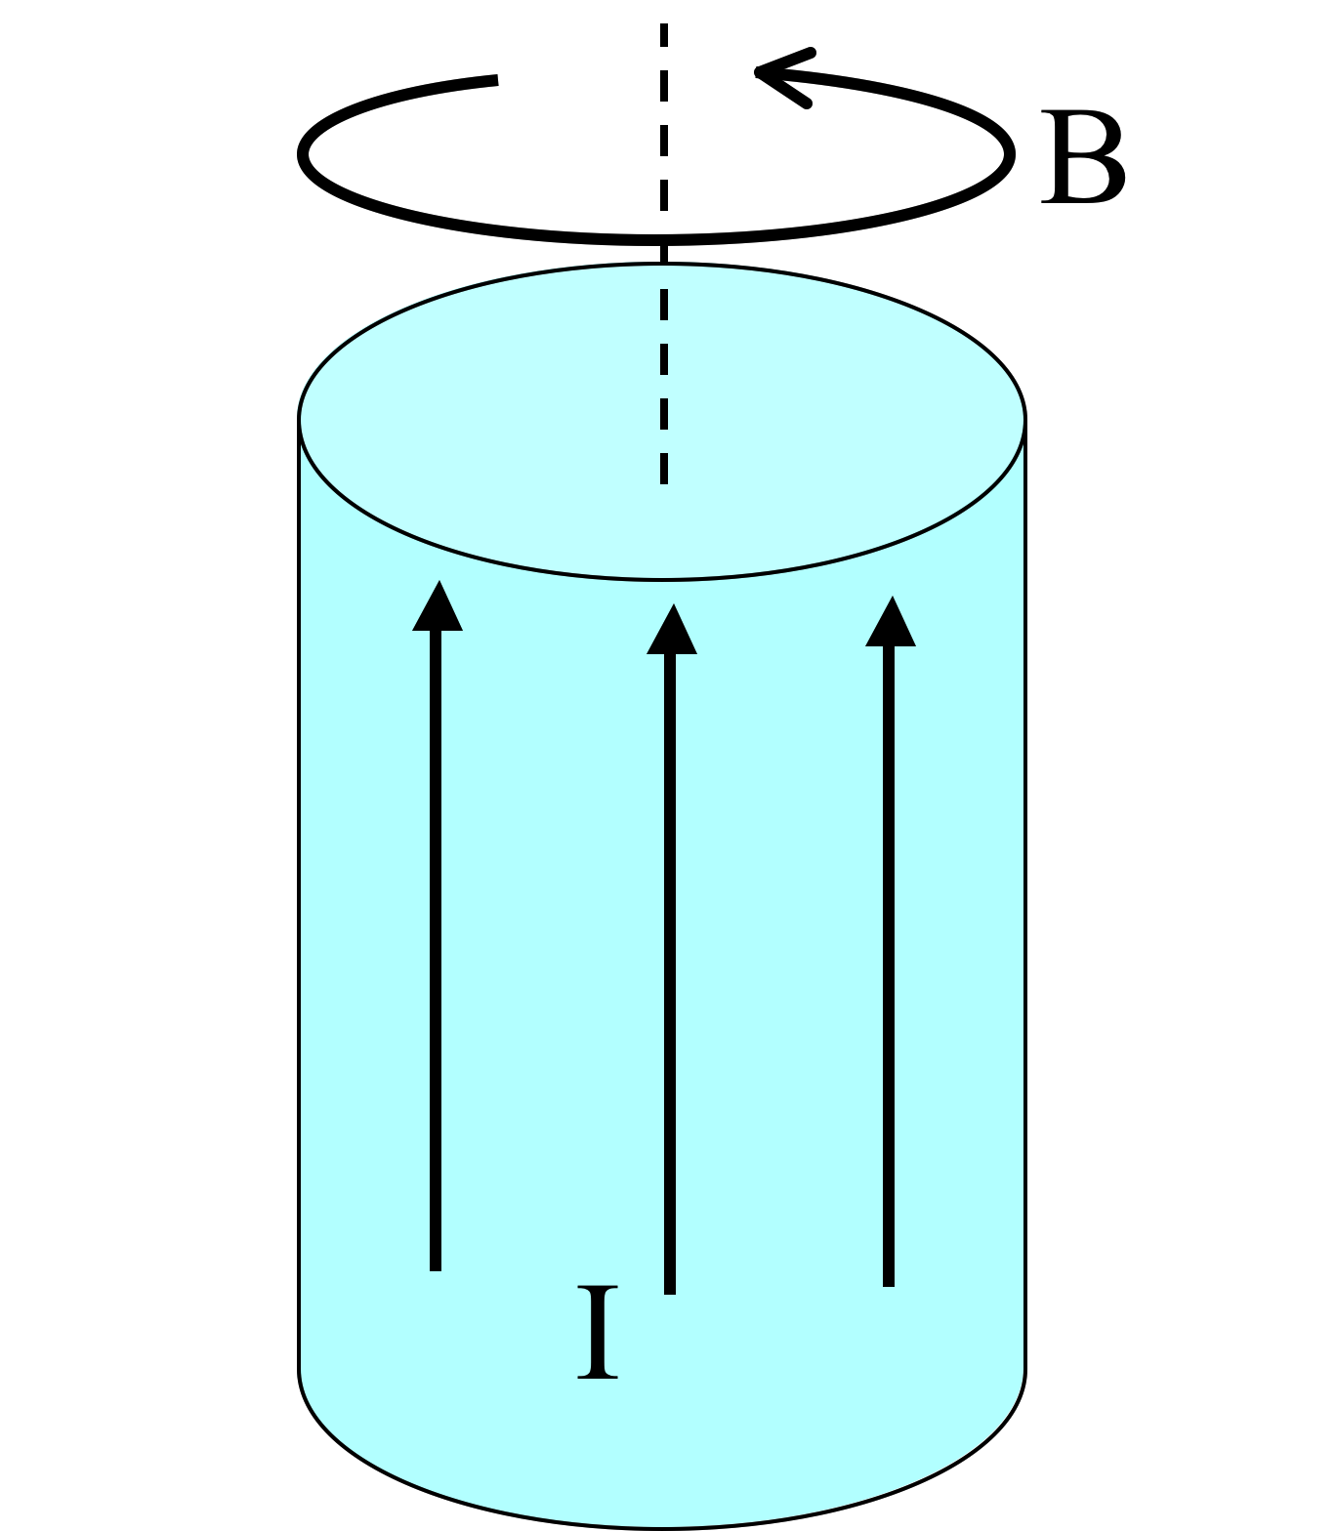
A very long aluminum (paramagnetic!) rod carries a uniformly distributed current I along the +z direction. We know B will be CCW as viewed from above. (Right?)
What about H and M inside the cylinder?
6.8
Both are CCW
B) Both are CW
C) H is CCW, but M is CW
D) H is CW, M is CCW
E) ???
Notes:
CORRECT ANSWER: A
USED IN: Fall 2008 (Dubson) and Spring 2008 and 13 (Pollock), Fall 2009 (Schibli)
LECTURE NUMBER: Dubson (Week 14, Lecture 39). Pollock (Lecture 39, 41 in 2013).
STUDENT RESPONSES: [[88%]] 2% 7% 0% 2% (FALL 2008)
[[81%]] 0% 19% 0% 0% (SPRING 2008)
[[39%]] 0% 45% 16% 0% (FALL 2009)
[[83]], 2, 9, 7, 0 (Sp ‘13)
INSTRUCTOR NOTES: 81% for A (with 20%, 3 votes, for C) Not a lot of problems, and the argument for why H is CCW seemed solid. (Note that H = B/mu0 - M looks, at first glance, ambiguous - you have "CCW" minus "CCW", which one wins? Several students pointed to integral of H dot dl = I(free, through) as direct evidence.)
Argument for M is that it’s a paramagnet, it should be PARAllel to B (That’s pretty much the definition of paramagnetism)
-SJP
WRITTEN BY: Steven Pollock (CU-Boulder)

Slide 3
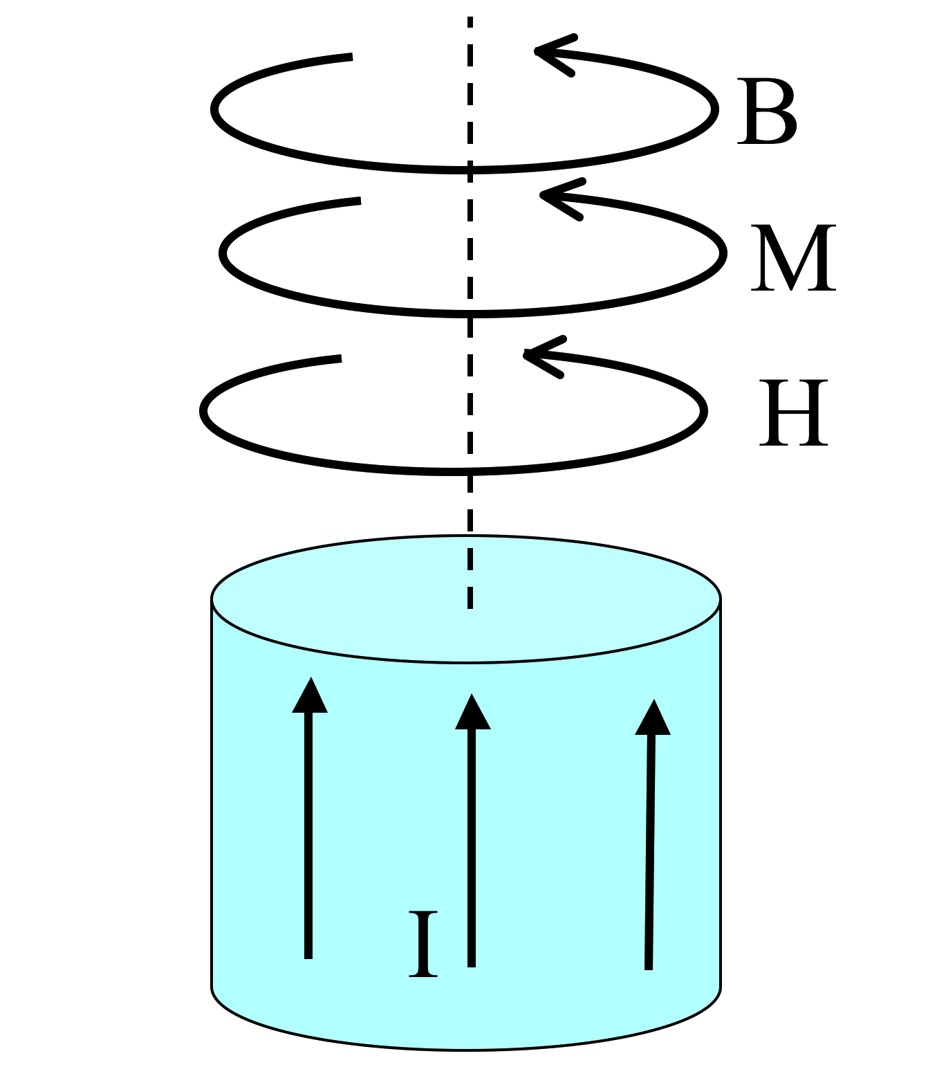
A very long aluminum (paramagnetic!) rod carries a uniformly distributed current I along the +z direction. What is the direction of the bound volume current?
J_{B} points parallel to I
J_{B} points anti-parallel to I
It’s zero!
Other/not sure
Notes:
CORRECT ANSWER: A
USED IN: Spring 2008 and ‘13 (Pollock)
LECTURE NUMBER: 40 (41 in ‘13)
STUDENT RESPONSES: [[100%]] 0% 0% 0% 0% (Sp ‘08)
[[89]], 11, 0, 0, (Sp ‘13)
INSTRUCTOR NOTES: Start of class. 100% correct. Good (and varied) explanations, no problems, too easy... Answer is A. Can argue by looking at magnetization (and take curl), or think about "para" & argue that B is slightly enhanced...
In 2013 there was a little more debate, some students were I think confused about whether “I” is “I free” in the picture? Couldn’t really get students to articulate a reason for voting B, though
We also did it mathematically: “remembered” that B goes like radius (without any magnetic effects, anyway), and thus curl(M) will be proportional (if it’s linear) to curl(B), which is 1/s d/ds (s M_phi), thus 1/s d/ds s^2 = 2(constants), i.e. a positive constant.
-SJP
WRITTEN BY: Steven Pollock (CU-Boulder)

Slide 4
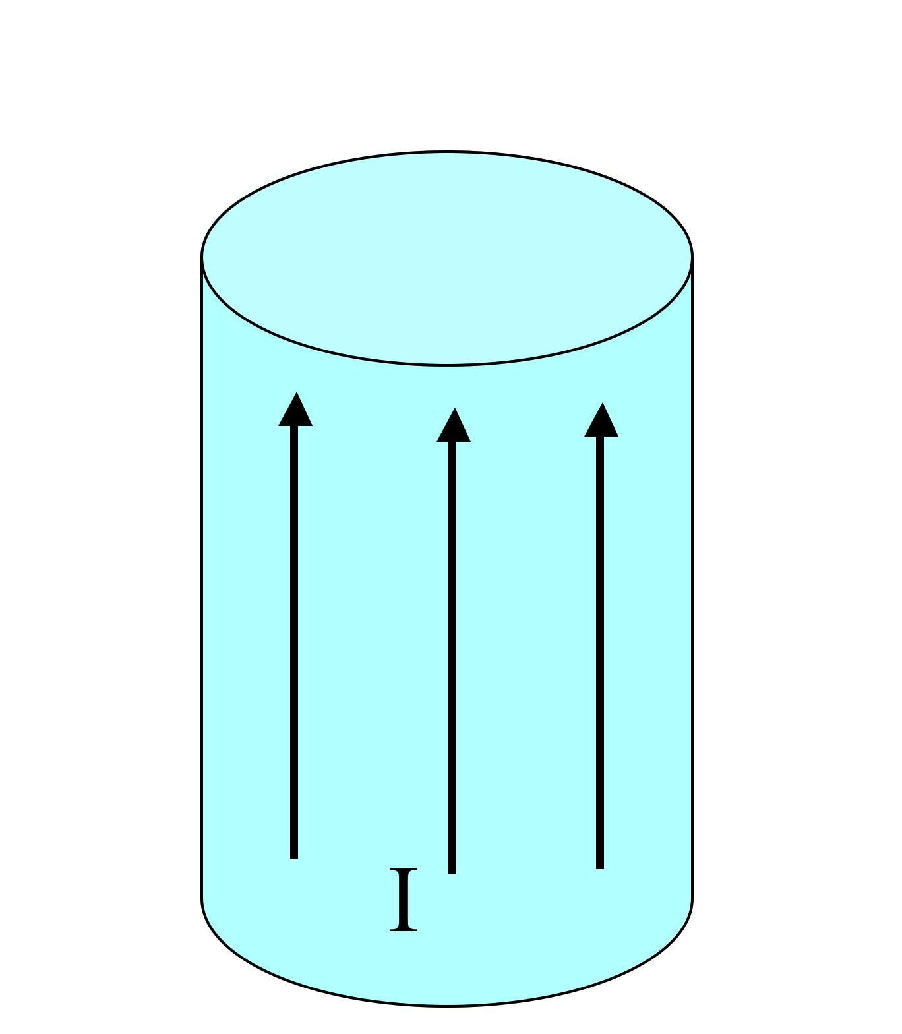
A very long aluminum (paramagnetic!) rod carries a uniformly distributed current I along the +z direction.
What is the direction of the bound surface current?
6.9b
K_{B} points parallel to I
K_{B} points anti-parallel to I
Other/not sure
Notes:
CORRECT ANSWER: B
USED IN: Spring 2008 (Pollock)
LECTURE NUMBER: 40
STUDENT RESPONSES: 11% [[89%]] 0% 0% 0%
INSTRUCTOR NOTES: 89% correct (2 votes for A) Again, piece of cake for them. One argument was "since Jb is up, Kb must be down to not violate current conservation", but the student (and I) were not quite able to articulate this argument precisely. (J and K are in different places, so it's some sort of global conservation law being invoked - how does one formalize this?) But anyway, we also talked about M cross N, and also (see next slide) I made the direct microscopic argument.
-SJP
WRITTEN BY: Steven Pollock (CU-Boulder)

Slide 5
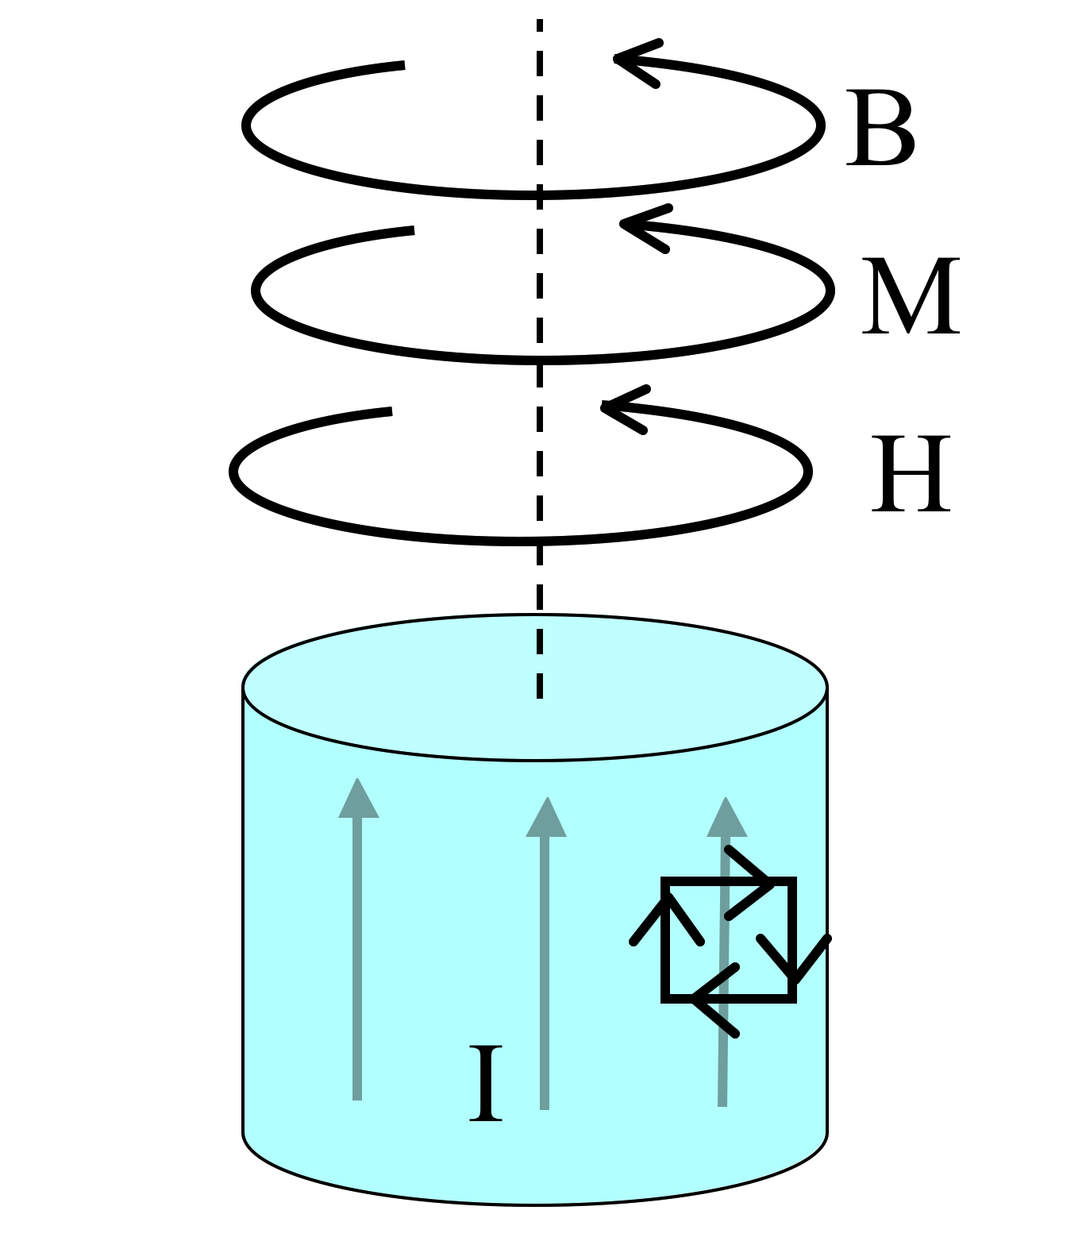
Summary:
A very long aluminum (paramagnetic!) rod carries a uniformly distributed current I along the +z direction.
J_{B} points parallel to I
K_{B} points anti-parallel to I
Total bound current vanishes, conservation of charge!
Notes:
Helps Answer previous by showing a little magnetic moment in the M direction near the edge.
Regarding J: If you think about the B field which grows with “s”, so does the M field, and thus you can ALSO think about a microscopic reason for why J points up, look at a PAIR of atomic loops side by side. The one “further out” is a little stronger, more current, and that leads to a net “up” current throughout the volume.

Slide 6
6.8
What if that long rod (the wire) was made of copper (diamagnetic!) instead. Of B, M, H, and J_bound, which ones “flip sign”?
A) All 4 flip
B) 3 of the 4 flip
C) 2 of the 4 flip
D) 1 of them flips
E) None of them flips
The “para” case
The “dia” case
Notes:
CORRECT ANSWER: C
USED IN: Spring 2013 (Pollock),
LECTURE NUMBER: Pollock (Lecture 41).
STUDENT RESPONSES: 2, 6, [[83]], 6, 2 (SP ‘13)
INSTRUCTOR NOTES: B does not flip, even in a diamagnet. (At best, in a superconductor, it can be cancelled out) H is determined by I(free), which is unchanged, so it too does not flip.
M however is now opposite H (and B), and this it does flip. And as a result, J_bound flips. So C is correct.
(One student wanted to ALSO count K_bound, which also flips, I just hadn’t listed it…)
-SJP
WRITTEN BY: Steven Pollock (CU-Boulder)

Slide 7
What if that long rod (the wire) was made of copper (diamagnetic!) instead. Of B, M, H, and J_bound, which ones “flip sign”?
6.8
A) All 4 flip
B) 3 of the 4 flip
C) 2 of the 4 flip
D) 1 of them flips
E) None of them flips
The “para” case
The “dia” case
Notes:
Animated to show the answer

Slide 8
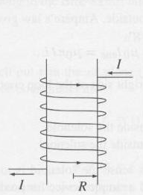
Inside a hollow solenoid,
B=B₀=μ₀nI.
What is the formula for H inside?
Notes:
CORRECT ANSWER: nI
USED IN: Spring ‘13 (Pollock)
LECTURE NUMBER: 41
I added this question in 2013, it helps with the next one, and reminds them of “Ampere’s law” for H fields.
Since curl(H) = I_free
Curl(B) = mu0 I,
And here I = Ifree (there’s nothing else going on) the same result can be “extracted” with no particular labor, no reason to go back to Amperian loops, just write down the answer!

Slide 9
Inside a hollow solenoid,
B=B₀=μ₀nI, ( so H=H₀=nI )
If the solenoid is filled with a normal paramagnetic material, like aluminum, what is B inside?...
Still exactly B₀
B) a little more than B₀
C) a lot more
D) a little less than B₀
E) a lot less than B₀
Notes:
CORRECT ANSWER: B
USED IN: Spring 2008 and ‘13 (Pollock), Fall 2009 (Schibli)
LECTURE NUMBER: 42 (41 in SP ‘13)
STUDENT RESPONSES: 0% [[85%]] 15% 0% 0% (SPRING 2008)
5% [[95%]] 0% 0% 0% (FALL 2009)
2, [[90]], 8 0,0 (Sp ‘13)
INSTRUCTOR NOTES: 85% B, couple C's. Not a lot of discussion, perhaps not a great question, just a nice little warmup...
In 2013, the formula B = mu H is on the board, so they really just have to convince themselves that H is the one that’s unaffected by the material (just the free current)
Answer is B, I fixed an issue in 2013 by explicating that it’s aluminum, so the “llittle” vs “lot” issue is now clearer.
-SJP
WRITTEN BY: Steven Pollock (CU-Boulder). Figure from Griffiths.

Slide 10
Inside a hollow solenoid,
B=B₀=μ₀nI, ( so H=H₀=nI )
If the solenoid is filled with iron, what is H inside?...
H₀
B) a little more than H₀
C) a lot more
D) a little less than H₀
E) a lot less than H₀
Notes:
CORRECT ANSWER: A
USED IN: Fall 2008 (Dubson) and Spring 2008 (Pollock), Fall 2009 (Schibli)
LECTURE NUMBER: Dubson (Week 14, Lecture 40). Pollock (Lecture 42, 41 in ‘13).
STUDENT RESPONSES: [[14%]] 7% 32% 11% 36% (FALL 2008)
[[ 78%]] 0% 6% 11% 6% (SPRING 2008)
[[47%]] 13% 32% 0% 8% (FALL 2009)
[[61]], 2, 2, 18, 16 (Sp ‘13)
INSTRUCTOR NOTES: Slightly a “trick” question, watch out for what I’m asking! 78% for A, but it took them quite a long time, and after about a minute (of good conversation!) they were about 33% for A. I made a few loud comments to several people which re-steered some conversations. E.g. One group was confident about "a lot more", but I asked why, and they said "well, B is huge in there". (Which is true, but I’m asking H, not B, and mu is also huge!)
The formula B = mu H is on the board. So I think some other students are thinking “mu is big, so H must be correspondingly small”, a kind of “compensation” argument. But this argument presumes B is somehow “fixed”, which it certainly is not.
Discussions tended to zoom in on curl(H)=J(free), but it took awhile! Answer is A, curl(H) = Jfree says H here is determined just by nI, nothing more... -SJP
WRITTEN BY: Steven Pollock (CU-Boulder). Figure from Griffiths.

Slide 11
BOUNDARY VALUE PROBLEMS
Notes:
WRITTEN BY: Steven Pollock (CU-Boulder)

Slide 12
I have a boundary sheet, and would like to learn about the change (or continuity!) of H(parallel) across the boundary.
6.11
H(above)
H//(above)
Am I going to need to know about
A)
B)
C)
???
Notes:
CORRECT ANSWER: A
USED IN: Fall 2008 (Dubson) and Spring 2008 and 13 (Pollock)
LECTURE NUMBER: Dubson (Week 14, Lecture 39). Pollock (Lecture 40, 41 in ‘13).
STUDENT RESPONSES: [[42%]] 58% 0% 0% 0% (FALL 2008)
[[63%]] 37% 0% 0% 0% (SPRING 2008)
[[73]], 27, 0, 0, 0 (Sp ‘13)
INSTRUCTOR NOTES: Nice one! 60/40 split, good discussion, they woke up for this one. Some students see this by now, but others still don't know this "game". It was productive to have THEM construct the argument, think about stokes theorem, (and divergence theorem/H perp came up, so I skipped next one, that's fine). A winner.
ANSWER is A, you need to construct a short Amperian loop, and use Stoke's theorem to argue that the line integral (which tells you about H// above - H//below) must be determined by the area integral of the curl. In this case, that would be the area integral of J(free), which will only be nonzero if there is a delta function, i.e. a surface free current on the sheet. Also good to talk about DIRECTIONS, since "H//" is really still a 2-D vector. (See Griffiths, the discontinuity is given by K(free) cross n hat. -SJP
WRITTEN BY: Steven Pollock (CU-Boulder)

Slide 13
I have a boundary sheet, and would like to learn about the change (or continuity!) of H(perp) across the boundary.
6.11b
H(above)
H⊥(above)
Am I going to need to know about
A)
B)
C)
???
Notes:
CORRECT ANSWER: B
USED IN
LECTURE NUMBER: Skipped
STUDENT RESPONSES: n/a
INSTRUCTOR NOTES: Skipped, but we talked all about it with the previous one.
Answer is B, you need to draw a Gaussian pillbox and use the divergence theorem. Here, Del . H = - Del.M, so you ONLY get a discontinuity in H(perp) if you have a sudden change in magnetization, like a wall of magnetized material. -SJP
WRITTEN BY: Steven Pollock (CU-Boulder)

Slide 14
A very long rod carries a uniformly distributed current I along the +z direction.
Compare the B-field OUTSIDE when the rod is a paramagnet (e.g. Al) to the B-field outside when the rod is a diamagnet (e.g. Cu)
6.8
B outside the paramagnetic rod is …
Slightly smaller than…
The same as…
Slightly larger than…
B outside the diamagnetic rod
Notes:
CORRECT ANSWER: B
USED IN: Spring 2013 (Pollock),
LECTURE NUMBER: Pollock (Lecture 42).
STUDENT RESPONSES: 7, [[74]], 19 (Sp ‘13)
INSTRUCTOR NOTES: Start of class/review question. Outside, H = B/mu_0, since there IS no magnetization out there, and same I_free means same H, thus same B.
The magnetization in this problem impacts the B field INSIDE the wire, but not outside!
(This is a feature of the high level of symmetry in this problem.
One could imagine hypothetical problems where e.g. the presence of magnetization adds in a “dipole field” outside the material which contributes to B field… But not here. This was indeed confusing to a student, who found it odd that there was no impact of the magnetization on the “outside world”)
-SJP
WRITTEN BY: Steven Pollock (CU-Boulder)

Slide 15
LINEAR AND NONLINEAR MEDIA
Notes:
WRITTEN BY: Steven Pollock (CU-Boulder)

Slide 16
A large chunk of paramagnetic material (χ_{m}>0) has a uniform field B₀ throughout its bulk, and thus a uniform H₀=??
6.10
Notes:
CORRECT ANSWER: B0/mu
USED IN: Spring 2013 (Pollock),
LECTURE NUMBER: 42
STUDENT RESPONSES: (Not a clicker question)
INSTRUCTOR NOTES: Just a quicky, I wanted them to realize this is the point of knowing mu, it makes such a question easy! (Just use the basic result B = mu H here, nothing else needed!)
-SJP
WRITTEN BY: Steven Pollock (CU-Boulder)

Slide 17
A large chunk of paramagnetic material (χ_{m}>0) has a uniform field B₀ throughout its bulk, and thus a uniform H₀ = B₀/μ = B₀ / μ₀(1+χ_{M})
We then cut out a cylindrical hole (very skinny, very tall!)
6.10
What is M at the center of that hole?
χ_{Μ}H₀ B) little more than χ_{Μ}H₀
C) Little less than χ_{Μ}H₀ D) Zero
E) ??? (it depends/not sure)
Notes:
CORRECT ANSWER: D
USED IN: Spring 2013 (Pollock),
LECTURE NUMBER: 42
STUDENT RESPONSES:
INSTRUCTOR NOTES: This is a setup for the next question, and a reminder that M = 0 in empty space. (It’s a HOLE! There’s nothing there to “magnetize”)
-SJP
WRITTEN BY: Steven Pollock (CU-Boulder)

Slide 18
A large chunk of paramagnetic material (χ_{m}>0) has a uniform field B0 throughout its interior.
We cut out a cylindrical hole (very skinny, very tall!)
6.10
What is B at the center of that hole?
B₀ B) more than B₀ C) less than B₀
D) ??
Notes:
CORRECT ANSWER: C
USED IN: Spring 2008 and 13 (Pollock), Fall 2009 (Schibli)
LECTURE NUMBER: 40 (42 in ‘13)
STUDENT RESPONSES: 10% 5% [[85%]] 0% 0% (SPRING 2008)
5% 13% [[82%]] 0% 0% (FALL 2009)
9, 7, [[83]], 0, 0 (SP ‘13)
INSTRUCTOR NOTES: 85% correct. There were several reasons given, one which I accepted (but now think is wrong, and the NEXT concept test will help them to see this!) was along the lines "there must be an external B, that creates this B0. Inside the hole, you'll just see that external B. In the bulk, which is paramagnetic, you'll see an enhanced B. So the B in the hole must be LESS than what you see in the bulk) This argument is flawed, why should B in the cylinder equal to this hypothetical external field? (And, see next slide).
But we also talked about continuity (H (parallel) is continuous if Jf=0, so H(center)=H(bulk), and then use the B = mu H argument. I also pointed out what the "bound surface current" on the wall will look like, it will generate a little solenoid-like DOWNWARD field, dropping B in the hole. -SJP
WRITTEN BY: Steven Pollock (CU-Boulder)

Slide 19
A large chunk of paramagnetic material (χ_{m}>0) has a uniform field B0 throughout its interior.
We cut out a wafer-like hole (very wide, very short!)
6.10b
What is B at the center of that hole?
B₀ B) more than B₀ C) less than B₀
D) ??
Notes:
CORRECT ANSWER: A
USED IN: Spring 2008 and 13 (Pollock), Fall 2009 (Schibli)
LECTURE NUMBER:41 (42 in ‘13)
STUDENT RESPONSES: [[93%]] 0% 7% 0% 0% (SPRING 2008)
[[66%]] 8% 26% 0% 0% (FALL 2009)
[43]], 2, 56, 0, 0
INSTRUCTOR NOTES: 93% (1 went for C) In later terms, this has proven a lot harder! Given discussion on question before this, where many argued that “outside field is strengthened in the material, but not the hole”, I expected them to flop on this. So I had the boundary conditions up on the board, and suggested they be sure their intuitions matched the math. Good long loud discussion, so I think the problem is good. Answers discussed included continuity of B_perp, but also they invoked the “Bound surface current is a ring, but it’s far away”. We also discussed why continuity of H fails in the vertical direction, and that it might VARY as you move from the edge to the center, so that’s not helpful. Also discussed how B AND H can’t BOTH be the same at the center of the hole as in the medium... I think it’s a good problem.-SJP
WRITTEN BY: Steven Pollock (CU-Boulder)

Slide 20
A sphere (with a spherical cavity inside it) is made of a material with very large positive χ_{m.}
It is placed in a region of uniform B field.
Which figure best shows the resulting B field lines?
E) None of these can be even remotely correct
Notes:
CORRECT ANSWER: A
USED IN: Spring 2008 and 13 (Pollock)
LECTURE NUMBER: 41 (42 in 2013)
STUDENT RESPONSES: [[87%]] 0% 13% 0% 0% (SPRING 2008)
[[95]], 0, 5, 0, 0 (Sp ‘13)
INSTRUCTOR NOTES: 87% (2 went for C). Loud, long, good discussions. They talked about continuity/boundary conditions, many made good physical arguments about paramagnetism.
We discussed what B was (nothing at all) and that D was a nearly perfect diamagnet, like a type II superconductor. (Not sure what C is, nor why they liked it). They asked, and so I talked about magnetic shielding - see next slide. Answer is A. (See Pollack and Stump for an analytic calculation of the field!) The paramagnetic material strengthens the B field INSIDE the material. -SJP
WRITTEN BY: Steven Pollock (CU-Boulder)

Slide 21
Mu-metal (75% nickel, 15% iron, plus copper and molybdenum) acts as a sort of “magnetic shield”...
(there is no perfect “Faraday cage” effect for magnetism - why not)
Notes:
See previous slide, makes for a lot of good discussion points. (The picture is just a sketch - might think about using MMA to generate more exact figure?

Slide 22
A superconducting ring sits above a strong permanent magnet (N side up). If you drop the ring, which way will current flow (as viewed from above), and what kind of force will the ring feel?
A) CW/repulsive
B) CW/attractive
C) CCW/repulsive
D) CCW/attractive
E) No net current will flow/no net force
To think about/discuss:
Remember Lenz’ law? What does it say about this situation?
What will the resulting motion of the ring look like?
What if you dropped a magnet onto the ring, instead of dropping the ring onto the magnet?
Notes:
CORRECT ANSWER: A
USED IN: Spring 2008 (Pollock)
LECTURE NUMBER: 41 (42 in ‘13)
STUDENT RESPONSES: [[73%]] 7% 0% 7% 13% (Sp ‘08)
65]], 2, 27, 6, 0 (Sp ‘13)
INSTRUCTOR NOTES: They struggled a little, and nobody could articulate a simple q v cross B argument. Only Lenz’ law was used (and we haven’t talked about it yet, so that was rusty)
Good question, and leads in to great animations from MIT (see next slide)
Not enough tie to do this one justice in ‘13)
-SJP
WRITTEN BY: Steven Pollock (CU-Boulder)
If the movie file is not attached to this powerpoint, just
Go to http://web.mit.edu/8.02t/www/802TEAL3D/visualizations/faraday/index.htm for this, and more more.
These are great, students loved them, you could spend a LOT of time on these!
I showed and discussed:
Falling ring with zero R
Falling magnet with zero R ring
Falling magnet with finite R ring (and, from within that page, there’s another “representation”, pure field lines, I also used)
Creating a magnetic field -SJP
WRITTEN BY: Steven Pollock (CU-Boulder)

Slide 23
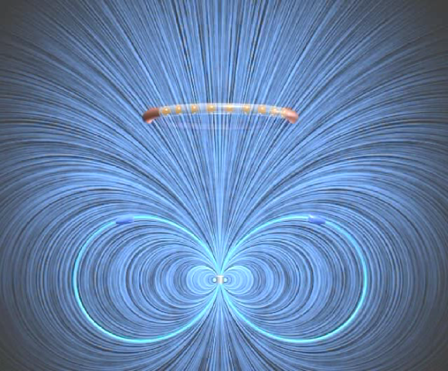
A superconducting ring sits above a strong permanent magnet (N side up). If you drop the ring, which way will current flow (as viewed from above), and what kind of force will the ring feel?
A) CW/repulsive
B) CW/attractive
C) CCW/repulsive
D) CCW/attractive
E) No net current will flow/no net force
To think about/discuss:
Remember Lenz’ law? What does it say about this situation?
What will the resulting motion of the ring look like?
What if you dropped a magnet onto the ring, instead of dropping the ring onto the agnet?
Notes:
http://web.mit.edu/8.02t/www/802TEAL3D/visualizations/faraday/index.htm

Slide 24
A large chunk of paramagnetic material (χ_{m}>0) has a uniform field B0 throughout its interior.
We cut out a wafer-like hole (very wide, very short!)
6.10b
What is B at the center of that hole?
B₀ B) more than B₀ C) less than B₀
D) ??
Notes:
CORRECT ANSWER: A
USED IN: Spring 2008 and 13 (Pollock), Fall 2009 (Schibli)
LECTURE NUMBER:41 (42 in ‘13) Again in lecture 43 in ‘13, as a review (since they did badly)
STUDENT RESPONSES: [[93%]] 0% 7% 0% 0% (SPRING 2008)
[[66%]] 8% 26% 0% 0% (FALL 2009)
[43]], 2, 56, 0, 0 (Sp ‘13) (Became [[88]] 3, 9, 0 next class. )
INSTRUCTOR NOTES: 93% (1 went for C) In later terms, this has proven a lot harder! Given discussion on question before this, where many argued that “outside field is strengthened in the material, but not the hole”, I expected them to flop on this. So I had the boundary conditions up on the board, and suggested they be sure their intuitions matched the math. Good long loud discussion, so I think the problem is good. Answers discussed included continuity of B_perp, but also they invoked the “Bound surface current is a ring, but it’s far away”. We also discussed why continuity of H fails in the vertical direction, and that it might VARY as you move from the edge to the center, so that’s not helpful. Also discussed how B AND H can’t BOTH be the same at the center of the hole as in the medium... I think it’s a good problem.-SJP
WRITTEN BY: Steven Pollock (CU-Boulder)

Slide 25
Last lecture: Ch 7 and beyond
“Trailer”

Slide 26
Charge Conservation
5.10
Which of the following is a statement of charge conservation?
A)
B)
C)
D)
E) Not sure/can't remember
Notes:
26
CORRECT ANSWER: D
USED IN: Spring 2008 and 13 (Pollock)
LECTURE NUMBER: 42 (44 in ‘13)
STUDENT RESPONSES: 0% 25% 25% [[50%]] 0% (SP ‘08)
7, 12, 14, [[64]], 2 (Sp ‘13)
INSTRUCTOR NOTES: Had given thismuch earlier (L30) Start of class. 94% correct. (Right after spring break). Repeated this last lecture , now it's only 50% correct! (With B and D splitting the rest).This is slippery, apparently. "Units" ruled the day, but I reviewed what the equation means, and how to interpret it. (Didn't talk/remind of divergence theorem explicitly, but should have!) One student asked about B, she wanted to know how you would interpret the right side - nice question! I let other students answer ("current through") . Slightly better in ‘2013, but still lots of alternative ideas on this…
-SJP
WRITTEN BY: Steven Pollock (CU-Boulder)

Slide 27
EMF I
Consider two situations:
1) a loop (purple) moves right at velocity v(loop)
2) a magnet (blue region) moves left, at v(mag).
If |v(loop)| = |v(mag)|,
what will the ammeter read in each case?
(Call CW current positive)
Blue region = uniform (but localized!) B field
out of page
B
I₁ > 0, I₂ = 0
I₁ < 0, I₂ = 0
I₁ = I₂
I₁ = -I₂
I₁ = 0, I₂ = 0 (special case)
A
Notes:
27
CORRECT ANSWER: C
USED IN: Spring 2008 (Pollock) and 2013
LECTURE NUMBER: 42 (44 in ‘2013)
STUDENT RESPONSES: 0% 6% [[88%]] 6% 0%
2,2, [[83]], 13, 0 (Sp ‘13)
INSTRUCTOR NOTES: End of class, 88% correct. It was a little rushed at the end, I didn't get much discussion from them.
This was my introduction to Faraday, I tried to argue that without Faraday, you'd have to answer B (no reason for current to flow in situation 2, but qvxB would make it flow (CCW) in situation 1.
I "reused it" (without clicking) in the last lecture, it's a great example to discuss "there no E in the reference frame of the magnet, but there IS an E in the reference frame of the coil". One student wanted to understand how to think about it in terms of flux, it would be a good one to come back to if we had time to really get into Faraday... Ans: C. (Relativity?) -SJP
WRITTEN BY: Steven Pollock (CU-Boulder)

Slide 28
Maxwell’s equations so far...
7.2
The Curl(E)=0 equation let us define Voltage!
But, it’s only true in statics…
Notes:
Final lecture, Spring 2013, SJP

Slide 29
Adding in time dependence modifies the curl(E) equation.
It’s now called “Faraday’s law”.
7.2
Notes:
Final lecture, Spring 2013, SJP

Slide 30
EMF I
Faraday’s law resolves the problem we found in the first question today:
Now CHANGING B can also induce currents.
Blue region = uniform (but localized!) B field
out of page
B
h
A
Notes:
30
Final lecture, Spring 2013, SJP
(Come back to this – Faraday’s law is what resolves the paradox we had that we got different results in different frames)

Slide 31
Adding in time dependence modifies the curl(E) equation.
It’s now called “Faraday’s law”.
7.2
Notes:
Final lecture, Spring 2013, SJP

Slide 32
Maxwell’s equations so far...
7.2
Using Stoke’s theorem on Faraday’s law gives...
A)
B)
C)
D)
E) NONE of the above is correct!
Notes:
CORRECT ANSWER: C
USED IN: Spring 2008 (Pollock)
LECTURE NUMBER: 42 (44 in ‘13)
STUDENT RESPONSES: 0% 6% [[88%]] 6% 0%
16, 6, [[72]], 4, 0 (Sp ‘13)
INSTRUCTOR NOTES: Last lecture. 88% for C (with a B, and a D). Good discussion, they really had to work on this, and some were still debating "what Stoke's theorem is". I used this as a pitch opportunity for what they need to take away from this course. It’s practice for the final, too! -SJP
WRITTEN BY: Steven Pollock (CU-Boulder)

Slide 33
Maxwell’s equations so far...
7.2
Using Stoke’s theorem on Faraday’s law gives...
A)
B)
C)
D)
E) NONE of the above is correct!
We can do work with
changing B-fields!
Notes:
Final lecture, Spring 2013, SJP

Slide 34
Look at our full set of “Maxwell’s equations”
7.3
What is ?
zero
B) non-zero
C) Could be either
D) Could be BOTH at the same time
E) My brain hurts!
Hint: Do you have your textbook? Look in the FRONT flyleaf!
Notes:
CORRECT ANSWER: C (sort of, it’s an odd one)
USED IN: Fall 2008 (Dubson) and Spring 2008 (Pollock)
LECTURE NUMBER: Dubson (Week 15, Lecture 44). Pollock (Lecture 42).
STUDENT RESPONSES: 77% 12% [[8%]] 2% 0% (FALL 2008)
0% 6% [[88%]] 6% 0% (SPRING 2008)
76, 8, 14, 0, 2
INSTRUCTOR NOTES: Last lecture. 81% voted for C, only 1 voted for E. Fun one! Great discussions, arguments in the class.
I argued "E is correct" (or D) This is the (or "an") origin of Maxwell's modification of Ampere's law. Mathematically, del dot del cross MUST vanish. But by applying Divergence to Ampere, you get that it equals del dot J (which is -drho/dt, not zero in general!) -SJP
WRITTEN BY: Steven Pollock (CU-Boulder)

Slide 35
Look at our full set of “Maxwell’s equations”
7.3
What is ?
It has to be zero (that’s math)!
But that says that
Notes:
Final lecture, Spring 2013, SJP

Slide 36
Charge Conservation
5.10
Which of the following is a statement of charge conservation?
A)
B)
C)
D)
E) Not sure/can't remember
Notes:
36
Final lecture, Spring 2013, SJP
Just to remind them, they clicked this just a few minutes ago!

Slide 37
7.3
Taking div(Ampere’s law) gave us:
But current conservation says:
Conclusion: Ampere’s law is WRONG!
Notes:
Final lecture, Spring 2013, SJP

Slide 38
7.2
How can we restore current conservation?
(without losing the “correct” features,
obtained from experiment!)
Not very “symmetric” either…
Maxwell fixed it up!
Notes:
Final lecture, Spring 2013, SJP

Slide 39
Maxwell’s equations:
7.5
This last term saves the day!
NOW when we take div(Maxwell-Ampere), we get an extra term,
yielding
You did this on a homework!
Notes:
Final lecture, Spring 2013, SJP

Slide 40
Maxwell’s equations:
7.5
In vacuum…?
Notes:
Final lecture, Spring 2013, SJP

Slide 41
Maxwell’s equations:
7.5
In vacuum!
Notes:
Final lecture, Spring 2013, SJP

Slide 42
Maxwell’s equations:
7.5
In vacuum, what is ?
In vacuum (!!!)....
Notes:
CORRECT ANSWER: ?
USED IN: Spring 2008 (Pollock)
LECTURE NUMBER: 42
STUDENT RESPONSES: n/a
INSTRUCTOR NOTES: Last lecture. Walked them through this - had them talk me through each step, discussed wave equations, it went very well! Great way to end the term... -SJP
WRITTEN BY: Steven Pollock (CU-Boulder)

Slide 43
It’s a wave equation…. With a solution
With speed
Notes:
Final lecture, Spring 2013, SJP

Slide 44
Maxwell’s equations:
7.5
Notes:
Final lecture, Spring 2013, SJP

Slide 45
"It's of no use whatsoever [...]
this is just an experiment that proves Maestro Maxwell was right - we just have these mysterious electromagnetic waves that we cannot see with the naked eye. But they are there.” - Heinrich Hertz, 1888
Asked about the ramifications of his discoveries, Hertz replied,
"Nothing, I guess.”
Marconi’s first wireless radio transmission over large distances (~6 km over water) was in 1897.
Notes:
Final lecture, Spring 2013, SJP

Slide 46
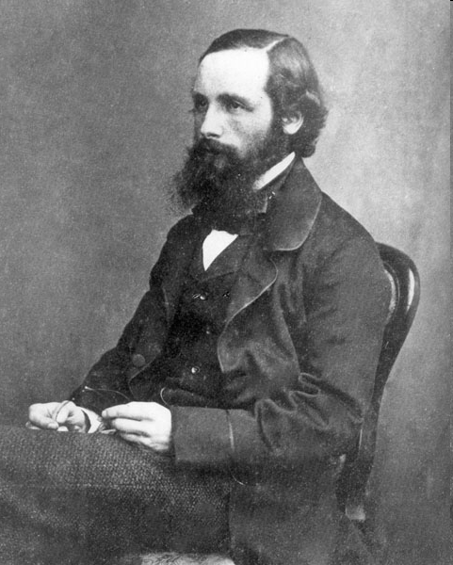
James Clerk Maxwell
Scottish 1831-1879
"From a long view of the history of mankind – seen from, say, ten thousand years from now – there can be little doubt that the most significant event of the 19th century will be judged as Maxwell’s discovery of the laws of electrodynamics. The American Civil War will pale into provincial insignificance in comparison with this important scientific event of the same decade."
– R.P. Feynman
Notes:
Final lecture, Spring 2013, SJP

