Slide 1
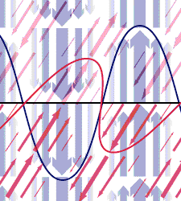
PH300 Modern Physics SP11
“From the long view of the history of mankind – seen from, say, ten thousand years from now – there can be little doubt that the most significant event of the 19th century will be judged as Maxwell’s discovery of the laws of electrodynamics. The American Civil War will pale into provincial insignificance in comparison with this important scientific event of the same decade.” – Richard Feynman
1/18 Day 2:
Questions?
Review E&M
Waves and Wave Equations
Next Time:
Interference
Polarization
Double-Slit Experiment

Slide 2
Today & Thursday:
“Classical” wave-view of light & its interaction with matter
Pre-quantum
Still useful in many situations.
Thursday:
HW01 due, beginning of class; HW02 assigned
Next week:
Special Relativity ➔ Universal speed of light
Length contraction, time dilation

Slide 3
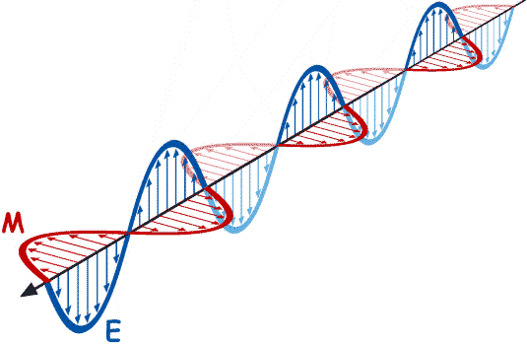
Maxwell’s Equations: Describe EM radiation
Aim is to cover Maxwell’s Equations in sufficient depth to understand EM waves
Understand the mathematics we’ll use to describe WAVES in general
E
B

Slide 4
‘Flux’ of a vector field through a surface:
The average outward-directed component of a vector field
multiplied by a surface area.
‘Circulation’ of a vector field around a path:
The average tangential component of a vector field
multiplied by the path length.

Slide 5
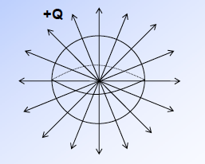
An example:
Gauss’ Law
Electric flux through a closed surface tells you
the total charge inside the surface.

Slide 6
If the electric field at the surface of a sphere (radius, r)
is radial and of constant magnitude,
what is the flux out of the sphere?
A)
B)
C)
D) Something else

Slide 7
An example:
Gauss’ Law
Electric flux through a closed surface tells you
the total charge inside the surface.
So:
Coulomb’s Law is contained
in Gauss’ Law

Slide 8
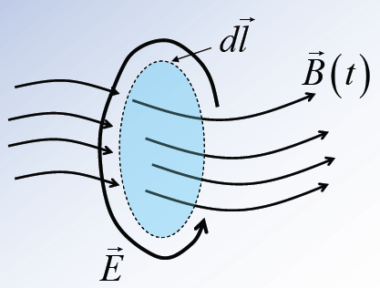
An example:
Faraday’s Law
Electric circulation around a closed path tells you the
(negative of) the time change of flux of B through any
open surface bounded by the path.

Slide 9
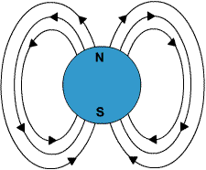
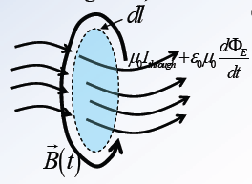

Slide 10
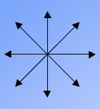
Consider the following configuration of field lines.
This could be…
…an E-field
…a B-field
Either E or B
Neither
No idea

Slide 12
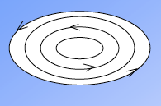
Consider the following configuration of field lines.
This could be…
…an E-field
…a B-field
Either E or B
Neither

Slide 14
Maxwell’s Equations in Vacuum
The words “in vacuum” are code for
“no charges or currents present”
The equations then become:

Slide 15
Maxwell’s Equations: Differential forms

Slide 16
Maxwell’s Equations: Differential forms
Each of these is a single partial differential equation.
Each of these is a set of three coupled partial differential equations.

Slide 17
Maxwell’s Equations: 1-Dimensional Differential Equations
OR

Slide 18
1-Dimensional Wave Equation
Solutions are sines and cosines:
…with the requirement that:
or

Slide 19
How are you doing?
I am completely confused and can’t even think of a question
I am pretty confused and have some questions
It looks familiar enough that it’s OK to continue
No problems!

Slide 20
Sinusoidal waves:
Wave in time: cos(2πt/T) = cos(ωt) = cos(2πft)
Wave in space: cos(2πx/λ) = cos(kx)
k is spatial analogue of angular frequency ω.
One reason we use k is because it’s easier to write sin(kx) than sin(2πx/λ).
T = Period = time of one cycle
t
ω = 2π/T = angular frequency = number of radians per second
λ = Wavelength = length of one cycle
x
k = 2π/λ = wave number = number of radians per meter
Notes:
Show quantum tunneling

Slide 21
Waves in space & time:
cos(kx + ωt) represents a sinusoidal
wave traveling…
A) …to the right (+x-direction).
B) …to the left (-x-direction).
Notes:
Show quantum tunneling

Slide 22
Light is an oscillating E-field
Oscillating ELECTRIC and magnetic field
Traveling to the right at speed of light (c)
Electromagnetic
radiation
Snap shot of E-field in time:
At t=0
A little later in time
E
c
X
Function of position (x) and time (t):
E_{max}sin(ax+bt)
E(x,t) = E_{max}sin(ax-bt)

Slide 23
1-Dimensional Wave Equation
The most general solution is:
A specific solution is found by applying boundary conditions

Slide 24
1-Dimensional Wave Equation

Slide 25
Complex Exponential Solutions
Recall solution for the Electric field (E) from the wave equation:
Euler’s Formula says:
For convenience, write:

Slide 26
Complex Exponential Solutions
Constant vector prefactor tells
the direction and maximum
strength of E.
Complex exponentials for the
sinusoidal space and time
oscillation of the wave.

Slide 27
The electric field for a plane wave is given by:
The vector tells you…
The direction of the electric field vector
The direction of the magnetic field vector
The direction in which the wave is not varying
The direction the plane wave moves
None of these

Slide 28
Complex Exponential Solutions
Constant vector prefactor tells
the direction and maximum
strength of E.
Complex exponentials for the
sinusoidal space and time
oscillation of the wave.
0 B) C)
D) E) None of these.

Slide 29
Complex Exponential Solutions
The complex equations reduce Maxwell’s Equations (in vacuum) to a set of vector algebraic relations between the three vectors , and , and the angular frequency :
Transverse waves. and are perpendicular to .
and are perpendicular to each other.

Slide 30
Complex Exponential Solutions
The complex equations reduce Maxwell’s Equations (in vacuum) to a set of vector algebraic relations between the three vectors , and , and the angular frequency :

Slide 31
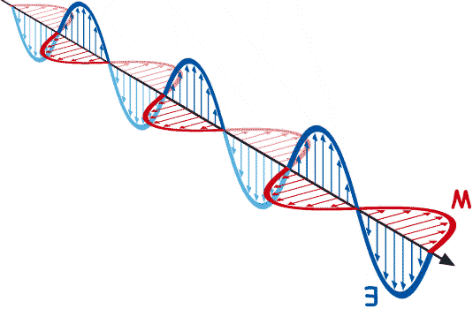
, , and form a ‘right-handed system’, with the wave traveling in the direction , at speed c.
The complex equations reduce Maxwell’s Equations (in vacuum) to a set of vector algebraic relations between the three vectors , and , and the angular frequency :

Slide 32
How do you generate light (electromagnetic radiation)?
Stationary charges
Charges moving at a constant velocity
Accelerating charges
B and C
A, B, and C
E
Stationary charges →
constant E-field, no magnetic (B)-field
+
Charges moving at a constant velocity →
Constant current through wire creates a B-field
But B-field is constant
B
I
Accelerating charges →
changing E-field and changing B-field
(EM radiation → both E and B are oscillating)

Slide 33
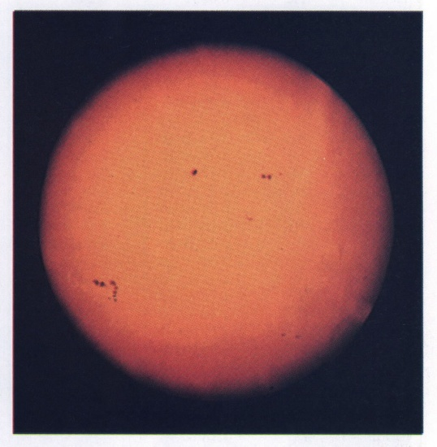
How do you generate light (electromagnetic radiation)?
Stationary charges
Charges moving at a constant velocity
Accelerating charges
B and C
A, B, and C
Answer is (C) Accelerating charges create EM radiation.
The Sun
Surface of sun- very hot!
Whole bunch of free electrons whizzing around like crazy. Equal number of protons, but heavier so moving slower, less EM waves generated.
+
+
+
+

Slide 34
EM radiation often represented by a sinusoidal curve.
OR
What does the curve tell you?
The spatial extent of the E-field. At the peaks and troughs the E-field is covering a larger extent in space
The E-field’s direction and strength along the center line of the curve
The actual path of the light travels
More than one of these
None of these.

Slide 35
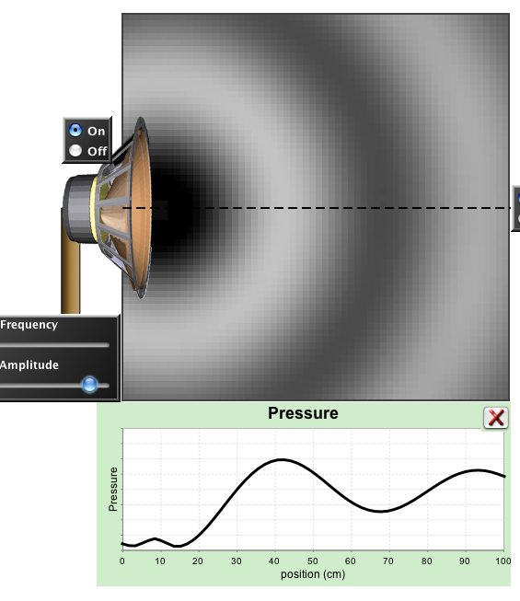
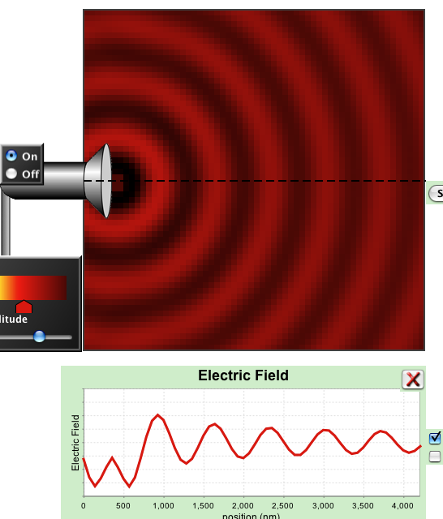
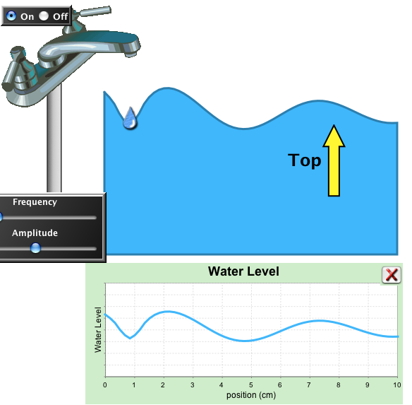
Making sense of the Sine Wave
What does the curve tell you?
For Water Waves?
For Sound Wave?
For E/M Waves?

Slide 36
EM radiation often represented by a sinusoidal curve.
What does the curve tell you?
Correct answer is (B) – the E-field’s direction and strength along the center line of the curve.
At this time, E-field at point X is strong and in the points upward.
Only know E-field,
along this line.
X
Path of EM Radiation is a straight line.
Notes:
Possibly change this to generic em wave

Slide 37
Snapshot of radio wave in air.
Length of vector represents strength of E-field
Orientation represents direction of E-field
What stuff is moving up and down in space as a radio wave passes?
Electric field
Electrons
Air molecules
Light ray
Nothing
Answer is (E): Nothing
Electric field strength
increases and decreases
– E-field does not move up and down.

Slide 38
Snapshot of radio wave in air.
What is moving to the right in space as radio wave propagates?
Disturbance in the electric field
Electrons
Air molecules
Nothing
Answer is (A). Disturbance in the electric field.
At speed c

Slide 39
Review :
Light interacts with matter when its electric field exerts forces on electrons.
In order to create light, we need both changing E and B fields. Can do this only with accelerating charges.
Light has a sinusoidally changing electric field
Sinusoidal pattern of vectors represents increase and decrease in strength of field, nothing is physically moving up and down in space

Slide 40
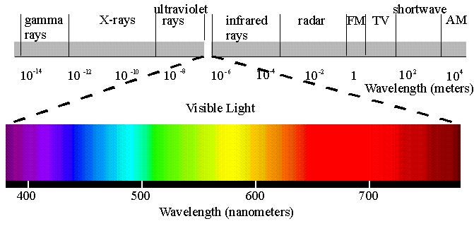
Electromagnetic Spectrum
Spectrum: All EM waves. Complete range of wavelengths.
Wavelength (λ) =
distance (x) until wave repeats
Frequency (f) =
# of times per second E-field at point changes through complete cycle as wave passes
λ
Blue light
λ
Red light
λ
Cosmic
rays
SHORT
LONG

Slide 41
d
How much time will pass before this peak reaches the antenna?
c = speed of light
A) cd B) c/d C) d/c
D) sin(cd) E) None of these
Distance = speed * time
Time = distance/speed = d/c
How much time does it take for E-field at point (X) to go through 1 complete oscillation?
Period (seconds/cycle) = λ/c
f λ=c
Frequency = (1 )/Period (Hertz)
= # of cycles per second

Slide 42
Electron oscillates with period of Τ=1/φ
How far away will this peak in the E-field be before the next peak is generated at this spot?
A) cλ B) c/λ C) λ/c
D) sin(cλ) E) None of these
Answer is (A):
Distance = velocity * time
Distance = cλ = c/f = 1 wavelength
so c/f = λ

Slide 43
Wave or Particle?
Question arises often throughout course:
Is something a wave, a particle, or both?
How do we know?
When best to think of as a wave? as a particle?
In classical view of light, EM radiation viewed as a wave
(after lots of debate in 1600-1800’s).
How decided it is a wave?
What is most definitive observation we can make that tells us something is a wave?

Slide 44
EM radiation is a wave
What is most definitive observation we can make that tells us something is a wave?
Ans: Observe interference.
Constructive interference:
(peaks are lined up and valleys are lined up)
c
c

Slide 45
EM radiation is a wave
What is most definitive observation we can make that tells us something is a wave?
Ans: Observe interference.
Destructive interference:
(peaks align with valleys ➔ add magnitudes ⎝ cancel out)
c
c

Slide 46
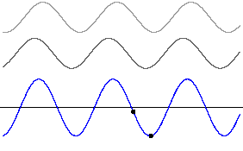
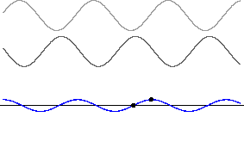
1-D interference
Constructive
Destructive
What happens with 1/4 phase interference?
c

Slide 47
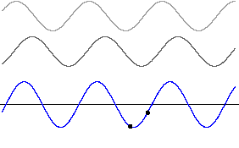
1/4 Phase Interference
c

Slide 48
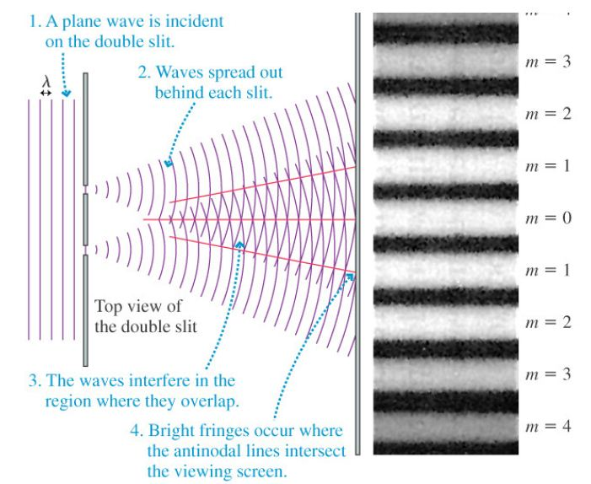
Two-Slit Interference

