Slide 1
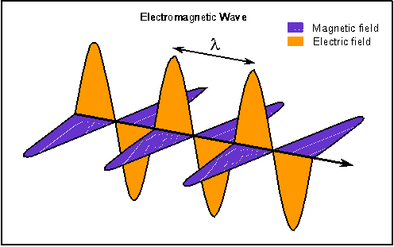
How do I know a wave is a wave?
"The precise formulation of the time space laws of [electromagnetic] fields was the work of Maxwell (1870s). Imagine his feelings when the differential equations he had formulated proved to him that the electromagnetic fields spread in the form of polarized waves and with the speed of light! ” - Albert Einstein
1/20 Day 3:
Questions?
Interference, Double-Slit
Polarization, Interferometers
Reminders:
HW01 due today
HW02 assigned today
Problem-Solving Sessions on Tuesdays
Notes:
21.1 - 21,3, 21.5, 21.7,
22.1-2, 22.6
1. Pick up group assignment; HW1.
2. Pick up partial syllabus (full version on the web)
3. Sit with your group and introduce yourself.

Slide 2
Today:
“Classical” wave-view of light & its interaction with matter
Pre-quantum
Still useful in many situations.
HW01 due, beginning of class; HW02 assigned
Next week:
Special Relativity ➔ Michelson-Morley experiment
Universal speed of light
Length contraction, time dilation

Slide 3
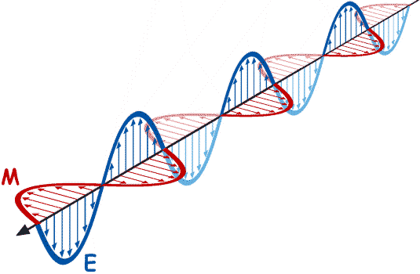
Review: How to generate light?
Stationary charges →
constant E-field, no magnetic (B)-field
(We don’t see charges glow in the dark)
E
+
Charges moving at a constant velocity →
Constant current through wire creates a B-field
but B-field is constant. (We don’t see DC.)
B
I
Accelerating charges →
changing E-field and changing B-field
(EM radiation → both E and B are oscillating)
We talked briefly about Maxwell equations
B
E

Slide 4
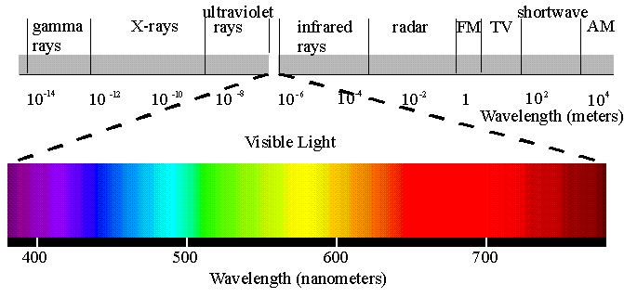
Electromagnetic Spectrum
Spectrum: All EM waves. Complete range of wavelengths.
Wavelength (λ) =
distance (x) until wave repeats
Frequency (f) =
# of times per second E-field at point changes through complete cycle as wave passes
λ
Blue light
λ
Red light
λ
Cosmic
rays
SHORT
LONG

Slide 5
Electromagnetic waves carry energy
E_{max}=peak amplitude
Light shines on a black tank full of water.
How much energy is absorbed?
c
X
E(x,t) = E_{max}sin(ax-bt)
Intensity = Power = energy/time ~ (E_{avg})²
area area
~ (amplitude of wave)² ~ E_{max}²

Slide 6
Light shines on three black barrels filled with water:
#1
X
#2
X
#3
X
(Use E_{1max} = E_{2max} > E_{3max})
Which barrel will heat up the fastest?
A) 2 > 1 > 3 B) 1 > 2 > 3 C) 1 = 2 > 3
D) 1 = 3 > 2 E) 2 > 1 = 3
Intensity = power/area ~ E_{max}²
Does not depend on frequency/color!

Slide 7
Classical waves: Intensity ~ E_{max}²
|E_{ave}|²
X
vs.
|E_{ave}|²
X
Classically:
Time average of the E-field squared: same… independent of frequency.
Intensity only depends on the E-field amplitude but not on the color (or frequency) of the light!
Notes:
Integral is the same…
Wave view consistent with experiment.
DO NOT KNOW ABOUT… or NEED photons yet.

Slide 8
Goals for waves
Superposition
Interference
Double-Slit Experiment
Polarization
Interferometers
Notes:
ｷ WATER WAVES
http://phet.colorado.edu/simulations/sims.php?sim=Wave_Interference
ｷ STANDING WAVES: An applet showing how standing waves form from a superposition of two traveling waves can be found at:
http://www.walter-fendt.de/ph14e/stwaverefl.htm
ｷ ELECTROMAGNETIC WAVES
http://phet.colorado.edu/simulations/sims.php?sim=Radio_Waves_and_Electromagnetic_Fields
ｷ YOUNG’S DOUBLE-SLIT EXPERIMENT – How can we know that something is behaving like a wave? By observing interference effects. Students should be able to connect features of the interference pattern with the wavelength of the light and the spacing between the two slits.
POLARIZATION
POLARIZERS
MIRRORS/BEAM SPLITTERS

Slide 9
Wave or Particle?
Question arises often throughout course:
Is something a wave, a particle, or both?
How do we know?
When best to think of as a wave? as a particle?
In classical view of light, EM radiation is viewed as a wave
(after lots of debate in 1600-1800’s).
In what sense does it act as a wave?
What is the most definitive observation we can make that tells us something is a wave?

Slide 10
EM radiation is a wave
What is most definitive observation we can make that tells us something is a wave?
Observe interference.
Constructive interference:
(peaks are lined up and valleys are lined up)
c
c

Slide 11
EM radiation is a wave
What is most definitive observation we can make that tells us something is a wave?
Observe interference.
Destructive interference:
(peaks align with valleys ➔ add magnitudes ⎝ cancel out)
c
c

Slide 12
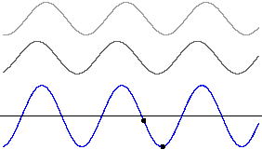
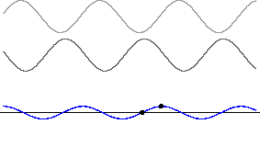
1-D interference
Constructive
Destructive
What happens with 1/4 phase interference?
c

Slide 13
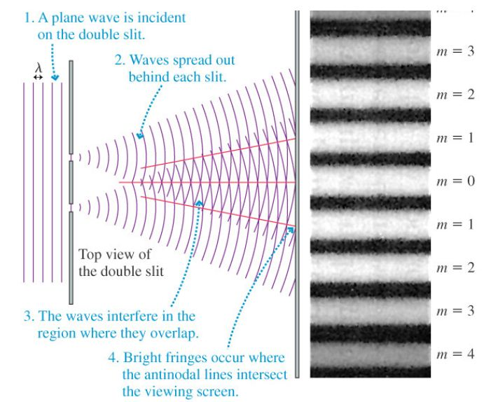
Two-Slit Interference

Slide 14
Double-Slit Experiment with Light
Recall solution for Electric field (E)
from the wave equation:
Let’s forget about the time-dependence for now:
Euler’s Formula says:
For convenience, write:

Slide 15
Double-Slit Experiment with Light
Before Slits
After Slits
&

Slide 16
Double-Slit Experiment with Light

Slide 17
Double-Slit Experiment with Light
INTERFERENCE!
For waves, we add the individual amplitudes to find
the amplitude of the total wave ( )
We square the sum ( ) to find the intensity.

Slide 18
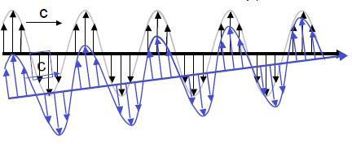
Double-Slit Experiment with Light
After slit, wave spreads in all directions
Waves from slits constructively interfere
Waves from slits destructively interfere
Notes:
technical issues have to worry about (mentioned in Wed. class)
1. electrons repel each other. Keep number small enough, so only one through slits at a time, can’t repel itself.
2. Electron has to cover both slits. Too small? How far electron wave is spread out sideways⇔ spread in momentum. “wave packets” Monday class.
Size is NOT amplitude of wave- that is just probability not spatial size. (convince everyone in group so remember!!)

Slide 19
Double-slit experiment Determining the space between peaks (H)
L
r₁
H
r₂
D
Θ
Θ₁
For constructive
D
Θ
Θ₂
Δr = r₂-r₁
Δr = mλ (where m=1,2,3…)
If screen far away
Θ₁
Θ
Δr = Dsin(Θ)=DΘ =mλ
≈
Θ₂
≈

Slide 20
Are they in phase? What’s the difference in path?
H=mLλ
D
m=1,2,3,…
L
r₁
H
r₂
D
Θ
H = Lsin(Θ) = LΘ
DΘ =mλ
Θ = mλ/D
c
c

Slide 21
Double-slit experiment
H=mLλ
D
m=1,2,3,…
L
r₁
H
r₂
D
Θ
If we change from blue light (high f) to red (small f) what happens to the spacing between peaks, H?
A) Increases B) Stays the same C) Decreases

Slide 22
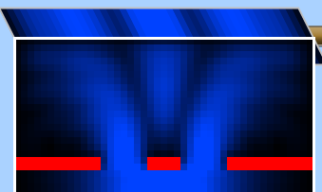
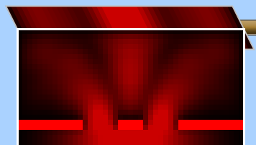
Double-slit experiment
H=mLλ
D
m=1,2,3,…
High f, Small λ
Small f, Bigger λ
If we change from blue light (high f) to red (low f) what happens to the spacing between peaks, H?
A) Increases B) Stays the same C) Decreases

Slide 23
E-field describes probability of finding light there
Electromagnetic wave (e.g. hitting screen of double slit)
Screen
High Amplitude
Low Amplitude
Describe EM wave spread out in space.
Probability of detection (peak / trough)
~ (Amplitude of EM wave)²
Notes:
Change to bright / dark screen

Slide 24
What are these waves?
EM Waves
Amplitude = electric field
tells you the intensity of the wave.
Maxwell’s Equations:
Solutions are sine/cosine waves:
Superposition:
If is a solution, and
is a solution, then
is also a solution.

Slide 25
So far… very 2D .. What about 3-D
Note: light is transverse wave .. Not longitudinal
E-field cannot oscillate in direction of propagation

Slide 26
Light is generally unpolarized
Now Imagine looking end on… down the x-axis
Could also be
Or more generally
y
z
Light is generally oscillating every which way…
Simplify by having just two components

Slide 27
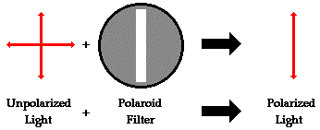
What happens if I run it through another filter:
+
= ?
All light passes
All light passes & becomes unpolarized
1/2 of light passes
No light passes

Slide 28
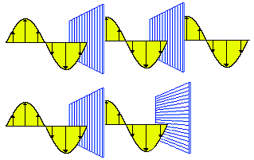
Polarizers

Slide 29
Polarization
What happens if I run it through another filter:
+
= ?
Hint:
Now add:
=
yields:

Slide 30
What happens if I run it through another filter
+
= ?
Nothing, right?
But what if I put this in the middle
Put this together…..
then
+
+
Hint:
=

Slide 31
Interferometers
1881 Michelson invented a device now known as the ‘Michelson Interferometer.’ (Nobel Prize, 1907)
We will see it in action in the famous Michelson-Morley experiment, which will lead us to the special relativity theory. → So the interferometer had a huge impact!!
Such interferometers are nowadays widely used for various precision measurements. State-of-the-art visible-light interferometers achieve resolutions of ~100pm! (X-ray interferometers are ~1pm).
(100pm = 1Å = diameter of a Hydrogen atom.)

Slide 32
Electromagnetic waves
E-field (for a single color):
E(x,t) = E₀ sin(ωt+^{2πx}/_{λ} +ϕ)
Light source
λ = 2πc/ω,
ω = 2πf = 2π/T
E
λ
A₀
x
ϕ
Wavelength λ of visible light is: λ ~ 350 nm … 750 nm.
E
x
B

Slide 33
The Michelson interferometer
Mirrors
Light source
Semi-transparent
mirror
Detector

Slide 34
EM-Waves in an interferometer
Mirrors
L
Light source
Light source
L
Semi-transparent
mirror

Slide 35
Constructive interference
E_{sum}(x,t) = ½ ·E₀ sin(ωt+2πx/λ +ϕ) + ½ ·E₀ sin(ωt+2πx/λ +ϕ) = ?
= E₀ sin(ωt+2πx/λ +ϕ)
= E_{light source}(x,t)
+
=
?
Screen:

Slide 36
Unequal arm lengths
L
Light source
Light source
L
+^{ΔL}/₂
^{ΔL}/₂
ΔL

Slide 37
Destructive interference
E_{sum}(x,t) = ½ ·E₀ sin(ωt+2πx/λ +ϕ) + ½ ·E₀ sin(ωt+2π(x+Δx)/λ +ϕ)
= ½ ·E₀ sin(ωt+2πx/λ +ϕ) - ½ ·E₀ sin(ωt+2πx/λ +ϕ) = 0
if Δx = λ / 2:
sin(x+π) = - sin(x)
+
=
?
Screen:

Slide 38
Moving mirror: What do you see?
Light source
ΔL
Intensity
Screen
^{λ}/₂
ΔL

Slide 39
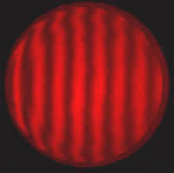
Tilted mirror: What do you see?
Fringes!
Light source
Screen

Slide 40
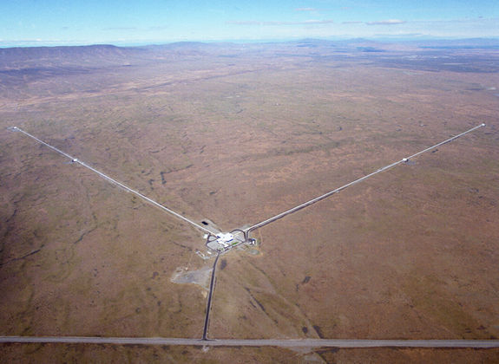
Gravitational wave detectors

Slide 41
Summary
Michelson interferometers allow us to measure tiny displacements. Displacements of less than 100 nm are made visible to the eye!
Interferometers find many applications in precision metrology such as for displacement, distance and stress measurements as well as flatness measurements.
Interferometers have played an important role in physics:
Michelson-Morley experiment → special relativity
Testing general relativity: Gravitational wave detection

Slide 42
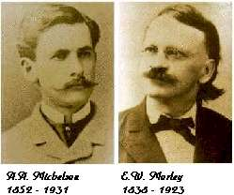
Michelson and Morley…
…performed a famous* experiment that effectively measured the speed of light in different directions with respect to the “ether wind.”
*some say, the most successful failure…

Slide 43
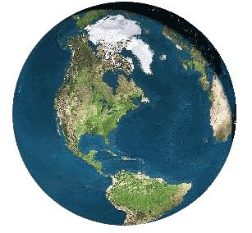
Frame of reference
Observer on the sun:
‘Ether’
v
Ether ‘viewed’ in the laboratory on the earth:
-v
-v

Slide 44
Ether in the laboratory frame
v
L
v
u'-v
How can we measure the speed v of the ether?
If the ether would be a river, we could measure the speed of the water using a boat that travels at a known speed u’. (u’ is the relative velocity between the boat and the water.)
If the boat travels the distance L within the time t, then we know v: L=(u’-v)t, therefore v = u’ – ^{L}/_{t}
But: Very difficult with light! u’ = c → t ~ 10ns and v ~ 0.0001*c.
→ We would have to measure t with an absolute precision of ~0.0000000000001s and we have to know c very precisely!

Slide 45
Measuring only differences in c
-v
-v
L
u’+v
B
A
L
u’-v
Compare the round-trip times t_{A} and t_{B} for paths A and B. This has the great benefit, that we do not have to measure the absolute times t_{A} and t_{B} (which are only a few ns) and we are less sensitive to uncertainties in the speed of light.

Slide 46
Michelson and Morley
Mirrors
-v
L
-v
Detector
L
Semi-transparent
mirror
“Interferometer”
Light source
The detector measures differences in the position of the maxima or minima of the light-waves of each of the two beams. (Yes, light is a wave!)

