Slide 1
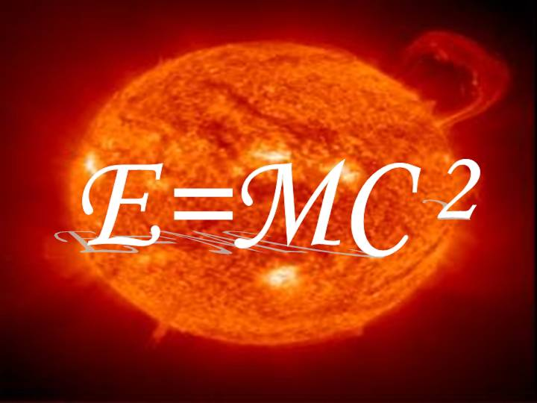
PH300 Modern Physics SP11
“Logic will get you from A to B. Imagination will take you everywhere.”
- Albert Einstein
2/3 Day 7:
Questions?
Relativistic Momentum
& Energy
Review
Next Week:
Intro to Quantum
Exam I (Thursday, 2/10)

Slide 2
Last time:
Spacetime, addition of velocities, Lorentz transformations
Today:
Relativistic momentum and energy
Review EM Waves and SR
HW03 due, beginning of class; HW04 assigned
Next week:
Intro to quantum
Exam I (in class)

Slide 3
Lorentz Transformations
v
v
?
…
A
B
A
B
t₀ = 0
t₁ = 1s
Two clocks (one at A and one at B) are synchronized. A third clock flies past A at a velocity v. The moment it passes A all three clocks show the same time t₀ = 0 (viewed by observers in A and B. See left image.)
What time does the third clock show (as seen by an observer at B) at the moment it passes the clock in B? The clock at B is showing t₁ = 1s at that moment. → Use Lorentz transformation!
A) γ · (t₁-t₀) B) γ²(t₁-t₀)(1 – v/c²) C) γ² (t₁-t₀)(1 + v²/c²)
D) (t₁-t₀) / γ E) γ(t₁-t₀)(1 + vx'/c²)

Slide 4
Hint: Use the following frames:
v
v
x'
?
x
…
A
B
A
B
t₀ = 0
t₁ = 1s
Two clocks (one at A and one at B) are synchronized. A third clock flies past A at a velocity v. The moment it passes A all three clocks show the same time t₀ = 0 (viewed by observers in A and B. See left image.)
What time does the third clock show (as seen by an observer at B) at the moment it passes the clock in B? The clock at B is showing t₁ = 1s at that moment. → Use Lorentz transformation!
A) γ · (t₁-t₀) B) γ²(t₁-t₀)(1 – v/c²) C) γ² (t₁-t₀)(1 + v²/c²)
D) (t₁-t₀) / γ E) γ(t₁-t₀)(1 + vx'/c²)
The moving clock shows the proper time interval!! Δt_{proper} = Δt / γ

Slide 5
Hint: Use the following systems:
v
v
x'
?
x
…
A
B
A
B
t₀ = 0
t₁ = 1s
The clock travels from A to B with speed v. Assume A is at position x = 0, then B is at position x = v·t, t=(t₁-t₀)
Use this to substitute x in the Lorentz transformation:
→ We get exactly the expression of the time dilation!

Slide 6
Relativistic Mechanics

Slide 7
Momentum
The classical definition of the momentum p of a particle with mass m is: p=mu.
In absence of external forces the total momentum is conserved (Law of conservation of momentum):
Due to the velocity addition formula, the definition p=mu is not suitable to obtain conservation of momentum in special relativity!!
→ Need new definition for relativistic momentum!

Slide 8
Conservation of Momentum
y
y'
Frame S’ moves along x with v = u_{1x}
m
m
u₂
u'₂
u₁
u_{1y}
u'₁
m
u_{1x}
m
S
S'
x
x'
If u₁ = -u₂ we find:
p_{tot,before} = 0
p_{tot,after} = 0
System S' is moving to the right with the velocity v = u_{1x}. We will use relativistic velocity transformations here.

Slide 9
Classical Momentum
y
p_{1, before} = m(u_{x} , u_{y})
p₂, _{before} = m(-u_{x} , -u_{y})
u₂ = (-u_{x},-u_{y})
m
p_{tot , before} = m(0 , 0)
p_{1, after} = m(u_{x} , -u_{y})
p₂, _{after} = m(-u_{x} , u_{y})
m
p_{tot , after} = m(0 , 0)
u₁=(u_{x},u_{y})
S
→ p_{tot , before} = p_{tot, after}

Slide 10
Galileo (classical):
y'
p_{1, before} = m(0 , u_{y})
p₂, _{before} = m(-2u_{x} , -u_{y})
p_{tot , before} = m(-2u_{x} , 0)
m
u'₂
p_{1, after} = m(0 , -u_{y})
p₂, _{after} = m(-2u_{x} , u_{y})
u'₁
m
p_{tot , after} = m (-2u_{x} , 0)
S'
x'
→ p_{tot , before} = p_{tot, after}

Slide 11
Velocity Transformation (3D)
Classical:
Relativistic:
u'_{x} = u_{x} – v
u'_{y} = u_{y}
u'_{z} = u_{z}

Slide 12
Lorentz Transformation
y'
Use:
m
u'₂
u'₁
Algebra
m
S'
x'
→ p_{tot , before} ≠ p_{tot, after}

Slide 13
Conservation of momentum is extremely useful in classical physics. → For the new definition of relativistic momentum we want:
1. At low velocities the new definition of p should match the classical definition of momentum.
2. The total momentum (Σp) of an isolated system of bodies is conserved in all inertial frames.

Slide 14
Relativistic Momentum
Classical definition:
Say we measure the mass 'm' in its rest-frame ('proper mass' or 'rest mass'). Since we measure 'm' it's rest-frame we agree on the same value for 'm' in all frames.
Assume we take the derivative with respect to the proper time t_{proper} = , which has the same meaning in all frames.
Relativistic definition:
This definition fulfills the conservation of momentum in SR!
To prove it you can apply the relativistic velocity transformation.

Slide 15
Relativistic Momentum
The time dilation formula implies that
We can therefore rewrite the definition of the relativistic momentum as follows:
An important consequence of the Lorentz-factor is that no object can be accelerated past
the speed of light.
☹

Slide 16
Classical vs. Relativistic Momentum
An electron has a mass m ≈ 9·10⁻³¹kg. The table below shows the classical and relativistic momentum of the electron at various speeds (units are 10⁻²²kg·m/s):
p=m·u
p=γm·u
u | classical | relativistic | difference [%]
0.1c | 0.273 | 0.276 | 1.1
0.5c | 1.36 | 1.57 | 15.4
0.9c | 2.46 | 5.63 | 128.9
0.99c | 2.7 | 19.2 | 611.1

Slide 17
Relativistic Momentum
A
B
Particle A has half the mass but twice the speed of particle B. If the particles’ momenta are p_{A} and p_{B}, then
a) p_{A} > p_{B}
b) p_{A} = p_{B}
c) p_{A} < p_{B}
is bigger for the faster particle.

Slide 18
Relativistic Force
We can define the classical force using Newton's law:
This is equivalent to:
Using the definition of the relativistic momentum we obtain a suitable definition for a relativistic force:

Slide 19
Relativistic Force
A particle with mass is at rest at , and experiences a constant force, .
Find the velocity of the particle as a function of time
Force acting on the particle:
Relativistic force:
Therefore:
Integrating both sides:
(Remember, is a constant!)

Slide 20
Example: Relativistic force (cont.)
Now: Solve
for the velocity u.
Dividing by
yields:
Square both sides:
Bring u to the left:
Divide by term in bracket and take the square root:
u
Classical
c
0
t

Slide 21
Energy
Similar to the definition of the relativistic momentum we want to find a definition for the energy E of an object that fulfills the following:
1. At low velocity, the value E of the new definition should match the classical definition.
2. The total energy (ΣE) of an isolated system of bodies should be conserved in all inertial frames.

Slide 22
Kinetic Energy
The work done by a force F to move a particle from position 1 to 2 along a path s is defined by:
K_{1,2} being the particle's kinetic energy at positions 1 and 2, respectively (true for frictionless system).
Using our prior definition for the relativistic force we can now find the relativistic kinetic energy of the particle. (After some 'slightly involved' algebra.)
→

Slide 23
Relativistic Kinetic Energy
The relativistic kinetic energy K of a particle with a rest mass m is:
K = γmc² - mc² = (γ-1)mc²
Note: This is very different from the classical K= ½mv² .
For slow velocities the relativistic energy equation gives the same value as the classical equation! Remember the binomial approximation for γ: γ ≈ 1+ ½v²/c²
→ K = γmc² - mc² ≈ mc² + ½ mc²v²/c² - mc² = ½ mv²

Slide 24
Total Energy
We rewrite the equation for the relativistic kinetic energy and define the total energy of a particle as:
E = γmc² = K + mc²
This definition of the relativistic mass-energy E fulfills the condition of conservation of total energy.
(Not proven here, but we shall see several examples where this proves to be correct.)

Slide 25
Rest Energy
E = γmc² = K + mc²
In the particle's rest frame, its energy is its rest
energy, E₀. What is the value of E₀?
A: 0
B: c²
C: mc²
D: (γ-1)mc²
E: ½ mc²

Slide 26
Which graph best represents the total energy of a particle (particle's mass m>0) as a function of its velocity u, in special relativity?
c)
b)
E
E
E = γmc² = K + mc²
0
0 c u
0 c u
d)
E
E
0 c u
0 c u

Slide 27
Equivalence of Mass and Energy
v
-v
m
m
E₁ = γmc² = K + mc²
E₂ = γmc² = K + mc²
Total energy:
E_{tot} = E₁+E₂ = 2K + 2mc²

Slide 28
Equivalence of Mass and Energy
v
-v
m
m
Conservation of the total energy requires that the final energy E_{tot,final} is the same as the energy E_{tot,} before the collision. Therefore:
E_{tot} = γ2mc² = 2K + 2mc²
E_{tot,final} = Mc² = 2K + 2mc² = E_{tot,initial}
We find that the total mass M of the final system is bigger than the sum of the masses of the two parts! M>2m.
Potential energy inside an object contributes to its mass!!!

Slide 29
Example: Rest energy of an object with 1kg
E₀ = mc² = (1 kg)·(3·10^{8 m}/_{s} )² = 9·10¹⁶ J
9·10¹⁶ J = 2.5·10¹⁰ kWh = 2.9 GW · 1 year
This is a very large amount of energy! (Equivalent to the yearly output of ~3 very large nuclear reactors.)
Enough to power all the homes in Colorado for a year!

Slide 30
How does nuclear power work?
Atomic cores are built from neutrons and protons. There are very strong attractive forces between them. The potential energy associated with the force keeping them together in the core is called the binding energy E_{B.}
We now know that the total rest energy of the particle equals the sum of the rest energy of all constituents minus the total binding energy E_{B}:
Mc² = Σ(m_{i} c²) – E_{B}

Slide 31
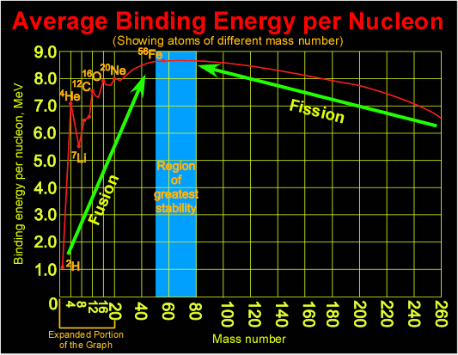

Slide 32
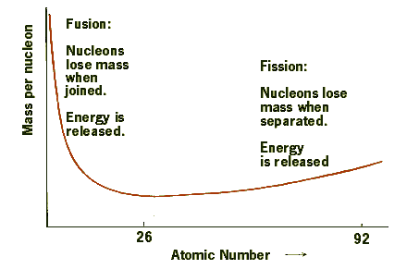
Or in terms of Mass per nucleon

Slide 33
Definitions:
We redefined several physical quantities to maintain the conservation laws for momentum and energy in special relativity.
Relativistic momentum:
Relativistic force:
Relativistic Energy:
E = γmc² = K + mc²
(K: kinetic energy)

Slide 34
Important Relation
(This results from the previous definitions)
Total energy of an object:
E = γmc²
Relativistic momentum of an object:
Energy – momentum relation:
E² =(pc)² + (mc²)²
Momentum of a massless particle:
p =E/c
Velocity of a massless particle:
u = c

Slide 35
Electromagnetic Waves
Review:

Slide 36
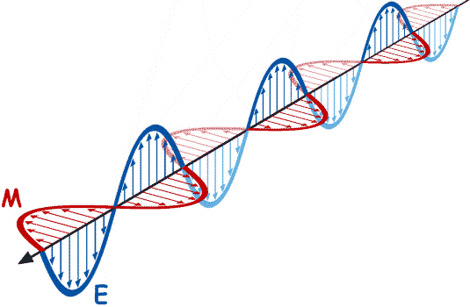
How do you generate light (electromagnetic radiation)?
We started somewhere here:
Stationary charges →
constant E-field, no magnetic (B)-field
E
+
Charges moving at a constant velocity →
Constant current through wire creates
a B-field, but B-field is constant
B
I
Accelerated charges →
changing E-field and changing B-field
EM radiation
→ both E and B are oscillating
B
E

Slide 37
1-Dimensional Wave Equation
Solutions are sines and cosines:
…with the requirement that:
or
A specific solution is found by applying boundary conditions

Slide 38
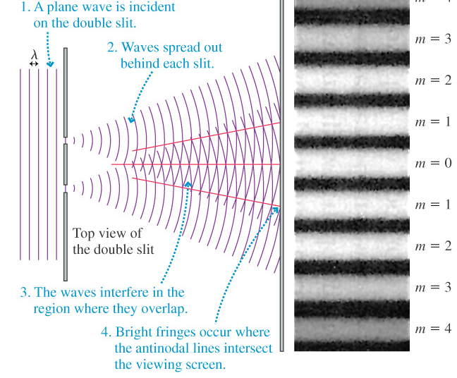
Light is a wave: Two slit interference

Slide 39
Double-slit experiment Determining the space between peaks (H)
L
r₁
H
r₂
D
Θ
Θ₁
For constructive
D
Θ
Θ₂
Δr = r₂-r₁
Δr = mλ (where m=1,2,3…)
If screen far away
Θ₁
Θ
Δr = Dsin(Θ)=DΘ =mλ
≈
Θ₂
≈

Slide 40
Are they in phase? What’s the difference in path?
H=mLλ
D
m=1,2,3,…
L
r₁
H
r₂
D
Θ
H = Lsin(Θ) = LΘ
DΘ =mλ
Θ = mλ/D
c
c

Slide 41
Electromagnetic waves carry energy
E_{max}=peak amplitude
Light shines on a black tank full of water.
How much energy is absorbed?
c
X
E(x,t) = E_{max}sin(ax-bt)
Intensity = Power = energy/time ~ (E_{avg})²
area area
~ (amplitude of wave)² ~ E_{max}²

Slide 42
Light shines on three black barrels filled w/ water:
#1
X
#2
X
#3
X
(Use E_{1max} = E_{2max} > E_{3max})
Which barrel will heat up the fastest?
A) 2 > 1 > 3 B) 1 > 2 > 3 C) 1 = 2 > 3
D) 1 = 3 > 2 E) 2 > 1 = 3
Intensity = power/area ~ E_{max}²
Does not depend on frequency/color!

Slide 43
Classical waves: Intensity ~ E_{max}²
|E_{ave}|²
X
vs.
|E_{ave}|²
X
Classically:
Time average of the E-field squared:
same… independent of frequency.
Intensity only depends on the E-field amplitude but not on the color (frequency) of the light!
Notes:
Integral is the same…
Wave view consistent with experiment.
DO NOT KNOW ABOUT… or NEED photons yet.

Slide 44
What exactly did we do during the last couple weeks?
Special Relativity
Spacetime
Galileo transformation: Classical relativity
Michelson-Morley → 'c' is same in all inertial frames
Einstein's postulate: Incompatible with Galilean relativity!
Consequences were 'time dilation' and 'length contraction'
→ Lorentz transformation → Velocity transformation
Spacetime interval: Invariant under Lorentz transformation
Relativistic Mechanics
Re-definition of important physical quantities to preserve conservation laws under Lorentz transformations:
- Momentum
- Force
- Kinetic Energy
- Rest Energy
- Total Energy

Slide 45
Einstein’s Postulate of Relativity
The speed of light in vacuum is the same in
all inertial frames of reference.
* An inertial frame is a reference frame that is not accelerating.

Slide 46
Velocity Transformation (a consequence of the Lorentz transformation)
If S’ is moving with speed v in the positive x direction relative to S, and the origin of S and S’ then the spacetime coordinates between two events is:
Lorentz transformation
(relativistic)
Velocity transformation
(relativistic)
u_{x}=^{Δx}/_{Δt}
…

Slide 47
Proper Time
Proper time: Time interval Δt = t₂ – t₁ between two events (x₁,y₁,z₁,t₁) and (x₂,y₂,z₂,t₂) measured in the frame, in which the two events occur at the same spatial coordinates, i.e. time interval that can be measured with one clock.
v
Same spatial coordinates means:
x₁ = x₂
y₁ = y₂
z₁ = z₂

Slide 48
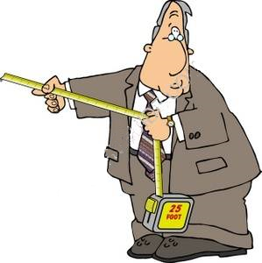
Proper Length
Proper length: Length of object measured in the frame where it is at rest (use a ruler)
... -3 -2 -1 0 1 2 3 ...

Slide 49
Spacetime Interval
Say we have two events: (x₁,y₁,z₁,t₁) and (x₂,y₂,z₂,t₂). Define the spacetime interval (sort of the "distance") between two events as:
With:
Spacetime interval
The spacetime interval has the same value in all reference frames! i.e. Δs² is “invariant” under Lorentz transformations.

Slide 50
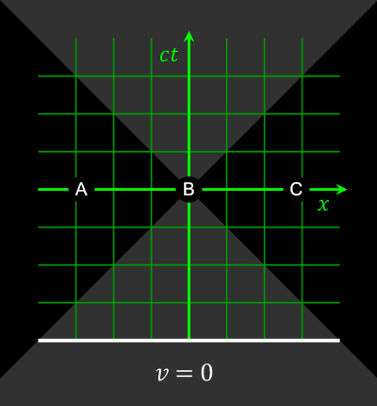
Simultaneity, time dilation & length contraction
As a consequence of Einstein's second postulate of relativity ('The speed of light is the same in all inertial frames of reference') we came to interesting conclusions:
- Relativity of simultaneity
- Time dilation
- Length contraction
All these effects are summarized in a set of equations:
The Lorentz transformation

Slide 51
Example from previous exam
A high-speed train is traveling at a velocity of v = 0.5c. The moment it passes over a bridge it launches a cannon ball with a velocity of 0.4c straight up (as seen by the train conductor). What is the velocity of the ball right after it was launched as seen by an observer standing on the bridge?
Situation seen by the onlooker on the bridge:
Cannon ball right after firing the cannon.
v

Slide 52
Velocity transformation
A high-speed train is traveling at a velocity of v = 0.5c. The moment it passes over a bridge it launches a cannon ball straight up (as seen by the train conductor) with a velocity of 0.4c. What is the velocity of the ball right after it was launched as seen by an observer standing on the bridge?
Attach reference frame S to the train:
Observer is in frame S' traveling from right to left (v is negative!!)
u_{x} = 0
u_{y} = 0.4c
Now use the velocity transformation:
y
y'
S
S'
x
v = -0.5c
x'

Slide 53
Velocity transformation
}
u'_{x} = 0.5c
u'_{y} = 0.346c
u_{x} = 0
u_{y} = 0.4c
Velocity transf.
y
y'
S
S'
x
v = -0.5c
x'

