Slide 1
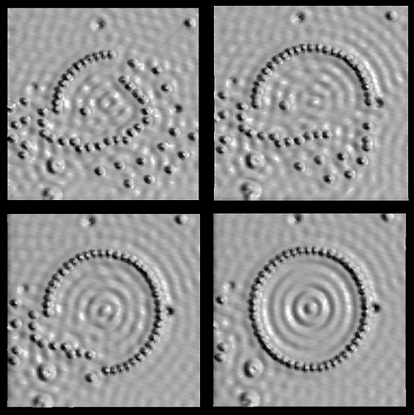
PH300 Modern Physics SP11
“Quantum Mechanics is the greatest intellectual accomplishment of the human race.” - Carl Wieman, Nobel Laureate in Physics 2001
2/8 Day 8:
Questions?
Review SR
Intro to Quantum, Photoelectric Effect
Next:
Exam I (In-class)
Photoelectric Effect

Slide 2
Last time:
Relativistic momentum and energy
Review EM Waves
Today:
Review SR
Intro to quantum/photoelectric effect
Thursday:
Exam I (in class); Homework 05 assigned(?)
Next Week:
Photoelectric effect, photons

Slide 3
Format of exam:
EM waves & special relativity (Lecture 07)
10 M/C @ 2pts + 3 Long Answer @ 10 pts = 50 pts
Bring:
pencil and eraser
calculator
ONE 3x5 card with whatever you want to write on both sides
Some constants and equations provided (see website)
Review information:
http://tinyurl.com/PH300SP11
Don’t Stress:
Can drop lowest exam score (see syllabus).

Slide 4
What exactly did we do during the last couple weeks?
Special Relativity
Spacetime
Galileo transformation: Classical relativity
Michelson-Morley → 'c' is same in all inertial frames
Einstein's postulate: Incompatible with Galilean relativity!
Consequences were 'time dilation' and 'length contraction'
→ Lorentz transformation → Velocity transformation
Spacetime interval: Invariant under Lorentz transformation
Relativistic Mechanics
Re-definition of important physical quantities to preserve conservation laws under Lorentz transformations:
- Momentum
- Force
- Kinetic Energy
- Rest Energy
- Total Energy

Slide 5
Einstein’s Postulate of Relativity
The speed of light in vacuum is the same in
all inertial frames of reference.
* An inertial frame is a reference frame that is not accelerating.

Slide 6
Velocity Transformation (a consequence of the Lorentz transformation)
If S’ is moving with speed v in the positive x direction relative to S, then the spacetime coordinates for two events in S’ are related to the spacetime coordinates in S via:
Lorentz transformation
(relativistic)
Velocity transformation
(relativistic)
u_{x}=^{Δx}/_{Δt}
…

Slide 7
Proper Time
Proper time: Time interval Δt = t₂ – t₁ between two events (x₁,y₁,z₁,t₁) and (x₂,y₂,z₂,t₂) measured in the frame, in which the two events occur at the same spatial coordinates, i.e. time interval that can be measured with one clock.
v
Same spatial coordinates means:
x₁ = x₂
y₁ = y₂
z₁ = z₂

Slide 8
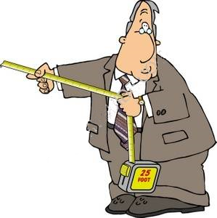
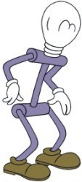
Proper Length
Proper length: Length of object measured in the frame where it is at rest (use a ruler)
... -3 -2 -1 0 1 2 3 ...

Slide 9
Spacetime Interval
Say we have two events: (x₁,y₁,z₁,t₁) and (x₂,y₂,z₂,t₂).
Define the spacetime interval (sort of the "distance") between two events as:
With:
Spacetime interval
The spacetime interval has the same value in all reference frames! i.e. Δs² is “invariant” under Lorentz transformations.

Slide 10
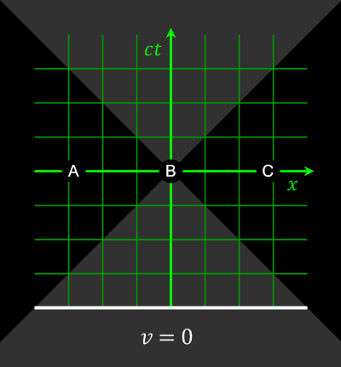
Simultaneity, time dilation & length contraction
As a consequence of Einstein's postulate of relativity
('The speed of light is the same in all inertial frames of reference') we came to interesting conclusions:
- Relativity of simultaneity
- Time dilation
- Length contraction
All these effects are summarized in a set of equations:
The Lorentz transformation

Slide 11
Definitions:
We redefined several physical quantities to maintain the conservation laws for momentum and energy in special relativity.
Relativistic momentum:
Relativistic force:
Relativistic Energy:
(K: kinetic energy)

Slide 12
Important Relation
(This results from the previous definitions)
Total energy of an object:
Relativistic momentum of an object:
Energy – momentum relation:
Momentum of a massless particle:
Velocity of a massless particle:

Slide 13
Example from some previous exam
A high-speed train is traveling at a velocity of v = 0.5c. The moment it passes over a bridge it launches a cannon ball with a velocity of 0.4c straight up (as seen by the train conductor). What is the velocity of the ball right after it was launched as seen by an observer standing on the bridge?
Situation seen by the onlooker on the bridge:
Cannon ball right after firing the cannon.
v

Slide 14
Velocity transformation
A high-speed train is traveling at a velocity of v = 0.5c. The moment it passes over a bridge it launches a cannon ball straight up (as seen by the train conductor) with a velocity of 0.4c. What is the velocity of the ball right after it was launched as seen by an observer standing on the bridge?
Attach reference frame S to the train:
Observer is in frame S' traveling from right to left (v is negative!!)
u_{x} = 0
u_{y} = 0.4c
Now use the velocity transformation:
y
y'
S
S'
x
v = -0.5c
x'

Slide 15
Velocity transformation
}
u'_{x} = 0.5c
u'_{y} = 0.346c
u_{x} = 0
u_{y} = 0.4c
Velocity transf.
y
y'
S
S'
x
v = -0.5c
x'

Slide 16
Part 2: Quantum Mechanics
Quantum Mechanics is the greatest intellectual accomplishment of human race.
- Carl Wieman, Nobel Laureate in Physics 2001
Courtesy of IBM

Slide 17
Is light a wave or a particle?
How do we know?
The beginnings of quantum mechanics

Slide 18
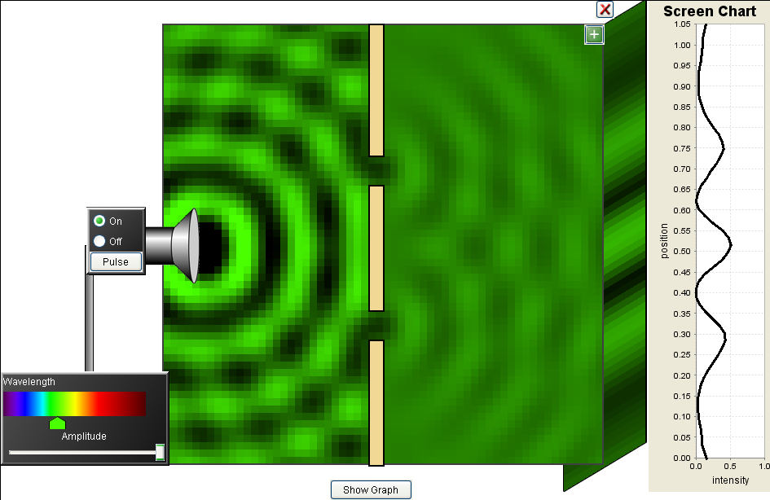
Light is a wave → interference!
The definite check that light IS a wave
Observe interference!

Slide 19
Electromagnetic waves carry energy
E_{max}=peak amplitude
Light shines on a black tank full of water.
How much energy is absorbed?
c
X
E(x,t) = E_{max}sin(ax-bt)
Intensity = Power = energy/time ~ (E_{avg})²
area area
~ (amplitude of wave)² ~ E_{max}²
Intensity only depends on the E-field amplitude but not on the color (frequency) of the light!

Slide 20
Classical waves: Intensity ~ E_{max}²
|E_{ave}|²
X
vs.
|E_{ave}|²
X
“Why do higher frequency gamma rays … carry more energy that lower frequency radio waves, but frequency has nothing to do with intensity?”
Energy carried by a beam of light
vs. Energy in a single quantum particle of light
Notes:
Integral is the same…
Wave view consistent with experiment.
DO NOT KNOW ABOUT… or NEED photons yet.

Slide 21
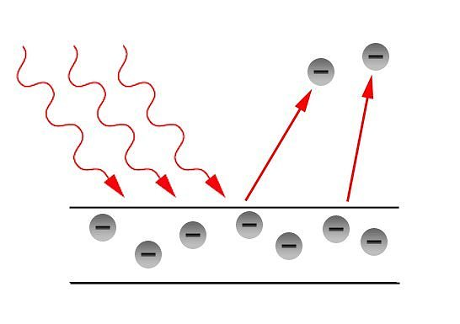
The photoelectric effect (~1900)
The photoelectric effect is a phenomenon in which electrons are emitted from a metal as a consequence of the electrons absorbing energy from light.
The effect was only observed with UV light, but not so with red or IR light. → Effect is frequency dependent!?
But Maxwell told us that the light intensity doesn’t depend on frequency! (Intensity only depends on |E|²)

Slide 22
The photoelectric effect
The results from the photoelectric effect where inconsistent with the classical view of EM theory.
(Discovered 1887 by Hertz, Explained by Einstein (using some of Plank's ideas) 1905. Nobel prize: 1921)
Einstein proposed:
"…the energy in a beam of light is not distributed continuously through space, but consists of a finite number of energy quanta, which are localized at points, which cannot be subdivided, and which are absorbed and emitted only as whole units.”
He took the energy of these single units to be hf, as proposed earlier by Planck.

Slide 23
The Photoelectric Effect
Photoelectric effect demonstrates that light also behaves like a particle.
Energy comes in particle-like chunks, the basics of quantum physics.
(energy of one chunk depends on frequency, a beam of light has
MANY chunks & the energy of the beam is the sum)
Next two classes:
I. Understand the P.E. experiment and what results you would expect if light were a classical wave (like physicists at the time expected the experiment should give).
II. What experimental results it actually did give.
III. The implications/interpretation of the results.
Notes:
Can only be explained by introducing some radical
ideas of quantum physics. (light is both wave and particle)
Also, basic physics of all sensitive light detectors, digital
cameras, etc.

Slide 24
The Farmer and the Seeds (a parable of scientific reasoning)
A seed is a square with some dots on it.
The farmer always plants 4 seeds in a group.
First Group: Second Group:
Farmer observes # of sprouts each group produces.
•
•
•
•
•
•
•
•
•
•
•
•
•
•
•
•
•
•
•
•
•
•
•
•
•
•

Slide 25
The Farmer and the Seeds
First Group: Second Group:
4 sprouts 6 sprouts
What do you think?
What schemes can we come up with that would predict the number of sprouts based on the dot pattern showing when the seeds are planted?
•
•
•
•
•
•
•
•
•
•
•
•
•
•
•
•
•
•
•
•
•
•
•
•
•
•

Slide 26
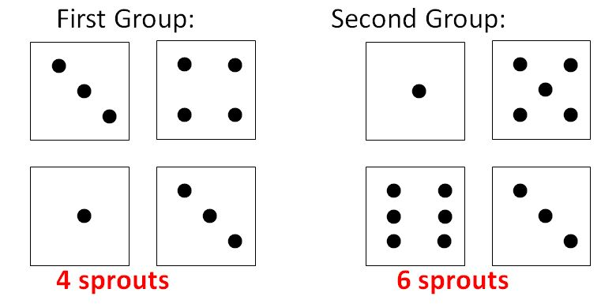
The Farmer and the Seeds
Possible Schemes
Totally Random (Numbers aren’t related to # of sprouts)
(Largest Number) = (# of Sprouts)
…

Slide 27
The Farmer and the Seeds
Another seed grouping the farmer tried:
•
•
•
•
•
•
•
What is the prediction of each of the different schemes the class has come up with for this seed grouping?
Notes:
(Once we have decided what the schemes predict we will find out what the farmer observed with this grouping.)
How should we make use of the comparison between each of these predictions and the outcome the farmer actually observed?
Where did these schemes we have been discussing come from? (Note: This question is not about the elements of the schemes, but the decisions as to what elements to use and how to use them.)
How do we know if we have figured out all the possible schemes?
If we have made many different tests of the seed groupings and have found a scheme that has worked on all of them so far, how do we know if will work on the next new test?

Slide 28
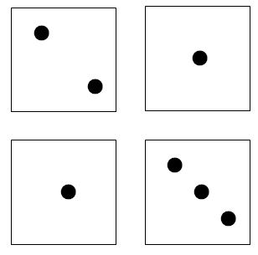
Another seed grouping the farmer tried:
2 sprouts!
Possible Schemes
Totally Random (Numbers aren’t related to # of sprouts)
(Largest Number) = (# of Sprouts)
…

Slide 29
Questions from this story:
Possible Schemes
Totally Random (???)
(Number that is even) = 2 Sprouts
[(Sum of all Numbers) – 3] / 2 = 2 Sprouts
How could we decide if any of these three schemes is the correct one?
If the farmer had to wait to plant more seeds, are there reasons we might in the meantime favor one scheme over another?
How do we know if we’ve figured out all the possible schemes?
Where did these schemes we’ve been discussing come from? (Note: This question is not about the elements of the schemes, but the decisions as to what elements to use and how to use them.)

Slide 30
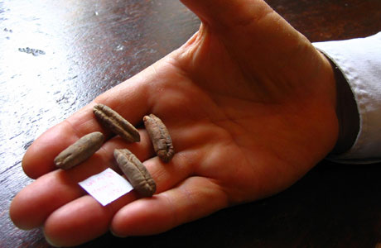
A MODEL

Slide 31
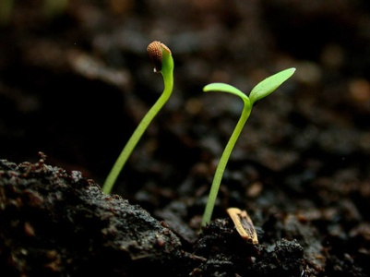
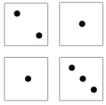
COMPETING THEORIES
EVEN NUMBER THEORY
(# OF SPROUTS) = 2 SPROUTS
2 sprouts!
COMPLEX MATHEMATICAL THEORY
(# OF SPROUTS) = [(1 + 1 + 2 + 3) - 3] / 2 = 2 SPROUTS

Slide 32
INTERPRETATION
EVEN NUMBER THEORY
(# OF SPROUTS) = 2 SPROUTS
2 sprouts!
COMPLEX MATHEMATICAL THEORY
(# OF SPROUTS) = [(1 + 1 + 2 + 3) - 3] / 2 = 2 SPROUTS
What do those numbers really represent?

Slide 33
Summary
Scientists “make up” theories to explain the evidence they see.
These theories are constrained by experiment.
We can’t always open up the seed and look inside. Have to make inferences from indirect evidence.
A theory with a plausible mechanism is more convincing than a rote algorithm.
The more different cases our theory works on, the more we believe it.
But it could always be wrong…

Slide 34
The photoelectric effect (~1900)
The photoelectric effect is a phenomenon in which electrons are emitted from a metal as a consequence of the electrons absorbing energy from light.
The effect was only observed with UV light, but not so with red or IR light. → Effect is frequency dependent!?
But Maxwell told us that the light intensity doesn’t depend on frequency! (Intensity only depends on |E|²)

Slide 35
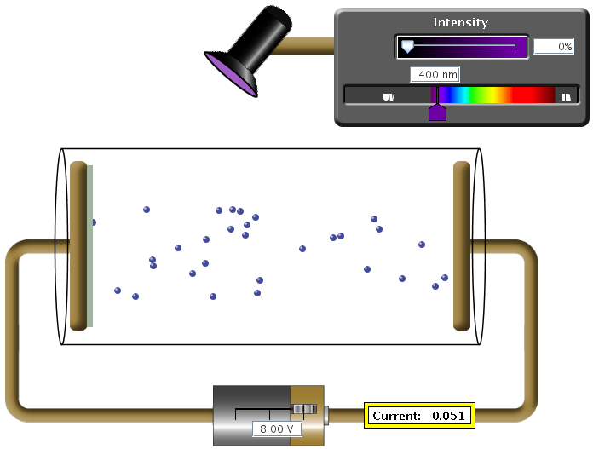
Experimental apparatus: PE effect
Metal surface
Glass cylinder
Vacuum

Slide 36
Experimental apparatus: PE effect
Metal surface
Glass cylinder
Vacuum
Adjustable voltage
Current meter

Slide 37
What happens?
A
B
2 ohms
-
+
10 V
Two metal plates in vacuum with a voltage between them.
How much current is flowing through the resistor?
A) 0 A
B) 0.2 A
C) 5 A
D) 10 A
E) infinite current
Answer: (A) 0 amps.
No electrons there to move.
Note: different from resistor across gap.

Slide 38
When does an electric field exert a force on a charge?
Always
Sometimes (depends on the charge)
Sometimes (need an oscillating E-field)
Sometimes (depends on many things)
Never

Slide 39
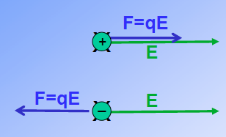
An electric field ALWAYS exerts a force on any charge!
In the absence of a magnetic field:
Force = charge x electric field

Slide 40
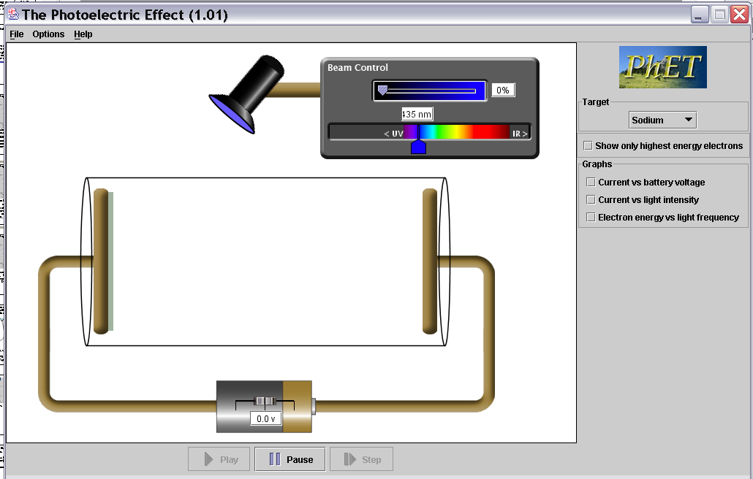
Photolelectric effect experiment apparatus.
Two metal plates in vacuum, adjustable voltage between
them, shine light on one plate. Measure current between plates.
A
B
Potential difference between A and B =
a. 0 V, b. 5 V, c. 10 V d. infinite volts
-
+
10 V
Notes:
What happens at 5V
186 responses, no breakdown

Slide 41
Potential difference between A and B is 10 V
Without light, no electrons can get across gap.
But if we put an electron near the surface of plate A it 'feels' the electric field between the two plates.
The electron accelerates towards the positive plate (B) and picks up the energy ΔE=qΔV= q(10V) = 1 electron charge x 10 V = 10 eV
Uniform E-field between plates
E
F=qE
+
+
+
+
+
10V
0V
A
B
Constant force on electron →constant acceleration
- 10V +
Current = 0 A
Current = 0.1 A
0V
10Volts

Slide 42
A note about units of energy
Joules are good for macroscopic energy conversions.
But when talking about energy of single electrons, Joules are inconvenient… (way too big!)
Define new energy unit: The electron-volt (eV)
1eV = kinetic energy gained by an electron when
accelerated through 1 volt of potential difference
1eV ≈ 1.6·10⁻¹⁹ J
+
+
+
+
0V
1V
F
E
path
+
1V
Notes:
For ref. not to be covered in class.

Slide 43
How to get the e⁻ out of plate A?
Shine light on the plate!!
Metal surface
Glass cylinder
+++++
A
Electrons get pulled towards plate B by the electric field
B
Vacuum
F = E·q_{e-}
Adjustable voltage
Current meter

Slide 44
Experimental apparatus: PE effect
Play with color and intensity. Measure current I. (I ~ ^{#e-}/_{s})
Measure the current!

Slide 45
First we could argue that the light heats up the plate → electrons pop-out
Measure the current!

Slide 46
Swimming Pool Analogy
If no water slops over side of pool, no flow. Little pump or big pump, still no water current. Similar to:
If electrons stuck inside metal plate, no current for little or big V.
pump
?
Pool party: put bunch of energy into water, splash some out,
get flow through pump.
Put energy into metal by heating it,
gives electrons energy, some “splash” out ➔ current.

Slide 47
Hot plate.
A few electrons get enough energy to just barely “splash” out.
What is the current vs. battery voltage?
Current
A
B
Current
0 Voltage
0 Voltage
Current
Current
C
C
D
0 Voltage
0 Voltage
Notes:
What happens at 5V
186 responses, no breakdown

Slide 48
What’s happening here?
Each electron that pops out is accelerated and hits the plate on the right side.
BUT: # of electrons = constant
Here, electrons are repelled by neg. electrode
sec
So current is constant!
Current
not I = V / R !!
0 Battery Voltage
reverse V,
no electrons
flow.
Vacuum tube diode. Works!
- early electronic device.

Slide 49
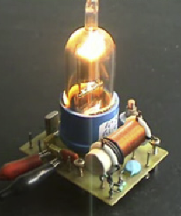
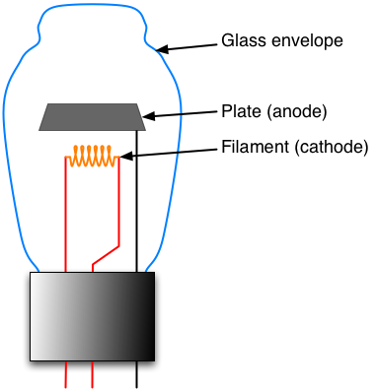
Vacuum tube diode
Current
voltage
reverse V,
no electrons
flow.

Slide 50
Photolelectric effect experiment apparatus.
Test metal
Electrons
So if light is classical wave, predict that just puts energy into plate, heats up, get diode current voltage curve.
Also takes time to heat up.
Light on longer, heat more, e’s
out faster = more current.
Color (frequency) of light does not matter, only intensity.
Current
C
0 Voltage
Notes:
What happens at 5V
186 responses, no breakdown

Slide 51
Recap for today. We know:
I. How apparatus works.
II. What would expect to see from classical wave view:
previous experiments like double slit interference, heating barrels, etc.
Current vs voltage step at zero then flat.
Color light does not matter, only intensity.
Takes time to heat up ⇒ current low and increases with time.
Increase intensity, increase current.
0
questions?
III. Do actual experiment, see if agrees with prediction.
I vs V (current vs. voltage)
How does this depends on intensity and color of light?
http://phet.colorado.edu/simulations/photoelectric/photoelectric.jnlp

