Slide 1
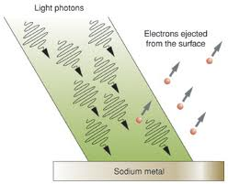
PH300 Modern Physics SP11
“Anyone who has never made a mistake has never tried anything new.” - Albert Einstein
2/15 Day 9:
Questions?
Exam 1
Photoelectric Effect
Thursday:
Photoelectric Effect
(continued)

Slide 2
Summary from last time…
Scientists “make up” theories to explain the evidence they see.
These theories are constrained by experiment.
We can’t always open up the seed and look inside. Have to make inferences from indirect evidence.
A theory with a plausible mechanism is more convincing than a rote algorithm.
The more different cases our theory works on, the more we believe it.
But it could always be wrong…

Slide 3
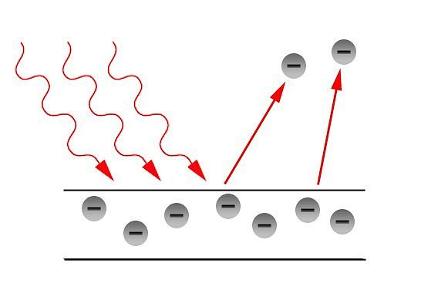
The Photoelectric Effect
The photoelectric effect is a phenomenon in which electrons are emitted from a metal as a consequence of the electrons absorbing energy from light.
The effect was only observed with UV light, but not so with red or IR light. → Effect is frequency dependent!?
But Maxwell told us that the light intensity doesn’t depend on frequency! (Intensity only depends on |E|²)

Slide 4
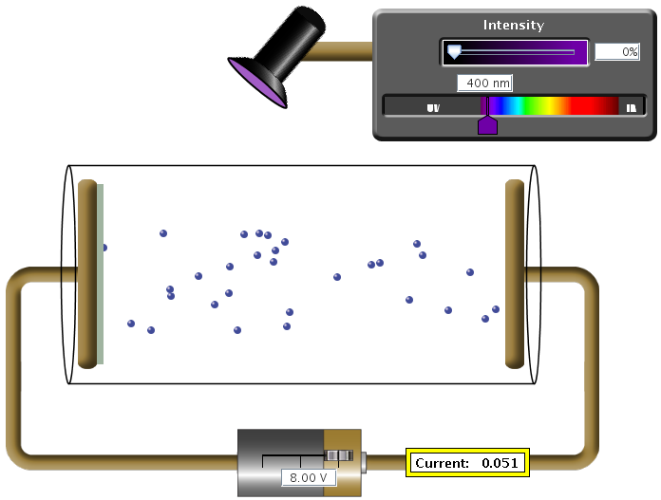
Experimental apparatus: PE effect
Metal surface
Glass cylinder
Vacuum

Slide 5
Experimental apparatus: PE effect
Metal surface
Glass cylinder
Vacuum
Adjustable voltage
Current meter

Slide 6
What happens?
A
B
2 ohms
-
+
10 V
Two metal plates in vacuum with a voltage between them.
How much current is flowing through the resistor?
A) 0 A
B) 0.2 A
C) 5 A
D) 10 A
E) infinite current
Answer: (A) 0 amps.
No electrons there to move.
Note: different from resistor across gap.

Slide 7
When does an electric field exert a force on a charge?
Always
Sometimes (depends on the charge)
Sometimes (need an oscillating E-field)
Sometimes (depends on many things)
Never

Slide 8
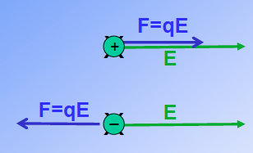
An electric field ALWAYS exerts a force
on any charge!
Lorentz force law
In the absence of a magnetic field:
Force = charge x electric field

Slide 9
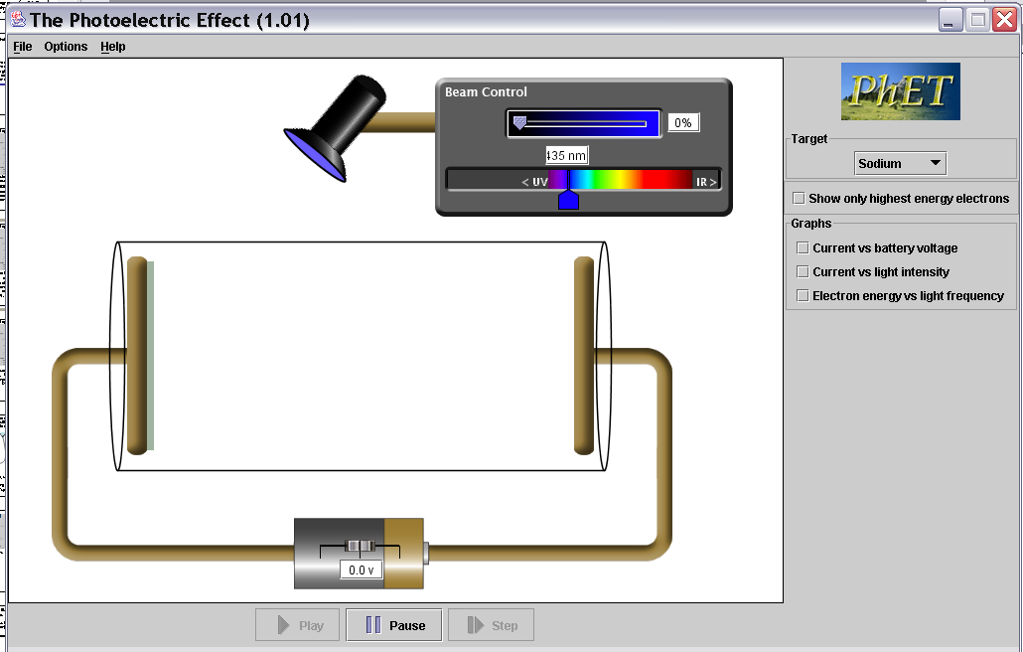
Photoelectric effect experiment apparatus.
Two metal plates in vacuum, adjustable voltage between
them, shine light on one plate. Measure current between plates.
A
B
Potential difference between A and B =
a. 0 V, b. 5 V, c. 10 V d. infinite volts
-
+
10 V
Notes:
What happens at 5V
186 responses, no breakdown

Slide 10
Potential difference between A and B is 10 V
Without light, no electrons can get across gap.
But if we put an electron near the surface of plate A it 'feels' the electric field between the two plates.
The electron accelerates towards the positive plate (B) and picks up the energy ΔE=qΔV= q(10V) = 1 electron charge x 10 V = 10 eV
Uniform E-field between plates
E
F=qE
+
+
+
+
+
10V
0V
A
B
Constant force on electron →constant acceleration
- 10V +
Current = 0 A
Current = 0.1 A
0V
10Volts

Slide 11
A note about units of energy
Joules are good for macroscopic energy conversions.
But when talking about energy of single electrons, Joules are inconvenient… (way too big!)
Define new energy unit: The electron-volt (eV)
1eV = kinetic energy gained by an electron when
accelerated through 1 volt of potential difference
1eV ≈ 1.6·10⁻¹⁹ J
+
+
+
+
0V
1V
F
E
path
+
1V
Notes:
For ref. not to be covered in class.

Slide 12
How to put the e⁻ close to plate A?
Shine light on the plate!!
Metal surface
Glass cylinder
+++++
A
Electrons get pulled towards plate B by the electric field
B
Vacuum
F = E·q_{e-}
Adjustable voltage
Current meter

Slide 13
First we could argue that the light heats up the plate → electrons pop-out
Measure the current!

Slide 14
Experimental apparatus: PE effect
Play with color and intensity & measure current.
Measure the current!

Slide 15
Swimming Pool Analogy
If no water slops over side of pool, no flow. Little pump or big pump, still no water current. Similar to:
If electrons stuck inside metal plate, no current for little or big V.
pump
?
Pool party: put bunch of energy into water, splash some out,
get flow through pump.
Put energy into metal by heating it very hot,
gives electrons energy, some “splash” out. Gives current.

Slide 16
Hot plate.
A few electrons get enough energy to just barely “splash” out.
What is the current vs. battery voltage?
Current
A
B
Current
0 Voltage
0 Voltage
Current
Current
C
D
0 Voltage
0 Voltage

Slide 17
What’s happening here?
Each electron that pops out is accelerated and hits the plate on the right side.
BUT: # of electrons = constant
Here, electrons are repelled by neg. electrode
sec
So current is constant!
Current
not I = V / R !!
0 Battery Voltage
reverse V,
no electrons
flow.
Vacuum tube diode!
- early electronic device.

Slide 18
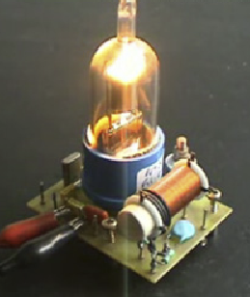
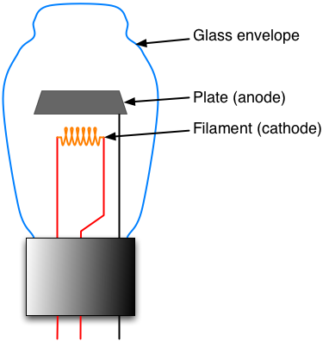
Vacuum tube diode
Current
voltage
reverse V,
no electrons
flow.

Slide 19
Photolelectric effect experiment apparatus.
Test metal
Electrons
So if light is classical wave, predict that it puts energy into plate, heats up, get diode current voltage curve.
Also takes time to heat up.
Light on longer, heat more, e’s
out faster = more current.
Color (frequency) of light does not matter, only intensity.
Current
0 Voltage
Notes:
What happens at 5V
186 responses, no breakdown

Slide 20
Recap for today. We know:
I. How apparatus works.
II. What would expect to see from classical wave view:
previous experiments like double slit interference, heating barrels, etc.
Current vs voltage step near zero then flat.
Color light does not matter, only intensity.
Takes time to heat up ⇒ current low and increases with time.
Increase intensity, increase current.
Current
0 Voltage
questions?
III. Do actual experiment, see if agrees with prediction.
I vs V (current vs. voltage)
How does this depends on intensity and color of light?
http://phet.colorado.edu/simulations/photoelectric/photoelectric.jnlp

Slide 21
e’s
I
First experiment- I vs. V high intensity, low intensity
Second experiment- I vs. V two different colors
write down what happens

Slide 22
HIGH intensity
e’s
I
voltage to turn around
most energetic electron
“stopping potential”
I
0 Battery Voltage

Slide 23
Which graph represents low and high intensity curves?
I
I
A
B
0 Batt. V
0 Batt. V
I
I
D
C
0 Batt. V
0 Batt. V
I
F
0 Batt. V

Slide 24
HIGH intensity
LOW intensity
e’s
I
Fewer electrons pop off metal
Current decreases.
Current proportional to light intensity.
I
ans. B
0 Battery Voltage

Slide 25
HIGH intensity
LOW intensity
e’s
I
Same KE electrons popping off metal. So same “stopping potential”.
I
0 Battery Voltage

Slide 26
Predict what happens to the initial KE of the electrons as the frequency of light changes? (Light intensity is constant)
e’s
I
Predict shape of the graph
Initial KE
0 Frequency of light
Notes:
Note what KE means (ask class: ke is speed?)
Have students make predictions on sheet.
look at sim for few different
colors, small forward V

Slide 27
A
B
Initial KE
Initial KE
0 Frequency
0 Frequency
C
D
Initial KE
Initial KE
0 Frequency
0 Frequency
E. something different
Notes:
A: 31
B: 8
C: 23
D: 38
182 responses

Slide 28
Correct answer is D.
There is a minimum frequency below which the light cannot kick out electrons…
even if wait a long time
e’s
I
As the frequency of light increases (shorter wavelength), the KE of electrons being popped off increases.
(it is a linear relationship)
Initial KE
What about different metals?
0 Frequency of light

Slide 29
Putting these together
I
high intensity
low intensity
Initial KE
0 Battery Voltage
0 Frequency of light
How does stopping potential (Voltage) relate to KE (of electrons)
Precise relation in a minute:
Note: One is positive and relates to electrons (KE)
The other negative and what it takes to stop electrons

Slide 30
Summary of Phot. Electric experiment results.
(play with sim to check and thoroughly understand)
1. Current linearly proportional to intensity.
2. Current appears with no delay.
3. Electrons only emitted if frequency of light exceeds a threshold. (same as “if wavelength short enough”).
4. Maximum energy that electrons come off with increases linearly with frequency (=c/wavelength).
(Max. energy = -stopping potential)
5. Threshold frequency depends on type of metal.
http://phet.colorado.edu/simulations/photoelectric/photoelectric.jnlp
how do these compare with classical wave predictions?

Slide 31
Classical wave predictions vs. experimental observations
Increase intensity, increase current.
experiment matches
Current vs voltage step near zero then flat.
(flat part matches, but experiment has tail of energetic electrons, energy of which depends on frequency)
Frequency does not matter, only intensity.
experiment shows strong dependence on frequency
Takes time to heat up ⇒ current low and increases with time.
experiment: electrons come out immediately, no time delay to heat up

Slide 32
Summary of what we know so far:
If light can kick out electron, then even smallest intensities of that light will continue to kick out electrons. KE of electrons does not depend on intensity.
2. Lower frequencies of light means lower initial KE of electrons
& KE changes linearly with frequency.
3. Is minimum frequency below which light won’t kick out electrons.
(Einstein) Need “photon” picture of light to explain observations:
- Light comes in chunks (“particle-like”) of energy (“photon”)
- a photon interacts only with single electron
- Photon energy depends on frequency of light, …
for lower frequencies, photon energy not enough to free an electron

Slide 33
Kicker analogy: a ball in a pit
Light like a Kicker…
Puts in energy. All concentrated
on one ball/electron.
Blue kicker always kicks the same,
Ball emerges with:
KE = kick energy - mgh
and harder than red kicker
always kicks.
mgh = energy needed to
make it up hill and out.
mgh for highest electron
analogous to work function.
Kick energy. Top ones
get out, bottom don’t.
Harder kick (shorter
wavelength light),
more get out.
electrons
metal
Notes:
show photon view
On sim…

Slide 34
Kicker analogy: a ball in a pit
Light like a Kicker…
Puts in energy. All concentrated
on one ball/electron.
Blue kicker always kicks the same,
and harder than red kicker
always kicks.
Ball emerges with:
KE = kick energy - mgh
energy needed to get most
energetic electron out of pit
(“work function”)
h
h
sodium- easy to kick out
small work function Φ = shallow pit
platinum, hard to kick out
large work function Φ = deep pit

Slide 35
If photon has enough energy, electron emerges with:
KE = photon energy – work function
Photon…
Puts in kick of energy
energy needed to kick
highest electron out of metal.
“WORK FUNCTION” (Φ)
Each photon has: Energy =h f = Planks constant * Frequency
(Energy in Joules) (Energy in eV)
E=hf=(6.626*10⁻³⁴ J-s)*(f s⁻¹) E=hf= (4.14*10⁻¹⁵ eV-s)*(f s⁻¹)
E=hc/λ = (1.99*10⁻²⁵ J-m)/(λ m) E= hc/λ = (1240 eV-nm)/(λ nm)
Initial KE of electron = E_{photon} - energy needed to kick
as it comes out of metal electron out of metal
Depends on type of metal.

Slide 36
Typical energies
Photon Energies:
Each photon has: Energy =h f = Planks constant * Frequency
(Energy in Joules) (Energy in eV)
E=hf=(6.626*10⁻³⁴ J-s)*(f s⁻¹) E=hf= (4.14*10⁻¹⁵ eV-s)*(f s⁻¹)
E=hc/λ = (1.99*10⁻²⁵ J-m)/(λ m) E= hc/λ = (1240 eV-nm)/(λ nm)
Red Photon: 650 nm
E_{photon} = 1240 eV-nm = 1.91 eV
650 nm
Work functions of metals (in eV):
Aluminum | 4.08 eV | Cesium | 2.1 | Lead | 4.14 | Potassium | 2.3
Beryllium | 5.0 eV | Cobalt | 5.0 | Magnesium | 3.68 | Platinum | 6.35
Cadmium | 4.07 eV | Copper | 4.7 | Mercury | 4.5 | Selenium | 5.11
Calcium | 2.9 | Gold | 5.1 | Nickel | 5.01 | Silver | 4.73
Carbon | 4.81 | Iron | 4.5 | Niobium | 4.3 | Sodium | 2.28
Uranium | 3.6
Zinc | 4.3

Slide 37
KE₃₀₀
V
A photon at 300 nm will kick out an electron with an amount of kinetic energy, KE₃₀₀. If the wavelength is halved and it hits an electron in the metal with same energy as the previous electron, the energy of the electron coming out is…
a. less than ½ KE₃₀₀.
b. ½ KE₃₀₀
c. = KE₃₀₀
d. 2 x KE₃₀₀
e. more than 2 x KE₃₀₀
(remember hill analogy, draw pictures to reason out answer,
don’t just pick answer without careful reasoning)

Slide 38
KE₃₀₀
V
CQ: A photon at 300 nm will kick out an electron with an amount of kinetic energy, KE₃₀₀. If the wavelength is halved and it hits an electron in the metal with same energy as the previous electron, the energy of the electron coming out is
e. more than 2 x KE₃₀₀
KE = photon energy-energy to get out
= hf – energy to get out
if λ is ½ then, f twice as big, E_{phot} =2hf₃₀₀
New KE_{new}= 2hf₃₀₀- energy to get out
Old KE₃₀₀ =hf₃₀₀- energy to get out
so KE_{new} is more than twice as big.
hf₁₅₀
Energy
hf₃₀₀
KE₃₀₀

Slide 39
Photoelectric effect experiment: Apply Conservation of Energy
Energy in = Energy out
Energy of photon = energy needed to kick + Initial KE of electron electron out of metal as exits metal
Loosely stuck electron, takes least energy to kick out
work function (Φ) = energy needed to kick
most energetic e⁻ out of metal
Electron Potential
Energy
Outside
metal
Warning!! This is not deeper in metal
It is more tightly bound!
Inside
metal
Tightly stuck, needs more energy to escape

Slide 40
Apply Conservation of Energy.
Energy in = Energy out
Energy of photon = energy needed to kick + Initial KE of electron electron out of metal as exits metal
What happens if send in bunch of blue photons?
E_{photon}
work function (Φ)
Electron Potential
Energy
Outside
metal
Photon gives electron
“kick of energy”.
Inside
metal
Electrons have equal chance of absorbing photon:
→ Max KE of electrons = photon energy - Φ
→ Min KE = 0
→ Some electrons, not enough energy to pop-out, energy into heat.

Slide 41
Electrons over large range of energy have equal chance of absorbing photons.
E_{phot}
E_{phot}
Electron potential
energy
work function Φ
Inside
metal
You initially have blue light shining on metal. If you change the frequency to violet light (at same # of photons per second), what happens to the number of electrons coming out?
a. fewer electrons kicked out
b. same # of electrons
c. more electrons kicked out
d. not enough information

Slide 42
KE₃₀₀
V
Shine in light of 300 nm. The most energetic electrons come out with kinetic energy, KE₃₀₀. A voltage diff of 1.8 V is required to stop these electrons. What is the work function Φ for this plate? (e.g. the minimum amount of energy needed to kick electron out of metal?)
a. 1.2 eV
b. 2.9 eV
c. 6.4 eV
d. 11.3 eV
e. none of the above

Slide 43
KE₃₀₀
V
Shine in light of 300 nm, most energetic electrons come out with kinetic energy, KE300. A voltage diff of 1.8 V is required to stop these electrons. What is the work function Φ for this plate? (e.g. the minimum amount of energy needed to kick e⁻ out of metal?)
a. 1.2 eV
b. 2.9 eV
c. 6.4 eV
d. 11.3 eV
e. none
Energy is conserved so:
the energy at the start (E_{phot}) = energy at end
E_{phot}= energy of the electron + energy to escape metal
so Φ= E_{phot} - electron energy
but electron energy = e x 1.8V = 1.8 eV, and
E_{phot} = 1240 eV nm/300 nm = 4.1 eV.
So Φ = 4.1eV - 1.8 eV = 2.3 eV

Slide 44
Photomultiplier tubes- application of photoelectric effect
most sensitive way to detect visible light, see single photons
(eye is incredibly good, can see a few photons)
glass vacuum enclosure
electron
amplifier,
gives pulse of current for each photoelectron
big voltage
What would be the best
choice of these materials to
make this out of?
a. Platinum Φ = 6.35 eV
b. Magnesium = 3.68 eV
c. Nickel = 5.01 eV
d. lead = 4.14 eV
e. Sodium = 2.28 eV
current
current
B
B
1
1
2
2
3
3
4
4
5
5
Time (
Time (
millisec
millisec
)
)

Slide 45
Photomultiplier tubes- application of photoelectric effect
most sensitive way to detect visible light, see single photons
(eye is incredibly good, can see a few photons)
glass vacuum enclosure
electron
amplifier,
gives pulse of current for each photoelectron
What would be the best
choice of these materials to
make this out of?
a. Platinum Φ = 6.35 eV
b. Magnesium = 3.68 eV
c. Nickel = 5.01 eV
d. lead = 4.14 eV
e. Sodium = 2.28 eV
big voltage
e. sodium. 2.28 eV
lower work function means
most visible light (<544 nm) will be
detected. Enough energy to eject electrons.

