Slide 1
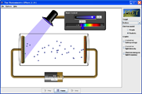
PH300 Modern Physics SP11
“I learned very early the difference between knowing the name of something and knowing something.”
- Richard Feynman
2/17 Day 10:
Questions?
Photoelectric Effect
(continued)
Photons
Next week:
Early atomic models
Atomic spectra
Lasers(!)

Slide 2
Today:
Finish photoelectric effect
Photons
Next Week:
Atomic spectra/Balmer series
Lasers
Key concepts for quantum physics.
Light energy is “quantized”.
Light has both wave-like and particle-like properties.

Slide 3
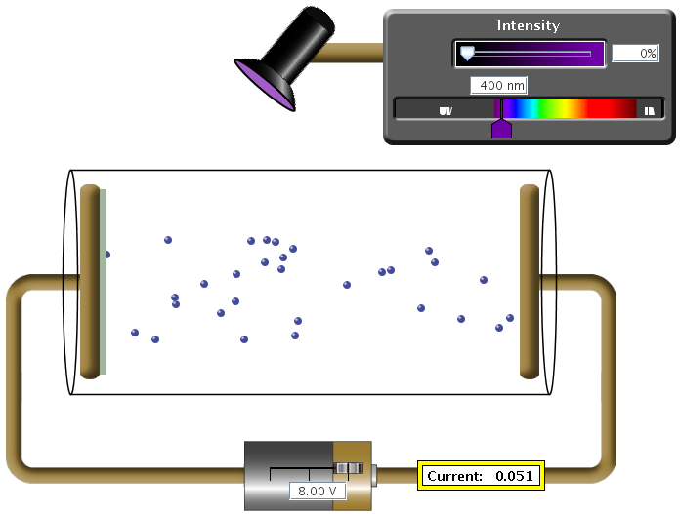
What did you think would happen?
Optical power P
- frequency f
Voltage U
Current I
1. Current vs. Voltage with the lamp on (fixed color of light, say UV).
2. Current vs. Frequency (color) at a fixed voltage (right plate is on positive potential)
3. Current vs. Intensity for fixed color (right plate is at positive voltage)

Slide 4
PE summary from last class:
http://phet.colorado.edu/simulations/photoelectric/photoelectric.jnlp
Current responds instantaneously to light on/off → Not just a heating effect!
Color matters: Below a certain frequency: No electrons. → Not just a heating effect!
Positive voltage does not increase the current (remember the 'pool analogy')
Negative voltages do decrease current → Stopping voltage is equal to initial kinetic energy!
Initial kinetic energy depends on color of the light.
Current is proportional to the light intensity.
how do these compare with classical wave predictions?

Slide 5
Summary PE effect:
2. Current vs. f:
1. Current vs. Voltage:
high intensity
I
I
low intensity
0 U
0 Frequency
3. Current vs. intensity:
or: Initial KE vs. f:
I
Initial KE
0 Intensity
0 Frequency

Slide 6
Classical wave predictions vs. experimental observations
Increase intensity, increase current.
experiment matches
Current vs voltage step near zero then flat.
(flat part matches, but experiment has tail of energetic electrons, energy of which depends on frequency)
Frequency does not matter, only intensity.
experiment shows strong dependence on frequency
Takes time to heat up ⇒ current low and increases with time.
experiment: electrons come out immediately, no time delay to heat up

Slide 7
Summary of what we know so far:
If light can kick out electron, then even smallest intensities of that light will continue to kick out electrons. KE of electrons does not depend on intensity.
2. Lower frequencies of light means lower initial KE of electrons
& KE changes linearly with frequency.
3. Minimum frequency below which light won’t kick out electrons.
(Einstein) Need “photon” picture of light to explain observations:
- Light comes in chunks (“particle-like”) of energy (“photon”)
- a photon interacts only with single electron
- Photon energy depends on frequency of light, …
for lower frequencies, photon energy not enough to free an electron

Slide 8
Kicker analogy: a ball in a pit
Light like a Kicker…
Puts in energy. All concentrated
on one ball/electron.
Blue kicker always kicks the same,
Ball emerges with:
KE = kick energy - mgh
and harder than red kicker
always kicks.
mgh = energy needed to
make it up hill and out.
mgh for highest electron
analogous to work function.
Kick energy. Top ones
get out, bottom don’t.
Harder kick (shorter
wavelength light),
more get out.
electrons
metal
Notes:
show photon view
On sim…

Slide 9
Kicker analogy: a ball in a pit
Light like a Kicker…
Puts in energy. All concentrated
on one ball/electron.
Blue kicker always kicks the same,
and harder than red kicker
always kicks.
Ball emerges with:
KE = kick energy - mgh
mgh = energy needed to
make it up hill and out.
mgh for highest electron
analogous to work function.
h
h
sodium- easy to kick out
small work function Φ = shallow pit
platinum, hard to kick out
large work function Φ = deep pit

Slide 10
If photon has enough energy, electron emerges with:
KE = photon energy – work function
Photon…
Puts in kick of energy
energy needed to kick out
least bound electron.
“WORK FUNCTION” (Φ)
Each photon has: Energy =h f = Planks constant * Frequency
(Energy in Joules) (Energy in eV)
E=hf=(6.626*10⁻³⁴ J-s)*(f s⁻¹) E=hf= (4.14*10⁻¹⁵ eV-s)*(f s⁻¹)
E=hc/λ = (1.99*10⁻²⁵ J-m)/(λ m) E= hc/λ = (1240 eV-nm)/(λ nm)
Initial KE of electron = E_{photon} - energy needed to kick
as it comes out of metal electron out of metal
Depends on type of metal.

Slide 11
Typical energies
Photon Energies:
Each photon has: Energy =h f = Planks constant * Frequency
(Energy in Joules) (Energy in eV)
E=hf=(6.626*10⁻³⁴ J-s)*(f s⁻¹) E=hf= (4.14*10⁻¹⁵ eV-s)*(f s⁻¹)
E=hc/λ = (1.99*10⁻²⁵ J-m)/(λ m) E= hc/λ = (1240 eV-nm)/(λ nm)
Red Photon: 650 nm
E_{photon} = 1240 eV-nm = 1.91 eV
650 nm
Work functions of metals (in eV):
Aluminum | 4.08 eV | Cesium | 2.1 | Lead | 4.14 | Potassium | 2.3
Beryllium | 5.0 eV | Cobalt | 5.0 | Magnesium | 3.68 | Platinum | 6.35
Cadmium | 4.07 eV | Copper | 4.7 | Mercury | 4.5 | Selenium | 5.11
Calcium | 2.9 | Gold | 5.1 | Nickel | 5.01 | Silver | 4.73
Carbon | 4.81 | Iron | 4.5 | Niobium | 4.3 | Sodium | 2.28
Uranium | 3.6
Zinc | 4.3

Slide 12
KE₃₀₀
V
A photon at 300 nm will kick out an electron with an amount of kinetic energy, KE₃₀₀. If the wavelength is halved and it hits an electron in the metal with same energy as the previous electron, the energy of the electron coming out is…
a. less than ½ KE₃₀₀.
b. ½ KE₃₀₀
c. = KE₃₀₀
d. 2 x KE₃₀₀
e. more than 2 x KE₃₀₀
(remember hill analogy, draw pictures to reason out answer,
don’t just pick answer without careful reasoning)

Slide 13
KE₃₀₀
V
CQ: A photon at 300 nm will kick out an electron with an amount of kinetic energy, KE₃₀₀. If the wavelength is halved and it hits an electron in the metal with same energy as the previous electron, the energy of the electron coming out is
e. more than 2 x KE₃₀₀
KE = photon energy-energy to get out
= hf – energy to get out
if λ is ½ then, f twice as big, E_{phot} =2hf₃₀₀
New KE_{new}= 2hf₃₀₀- energy to get out
Old KE₃₀₀ =hf₃₀₀- energy to get out
so KE_{new} is more than twice as big.
hf₁₅₀
Energy
hf₃₀₀
KE₃₀₀

Slide 14
Photoelectric effect experiment: Apply Conservation of Energy
Energy in = Energy out
Energy of photon = energy needed to kick + Initial KE of electron electron out of metal as exits metal
Loosely stuck electron, takes least energy to kick out
work function (Φ) = energy needed to kick
most energetic e⁻ out of metal
Electron Potential
Energy
Outside
metal
Warning!! This is not deeper in metal
It is more tightly bound!
Inside
metal
Tightly stuck, needs more energy to escape

Slide 15
Apply Conservation of Energy.
Energy in = Energy out
Energy of photon = energy needed to kick + Initial KE of electron electron out of metal as exits metal
What happens if send in bunch of blue photons?
E_{photon}
work function (Φ)
Electron Potential
Energy
Outside
metal
Photon gives electron
“kick of energy”.
Inside
metal
Electrons have equal chance of absorbing photon:
→ Max KE of electrons = photon energy - Φ
→ Min KE = 0
→ Some electrons, not enough energy to pop-out, energy into heat.

Slide 16
Electrons over large range of energy have equal chance of absorbing photons.
E_{phot}
E_{phot}
Electron potential
energy
work function Φ
Inside
metal
You initially have blue light shining on metal. If you change the frequency to violet light (at same # of photons per second), what happens to the number of electrons coming out?
a. fewer electrons kicked out
b. same # of electrons
c. more electrons kicked out
d. not enough information

Slide 17
KE₃₀₀
V
Shine in light of 300 nm. The most energetic electrons come out with kinetic energy, KE₃₀₀. A voltage diff of 1.8 V is required to stop these electrons. What is the work function Φ for this plate? (e.g. the minimum amount of energy needed to kick electron out of metal?)
a. 1.2 eV
b. 2.9 eV
c. 6.4 eV
d. 11.3 eV
e. none of the above

Slide 18
KE₃₀₀
V
Shine in light of 300 nm, most energetic electrons come out with kinetic energy, KE300. A voltage diff of 1.8 V is required to stop these electrons. What is the work function Φ for this plate? (e.g. the minimum amount of energy needed to kick e⁻ out of metal?)
a. 1.2 eV
b. 2.9 eV
c. 6.4 eV
d. 11.3 eV
e. none
Energy is conserved so:
the energy at the start (E_{phot}) = energy at end
E_{phot}= energy of the electron + energy to escape metal
so Φ= E_{phot} - electron energy
but electron energy = e x 1.8V = 1.8 eV, and
E_{phot} = 1240 eV nm/300 nm = 4.1 eV.
So Φ = 4.1eV - 1.8 eV = 2.3 eV

Slide 19
Photomultiplier tubes- application of photoelectric effect
most sensitive way to detect visible light, see single photons
(eye is incredibly good, can see a few photons)
glass vacuum enclosure
electron
amplifier,
gives pulse of current for each photoelectron
big voltage
What would be the best
choice of these materials to
make this out of?
a. Platinum Φ = 6.35 eV
b. Magnesium = 3.68 eV
c. Nickel = 5.01 eV
d. lead = 4.14 eV
e. Sodium = 2.28 eV
current
current
B
B
1
1
2
2
3
3
4
4
5
5
Time (
Time (
millisec
millisec
)
)

Slide 20
Photomultiplier tubes- application of photoelectric effect
most sensitive way to detect visible light, see single photons
(eye is incredibly good, can see a few photons)
glass vacuum enclosure
electron
amplifier,
gives pulse of current for each photoelectron
What would be the best
choice of these materials to
make this out of?
a. Platinum Φ = 6.35 eV
b. Magnesium = 3.68 eV
c. Nickel = 5.01 eV
d. lead = 4.14 eV
e. Sodium = 2.28 eV
big voltage
e. sodium. 2.28 eV
lower work function means
most visible light (<544 nm) will be
detected. Enough energy to eject electrons.

Slide 21
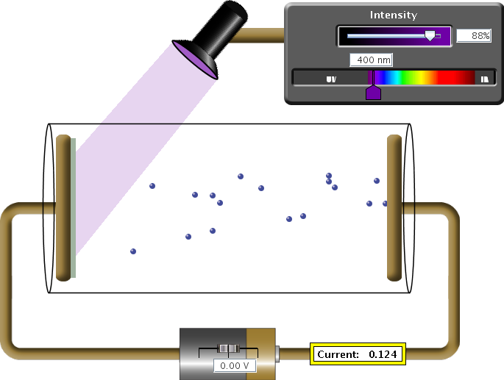
Is light a stream of particles?
Yes! also….
E = hf
E_{kin,max}=hf - Φ

Slide 22
Photons
The frequency of a beam of light is decreased but the light’s intensity remains unchanged. Which of the following is true?
A. There are more photons per second but each photon has less energy.
B. There are more photons per second but each photon has more energy.
C. There are fewer photons per second and each photon has less energy.
D. There are fewer photons per second but each photon has more energy.
E. Nothing happens to the photon number because light is a wave.
Notes:
Change

Slide 23
Electromagnetic Waves and Photons
are describing the same thing!
Need to have a model where these views/perspectives all fit together and are consistent with each other!
1. Light, Radio waves, X-rays are all electromagnetic waves!
2. The electromagnetic wave is made up from lots of photons.
3. Photons can be thought of as mini E/M wave segments
(each has a specific energy hf and a wavelength c/f )
Electromagnetic
Wave
E
Travels
Straight
Made up from
photons
Made up from
lots of photons
This picture can explain wave view and particle view.
“Particle” = little chunk of the electromagnetic wave.
Energy of photon (hf) is in its oscillating E and B fields.
(Sometimes it also helps to think of a photon as a tiny particle/energy packet).

Slide 24
If you think of photons as particles you probably automatically think of them as perfectly localized - like a tiny billiard ball at a coordinate (x, y, z).
This is what get's you into trouble in QM!!
Billiard balls never produce a diffraction pattern
Billiard balls have no wavelength/frequency
Billiard balls cannot go through two slits at the same time (photons can; electrons too! Will show later)

Slide 25
When is it important to think
about particle aspect of light?
Only if your “detection system” is good enough to see individual photons!
Examples where important to think about particle behavior:
Photoelectric effect: Individual electrons popping out of metal
Lasers: Electrons in atoms transitioning between energy levels
Molecular bonds: Chemical bonds breaking
Examples where don’t need to think about particle behavior (detection system isn’t good enough and wave behavior is easier):
Heating: Energy absorbed in microwave or by black asphalt.
Optics: Light bending through lenses or passing through slits
Laser beam: Treat it just like a beam of light… (Understanding
the working principle of a laser requires photon picture.)

Slide 26
Consistent descriptions:
Lots of light means …
Big amplitude E/M wave
Made from many photons
(mini E/M wave segments)
Bright Red Laser
When a photon interacts with something (e.g. an electron) all the energy of its wave segment ends up concentrated in one spot (like a particle!)
Until a photon interacts with something (e.g. absorbed by an electron), it is a wave. How does the wavelength of the photon compare to the wavelength of the light in the red laser?
Photon has a smaller wavelength
Photon has same wavelength
Photon has a larger wavelength
Photons are points in space. They have no wavelength.

Slide 27
Properties of photons
The energy of a photon is E = hf
The wavelength of a photon is λ = c/f = hc/E
The momentum of a photon is p = h/λ = E/c
The mass of a photon is m = 0
h ≈ 6.626 ·10⁻³⁴ J·s: Plank constant
It sometimes is useful to define h = h/(2π)
The energy of a photon is then: E = hf = hω

Slide 28
What if the intensity is really small?
Wimpy Laser beam: P = 10⁻¹⁹ W
First photon strikes here
3rd…
Next photon strikes here
.
.
.
screen
If the laser power is 10⁻¹⁹ W, we get only about one photon per second in the beam! (assuming λ ≈ 780 nm)
Where's that one photon?
Well, we can't know anything about its location
until it strikes the screen.
Most photons seem to hit the screen where intensity is high.

Slide 29
Where’s the photon?
Great question!
But no one can answer it…
It will strike the screen at random position!
However: We do observe that more photons strike at the places where the intensity of the laser beam is largest.
Important conclusion:
The probability to find a photon at a specific location in a beam of light is proportional to the intensity of the beam at that location.
i.e.: Probability is proportional to E²_{max}

Slide 30
Probability and randomness
Photon is 3-D-spread-out-little-chunk of an EM wave.
Gazillions of electrons in metal:
Which one will be kicked out?
Can’t tell, but photon uniformly spread out so pretty much equal probability everywhere.
What if shape of single photon wave looked like this?
Gazillion electrons
Which one will be kicked out?
Answer: Can’t tell, but probability of photon collapse at particular point (kicking out electron) related to intensity of wave (E_{max}²)
quantum-wave-interference sim

Slide 31
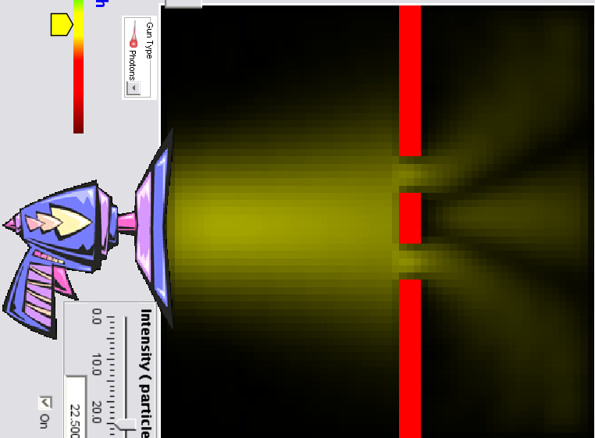
How can light behave like a wave (interference etc), but be made up of particles (photons) that seem to hit at random places?
Which is best answer, and why? (will randomly ask for reasons)
If I shoot a photon through the two slits to hit the screen, it…
a. cannot hit in the middle, because block is in the way.
b. is completely random where it can hit. Has equal chance of hitting anywhere on the screen.
c. must hit at the maximum of the interference pattern
d. has some chance of being anywhere, but on average better chance at being where interference pattern in brightest.
e. will hit anywhere it has a straight shot through either slit
Notes:
A: 0
B: 5
C: 1
D: 90
E: 4
178 responses

Slide 32
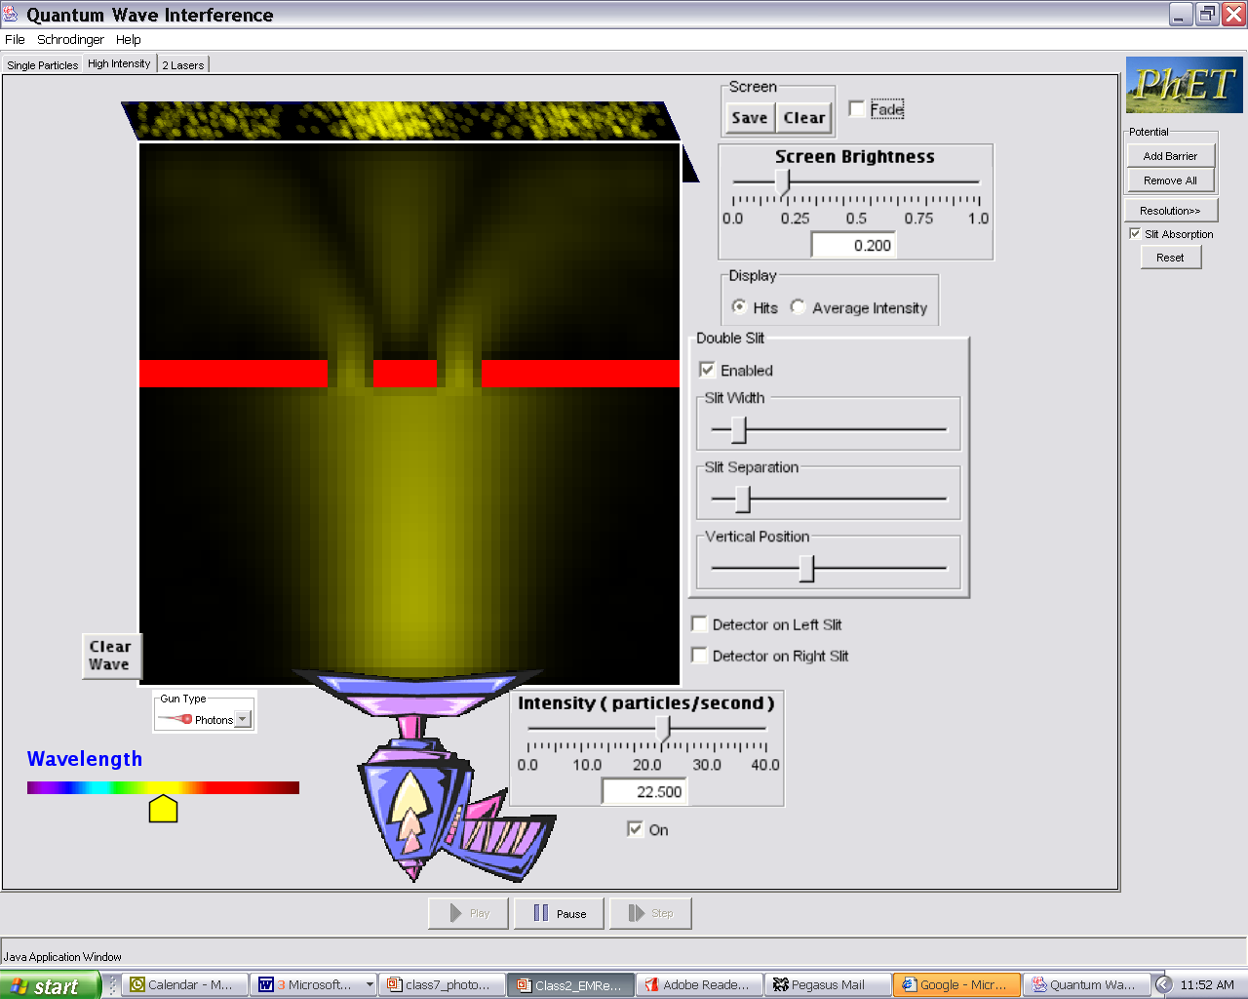
Probability of photon hitting given by where field is biggest
(electric field strength)² ~ Intensity &
gives probability of where photon will be!
standard electric field
representation of light field
Classical electric field wave pattern describes probability of where photons will be… higher intensity, higher likelihood that photon will be detected there.
If I shoot a photon through the two slits to hit the screen, it has some chance of being detected anywhere on screen, but on average better chance at being where interference pattern in brightest.

Slide 33
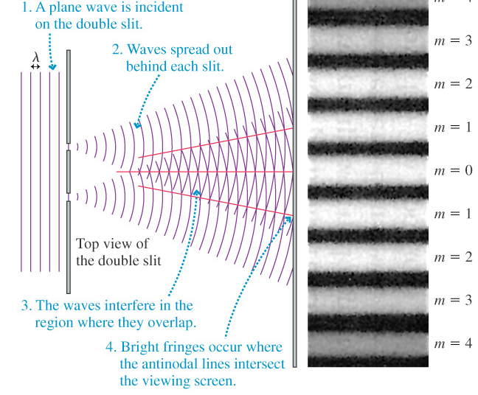
Two slit interference
Notes:
Wave interference…

Slide 34
If we run the photoelectric effect with very low intensity light that uniformly illuminates the surface, we observe an electron pops out about every few seconds. Why does one particular electron pop out?
a. because that is where the light hit the metal.
b. that electron had more energy than any of the others so it was the easiest to remove.
c. no physical reason, that electron just got lucky and won the “escape from metal” lottery.
d. there must be some other physical reason, but I am not sure what it is.
e. there is a physical reason that is not listed above, and I think I know what it is.
Notes:
A: 9
B: 30
C: 30
D: 13
E: 18
179 responses

Slide 35
If we run the photoelectric effect with very low intensity light that uniformly illuminates the surface, we observe an electron pops out about every few seconds. Why does one particular electron pop out?
c. no physical reason, that electron just got lucky and won the “escape from metal” lottery.
"Uniformly illuminated" means:
probability to find a photon is the same at every location,
but cannot know where that photon will hit
There is a random probability of kicking out any particular electron, so it is just random luck that picked that electron.
Notes:
Photon sim-- hitting screen, no slits.

Slide 36
Randomness in physics??!
A completely new concept in QM is that the outcome of a measurement can often times not be predicted precisely. We can only predict the probability of obtaining a certain result!
Examples:
Where will a photon hit the screen?
Well, I don’t know, but the probability is largest where the intensity of the light is largest ~ (field amplitude)²
Where is the electron in a hydrogen atom?
The probability of where it will be found is largest at the location where the square of the matter-wave amplitude is largest.
(Randomness is negligible for macroscopic objects but important on atomic scale!)

Slide 37
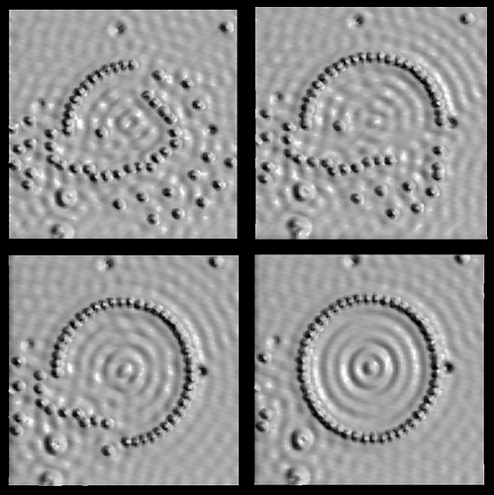
Remember this picture?
The probability of finding the electron that is trapped inside this ring of atoms is highest at the place, where the square of the wave amplitude for the electron is largest.

Slide 38
QM: Fundamental change in the way to think about physics:
Before (pre 1900, Physics I and II) -- everything could be known exactly, if measured and calculated carefully enough.
Now-- physics behavior is fundamentally inexact.
Contains randomness, can only predict and measure
probabilities for what happens, not exact behavior!
Einstein didn’t accept this fact!
(…much more about this later…)

Slide 39
Which slit did this photon go through?
a. left
b. right
c. both
d. neither
e. either left or right we just cannot know which one
Notes:
A: 7
B: 16
C: 65
D: 11
178 responses

Slide 40
Which slit did this photon go through?
c. both!
If one slit:
Get single slit pattern
(i.e. no interference)
But: that photon is part
of the two slit interference pattern,
the probability pattern of where it lands is described by
the 2 slit interference pattern, it must have gone through both
slits i. e. as a wave!
When it interacts with the screen it acts like particle!
Notes:
If can know that
went through only
one slit, must get
photon pattern that
corresponds to light
going through a single
slit, i.e. no interference
between the two paths corresponding to the two slits.
Since that photon is part of the two slit interference pattern,
and the probability pattern of where it lands is described by
the 2 slit interference pattern, it must have gone through both
slits i. e. as a wave. But when interacted with e like particle.

Slide 41
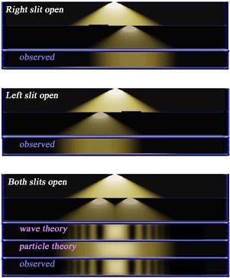

Slide 42
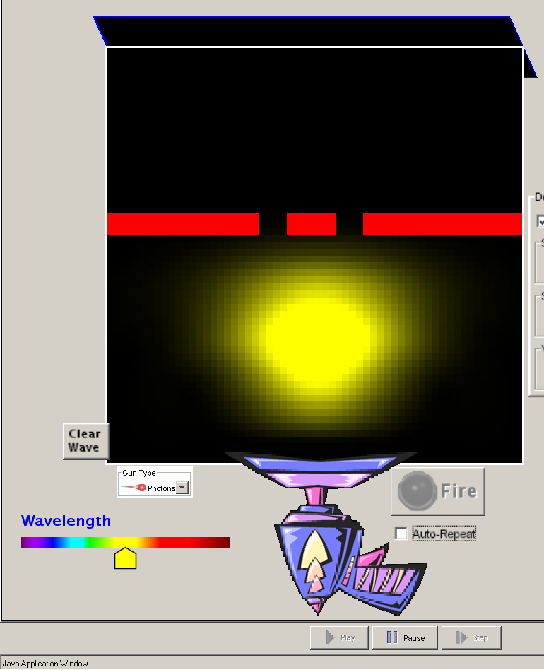
Photon before it goes through the slits
Photon as little segment of wave moving towards slits
Intensity of wave in various places, indicates probability of finding the photon there if you looked at that moment.

Slide 43
Photon after it goes through the slits
Photon is a wave…
it can interfere with itself.
Intensity of wave in various places indicates the probability of the photon concentrating at that spot if you had detector (e.g. a bunch of atoms or a sheet of metal)

Slide 44
Photon after it goes through the slits
When photon interacts with an electron or atom, all energy ends up in one spot… behaves like a particle with energy = hc/λ
= hf
Photon is a wave…
it can interfere with itself.
Intensity of wave in various places still indicates probability of the photon concentrating at that spot if you had detector (e.g. a bunch of atoms or a sheet of metal)

