Slide 1
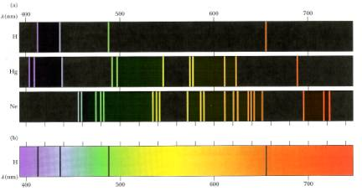
PH300 Modern Physics SP11
All these fifty years of conscious brooding have brought me no nearer to the answer to the question, 'What are light quanta?' Nowadays every Tom, Dick and Harry thinks he knows it, but he is mistaken. (Albert Einstein, 1954)
2/22 Day 11:
Questions?
Photons
Atomic Spectra
Thursday:
Lasers(!)

Slide 2
Last time:
Finished photoelectric effect
Photons
Today:
Photons (continued)
Atomic spectra
Key concepts for quantum physics.
Light energy is “quantized”.
Light has both wave-like and particle-like properties.

Slide 3
Electromagnetic Waves and Photons
are describing the same thing!
Need to have a model where these views/perspectives all fit together and are consistent with each other!
1. Light, Radio waves, X-rays are all electromagnetic waves!
2. The electromagnetic wave is made up from lots of photons.
3. Photons can be thought of as mini E/M wave segments
(each has a specific energy hf and a wavelength c/f )
Electromagnetic
Wave
E
Travels
Straight
Made up from
photons
Made up from
lots of photons
This picture can explain wave view and particle view.
“Particle” = little chunk of the electromagnetic wave.
Energy of photon (hf) is in its oscillating E and B fields.
(Sometimes it also helps to think of a photon as a tiny particle/energy packet).

Slide 4
If you think of photons as particles you probably automatically think of them as perfectly localized - like a tiny billiard ball at a coordinate (x, y, z).
This is what get's you into trouble in QM!!
Billiard balls never produce a diffraction pattern
Billiard balls have no wavelength/frequency
Billiard balls cannot go through two slits at the same time (photons can; electrons too! Will show later)

Slide 5
When is it important to think
about particle aspect of light?
Only if your “detection system” is good enough to see individual photons!
Examples where important to think about particle behavior:
Photoelectric effect: Individual electrons popping out of metal
Lasers: Electrons in atoms transitioning between energy levels
Molecular bonds: Chemical bonds breaking
Examples where don’t need to think about particle behavior (detection system isn’t good enough and wave behavior is easier):
Heating: Energy absorbed in microwave or by black asphalt.
Optics: Light bending through lenses or passing through slits
Laser beam: Treat it just like a beam of light… (Understanding
the working principle of a laser requires photon picture.)

Slide 6
Consistent descriptions:
Lots of light means …
Big amplitude E/M wave
Made from many photons
(mini E/M wave segments)
Bright Red Laser
When a photon interacts with something (e.g. an electron) all the energy of its wave segment ends up concentrated in one spot (like a particle!)
Until a photon interacts with something (e.g. absorbed by an electron), it acts like a wave. How does the wavelength of the photon compare to the wavelength of the light in the red laser?
Photon has a smaller wavelength
Photon has same wavelength
Photon has a larger wavelength
Photons are points in space. They have no wavelength.

Slide 7
Properties of photons
The energy of a photon is E = hf
The wavelength of a photon is λ = c/f = hc/E
The mass of a photon is m = 0
The momentum of a photon is p = E/c = h/λ
h ≈ 6.626 ·10⁻³⁴ J·s: Plank constant
It sometimes is useful to define h = h/(2π)
The energy of a photon is then: E = hf = hω

Slide 8
What if the intensity is really small?
Wimpy Laser beam: P = 10⁻¹⁹ W
First photon strikes here
3rd…
Next photon strikes here
.
.
.
screen
If the laser power is 10⁻¹⁹ W, we get only about one photon per second in the beam! (assuming λ ≈ 780 nm)
Where's that one photon?
Well, we can't know anything about its location
until it strikes the screen.
Most photons seem to hit the screen where intensity is high.

Slide 9
Where’s the photon?
It will strike the screen at random position!
However: We do observe that more photons strike at the places where the intensity of the laser beam is largest.
Important conclusion:
The probability to find a photon at a specific location in a beam of light is proportional to the intensity of the beam at that location.
i.e.: Probability is proportional to E²_{max}

Slide 10
Probability and randomness
Photon is 3-D-spread-out-little-chunk of an EM wave.
Gazillions of electrons in metal:
Which one will be kicked out?
Can’t tell, but photon uniformly spread out so pretty much equal probability everywhere.
What if shape of single photon wave looked like this?
Gazillion electrons
Which one will be kicked out?
Answer: Can’t tell, but probability of photon collapse at particular point (kicking out electron) related to intensity of wave (E_{max}²)
quantum-wave-interference sim

Slide 11
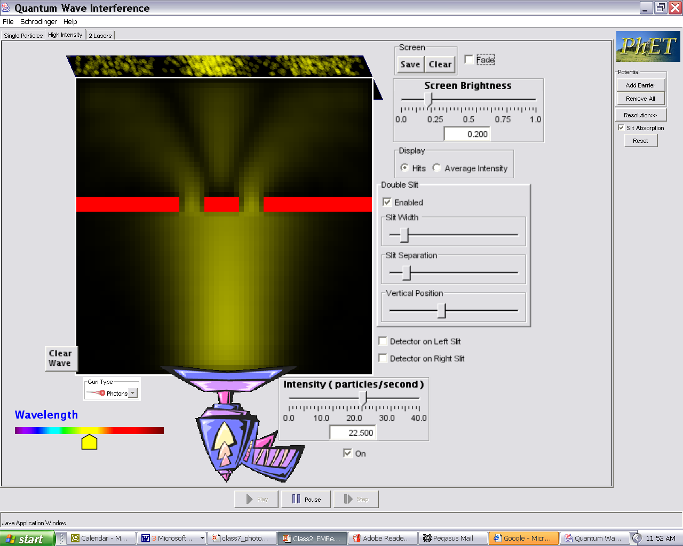
Probability of photon hitting given by where field is biggest
(electric field strength)² ~ Intensity &
gives probability of where photon will be!
standard electric field
representation of light field
Classical electric field wave pattern describes probability of where photons will be… higher intensity, higher likelihood that photon will be detected there.
If I shoot a photon through the two slits to hit the screen, it has some chance of being detected anywhere on screen, but on average better chance at being where interference pattern in brightest.

Slide 12
Randomness in physics??!
A completely new concept in QM is that the outcome of a measurement can often times not be predicted precisely. We can only predict the probability of obtaining a certain result!
Examples:
Where will a photon hit the screen?
Well, I don’t know, but the probability is largest where the intensity of the light is largest ~ (field amplitude)²
Where is the electron in a hydrogen atom?
The probability of where it will be found is largest at the location where the square of the matter-wave amplitude is largest.
(Randomness is negligible for macroscopic objects but important on atomic scale!)

Slide 13
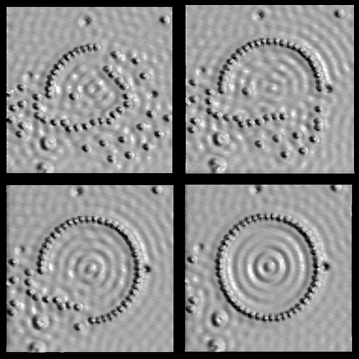
Remember this picture?
The probability of finding the electron that is trapped inside this ring of atoms is highest at the place, where the square of the wave amplitude for the electron is largest.

Slide 14
Which slit did this photon go through?
a. left
b. right
c. both
d. neither
e. either left or right we just cannot know which one
Notes:
A: 7
B: 16
C: 65
D: 11
178 responses

Slide 15
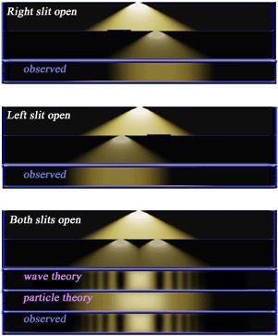

Slide 16
Which slit did this photon go through?
c. both!
If one slit:
Get single slit pattern
(i.e. no interference)
But: that photon is part
of the two slit interference pattern,
the probability pattern of where it lands is described by
the 2 slit interference pattern, it must have gone through both
slits i. e. as a wave!
When it interacts with the screen it acts like particle!
Notes:
If can know that
went through only
one slit, must get
photon pattern that
corresponds to light
going through a single
slit, i.e. no interference
between the two paths corresponding to the two slits.
Since that photon is part of the two slit interference pattern,
and the probability pattern of where it lands is described by
the 2 slit interference pattern, it must have gone through both
slits i. e. as a wave. But when interacted with e like particle.

Slide 17
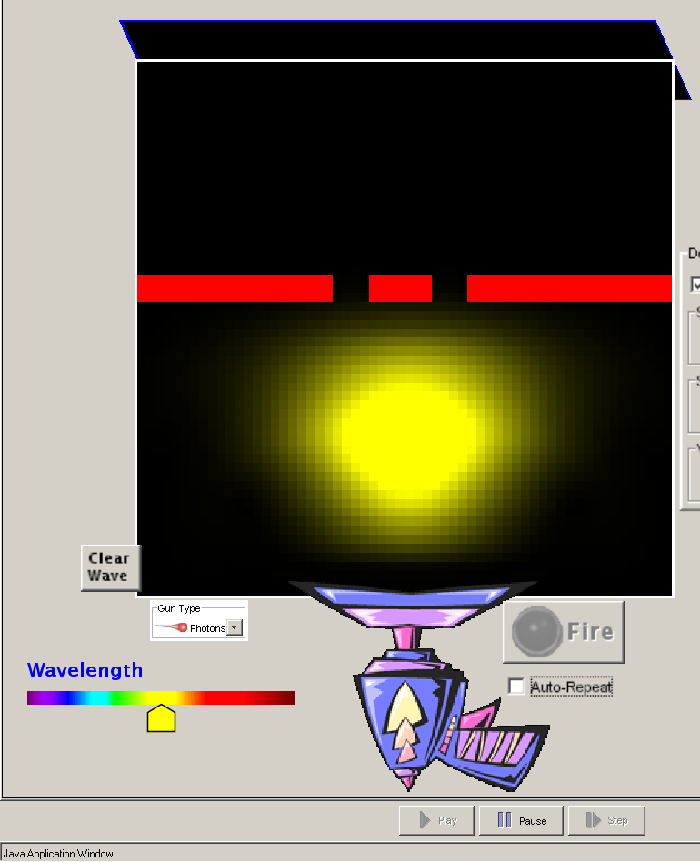
Photon before it goes through the slits
Photon as little segment of wave moving towards slits
Intensity of wave in various places, indicates probability of finding the photon there if you looked at that moment.

Slide 18
Photon after it goes through the slits
Photon is a wave…
it can interfere with itself.
Intensity of wave in various places indicates the probability of the photon concentrating at that spot if you had detector (e.g. a bunch of atoms or a sheet of metal)

Slide 19
Photon after it goes through the slits
When photon interacts with an electron or atom, all energy ends up in one spot… behaves like a particle with energy = hc/λ
= hf
Photon is a wave…
it can interfere with itself.
Intensity of wave in various places still indicates probability of the photon concentrating at that spot if you had detector (e.g. a bunch of atoms or a sheet of metal)

Slide 20
Questions?
What does this imply about the nature light?
What does this say about the nature of measurement?
Notes:
So… if the detector causes the photon wave to become like a particle then what do you suppose would happen if I measured which slit the photon went through?

Slide 21
Big Picture: Ideas central to understanding and using Quantum Mechanics
Light has both particle-like and wave-like characteristics. (Photoelectric Effect, Interference Patterns) (application- light detectors)
This implies not everything exactly determined. Behavior fundamentally governed by randomness and probability.
3. How light interacts with and is produced by individual atoms. Implications about atoms and behavior of electrons in atoms.
4. Wave-particle duality of photons applies to electrons (and everything else), so does randomness and probability!
5. Mathematical description to calculate.
6. Apply these ideas to all kinds of interesting stuff.

Slide 22
Develop model of how light interacts with and is produced by individual atoms & what that tells us about how to describe atoms and about behavior of electrons in atoms
How to look at structure of atoms?
Experiment!
Hit atoms with various things and see what happens.
Atom
Electrons
Light
Learning Goals: 1. What one sees if bash atoms with anything, particularly electrons, as in a discharge lamp.
2. What light coming from atoms (“spectra”) imply about behavior of electrons in atom.

Slide 23
Atom: Tiny nucleus with protons and neutrons (99.9% of mass)
Surrounded by large diffuse cloud of low mass electrons
10⁻¹⁰ m
n
p
n
p
n
p
p
n
p
10⁻¹⁴ m
Notes:
Order of magnitude estimate
Baseball … where is edge?
4” -> 40000
3,333’
2/3 of a mile.
50’
Google map
> 500,000 ft; 100 miles

Slide 24
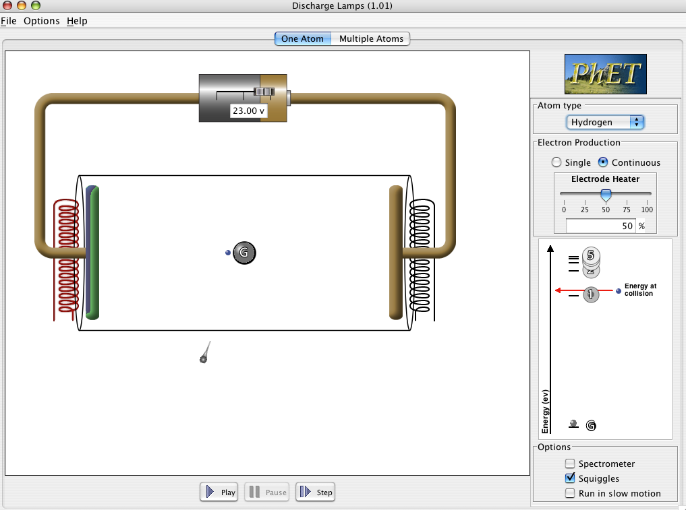
Notes:
Note: on mac, there is a drawing problem (no emission squiggles on energy levels)

Slide 25
Discussion: Given what we know about light, what does this imply about electrons in atoms?
Implies that electrons only change between very specific energies.
Only way for individual atoms to give off energy is as light.
Each time a photon is emitted an electron must be changing in energy by that amount (releasing energy).
Atoms are “lazy” - always want to go back to lowest energy state.
2. Excited atom ..electron in atom goes to higher energy
3. Electron jumps back to low energy
Fast electron
hits atom
e
Less KE
e
e
10ns
Excited
state
e
e
Higher
energy
Ground
state
e

Slide 26
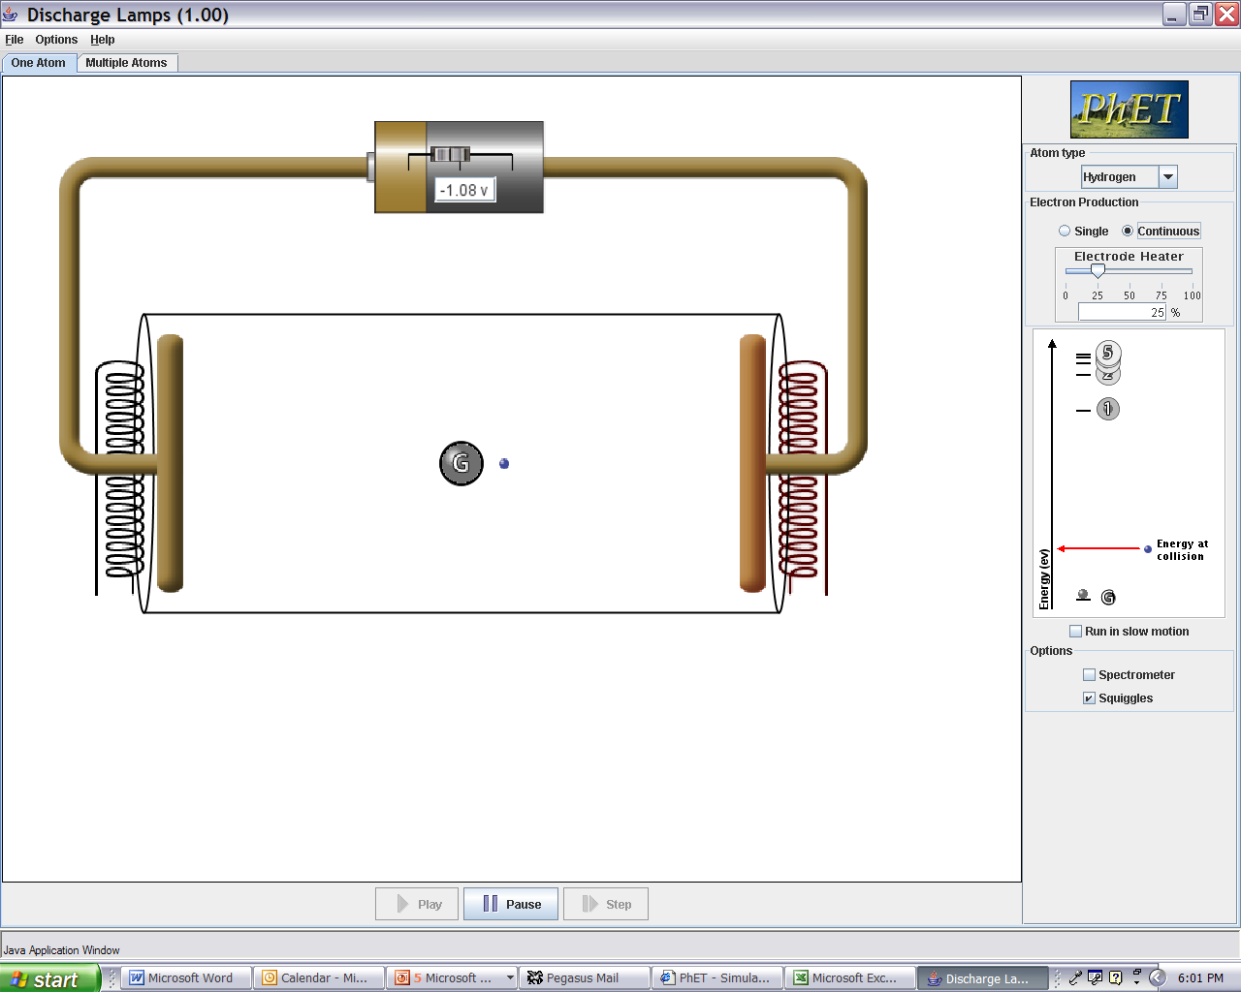
energy levels of electron
stuck in atom
4
energy
of colliding
electron
3
2
1 (ground)
If the colliding electrons have an energy between that of level 3
and level 4 when they hit the atoms
no levels will be excited, and so no light will come out.
b. 1 color of light will come out
c. 2 colors of light will come out
d. 3 colors of light will come out
e. 4 colors come out.
ans. d. enough energy to excite level 3, then get 3⎝2 followed
by 2⎝1, but also can go 3⎝1.

Slide 27
Energy level diagrams- represent energy electron can go to.
different height = different energy
e
e
e
e
e
e
For Hydrogen, transitions to ground state in ultraviolet!
No light emitted with colors in this region because no energy levels spaced with this energy.

Slide 28
In discharge lamps, one electron bashes into an atom.
-2 eV
10 V
-3 eV
d
D
-6 eV
If atom fixed at this point in tube,
list all the possible energy photons (colors) that you might see?
A. 1eV, 2eV, 3eV, 4eV, 7eV, 8eV
B. 4eV, 7eV, 8eV
C. 1eV, 3eV, 4eV
D. 4eV
E. Impossible to tell.
-10eV
Answer is D. Electron only gains about 5eV!
Electron energy = qΔV = e(Ed),
where E is the electric field = (battery V)/(total distance D),
and d is the distance it goes before a collision.
Notes:
A: 93
B: 0
C: 2
D: 5
E: 0
170 responses

Slide 29
Important Ideas
Electrons in atoms only found in specific energy levels
Different set of energy levels for different atoms
1 photon emitted per electron jump down between energy levels. Photon color determined by energy difference.
electron spends very little time (10⁻⁸ s) in excited state before hopping back down to lowest unfilled level.
5) If electron not stuck in atom, can have any energy.
Hydrogen
Lithium
Electron energy levels in 2 different atoms …
Levels have different spacing.
Atoms with more than one electron … lower levels filled.
Energy
(not to scale)
Notes:
Note increase in energy is increase in PE! (or energy INPUT into atom).

Slide 30
5ev
3ev
2ev
Photon energy
0
100
200
300
400
500
600
700
800 nm
What energy levels for electrons are consistent with this spectrum for “Finkelonium”?
Electron Energy levels:
A
B
C
D
E
0eV
0eV
0eV
10eV
-2eV
-3eV
7eV
-5eV
5eV
5eV
-5eV
-5eV
-7eV
-7eV
3eV
-8eV
2eV
-10eV
-10eV
0eV
0eV
Notes:
A: 17
B: 15
C: 40
D: 12
E: 17
172 responses

Slide 31
Electron energy levels = PE + KE
Since PE = 0 at infinity (e.g. electron escaping from atom). A positive total energy would mean that KE>PE and electron would leave atom!
5ev
3ev
2ev
Photon energy
0
100
200
300
400
500
600
700
800
900
1000 nm
What energy levels for electrons are consistent with this spectrum for “Finkelonium”?
At 0eV, electron has escaped atom.
Electron Energy levels:
A
B
D
C
0eV
10eV
E
0eV
0eV
-2eV
-3eV
7eV
-5eV
5eV
5eV
-5eV
-5eV
-7eV
-7eV
3eV
-8eV
2eV
-10eV
-10eV
0eV
0eV

Slide 32
Applications of atomic spectroscopy (how it is useful)
1. Detecting what atoms are in a material.
(excite by putting in discharge lamp or heating in flame
to see spectral lines)
2. Detecting what sun and stars are made of.
Look at light from star with diffraction grating, see
what lines there are- match up to atoms on earth.
telescope
diffraction
grating
star
3. Making much more efficient lights!
Incandescent light bulbs waste 88% of the electrical
energy that goes into them! (12% efficient)
Streetlight discharge lamps (Na or Hg) 80% efficient.
Fluorescent lights ~ 40-60% efficient.

Slide 33
Incandescent light (hot filament)
Discharge lamp
Temperature = 2500-3000K
Energy levels in
isolated atom.
Hot electrons jump between many very closely spaced levels (solid metal). Produce all colors.
Mostly infrared at temp
of normal filament.
88% is worthless IR
IR = longer than 680nm
kick up,
only certain
wavelengths when
come down.
120 V or more
IR
Right atom, right pressure
and voltage, mostly visible light.
λ
Streetlight discharge lamps
(Na or Hg) 80% efficient.
12% of energy is
useful visible light

Slide 34
Florescent Lights. Similar idea, but little more complicated
to get out light that looks white to eye.
Converting UV light into visible photons with phosphor.
Phosphors block all but UV, converts to visible.
phosphor
coating
254 nm far UV
Hg
e
energy of electron
in phosphor molecule

Slide 35
In discharge lamps, lots of electrons given bunch of energy
(voltage). Bash into atoms. (“discharge tube”)
120 V or more with long tube
see simulation
If proper pressure and voltage, almost all free electron’s energy
goes into exciting atom to level that produces visible light.
Why are pressure and voltage important?
Voltage needs to be high enough for free electrons to get energy to excite atom to desired level between collisions.
b. Pressure determines distance between collisions.
c. Only voltage matters for electron excitation.
Pressure just has to be low enough to keep tube from exploding.
d. Voltage needs to be high enough for free electron to excite atoms.

Slide 36
V
D
Na
Na
Na
Na
Na
Na
Na
Na
Na
Na
Electron energy = qΔV=q(Ed),
E is electric field = V/D,
d is the distance between energy losing collisions.
The higher the pressure, the higher the density,
=> the smaller is d.
d decreases if the collision cross section σ (“atom size”) increases.
looking at geometry, d = (# atoms/m³ x σ)⁻¹
if σ is in m². σ is typically a few x 10⁻²⁰ m²

Slide 37
sources of light (traditional):
atom discharge lamps
light bulb filament
Electron jumps
to lower levels.
Hot electrons.
very large # close energy levels (metal)
Radiate spectrum of colors. Mostly IR.
Only specific
wavelengths.
120 V or more with long tube
P
IR
Light from extended source
Going different directions
Range of wavelengths
λ
laser light-- all exactly the same
photon
view
whole bunch of identical photons
(actually on top of each other)
big electric field
nearly perfect sinewave
wave
view

Slide 38
Light from a laser all the same exact color and direction.
light from lasers are much more likely to damage the retina of the eye than light from a bulb because
a. laser is at a more dangerous color.
b. has lots more power in the beam.
c. light is concentrated to a much smaller spot on the retina.
d. light from bulb is turning off and on 60 times per second so light is not as intense.
c. focuses to much smaller spot on retina, local burn.
100 W light bulb no big deal
100 W laser beam cuts through steel like butter
laser light is special and useful because all light exactly the same color and direction.
Can be controlled much better.
Easy to reach uncertainty principle limit for beam focus
and collimation.
small spot = high intensity
Notes:
A: 0
B: 31
C: 69
D: 0
148 responses

Slide 39
How to produce laser light?
- photons exactly same color
- same direction
- in phase
Base on how light interacts with atoms!

Slide 40
“Stimulated emission” of light. First realized by A. Einstein
e
1
G
Photon hits atom already in higher energy level.
original photon continues and atom emits second identical one
atom in excited state
photon
second identical photon comes out. Atom jumps down.
Cloning photon.
Notes:
A: 5
B: 29
C: 63
D: 3
151 responses

Slide 41
Three processes by which light interacts with atoms
2
e
2
e
2
in
out
in
out
out
in
e
1
1
1
absorption
(of light)
stimulated
emission
(of light)
spontaneous
emission (of light)
(After elec. coll. or
light excited atom)
Surprising fact. Chance of stimulated emission of excited atom EXACTLY the same as chance of absorption by lower state atom. Critical fact for making a laser.
Laser-- just use stimulated emission to clone photon many times (~10²⁰ /sec)
Light Amplification by Stimulated Emission of Radiation

Slide 42
Questions on applications of discharge lamps to lighting?
Lasers: (“light amplification by stimulated emission of radiation”)
1. What is different/special about laser light.
2. Physics of interactions of atoms with light.
(how use to make whole bunch of identical photons)
3. How to build a laser
(you’ll have to find your own shark)

Slide 43
Chance of stimulated emission of excited atom EXACTLY the same as chance of absorption by ground state atom.
Glass tube below, full of atoms, like discharge lamp. Some excited some not excited (as shown)
For the condition above: what do you expect?
More photons will come out right hand end of tube,
Fewer photons will come out right hand end of tube
c. Same number as go in,
d. None will come out.
Notes:
A: 34
B: 39
C: 25
D: 1
143 responses

Slide 44
X
X
X
b. less come out right
3 excited atoms can emit photons,
6 ground state atoms will absorb. Absorption wins.
Think about statistics / probabilities
Notes:
No breakdown

Slide 45
LASER - Light Amplification by Stimulated Emission of Radiation
Need to clone lots of photons → LOTS of identical light.
Three process, all play important roles:
2
e
2
e
2
in
out
in
out
out
in
e
1
1
1
stimulated
emission
spontaneous emission
absorption
Basic requirements for laser:
1) Need more atoms in an upper level than a lower one
(“Population Inversion”) (hard part of making laser)
2) Need method of re-cycling photons to clone more times (“feedback”) (mirrors)

Slide 46
To increase number of photons after going through the atoms need
more in upper energy level than in lower.
Need a “Population inversion”
(This is the hard part of making laser, b/c atoms jump down so quickly.)
N_{upper} > N_{lower}, (more reproduced than eaten)
N_{upper} < N_{lower}, fewer out than in.

Slide 47
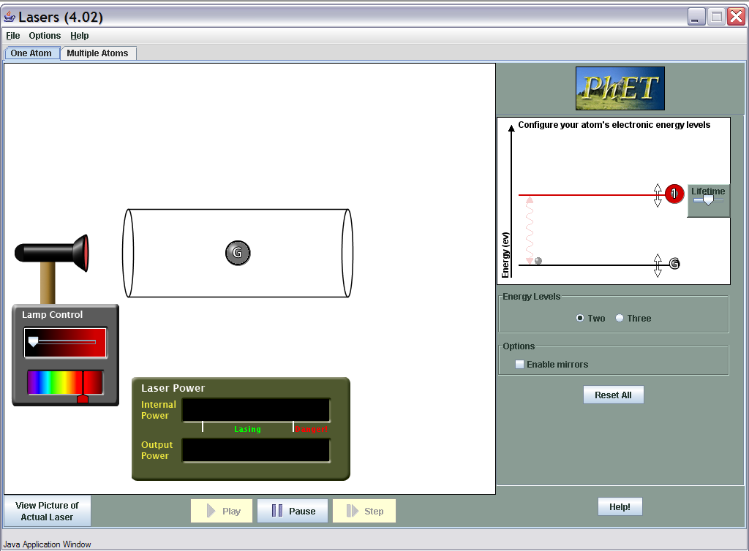
Can you get a population inversion in a two level system?
http://phet.colorado.edu/simulations/lasers/lasers.jnlp

Slide 48
Getting a population inversion
need at least one more energy level involved.
Trick: use a second color of light
(why two levels (one color) won’t work as HW problem (maybe))
To create population inversion
between G and level 1 would need:
a. time spent in level 2 (t₂) before spontaneously jumping to 1 is long, and time spent in level 1 (t₁) before jumping to G is short.
b. t₁=t₂
c. t₂ short, t₁ long
d. does not matter
2
t₂
also can kick up by
bashing with electron
1
t₁
G
“pumping” process to
produce population inversion
ans. c. show on sim
Notes:
show laser sim, multi atom 3 levels

Slide 49
Laser-- Light Amplification by Stimulated Emission of Radiation
lots of cloning of photons- LOTS of identical light.
Figure out conditions for l.a.s.e.r.
Important roles all played by:
absorption
stimulated emission
spontaneous emission
Requires
1) more atoms in an upper level than a lower one
(“population inversion”)
(hard part of making laser)
2) Method of re-cycling photons to clone more times (“feedback”)
(mirrors)

Slide 50
Amplifying light:
Population inversion⇒ give amplification of photons from left.
But much easier if not all light escapes. Reuse. Use mirror to reflect the light. (sim)
If 3 in becomes 6 at end, What does 6 become?

Slide 51
Laser Gain
One photon becomes two,
2 becomes 4,
4 becomes 8,
8 sixteen.. Etc…
Do you know the words of Al Bartlett? (the lack of understanding the exponential function is the great failure of the human race)
May be bad for human population. Good for photon population.
Number of photons between the mirrors,
n = n₀e^{Gt}
“gain” G >0 exponential increase.
Very quickly increases until nearly all input power is going into laser light. Use partially reflective mirror on one end.
Let some of laser light inside leak out --- that’s what we see.

Slide 52
Two types of lasers: He-Ne and Diode
Gas laser like Helium Neon.
Just like neon sign with helium and neon mixture in it and mirrors on end.
Diode laser-
Same basic idea, but light from diode at P-N diode junction. Mirrors on it.

Slide 53
Many applications of lasers
High energy small area:
Cutting: surgery, laser welding
“communication” (and weapons)
Focus light into extremely small spot:
(diffraction limit, because in phase!)
CDs, DVDs, …
Collimated beam
Tracking, leveling,
Pure color
LIDAR….

Slide 54
End of general atomic spectra.
Understanding of what has been observed, how implies electrons in atoms only in certain energy levels.
When hop from higher to lower give off light.
Applications: neon lights, lasers
Questions?
Next:
Why?
Start with characterizing Hydrogen spectra (Balmer)
then try to explain (Bohr model → Schrodinger)
Notes:
A: 2
B: 25
C: 6
D: 9
E: 58
177 responses

