Slide 1
PH300 Modern Physics SP11
“I have one simple request, and that is to have sharks with frickin' laser beams attached to their heads!” – Dr. Evil
2/24 Day 12:
Questions?
Finish atomic spectra
Frickin’ Lasers!
Next Week:
Atomic models (Bohr)
Experiments with atoms

Slide 2
Last time:
Photons
Atomic spectra/discharge lamp
Today:
Finish atomic spectra
Apply properties of photons and atoms to create lasers
Key concepts for quantum physics.
Light energy is “quantized”.
Light has both wave-like and particle-like properties.
Electrons in atoms can only exist at certain energy levels (quantized energy).
Atom emits (or absorbs) a single photon each time an electron transitions between energy levels.

Slide 3
Incandescent light (hot filament)
Discharge lamp
Temperature = 2500-3000K
Energy levels in
isolated atom.
Hot electrons jump between many very closely spaced levels (solid metal). Produce all colors.
Mostly infrared at temp
of normal filament.
88% is worthless IR
IR = longer than 680nm
kick up,
only certain
wavelengths when
come down.
120 V or more
IR
Right atom, right pressure
and voltage, mostly visible light.
λ
Streetlight discharge lamps
(Na or Hg) 80% efficient.
12% of energy is
useful visible light

Slide 4
Florescent Lights. Similar idea, but little more complicated
to get out light that looks white to eye.
Converting UV light into visible photons with phosphor.
Phosphors block all but UV, converts to visible.
phosphor
coating
254 nm far UV
Hg
e
energy of electron
in phosphor molecule

Slide 5
In discharge lamps, lots of electrons given bunch of energy
(voltage). Bash into atoms. (“discharge tube”)
120 V or more with long tube
see simulation
If proper pressure and voltage, almost all free electron’s energy
goes into exciting atom to level that produces visible light.
Why are pressure and voltage important?
Voltage needs to be high enough for free electrons to get energy to excite atom to desired level between collisions.
b. Pressure determines distance between collisions.
c. Only voltage matters for electron excitation.
Pressure just has to be low enough to keep tube from exploding.
d. Voltage needs to be high enough for free electron to excite atoms.

Slide 6
V
D
Na
Na
Na
Na
Na
Na
Na
Na
Na
Na
Electron energy = qΔV=q(Ed),
E is electric field = V/D,
d is the distance between energy losing collisions.
The higher the pressure, the higher the density,
=> the smaller is d.
d decreases if the collision cross section σ (“atom size”) increases.
looking at geometry, d = (# atoms/m³ x σ)⁻¹
if σ is in m². σ is typically a few x 10⁻²⁰ m²

Slide 7
Questions on applications of discharge lamps to lighting?
Lasers: (“light amplification by stimulated emission of radiation”)
1. What is different/special about laser light.
2. Physics of interactions of atoms with light.
(how use to make whole bunch of identical photons)
3. How to build a laser
(you’ll have to find your own shark)

Slide 8
sources of light (traditional):
atom discharge lamps
light bulb filament
Electron jumps
to lower levels.
Hot electrons.
very large # close energy levels (metal)
Radiate spectrum of colors. Mostly IR.
Only specific
wavelengths.
120 V or more with long tube
P
IR
Light from extended source
Going different directions
Range of wavelengths
λ
laser light-- all exactly the same
photon
view
whole bunch of identical photons
(actually on top of each other)
big electric field
nearly perfect sinewave
wave
view

Slide 9
Light from a laser all the same exact color and direction.
Light from lasers are much more likely to damage the retina of the eye than light from a bulb because
a. laser is at a more dangerous color.
b. has lots more power in the beam.
c. light is concentrated to a much smaller spot on the retina.
d. light from bulb is turning off and on 60 times per second so light is not as intense.
c. focuses to much smaller spot on retina, local burn.
100 W light bulb no big deal
100 W laser beam cuts through steel like butter
laser light is special and useful because all light exactly the same color and direction.
Can be controlled much better.
Easy to reach uncertainty principle limit for beam focus
and collimation.
small spot = high intensity
Notes:
A: 0
B: 31
C: 69
D: 0
148 responses

Slide 10
How to produce laser light?
- photons exactly same color
- same direction
- in phase
Base on how light interacts with atoms!

Slide 11
“Stimulated emission” of light. First realized by A. Einstein
e
1
G
Photon hits atom already in higher energy level.
original photon continues and atom emits second identical one
atom in excited state
photon
second identical photon comes out. Atom jumps down.
Cloning photon.
Notes:
A: 5
B: 29
C: 63
D: 3
151 responses

Slide 12
Three processes by which light interacts with atoms
2
e
2
e
2
in
out
in
out
out
in
e
1
1
1
absorption
(of light)
stimulated
emission
(of light)
spontaneous
emission (of light)
(After elec. coll. or
light excited atom)
Surprising fact. Chance of stimulated emission of excited atom EXACTLY the same as chance of absorption by lower state atom. Critical fact for making a laser.
Laser-- just use stimulated emission to clone photon many times (~10²⁰ /sec)
Light Amplification by Stimulated Emission of Radiation

Slide 13
Chance of stimulated emission of excited atom EXACTLY the same as chance of absorption by ground state atom.
Glass tube below, full of atoms, like discharge lamp. Some excited some not excited (as shown)
For the condition above: what do you expect?
More photons will come out right hand end of tube,
Fewer photons will come out right hand end of tube
c. Same number as go in,
d. None will come out.
Notes:
A: 34
B: 39
C: 25
D: 1
143 responses

Slide 14
X
X
X
b. less come out right
3 excited atoms can emit photons,
6 ground state atoms will absorb. Absorption wins.
Think about statistics / probabilities
Notes:
No breakdown

Slide 15
LASER - Light Amplification by Stimulated Emission of Radiation
Need to clone lots of photons → LOTS of identical light.
Three process, all play important roles:
2
e
2
e
2
in
out
in
out
out
in
e
1
1
1
stimulated
emission
spontaneous emission
absorption
Basic requirements for laser:
1) Need more atoms in an upper level than a lower one
(“Population Inversion”) (hard part of making laser)
2) Need method of re-cycling photons to clone more times (“feedback”) (mirrors)

Slide 16
To increase number of photons after going through the atoms need
more in upper energy level than in lower.
Need a “Population inversion”
(This is the hard part of making laser, b/c atoms jump down so quickly.)
N_{upper} > N_{lower}, (more reproduced than eaten)
N_{upper} < N_{lower}, fewer out than in.

Slide 17
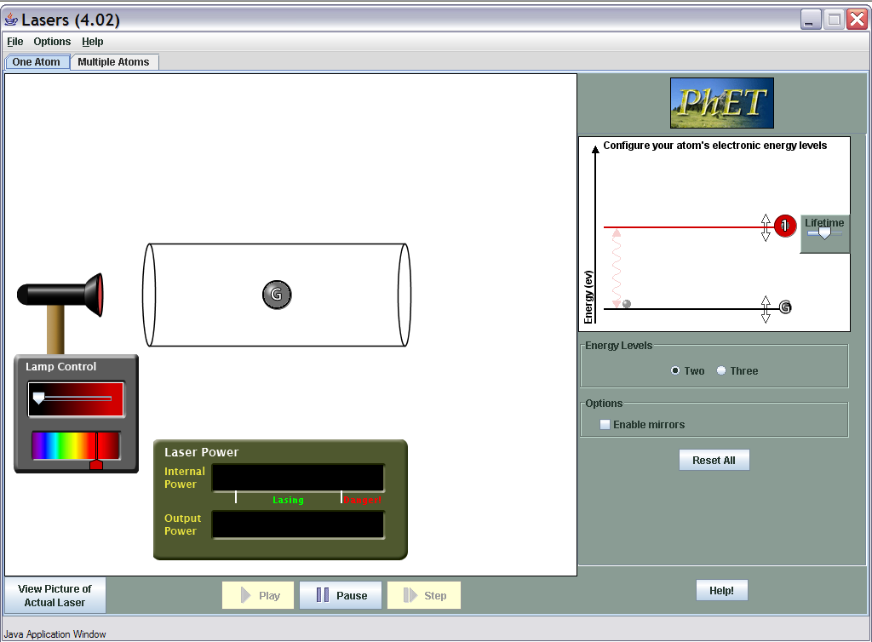
Can you get a population inversion in a two level system?
http://phet.colorado.edu/simulations/lasers/lasers.jnlp

Slide 18
Getting a population inversion
need at least one more energy level involved.
Trick: use a second color of light
(why two levels (one color) won’t work as HW problem)
To create population inversion
between G and level 1 would need:
a. time spent in level 2 (t₂) before spontaneously jumping to 1 is long, and time spent in level 1 (t₁) before jumping to G is short.
b. t₁=t₂
c. t₂ short, t₁ long
d. does not matter
2
t₂
also can kick up by
bashing with electron
1
t₁
G
“pumping” process to
produce population inversion
ans. c. show on sim
Notes:
show laser sim, multi atom 3 levels

Slide 19
Laser-- Light Amplification by Stimulated Emission of Radiation
lots of cloning of photons- LOTS of identical light.
Figure out conditions for l.a.s.e.r.
Important roles all played by:
absorption
stimulated emission
spontaneous emission
Requires
1) more atoms in an upper level than a lower one
(“population inversion”)
(hard part of making laser)
2) Method of re-cycling photons to clone more times (“feedback”)
(mirrors)

Slide 20
Amplifying light:
Population inversion: gives amplification of photons from left.
But much easier if not all light escapes. Reuse. Use mirror to reflect the light. (sim)
If 3 in becomes 6 at end, What does 6 become?

Slide 21
Laser Gain
One photon becomes two,
2 becomes 4,
4 becomes 8,
8 sixteen.. Etc…
Do you know the words of Al Bartlett? (the lack of understanding the exponential function is the great failure of the human race)
May be bad for human population. Good for photon population.
Number of photons between the mirrors,
n = n₀e^{Gt}
“gain” G >0 exponential increase.
Very quickly increases until nearly all input power is going into laser light. Use partially reflective mirror on one end.
Let some of laser light inside leak out --- that’s what we see.

Slide 22
Two types of lasers: He-Ne and Diode
Gas laser like Helium Neon.
Just like neon sign with helium and neon mixture in it and mirrors on end.
Diode laser-
Same basic idea, but light from diode at P-N diode junction. Mirrors on it.

Slide 23
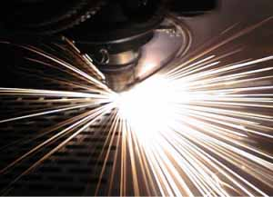
Many applications of lasers
High energy small area:
Cutting: surgery, laser welding
“communication” (and weapons)
Focus light into extremely small spot:
(diffraction limit, because in phase!)
CDs, DVDs, …
Collimated beam
Tracking, leveling,
Pure color
LIDAR….

Slide 24
End of general atomic spectra.
Understanding of what has been observed, how implies electrons in atoms only in certain energy levels.
When hop from higher to lower give off light.
Applications: neon lights, lasers
Questions?
Next:
Why?
Start with characterizing Hydrogen spectra (Balmer)
then try to explain (Bohr model → Schrodinger)
Notes:
A: 2
B: 25
C: 6
D: 9
E: 58
177 responses

Slide 25
Important Ideas
Electrons in atoms only found in specific energy levels
Different set of energy levels for different atoms
1 photon emitted per electron jump down between energy levels. Photon color determined by energy difference.
electron spends very little time (10⁻⁸ s) in excited state before hopping back down to lowest unfilled level.
5) If electron not stuck in atom, can have any energy.
Hydrogen
Lithium
Electron energy levels in 2 different atoms …
Levels have different spacing.
Atoms with more than one electron … lower levels filled.
Energy
(not to scale)
Notes:
Note increase in energy is increase in PE! (or energy INPUT into atom).

Slide 26
Nucleus
Electron
++
++
-
Energy
levels
Higher
Energy
-
When electron moves to location further from the nucleus,
energy of electron decreases because energy is released as positive and negative charges are separated, and there is a decrease in electrostatic potential energy of electron since it is now further away
energy of electron increases because it takes energy input to separate positive and negative charges, and there is an increase in the electrostatic potential energy of the electron.
energy of electron increases because it takes energy input to separate positive and negative charges, and there is a decrease in the electrostatic potential energy of the electron.
Notes:
A: 1
B: 86
C: 13
174 responses

Slide 27
Nucleus
Electron
++
++
-
Energy
levels
Higher
Energy
-
When electron moves to location further from the nucleus,
energy of electron decreases because energy is released as positive and negative charges are separated, and there is a decrease in electrostatic potential energy of electron since it is now further away
energy of electron increases because it takes energy input to separate positive and negative charges, and there is an increase in the electrostatic potential energy of the electron.
energy of electron increases because it takes energy input to separate positive and negative charges, and there is a decrease in the electrostatic potential energy of the electron.
(Force on electron is less, but Potential Energy is higher!)

Slide 28
Nucleus
Electron
F
Energy
levels
++
++
-
Higher
Energy
-
Electron feels force toward nucleus. Must work against that force to move electron farther away, so increase in PE.
When electron moves to location further from the nucleus,
Answer is b. energy of electron increases because it takes energy input to separate positive and negative charges, and there is an increase in the electrostatic potential energy of the electron. It’s like pushing a boulder out of a ditch (steep at first and shallow later on).
So electrons at higher energy levels are further from the nucleus!

Slide 29
Calculating potential energy of electron
D
F
E
+
-
r
We define electron’s PE as 0 when far, far away from proton!!!!
Change in electrons PE = - (Work done by electric field)
Coulomb’s constant
-e
e

Slide 30
Calculating potential energy of electron
D
F
E
+
-
r
We define electron’s PE as 0 when far, far away from proton!!!!
Change in electrons PE = - (Work done by electric field)
Coulomb’s constant
-e
e
PE at distance D = -ke²
D
+
+
PE = -ke(Ze)
D
+
+
(For Z protons)
ke² = 1.440eV-nm

Slide 31
Calculating potential energy of electron
D
F
E
+
-
PE at distance D = -ke²
D
r
ke² = 1.440eV-nm
Predict SHAPE of potential energy curve as function of distance from proton:
Potential Energy of electron
Distance from proton

Slide 32
D
0
PE of electron
A
B
PE of electron
0
Distance from nucleus (D)
C
PE of electron
D
0
D
D
PE of electron
0
PE of electron
E
0
D
Notes:
A: 1
B: 6
C: 1
D: 91
E: 1
172 responses

Slide 33
0
D
PE of electron
A
PE of electron
B
0
Distance from nucleus
(PE as function of D) = -ke²
D
C
PE of electron
0
D
d
PE of electron
Correct answer:
PE has 1/D relationship
D gets really small..then PE really large negative!
0
D
PE of electron
E
0
D
Notes:
A: 1
B: 6
C: 1
D: 91
E: 1
172 responses

