Slide 1
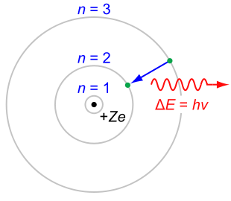
PH300 Modern Physics SP11
“If this nonsense of Bohr should in the end prove to be right, we will quit physics! ”
- Otto Stern & Max von Laue
3/3 Day 14:
Questions?
Atomic Models
Magnets/magnetic moments
Stern-Gerlach Experiments
Next Week:
Entanglement
Quantum Cryptography
Quantum Physics & Reality

Slide 2
Last time:
Balmer formula, atomic spectra
Bohr model
de Broglie waves
Today:
Magnets and magnetic fields
Atomic spin
Stern-Gerlach experiments
Next Week:
Reading on Blackboard before class
Entanglement/EPR “paradox”
Quantum physics and reality

Slide 3
Models of the Atom
–
–
–
–
–
Thomson – “Plum Pudding”
  Why? Known that negative charges can be removed from atom.
  Problem: Doesn’t match spectral lines
Rutherford – Solar System
  Why? Scattering showed a small, hard core.
  Problem: electrons should spiral into nucleus in ~10⁻¹¹ sec.
+
–
Bohr – fixed energy levels
  Why? Explains spectral lines.
  Problem: No reason for fixed energy levels

Slide 4
deBroglie Waves
deBroglie (French grad student) suggested: maybe electrons are actually little waves going around the nucleus.
This seems plausible because…
  Standing waves have quantized frequencies, might be related to quantized energies.
  Einstein had shown that light, typically thought of as waves, have particle properties. Might not electrons, typically thought of as particles, have wave properties?

Slide 5
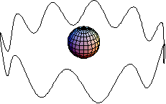
deBroglie Waves
What is n for the ‘electron wave’ in this picture?
1
5
10
20
Cannot determine from picture
Answer: C. 10
3
4
5
2
6
1
7
10
9
8
n = number of wavelengths.
It is also the number of the energy level E_{n} = -13.6/n².
So the wave above corresponds to
E₁₀ = -13.6/10² = -0.136eV
(will explain soon)

Slide 6
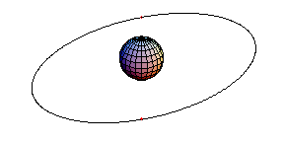
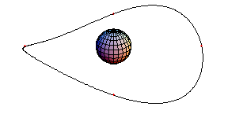
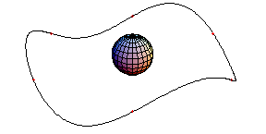
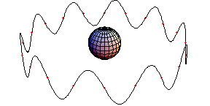
deBroglie Waves
n=1 n=2 n=3
…n=10
= node = fixed point that doesn’t move.

Slide 7
deBroglie Waves
If electron orbits are standing waves, there is a relationship between orbital radius and wavelength: 2πr = nλ
But what is the wavelength of an electron?!
For photons, it was known that photons have momentum E= pc= hc/ λ
⎝ p=h/λ ⎝ λ=h/p
deBroglie proposed that this
is also true for massive particles (particles w/mass)!
λ=h/p = “deBroglie wavelength”
(momentum)
p
λ
(wavelength)
Notes:
E = pc = hc/λ
p = E/c
λ = h/p = hc/E

Slide 8
deBroglie Waves
Substituting the deBroglie wavelength (λ=h/p) into the condition for standing waves (2πr = nλ), gives:
2πr = nh/p
Or, rearranging:
pr = nh/2π
L = nħ
deBroglie EXPLAINS quantization of angular momentum, and therefore EXPLAINS quantization of energy!

Slide 9
In the deBroglie picture, the electrons have an intrinsic wavelength associated with them. We have also been told that one wavelength fits around the circumference for the n=1 level of hydrogen, 2 fit around the circumference for n=2, 5 fit for n=5, etc.
Therefore, we expect that the n=5 circumference is 5 times as large as the n=1 circumference.
A) True
B) False

Slide 10
False!
From the Bohr model we know that r_{n}=n²a_{o}.
Here the other thing changing with n is the deBroglie wavelength of the electrons, because the electron energy and momentum also change with n.

Slide 11
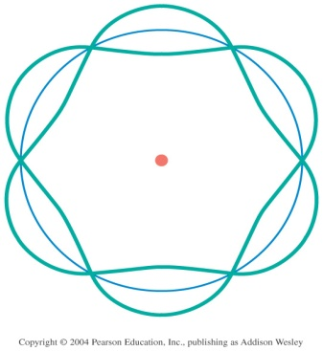
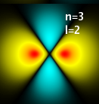
Models of the Atom
–
–
–
–
–
Thomson – “Plum Pudding”
  Why? Known that negative charges can be removed from atom.
  Problem: Doesn’t match spectral lines
Rutherford – Solar System
  Why? Scattering showed a small, hard core.
  Problem: electrons should spiral into nucleus in ~10⁻¹¹ sec.
+
–
Bohr – fixed energy levels
  Why? Explains spectral lines.
  Problem: No reason for fixed energy levels
deBroglie – electron standing waves
  Why? Explains fixed energy levels
  Problem: still only works for Hydrogen.
+
Schrodinger – quantum wave functions
  Why? Explains everything!
  Problem: None (except that it’s abstract)

Slide 12
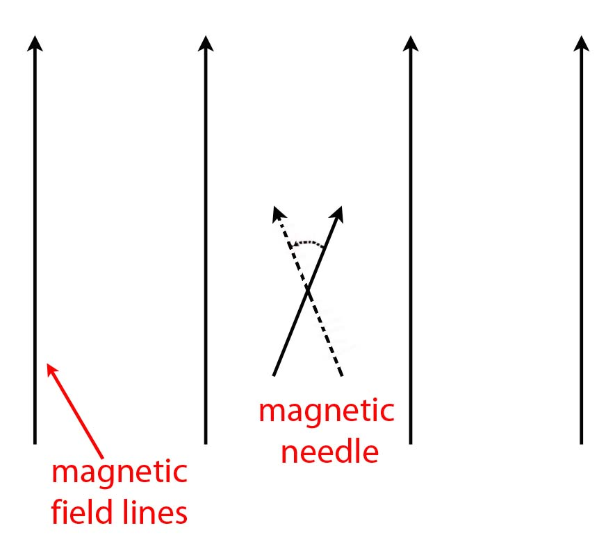
Compass Needle in a Uniform Magnetic Field
Notes:
A magnetic field works to align the north pole of a compass needle along the direction of the magnetic field, and the south pole in the direction opposite the field. If the needle is not originally aligned with the magnetic field, there will be a net torque and (in the absence of friction) the needle will oscillate back and forth about the equilibrium position. Here, the arrow representing the compass needle points in the direction of the north pole. By “uniform” we mean the magnetic field has the same strength and points in the same direction everywhere in space.

Slide 13
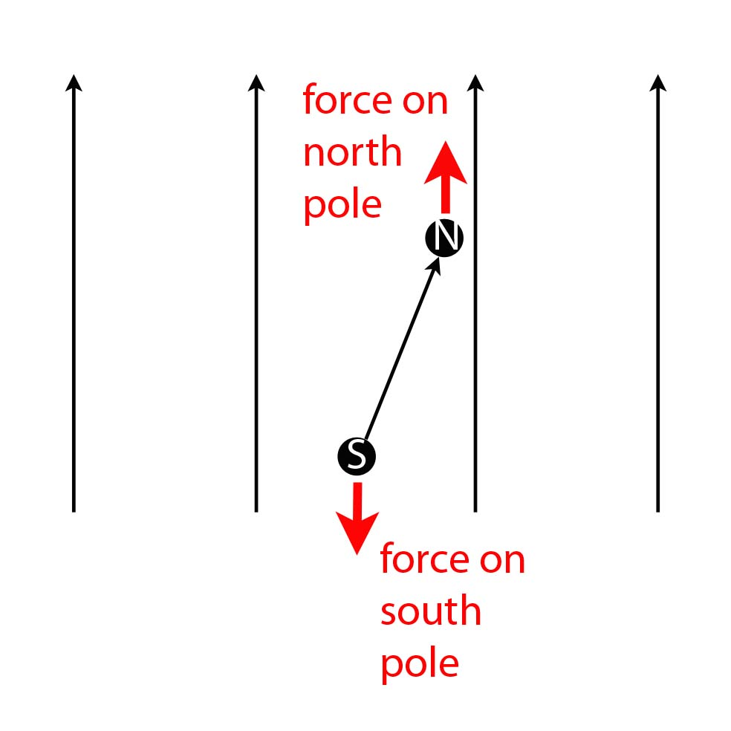
Compass Needle in a Uniform Magnetic Field
Notes:
In a uniform magnetic field, the force on the north pole of the needle is equal and opposite the force on the south pole, and so the net force on the needle is zero and it experiences no (linear) acceleration.

Slide 14
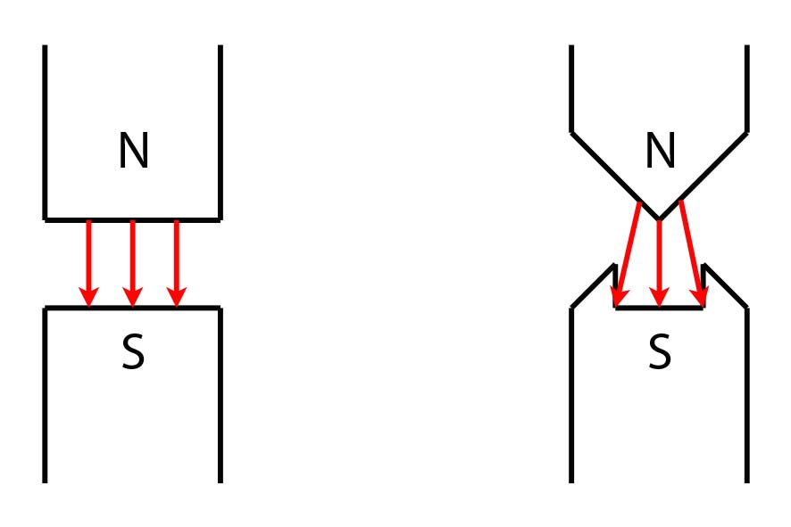
Uniform vs. Non-Uniform Magnetic Fields
uniform
magnetic
field
non-uniform
magnetic
field
Notes:
For two regular bar magnets held close together, the magnetic field between them is approximately uniform. If we change the shape of the bar magnets, we can create a magnetic field that is non-uniform. The actual field lines would look more complicated, but this image gives us a general idea of what we’re talking about.

Slide 15
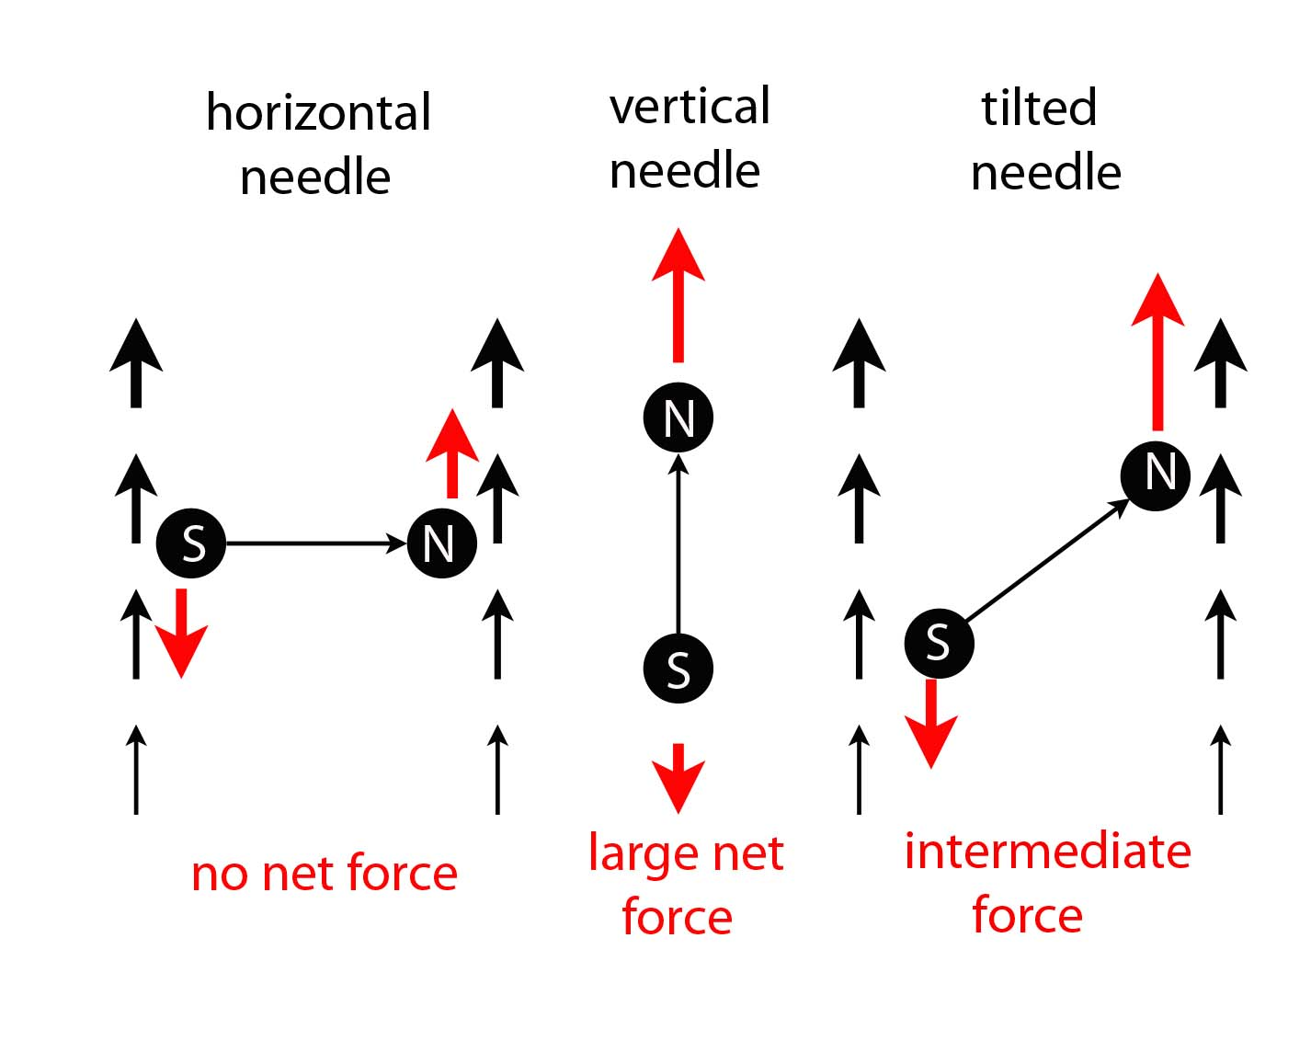
Compass Needle in a Non-Uniform Magnetic Field
Notes:
If the magnetic field is not uniform in space, then the forces on the two poles will in general not be equal, and the needle will experience a net force, causing it to accelerate.

Slide 16
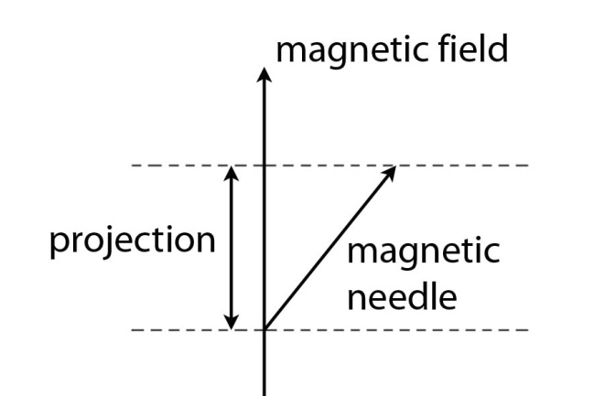
Compass Needle in a Non-Uniform Magnetic Field
It turns out the net force is proportional to the projection of the
magnetic needle onto the magnetic field.
Θ
Notes:
The net force on the needle in a non-uniform magnetic field is going to be proportional to the projection of the magnetic needle onto the axis of the field. When the projection is large, the net force will be large; when the projection is zero, there is zero net force; a negative projection implies a force in the opposite direction.

Slide 17
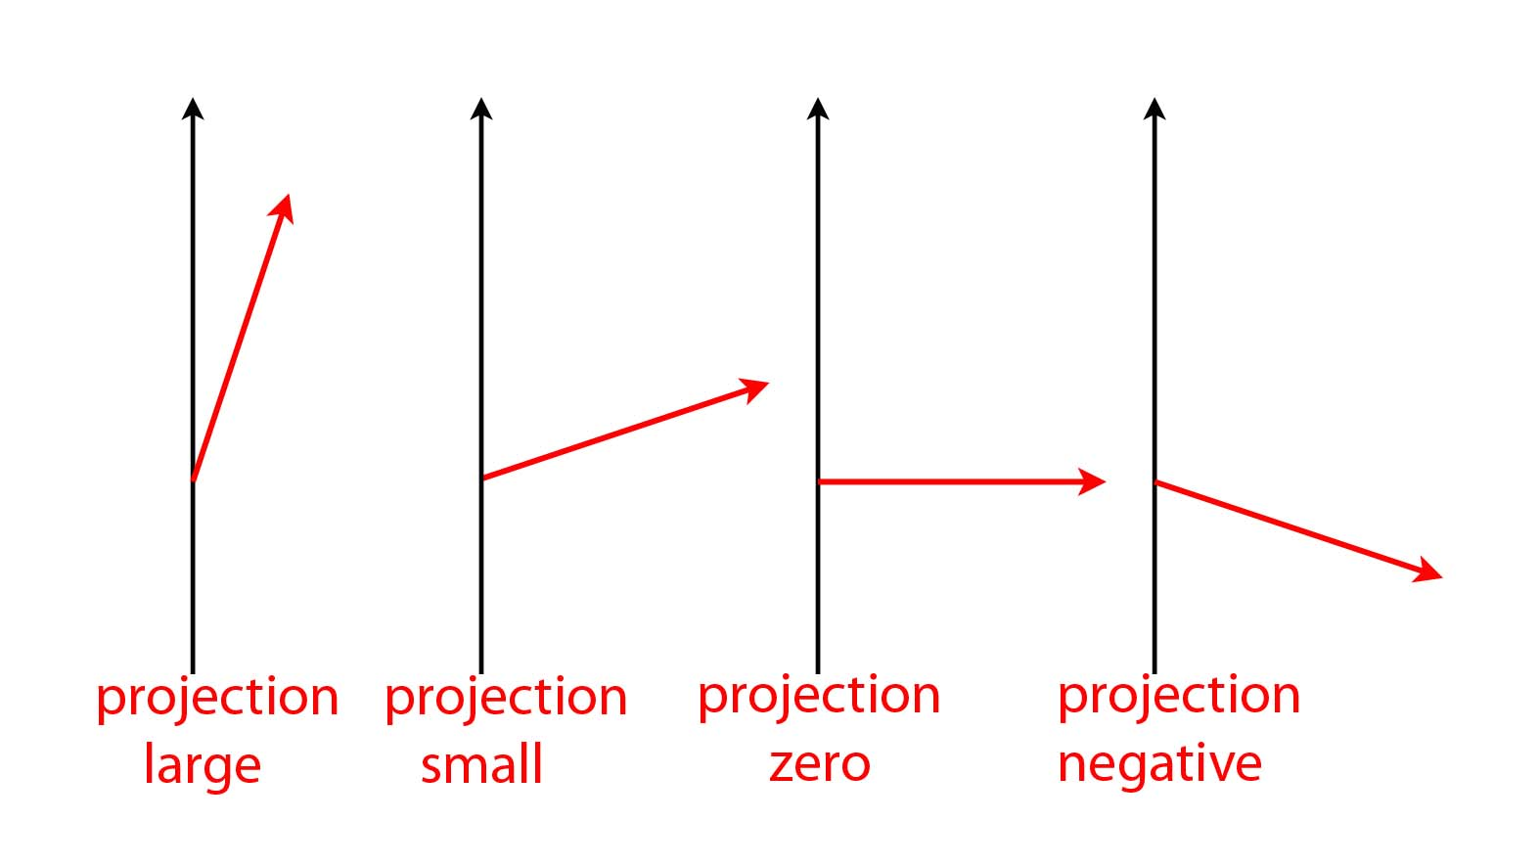
For a magnetic needle, all types of projections are allowed:
Notes:
In the case of a magnetic needle, all types of projections are allowed.

Slide 18
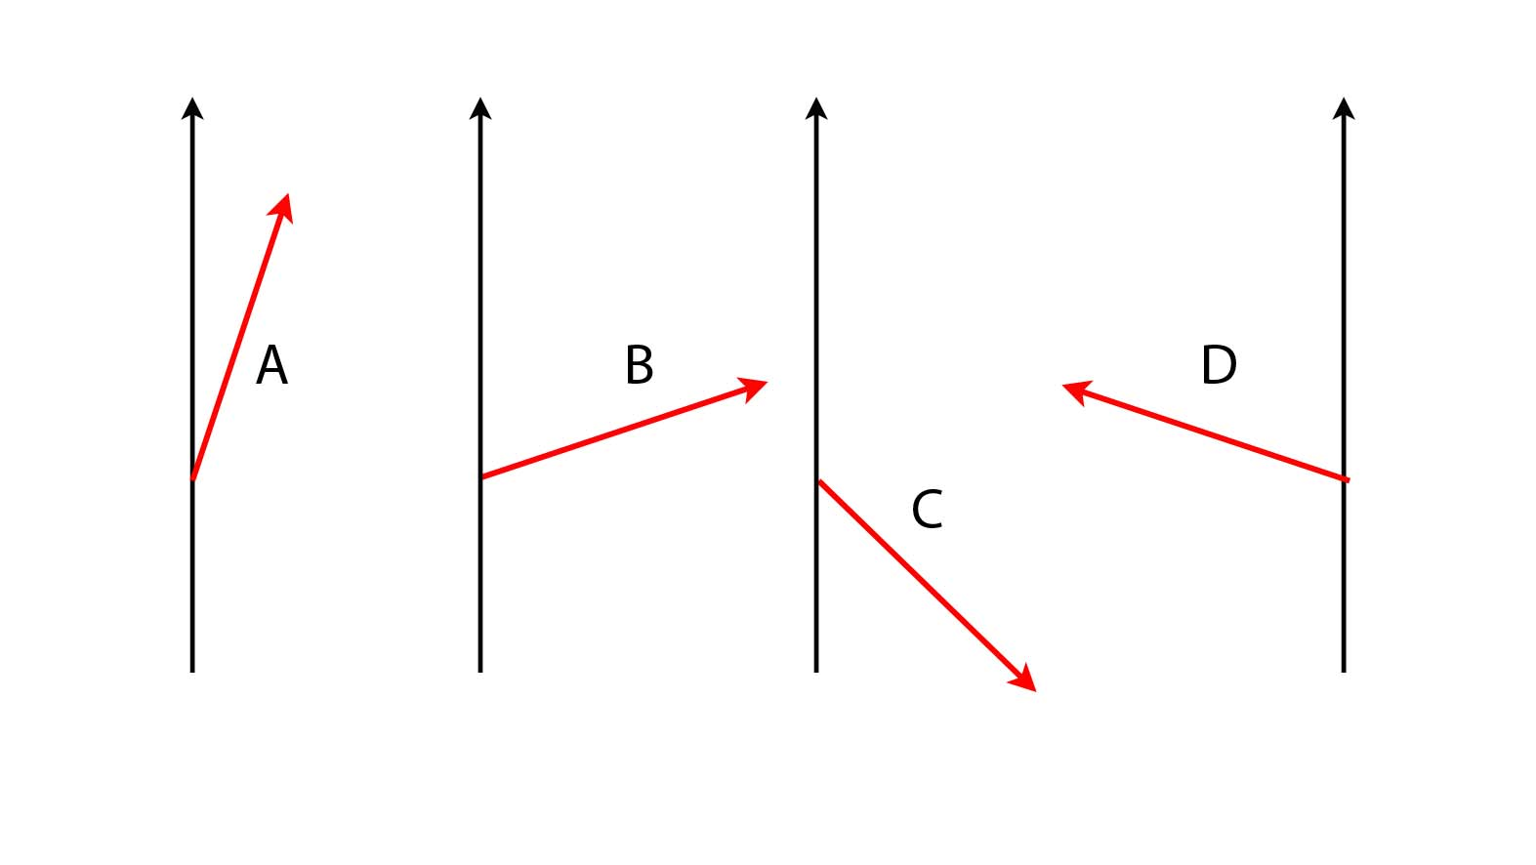
Below are four magnetic arrows (A, B, C, and D), shown relative to magnetic
field lines pointing vertically upward. All four arrows have the same length.
magnetic field lines
Rank the arrows from highest value of the projection onto the vertical axis to the lowest. If two projections are equal, then say so.
A > B > C > D
B) A > B > D > C
C) A > B = D > C
A > C > B = D
None of the above.
Notes:
Concept Test. Correct answer is (C).

Slide 19
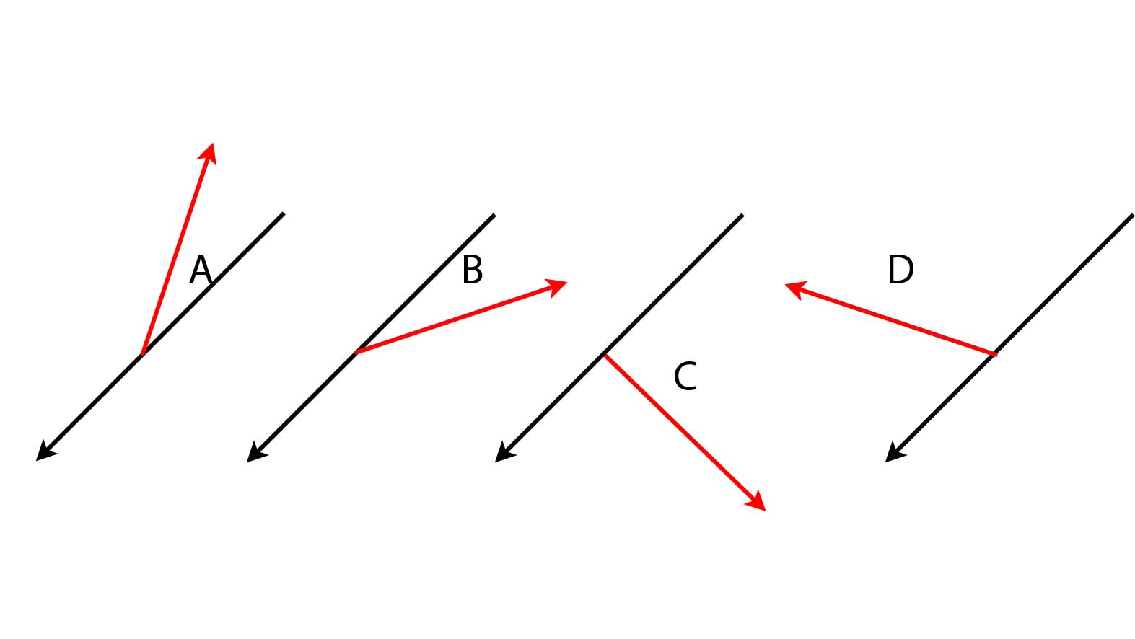
Below are four magnetic arrows (A, B, C, and D), shown relative to magnetic
field lines pointing left & downward. All four arrows have the same length.
Rank the arrows from highest value to lowest of the projection
onto the shown axis. If two projections are equal, then say so.
A > B = D > C
B) D > C > B = A
C) C > D = B > A
A = B > C > D
None of the above.
Notes:
Concept Test. Correct answer is (C).

Slide 20
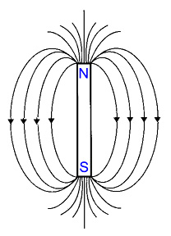
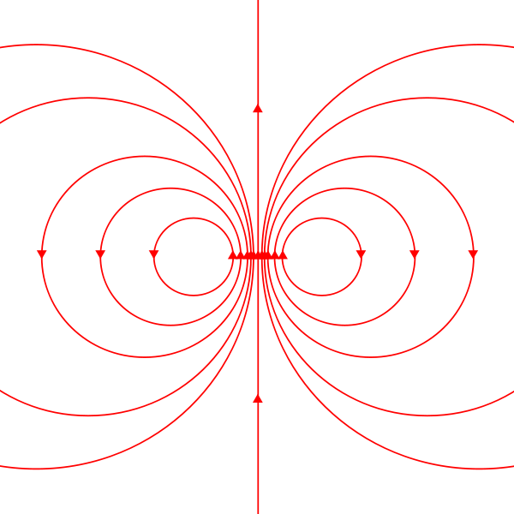
Magnetic field lines
of a bar magnet
Magnetic field lines
of a current loop
Notes:
The magnetic field produced by a bar magnet is similar to the magnetic field produced by a current loop.

Slide 21
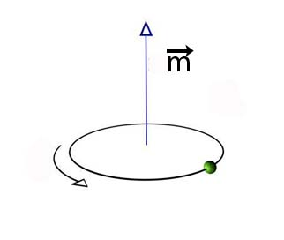
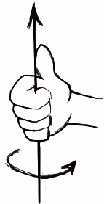
Magnetic Moment of a Current Loop
r
I
points in the direction perpendicular to the plane
of the current loop, in the direction given by
the right-hand rule.
Notes:
An arrow representing the orientation of the compass needle could also describe the magnetic moment of a current loop (by the right-hand rule). The magnetic moment vector is given by the product of the current times the area of the loop, and points in a direction perpendicular to the plane of the loop, in a direction given by the right-hand rule.

Slide 22
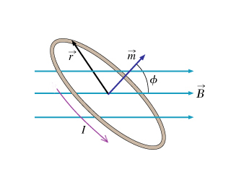
Torque on a Current Loop in a Magnetic Field
What effect does this torque have on the current loop?
The magnetic moment vector precesses about the
magnetic field lines, but the angle φ remains constant.
Notes:
Defining the magnetic moment in this way makes it easy to find the torque on a current loop in the presence of a magnetic field. The magnetic field exerts a torque on the current loop, but does not make it align with the magnetic field like it did with the compass needle. Instead, the magnetic moment vector precesses about the magnetic field lines in such a way that the projection of the magnetic moment vector onto the direction of the field remains constant (this is analogous to the precession of a spinning gyroscope in a gravitational field; the rotating mass is analogous to the current in the loop, see next slide).

Slide 23
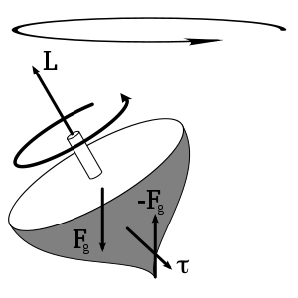
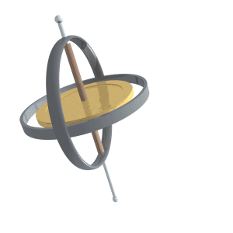
Precession of a Gyroscope in a Gravitational Field:
The gyroscope can only spin about the symmetry axis
The torque acts at right angles to the angular momentum
vector, so it changes the direction of the angular momentum
vector, but not its magnitude.
Notes:
This is analogous to the precession of a spinning gyroscope in a gravitational field; the rotating mass is analogous to the current in the loop, and the gravitational field is analogous to the magnetic field. The torque wants to change the axis of rotation for the spinning mass, but the gyroscope can only spin about its symmetry axis; the effect is for the axis of rotation to precess instead.

Slide 24
What corresponds to what?
Take-Home Message:
The torque does not cause the magnetic moment vector of the current loop to flip directions.
Since ϕ = constant, the projection of the magnetic moment vector onto the direction of the B-field does not change while the current loop is interacting with the B-field.
Notes:
This is analogous to the precession of a spinning gyroscope in a gravitational field; the rotating mass is analogous to the current in the loop, and the gravitational field is analogous to the magnetic field. The torque wants to change the axis of rotation for the spinning mass, but the gyroscope can only spin about its symmetry axis; the effect is for the axis of rotation to precess instead.

Slide 25
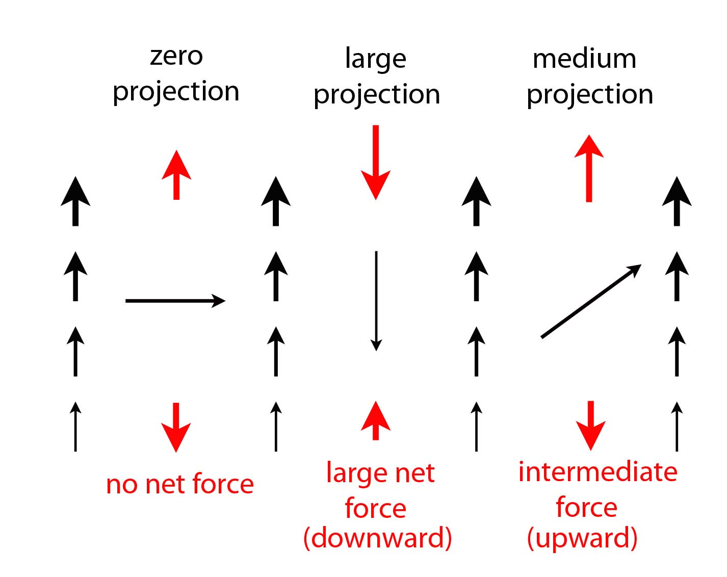
Magnetic Moment in a Non-Uniform Magnetic Field
Notes:
A current loop in a non-uniform magnetic field will experience a net force (just as the compass needle does). Like the compass needle, the net force experienced by the current loop is proportional to the projection of the magnetic moment onto the direction of the field (which remains constant, as with the gyroscope).

Slide 26
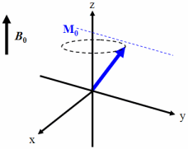



Magnetic Moment in a Non-Uniform Magnetic Field

Slide 27
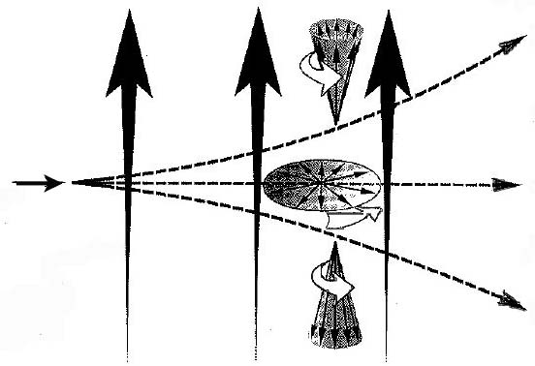
Magnetic Moment in a Non-Uniform Magnetic Field
Projection
large, positive
small
Atom
injected
zero
small
Non-uniform
magnetic field
lines
large, negative
Deflection
Notes:
We could form a beam of atoms by boiling them off from an oven and collimating the beam. The spin of each atom would point in some random direction (some straight up, some straight down, most somewhere in between). The projection remains constant, and so some would experience a maximum deflection, but most somewhere in between.

Slide 28
Remember the Bohr Model:
We know how magnetic moments (current loops) behave
in the presence of a magnetic field.
Orbital angular momentum does contribute to the magnetic moment of an atom – even in modern theories
We know a neutral atom has a magnetic moment when it is
deflected by a non-uniform magnetic field.
Measuring this deflection (when the B-field is well known) is a measurement of the projection of the atom’s magnetic
moment onto the axis of the magnetic field.
Notes:
Remember the Bohr Model: The orbital motion of the electron forms a current loop. The Bohr Model gets the angular momentum of the ground state wrong (it is zero, not ħ). However, the orbital motion of an electron does contribute to the magnetic moment of an atom, so this model is not all bad. There are other things that contribute to the magnetic moment of an atom, which we will discuss later. In the end, we care that atoms have magnetic moments, and not so much about where they come from.

Slide 29
Remember the Bohr Model:
We know how magnetic moments (current loops) behave
in the presence of a magnetic field.
Orbital angular momentum does contribute to the magnetic moment of an atom – even in modern theories
We know a neutral atom has a magnetic moment when it is
deflected by a non-uniform magnetic field.
Measuring this deflection (when the B-field is well known) is a measurement of the projection of the atom’s magnetic
moment onto the axis of the magnetic field.
Notes:
Remember the Bohr Model: The orbital motion of the electron forms a current loop. The Bohr Model gets the angular momentum of the ground state wrong (it is zero, not ħ). However, the orbital motion of an electron does contribute to the magnetic moment of an atom, so this model is not all bad. There are other things that contribute to the magnetic moment of an atom, which we will discuss later. In the end, we care that atoms have magnetic moments, and not so much about where they come from.

Slide 30
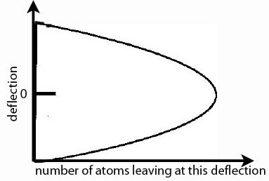
Classical Expectations(?)

Slide 31
Key Ideas/Concepts
Classically, we expect:
Magnetic moments are deflected in a non-uniform magnetic field
Magnetic moments precess in the presence of a magnetic field, and the projection of the magnetic moment along the field axis remains constant.
If the magnetic moment vectors are randomly oriented, then we should see a broadening of the particle beam

Slide 32
Classical Expectations

Slide 33
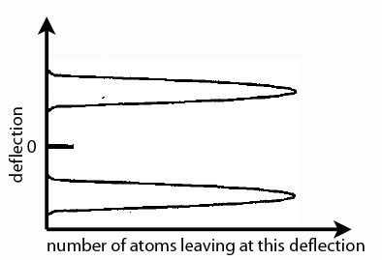
Observation:
Notes:
If the magnetic moments for each of the atoms are pointing in random directions (some straight up, some straight down, most somewhere in between), then one would expect to see a smooth distribution of deflections that peaks in the middle. This is because the projection of the magnetic moment should remain constant, with the atom therefore experiencing a constant force of magnitude determined by the value of the projection.

Slide 34
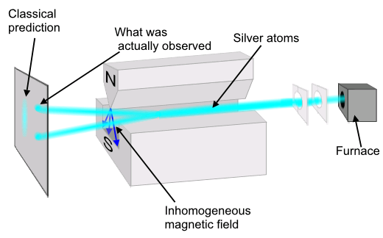
Stern-Gerlach Experiment with Silver Atoms (1922)*
*Nobel Prize for Stern in 1943
Notes:
What is actually observed is that all atoms experience the maximum deflection, either up or down along the direction of the magnetic field, no matter the orientation of the apparatus. The value of the projection along any axis is found to always be an integer multiple of the Bohr magneton, m_{B} = 9.27 x 10⁻²⁴ joule/tesla (e.g. for silver, the observed values are +m_{B} and –m_{B}; for nitrogen they are +3m_{B}, +m_{B}, -m_{B}, and -3m_{B}). Simplest case with a two-state system like silver atoms, as were used in the original Stern-Gerlach experiment; will speak from here on out only in terms of “atoms” having spin “plus” (+m_{B}) or “minus” (-m_{B}) along any given axis.

Slide 35
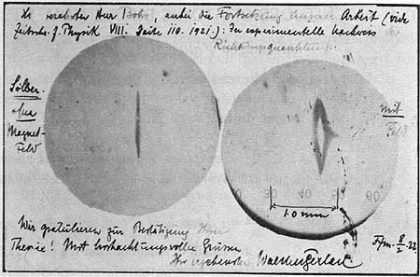
Postcard from Gerlach to Bohr showing results
from earliest Stern-Gerlach experiments:
“…attached is the continuation of our work: the experimental proof of
directional quantization. Silver without magnetic field/with magnetic field.”
“Stern and Gerlach: How a Bad Cigar Helped Reorient Atomic Physics” – Available on Blackboard

Slide 36
“Directional Quantization”?
Quantized means discrete – the quantity comes in discrete values instead of continuous.
What kinds of quantization have we seen so far?
  Quantization of photon energy
  Quantization of atomic energy levels
  Quantization of angular momentum
Classically, we would expect that the magnetic moment vector could be pointing in any direction when we measure it.
By directional quantization, they are referring to how the projection of the magnetic moment vector for the silver atoms onto any axis only comes in two discrete values [+m_{B} or -m_{B}], and not in a continuous spectrum.

Slide 37
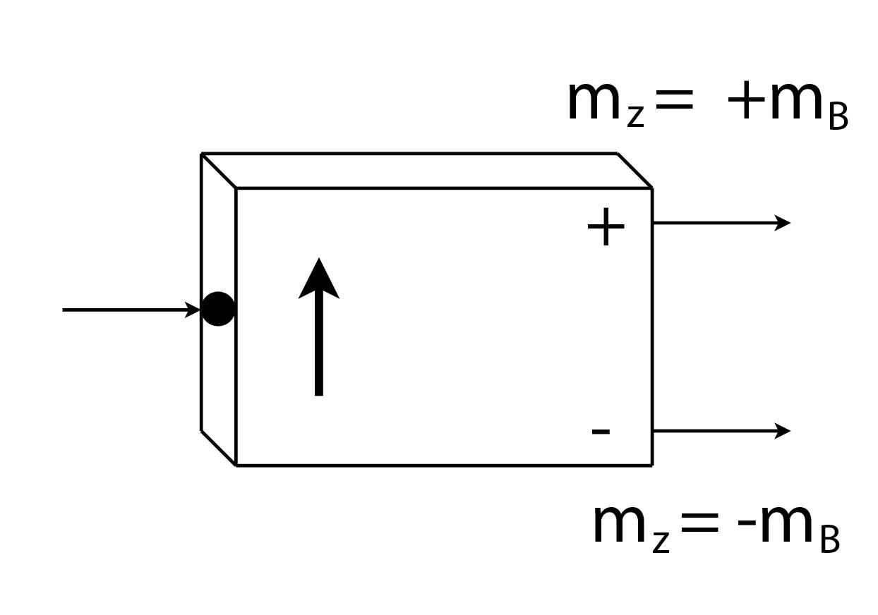
In the future…
Some atoms have more than two possible projections of the magnetic moment vector along a given axis, but we will only deal with “two-state” systems when talking about atomic spin.
When we say a particle is measured as “spin up” (or down) along a given axis, we are saying that we measured the projection of the magnetic moment along that axis (+m_{B} or -m_{B}), and observed it exiting the plus-channel (minus-channel) of a Stern-Gerlach type apparatus.
A simplified
Stern-Gerlach analyzer:

Slide 38
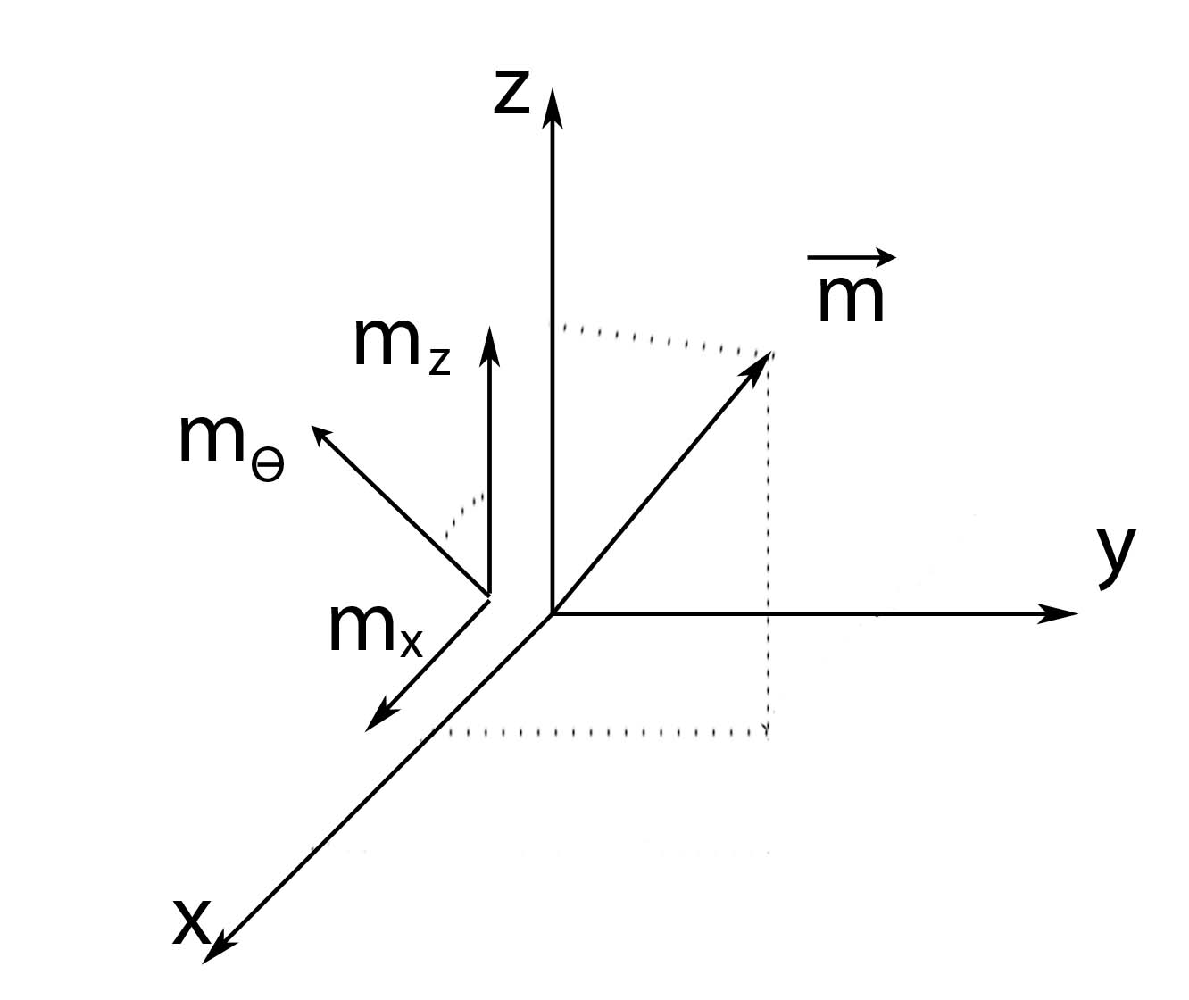
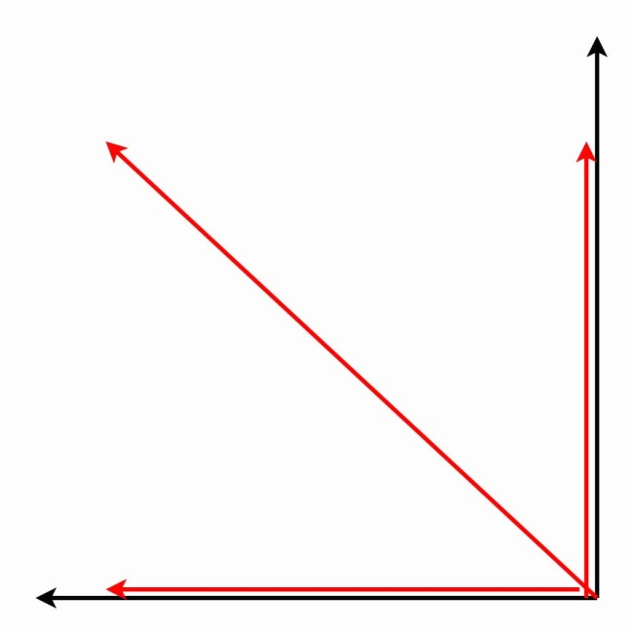
Notation for projection values:
Θ
Head-on view
Notes:
We said we could measure m along any axis we want, so let’s have some notation for the component of the magnetic moment vector we are measuring. A measurement along the +z-axis tells us about m_{Z}; similarly, a measurement along the +x-axis tells us about m_{X}; a measurement along some arbitrary angle theta (measured relative to the z-axis) gives us the value of m_{Θ}. Remember, no matter what axis we choose, we only get one of two possible values: +m_{B} or –m_{B}.

Slide 39
A simplified Stern-Gerlach analyzer:
However the analyzer is oriented, we always measure
one of two values: spin-up (+m_{B}) or spin-down (-m_{B}).
Notes:
Instead of drawing all the intricate parts of a real Stern-Gerlach analyzer, let’s introduce this simplified version. The arrow coming in represents the incoming beam of atoms; the arrow on the device indicates the direction of the magnetic field; atoms are guided into either the plus-channel (m_{Z} = +m_{B}) or the minus-channel (m_{Z} = -m_{B}), depending upon the value of the projection of the magnetic moment vector onto the magnetic field.

Slide 40
A simplified Stern-Gerlach analyzer:
If the analyzer is oriented along the +z-direction:
Notes:
Instead of drawing all the intricate parts of a real Stern-Gerlach analyzer, let’s introduce this simplified version. The arrow coming in represents the incoming beam of atoms; the arrow on the device indicates the direction of the magnetic field; atoms are guided into either the plus-channel (m_{Z} = +m_{B}) or the minus-channel (m_{Z} = -m_{B}), depending upon the value of the projection of the magnetic moment vector onto the magnetic field.

Slide 41
A simplified Stern-Gerlach analyzer:
If the analyzer is oriented along the θ-direction:
Notes:
Instead of drawing all the intricate parts of a real Stern-Gerlach analyzer, let’s introduce this simplified version. The arrow coming in represents the incoming beam of atoms; the arrow on the device indicates the direction of the magnetic field; atoms are guided into either the plus-channel (m_{Z} = +m_{B}) or the minus-channel (m_{Z} = -m_{B}), depending upon the value of the projection of the magnetic moment vector onto the magnetic field.

Slide 42
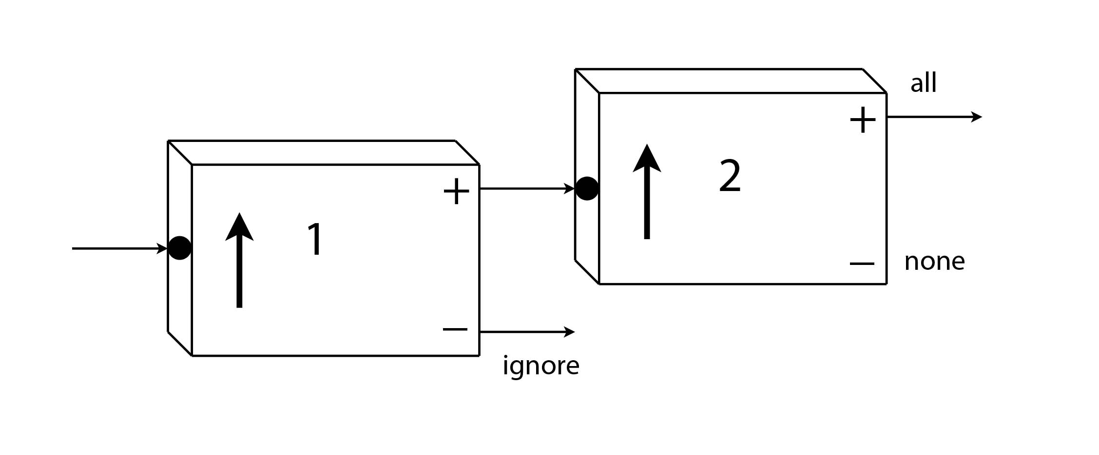
Repeated spin measurements:
???
Ignore the atoms exiting from the minus-channel of Analyzer 1,
and feed the atoms exiting from the plus-channel into Analyzer 2.
All of the atoms also leave from the plus-channel of Analyzer 2.

Slide 43
State Preparation
The atoms leaving the plus-channel of vertical Analyzer 1 were
all in the state
We confirmed this when all these atoms also leave the plus-channel
of vertical Analyzer 2. We can repeat this as often as we like…
All of these atoms were in the definite state
Bracket Notation
We’ll place any information we have about a quantum state inside a bracket: = “Psi” is a generic symbol for a quantum state
For the atoms leaving the plus-channel of Analyzer 1 we write:
OR

Slide 44
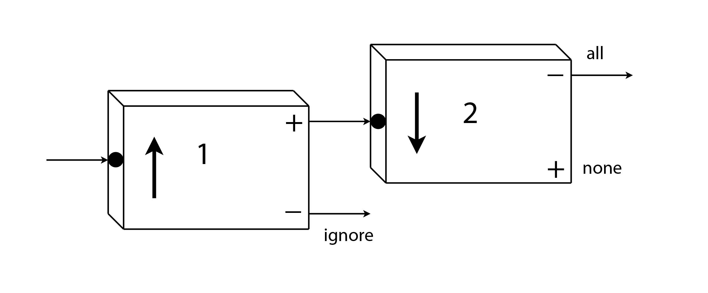
Analyzer 2 is now oriented downward:
???
Ignore the atoms exiting from the minus-channel of Analyzer 1,
and feed the atoms exiting from the plus-channel into Analyzer 2.
What happens when these atoms enter Analyzer 2?
They all exit from the plus-channel.
They all exit from the minus-channel.
Notes:
Concept Test

Slide 45
Analyzer 2 is now oriented downward:
All the atoms leave from the minus-channel of Analyzer 2.
Remember, with Analyzer 2 we are now measuring m_{(-Z)}
An atom in the state is also in the state
Notes:
Concept Test

