Slide 1
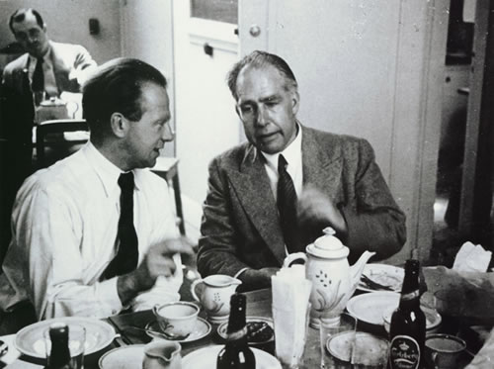
PH300 Modern Physics SP11
“The problems of language here are really serious. We wish to speak in some way about the structure of the atoms. But we cannot speak about atoms in ordinary language.“
- Werner Heisenberg
3/10 Day 16:
Questions?
Hidden Variables
Local Realism & EPR
Next Week (after Spring Break!):
Single-Photon Experiments
Complementarity
Matter Waves

Slide 2
Recently:
  Probabilistic descriptions of measurement outcomes.
  Classical probability and probability distributions.
Today:
  Interpretations of repeated spin measurements
  (hidden variables).
  2. Local Realism (an intuitive view of the universe).
  3. Distant correlated measurements & entanglement.
  4. Quantum cryptography (?)

Slide 3
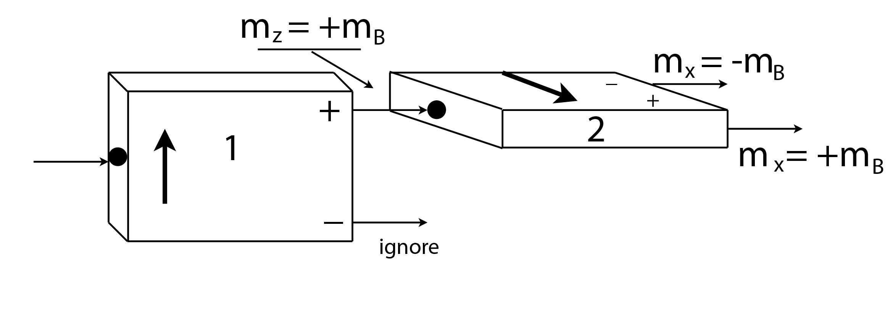

50%
50%
Interpretation One
An atom with a definite value of m_{Z} also has a definite value of m_{X} but that value changes so rapidly that we can’t predict it ahead of time.
(Remember, magnetic moments
precess in the presence of a
magnetic field.)

Slide 4
50%
50%
Interpretation Two
An atom with a definite value of m_{Z} also has a definite value of m_{X} but measuring m_{Z} disturbs the value of m_{X} in some unpredictable way.

Slide 5
50%
50%
Interpretation Three
An atom with a definite value of m_{Z} doesn’t have a definite value of m_{X}. All we can say is that there is a 50% probability for either value to be found when we make the measurement.

Slide 6
Which interpretation sounds most reasonable to you?
Interpretation One: An atom with a definite value of m_{Z} also has a definite value of m_{X}, but that value changes so rapidly that we can’t predict it ahead of time.
Interpretation Two: An atom with a definite value of m_{Z} also has a definite value of m_{X} but measuring m_{Z} disturbs the value of m_{X} in some unpredictable way.
Interpretation Three: An atom with a definite value of m_{Z} doesn’t have a definite value of m_{X} until measured.
A & B seem equally reasonable.
Something else…

Slide 7
Hidden Variables
By either of the first two interpretations, the value of m_{X} for an
atom in the state would be called a hidden variable.
If m_{X} has some real value at any given moment in time that is
unknown to us, then that variable is hidden:
The value of m_{X} exists, but we can’t predict ahead of time what
we’ll measure (“up” or “down”).
The objectively real value of m_{X} is unknown to us until
we make an observation.

Slide 8
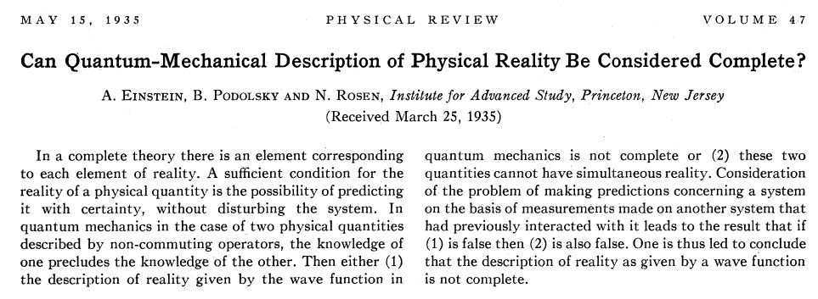
Albert Einstein believed that the properties of a physical system are objectively real – they exist whether we measure them or not.
Einstein, Podolsky and Rosen (EPR) believed in the reality of hidden variables not described by quantum mechanics.
What do they mean by complete?

Slide 9
Completeness
Quantum mechanics doesn’t predict what value of m_{X} will be measured, only the probability for a specific outcome.
A theory that can’t describe (predict) the value of a real (but unknown) physical quantity would be called incomplete.
A Realist (hidden variable) interpretation would say that quantum mechanics is incomplete (Interpretations One & Two).
Interpretation Three says that m_{X} doesn’t have a definite, real value - the value of m_{X} is indeterminate.
Quantum mechanics is not necessarily incomplete if it doesn’t describe the value of a physical quantity that doesn’t have a definite value to begin with.

Slide 10
Locality
EPR make one other assumption, but is it really an assumption?
1
2
Suppose we have two physical systems, 1 & 2.
1
2
If 1 & 2 are physically separated from one another, locality assumes that a measurement performed on System 1 can’t affect the outcome of a measurement performed on System 2, and vice-versa.

Slide 11
Local Realism
Put together a Realist perspective and the assumption of locality and we get an interpretation of quantum mechanics that we’ll call Local Realism.
Local Realism says that hidden variables exist and that quantum mechanics is an incomplete description of reality.
Is this a question of science or philosophy?
How could we decide?
Can we devise an experiment to test whether the assumptions of Local Realism are correct?
Yes!! But first we have to learn about entanglement…

Slide 12
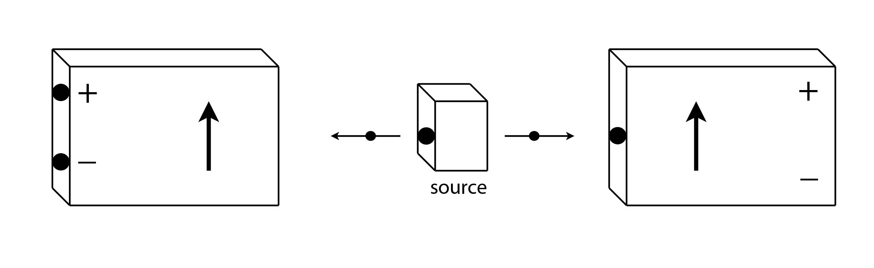
Entanglement
Suppose we have a source that produces pairs of atoms traveling in opposite directions, and having opposite spins:
1
1
2
2
Total spin = 0
OR
1
1
2
2

Slide 13
Entanglement
1
2
Place two Stern-Gerlach analyzers to the left and right of the source, and oriented at the same angle.
Let represent the quantum state of both atoms 1 & 2.

Slide 14
Entanglement
1
2
1
1
2
2
If Atom 1 exits through the plus-channel of Analyzer 1, then
Atom 2 will always exit through the minus-channel of Analyzer 2.
We can write this state as:

Slide 15
Entanglement
1
2
1
1
2
2
If Atom 1 exits through the minus-channel of Analyzer 1, then
Atom 2 will always exit through the plus-channel of Analyzer 2.
We can write this state as:

Slide 16
Entanglement
1
2
We can’t predict what the result for each individual atom pair will be.
and are both equally likely.
Quantum mechanics says to describe the quantum state of each atom pair as a superposition of the two possible states:
When we perform the measurement, we only get one of the two possible outcomes, each with a probability of 1/2.

Slide 17
Experiment One
1
2
Rotate the analyzers by any angle, as long as they’re both pointing along the same direction.
If we measure along the x-axis, the result is either
or
If we measure along the z-axis, the result is either
or
This is true no matter what angle we choose, as long as
both analyzers point along the same direction.

Slide 18
Experiment One
1
2
The results of Experiment One show that the measurements performed on Atom 1 and on Atom 2 are anti-correlated.
Anti-correlated means that, whatever answer we get for Atom 1, we’ll get the opposite answer for Atom 2, as long as we’re asking the same question.
Atom pairs in a correlated state
    are said to be entangled.
Note that !!

Slide 19
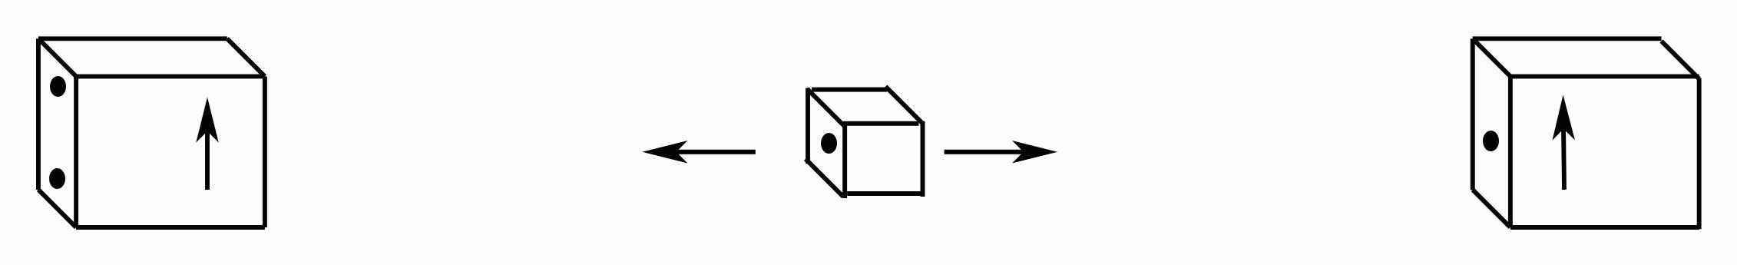
Experiment Two
Albert
Niels
+
+
1
2
-
-
5 km
5 km
+ 1 meter
Analyzer 1 (watched by Albert) is placed 5 km to the left of the source.
Analyzer 2 (watched by Niels) is placed 5 km plus one meter to the
right of the source.
Perform Experiment One, exactly as before.

Slide 20
Experiment Two
Albert
Niels
+
+
1
2
-
-
5 km
5 km
+ 1 meter
Albert can tilt Analyzer 1 any way he wants, and Niels can do the
same with Analyzer 2.
When Analyzers 1 & 2 are tilted at different angles, they sometimes
get the same answer, sometimes different answers.
But when they compare their data, whenever the analyzers were
tilted at the same angle they got opposite answers.
The measurements are still 100% anti-correlated.

Slide 21

Let them orient their analyzers at random
and record the results:
Now, let’s compare the data for when the orientation agreed:
down up
Z Z
down down
X Z
up down
Z Z
up up
Z X
down up
X Z
up down
X Z
up down
Z Z
down up
X X

Slide 22
The EPR Argument
Albert
Niels
+
+
1
2
-
-
5 km
5 km
+ 1 meter
Analyzers 1 & 2 are set at the same angle and Albert measures the spin of Atom 1 first. He observes .
Albert knows what the result of Niels’ measurement will be before Atom 2 reaches Analyzer 2. [And Niels knows he knows it.]
If we assume locality, then Albert’s measurement can’t change the
outcome of Niels’ measurement! Niels observes ,
and that must have been the state of Atom 2 all along.
What will be the outcome of Niels’ measurement?

Slide 23
The EPR Argument
Albert
Niels
+
+
1
2
-
-
5 km
5 km
+ 1 meter
In other words, if Albert can predict with 100% certainty that Niels
will observe before he performs the measurement,
then must have been the real, definite state of Atom 2
at the moment the atom pair was produced.
Local Realism says the atom pair was produced in the state
and the measurements revealed this unknown reality to us.

Slide 24
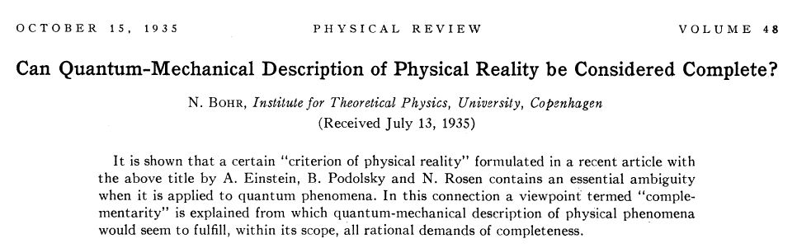
The Copenhagen Interpretation says the atom pair was produced
in the superposition state
Alberts’s measurement of instantly collapses
into the definite state
This collapse must be instantaneous, because there is no time for a signal to travel from 1 to 2.

Slide 25
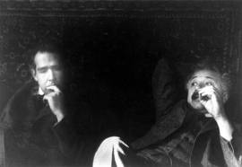
Albert Einstein: God does not play dice with the universe.
Niels Bohr: Who are we to tell God how to act?
Niels Bohr and Albert Einstein together at the 1930 Solvay Conference.
Philosophy or Science?

Slide 26



Classical Ignorance vs. Quantum Uncertainty
Classical Experiment:
  Take a blue sock and a red sock
  Seal them up in identical boxes
  Mix up boxes
  Take them to opposite ends of galaxy
  Open just one box, and you know what color sock is in the other box.

Slide 27
Classical Ignorance vs. Quantum Uncertainty
No one knew which color was in which box until the moment one of the boxes was opened.
Opening the first box only revealed to us something that was
real and already predetermined here on Earth.
Quantum mechanics would say that “quantum socks” are in a superposition state of equal parts blue and red.
Opening just one box instantly forces both socks to assume definite (but always opposite) colors at random, even though the boxes are very far apart.
Local Realism says the superposition state is a reflection of
classical ignorance.

Slide 28
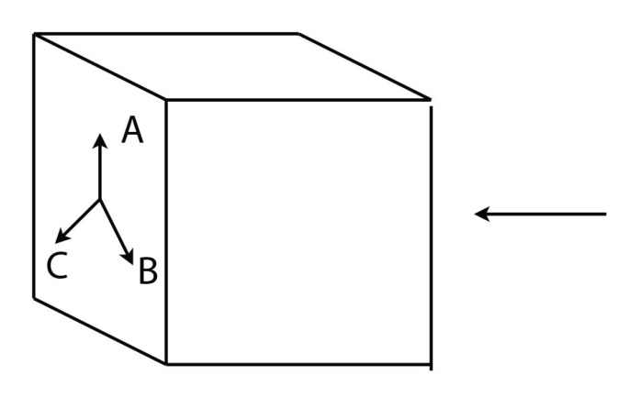
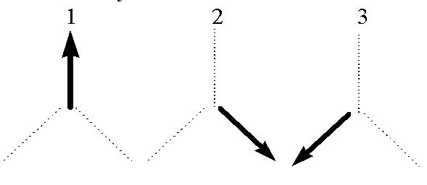
Remember this problem?
A
B
C
If we send in an atom in a definite state , the probability for the atom to leave from the plus-channel if the setting on the analyzer is random is:
[1/3 x 1] + [1/3 x 1/4] + [1/3 x 1/4]
= 4/12 + 1/12 + 1/12 = 6/12 = 1/2
Remember:

Slide 29
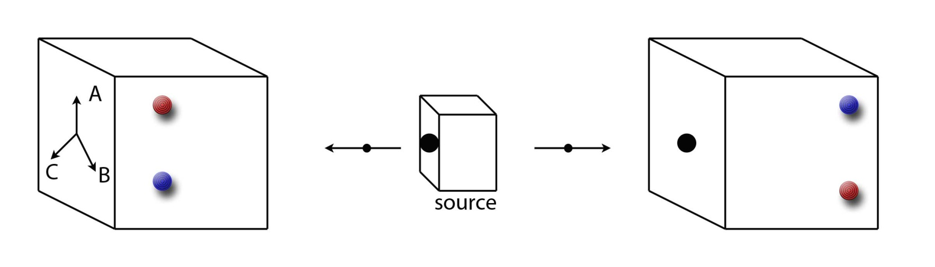
“Local-Reality Machine”
L
R
Imagine a pair of Stern-Gerlach analyzers with three settings,
each oriented 120⁰ from the other:
A
B
C

Slide 30
“Local-Reality Machine”
L
R
Whatever the setting of the Left Analyzer (A, B, or C), if the answer is +m_{B} the red bulb flashes, and the blue bulb flashes if the answer is –m_{B}.
For the Right Analyzer, the opposite is true. This way, when the analyzers have the same setting, they always both light up the same color.

Slide 31
“Local-Reality Machine”
L
R
OBSERVATION
We ignore the settings for both analyzers and let them change at random.
50% of the time, the analyzers flash the same color.
50% of the time, the analyzers flash different colors.

Slide 32
“Local-Reality Machine”
L
R
Can we devise a local realistic scheme that accounts for these results?
Suppose there were some quality possessed by each atom pair that predetermines which bulb is going to light up.
Say each atom pair is created with an instruction set that will determine which bulb lights up for each of the three settings A, B and C.

Slide 33
Instruction Sets
For example, suppose an atom pair is produced in the state:
This instruction set tells each analyzer to:
light red if the device is set to A
light red if the device is set to B
light blue if the device is set to C
represents the quantum state of that type of atom pair at the moment the atom pair is produced at the source.

Slide 34
Instruction Sets
Each detector has three possible settings (A, B & C), and two possible outcomes for each setting (red or blue).
There are therefore eight types of atom pairs that can be produced. Which type of atom pair is produced is random.
??
 | RESULT FOR EACH RUN, IF THE SWITCH IS SET TO:
TYPE OF ATOM | A | B | C
I | RED | RED | RED
II | RED | RED | BLUE
III | RED | BLUE | RED
IV | RED | BLUE | BLUE
V | BLUE | RED | RED
VI | BLUE | RED | BLUE
VII | BLUE | BLUE | RED
VIII | BLUE | BLUE | BLUE

Slide 35
Instruction Sets
??
There are nine different combinations for how each of the two analyzers could be set:
ANALYZER SETTING |  | TYPE OF ATOM-PAIR
LEFT | RIGHT | I | II | III | IV
A | A | R/R | R/R | R/R | R/R
A | B | R/R | R/R | R/B | R/B
A | C | R/R | R/B | R/R | R/B
B | A | R/R | R/R | B/R | B/R
B | B | R/R | R/R | B/B | B/B
B | C | R/R | R/B | B/R | B/B
C | A | R/R | B/R | R/R | B/R
C | B | R/R | B/R | R/B | B/B
C | C | R/R | B/B | R/R | B/B
# OF SETTINGS FLASHING SAME COLOR |  | 9 | 5 | 5 | 5

Slide 36
Instruction Sets
There are 72 (9 x 8) possible outcomes, with 48 outcomes where the bulbs flash the same color:
TYPE OF ATOM PAIR | I | II | III | IV | V | VI | VII | VIII
# OF SETTINGS FLASHING SAME COLOR | 9 | 5 | 5 | 5 | 5 | 5 | 5 | 9
The probability for both analyzers to flash the same color is:
??
We observe that the bulbs flash the same color 50% of the time.
Something seems to be wrong with our deterministic scheme!

Slide 37
The quantum state of both (entangled) particles is described by:
Remember: We can measure along any axis we like and the bulbs flash the same color whenever both analyzers measure along the same axis.
The quantum state describing both particles is not a product of two independent states:

Slide 38
How do we know the quantum state is not described by:
This state could also make the analyzers flash the same color half the time and different colors half the time…
But then there would be a possibility for the analyzers to be on the same setting and we get the result:
OR
which never happens!

Slide 39
A probabilistic interpretation correctly predicts the likelihood for the two analyzers to flash the same color.
Our deterministic scheme incorrectly predicts how often the bulbs should flash the same color.
Which assumption of Local Realism is incorrect?
Locality
Realism
Both
Neither
I don’t know…

Slide 40
Bell’s Theorem
There is a more general theorem by J. S. Bell that proves:
No local interpretation of quantum phenomena can reproduce all of the predictions of quantum mechanics.
[We can devise a realistic scheme that is non-local, but most scientists are uncomfortable with this kind of interpretation.]
Number of annual citations of “On the Einstein-Podolsky-Rosen Paradox” J. S. Bell, Physics 1, 195 (1964)

Slide 41
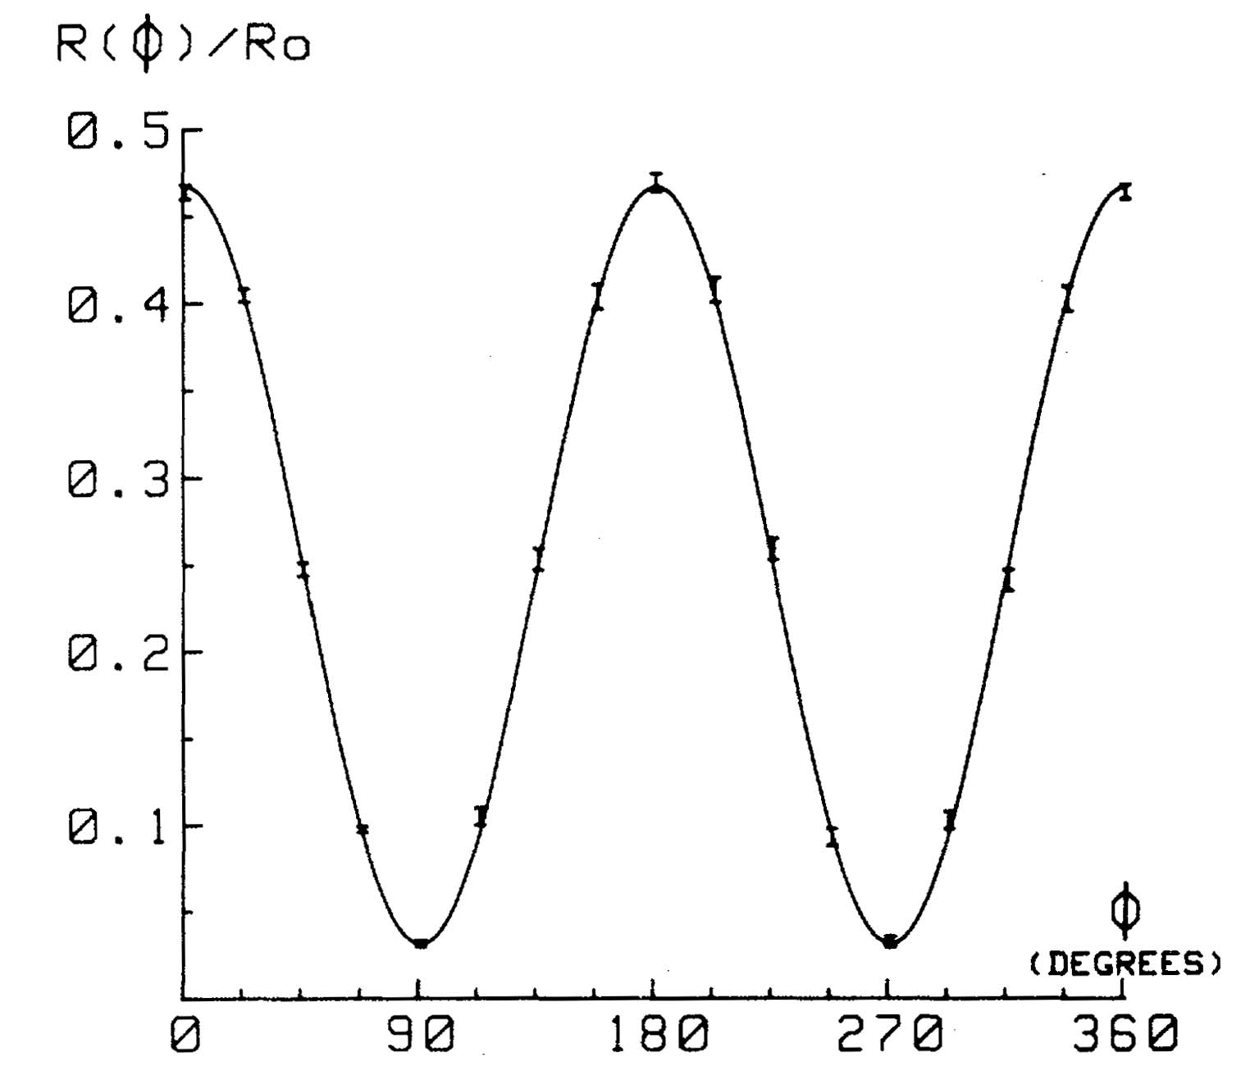
Bell’s Theorem
There is a more general theorem by J. S. Bell that proves:
No local interpretation of quantum phenomena can reproduce all of the predictions of quantum mechanics.
Error bars represent one standard deviation
Not a “best-fit” curve !!
A test of Bell’s Theorem performed by A. Aspect (1981)

Slide 42
Interpretations One & Two involved hidden variables.
Interpretation Three said:
In general, the state of a quantum system is indeterminate
until measured.
We can restate this as:
The outcome of a QUANTUM experiment cannot, in general*, be predicted exactly; only the probabilities of the various outcomes can be found.
*IN GENERAL – What would be a counter-example to this?

Slide 43
Cryptography
Any message can be encoded as a string of 1’s & 0’s:
c = 1100011
a = 1100001
t = 1110100
“cat” = 110001111000011110100
“message” = {p₁, p₂, p₃, …, p_{n}}
key = {k₁, k₂, k₃,…, k_{m}} (m ≥ n)
“encrypted message” = {c₁, c₂, c₃, …, c_{n}}
c_{j} = p_{j} + k_{j} (mod 2)

Slide 44
Cryptography
Any message can be encoded as a string of 1’s & 0’s:
c = 1100011
a = 1100001
t = 1110100
“cat” 110001111000011110100
+ key 101011001101011010101
= 011010110101000100001
0110101 = 5
1010100 = T
0100001 = !
This message is secure so long as the key is secure!

Slide 45
Suppose we have two observers with their analyzers oriented along the +z-direction:
With the magnets oriented along the same direction, you get a random sequence of up and down, but with the two particles always giving opposite results.
Down Up
Up Down
Up Down
Down Up
Down Up
Up Down
Up Down
Down Up

Slide 46
Suppose we call “up” along +z-direction “1”,and “down” along the +z-direction “0”.
If both observers know their analyzers are oriented along the same direction, then each observer always knows what the other observer measured.
0 1
1 0
1 0
0 1
0 1
1 0
1 0
0 1

Slide 47
Suppose we call “up” along +z-direction “1”,and “down” along the +z-direction “0”.
Suppose we now invert the number assignment for just one of our observers (say, the left one).
1 1
0 0
0 0
Now, both observers have recorded the same random sequence of 1’s and 0’s.
1 1
1 1
0 0
0 0
1 1

Slide 48
What if you rotate one magnet and not the other?
?
Suppose you rotate the left magnet so it points along the +x-axis, while the right magnet still points along the z-axis. If you measure the right particle to be spin down, what will you happen when you measure the spin of the left particle?
  A. It will be spin up (in the + x-direction).
  B. It will be spin down (in the – x-direction).
  C. It will be spin up or spin down, with a 50/50 probability.
  D. It will be spin up or spin down, with some other probability.
  E. Something else.

Slide 49
If the right particle is spin down in the +z-direction, then the left particle is spin up in the +z-direction. So you have a 50/50 probability of measuring the right particle as up or down along +x-direction.
1 1
1 0
0 0
0 1
0 1
1 0
0 0
1 1

Slide 50
Let them orient their analyzers at random
and record the results (Trial 1):
Now, let’s compare the data for when the orientation agreed:
1 1
Z Z
1 0
X Z
0 0
Z Z
0 1
Z X
1 1
X Z
0 0
X Z
0 0
Z Z
1 1
X X

Slide 51
Let them orient their analyzers at random
and record the results (Trial 2):
1 1
Z Z
1 0
X Z
1 0
Z Z
0 1
Z X
1 1
X Z
0 0
X Z
0 0
Z Z
1 1
X X

Slide 52
1 1
Z Z
1 0
X Z
0 0
Z Z
0 1
Z X
0 1
X Z
1 0
X Z
0 0
Z Z
1 1
X X

