Slide 1
PH300 Modern Physics SP11
“Why do some textbooks not mention complementarity? Because it will not help in quantum mechanical calculations or in setting up experiments. Bohr’s considerations are extremely relevant, however, to the scientist who occasionally likes to reflect on the meaning of what she or he is doing.”
– Abraham Pais
Particle?
Wave?
“Wavicle”?
3/22 Day 17:
Questions?
Single-Photon Experiments
Wave-Particle Duality
Thursday:
Electron Diffraction
Matter Waves

Slide 2
Recently:
Entanglement
Testing the assumptions of Local Realism.
Quantum cryptography
Today:
Creating a “single-photon” source.
Demonstrating the particle nature of photons.
Demonstrating the wave nature of photons.
Delayed-Choice experiments and Wave/Particle Duality
Thursday:
Electron diffraction
Matter waves

Slide 3
Recall the Double-Slit Experiment
Quantum Wave
Interference Sim

Slide 4
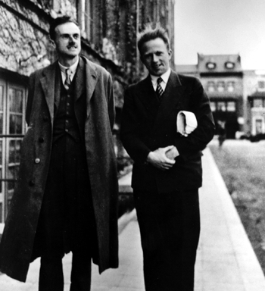
How to interpret this?
“…each photon interferes only with itself. Interference between different photons never occurs.
P. A. M. Dirac, The Principles of Quantum Mechanics (1947).

Slide 5
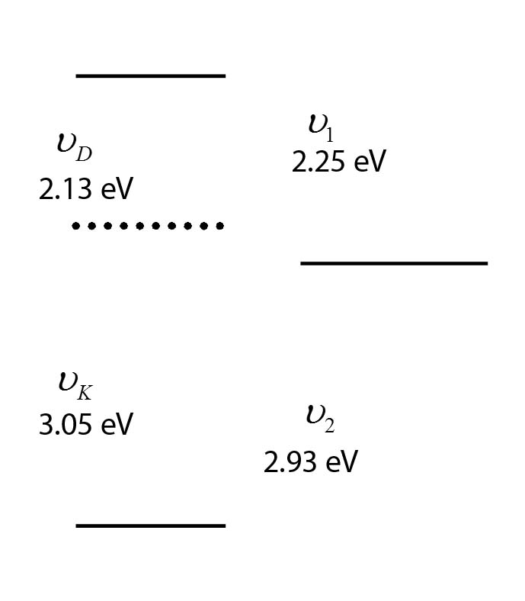
Single Photon Source
Calcium atoms are excited by a two-photon absorption process
(E_{K} = 3.05 eV) + (E_{D} = 2.13 eV).
The excited state first decays by single photon emission (E₁ = 2.25 eV).
The lifetime of the intermediate state is τ ~ 5 ns.
High probability the second photon (E₂ = 2.93 eV) is emitted within t = 2τ
Why two-photon excitation? Why not a single laser pulse of 5.18 eV?

Slide 6
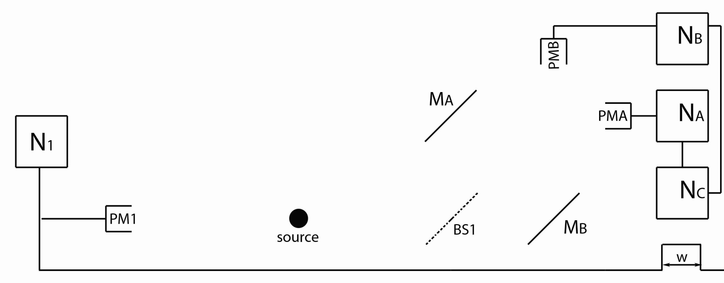
Experiment One
M_{A} and M_{B} are mirrors.
BS1 is a beam splitter.
PM1, PMA & PMB are all photomultipliers.
N₁, N_{A}, N_{B} & N_{C} are counters that record photon detections.

Slide 7
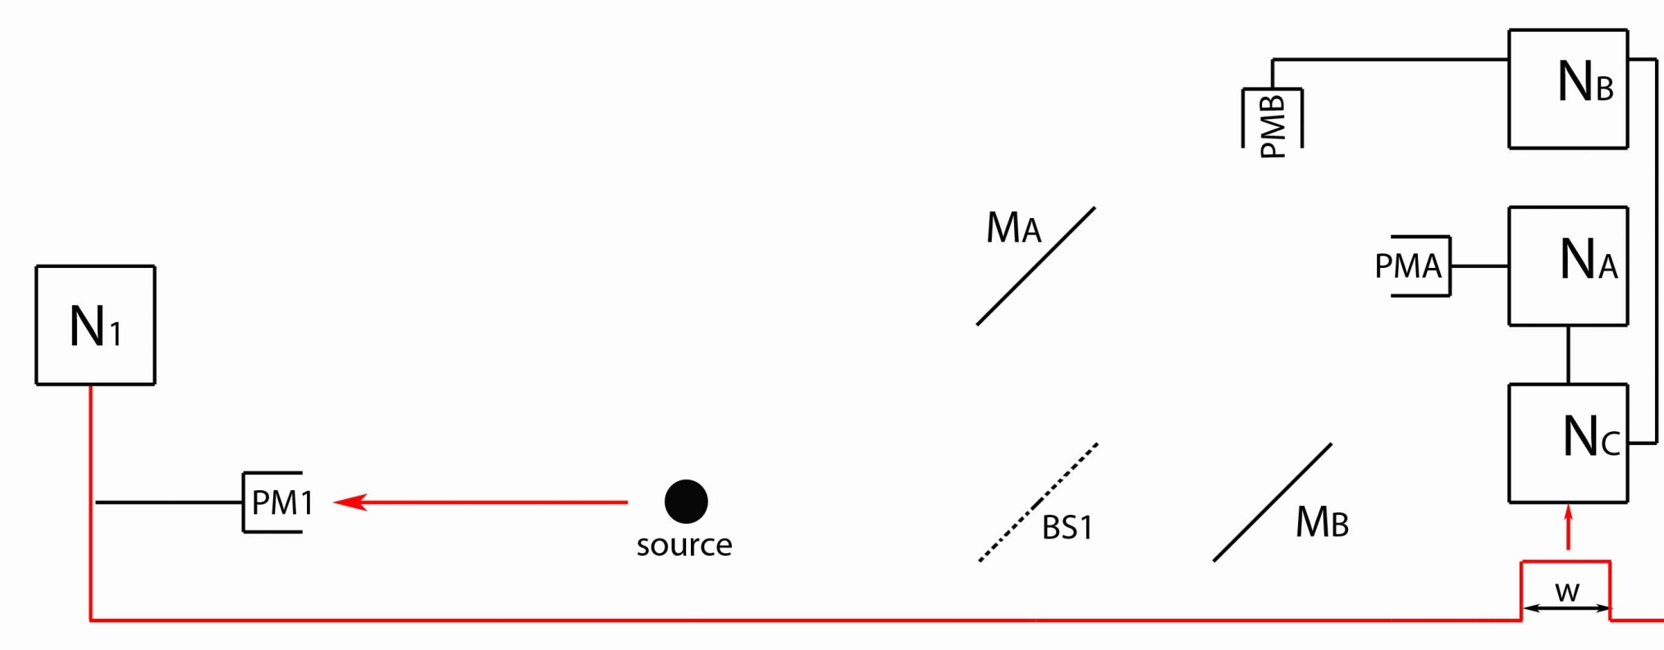
Experiment One
ν₁
ν₂
ν₁ and ν₂ are emitted back-to-back.
Detection of first photon (ν₁) is counted by N₁.
A signal is sent to tell the counters (N_{A}, N_{B} & N_{C}) to expect a second photon (ν₂) within a time w = 2τ.

Slide 8
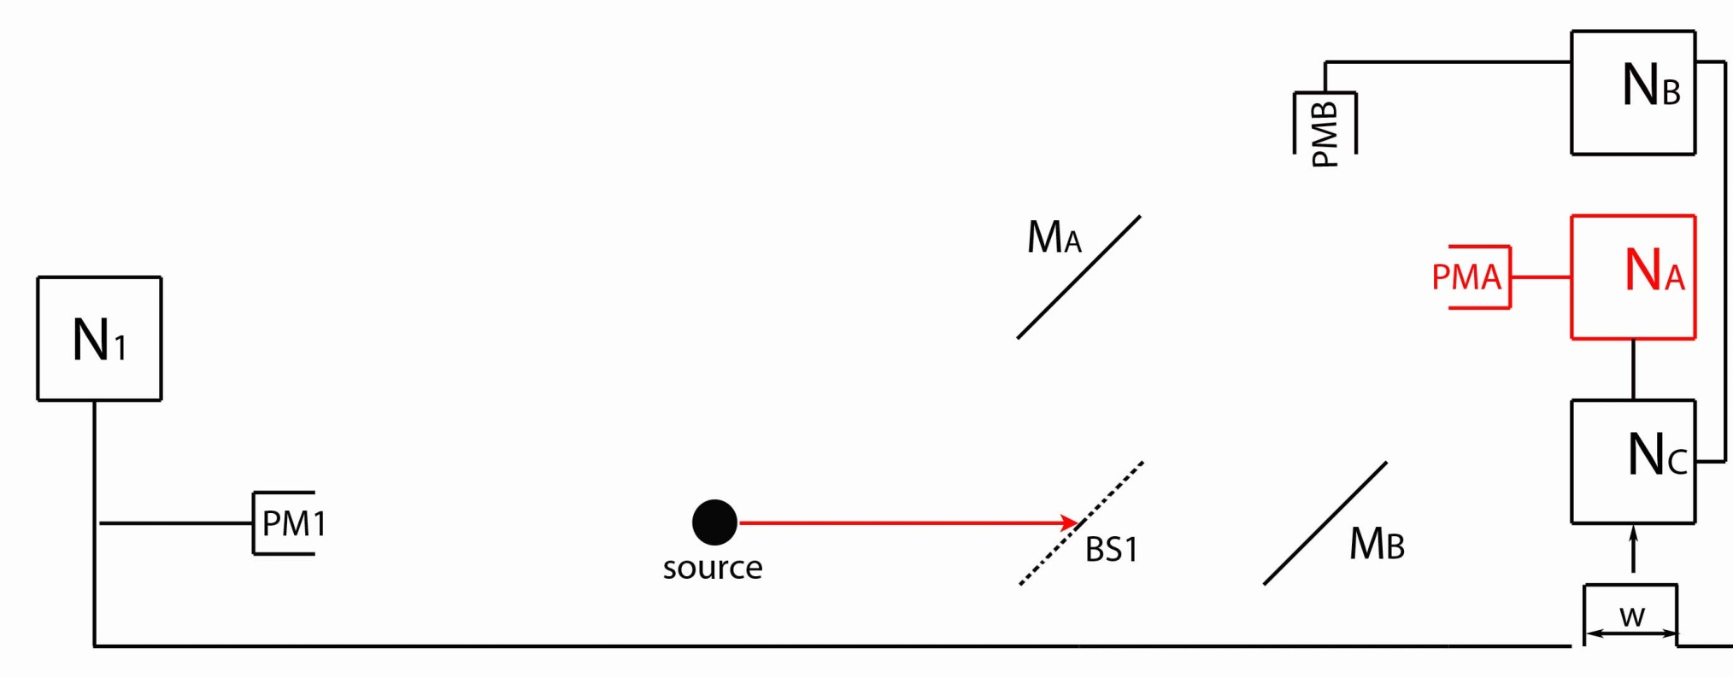
Experiment One
ν₁
ν₂
If the second photon (ν₂) is detected by PMA, then the photon must have been…
…reflected at BS1
…transmitted at BS1
…either reflected or transmitted at BS1
Not enough information.

Slide 9
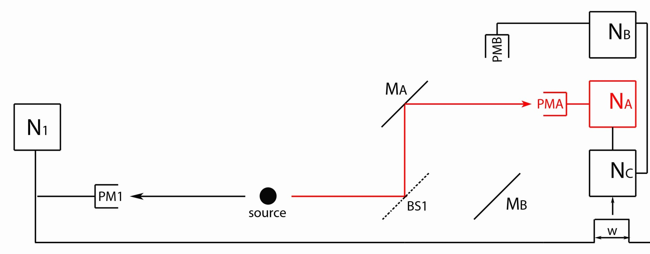
Experiment One
ν₁
ν₂
If the second photon (ν₂) is detected by PMA, then the photon must have traveled along Path A (via M_{A}).
(Reflected at BS1)

Slide 10
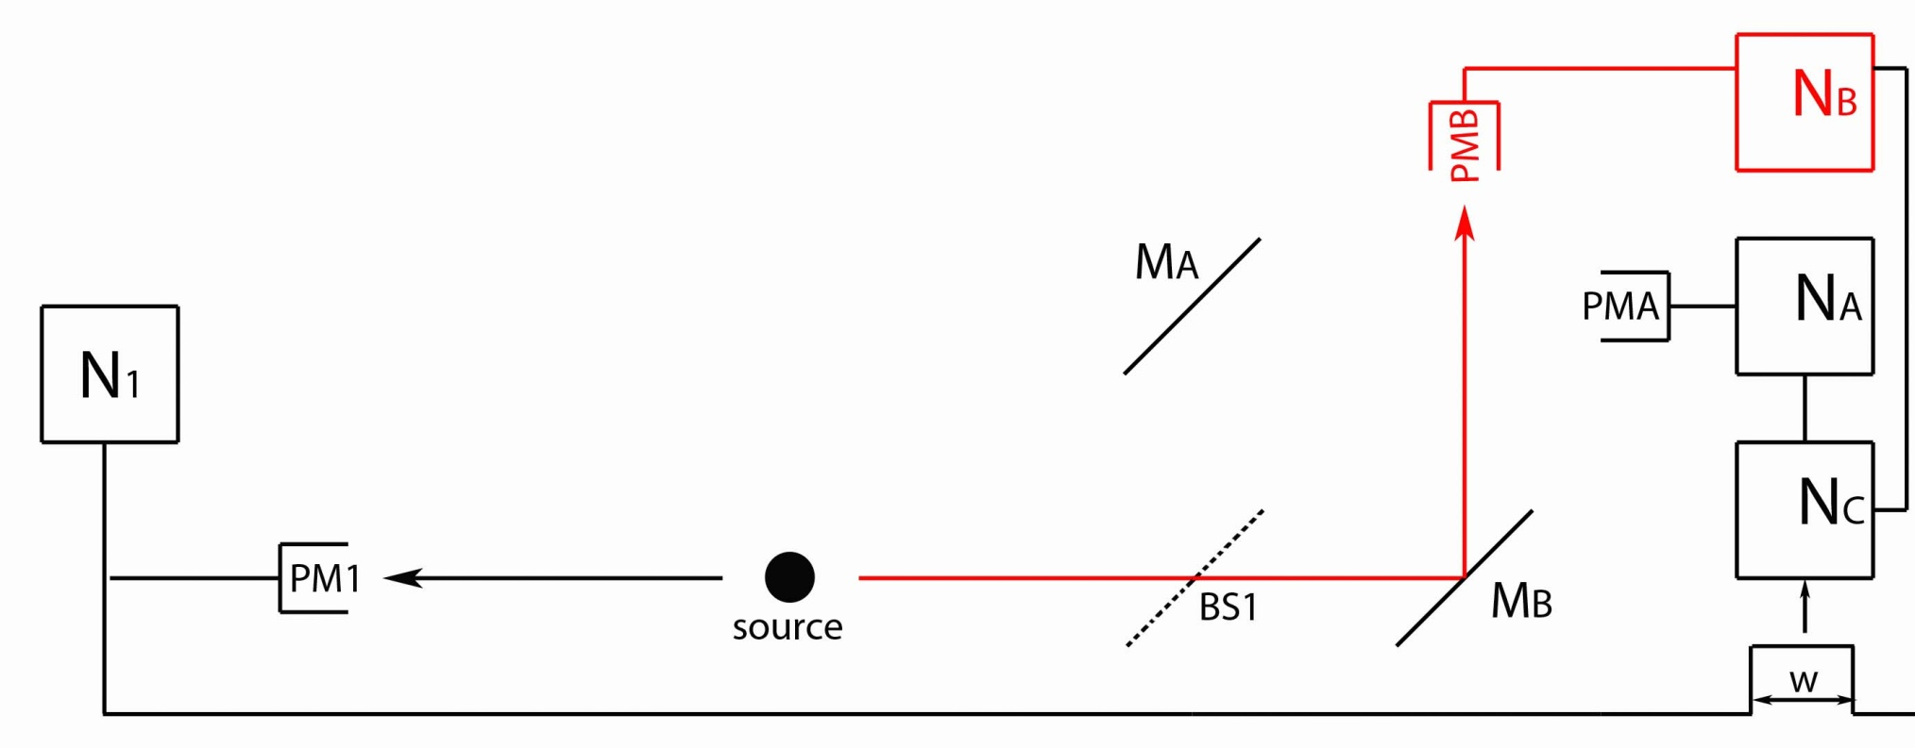
Experiment One
ν₁
ν₂
If the second photon (ν₂) is detected by PMB, then the photon must have traveled along Path B (via M_{B}).
(Transmitted at BS1)

Slide 11
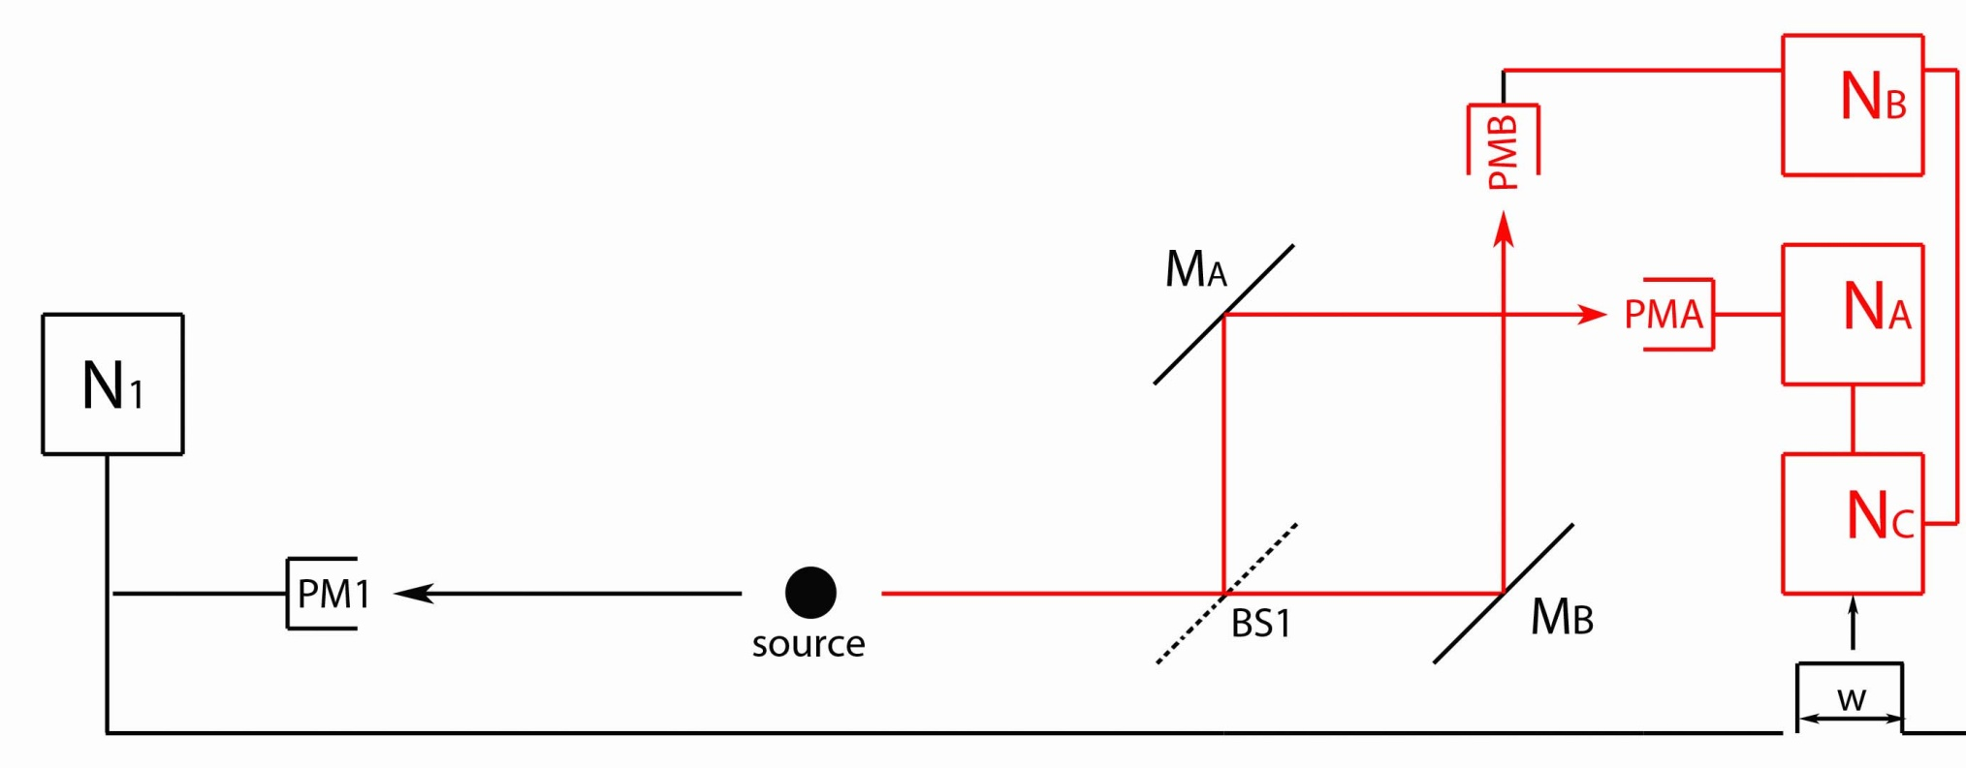
Experiment One
ν₁
ν₂
If both PMA & PMB are triggered during w = 2τ, then the coincidence counter (N_{C}) is triggered.

Slide 12
Anti-Correlation Parameter
Need some kind of measure of how often PMA & PMB are being triggered at the same time.
Let
P_{A} is the probability for N_{A} to be triggered.
P_{B} is the probability for N_{B} to be triggered.
P_{C} is the probability for the coincidence counter (N_{C}) to be triggered (both N_{A} and N_{B} during t = 2τ).

Slide 13
Anti-Correlation Parameter
If N_{A} and N_{B} are being triggered randomly and independently, then α = 1.
P_{C} = P_{A} x P_{B} which is consistent with:
Many photons present at once
EM waves triggering N_{A} & N_{B} at random.
If photons act like particles, then α ≥ 0.
P_{C} = 0 when photons are always detected by PMA or by PMB, but not both simultaneously.
If photons act like waves, then α ≥ 1.
P_{C} > P_{A} x P_{B} means PMA and PMB are firing together more often than by themselves (“clustered”).
?
?
?

Slide 14
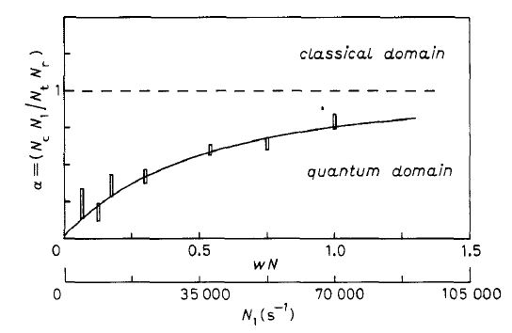
Single-Photon Experiment 1
EM Waves → α ≥ 1 Quantum Particles → α ≥ 0
Photons take either Path A or Path B, but not both!!
If photons are particles, why don’t we always measure α = 0?

Slide 15
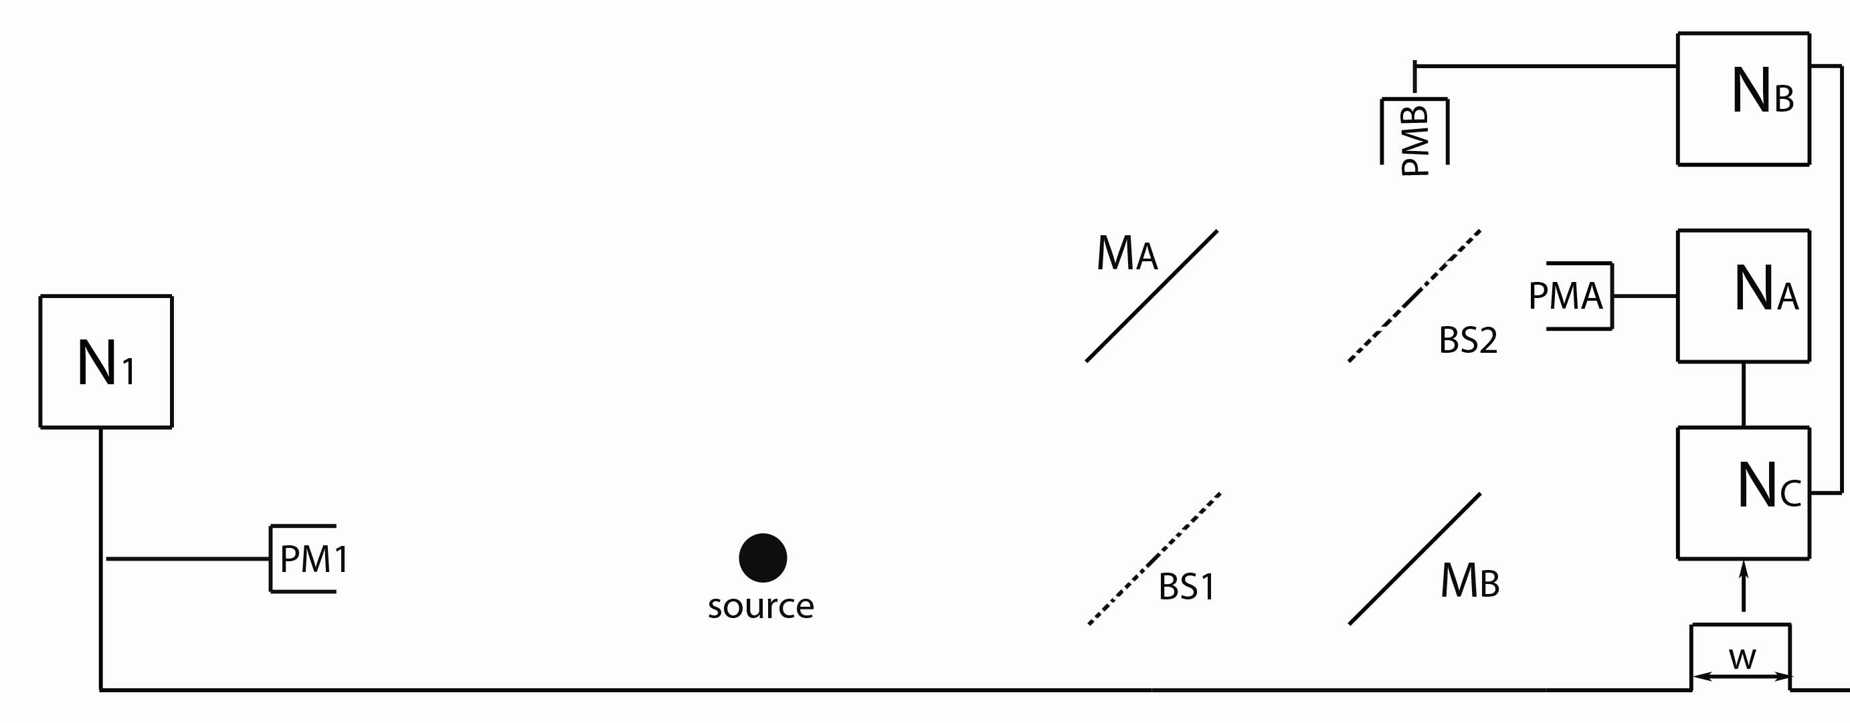
Experiment Two
Use same single-photon source, but now insert a
second beam splitter. (BS2)
Run experiment as before…

Slide 16
Experiment Two
If the photon is detected in PMA, then it must have been…
A) …reflected at BS1.
B) …transmitted at BS1.
C) …either reflected or transmitted at BS1
D) Not enough information.

Slide 17
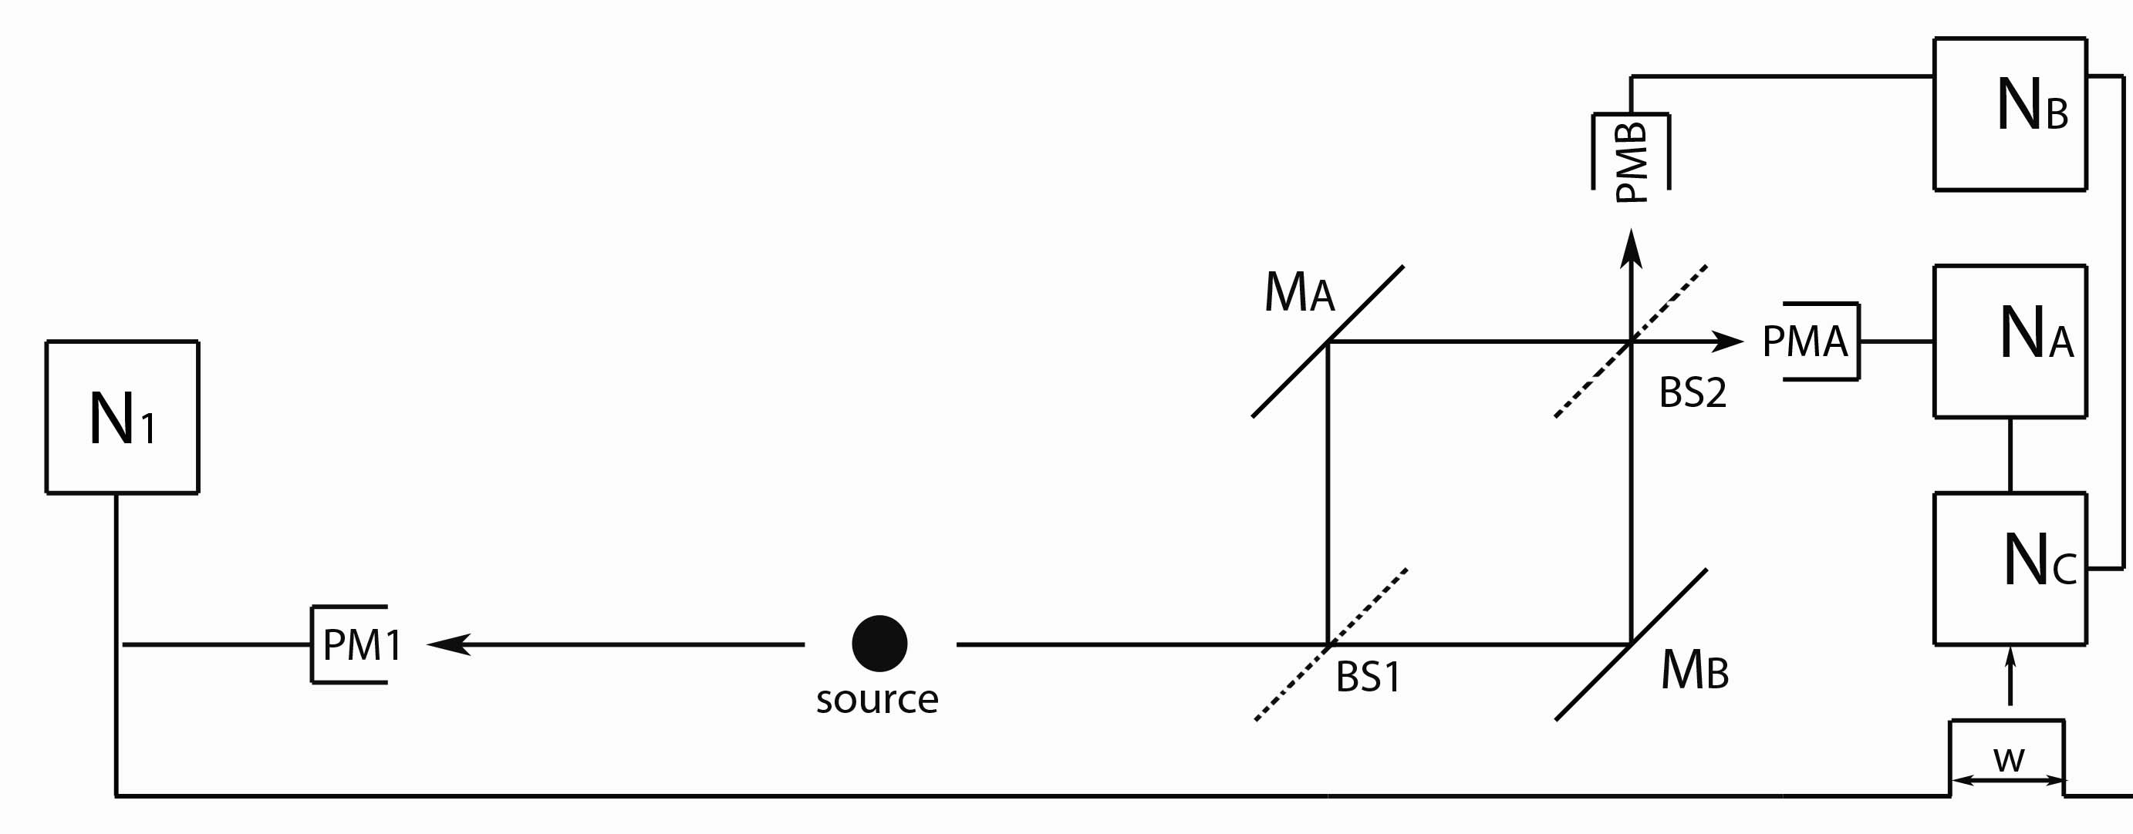
Experiment Two
Whether the photon is detected in PMA or PMB, we have
no information about which path (A or B) any photon took.
What do we observe when we compare data from PMA & PMB?

Slide 18
Experiment Two
N_{A}
N_{B}
Slowly change one of the path lengths (Move M_{B}, for example), and we observe interference!
For some path length differences, all the photons are detected by PMA and none in PMB (and vice-versa).
For some path length differences, there is an equal probability for either detector to be triggered.
Each photon is somehow “aware” of both paths!

Slide 19
Experiments One & Two
Photons in Experiment One took only Path A or Path B.
(which-path information – a particle encounters BS1 and takes either one path or the other)
Photons in Experiment Two take both Path A and Path B.
(no path information – a wave encounters BS1 and
splits equally to take both paths)
Experiment One says photons behave
like particles at BS1.
Experiment Two says photons behave
like waves at BS1.
Can a photon be both at once?
A) Yes B) No C) Maybe?

Slide 20
The “Conspiracy” Theory
How can the photon “know” whether we are conducting Experiment One or Experiment Two when it encounters BS1?
Perhaps each photon “senses” the entire experimental apparatus and always behaves accordingly.
Can we “trick” a photon into acting like a particle at BS1 when it should act like a wave, or the other way around?
Suppose we let the photon enter the apparatus when only one path is available, but then open up a second path at the last moment.

Slide 21
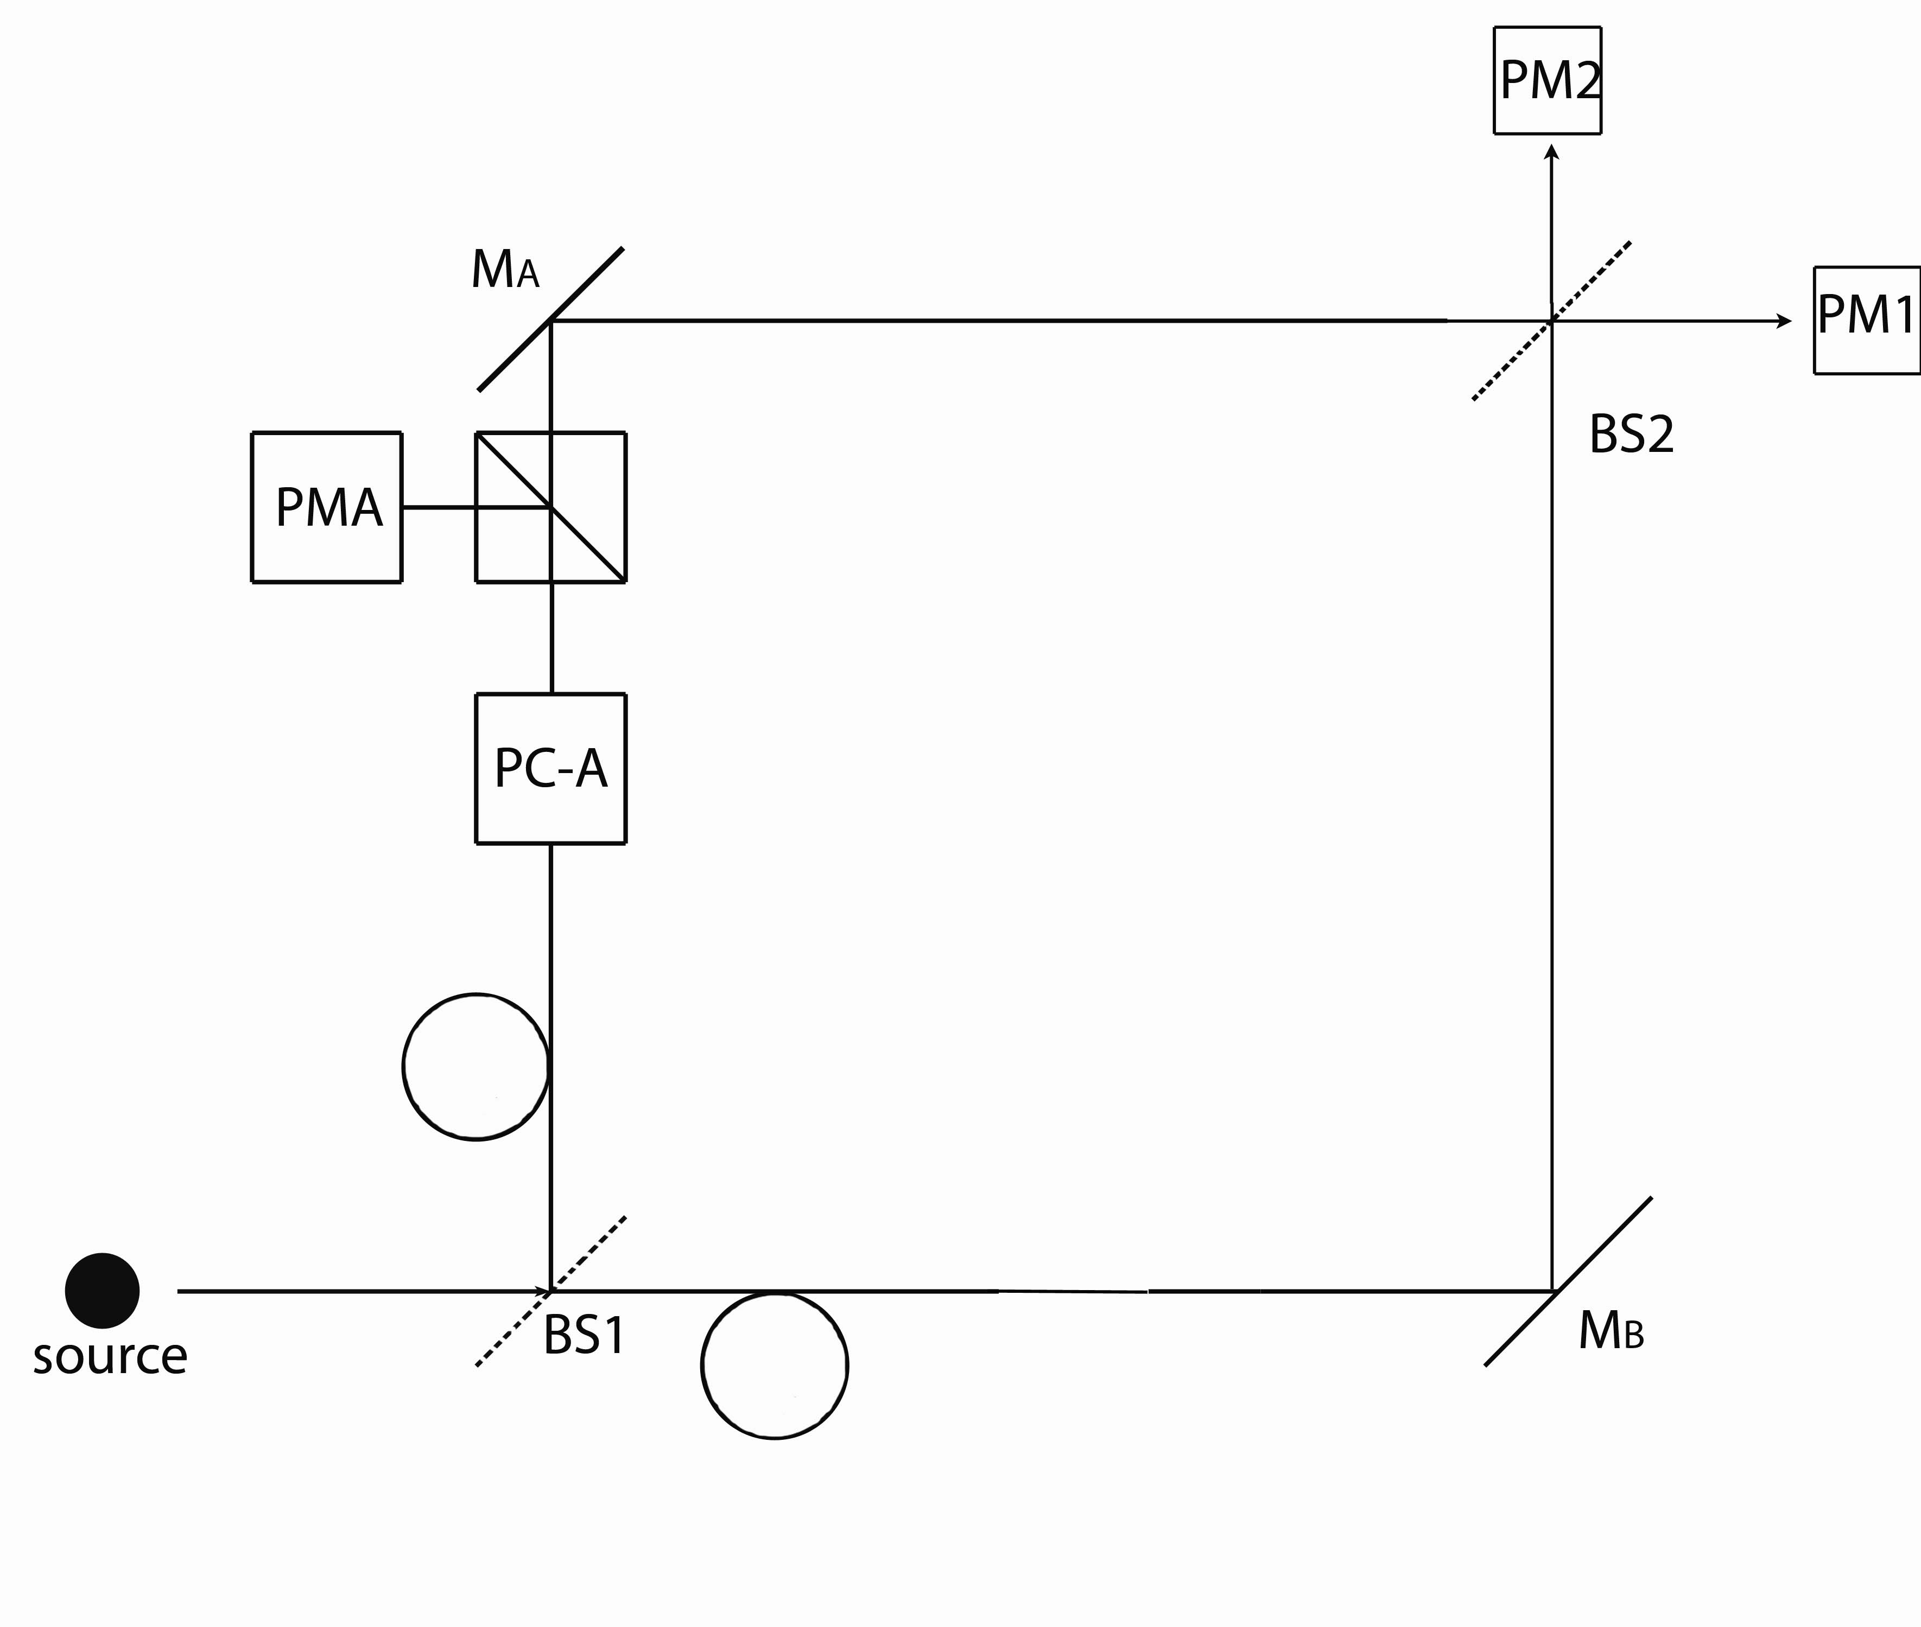
Experiment Three
Impossible to physically insert/remove a path at the necessary speed, but this type of experimental setup is equivalent to what we just described.

Slide 22
Experiment Three
PC-A is a “Pockels Cell” set into Path A
When a voltage is applied to PC-A, it causes any photon passing through to be deflected and detected at PMA. We can turn this voltage on and off very quickly (and randomly).

Slide 23
Experiment Three
10 meter lengths of fiber optic cable are
inserted into both paths.
How much extra time-delay is introduced by inserting these fiber optic cables?

Slide 24
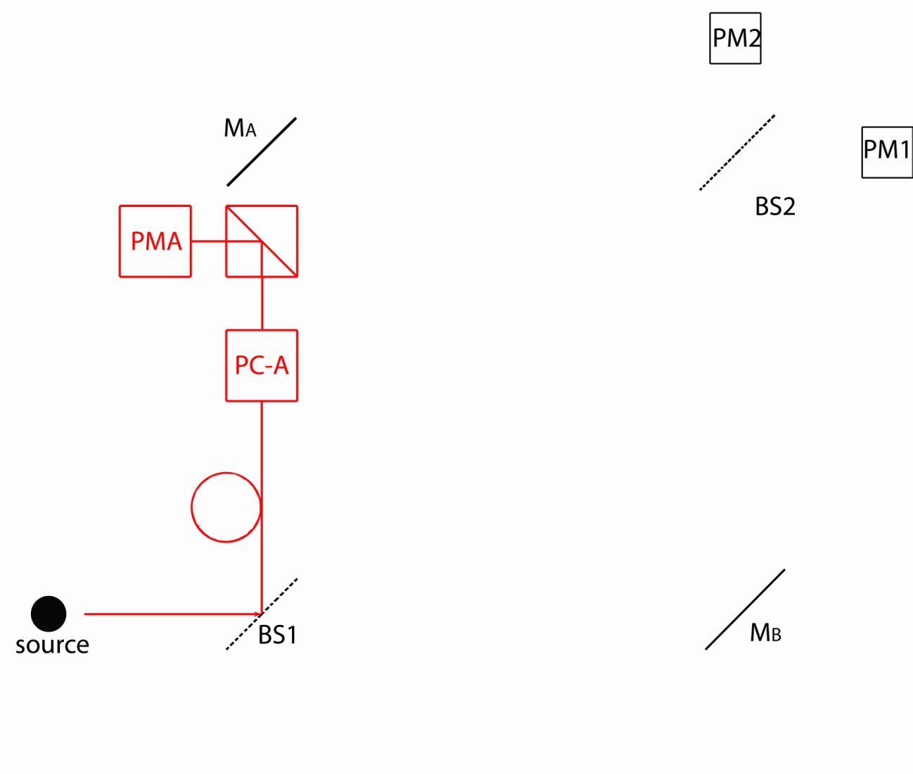
Experiment Three
If the photon is reflected at BS1 when a voltage is applied to PC-A, then the photon is always detected in PMA.

Slide 25
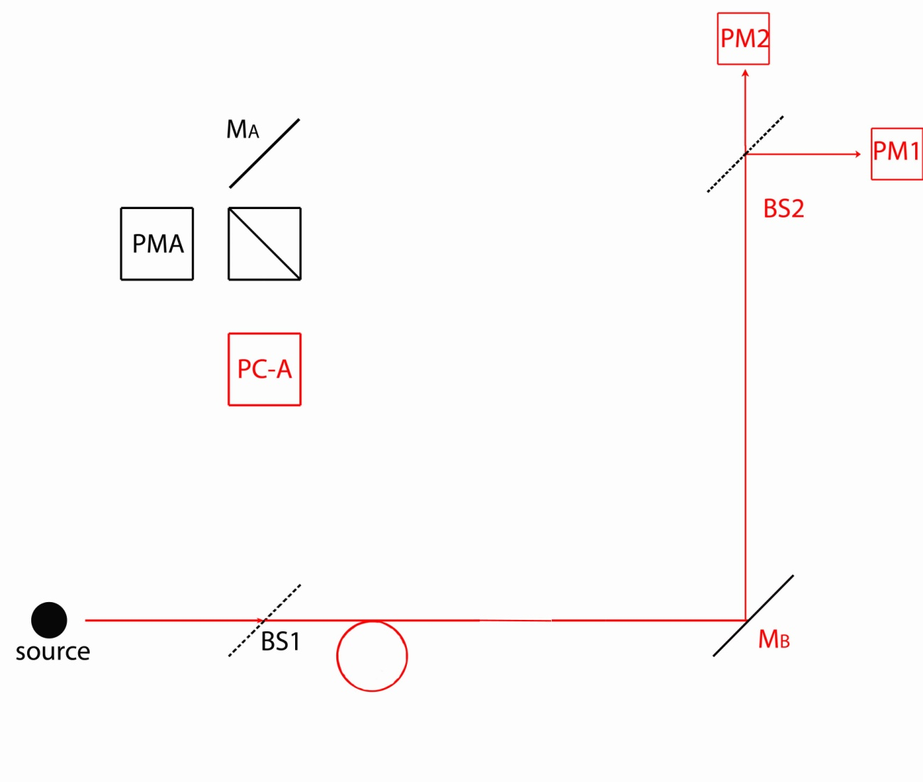
Experiment Three
If the photon is transmitted at BS1 when a voltage is applied to
PC-A, then the photon is detected in either PM1 or PM2 with equal probability (no interference).

Slide 26
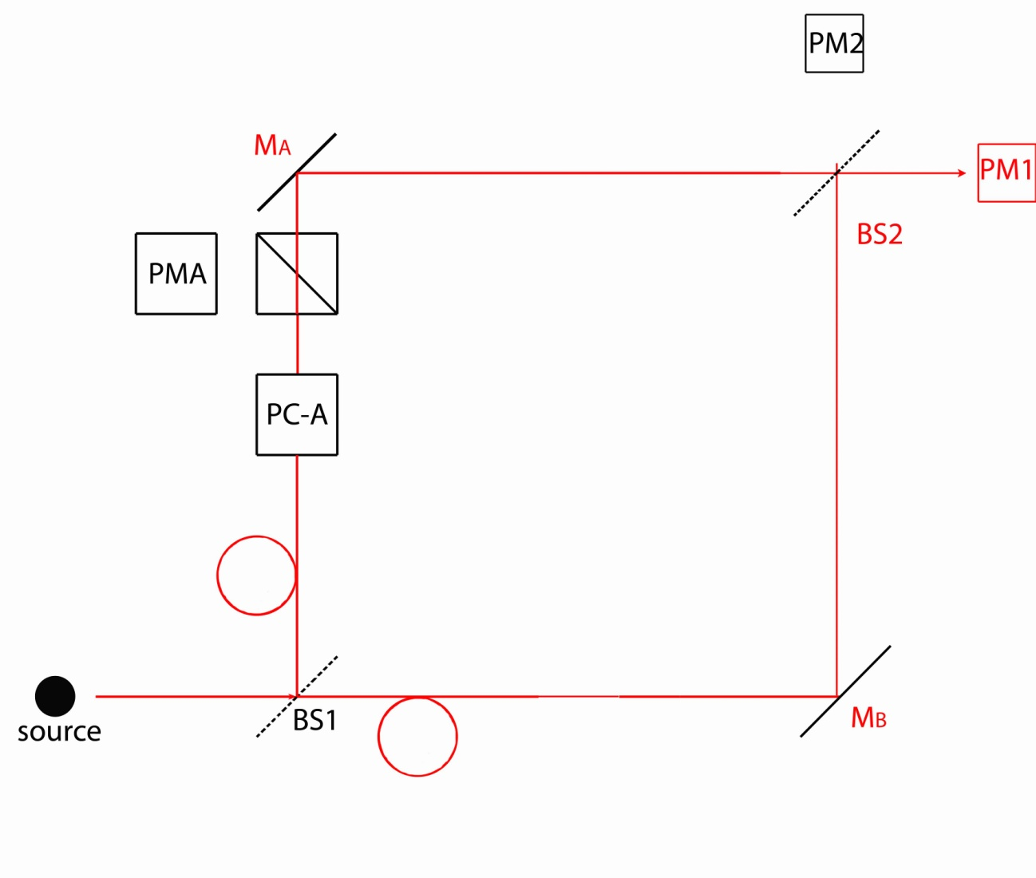
Experiment Three
When NO voltage is applied to PC-A, then both Paths A & B are possible.
Fix the mirrors so that photons are always detected in PM1
(Interference)

Slide 27
Experiment Three
No voltage applied to PC-A:
Both paths are possible and photon is detected in PM1 only.
TWO PATHS = INTERFERENCE
Voltage applied to PC-A:
If photon detected in PMA ←→ Photon took Path A
If photon detected in PM1 or PM2 ←→ Photon took Path B
ONE PATH = NO INTERFERENCE.

Slide 28
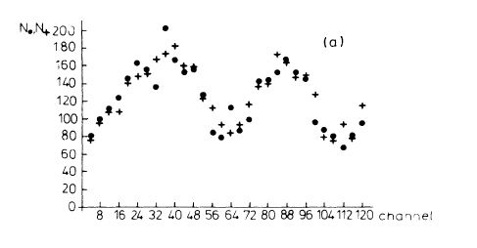
Experiment Three
Dots represent apparatus operating in “normal” mode
- no voltage applied to PC-A.
Crosses represent apparatus operating in “delayed-choice” mode
- photon enters apparatus with only one path open.
- photon should choose one path or the other at BS1
- paths are unblocked, and interference is still observed.

Slide 29
How to interpret this?
“The result of [the detection] must be either the whole
photon or nothing at all. Thus the photon must change
suddenly from being partly in one beam and partly in
the other to being entirely in one of the beams.”
P. A. M. Dirac, The Principles of Quantum Mechanics (1947).

Slide 30
Experiments One & Two & Three
Experiment One says photons behave like particles.
Experiment Two says photons behave like waves.
Experiment Three says photons do not behave like
particle and wave at the same time.

Slide 31
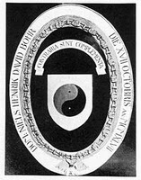
Complementarity
Sometimes photons behave like waves, and sometimes like particles, but never both at the same time.
According to Bohr, particle or wave are just classical concepts, used to describe the different behaviors of quanta under different circumstances.
Neither concept by itself can completely describe the behavior of quantum systems.
Contraria
sunt
Complementa
Latin for:
opposites
are
complements

Slide 32
Complementarity
Depending on the context, complementarity can refer to:
The mental picture we have of a physical system.
(particle vs. wave )
What an experiment can reveal.
(which-path vs. interference)
What quantum mechanics allows us to know.
(position vs. momentum)
Contraria
sunt
Complementa
Latin for:
opposites
are
complements

Slide 33
Complementarity
Complementarity applies to what are known as incompatible observables. Some examples from class so far are:
If we know the spin of an atom along one direction, its spin along other directions is indeterminate.
If we know which path a photon takes, we can’t observe its wave behavior.
Other Examples:
(from the readings, perhaps?)
Truth
vs.
Brevity

Slide 34
Classical Systems
For a classical system we can write down a list of all the characteristics of a physical system:
POSITION
LINEAR MOMENTUM
ANGULAR MOMENTUM
ENERGY
etc…
In principle, all of these quantities can be simultaneously measured with as much accuracy as we require.
Knowing these quantities initially allows us to predict these quantities at later times. [DETERMINISM]

Slide 35
Quantum Systems
For a quantum system we have to write down TWO lists:
A | B
PARTICLE WHICH-PATH POSITION | WAVE INTERFERENCE MOMENTUM
For every characteristic in List A, there is a corresponding characteristic in List B.
Knowing a lot about one means we know only a little about the other.

Slide 36
Quantum Systems
These are also incompatible observables, but in a slightly different way than those in the previous list:*
A | B
L_{Z} | L_{X}, L_{Y}
L_{Z} = angular momentum about the z-axis (think magnetic moments)
If we know L_{Z}, then angular momentum about any other direction is indeterminate.
*This incompatibility is a consequence of the more familiar
constraints placed on position and momentum
about which we’ll learn a lot more!

Slide 37
Quantum Systems
These are also incompatible observables, but in a slightly different way than those in the previous list:
A | B
ENERGY | TIME
Time is not a quality possessed by a physical system – it is a parameter in our equations. Here time refers to:
The time required to measure the energy of a system.
The lifetime of a state where there is uncertainty in the energy of that state (broadening of spectral lines).
The time over which the average properties of a system change significantly.

Slide 38
Wave/Particle Duality
We have discussed wave/particle duality for photons:
A single photon is detected at one point in space.
[PARTICLE]
When two paths are possible, each photon interferes with itself. [WAVE]
Is there something special about massless particles?
Do massive particles exhibit the same kind of behavior?
A) Yes B) No C) Maybe(?)

Slide 39
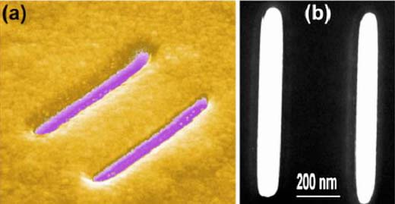
Electron Interference?
Images of a nanometer scale double-slit system created using gold foil and a focused ion beam (2008).
Slits are 83 nm wide and spaced 420 nm apart

Slide 40
Double-Slit Experiment with Single Electrons (1989)
http://www.hitachi.com/rd/research/em/doubleslit.html
A. Tonomura, J. Endo, T. Matsuda, T. Kawasaki and H. Ezawa,
"Demonstration of Single-Electron Buildup of an Interference Pattern,“
Amer. J. Phys. 57, 117 (1989).

Slide 41
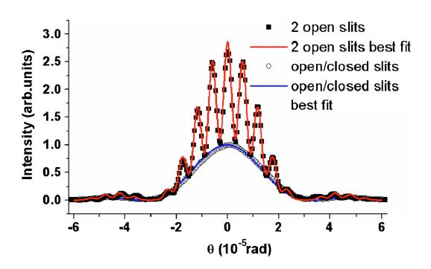
Electron Interference

Slide 42
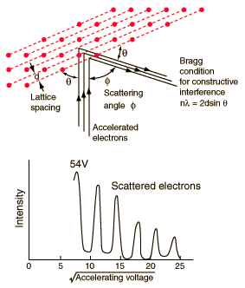
Davisson-Germer Experiment (1924)
Electrons scatter off nickel atoms in a crystal lattice
Each atom in the lattice acts like a source of scattered electrons
Electrons behave like in the double-slit experiment, but with many slits instead of two.

Slide 43
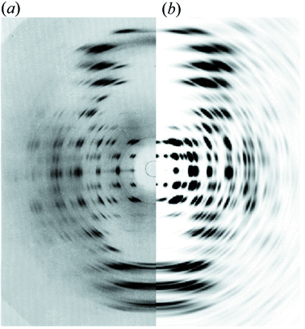
X-Ray Diffraction
DNA!! (Crick, 1952)
represents actual measurement
represents theoretical prediction for a double-helix
???

Slide 44
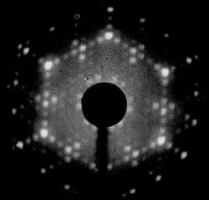
Low Energy Electron Diffraction (LEED)
LEED image of a silicon crystal

Slide 45
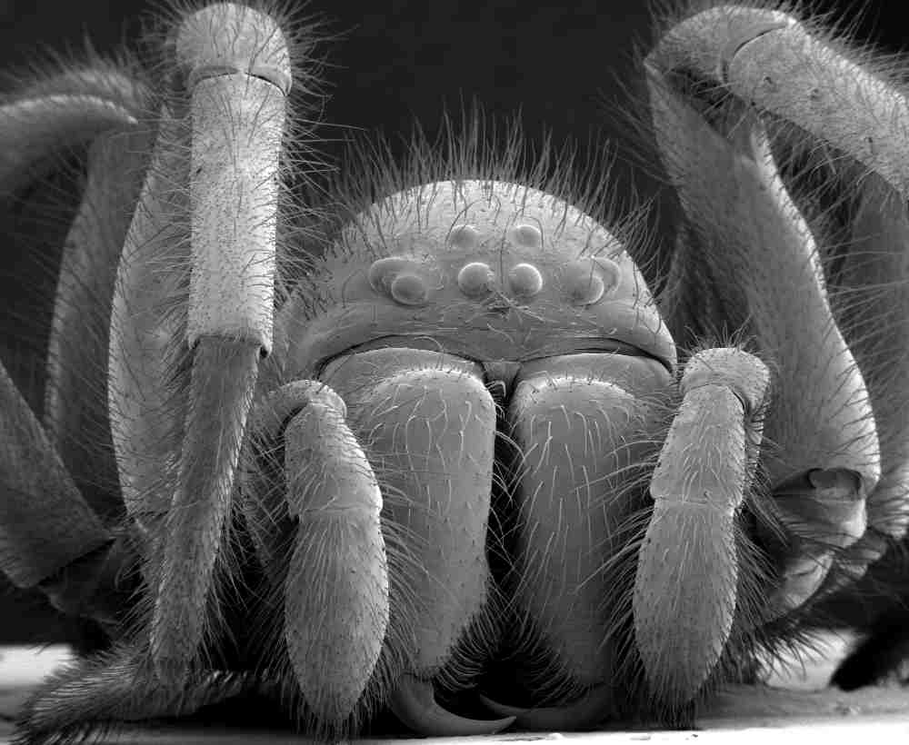
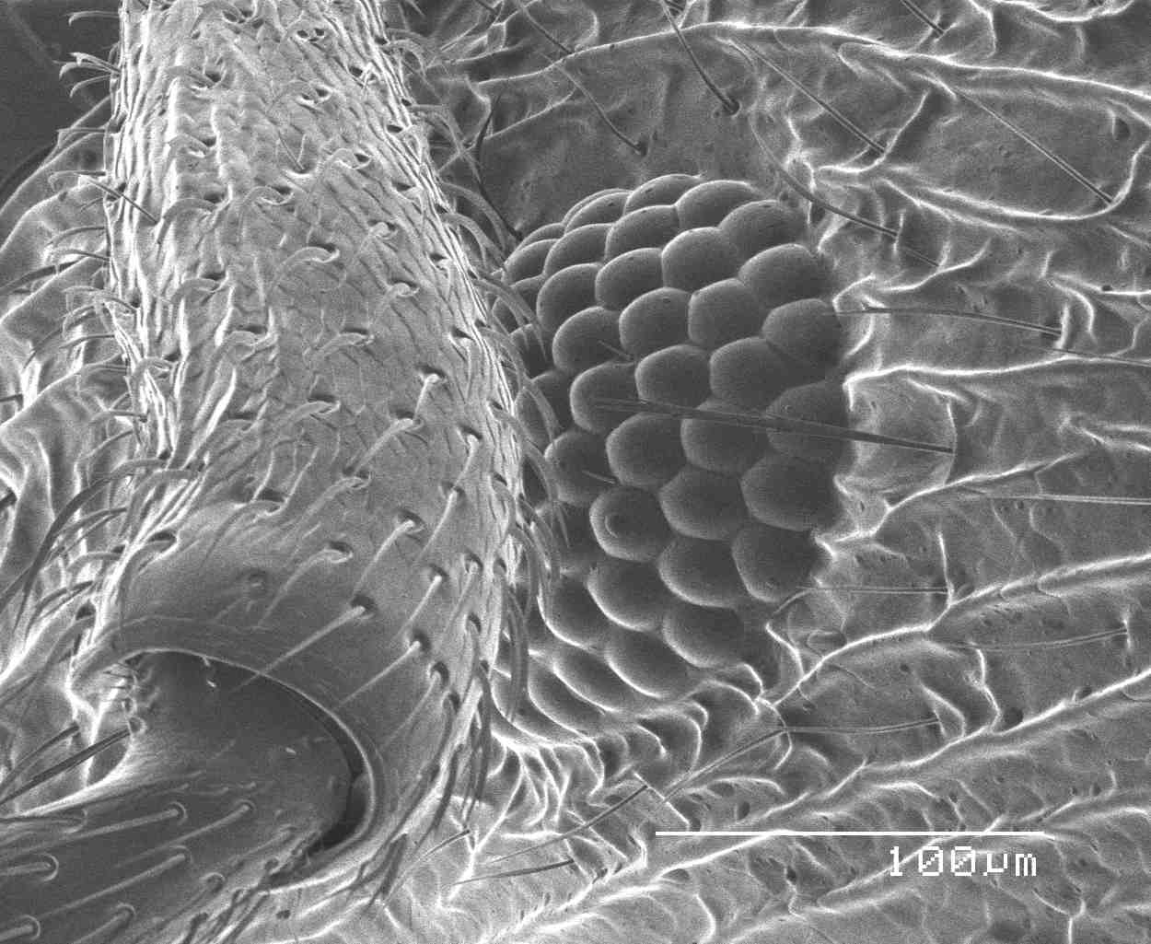
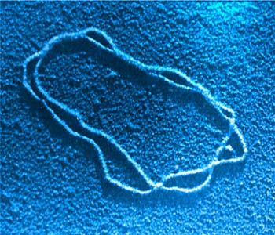
Electron Microscopy
Use electron waves just like light waves:
Ant’s Eye
Tiny Spider
DNA Molecule

Slide 46
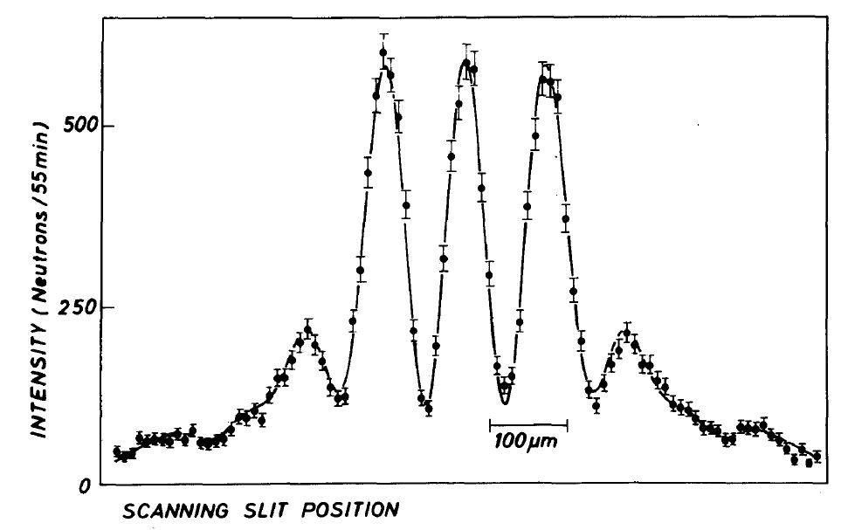
Neutron Interference

Slide 47
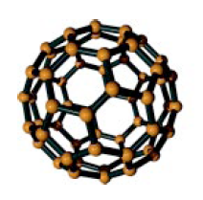
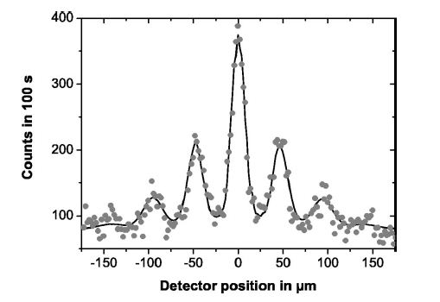
C-60 Interference

Slide 48
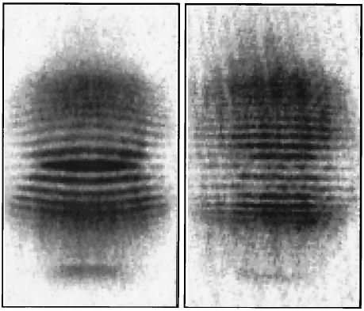
BEC Interference

