Slide 1
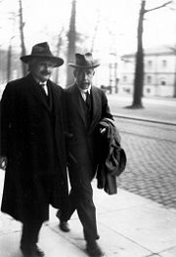
Matter-Waves and Electron Diffraction
“The most incomprehensible thing about the world is that it is comprehensible.”
– Albert Einstein
Day 18, 3/31:
Questions?
Electron Diffraction
Wave packets and uncertainty
Next Week:
Schrodinger equation
The Wave Function
Exam 2 (Thursday)

Slide 2
Exam II is next Thursday 3/31, in class.
HW09 will be due Wednesday (3/30) by 5pm in my mailbox.
HW09 solutions posted at 5pm on Wednesday
Recently:
  Single-photon experiments
  Complementarity and wave-particle duality
  Matter-Wave Interference
Today:
  Electron diffraction and matter waves
  Wave packets and uncertainty

Slide 3
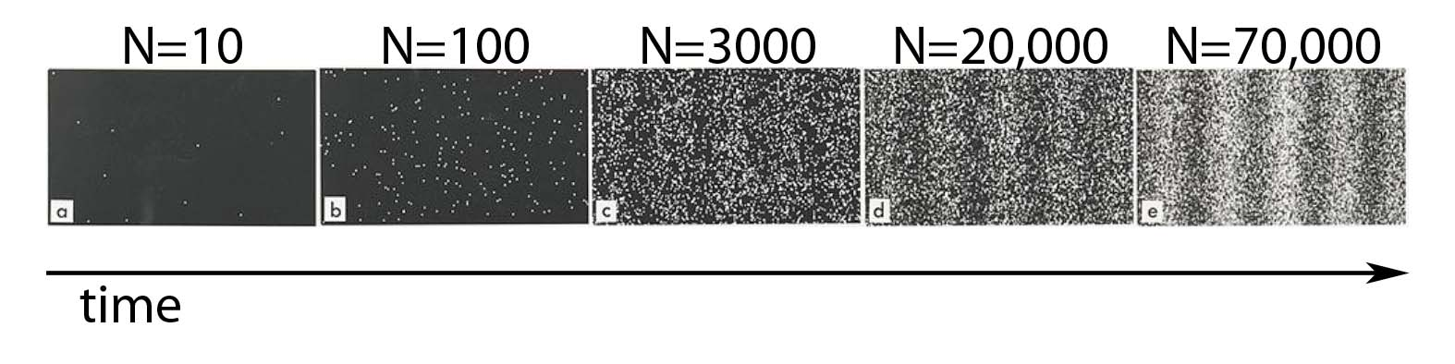
Double-Slit Experiment
Pass a beam of electrons through a double-slit apparatus.
Individual electrons are detected as points on the screen.
Over time, a fringe pattern of dark and light bands appears.

Slide 4

Double-Slit Experiment with Single Electrons (1989)
http://www.hitachi.com/rd/research/em/doubleslit.html
A. Tonomura, J. Endo, T. Matsuda, T. Kawasaki and H. Ezawa,
"Demonstration of Single-Electron Buildup of an Interference Pattern,“
Amer. J. Phys. 57, 117 (1989).

Slide 5
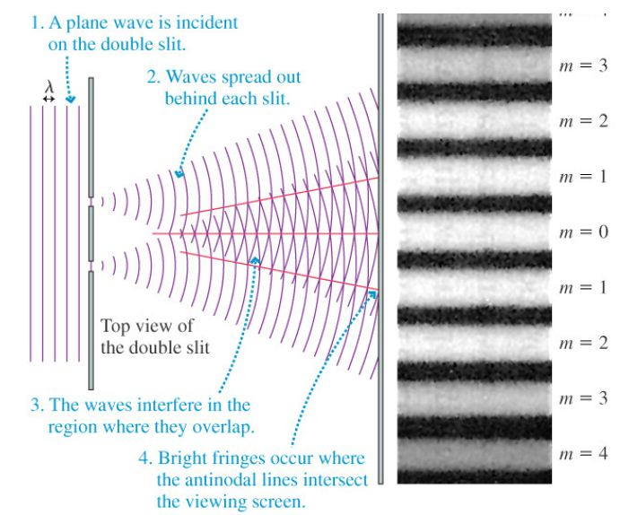

Slide 6
Double-Slit Experiment with Light
Recall solution for Electric field (E)
from the wave equation:
Let’s forget about the time-dependence for now:
Euler’s Formula says:
For convenience, write:

Slide 7
Double-Slit Experiment with Electrons
Before Slits
After Slits
&

Slide 8
Double-Slit Experiment

Slide 9
Double-Slit Experiment
How do we connect this with what we observe?

Slide 10
Double-Slit Experiment
INTERFERENCE!
In quantum mechanics, we add the individual amplitudes and
square the sum to get the total probability
In classical physics, we added the individual probabilities to get
the total probability.

Slide 11
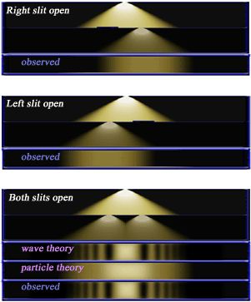

Slide 12
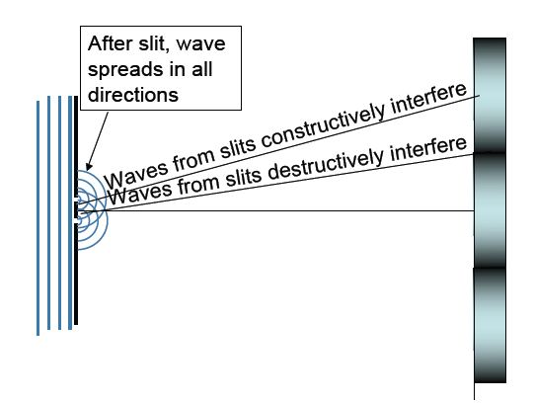
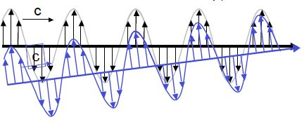
Double-Slit Experiment

Slide 13
Determining the spacing between the slits:

Slide 14
Spacing between bright fringes

Slide 15
Distance to first maximum for visible light:
Let , ,
If , then

Slide 16
Double-Slit Experiment
For a specific λ, describes where we find
the interference maxima and minima
of the fringe pattern.
What is the wavelength of an electron?

Slide 17
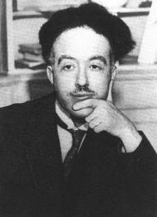
Matter Waves
As a doctoral student (1923), Louis de Broglie proposed
that electrons might also behave like waves.
  Light, often thought of as a wave, had been shown to have particle-like properties.
  For photons, we know how to relate momentum to wavelength:
From the photoelectric effect:
From special relativity:
Combined:

Slide 18
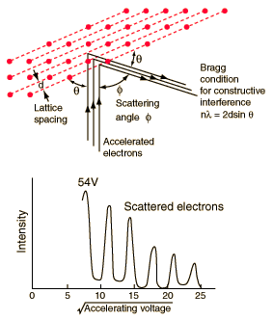
Matter Waves
de Broglie wavelength:
Confirmed experimentally by
Davisson and Germer (1924).

Slide 19
Matter Waves
de Broglie wavelength:
In order to observe electron interference, it would be best to perform a double-slit experiment with:
Lower energy electron beam.
Higher energy electron beam.
It doesn’t make any difference.

Slide 20
Matter Waves
de Broglie wavelength:
In order to observe electron interference, it would be best to perform a double-slit experiment with:
Lower energy electron beam.
Higher energy electron beam.
It doesn’t make any difference.
Lowering the energy will increase the wavelength of the electron.
Can typically make electron beams with energies from 25 – 1000 eV.

Slide 21
Matter Waves
de Broglie wavelength:
For an electron beam of 25 eV, we expect Θ (the angle between
the center and the first maximum) to be:
Θ << 1
Θ < 1
Θ > 1
Θ >> 1
Use
and remember:
&

Slide 22
Matter Waves
de Broglie wavelength:
For an electron beam of 25 eV:

Slide 23
Matter Waves
de Broglie wavelength:
For an electron beam of 25 eV:
for
Too small to easily see!

Slide 24
Matter Waves
de Broglie wavelength:
For an electron beam of 25 eV, how can we make the diffraction pattern more visible?
Make D much smaller.
Decrease energy of electron beam.
Make D much bigger.
A & B
B & C

Slide 25
Matter Waves
de Broglie wavelength:
For an electron beam of 25 eV, how can we make the diffraction pattern more visible?
Make D much smaller.
Decrease energy of electron beam.
Make D much bigger.
A & B
B & C
25 eV is a lower bound on the energy of a decent electron beam.
Decreasing the distance between the slits will increase Θ.

Slide 26
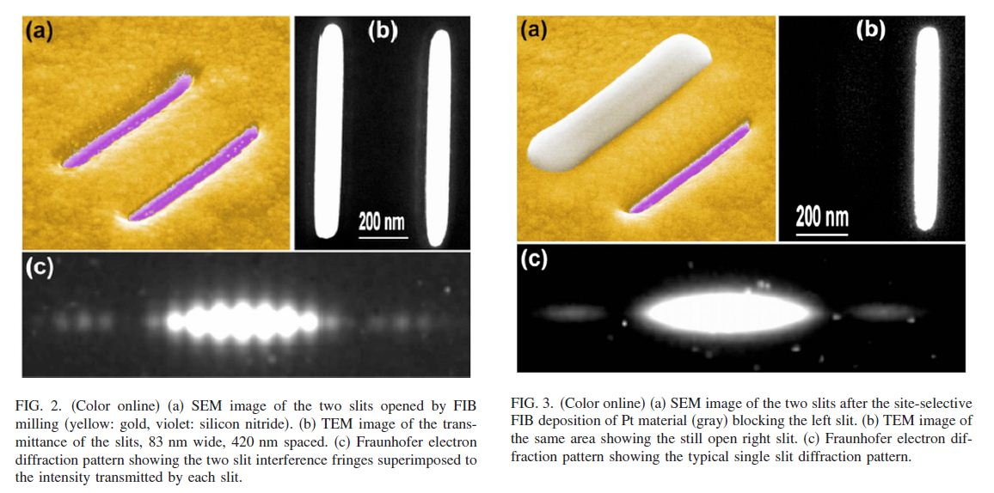
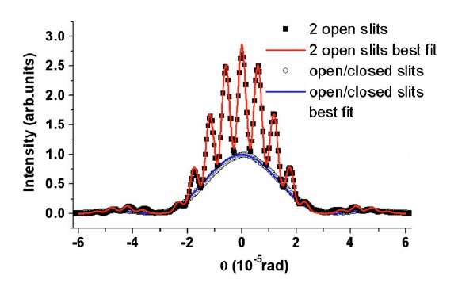
S. Frabboni, G. C. Gazzadi, and G. Pozzi, Nanofabrication and the realization of Feynman’s two-slit experiment, Applied Physics Letters 93, 073108 (2008).
Slits are 83 nm wide and
spaced 420 nm apart

Slide 27
If we were to use protons instead of electrons,
but traveling at the same speed, what happens to the distance to the first maximum, H?
Increases
Stays the same
Decreases

Slide 28
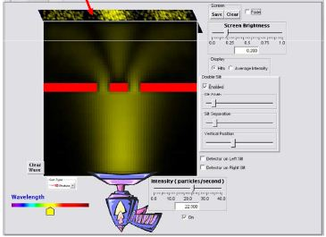
Which slit did this electron go through?
Left
Right
Both
Neither
Either left or right, we just can’t know which one.

Slide 29
Each electron passes through both slits, interferes with itself, then becomes localized when detected.
For a low-intensity beam, can have as little as one electron in the apparatus at a time.
Each electron must interfere with itself
Each electron is “aware” of both paths.
Asking which slit the electron went through disrupts the fringe pattern.

Slide 30
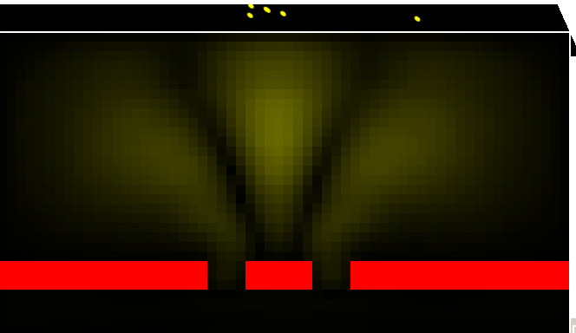
Light Waves
High Amplitude
Screen
Low Amplitude
Describe photon’s EM wave spread out in space.

Slide 31
Light Waves
E-field x-section at screen
x
ρ(x) =probability density
Photons

Slide 32
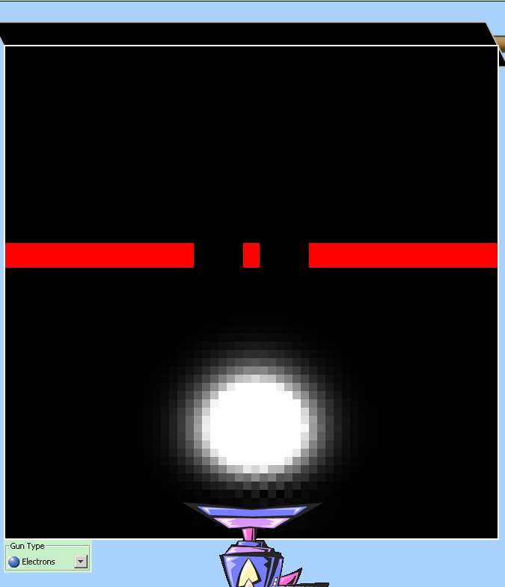
Follow same prescription for matter waves:
  Describe massive particles with wave functions:
  Interpret (wave amplitude)² as a probability density:
Electron double slit experiment.
Display=Magnitude of wave function
Large Magnitude (|Ψ|)=
probability of detecting electron here is high
Small Magnitude (|Ψ|)=
probability of detecting electron here is low

Slide 33
What are these waves?
EM Waves (light/photons)
Amplitude = electric field
tells you the probability of detecting a photon.
Maxwell’s Equations:
Solutions are sine/cosine waves:
Matter Waves (electrons/etc)
Amplitude = matter field
tells you the probability of detecting a particle.
Schrödinger Equation:
Solutions are complex sine/cosine waves:

Slide 34
Matter Waves
Describe a particle with a wave function.
Wave does not describe the path of the particle.
Wave function contains information about the probability to find a particle at x, y, z & t.
In general:
-L
L
x
Simplified:
&

Slide 35
Matter Waves
-L
Wavefunction
L
x
Probability Density
-L
L
x
Probability of finding particle
in the interval dx is
Normalized wave functions

Slide 36
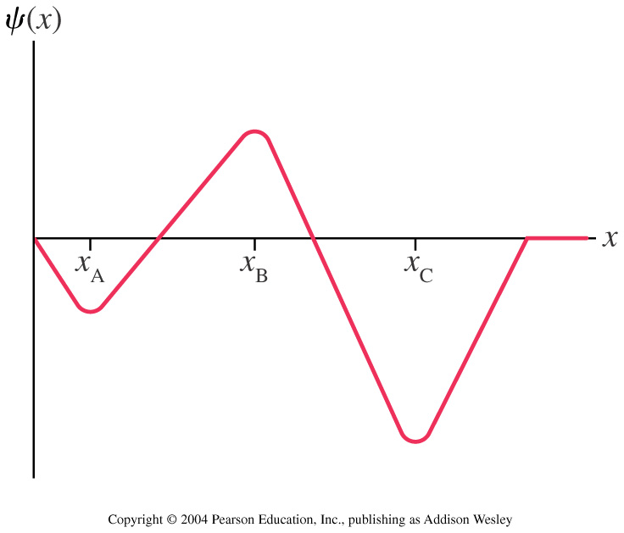
Matter Waves
Below is a wave function for a neutron. At what value of x
is the neutron most likely to be found?
A) X_{A} B) X_{B} C) X_{C} D) There is no one most likely place

Slide 37
An electron is described by the following wave function:
a
b
c
d
dx
x
L
How do the probabilities of finding the electron near (within dx) of a,b,c, and d compare?
d > c > b > a
a = b = c = d
d > b > a > c
a > d > b > c

Slide 38
An electron is described by the following wave function:
α
a
b
c
d
dx
x
L
How do the probabilities of finding the electron near (within dx) of a,b,c, and d compare?
d > c > b > a
a = b = c = d
d > b > a > c
a > d > b > c

Slide 39
Plane Waves
Plane waves (sines, cosines, complex exponentials)
extend forever in space:
Different k’s correspond to different energies, since

Slide 40
Superposition
If and are solutions to a wave equation,
then so is
Superposition (linear combination) of two waves
We can construct a “wave packet” by combining many
plane waves of different energies (different k’s).

Slide 41
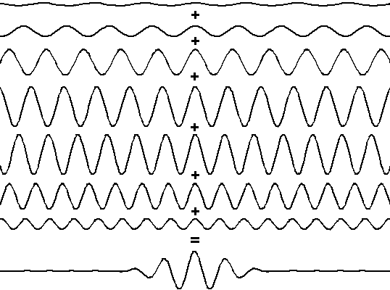
Superposition

Slide 42

Plane Waves vs. Wave Packets
Which one looks more like a particle?

Slide 43
Plane Waves vs. Wave Packets
For which type of wave are the position (x) and momentum (p) most well-defined?
x most well-defined for plane wave, p most well-defined for wave packet.
p most well-defined for plane wave, x most well-defined for wave packet.
p most well-defined for plane wave, x equally well-defined for both.
x most well-defined for wave packet, p equally well-defined for both.
p and x are equally well-defined for both.

Slide 44
Uncertainty Principle
Δx
small Δp – only one wavelength
Δx
medium Δp – wave packet made of several waves
Δx
large Δp – wave packet made of lots of waves

Slide 45
Uncertainty Principle
In math:
In words:
The position and momentum of a particle
cannot both be determined with complete precision. The more precisely one is determined, the less precisely the other is determined.
What do (uncertainty in position) and
(uncertainty in momentum) mean?

Slide 46
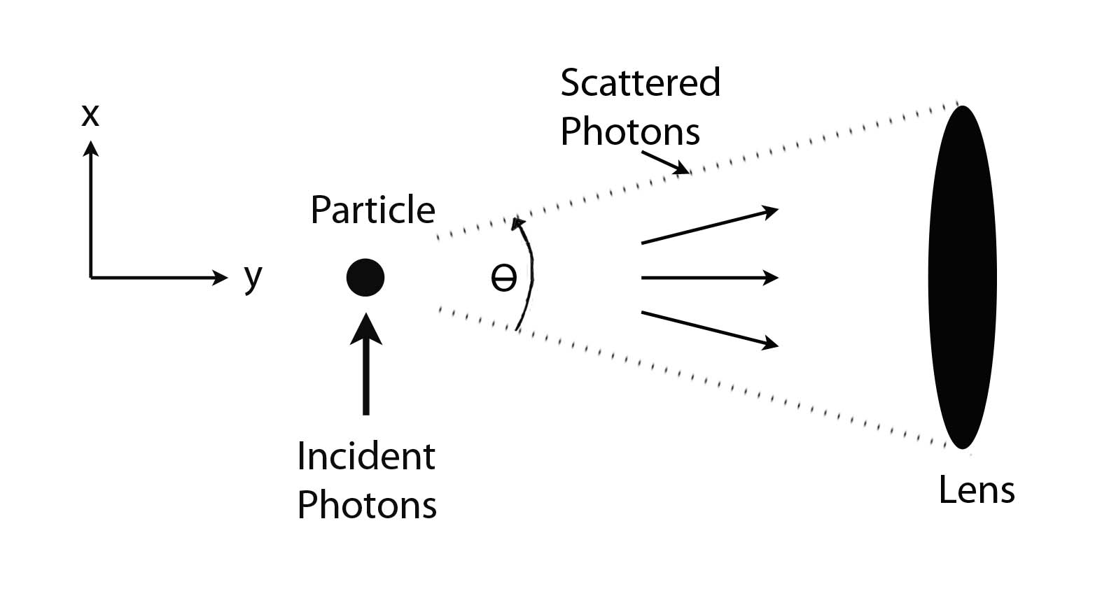
Uncertainty Principle
A Realist
Interpretation:
Photons are scattered by localized particles.
Due to the lens’ resolving power:
Due to the size of the lens:

Slide 47
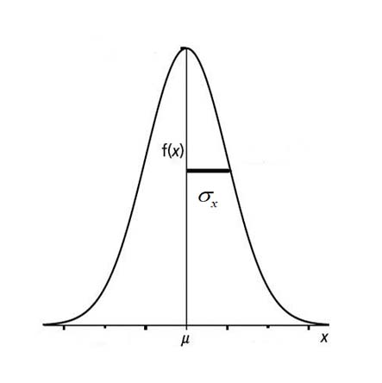
Uncertainty Principle
A Statistical
Interpretation:
Measurements are performed on an ensemble of similarly prepared systems.
Distributions of position and momentum values are obtained.
Uncertainties in position and momentum are defined in terms of the standard deviation.

Slide 48
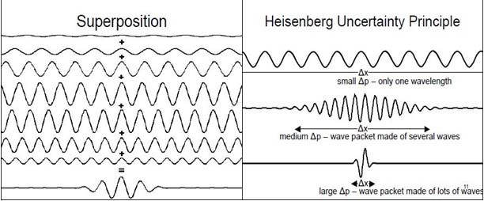
Uncertainty Principle
A Wave
Interpretation:
Wave packets are constructed from a series of plane waves.
The more spatially localized the wave packet, the less uncertainty in position.
With less uncertainty in position comes a greater uncertainty in momentum.

Slide 49
Matter Waves (Summary)
Electrons and other particles have wave properties
(interference)
When not being observed, electrons are spread out in space
(delocalized waves)
When being observed, electrons are found in one place
(localized particles)
Particles are described by wave functions:
(probabilistic, not deterministic)
Physically, what we measure is
(probability density for finding a particle in a particular place at a particular time)
Simultaneous measurements of x & p are constrained by the
Uncertainty Principle:

