Slide 1

PH300 Modern Physics SP11
“It doesn't matter how beautiful your theory is; it doesn't matter how smart you are. If it doesn't agree with experiment, it's wrong.”
– Richard Feynman
Day 19, 3/29:
Questions?
Matter Waves and Measurement
Review for Exam 2
Thursday:
Exam 2 (in class)

Slide 2
Exam 2 is this Thursday, 3/31, in class.
HW09 will be due Wednesday (3/30) by 5pm in my mailbox.
HW09 solutions posted at 5pm on Wednesday
Recently:
  Electron diffraction and matter waves
  Wave packets and uncertainty
Today:
  Finish matter waves/wave function
  Review for Exam 2

Slide 3
Superposition
If and are solutions to a wave equation,
then so is
Superposition (linear combination) of two waves
We can construct a “wave packet” by combining many
plane waves of different energies (different k’s).

Slide 4
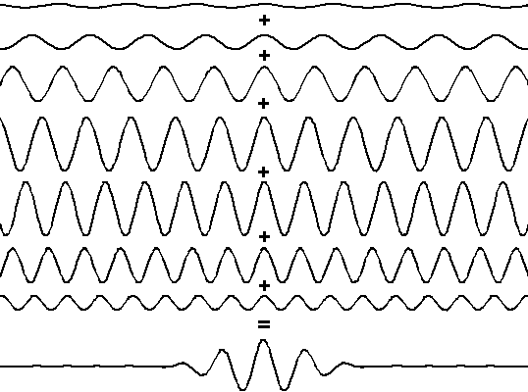
Superposition

Slide 5

Plane Waves vs. Wave Packets
Which one looks more like a particle?

Slide 6
Plane Waves vs. Wave Packets
For which type of wave are the position (x) and momentum (p) most well-defined?
x most well-defined for plane wave, p most well-defined for wave packet.
p most well-defined for plane wave, x most well-defined for wave packet.
p most well-defined for plane wave, x equally well-defined for both.
x most well-defined for wave packet, p equally well-defined for both.
p and x are equally well-defined for both.

Slide 7
Uncertainty Principle
Δx
small Δp – only one wavelength
Δx
medium Δp – wave packet made of several waves
Δx
large Δp – wave packet made of lots of waves

Slide 8
Uncertainty Principle
In math:
In words:
The position and momentum of a particle
cannot both be determined with complete precision. The more precisely one is determined, the less precisely the other is determined.
What do (uncertainty in position) and
(uncertainty in momentum) mean?

Slide 9
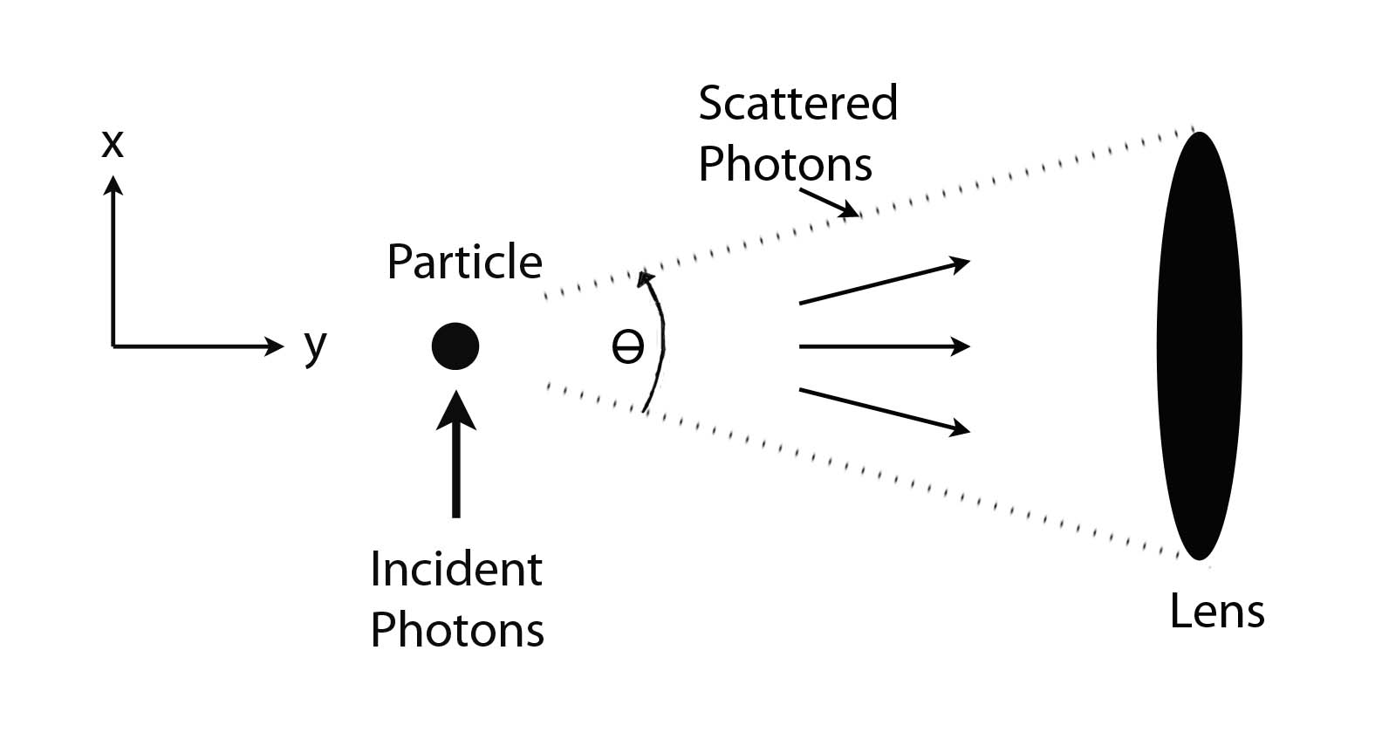
Uncertainty Principle
A Realist
Interpretation:
Photons are scattered by localized particles.
Due to the lens’ resolving power:
Due to the size of the lens:

Slide 10
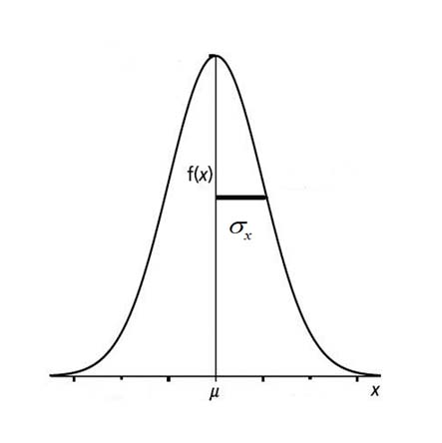
Uncertainty Principle
A Statistical
Interpretation:
Measurements are performed on an ensemble of similarly prepared systems.
Distributions of position and momentum values are obtained.
Uncertainties in position and momentum are defined in terms of the standard deviation.

Slide 11
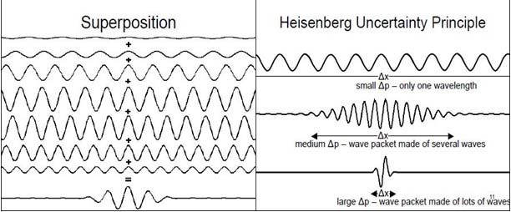
Uncertainty Principle
A Wave
Interpretation:
Wave packets are constructed from a series of plane waves.
The more spatially localized the wave packet, the less uncertainty in position.
With less uncertainty in position comes a greater uncertainty in momentum.

Slide 12
Matter Waves (Summary)
Electrons and other particles have wave properties
(interference)
When not being observed, electrons are spread out in space
(delocalized waves)
When being observed, electrons are found in one place
(localized particles)
Particles are described by wave functions:
(probabilistic, not deterministic)
Physically, what we measure is
(probability density for finding a particle in a particular place at a particular time)
Simultaneous knowledge of x & p are constrained by the
Uncertainty Principle:

Slide 13
PE summary:
http://phet.colorado.edu/simulations/photoelectric/photoelectric.jnlp
Current responds instantaneously to light on/off
→ Not just a heating effect!
Color matters: Below a certain frequency: No electrons
→ Not just a heating effect!
Positive voltage does not increase the current (remember the 'pool analogy')
Negative voltages do decrease current
→ Stopping voltage is equal to initial kinetic energy!
Initial kinetic energy depends on color of the light.
Current is proportional to the light intensity.

Slide 14


Summary PE effect:
2. Current vs. f:
1. Current vs. Voltage:
high intensity
I
I
low intensity
0 U
0 Frequency
3. Current vs. intensity:
or: Initial KE vs. f:
I
Initial KE
0 Intensity
0 Frequency

Slide 15
Summary of what we know so far:
If light can kick out electron, then even smallest intensities of that light will continue to kick out electrons. KE of electrons does not depend on intensity.
2. Lower frequencies of light means lower initial KE of electrons
& KE changes linearly with frequency.
3. Minimum frequency below which light won’t kick out electrons.
(Einstein) Need “photon” picture of light to explain observations:
- Light comes in chunks (“particle-like”) of energy (“photon”)
- a photon interacts only with single electron
- Photon energy depends on frequency of light …
for lower frequencies, photon energy not enough to free an electron

Slide 16
individual atoms vs. atoms bound in solids
Individual atom:
Solid metal: ~10²³ atoms per cm³
Specific, discrete energy levels
Highest energy electrons are in a “band” of energy levels: Lots and lots of energy levels spaced really close together
(a continuum of levels)
Energy
Energy
Inside
metal
Outside metal

Slide 17
Metal A
Metal B
E_{phot}
E_{phot}
Energy
Inside
metal
Outside metal
Inside
metal
Outside metal
In each case, the blue photon ejects the red electron. Consider the following statements:
I. The work functions are the same in both cases.
II. The KE of the ejected electrons are the same in both cases.
A. I=True, II=True
B. I=True, II=False
C. I=False, II=True
D. I=False, II=False

Slide 18
Metal A
Metal B
E_{phot}
E_{phot}
work function Φ
work function Φ
Energy
Most loosely
bound e
Inside
metal
Outside metal
Inside
metal
Outside metal
In each case, the blue photon ejects the red electron. Consider the following statements:
I. The work functions are the same in both cases.
II. The KE of the ejected electrons are the same in both cases.
A. I=True, II=True
B. I=True, II=False
C. I=False, II=True
D. I=False, II=False
Work function = amount of energy needed to kick out most loosely bound electron out of the metal.

Slide 19
Metal A
Metal B
E_{phot}
E_{phot}
work function Φ
work function Φ
Energy
Most loosely
bound e
Inside
metal
Outside metal
Inside
metal
Outside metal
In each case, the blue photon ejects the red electron. Consider the following statements:
I. The work functions are the same in both cases.
II. The KE of the ejected electrons are the same in both cases.
A. I=True, II=True
B. I=True, II=False
C. I=False, II=True
D. I=False, II=False
Conservation of energy
KE of ejected = Photon – Energy needed
electron energy to extract electron from metal.

Slide 20
E=hc/λ…
…is true for both photons and electrons.
…is true for photons but not electrons.
…is true for electrons but not photons.
…is not true for photons or electrons.
E = hf is always true but f = c/λ only applies to light, so E = hf ≠ hc/λ for electrons.
c = speed of light!

Slide 21
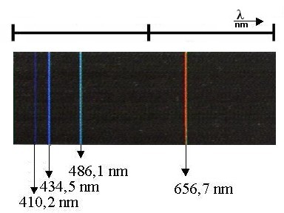
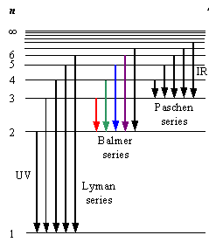
Balmer had a mathematical formula to describe hydrogen spectrum, but no mechanism for why it worked.
Hydrogen energy levels
Balmer’s formula
410.3
486.1
656.3 nm
434.0
where m=1,2,3
and where n = m+1, m+2
m=1, n=2

Slide 22
Hydrogen atom- Balmer series
410.3
486.1
656.3 nm
434.0
Balmer (1885) noticed wavelengths followed a progression
where n = 3,4,5, 6, ….
As n gets larger, what happens to wavelengths of emitted light?
  a. gets larger and larger without limit
  b. gets larger and larger, but approaches a limit
  c. gets smaller and smaller without limit
  d. get smaller and smaller, but approaches a limit

Slide 23
If electron going around in little orbits, important implications from
classical physics
v
Basic connections between
r, v, and energy!
-
F_{cent}
F = ma= F_{cent} = ?
(quick memory check)
a) -mv
b) -mv²/r
c) -v²/r²
d) -mvr
e) don’t remember learning anything related to this
r
+
Ans b) F_{cent} = -mv²/r
Equate to Coulomb force, = kq₊ q₋/r²,
mv²/r =ke²/r²
mv² = ke²/r

Slide 24
If calculate angular momentum of atom L = mvr,
for orbit, get L=nh/2π.
Angular momentum only comes in units of h/2π = ħ
( “quantized” in units of “h-bar” )
Bohr Model:
Success! What it can do:
predict energy levels fairly precisely (although not fine splittings discovered short time later) for any one electron atom.
Problems: It cannot:
explain anything about jumps between levels, atomic lifetimes, why some transitions stronger than others, atoms with multiple electrons.

Slide 25
Compare the energy of the photon given off when the electron goes from the n=2 level of H to the ground level (n=1) with the energy difference between the n=4 level and the n=2 level.
E₂₋₁/E₄₋₂ = ????
a. 2, b. 4 c. ½, d. ¼ , e. 3/16
E₄
E₃
E₂
E₁

Slide 26
5ev
3ev
2ev
Photon energy
0
100
200
300
400
500
600
700
800 nm
What energy levels for electrons are consistent with this spectrum for “Finkelnolium”?
Electron Energy levels:
A
B
C
D
E
0eV
0eV
0eV
0eV
-2eV
-2eV
-3eV
5eV
-5eV
-5eV
-5eV
-5eV
-7eV
3eV
-7eV
2eV
-8eV
0eV
-10eV
-10eV
Notes:
A: 17
B: 15
C: 40
D: 12
E: 17
172 responses

Slide 27
Electron energy levels = PE + KE
Since PE = 0 at infinity (e.g. electron escaping from atom).
A positive total energy would mean that KE>PE and electron would leave atom!
5ev
3ev
2ev
Photon energy
0
100
200
300
400
500
600
700
800
900
1000 nm
What energy levels for electrons are consistent with this spectrum for “Finkelnolium”?
At 0eV, electron has escaped atom. (So no transitions from 0 eV back down)
Electron Energy levels:
A
B
C
D
E
0eV
0eV
0eV
0eV
-2eV
-2eV
-3eV
5eV
-5eV
-5eV
-5eV
-5eV
-7eV
3eV
-7eV
2eV
-8eV
0eV
-10eV
-10eV

Slide 28
In discharge lamps, one electron bashes into an atom.
10 V
-2 eV
1
-3 eV
2
3
-6 eV
-10eV
If atoms fixed at these points in tube,
what will you see from each atom?
A. All atoms will emit the same colors.
B. Atom 1 will emit more colors than 2 which will emit more colors than 3
C. Atom 3 will emit more colors than 2 which will emit more colors than 1
D. Atom 3 will emit more colors than 2. Atom 1 will emit no colors.
E. Impossible to tell.
Notes:
A: 0
B: 1
C: 16
D: 80
E: 3
176 responses

Slide 29
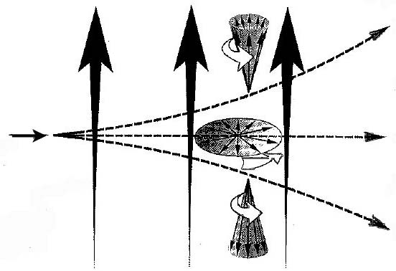
Magnetic Moment in a Non-Uniform Magnetic Field
Projection
large, positive
small, positive
Atom
injected
zero
small, negative
Non-uniform
magnetic field
lines
large, negative
Deflection
Notes:
We could form a beam of atoms by boiling them off from an oven and collimating the beam. The spin of each atom would point in some random direction (some straight up, some straight down, most somewhere in between). The projection remains constant, and so some would experience a maximum deflection, but most somewhere in between.

Slide 30
Key Ideas/Concepts
Classically, we expect:
Magnetic moments are deflected in a non-uniform magnetic field
Magnetic moments precess in the presence of a magnetic field, and the projection of the magnetic moment along the field axis remains constant.
If the magnetic moment vectors are randomly oriented, then we should see a broadening of the particle beam

Slide 31
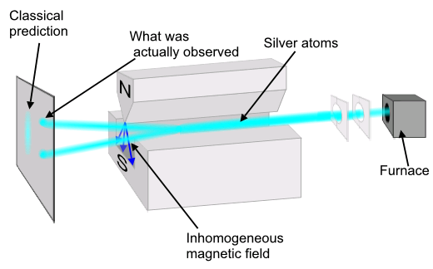
Stern-Gerlach Experiment with Silver Atoms (1922)*
*Nobel Prize for Stern in 1943
Notes:
What is actually observed is that all atoms experience the maximum deflection, either up or down along the direction of the magnetic field, no matter the orientation of the apparatus. The value of the projection along any axis is found to always be an integer multiple of the Bohr magneton, m_{B} = 9.27 x 10⁻²⁴ joule/tesla (e.g. for silver, the observed values are +m_{B} and –m_{B}; for nitrogen they are +3m_{B}, +m_{B}, -m_{B}, and -3m_{B}). Simplest case with a two-state system like silver atoms, as were used in the original Stern-Gerlach experiment; will speak from here on out only in terms of “atoms” having spin “plus” (+m_{B}) or “minus” (-m_{B}) along any given axis.

Slide 32
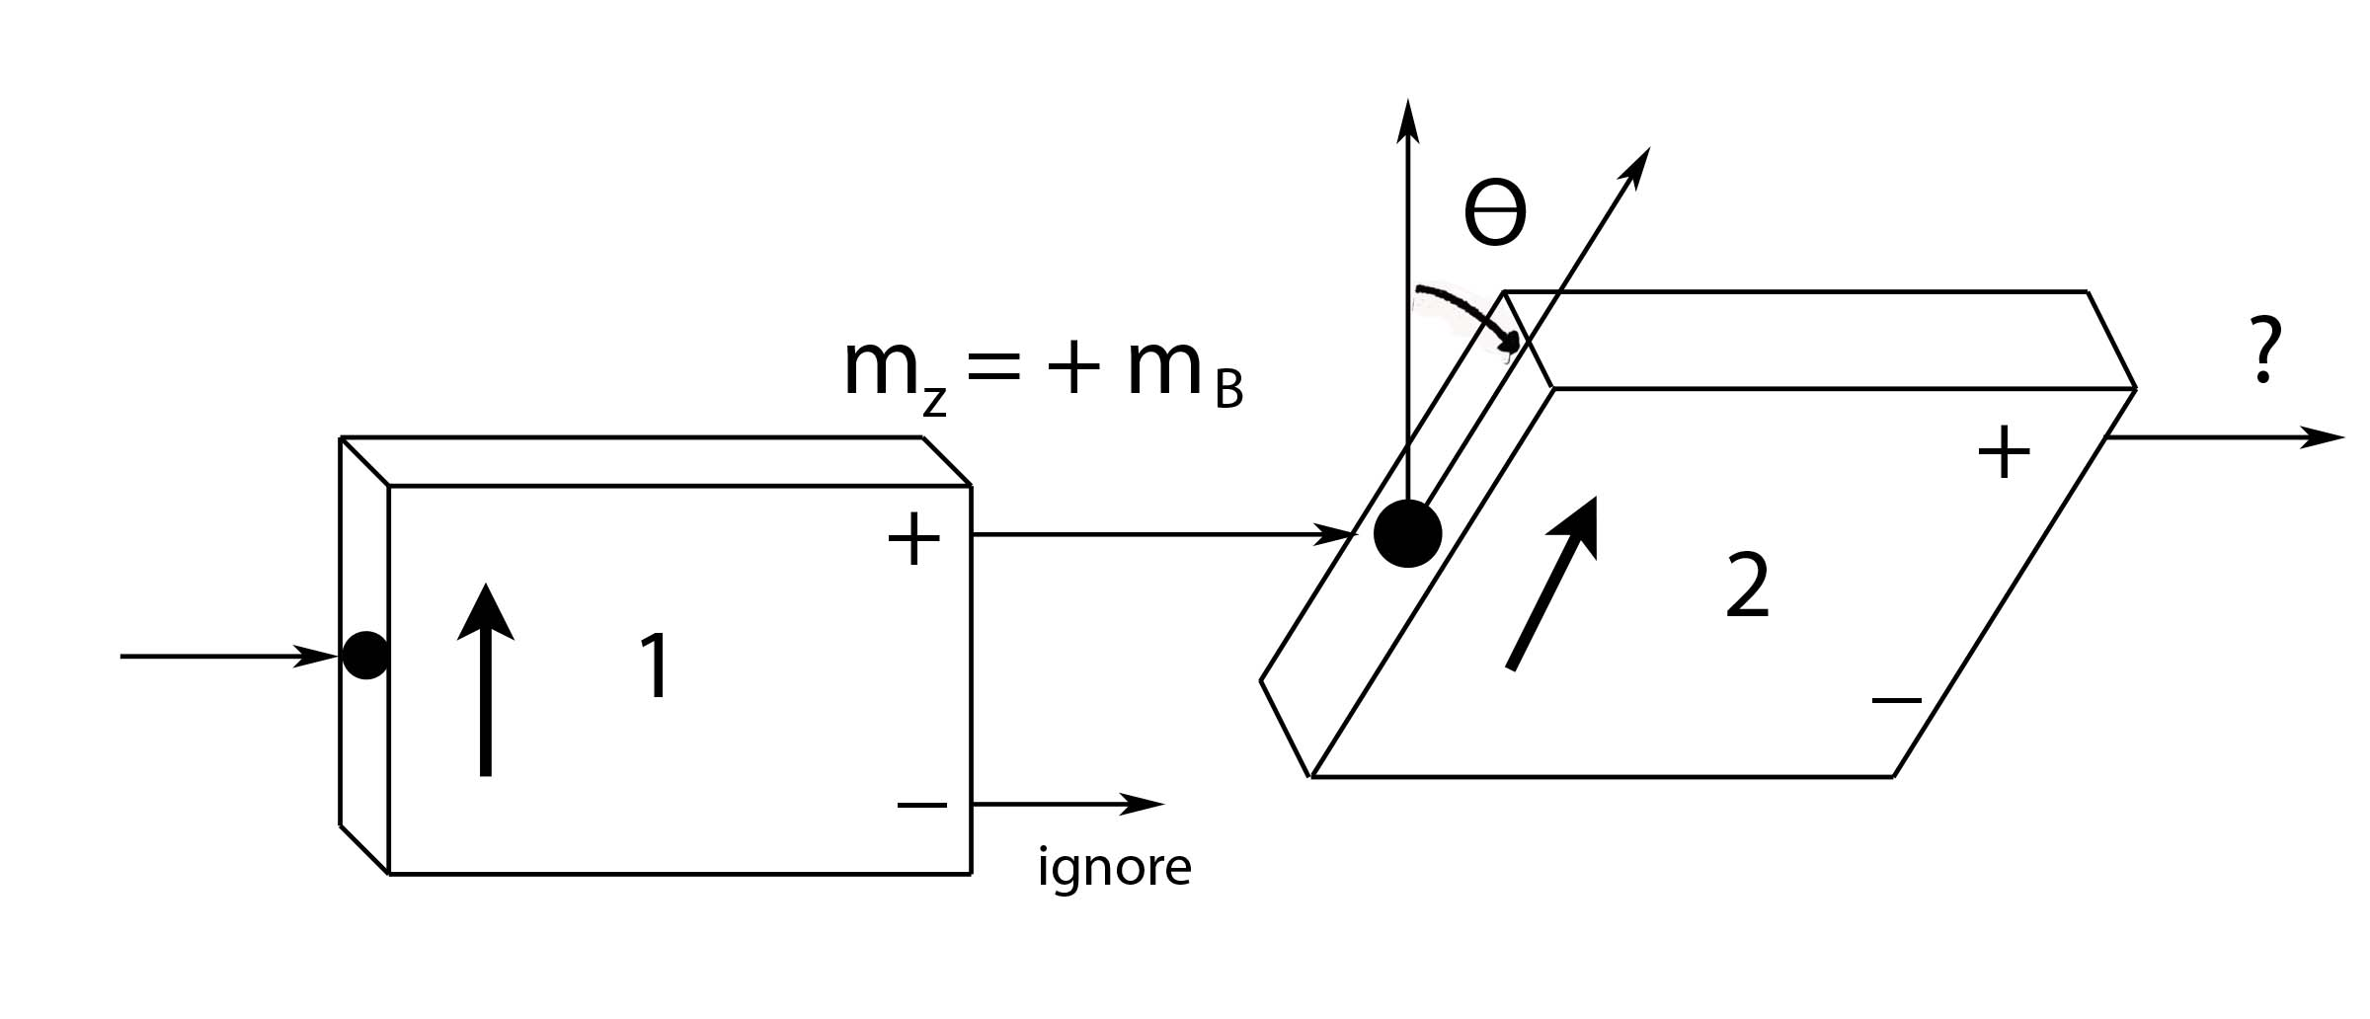
Analyzer 2 is oriented at an angle Θ:
Ignore the atoms exiting from the minus-channel of Analyzer 1,
and feed the atoms exiting from the plus-channel into Analyzer 2.
What is the probability for an atom to exit from the plus-channel
of Analyzer 2?

Slide 33
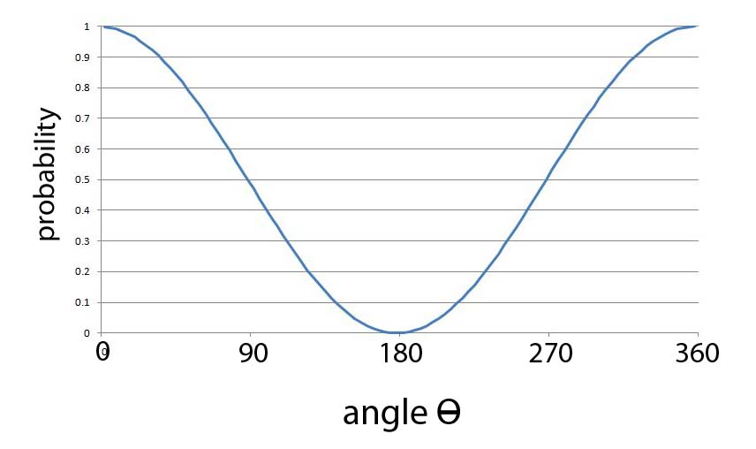
For atoms entering in the state
X
X
X
For Θ = 0, 100% of the atoms exit from the plus-channel.
For Θ = 90⁰, 50% of the atoms exit from the plus-channel.
For Θ = 180⁰, 0% of the atoms exit from the plus-channel.

Slide 34
Probability
When tossing a die, what is the probability of
rolling either a 1 or a 3?
In general*, the word “OR” is a signal to add probabilities:
Simultaneously toss a die and flip a coin. What is the
probability of getting 2 and Tails?
In general*, the word “AND” is a signal to multiply:
*Only if P1 & P2
are independent

Slide 35
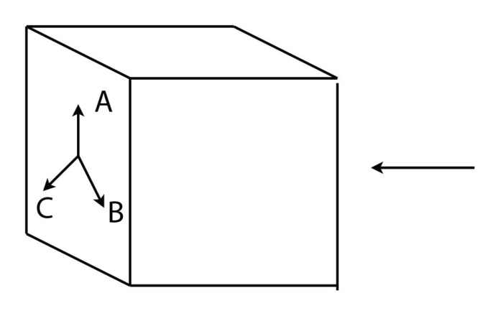
Probability
If the setting is in the +z-direction (A), then the probability
to leave through the plus-channel is 1.
For either of the two other settings (B & C), the probability
of leaving through the plus-channel is 1/4. [cos²(120⁰/2)]
If the settings are random, then there is 1/3 probability
that the analyzer is set to a specific orientation.
?
?
?
The probability of leaving through the plus-channel is:
[1/3 x 1] + [1/3 x 1/4] + [1/3 x 1/4]
= 4/12 + 1/12 + 1/12 = 6/12 = 1/2

Slide 36
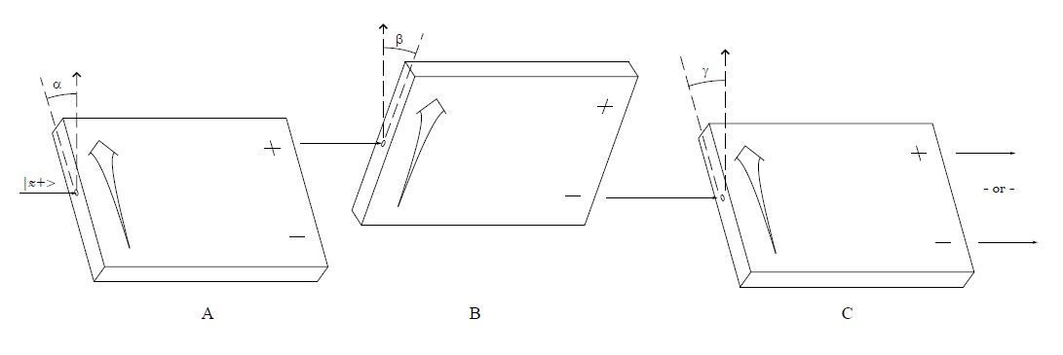

Slide 39
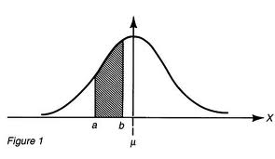
Continuous Probability Distributions
ρ(x) is a probability density (not a probability). We approximate
the probability to obtain x_{i} within a range Δx with:
The probability of obtaining a range of values is equal to the area
under the probability distribution curve in that range:
For (discrete values):
For continuous x:

Slide 40
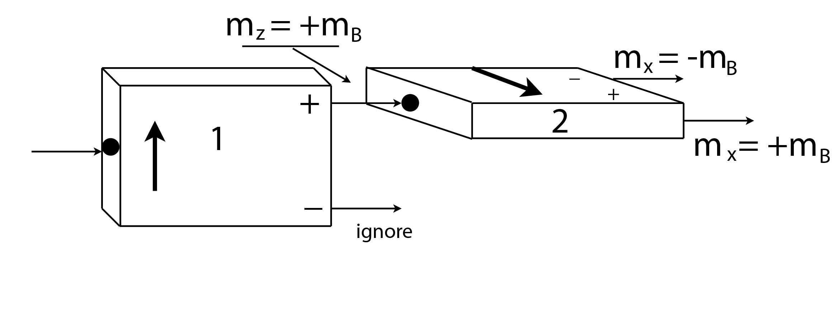
Hidden Variables
50%
50%
If you believe the magnetic moment vector always points in some direction, the value of m_{X} for an atom in the state would be called a hidden variable.
If m_{X} has some real value at any given moment in time that is
unknown to us, then that variable is hidden:
The value of m_{X} exists, but we can’t predict ahead of time what
we’ll measure (“up” or “down”).

Slide 41
Locality
EPR make one other assumption, but is it really an assumption?
1
2
Suppose we have two physical systems, 1 & 2.
1
2
If 1 & 2 are physically separated from one another, locality assumes that a measurement performed on System 1 can’t affect the outcome of a measurement performed on System 2, and vice-versa.

Slide 42
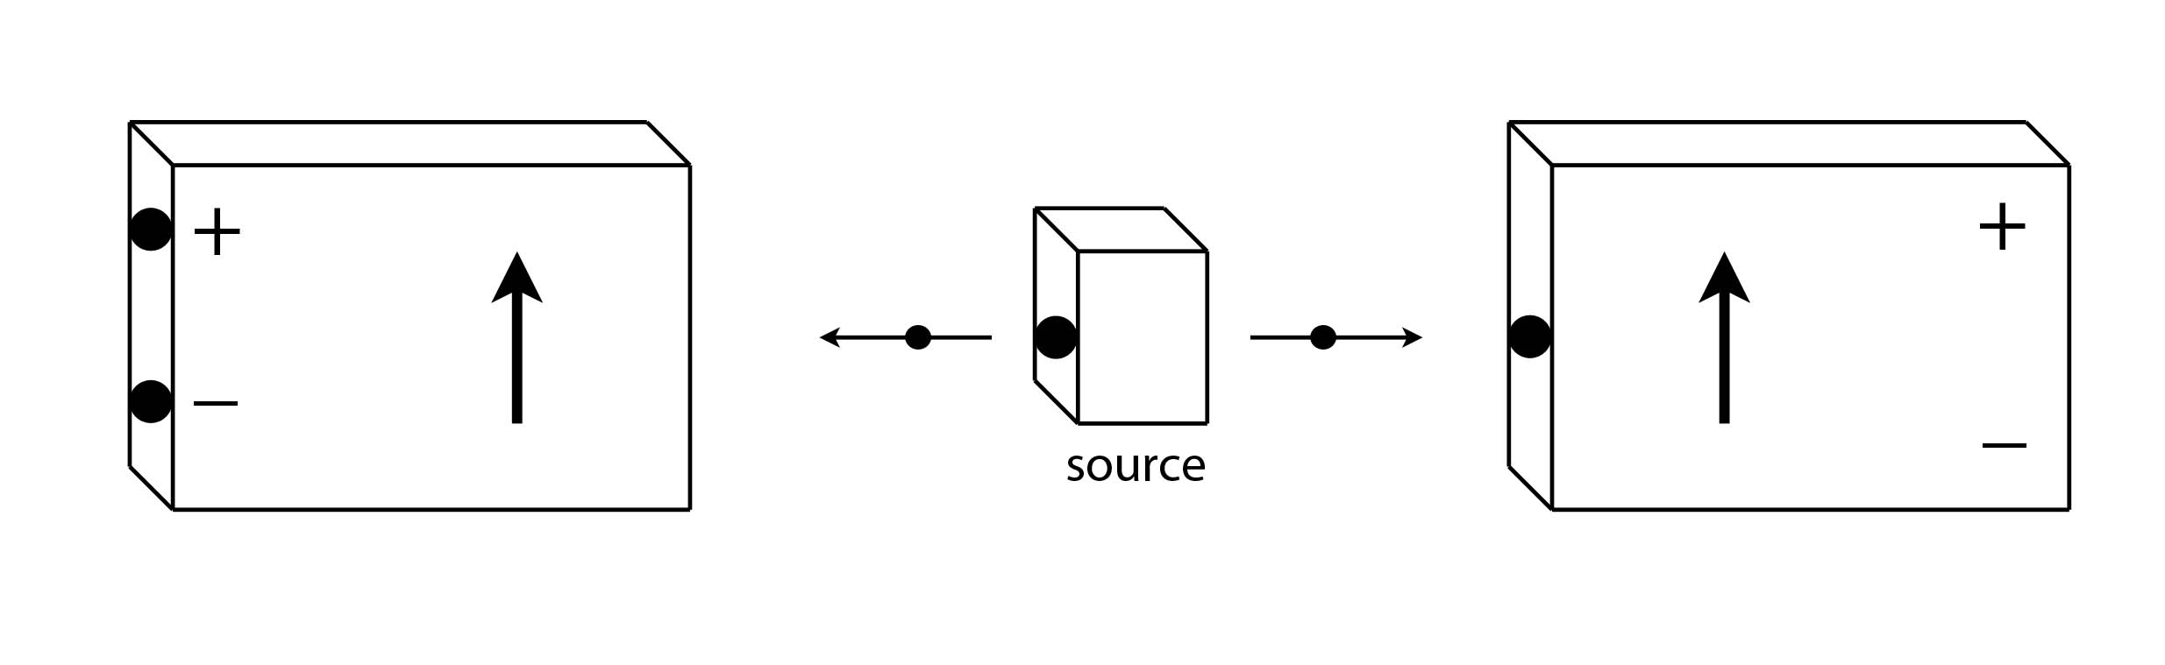
Entanglement
Suppose we have a source that produces pairs of atoms traveling in opposite directions, and having opposite spins:
1
1
2
2
Total spin = 0
OR
1
1
2
2

Slide 43
Entanglement
1
2
We can’t predict what the result for each individual atom pair will be.
and are both equally likely.
Quantum mechanics says to describe the quantum state of each atom pair as a superposition of the two possible states:
When we perform the measurement, we only get one of the two possible outcomes, each with a probability of 1/2.

Slide 44
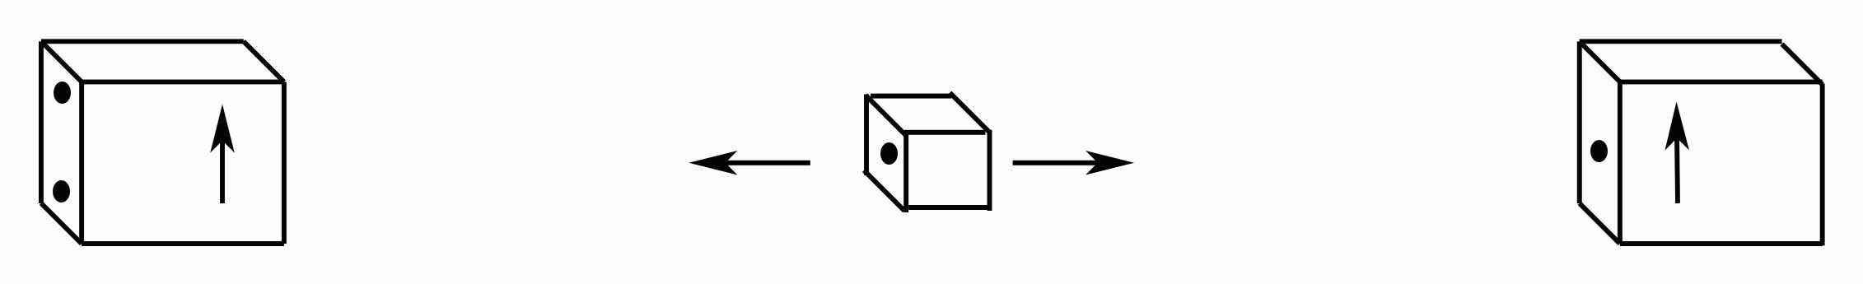
The EPR Argument
Albert
Niels
+
+
1
2
-
-
5 km
5 km
+ 1 meter
Both Albert & Niels agree that we must describe the atom-pair
with the superposition state
Albert says the real state of the atom-pair was
and the measurements revealed this unknown reality to us.
Niels says that was the actual,
indefinite state of the atom-pair and the first measurement instantly collapsed the state into

Slide 45
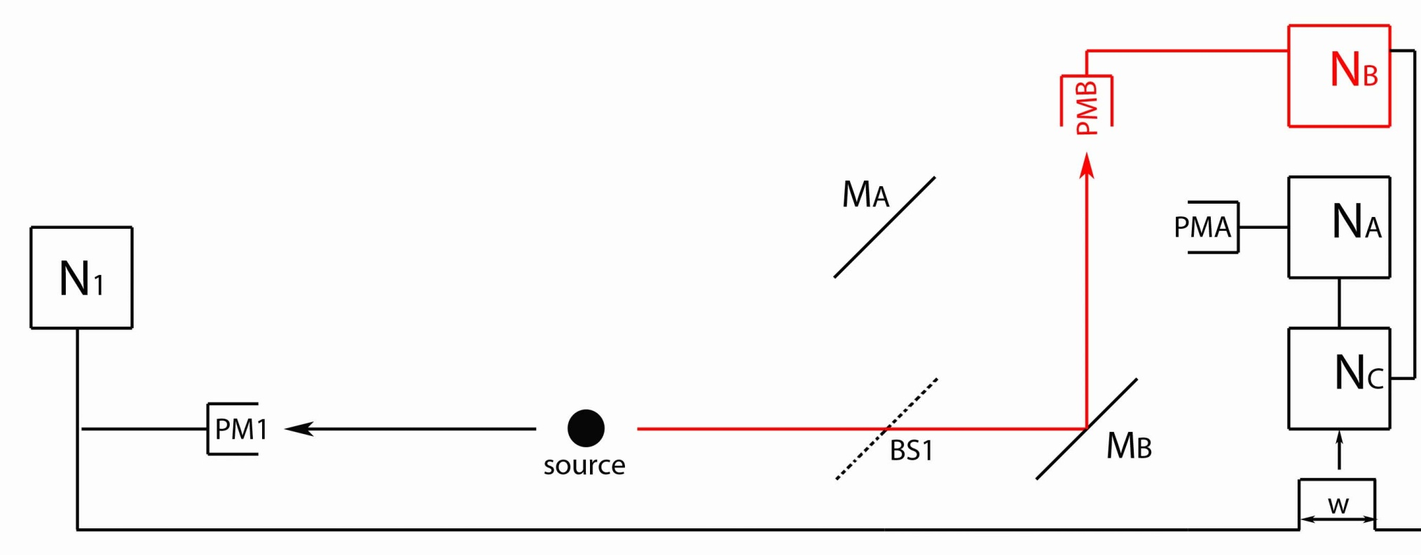
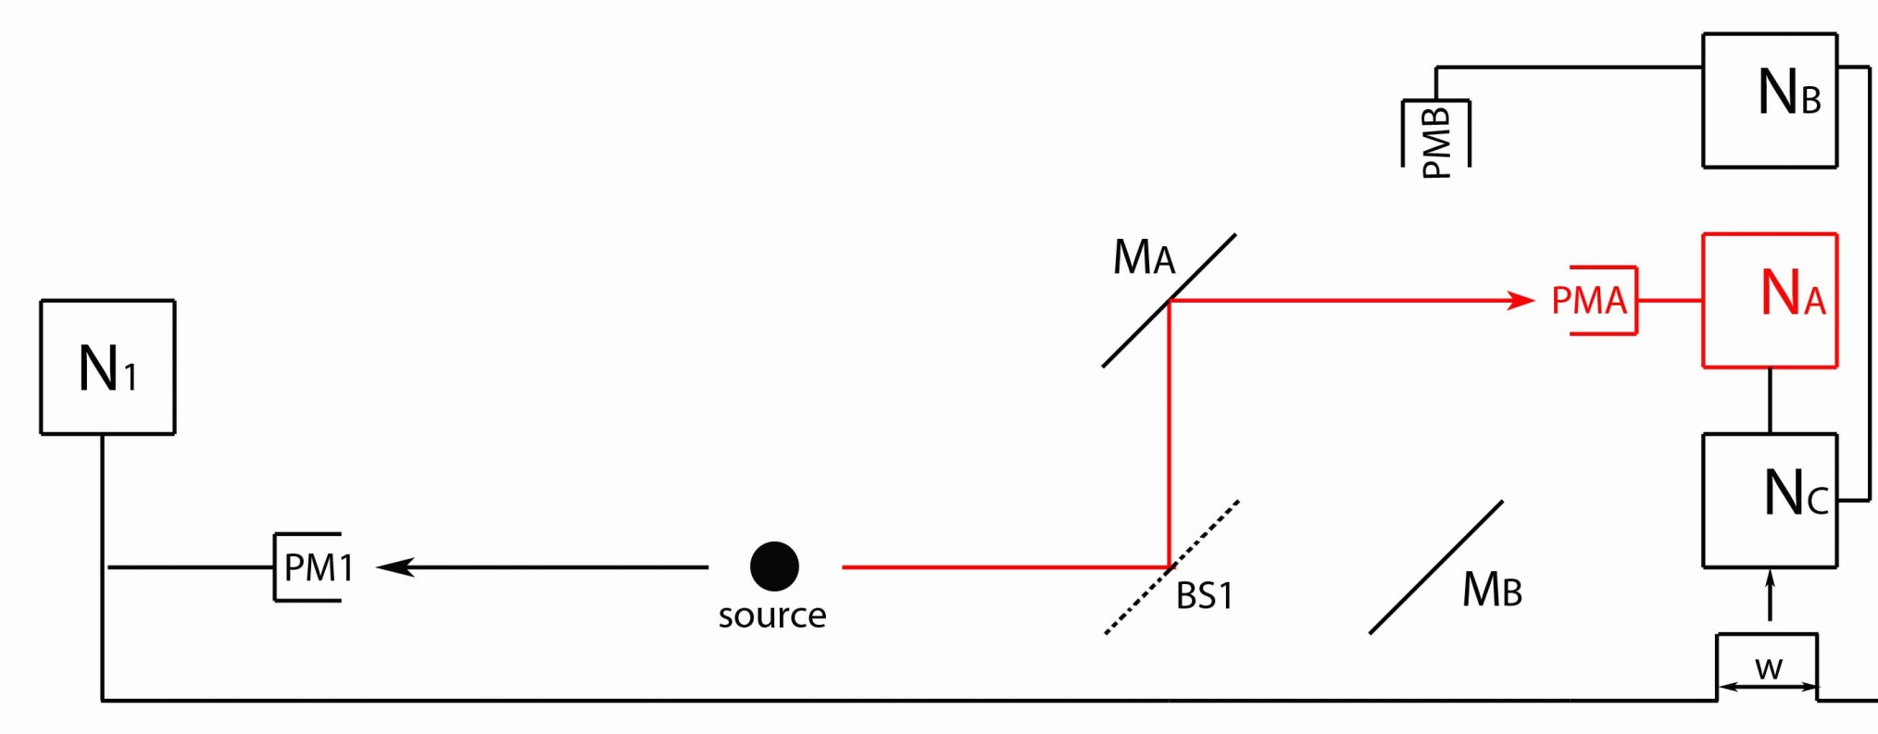
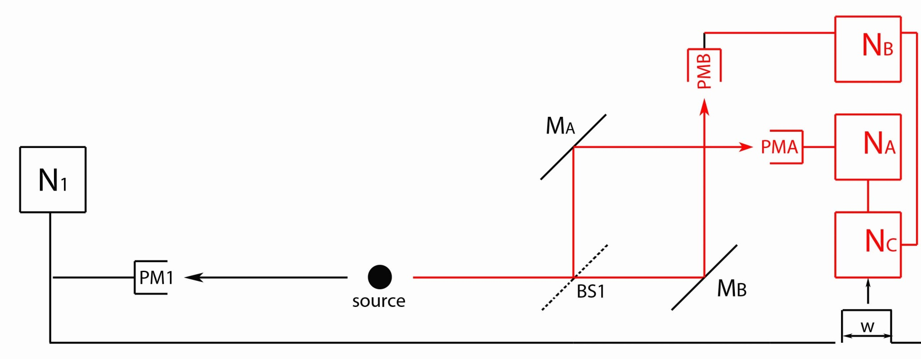
Experiment One
ν₁
ν₂
If the second photon (ν₂) is detected by PMA, then the photon must have traveled along Path A.
If the second photon (ν₂) is detected by PMB, then the photon must have traveled along Path B.
The photon must decide at BS1 whether to take Path A or Path B.

Slide 46
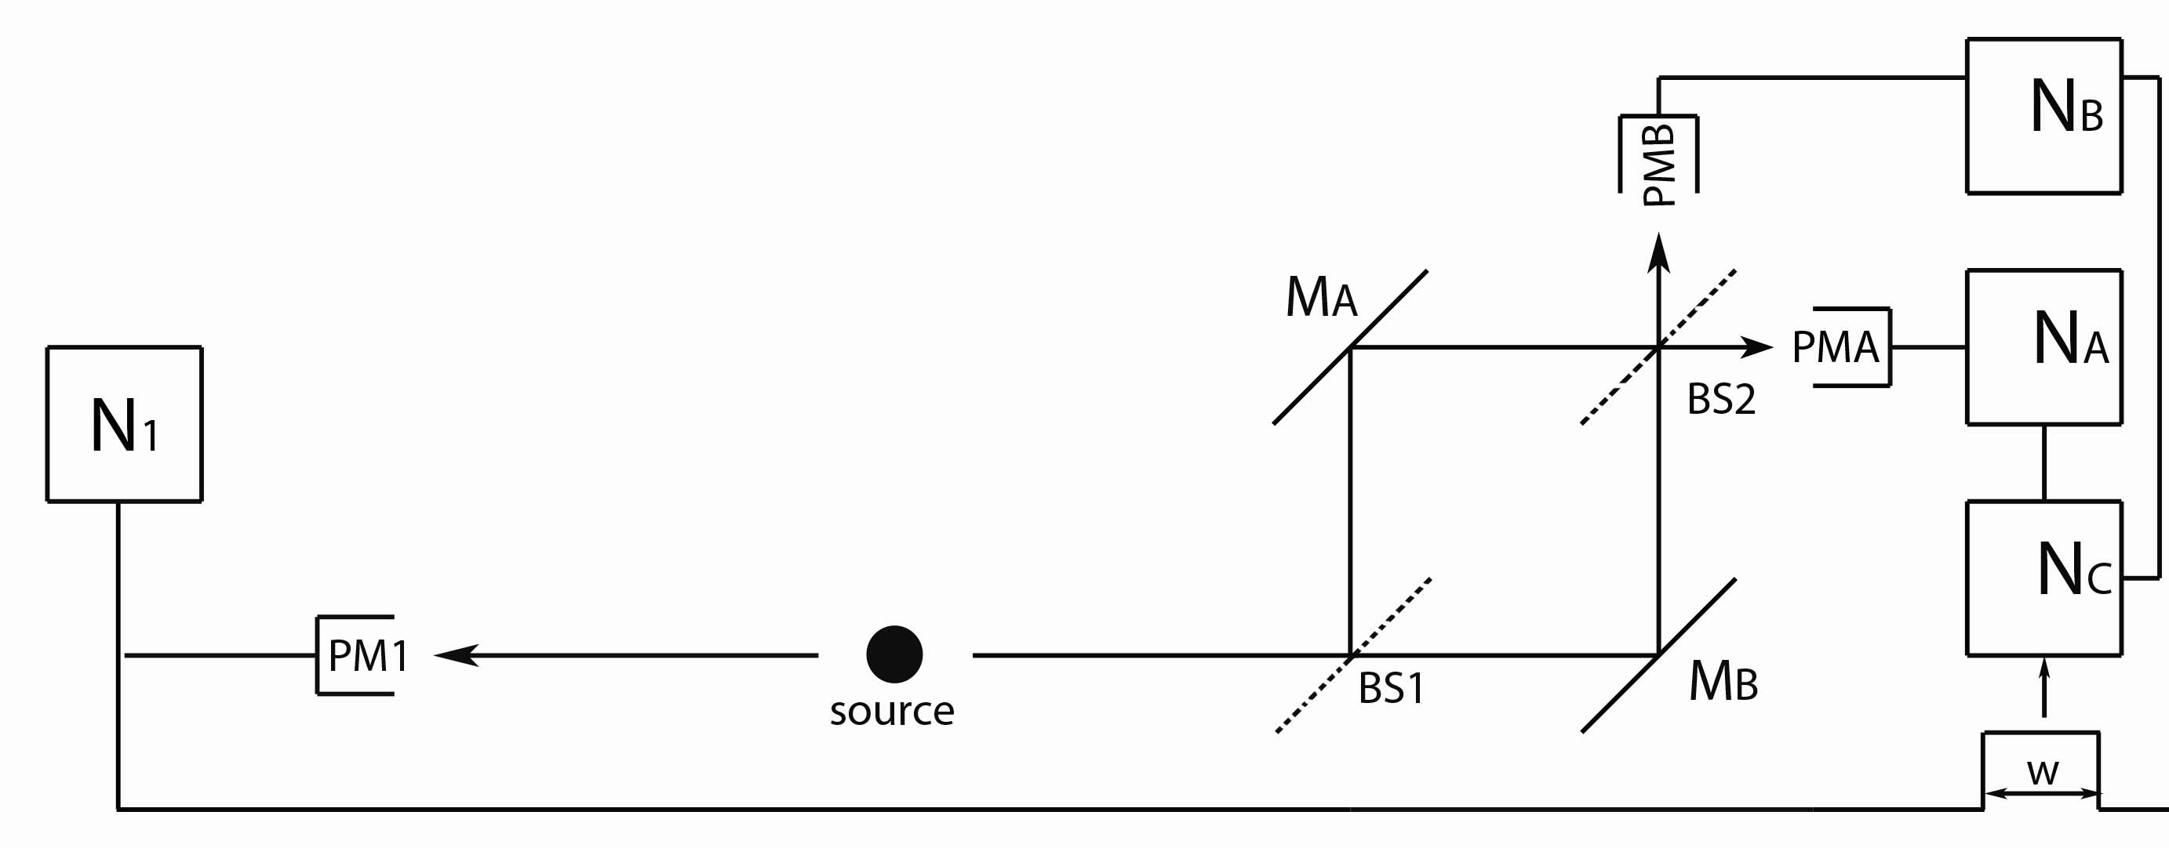
Experiment Two
Whether the photon is detected in PMA or PMB, both Path A or Path B are possible.
When we compare data from PMA & PMB, we observe interference – the photon must decide at BS1 to take
both paths.

Slide 47
Delayed-Choice
How can the photon “know” when it encounters BS1 whether one or two paths are open? (whether we’re conducting Experiment One or Experiment Two?)
What if the photon encounters BS1 while we are conducting Experiment One?
- There is only one path to the second beam splitter.
- It must “choose” to take that one path at BS1.
Suppose we open up a second path to BS2 (switch to Experiment Two) while the photon is still in the apparatus, but before it reaches a detector.
When we look at the data, we observe interference, as though two paths had been available all along.

Slide 48
Three Experiments with Photons
Experiment One says photons behave like particles.
Experiment Two says photons behave like waves.
Delayed Choice says photons do not behave like
particle and wave at the same time.

Slide 49
Particle or Wave?
Bohr: Complementarity – We can only observe one type of behavior or another. The photon interacts with the entire measurement apparatus (including any business about switching between experiments).
Dirac: The photon always behaves like a wave at the first beam splitter. A (random) interaction with one of the PMT’s causes the state to collapse instantaneously into one point in space.

Slide 50
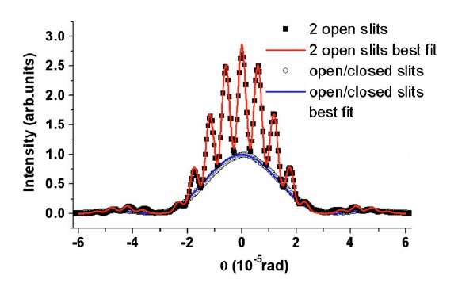
Matter Waves
de Broglie proposed that matter can be described with waves.
Experiments demonstrate the wave nature of particles, where the wavelength matches de Broglie’s proposal.

Slide 51
Double-Slit Experiment
INTERFERENCE!
In quantum mechanics, we add the individual amplitudes and
square the sum to get the total probability
In classical physics, we added the individual probabilities to get
the total probability.

Slide 52
Distance to first maximum for visible light:
Let , ,
If , then

Slide 53
If we were to use protons instead of electrons,
but traveling at the same speed, what happens to the distance to the first maximum, H?
Increases
Stays the same
Decreases

Slide 54
Hydrogen atom- Balmer series
410.3
486.1
656.3 nm
434.0
Balmer (1885) noticed wavelengths followed a progression
where n = 3,4,5, 6, ….
As n gets larger, what happens to wavelengths of emitted light?
  a. gets larger and larger without limit
  b. gets larger and larger, but approaches a limit
  c. gets smaller and smaller without limit
  d. get smaller and smaller, but approaches a limit

Slide 55
Compare the energy of the photon given off when the electron goes from the n=2 level of H to the ground level (n=1) with the energy difference between the n=4 level and the n=2 level.
E₂₋₁/E₄₋₂ = ????
a. 2, b. 4 c. ½, d. ¼ , e. 3/16
E₄
E₃
E₂
E₁

Slide 56
If electron going around in little orbits, important implications from
classical physics
v
Basic connections between
r, v, and energy!
-
F_{cent}
F = ma= F_{cent} = ?
(quick memory check)
a) -mv
b) -mv²/r
c) -v²/r²
d) -mvr
e) don’t remember learning anything related to this
r
+
Ans b) F_{cent} = -mv²/r
Equate to Coulomb force, = kq₊ q₋/r²,
mv²/r =ke²/r²
mv² = ke²/r

Slide 57
(total) Energy levels
for electrons in H
3rd ex. lev.
2nd ex. lev.
1st excited
level
ground level
Bohr- “Electron in orbit with only certain particular energies”.
This implies that an electron in Bohr model of hydrogen atom:
a. is always at one particular distance from nucleus
b. can be at any distance from nucleus.
c. can be at certain distances from nucleus corresponding to energy levels it can be in.
d. must always go into center where potential energy lowest

Slide 58
Which of the following principles of classical physics is violated in the Bohr model?
Opposite charges attract with a force inversely proportional to the square of the distance between them.
The force on an object is equal to its mass times its acceleration.
Accelerating charges radiate energy.
Particles always have a well-defined position and momentum.
All of the above.
Note that both A & B are used in derivation of Bohr model.
Notes:
SKIP but leave in notes

Slide 59
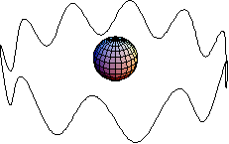
deBroglie Waves
What is n for electron wave in this picture?
1
5
10
20
Cannot determine from picture
Answer: C. 10
3
4
5
2
6
1
7
10
9
8
n = number of wavelengths.
It is also the number of the energy level E_{n} = -13.6/n².
So the wave above corresponds to
E₁₀ = -13.6/10² = -0.136eV

Slide 60
deBroglie Waves
Given the deBroglie wavelength (λ=h/p) and the condition for standing waves on a ring (2πr = nλ), what can you say about the angular momentum L of an electron if it is a deBroglie wave?
  L = n/r
  L = n
  L = n/2
  L = 2n/r
  L = n/2r
(Recall:  = h/2π)
L = angular momentum = pr p = momentum = mv

Slide 61
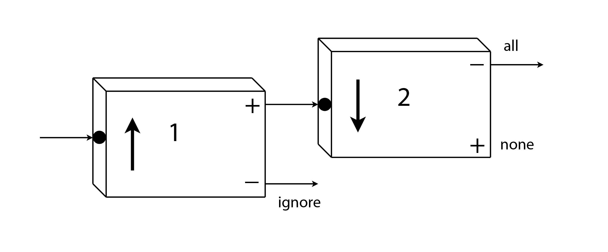
Analyzer 2 is now oriented downward:
Ignore the atoms exiting from the minus-channel of Analyzer 1,
and feed the atoms exiting from the plus-channel into Analyzer 2.
What happens when these atoms enter Analyzer 2?
They all exit from the plus-channel.
They all exit from the minus-channel.
Notes:
Concept Test

Slide 62
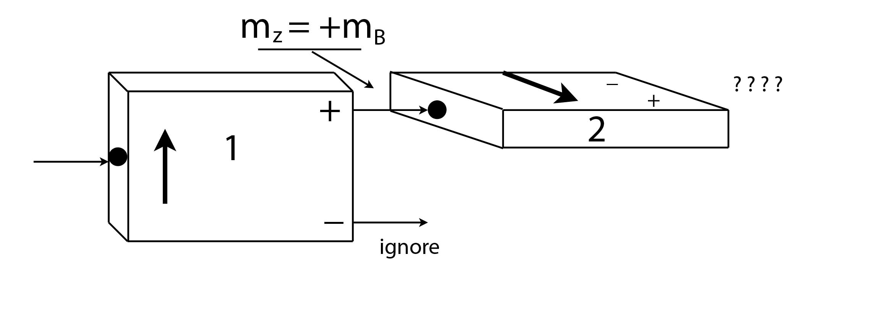
Analyzer 2 is now oriented horizontally (+x):
Ignore the atoms exiting from the minus-channel of Analyzer 1,
and feed the atoms exiting from the plus-channel into Analyzer 2.
What happens when these atoms enter Analyzer 2?
They all exit from the plus-channel.
They all exit from the minus-channel.
Half leave from the plus-channel, half from the minus-channel.
Nothing, the atoms’ magnetic moments have zero projection along
the +x-direction
Notes:
Concept Test

Slide 63
Analyzer 2 is oriented at an angle Θ:
Ignore the atoms exiting from the minus-channel of Analyzer 1,
and feed the atoms exiting from the plus-channel into Analyzer 2.
What is the probability for an atom to exit from the plus-channel
of Analyzer 2?

Slide 64
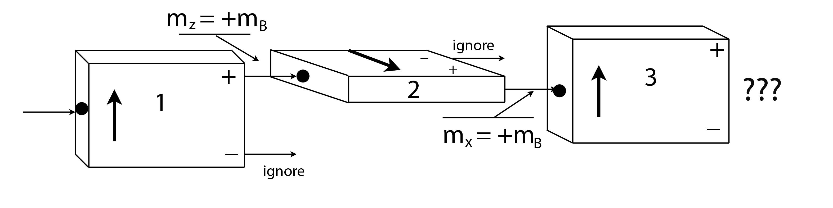
Repeated spin measurements:
Ignore the atoms exiting from the minus-channel of Analyzer 1,
and feed the atoms exiting from the plus-channel into Analyzer 2.
Ignore the atoms exiting from the minus-channel of Analyzer 2,
and feed the atoms exiting from the plus-channel into Analyzer 3.
What happens when these atoms enter Analyzer 3?
They all exit from the plus-channel.
They all exit from the minus-channel.
Half leave from the plus-channel, half from the minus-channel.
Nothing, the atoms’ magnetic moments have zero projection along
the +z-direction

Slide 65
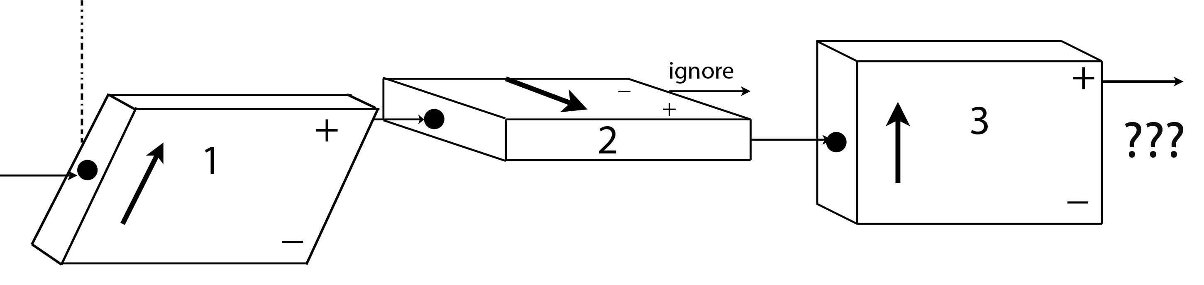
30⁰
Instead of vertical, suppose Analyzer 1 makes an angle of
30⁰ from the vertical. Analyzers 2 & 3 are left unchanged.
What is the probability for an atom leaving the plus-channel
of Analyzer 2 to exit from the plus-channel of Analyzer 3?
A) 0% B) 25% C) 50% D) 75% E) 100%
Hint: Remember that
Notes:
An atom leaving the plus-channel of Analyzer B has m_{X} = +m_{B}. It doesn’t matter what state it was in when it entered Analyzer B – it could have come directly from an oven, or it could have come through a complicated set of a dozen analyzers tilted at various angles – the output state is specified completely by saying m_{X} = +m_{B}. Thus, half of the atoms entering Analyzer C will leave through the plus-channel whether Analyzer A is tilted at 30⁰, 0⁰, or any other angle.

Slide 66
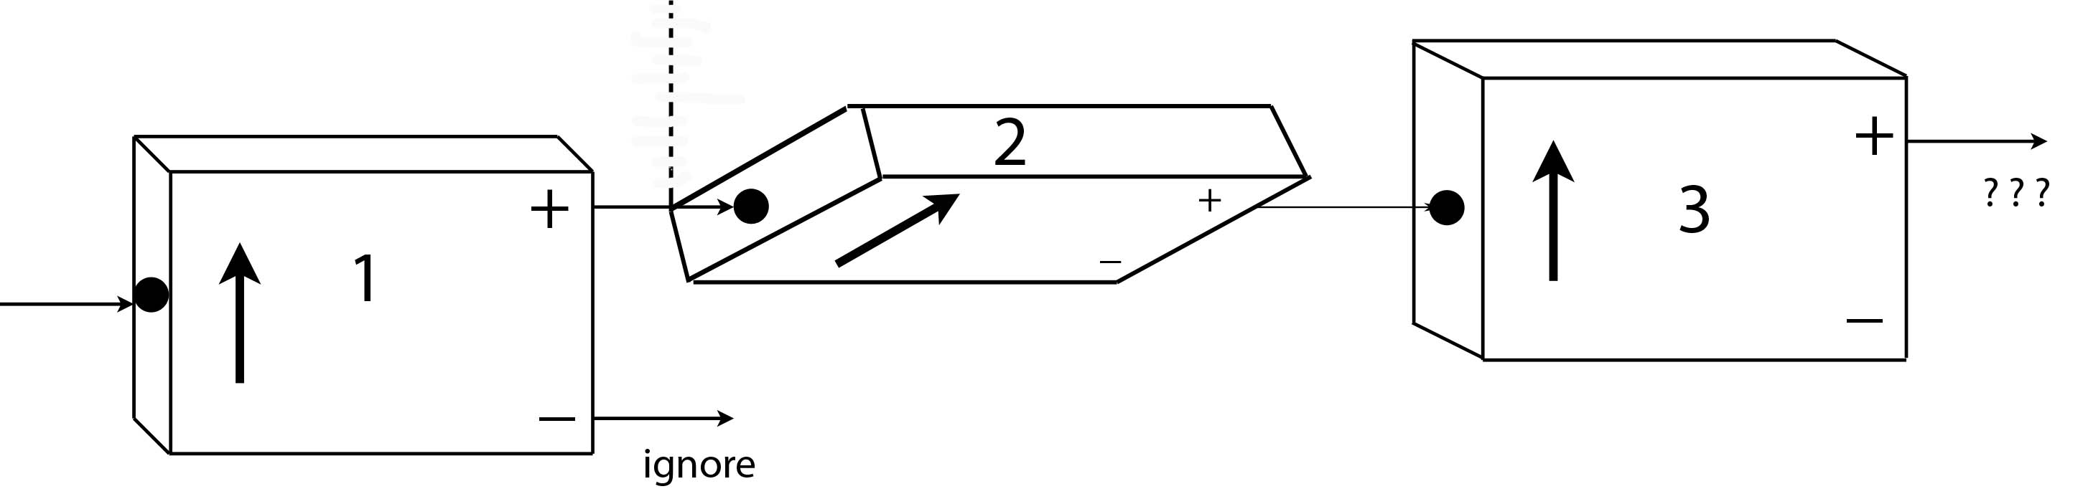
60⁰
Instead of horizontal, suppose Analyzer 2 makes an angle
of 60⁰ from the vertical. Analyzers 1 & 3 are unchanged.
What is the probability for an atom leaving the plus-channel
of Analyzer 2 to exit from the plus-channel of Analyzer 3?
A) 0% B) 25% C) 50% D) 75% E) 100%
Hint: Remember that
Notes:
Atoms leaving Analyzer B are in a definite state of m₍₆₀₎ = +m_{B}. Analyzer B makes an angle of 60⁰ with Analyzer C, so these atoms have a 75% chance of leaving through the plus-channel of Analyzer C. The probability of atoms leaving through the minus-channel of Analyzer C is 25%. [Note that they must add up to 100% - unity.]

Slide 67
Probability
If the setting is in the +z-direction (A), then the probability
to leave through the plus-channel is 1.
For either of the two other settings (B & C), the probability
of leaving through the plus-channel is 1/4. [cos²(120⁰/2)]
If the settings are random, then there is 1/3 probability
that the analyzer is set to a specific orientation.
The probability of leaving through the plus-channel is:
[1/3 x 1] + [1/3 x 1/4] + [1/3 x 1/4]
= 4/12 + 1/12 + 1/12 = 6/12 = 1/2

Slide 68
Probability
Flip a coin three times. What is the probability of
obtaining Heads twice?
1/4
3/8
1/2
5/8
3/4
Notes:
Correct answer is (C)

Slide 69
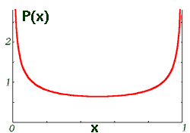
What if the probability curve is not normal?
What kind of system might
this probability distribution
describe?
Harmonic oscillator
Ball rolling in a valley
Block on a spring
0
1/2
1
Not defined, since there are two places where
x is most likely.

Slide 70
50%
50%
What would be the expectation (average) value for m_{X}?

Slide 71
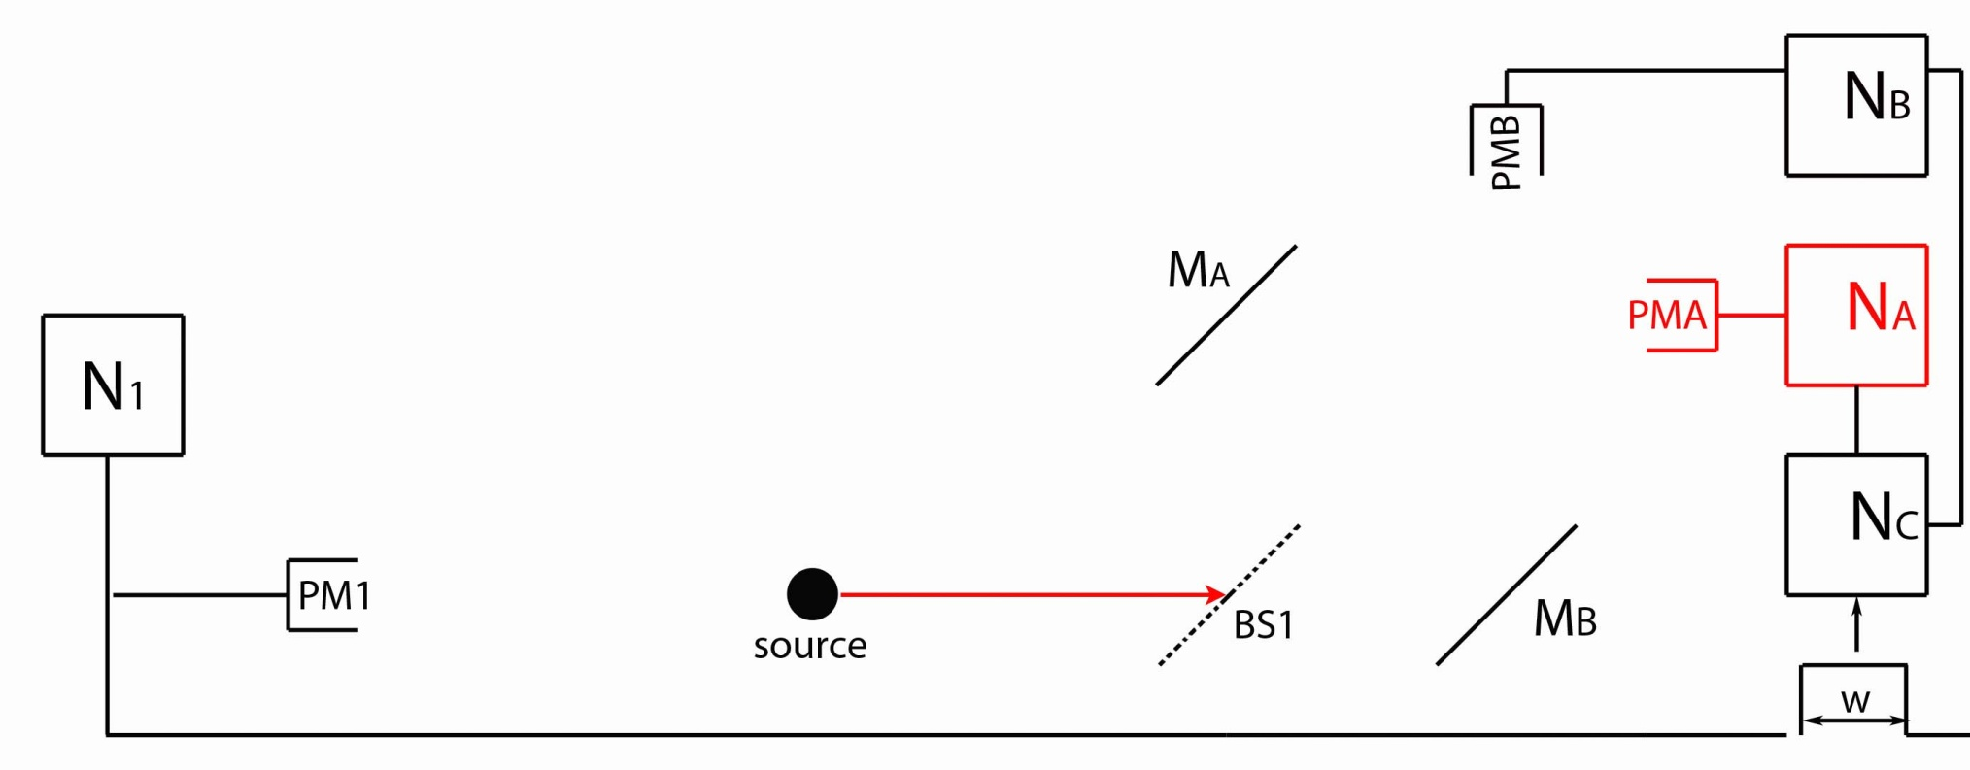
Experiment One
ν₁
ν₂
If the second photon (ν₂) is detected by PMA, then the photon must have traveled along which path?
Path A (via Mirror A)
Path B (via Mirror B)
Both Path A & Path B are possible.
Not enough information.

Slide 72
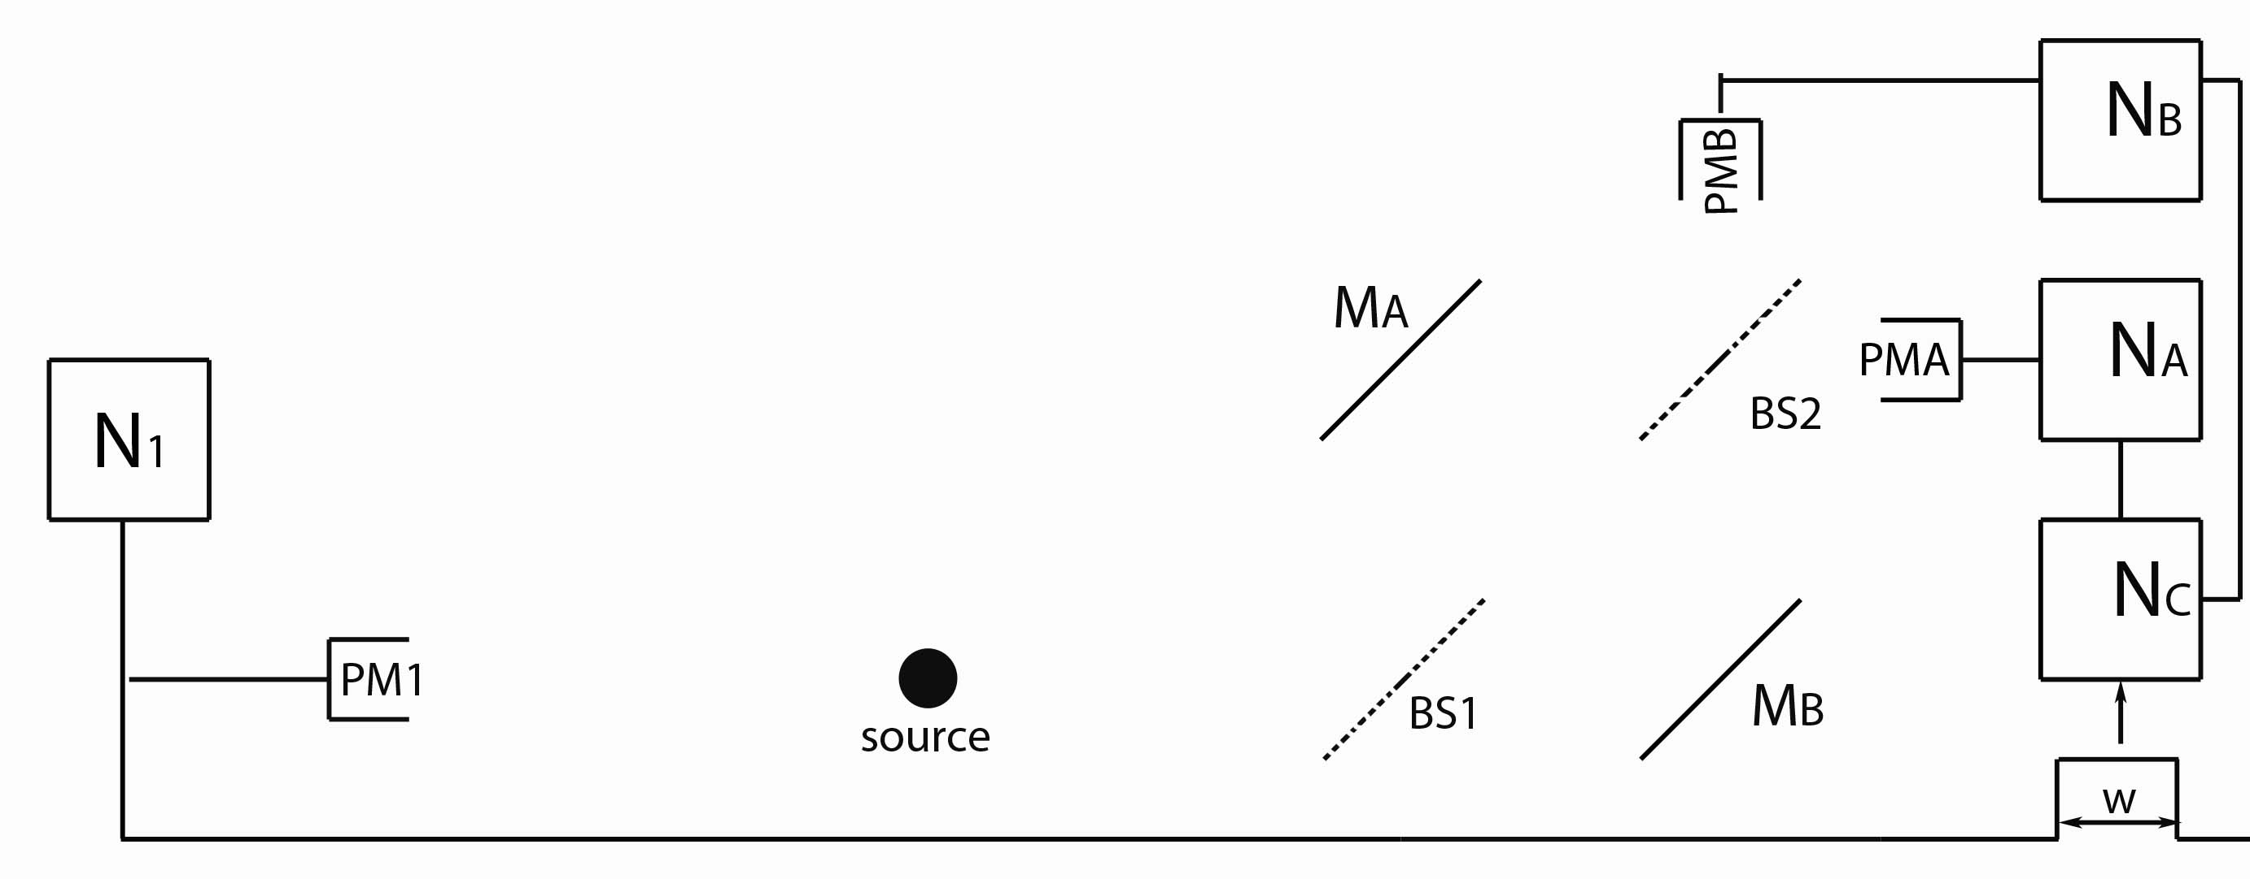
Experiment Two
If the photon is detected in PMA, then it must have taken:
A) Path A (via Mirror A)
B) Path B (via Mirror B)
C) Both Path A & Path B are possible.
D) Not enough information.

Slide 73
Quantum Systems
For a quantum system we have to write down TWO lists:
A | B
PARTICLE WHICH-PATH POSITION | WAVE INTERFERENCE MOMENTUM
For every characteristic in List A, there is a corresponding characteristic in List B.
Knowing a lot about one means we know only a little about the other.

Slide 74
Quantum Systems
These are also incompatible observables, but in a slightly different way than those in the previous list:*
A | B
L_{Z} | L_{X}, L_{Y}
L_{Z} = angular momentum about the z-axis (think magnetic moments)
If we know L_{Z}, then angular momentum about any other direction is indeterminate.
*This incompatibility is a consequence of the more familiar
constraints placed on position and momentum
about which we’ll learn a lot more!

Slide 75
Distance to first maximum for visible light:
Let , ,
If , then

Slide 76
Matter Waves
de Broglie wavelength:
In order to observe electron interference, it would be best to perform a double-slit experiment with:
Lower energy electron beam.
Higher energy electron beam.
It doesn’t make any difference.
Lowering the energy will increase the wavelength of the electron.
Can typically make electron beams with energies from 25 – 1000 eV.

Slide 77
Matter Waves
de Broglie wavelength:
For an electron beam of 25 eV, we expect Θ (the angle between
the center and the first maximum) to be:
Θ << 1
Θ < 1
Θ > 1
Θ >> 1
Use
and remember:
&

Slide 78
Matter Waves
de Broglie wavelength:
For an electron beam of 25 eV, how can we make the diffraction pattern more visible?
Make D much smaller.
Decrease energy of electron beam.
Make D much bigger.
A & B
B & C
25 eV is a lower bound on the energy of a decent electron beam.
Decreasing the distance between the slits will increase Θ.

Slide 79
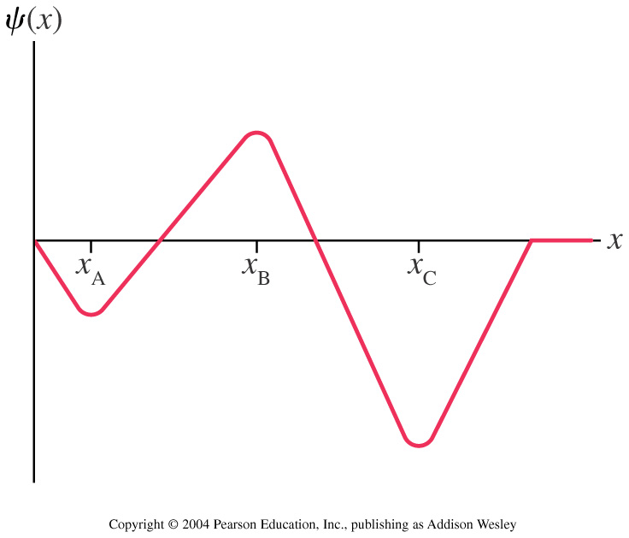
Matter Waves
Below is a wave function for a neutron. At what value of x
is the neutron most likely to be found?
A) X_{A} B) X_{B} C) X_{C} D) There is no one most likely place

Slide 80
An electron is described by the following wave function:
a
b
c
d
dx
x
L
How do the probabilities of finding the electron near (within dx) of a,b,c, and d compare?
d > c > b > a
a = b = c = d
d > b > a > c
a > d > b > c

Slide 81
Plane Waves vs. Wave Packets
For which type of wave are the position (x) and momentum (p) most well-defined?
x most well-defined for plane wave, p most well-defined for wave packet.
p most well-defined for plane wave, x most well-defined for wave packet.
p most well-defined for plane wave, x equally well-defined for both.
x most well-defined for wave packet, p equally well-defined for both.
p and x are equally well-defined for both.

