Slide 1
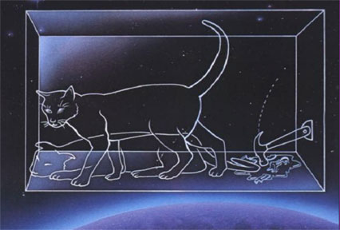
PH300 Modern Physics SP11
“Is the state of the cat to be created only when a physicist investigates the situation at some definite time? Nobody really doubts that the presence or absence of a dead cat is something independent of observation.”
– Albert Einstein
4/5 Day 20:
Questions?
Review waves and wave equations
Schrodinger equation
Square well potential
Thursday:
Finite Square Well
Quantum Tunneling

Slide 2
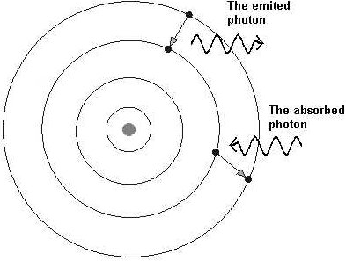
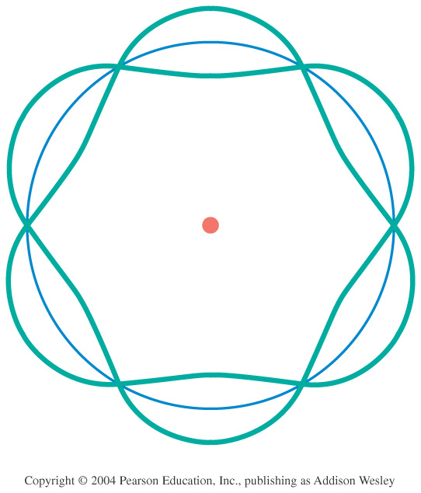
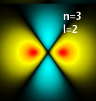
Models of the Atom
–
–
–
–
–
Thomson – Plum Pudding
Why? Known that negative charges can be removed from atom.
Problem: just a random guess
Rutherford – Solar System
Why? Scattering showed hard core.
Problem: electrons should spiral into nucleus in ~10⁻¹¹ sec.
Bohr – fixed energy levels
Why? Explains spectral lines.
Problem: No reason for fixed energy levels
deBroglie – electron standing waves
Why? Explains fixed energy levels
Problem: still only works for Hydrogen.
Schrödinger – will save the day!!
+
–
+
+

Slide 3
What are these waves?
EM Waves (light/photons)
Amplitude = electric field
tells you the probability of detecting a photon.
Maxwell’s Equations:
Solutions are sine/cosine waves:
Matter Waves (electrons/etc)
Amplitude = matter field
tells you the probability of detecting a particle.
Schrödinger Equation:
Solutions are complex sine/cosine waves:

Slide 4
Today: Work towards finding an equation that describes the probability wave for a particle in any situation.
Rest of QM: Solving this differential equation for various cases and using it to understand nature and technology
Look at general aspects of wave equations …
…apply to classical and quantum waves.
Start by reviewing some classical wave equations.
Introduce Schrödinger equation.

Slide 5
Schrodinger equation development--
new approach to physics
Old approach- understand physical system well, reason out
equations that must describe it.
New approach-- see what experiment shows but not know why.
Write down equation that has sensible basic math properties.
See if when solved, gives solutions that match experiment.
Schrödinger starting point-- what do we know about
classical waves (radio, violin string)?
Which aspects of a particle wave equation need to be similar
and which different from classical wave equations?

Slide 6
Wave Equations
Electromagnetic waves:
Vibrations on a string:
E
y
x
x
c=speed of light
v=speed of wave
Solutions: E(x,t)
Solutions: y(x,t)
Magnitude is non-spatial:
= Strength of electric field
Magnitude is spatial:
= Vertical displacement of string

Slide 7
Wave Equation
How to solve?
In DiffEq class, learn lots of algorithms
for solving DiffEq’s.
In this class, focus on only 2 Diff Eq’s:
and
(k & α ~ constants)
How to solve a differential equation in physics:
1) Guess functional form for solution
2) Make sure functional form satisfies Diff EQ
(find any constraints on constants)
1 derivative: need 1 soln → f(x,t)=f₁
2 derivatives: need 2 soln → f(x,t) = f₁ + f₂
3) Apply all boundary conditions
(find any constraints on constants)
The hardest part!
Notes:
A: 16
B: 37
C: 34
D: 14
169 responses

Slide 8
1) Guess functional form for solution
Which of the following functional forms works as a possible solution to this differential equation?
I. y(x, t) = Ax²t², II. y(x, t) = Asin(Bx)
III. y(x,t) = Acos(Bx)sin(Ct)
a. I b. III c. II, III d. I, III e. None or some other combo
Does it satisfy Diff EQ?
Answer is b. Only: y(x,t)=Acos(Bx)sin(Ct)
General Soln (usually use k and ω):
y(x,t) = Asin(kx)cos(ωt) + Bcos(kx)sin(ωt)
Notes:
A: 24
B: 26
C: 3
D: 15
E: 32
170 responses

Slide 9
1) Guess functional form for solution
II. y(x, t) = Asin(Bx) III. y(x,t) = Acos(Bx)sin(Ct)
LHS:
LHS:
RHS:
RHS:
Not OK! x is a variable. There are many values of x for which this is not true!
OK! B and C are constants.
Constrain them so satisfy this.
Notes:
A: 24
B: 26
C: 3
D: 15
E: 32
170 responses

Slide 10
υ = speed of wave
What functional form works? Two examples:
y(x,t)=Asin(kx)cos(ωt) + Bcos(kx)sin(ωt)
y(x,t)=Csin(kx-ωt) + Dsin(kx+ωt)
k, ω, A, B, C, D are constants
Satisfies wave eqn if:

Slide 11
y(x,t)=Asin(kx)cos(ωt) + Bcos(kx)sin(ωt)
y(x,t)=Csin(kx-ωt) + Dsin(kx+ωt)
t=0
y
x
What is the wavelength of this wave? Ask yourself …
→How much does x need to increase to increase kx-ωt by 2π?
sin(k(x+λ) – ωt) = sin(kx – ωt + 2π)
k(x+λ)=kx+2π
kλ=2π ➔ k=2π/ λ
k=wave number (radians-m⁻¹)
What is the period of this wave? Ask yourself …
→How much does t need to increase to increase kx-ωt by 2π?
sin(kx-ω (t+Τ)) = sin(kx – ωt + 2π )
Speed
ωΤ=2π ➔ ω=2π/Τ
= 2πf
ω= angular frequency

Slide 12
0
L
Functional form of solution?
y(x,t) = Asin(kx)cos(ωt) + Bcos(kx)sin(ωt)
Boundary conditions?
l. y(x,t) = 0 at x=0 and x=L
At x=0: y(x,t) = Bsin(ωt) = 0
y(x,t) = Asin(kx)cos(ωt)
→ only works if B=0
Evaluate y(x,t)=0 at x=L. What are possible values for k?
a. k can have any positive or negative value
b. π/(2L), π/L, 3π/(2L), 2π/L …
c. π/L
d. π/L, 2π/L, 3π/L, 4π/L …
e. 2L, 2L/2, 2L/3, 2L/4, ….
Answer is d: k=nπ/L
Boundary conditions put constraints on k …
causes quantization of k and λ!!!

Slide 13
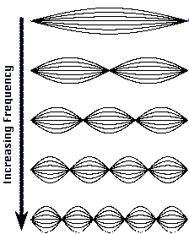
0
L
Which boundary conditions need to be satisfied?
I. y(x,t) = 0 at x=0 and x=L
n=1
y(x,t) = Asin(kx)cos(ωt) +Bcos(kx)sin(ωt)
n=2
At x=0:
y = Bsin(ωt) = 0
→ B=0
At x=L:
y= Asin(kL)cos(ωt)= 0
→ sin(kL)=0
→ kL = nπ (n=1,2,3, … )
→ k=nπ/L
n=3
y(x,t) = Asin(nπx/L)cos(ωt)

Slide 14
With Wave on Violin String:
Find: Only certain values of k (and thus λ) allowed
→ because of boundary conditions for solution
Same as for electromagnetic wave in microwave oven:
Exactly same for electrons in atoms:
Find: Quantization of electron energies (wavelengths) …
→ from boundary conditions for solutions
to Schrodinger’s Equation.
Notes:
Wave on String…

Slide 15
Three strings:
y
Case I: no fixed ends
x
y
Case II: one fixed end
x
y
Case III, two fixed end:
x
For which of these cases, do you expect to have only certain frequencies or wavelengths allowed… that is for which cases will the allowed frequencies be quantized.
a. I only b. II only c. III only d. more than one
Notes:
Show Wave on String Sim?

Slide 16
Three strings:
y
Case I: no fixed ends
x
y
Case II: one fixed end
x
y
Case III, two fixed end:
x
For which of these cases, do you expect to have only certain frequencies or wavelengths allowed… that is for which cases will the allowed frequencies be quantized.
a. I only b. II only c. III only d. more than one
Quantization came in when applied 2nd boundary condition, bound on both sides

Slide 17
Electron bound
in atom (by potential energy)
Free electron
PE
Only certain energies allowed
Quantized energies
Any energy allowed
Boundary Conditions
⎝ standing waves
No Boundary Conditions
⎝ traveling waves

Slide 18
Schrodinger’s starting point:
What do we know about classical waves (radio, violin string)?
What aspects of electron wave eq’n need to be similar and what different from those wave eqs?
Not going to derive it, because there is no derivation…
Schrodinger just wrote it down.
Instead, give plausibility argument.

Slide 19
Works for light, why not for an electron?
simple answer-- not magic but details not useful to you.
Advanced formulation of classical mechanics.
Each p, 1 partial derivative with respect to x.
Each E, 1 partial derivative with respect to time.
light: E²=(pc)², so equal number derivatives x and t.
electron: E = p²/2m +V, so need 1 time derivative, 2 derivatives with respect to x, plus term for potential energy V.
(KE) (PE)

Slide 20
so finally...
the Schrödinger equation for an electron wave in one
dimension Ψ(x,t)
Of course for any real system, need in 3 dimensions,
⎝ just add partial derivatives of y and z, and V(x,y,z) etc.
Schrödinger wrote it down, solved for hydrogen,
got solutions that gave exactly the same electron energy levels as Bohr.

Slide 21
the Schrodinger equation for an electron wave in one
dimension Ψ(x,t)
Can differ from book to book:
Many give an equation with no t’s in it!!
Some use U(x) … we use V(x)
Above is correct equation for describing electron as produced by Schrödinger.
We will work out a simplified version that leaves out the time dependence.
Notes:
ALSO … note he says “rigid box” when we say infinite square well

Slide 22
Very important question for a modern engineer:
Nanotechnology: how small does an object have to be
before behavior of electrons starts to depend on size and shape of the object due to quantum effects?
How to start?
Need to look at:
Size of wire compared to size of atom.
Size of wire compared to size of electron wave function.
Energy level spacing compared to thermal energy, kT.
Energy level spacing compared to some other quantity.
(What?)
E. Something else. (What?)

Slide 23
Nanotechnology: how small does a wire have to be
before movement of electrons starts to depend on size
and shape due to quantum effects?
How to start?
Need to look at
C. Energy level spacing compared to thermal energy, kT.
Almost always focus on energies in QM.
Electrons, atoms, etc. hopping around with random energy kT.
kT >> than spacing, spacing irrelevant. Smaller, spacing big deal.
So need to calculate energy levels.
pit depth compared
to kT?

Slide 24
The Schrodinger equation for an electron wave in 1-D: Ψ(x,t)
Want to use this to calculate electron waves in a
physical situation. First step is:
Figure out how many electrons will be interacting
Figure out what general solutions will be by plugging in trial solutions and seeing if can solve.
Figure out what the forces will be on the electron in that physical situation.
Figure out what the boundary conditions must be on the electron wave.
Figure out what potential energy is at different x and t for the physical situation.

Slide 25
The Schrodinger equation for electron wave in 1-D: Ψ(x,t)
Want to use to calculate electron waves in a physical
situation. First step is:
E. Figure out what potential energy is at different x and t for
the physical situation.
Already know m is mass of electron, so all need to know is the potential energy V(x,t), which completely determines the situation, and how electron will behave!
Need V(x,t) for small wire to answer our basic question.
Warm up with just a proton.

Slide 26
what is V(r,t) for electron interacting
with proton?
+
-
-ke²/r, where r is the distance from electron to origin.
-ke²/r where r is distance between + and - .
Impossible to tell unless we know how electron is moving, because that determines the time dependence.
(-ke²/r) x sin(ωt)
Something else…
Ans: B - Although potential energy will be different as
electron moves to different distance, at any given distance
will be same for all time. So V(r,t) = V(r) = -ke²/r.
H atom.

Slide 27
Most physical situations, like H atom, no time dependence in V!
Simplification #1:V = V(x) only. (works in 1D or 3D)
(Important, will use in all Shrödinger equation problems!!)
Ψ(x,t) separates into position part dependent part ψ(x) and time dependent part ϕ(t) =exp(-iEt/ħ). Ψ(x,t)= ψ(x)ϕ(t)
Plug in, get equation for ψ(x)
Seems like a good exercise for HW.
“time independent Schrodinger equation”

Slide 28
Solving the Schrödinger equation for electron wave in 1-D:
1. Figure out what V(x) is, for situation given.
2. Guess or look up functional form of solution.
3. Plug in to check if ψ’s and all x’s drop out, leaving an equation involving only a bunch of constants.
4. Figure out what boundary conditions must be to make sense physically.
5. Figure out values of constants to meet boundary conditions and normalization:
6. Multiply by time dependence ϕ(t) =exp(-iEt/ħ) to have full solution if needed. STILL TIME DEPENDENCE!
∞
|ψ(x)|²dx =1
-∞

Slide 29
Where does the electron want to be?
The place where V(x) is lowest.
V(x)
Electrons always tend toward the position
of lowest potential energy, just like a
ball rolling downhill.
x

Slide 30
0
L
Solving Schrod. equ.
Before tackling wire, understand simplest case.
Electron in free space, no electric fields or gravity around.
1. Where does it want to be?
2. What is V(x)?
3. What are boundary conditions on ψ(x)?
No preference- all x the same.
Constant.
None, could be anywhere.
Smart choice of
constant, V(x) = 0!

Slide 31
What does this equation describe?
A. Nothing physical, just a math exercise.
B. Only an electron in free space along the x-axis with no electric fields around.
C. An electron flying along the x-axis between two metal plates with a voltage between them as in photoelectric effect.
D. An electron in an enormously long wire not hooked to any voltages.
E. More than one of the above.
Ans: E – Both (B) and (D) are correct. No electric field or voltage
means potential energy constant in space and time, V=0.

Slide 32
A solution to this differential equation is:
A cos(kx)
A e^{-kx}
A sin (kx)
(B & C)
(A & C)
Ans: E – Both (A) and (C) are solutions.
solution if

Slide 33
…makes sense, because
Condition on k is just saying that (p²)/2m = E.
V=0, so E= KE = ½ mv² = p²/2m
The total energy of the electron is:
Quantized according to E_{n} = (constant) x n², n= 1,2, 3,…
Quantized according to E_{n} = const. x (n)
Quantized according to E_{n} = const. x (1/n²)
Quantized according to some other condition but don’t know what it is.
Not quantized, energy can take on any value.
Ans: E - No boundary, energy can take on any value.

Slide 34
k (and therefore E) can take on any value.
Almost have a solution, but remember we still have to include
time dependence:
…bit of algebra, using identity: e^{ix} =cos(x) + i sin(x)

Slide 35
electron in free space or long wire with no voltage
if k positive
x = 0
x = L
Using equation, probability of electron being in dx at x = L is _______ probability of being in dx at x = 0.
A. always bigger than B. always same as
C. always smaller than
D. oscillates up and down in time between bigger and smaller
E. Without being given k, can’t figure out
Ans: B - Prob ~ ψ*ψ = A²cos²(kx-ωt) +A²sin²(kx-ωt)= A²,
so constant and equal, all x, t.

Slide 36
Which free electron has more kinetic energy?
A) 1 B) 2 C) Same
big k = big KE
1.
2.
small k = small KE
if V=0, then E= Kinetic Energy.
So first term in Schöd. Eq. is always just kinetic energy!
Curvature ➔ KE

Slide 37
Nanotechnology: how small (short) does a wire have to be
before movement of electrons starts to depend on size
and shape due to quantum effects?
Look at energy level spacing compared to thermal energy, kT= 1/40 eV at room temp.
Calculate energy levels for electron in wire of length L.
Know spacing big for 1 atom, what L when ~1/40 eV?
0
L
Use time independ. Schrod. eq.
E
?
Figure out V(x), then figure out
how to solve, what solutions
mean physically.

Slide 38
0
L
Short copper wire, length L.
What is V(x)?
Remember photoelectric effect.
Took energy to kick electron out. So wants to be inside wire.
⎝ inside is lower PE.
Everywhere inside the same?

Slide 39
PE
+
+
+
+
+
+
+
+
+
+
1 atom
many atoms
but lot of e’s
move around
to lowest PE
repel other electrons = potential energy near that spot higher.
As more electrons fill in, potential energy for later ones gets
flatter and flatter. For top ones, is VERY flat.
Notes:
Note UP in one is energy.. Wire up is Y direction (don’t care about)

Slide 40
PE for electrons with most PE. “On top”
+ + + + + + + + + + + + + + + +
As more electrons fill in, potential energy for later ones gets
flatter and flatter. For top ones, is VERY flat.
How could you find out how deep the pit is for the top
electrons in copper wire?

Slide 41
work function of
copper = 4.7 eV
PE for electrons with most PE. “On top”
This is just the energy needed to remove them from the metal.
That is the work function!!
As more electrons fill in, potential energy for later ones gets
flatter and flatter. For top ones, is VERY flat.
How could you find out how deep the pit is for the top
electrons in copper wire?

Slide 42
4.7 eV
Energy
0
L
x
0 eV
x<0, V(x) = 4.7 eV
x> L, V(x) = 4.7 eV
0<x<L, V(x) =0
0 L
x
How to solve?
1. Mindless mathematical approach:
Find ψ in each region, make solutions match at boundaries, normalize.
Works, but bunch of math.
Notes:
Note… can move well around anywhere on graph!!!

Slide 43
0 L
4.7 eV
mathematically
V(x) = 4.7 eV for x<0 and x>L
V(x) = 0 eV for 0>x<L
0 eV
2. Clever approach:
Reasoning to simplify how to solve.
Electron energy not much more than ~kT=0.025 eV.
Where is electron likely to be?
What is the chance it will be outside of well?
A. zero chance B. very small chance, C. small, D. likely
B. 0.025 eV<< 4.7eV. So very small chance (e^{-4.7/.02}) an electron could have enough energy get out.
What does that say about boundary condition on ψ(x) ?
ψ(x) must be same x<0, 0<x<L, x>L
B. ψ(x<0) ~ 0, ψ(x>0) ≥ 0
C. ψ(x) ~ 0 except for 0<x<L
Ans: C

Slide 44
x<0, V(x) ~ infinite
x> L, V(x) ~ infinite
0<x<L, V(x) =0
Clever approach means
just have to solve:
Energy
with boundary conditions,
ψ(0)=ψ(L) =0
0
x
0
L
Solution a lot like microwave & guitar string

Slide 45
∞
∞
0 eV
0 L
functional form of solution:
Apply boundary conditions
x=0 → ?
→ A=0
x=L →
kL=nπ (n=1,2,3,4 …)
→ k=nπ/L
2
1
What is the momentum, p?

Slide 46
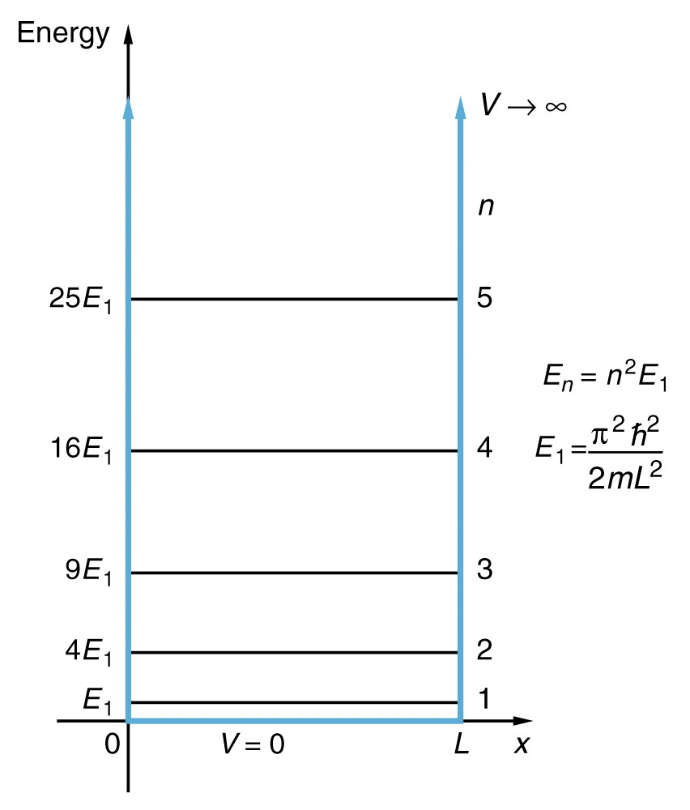
E quantized by B. C.’s
What is E?
A. can be any value (not quantized).
B.
D.
C.
E.
Does this L dependence make sense?
What value of L when E₂- E₁ = kT?
( when motion of e’s depends on wire size)
you should check,
I estimate L ~200 atoms
Notes:
Screwy rep…. Energy vs. space..!

Slide 47
Solving completely- everything there is to know about
electron in small metallic object (flat V(x) with high walls).
Normalize wavefunction …
Probability of finding electron between -∞ and ∞ must be 1.
(Did in Homework)

Slide 48
Results:
Quantized: k=nπ/L
Quantized:
0
L
Real(ψ)
n=1
0
L
What is potential energy of electron in the lowest energy state (n=1)?
a. E₁ b. 0 c. ∞
d. could be anything
For n=4
KE
Correct answer is b!
V=0 between 0 and L (We set it!)
→ So electron has KE = E1.
Notes:
Note two different energies plotted KE and PE!

