Slide 1
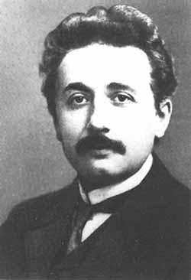
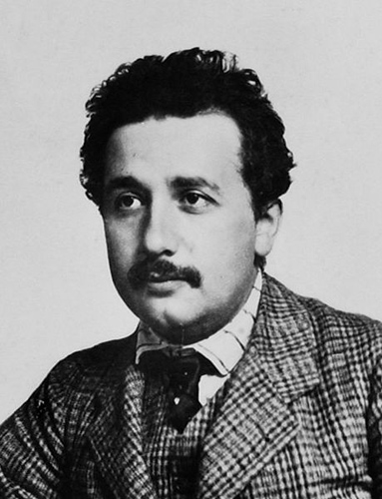
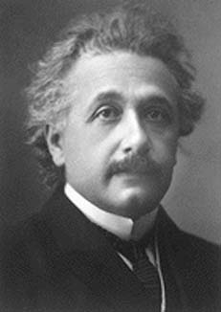
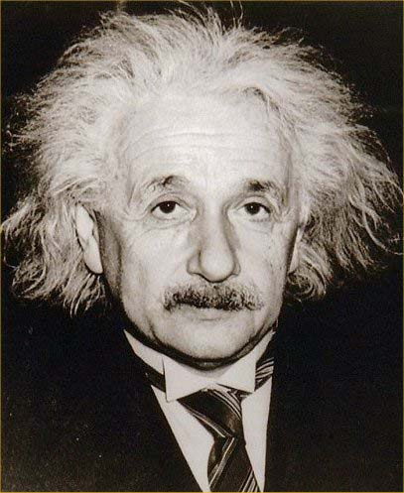
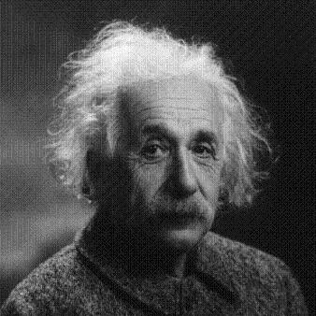
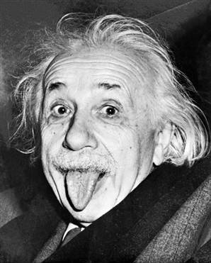
PH300 Modern Physics SP11
“The most incomprehensible thing about the world is that it is comprehensible.”– Albert Einstein
4/7 Day 21:
Questions?
Infinite/finite square well
Quantum tunneling
Next Week:
Tunneling
Alpha-decay and radioactivity
Scanning Tunneling Microscopes

Slide 2
Recently:
Waves and wave equations
Schrödinger equation, free particle
Square well potential
Today:
Infinite square well
Finite wells and electrons in wires
Quantum tunneling
Next Week:
alpha-decay & radioactivity
Scanning Tunneling Microscopes

Slide 3
0
L
Solving Schrod. equ.
Before tackling wire, understand simplest case.
Electron in free space, no electric fields or gravity around.
1. Where does it want to be?
2. What is V(x)?
3. What are boundary conditions on ψ(x)?
No preference- all x the same.
Constant.
None, could be anywhere.
Smart choice of
constant, V(x) = 0!

Slide 4
…makes sense, because
Condition on k is just saying that (p²)/2m = E.
V=0, so E= KE = ½ mv² = p²/2m
The total energy of the electron is:
Quantized according to E_{n} = (constant) x n², n= 1,2, 3,…
Quantized according to E_{n} = const. x (n)
Quantized according to E_{n} = const. x (1/n²)
Quantized according to some other condition but don’t know what it is.
Not quantized, energy can take on any value.
Ans: E - No boundary, energy can take on any value.

Slide 5
Nanotechnology: how small (short) does a wire have to be
before movement of electrons starts to depend on size
and shape due to quantum effects?
Look at energy level spacing compared to thermal energy, kT= 1/40 eV at room temp.
Calculate energy levels for electron in wire of length L.
Know spacing big for 1 atom, what L when ~1/40 eV?
0
L
Use time independ. Schrod. eq.
E
?
Figure out V(x), then figure out
how to solve, what solutions
mean physically.

Slide 6
0
L
Short copper wire, length L.
What is V(x)?
Remember photoelectric effect.
Took energy to kick electron out. So wants to be inside wire.
⎝ inside is lower PE.
Everywhere inside the same?

Slide 7
PE
+
+
+
+
+
+
+
+
+
+
1 atom
many atoms
but lot of e’s
move around
to lowest PE
repel other electrons = potential energy near that spot higher.
As more electrons fill in, potential energy for later ones gets
flatter and flatter. For top ones, is VERY flat.
Notes:
Note UP in one is energy.. Wire up is Y direction (don’t care about)

Slide 8
PE for electrons with most PE. “On top”
+ + + + + + + + + + + + + + + +
As more electrons fill in, potential energy for later ones gets
flatter and flatter. For top ones, is VERY flat.
How could you find out how deep the pit is for the top
electrons in copper wire?

Slide 9
work function of
copper = 4.7 eV
PE for electrons with most PE. “On top”
This is just the energy needed to remove them from the metal.
That is the work function!!
As more electrons fill in, potential energy for later ones gets
flatter and flatter. For top ones, is VERY flat.
How could you find out how deep the pit is for the top
electrons in copper wire?

Slide 10
4.7 eV
Energy
0
L
x
0 eV
x<0, V(x) = 4.7 eV
x> L, V(x) = 4.7 eV
0<x<L, V(x) =0
0 L
x
How to solve?
1. Mindless mathematical approach:
Find ψ in each region, make solutions match at boundaries, normalize.
Works, but bunch of math.
Notes:
Note… can move well around anywhere on graph!!!

Slide 11
0 L
4.7 eV
mathematically
V(x) = 4.7 eV for x<0 and x>L
V(x) = 0 eV for 0>x<L
0 eV
2. Clever approach:
Reasoning to simplify how to solve.
Electron energy not much more than ~kT=0.025 eV.
Where is electron likely to be?
What is the chance it will be outside of well?
A. zero chance B. very small chance, C. small, D. likely
B. 0.025 eV<< 4.7eV. So very small chance (e^{-4.7/.02}) an electron could have enough energy get out.
What does that say about boundary condition on ψ(x) ?
ψ(x) must be same x<0, 0<x<L, x>L
B. ψ(x<0) ~ 0, ψ(x>0) ≥ 0
C. ψ(x) ~ 0 except for 0<x<L
Ans: C

Slide 12
x<0, V(x) ~ infinite
x> L, V(x) ~ infinite
0<x<L, V(x) =0
Clever approach means
just have to solve:
Energy
with boundary conditions,
ψ(0)=ψ(L) =0
0
x
0
L
Solution a lot like microwave & guitar string

Slide 13
∞
∞
0 eV
0 L
functional form of solution:
Apply boundary conditions
x=0 → ?
→ A=0
x=L →
kL=nπ (n=1,2,3,4 …)
→ k=nπ/L
2
1
What is the momentum, p?

Slide 14
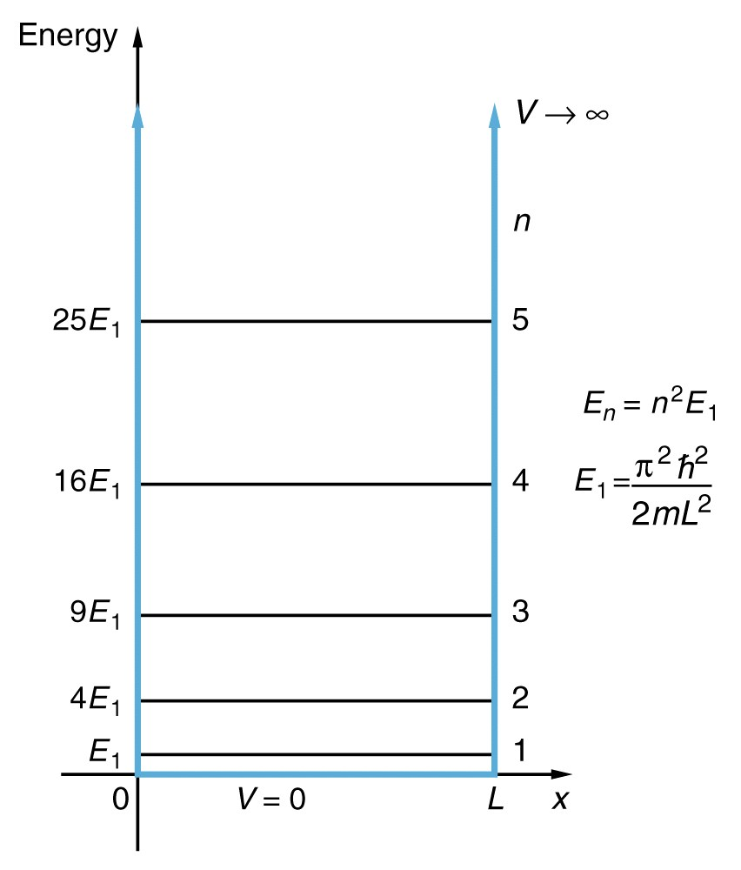
E quantized by B. C.’s
What is E?
A. can be any value (not quantized).
B.
D.
C.
E.
Does this L dependence make sense?
What value of L when E₂- E₁ = kT?
( when motion of e’s depends on wire size)
you should check,
I estimate L ~200 atoms
Notes:
Screwy rep…. Energy vs. space..!

Slide 15
Solving completely- everything there is to know about
electron in small metallic object (flat V(x) with high walls).
Normalize wavefunction …
Probability of finding electron between -∞ and ∞ must be 1.
(Did in Homework)

Slide 16
Results:
Quantized: k=nπ/L
Quantized:
0
L
Real(ψ)
n=1
0
L
What is potential energy of electron in the lowest energy state (n=1)?
a. E₁ b. 0 c. ∞
d. could be anything
For n=4
KE
Correct answer is b!
V=0 between 0 and L (We set it!)
→ So electron has KE = E1.
Notes:
Note two different energies plotted KE and PE!

Slide 17
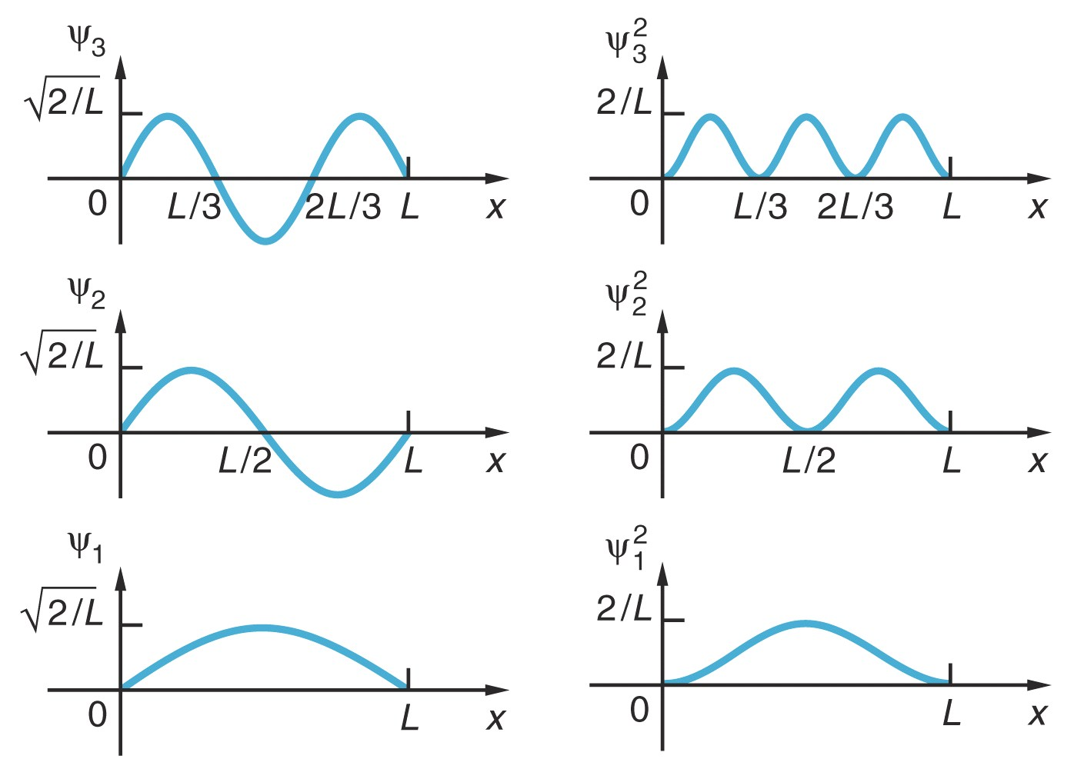
Quantized: k=nπ/L
Quantized:
How does probability of finding electron close to L/2 if in n = 3 excited state compared to probability for when n = 2 excited state?
much more likely for n=3.
B. equal prob. for both n = 2 and 3.
C. much more likely for n=2
Correct answer is a!
For n=2, ψ²=0
For n=3, ψ² at peak
Notes:
Even screwier.. Now note WAVE FUNCTION!!!! Vs. postion on energy graph

Slide 18
Careful about plotting representations….
V(x)
Energy
Total energy
E (n=3)
E (n=2)
E (n=1)
V=0 eV
0 L
x
ψ(x)
Careful… plotting 3 things on same graph: Potential Energy V(x)
Total Energy E
Wave Function ψ(x)
0

Slide 19
Quantized: k=nπ/L
Quantized:
ψ
n=2
What you expect classically:
Electron can have any energy
Electron is localized
What you get quantum mechanically:
Electron can only have specific
energies. (quantized)
Electron is delocalized
… spread out between 0 and L
Electron is not a localized particle bouncing back and forth!

Slide 20
Nanotechnology:
How small does a wire have to be before movement of electrons starts to depend on size and shape due to quantum effects?
Look at energy level spacing compared to thermal energy, kT= 1/40 eV at room temp.
V(x)
0
L
Energy
E
?
0
x
0
L
Notes:
Answer = 6.6 nm ~30 Atoms.

Slide 21
wire
Need to solve Schrodinger Eqn:
V(x)
4.7eV
Energy
E_{electron}
0
x
0
L
Region I
Region II
Region III
In Region III … total energy E < potential energy V
α is real
Positive
What functional forms of ψ(x) work?
a. e^{iαx} b. sin(αx) c. e^{αx} d. more than one of these

Slide 22
wire
V(x)
4.7eV
Energy
E_{electron}
0
x
0
L
Region I
Region II
Region III
In Region III … total energy E < potential energy V
α is real
Positive
Why not e^{iαx}?
Answer is C: e^{αx} … could also be e^{-αx}.
Exponential decay or growth
LHS
RHS

Slide 23
Back to case of wire with workfunction of 4.7 eV
4.7 eV = V₀
Energy
E_{particle}
0 eV
0 L
x
Positive number
Answer is (C) … could also be e^{-αx}.
Exponential decay or growth
ψ

Slide 24
Good Approximation:
Electrons never leave wire
ψ(x<0 or x>L) =0.
(OK when Energy << work function)
Exact Potential Energy curve (V):
Small chance electrons get out!
ψ(x<0 or x>L)~0, but not exactly 0!
V(x)
Energy
0
x
0
L
What happens if electron Energy bigger?
What if two wires very close to each other?
Then whether ψ leaks out a little or not is very important!
E(total)
Notes:
Infinite Work Function!!!!

Slide 25
Need to solve for exact Potential Energy curve:
V(x): small chance electrons get out of wire
ψ(x<0 or x>L)~0, but not exactly 0!
wire
Finite
Square Well
V(x)
Energy
Work function
0
x
0
L
Important for thinking about “Quantum tunneling”:
Scanning tunneling microscope to study surfaces
Radioactive decay
Notes:
Target.

Slide 26
wire
Need to solve Schrodinger Eqn:
V(x)
4.7eV
Energy
E_{electron}
0
x
0
L
Region I
Region II
Region III
In Region II … total energy E > potential energy V
k is real
Negative number
When E>V: Solutions = sin(kx), cos(kx), e^{ikx}.
Always expect sinusoidal (oscillatory) functions

Slide 27
wire
V(x)
4.7eV
Energy
E_{electron}
0
x
0
L
Region I
Region II
Region III
What will wave function in Region III look like?
What makes sense for constants A and B?
a. A must be 0 b. B must be 0 c. A and B must be equal
d. A=0 and B=0 e. A and B can be anything, need more info.

Slide 28
wire
V(x)
4.7eV
Energy
E_{electron}
0
x
0
L
Region I
Region II
Region III
What will wave function in Region III look like?
What makes sense for constants A and B?
Answer is a. A must be 0 .. otherwise ψ blows up as x gets bigger.
This doesn’t make physical sense!
ψ and probability should → 0 at large x!
Need to be able to normalize ψ

Slide 29
Outside well
(E<V):
(Region I)
Inside well (E>V):
(Region II)
Outside well (E<V):
(Region III)
4.7 eV
Energy
E_{electron}
V=0 eV
0 L
x
Boundary
Conditions:

Slide 30
Inside well (E>V):
Outside well (E<V):
4.7 eV
Energy
E_{electron}
V=0 eV
0 L
x
“Classically forbidden” region.
Electron is delocalized … spread out.
Some small part of wave is where the
total Energy is less than potential energy!

Slide 31
E_{electron}
0 L
wire
wire
If very very long wire gets closer and closer, what will happen?
a. electron is “shared” between wires, with fraction in each constant over time
b. the electron will flow away through wire 2
c. electron will jump back and forth between wire 1 and wire 2
d. electron stays in wire 1.
e. something else happens.

Slide 32
E_{electron}
0 L
wire
wire
If very very long wire gets closer and closer, what will happen?
a. electron is “shared” between wires, with fraction in each constant over time
b. the electron will flow away through wire 2
c. electron will jump back and forth between wire 1 and wire 2
d. electron stays in wire 1.
e. something else happens.

Slide 33
E_{electron}
0 L
wire
wire
If very very long wire gets closer and closer, what will happen?
a. electron is “shared” between wires, with fraction in each constant over time
b. the electron will flow away through wire 2
c. electron will jump back and forth between wire 1 and wire 2
d. electron stays in wire 1.
e. something else happens.
Notes:
Recall long wire E ~ 1/L^2

Slide 34
E_{electron}
0 L
1/α
wire
How far does wave extend into this “classically forbidden” region?
big -> quick decay
small -> slow decay
Measure of penetration depth = 1/α
ψ(x) decreases by factor of 1/e
For V-E = 4.7eV, 1/α ..9x10⁻¹¹ meters (very small ~ an atom!!!)

Slide 35
Inside well (E>V):
Outside well (E<V):
Energy
E_{particle}
V=0 eV
0 L
x
What changes could increase how far wave penetrates into classically forbidden region?
(And so affect chance of tunneling into adjacent wire)
Notes:
A: 63
B: 36
C: 1
163 responses

Slide 36
Thinking about α and penetration distance
Under what circumstances would you have a largest penetration?
Order each of the following case from smallest to largest.
Potential curve is changing.
Energy of the particle
is changing
V(x)
V(x)
E
E
E
E (Particle’s
Energy)
0
L
0
L

Slide 37
Thinking about α and penetration distance
Under what circumstances would you have a largest penetration?
Order each of the following case from smallest to largest.
CQ: Which cases correspond to
the smallest penetration?
A
C
V(x)
V(x)
A
D
E
B
D
E
B
C
E
E (Particle’s
Energy)
0
L
0
L
Notes:
A: 6
B: 3
C: 90
D: 1
158 responses

Slide 38
Thinking more about what α means
CQ: Which cases correspond to
the smallest penetration?
ψ(x) for x>L
Bigger diff
btwn V and E,
Larger α
Faster decay
Smaller penetration
L
C
V(x)
V(x)
E
E
C
E
E (Particle’s
Energy)
0
L
0
L

Slide 39
So the thinner and shorter the barrier, the easier it is to tunnel …
Energy
E_{particle}
V=0 eV
0 L
x
And particle can escape…
Application: Alpha-Decay, Scanning tunneling microscope

Slide 40
Radioactive decay
Nucleus is unstable → emits a particle
Typically found for large atoms with lots of protons and neutrons.
Alpha Decay → Nucleus emits an alpha particle
An alpha particle is 2 neutrons and 2 protons.
Radon-222
86 protons,
136 neutrons
Proton (positive charge)
Neutron (no charge)
Nucleus has lots of protons and lots of neutrons.
Two forces acting in nucleus:
- Coulomb force .. Protons really close together, so very big repulsion from coulomb force
- Nuclear force (attraction between nuclear particles is very strong if very close together) … called the STRONG Force.

Slide 41
Radioactive decay
Proton (positive charge)
Neutron (no charge)
In alpha-decay, an alpha-particle is emitted from the nucleus.
Radon-222
86 protons,
136 neutrons
This raises the ratio of neutrons to protons … makes for a more stable atom.
(Neutron are neutral.. no coulomb repulsion, but nuclear force attraction)

Slide 42
How does this happen…
Starting point always to look at potential energy curve for particle
+
Nucleus
(Z protons,
Bunch o’ neutrons)
New nucleus
(Z-2 protons,
Bunch o’ neutrons)
Alpha particle
(2 protons,
2 neutrons)
Look at this system… as the distance between the alpha particle and the nucleus changes.
As bring α closer,
What happens to potential energy?
(Z-2)
V=0
At a great distance

Slide 43
How does this happen…
Starting point always to look at potential energy curve for particle
As bring α closer, what happens to potential energy?
V=0 At a great distance
A
V(r)
r
C
V(r)
r
B
V(r)
D. Something else
r
Notes:
A: 19
B: 78
C: 1
D: 2
161 responses

Slide 44
How does this happen…
Starting point always to look at potential energy curve for particle
As bring α closer,
What happens to potential energy?
V=0 At a great distance
B
V(r)
Takes energy to push α towards the nucleus, so potential energy must increase.

