Slide 1
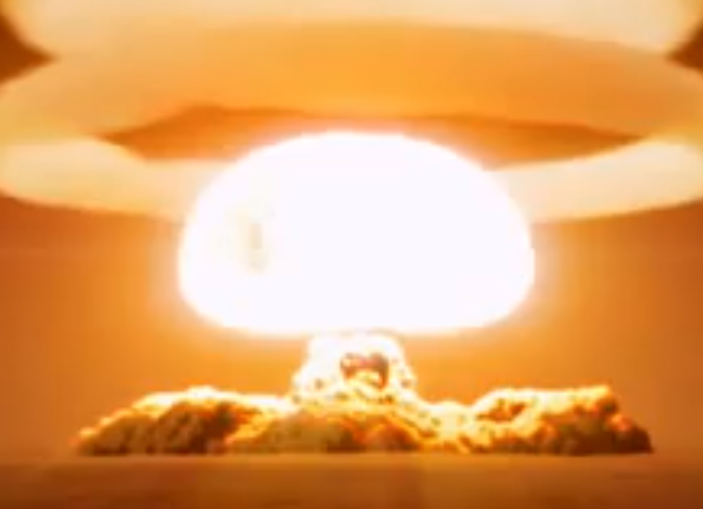
PH300 Modern Physics SP11
“I am one of those who think like Nobel, that humanity will draw more good than evil from new discoveries.”
– Marie Curie
4/12 Day 22:
Questions?
Tunneling
Alpha-decay, radioactivity
Thursday:
Radioactivity
Scanning Tunneling Microscopes

Slide 2
Recently:
Schrödinger equation, free particle
Square well potential
Quantum tunneling
Today:
Tunneling (cont.)
Alpha-decay
Radioactivity
Thursday:
Radioactivity (cont.)
Scanning Tunneling Microscopes

Slide 3
E_{electron}
0 L
1/α
wire
How far does wave extend into this “classically forbidden” region?
big -> quick decay
small -> slow decay
Measure of penetration depth = 1/α
ψ(x) decreases by factor of 1/e
For V-E = 4.7eV, 1/α = 9x10⁻¹¹ meters (very small ~ an atom!!!)

Slide 4
Inside well (E>V):
Outside well (E<V):
Energy
E_{particle}
V=0 eV
0 L
x
What changes could increase how far wave penetrates into classically forbidden region?
(And so affect chance of tunneling into adjacent wire)
Notes:
A: 63
B: 36
C: 1
163 responses

Slide 5
Thinking about α and penetration distance
Under what circumstances would you have largest penetration?
Order each of the following case from smallest to largest.
Potential curve is changing.
Energy of the particle
is changing
V(x)
V(x)
E
E
E
E (Particle’s
Energy)
0
L
0
L

Slide 6
Thinking about α and penetration distance
Under what circumstances would you have largest penetration?
Order each of the following case from smallest to largest.
CQ: Which cases correspond to
the smallest penetration?
A
C
V(x)
V(x)
A
D
E
B
D
E
B
C
E
E (Particle’s
Energy)
0
L
0
L
Notes:
A: 6
B: 3
C: 90
D: 1
158 responses

Slide 7
Thinking more about what α means:
CQ: Which cases correspond to
the smallest penetration?
ψ(x) for x>L
Bigger difference
btwn V and E ➔
Larger α
Faster decay
Smaller penetration
L
C
V(x)
V(x)
E
E
C
E
E (Particle’s
Energy)
0
L
0
L

Slide 8
So the thinner and shorter the barrier, the easier it is to tunnel …
Energy
E_{particle}
V=0 eV
0 L
x
…and electron can escape.
Application: Alpha-Decay, Scanning tunneling microscope

Slide 9
Radioactive decay
Nucleus is unstable → emits a particle
Typically found for large atoms with lots of protons and neutrons.
Alpha Decay → Nucleus emits an alpha particle
An alpha particle is 2 neutrons and 2 protons.
Radon-222
86 protons,
136 neutrons
Proton (positive charge)
Neutron (no charge)
Nucleus has lots of protons and lots of neutrons.
Two forces acting in nucleus:
- Coulomb force .. Protons really close together, so very big repulsion from coulomb force
- Nuclear force (attraction between nuclear particles is very strong if very close together) … called the STRONG Force.

Slide 10
Radioactive decay
Proton (positive charge)
Neutron (no charge)
In alpha-decay, an alpha-particle is emitted from the nucleus.
Radon-222
86 protons,
136 neutrons
This raises the ratio of neutrons to protons … makes for a more stable atom.
(Neutrons are neutral.. no coulomb repulsion, but nuclear force attraction)

Slide 11
How does this happen?
Starting point always to look at potential energy curve for particle
+
Nucleus
(Z protons,
Bunch o’ neutrons)
New nucleus
(Z-2 protons,
Bunch o’ neutrons)
Alpha particle
(2 protons,
2 neutrons)
Look at this system… as the distance between the alpha particle and the nucleus changes.
As we bring α-particle closer,
what happens to potential energy?
(Z-2)
V=0
At a great distance

Slide 12
How does this happen?
Starting point always to look at potential energy curve for particle
As we bring α-particle closer, what happens to potential energy?
V=0 At a great distance
A
V(r)
r
C
V(r)
r
B
V(r)
D. Something else
r
Notes:
A: 19
B: 78
C: 1
D: 2
161 responses

Slide 13
How does this happen…
Starting point always to look at potential energy curve for particle
As we bring α−παρτιχλε closer,
what happens to potential energy?
V=0 At a great distance
B
V(r)
Takes energy to push α-particle towards the nucleus, so potential energy must increase.

Slide 14
What if proton starts out going towards nitrogen
nucleus with a lot of speed (lots of kinetic energy)?
Starts with lots of kinetic energy →
Repelling force from nucleus slows down proton →
Proton’s kinetic energy converted into electrostatic potential energy
as it gets closer to nucleus
r, separation distance
Potential energy curves-
represent energy to bring
particles together.
Potential energy
Kinetic energy
Gravity energy analogy:
separation distance, r
If at center, want to roll down hill/fly apart … lots of electrostatic potential energy

Slide 15
Potential energy curves- represent energy to bring particles together.
r, separation distance
Consider Simple Case:
Oxygen and 1 proton
Potential energy
Kinetic energy
separation distance, r
Potential energy = k x charge of 7 nucl. protons x charge of single proton
at separation (separation distance)
distance of r
Charge of 1 proton = 1.6 x 10⁻¹⁹ Coulombs; Charge of 7 protons=11.2 x 10⁻¹⁹ C
So at 10⁻¹⁵ m away (~ radius of nucleus),
Potential energy = 8.99 x 10⁹ N m²/C² x 11.2 x 10⁻¹⁹ C x 1.6 x 10⁻¹⁹ C
(10⁻¹⁵ m)
= 1.61 x 10⁻¹² Joules = 10 million electron Volts.

Slide 16
Potential energy curve for proton approaching nucleus
Energy scale gigantic compared
to chemical energy.
Why? Simple coulomb’s law.
F= k (charge of #1)(charge of #2)
r²
Chemistry- forces between electrons and protons on distance scale of atomic size
(> 10⁻¹⁰ m).
Nuclear forces- forces between protons on distance scale
10-100,000 times smaller.
10,000 times closer means forces 100,000,000 times bigger because of 1/r². Lots more potential energy stored!!!
electrostatic
repulsion
separation distance, r
attractive
nuclear
combination--real nucleus
separation distance, r

Slide 17
Each element has different number of protons.
Atom ingredients:
Proton (positive charge) – charge = 1.6 x 10⁻¹⁹ Coulombs
mass = 1.66 x 10⁻²⁷ kg.
Neutron (no charge) – no charge
mass = 1.66 x 10⁻²⁷ kg.
Electron (negative charge) – charge = -1.6 x 10⁻¹⁹ Coulombs mass = 9.10 x 10⁻³¹ kg.
hydrogen
1 p
deuterium
1 p, 1n
helium
2 p, 2 n
Uranium 238
92 p, 146 n

Slide 18
Atomic nuclei
Gets deeper until iron (26 P, 30 N) less deep if bigger.
helium
beryllium
harder to push together,
but bigger drop when do.
Really stable:
Have to add a whole bunch of energy to break up!
Really big nucleus, >100 P, >100 N,
like Uranium or Plutonium

Slide 19
Nuclear decay- one kind of nucleus changes into another.
alpha decay, beta decay, induced fission
Alpha decay: α-particle = 2p and 2n.
Most radioactivity is this type (e.g. radon).
2P-2N
If alpha particle, finds itself outside, lots of PE, zooms away PE→KE

Slide 20
Starting point always to look at potential energy curve for particle
Bring alpha-particle closer
Coulomb
&Nuclear
30 MeV
V(r)
Coulomb force dominates
r
Energy
Edge of the nucleus (~8x10⁻¹⁵ m),
nuclear (Strong) force starts acting.
Strong attraction between nucleons.
Potential energy drops dramatically.

Slide 21
Observations show Alpha-particles exit with a range of energies
30 MeV
V(r)
4 to 9MeV
of KE
Inside α
particle can
form and has
lots of KE

Slide 22
How does this happen?
Starting point always to look at potential energy curve for particle
30 MeV
V(r)
4MeV of KE
100MeV of KE
Notes:
WHY DOES 100 MeV show up on this 4MeV line?
What aout 30MeV?

Slide 23
Observe α-particles from different isotopes (same protons, different neutrons), exit with different amounts of energy.
30 MeV (Same peak height if protons same)
V(r)
Decay constant:
9MeV KE
4MeV KE
Was one or the other more likely to tunnel through? And WHY???
a. the 9MeV alpha particle was more likely
b. the 4MeV alpha particle was more likely
c. both had the same probability of tunneling
Notes:
A: 71
B: 19
C: 10
158 responses

Slide 24
Observe α-particles from different isotopes (same protons, different neutrons), exit with different amounts of energy.
1. Less distance to tunnel.
2. Decay constant always smaller
3. Wave function doesn’t decay as much before reaches other side … more probable!
30 MeV
V(r)
9MeV KE
4MeV KE
Answer is a.
The 9 MeV electron more probable…
Isotopes that emit higher energy alpha particles, have shorter lifetimes!!!

Slide 25
Solving Schrodinger equation for this potential energy is hard!
Square barrier is much easier… and get almost the same answer!
V(x)
V(x)

Slide 26
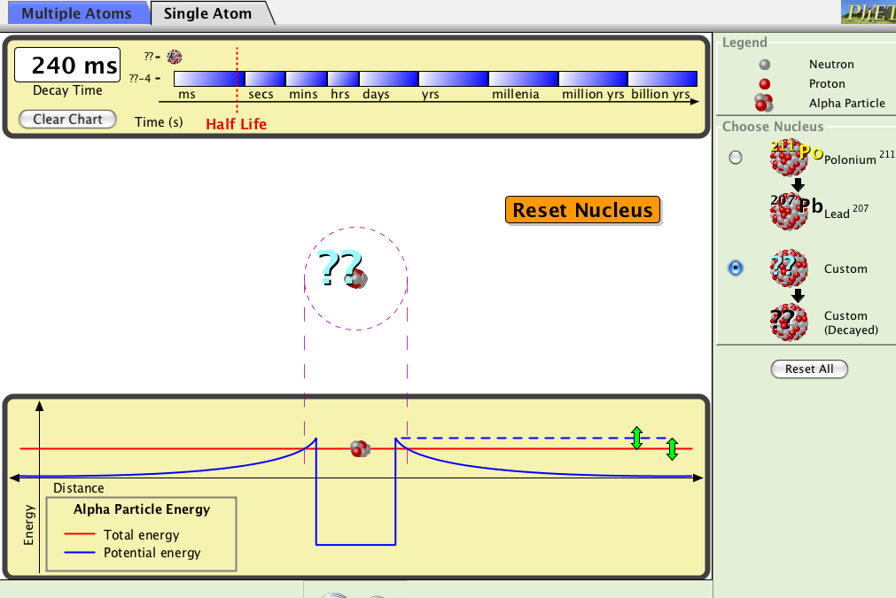
Alpha decay

Slide 27
tunneling difficulty = width x depth of tunnel
E
nucleus1
2
3
hard- takes long time,
billions of years!
medium
easy!,
happens in
millionths of
a second!
How much energy released?
a. 1 most, 2 second, 3 least
b. 2 most, 1, 3 least
c. 3 most, 2, 1 least
d. 3 most, 1, 2 least
Energy is difference from
bottom of crater to outside.
3 is most, 2 second, 1 is least

Slide 28
Radioactive decay-fission
Neutron Induced fission- key to atomic bombs
two smaller nuclei
few extra free neutrons
LOTS OF ENERGY!!
(+sometimes other bad stuff)
Neutron
“parent” nucleus
“daughter” nuclei
“daughter” nuclei – come out in excited nuclear energy state
…. Give off gamma rays as drop to lower energy.
Jumps down in energy …
Gives off gamma ray…
VERY HIGH ENERGY PHOTON

Slide 29
Neutron Induced fission - key to atomic bombs
N
two smaller nuclei
few extra free neutrons
LOTS OF ENERGY!!
(+sometimes other bad stuff)
“parent” nucleus
“daughter” nuclei
N
Neutron absorbed →
Excites U235 nucleus up above potential barrier →
Splits into two smaller nuclei…
which zoom apart due to electrostatic repulsion!
Uranium 235
92 p, 143 n

Slide 30
Neutron induced fission
If don’t get swallowed
the 3 free neutrons can induce more fission.
Ur 235
Chain reaction: neutrons making fission that makes more neutrons, that makes more
fission that makes more neutrons, that makes more fission that makes
more neutrons, that makes more fission that makes more
neutrons, that makes more fission that makes
more neutrons, that makes more fission that makes more neutrons, that makes more

Slide 31
Fission Nuclear explosion
“atomic bomb”
2nd generation
1st generation
Uranium 235
or plutonium

Slide 33
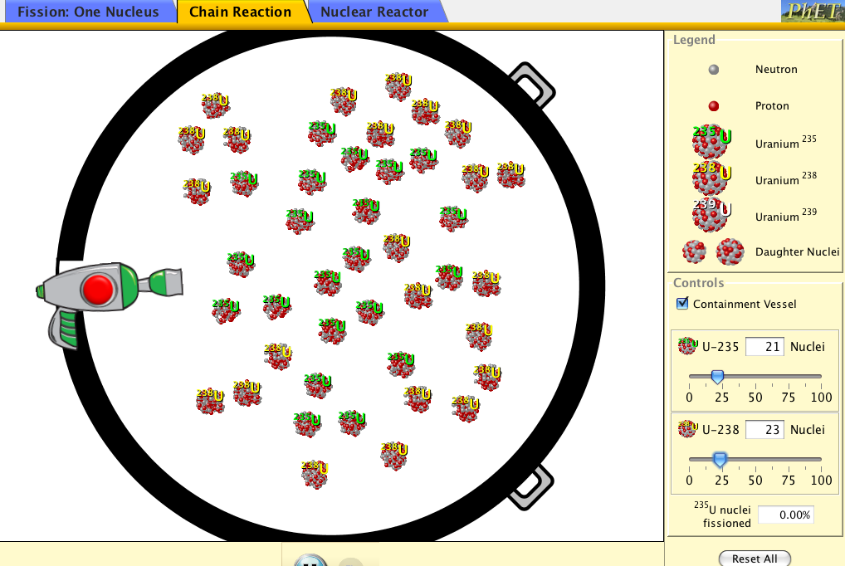
A useful simulation
http://phet.colorado.edu/simulations/sims.php?sim=Nuclear_Fission

Slide 34
CHAIN REACTION
Fission Nuclear explosion:
“atomic bomb”
Many
Generations:
3rd, 4th, 5th, …
2nd generation
1st generation
Very special stuff:
Uranium 235
or plutonium
Why U 235 & not U 238? U 238 has 3 extra neutrons help hold it together. Deeper crater in potential energy.
vs
Eats extra neutrons!
238
235

Slide 35
U235 and U238 atoms are placed into a container, which are likely to result in a chain reaction (resulting in explosion) when a free neutron triggers fission of one of the U235:
#5
#1
#2
#3
#4
#2 only
#1, #2, and #5
#2 and #4
#2, #3, and #4
#2, #4, and #5.
Lots of uranium in the ground…
why doesn’t just blow up?
Correct answer is c. (#2 and #4) Analysis:
#1 is too sparse .. most neutrons will leave box before hitting another U235.
#2 is good.. Pure U235, densely packed, large package
#3 has too many U238’s… more U238’s than 235’s. Free neutrons more likely to be absorbed by 238’s than to hit and fission another 235.
#4 is OK … More U235’s than 238’s, still densely packed, large package
#5 is too small of package … neutrons likely to escape package before hitting another U235.

Slide 36
A useful simulation
http://phet.colorado.edu/simulations/sims.php?sim=Nuclear_Fission

Slide 37
Recipe for fission bomb.
Find neutron induced fissionable material that produces bunch of extra free neutrons when fissions.
Sift it well to remove all the other material that will harmlessly swallow up the extra neutrons. (THE HARDEST STEP.)
3. Assemble “supercritical mass”, really fast!. Need enough stuff that the neutrons run into other nuclei rather than just harmlessly leaving sample.
If your mass tends to melt with a small
fizzle you are not assembling fast enough to be supercritical. Put together faster.
4. Let sit for 1 millionth of a second- will bake itself!

Slide 38
Fission bomb (basic picture)
chemical explosive
Plutonium or 235 Uran.
1. set off chemical
explosive, assembles
supercritical mass.
2. nuclear chain
reaction- fission
bomb.
chemical explosive

Slide 39
Fusion bomb or “hydrogen bomb”
Basic process like in sun. Stick small nuclei together.
Deuterium on Tritium
Deuterium on Deuterium
Which will release more energy during fusion?
Deuterium combining with deuterium
Deuterium combining with tritium
Answer is b. Incoming deuterium particle has comparatively more potential energy!

Slide 40
Fusion bomb or “hydrogen bomb”
Basic process like in sun. Stick small nuclei together.
activation energy of 100 million degrees
push together
energy required
Stick hydrogen isotopes
together to make helium.
energy released if push over the hump
+ =
helium
Simple if can push hard enough- just use fission bomb!
More energy per atom than fission. Can use LOTS of hydrogen.
End up with GIGANTIC bombs
1000 times bigger than first fission bombs
http://www.youtube.com/watch?v=WwlNPhn64TA

Slide 41
Fusion bomb (simple picture)
chemical explosive
hydrogen isotopes
tritium,deuterium
Plutonium “trigger”
chemical explosive
Shaped plutonium and assembled bombs at Rocky Flats.

Slide 42
Plutonium reaches
supercritical, explodes.
(fission bomb)

Slide 43
Plutonium reaches
supercritical, explodes.
Tritium etc. nuclei pushed together
and combine to form helium.

Slide 44
Energy:
1 fission of Uranium 235 releases:
~10⁻¹¹ Joules of energy
1 fusion event of 2 hydrogen atoms:
~10⁻¹³ Joules of energy
Burning 1 molecule of TNT releases:
~10⁻¹⁸ Joules of energy
1 green photon:
~10 ⁻¹⁹ Joules of energy
Dropping 1 quart of water 4 inches ~ 1J of energy
Useful exercise… compare this volume of TNT, H2, and U235

Slide 45
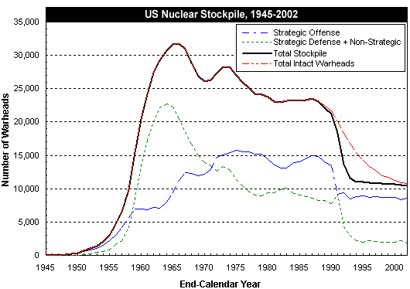
US Nuclear weapons
US sizes = 170kTon-310kTon
Russian as large as 100MTon

Slide 46
In the first plutonium bomb a 6.1 kg sphere of plutonium was used and the explosion produced the energy equivalent of 22 ktons of TNT = 8.8 x 10¹³ J.
17% of the plutonium atoms underwent fission.

Slide 47
In atomic bomb, roughly 20% of Pl or Ur decays by induced fission.
This means that after an explosion there are…
about 20% fewer atomic nuclei than before with correspondingly fewer total neutrons and protons,
20% fewer atomic nuclei but about same total neutrons and protons.
about same total neutrons and protons and more atomic nuclei.
almost no atomic nuclei left, just whole bunch of isolated neutrons and protons
almost nothing of Ur or Pl left, all went into energy.
ans. c. Makes and spreads around lots of weird radioactive “daughter” nuclei (iodine etc.) that can be absorbed by people and plants and decay slowly giving off damaging radiation.
Lots of free neutrons directly from explosion can also induce radioactivity in some other nuclei.

Slide 48
Alpha particles: helium nuclei
- most of radiation is this type
- common is Radon (comes from natural decay process of U²³⁸), only really bad because Radon is a gas .. Gets into lungs, if decays there bad for cell.
In air:
Travels ~2 cm ionizing air molecules and slowing down …
eventually turns into He atom with electrons
If decays in lung, hits cell and busts up DNA and other molecules:
+
+
Usually doesn’t get far -- because it hits things
Beta particles:
energetic electrons … behavior similar to alpha particles, but smaller and higher energy

Slide 49
Sources of Gamma Radiation
two smaller nuclei
few extra free neutrons
LOTS OF ENERGY!!
(+sometimes other bad stuff)
Neutron
“parent” nucleus
“daughter” nuclei
“daughter” nuclei – come out in excited nuclear energy state
…. Give off gamma rays as drop to lower energy.
Jumps down in energy …
Gives off gamma ray…
VERY HIGH ENERGY PHOTON

Slide 50
gamma rays: high-energy photons
- So high energy can pass through things (walls, your body) without being absorbed, but if absorbed really bad!
In air:
Can travel long distances until absorbed
In body, if absorbed by DNA or other molecule in cell …
damages cell… can lead to cancer.
+
+
Most likely
If pass through without interacting with
anything in cell then no damage.

Slide 51
+
Also break DNA➔ cancer
+
But also can cure cancer- Concentrate radiation on cancer cells to kill them.

Slide 52
An odd world…
You find yourself in some diabolical plot where you are given an alpha (α) source, beta (β) source, and gamma (γ) source. You must eat one, put one in your pocket and hold one in your hand. You …
a) α hand, β pocket, γ eat
b) β hand, γ pocket, α eat
c) γ hand, α pocket, β eat
d) β hand, α pocket, γ eat
e) α hand, γ pocket, β eat
α - very bad, but easy to stop -- your skin / clothes stop it
β - quite bad, hard to stop -- pass into your body -- keep far away
γ - bad, but really hard to stop--- rarely rarely gets absorbed
Me--- I pick (d)---

Slide 53
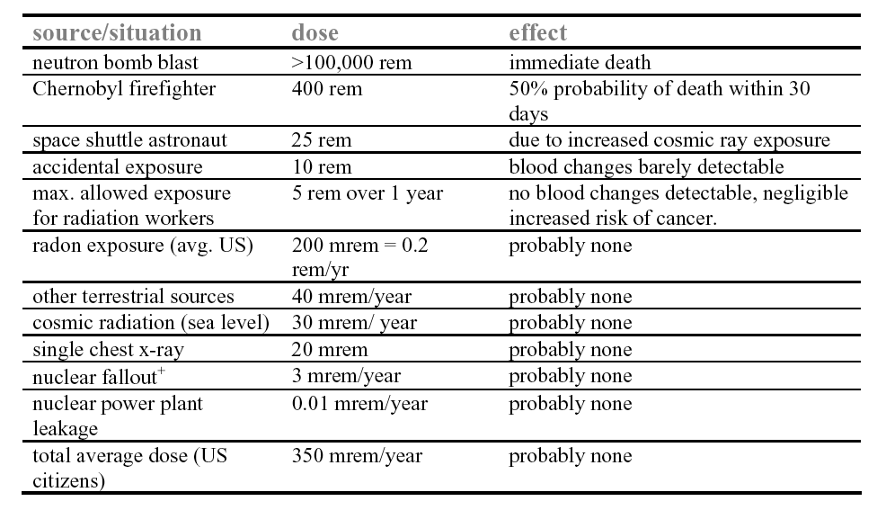
Results of radiation
~4,000 counts/min = .002 Rem/hr
dose in rem = dose in rad x RBE factor (relative biological effectiveness)
RBE = 1 for γ , 1.6 for β, and 20 for α.
A rad is the amount of radiation which deposits 0.01 J of energy into 1 kg of absorbing material.
+ πριμαριλψ δυε το ατμοσπηεριχ τεστινγ οφ νυχλεαρ ωεαπονσ βψ ΥΣ ανδ ΥΣΣΡ ιν τηε 50’σ ανδ εαρλψ
60’σ, πριορ το τηε νυχλεαρ τεστ−βαν τρεατψ ωηιχη φορβιδ αβοϖε−γρουνδ τεστινγ.

