Slide 1
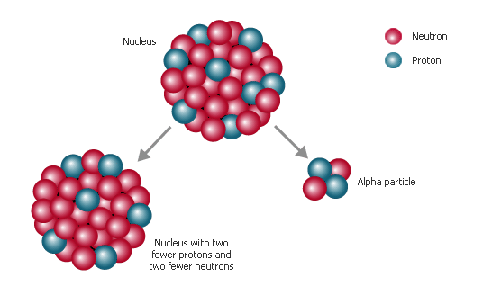
PH300 Modern Physics SP11
What did you think about the Tutorials?
  I learned something cool about tunneling
  I got through it pretty well and learned a bit
  It was fun but I didn’t learn much
  It wasn’t much fun and I didn’t learn much
  How come Noah hates us so much?
I know not with what weapons World War III will be fought, but World War IV will be fought with sticks and stones. - A. Einstein
Next Week:
Hydrogen Atom
Periodic Table
Molecular Bonding
4/14 Day 23:
Questions?
Radioactivity & STM

Slide 2
Final Essay
Three options:
A) There is only a final paper, and no essay portion on the final.
B) People may choose, but those who turn in a paper will have more time on M/C than those who do not.
C) No final paper, only an essay portion on the exam for everyone.

Slide 3
Recently:
  Quantum tunneling
  Alpha-Decay
  Radioactivity
Today:
  Radioactivity (cont.)
  Scanning Tunneling Microscopes
  Other examples…
Next 2 weeks:
  Schrodinger equation in 3-D
  Hydrogen atom
  Periodic table of elements
  Bonding

Slide 4
Energy:
1 fission of Uranium 235 releases:
~10⁻¹¹ Joules of energy
1 fusion event of 2 hydrogen atoms:
~10⁻¹³ Joules of energy
Burning 1 molecule of TNT releases:
~10⁻¹⁸ Joules of energy
1 green photon:
~10 ⁻¹⁹ Joules of energy
Dropping 1 quart of water 4 inches ~ 1J of energy
Useful exercise… compare this volume of TNT, H2, and U235

Slide 5
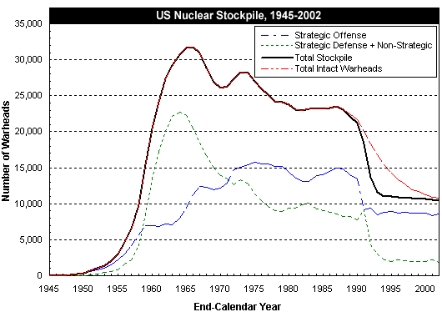
US Nuclear weapons
US sizes = 170kTon-310kTon
Russian as large as 100MTon

Slide 6
In the first plutonium bomb a 6.1 kg sphere of plutonium was used and the explosion produced the energy equivalent of
22 ktons of TNT = 8.8 x 10¹³ J.
17% of the plutonium atoms underwent fission.

Slide 7
In atomic bomb, roughly 20% of Pl or Ur decays by induced fission.
This means that after an explosion there are…
about 20% fewer atomic nuclei than before with correspondingly fewer total neutrons and protons,
20% fewer atomic nuclei but about same total neutrons and protons.
about same total neutrons and protons and more atomic nuclei.
almost no atomic nuclei left, just whole bunch of isolated neutrons and protons
almost nothing of Ur or Pl left, all went into energy.
ans. c. Makes and spreads around lots of weird radioactive “daughter” nuclei (iodine etc.) that can be absorbed by people and plants and decay slowly giving off damaging radiation.
Lots of free neutrons directly from explosion can also induce radioactivity in some other nuclei.

Slide 8
Alpha particles: helium nuclei
- most of radiation is this type
- common is Radon (comes from natural decay process of U²³⁸), only really bad because Radon is a gas .. Gets into lungs, if decays there bad for cell.
In air:
Travels ~2 cm ionizing air molecules and slowing down …
eventually turns into He atom with electrons
If decays in lung, hits cell and busts up DNA and other molecules:
+
+
Usually doesn’t get far -- because it hits things
Beta particles:
energetic electrons … behavior similar to alpha particles, but smaller and higher energy

Slide 9
Sources of Gamma Radiation
two smaller nuclei
few extra free neutrons
LOTS OF ENERGY!!
(+sometimes other bad stuff)
Neutron
“parent” nucleus
“daughter” nuclei
“daughter” nuclei – come out in excited nuclear energy state
…. Give off gamma rays as drop to lower energy.
Jumps down in energy …
Gives off gamma ray…
VERY HIGH ENERGY PHOTON

Slide 10
gamma rays: high-energy photons
- So high energy can pass through things (walls, your body) without being absorbed, but if absorbed really bad!
In air:
Can travel long distances until absorbed
In body, if absorbed by DNA or other molecule in cell …
damages cell… can lead to cancer.
+
+
Most likely
If pass through without interacting with
anything in cell then no damage.

Slide 11
+
Also break DNA➔ cancer
+
But also can cure cancer- Concentrate radiation on cancer cells to kill them.

Slide 12
An odd world…
You find yourself in some diabolical plot where you are given an alpha (α) source, beta (β) source, and gamma (γ) source. You must eat one, put one in your pocket and hold one in your hand. Your choices:
  a) α hand, β pocket, γ eat
  b) β hand, γ pocket, α eat
  c) γ hand, α pocket, β eat
  d) β hand, α pocket, γ eat
  e) α hand, γ pocket, β eat
α - very bad, but easy to stop -- your skin / clothes stop it
β - quite bad, hard to stop -- pass into your body -- keep far away
γ - bad, but really hard to stop--- rarely rarely gets absorbed
Me--- I pick (d)---

Slide 13
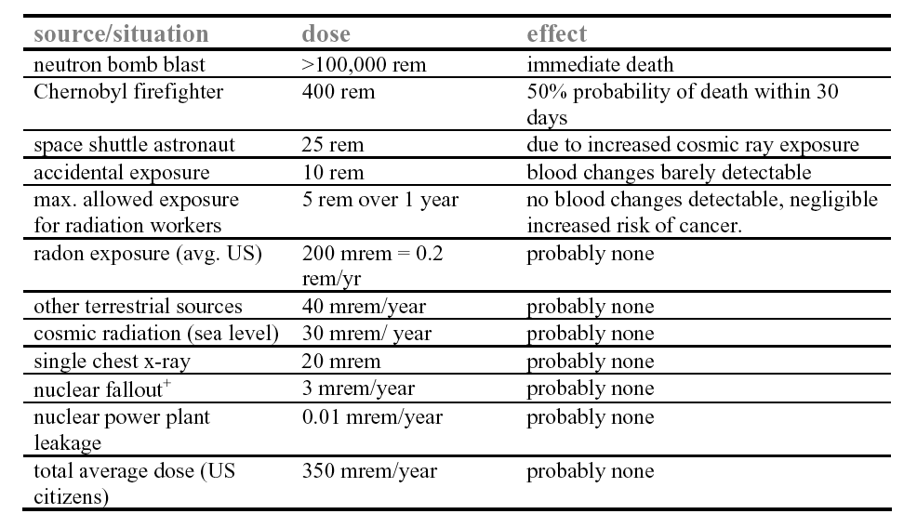
Results of radiation
~4,000 counts/min = .002 Rem/hr
dose in rem = dose in rad x RBE factor (relative biological effectiveness)
RBE = 1 for ϒ , 1.6 for β, and 20 for α.
A rad is the amount of radiation which deposits 0.01 J of energy into 1 kg of absorbing material.
+ πριμαριλψ δυε το ατμοσπηεριχ τεστινγ οφ νυχλεαρ ωεαπονσ βψ ΥΣ ανδ ΥΣΣΡ ιν τηε 50’σ ανδ εαρλψ
60’σ, πριορ το τηε νυχλεαρ τεστ−βαν τρεατψ ωηιχη φορβιδ αβοϖε−γρουνδ τεστινγ.

Slide 14
Effect Dose
Blood count changes 50 rem
Vomiting (threshold) 100 rem
Mortality (threshold) 150 rem
LD_{50/60} 320 – 360 rem
(with minimal supportive care)
LD_{50/60} 480 – 540 rem
(with supportive medical treatment)
100% mortality 800 rem
(with best available treatment)
Short-Term Risk:

Slide 15
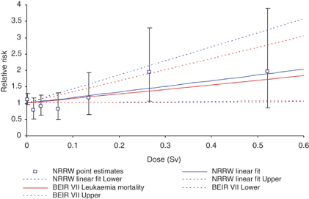
Long-Term Risk:
1 Sievert = 1 rem

Slide 16
Each of these contributes the same increased risk of death (+1 in a million):
Smoking 1.4 cigarettes in a lifetime (lung cancer)
Eating 40 tablespoons of peanut butter (aflatoxin)
Spending two days in New York City (air pollution)
Driving 40 miles in a car (accident)
Flying 2500 miles in a jet (accident)
Canoeing for 6 minutes (drowning)
Receiving a dose of 10 mrem of radiation (cancer)

Slide 17
Substance Half-Life
Polonium-215 0.0018 s
Bismuth-212 1 hour
Iodine-131 8 days
Cesium-137 30 years
Plutonium-239 1620 years
Uranium-235 710 million yrs
Uranium-238 4.5 billion yrs
Greatest danger from intermediate half-lives!

Slide 18

The International Nuclear and Radiological Event Scale

Slide 19
The highest cesium-137 levels found in soil samples in some villages near Chernobyl were 5 million Bq/m².
(1 Bequerel = 1 decay/second)
March 20: Similar levels of cesium-137 measured in the soil
at a location 40 km northwest from Fukushima plant.
April 12: Strontium-90 (half-life: 30 years) found near
Fukushima plant.
If preliminary information is correct, Fukushima
could already the worst nuclear disaster in history…

Slide 20
Rest of today:
other applications of tunneling in real world
Scanning tunneling microscope (STM):
how QM tunneling lets us map individual atoms on surface
Interesting example not time to cover but in notes:
  Sparks and corona discharge (also known as field emission) electrons popping out of materials when voltage applied.
  Many places including plasma displays.

Slide 21
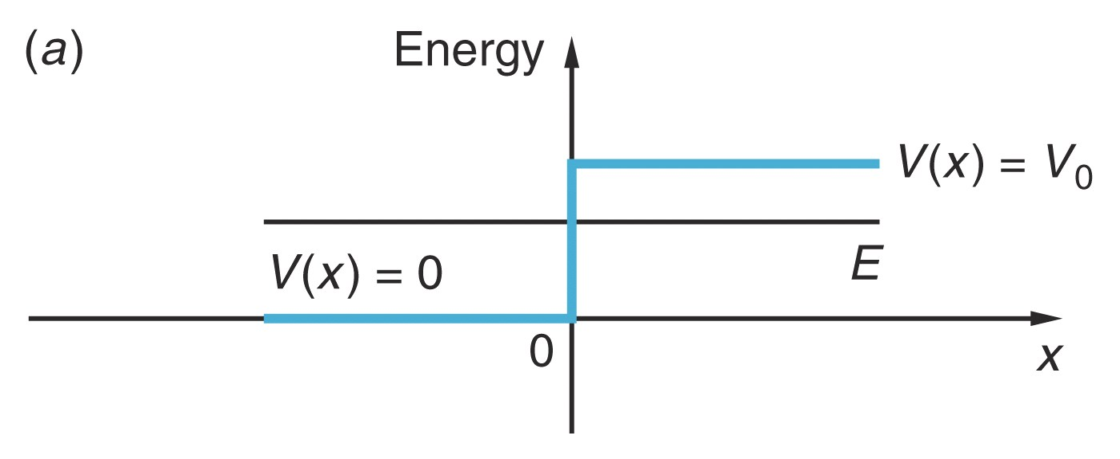
warm up on what
electron does at barrier
then apply
If the total energy E of the electron is LESS than the work function of the metal, V₀, when the electron reaches the end of the wire, it will…
stop.
be reflected back.
exit the wire and keep moving to the right.
either be reflected or transmitted with some probability.
dance around and sing, “I love quantum mechanics!”

Slide 22
If the total energy E of the electron is LESS than the work function of the metal, V₀, when the electron reaches the end of the wire, it will…
Quantum physics is not so weird that electron can keep going forever in region where V>E. Remember that ψ decays exponentially in this region!
stop.
be reflected back.
exit the wire and keep moving to the right.
either be reflected or transmitted with some probability.
dance around and sing, “I love quantum mechanics!”

Slide 23
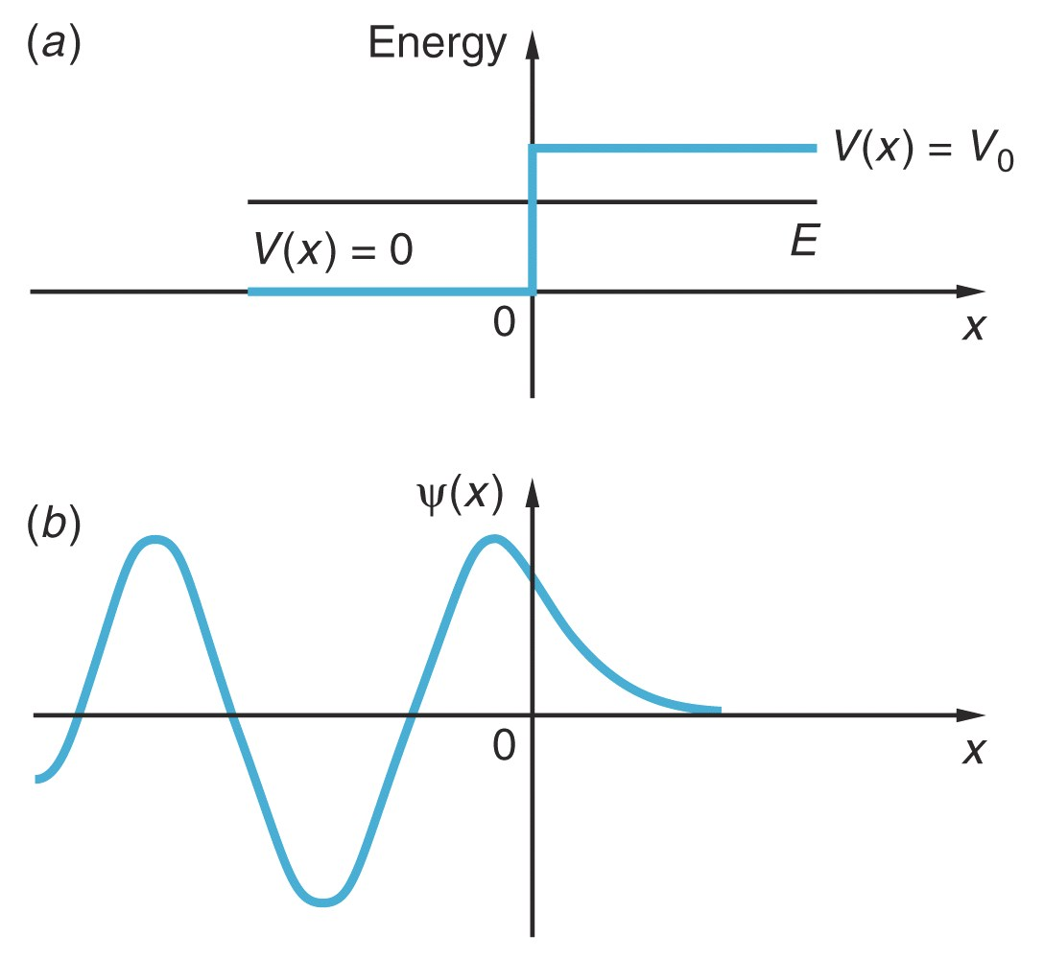
Once you have amplitudes,can draw wave function:
Real( )
Electron penetrates into barrier, but reflected eventually.
“transmitted” means continues
off to right forever. Wave function not go down to zero.

Slide 24
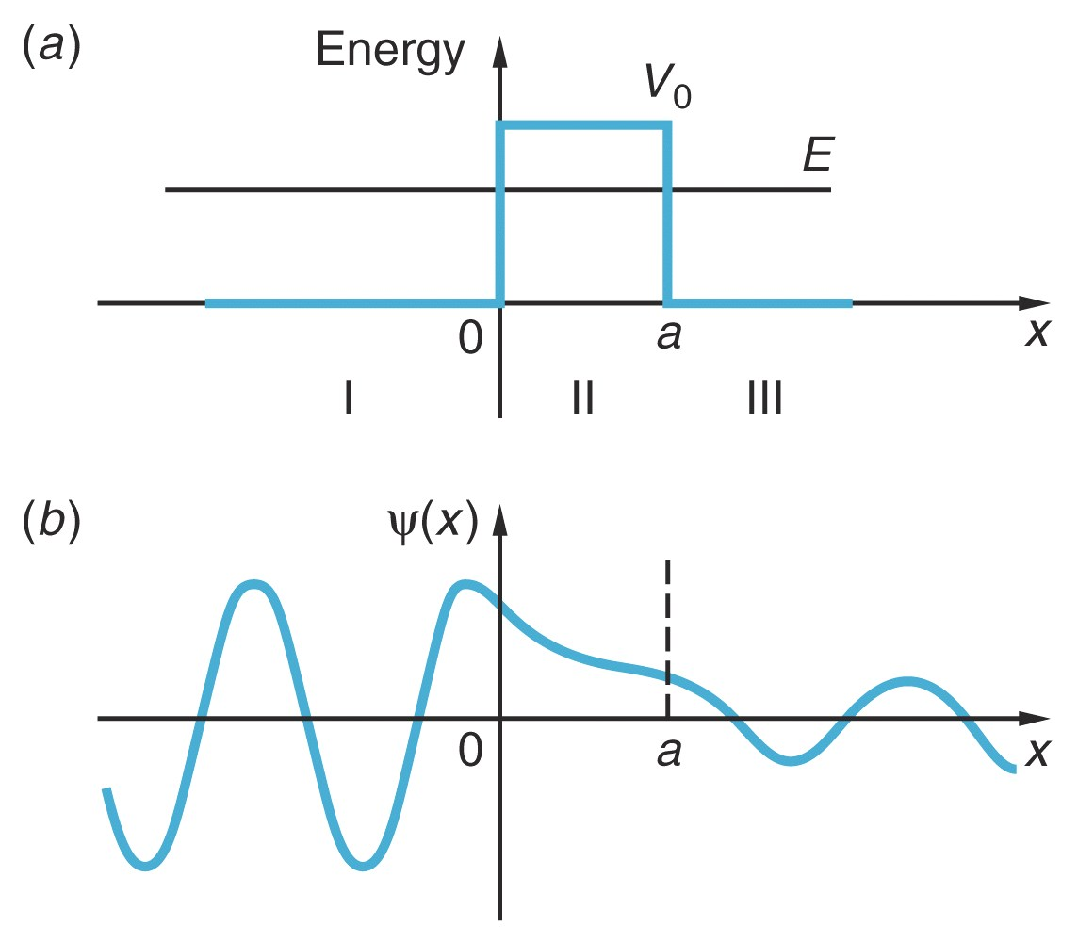
Can have transmission only if third region where solution is not real exponential! (electron tunneling through oxide layer between wires)
Real( )
E>P,
Ψ(x) can live!
electron tunnels
out of region I
CuO
Cu #2
Cu wire 1

Slide 25
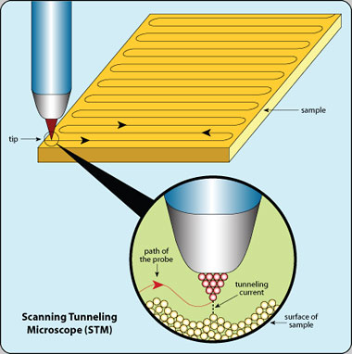
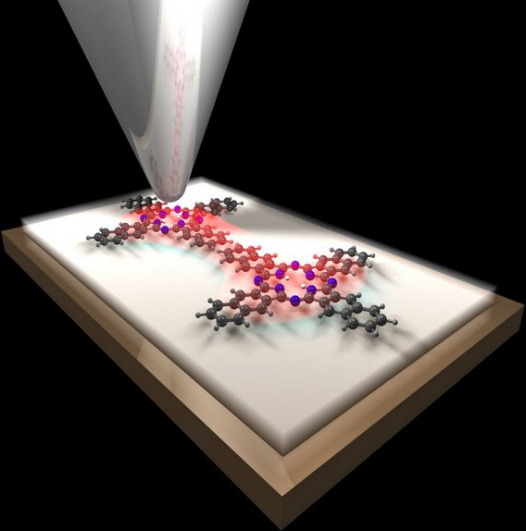
Application of quantum tunneling: Scanning
Tunneling Microscope → 'See' single atoms!
Use tunneling to measure very(!) small changes in distance.
Nobel prize winning idea: Invention of scanning tunneling
microscope (STM). Measure atoms on conductive surfaces.
Measure current between tip and sample

Slide 26
Look at current from sample to tip to measure gap.
Tip
Electron tunnels from sample
to tip.
How would V(x) look like after an electron tunneled from the sample to the tip if sample and tip were isolated from each other?
  a. same as before.
  b. V in tip higher, V sample lower.
  c. V in tip lower, V sample higher.
  d. V same on each side as before but barrier higher.
-
SAMPLE
(metallic)
SAMPLE METAL
x
energy
sample
tip
ans. b. electron piled on top (in energy) of many other electrons
that contribute to V(x). Add electron, makes higher V(x),
remove makes lower.
So what does next electron want to do?

Slide 27
Correct picture of STM-- voltage applied between tip and
sample. Holds potential difference constant, electron current.
Figure out what potential energy looks like in different regions so can calculate current, determine sensitivity to gap distance.
What does V tip look like?
a. higher than V sample
b. same as V sample
c. lower than V sample
d. tilts downward from left to right
e. tilts upward from left to right
V
+
Tip
I
SAMPLE
(metallic)
I
energy
SAMPLE METAL
applied voltage
sample
tip

Slide 28
Correct picture of STM-- voltage applied between tip and sample.
Potential energy in different regions so can calculate current, determine sensitivity to gap distance.
V
What is potential in air gap
approximately?
+
Tip
linear connection
I
SAMPLE
(metallic)
I
Notice changing V will
change barrier, and hence
tunneling current.
energy
SAMPLE METAL
applied voltage
sample
tip

Slide 29
cq. if tip is moved closer to sample which picture is correct?
a.
b.
c.
d.
tunneling current will go: (a) up, (b) stay same, (c) go down
(a) go up. a is smaller, so e^{-2αa} is bigger (not as small), T bigger
Notes:
A: 1
B:
C: 94
D: 5
161 responses

Slide 30
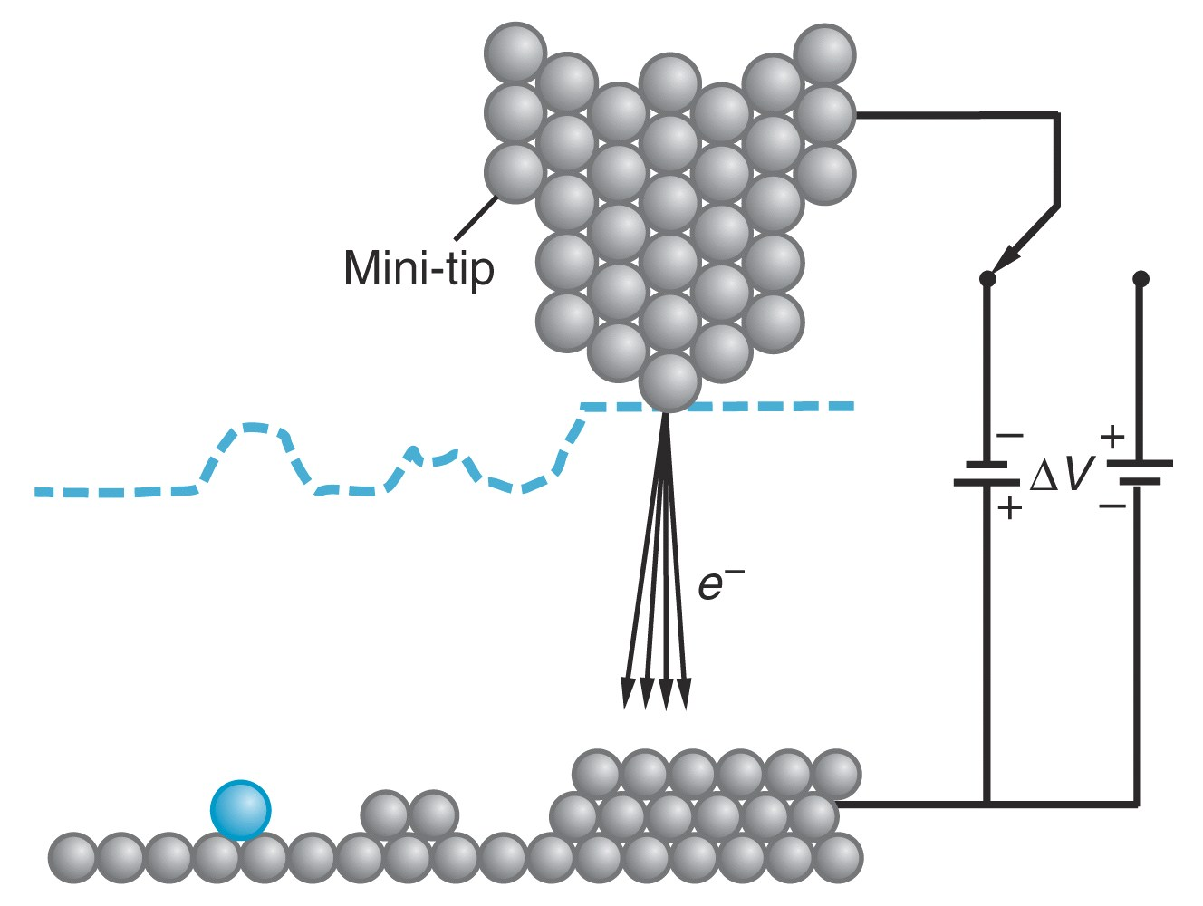
STM (picture with reversed voltage, works exactly the same)
end of tip always
atomically sharp

Slide 31

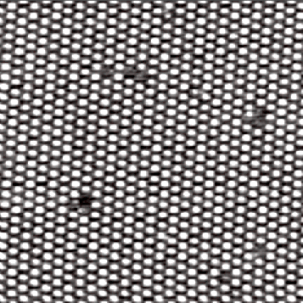
How sensitive to distance?
Need to look at numbers.
Tunneling rate: T ~ (e^{-αd})² = e^{-2αd}
How big is α?
d
If V₀-E = 4 eV, α = 1/(10⁻¹⁰ m)
So if d is 3 x 10⁻¹⁰ m, T ~ e⁻⁶ = .0025
add 1 extra atom (d ~ 10⁻¹⁰ m),
how much does T change?
T ~ e⁻⁴ =0.018
Decrease distance by diameter of one atom:
Increase current by factor 7!
Notes:
WORK THIS OUT

Slide 32
In typical operation, STM moves tip across surface, adjusts distance to keep tunneling current constant. Keeps track of how much tip moves up and down to keep current constant.
Scan in x+y directions.
Draw a 2D map of surface

Slide 33
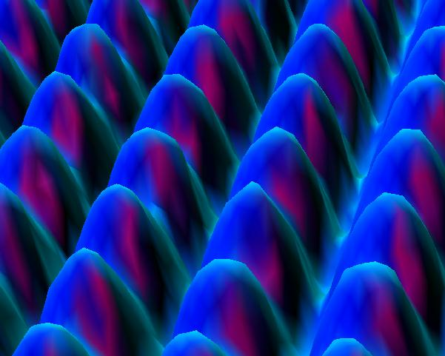
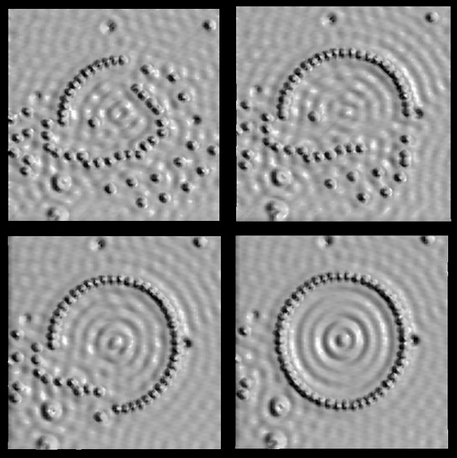
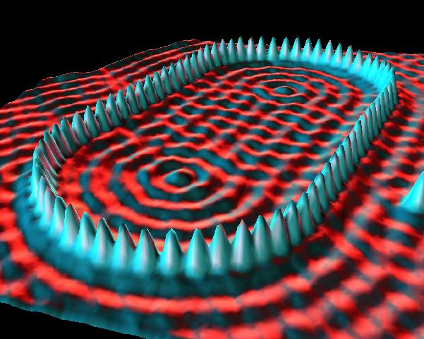
Crystal of Ni atoms
Fe atoms on Cu surface

Slide 34
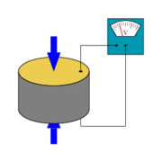
Scanning Tunneling Microscope
Requires very precise control of the tip position and height. How to do it?
Measure current between tip and sample
With a piezoelectric actuator!
Typical piezo: 1V → 100nm displacement.
Applying 1mV moves tip by one atom diameter (~100pm)

Slide 35
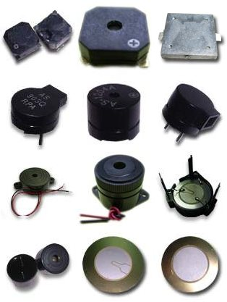
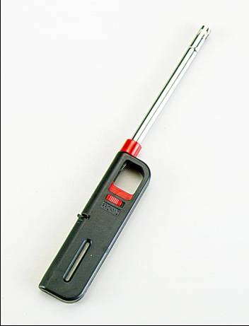

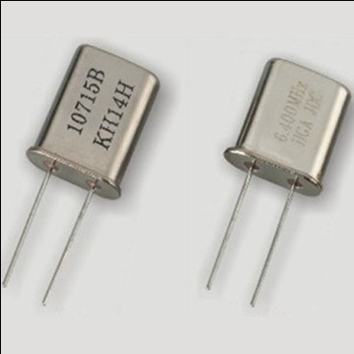
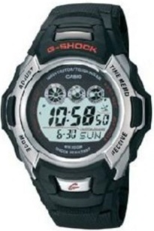

Piezoelectric actuators and sensors are everywhere!
Buzzers in electronic gadgets and in smoke alarms.
Microphones in cell-phones.
Quartz crystals.
BBQ grills and lighters.
Knock sensors in car engines.
Seismology.
Concrete compactors
Sonar devices (Submarines, Robotics, Automatic doors)
Bones

Slide 36
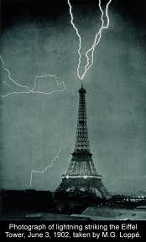
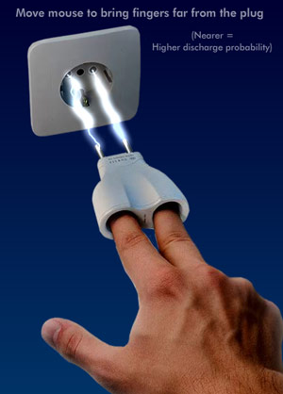
A more common manifestation of QM tunneling
Understanding electrical discharges.

Slide 37
A more common manifestation of QM tunneling
Understanding electrical discharges.
What electric field needed to rip electron from atom if no tunneling?
r
+
-
Applied E must exceed E_{Nucleus}
Typically, electric breakdown in air occurs at E ~ 2 MV/m
r
+
-
r
+
-
r
+
-
r
+
-
r
+
-
r
+
-
gas

Slide 38
Get few million volts from rubbing feet on rug?
NO! Electrons tunnel out at much lower voltage.
d
1
3
2
Energy
V
E
Work
Function
Of finger
Potential difference between finger/door
V = 0, T ~e^{-2αa} tiny.
Work
Function
Of doorknob
U
Rub feet, what happens
to potential energy?
d
Distance to tunnel much smaller. Big V ➔ a small, so e^{-2αa} big enough, e’s tunnel out!
x

Slide 39
Review of Energy Eigenstates
So far we’ve talked about energy eigenstates…
Solve Schrodinger equation:
Get solutions for a bunch of different energies: E₁, E₂, E₃,…
Different solution for each energy: ψ₁(x), ψ₂(x), ψ₃(x),…where Ψ₁(x,t) = ψ₁(x)e^{–iE1t/},
Ψ₂(x,t) = ψ₂(x)e^{–iE2t/}, Ψ₃(x,t) = ψ₃(x)e^{–iE3t/},…
State with a single energy is called an “energy eigenstate.”

Slide 40
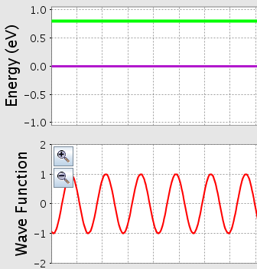
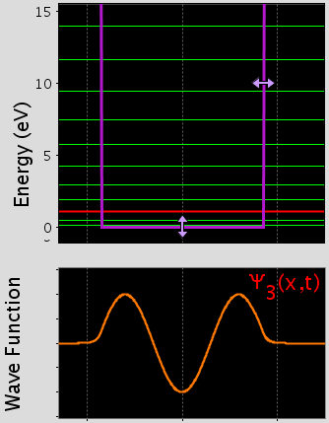
Examples of Energy Eigenstates
Free Particle
Ψ(x) = e^{ikx} or e^{-ikx}
Infinite Square Well /Rigid Box
Ψ_{n}(x) = sin(nπx/L)
From “Quantum Bound States” simulation
From “Quantum Tunneling” simulation

Slide 41

Superposition Principle
If Ψ₁(x,t) and Ψ₂(x,t) are both solutions to Schrodinger equation, so is:
Ψ(x,t) = aΨ₁(x,t) + bΨ₂(x,t)
Note: we are still talking about a single electron!
Examples of superposition states:
  Wave Packet: superposition of many plane waves: Ψ(x,t) = Σ_{n}A_{n}exp(i(k_{n}x-ω_{n}t))
  Double Slit Interference: superposition of going through left slit and going through right slit:
Ψ_{tot} = Ψ₁ + Ψ₂
|Ψ_{tot} |² = |Ψ₁ + Ψ₂|² = |Ψ₁ |² + |Ψ₂|² + Ψ₁*Ψ₂ + Ψ₂*Ψ₁
Interference Terms:
negative → destructive interference
positive → constructive interference
Ψ₁
Ψ₂

Slide 42
Review of Time Dependence
An electron is in the state
where Ψ₁(x,t) is the wave function for the ground state of the infinite square well.
Does the probability density of the electron change in time?
a. Yes b. No c. Only the phase changes
d. Not enough information
Remember: You can always write an energy eigenstates as Ψ(x,t) = ψ(x)e^{–iEt/}.
Probability density = |Ψ(x,t)|² = Ψ(x,t)Ψ*(x,t)
= ψ(x)e^{–iEt/ψ}*(x)e^{+iEt/} = ψ(x)ψ*(x) = |ψ(x)|²
Ψ wave function has time dependence in phase.
⎝probability density has no time dependence.
Time dependence of wave function is not observable. Only probability density is observable.

Slide 43
Time Dependence of Superposition States
An electron is in the state
where Ψ₁(x,t) = ψ₁(x)e^{–iE1t/}
and Ψ₂(x,t) = ψ₂(x)e^{–iE2t/} are the ground state and first excited state of the infinite square well. Does the probability density of the electron change in time?
a. Yes b. No
c. Only the phase changes
d. Not enough information

Slide 44
Answer: a: probability doesn’t change in time for energy eigenstates, but does for superpositions of eigenstates!
Probability density:
Cross terms oscillate between constructive and destructive interference!

Slide 45
What does it mean for a particle to be in a superposition of states Ψ₁(x,t) and Ψ₂(x,t)?
There are two particles, one described by Ψ₁(x,t) and the other described by Ψ₂(x,t), that travel together in a packet.
The probability of finding the particle at position x at time t is given by the absolute square of the sum of the two wave functions, each multiplied by some factor.
The particle is located at a position somewhere in between the position described by Ψ₁(x,t) and the position described by Ψ₂(x,t).
The particle has an energy somewhere in between the energies E₁ and E₂.
More than one of the answers above is true.

Slide 46
Measurement
Measurement is a discontinuous process, not described by the Schrodinger equation.
  (Schrodinger describes everything before and after, but not moment of measurement.)
If you measure energy of particle, will find it in a state of definite energy (= energy eigenstate).
If you measure position of particle, will find it in a state of definite position (= position eigenstate).
If you measure ____ of particle, will find it in a state of definite ____ (= ____ eigenstate).
Unlike classical physics, measurement in QM doesn’t just find something that was already there – it CHANGES the system!

Slide 47
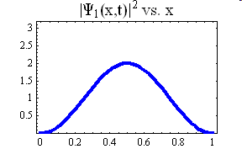
How to compute the probability of measuring a particular state:
Suppose you have a particle with wave function Ψ(x,t) = c₁Ψ₁(x,t) + c₂Ψ₂(x,t) + c₃Ψ₃(x,t) + …
Measuring position:
Measuring energy:
P(E_{n}) = |c_{n}|²
a b
Von Neumann Postulate: If you make measurement of particle in a state Ψ(x,t), the probability of finding particle in a state Ψ_{a}(x,t) is given by:
= overlap between Ψ & Ψ_{a}.

Slide 48

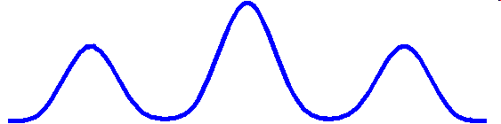
Measuring position
Example:
double slit experiment:
Probability density at screen looks like:
Probability of measuring particle at particular pixel:
|Ψ(x,t)|²
x
a b

Slide 49



What does the probability density of the particle look like immediately after you measure its position? (assuming you have a non-destructive way of measuring particle – don’t destroy it, just measure where it is)
|Ψ(x,t)|²
|Ψ(x,t)|²
A
B
|Ψ(x,t)|²
|Ψ(x,t)|²
C
D
E Could be B, C, or D, depending on where you found it.
QT sim
Measurement changes wave function: particle localized where you measured it, so if you measure it again, will probably find it in the same place.
Notes:
A: 5
B: 0
C: 2
D: 0
E: 93
101 responses

Slide 50

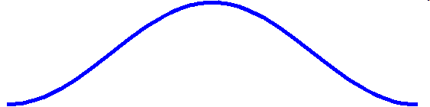
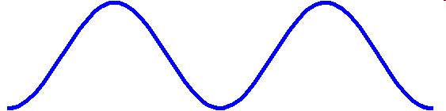
Measuring energy
Suppose you have a particle in the state:
where Ψ₁(x,t) and Ψ₂(x,t) are the ground state and first excited state of the infinite square well. What does the probability density of this particle look like immediately after you measure its ENERGY?
Or another graph like this but shifted to left or right, depending on where you found it.
|Ψ(x,t)|²
|Ψ(x,t)|²
A
B
|Ψ(x,t)|²
|Ψ(x,t)|²
C
D
E Could be C or D, depending on what energy you found.
Notes:
A: 8
B: 20
C: 9
D: 1
E: 61
98 responses

Slide 51
Note on position and energy measurements:
Energy eigenstates tend to be spread out in space.
Position eigenstates tend to be localized in space.
This is why you can’t know both at the same time (wave packets vs. plane waves)
Measuring position messes up energy eigenstate and vice versa.
Measure Position
Measure Energy

Slide 52
Scientific theory-
  predict results of an experiment
  Good sci. theory (like Shrod. QM)-- predict results of many experiments, and results match predictions.
But how to figure out exactly what does Shrod. eq. predict for any particular experiment?
(general concepts of: how to interpret Ψ, and what “measurement” in QM means)
Shrod. wave sim., experiment is measure position of electron
-- issues jump out. Just what is a measurement?
  I. result of 1st measurement on electron.
  II. result of 2nd measurement on same electron (immediate).
  III. result of 2nd measurement on different but identical electron.
same? different? how?
Notes:
students got quite confused and asked lots of questions about this question (which is not all bad). It took up more than half of the class. Needed to address certain key points differently. These are illustrated on first slide of following class which was prepared as a better way to address this material.

Slide 53
Shrod. wave sim., experiment is measure position of electron
  I. result of 1st measurement on electron.
  II. result of 2nd measurement on same electron (immediate).
  III. result of 2nd measurement on different but identical electron
CQ. How are expected results of these 3 measurements same or different?
answer individually and think of reasons,
then will discuss and revote, group come to consensus and all group members have to input the same answer.
a. I, II and III always the same.
b. I and II always same, and different from III.
c. I and II same, I and III could be the same or different.
d. I, II, and III could all be same or different from each other.
e. I, II, III always different from each other.
Notes:
A: 1
B: 6
C: 25
D: 55
E: 12
165 responses
Individual responses

Slide 54
position of electron
I. result of 1st measurement on electron.
II. result of 2nd measurement on same electron (immediately).
III. result of 2nd measurement on different but identical electron
a. I, II and III always the same.
b. I and III always same, and different from III.
c. I and II same, I and III could be the same or different.
d. I, II, and III could all be same or different from each other.
e. I, II, III always different from each other.
I and II always the same, because after first measurement
know exactly where electron is.
so d. and e. have to be wrong.
III has same probability distribution as for I, but is distribution.
Could come out the same but usually not. C. is correct.
Repeat measurement on same electron is different from making
new measurement on identical new electron!
Electron wave function changed by measurement (“collapses”).

