Slide 1
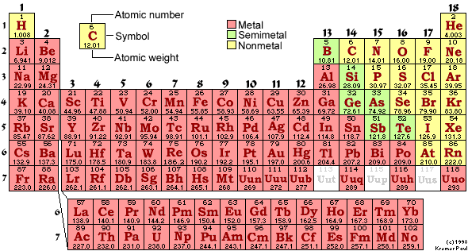
PH300 Modern Physics SP11
“Science is imagination constrained by reality.”
- Richard Feynman
Day 24,4/19:
Questions?
H-atom and Quantum Chemistry
Up Next:
Periodic Table
Molecular Bonding

Slide 2
Final Essay
There will be an essay portion on the exam, but you don’t need to answer those questions if you submit a final essay by the day of the final: Sat. 5/7
Those who turn in a paper will consequently have more time to answer the MC probs.
I will read rough draft papers submitted by class on Tuesday, 5/3

Slide 3
Recently:
  Quantum tunneling
  Alpha-Decay, radioactivity
  Scanning tunneling microscopes
Today:
  STM’s (quick review)
  Schrödinger equation in 3-D
  Hydrogen atom
Coming Up:
  Periodic table of elements
  Bonding

Slide 4
Look at current from sample to tip
to measure distance of gap.
Tip
-
-
Electrons have an equal likelihood of tunneling to the left as tunneling to the right
-> no net current
SAMPLE
(metallic)
SAMPLE METAL
x
energy
sample
tip

Slide 5
Correct picture of STM-- voltage applied
between tip and sample.
V
+
Tip
I
SAMPLE
(metallic)
I
energy
SAMPLE METAL
applied voltage
sample
tip

Slide 6
V
+
Tip
I
I
applied voltage
sample
tip
SAMPLE METAL
What happens to the potential energy curve if we decrease the distance between tip and sample?

Slide 7
cq. if tip is moved closer to sample which picture is correct?
a.
b.
c.
d.
tunneling current will go up:
a is smaller, so e^{-2αa} is bigger (not as small), T bigger
Notes:
A: 1
B:
C: 94
D: 5
161 responses

Slide 8
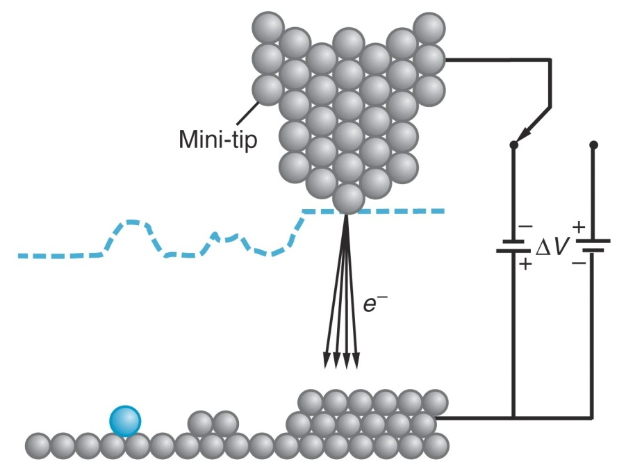
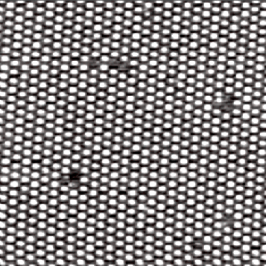
How sensitive to distance?
Need to look at numbers.
Tunneling rate: T ~ (e^{-αd})² = e^{-2αd}
How big is α?
d
If V₀-E = 4 eV, α = 1/(10⁻¹⁰ m)
So if d is 3 x 10⁻¹⁰ m, T ~ e⁻⁶ = .0025
add 1 extra atom (d ~ 10⁻¹⁰ m),
how much does T change?
T ~ e⁻⁴ =0.018
Decrease distance by diameter of one atom:
Increase current by factor 7!
Notes:
WORK THIS OUT

Slide 9
The 3D Schrodinger Equation:
In 1D:
In 2D:
In 3D:

Slide 10
3D example: “Particle in a rigid box”
Simplest case: 3D box, infinite wall strength
V(x,y,z) = 0 inside, = infinite outside.
c
b
a
Use separation of variables:
Assume we could write the solution as:
Ψ(x,y,z) = X(x)Y(y)Z(z)
"separated function"
Plug it in the Schrödinger eqn. and see what happens!

Slide 11
Ψ(x,y,z) = X(x)Y(y)Z(z) Now, calculate the derivatives for each coordinate:
(Do the same for y and z parts)
Now put in 3D Schrödinger and see what happens:
(For simplicity I wrote X instead of X(x) and X" instead of )
Divide both sides by XYZ=Ψ

Slide 12
So we re-wrote the Schrödinger equation as:
with: Ψ (x,y,z) = X(x)Y(y)Z(z)
For the particle in the box we said that V=0 inside and V=∞ outside the box. Therefore, we can write:
for the particle inside the box.

Slide 13
The right side is a simple constant:
A) True B) False
(and similar for Y and Z)
The right side is independent of x!
→ left side must be independent of x as well!!
→

Slide 14
If we call this const. '-k_{x}²' we can write:
X"(x) = - k_{x}² X(x)
Does this look familiar?
How about this:
ψ"(x) = - k² ψ(x)
→ This is the Schrödinger equation for a particle in a one-dimensional rigid box!! We already know the solutions for this equation:

Slide 15
Repeat for Y and Z:
And the total energy is:
And:
or:
with:
Now, remember:
Ψ(x,y,z) = X(x)Y(y)Z(z)
Done!

Slide 16
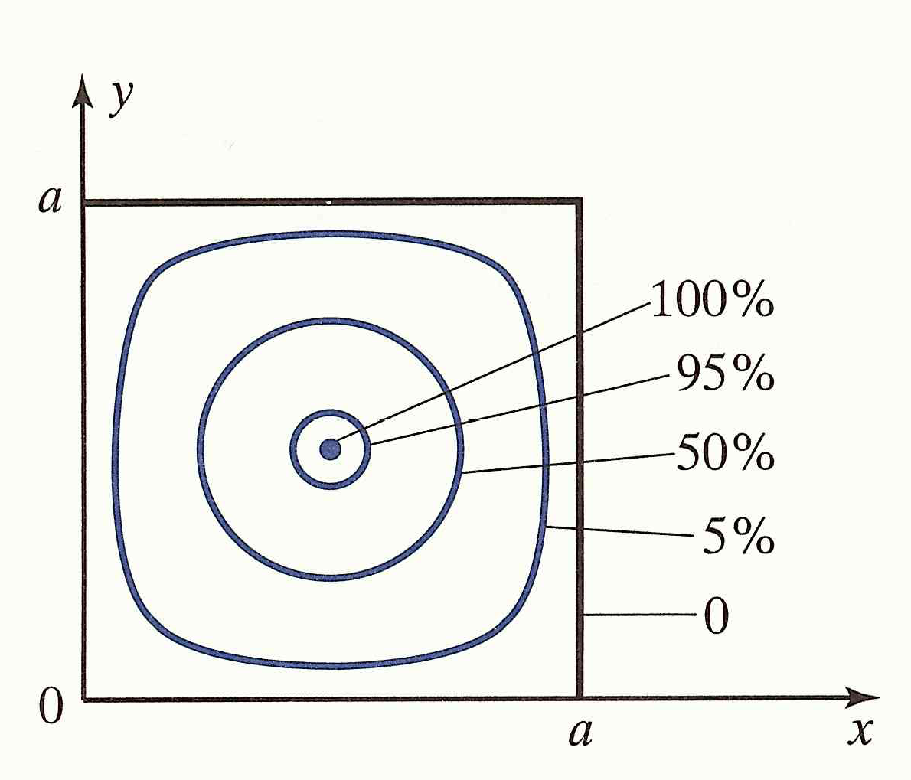
2D box: Square of the wave function for n_{x}=n_{y}=1
‘Percent’ relative to maximum

Slide 17
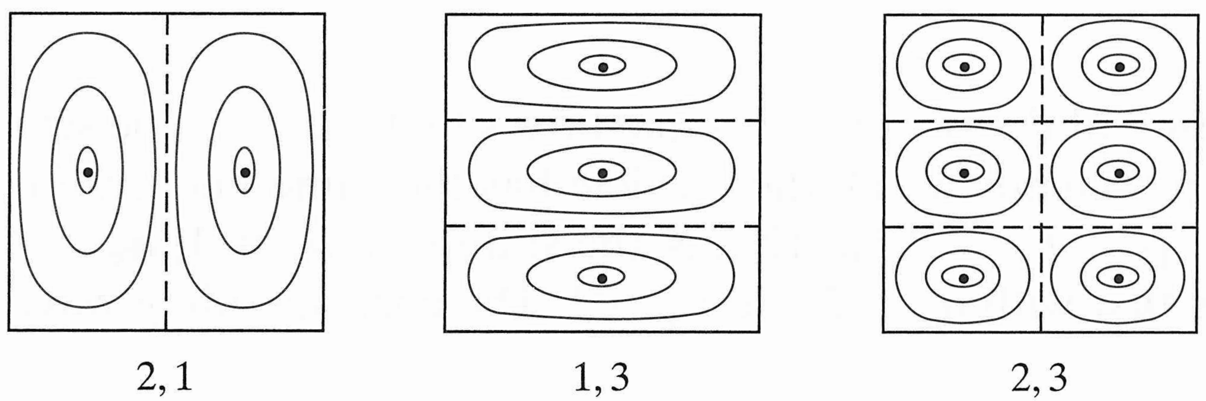
2D box: Square of the wave function of selected excited states
0%
100%
n_{x}
n_{y}

Slide 18
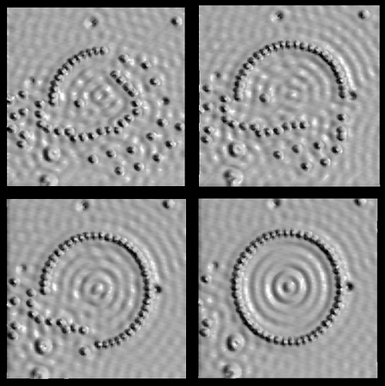

Slide 19
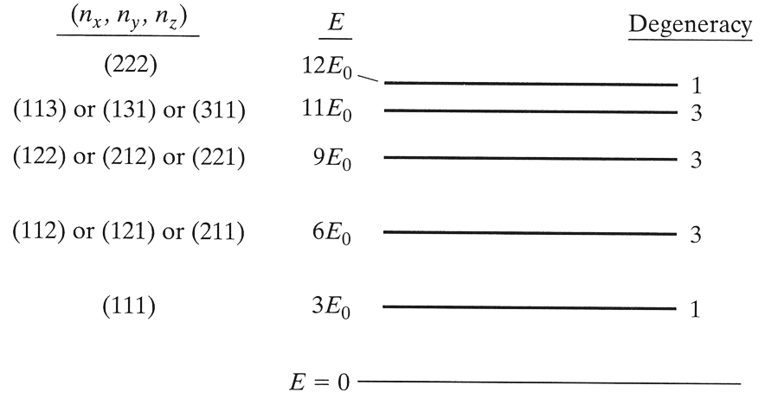
Degeneracy
Sometimes, there are several solutions with the exact same energy. Such solutions are called ‘degenerate’.
E = E₀(n_{x}²+n_{y}²+n_{z}²)
Degeneracy of 1 means “non-degenerate”

Slide 20
The ground state energy of the 2D box of size L x L is 2E₀, where E₀ = π²ħ²/2mL² is the ground state energy of a 1D box of size L.
y
L
E=E₀(n_{x}²+n_{y}²)
L
x
What is the energy of the 1st excited state of this 2D box?
3E₀
4E₀
5E₀
8E₀

Slide 21
The ground state energy of the 2D box of size L x L is 2E₀, where E₀ = π²ħ²/2mL² is the ground state energy of a 1D box of size L.
y
L
E=E₀(n_{x}²+n_{y}²)
L
x
What is the energy of the 1st excited state of this 2D box?
3E₀
4E₀
5E₀
8E₀
n_{x}=1, n_{y}=2 or n_{x}=2 n_{y}=1
➔ degeneracy(5E₀) = 2

Slide 22
Imagine a 3D cubic box of sides L x L x L. What is the degeneracy of the ground state and the first excited state?
Degeneracy of ground state
Degeneracy of 1st excited state
1, 1
3, 1
1, 3
3, 3
0, 3
L
L
L
Ground state = 1,1,1 : E₁ = 3E₀
1st excited state: 2,1,1 1,2,1 1,1,2 : all same E₂ = 6 E₀

Slide 23
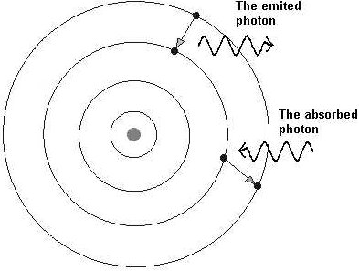
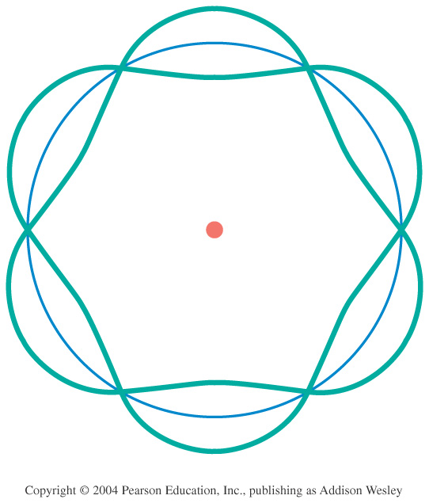
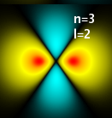


Review Models of the Atom
–
–
Thomson – Plum Pudding
  Why? Known that negative charges can be removed from atom.
  Problem: Rutherford showed nucleus is hard core.
Rutherford – Solar System
  Why? Scattering showed hard core.
  Problem: electrons should spiral into nucleus in ~10⁻¹¹ sec.
Bohr – fixed energy levels
  Why? Explains spectral lines, gives stable atom.
  Problem: No reason for fixed energy levels
deBroglie – electron standing waves
  Why? Explains fixed energy levels
  Problem: still only works for Hydrogen.
Schrodinger – quantum wave functions
  Why? Explains everything!
  Problem: None (except that it’s abstract)
–
–
–
+
–
+
+

Slide 24
Schrodinger’s Solutions for Hydrogen
How is it same or different than Bohr, deBroglie?
(energy levels, angular momentum, interpretation)
What do wave functions look like? What does that mean?
Extend to multi-electron atoms,
atoms and bonding,
transitions between states.
How does
Relate to atoms?

Slide 25
Next:
Apply Schrodinger Equation to atoms
and make sense of chemistry!
(Reactivity/bonding of atoms and Spectroscopy)
Schrodinger predicts: discrete energies and wave functions for electrons in atoms
How atoms bond, react, form solids?
Depends on:
the shapes of the electron wave functions
the energies of the electrons in these wave functions, and
how these wave functions interact as atoms come together.

Slide 26
What is the Schrödinger Model of Hydrogen Atom?
Electron is described by a wave function Ψ(x,t) that is the solution to the Schrodinger equation:
r
where:
V

Slide 27
Can get rid of time dependence and simplify:
Equation in 3D, looking for Ψ(x,y,z,t):
Since V not function of time:
Time-Independent Schrodinger Equation:

Slide 28
Quick note on vector derivatives
Laplacian in cartesian coordinates:
Same thing! Just different coordinates.
Laplacian in spherical coordinates:
3D Schrödinger with Laplacian (coordinate free):

Slide 29
Since potential spherically symmetric , easier to solve w/ spherical coords:
z
Note: physicists and engineers may use opposite definitions of θ and ϕ… Sorry!
θ
r
Schrodinger’s Equation in
Spherical Coordinates & w/no time:
φ
y
x
(x,y,z) =
(rsinθcosϕ, rsinθsinϕ, rcosθ)
Technique for solving = Separation of Variables

Slide 30
z
In 3D, now have 3 degrees of freedom:
Boundary conditions in terms of r,θ,φ
θ
r
φ
y
x
What are the boundary conditions on the function R(r) ?
a. Ρ must go to 0 at r=0
b. Ρ must go to 0 at r=infinity
c. Ρ at infinity must equal Ρ at 0
d. (a) and (b)
ψ must be normalizable, so needs to go to zero …
Also physically makes sense … not probable to find electron there

Slide 31
z
In 3D, now have 3 degrees of freedom:
Boundary conditions in terms of r,θ,φ
θ
r
φ
y
x
What are the boundary conditions on the function g(φ)?
a. γ must go to 0 at φ =0
b. γ must go to 0 at φ=infinity
c. γ at φ=2π must equal γ at φ=0
d. A and B
e. A and C

Slide 32
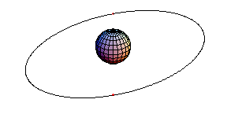
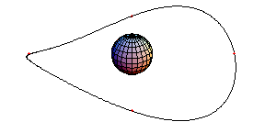
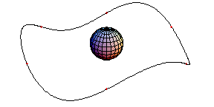
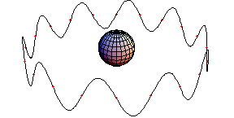
Remember deBroglie Waves?
n=1 n=2 n=3
…n=10
= node = fixed point that doesn’t move.

Slide 33
z
In 1D (electron in a wire):
Have 1 quantum number (n)
In 3D, now have 3 degrees of freedom:
Boundary conditions in terms of r,θ,φ
θ
r
φ
y
x
How many quantum numbers are there in 3D?
In other words, how many numbers do you need to specify unique wave function? And why?
a. 1
b. 2
c. 3
d. 4
e. 5
Answer: 3 – Need one quantum number for each dimension:
r: n
θ: l
ϕ: m
(If you said 4 because you were thinking about spin, that’s OK too. We’ll get to that later.)

Slide 34
z
In 1D (electron in a wire):
Have 1 quantum number (n)
In 3D, now have 3 degrees of freedom:
Boundary conditions in terms of r,θ,φ
Have 3 quantum numbers (n, l, m)
θ
r
φ
y
x

Slide 35
z
In 1D (electron in a wire):
Have 1 quantum number (n)
In 3D, now have 3 degrees of freedom:
Boundary conditions in terms of r,θ,φ
Have 3 quantum numbers (n, l, m)
θ
r
φ
y
x
“Spherical Harmonics”
Solutions for θ & ϕ dependence of S.E.
whenever V = V(r) ➔ All “central force problems”

Slide 36
z
In 1D (electron in a wire):
Have 1 quantum number (n)
In 3D, now have 3 degrees of freedom:
Boundary conditions in terms of r,θ,φ
Have 3 quantum numbers (n, l, m)
θ
r
φ
y
x
Shape of ψ depends on n, l ,m. Each (nlm) gives unique ψ
n=1, 2, 3 … = Principle Quantum Number
2p
l=0, 1, 2, 3 …= Angular Momentum Quantum Number
=s, p, d, f (restricted to 0, 1, 2 … n-1)
n=2
l=1
m=-1,0,1
m = ... -1, 0, 1.. = z-component of Angular Momentum
(restricted to –l to l)

Slide 37
Comparing H atom & Infinite Square Well:
Infinite Square Well: (1D)
V(x) = 0 if 0<x<L
      ∞ otherwise
Energy eigenstates:
Wave functions:
H Atom: (3D)
V(r) = -Zke²/r
Energy eigenstates:
Wave functions:
r
∞
∞
x
0 L

Slide 38
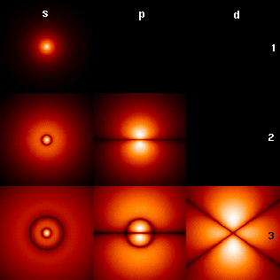
What do the wave functions look like?
n = 1, 2, 3, …
l (restricted to 0, 1, 2 … n-1)
m (restricted to –l to l)
Much harder to draw in 3D than 1D. Indicate amplitude of ψ with brightness.
n=1
Increasing n: more nodes in radial direction
Increasing l: less nodes in radial direction; More nodes in azimuthal direction
n=2
n=3
See simulation:
falstad.com/qmatom
s (l=0)
p (l=1)
d (l=2)
m = -l .. +l changes angular distribution

Slide 39
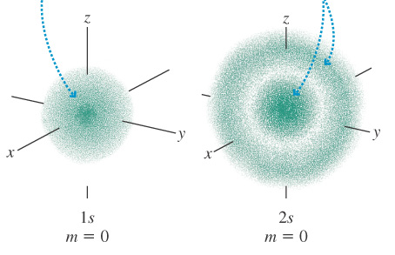
Shapes of hydrogen wave functions:
Look at s-orbitals (l=0): no angular dependence
n=1
n=2

Slide 40
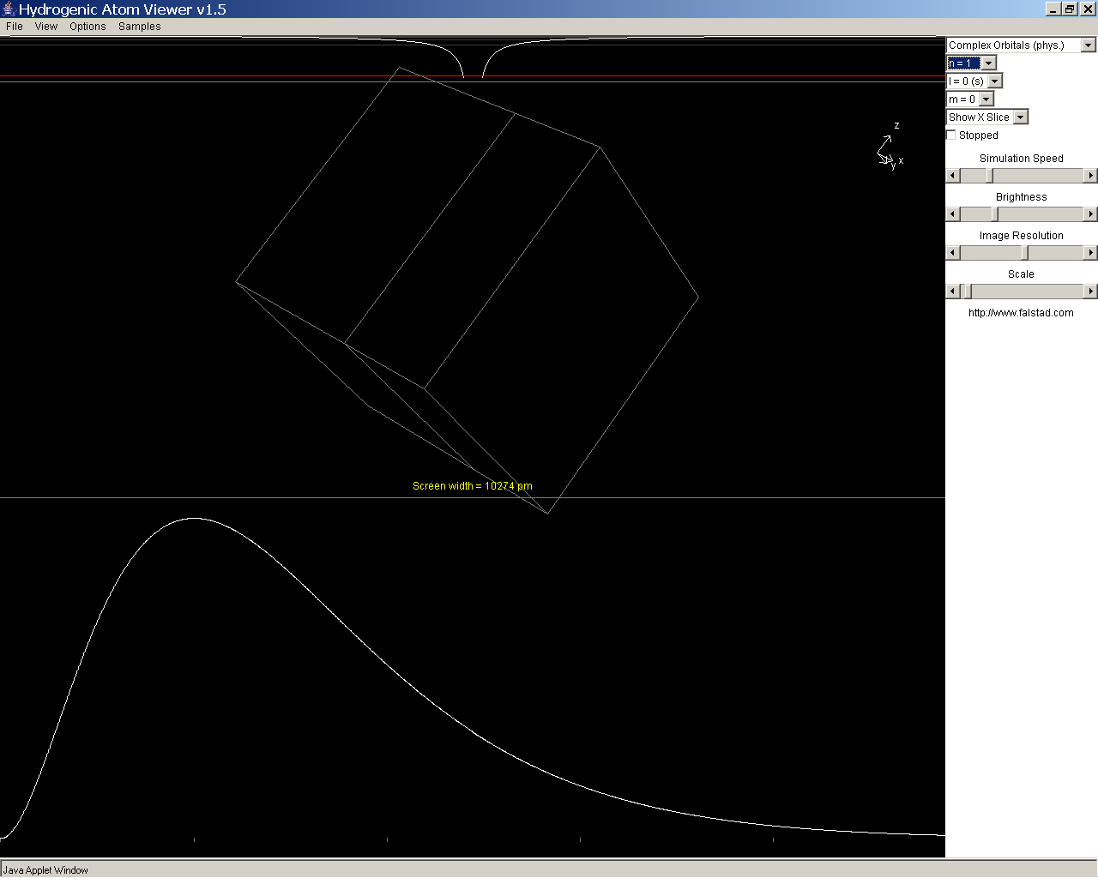
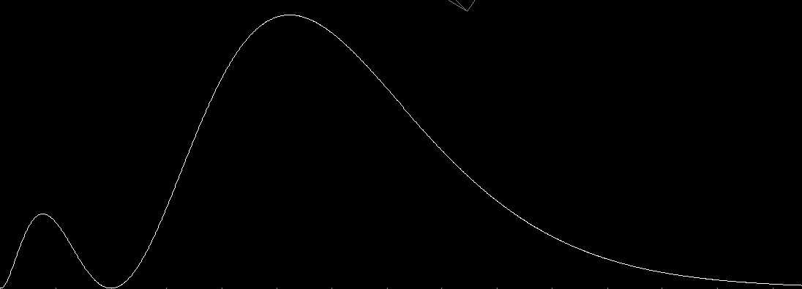
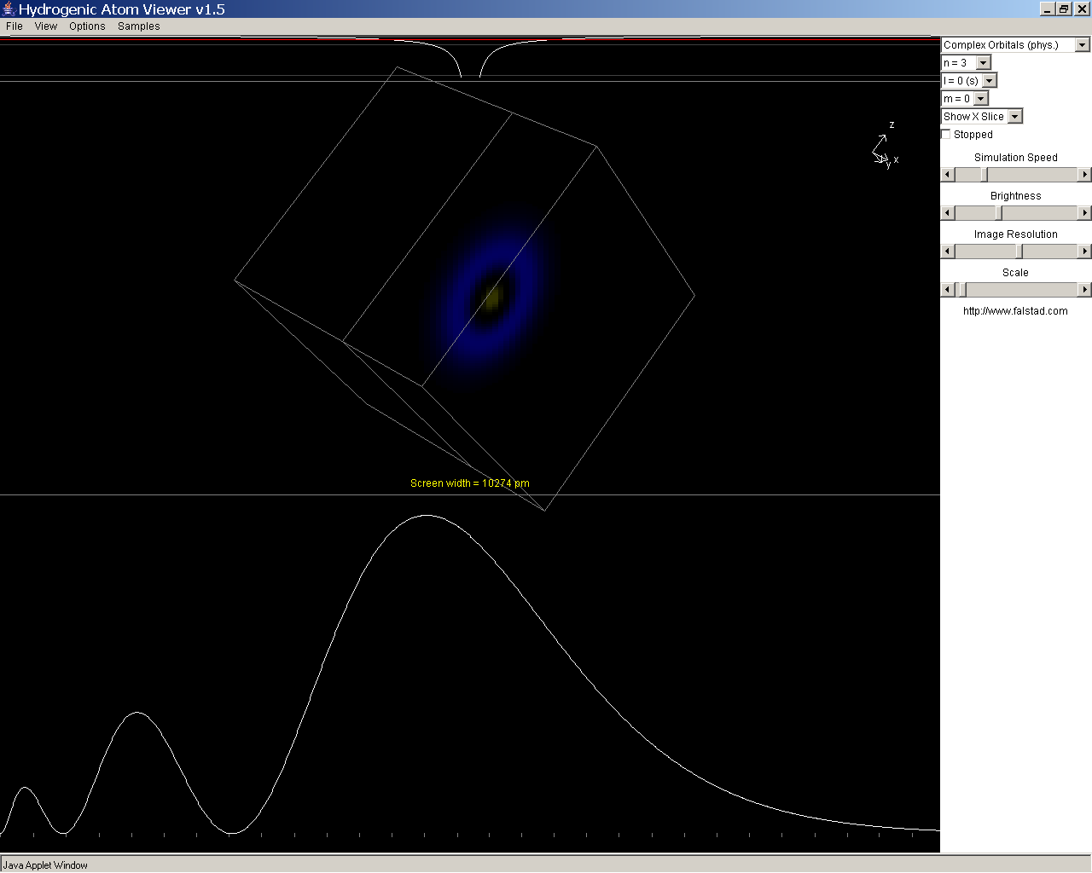
Higher n → average r bigger
→ more spherical shells stacked within each other
→ more nodes as function of r
n=1
l=0
Probability finding electron as a function of r
P(r)
n=2
l=0
n=3
l=0
Radius (units of Bohr radius, a₀)
0.05nm

Slide 41
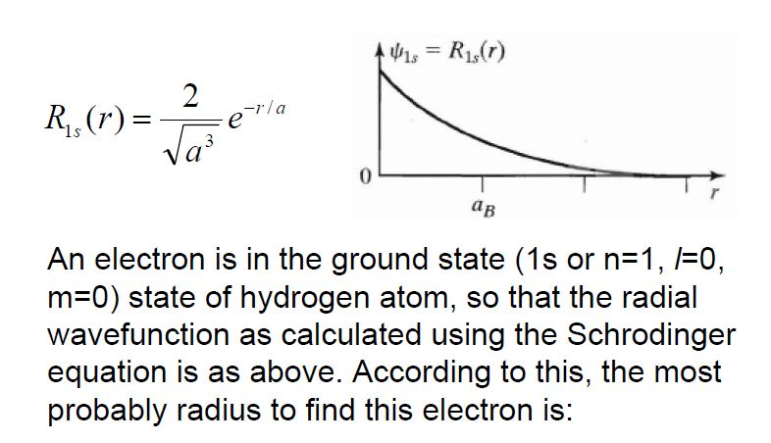
An electron is in the ground state of hydrogen
(1s, or n=1, l=0, m=0, so that the radial wave function given by the Schrodinger equation is as above. According to this, the most likely radius for where we might find the electron is:
probable
a) Zero b) a_{B} c) Somewhere else

Slide 42
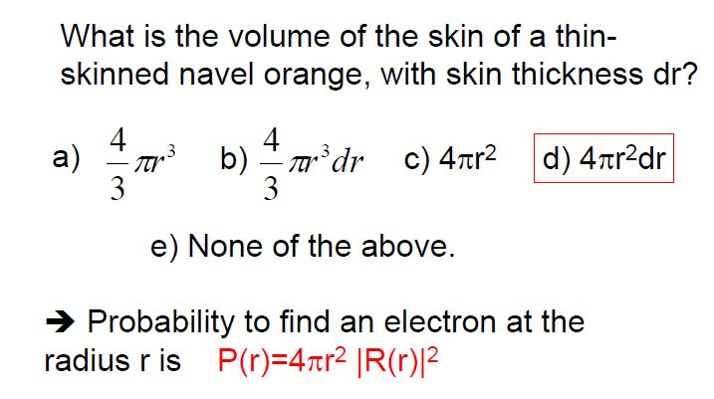
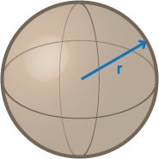
d) 4πr² dr

Slide 43
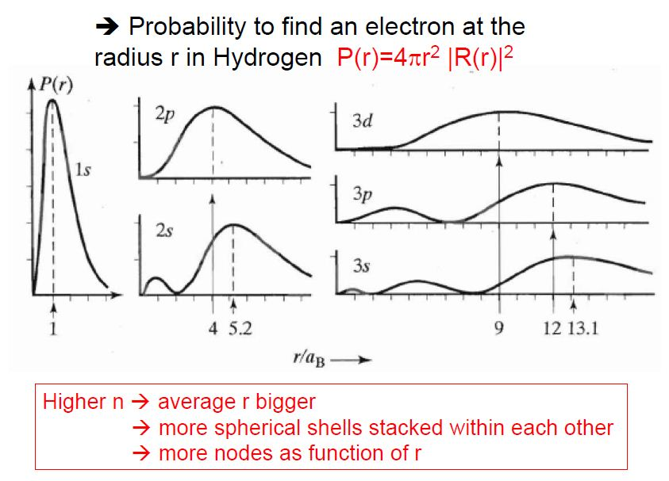

Slide 44
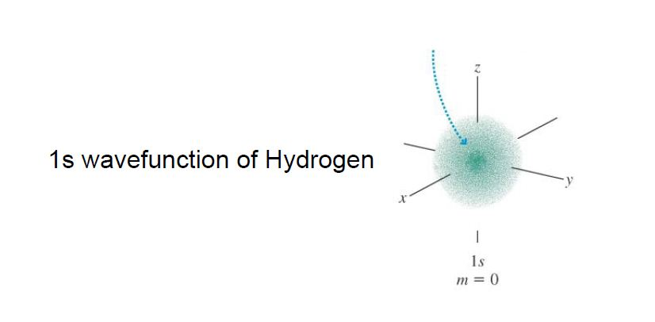
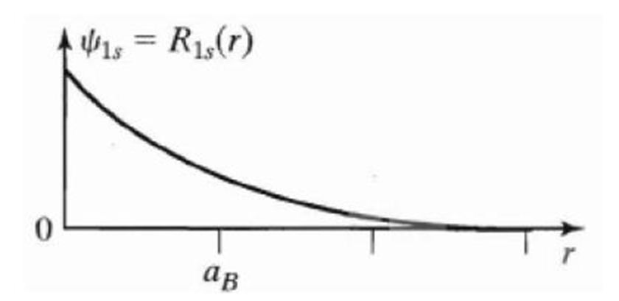
In the 1s state, the most likely single place to find the electron is:
r = 0 B) r = a_{B} C) Why are you confusing
us so much?

Slide 45
Shapes of hydrogen wave functions:
l=1, called p-orbitals: angular dependence (n=2)
l=1, m=0: p_{z} = dumbbell shaped.
l=1, m=-1: bagel shaped around z-axis (traveling wave)
l=1, m=+1
Superposition applies:
p_{x}=superposition (addition of m=-1 and m=+1)
p_{y}=superposition (subtraction of m=-1 and m=+1)
Dumbbells
(chemistry)

Slide 46
Physics vs Chemistry view of orbits:
2p wave functions
(Physics view)
(n=2, l=1)
Dumbbell Orbits
(chemistry)
p_{x}
p_{z}
p_{y}
m=1
m=-1
m=0
p_{x}=superposition
(addition of m=-1 and m=+1)
p_{y}=superposition
(subtraction of m=-1 and m=+1)

Slide 47
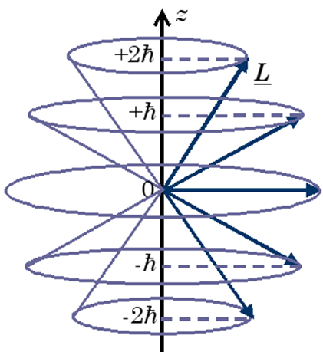
Chemistry: Shells – set of orbitals with similar energy
1s² 2s², 2p⁶ (p_{x}², p_{y}², p_{z}²) 3s², 3p⁶, 3d¹⁰
n
l
These are the wave functions (orbitals) we just found:
n=1, 2, 3 … = Principle Quantum Number
(for Hydrogen, same as Bohr)
l=s, p, d, f … = Angular Momentum Quantum Number
=0, 1, 2, 3 (restricted to 0, 1, 2 … n-1)
m = ... -1, 0, 1.. = z-component of Angular Momentum (restricted to –l to l)

Slide 48
n=1, 2, 3 … = Principle Quantum Number
(for Hydrogen, same as Bohr)
l=s, p, d, f … = Angular Momentum Quantum Number
=0, 1, 2, 3 (restricted to 0, 1, 2 … n-1)
m = ... -1, 0, 1.. = z-component of Angular Momentum
(restricted to -l to l)
What is the magnitude of the angular momentum of the ground state of Hydrogen?
a. 0 b. ħ c. sqrt(2)ħ d. not enough information
Answer is a.
n=1 so l=0 and m=0 ... Angular momentum is 0 …

Slide 49
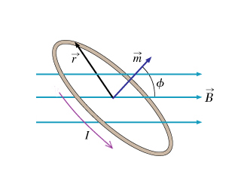
Energy of a Current Loop in a Magnetic Field:
For an electron moving in a circular orbit: (old HW problem)
Notes:
Defining the magnetic moment in this way makes it easy to find the torque on a current loop in the presence of a magnetic field. The magnetic field exerts a torque on the current loop, but does not make it align with the magnetic field like it did with the compass needle. Instead, the magnetic moment vector precesses about the magnetic field lines in such a way that the projection of the magnetic moment vector onto the direction of the field remains constant (this is analogous to the precession of a spinning gyroscope in a gravitational field; the rotating mass is analogous to the current in the loop, see next slide).

Slide 50
According to Schrödinger:
(S-state)
According to Bohr:
(ground state)
Bohr magneton!!

Slide 51
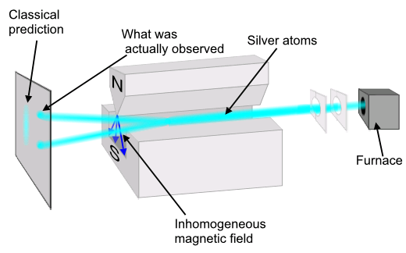
Stern-Gerlach Experiment with Silver Atoms (1922)
Ag = 4d¹⁰5s¹
What gives?!?
Notes:
What is actually observed is that all atoms experience the maximum deflection, either up or down along the direction of the magnetic field, no matter the orientation of the apparatus. The value of the projection along any axis is found to always be an integer multiple of the Bohr magneton, m_{B} = 9.27 x 10⁻²⁴ joule/tesla (e.g. for silver, the observed values are +m_{B} and –m_{B}; for nitrogen they are +3m_{B}, +m_{B}, -m_{B}, and -3m_{B}). Simplest case with a two-state system like silver atoms, as were used in the original Stern-Gerlach experiment; will speak from here on out only in terms of “atoms” having spin “plus” (+m_{B}) or “minus” (-m_{B}) along any given axis.

Slide 52
The Zeeman Effect:
Spectrum: With no external B-field
External B-field ON
m = +1
m = +1, 0, -1
m = 0
Energy
m = -1
21.0 eV
m = 0
Helium (2 e⁻) in the excited state 1s¹2p¹
m = 0 states unaffected
m = +/- 1 states split into
Notes:
What is actually observed is that all atoms experience the maximum deflection, either up or down along the direction of the magnetic field, no matter the orientation of the apparatus. The value of the projection along any axis is found to always be an integer multiple of the Bohr magneton, m_{B} = 9.27 x 10⁻²⁴ joule/tesla (e.g. for silver, the observed values are +m_{B} and –m_{B}; for nitrogen they are +3m_{B}, +m_{B}, -m_{B}, and -3m_{B}). Simplest case with a two-state system like silver atoms, as were used in the original Stern-Gerlach experiment; will speak from here on out only in terms of “atoms” having spin “plus” (+m_{B}) or “minus” (-m_{B}) along any given axis.

Slide 53
The Anomalous Zeeman Effect:
Spectrum: With no external B-field
External B-field ON
m = 0
Energy
Hydrogen (1 e⁻) in the ground state: 1s¹
m = 0 state splits into:
Notes:
What is actually observed is that all atoms experience the maximum deflection, either up or down along the direction of the magnetic field, no matter the orientation of the apparatus. The value of the projection along any axis is found to always be an integer multiple of the Bohr magneton, m_{B} = 9.27 x 10⁻²⁴ joule/tesla (e.g. for silver, the observed values are +m_{B} and –m_{B}; for nitrogen they are +3m_{B}, +m_{B}, -m_{B}, and -3m_{B}). Simplest case with a two-state system like silver atoms, as were used in the original Stern-Gerlach experiment; will speak from here on out only in terms of “atoms” having spin “plus” (+m_{B}) or “minus” (-m_{B}) along any given axis.

Slide 54
For the orbital angular momentum of an electron:
What if there were an additional component of angular momentum?

Slide 55
For the total angular momentum of an electron:
For the total magnetic moment due to the electron:
Why the factor of 2?
It is a relativistic correction!
Bohr solved:
Schrödinger solved:
Dirac solved:

Slide 56

Dirac solved:
Solutions to the Dirac equation require:
  Electrons have an “intrinsic” angular momentum - “SPIN”
  Positive and negative energy solutions, ±E
  ➔ negative E solutions correspond to the electron’s antiparticle
  “POSITRON”
  Dirac’s relativistic equation predicted the existence of antimatter!!!

Slide 57
n=1, 2, 3 … = Principle Quantum Number
(for Hydrogen, same as Bohr)
l=s, p, d, f … = Angular Momentum Quantum Number
=0, 1, 2, 3 (restricted to 0, 1, 2 … n-1)
m = ... -1, 0, 1.. = z-component of Angular Momentum
(restricted to -l to l)
An electron in hydrogen is excited to Energy = -13.6/9 eV. How many different wave functions ψ_{nlm} in H have this energy?
a. 1 b. 3 c. 6 d. 9 e. 10

Slide 58
Energy Diagram for Hydrogen
l=0
(s)
l=1
(p)
l=2
(d)
n=3
3s
3p
3d
n=2
2s
2p
In HYDROGEN, energy only depends on n, not l and m.
(NOT true for multi-electron atoms!)
n=1
l=0,m=0
1s
Notes:
A: 4
B: 54
C: 5
D: 27
E: 9
170 responses

Slide 59
An electron in hydrogen is excited to Energy = -13.6/9 eV. How many different wave functions in H have this energy?
a. 1 b. 3 c. 6 d. 9 e. 10
n= Principle Quantum Number:
n=3
l=(restricted to 0, 1, 2 … n-1)
l=0,1,2
m=(restricted to -l to l)
Answer is d:
9 states all with the same energy
n l m
3 0 0
3 1 -1
3 1 0
3 1 1
3 2 -2
3 2 -1
3 2 0
3 2 1
3 2 2
3s states
3p states (l=1)
With the addition of spin, we now have 18 possible quantum states for the electron with n=3
3d states (l=2)

Slide 60
Schrodinger finds quantization of energy and angular momentum:
n=1, 2, 3 …
l=0, 1, 2, 3 (restricted to 0, 1, 2 … n-1)
How does Schrodinger compare to what Bohr thought?
I. The energy of the ground state solution is ________
II. The orbital angular momentum of the ground state
solution is _______
III. The location of the electron is _______
same
different
different
a. same, same, same
b. same, same, different
c. same, different, different
d. different, same, different
e. different, different, different
Bohr got energy right, but he said orbital angular momentum L=nħ, and thought the electron was a point particle orbiting around nucleus.
Notes:
A: 92
B: 5
C: 3
D: 1
170 responses

Slide 61
Bohr model:
  Postulates fixed energy levels
  Gives correct energies.
  Doesn’t explain WHY energy levels fixed.
  Describes electron as point particle moving in circle.
deBroglie model:
  Also gives correct energies.
  Explains fixed energy levels by postulating electron is standing wave, not orbiting particle.
  Only looks at wave around a ring: basically 1D, not 3D
Both models:
  Gets angular momentum wrong.
  Can’t generalize to multi-electron atoms.
+
+

Slide 62
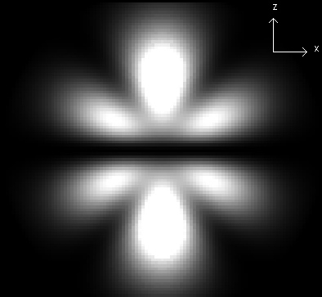
How does Schrodinger model of atom compare with other models? Why is it better?
Schrodinger model:
  Gives correct energies.
  Gives correct orbital angular momentum.
  Describes electron as 3D wave.
  Quantized energy levels result from boundary conditions.
  Schrodinger equation can generalize to multi-electron atoms.
  How?

Slide 63
Schrodinger’s solution for multi-electron atoms
What’s different for these cases?
Potential energy (V) changes!
(Now more protons AND other electrons)
Need to account for all the interactions among the electrons
Must solve for all electrons at once! (use matrices)
V (for q₁) = kq_{nucleus}q₁/r_{n-1} + kq₂q₁/r₂₋₁ + kq₃q₁/r₃₋₁ + ….
Gets very difficult to solve … huge computer programs!
Solutions change:
- wave functions change
higher Z → more protons→ electrons in 1s more strongly bound → radial distribution quite different general shape (p-orbital, s-orbital) similar but not same
- energy of wave functions affected by Z (# of protons)
higher Z → more protons→ electrons in 1s more strongly bound (more negative total energy)

Slide 64
A brief review of chemistry
Electron configuration in atoms:
How do the electrons fit into the available orbitals?
What are energies of orbitals?
3d
3p
3s
Total Energy
2p
2s
1s

Slide 65
A brief review of chemistry
Electron configuration in atoms:
How do the electrons fit into the available orbitals?
What are energies of orbitals?
Filling orbitals … lowest to highest energy, 2 e’s per orbital
H
Oxygen = 1s² 2s² 2p⁴
He
3d
Li
3p
Be
3s
B
C
e
e
e
e
Total Energy
2p
N
e
e
2s
O
Shell not full – reactive
Shell full – stable
e
e
1s

Slide 66
Will the 1s orbital be at the same energy level for each atom? Why or why not? What would change in Schrodinger’s equation?
No. Change number of protons … Change potential energy in Schrodinger’s equation … 1s held tighter if more protons.
The energy of the orbitals depends on the atom.
H
He
3d
Li
3p
Be
3s
B
C
e
e
e
e
Total Energy
2p
N
e
e
2s
O
Shell not full – reactive
Shell full – stable
e
e
1s

Slide 67
A brief review of chemistry
Electron configuration in atoms:
How do the electrons fit into the available orbitals?
What are energies of orbitals?
1, 2, 3 … principle quantum number, tells you some about energy
s, p, d … tells you some about geometric configuration of orbital
3d
3p
3s
2p
e
e
e
e
Shell 2
e
e
2s
Shell 1
e
e
1s

Slide 68
Can Schrodinger make sense of the periodic table?
1869: Periodic table (based on chemical behavior only)
1897: Thompson discovers electron
1909: Rutherford model of atom
1913: Bohr model

Slide 69
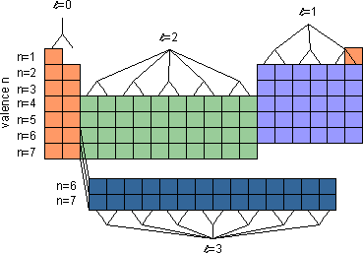
For a given atom, Schrodinger predicts allowed wave functions and energies of these wave functions.
l=0
l=1
l=2
4p
3d
4s
m=-2,-1,0,1,2
Li (3 e’s)
Energy
3p
3s
Na (11 e’s)
2p
2s
m=-1,0,1
1s
Why would behavior of Li be similar to Na?
a. because shape of outer most electron is similar.
b. because energy of outer most electron is similar.
c. both a and b
d. some other reason

Slide 70
Wave functions for sodium
Li (3 e’s)
3s
Na (11 e’s)
2p
1s
2s
In case of Na, what will energy of outermost electron be and WHY?
a. much more negative than for the ground state of H
b. somewhat similar to the energy of the ground state of H
c. much less negative than for the ground state of H
Notes:
A: 25
B: 48
C: 28
145 responses

Slide 71
Wave functions for sodium
Sodium has 11 protons.
2 electrons in 1s
2 electrons in 2s
6 electrons in 2p
Left over: 1 electron in 3s
Electrons in 1s, 2s, 2p generally closer to nucleus that 3s electron, what effective charge does 3s electron feel pulling it towards the nucleus?
3s
2p
1s
2s
Close to 1 proton… 10 electrons closer in shield (cancel) a lot of the nuclear charge.
In case of Na, what will energy of outermost electron be and WHY?
a. much more negative than for the ground state of H
b. somewhat similar to the energy of the ground state of H
c. much less negative than for the ground state of H
Notes:
A: 25
B: 48
C: 28
145 responses

Slide 72
Schrodinger predicts wave functions and energies of these wave functions.
l=0
l=1
l=2
4p
3d
4s
m=-2,-1,0,1,2
3p
Li
Energy
3s
Na
2p
2s
m=-1,0,1
1s
Why would behavior of Li be similar to Na?
a. because shape of outer most electron is similar.
b. because energy of outer most electron is similar.
c. both a and b
d. some other reason

Slide 73
