Slide 1
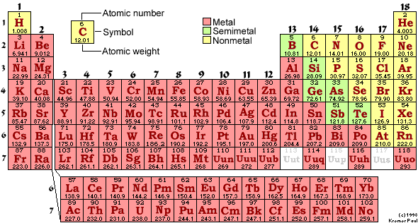
PH300 Modern Physics SP11
“Science is imagination constrained by reality.”
- Richard Feynman
Day 25,4/21:
Questions?
H-atom and Quantum Chemistry
Up Next:
Periodic Table
Molecular Bonding

Slide 2
Final Essay
There will be an essay portion on the exam, but you don’t need to answer those questions if you submit a final essay by the day of the final: Sat. 5/7
Those who turn in a paper will consequently have more time to answer the MC probs.
I will read rough draft papers submitted by class on Tuesday, 5/3

Slide 3
Recently:
Quantum tunneling
Schrödinger equation in 3-D
Hydrogen atom
Today:
Hydrogen atom (cont.)
Multi-electron atoms
Periodic table
Bonding (?)
Coming Up:
Finish bonding/banding…
Exam 3 – Next Thursday, 4/28
Lecture for Tuesday, 5/3 ?

Slide 5
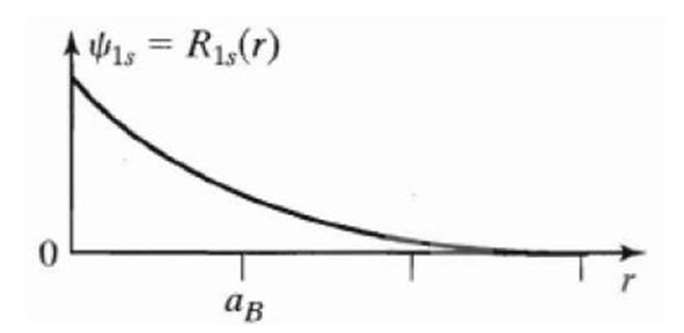
In the 1s state, the most likely single place to find the electron is:
r = 0 B) r = a_{B} C) Why are you confusing
us so much?

Slide 6
Shapes of hydrogen wave functions:
l=1, called p-orbitals: angular dependence (n=2)
l=1, m=0: p_{z} = dumbbell shaped.
l=1, m=-1: bagel shaped around z-axis (traveling wave)
l=1, m=+1
Superposition applies:
p_{x}=superposition (addition of m=-1 and m=+1)
p_{y}=superposition (subtraction of m=-1 and m=+1)
Dumbbells
(chemistry)

Slide 7
Physics vs Chemistry view of orbits:
2p wave functions
(Physics view)
(n=2, l=1)
Dumbbell Orbits
(chemistry)
p_{x}
p_{z}
p_{y}
m=1
m=-1
m=0
p_{x}=superposition
(addition of m=-1 and m=+1)
p_{y}=superposition
(subtraction of m=-1 and m=+1)

Slide 8
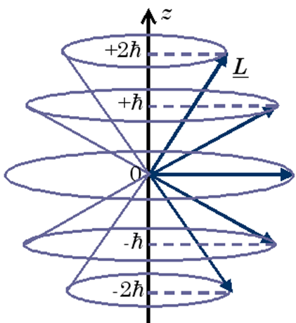
Chemistry: Shells – set of orbitals with similar energy
1s² 2s², 2p⁶ (p_{x}², p_{y}², p_{z}²) 3s², 3p⁶, 3d¹⁰
n
l
These are the wave functions (orbitals) we just found:
n=1, 2, 3 … = Principle Quantum Number
(for Hydrogen, same as Bohr)
l=s, p, d, f … = Angular Momentum Quantum Number
=0, 1, 2, 3 (restricted to 0, 1, 2 … n-1)
m = ... -1, 0, 1.. = z-component of Angular Momentum (restricted to –l to l)

Slide 9
n=1, 2, 3 … = Principle Quantum Number
(for Hydrogen, same as Bohr)
l=s, p, d, f … = Angular Momentum Quantum Number
=0, 1, 2, 3 (restricted to 0, 1, 2 … n-1)
m = ... -1, 0, 1.. = z-component of Angular Momentum
(restricted to -l to l)
What is the magnitude of the angular momentum of the ground state of Hydrogen?
a. 0 b. ħ c. sqrt(2)ħ d. not enough information
Answer is a.
n=1 so l=0 and m=0 ... Angular momentum is 0 …

Slide 10
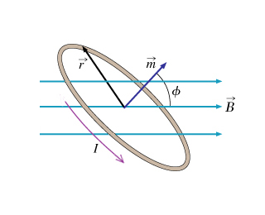
Energy of a Current Loop in a Magnetic Field:
For an electron moving in a circular orbit: (old HW problem)
Notes:
Defining the magnetic moment in this way makes it easy to find the torque on a current loop in the presence of a magnetic field. The magnetic field exerts a torque on the current loop, but does not make it align with the magnetic field like it did with the compass needle. Instead, the magnetic moment vector precesses about the magnetic field lines in such a way that the projection of the magnetic moment vector onto the direction of the field remains constant (this is analogous to the precession of a spinning gyroscope in a gravitational field; the rotating mass is analogous to the current in the loop, see next slide).

Slide 11
According to Schrödinger:
(S-state)
According to Bohr:
(ground state)
Bohr magneton!!

Slide 12
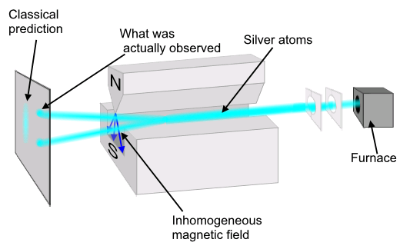
Stern-Gerlach Experiment with Silver Atoms (1922)
Ag = 4d¹⁰5s¹
What gives?!?
Notes:
What is actually observed is that all atoms experience the maximum deflection, either up or down along the direction of the magnetic field, no matter the orientation of the apparatus. The value of the projection along any axis is found to always be an integer multiple of the Bohr magneton, m_{B} = 9.27 x 10⁻²⁴ joule/tesla (e.g. for silver, the observed values are +m_{B} and –m_{B}; for nitrogen they are +3m_{B}, +m_{B}, -m_{B}, and -3m_{B}). Simplest case with a two-state system like silver atoms, as were used in the original Stern-Gerlach experiment; will speak from here on out only in terms of “atoms” having spin “plus” (+m_{B}) or “minus” (-m_{B}) along any given axis.

Slide 13
The Zeeman Effect:
Spectrum: With no external B-field
External B-field ON
m = +1
m = +1, 0, -1
m = 0
Energy
m = -1
21.0 eV
m = 0
Helium (2 e⁻) in the excited state 1s¹2p¹
m = 0 states unaffected
m = +/- 1 states split into
Notes:
What is actually observed is that all atoms experience the maximum deflection, either up or down along the direction of the magnetic field, no matter the orientation of the apparatus. The value of the projection along any axis is found to always be an integer multiple of the Bohr magneton, m_{B} = 9.27 x 10⁻²⁴ joule/tesla (e.g. for silver, the observed values are +m_{B} and –m_{B}; for nitrogen they are +3m_{B}, +m_{B}, -m_{B}, and -3m_{B}). Simplest case with a two-state system like silver atoms, as were used in the original Stern-Gerlach experiment; will speak from here on out only in terms of “atoms” having spin “plus” (+m_{B}) or “minus” (-m_{B}) along any given axis.

Slide 14
The Anomalous Zeeman Effect:
Spectrum: With no external B-field
External B-field ON
m = 0
Energy
Hydrogen (1 e⁻) in the ground state: 1s¹
m = 0 state splits into:
Notes:
What is actually observed is that all atoms experience the maximum deflection, either up or down along the direction of the magnetic field, no matter the orientation of the apparatus. The value of the projection along any axis is found to always be an integer multiple of the Bohr magneton, m_{B} = 9.27 x 10⁻²⁴ joule/tesla (e.g. for silver, the observed values are +m_{B} and –m_{B}; for nitrogen they are +3m_{B}, +m_{B}, -m_{B}, and -3m_{B}). Simplest case with a two-state system like silver atoms, as were used in the original Stern-Gerlach experiment; will speak from here on out only in terms of “atoms” having spin “plus” (+m_{B}) or “minus” (-m_{B}) along any given axis.

Slide 15
For the orbital angular momentum of an electron:
What if there were an additional component of angular momentum?

Slide 16
For the total angular momentum of an electron:
For the total magnetic moment due to the electron:
Why the factor of 2?
It is a relativistic correction!
Bohr solved:
Schrödinger solved:
Dirac solved:

Slide 17
Dirac solved:
Solutions to the Dirac equation require:
Electrons have an “intrinsic” angular momentum - “SPIN”
Positive and negative energy solutions, ±E
➔ negative E solutions correspond to the electron’s antiparticle
“POSITRON”
Dirac’s relativistic equation predicted the existence of antimatter!!!

Slide 18
n=1, 2, 3 … = Principle Quantum Number
(for Hydrogen, same as Bohr)
l=s, p, d, f … = Angular Momentum Quantum Number
=0, 1, 2, 3 (restricted to 0, 1, 2 … n-1)
m = ... -1, 0, 1.. = z-component of Angular Momentum
(restricted to -l to l)

Slide 19
Energy Diagram for Hydrogen
l=0
(s)
l=1
(p)
l=2
(d)
n=3
3s
3p
3d
n=2
2s
2p
In HYDROGEN, energy only depends on n, not l and m.
(NOT true for multi-electron atoms!)
n=1
l=0,m=0
1s
Notes:
A: 4
B: 54
C: 5
D: 27
E: 9
170 responses

Slide 20
An electron in hydrogen is excited to Energy = -13.6/9 eV. How many different wave functions in H have this energy?
a. 1 b. 3 c. 6 d. 9 e. 10
n= Principle Quantum Number:
n=3
l=(restricted to 0, 1, 2 … n-1)
l=0,1,2
m=(restricted to -l to l)
Answer is d:
9 states all with the same energy
n l m
3 0 0
3 1 -1
3 1 0
3 1 1
3 2 -2
3 2 -1
3 2 0
3 2 1
3 2 2
3s states
3p states (l=1)
With the addition of spin, we now have 18 possible quantum states for the electron with n=3
3d states (l=2)

Slide 21
Schrodinger finds quantization of energy and angular momentum:
n=1, 2, 3 …
l=0, 1, 2, 3 (restricted to 0, 1, 2 … n-1)
How does Schrodinger compare to what Bohr thought?
I. The energy of the ground state solution is ________
II. The orbital angular momentum of the ground state
solution is _______
III. The location of the electron is _______
same
different
different
a. same, same, same
b. same, same, different
c. same, different, different
d. different, same, different
e. different, different, different
Bohr got energy right, but he said orbital angular momentum L=nħ, and thought the electron was a point particle orbiting around nucleus.
Notes:
A: 92
B: 5
C: 3
D: 1
170 responses

Slide 22
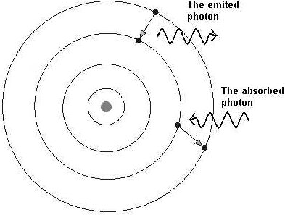
Bohr model:
Postulates fixed energy levels
Gives correct energies.
Doesn’t explain WHY energy levels fixed.
Describes electron as point particle moving in circle.
deBroglie model:
Also gives correct energies.
Explains fixed energy levels by postulating electron is standing wave, not orbiting particle.
Only looks at wave around a ring: basically 1D, not 3D
Both models:
Gets angular momentum wrong.
Can’t generalize to multi-electron atoms.
+
+

Slide 23
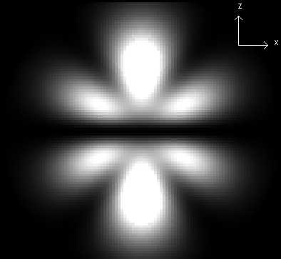
How does Schrodinger model of atom compare with other models? Why is it better?
Schrodinger model:
Gives correct energies.
Gives correct orbital angular momentum.
Describes electron as 3D wave.
Quantized energy levels result from boundary conditions.
Schrodinger equation can generalize to multi-electron atoms.
How?

Slide 24
Schrodinger’s solution for multi-electron atoms
What’s different for these cases?
Potential energy (V) changes!
(Now more protons AND other electrons)
Need to account for all the interactions among the electrons
Must solve for all electrons at once! (use matrices)
V (for q₁) = kq_{nucleus}q₁/r_{n-1} + kq₂q₁/r₂₋₁ + kq₃q₁/r₃₋₁ + ….
Gets very difficult to solve … huge computer programs!
Solutions change:
- wave functions change
higher Z → more protons→ electrons in 1s more strongly bound → radial distribution quite different general shape (p-orbital, s-orbital) similar but not same
- energy of wave functions affected by Z (# of protons)
higher Z → more protons→ electrons in 1s more strongly bound (more negative total energy)

Slide 25
A brief review of chemistry
Electron configuration in atoms:
How do the electrons fit into the available orbitals?
What are energies of orbitals?
3d
3p
3s
Total Energy
2p
2s
1s

Slide 26
A brief review of chemistry
Electron configuration in atoms:
How do the electrons fit into the available orbitals?
What are energies of orbitals?
Filling orbitals … lowest to highest energy, 2 e’s per orbital
H
Oxygen = 1s² 2s² 2p⁴
He
3d
Li
3p
Be
3s
B
C
e
e
e
e
Total Energy
2p
N
e
e
2s
O
Shell not full – reactive
Shell full – stable
e
e
1s

Slide 27
Will the 1s orbital be at the same energy level for each atom? Why or why not? What would change in Schrodinger’s equation?
No. Change number of protons … Change potential energy in Schrodinger’s equation … 1s held tighter if more protons.
The energy of the orbitals depends on the atom.
H
He
3d
Li
3p
Be
3s
B
C
e
e
e
e
Total Energy
2p
N
e
e
2s
O
Shell not full – reactive
Shell full – stable
e
e
1s

Slide 28
A brief review of chemistry
Electron configuration in atoms:
How do the electrons fit into the available orbitals?
What are energies of orbitals?
1, 2, 3 … principle quantum number, tells you some about energy
s, p, d … tells you some about geometric configuration of orbital
3d
3p
3s
2p
e
e
e
e
Shell 2
e
e
2s
Shell 1
e
e
1s

Slide 29
Can Schrodinger make sense of the periodic table?
1869: Periodic table (based on chemical behavior only)
1897: Thompson discovers electron
1909: Rutherford model of atom
1913: Bohr model

Slide 30
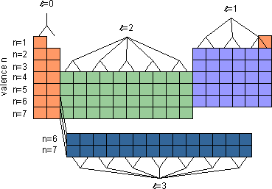
For a given atom, Schrodinger predicts allowed wave functions and energies of these wave functions.
l=0
l=1
l=2
4p
3d
4s
m=-2,-1,0,1,2
Li (3 e’s)
Energy
3p
3s
Na (11 e’s)
2p
2s
m=-1,0,1
1s
Why would behavior of Li be similar to Na?
a. because shape of outer most electron is similar.
b. because energy of outer most electron is similar.
c. both a and b
d. some other reason

Slide 31
Wave functions for sodium
Li (3 e’s)
3s
Na (11 e’s)
2p
1s
2s
In case of Na, what will energy of outermost electron be and WHY?
a. much more negative than for the ground state of H
b. somewhat similar to the energy of the ground state of H
c. much less negative than for the ground state of H
Notes:
A: 25
B: 48
C: 28
145 responses

Slide 32
Wave functions for sodium
Sodium has 11 protons.
2 electrons in 1s
2 electrons in 2s
6 electrons in 2p
Left over: 1 electron in 3s
Electrons in 1s, 2s, 2p generally closer to nucleus that 3s electron, what effective charge does 3s electron feel pulling it towards the nucleus?
3s
2p
1s
2s
Close to 1 proton… 10 electrons closer in shield (cancel) a lot of the nuclear charge.
In case of Na, what will energy of outermost electron be and WHY?
a. much more negative than for the ground state of H
b. somewhat similar to the energy of the ground state of H
c. much less negative than for the ground state of H
Notes:
A: 25
B: 48
C: 28
145 responses

Slide 33
Schrodinger predicts wave functions and energies of these wave functions.
l=0
l=1
l=2
4p
3d
4s
m=-2,-1,0,1,2
3p
Li
Energy
3s
Na
2p
2s
m=-1,0,1
1s
Why would behavior of Li be similar to Na?
a. because shape of outer most electron is similar.
b. because energy of outer most electron is similar.
c. both a and b
d. some other reason

Slide 34
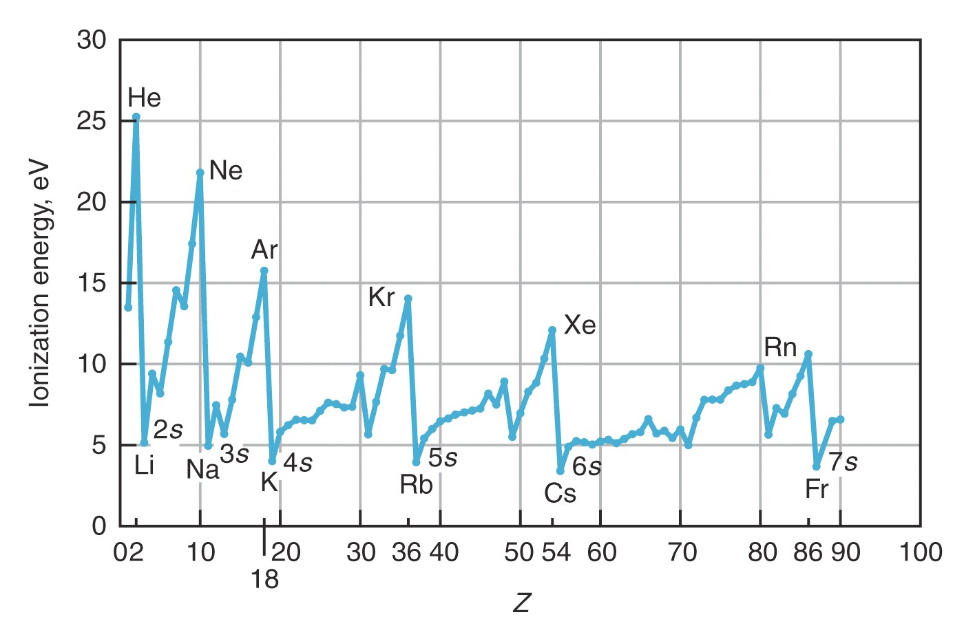
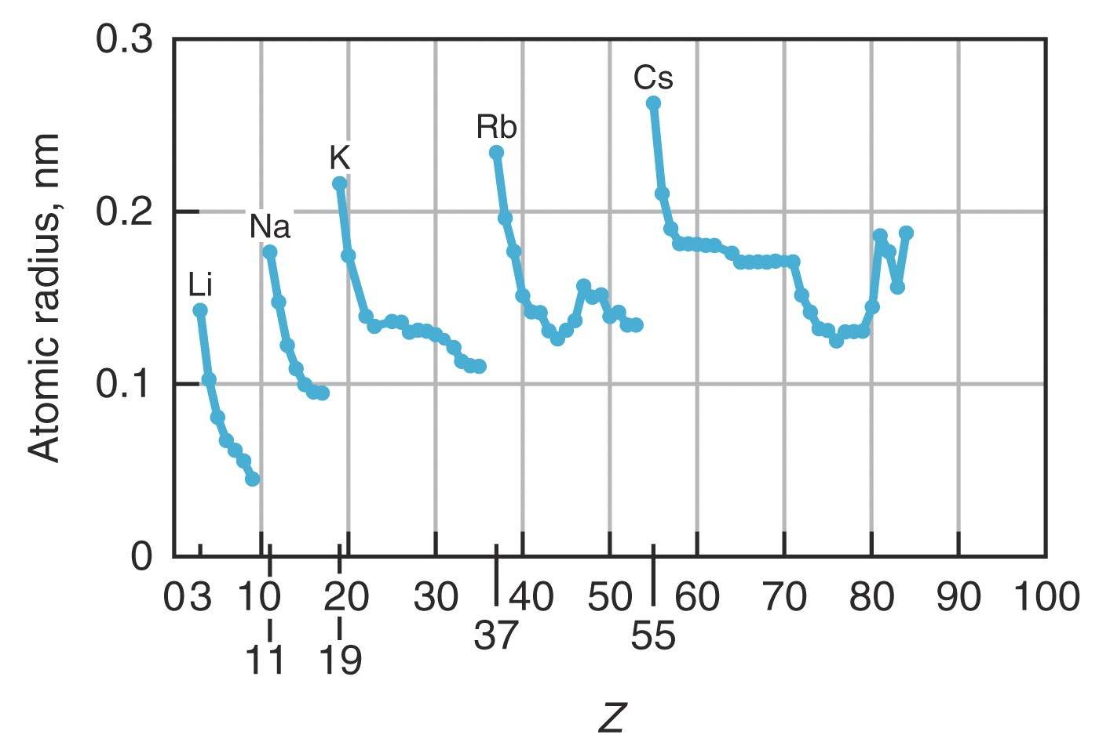

Slide 35
As go from Li to N,
end up with 3 electrons in 2p (one in each orbital),
Why is ionization energy larger and size smaller than in Li?
2p
2s
1s
P orbitals each have direction… electrons in p_{x} do not effectively shield electrons in p_{y} from the nucleus.
So electrons in p orbitals:
1. feel larger effective positive charge
2. are held closer to nucleus.
Notes:
A: 25
B: 48
C: 28
145 responses

Slide 36
All atoms in this row have common filling of outer most shell (valence electrons), common shapes, similar energies … so similar behavior
l=0 (s-orbitals)
l=1 (p-orbitals)
l=2 (d-orbitals)
Valence (n)
l=2 (f-orbitals)

Slide 37
Hydrogen (1p, 1e)
Boron (5p, 5e’s)
NOT TO SCALE!
l=0
(s)
l=1
(p)
l=2
(d)
4p
2p
3d
n=3
4s
3s
3p
3d
3p
n=2
3s
2s
2p
2s²
1s²
2p
m=-1,0,1
2s
n=1
Splitting of s and p
energy levels (shielding)
1s
l=0,m=0
ENERGY
Energy only
depends on n
Energy depends on n and l
1s
Notes:
A: 25
B: 48
C: 28
145 responses

Slide 38
In multi-electron atoms, energy of electron level depends on
n and l quantum numbers:
l=0
l=1
m=-1,0,1
l=2
m=-2,-1,0,1,2
4p
3d
4s
What is electron configuration for
atom with 20 electrons?
Write it out (1s² etc… !
3p
3s
Energy
a. 1s², 2s², 2p⁶, 3s², 3p⁴
b. 1s², 2s², 2p⁶, 3s², 3p⁶, 3d²
2p
c. 1s², 2s², 2p⁶, 3s², 3p⁶, 4s², 3d⁶
2s
d. 1s², 2s², 2p⁶, 3s², 3p⁶, 4s²
e. none of the above
Answer is d! Calcium: Fills lowest energy levels first
Which orbitals are occupied effects:
chemical behavior (bonding, reactivity, etc.)
1s
Notes:
A: 1
B: 3
C: 2
D: 95
E: 0
146 responses

Slide 39
In multi-electron atoms, energy of electron level depends on
n and l quantum numbers:
l=0
l=1
m=-1,0,1
l=2
m=-2,-1,0,1,2
Calcium has 3 complete shells.
Incomplete shell:
Chemical behavior & bonding determined by electrons in outer most shell (furthest from the nucleus).
4p
4th Shell
3d
4s
3p
3s
3rd Shell
Energy
4
3
3
2p
2
2st Shell
2s
1
1st Shell
1s

Slide 40
Electronic structure of atom determines its form
(metal, semi-metal, non-metal):
- related to electrons in outermost shell
- how these atoms bond to each other
Semiconductors

Slide 41
Bonding
- Main ideas:
1. involves outermost electrons and their wave functions
2. interference of wave functions
(one wave function from each atom) that produces situation where atoms want to stick together.
3. degree of sharing of an electron across 2 or more atoms determines the type of bond
Degree of sharing of electron
Ionic
Covalent
Metallic
electron completely transferred from one atom to the other
electron equally shared between two adjacent atoms
electron shared between all atoms
in solid
Li⁺ F⁻
H₂
Solid Lead

Slide 42
Ionic Bond (NaCl)
Na (outer shell 3s¹)
Cl (outer shell 3s²3p⁵)
Has one weakly bound electron
Low ionization energy
Needs one electron to fill shell
Strong electron affinity
Na
e
-
+
Cl
V(r)
Repulsion when
atoms overlap
Separation
of ions
Na⁺
Cl⁻
Cl⁻
Na⁺
Energy
Attracted by coulomb attraction
Coulomb attraction

Slide 43
Covalent Bond
Sharing of an electron… look at example H₂⁺
(2 protons (H nuclei), 1 electron)
Protons far apart …
Ψ₁
Wave function if electron bound to proton 1
Proton 1
Proton 2
Potential energy curve
V(r) that goes into Schrodinger equation

Slide 44
Covalent Bond
Sharing of an electron… look at example H₂⁺
(2 protons (H nuclei), 1 electron)
Protons far apart …
Ψ₁
Wave function if electron bound to proton 1
Proton 1
Proton 2
Ψ₂
Wave function if electron bound to proton 2
Proton 1
Proton 2

Slide 45
Covalent Bond
Sharing of an electron… look at example H₂⁺
(2 protons (H nuclei), 1 electron)
If Ψ₁ and Ψ₂ are both valid solutions,
then any combination is also valid solution.
Ψ₊ = Ψ₁ + Ψ₂
(molecular orbitals)
Ψ₁
Ψ₂
Add solutions
(symmetric):
Ψ₊ = Ψ₁ + Ψ₂ and
Ψ₋ = Ψ₁ – Ψ₂
Subtract solutions
(antisymmetric):
Ψ₋ = Ψ₁ – Ψ₂
−Ψ₂

Slide 46
Look at what happens to these wave functions as bring protons closer…
Visualize how electron cloud is distributed…
For which wave function would this cloud distribution tend to keep protons together? (bind atoms?) … what is your reasoning?
a. Ψ_{S} or Ψ₊
b. Ψ_{A} or Ψ₋
Notes:
A: 54
B: 46
149 responses

Slide 47
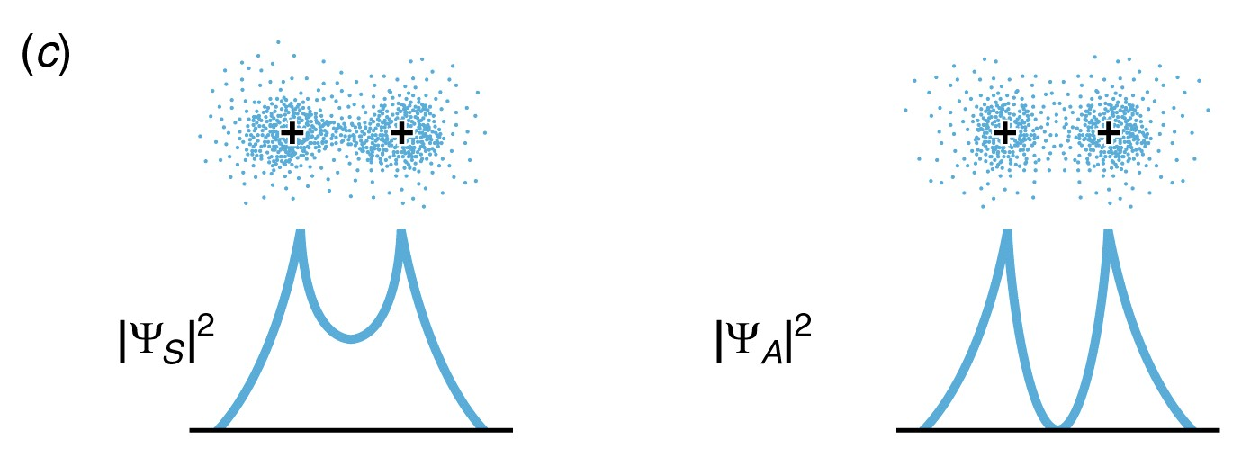
Look at what happens to these wave functions as bring protons closer…
Ψ₊ puts electron density between protons .. glues together protons.
Ψ₋ … no electron density between protons … protons repel (not stable)
Bonding Orbital
Antibonding Orbital

Slide 48
Ψ₊ = Ψ₁ + Ψ₂
(molecular orbitals)
Ψ₁
Ψ₂
Ψ₋ = Ψ₁-Ψ₂
−Ψ₂
V(r)
Energy of Ψ₋ as distance decreases
Energy (molecule)
Separation of protons
Energy of Ψ₊ as distance decreases
(more of electron cloud between them)

Slide 49
Quantum Bound State Sim

Slide 50
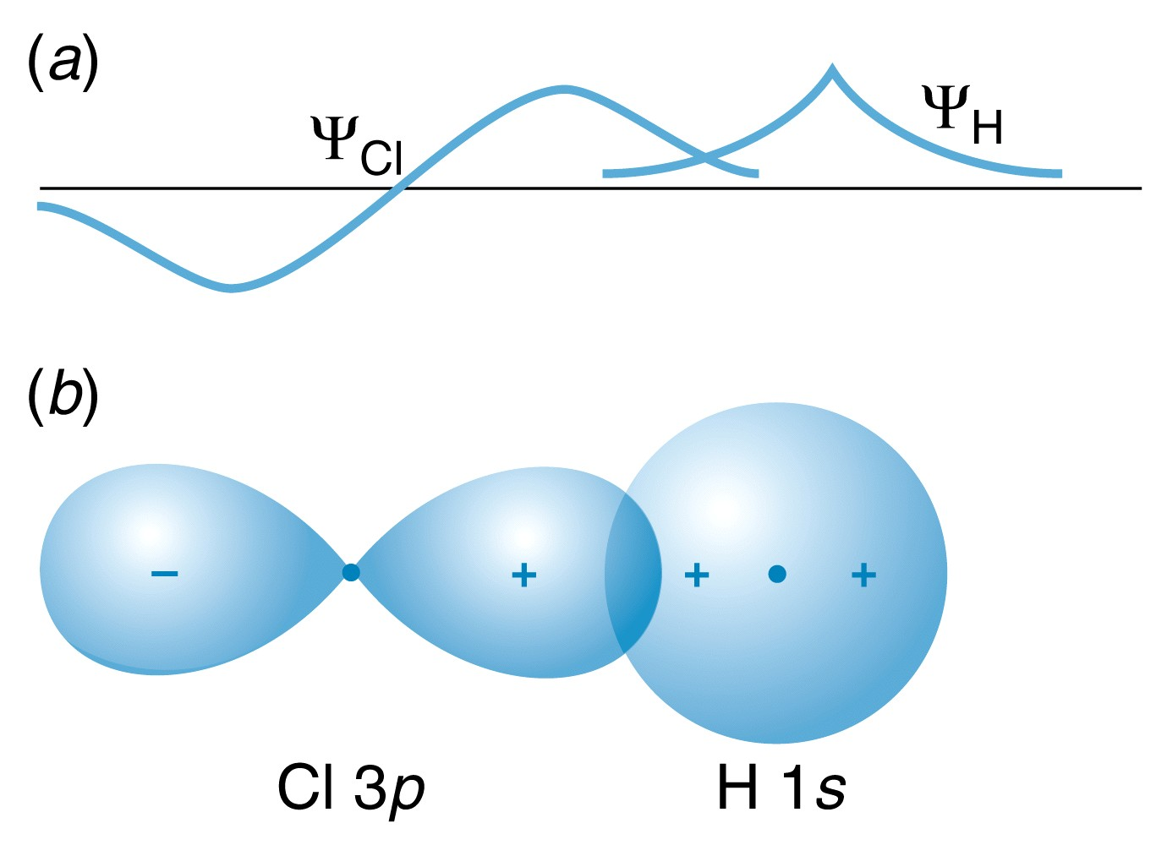
Same idea with p-orbital bonding … need constructive interference of wave functions between 2 nuclei.
Sign of wave function matters!
Determines how wave functions interfere.

Slide 51
Why doesn’t He-He bond?
Not exact same molecular orbitals as H₂⁺, but similar.
With He₂, have 4 electrons …
fill both bonding and anti-bonding orbitals. Not stable.
So doesn’t form.
Notes:
A: 54
B: 46
149 responses

