Slide 1
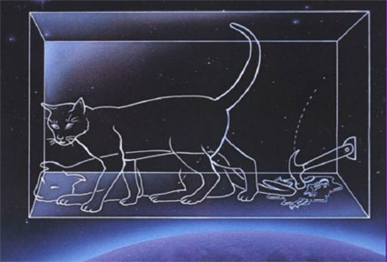
PH300 Modern Physics SP11
Day 26,4/21:
Questions?
Multi-electron atoms
Review for Exam 3
Up Next:
Exam 3, Thursday 4/28

Slide 2
Recently:
  Schrödinger equation in 3-D
  Hydrogen atom
  Multi-electron atoms
Today:
  Periodic table
  Tunneling (review)
  Review for Exam 3 – Thursday 4/28
Coming Up:
More applications of QM!
Review for final
Final Exam – Saturday, 5/7 – 1pm-3pm

Slide 3
Schrodinger’s solution for multi-electron atoms
What’s different for these cases?
Potential energy (V) changes!
(Now more protons AND other electrons)
Need to account for all the interactions among the electrons
V (for q₁) = kq_{nucleus}q₁/r_{n-1} + kq₂q₁/r₂₋₁ + kq₃q₁/r₃₋₁ + ….
Gets very difficult to solve … huge computer programs!
Solutions change:
- wave functions change
higher Z → more protons→ electrons in 1s more strongly bound → radial distribution quite different general shape (p-orbital, s-orbital) similar but not same
- energy of wave functions affected by Z (# of protons)
higher Z → more protons→ electrons in 1s more strongly bound (more negative total energy)

Slide 4
A brief review of chemistry
Electron configuration in atoms:
How do the electrons fit into the available orbitals?
What are energies of orbitals?
3d
3p
3s
Total Energy
2p
2s
1s

Slide 5
A brief review of chemistry
Electron configuration in atoms:
How do the electrons fit into the available orbitals?
What are energies of orbitals?
Filling orbitals … lowest to highest energy, 2 e’s per orbital
H
Oxygen = 1s² 2s² 2p⁴
He
3d
Li
3p
Be
3s
B
C
e
e
e
e
Total Energy
2p
N
e
e
2s
O
Shell not full – reactive
Shell full – stable
e
e
1s

Slide 6
Will the 1s orbital be at the same energy level for each atom? Why or why not? What would change in Schrodinger’s equation?
No. Change number of protons … Change potential energy in Schrodinger’s equation … 1s held tighter if more protons.
The energy of the orbitals depends on the atom.
H
He
3d
Li
3p
Be
3s
B
C
e
e
e
e
Total Energy
2p
N
e
e
2s
O
Shell not full – reactive
Shell full – stable
e
e
1s

Slide 7
A brief review of chemistry
Electron configuration in atoms:
How do the electrons fit into the available orbitals?
What are energies of orbitals?
1, 2, 3 … principle quantum number, tells you some about energy
s, p, d … tells you some about geometric configuration of orbital
3d
3p
3s
2p
e
e
e
e
Shell 2
e
e
2s
Shell 1
e
e
1s

Slide 8
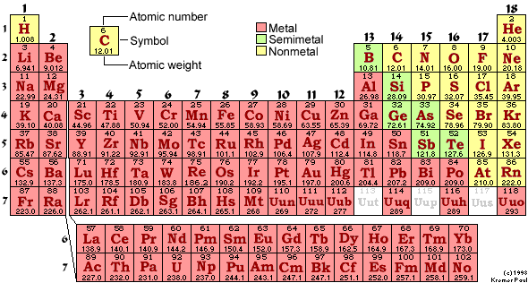
Can Schrodinger make sense of the periodic table?
1869: Periodic table (based on chemical behavior only)
1897: Thompson discovers electron
1909: Rutherford model of atom
1913: Bohr model

Slide 9
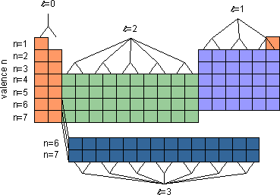
Wave functions for sodium
Li (3 e’s)
3s
Na (11 e’s)
2p
1s
2s
In case of Na, what will energy of outermost electron be and WHY?
a. much more negative than for the ground state of H
b. somewhat similar to the energy of the ground state of H
c. much less negative than for the ground state of H
Notes:
A: 25
B: 48
C: 28
145 responses

Slide 10
Wave functions for sodium
Sodium has 11 protons.
2 electrons in 1s
2 electrons in 2s
6 electrons in 2p
Left over: 1 electron in 3s
Electrons in 1s, 2s, 2p generally closer to nucleus than 3s electron. What effective charge does 3s electron feel pulling it towards the nucleus?
3s
2p
1s
2s
Close to 1 proton… 10 electrons closer in shield (cancel) a lot of the nuclear charge.
In case of Na, what will energy of outermost electron be and WHY?
a. much more negative than for the ground state of H
b. somewhat similar to the energy of the ground state of H
c. much less negative than for the ground state of H
Notes:
A: 25
B: 48
C: 28
145 responses

Slide 11
For a given atom, Schrodinger predicts allowed wave functions and energies of these wave functions.
l=0
l=1
l=2
4p
3d
4s
m=-2,-1,0,1,2
Li (3 e’s)
Energy
3p
3s
Na (11 e’s)
2p
2s
m=-1,0,1
1s
Why would behavior of Li be similar to Na?
a. because shape of outer most electron is similar.
b. because energy of outer most electron is similar.
c. both a and b
d. some other reason

Slide 12
Schrodinger predicts wave functions and energies of these wave functions.
l=0
l=1
l=2
4p
3d
4s
m=-2,-1,0,1,2
Li (3 e’s)
Energy
3p
3s
Na (11 e’s)
2p
2s
m=-1,0,1
1s
Why would behavior of Li be similar to Na?
a. because shape of outer most electron is similar.
b. because energy of outer most electron is similar.
c. both a and b
d. some other reason

Slide 13
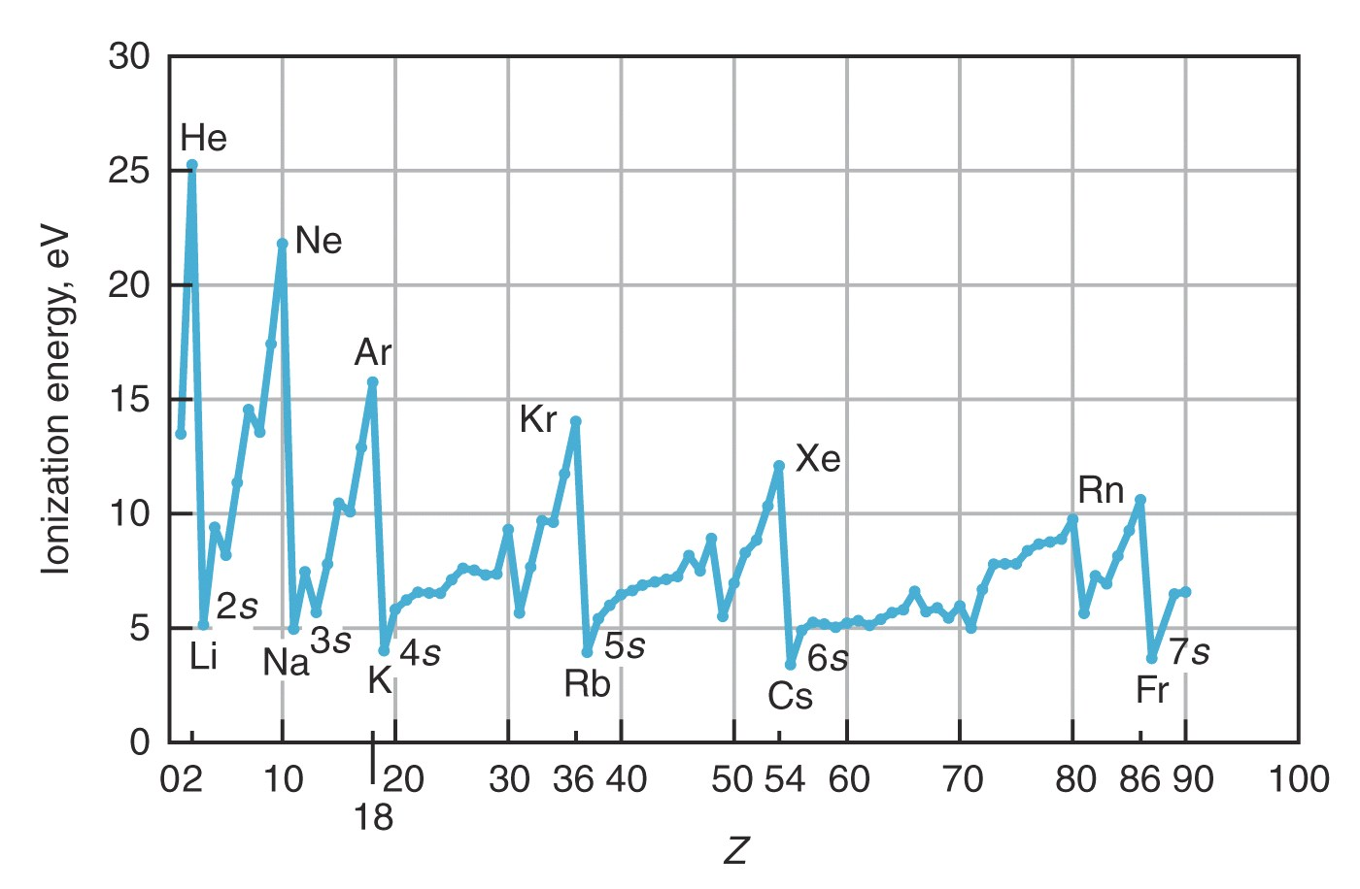
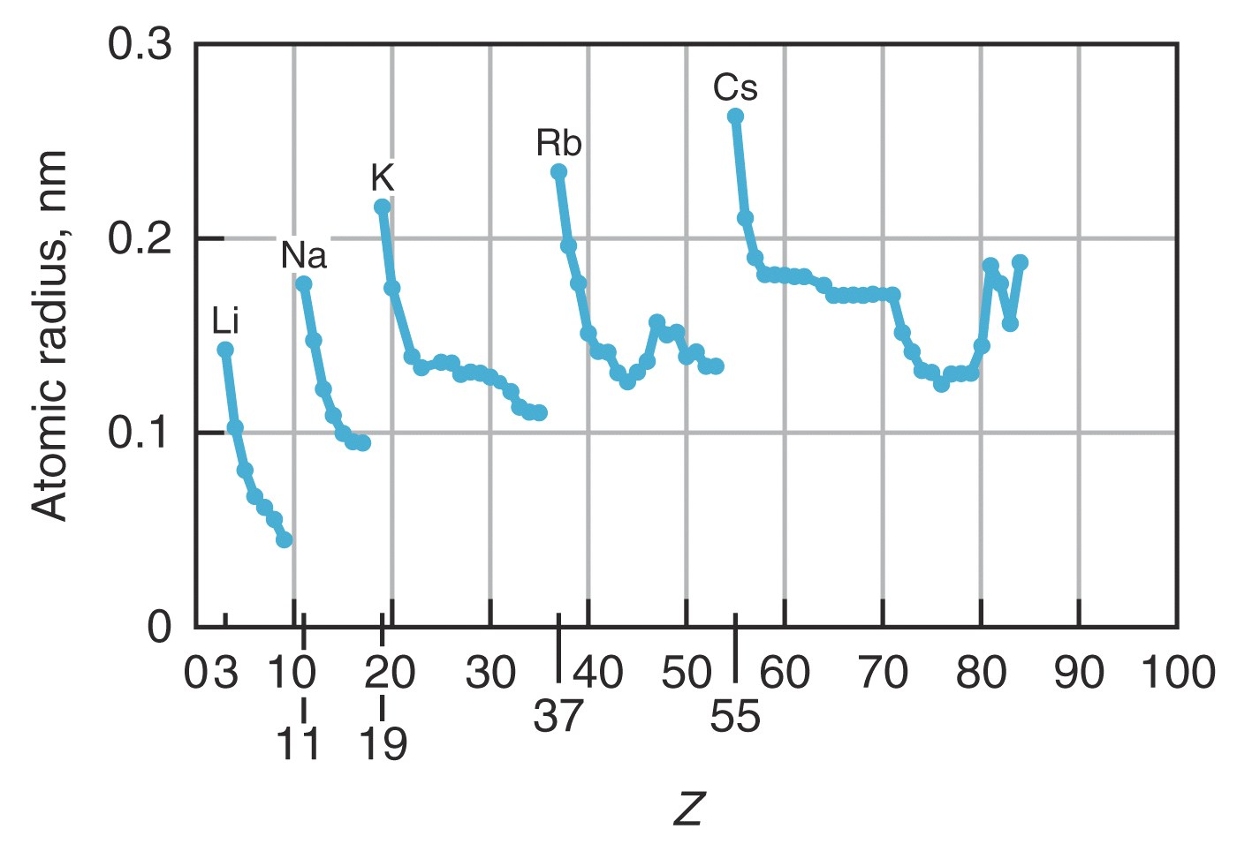

Slide 14
As go from Li to N,
end up with 3 electrons in 2p (one in each orbital),
Why is ionization energy larger and size smaller than in Li?
2p
2s
1s
P orbitals each have direction… electrons in p_{x} do not effectively shield electrons in p_{y} from the nucleus.
So electrons in p orbitals:
  1. feel larger effective positive charge
  2. are held closer to nucleus.
Notes:
A: 25
B: 48
C: 28
145 responses

Slide 15
All atoms in this row have common filling of outer most shell (valence electrons), common shapes, similar energies … so similar behavior
l=0 (s-orbitals)
l=1 (p-orbitals)
l=2 (d-orbitals)
Valence (n)
l=2 (f-orbitals)

Slide 16
Hydrogen (1p, 1e)
Boron (5p, 5e’s)
NOT TO SCALE!
l=0
(s)
l=1
(p)
l=2
(d)
4p
2p
3d
n=3
4s
3s
3p
3d
3p
n=2
3s
2s
2p
2s²
1s²
2p
m=-1,0,1
2s
n=1
Splitting of s and p
energy levels (shielding)
1s
l=0,m=0
ENERGY
Energy only
depends on n
Energy depends on n and l
1s
Notes:
A: 25
B: 48
C: 28
145 responses

Slide 17
In multi-electron atoms, energy of electron level depends on
n and l quantum numbers:
l=0
l=1
m=-1,0,1
l=2
m=-2,-1,0,1,2
4p
3d
4s
What is electron configuration for
atom with 20 electrons?
Write it out (1s² etc… !
3p
3s
Energy
a. 1s², 2s², 2p⁶, 3s², 3p⁴
b. 1s², 2s², 2p⁶, 3s², 3p⁶, 3d²
2p
c. 1s², 2s², 2p⁶, 3s², 3p⁶, 4s², 3d⁶
2s
d. 1s², 2s², 2p⁶, 3s², 3p⁶, 4s²
e. none of the above
Answer is d! Calcium: Fills lowest energy levels first
Which orbitals are occupied effects:
chemical behavior (bonding, reactivity, etc.)
1s
Notes:
A: 1
B: 3
C: 2
D: 95
E: 0
146 responses

Slide 18
Electronic structure of atom determines its form
(metal, semi-metal, non-metal):
- related to electrons in outermost shell
- how these atoms bond to each other
Semiconductors

Slide 19
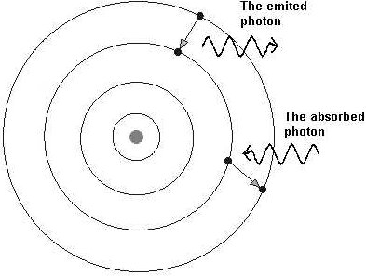
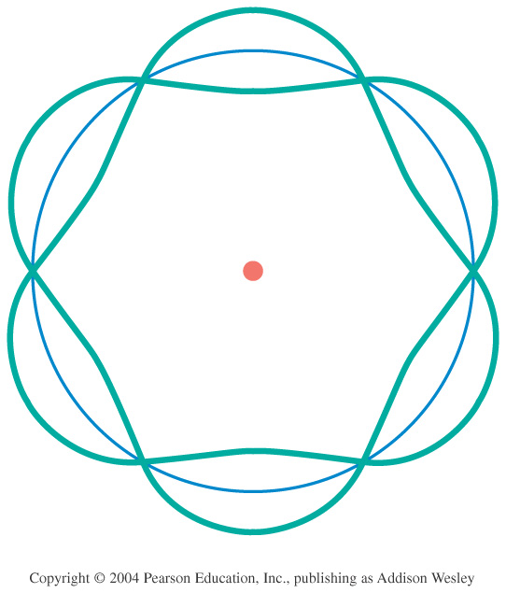
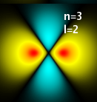


Models of the Atom
–
–
–
–
–
Thomson – Plum Pudding
  Why? Known that negative charges can be removed from atom.
  Problem: just a random guess
Rutherford – Solar System
  Why? Scattering showed hard core.
  Problem: electrons should spiral into nucleus in ~10⁻¹¹ sec.
Bohr – fixed energy levels
  Why? Explains spectral lines.
  Problem: No reason for fixed energy levels
deBroglie – electron standing waves
  Why? Explains fixed energy levels
  Problem: still only works for Hydrogen.
Schrödinger – will save the day!!
+
–
+
+

Slide 20
Solving the Schrödinger equation for electron wave in 1-D:
1. Figure out what V(x) is, for situation given.
2. Guess or look up functional form of solution.
3. Plug in to check if ψ’s and all x’s drop out, leaving an equation involving only a bunch of constants.
4. Figure out what boundary conditions must be to make sense physically.
5. Figure out values of constants to meet boundary conditions and normalization:
6. Multiply by time dependence ϕ(t) =exp(-iEt/ħ) to have full solution if needed. STILL TIME DEPENDENCE!
∞
|ψ(x)|²dx =1
-∞

Slide 21
What are these waves?
EM Waves (light/photons)
Amplitude = electric field
tells you the probability of detecting a photon.
Maxwell’s Equations:
Solutions are sine/cosine waves:
Matter Waves (electrons/etc)
Amplitude = matter field
tells you the probability of detecting a particle.
Schrödinger Equation:
Solutions are complex sine/cosine waves:

Slide 22
0
L
Solving Schrod. equ.
Before tackling wire, understand simplest case.
Electron in free space, no electric fields or gravity around.
1. Where does it want to be?
2. What is V(x)?
3. What are boundary conditions on ψ(x)?
No preference- all x the same.
Constant.
None, could be anywhere.
Smart choice of
constant, V(x) = 0!

Slide 23
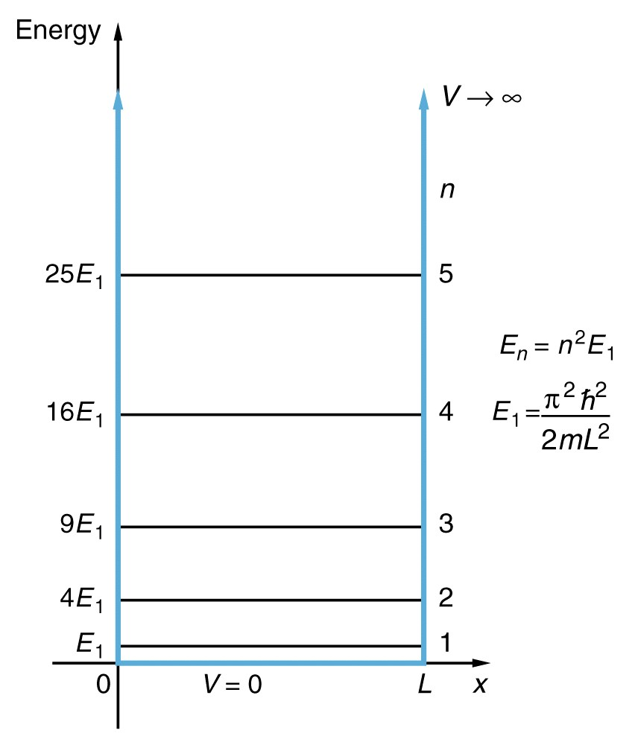
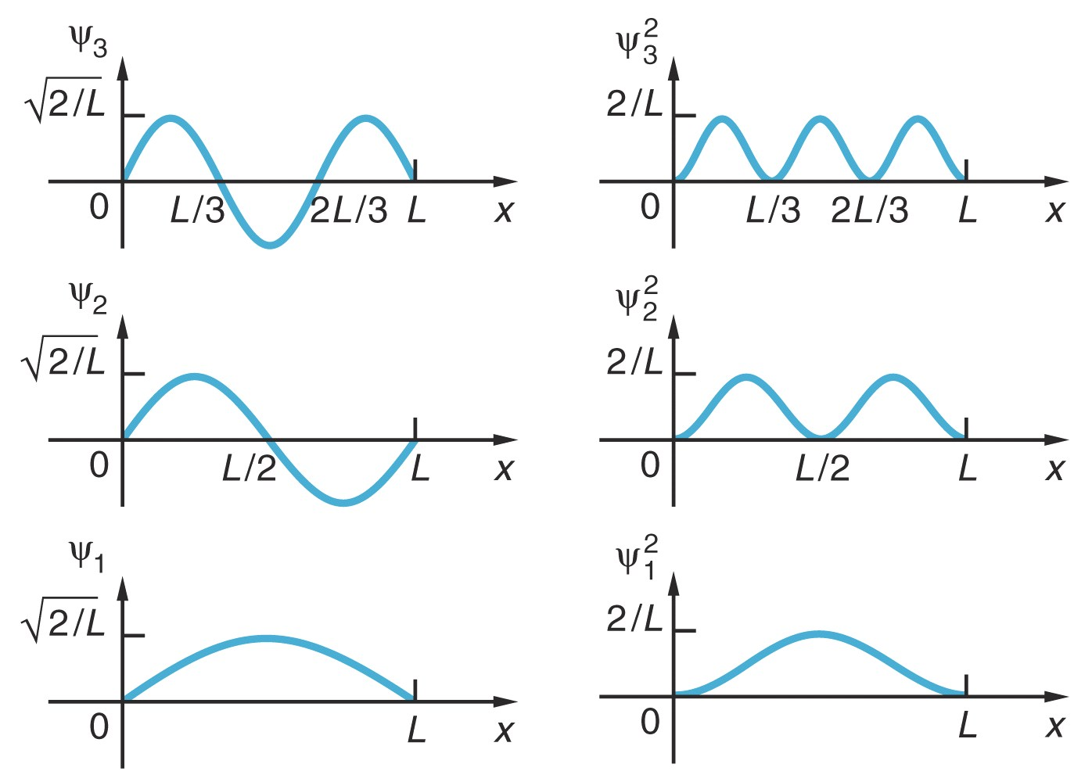
Quantized: k=nπ/L
Quantized:
How does probability of finding electron close to L/2 if in n = 3 excited state compared to probability for when n = 2 excited state?
much more likely for n=3.
B. equal prob. for both n = 2 and 3.
C. much more likely for n=2
Correct answer is a!
For n=2, ψ²=0
For n=3, ψ² at peak
Notes:
Even screwier.. Now note WAVE FUNCTION!!!! Vs. postion on energy graph

Slide 24
Case of wire with workfunction of 4.7 eV
4.7 eV = V₀
Energy
E_{particle}
0 eV
0 L
x
Positive number
ψ

Slide 25
Outside well
(E<V):
(Region I)
Inside well (E>V):
(Region II)
Outside well (E<V):
(Region III)
4.7 eV
Energy
E_{electron}
V=0 eV
0 L
x
Boundary
Conditions:

Slide 26
E_{electron}
0 L
1/α
wire
How far does wave extend into this “classically forbidden” region?
big -> quick decay
small -> slow decay
Measure of penetration depth = 1/α
ψ(x) decreases by factor of 1/e
For V-E = 4.7eV, 1/α ..9x10⁻¹¹ meters (very small ~ an atom!!!)

Slide 27
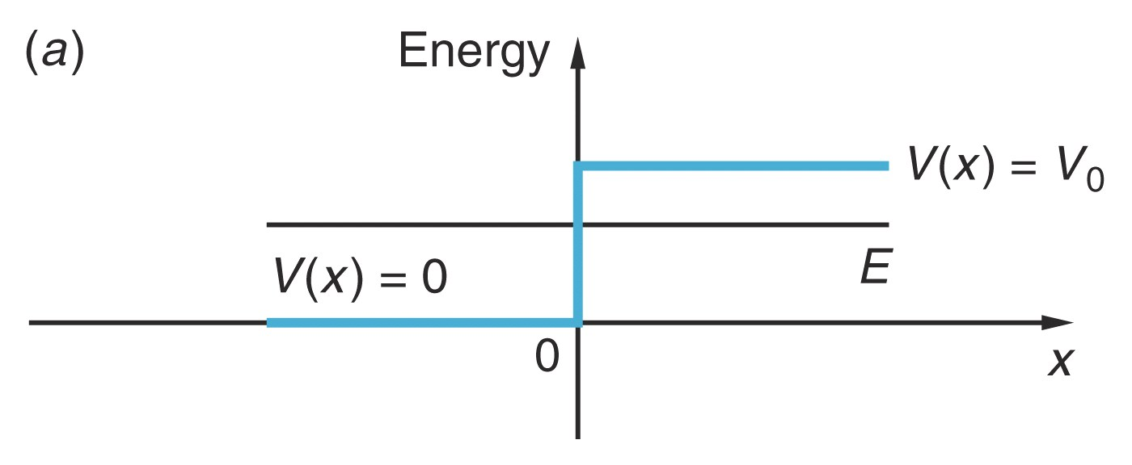
If the total energy E of the electron is LESS than the work function of the metal, V₀, when the electron reaches the end of the wire, it will…
stop.
be reflected back.
exit the wire and keep moving to the right.
either be reflected or transmitted with some probability.
dance around and sing, “I love quantum mechanics!”

Slide 28
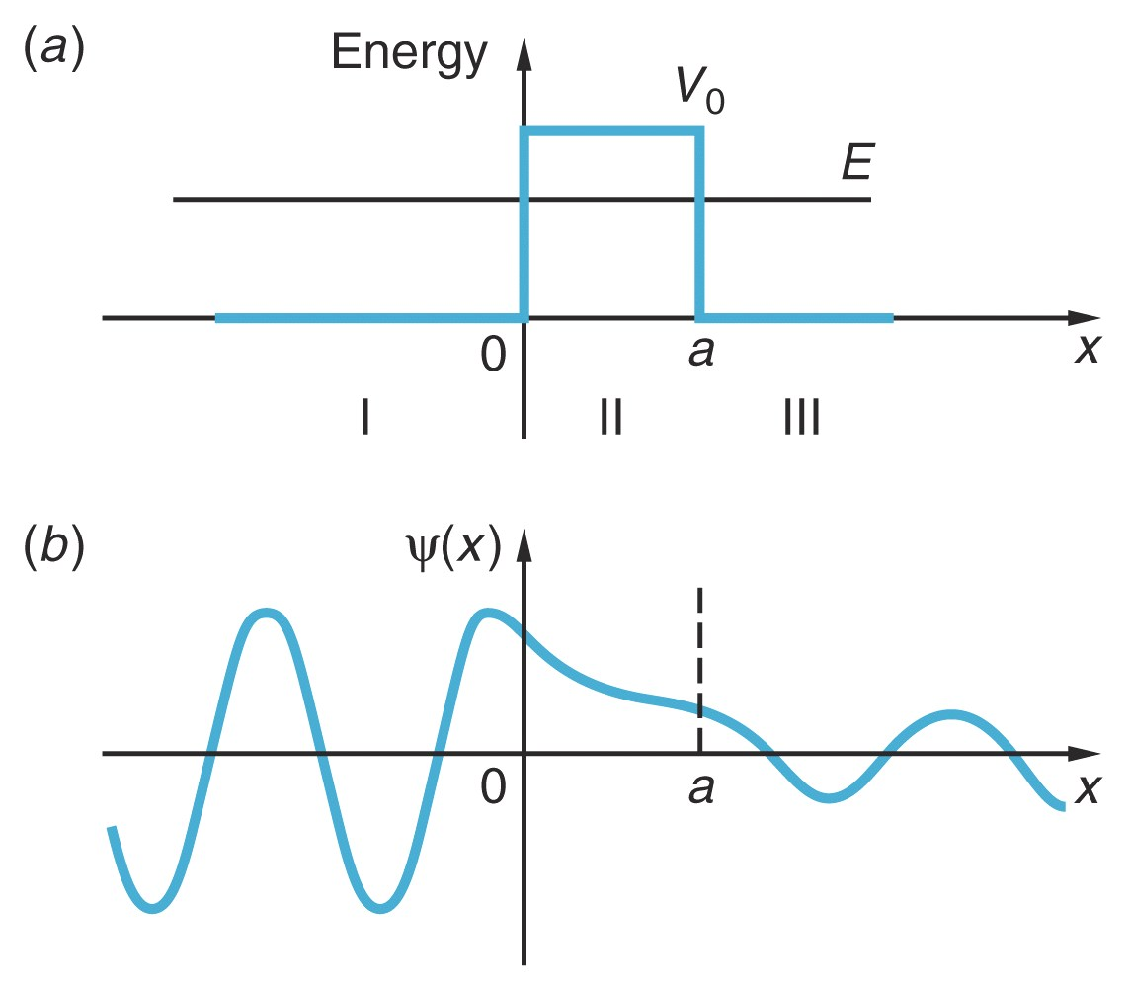
Can have transmission only if third region where solution is not real exponential! (electron tunneling through oxide layer between wires)
Real( )
E>P,
Ψ(x) can live!
electron tunnels
out of region I
CuO
Cu #2
Cu wire 1

Slide 29
Look at current from sample to tip
to measure distance of gap.
Tip
-
-
Electrons have an equal likelihood of tunneling to the left as tunneling to the right
-> no net current
SAMPLE
(metallic)
SAMPLE METAL
x
energy
sample
tip

Slide 30
Correct picture of STM-- voltage applied
between tip and sample.
T ~ e^{-2αx}
V
+
Tip
I
SAMPLE
(metallic)
I
α, big
x, small
α, small
x, big
energy
SAMPLE METAL
tunnel to right
applied voltage
sample
tip

Slide 31
Correct picture of STM-- voltage applied
between tip and sample.
T ~ e^{-2αx}
V
+
Tip
I
SAMPLE
(metallic)
I
α, big
x, big
α, small
x, small
energy
SAMPLE METAL
tunnel to left
applied voltage
sample
tip

Slide 32
V
+
Tip
I
I
applied voltage
sample
tip
SAMPLE METAL
What happens to the potential energy curve if we decrease the distance between tip and sample?

Slide 33
cq. if tip is moved closer to sample which picture is correct?
a.
b.
c.
d.
tunneling current will go up:
a is smaller, so e^{-2αa} is bigger (not as small), T bigger
Notes:
A: 1
B:
C: 94
D: 5
161 responses

Slide 34
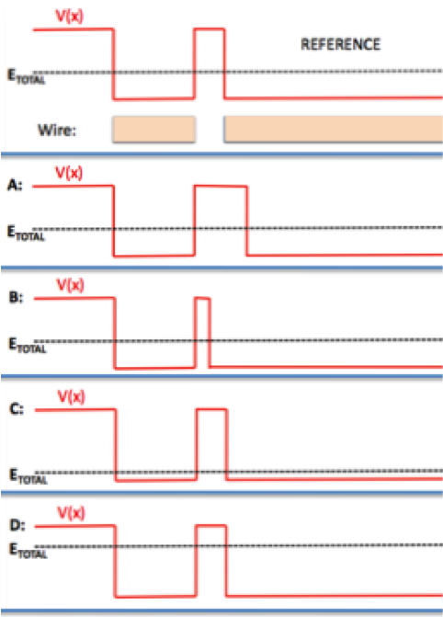
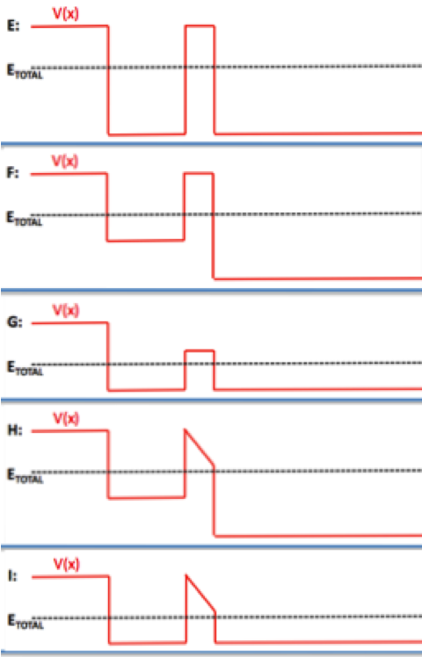

Slide 36
Starting point always to look at potential energy curve for particle
Bring alpha-particle closer
Coulomb
&Nuclear
30 MeV
V(r)
Coulomb force dominates
r
Energy
Edge of the nucleus (~8x10⁻¹⁵ m),
nuclear (Strong) force starts acting.
Strong attraction between nucleons.
Potential energy drops dramatically.

Slide 37
Observe α-particles from different isotopes (same protons, different neutrons), exit with different amounts of energy.
1. Less distance to tunnel.
2. Decay constant always smaller
3. Wave function doesn’t decay as much before reaches other side … more probable!
30 MeV
V(r)
9MeV KE
4MeV KE
The 9 MeV electron more probable…
Isotopes that emit higher energy alpha particles, have shorter lifetimes!!!

Slide 38
z
In 1D (electron in a wire):
Have 1 quantum number (n)
In 3D, now have 3 degrees of freedom:
Boundary conditions in terms of r,θ,φ
Have 3 quantum numbers (n, l, m)
θ
r
φ
y
x
Shape of ψ depends on n, l ,m. Each (nlm) gives unique ψ
n=1, 2, 3 … = Principle Quantum Number
2p
l=0, 1, 2, 3 …= Angular Momentum Quantum Number
=s, p, d, f (restricted to 0, 1, 2 … n-1)
n=2
l=1
m=-1,0,1
m = ... -1, 0, 1.. = z-component of Angular Momentum
(restricted to –l to l)

Slide 39
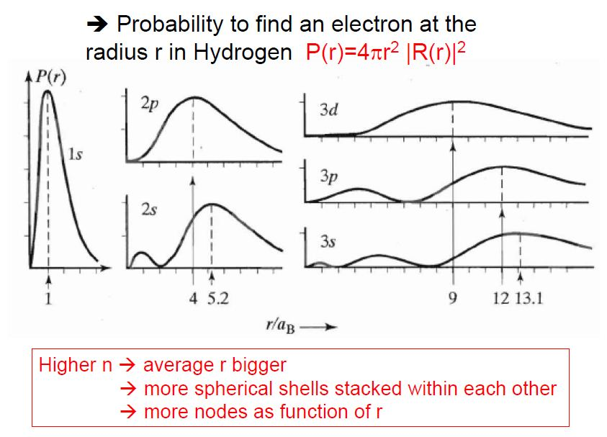

Slide 40
Energy Diagram for Hydrogen
l=0
(s)
l=1
(p)
l=2
(d)
n=3
3s
3p
3d
n=2
2s
2p
In HYDROGEN, energy only depends on n, not l and m.
(NOT true for multi-electron atoms!)
n=1
l=0,m=0
1s
Notes:
A: 4
B: 54
C: 5
D: 27
E: 9
170 responses

Slide 41
An electron in hydrogen is excited to Energy = -13.6/9 eV. How many different wave functions in H have this energy?
a. 1 b. 3 c. 6 d. 9 e. 10
n= Principle Quantum Number:
n=3
l=(restricted to 0, 1, 2 … n-1)
l=0,1,2
m=(restricted to -l to l)
Answer is d:
9 states all with the same energy
n l m
3 0 0
3 1 -1
3 1 0
3 1 1
3 2 -2
3 2 -1
3 2 0
3 2 1
3 2 2
3s states
3p states (l=1)
With the addition of spin, we now have 18 possible quantum states for the electron with n=3
3d states (l=2)

Slide 42
Bonding
- Main ideas:
1. involves outermost electrons and their wave functions
2. interference of wave functions
(one wave function from each atom) that produces situation where atoms want to stick together.
3. degree of sharing of an electron across 2 or more atoms determines the type of bond
Degree of sharing of electron
Ionic
Covalent
Metallic
electron completely transferred from one atom to the other
electron equally shared between two adjacent atoms
electron shared between all atoms
in solid
Li⁺ F⁻
H₂
Solid Lead

Slide 43
Ionic Bond (NaCl)
Na (outer shell 3s¹)
Cl (outer shell 3s²3p⁵)
Has one weakly bound electron
Low ionization energy
Needs one electron to fill shell
Strong electron affinity
Na
e
-
+
Cl
V(r)
Repulsion when
atoms overlap
Separation
of ions
Na⁺
Cl⁻
Cl⁻
Na⁺
Energy
Attracted by coulomb attraction
Coulomb attraction

Slide 44
Covalent Bond
Sharing of an electron… look at example H₂⁺
(2 protons (H nuclei), 1 electron)
Protons far apart …
Ψ₁
Wave function if electron bound to proton 1
Proton 1
Proton 2
Potential energy curve
V(r) that goes into Schrodinger equation

Slide 45
Covalent Bond
Sharing of an electron… look at example H₂⁺
(2 protons (H nuclei), 1 electron)
Protons far apart …
Ψ₁
Wave function if electron bound to proton 1
Proton 1
Proton 2
Ψ₂
Wave function if electron bound to proton 2
Proton 1
Proton 2

Slide 46
Covalent Bond
Sharing of an electron… look at example H₂⁺
(2 protons (H nuclei), 1 electron)
If Ψ₁ and Ψ₂ are both valid solutions,
then any combination is also valid solution.
Ψ₊ = Ψ₁ + Ψ₂
(molecular orbitals)
Ψ₁
Ψ₂
Add solutions
(symmetric):
Ψ₊ = Ψ₁ + Ψ₂ and
Ψ₋ = Ψ₁ – Ψ₂
Subtract solutions
(antisymmetric):
Ψ₋ = Ψ₁ – Ψ₂
−Ψ₂

Slide 47
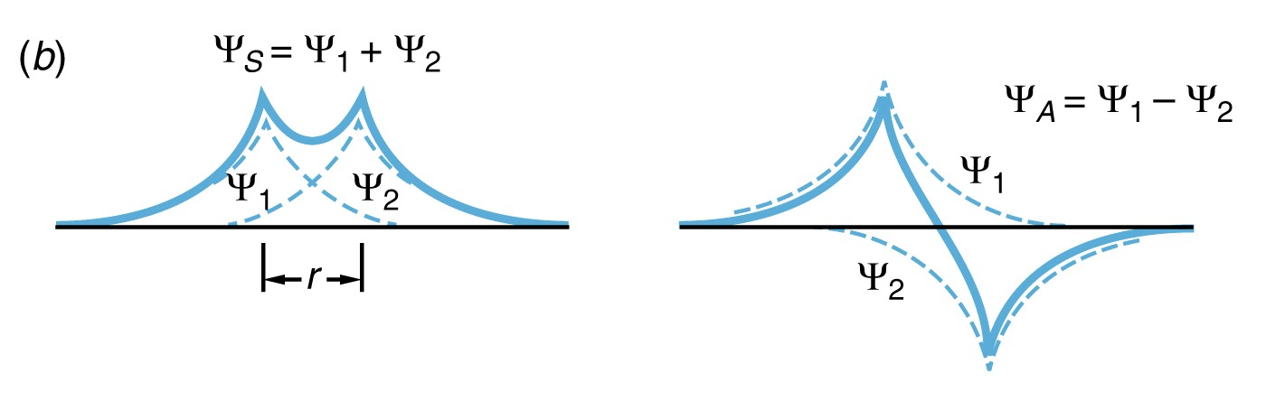
Look at what happens to these wave functions as bring protons closer…
Visualize how electron cloud is distributed…
For which wave function would this cloud distribution tend to keep protons together? (bind atoms?) … what is your reasoning?
a. Ψ_{S} or Ψ₊
b. Ψ_{A} or Ψ₋
Notes:
A: 54
B: 46
149 responses

Slide 48
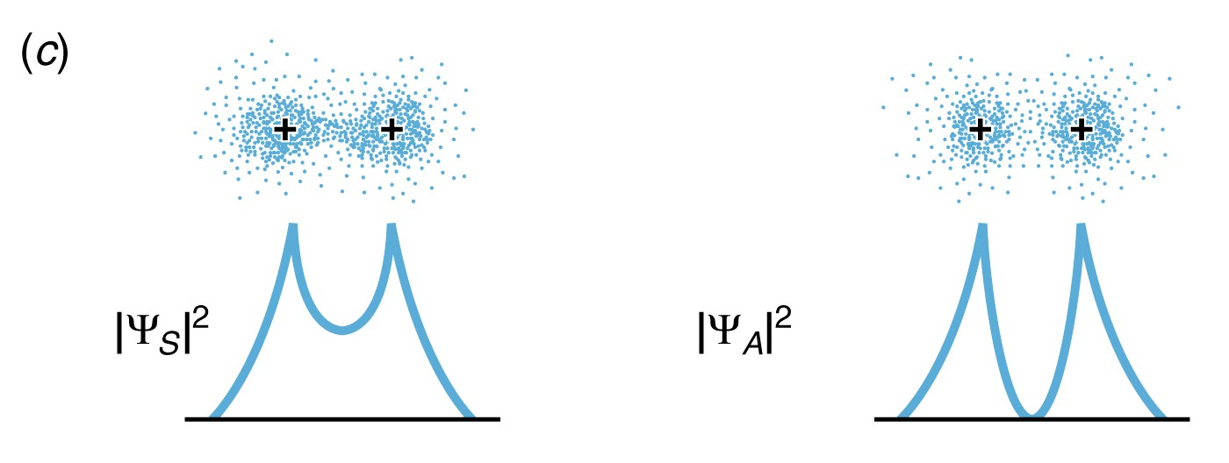
Look at what happens to these wave functions as bring protons closer…
Ψ₊ puts electron density between protons .. glues together protons.
Ψ₋ … no electron density between protons … protons repel (not stable)
Bonding Orbital
Antibonding Orbital

Slide 49
Ψ₊ = Ψ₁ + Ψ₂
(molecular orbitals)
Ψ₁
Ψ₂
Ψ₋ = Ψ₁-Ψ₂
−Ψ₂
V(r)
Energy of Ψ₋ as distance decreases
Energy (molecule)
Separation of protons
Energy of Ψ₊ as distance decreases
(more of electron cloud between them)

Slide 50
Quantum Bound State Sim

Slide 51
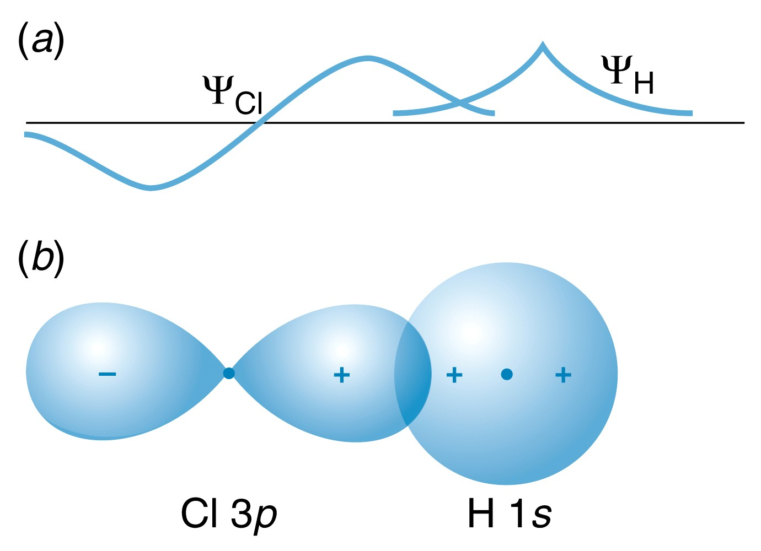
Same idea with p-orbital bonding … need constructive interference of wave functions between 2 nuclei.
Sign of wave function matters!
Determines how wave functions interfere.

Slide 52
Why doesn’t He-He bond?
Not exact same molecular orbitals as H₂⁺, but similar.
With He₂, have 4 electrons …
fill both bonding and anti-bonding orbitals. Not stable.
So doesn’t form.
Notes:
A: 54
B: 46
149 responses

