Slide 1
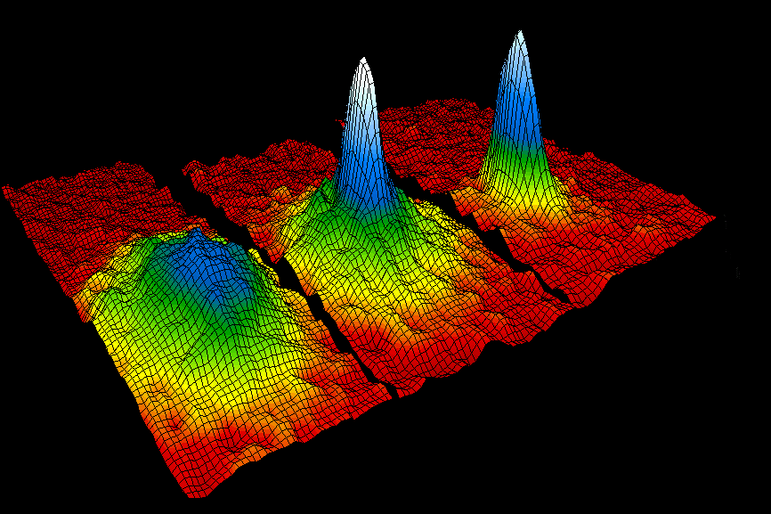
PH300 Modern Physics SP11
“Quantum mechanics is the greatest intellectual achievement of mankind.” – Carl Wieman
Day 27,5/3:
Questions?
Molecular Bonding (?)
BEC (!)
This Week:
Final Exam, Saturday 4/28
1:00-3:00pm

Slide 2
Bonding
- Main ideas:
1. involves outermost electrons and their wave functions
2. interference of wave functions
(one wave function from each atom) that produces situation where atoms want to stick together.
3. degree of sharing of an electron across 2 or more atoms determines the type of bond
Degree of sharing of electron
Ionic
Covalent
Metallic
electron completely transferred from one atom to the other
electron equally shared between two adjacent atoms
electron shared between all atoms
in solid
Li⁺ F⁻
H₂
Solid Lead

Slide 3
Ionic Bond (NaCl)
Na (outer shell 3s¹)
Cl (outer shell 3s²3p⁵)
Has one weakly bound electron
Low ionization energy
Needs one electron to fill shell
Strong electron affinity
Na
e
-
+
Cl
V(r)
Repulsion when
atoms overlap
Separation
of ions
Na⁺
Cl⁻
Cl⁻
Na⁺
Energy
Attracted by coulomb attraction
Coulomb attraction

Slide 4
Covalent Bond
Sharing of an electron… look at example H₂⁺
(2 protons (H nuclei), 1 electron)
Protons far apart …
Ψ₁
Wave function if electron bound to proton 1
Proton 1
Proton 2
Potential energy curve
V(r) that goes into Schrodinger equation

Slide 5
Covalent Bond
Sharing of an electron… look at example H₂⁺
(2 protons (H nuclei), 1 electron)
Protons far apart …
Ψ₁
Wave function if electron bound to proton 1
Proton 1
Proton 2
Ψ₂
Wave function if electron bound to proton 2
Proton 1
Proton 2

Slide 6
Covalent Bond
Sharing of an electron… look at example H₂⁺
(2 protons (H nuclei), 1 electron)
If Ψ₁ and Ψ₂ are both valid solutions,
then any combination is also valid solution.
Ψ₊ = Ψ₁ + Ψ₂
(molecular orbitals)
Ψ₁
Ψ₂
Add solutions
(symmetric):
Ψ₊ = Ψ₁ + Ψ₂ and
Ψ₋ = Ψ₁ – Ψ₂
Subtract solutions
(antisymmetric):
Ψ₋ = Ψ₁ – Ψ₂
−Ψ₂

Slide 7
Look at what happens to these wave functions as bring protons closer…
Visualize how electron cloud is distributed…
For which wave function would this cloud distribution tend to keep protons together? (bind atoms?) … what is your reasoning?
a. Ψ_{S} or Ψ₊
b. Ψ_{A} or Ψ₋
Notes:
A: 54
B: 46
149 responses

Slide 8
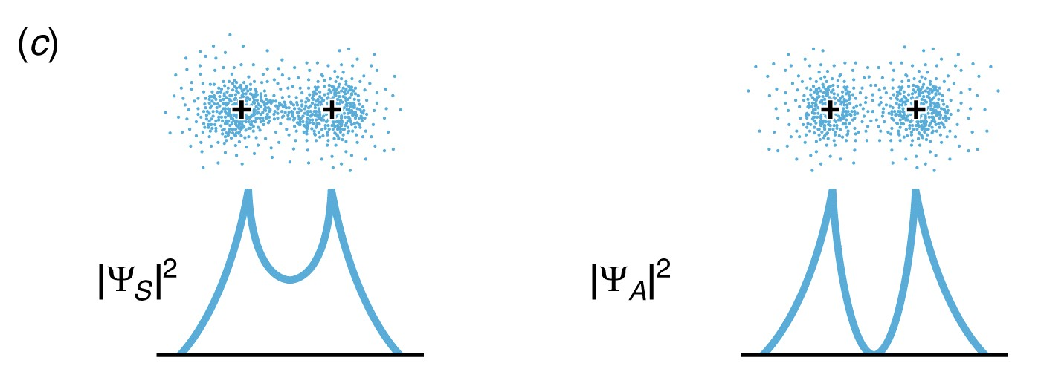
Look at what happens to these wave functions as bring protons closer…
Ψ₊ puts electron density between protons .. glues together protons.
Ψ₋ … no electron density between protons … protons repel (not stable)
Bonding Orbital
Antibonding Orbital

Slide 9
Ψ₊ = Ψ₁ + Ψ₂
(molecular orbitals)
Ψ₁
Ψ₂
Ψ₋ = Ψ₁-Ψ₂
−Ψ₂
V(r)
Energy of Ψ₋ as distance decreases
Energy (molecule)
Separation of protons
Energy of Ψ₊ as distance decreases
(more of electron cloud between them)

Slide 10
Quantum Bound State Sim

Slide 11
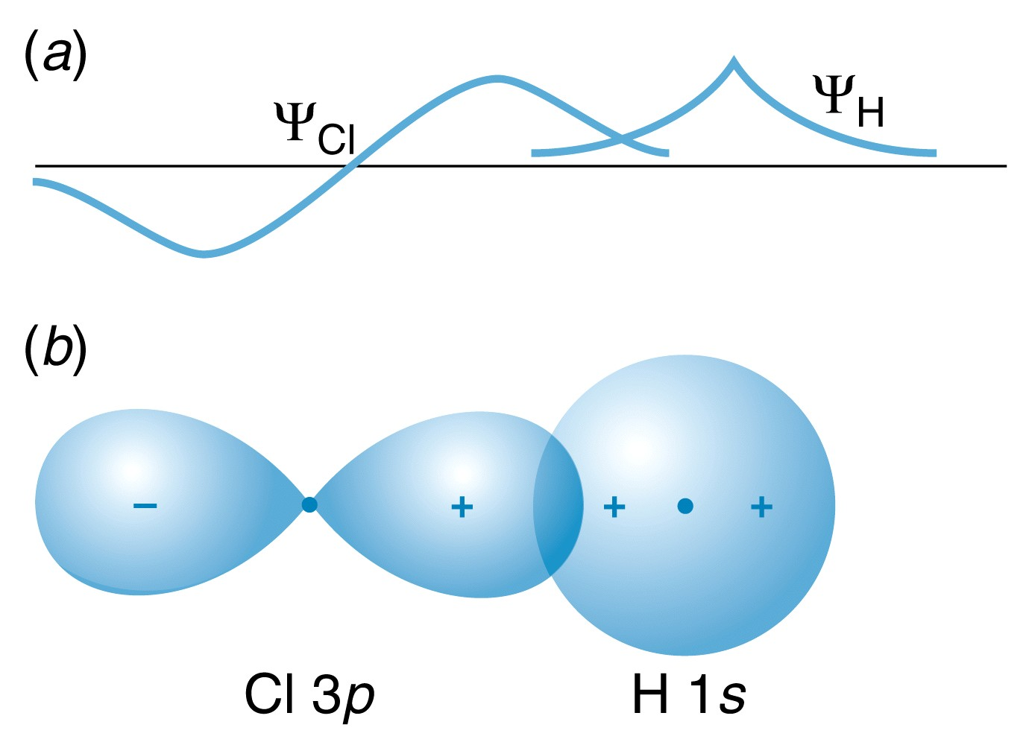
Same idea with p-orbital bonding … need constructive interference of wave functions between 2 nuclei.
Sign of wave function matters!
Determines how wave functions interfere.

Slide 12
Why doesn’t He-He bond?
Not exact same molecular orbitals as H₂⁺, but similar.
With He₂, have 4 electrons …
fill both bonding and anti-bonding orbitals. Not stable.
So doesn’t form.
Notes:
A: 54
B: 46
149 responses

Slide 13
Bose-Einstein Condensation (BEC):
Quantum weirdness at
lowest temperature in the universe
JILA BEC Effort Eric Cornell, Carl Wieman 1990-
Anderson, Ensher, Jin, Hall, Matthews, Myatt, Monroe, Claussen, Roberts, Cornish, Haljan, Donley, Thompson, Papp, Zirbel, Lewandowski, Harber, Coddington, Engels, McGuirk, Hodby,...
$$ (NSF, ONR, NIST)
Part I. (1924-95) Making Bose-Einstein Condensation in a gas.
BEC- a new form of matter predicted by Einstein in 1924 and first created in 1995 by Cornell/Wieman group.
Part II. An example of more recent research with BEC.

Slide 14
Absolute
(Kelvin)
Fahrenheit
(degrees)
300
70
Room Temp
earth
Water freezes
250
200
Dry Ice
150
100
Air freezes
50
Deep space, 3 K
Absolute zero!
-273 ºC
0
-460
BEC at .000 000 1º above absolute zero

Slide 15
temperature applet

Slide 16
Why low temperature is interesting for quantum mechanics
At room temperature typical de Broglie wavelength for rubidium
atom is 2 x 10⁻¹¹ m.
If decrease the temperature of a sample from 300 K to 3 microK
how does the de Broglie wavelength change?
a. smaller by 10⁸
b. smaller by 10⁴
c. bigger by 10⁸
d. bigger by 10⁴
e. stays the same
3/2 (kT) =1/2 mv²
λ_{db} = h/mv ~ 1/T^{0.5}
so 10⁸ decrease in Temp gives
10⁴ increase in λ_{db.}
So colder make more quantum
wavelike.
Hint: 3/2 (kT) =1/2 mv²

Slide 17
How closely are the levels spaced?
How would spacing scale with size?
Level spacing in square well
goes like 1/size.
So 1 cm well MANY orders of
magnitude smaller spacing than atom.
quantized energy levels
1 cm bowl, small spacing

Slide 18
Hot atoms
(more than 10 millionths
of degree above abs. zero)
Cold atoms
A. E. 1924
“Bosonic” atoms,
opposite to
Pauli exclusion
principle. Want
to be in same
state.
BEC
100 billionths of a degree
quantized energy levels
1 cm bowl, small spacing
"superatom" --single quantum wave

Slide 19
So basic condition for BEC-- need de Broglie waves of atoms to overlap.
~ Product of density and coldness.
BUT atoms have to stay far apart so see each other as
friendly Bosons who want to be in same quantum state.
Not bunch of interacting electrons and protons (unfriendly fermions)
who also want to turn into molecules and freeze into ice cubes.
Means cannot make dense at all, so have to make VERY cold!
size of electron
cloud
de Broglie wavelength

Slide 20
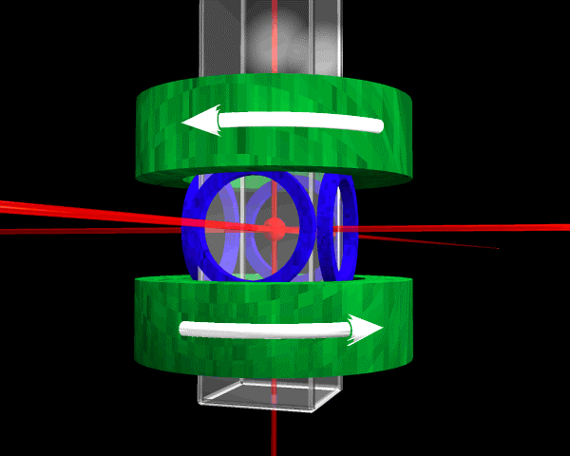
evacuated
glass cell
coils of wire
diode lasers
(cheap)
B coils
2.5 cm

Slide 21
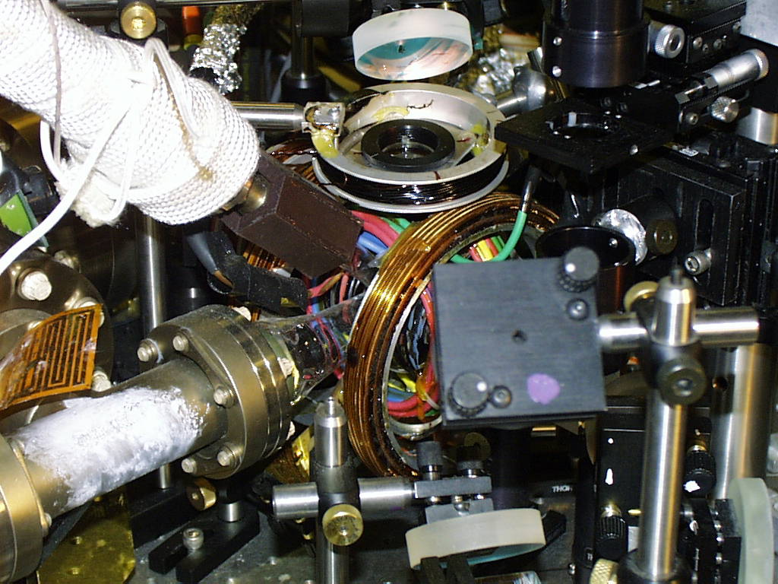
JILA BEC #2 (#1 at Smithsonian)
2 in.

Slide 22
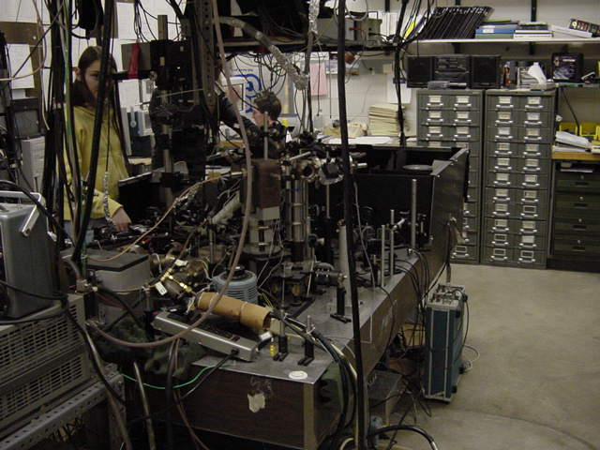

Slide 23
Getting atoms cold- step 1
Rb
A
Laser
Pushing atoms with light
momentum kick when atom absorbs,
then reemits photon.

Slide 24
if light just the right color…
electrons absorb light jump to higher energy level
jump back down, give off light
(wiggling a bunch while jumping)
laser cooling applet

Slide 25
optical molasses applet
magnetic trapping applet
evaporative cooling applet

Slide 26
Shadow “snapshot” of BEC
CCD array
(TV camera)

Slide 27
Shadow images of clouds
1
2
CQ. Which cloud is hotter?
1 is hotter than 2.
2 is hotter than 1.
Impossible to tell just from shadow picture

Slide 28
Shadow images of clouds
Hot cloud
Cold cloud
fill few E levels

Slide 29
useful trick- turn off trap, let cloud/wave function expand
for 0.1 sec, then take picture.
bigger, easier to see,
but same shape as original (because parabolic potential)

Slide 30
BEC! JILA-June 1995
50 billionths
~ 200 billionths
400 billionths
of degree
0.2 mm
False color images of cloud

Slide 31
Why does narrow spire appearing show that
we have created Bose-Einstein condensate?
a. because a different shaped peak means
we have created new type of atom.
b. Because the condensate is bluish-white in color, so when see that color in image, it means must be condensate there.
c. because if atoms have lowest possible
energy, they will collect close together
at bottom of bowl.
d. narrow spire indicates that shining laser
light on the cloud has caused it to explode.

Slide 32
Size of BEC wave function depends on how tight the
magnetic trap squeeze.
If trap squeezed tighter to make wave function smaller, it
will expand out when trap is turned off
a. faster than with less squeeze,
b. same as when less squeeze
c. slower than when less squeeze
a. faster. If squeezed down tighter, wave function is not
as spread out, uncertainty in x smaller, so uncertainty in p bigger, means must have more components of p in wave function.

Slide 33
Quantum physics on “human” size scale
Control and Observe
Putting one condensate on top of another
about width of human hair
Fringes formed with two overlapping condensates- waves interfering.
Fringe spacing depends on v,
according to deBroglie λ=h/p
(NIST Gaithersburg atom cooling group
- courtesy S. Rolston)

Slide 34
Where BEC now (post June ‘95)?
New regime of physics-
directly observe and manipulate quantum wave function
~ 200+ working experiments, many atoms (⁸⁷Rb, Na, Li, H, ⁸⁵Rb, He*,K, Cs)
countless theorists-
many thousands of papers
>1000 scientists
Measured and predicted all sorts of novel properties.
New ways to study, make and manipulate.
Potential applications.

Slide 35
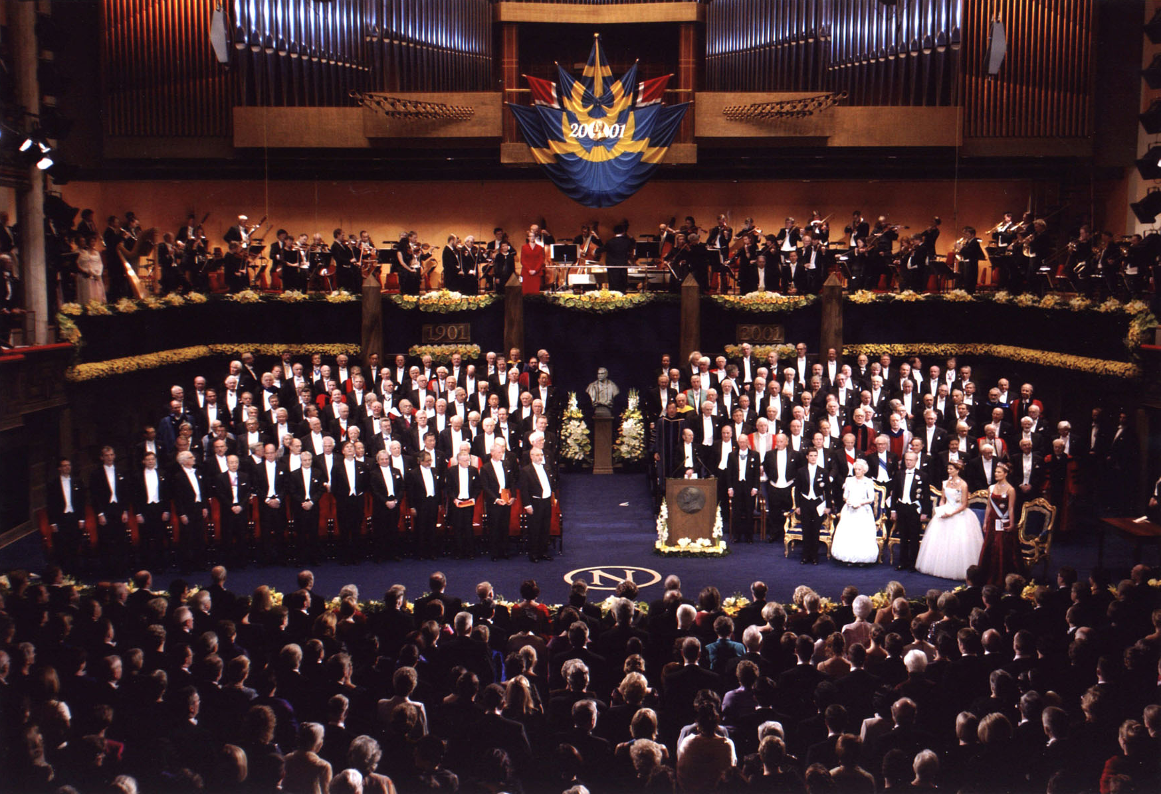
Stockholm Sweden, Dec. 10, 2001

Slide 36
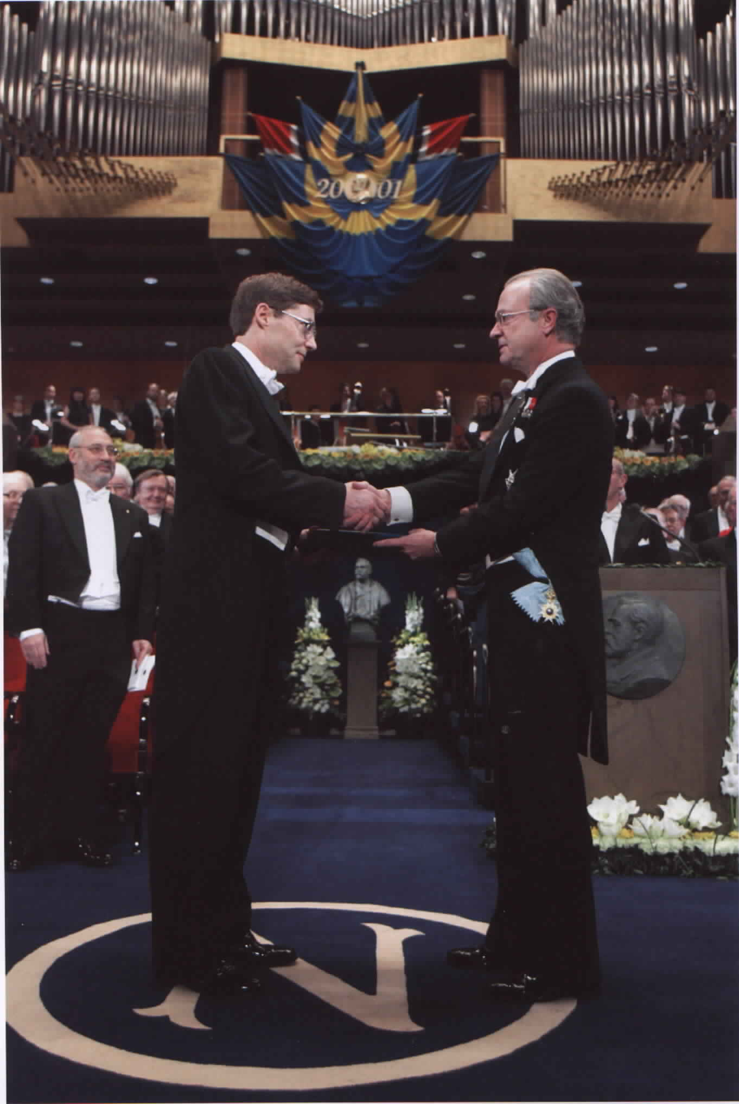

Slide 38
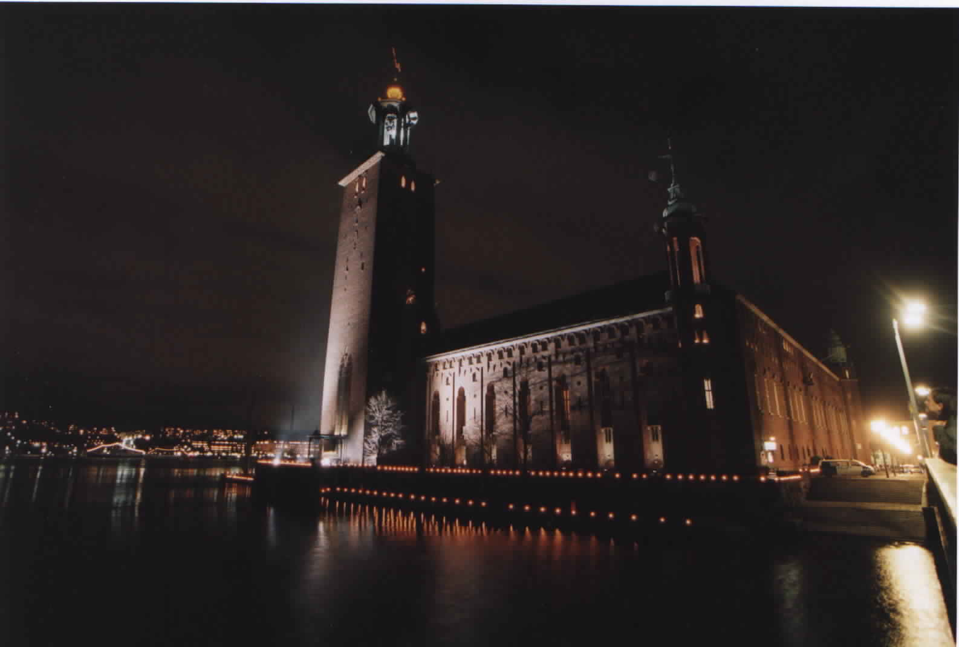

Slide 39
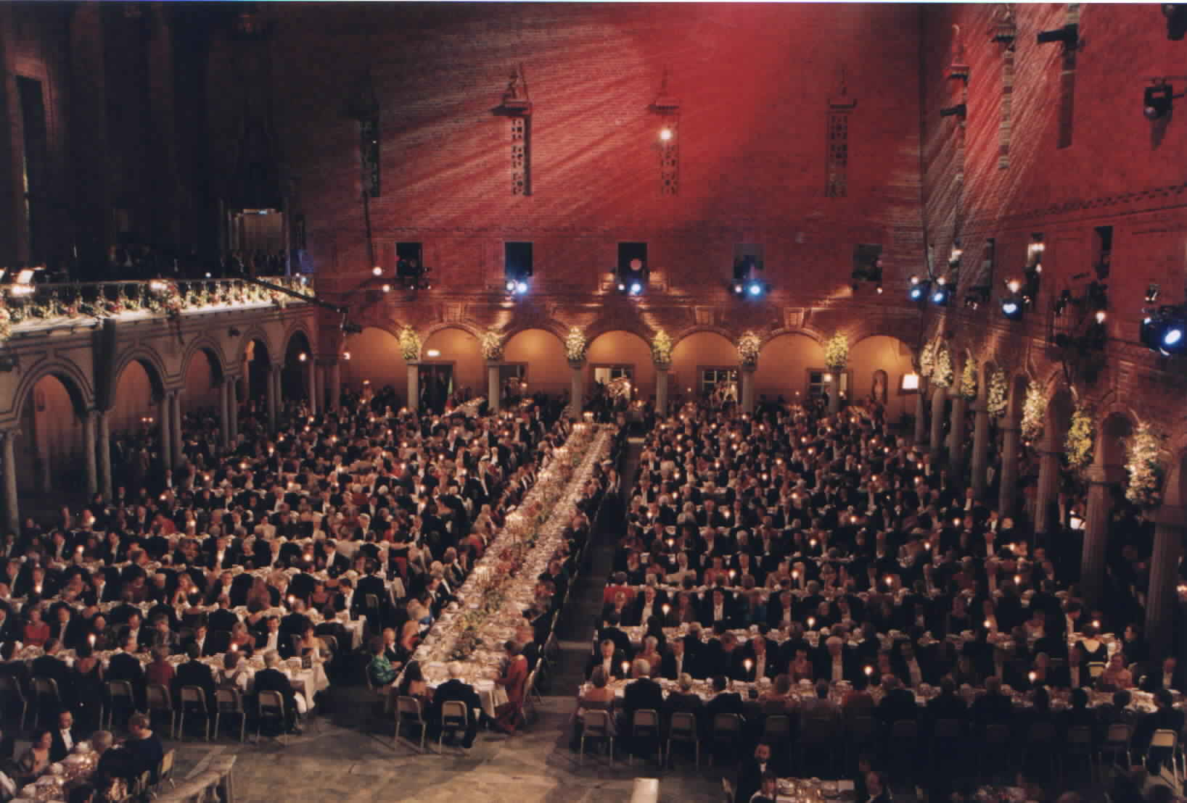

Slide 40
Part II. Some more recent research.

Slide 41
Controlling self-interactions with ⁸⁵Rubidium BEC
Roberts, Claussen, Donley, Thompson, CEW
repulsive (⁸⁷RB, Na), a > 0
attractive (Li, ⁸⁵Rb), a < 0
(unstable if N large, N_{max}∝1/a)
in 85 Rb have experimental knob to adjust from large
repulsive to nothing to large attractive!
3 billionths of a degree!
Magnetic field
(like knob to control gravity --position of very highest energy level)

Slide 42
Plunging into the unknown– interaction attractive
Lots of theory, varied wildly.
Schrodinger eq. + interaction term
?
Make BEC
magnetic field
where repulsive
2. Switch to attractive.
What happens?
(how do quantum wavefunctions die?

Slide 43
Start: 10,000 atom BEC
Collapse
time
then…

Slide 44
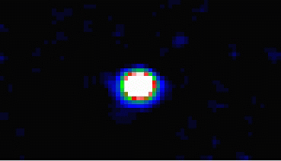
Explosion !!
x 3
(much less dense than air)

Slide 45
10,000 atoms
like supernova:
collapse
explosion… (x 10⁻⁷³ )
cold remnant
0.2ms
0.7ms
“Bosenova”
1.8ms
0.1 mm
What is the physics of
explosion???
Why remnant remains?
2.3ms
progress…
4.3ms
4.8ms
1500 atom explosion
T ~ 200 nK
X 3
Notes:
From top to bottom files:
173, 177, 179, 181, 186, 187 from Oct. 28th

Slide 46
source of energy of Bosenova--chemical
A New Type of Chemistry--
changing magnetic field just right turns atoms in BEC into unusual Rb₂ "molecules".
10,000 times larger than normal molecules
new formation processes
learned something new about nature--being studied
and used for all sorts of research. Big new area of
atomic physics now is using this to make ultracold
molecules, seeing BEC, exotic interactions, ...
explained source of energy, but not survival of remnant-
few years later, proved was forming “soliton” wave function.
Very tough and long lasting.

Slide 47
(what is it good for?)
What is next ?
I. Measure and understand properties.
New area of quantum world to explore–
turning BEC atoms into strange new sort of molecules
II. Uses (??).... 5-20 years (“laser-like atoms”)
a. Ultrasensitive detectors (time, gravity, rotation). (wave function
making a quantum computer(?). interference)
b. Making tiny stuff--putting atoms exactly where want them
simulations shown (and more) www.colorado.edu/physics/2000/ see BEC section
interactive simulations for learning lots of other physics
PHET.Colorado.edu

