Slide 1
An astronaut drops a hammer and a feather at the same time from the same height on the surface of the Moon, which hits the ground first:
a) The hammer
b) The feather
c) They hit at the same time
d) Not enough information
(Please do not talk to your neighbor about this question)

Slide 2
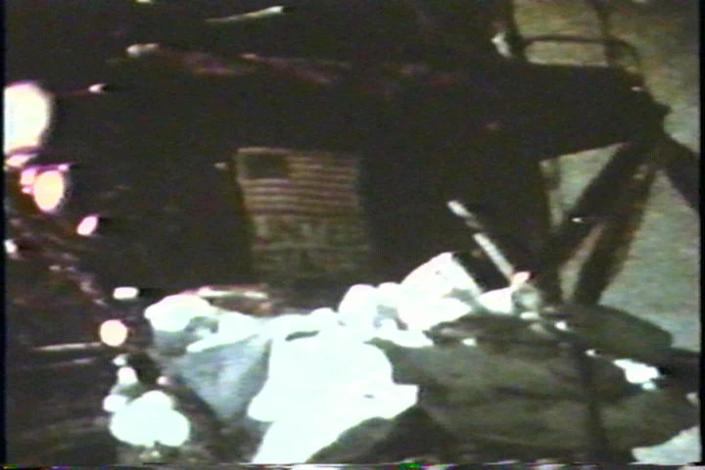
Notes:
At the end of the last Apollo 15 moon walk, Commander David Scott (pictured above) performed a live demonstration for the television cameras. He held out a geologic hammer and a feather and dropped them at the same time.
Apollo 15 was the ninth manned mission in the Apollo program, the fourth mission to land on the Moon and the eighth successful manned mission. It was the first of what were termed "J missions", long duration stays on the Moon with a greater focus on science than had been possible on previous missions. It was also the first mission where the Lunar rover was used.
The mission began on July 26, 1971,

Slide 3
If you finish the tutorial early:
Follow the same reasoning that you used in section II of the tutorial by expressing the terminal velocity of an object of mass m for the case in which the force of air resistance is:
quadratic with respect to speed (c₁ = 0, c₂ ≠ 0)
is expressed as a combination of both linear and quadratic terms (c₁ ≠ 0, c₂ ≠ 0)
Find an expression for v(t) from part I. (You sketched this function qualitatively in IB). You will need to solve a differential equation.

