Slide 1
GRAVITY

Slide 2
GRAVITY
- Newton’s law of gravity
Gravitational force (direct integration)
gravitational field
Symmetry and Invariance arguments
gravitational potential, and PE
Notes:
SJP, Sp ‘11 Lecture #14
(Didn’t really do much with this slide in Sp 12)

Slide 3
What is the force of gravity on (pointlike) M₂ caused by (pointlike) M₁ ?
M₂
r
M₁
Challenge question: Can you use your answer to predict the mathematical form of “Gauss’ law for gravity”?
Notes:
Phys 2210 Sp12 SJP L14
13, 2, 11, 5, [[70]]
Sp ‘11: 39, 4, 2, 2, [53]
Bit of a “trick” question, I started lecture with this. But I carefully pointed out right at the start that the difference between C/D and A/B was BOTH switching rhat to r, and r^2 to r^3.
Important to discuss: why would you WANT to use form C? Because R(vector) = (x,y,z) is simple, no Sqrt[x^2+y^2+z^2] to hassle with!
Notes from ‘11:
The clue was not enough – it was more than 50% A, so I told them the vote was roughly 50/50, and a few realized there was a trick and resolved it. This is nice – simple, but you need to point out this trick (which is commonly used). I motivated why r(vector) is often nicer than rhat – the components are easier to write down in Cartesian, at least.
We decided to start with “Challenge questions” here, and should probably start to backfill with ones for earlier questions that were too easy. I told them that these were to fill their time if they felt they had completely solved the problem, that we wouldn’t always discuss them explicitly (uness they wanted to), but that it was worth thinking about offline. (This particular one will be addressed
S. Pollock

Slide 4
5 masses, m, are arranged in a regular pentagon, as shown.
What is the force of gravity on a test mass at the center?
2.5
m
m
m
m
m
Zero
Non-zero
Really need trig and a calculator to decide!
Notes:
Phys 2210 Sp12 SJP L14
[[88]], 11, 2
Sp 11: STUDENT RESPONSES:[[71%]] 24% 5%
I ask this silently, and didn’t complete the discussion of it (yet), we return to it after more discussion of symmetry. I did go through the argument of why the “x” component is easily seen to be zero, and also how, if you had a square rather than a pentagon, that the “canceling in symmetrical pairs” argument is compelling. Tried to convince them that the pentagon argument requires a little more care, then left it.
Notes from 11’: Very good question got good discussion going. 71% got it.
Answer is A, but many students get it without being able to justify their answer. It’s easy to “prove” if you have an even number of charges, but with 5, the argument is subtler, and that was sort of the point.
Could discuss the fact that sometimes your really do just need to calculate! (Though not here :-)
The symmetry argument is NOT “obvious”, I claim - can we solicit a good articulation of WHY symmetry tells you that BOTH x and y components of E vanish. (One, the sideways component here, is obvious, the other (vertical component) may be not immediately so obvious. There are, e.g. “more charges above the center than below it!) One student came up with the nice argument that if it was not zero, it would point in some direction. But if you tilted your head 1/5 of the way around, the charges would be the same, but the answer would now point in a DIFFERENT direction... so it can’t point any direction at all.... –SJP
WRITTEN BY: Steven Pollock (CU-Boulder), but copied from somewhere (I can't remember where now! If you know the source, please let me know)

Slide 5
A “little man” is standing a height z above the origin. There is an infinite line of mass (uniform density) lying along the x-axis.
Which components of the local g field can little man argue against just by symmetry alone?
ONLY that there is no g_{x}
ONLY that there is no g_{y}
ONLY that there is no g_{z}
ONLY that there is neither g_{x} nor g_{y}
That there is neither g_{x}, g_{y}, nor g_{z}
Challenge: Which components (g_{r}, g_{Φ}, and/or g_{z}) of the local g field can the little man argue against just by symmetry if he is thinking in cylindrical coordinates – be thoughtful about what direction you have the cylindrical z-axis – is it the same as in Cartesian coordinates?
Notes:
Phys 2210 Sp12 SJP L14
44, 3, 3, [[50]]
Students are struggling with what we’re after here, we’re introducing a new kind of symmetry argument that goes beyond simple “vector cancellation in pairs”. I heard good discussions, this took a while to go through. Students did still make the “vector cancellation” argument, which I agreed is fine, but it requires knowing Newton’s law of gravity. Think of this, what if there is a NEW FORCE of nature, as yet undiscovered, between “superweak” charges on this line, and a “superweak” charge on little man. I don’t yet know the force law! Yet, I claim “little man” can argue, by symmetry alone, that if those charges are scalars, then there can be neither gx nor gy components of this new force of nature. It’s a DEEPER statement than argue by vector cancellation, which itself depends on knowing the underlying force law is in the rhat direction.
Comments from ‘11:
I have explained the “little man” argument (of Manogue) to them in another context (e.g. above a large disc of mass), and then let them work out their own cases here.
I had first solicited from them what “by symmetry” means when we argue that e.g. the field is straight down above the center of a disk. The first student argument I heard was very direct (do the integration, and one dm on ONE side of the disc will partner up with a symmetric dm on the other side, to cancel out x components) Then I introduced the idea of “invariance” and another student did spontaneously come up with the little man “proof by contradiction” (assume there is a gx, rotate little man by 180 degrees, and the universe looks the same, but now you would have to argue for a gx pointing the other way. It can’t be both, so it must be zero)
They did fine, the discussions were very good, and many students started off by using the former (two patches of dm cancel) argument, so we pushed them to ALSO make a “little man” argument (contradication/invariance argument). Good things that come up – students argue that if you rotate by 90 degrees, the universe looks DIFFERENT, and somehow they tried to use this to argue that the field must vanish. But that argument doesn’t work, it was nice to be very explicit and clear about how proof by contradiction really works.
Steven Pollock

Slide 6
A “little man” is standing a height z above the origin. There is an infinite line of mass (uniform density) lying along the x-axis.
He has already decided
Which dependences of the local g_{z}(x,y,z) field can he argue against, just by symmetry alone!
ONLY that there is no x dependence,
i.e. only that
ONLY that there is no y dependence
ONLY that there is no z dependence
ONLY that there is neither x nor y dependence
That there is neither x, y, nor z dependence.
Challenge: Again try switching to cylindrical coordinates. He has decided that g= g_{r}(r,Φ,z) r-hat. Which dependences (r,Φ, and/or z) can he argue against by symmetry alone?
Notes:
Phys 2210 Sp12 SJP L14
[[79]], 0, 3, 15, 3
Sp ‘11: 74, 4, 0, 20, 2
(This was the version we in fact clicked on) We changed options AFTER class, to try to get a new distraction. See next slide!
Comments from ‘11:
This is a very different argument than the previous one. Now you are thinking about dependence, NOT the vector direction. The little man argument is different here, now it’s a pure (direct) invariance argument, no “proof by contradiction” needed. If you step to the right, the universe looks the same, so the field must be the same. (Whereas, if you step forward, the universe looks DIFFERENT, and then you have no basis to make any claims at all) Many students liked d, some argued by analogy to the previous question, some thought the universe did “look the same” when you stepped forward, they were not taking the perspective of “little man”.
The cylindrical challenge question came up, and a student argued very nicely that it only makes sense/works if you change your cylindrical system so the “z axis” points along the wire! This was an excellent point. And together we noted that in that system, there is neither z nor phi dependence, so THIS looks like the coordinate system of choice, because we have eliminated 2/3 directions AND 2/3 variables to hassle with!

Slide 7
A “little man” is standing a height z above the origin. There is an infinite line of mass (uniform density) lying along the x-axis.
He has already decided
Which dependences of the local g_{z}(x,y,z) field can he argue against, just by symmetry alone!
ONLY that there is no x dependence,
i.e. only that
ONLY that there is no z dependence
ONLY that there is neither x nor z dependence
ONLY that there is neither x nor y dependence
That there is neither x, y, nor z dependence.
Challenge: Again try switching to cylindrical coordinates. He has decided that g= g_{r}(r,Φ,z) r-hat. Which dependences (r,Φ, and/or z) can he argue against by symmetry alone?
Notes:
Phys 2210 Sp12 SJP L14
We changed options AFTER class, to try to get a new distraction. Maybe try this version next time! (See comments on previous slide)

Slide 8
5 masses, m, are arranged in a regular pentagon, as shown.
What is the g field at the center?
2.5
m
m
m
m
m
Zero
Non-zero
Really need trig and a calculator to decide
Notes:
Phys 2210 Sp12 SJP L14
Returned to this to complete using “little man” argument. Multiple students (including some new voices) came up with it. Did not reclick.

Slide 9
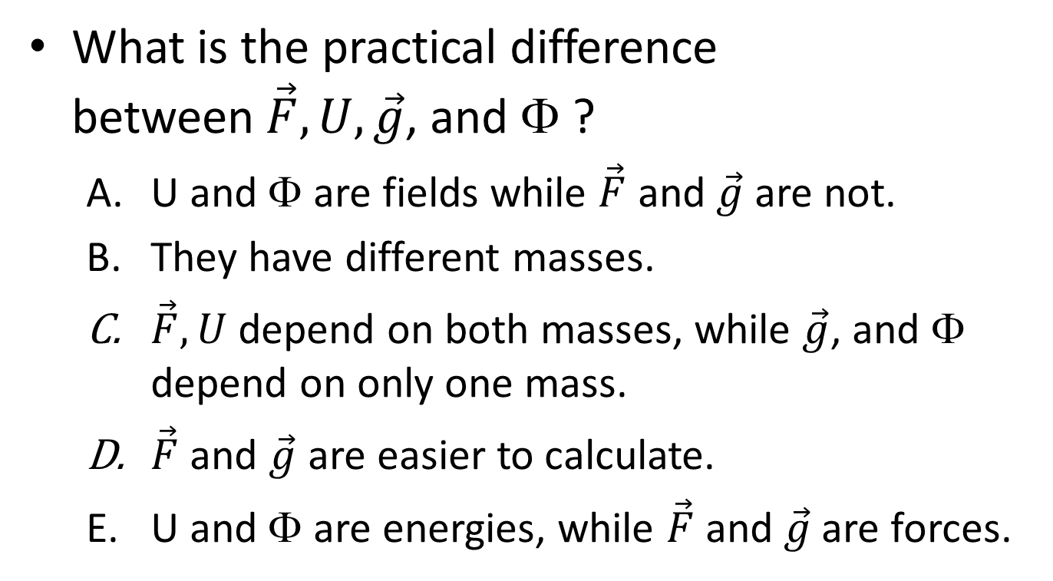
Force, potential energy, gravitational potential, gravitational acceleration
What is the practical difference between$\vec{F}, U,\vec{g}$, and Φ ?
  U and Φ are fields while $\vec{F}$ and $\vec{g}$ are not.
  They have different masses.
  $\vec{F},U$ depend on both masses, while $\vec{g}$, and Φ depend on only one mass.
  $\vec{F}$ and $\vec{g}$ are easier to calculate.
  U and Φ are energies, while $\vec{F}$ and $\vec{g}$are forces.
Notes:
Lincoln Carr, Mines

Slide 10
For g along the z-axis above a massive disk, we need
z
(0,0,z)
r
dA’
r’
x
Notes:
Phys 2210 Sp12 SJP L14
Setup. Do it in parallel on the board.
S. Pollock

Slide 11
What is
z
(0,0,z)
r
dA’
r’
x
Notes:
Phys 2210 Sp12 SJP L14
3, 10, [[84], 2, 2
Sp ‘11: 2, 8, [73], 6, 10
One problem here is that what I call “r” in this slide I’m going to call “r-r’” in the associated tutorial next time. Maybe should change this slide!
Students seemed to intuit this. I argue it by writing rhat = rvector/r, and rector(sub z) here is, look at the picture, just z!
Sp 11 comments:
I could not get anyone to explain to me why they, or anyone, had voted for E!
Took them a minute, but this was nice for them to think about. Gave me the opportunity to discuss again what our conventions are, and the difference between r and r’.

Slide 12
What is
z
(0,0,z)
r
dA’
r’
x
Notes:
Phys 2210 Sp12 SJP L14
0,8,3, [[89]],
Sp ‘11: 0, 2, 8, [90], 0
No big issues. See previous slide, might want to change notation!
Sp 11 comments: C is sort of an obvious mistake, this was very quick. (Previous one and this one together took ~4 minutes, including full discussion. More than I would use in lecture, but I think worth having them do real-time)
We then went on to complete the problem on the board, and in particular the first thing was to have them tell me what we should be integrating over, (someone said r dr dtheta, so we got to discuss the prime vs unprime business)
S. Pollock

Slide 13
Last class we started calculating the g field above the center of a uniform disk.
Could we have used Gauss’ law with the Gaussian surface depicted below?
Gaussian surface:
Flat, massive,
uniform disk
Yes, and it would have made the problem easier!!!
Yes, but it’s not easier.
No, Gauss’ law applies, but it would not have been useful to compute “g”
No, Gauss’ law would not even apply in this case
Notes:
Phys 2210 Sp12 SJP L15
Preclass: 26, 30, [[41]], 3, 0
Then some more discussion: 27, 22, [[52]], 0, 0
Sp 11: 20, [54], 26 (Responses were different last year, this corresponds to A, [[C]], and D)
I love this question – it created a ton of buzz in the room, they didn’t want to stop talking about it. One student wanted to know how answers B and C are different. I had to emphasize that B says you COULD do it if you know enough math, C says you just can’t do it. (I claim the latter is correct, NOT the former! See below)
One student gave such a clear and articulate reasoning for “C” that it shut down some conversation, but questions still came up. (E.g, “couldn’t a sufficiently powerful computer do it”, which another student articulately rebutted using my example from last time, knowing a 1D integral of f(x) dx = 17, does not let you figure out f(x), no matter how powerful your computer is!)
Comments from Sp 11:
A “classic” question, good discussions here. We had really just started on Gauss’ law. As a way to help them, I wrote the 1-D integral
Integral(0 to 10) f(x) dx = 17
And asked them, can you tell me f(x), given this integral? Most said no. I asked, “what if you were REALLY good at calculus, or had a supercomputer at your disposal”? The point is, knowing the integral of an unknown function CANNOT tell you the function, not enough information! You MUST have some symmetry argument to simplify, to “pull the function out” (I asked, if you know apriori that f(x) was constant, THEN could you figure out what f(x) is?)
Students were very clear in the discussion that g varies both in magnitude and angle across the surface.
We had some discussion about “not apply” because we couldn’t evaluate the dot product without knowing g. Another student countered that physically, g IS physically defined everywhere, and thus the integral must be well defined, as is “M(enclosed)”, so really there is no problem, even if we can’t USE it. This was what I was after! I framed Gauss’ law as a deep, fundamental truth about nature (“even for black holes, even when relativity is involved”)
S. Pollock, but I stole it from somewhere, perhaps Singh? Not sure!

Slide 14
Last class we started working out
What is dA’ here?
z
(0,0,z)
dA’
r’
a
x
Notes:
Phys 2210 Sp12 SJP L15
2, 8, [[91]], 0, 0
Just a quick review from last time, they did fine on this.

Slide 15
Above the center of a massive disk (radius a), g_{z}(0,0,z) is
2.16
If z>>a, let’s Taylor expand. What should we do first?
Notes:
Phys 2210 Sp12 SJP L15
I derived the result shown on the board first, and we started checking. (I asked the class what to check. “Units” was the first call, that works. Then, “sign”, which requires a little thought! (Note that the first time is smaller than the second) Also need to discuss why 1/Sqrt[z^2] = 1/z (and not -1/z, unless z<0, when it IS -1/z!) .
Then someone called out limits. That leads to this slide. The student wanted me to look at z-> 0, which it turns out is a BAD limit to investigate (because it’s not super intuitive – g goes to a constant, of opposite sign on the two sides, rather than the obvious “zero”). So, let’s focus on z large.
Z large is NOT a limit we’ve done before (we always Taylor expanded for small quantities), so this proves to be a nice exercise. I reminded them of the binomial expansion on the board (many had forgotten it!)
Also worked out Sqrt[a^2+z^2] = zSqrt[1+a/^2/z^2] on the board, as prelude to next slide.
S. Pollock

Slide 16
Above the disk, g_{z}(0,0,z)=
2.16
If z>>a, let’s Taylor expand. What should we do first?
Find d/dz of this whole expression, and evaluate it at z=0
Rewrite and then use the “binomial”
expansion
C) Rewrite and then use the “binomial”
expansion.
D) Just expand
Notes:
Phys 2210 Sp12 SJP L15
0, 6, [[88]], 6
Sp 11: 2, 0, [[88]], 10
They did fine on the vote, but the discussion was loud, I’m pretty sure this is a worthwhile activity. I emphasized that this is not the z>>1 limit (which is meaningless), you must compare z to something with the same dimensions.
Notes from Sp11:
Although they clicked well, this was a good question. They are still unsure about this method of expansion that we so take for granted. We discussed A (this is what people tend to do, e.g. on our last exam. Here, it’s quite terrible, since it’s at best what you would do for SMALL z, not large z. And in any case, it’s simpler to focus on the part that needs expanding, rather than dealing with the whole messy business as one entity)
I got asked “what’s wrong with D”, and in the heat of lecture did not realize how absurd it was (look at z=0, the two sides don’t even agree!) I simply said “this isn’t the binomial expansion, so you mustn’t try to “generalize” it in this way, it’s certainly not guaranteed to work” But, I’ve added this as a followup question, see next slide for next class, because not a single person in the class noticed or commented on just how obviously wrong/nonsensical D is!
S. Pollock

Slide 17
The binomial expansion is:
2.16
On Tuesday, a clicker question suggested we might try :
When z is small. We didn’t talk about it. So, what do you think? Is that…
It’s fine, it’s correct to all orders, it’s the binomial expansion!
Correct, but only to leading order, it will fall apart in the next term
Utterly false, even to leading order.
Notes:
Didn’t bother with this in ‘12
In ‘11:
SJP, Sp ‘11 Lecture #16
10,6,[83]
16% still voted for A or B. No real need for this to be a separate question, it might work just as well to talk this through when giving the earlier question from which it came. But it seemed important to talk it through, students are still struggling with Taylor series, and what it means to “expand in something small” (so this a^2+z^2 example is good to keep returning to)
Note that the “obvious’ way to see that this is nonsense is simply to take the limit z=0, where the proposed expansion would then read
1/a = a^2 (!!!???)

Slide 18
Given that
What should we write for P.E.:
Notes:
Phys 2210 Sp12 SJP L15
[[34]], 55, 4, 4, 1
Sp ‘11 [[29]], 66, 5, 0, 0
Majority get this wrong, interesting! See comments below. Only new comment this year was a student who is used to seeing the familiar ‘image’ of a gravity well like a rubber sheet which gets stretched down.
Notes from ‘11:
Fascinating! Majority got the sign wrong. (there was a small clicker glitch so they saw the histogram and were able to continue voting for a few seconds, those starting to “flop” to the popular but wrong answer, but it was already definitely in the “B” majority before that happened)
. I thought this would be a quicky, but we had an extended discussion with many student contributions. Several tried to do the relevant integral of F dot dr, (and lost track of minus signs, or, one of them attributed it to the integration variable ordering) One tried to “take the derivative” in their head, again unclear where the minus sign went (but there are three, the – sign in answer A, the minus from the derivative of 1/r, and then the minus from –grad U. )
Others were thinking more physically, e.g. one argued that as you lift an object, the U goes up (but, they incorrectly decided that led to B, because they were thinking of mgh which has a positive sign. Another student politely disagreed, pointing out that 1/r goes DOWN, not UP, as r increases. Great! Another student suggested plotting A and B on the board (which I did), and then he pointed out that objects roll “down the potential hill”, thus making A the correct answer. At last!
By the way, a couple voted for 1/r^3, (I simply pointed out that the differentation is of U to get F, not the other way. )
S. Pollock

Slide 19
g tutorial
Done with side 1 of part 1
Done with side 2 of part 1
Done with side 1 of part 2
Done with side 2 of part 2
Done with the question below too!
To think about if you’re done:
For the “massive disk” problem we just worked out, set up the integral to find Φ(0,0,z)
- Do you expect g = -dΦ(0,0,z)/dz here?
Notes:
Phys 2210 Sp12 SJP L15
21, 22, 16, 40, 0
We spent about 20 minutes on the gravitation_tutorial.pdf
It went very well – students spent a lot of time on page 1. I was surprised how many groups didn’t “see” right away that density is M/(4/3 pi R^3) I was less surprised at how many groups were able to “convince themselves” that r^2 sin theta dr dtheta dpi is right for dV without being able to argue WHY.
Many groups were confused about whether you can write dV = dx dy dz when the mass is distributed over a sphere.
Not so many got to the last pages, so I didn’t hear too much of the discussions there.

Slide 20
Gauss’ law:
Notes:
Phys 2210 Sp12 SJP L15

Slide 21
The uniform solid sphere has
mass density ρ,
and radius a.
What is Menclosed, for r>a?
a
r
4πr²ρ
4πa²ρ
(4/3) πr³ρ
(4/3) πa³ρ
Something else entirely!
Notes:
Phys 2210 Sp12 SJP L15
0, 0, 10, [[87]]
Sp 11: 2,0,6,[91],0
We were a little rushed this year, but no big problem here.
Sp ‘11 comments: No problems here. Took < 45 seconds. It did open up some good discussion, e.g. “what if mass density is not constant”, and “what if mass density depends on theta”. Was important to clarify what is the physical surface, and what is the imaginary Gaussian surface.

Slide 22
The uniform solid sphere has
mass density ρ,
and radius a.
What is ?
a
r
-g 4πr²
-g 4πa²
-g (4/3) πr³
-g (4/3) πa³
Something else entirely! (e.g, signs!)
Notes:
Phys 2210 Sp12 SJP L15
[[56]], 3, 17, 17, 6
Sp ‘11: [63], 16, 4, 16, 0
Nobody had an issue with signs (I clarifed that “g” here meant |g(r)|) I pointed out that they are not to USE Gauss’ law yet, but just to directly evaluate this integral, taking advantage of symmetry. Not sure where the “volume-like” votes came from, but it was quite a few. (Both years!) Similarly some confusion about which surface we are integrating over!

Slide 23
Notes:
Phys 2210 Sp12 SJP L15
While the concept test sequence before and after this is good for conceptual underpinnings, I have evidence from exams that students are not so quick/proficient at USING Gauss’ law in circumstances where it’s the “best way”.
What I feel was missing this term was a fairly direct, perhaps even “pure lecture” presentation of a SAMPLE problem, from start to finish, where the steps and final outcome are shown for them. I think it fits here – this sequence of questions (before and after) took us through a constant density problem. Perhaps redo it in class with a different rho(r), and just DO it for them, so they have something concrete/computational to fall back on.

Slide 24
The uniform solid sphere has
mass density ρ,
and radius a.
What is Menclosed, for r<a?
a
r
4πr²ρ
4πa²ρ
(4/3) πr³ρ
(4/3) πa³ρ
Something else entirely!
Notes:
Phys 2210 Sp12 SJP L15
Didn’t click, had them call it out. Seems ok.

Slide 25
The uniform solid sphere has
mass density ρ,
and radius a.
What is ?
a
r
-g 4πr²
-g 4πa²
-g (4/3) πr³
-g (4/3) πa³
Something else entirely! (e.g, signs!)
Notes:
Phys 2210 Sp12 SJP L15
Ran out of time here.

Slide 26
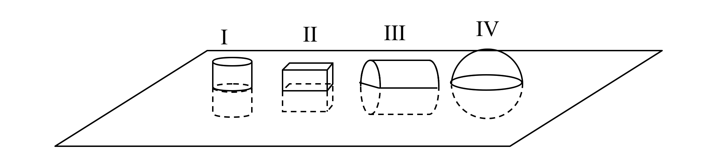
Consider these four closed gaussian surfaces, each of which straddles an infinite sheet of constant areal mass density.
The four shapes are
I: cylinder II: cube III: cylinder IV: sphere
For which of these surfaces does gauss's law,
hold ?
All B) I and II only C) I and IV only D) I, II and IV only
E) Some other combo
Notes:
Skipped. Inspired by one from C. Singh

Slide 27
Consider these four closed gaussian surfaces, each of which straddles an infinite sheet of constant areal mass density.
The four shapes are
I: cylinder II: cube III: cylinder IV: sphere
For which of these surfaces does gauss's law,
help us find g near the surface??
All B) I and II only C) I and IV only D) I, II and IV only
E) Some other combo
Notes:
Phys 2210 Sp 12 SJP L16
4, [[80]], 4, 5, 7
Sp 11: 0, [85], 9, 2, 4
Although they do fine, I think after a few weeks this gets lost. WHEN do you use Gauss’ law, and when “direct integration”. Should revisit this, perhaps in class, definitely in homeworks!
Pre-class question, they did fine. Good discussion points – symmetry is required to tell us g is everywhere “in”, then we need surfaces over which g is constant/can be pulled out of the Gaussian integral. One student was puzzling about the fact that g is everywhere in, he was looking at surface I, and said basically “if only the mass inside that cylinder is needed to compute g, then you only have a small disc of mass, and then g will NOT be uniform on the top surface” Interesting, it was good to get that “out there” and talk it through (It’s not that all the outside mass is not contributing, it is, it just isn’t needed to COMPUTE g once your symmetry argument has been made!)
Notes from 11:
SJP, Sp ‘11 Lecture #15
Good discussion here (despite the high success rate). I used this to lead in to the symmetry discussion (this case is different from the previous one, now we CAN construct surfaces where g dot dA is constant) Someone liked IV, because he thought we could figure out the dot product geometrically. I then asked how you would deal with the unknown g(height), and he said “but we know g is constant”. Ah, but you know this not from symmetry, but from having previously solved this problem( with Gauss’ law! ) At least, if you don’t KNOW that g is constant, then III and IV are useless surfaces, ( and even if you somehow do know it, the geometry is nasty! )
We used this to go ahead and DO the calculation of g. I only integrated over the top of can I, getting an answer wrong by a factor of 2, and let the class brainstorm what was missing (they didn’t know it was wrong, but I told them it was!) Needed a lot of prompting, almost nobody realized you MUST integrate over the entire closed surface. But once I pointed that out, they were quick to get the other endcap. Good discussion of why that 2nd cap doubles (and does not cancel) the left hand side.
Question closely related to one from Chandralekha Singh
_________

Slide 28
The next 2 clicker questions involve finding the area of a little square of area on the surface of a square…
Notes:
Phys 2210 Sp 12 SJP L16
A little review – I brought in a big demo of this, kind of nice. (It’s a large “chalkboard’ globe)
From A. Marino

Slide 29
What is the length of the highlighted edge (side 1)
of this area on the surface of a sphere of radius r’?
Side View
φ’
dθ’
dφ’
r’dθ’
r’dφ’
r’ sinθ’ dθ’
dθ’
Notes:
Phys 2210 Sp 12 SJP L16
2,0, 89, 0, 9
No problems here, this vote was silent. 10% is still putting in a sin(theta), (I pointed out that as theta -> 0, there’s no reason for dtheta to get small here!)
From A. Marino

Slide 30
What is the length of the highlighted edge (side 2)
of this area on the surface of a sphere of radius r’?
r’ sinθ’ dθ’
r’ sinθ’ dφ’
r’dθ’
r’dφ’
???
Side View
Top View
φ’
dθ’
Notes:
Phys 2210 Sp 12 SJP L16
Silent: 3, [[70]], 0, 27,0
Brief talk: 0, [[98]], 0, 2, 0
I did the vote twice, there was still some confusion, and so I let them talk to each other, that really cleared it up quickly!
From A. Marino

Slide 31
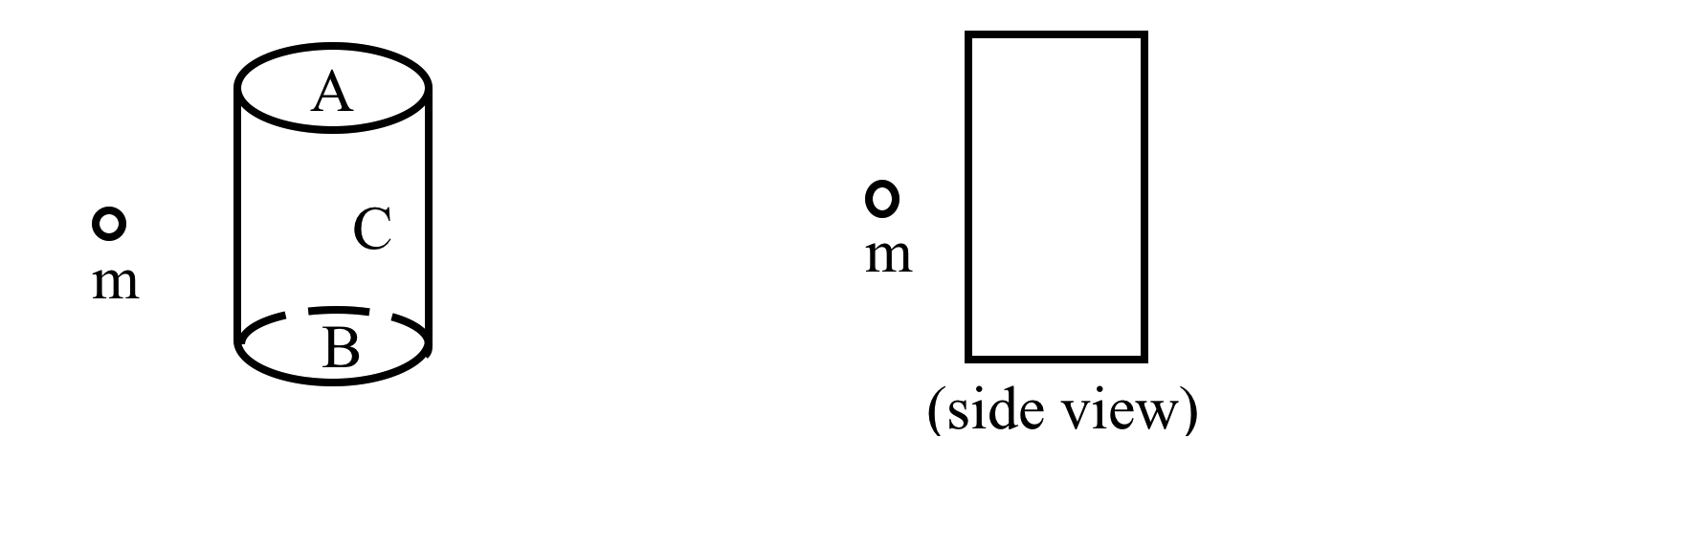
A point mass m is near a closed cylindrical gaussian surface. The closed surface consists of the flat end caps (labeled A and B) and the curved barrel surface (C). What is the sign of through surface C?
A) + B) - C) zero D) ????
(the direction of the surface vector is the direction of the outward normal.)
Notes:
Inspired by UW Tutorial
Phys 2210 Sp 12 SJP L16
(No time, too bad!)
From U. Washington Tutorials.
Notes from Sp 11 (L 15): ]38], 29, 31
Good one! Some students just made the simple mistake of thinking about electricity (getting the sign wrong). Some were confused about convention of dA, and thus sign of dot product. One student spontaneously came up with the field line diagram (next slide) which helped her make sense of this
I wrote out Gauss’ law left side as a sum (surface A + B + C), and they immediately saw the M(enc)=0, so the sum of those THREE fluxes must vanish. Most have no trouble seeing flux(A)=flux(B)=negative. Thus, answer for C must be +.

Slide 32
A point mass m is near a closed cylindrical gaussian surface. The closed surface consists of the flat end caps (labeled A and B) and the curved barrel surface (C). What is the sign of through surface C?
A) + B) - C) zero D) ????
(the direction of the surface vector is the direction of the outward normal.)
Notes:
Inspired by UW Tutorial
Phys 2210 Sp 12 SJP L16
(No time!) Just a helpful picture for explaining previous question.

Slide 33
The spherical shell has mass density ρ,
inner radius a, outer radius b.
How does the gravitational potential
ϕ depend on r, for r>b?
b
a
~r
~r²
~r ⁻¹
~r ⁻²
Something else entirely!
Notes:
Skipped

Slide 34
The spherical shell has mass density ρ,
inner radius a, outer radius b.
How does the gravitational potential
ϕ depend on r, for r>a?
b
a
~r
~r²
~r ⁻¹
~r ⁻²
Something else entirely!
Notes:
Skipped

Slide 35
You have a THIN spherical uniform mass shell of radius R, centered on the origin.
What is the g-field at a point “x” near an edge, as shown?
zero
nonzero, to the right
nonzero, to the left
Other/it depends!
x
R
Challenge question: Can you prove/derive your answer by thinking about Newton’s law of gravity directly?
Notes:
Phys 2210 Sp 12 SJP L16
[[94]], 3, 3, 0
Sp 11: [78], 20, 2
Despite the high success, this felt like a good question, they explained it “two ways” (gauss’ law, and also a geometrical cancellation argument)
Notes from Sp 11:
I was happy they did so well, seemed like a lot of (loud) discussion. I asked for reasons for B and got some nice ones: the obvious “x is closer to the wall, so the 1/r^2 dominates”, and a more subtle “g=0 when you have symmetry, but here you have BROKEN the symmetry, so g doesn’t have to be 0”. Then we talked about why it IS still 0, I got the Gauss’ law argument, but they never really said anything about the surface integral, just that “M_enclosed is 0”. So I pushed on that, and got students to STATE the symmetry argument (whatever g is, it has to be the same around the imaginary gaussian surface, AND everywhere normal to dA, so you can pull it out, and THEN the argument is complete)
One student answered the challenge question, pointing out that there is MORE mass on the “far side” to balance the smaller amount of (closer) mass. (I drew this on the board) But they didn’t get to it until the next question (about the graph of F vs r)
I used next slide to facilitate conversation about the Gaussian surface.
S. Pollock

Slide 36
You have a THIN spherical uniform mass shell of radius R, centered on the origin.
What is the g-field at a point “x” near an edge, as shown?
zero
nonzero, to the right
nonzero, to the left
Other/it depends!
x
R
Challenge question: Can you prove/derive your answer by thinking about Newton’s law of gravity directly?
Notes:
Phys 2210 Sp 12 SJP L16
(Just animating the dashed line here)

Slide 37
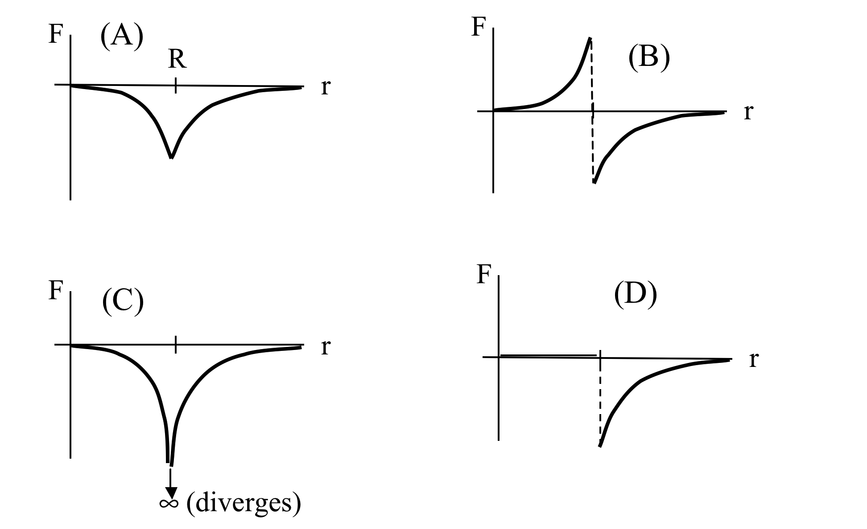
A test mass m moves along a straight line toward the origin, passing through a THIN spherical mass shell of radius R, centered on the origin.
Sketch the force F on the test mass vs. position r.
R
E) Other!
Notes:
Phys 2210 Sp 12 SJP L16
Did this as a whiteboard activity, it works well. Students debate whether it goes to infinity at R, but this is pretty fast. (Slide is animated to allow students to start sketching, unbiased)
Notes from SP 11:
Didn’t click, since we had just discussed this, but I showed it, and let them call it out. We did spend some time discussing how interesting this is. Picture a little astronaut, in a giant spherical ship like this. On the INSIDE she floats, on the OUTSIDE she is pinned to the surface. But if the ship is giant, isn’t that surprising, in both cases the tiny person sees what looks like a vast flat wall of mass next to them, but in one case there’s 0g, and the other case it’s constant. This was a good conversation, students really helped complete the argument (this was where the student came up with the “physical” reason for the difference between the inside and outside of this shell, by noting that the “faraway” wall has a big contribution)
In referring to moving from outside to inside, I made a joke about a “sudden disturbance in the force (Luke Skywalker)”, but wanted to make the point that if you have “a sheet of mass”, you CAN have a discontinuity in the force (this is a lead in to the next question, where we will want to argue that you can NOT have a discontinuity in the PE, as long as forces are finite)

Slide 38
Assuming that U(∞)=0, what can you say about the potential at point x?
It is zero (everywhere inside the sphere)
It is positive and constant everywhere inside the sphere
It is negative, and constant everywhere inside the sphere
It varies within the sphere
Other/not determined
x
R
Challenge question: What is the formula for U(0)-U(∞)?
Notes:
Phys 2210 Sp 12 SJP L16
23, 9, [[64]], 2, 2 (? See below)
Sp 11: 16, 8, [76], 0, 0
Did THIS as a whiteboard activity in parallel with this clicker question (I believe I left the question open into the discussion period, so not sure if the clicker numbers are accurate). It’s a very good question and couples nicely with the previous one. The big debate amongst students tended to be whether U(r) “jumps” back to 0 when you get inside r<R or not. So, students brought up all the key ideas - we talked about continuity, thinking of F = -Grad(U), thinking about work done coming in from infinity, thinking about work done to “take a step”, thinking about the PE diagram as telling you what “KE” would be at various radii for a ball released from infinity.
Notes from Sp 11:
They did well here (again, lots of student discussion). Began by asking why U IS determined here (BC at infinity)
We drew a graph of U(r), discussed that outside it’s the usual, looked at –grad(U)=0 inside (so, U= constant), and finally invoked continuity of U to get the answer (C). I had them explain WHY U is continuous (when we just saw F doesn’t have to be), and did get students to volunteer (what amounts to) dU = -F dr, and so U can’t suddenly jump with physical forces.

Slide 39
A rock is released from rest at a point in space far beyond the orbit of the Moon. It falls toward the Earth and crosses the orbit of the Moon.
When the rock is the same distance from the Earth as the Moon, the acceleration of the rock is: (Ignore the gravitational force between the rock and the Moon.)
greater than
smaller than
the same as
the acceleration of the Moon.
Notes:
Skipped
M Dubson, intro physics

Slide 40
As the rock falls toward the Earth, its acceleration is:
A) constant. B) not constant.
Notes:
Skipped
M. Dubson, intro physics

Slide 41
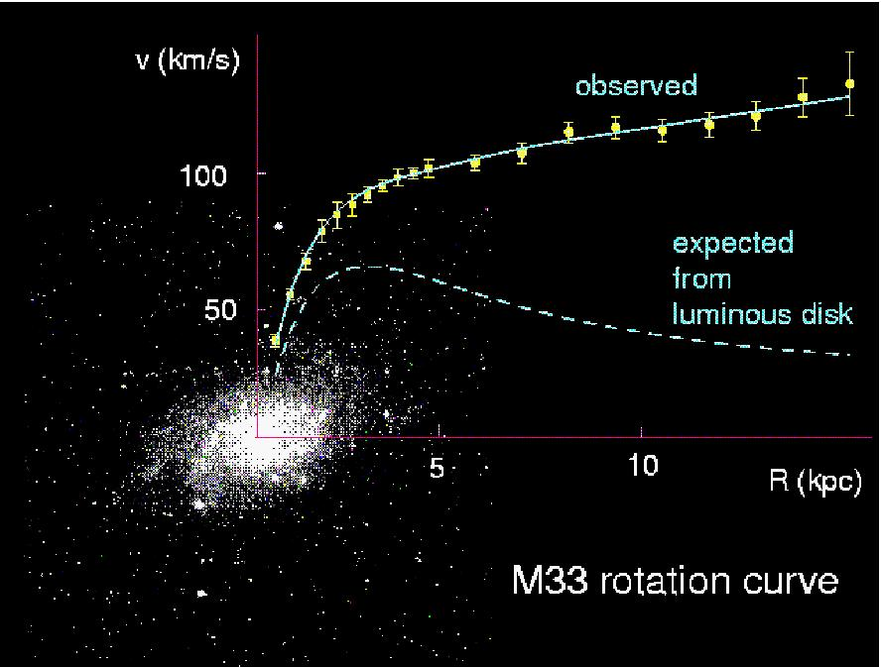
Summary: Gauss’ law
Notes:
Phys 2210 Sp 12 SJP L16
I worked out the math of the “expected” graph before showing them this, and then had them discuss with their neighbors what they would want to say to their advisor if they had spent all weekend plotting up this data and got what was shown (not what was expected). Very fun discussion – everything from “fudge the data” to “I made a mistake” to “someone ELSE made a mistake” to “dark matter’ to “Newton’s laws/Gauss’ law is wrong”. It makes for a great conversation about the nature of science, and Occam’s razor too, not just the dark matter story.
Notes from Sp11:
Nice data to show and discuss, talk about “dark matter” (I also led a small discussion about whether this data would lead YOU, as a scientist, to propose that Newton’s law is wrong) Nice “nature of science” discussion, about what other data is needed to go along with this to start to make claims about the nature of the “unknown physics”.
(Talked about Wimps and Machos here)
Image came from Alysia Marino, I’m afraid I don’t know the original source!

Slide 42
Gravity Anomaly Map from GRACE satellite
Image from U Texas Center for Space Research and NASA
Notes:
Phys 2210 Sp 12 SJP L16
Spent quite a few minutes talking through what your are seeing here (including description of the 2 satellites “Tom and Jerry” chasing each other in a polar orbit (Students were able to explain why polar!) and how they can measure g, and then a brief explanation of what “gravity anomaly” is (you’re basically measuring g, subtracting nominal g (about 9.8), subtracting effects of prolate shape of earth…) That’s what you see here.( I believe the scale is mgal, which is millionths of g, but not positive. ) I used to think “red means mountains”, but that’s not correct. Mountains are a bit like icebergs – they “float”, and the total integrated gravity from the mass in a column running from the top of the mountain down to the core is largely independent of whether there’s a big mountain up there or not (at least to leading order). The red in peru is the subduction of a continental plate (see lecture notes for a bit of an explanation). Also, next slide shows nicely the expected “high, low, high” gravity pattern near a subduction zone. Talked about accuracy (apparently 1 cm of groundwater over a large area can show up in grace data) Student mentioned ice sheets, and I showed the Greenland movie (separate file).
NASA movies:
http://svs.gsfc.nasa.gov/search/Series/GRACEGlobalMassBalanceTrend.html
My Greenland movie is attached.
Here's a high-resolution gravity field map:
ftp://cddis.gsfc.nasa.gov/pub/egm96/general_info/ano30x30_egm96_f002t360_logos.gif

Slide 43
Gravity Anomaly Map from GRACE satellite
Image from U Texas Center for Space Research and NASA
Notes:
Phys 2210 Sp 12 SJP L16
Zooming in to see the subduction line (+ - + pattern), quite lovely!

Slide 44
Gravity Anomaly Map for Colorado
Bouguer model
=1 millionth g
USGS
Notes:
Phys 2210 Sp 12 SJP L16
This is not Grace data, it’s older (manual, I suspect) measurements of g good old fashioned ways (measuring the stretch of a spring?!)
Bouguer model takes into account elevation, it’s like you’re “subtracting off” the gravity from all the earth above sea level, according to some simple uniform model. So, it’s everywhere negative in colorado, and MORE negative under the mountains (think of that as like the big roots under the iceberg, or if you prefer, think of a crust pushed up leaving less mass down below. When you subtract off the top assuming it’s uniform, you “see” the missing mass down lower in this plot.

Slide 45
Gravity Anomaly Map for New Jersey
Appalachians
Dense Basalt Rock
=1 millionth g
USGS
Notes:
Phys 2210 Sp 12 SJP L16
(No time for this)

Slide 46
Summary
Notes:
Skipped in ‘12, notes from ‘11:
SJP, Sp ‘11 Lecture #15
The bottom half of this was in fact new material. I reiterated that the “r” in the integral formulas is NOT the “position of M2”, it’s the arrow from dm1 to M2. I’m sure that my telling them won’t help, but it’s an important and inobvious issue here. (I prefer Griffith’s “curly R” notation to distinguish the r of M2 from the curly r in the integral, but decided not to deviate from Taylor’s notation. It’s not a central point for this course at this time, for us)

Slide 47
Summary
Notes:
Phys 2210 Sp12 SJP L15
Skipped. Notes from Sp 11:
The bottom half of this was new material. I reiterated that the “r” in the integral formulas is NOT the “position of M2”, it’s the arrow from dm1 to M2. I’m sure that my telling them won’t help, (and have evidence of this from exams!) but it’s an important and inobvious issue here. (I prefer Griffith’s “curly R” notation to distinguish the r of M2 from the curly r in the integral, but decided not to deviate from Taylor’s notation. It’s not a central point for this course at this time, for us)

Slide 48
Oscillations
Notes:
Phys 2210 Sp 12 SJP L16

Slide 49
How many initial conditions are required
to fully determine the general solution
to a 2nd order linear differential equation?
Notes:
Phys 2210 Sp 12 SJP L16
Students are quick on this one. But, I solved the x’’ = -k/m x (by guess and check), and we talked about whether omega = Sqrt[k/m] we put in our solution (A cos(omega t)) is one of the parameters determined by initial conditions (it certainly is not!)

Slide 50
Since cos(ωt) and cos(-ωt) are both solutions of
can we express the general solution as
x(t)=C₁cos(ωt) + C₂cos(-ωt) ?
yes
no
???/depends
Notes:
Phys 2210 Sp 12 SJP L16
40 [[54]], 6, 0, 0
Just a fun little question. We had just explicitly shown cos(omega t) works, and I quickly showed that cos(-omega t) does too, so then asked this. This leads to a nice discussion of linear dependence, and the need for two independent solutions. (I also briefly mention the Wronskian check method, but don’t have them practice it)

Slide 51
Richard Feynman’s notebook (Age 14)
Notes:
Phys 2210 Sp 12 SJP L16
Got this slide from A. Marino/D. Caballero. Just fun, intro to complex numbers.

Slide 52
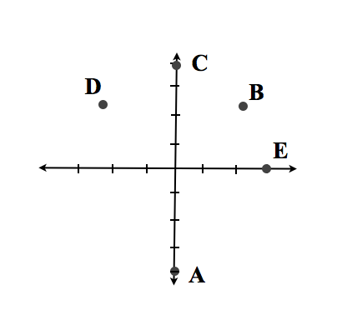
Which point below best represents 4e^{i3π/4} on the complex plane?
Challenge question: Keeping the general form Ae^{i θ}, do any OTHER values of θ represent the SAME complex number as this? (If so, how many?)
Notes:
No time – do it next time.

Slide 53
On a white board, draw points showing
i) e ^{i π/6}
ii) e ^{i π/3}
iii) e ^{i π/3} e ^{i π/6}
iv) e ^{i π/3} / e ^{i π/6}

Slide 54
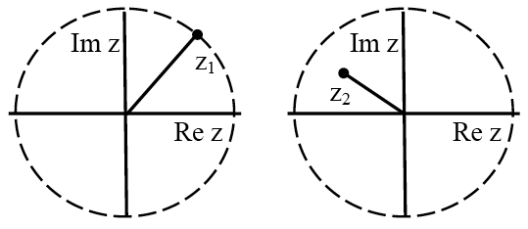
Consider two complex numbers, z₁ and z₂.
The dotted circle shows the unit circle, where |z|=1.

Slide 55
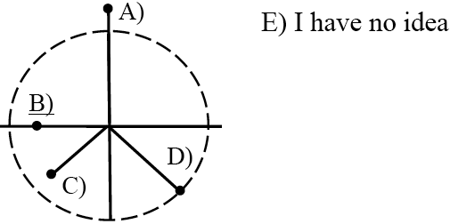
Consider two complex numbers, z₁ and z₂.
The dotted circle shows the unit circle, where |z|=1.
Which shows the product z₁z₂ ?

Slide 56

Consider two complex numbers, z₁ and z₂.
The dotted circle shows the unit circle, where |z|=1.
π/4
Which shows the product z₁z₂ ?

Slide 57
What is 1/(1+i) in “polar” form?
e^{i π/4}
e^{-i π/4}
0.5 e^{i π/4}
0.5 e ^{-iπ/4}
Something else!

Slide 58
What is (1+i)²/(1-i)
e^{i π/4}
Sqrt[2] e^{i π/4}
e^{i 3π/4}
Sqrt[2]e^{i 3π/4}
Something else!

Slide 59
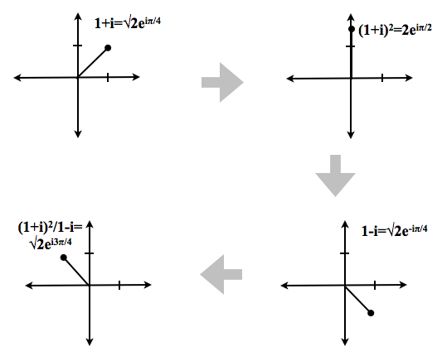
What is (1+i)²/(1-i)

Slide 60
What is (1+i)²/(1-i)

Slide 61
What is (1+i)²/(1-i)

Slide 62
What is (1+i)²/(1-i)

Slide 63
What is the general solution to the ODE
where ω is some (known) constant?
Challenge question: Is there any OTHER general form for this solution?

Slide 64
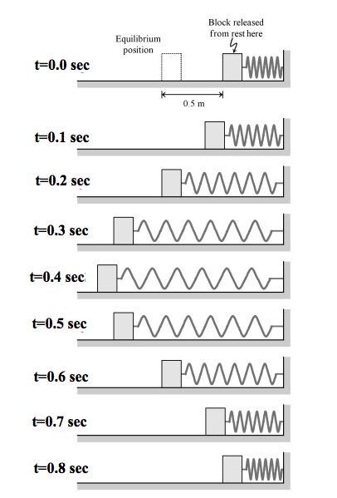
Based on the pictures what is the period of motion of the block?
.2 s
.4 s
.6 s
.8 s
None of these/
not enough info!

