Slide 1
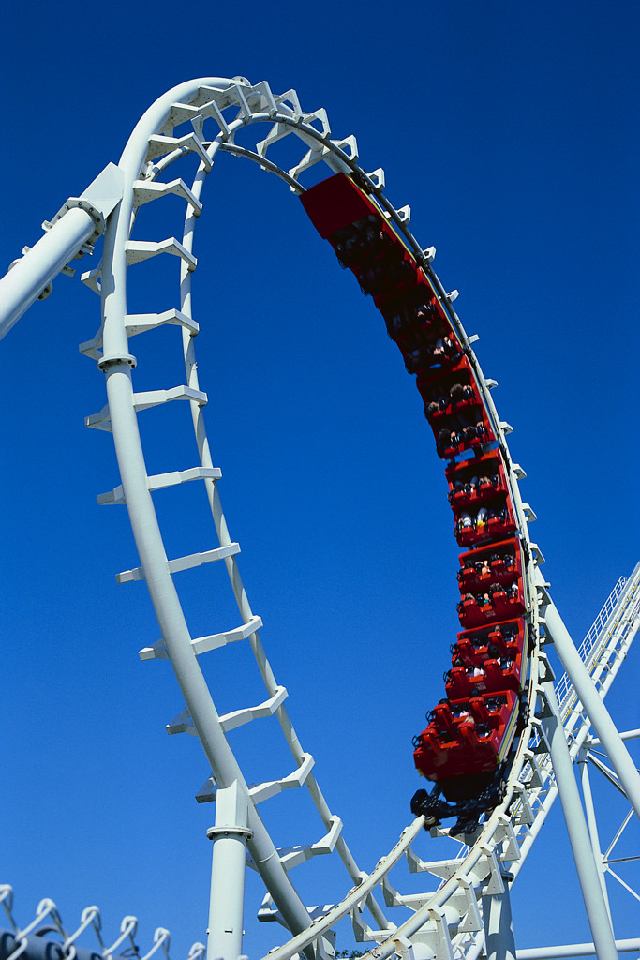
Non Inertial Reference Frames
Linear Acceleration:
Today
Rotating Frame: Thursday
Centrifugal Force
Coriolis Force
Notes:
AMR, Sp ‘11 Lecture #29.
(AMR lecture this week) Today was 50 minute “posttest”, with just a short 20 minute intro.
NOTE: OUR class just did a very short (1.5 lecture) treatement of this topic. See keynote slides from A. Marino for more ideas!

Slide 3
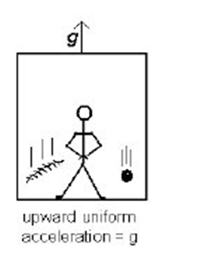
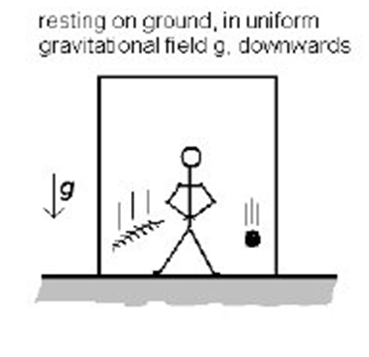
Observers a and b both release the ball initially at rest with respect to each of them. The time the ball takes to hit the floor is
a
b
A) Longer for a than for b
B) Longer for b than for a
C) The same D) Do not know
Notes:
This was the slide used, see next one for clarification

Slide 4
Observers a and b both release the ball initially at rest with respect to each of them. The time the ball takes to hit the floor is
a
b
Note: observer b is in free space
A) Longer for a than for b
B) Longer for b than for a
C) The same D) Do not know
Notes:
AMR, Sp ‘11 Lecture #29.
Almost unanimous for b.
Student next to me is very strong, and his response was “I”m sure it’s C, I’ve seen this before” (!) So, might be worth thinking carefully about what the conversation you want students to have around this question.
When asked for reasoning, one student replied “In a, the ball accelerates down towards the floor at g. In b, the floor accelerates up towards the ball at g. Same thing”.

Slide 5
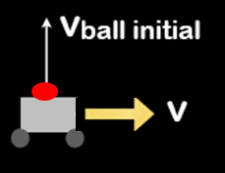
The cart is moving at a constant velocity v. The ball is launched in the air, where does it land relative to the cart?
A) In front of the cart
B) On the cart
C) Behind the cart
Notes:
AMR, Sp ‘11 Lecture #29.
Nearly unaminous for correct answer. This was the original version

Slide 6
The cart is moving at a constant velocity v. The ball is launched straight upwards from the moving cart, where does it land relative to the cart?
A) In front of the cart
B) On the cart
C) Behind the cart
Note: v_{ball init} is drawn with respect to an observer in the cart. Neglect air friction
Notes:
AMR, Sp ‘11 Lecture #29.
Nearly unaminous for correct answer.
I changed the wording (and added the red text) to try to clarify ambiguities in our version.
Several students (the best in the class) pointed out correctly that the picture as shown (without the red text and with different text) was ambiguous. In what FRAME is the ball’s initial velocity vertical? If it’s in the lab frame (the SAME frame as the velocity v arrow is shown!!) then the answer is C.
Also, I changed “in the air” to get rid of the temptation to worry about air friction.
There wasn’t much discussion, students pretty much all know this (or at least, know what they’re supposed to say). Not sure how to make this more interesting/challenging, might be worth thinking about.

Slide 7
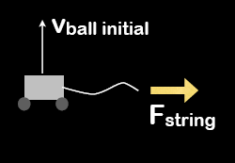
The cart is now pulled to the right. After the cart is released from rest, the ball is launched in the air, where does it land relative to the cart?
A) In front of the cart
B) On the cart
C) Behind the cart
Notes:
AMR, Sp ‘11 Lecture #29.
Vote was nearly 40/60 split for B and C. But they were confused by the wording, they thought that the F(string) was “released” (i.e. turned to zero) at the time of launch, in which case it’s the same as the previous one.
After clarifying, it went to nearly unaminous for C.

Slide 8
The cart is pulled to the right with a constant F. At t₀, the ball is launched straight upwards from the moving cart. Where does it land relative to the cart?
A) In front of the cart
B) On the cart
C) Behind the cart
Note: v_{ball init} is drawn with respect to an observer in the cart. Neglect air friction
Notes:
AMR, Sp ‘11 Lecture #29.
Here’s an attempt at rewording it. But, I don’t think students will have any difficulty with this.
Again, might think about how to make it more challenging. See next slide.

Slide 9
The cart is pulled to the right with a constant F. At t₀, the ball is launched straight upwards from the moving cart. Where does it land relative to the cart?
A) In front of the cart
B) On the cart
C) Behind the cart
Note: v_{ball init} is drawn with respect to an observer in the cart. Neglect air friction
Challenge: As viewed by an observer on the cart, what path does the ball appear to follow?
Notes:
AMR, Sp ‘11 Lecture #29.
Here’s an attempt at rewording it. I don’t think students will have any difficulty with this. Again, might think about how to make it more challenging. Perhaps have them think about the PATH TAKEN by the ball, as observed from inside the cart. (Straight up and down? Diagonal straight line to right, or to left/? Parabolic arcing to the left? To the right? Something entirely different?

Slide 10
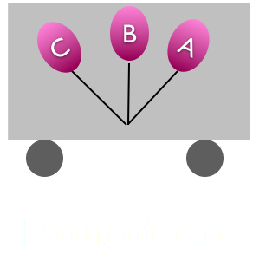
Now consider a helium balloon inside a car that is accelerating in the forward direction. In the frame of the car, which describes the tilt of the balloon?
Forward
Notes:
From A. Marino
See
http://www.youtube.com/watch_popup?v=XXpURFYgR2E&vq=medium%23t=38

Slide 11
Non Inertial Reference Frames
Linear Acceleration:
Tuesday
Rotating Frame: Today
Centrifugal Force
Coriolis Force
Notes:
AMR, Sp ‘11 Lecture #30.

Slide 12
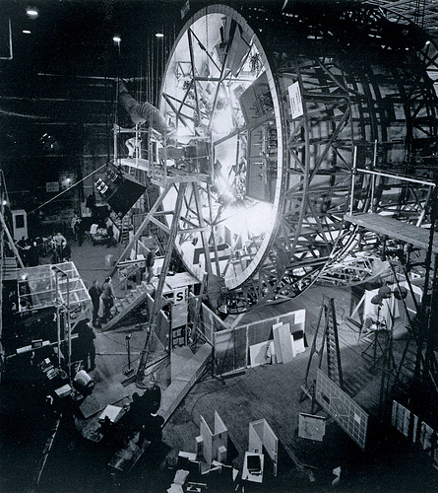
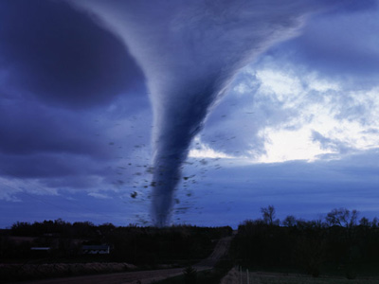
Centrifuge Set
Coriolis Effect
http://www.youtube.com/watch?v=TqHjZZCCkxg
Notes:
Set for 2001.

Slide 13
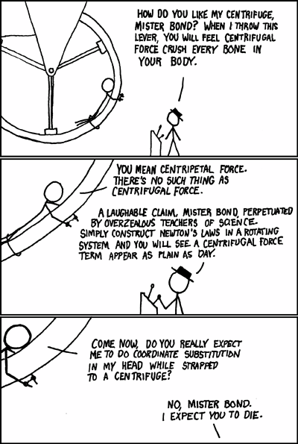

Slide 14
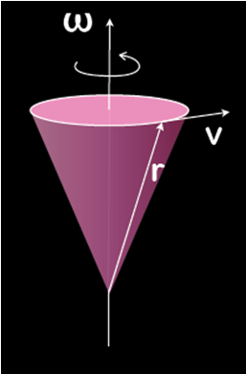
Which one is correct?
A) V= ω Χ r
B) V = r x ω
Notes:
AMR, Sp ‘11 Lecture #30
[88], 18
This took a good minute, and I saw quite a few people having to remember/rethink/practice this right hand rule. Worth doing.

Slide 15
Which force is more important for an
object that is moving very slowly in a
rotating frame?
A) Coriolis
B) Centrifugal
C) Equal
D) Need more info
Notes:
AMR, Sp ‘11 Lecture #30
20, [73], 5, 2
Students argued that Coriolis is proportional to v, and Centrifugal is not, so small v should make Coriolis vanish. This is largely true and what we were after (although with some caveats. E.g. “slowly” compared to what? The scale is generically “Omega * r”. If e.g. r=0, then centrifugal vanishes, but coriolis need not, so it’s not universally B. Angles can also enter in the cross product. (So technically, D is probably correct here!)

Slide 16
Consider a person sitting at rest on a Merry-go-round that is rotating with constant angular velocity. To the person, what is the direction of the centrifugal force?
A
ω
C
B
D
A) B) C) D)
E) Something else!
Notes:
AMR, Sp ‘11 Lecture #30
2, [81], 12, 2, 2
They again needed a minute. Some were using the right hand rule (twice!) and others were just arguing from their physical understanding. Both are fine, it was a good chance to *match* those two things, and give them more practice with RHR. One student was asking about difference between centripetal and centrifugal forces here, this is still novel for them.

Slide 17
A bead is on a wire that makes an angle θ with the vertical. The wire rotates with an angular velocity ω around an axis. In the rotating frame, what is the magnitude and direction of the centrifugal force?
ω
m ω²r sinθ, towards axis
m ω²r sinθ, away from axis
m ω²r cosθ, towards axis
m ω²r cosθ away from axis
Something else!
θ
r
Notes:
From A. Marino

Slide 18
You fire a cannon due north at a latitude of 45º N. What is the direction of the Coriolis force on the cannon ball?
Ω
A) North
B) South
C) East
D) West
V
Notes:
AMR, Sp ‘11 Lecture #30
20, [73], 5, 2, 0
This one took several minutes. The cross product is a little trickier (the formula is still on the board), and students near me were struggling with connecting “into the page in the figure” to “East”! Well worthwhile. And, leads in to discussion of weather patterns (and anecdote, perhaps apocryphal, about WWI Bri

Slide 19
Where is your measured weight the greatest?
Ω
A
B
C
D) All 3 exactly the same!
Notes:
From A. Marino (no time to use)

Slide 20
You fire a cannon due north at a latitude of 45º S. What is the direction of the Coriolis force on the cannon ball?
Ω
A) North
B) South
C) East
D) West
V
Notes:
AMR, Sp ‘11 Lecture #30
0, 0, 5, [95]
Quicker. Still seemed worth doing. And, leads in to discussion of weather patterns (and anecdote, perhaps apocryphal, about WWI Briitish gunners missing the Germans because they were using their calibrations from the northern hemisphere!)

Slide 21
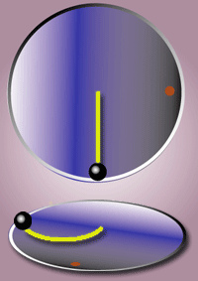
Coriolis effect
Notes:
We had an animation of this (it doesn’t work great, might be worth looking for, or generating, a better one). Came from Wikipedia,
17_Corioliskraftanimation.gif

Slide 22
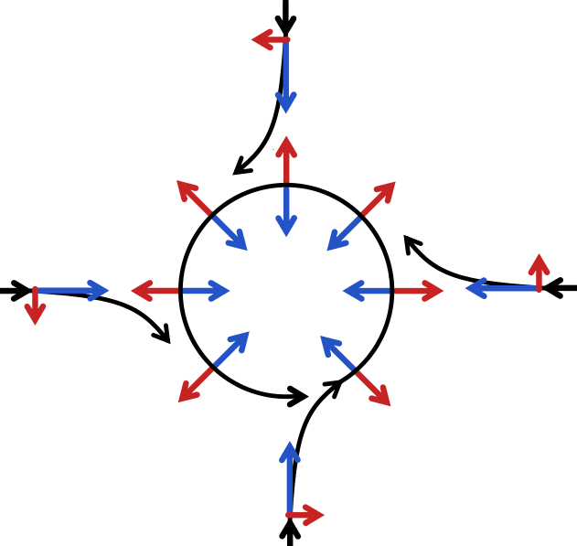
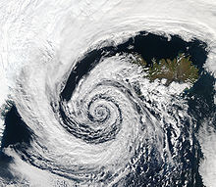
Perhaps the most important instance of the Coriolis effect is in the large-scale dynamics of the oceans and the atmosphere.
This low pressure system over Iceland spins counter-clockwise due to balance between the Coriolis force and the pressure gradient force.

Slide 23
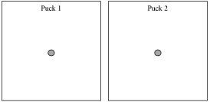
If you finish early, for each case below, draw free-body diagrams for pucks 1 and 2 as measured in the platform frame. (Assume that the initial velocities of the pucks as measured in the platform frame are the same as before.)
The platform spins counter-clockwise more quickly than before (but still at a constant rate).
The platform spins clockwise (rather than counter-clockwise) at a constant rate.
Notes:
To go along with the longer version of the Maine Tutorial (we didn’t do this, but A. Marino did)

Slide 24
Where is the Coriolis effect the greatest?
North Pole
Either pole
Equator
45 degrees latitude
Notes:
From A. Marino

Slide 25
As seen from above, what path does the pendulum take due to the Coriolis force, as it swings East?
N
A
W
B
E
C
S
Notes:
From A. Marino

Slide 26
As seen from above, what path does the pendulum take due to the Coriolis force, as it swings West?
N
A
W
B
E
C
S
Notes:
From A. Marino

Slide 27
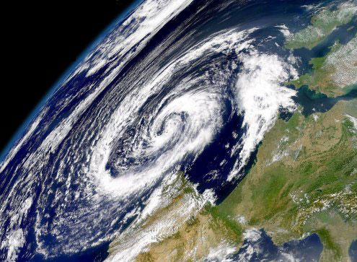
Rotating Frames:

