Slide 1
Pre-semester
Notes:
© STEVEN POLLOCK, 2008

Slide 2

Preclass0
Do you have an Iclicker to use for this term?
Yes, I do!
Press & HOLD power (blue light flashes)
Key in AB (OUR code for this room)
Brief green Status flash confirms!
(Blue light steady)
(You can do this only while I’m collecting votes)

Slide 3
Preclass0
Have you looked at the 3310 course web page yet?
A) Yes
B) Not yet
www.colorado.edu/physics/phys3310

Slide 4
Preclass0
Do office hours (homework help sessions) Mon and Tues, 4-5+ PM
work for you?
(HW is due Wed at the start of class)
Yes, one or both is ok
Yes, but only if the “+” extends past 5
C) No, I really want a different day/time
D) No, but I’m unlikely to attend so it’s ok with me as it is…

Slide 5
Help/ HW study sessions
Monday:
3-4
4-5
5-6
Notes:
CORRECT ANSWER:
USED IN: Fall 2009 (Schibli)
LECTURE NUMBER: 1
STUDENT RESPONSES: 42% 36% 6% 12% 3%
INSTRUCTOR NOTES:
WRITTEN BY: Thomas Schibli (CU-Boulder)

Slide 6
Help/ HW study sessions
Tuesday:
3-4
4-5
5-6
Notes:
CORRECT ANSWER:
USED IN: Fall 2009 (Schibli)
LECTURE NUMBER: 1
STUDENT RESPONSES: 42% 36% 6% 12% 3%
INSTRUCTOR NOTES:
WRITTEN BY: Thomas Schibli (CU-Boulder)

Slide 7
Thinking of what you want to get out of your college education and this course, which of the following is most important to you?
Acquiring information (facts, principles, concepts, procedures)
Learning how to use information and knowledge in new situations
Developing lifelong learning skills
Notes:
CORRECT ANSWER:
USED IN: Fall 2009 (Schibli)
LECTURE NUMBER: 1
STUDENT RESPONSES: 32% 50% 215% 0% 3%
INSTRUCTOR NOTES: Added in Fall09 by TRS based on ‘The national Teaching and Learning Forum, Vol 17, #5, september 2008. Great discussion. Only one student felt that this is silly. I guess he voted for E. Followed up with next one...(Schibli)
WRITTEN BY: Thomas Schibli (CU-Boulder)
7

Slide 8
All three of these goals are clearly important. However, which of these three goals do you think you can do on our own (say, before class)?
Acquiring information (facts, principles, concepts, procedures)
Learning how to use information and knowledge in new situations
Developing lifelong learning skills
Notes:
CORRECT ANSWER:
USED IN: Fall 2009 (Schibli)
LECTURE NUMBER: 1
STUDENT RESPONSES: 59% 12% 29% 0% 0%
INSTRUCTOR NOTES: Added in Fall09 by TRS based on ‘The national Teaching and Learning Forum’, Vol. 17, #5, September 2008. This is a follow-up from the previous one (after some discussion of the previous one). Had them pretty much where I wanted them. Majority at A, which I then shamelessly used to briefly remind them that reading assignments fall in this category. Option C might need some re-phrasing as many students didn’t quite understand what it meant. (Schibli)
WRITTEN BY: Thomas Schibli (CU-Boulder)
8

Slide 9
Chapter 1
Mathematical background
Notes:
9

Slide 10
Two charges +Q and -Q are fixed a distance r apart. The direction of the force on a test charge -q at A is…
Up
Down
Left
Right
Some other direction, or F =0
Notes:
This is from Dubson’s pre-test
CORRECT ANSWER: A
USED IN: Sp 2013 (Pollock)
Student Responses: [[92]] 4 0 2 2 (Sp 2013)
INSTRUCTOR NOTES: WRITTEN BY: Mike Dubson (CU-Boulder)
SJP Comment: The first concept test, it went quickly, and when they did it silently it was about 70% correct. I used this to point out that even elementary questions are easy to mess up, and conversing with neighbors “fixes” simple problems. We can’t move in if 1/3 of the class is getting THIS wrong! Mentioned to some individuals that E is down, which was a nice reminder for them.

Slide 11
How is the vector related to r₁ and r₂?
2.1b
r₁
r₂
Notes:
CORRECT ANSWER: C
USED IN: Fall 2008 (Dubson), Spring 2009 (Kinney), Fall 2009 (Schibli), Sp 2012 (Pollock0
LECTURE NUMBER: Dubson (Week 1, Lecture 2) Kinney (Week 1, Lecture 2) Pollock (Week 1, lecture 1)
STUDENT RESPONSES: 2% 16% [[82%]] 0% 0% (FALL 2008)
STUDENT RESPONSES: 0% 0% [[100%]] 0% 0% (Spring 2009)
STUDENT RESPONSES: 6% 2% [[92%]] 0% 0% (Sp 2013)
INSTRUCTOR NOTES: New CT. –MD
WRITTEN BY: Mike Dubson (CU-Boulder)
SJP Comment: Nice concept test. I asked my students first: given a charge q1 and r1 and q2 at r2, what physical vector does Coulomb’s law implicitly have in it,i..e what’s the “r vector” in the simple version of Coulomb’s law? I got several responses, including the sum (average) of r1 and r2, or the difference… That lead beautifully into this question. Silently they were about 70% correct, after brief discussion it went to 90+%. It’s not hard, but very worth while. The point here is that R12 as shown is clearly what you physically want, and then the picture tells you how to construct it, this is not something to “memorize”, it just makes sense!

Slide 12
Coulomb's law:
In the fig, q1 and q2 are 2 m apart.
Which arrow can represent ?
A
q1
q2
B
C
D) More than one (or NONE) of the above
E) You can't decide until you know if q1 and q2
are the same or opposite signed charges
Notes:
CORRECT ANSWER: D
USED IN: Fall 2008 (Dubson), Spring 2008 (Pollock), Sp2012 (Pollock)
LECTURE NUMBER: Dubson (Week 1, Lecture 1). Pollock (Lecture 1) both times.
STUDENT RESPONSES: 21% 0% 14% [[36%]] 29% (FALL 2008)
7% 7% 26% [[41%]] 19% (SPRING 2008)
8,8,29,[[35]], 20 (Spring 2012)
INSTRUCTOR NOTES: A keeper. It’s a trick - This question was aimed to get people to realize that UNIT vectors have no units (!) So, their length is arbitrary on a picture with dimensions. Also, I wanted to make sure they understood the simple convention (defined just before this) that R12 points FROM 1 to 2.
My answer: D, because both A and C are fine. Discussion points for class: R12 is a UNIT vector, it has no dimensions. The “lengths” of the arrows in the figure have no scale, there’s no possible way for me to decide if A or C is “more correct” to represent a rightwards unit arrow. The fact that q1 and q2 are 2 meters apart does NOT mean that A is wrong (2 meters is not “the number 2”) And, the location of the arrow is also irrelevant, it’s a vector!
Used in lecture #1. 7% voted A (big right arrow), 7% voted B (small left arrow), 26% voted C (small right arrow located at point 2) 41% votes D (more than one, or none of these), 19% voted E (need to know signs first)
Good discussion, 2 questions from students: (1) Does the fact that R12 is “unit” length mean the arrow needs to be 1 meter long, and (2) is the question ambiguous, because if q1 was opposite sign, then the force would be the other way. -SJP
In Dubson class, One person thought that the length of the arrow mattered because of unit vector, another figured they weren’t to scale.
WRITTEN BY: Steven Pollock (CU-Boulder)

Slide 13
In cylindrical (2D) coordinates, what would be the correct description of the position vector “r” of the point P shown at (x,y) = (1, 1)
1.1a
y
P
r
Origin
x
E) Something else entirely
Notes:
CORRECT ANSWER: A
USED IN: Spring 2013 (Pollock)
LECTURE NUMBER: 6 (Gauss’ Law)
STUDENT RESPONSES: [[84]], 16, 0, 0 0 Sp ’13 (preclass question)
INSTRUCTOR NOTES This was the “review’ question to start class. We had done almost exactly the same question at the start of the previous class, so I thought it would be even higher. (The position vector is different from the coordinates! Students seem to be confused about this - the point P has r=Sqrt[2], phi=pi/4, but it is certainly not the case that, e.g.
B would be the position vector. The units aren’t even correct!) -SJP
WRITTEN BY: Steven Pollock (CU-Boulder) NEW in 2013

Slide 14
In spherical coordinates, what would be the correct description of the position vector “r” of the point P shown at (x,y,z) = (0, 2 m, 0)
1.1
z
y
P
r
Origin
x
E) None of these
Notes:
Sp08, gave this in lecture 5 (on Gauss’ law) ( only 1 voted correctly)
Correct answer is A. The position vector points in the “r” direction. There was a lot of discussion about this, it was clearly confusing to them.
(I gave a slightly different version, in which option “D” above was not available, so most of my students voted “None of these”

Slide 15
What are the units of δ(x) if x is measured in meters?
δ is dimension less (‘no units’)
[m]: Unit of length
[m²]: Unit of length squared
[m⁻¹]: 1 / (unit of length)
[m⁻²]: 1 / (unit of length squared)
Notes:
(There’s a duplicate of this in the Chapter 2 file, see comments there
CORRECT ANSWER: D
USED IN: Fall 2009 (Schibli), Sp 2013 (Pollock)
LECTURE NUMBER: Schibli (Week 2, Lecture 6) Pollock (Week 2, Lecture 5)
STUDENT RESPONSES: 31% 16% 8% [[41%]] 4% (FALL 2009)
32%, 3% 5%, [[54%]], 5% (SP ‘2013)
INSTRUCTOR NOTES: Added by trs in fall 09 based on the students difficulties in previous years.(Schibli)
This was a very good question to have – good conversation, and it’s a known difficulty/issue for students. I wrote the integral of delta(x) dx = 1 formula on the board while they were clicking, as a reminder.
WRITTEN BY: Thomas Schibli (CU-Boulder)
15

Slide 16
A point charge (q) is located at position R, as shown. What is ρ(r), the charge density in all space?
1.2
E) None of these/more than one/???
Notes:
(There’s a duplicate of this in the Chapter 2 file, see comments there
CORRECT ANSWER: E
USED IN: Spring 2008 and 2013 (Pollock)
LECTURE NUMBER: 5
STUDENT RESPONSES:14% 9% 59% 9% [[9%]] (Sp 2008)
14, 2, 67, 9, [[9]]
INSTRUCTOR NOTES☹. E is really correct (since both C and D are good), although that’s a *little* mean! 60% voted for C, we had votes for A and B as well, though. Quick but useful discussion, the delta function is +1 when it’s argument vanishes. It is never negative, and r-R=0 is the SAME as R-r=0, both simply say that this charge density “blows up” when r=R.
Few voted for A again this time! Gotta nip this in the bud, A is not a function of r!
Based on HW, delta function is hard and I didn’t treat it thoroughly enough. I think we could easily add even more CT’s about the delta function
-SJP
WRITTEN BY: Steven Pollock (CU-Boulder)

Slide 17
Given the formula what are the units of this delta function?
1.2
Unitless
Meters
Meters^3
D) Meters^-1
E) Meters^-3
Notes:
Sp08: Added this afterwards but didn’t use it. See next slide for an alternate that was used (though this one has the virtue of making it more “physical”.
Delta functions are NOT easy/obvious for students, should really build a couple more concept tests about interpretation of delta functions!
For example, how about giving them “rho(r) = c delta(z-2)”, and asking what physical situation that describes? (A point charge, a line charge, a sheet of charge, a volume of charge)
Answer is E.

Slide 18
What are the units of δ³( r ) if the components of r are measured in meters?
[m]: Unit of length
[m²]: Unit of length squared
[m⁻¹]: 1 / (unit of length)
[m⁻²]: 1 / (unit of length squared)
None of these.
Notes:
CORRECT ANSWER: E (should be m^-3!)
USED IN: Fall 2009 (Schibli)
LECTURE NUMBER: Schibli (Week 2, Lecture 6)
Discussed (but, no time to click) in Pollock (Week 2, Lecture 5, Sp ‘13)
STUDENT RESPONSES: 0% 0% 18% 8% [[74%]] (FALL 2009)
INSTRUCTOR NOTES: Added by trs in fall 09 based on the students difficulties in previous years. (Schibli)
Worthwhile to talk about. I had rho(r)=+q delta^3(r) on the board already from earlier in the class, so pointed out that the UNITS of that equation only make sense if this clicker answer is E.
WRITTEN BY: Thomas Schibli (CU-Boulder)
18

Slide 19
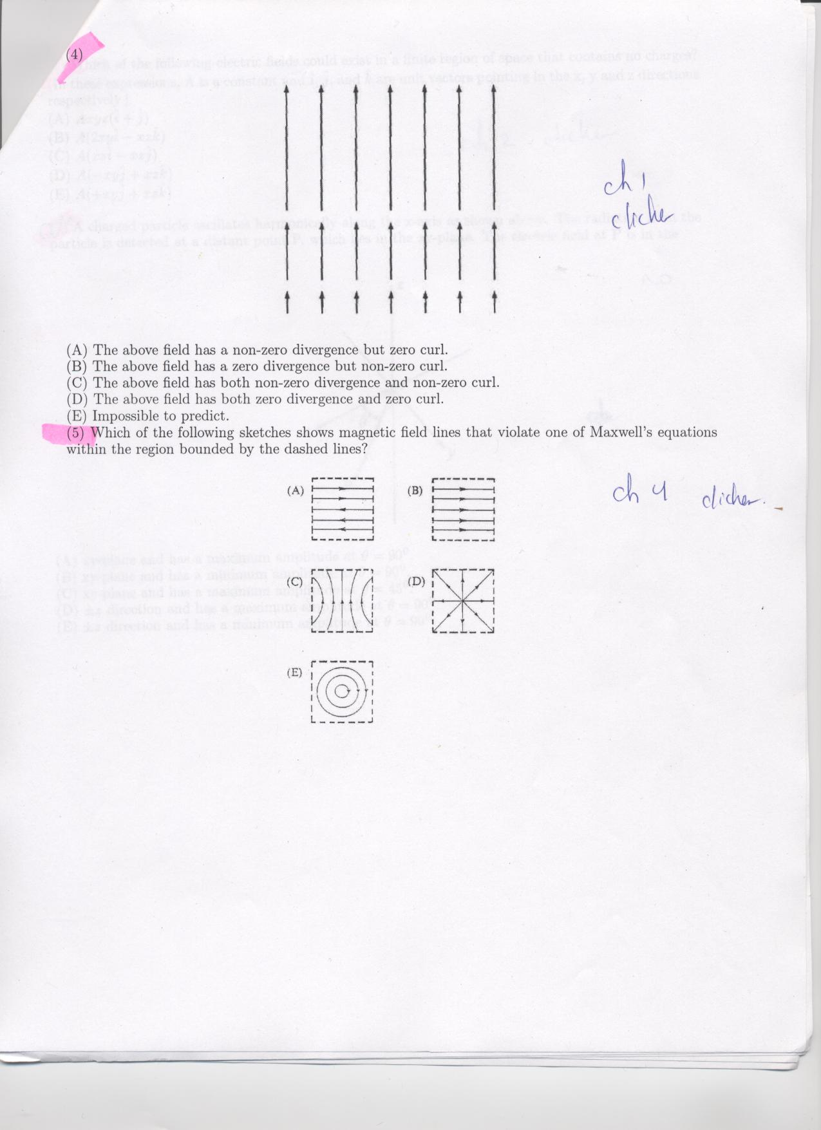
What is the divergence and curl of this vector field in the region shown?
1.3
A) non-zero divergence, but zero curl.
B) zero divergence, but non-zero curl.
C) non-zero divergence, and non-zero curl.
D) zero divergence, and zero curl.
E) Impossible to predict, you need a formula!
Notes:
Sp08: Used a variant of this, see next slide.
Answer is A... IF you assume uniformity in the z direction (I suppose that would make E also correct?)

Slide 20
Which of the following two fields has zero divergence?
1.4
I
II
Both do B) Only I is zero
C) Only II is zero D) Neither is zero
E) ??
Notes:
CORRECT ANSWER: B
USED IN: Spring 2008 (Pollock)
LECTURE NUMBER: 5 in SP ‘08, 4 in Sp ‘13
STUDENT RESPONSES: 4% [[83%]] 9% 4% 0%
16%, [74%]], 4, 7, 0 (Sp ‘13)
INSTRUCTOR NOTES: 83% correct, some interesting discussion about why/how. (One student loved my using the math, d/dx(Fx)+d/dy(Fy) etc to “see” it). My answer is B, I has no divergence (no dEx/dx) (But again, I’m making an assumption about uniformity in z. For example, II is a good graph of the e-field if you have a long line charge offscreen to the left, and then *in the region shown,* there is no divergence!!). You could make this explicit, but I valued leaving that ambiguity in and letting it be part of the discussion – SJP
In Sp ‘13 we talked more about the basic definition of div as “outward flux from a small local volume” per unit volume. With this in mind, Fig I has equal flux in and out for small boxes located anywhere in the picture, but Fig 2 has “more exiting than entering”, thus posit flux. I then asked what if the arrows all flipped sign – would that change the sign of div(E), or not? (Answer is no, still more lines exiting than entering!)
Written by:?? (We got it from somewhere!)

Slide 21
What is the divergence of this vector field in the boxed region?
1.5
Zero
Not zero
Not enough info
Notes:
CORRECT ANSWER: A
USED IN: Spring 2008 (Pollock)
LECTURE NUMBER: 5 in SP ‘08, 4 in Sp ‘13
STUDENT RESPONSES:[[95%]] 5% 0% 0% 0%
[[60%]], 38, 2, 0, 0 in Sp ‘13
INSTRUCTOR NOTES:95% correct, (only 60 the next time) but very good source of conversation. In ‘08 I made them DO it (using spherical coordinates, find the divergence of the Coulomb field from the front flyleaf). We also discussed “lines in = lines out” argument. I also went through the argument that “Ex/dx is negative, but dEy/dy is positive”, and those can cancel if the radial dependence is “just so”. This leads in to the delta function…
Answer is A, (although again, there’s implicit 3-D assumptions being made here, I was viewing this as “E field lines from a point charge” . Fact is that the “box” is 3D and you aren’t SEEING information about the field in the 3rd dimension, you’re just assuming... But I think this was not important for the discussions at hand here) -SJP
WRITTEN BY: Steven Pollock (CU-Boulder)

Slide 22
Which of the following two fields has zero curl?
1.7a
I
II
Both do B) Only I is zero
C) Only II is zero D) Neither is zero
E) ??
Notes:
SP08: Skipped, but did variant, see next slide. (I clearly has non-zero curl, and II appears to have zero curl)

Slide 23
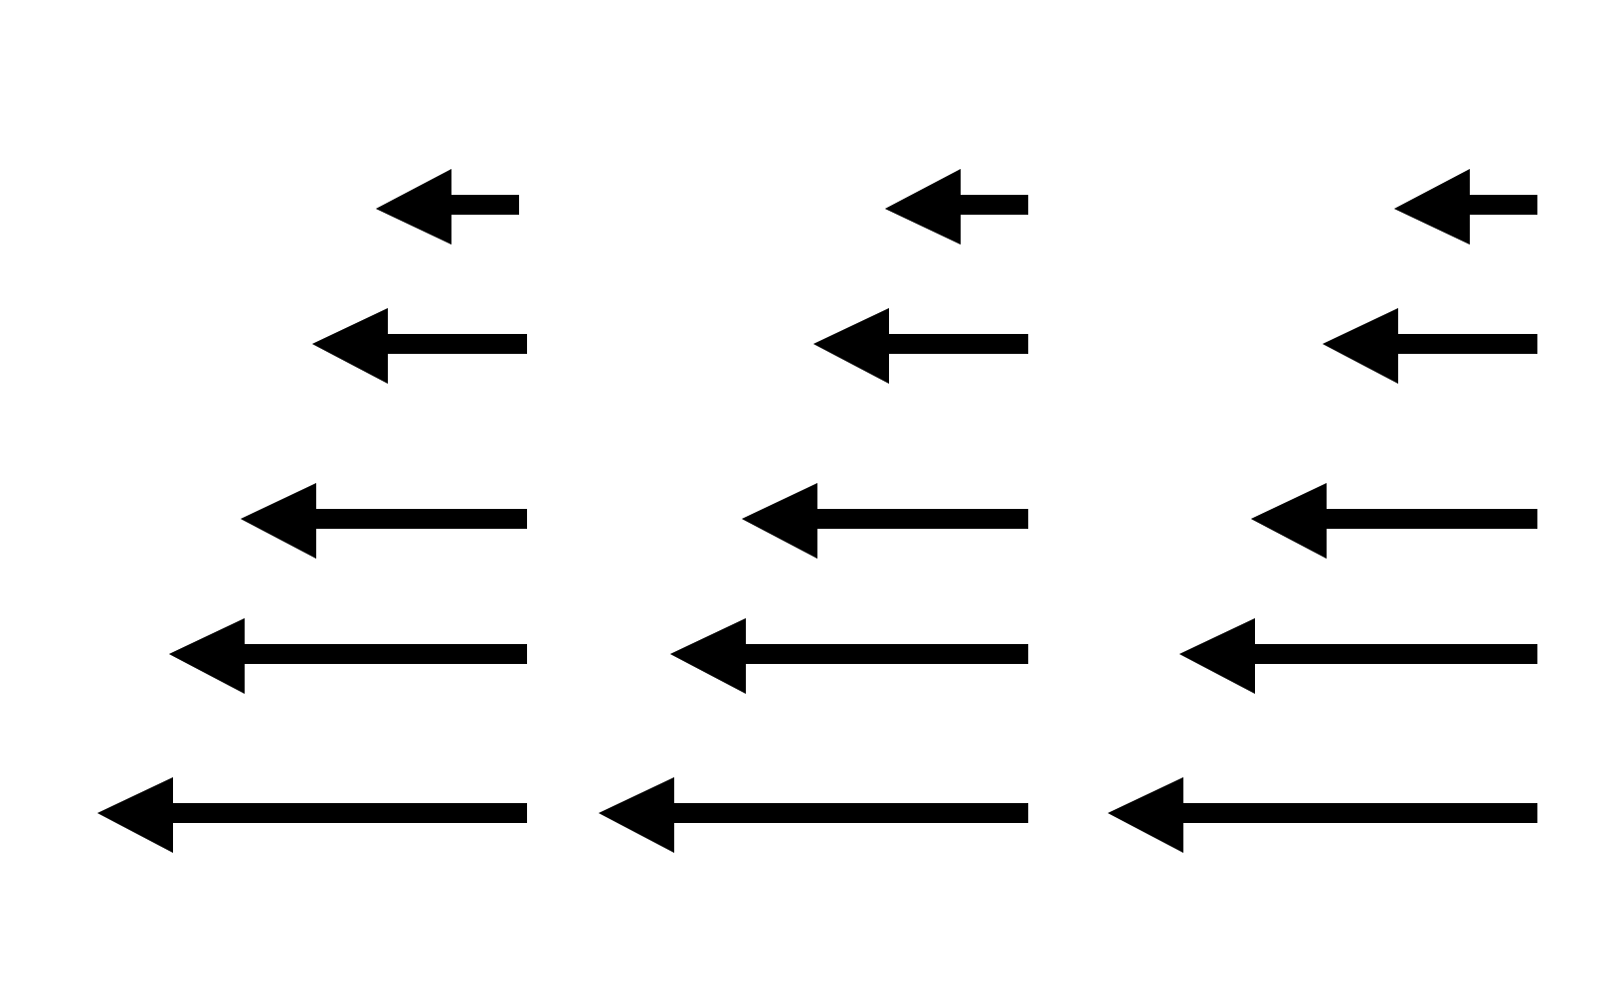
What is the curl of this vector field, in the region shown below?
1.7c
non-zero everywhere
Non-zero at a limited set of points
zero curl everywhere
We need a formula to decide for sure
Notes:
CORRECT ANSWER: A
USED IN: Spring 2013 (Pollock)
LECTURE NUMBER: 8 (intro to voltage)
STUDENT RESPONSES: [[77]], 16, 3, 5, 0 (preclass question, have not dicussed curl yet)
INSTRUCTOR NOTES : This was used as a warmup, to see how many know the answer before we’ve talked about it. I didn’t discuss it much, I did have the FORMULA for curl in Cartesian coordinates up on the board, so I could point out that it has a nonzero “d/dy of Ex” bit, which gives a z-component of curl. But we came back later and really worked out the reasoning (by drawing a small loop and computing the circulation)
WRITTEN BY: Steven Pollock
23

Slide 24
Which of the following could be a static physical E field in a small region?
1.7b
I
II
Both B) Only I
C) Only II D) Neither
E) ??
Notes:
SP08: (This question also appears in Ch2 file as 2.43b, with more discussion) L8 preclass questionCORRECT ANSWER: B
USED IN: Fall 2008 (Dubson) and Spring 2008 and ‘13 (Pollock)
LECTURE NUMBER: Dubson (Week 3, Lecture 6). Pollock (Lecture 8).
STUDENT RESPONSES: 0% [[91%]] 6% 4% 0% (FALL 2008)
50% correct (SPRING 2008)
0 [[95]], 0, 5%, 0 (Sp ’13)
INSTRUCTOR NOTES: Answer is B (I is forbidden by curl)
Used at start of class. In ‘08 50% correct. Good discussion, which was not merely about “seeing the curl” but also we discussed the field in II wrt Gauss law. (So, some students said II was no good because it has a nonzero divergence, thinking “small region” must have rho=0.) We also got into a nice discussion when I argued that there MUST be charge in region II, since div is clearly 0 (which turns out not to be correct - a student pointed out that this is the field as you approach a negative line charge on the left. So we had to talk about the 3-D *assumptions* I was implicitly making. Another student wanted to argue (incorrectly) this was the field if you have two SHEETS on either side, with low sigma on the right, and high negative sigma on the left. So that made a nice review conversation too. -SJP
Remarkably similar conversations in Sp ‘13! I did not get to hear from the few students who thought “Neither”.
WRITTEN BY: Steven Pollock (CU-Boulder)

Slide 25
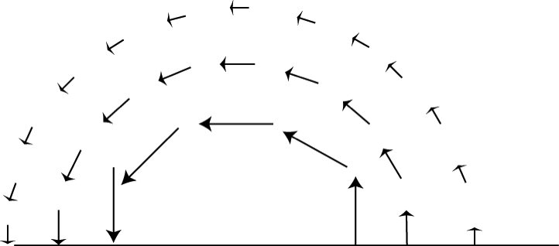
What is the curl of this vector field, in the region shown below?
1.8
non-zero everywhere
Non-zero at a limited set of points
zero curl everywhere shown
We need a formula to decide for sure
Notes:
Sp08: Skipped, but could be a good one. (I think the answer is D, since it depends on whether it goes *exactly* as 1/r! From this crude a picture, you can’t tell for sure, but it is certainly consistent with the possibility of C, so I think both would be good answers )
See 1_3-Clickers-Potential_Sp13 for more examples like this, it’s part of “Chapter 2” questions.
25

