Slide 1
POLARIZATION
Notes:
WRITTEN BY: Steven Pollock (CU-Boulder)

Slide 2
Class Activities:
Polarization (1)

Slide 3
Class Activities:
Polarization (2)

Slide 4
MD8-1
A stationary point charge +Q is near a block of polarization material (a linear dielectric). The net electrostatic force on the block due to the point charge is
attractive (to the left)
B) repulsive (to the right)
C) zero
+Q
+
Notes:
CORRECT ANSWER: A
USED IN: Fall 2008 (Dubson), Fall 2009 (Schibli)
LECTURE NUMBER: Dubson (Week 8, Lecture 19)
STUDENT RESPONSES: [[73%]] 2% 24% 0% 0% (FALL 2008)
[[94%]] 6% 0% 0% 0% (FALL 2009)
INSTRUCTOR NOTES:
WRITTEN BY: Mike Dubson (CU-Boulder)
4

Slide 5
The sphere below (radius a) has uniform polarization P₀ (which points in the z direction.)
What is the total dipole moment of this sphere?
4.1
alt
zero
B) P₀ a³
C) 4πa³ P₀/3
D) P₀
E) None of these/must be more complicated
P0
Notes:
CORRECT ANSWER: C
USED IN: Spring 2008 and 13 (Pollock)
LECTURE NUMBER: 23
STUDENT RESPONSES: 0% 6% [[ 94%]] 0% 0%
4%, 11%, [[80%] 2, 4 (end of L22 in ‘2013)
INSTRUCTOR NOTES: L23 - Started class with this. 94% correct. Super simple!
In 2013 it was a rush job at the VERY end of class (clicker started at 1:50) and still did fine.
-SJP
WRITTEN BY: Steven Pollock (CU-Boulder)

Slide 6
The cube below (side a) has uniform polarization P₀
(which points in the z direction.)
What is the total dipole moment of this cube?
4.1
zero
B) a³ P₀
C) P₀
D) P₀ /a³
E) 2 P₀ a²
z
x
Notes:
CORRECT ANSWER: B
USED IN: Fall 2008 (Dubson), Spring 2008 (Pollock), Fall 2009 (Schibli)
LECTURE NUMBER: Dubson (Week 8, Lecture 19), Pollock (Lecture 22, 23 in ‘13)
STUDENT RESPONSES: 0% [[92%]] 2% 6% 0% (FALL 2008)
6% [[78%]] 6% 11% 0% (SPRING 2008)
2% [[88%]] 2% 8% 0% (FALL 2009)
2 [[83]] 2 13 (Sp ’13)
INSTRUCTOR NOTES: Started class with this. Asked it silently (78%) then collaborating (90%, and the mistakes were accompanied by moans of “I meant to multiply” when I said the answer) Super simple, but I think it was helpful as a pre-class question just to emphasize units and the IDEA of “P * dt = dipole moment” that we will use in class today. -SJP
Dubson: Good question for establishing terminology.
WRITTEN BY: Steven Pollock (CU-Boulder)

Slide 7
FIELD OF POLARIZED OBJECT
Notes:
WRITTEN BY: Steven Pollock (CU-Boulder)
7

Slide 8
- - - - - - - - - - - - - - - - - - - - - - - - - - - - - - - - - - - - - - - - - - - - - - - - - - - - - -
+ + + + + + + + + + + + + + + + + + + + + + + + + + + + + + + + + + + + + + + + + + + + + + + + + + + + + +
Notes:
CORRECT ANSWER: N/A
USED IN: Spring 2008 (Pollock), Fall 2009 (Schibli)
LECTURE NUMBER: 22 and 23
STUDENT RESPONSES: n/a
INSTRUCTOR NOTES: Joked about “steve’s version of Phet”. A Simple animation of “polarizing” these atoms in 4 small steps, so in the end they are displaced by ONE atomic diamater. You very visually see the appearance of the surface charge, and the volume also visually has no bound charge, and you can see that polarization by “just” one atomic diamter has a dramatic visible effect, as though charges had “moved” ALL the way across the macroscopic sample. -SJP
WRITTEN BY: Steven Pollock (CU-Boulder)

Slide 9
- - - - - - - - - - - - - - - - - - - - - - - - - - - - - - - - - - - - - - - - - - - - - - - - - - - - - -
+ + + + + + + + + + + + + + + + + + + + + + + + + + + + + + + + + + + + + + + + + + + + + + + + + + + + + +

Slide 10
- - - - - - - - - - - - - - - - - - - - - - - - - - - - - - - - - - - - - - - - - - - - - - - - - - - - - -
+ + + + + + + + + + + + + + + + + + + + + + + + + + + + + + + + + + + + + + + + + + + + + + + + + + + + + +

Slide 11
- - - - - - - - - - - - - - - - - - - - - - - - - - - - - - - - - - - - - - - - - - - - - - - - - - - - - -
+ + + + + + + + + + + + + + + + + + + + + + + + + + + + + + + + + + + + + + + + + + + + + + + + + + + + + +

Slide 12
- - - - - - - - - - - - - - - - - - - - - - - - - - - - - - - - - - - - - - - - - - - - - - - - - - - - - -
+ + + + + + + + + + + + + + + + + + + + + + + + + + + + + + + + + + + + + + + + + + + + + + + + + + + + + +

Slide 13
Notes:
CORRECT ANSWER: n/a
USED IN: Spring 2008 (Pollock)
LECTURE NUMBER: 22?
STUDENT RESPONSES: n/a
INSTRUCTOR NOTES: I had them do a whiteboard activity to derive the formula for sigma bound, and this sequence of pictures was very helpful to set the stage. (So, I told them they are given N particles/volume, q charge on each particle which is separating, d = separation of the charge in one particle, A = area of top of box, H = height of box, and asked them to derive “Q on top”, “Sigma on top”, P (polarization), followed by “Sigma on top in TERMS of P”. Took a little under 10 minutes, but seemed rather worthwhile. At the end, I asked them “what if the polarization axis is tilted by angle theta wrt the vertical”. Basically, all of the class with a couple exceptions got to Sigma = P, and most were getting to P dot N. -SJP
WRITTEN BY: Steven Pollock (CU-Boulder)

Slide 16
MD8-2
A VERY thin slab of thickness d and area A has
volume charge density ρ = Q / V .
Because it’s so thin, we may think of it as a
surface charge density σ = Q / A .
A
d
The relation between ρ and σ is
σ = ρ
B) σ = d ρ C) d σ = ρ
D) σ = V ρ E) V σ = ρ
Notes:
CORRECT ANSWER: B
USED IN: Fall 2008 (Dubson)
LECTURE NUMBER: Dubson (Week 8, Lecture 19)
STUDENT RESPONSES: 0% [[98%]] 2% 0% 0%
INSTRUCTOR NOTES: Used the results of that clicker to then complete the derivation of the formula for sigma.
WRITTEN BY: Mike Dubson (CU-Boulder)
16

Slide 17
Imagine two fluids, red (+) and blue (-), each uniform, identical, in a rectangular shape (area A, height H).
This fluid has N "atoms"/m^3, and each "atom" (or unit) has available a charge q (which can separate/move). Imagine the red fluid moves UP the page, uniformly, a distance "d".
1) How much charge Q appears on the top surface? (on the bottom? the sides?)
2) What is σ on the top, in terms N, q, d, A, and/or H
3) What is the polarization P in terms of those variables?
4) What is σ on the top in terms of P?=
5) What if we displace the fluid that same distance "d", but at an angle θ with respect to the vertical. What are the answers above?
Notes:
No longer used, see Tutorial

Slide 18
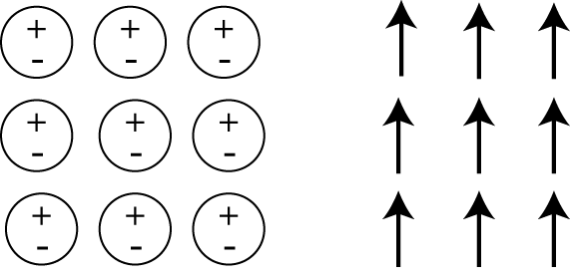
In the following case, is the bound surface and volume charge zero or nonzero?
4.3
σ_{b} = 0, ρ_{b}≠0
σ_{b} ≠ 0, ρ_{b}≠0
σ_{b} = 0, ρ_{b}=0
σ_{b} ≠ 0, ρ_{b}=0
Physical dipoles idealized dipoles
Notes:
CORRECT ANSWER: D
USED IN: Fall 2008 (Dubson), Spring 2008 (Pollock), Fall 2009 (Schibli)
LECTURE NUMBER: Dubson (Week 8, Lecture 19), Pollock (22)
STUDENT RESPONSES: 5% 15% 10% [[70%]] 0% (FALL 2009)
INSTRUCTOR NOTES: : My answer is D. div(P)=0 inside
WRITTEN BY: Steven Pollock (CU-Boulder)
SJP solution: This is a case of no divergence of P, so rhob=0. But there is certainly a P dot n on any surface (top or bottom). So there is a little ambiguity (sigma(b) is zero on left and right sides, for example!)
18

Slide 19
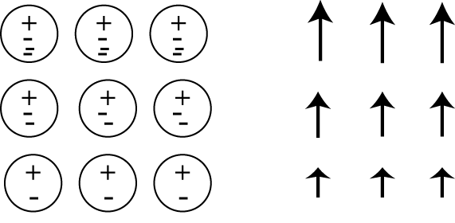
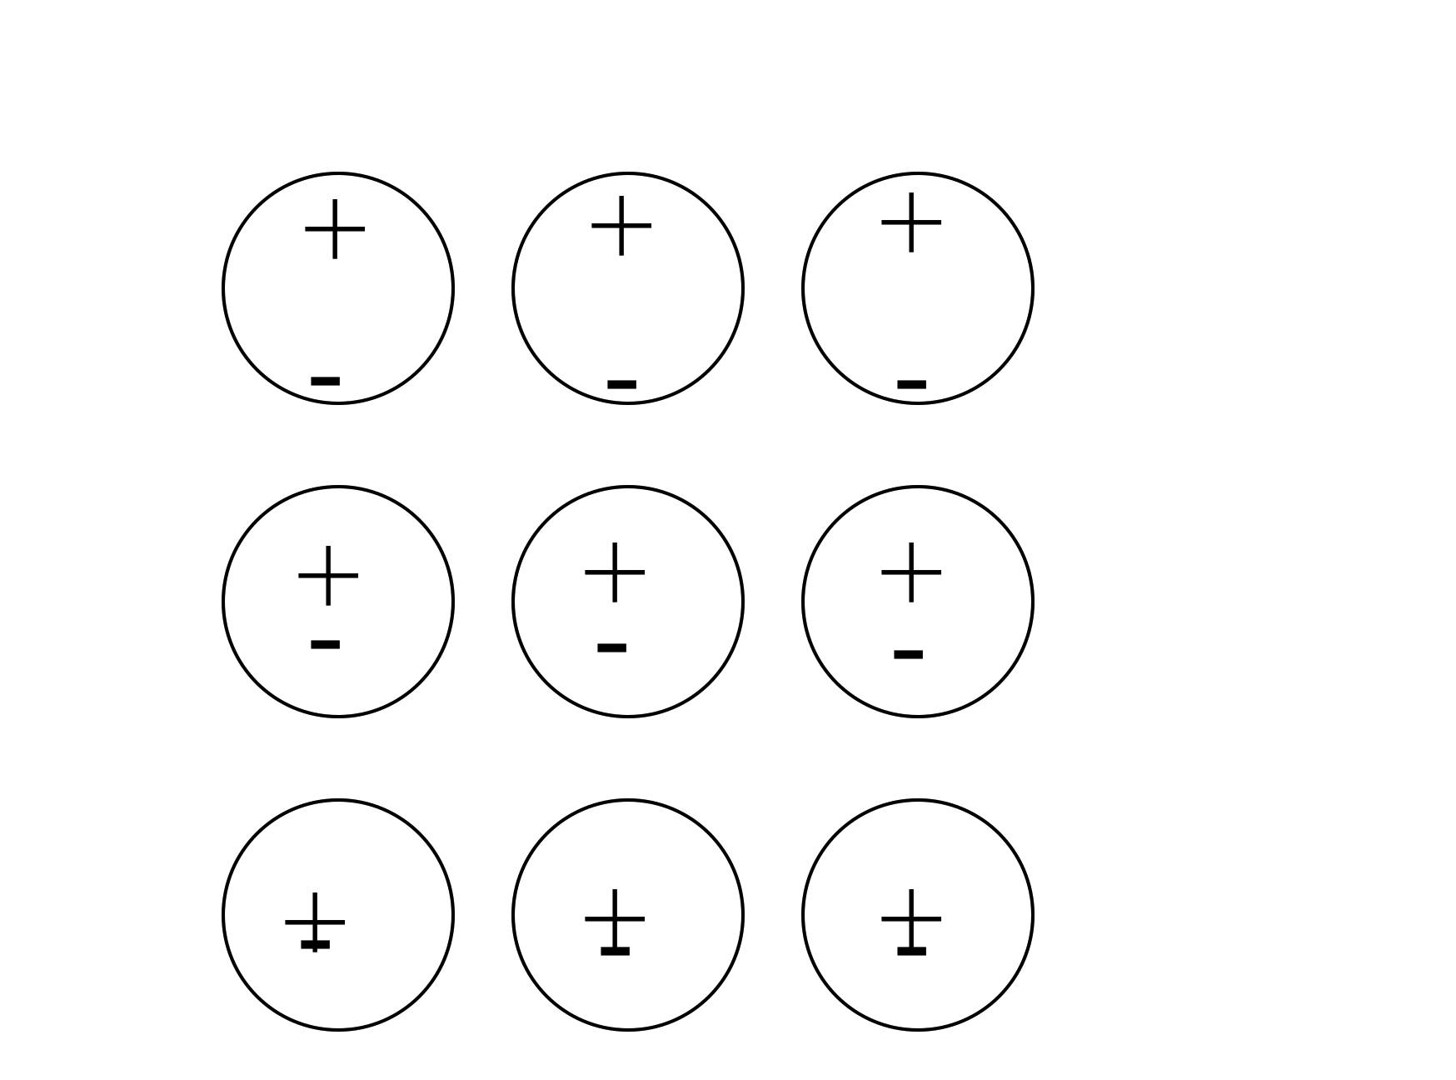
In the following case, is the bound surface and volume charge zero or nonzero?
4.3b
σ_{b} = 0, ρ_{b}≠0
σ_{b} ≠ 0, ρ_{b}≠0
σ_{b} = 0, ρ_{b}=0
σ_{b} ≠ 0, ρ_{b}=0
Physical dipoles idealized dipoles
Notes:
CORRECT ANSWER: B
USED IN: Spring 2008 (Pollock)
LECTURE NUMBER: 22
STUDENT RESPONSES: 10% [[80%]] 5% 5% 0% (SPRING 2008)
0% [[88%]] 2% 8% 2% (SPRING 2008)
INSTRUCTOR NOTES: : 80% correct. Not sure why it wasn’t 100%, didn’t get good arguments from the class. Some were confused about “where the negative bound volume charge density actually comes from”. Seems like a pretty good example to talk through.
(SJP - Note that I redrew the physical dipoles - the original picture is “hidden” behind , they did not look neutral. If the “---” is supposed to represent more spread out electrons, then this looks like a SMALLER dipole moment to me... but ok, the picture on the right works)
Note that bound surface charge is less than zero on the bottom and greater than zero on the top -SJP
Dubson: I hear a lot of people looking at just the physical dipole picture and not the idealized dipole picture. Doing physical counting instead of looking at formulas. But most people got it right in the end.
WRITTEN BY: Steven Pollock (CU-Boulder)
19

Slide 20
Notes:
CORRECT ANSWER: n/a
USED IN: Spring 2008 (Pollock)
LECTURE NUMBER: 30
STUDENT RESPONSES: n/a
INSTRUCTOR NOTES: Used to discuss the “rho(bound) story” note that stretching the red (negative) sphere leaves some negative charge on the surface, and some excess + charge in the middle. -SJP
WRITTEN BY: Steven Pollock (CU-Boulder)

Slide 22
MD8-3
A linear dielectric in the shape of a rectangular block has a uniform polarization P (due to an external E-field) parallel to an edge, as shown. How many of the sides of the block have a non-zero surface charge density?
A) 1 B) 2 C) 4 D) 6 E) 0
P = constant
Notes:
Skipped in ‘13
CORRECT ANSWER: B
USED IN: Fall 2008 (Dubson)
LECTURE NUMBER: Dubson (Week 8, Lecture 20)
STUDENT RESPONSES: 0% [[95%]] 2% 0% 2%
INSTRUCTOR NOTES:
WRITTEN BY: Mike Dubson (CU-Boulder)
22

Slide 23
A dielectric slab (top area A, height h) has been polarized, with P=P₀ (in the +z direction) What is the surface charge density, σ_{b,} on the bottom surface?
4.4
P0
0
B) -P₀
P₀
D) P₀ A h
E) P₀ A
Notes:
Skipped in ‘13
CORRECT ANSWER: B
USED IN: Spring 2008 (Pollock), Fall 2009 (Schibli)
LECTURE NUMBER: 23
STUDENT RESPONSES: n/a
0% [[92%]] 0% 0% 8% (FALL 2009)
INSTRUCTOR NOTES: Discussed (didn't bother clicking, little too easy). -SJP
WRITTEN BY: Steven Pollock (CU-Boulder)
23

Slide 24
Are σ_{b} and ρ_{b} due to real charges?
Of course not! They are as fictitious as it gets! (Like in the ‘method of images.’)
Of course they are! They are as real as it gets! (Like σ and ρ in Chapter 2.)
I have no idea ☹
Notes:
CORRECT ANSWER: B
USED IN: Fall 2009 (Schibli)Pollock Sp 2013
LECTURE NUMBER:
STUDENT RESPONSES: 35% 62% 2% 0% 0% (FALL 2009)
14, [[82]], 0, 2, 2 (Sp ‘13)
INSTRUCTOR NOTES: Just for fun, I did hear some students debating this, they were looking at the formula on the board and arguing it’s “must a formula”, a trick of some sort. But no, those bound charges are real, they’re there…
WRITTEN BY: Thomas Schibli (CU-Boulder)

Slide 25
A dielectric sphere is uniformly polarized,
What is the surface charge density?
A) 0
B) Non-zero Constant
C) constant*sin(θ)
constant*cos(θ)
E) ??
P0
Notes:
CORRECT ANSWER: D
USED IN: Spring 2013 (Pollock) (Pre class question)
LECTURE NUMBER: 24
STUDENT RESPONSES: 4, 16, 4, [[76]], 0
INSTRUCTOR NOTES –
Next slide duplicates this one and brings up the appropriate formula, but I had them on the board anyway. This is a “preclass” question, didn’t seem too hard for most of them, good conversations. Some students reasoned it out mathematically (z dot rhat) others were thinking more physically, e.g. “should be + at north, and – at south”. Good to go back to the way of thinking about it from previous class: lifting a sphere of + up a little w.r.t. a sphere of – yields exactly this setting, with a “bulge” of + at the top.
-SJP
WRITTEN BY: Steven Pollock (CU-Boulder)

Slide 26
A dielectric sphere is uniformly polarized,
What is the surface charge density?
A) 0
B) Non-zero Constant
C) sin(θ)
cos(θ)
E) ??
P0
Notes:
INSTRUCTOR NOTES
(Just animated the formulas)
-SJP
WRITTEN BY: Steven Pollock (CU-Boulder)

Slide 27
In your own words, define what we mean by "free charge", and "bound charge"
Notes:
27
Thought about doing this as a pre-class “freewrite”, but we didn’t get to it.
free = The charges that would exist if there were no dielectric?
bound = the charge distributions that "appear" as a result of polarization of the medium? -SJP
WRITTEN BY: Steven Pollock (CU-Boulder)

Slide 28
The sphere below (radius a) has uniform polarization P₀ (which points in the z direction.)
What is the total dipole moment of this sphere?
4.1
alt
zero
B) P₀ a³
C) 4πa³ P₀/3
D) P₀
E) None of these/must be more complicated
P0
Notes:
CORRECT ANSWER: C
USED IN: Spring 2008 and 13 (Pollock)
LECTURE NUMBER: 23
STUDENT RESPONSES: 0% 6% [[ 94%]] 0% 0%
4%, 11%, [[80%] 2, 4 (end of L22 in ‘2013)
INSTRUCTOR NOTES: L23 - Started class with this. 94% correct. Super simple!
In 2013 it was a rush job at the VERY end of class (clicker started at 1:50) and still did fine.
-SJP
WRITTEN BY: Steven Pollock (CU-Boulder)

Slide 29
A dielectric sphere is uniformly polarized,
What is the volume charge density?
A) 0
B) Non-zero Constant
C) Depends on r, but not θ
D) Depends on θ, but not r
E) ?
P0
Notes:
CORRECT ANSWER: A
USED IN: Spring 2013 (Pollock)
LECTURE NUMBER: 24
STUDENT RESPONSES: [[75]], 4, 6, 16
INSTRUCTOR NOTES – Good followup. Some students were arguing about taking div in spherical coordinates (which you should not do if the formula is GIVEN in Cartesian coords!) Again, roll back to our model from last one of displacing uniform + and – spheres, in the bulk, there is no net charge. (And, cos(theta) has no net charge, so no NEED for a bulk overall charge, anyway)
-SJP
WRITTEN BY: Steven Pollock (CU-Boulder)

Slide 30
FORCE AND ENERGY
Notes:
WRITTEN BY: Steven Pollock (CU-Boulder)
This came later in ‘13

Slide 31
We argued that C goes UP by a factor of ε_{r} if you fill a capacitor with dielectric. What happens to the stored energy of a capacitor if it’s filled with a dielectric?
4.11
It goes up
It goes down
It is unchanged
The answer depends on what else is “held fixed” (V? Q?)
Notes:
CORRECT ANSWER: D
USED IN: Spring 2008 and 13 (Pollock), Fall 2009 (Schibli)
LECTURE NUMBER: 27 (28 in ‘13)
STUDENT RESPONSES: 7% 53% 0% [[40%]] 0% (SPRING 2008)
17% 31% 3% [[49%]] 0% (FALL 2009)
29, 45, 10, [[17]] Sp 13
INSTRUCTOR NOTES: I was clear when presenting the problem that I was NOT telling them if it was isolated, or connected to a battery, or what. In ‘13 I drew pictures on the board. Still, many voted for B, about 40% for D (which is correct). It was more like 70% for B until I wrote (in the middle of the concept test, on the board) the THREE formulas for stored energy of a capacitor (1/2 C V^2, 1/2 Q^2/C, 1/2 QV)
Good discussion followed - the point being that it could go up OR down depending on what you hold fixed.
The *reason* for voting B that I heard seemed to be that the “E field is reduced by the dielectric, so the energy is lower” In ‘13 I had just stated that E goes down in a dielectric (which in retrospect was confusing to them, e.g. if connected to a battery, E is what it always was)
-SJP
WRITTEN BY: Steven Pollock (CU-Boulder)
31

Slide 32
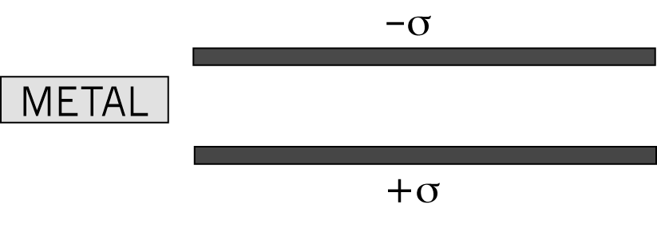
If we push this conductor inside the isolated capacitor, will it be drawn into the capacitor or repelled?
4.12
It gets sucked into the capacitor
It gets pushed out from the capacitor
I just don’t know.
Notes:
32
CORRECT ANSWER: A
USED IN: Spring 2008 (Pollock)
LECTURE NUMBER: 27
STUDENT RESPONSES: [[100%]] 0% 0% 0% 0%
INSTRUCTOR NOTES: 100% correct! Still, it was a good conversation starter - Their arguments all were basically “it polarizes, with + on top, and - on bottom, and opposite charges attract, so it gets sucked in”.
I didn’t hear anyone argue for their answer by an energy argument, so I introduced it later.
I tried to first “counter” their field argument by arguing that the field lines MUST enter the top and bottom of that metal perpendicularly, and thus cannot provide any sideways component of force! Then they argued that it must be the charges induced on the right side/corners of the metal as it comes in. (I’m a little confused on this point, but think that must be correct. Field lines MUST be perpendicular to the conductor at every point, so I don’t see how the induced charges on the top and bottom would give a “rightward pull”)
SJP explanation: A) When the metal is inside (assuming it is also isolated from the plates!) the E field will be zero through most of the volume, which means the stored energy in the volume has gone down. Where did it go? It must have done work ON the metal, pulling it in.
Note that the capacitor must be isolated for my explanation to hold. If e.g. the Capacitor is held at fixed voltage, then the energy of the system would go UP (bigger capacitance, you’ll get more charge pulled onto the two plates) and I’m then not sure how to complete the argument. (Maybe Stephanie’s argument below still holds, though...)
(from Stephanie) It gets sucked in because the fringe fields get it. There are analogies with this and magnetism. Electric materials polarize in opposite direction, like a diamagnet. Ward has a question on diamagnet vs. paramagnet in a B field. -SJP
WRITTEN BY: Steven Pollock (CU-Boulder)

Slide 33
If we push this dielectric inside the isolated capacitor, will it be drawn into the capacitor or repelled?
4.12b
DIELECTRIC
It gets sucked into the capacitor
It gets pushed out from the capacitor
I just don’t know.
Notes:
33
CORRECT ANSWER: A
USED IN: Spring 2008 (Pollock), Fall 2009 (Schibli)
LECTURE NUMBER: 27 (28 in ‘13)
STUDENT RESPONSES: n/a
[[78%]] 19% 3% 0% 0% (FALL 2009)
[[95]], 5, 0, 0, (Sp 13) but I pretty much gave away the answer during the discusson
INSTRUCTOR NOTES: Showed this, we talked about it, but did not click.
SJP explanation: A) When the dielectric is inside (assuming it is also isolated from the plates!) the E field will be reduced through most of the volume, which means the stored energy in the volume has gone down. Where did it go? It must have done work ON the dielectric, pulling it in
You can also draw the fringe fields and think about the forces on the bound charges
-SJP
(Interesting discussion point: We had asked a similar question where it was a conductor being brought in (but not in direct contact) Would the forcehere be larger or smaller than in that previous example? One student argued LARGER because now the field lines do NOT have to be perpendicular to the dielectric, so the induced charges on the top and bottom can contribute to the sideways force. But another argument was that overall energy “reduction” in the system is less here than for the conductor (there’s still some residual E field), so the F = -dW/dx argument implies WEAKER force here. I agree with the latter argument, but am not sure what the flaw is in the former (although the former is vague - there are more charges contributing to the force, but each is weaker, so who says what the net result is? I think “fringe field” arguments are intrinsically hard, and would go with the simpler energy arguments!)
WRITTEN BY: Ward Handley (CU-Boulder)

