Slide 1
MAGNETIC VECTOR POTENTIAL
Notes:
WRITTEN BY: Steven Pollock (CU-Boulder)

Slide 2
Class Activities: Vector Potential

Slide 3
One of Maxwell’s equations, made it useful for us to define a scalar potential V, where
Similarly, another one of Maxwell’s equations makes it useful for us to define the vector potential, A. Which one?
Notes:
CORRECT ANSWER: D
USED IN: Spring 2013 (Pollock)
LECTURE NUMBER: 35
STUDENT RESPONSES: 3, 3, 32, [[62]] (pre-class question) (Sp 13)
INSTRUCTOR NOTES: (Used as review/pre-class question for L35, we ended last class talking it through).
-SJP
WRITTEN BY: Steven Pollock (CU-Boulder)

Slide 4
Can add a constant ‘c’ to V without changing E
(“Gauge freedom”): ∇constant = 0,
Can add any vector function ‘a’ with ∇xa=0 to A without changing B (“Gauge freedom”)
∇ x (A+a) = ∇ x A + ∇ x a = ∇ x A = B
0
Notes:
CORRECT ANSWER:
USED IN: Fall 2009 (Schibli)
LECTURE NUMBER: (35 in Sp ‘13)
STUDENT RESPONSES:
INSTRUCTOR NOTES: Not a clicker question. It “animates”, I used it as review after we had already talked about this.
WRITTEN BY: Thomas Schibli (CU-Boulder)

Slide 5
In Cartesian coordinates, this means:
, etc.
5.25
Does it also mean, in spherical coordinates, that
Yes
No
Notes:
CORRECT ANSWER: B
USED IN: Fall 2008 (Dubson) and Spring 08 and ‘13 (Pollock), Fall 2009 (Schibli)
LECTURE NUMBER: Dubson (Week 12, Lecture 30) Pollock (Wedk 12, Lecture 35)
STUDENT RESPONSES: 14% [[84%]] 0% 2% 0%
6% [[94%]] 0% 0% 0% (FALL 2009)
INSTRUCTOR NOTES: Pollock talked about it in SP 13, and followed up with next question
WRITTEN BY: Steven Pollock (CU-Boulder)

Slide 6
Can you calculate that integral using spherical coordinates?
5.25b
Yes, no problem
Yes, r' can be in spherical, but J still
needs to be in Cartesian components
C) No.
Notes:
CORRECT ANSWER: B
USED IN: Fall 2008 (Dubson), Spring 2008 AND ‘13 (Pollock), Fall 2009 (Schibli)
LECTURE NUMBER: Dubson (Week 12, Lecture 31), Pollock(34, 35 IN ‘13)
STUDENT RESPONSES: 0% [[100%]] 0% 0% 0% (FALL 08) (?)
35% [[53%]] 12% 0% 0% (SPRING 08)
58% [[36%]] 6% 0% 0% (FALL 2009)
51, [[32]], 17, 0, 0(Sp ’13)
INSTRUCTOR NOTES: Quite mixed.
It's subtle, but I claim the answer is B. Griffiths discusses this in a footnote, you can't solve for, say, the phi component of A by integrating the "phi component" of J (because the unit vectors in spherical coordinates themselves depend on position, and get differentiated by del^2 too) -
We encountered a similar issue at the start of the term when E was an integral of “rhat”, and although we certainly DID do problems where it was convenient to write dtau’ or da’ in spherical or cylindrical coordinates, we nevertheless had to write rhat (or curly r vector) in terms of its ihat, jhat, and khat *components*.
SJP
WRITTEN BY: Steven Pollock (CU-Boulder)

Slide 7
MD12-3
The vector potential A due to a long straight wire with current I along the z-axis is in the direction parallel to:
z
I
A = ?
Assume Coulomb gauge
Notes:
CORRECT ANSWER: A
USED IN: Fall 2008 (Dubson), Fall 2009 (Schibli) (Sp ‘13)
LECTURE NUMBER: Dubson (Week 12, Lecture 31) Pollock Lecture 35
STUDENT RESPONSES: [[95%]] 5% 0% 0% 0% (FALL 2008)
[[88%]] 3% 9% 0% 0% (FALL 2009)
[[66] 6, 28, 0,0 (Sp ‘13)
INSTRUCTOR NOTES: Wasn’t quite as strong in SP 13 as I expected: A = integral (J/ curly R) was on the board and we had just talked aboutt his idea. But, students were going back to B = curl(A), and one argued that A had to be perpendicular to B which is phi-hat(true) and thus concluded that is must be in the shat direction (because he hadn’t considered that zhat is ALSO perpendicular to phi-hat!) Another student suggested than an shat component is no good because it would lead to a divergence, and on the board we had just discussed the Coulomb gauge (which is implicit in this question, otherwise the direction of A could be anything! I added it to the slide after class…)
WRITTEN BY: Mike Dubson (CU-Boulder)
7

Slide 8
MD12-4a,b
A circular wire carries current I in the xy plane. What can you say about the vector potential A at the points shown?
At point a, the vector potential A is:
Zero
Parallel to x-axis
Parallel to y-axis
Parallel to z-axis
Other/not sure…
z
b
a
Assume Coulomb gauge, and A vanishes at infinity
y
I
At point b, the vector potential A is:
Zero
Parallel to x-axis
Parallel to y-axis
Parallel to z-axis
Other/not sure
x
Notes:
CORRECT ANSWER: B
USED IN: Fall 2008 (Dubson) Sp 13 Pollock
LECTURE NUMBER: Dubson (Week 12, Lecture 31) Pollock (Lecture 35)
STUDENT RESPONSES: 6, [77]], 8, 4, 4 (Sp ’13)
INSTRUCTOR NOTES: This followed the previous question so wasn’t too hard for them. The fact that there is no z-component is a direct consequence of A = integral J/ curly R. The lack of any y component is *slightly* subtler: consider two symmetric “chunks” of current, one heading away, one heading towards: they have the same curl R to point a, yet opposite J, so they cancel (in the y direction. If you consider x components, they ADD, and the one which does cancel in direction is on the far side of the circle, hence different curly R, hence does NOT cancel)
Second answer: A
USED IN: Fall 2008 (Dubson) Sp 13 Pollock
LECTURE NUMBER: Dubson (Week 12, Lecture 31) Pollock (Week 12, Lecture 35)
STUDENT RESPONSES: [100], 0, 0, 0 (Fa08)
[[83]], 0, 2, 2, 13 (Sp ‘13)
INSTRUCTOR NOTES: They’re beginning to get it ☺ One student was bothered by the idea that A is zero here, but B is NOT. Since B = curl(A), he felt that A=0 required B=0… that was a nice point to discuss (I pointed out in 1D that a derivative can be nonzero even if the function is passing through zero!) We also noted that this means A is NOT zero if you shift even a little off axis.
WRITTEN BY: Mike Dubson (CU-Boulder)
8

Slide 9
The vector potential in a certain region is given by
(C is a positive constant) Consider the imaginary loop shown. What can you say about the magnetic field in this region?
5.19
B is zero
B is non-zero, parallel to z-axis
B is non-zero, parallel to y-axis
B is non-zero, parallel to x-axis
y
A
x
Notes:
9
Skipped in ‘13
CORRECT ANSWER: B
USED IN: Fall 2008 (Dubson), Spring 2008 (Pollock), Fall 2009 (Schibli)
LECTURE NUMBER: Dubson (Week 12, Lecture 30), Pollock (32)
STUDENT RESPONSES: 9% [[88%]] 0% 2% 0% (FALL 08)
53% [[47%]] 0% 0% 0% (SPRING 08)
5% [[82%]] 10% 2% 0% (FALL 2009)
INSTRUCTOR NOTES: (Also asked them for the sign/direction of the current, if it’s nonzero.)
Almost perfect 50/50 split between A and B!
(There was some confusion about “what causes what” - student wanted to know where would the current from from, does the B field produce it?? Interesting!)
Not sure why so many voted A, some didn’t notice the contributions on the top and bottom of the loop, some were confusing these arrows with E arrows. A very good student wanted to know if I_through is the same as “flux”. It’s interting, “J dotdA” is flux , it’s the flux of the electric CURRENT density, but we had been using flux in this class for flux of a field (E or, soon, B). Anyway, this was a good discussion, about notation and the difference between CURRENT and E field, which it turned out he was confused about (and I think is still a difficulty for some students).
Correct answer is B, the curl of this B is -A zhat, so there is a uniform J INTO the page. Can also integrate around that loop, and note the upper line contributes more than the lower, so integral is nonzero, so nonzero current enters. -SJP
WRITTEN BY: Mike Dubson (CU-Boulder)

Slide 10
AFTER you are done with the front side:
The left figure shows the B field from a long, fat, uniform wire.
What is the physical situation associated with the RIGHT figure?
A) A field from a long, fat wire
B) A field from a long solenoid pointing to the right
C) A field from a long solenoid pointing up the page
D) A field from a torus
E) Something else/???
Notes:
Used with Tutorial #10 on A field
CORRECT ANSWER: C
USED IN: Sp 13 Pollock
LECTURE NUMBER: Pollock (Lecture 35)
STUDENT RESPONSES: 5, 10, [80]],, 5, 0 (Sp ’13)
INSTRUCTOR NOTES: I had a Tutorial on finding the A-field, and they did this clicker question to let me know when they were done with the first page. The picture they have on the document is a B field which points uniformly in z out to a radius a, and then abrubtly vanishes. This is precisely the B field of a long solenoid. (They were “guessing” the A field, which is precisely the same shape and direction as the B field for a fat wire)

Slide 11
Suppose A is azimuthal, given by
(in cylindrical coordinates)
What can you say about curl(A)?
5.27b
curl(A) =0 everywhere
B) curl(A) = 0 everywhere except at s=0.
C) curl(A) is nonzero everywhere
D) ???
Notes:
CORRECT ANSWER: B
USED IN: Spring 2008 (Pollock)
LECTURE NUMBER: 34 (36 In ’13)
STUDENT RESPONSES: 53% [[24%]] 24% 0% 0%
In ‘13, It was very mixed, similar to above (didn’t record it), but then I made them TAKE the curl mathematically, and it flipped to 86% for A (since they didn’t spontaneously think about the delta function)
INSTRUCTOR NOTES: End of class, not a lot of time. Votes were 50, 25, 25%.
Correct answer is very subtle - it's B! The curl of this field is 0 by the "formula in the front flyleaf" (1/s d/ds (s A_phi)) zhat. But as usual, at the origin, you should check via Stokes - integrate A dot dl around a circle. You can DO the integral, it's simply 2 pi c. But Stokes says that should be the area (surface) integral of curl dot dA. If curl was REALLY zero everywhere, we'd have a paradox. There must be a delta function at the origin! -SJP
WRITTEN BY: Steven Pollock (CU-Boulder)

Slide 12
If the arrows represent the vector potential A (note that |A| is the same everywhere), is there a nonzero B in the dashed region?
5.24
Yes
No
Need more information to decide
Notes:
CORRECT ANSWER: A
USED IN: Spring 2008 (Pollock)
LECTURE NUMBER: 35 (36 in ‘13)
STUDENT RESPONSES: [[94%]] 6% 0% 0% 0% (Sp ’08)
[[91]], 9, 0, 0, 0 (Sp ‘13)
INSTRUCTOR NOTES: Same exact question as 5.17. 95% correct. (So, they've got it now!) Not much discussion, (although some question about whether this field was "physical" or not)
Answer is A, yes. If I consider the loop (which appears in the next slide), the line integral around the loop is manifestly NOT zero (A has same magnitude everywhere, but length is bigger on the outer path). Nonzero line integral means flux of B (and thus B itself) must be nonzero. -SJP
WRITTEN BY: Steven Pollock (CU-Boulder)

Slide 13
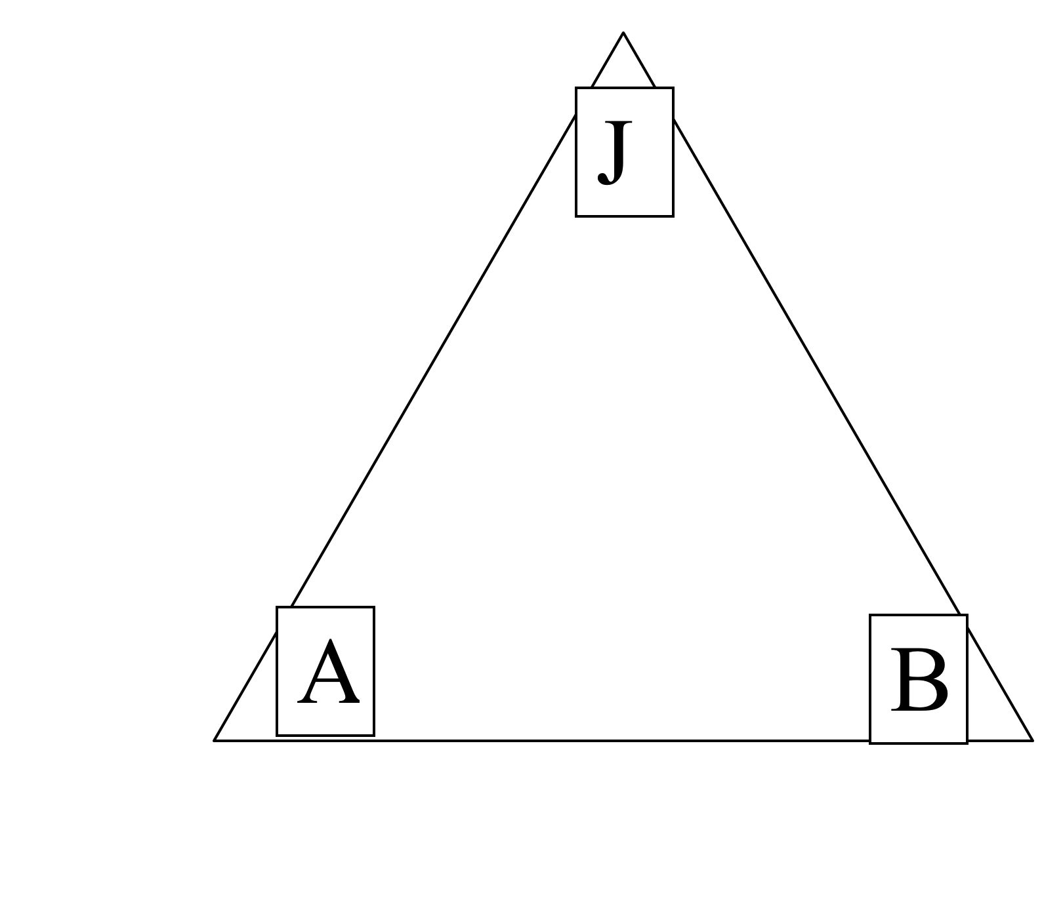
Vector Potential
Compare the magnetostatic triangle (p.240) with the electrostatic triangle (pg. 87). How is the potential similar/different to the vector potential?
Notes:
13
Skipped in ‘13
CORRECT ANSWER: N/A
USED IN: Spring 2008 (Pollock)
LECTURE NUMBER: 36
STUDENT RESPONSES: n/a
INSTRUCTOR NOTES: Not a clicker question - just to think about.
Did this as a whiteboard activity, it’s good. ~5 minutes, plus 5 minutes discussion. - SJP
WRITTEN BY: Ward Handley (CU-Boulder)

Slide 14
What is
The current density J
B) The magnetic field B
C) The magnetic flux Φ_{B}
D) It's none of the above, but is something simple and concrete
E) It has no particular physical interpretation at all
Notes:
CORRECT ANSWER: C
USED IN: Fall 2008 (Dubson), Spring 2008 and ‘13 (Pollock), Fall 2009 (Schibli)
LECTURE NUMBER: Dubson (Week 12, Lecture 32), Pollock (35, 36 in ‘13)
STUDENT RESPONSES: 0% 14% [[81%]] 2% 2% (FALL 08)
0% 6% [[94%]] 0% 0% (SPRING 08)
5% 8% [[72%]] 2% 12% (FALL 2009)
2, 2, [[96]], 0, 0 (Sp ‘13)
INSTRUCTOR NOTES: 95% correct (I had worked a problem where we COMPUTED the integral for the field 1/s dphi, i.e. from the next clicker question, 5.27b, so we had seen Stoke's theorem invoked. Thus, it was only one step for them to notice curl of A is B).
Answer is C, by Stokes, this is the surface integral of the curl of A, which is flux of B. -SJP
(After this question I give a brief discussion about Aharonov-Bohm effect, which ends up showing that quantum mechanical phase depends on this integral)
WRITTEN BY: Steven Pollock (CU-Boulder)

Slide 15
Choose boundary conditions
5.28
When you are done with p. 1:
Choose all of the following statements that are implied if for any/all closed surfaces
(I)
(II)
(III)
A) (I) only
B) (II) only
C) (III) only
D) (I) and (II) only
E) (I) and (III) only
Notes:
CORRECT ANSWER: D
USED IN: Spring 2008 and 13 (Pollock), Fall 2009 (Schibli)
LECTURE NUMBER: 36 (and again in 37 in 13) SJP
STUDENT RESPONSES: 11% 6% 39% [[28%]] 17% (SPRING 2008)
3% 13% 8% [[77%]] 0% (FALL 2009)
0, 24, 10, [[62]], 3 (Sp ‘13), End of class, not all voted. Start of class: 4, 4, 2, 7, [[82]]
INSTRUCTOR NOTES: Start of class with this. I did it silently first, and they were all over the map. (Correct answer D had 28%). Then I let them talk to their neighbors, D moved to 50% (and C and E were equally represented). I'm voting for I and also III, which gives D. –SJP
WRITTEN BY: Chandralekha Singh. Improving students' understanding of magnetism, C. Singh,Proceedings of the Annual Conference of the American Society forEngineering Education (ASEE), AC 2008-90, 1-16, (2008): http://www.asee.org/conferences/v2Search.cfm
15

Slide 16
I have a boundary sheet, and would like to learn about the change (or continuity!) of B(parallel) across the boundary.
6.11
B(above)
B//(above)
Am I going to need to know about
A)
B)
C) ???
Notes:
CORRECT ANSWER: A
USED IN: Fall 2008 (Dubson) and Spring 2008 and 13 (Pollock)
LECTURE NUMBER: Dubson (Week 14, Lecture 39). Pollock (Lecture 40, 37 in ‘13).
STUDENT RESPONSES: [[42%]] 58% 0% 0% 0% (FALL 2008)
[[63%]] 37% 0% 0% 0% (SPRING 2008)
[[88]], 13, 0, 0, 0 (Sp ‘13)
INSTRUCTOR NOTES: Nice one! 60/40 split, good discussion, they woke up for this one. Some students see this by now, but others still don't know this "game". It was productive to have THEM construct the argument, think about stokes theorem, (and divergence theorem/H perp came up, so I skipped next one, that's fine). A winner.
ANSWER is A, you need to construct a short Amperian loop, and use Stoke's theorem to argue that the line integral (which tells you about H// above - H//below) must be determined by the area integral of the curl. In this case, that would be the area integral of J(free), which will only be nonzero if there is a delta function, i.e. a surface free current on the sheet. Also good to talk about DIRECTIONS, since "H//" is really still a 2-D vector. (See Griffiths, the discontinuity is given by K(free) cross n hat.
In ‘Sp ‘13 this happened DURING an in-class tutorial that targeted exactly this idea, and I had clearly outlined that the divergence of B gives you info on B_perp, so no surprise it was a stronger outcome (not sure why it was not 100%, in fact!)
-SJP
WRITTEN BY: Steven Pollock (CU-Boulder)

Slide 17
In general, which of the following are continuous as you move past a boundary?
5.28b
A) A B) Not all of A, just A_{perp}
C) Not all of A, just A//
D) Nothing is guaranteed to be continuous regarding A
Notes:
CORRECT ANSWER: A
USED IN: Fall 2008 (Dubson), Spring 2008 and ‘13 (Pollock), Fall 2009 (Schibli)
LECTURE NUMBER: Dubson (Week 12, Lecture 32), Pollock (36, 37 in ‘13)
STUDENT RESPONSES: [[40%]] 24% 17% 19% 0% (FALL 08)
[[88%]] 6% 6% 0% 0% (SPRING 08)
[[39%]] 50% 7% 4% 0% (FALL 2009)
[[56]], 26, 14, 4, 0 (Sp ‘13)
INSTRUCTOR NOTES: 88%. They knew the answer because I’ve told them several times, but during the discussion they were not able to articulate WHY. Answer A) A is continuous everywhere (as long as you have no infinite or Delta function B fields anywhere, which would not be physical?).
Think of B = Curl(A), if B is finite, then A will have to be continuous to have a finite curl. Griffiths has a more rigorous discussion... But in Coulomb gauge, Del.A =0 gives you continuity of A_perp, and curlA=B, integrated a la Stokes gives you continuity of A parallel as long as you can make the B flux go to zero (i.e, no infinite B fields!)
(In ‘13 we had a discussion I’m not sure of the answer to – from curl(A)=B ALONE I seem to only be able to argue for C… without the Coulomb gauge *choice*, I don’t see how to say anything about A_perp. So, IS it a choice, or is it guaranteed. )
-SJP
WRITTEN BY: Steven Pollock (CU-Boulder)

Slide 18
DIPOLES, MULTIPOLES
Notes:
WRITTEN BY: Steven Pollock (CU-Boulder)

Slide 19
The formula from Griffiths for a magnetic dipole at the origin is:
5.29
Is this the exact vector potential for a flat ring of current with m=Ia, or is it approximate?
It's exact
It's exact if |r| > radius of the ring
It's approximate, valid for large r
It's approximate, valid for small r
Notes:
CORRECT ANSWER: C
USED IN: Fall 2008 (Dubson), Spring 2008 and ‘13 (Pollock)
LECTURE NUMBER: Dubson (Week 12, Lecture 32), Pollock (37, 38 in ‘13)
STUDENT RESPONSES: 29% 12% [[57%]] 2% 0% (FALL 08)
13% 7% [[80%]] 0% 0% (SPRING 08)
18. 5, [[71]], 5, 0 (Sp ’13)
INSTRUCTOR NOTES: Did it silent - the machine said 67% correct, (although then a couple more voted quickly and it was 80% correct.) Still, I let them talk with their neighbor, and there was an interesting amount of discussion, Many know it was approximate, but they found it difficult to articulate how or why, or where this formula came from (despite seeing the derivation last lecture). The discussion period on this question was rather long, there was a lot of student-student argument. In ‘13 we re-sketched the derivation (there is a step at the end where “magical vector calculus” is invoked (Griffiths refers to a slightly obscure Ch 1 homework problem which itself requires Stoke’s theorem and integration by parts, which I did not work out!) I try to play up the strong analogy with our electric dipole voltage formula.
-SJP
WRITTEN BY: Steven Pollock (CU-Boulder)

Slide 20
The leading term in the vector potential multipole expansion involves
What is the magnitude of this integral?
5.30
A) R
B) 2 π R
0
D) Something entirely different/it depends!
Notes:
CORRECT ANSWER: C
USED IN: Spring 2008 (Pollock)
LECTURE NUMBER: 36 (38 in ‘13)
STUDENT RESPONSES: 0% 37% [[58%]] 5% 0% (Sp ’08)
2, 32, [57]], 9, 0 (Sp ‘13)
INSTRUCTOR NOTES:
Good one! I had set this up on the board, doing the formal expansion (making it look “parallel” to the old voltage derivation) and got to this, the monopole term.
Correct answer is C, the vector nature of dl’ means that adding them over a loop gives you zero. (One student argued you could “pair up opposite dl’s” as you go around half the loop, that’s a nice way to see it) And of course, if this was NOT zero, it would lead to a monopole potential for A, which is not physical. -SJP
In ‘13 a student was puzzling over why this integral is always zero, yet the integral of B dot dl is NOT always zero. It was nice to compare/contrast this vector integral with that scalar integral. (And I pointed out that if B was uniform, then the integral of B dot dl WOULD come out zero!)
WRITTEN BY: Steven Pollock (CU-Boulder)

Slide 21
This is the formula for an ideal magnetic dipole:
What is different in a sketch of a real (physical) magnetic dipole (like, a small current loop)?
Notes:
CORRECT ANSWER: N/A
USED IN: Spring 2008 and ‘13 (Pollock)
LECTURE NUMBER: 37 (38 in ’13)
STUDENT RESPONSES:
INSTRUCTOR NOTES: Gave about 5 minutes for this, they did it on paper but talked to each other. It was a very useful exercise - we'd done this before for the electric dipole (same thing!) but they STILL struggled in a variety of ways. Some (most) "knew the answer" either from memory or their heuristics about fields around rings, but they were not good about seeing the connection to the formula. I poked some groups with questions like "on the x axis, at very small x, what is the direction of B for the two cases (ideal and real), and can you reconcile these"? -SJP
WRITTEN BY: Steven Pollock (CU-Boulder)

Slide 22
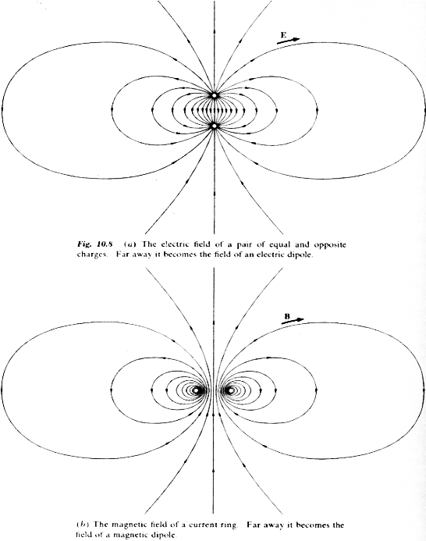
E-field around
electric dipole
B-field around
magnetic dipole
(current loop)
From Purcell,
Electricity and Magnetism
Notes:
CORRECT ANSWER: B
USED IN: Fall 2008 (Dubson)
LECTURE NUMBER: Dubson (Week 12, Lecture 31) (L 38 in ‘13)
STUDENT RESPONSES:
INSTRUCTOR NOTES:
WRITTEN BY: Mike Dubson (CU-Boulder)
It’s nice to point out some of the features of “physical” dipoles, to contrast with the “ideal” formula and figure. Students are still wrestling with what “very far away” means, and how accurate our expansion is, I think there is still some fundamental discomfort about multipole (or any other kind) of expansion in which we drop terms.
22

Slide 23
Writing assignment
On paper (don’t forget your name!) in your own words (by yourself):
What is the idea behind the magnetic vector potential?
What does it accomplish, why might we care about it?
In what ways is it like (or NOT like!) the electric potential?
Notes:
CORRECT ANSWER: n/a
USED IN: Spring 2008 (Pollock)
LECTURE NUMBER: 37
STUDENT RESPONSES: n/a
INSTRUCTOR NOTES: Done in 5 minute writing assignment at the end of class.
WRITTEN BY: Steven Pollock (CU-Boulder)

Slide 24
MD12-6
In the plane of a magnetic dipole, with magnetic moment m (out), the vector potential A looks like kinda like this
with A ~ 1/r²
At point x, which way
does curl(A) point?
Right
Left
In
Out
Curl is zero
x
Notes:
CORRECT ANSWER: C
USED IN: Fall 2008 (Dubson)
LECTURE NUMBER: Dubson (Week 12, Lecture 32)
STUDENT RESPONSES: 0% 2% [[46%]] 51% 0%
INSTRUCTOR NOTES:
WRITTEN BY: Mike Dubson (CU-Boulder)
24

Slide 25
MD12-5
Two magnetic dipoles m1 and m2 (equal in magnitude) are oriented in three different ways.
m1
m2
Which ways produce a dipole field at large distances?
None of these
All three
1 only
1 and 2 only
1 and 3 only
1.
2.
3.
Notes:
CORRECT ANSWER: E
USED IN: Fall 2008 (Dubson), Sp ‘13 (Pollock)
LECTURE NUMBER: Dubson (Week 12, Lecture 31) (LECT 38 IN ‘13)
STUDENT RESPONSES: 0% 10% 12% 2% [[76%]] (FALL 2008)
0, 2, 30, 7, [[61]] (SP ‘13)
INSTRUCTOR NOTES: It’s a nice little question. Here we can talk about the analogy with electric dipoles again: dipole moments add as vectors, so Fig 1 and 3 results in a non-zero sum, and 2 results in a zero sum. (You have to assume m1=m2, I just added it after class) Students weren’t sure about what the outcome of “2” is (it’s a magnetic quadrupole, it’s definitely NOT zero, but has no dipole term). Another student was puzzling about whether 3 would be CALLED a dipole when it pretty obviously is not PURE dipole. (Fair question, it’s terminology, I say yes, at large distances any higher order terms are non-zero but negligible, so 1 and 3 ARE dipole patterns far away) We also talked about the fact that 3 results in a Sqrt[2] rather than 2 enhancement, and that the pattern is “tilted” but still dipole in nature.
WRITTEN BY: Mike Dubson (CU-Boulder)
25

Slide 26
The force on a segment of wire L is
MD12-7
A current-carrying wire loop is in a constant
magnetic field B = B z_hat as shown.
What is the direction of the torque on the loop?
A) Zero B) +x C) +y D) +z
E) None of these
z
I(out)
B
B
y
I(in)
z
x
I
y
Notes:
CORRECT ANSWER: B
USED IN: Fall 2008 (Dubson), Fall 2009 (Schibli), SP ‘13 Pollock
LECTURE NUMBER: Dubson (Week 12, Lecture 32) Pollock (Week 12 Lecture 38)
STUDENT RESPONSES: 5% [[90%]] 3% 0% 3% (FALL 2008)
11% [[68%]] 5% 5% 11% (FALL 2009)
17, [[70]], 7, 4, 2 (Sp ’13)
INSTRUCTOR NOTES: I was surprised that students are still struggling with a variety of aspects. One which I anticipated and explained before starting the vote was what the “direction of torque” means, it is r cross F, so if e.g. you “twist” a loop around the +x axis, then we say the torque is in the +x direction. (Following a right-handed sense convention). They got that, but many did not know it!?
Students were not drawing a picture, they were trying to do it all in their heads (and with right hands)
I used this example to *show* that torque = m cross B in this situation, setting up the next question.
WRITTEN BY: Mike Dubson (CU-Boulder)
26

Slide 27
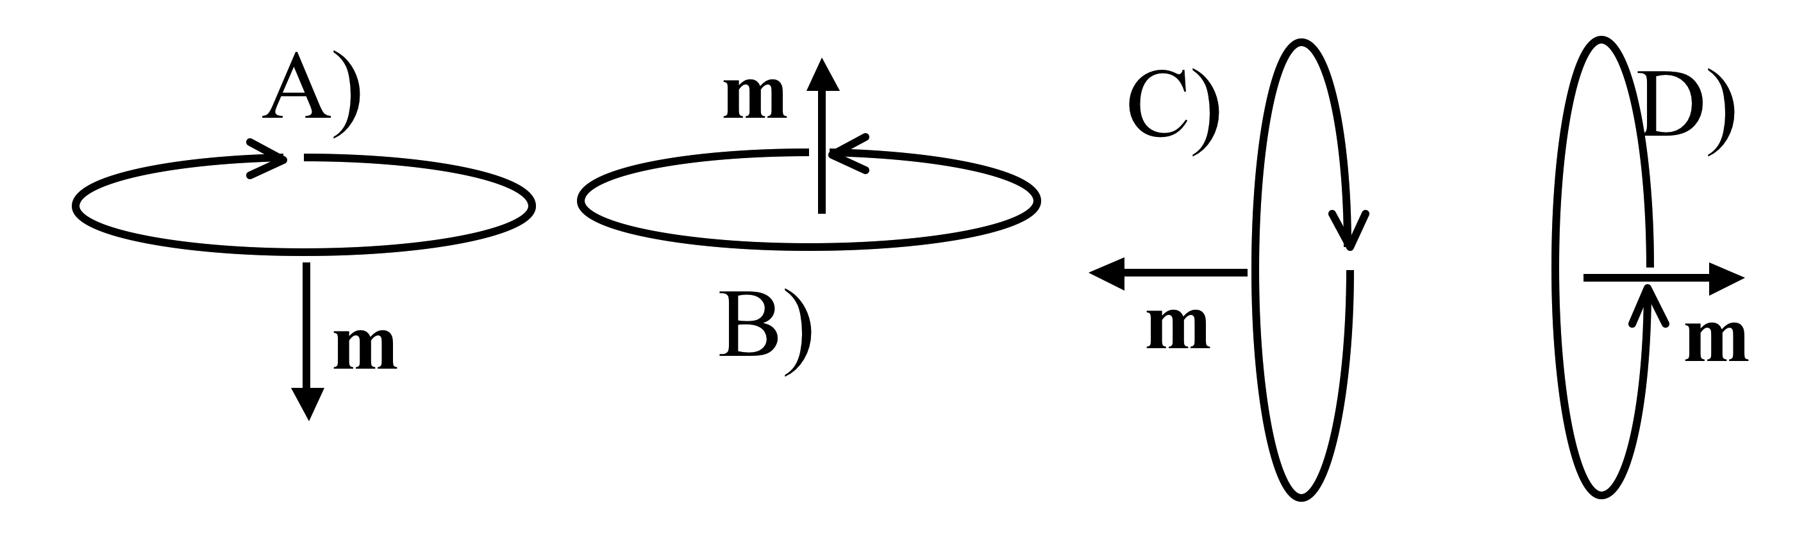
Griffiths argues that the torque on a magnetic dipole in a B field is:
6.1
How will a small current loop line up if the B field points uniformly up the page?
Notes:
CORRECT ANSWER: B
USED IN: Fall 2008 (Dubson), Spring 2008 and ‘13 (Pollock), Fall 2009 (Schibli)
LECTURE NUMBER: Dubson (Week 12, Lecture 32), Pollock (37)
STUDENT RESPONSES: 0% [[100%]] 0% 0% 0% (FALL 08)
0% [[87%]] 0% 13% 0% (SPRING 08)
3% [[95%]] 3% 0% 0% (FALL 2009)
2, [[93]], 2, 0, 2 (Sp ’13)
INSTRUCTOR NOTES: 87% correct. 2 voted for D. I pointed out to them to think about it in two ways - by the torque formula, but also thinking about I L cross B for pieces of a tilted loop. (And, we discussed the "metastability" of answer A, which several students raised) -SJP
WRITTEN BY: Steven Pollock (CU-Boulder)

Slide 28
Griffiths argues that the force on a magnetic dipole in a B field is:
6.2
If the dipole m points in the z direction, what can you say about B if I tell you the force is in the x direction?
B simply points in the x direction
B) Bz must depend on x
C) Bz must depend on z
D) Bx must depend on x
E) Bx must depend on z
Notes:
CORRECT ANSWER: B
USED IN: Spring 2008 and ‘13 (Pollock)
LECTURE NUMBER: 37 (38 in ‘13)
STUDENT RESPONSES: 7% [[67%]] 13% 7% 7% (SPRING 2008)
0, [[80]], 7, 4, 9 (Sp ‘13)
INSTRUCTOR NOTES: Only 2/3 got this one right! Lot of confusion on many of their parts about how to think about this conceptuallly? Note that it's basically identical to an earlier question we had about electric dipoles. Answer: B. m dot B will be m Bz, so if the force has only an x component, then Bz must depend (only!) on X.
In ‘13 it went more smoothly, not sure why. I had set up the picture on the board more clearly to start them off. Someone pointed out that if F is in x, then we can make STRONGER statements than these, e.g. Bz must NOT depend on y or z)
-SJP
WRITTEN BY: Steven Pollock (CU-Boulder)

Slide 29
(See Chapter 6 concept tests for force and torque on dipole questions. )
Notes:
29

Slide 30
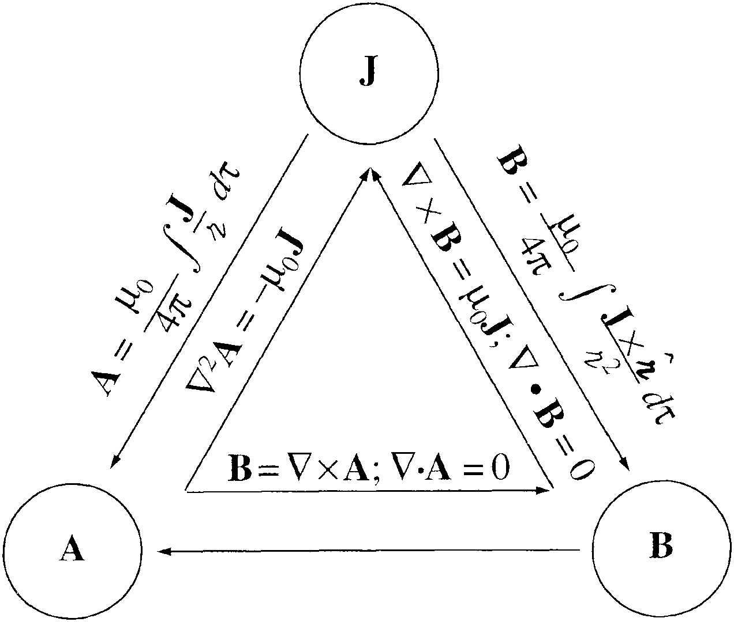
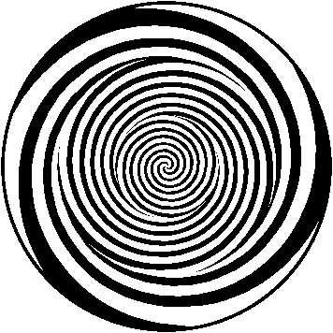
Notes:
CORRECT ANSWER:
USED IN: Fall 2009 (Schibli)
LECTURE NUMBER:
STUDENT RESPONSES:
INSTRUCTOR NOTES: Griffiths triangle in brainwash configuration... Click for hypnotic animation
WRITTEN BY: Thomas Schibli (CU-Boulder)
30

