Slide 1
MAGNETIZATION+DIPOLES
Notes:
WRITTEN BY: Steven Pollock (CU-Boulder)

Slide 2
Class Activities: Magnetization (1)

Slide 3
Class Activities: Magnetization (2)

Slide 4
The leading term in the vector potential multipole expansion involves
What is the magnitude of this integral?
5.30
A) R
B) 2 π R
0
D) Something entirely different/it depends!
Notes:
CORRECT ANSWER: C
USED IN: Spring 2008 (Pollock)
LECTURE NUMBER: 36 (38 in ‘13)
STUDENT RESPONSES: 0% 37% [[58%]] 5% 0% (Sp ’08)
2, 32, [57]], 9, 0 (Sp ‘13)
INSTRUCTOR NOTES:
Good one! I had set this up on the board, doing the formal expansion (making it look “parallel” to the old voltage derivation) and got to this, the monopole term.
Correct answer is C, the vector nature of dl’ means that adding them over a loop gives you zero. (One student argued you could “pair up opposite dl’s” as you go around half the loop, that’s a nice way to see it) And of course, if this was NOT zero, it would lead to a monopole potential for A, which is not physical. -SJP
In ‘13 a student was puzzling over why this integral is always zero, yet the integral of B dot dl is NOT always zero. It was nice to compare/contrast this vector integral with that scalar integral. (And I pointed out that if B was uniform, then the integral of B dot dl WOULD come out zero!)
WRITTEN BY: Steven Pollock (CU-Boulder)

Slide 5
MD12-5
Two magnetic dipoles m1 and m2 (equal in magnitude) are oriented in three different ways.
m1
m2
Which ways produce a dipole field at large distances?
None of these
All three
1 only
1 and 2 only
1 and 3 only
1.
2.
3.
Notes:
CORRECT ANSWER: E
USED IN: Fall 2008 (Dubson), Sp ‘13 (Pollock)
LECTURE NUMBER: Dubson (Week 12, Lecture 31) (LECT 38 IN ‘13)
STUDENT RESPONSES: 0% 10% 12% 2% [[76%]] (FALL 2008)
0, 2, 30, 7, [[61]] (SP ‘13)
INSTRUCTOR NOTES: It’s a nice little question. Here we can talk about the analogy with electric dipoles again: dipole moments add as vectors, so Fig 1 and 3 results in a non-zero sum, and 2 results in a zero sum. (You have to assume m1=m2, I just added it after class) Students weren’t sure about what the outcome of “2” is (it’s a magnetic quadrupole, it’s definitely NOT zero, but has no dipole term). Another student was puzzling about whether 3 would be CALLED a dipole when it pretty obviously is not PURE dipole. (Fair question, it’s terminology, I say yes, at large distances any higher order terms are non-zero but negligible, so 1 and 3 ARE dipole patterns far away) We also talked about the fact that 3 results in a Sqrt[2] rather than 2 enhancement, and that the pattern is “tilted” but still dipole in nature.
WRITTEN BY: Mike Dubson (CU-Boulder)
5

Slide 6
The force on a segment of wire L is
MD12-7
A current-carrying wire loop is in a constant
magnetic field B = B z_hat as shown.
What is the direction of the torque on the loop?
A) Zero B) +x C) +y D) +z
E) None of these
z
I(out)
B
B
y
I(in)
z
x
I
y
Notes:
CORRECT ANSWER: B
USED IN: Fall 2008 (Dubson), Fall 2009 (Schibli), SP ‘13 Pollock
LECTURE NUMBER: Dubson (Week 12, Lecture 32) Pollock (Week 12 Lecture 38)
STUDENT RESPONSES: 5% [[90%]] 3% 0% 3% (FALL 2008)
11% [[68%]] 5% 5% 11% (FALL 2009)
17, [[70]], 7, 4, 2 (Sp ’13)
INSTRUCTOR NOTES: I was surprised that students are still struggling with a variety of aspects. One which I anticipated and explained before starting the vote was what the “direction of torque” means, it is r cross F, so if e.g. you “twist” a loop around the +x axis, then we say the torque is in the +x direction. (Following a right-handed sense convention). They got that, but many did not know it!?
Students were not drawing a picture, they were trying to do it all in their heads (and with right hands)
I used this example to *show* that torque = m cross B in this situation, setting up the next question.
WRITTEN BY: Mike Dubson (CU-Boulder)
6

Slide 7
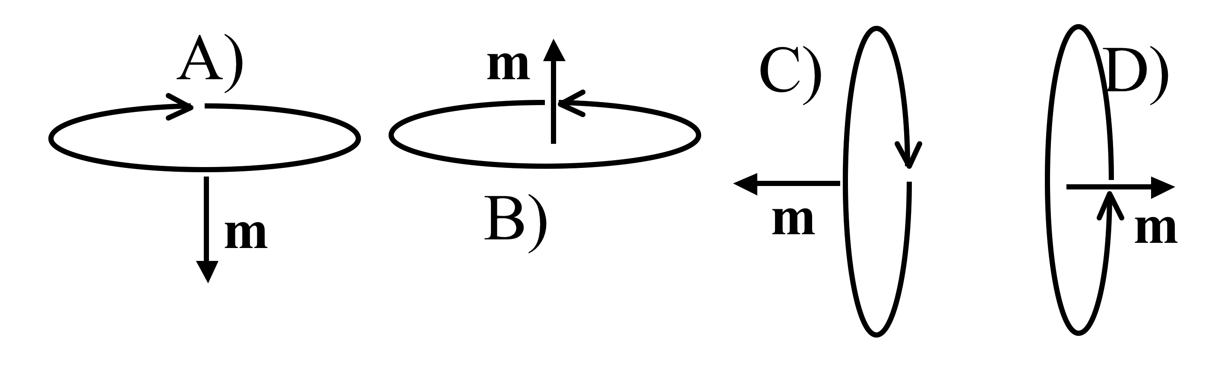
Griffiths argues that the torque on a magnetic dipole in a B field is:
6.1
How will a small current loop line up if the B field points uniformly up the page?
Notes:
CORRECT ANSWER: B
USED IN: Fall 2008 (Dubson), Spring 2008 and ‘13 (Pollock), Fall 2009 (Schibli)
LECTURE NUMBER: Dubson (Week 12, Lecture 32), Pollock (37)
STUDENT RESPONSES: 0% [[100%]] 0% 0% 0% (FALL 08)
0% [[87%]] 0% 13% 0% (SPRING 08)
3% [[95%]] 3% 0% 0% (FALL 2009)
2, [[93]], 2, 0, 2 (Sp ’13)
INSTRUCTOR NOTES: 87% correct. 2 voted for D. I pointed out to them to think about it in two ways - by the torque formula, but also thinking about I L cross B for pieces of a tilted loop. (And, we discussed the "metastability" of answer A, which several students raised) -SJP
WRITTEN BY: Steven Pollock (CU-Boulder)

Slide 8
Griffiths argues that the force on a magnetic dipole in a B field is:
6.2
If the dipole m points in the z direction, what can you say about B if I tell you the force is in the x direction?
B simply points in the x direction
B) Bz must depend on x
C) Bz must depend on z
D) Bx must depend on x
E) Bx must depend on z
Notes:
CORRECT ANSWER: B
USED IN: Spring 2008 and ‘13 (Pollock)
LECTURE NUMBER: 37 (38 in ‘13)
STUDENT RESPONSES: 7% [[67%]] 13% 7% 7% (SPRING 2008)
0, [[80]], 7, 4, 9 (Sp ‘13)
INSTRUCTOR NOTES: Only 2/3 got this one right! Lot of confusion on many of their parts about how to think about this conceptuallly? Note that it's basically identical to an earlier question we had about electric dipoles. Answer: B. m dot B will be m Bz, so if the force has only an x component, then Bz must depend (only!) on X.
In ‘13 it went more smoothly, not sure why. I had set up the picture on the board more clearly to start them off. Someone pointed out that if F is in x, then we can make STRONGER statements than these, e.g. Bz must NOT depend on y or z)
-SJP
WRITTEN BY: Steven Pollock (CU-Boulder)

Slide 9
(See Chapter 6 concept tests for force and torque on dipole questions. )
Notes:
9

Slide 10
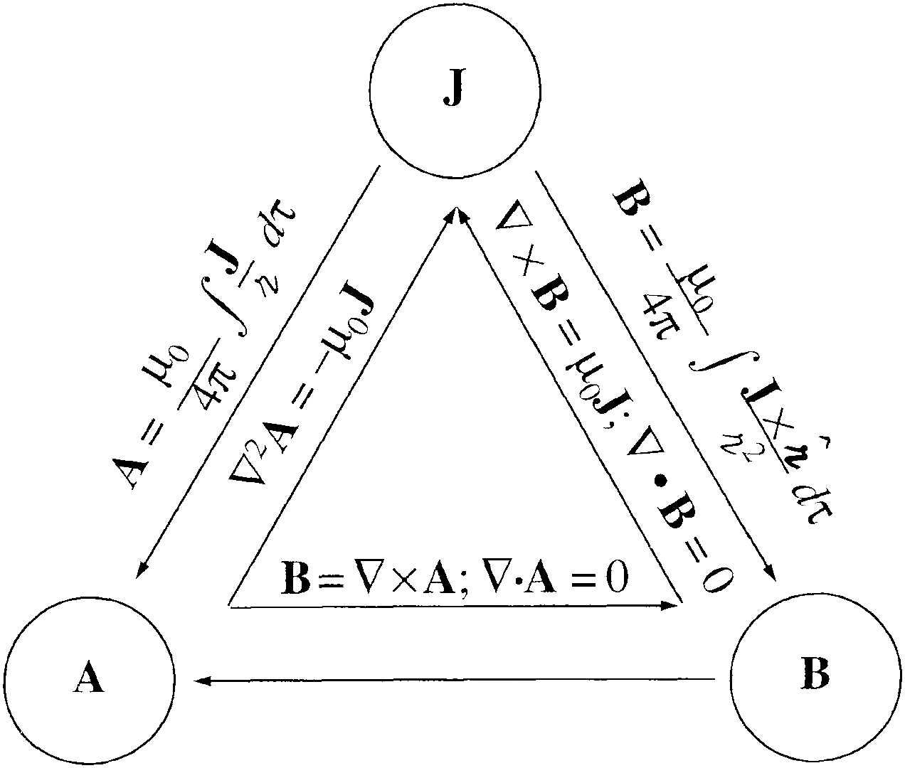
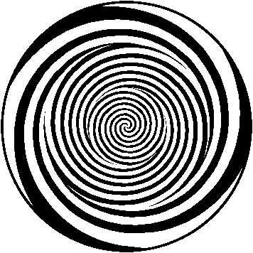
Notes:
CORRECT ANSWER:
USED IN: Fall 2009 (Schibli)
LECTURE NUMBER:
STUDENT RESPONSES:
INSTRUCTOR NOTES: Griffiths triangle in brainwash configuration... Click for hypnotic animation
WRITTEN BY: Thomas Schibli (CU-Boulder)
10

Slide 11
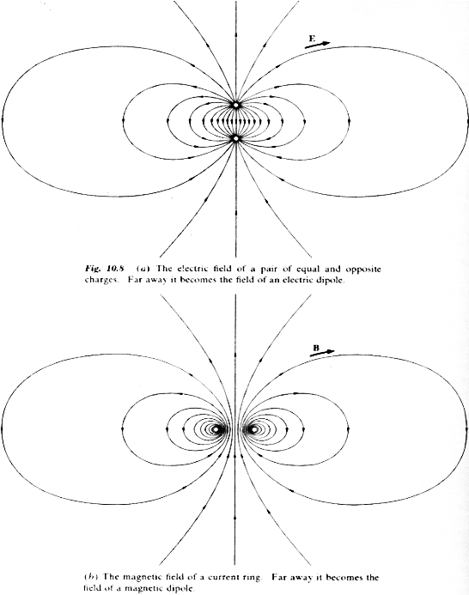
E-field around
electric dipole
B-field around
magnetic dipole
(current loop)
From Purcell,
Electricity and Magnetism
Notes:
CORRECT ANSWER: B
USED IN: Fall 2008 (Dubson)
LECTURE NUMBER: Dubson (Week 12, Lecture 31)
STUDENT RESPONSES:
INSTRUCTOR NOTES:
WRITTEN BY: Mike Dubson (CU-Boulder)
11

Slide 12
Suppose I place a small dipole M at various locations near the end of a large solenoid. At which point is the magnitude of the force on the dipole greatest?
6.2x
M
A
B
C
K
D) Not enough information to answer
E) There is no net force on a dipole
Notes:
Skipped in ‘13 for time
CORRECT ANSWER: B
USED IN: Fall 2008 (Dubson), Fall 2009 (Schibli)
LECTURE: Dubson (Week 13, Lecture 37)
STUDENT RESPONSES: 27% [[22%]] 34% 2% 15% (FALL 2008)
10% [[72%]] 10% 0% 8% (FALL 2009)
INSTRUCTOR NOTES:
WRITTEN BY: Mike Dubson (CU-Boulder)

Slide 13
Writing assignment
Coming up first today: Write down (by yourself, without book or notes or collaboration, yet!) what you remember about electric Polarization P, and all related concepts and formulas we've worked with!
Notes:
CORRECT ANSWER: n/a
USED IN: Spring 2008 (Pollock)
LECTURE NUMBER: 38
STUDENT RESPONSES: n/a
INSTRUCTOR NOTES: Starting activity. Followed this up by having them get in groups of three, and writing *on classroom blackboards* what they had - followed by presentations. (They would erase anything they had the was discussed by another group, and argue when they disagreed). Worked very well, we got a LOT of the basic Chapter 4 stuff reviewed this way. -SJP
WRITTEN BY: Steven Pollock (CU-Boulder)

Slide 14
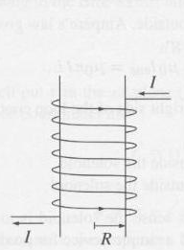
A small chunk of material (the “tan cube”) is placed above a solenoid. It magnetizes, weakly, as shown by small arrows inside.
What kind of material must the cube be?
6.7a
m
A) Dielectric
B) Conductor
C) Diamagnetic
D) Paramagnetic
E) Ferromagnetic
Notes:
CORRECT ANSWER: C
USED IN: Fall 2008 (Dubson) and Spring 2008 and 13 (Pollock)
LECTURE NUMBER: Dubson (Week 13, Lecture 37). Pollock (Lecture 38, 39 in ‘13).
STUDENT RESPONSES: 0% 0% [[95%]] 2% 2% (FALL 2008)
6% 0% [[81%]] 13% 0% (SPRING 2008)
2, 2, [[90]], 4, 2 (Sp ‘13) This was “preclass”, but I pretty much had the answer up on the board.
INSTRUCTOR NOTES: 80% correct, this is quick and easy, just a review of notation from last time, but I wanted it as a lead-in to next one. -SJP
WRITTEN BY: Steven Pollock (CU-Boulder). Figure from Griffiths.

Slide 15
Predict the results of the following experiment: a paramagnetic bar and a diamagnetic bar are pushed inside of a solenoid.
6.7b
The paramagnet is pushed out, the diamagnet is sucked in
The diamagnet is pushed out, the paramagnet is sucked in
Both are sucked in, but with different force
Both are pushed out, but with different force
Notes:
15
CORRECT ANSWER: B
USED IN: Fall 2008 (Dubson) and Spring 2008 (Pollock), Fall 2009 (Schibli)
LECTURE NUMBER: Dubson (Week 13, Lecture 37). Pollock (Lecture 38).
STUDENT RESPONSES: 2% [[95%]] 0% 0% 2% (FALL 2008)
25% [[75%]] 0% 0% 0% (SPRING 2008)
10% [[82%]] 8% 0% 0% (FALL 2009)
20, [[80]], 0, 0, 0 (Sp ‘13)
INSTRUCTOR NOTES: 75% for B, rest for A. This is a good one, nice discussions. Answer is B. One argument is to DRAW the polarization (like in previous slide, 6.7a) and then label magnets as "N" or "S" sides. (This requires some discussion about the convention when you are looking INSIDE, one student said they were unhappy about B field lines going FROM S TO N inside, so we had to go back and discuss that). But once you're good there, you see magnets attracting or repelling. There are other arguments, including "parallel currents attract", or going back to F = grad(m dot B), noting that the B field is spreading out at the top of the solenoid). -SJP
WRITTEN BY: Steven Pollock (CU-Boulder)

Slide 16
Which type of magnetic material has the following properties:
ERK6.1
The atoms of the material have an odd number of electrons
The induced atomic magnetic dipoles align in the same direction as an applied magnetic field
Thermal energy tends to randomize the induced dipoles
Ferromagnetic
Diamagnetic
Paramagnetic
Notes:
16
Skipped in ‘13,
CORRECT ANSWER: C
USED IN: Spring 2009 (Kinney), Fall 2009 (Schibli)
LECTURE NUMBER:
STUDENT RESPONSES: 11% 3% [[87%]] 0% 0% (FALL 2009)
INSTRUCTOR NOTES: Reading Question
WRITTEN BY: Ed Kinney (CU-Boulder)
Skipped in ‘2013.

