Slide 1
PH300 Modern Physics SP11
“I will never believe that god plays dice with the universe.”
- Albert Einstein
3/8 Day 15:
Questions?
Repeated spin measurements
Probability
Thursday:
Entanglement
Quantum Physics & Reality
Quantum Cryptography

Slide 2
Last Week:
Balmer formula, atomic spectra
Bohr model, de Broglie waves
Stern-Gerlach experiments
Today:
Repeated spin measurements
Probability
Thursday:
Reading on Blackboard before class
Entanglement/EPR “paradox”
Quantum physics and reality

Slide 3
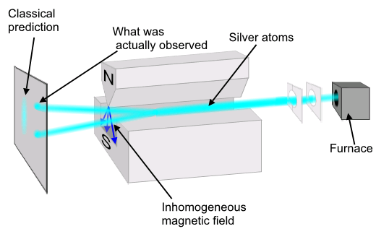
Stern-Gerlach Experiment with Silver Atoms (1922)*
*Nobel Prize for Stern in 1943
Notes:
What is actually observed is that all atoms experience the maximum deflection, either up or down along the direction of the magnetic field, no matter the orientation of the apparatus. The value of the projection along any axis is found to always be an integer multiple of the Bohr magneton, m_{B} = 9.27 x 10⁻²⁴ joule/tesla (e.g. for silver, the observed values are +m_{B} and –m_{B}; for nitrogen they are +3m_{B}, +m_{B}, -m_{B}, and -3m_{B}). Simplest case with a two-state system like silver atoms, as were used in the original Stern-Gerlach experiment; will speak from here on out only in terms of “atoms” having spin “plus” (+m_{B}) or “minus” (-m_{B}) along any given axis.

Slide 4
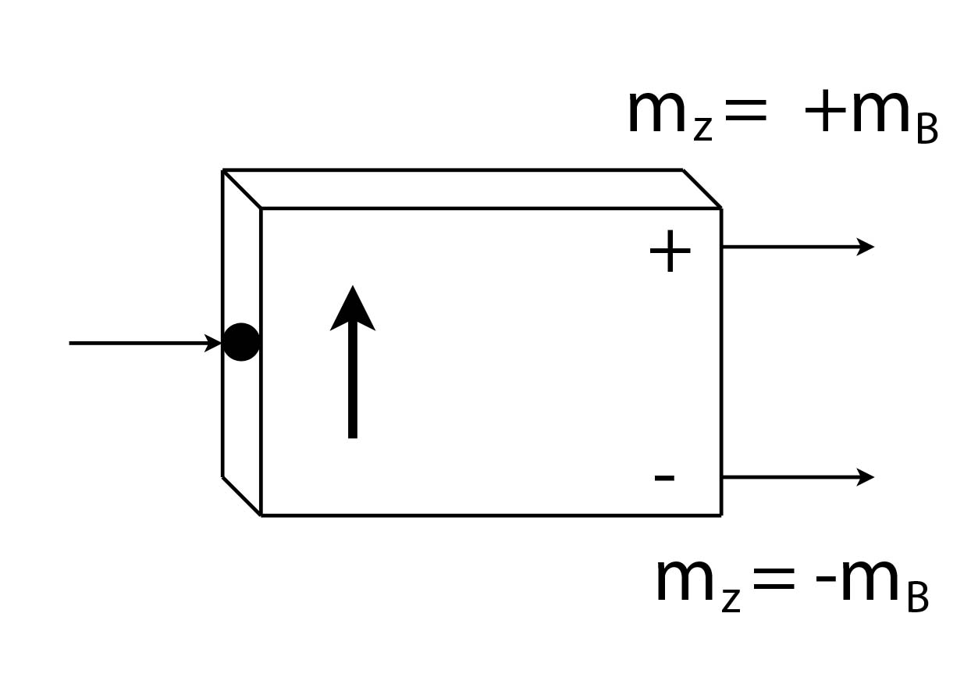
In the future…
Some atoms have more than two possible projections of the magnetic moment vector along a given axis, but we will only deal with “two-state” systems when talking about atomic spin.
When we say a particle is measured as “spin up” (or down) along a given axis, we are saying that we measured the projection of the magnetic moment along that axis (+m_{B} or -m_{B}), and observed it exiting the plus-channel (minus-channel) of a Stern-Gerlach type apparatus.
A simplified
Stern-Gerlach analyzer:

Slide 5
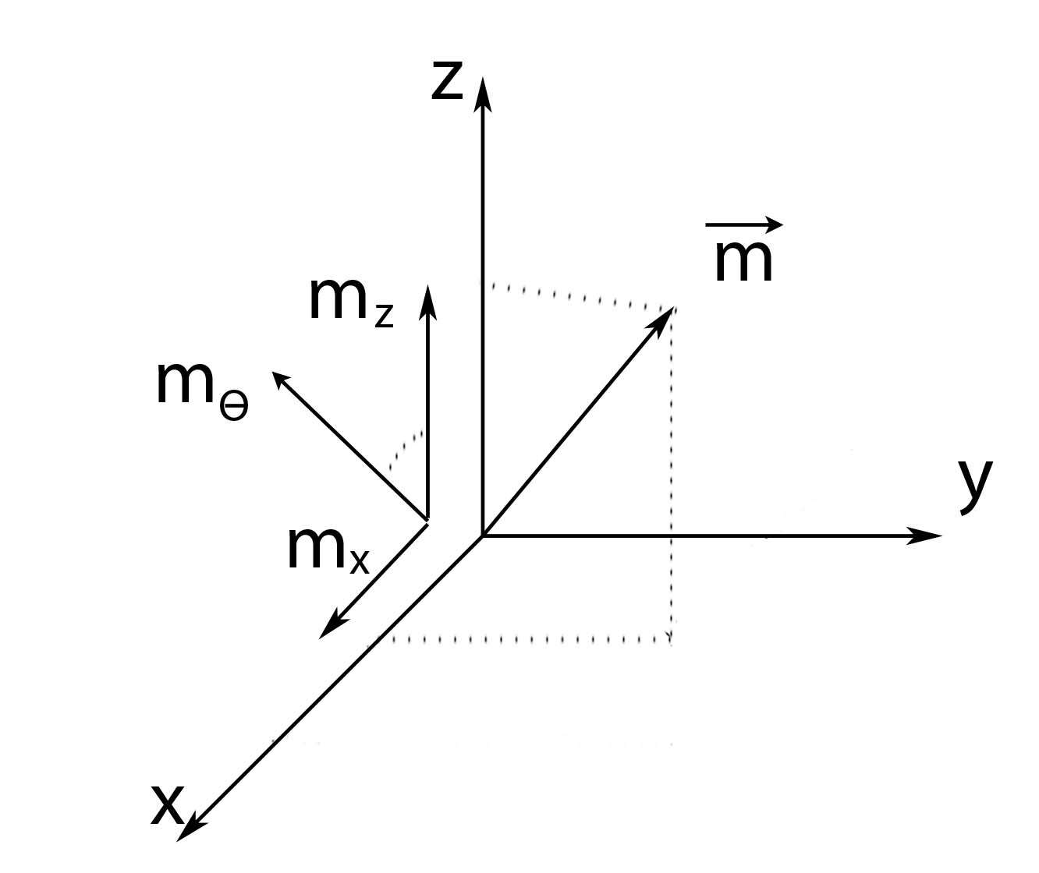
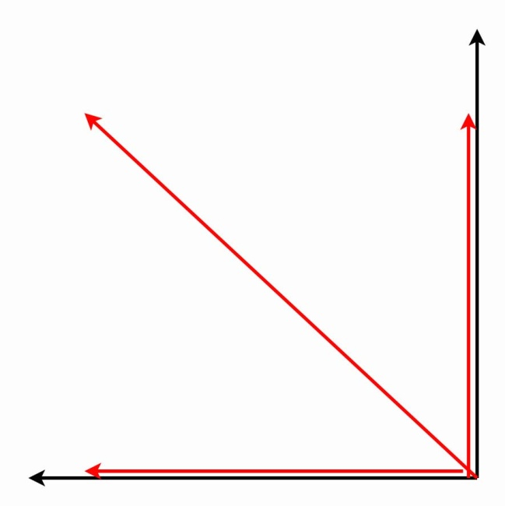
Notation for projection values:
Θ
Head-on view
Notes:
We said we could measure m along any axis we want, so let’s have some notation for the component of the magnetic moment vector we are measuring. A measurement along the +z-axis tells us about m_{Z}; similarly, a measurement along the +x-axis tells us about m_{X}; a measurement along some arbitrary angle theta (measured relative to the z-axis) gives us the value of m_{Θ}. Remember, no matter what axis we choose, we only get one of two possible values: +m_{B} or –m_{B}.

Slide 6
A simplified Stern-Gerlach analyzer:
However the analyzer is oriented, we always measure
one of two values: spin-up (+m_{B}) or spin-down (-m_{B}).
Notes:
Instead of drawing all the intricate parts of a real Stern-Gerlach analyzer, let’s introduce this simplified version. The arrow coming in represents the incoming beam of atoms; the arrow on the device indicates the direction of the magnetic field; atoms are guided into either the plus-channel (m_{Z} = +m_{B}) or the minus-channel (m_{Z} = -m_{B}), depending upon the value of the projection of the magnetic moment vector onto the magnetic field.

Slide 7
A simplified Stern-Gerlach analyzer:
If the analyzer is oriented along the +z-direction:
Notes:
Instead of drawing all the intricate parts of a real Stern-Gerlach analyzer, let’s introduce this simplified version. The arrow coming in represents the incoming beam of atoms; the arrow on the device indicates the direction of the magnetic field; atoms are guided into either the plus-channel (m_{Z} = +m_{B}) or the minus-channel (m_{Z} = -m_{B}), depending upon the value of the projection of the magnetic moment vector onto the magnetic field.

Slide 8
A simplified Stern-Gerlach analyzer:
If the analyzer is oriented along the θ-direction:
Notes:
Instead of drawing all the intricate parts of a real Stern-Gerlach analyzer, let’s introduce this simplified version. The arrow coming in represents the incoming beam of atoms; the arrow on the device indicates the direction of the magnetic field; atoms are guided into either the plus-channel (m_{Z} = +m_{B}) or the minus-channel (m_{Z} = -m_{B}), depending upon the value of the projection of the magnetic moment vector onto the magnetic field.

Slide 9
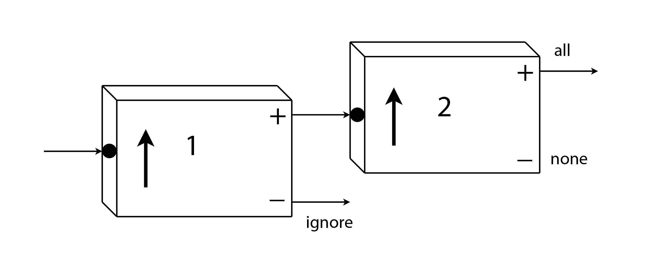
Repeated spin measurements:
???
Ignore the atoms exiting from the minus-channel of Analyzer 1,
and feed the atoms exiting from the plus-channel into Analyzer 2.
All of the atoms also leave from the plus-channel of Analyzer 2.

Slide 10
State Preparation
The atoms leaving the plus-channel of vertical Analyzer 1 were
all in the state
We confirmed this when all these atoms also leave the plus-channel
of vertical Analyzer 2. We can repeat this as often as we like…
All of these atoms were in the definite state
Bracket Notation
We’ll place any information we have about a quantum state inside a bracket: = “Psi” is a generic symbol for a quantum state
For the atoms leaving the plus-channel of Analyzer 1 we write:
OR

Slide 11
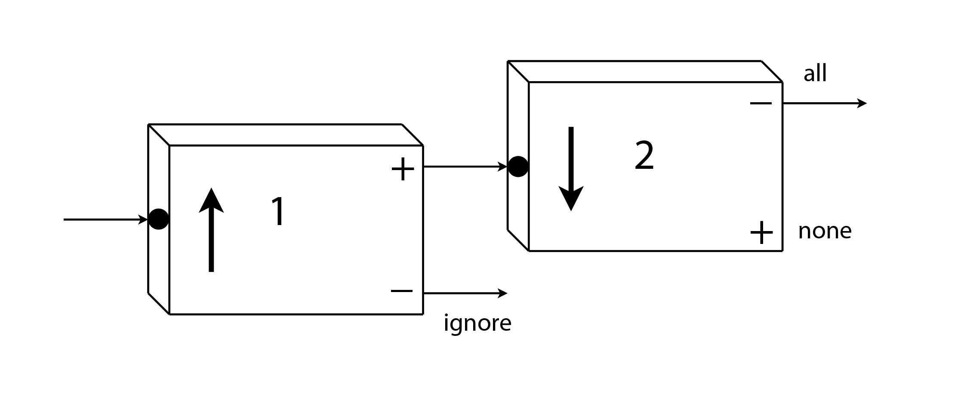
Analyzer 2 is now oriented downward:
???
Ignore the atoms exiting from the minus-channel of Analyzer 1,
and feed the atoms exiting from the plus-channel into Analyzer 2.
What happens when these atoms enter Analyzer 2?
They all exit from the plus-channel.
They all exit from the minus-channel.
Notes:
Concept Test

Slide 12
Analyzer 2 is now oriented downward:
All the atoms leave from the minus-channel of Analyzer 2.
Remember, with Analyzer 2 we are now measuring m_{(-Z)}
An atom in the state is also in the state
Notes:
Concept Test

Slide 13
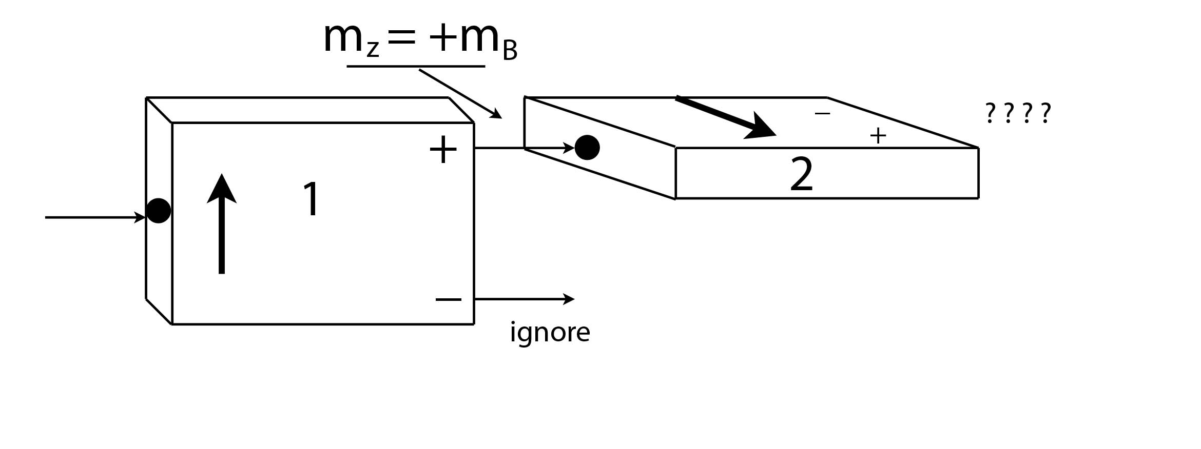
Analyzer 2 is now oriented horizontally (+x):
???
Ignore the atoms exiting from the minus-channel of Analyzer 1,
and feed the atoms exiting from the plus-channel into Analyzer 2.
What happens when these atoms enter Analyzer 2?
They all exit from the plus-channel.
They all exit from the minus-channel.
Half leave from the plus-channel, half from the minus-channel.
Nothing, the atoms’ magnetic moments have zero projection along the +x-direction
Notes:
Concept Test

Slide 14
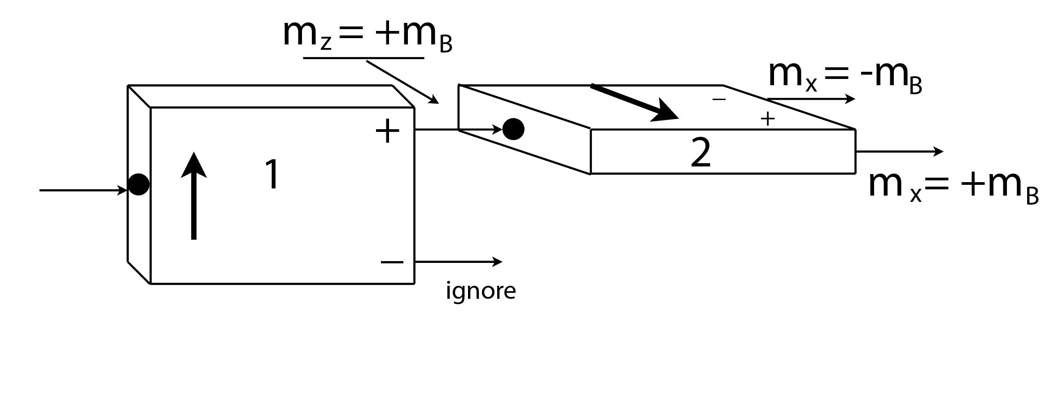
Analyzer 2 is now oriented horizontally (+x):
50%
50%
Half the atoms leave from the plus-channel of Analyzer 2,
and half leave from the minus-channel.
Remember, we always get one of two values (“plus” or “minus”),
regardless of how the analyzer is oriented, and regardless
of what state the atom is in when it enters Analyzer 2.

Slide 15
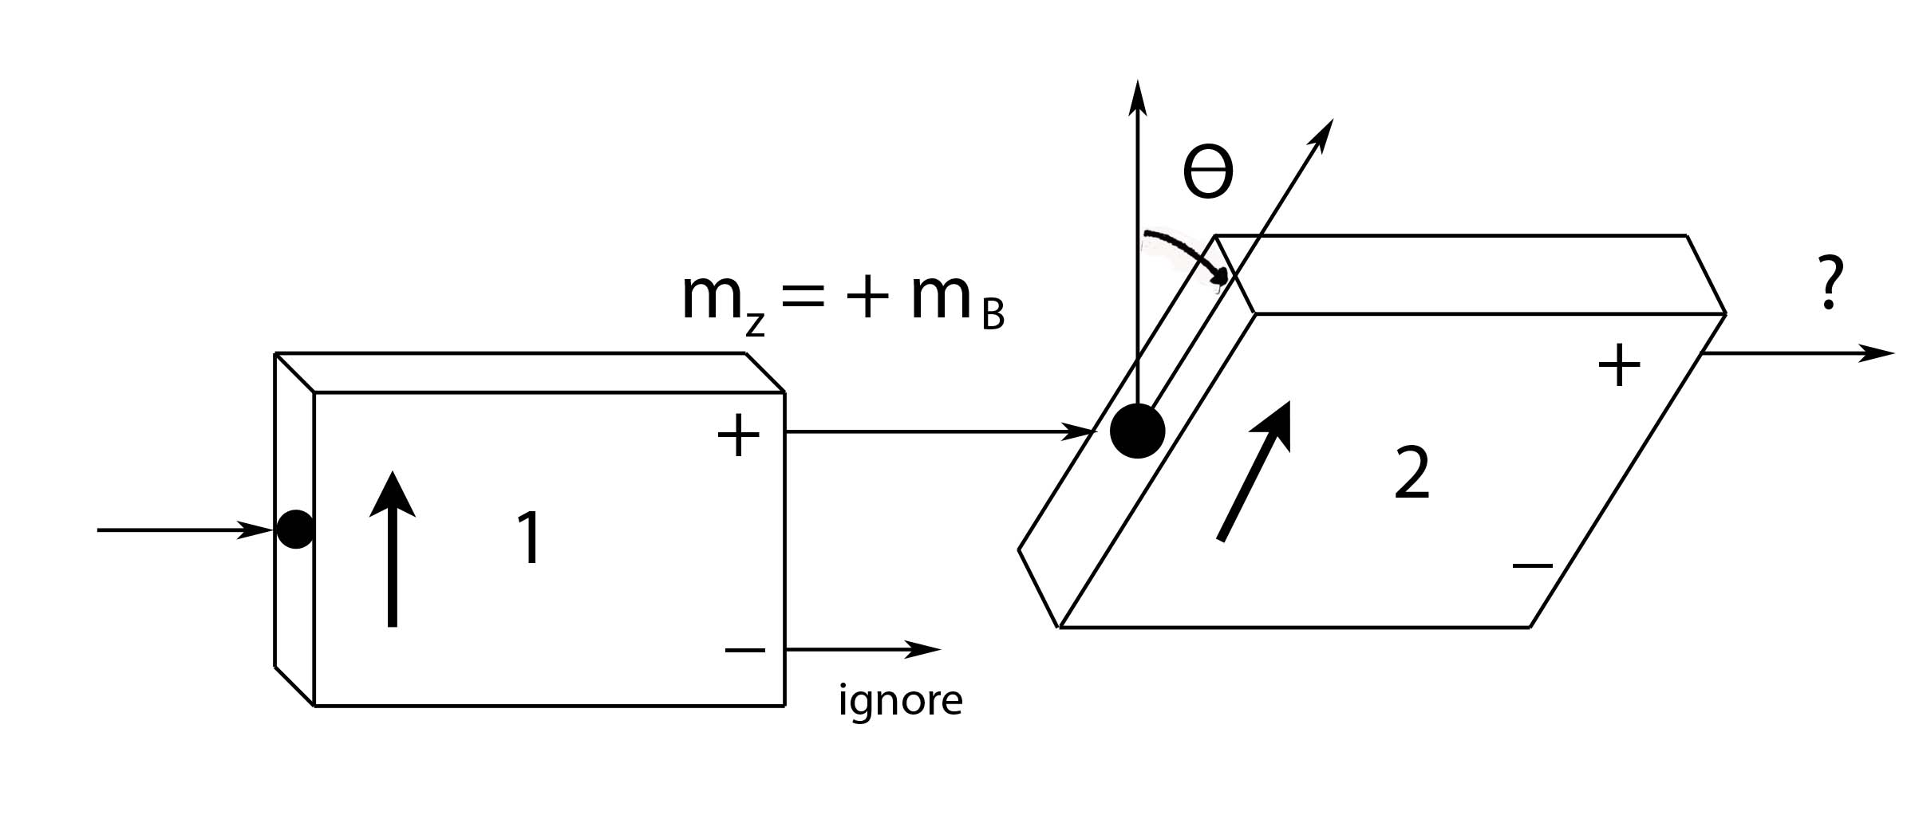
Analyzer 2 is oriented at an angle Θ:
Ignore the atoms exiting from the minus-channel of Analyzer 1, and feed the atoms exiting from the plus-channel into Analyzer 2.
What is the probability for an atom to exit from the plus-channel
of Analyzer 2?

Slide 16
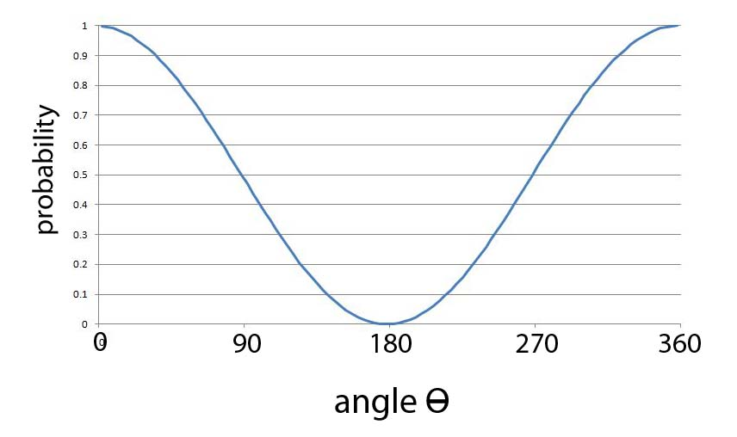
For atoms entering in the state
X
X
X
For Θ = 0, 100% of the atoms exit from the plus-channel.
For Θ = 90⁰, 50% of the atoms exit from the plus-channel.
For Θ = 180⁰, 0% of the atoms exit from the plus-channel.

Slide 17
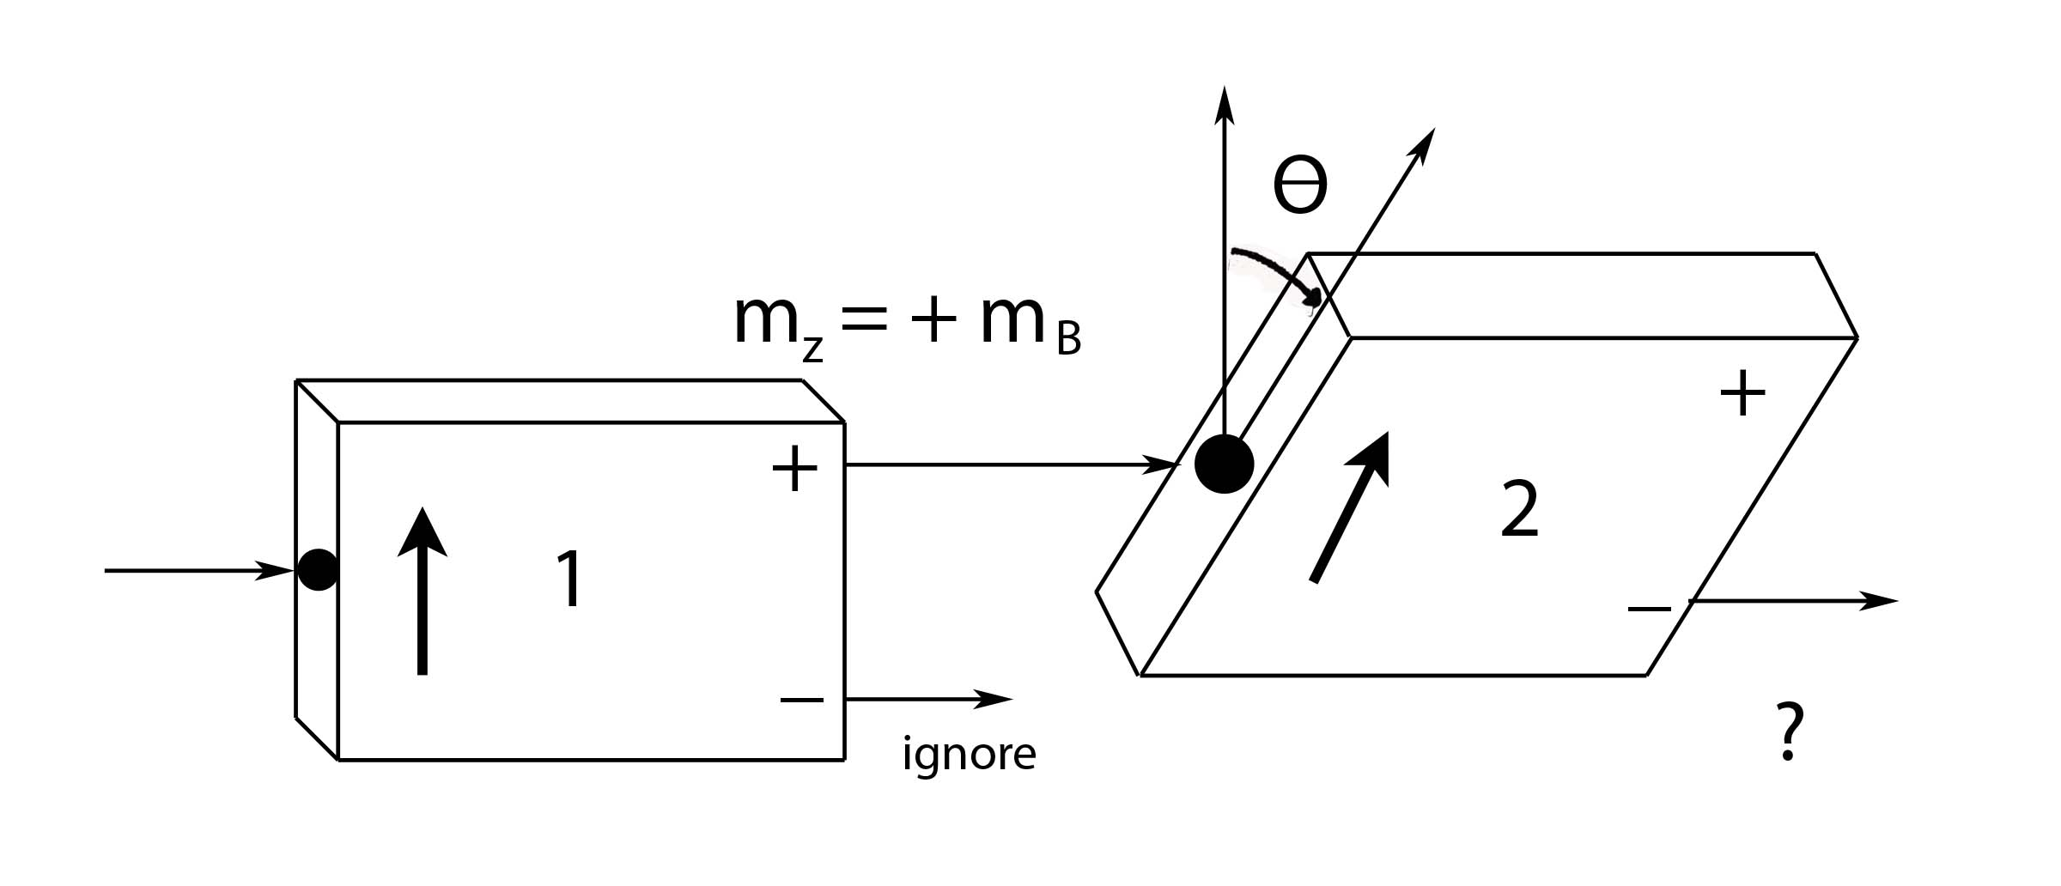
What is the probability of leaving from the minus-channel?
Hint:
Notes:
There are only two possibilities, so the probabilities for both must add up to one (unity). Therefore, the probability of leaving from the minus-channel is sin2(theta/2).

Slide 18
Repeated spin measurements:
Ignore the atoms exiting from the minus-channel of Analyzer 1,
and feed the atoms exiting from the plus-channel into Analyzer 2.
Ignore the atoms exiting from the minus-channel of Analyzer 2,
and feed the atoms exiting from the plus-channel into Analyzer 3.
What happens when these atoms enter Analyzer 3?
They all exit from the plus-channel.
They all exit from the minus-channel.
Half leave from the plus-channel, half from the minus-channel.
Nothing, the atoms’ magnetic moments have zero projection along the +z-direction

Slide 19
50%
50%
Half the atoms leave from the plus-channel of Analyzer 3, and half leave from the minus-channel.
Atoms leaving the plus-channel of Analyzer 1 are in the state
Atoms leaving the plus-channel of Analyzer 2 are in the state
The atoms that were in a definite state are no longer in a
definite state of m_{Z} after measuring m_{X}.
Measurement along the x-direction erases the information about
the projection of the atom’s magnetic moment along the z-direction.

Slide 20
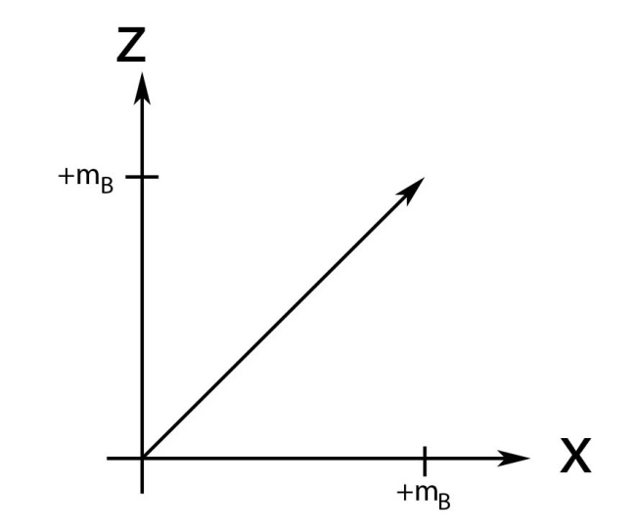
45⁰
An atom can’t have BOTH AND
since a measurement along would yield .
Measurement along any axis forces the projection of the atom’s magnetic arrow to assume one of two values (+m_{B} or -m_{B})
along that axis.
Notes:
Atoms in a definite spin state along one axis are not in a definite spin state along any other axis.

Slide 21
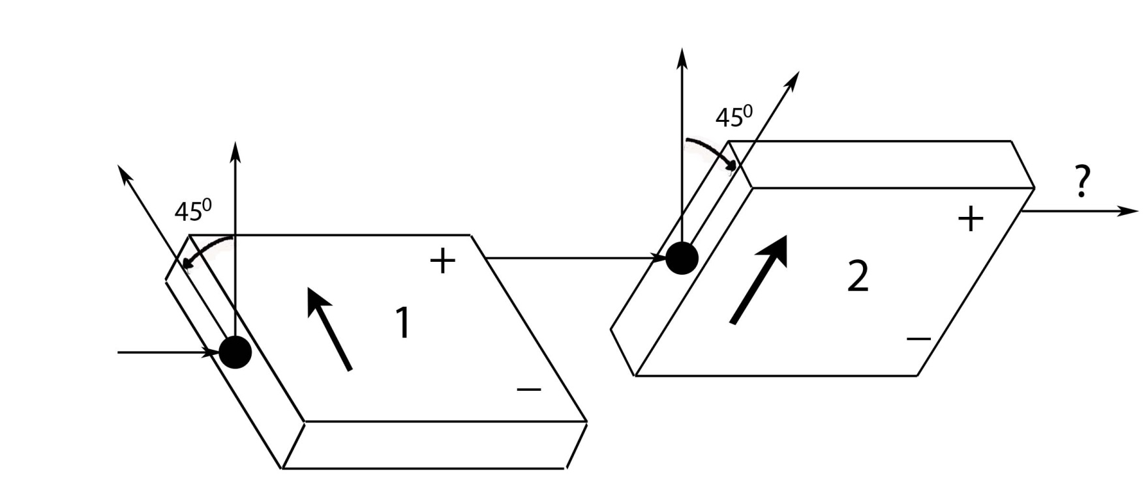
Analyzer 1 is tilted 45⁰ to the left of vertical, while Analyzer 2 is
tilted 45⁰ to the right of vertical. Atoms leaving the plus-channel
of Analyzer 1 are fed into the input of Analyzer 2. What is the
probability that an atom entering Analyzer 2 will leave through
the plus-channel?
A) 0% B) 50% C) 100% D) Something else.
Notes:
Correct Answer: (B) What matters is the relative angle between the two analyzers, which is 90⁰. The problem is identical to measuring m_{Z} and then m_{X}, with the entire apparatus rotated by 45⁰. The probability of leaving from the plus-channel is therefore 1/2.

Slide 22
30⁰
Instead of vertical, suppose Analyzer 1 makes an angle of
30⁰ from the vertical. Analyzers 2 & 3 are left unchanged.
What is the probability for an atom leaving the plus-channel
of Analyzer 2 to exit from the plus-channel of Analyzer 3?
A) 0% B) 25% C) 50% D) 75% E) 100%
Hint: Remember that
Notes:
An atom leaving the plus-channel of Analyzer B has m_{X} = +m_{B}. It doesn’t matter what state it was in when it entered Analyzer B – it could have come directly from an oven, or it could have come through a complicated set of a dozen analyzers tilted at various angles – the output state is specified completely by saying m_{X} = +m_{B}. Thus, half of the atoms entering Analyzer C will leave through the plus-channel whether Analyzer A is tilted at 30⁰, 0⁰, or any other angle.

Slide 23
60⁰
Instead of horizontal, suppose Analyzer 2 makes an angle
of 60⁰ from the vertical. Analyzers 1 & 3 are unchanged.
What is the probability for an atom leaving the plus-channel
of Analyzer 2 to exit from the plus-channel of Analyzer 3?
A) 0% B) 25% C) 50% D) 75% E) 100%
Hint: Remember that
Notes:
Atoms leaving Analyzer B are in a definite state of m₍₆₀₎ = +m_{B}. Analyzer B makes an angle of 60⁰ with Analyzer C, so these atoms have a 75% chance of leaving through the plus-channel of Analyzer C. The probability of atoms leaving through the minus-channel of Analyzer C is 25%. [Note that they must add up to 100% - unity.]

Slide 24
Questions?

Slide 25
Probability
In general, the probability for a particular outcome
is the ratio of the number of desired outcomes to
the total number of possible outcomes.
If we roll a six-sided die, what is the probability
that we obtain a 1?
There are six possible outcomes, and each one
is equally likely, so the probability is 1/6.

Slide 26
Probability
When tossing a die, what is the probability of
rolling either a 1 or a 3?
There are six possible outcomes and two desired
outcomes, meaning the probability of success is:
1/6 + 1/6 = 2/6 = 1/3.
So there is a one in three chance of rolling a 1 or a 3.
In general*, the word “OR” is a signal to add probabilities:
*Only if P1 & P2
are independent

Slide 27
Probability
Simultaneously toss a die and flip a coin. What is the
probability of getting 2 and Tails?
There is a 1/6 chance of getting a two and a 1/2
probability of getting Tails:
1/6 x 1/2 = 1/12
We could also find this by counting up the number
of possible outcomes: 12.
In general*, the word “AND” is a signal to multiply:
*Only if P1 & P2
are independent

Slide 28
Probability
Flip a coin three times. What is the probability of
obtaining Heads twice?
1/4
3/8
1/2
5/8
3/4
Notes:
Correct answer is (C)

Slide 29
Probability
Flip a coin three times. What is the probability of
obtaining Heads twice?
OUTCOME | PROBABILITY | # OF HEADS
HHH | 1/8 | 3
HHT | 1/8 | 2
HTH | 1/8 | 2
THH | 1/8 | 2
HTT | 1/8 | 1
THT | 1/8 | 1
TTH | 1/8 | 1
TTT | 1/8 | 0
The probability of obtaining three Heads is 1/8, of two Heads 3/8,
of one Head 3/8, and no Heads 1/8.
Note that these probabilities must add up to one – we must get
one of the four possibilities with 100% certainty.

Slide 30
Probability
Toss two dice simultaneously.
What is the probability that the sum of the results is four?
The probability for any single outcome is 1/36 = 1/6 x 1/6.
The probability that the sum result is four is:
P[2,2] + P[1,3] + P[3,1].
The probability for each of these outcomes is 1/36, so
the probability that the outcome adds to four is:
1/36 + 1/36 + 1/36 = 3/36 = 1/12

Slide 31
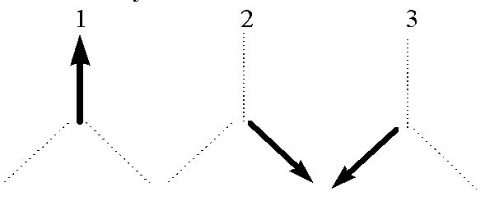
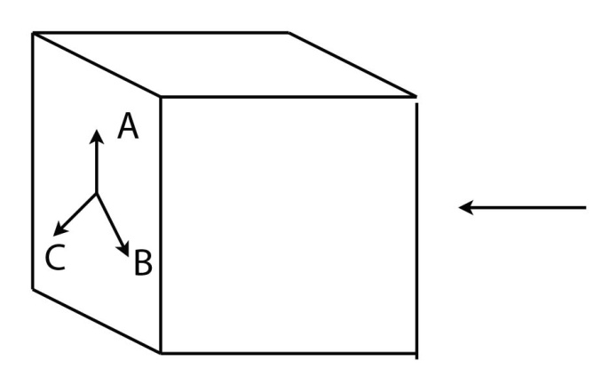
Probability
Imagine a Stern-Gerlach analyzer with three settings,
each oriented 120⁰ from the other:
A
B
C
If we send in an atom in the definite state ,
what is the probability the atom will leave
from the plus-channel if the setting on
the analyzer is random?

Slide 32
Probability
If the setting is in the +z-direction (A), then the probability
to leave through the plus-channel is 1.
For either of the two other settings (B & C), the probability
of leaving through the plus-channel is 1/4. [cos²(120⁰/2)]
If the settings are random, then there is 1/3 probability
that the analyzer is set to a specific orientation.
?
?
?
The probability of leaving through the plus-channel is:
[1/3 x 1] + [1/3 x 1/4] + [1/3 x 1/4]
= 4/12 + 1/12 + 1/12 = 6/12 = 1/2

Slide 33
Probability Distributions
There are two types of probability distributions:
Discrete
Continuous

Slide 34
Discrete Probability Distributions
Flip a coin five times. There are 32 possible outcomes:
 |  | HTTTH HTTHT THTTH TTHTH THTHT HTHTT TTTHH TTHHT THHTT HHTTT | THHHT THHTH HTHHT THTHH HTHTH HHTHT TTHHH HTTHH HHTTH HHHTT
 | HTTTT THTTT TTHTT TTTHT TTTTH |  |  | THHHH HTHHH HHTHH HHHTH HHHHT
TTTTT |  |  |  |  | HHHHH
5T
4T,1H
3T,2H
2T,3H
1T,4H
5H
Notes:
We can represent this outcome with a histogram, showing the number of outcomes for each possible outcome.

Slide 35
Discrete Probability Distributions
Can also represent this in
terms of the number of
Heads obtained:
The probability P[k] for obtaining a specific number of Heads (k) is found by dividing through by the total number of possible outcomes [32]:
P[k]
*
*P[k] is normalized
k = # of Heads

Slide 36
Discrete Probability Distributions
Flip a coin ten times. (Yes, actually do this!)
Record the number of times the outcome is heads.
K=# of heads | 1 | 2 | 3 | 4 | 5 | 6 | 7 | 8 | 9 | 10
# of students
How can we decide if a coin is fair (not biased)?

Slide 37
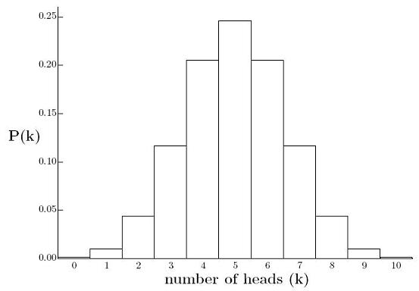
Toss a coin 10 times:
P[k]

Slide 38
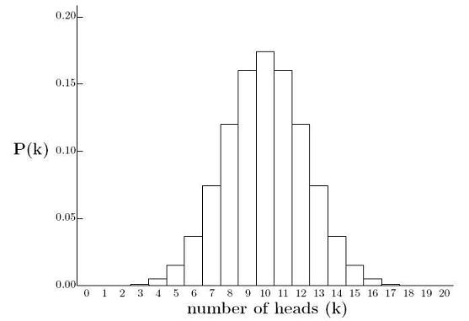
Toss a coin 20 times:
P[k]

Slide 39
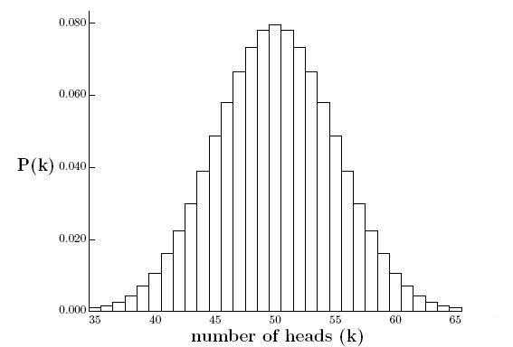
Toss a coin 100 times:
P[k]
???

Slide 40
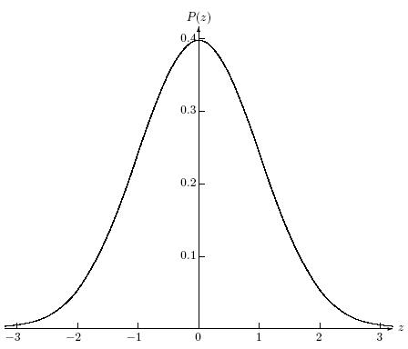
Continuous Probability Distributions
Central Limit Theorem says that, with more and more coin tosses,
the probability distribution can be described by a continuous function:
Normal distribution
(or Gaussian)
Describes large numbers of
random, independent
variables.

Slide 41
Continuous Probability Distributions
Normalization!!

Slide 42
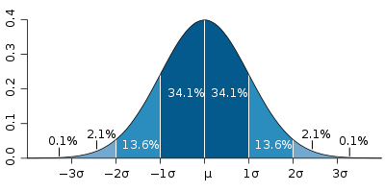
Continuous Probability Distributions

Slide 43
Continuous Probability Distributions

Slide 44
Continuous Probability Distributions

Slide 45
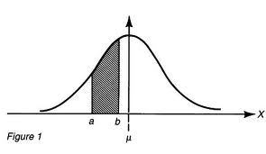
Continuous Probability Distributions
ρ(x) is a probability density (not a probability). We approximate the probability to obtain x_{i} within a range Δx with:
The probability of obtaining a range of values is equal to the area under the probability distribution curve in that range:
For (discrete values):
For continuous x:

Slide 46
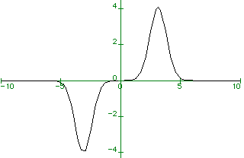
Continuous Probability Distributions
since is symmetric about x = 0
since is anti-symmetric about x = 0

Slide 47
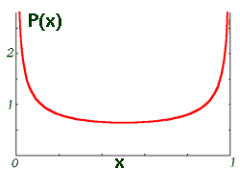
What if the probability curve is not normal?
What kind of system might
this probability distribution
describe?
0
1/2
1
Not defined, since there are two places where
x is most likely.

Slide 48
50%
50%
We always get one of two possible results: or
With Analyzer 2 oriented at 90⁰ to Analyzer 1, either result
or is equally likely.
We can’t predict ahead of time whether an atom will exit through the plus-channel or the minus-channel of Analyzer 2, only that there is a 50/50 chance for either to occur.

Slide 49
50%
50%
What would be the expectation (average) value for m_{X}?

