Slide 1
L
1
2
3
4
5
6
7
K
1
2
3
4
5
6
J
1
2
3
4
5
6
7
8
I
1
2
3
4
5
6
7
8
9
H
1
2
3
4
5
6
7
8
9
10
G
1
2
3
4
5
6
7
8
9
10
F
1
2
3
4
5
6
7
8
9
10
E
1
2
3
4
5
6
7
8
9
10
11
D
1
2
3
4
5
6
7
8
9
10
11
12
C
1
2
3
4
5
6
7
8
9
10
11
12
B
1
2
3
4
5
6
7
8
9
10
A
1
2
3
4
5
6
7
8
9
10
11
E 0046

Slide 2
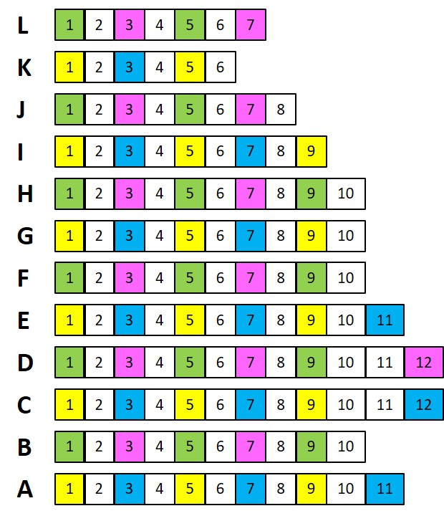
E 0046: FRONT of room
Note: The seats and rows are not numbered in this room.
TA to label seats at either end of row. It’s a small enough room that students can count seats along the row

