Slide 1
A book is lying at rest on a table. The book will remain there at rest because…
there is a net force but the book has too much inertia.
there are no forces acting on it at all.
there is no net force on the book.
there is a net force, but the book is too heavy to move.
It does move, but too slowly to be seen.

Slide 2
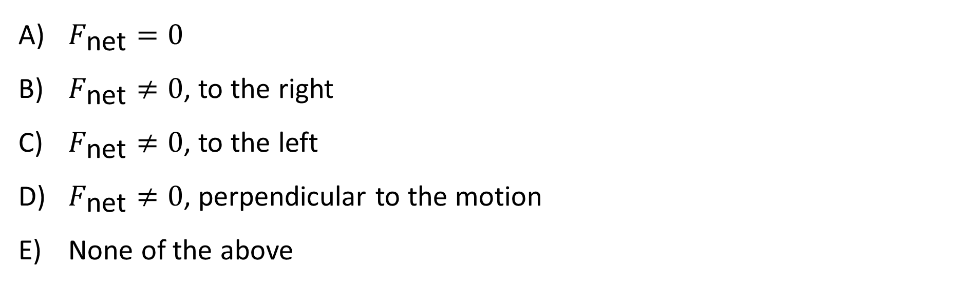
An air-track glider slides at constant speed. There is no friction (assume air resistance is negligible). What can you say about the net force (total force) on the glider?
$F_{\text{net}}=0$
$F_{\text{net}}≠0$, to the right
$F_{\text{net}}≠0$, to the left
$F_{\text{net}}≠0$, perpendicular to the motion
None of the above

Slide 3
You put your book on the (frictionless) bus seat next to you. When the bus stops suddenly, the book slides forward off the seat. Which of the following best explains this? (Take the perspective of an outside observer)
A net force acted on it.
No net force acted on it.
It remained at rest.
It did not move, but only seemed to.
Gravity briefly stopped acting on it.

Slide 4
A sailboat is blown across the sea at a constant velocity. What is the direction of the net force on the boat?
Left
Right
Down
The net force is zero
None of these

Slide 5
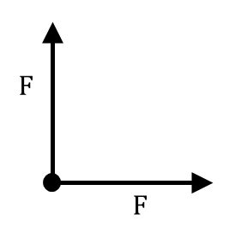
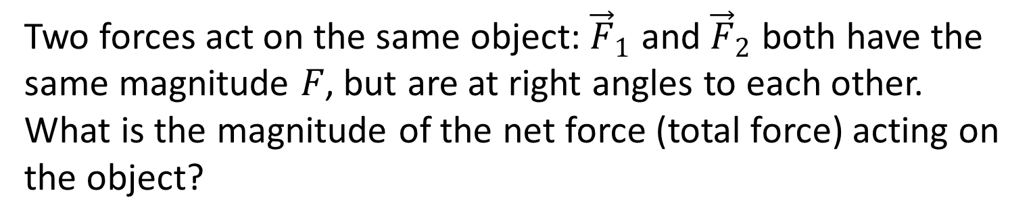
Two forces act on the same object: ${\vec{F}}_{1}$ and ${\vec{F}}_{2}$ both have the same magnitude $F$, but are at right angles to each other. What is the magnitude of the net force (total force) acting on the object?
F
2F
Something between F and 2F
More than 2F
Not enough information

Slide 6
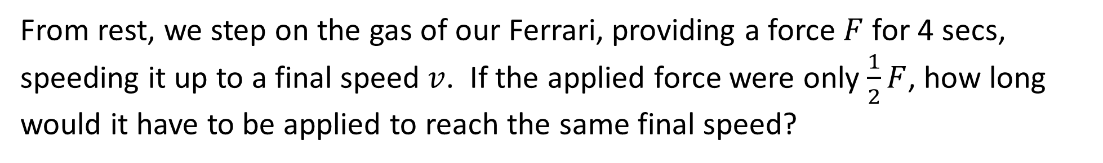
From rest, we step on the gas of our Ferrari, providing a force $F$ for 4 secs, speeding it up to a final speed $v$. If the applied force were only $\frac{1}{2}F$, how long would it have to be applied to reach the same final speed?
16 s
8 s
4 s
2 s
1 s

Slide 7

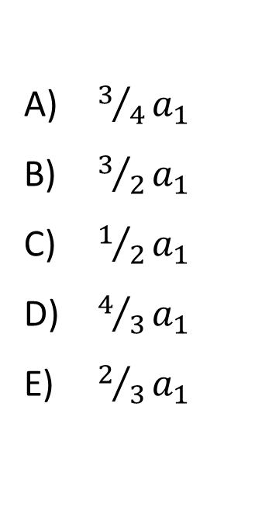
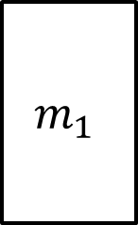


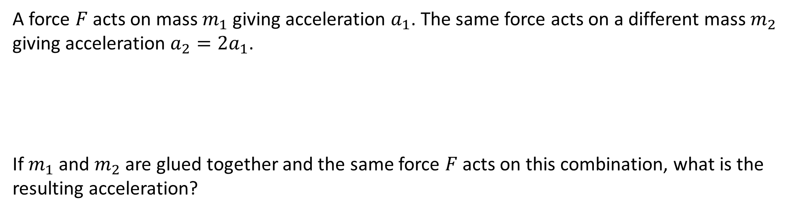

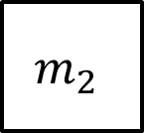



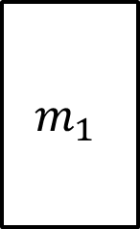
A force $F$ acts on mass $m_{1}$ giving acceleration $a_{1}$. The same force acts on a different mass $m_{2}$ giving acceleration $a_{2}=2a_{1}$.
If $m_{1}$ and $m_{2}$ are glued together and the same force $F$ acts on this combination, what is the resulting acceleration?
$$m_{1}$$
$$m_{2}$$
$$F$$
$$F$$
$$a_{1}$$
$$a_{2}=2a_{1}$$
$$m_{1}$$
$$m_{2}$$
$$F$$
$$a_{3}=??$$
$3/4a_{1}$
$3/2a_{1}$
$1/2a_{1}$
$4/3a_{1}$
$2/3a_{1}$

Slide 8
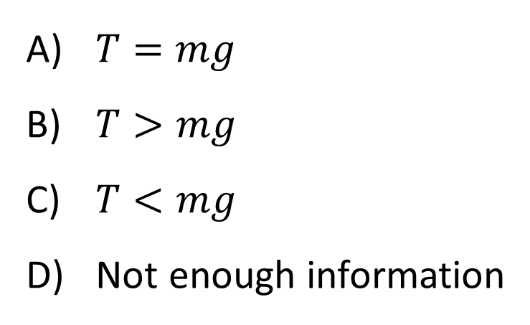
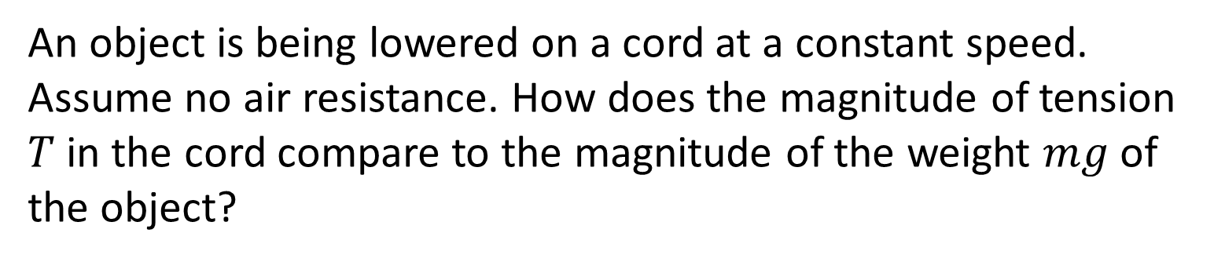
An object is being lowered on a cord at a constant speed. Assume no air resistance. How does the magnitude of tension $T$in the cord compare to the magnitude of the weight $mg$of the object?
constant
v
$T=mg$
$T>mg$
$T<mg$
Not enough information

Slide 9
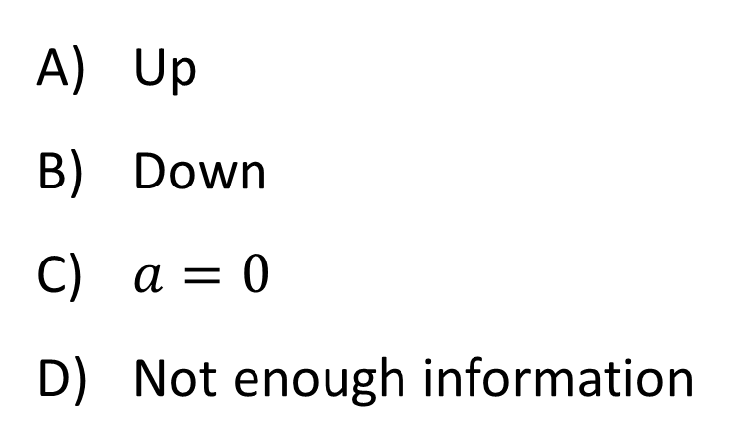
An object is being lowered on a cord at a speed which is decreasing with time! (Assume the only forces acting are weight and tension) What is the direction of the acceleration?
Decreasing
speed
Up
Down
$a=0$
Not enough information

Slide 10
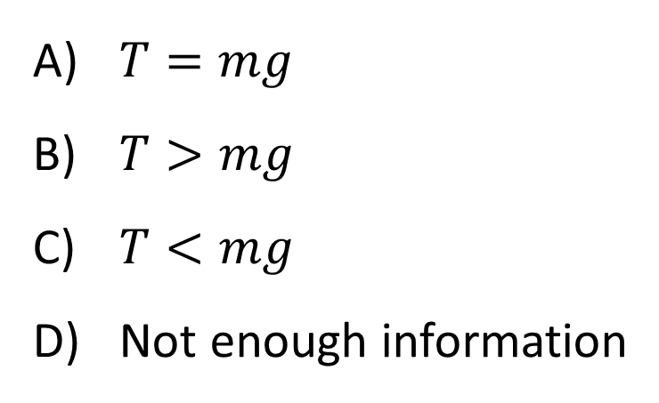
An object is being lowered on a cord at a speed which is decreasing with time! (Assume the only forces acting are weight and tension) Which equation below is true?
Decreasing
speed
$T=mg$
$T>mg$
$T<mg$
Not enough information

Slide 11
A very large truck sits on a frozen lake. Assume there is no friction between the tires and the ice. A fly suddenly smashes against the front window. Describe the truck’s motion a few seconds later.
It is too heavy, so it just sits there
It is moving backward at constant speed
It is accelerating backward
It is moving forward at constant speed
It is accelerating forward

Slide 12
If I bring the hammer down, which string will break?
Upper
Lower
It depends on how you bring the hammer down!

Slide 13
If I bring the hammer down quickly (meaning the magnitude of the acceleration will be LARGE), which string will break? Hint: Use a FBD and NII to relate the two tension forces. The string with more tension will break first!
Upper
Lower
It will be random

Slide 14
If I bring the hammer down slowly, which string will break?
Upper
Lower
It will be random

Slide 15
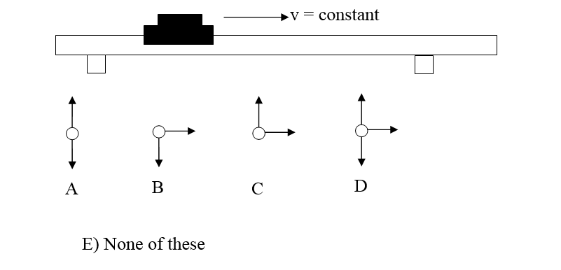
A glider on a level air track is coasting along at constant velocity. Which of the following free-body diagrams correctly indicates all the forces on the glider? Assume that there is no air resistance or friction.

Slide 16
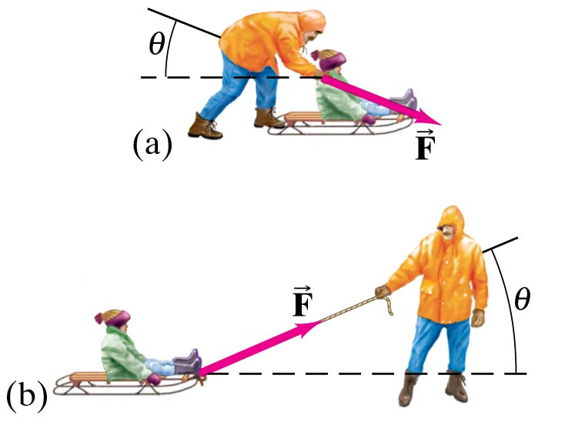
Below you see two cases: a physics student pulling or pushing a sled with a force $F$ which is applied at an angle $θ$. In which case is the normal force greater?
Case 1
Case 1
Case 2
It’s the same for both
It depends on the magnitude of the force $F$
It depends on the ice surface
Case 2

Slide 17
Which equation matches this free-body diagram?
+y
T
a
mg
$T+mg=ma$
$T−mg=ma$
$T+mg=−ma$
$T−mg=−ma$
None of these

Slide 18
Which equation matches this free-body diagram?
+y
T
a
mg
$T+mg=ma$
$T−mg=ma$
$T+mg=−ma$
$T−mg=−ma$
None of these

Slide 19
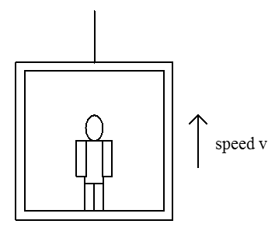
Consider a person standing in an elevator that is moving upward at constant speed. The magnitude of the upward normal force, $N$, exerted by the elevator floor on the person’s feet is (larger than/same as/smaller than) the magnitude of the downward weight, $W$, of the person.
constant
$N>W$
$N=W$
$N<W$

Slide 20
Now suppose the elevator were accelerating upward. How do the forces compare then?
increasing
speed
$N>W$
$N=W$
$N<W$

Slide 21
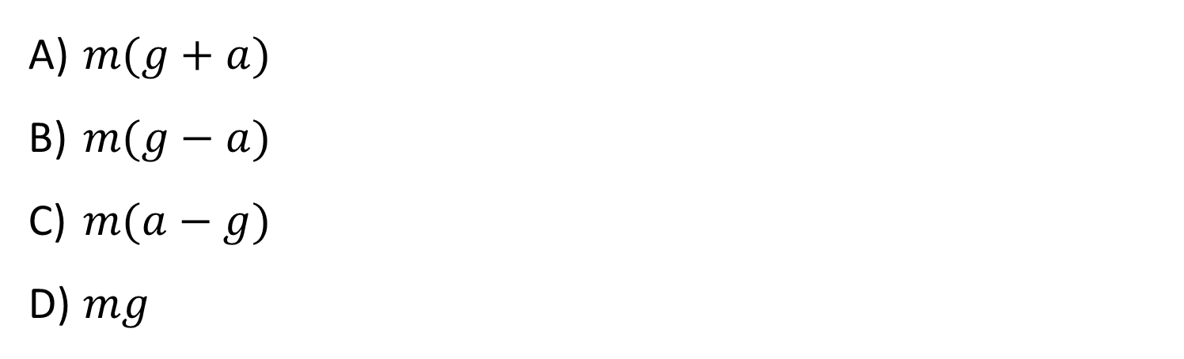
A box of mass m is sitting in an elevator which is moving upward, and the speed is decreasing. The magnitude of the acceleration of the elevator is a. The magnitude of the normal force on the box from the floor is N. What is the correct expression for the magnitude of the normal force N on the box?
Moving upward,
slowing
m
$m(g+a)$
$m(g−a)$
$m(a−g)$
$mg$

Slide 22
A person of mass m is sitting in an elevator which is moving down, and the speed is increasing. The magnitude of the acceleration of the elevator is a. The magnitude of the normal force on the person from the floor is N. What is the formula for the normal force N, given the acceleration a?
m(g+a)
m(g−a)
m(a−g)
mg
ma
v down and
increasing
Notes:
Phys 1110 Fa 15 SJP Lect #13 (review day) :

Slide 23
You are pushing a heavy box across a rough floor. When you are initially pushing the box and it is accelerating…
the box exerts a force on you, but you do not exert a force on the box.
you exert a force on the box, but the box does not exert a force on you.
the force you exert on the box is greater than the force the box exerts on you.
the force the box exerts on you is greater than the force you exert on the box.
the force you exert on the box is equal to the force the box exerts on you.

Slide 24
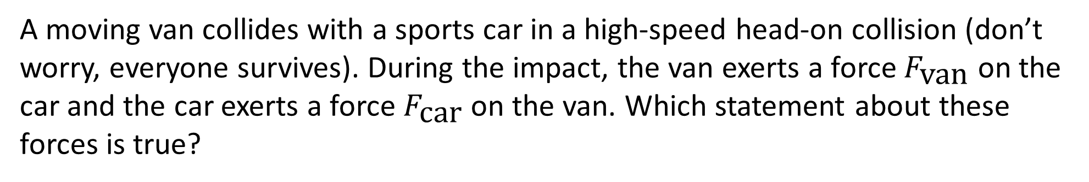
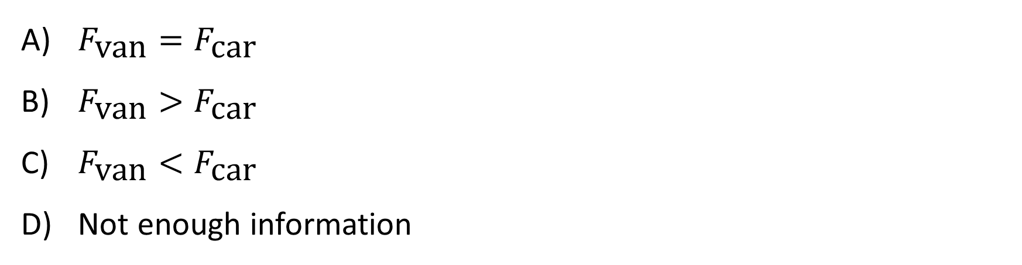
A moving van collides with a sports car in a high-speed head-on collision (don’t worry, everyone survives). During the impact, the van exerts a force $F_{\text{van}}$ on the car and the car exerts a force $F_{\text{car}}$ on the van. Which statement about these forces is true?
$F_{\text{van}}=F_{\text{car}}$
$F_{\text{van}}>F_{\text{car}}$
$F_{\text{van}}<F_{\text{car}}$
Not enough information

Slide 25
Steve and a Sumo Wrestler are having a tug-of-war. So far, no one is winning. What is the direction of the force of friction from the floor on Steve’s feet?
S
W
Right
Left

Slide 26
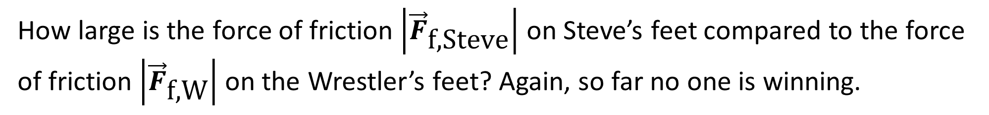
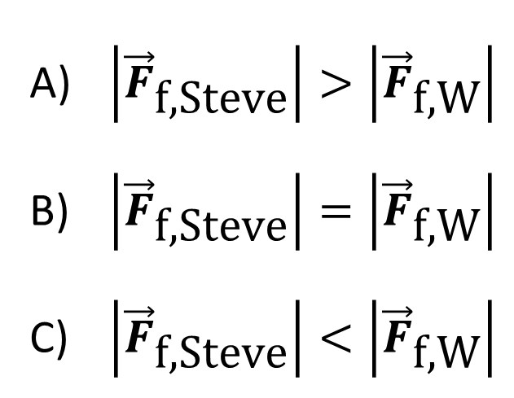
How large is the force of friction $\left|{\vec{F}}_{\text{f}\text{,}\text{Steve}}\right|$ on Steve’s feet compared to the force of friction $\left|{\vec{F}}_{\text{f}\text{,}\text{W}}\right|$ on the Wrestler’s feet? Again, so far no one is winning.
S
W
$\left|{\vec{F}}_{\text{f}\text{,}\text{Steve}}\right|>\left|{\vec{F}}_{\text{f}\text{,}\text{W}}\right|$
$\left|{\vec{F}}_{\text{f}\text{,}\text{Steve}}\right|=\left|{\vec{F}}_{\text{f}\text{,}\text{W}}\right|$
$\left|{\vec{F}}_{\text{f}\text{,}\text{Steve}}\right|<\left|{\vec{F}}_{\text{f}\text{,}\text{W}}\right|$

Slide 27
A book sits on a table. Everything is at rest. The normal force from the table on the book equals (in magnitude) the weight of the book. Are the normal force and the weight force members of an "action-reaction” force pair from Newton's 3rd Law?
N = "normal" force
W = mg
Yes
No
Not enough information

Slide 28
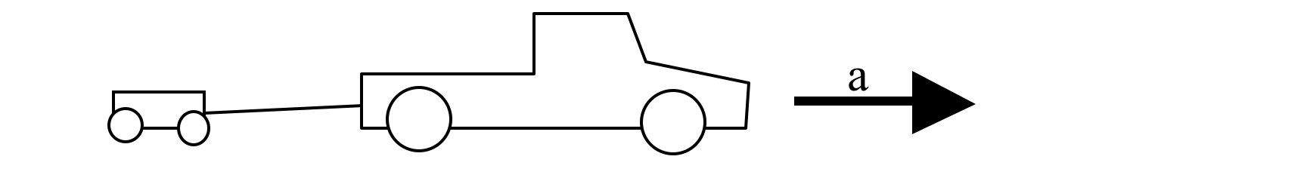
A heavy-duty truck pulling a light trailer is accelerating forward. How does the magnitude of the force on the truck F_{on Truck} from the trailer compare to the magnitude of the force on the trailer F_{on Trailer} from the truck?
F_{on Truck} > F_{on Trailer}
F_{on Trailer} > F_{on Truck}
F_{on Trailer} = F_{on Truck}
Notes:
Phys 1110 Fa 15 SJP Lect #13 (review day) : 9, 16, [[75]], 0, 0 2PM: 5, 9, [[85]], 0, 0
This was about 75% silent, and did not shift much when they were allowed to talk about it! It’s pure N-III, but of course it’s easy to mess this up (that’s what a bunch of the FCI or FMCE questions show, this is a robust difficulty!)

Slide 29
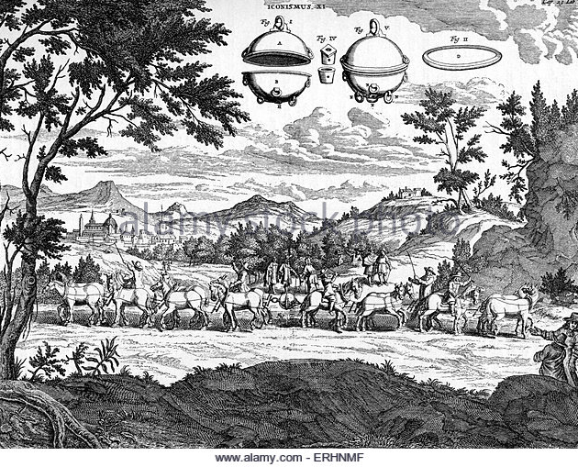
In the 1600's, Otto Van Güricke, a physicist in Magdeburg, fitted two hollow bronze hemispheres together and removed the air from the resulting sphere with a pump. Two 8-horse teams couldn’t pull the spheres apart, even though the hemispheres fell apart when air was re-admitted. Suppose von Güricke had tied both teams of horses to one side and bolted the other side to a heavy tree trunk. The tension in the rope tied to the tree would be...
Double the previous tension.
unchanged.
Half the previous tension.

Slide 30
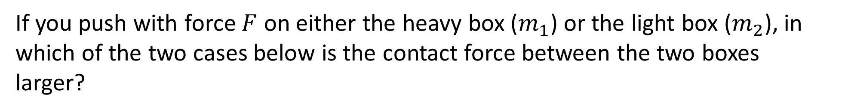
If you push with force $F$ on either the heavy box ($m_{1}$) or the light box ($m_{2}$), in which of the two cases below is the contact force between the two boxes larger?
A
m₁
m₂
F
B
Case A
Case B
Same in both cases
m₁
F
m₂

