Slide 1
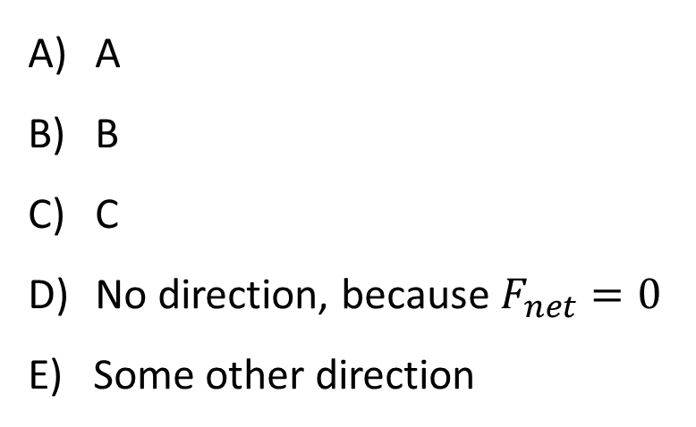
A glider slides down a tilted air track (no friction). Which direction is $F_{\text{net}}$ on the glider?
A
B
v
C
A
B
C
No direction, because $F_{net}=0$
E) Some other direction

Slide 2
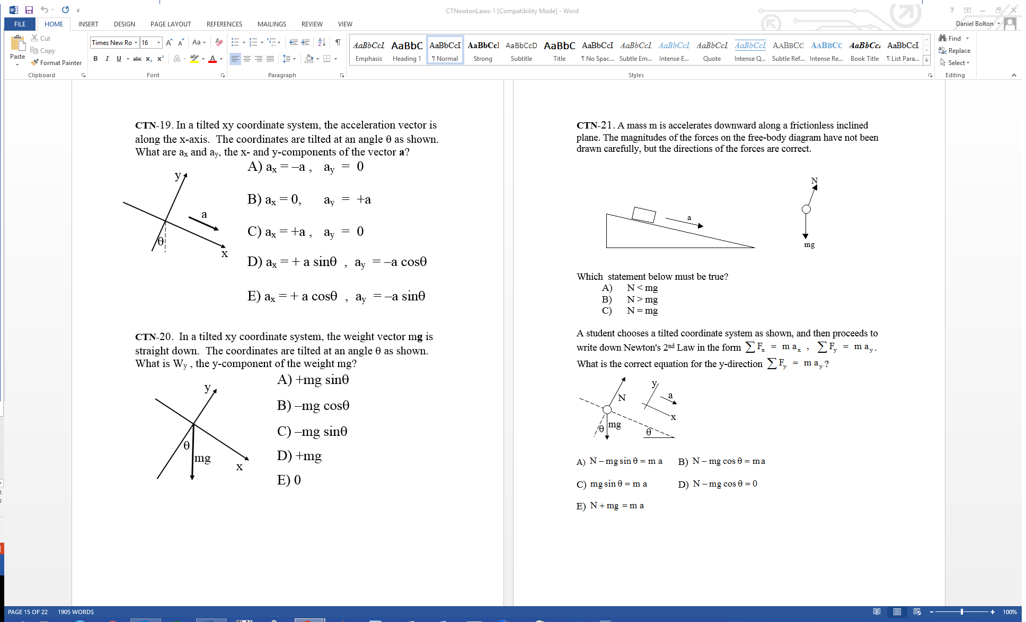
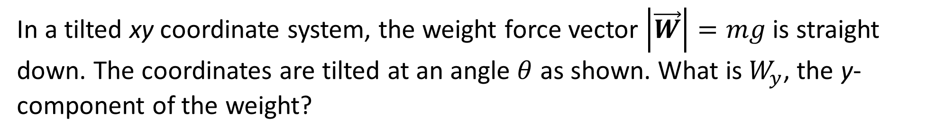
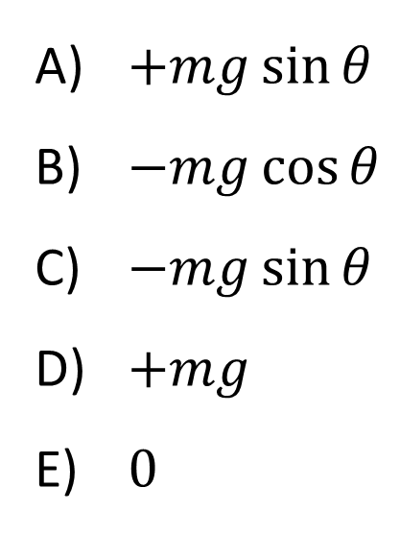
In a tilted xy coordinate system, the weight force vector $\left|\vec{W}\right|=mg$ is straight down. The coordinates are tilted at an angle $θ$ as shown. What is $W_{y}$, the y-component of the weight?
$+mg\sin{θ}$
$−mg\cos{θ}$
$−mg\sin{θ}$
$+mg$
$0$

Slide 3
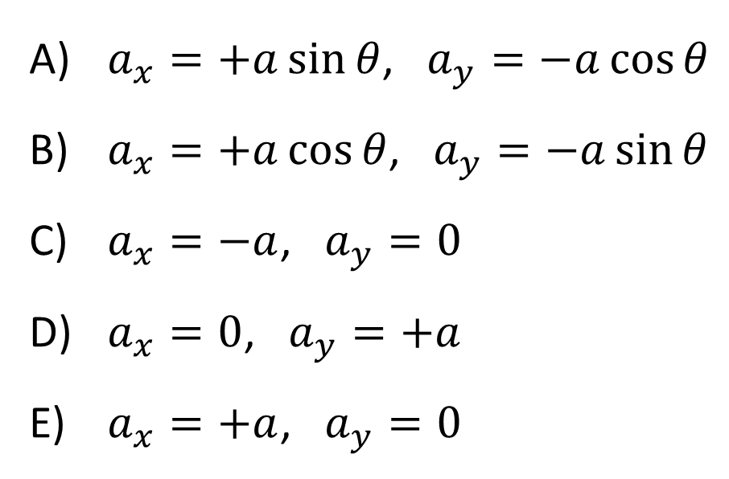
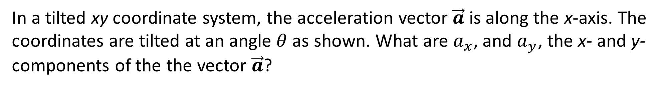

In a tilted xy coordinate system, the acceleration vector $\vec{a}$ is along the x-axis. The coordinates are tilted at an angle $θ$ as shown. What are $a_{x}$, and $a_{y}$, the x- and y-components of the the vector $\vec{a}$?
+y
$$θ$$
a
$a_{x}=+a\sin{θ}$, $a_{y}=−a\cos{θ}$
$a_{x}=+a\cos{θ}$, $a_{y}=−a\sin{θ}$
$a_{x}=−a$, $a_{y}=0$
$a_{x}=0$, $a_{y}=+a$
$a_{x}=+a$, $a_{y}=0$
+x

Slide 4
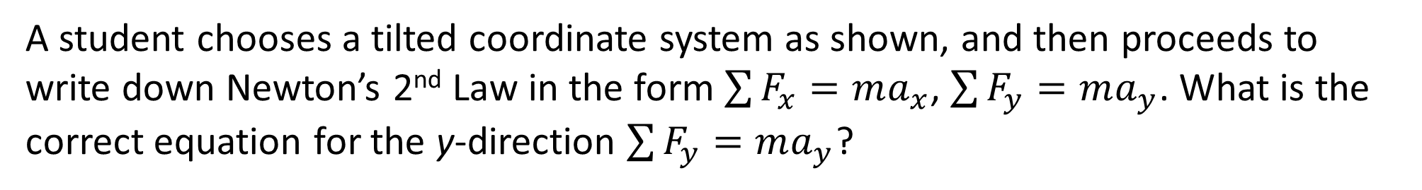
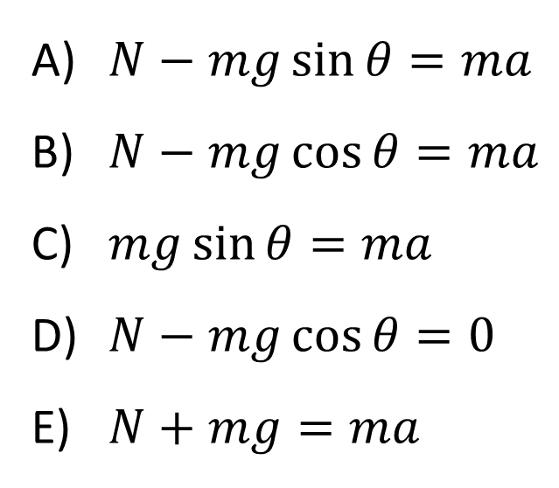
A student chooses a tilted coordinate system as shown, and then proceeds to write down Newton’s 2nd Law in the form $\sum{F_{x}}=ma_{x}$, $\sum{F_{y}}=ma_{y}$. What is the correct equation for the y-direction $\sum{F_{y}}=ma_{y}$?
$N−mg\sin{θ}=ma$
$N−mg\cos{θ}=ma$
$mg\sin{θ}=ma$
$N−mg\cos{θ}=0$
$N+mg=ma$

Slide 5
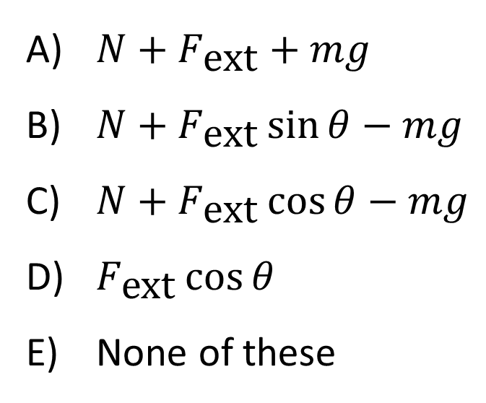
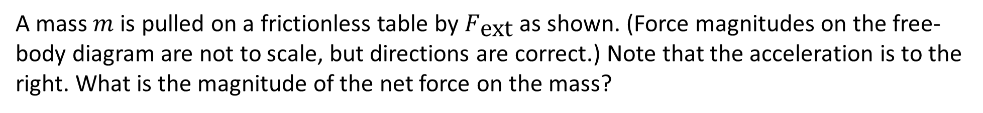
A mass $m$ is pulled on a frictionless table by $F_{\text{ext}}$ as shown. (Force magnitudes on the free-body diagram are not to scale, but directions are correct.) Note that the acceleration is to the right. What is the magnitude of the net force on the mass?
N
F_{ext}
No friction
F_{ext}
a
θ
mg
$N+F_{\text{ext}}+mg$
$N+F_{\text{ext}}\sin{θ}−mg$
$N+F_{\text{ext}}\cos{θ}−mg$
$F_{\text{ext}}\cos{θ}$
None of these

Slide 6
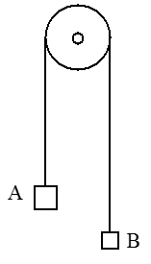
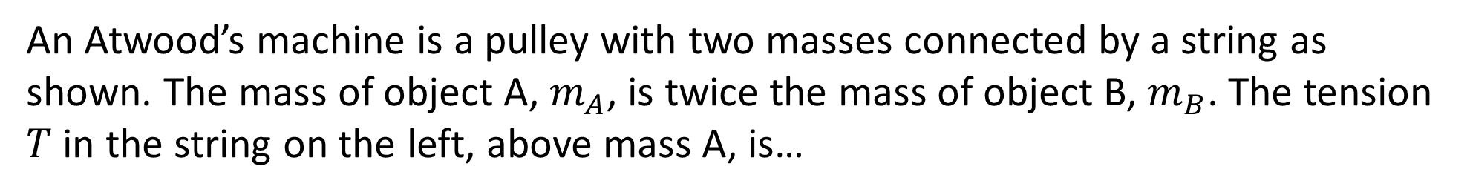
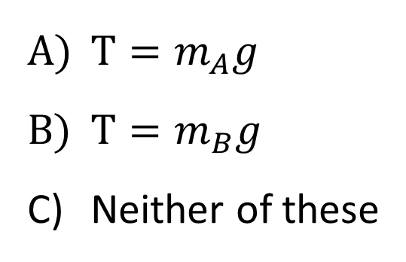
An Atwood’s machine is a pulley with two masses connected by a string as shown. The mass of object A, $m_{A}$, is twice the mass of object B, $m_{B}$. The tension $T$ in the string on the left, above mass A, is…
$T=m_{A}g$
$T=m_{B}g$
Neither of these

Slide 7
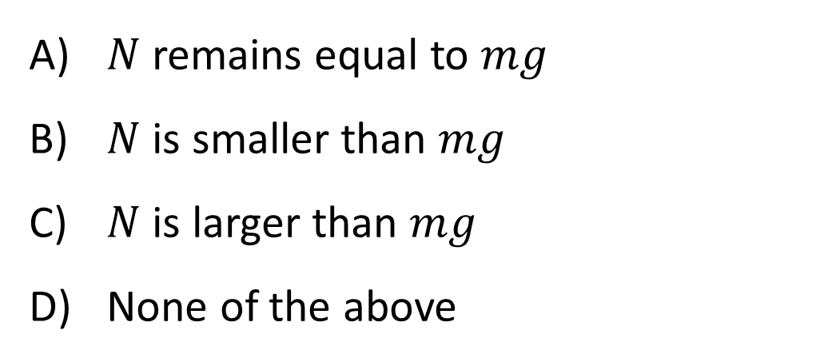
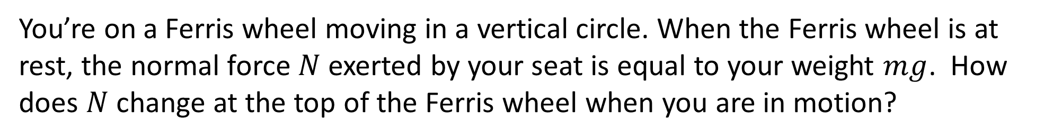
You’re on a Ferris wheel moving in a vertical circle. When the Ferris wheel is at rest, the normal force $N$exerted by your seat is equal to your weight $mg$. How does $N$change at the top of the Ferris wheel when you are in motion?
$N$remains equal to $mg$
$N$is smaller than $mg$
$N$is larger than $mg$
None of the above

Slide 8
A bucket containing a brick is swung in a circle at constant speed in a vertical plane as shown. The bucket is swung fast enough that the brick does not fall out. F_{net} on the brick has max magnitude at the…
top (T).
bottom (B).
right (R).
Same everywhere!

Slide 9
Consider the normal force on the brick by the bucket when the bucket is at the three positions shown: R, T, B. The magnitude of the normal force is a maximum at position...
top (T).
bottom (B).
right (R).
Same everywhere!

Slide 10
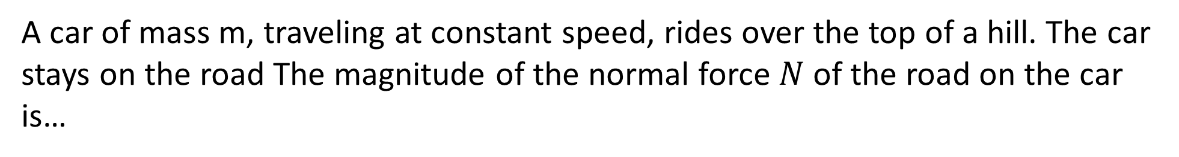
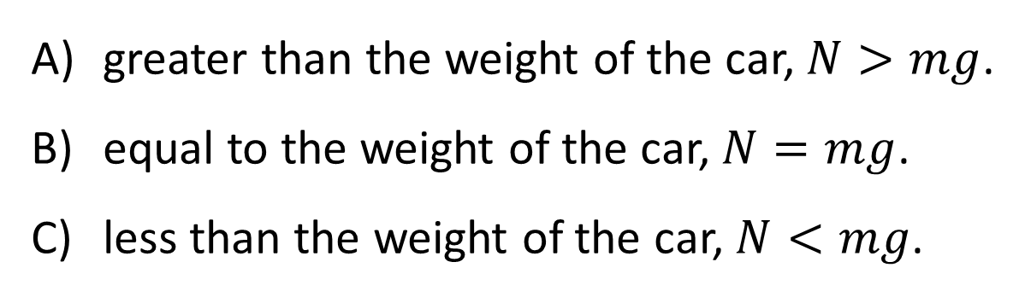
A car of mass m, traveling at constant speed, rides over the top of a hill. The car stays on the road The magnitude of the normal force $N$ of the road on the car is…
greater than the weight of the car, $N>mg$.
equal to the weight of the car, $N=mg$.
less than the weight of the car, $N<mg$.

Slide 11
A hockey puck which was recently hit by a stick, slides up and over an icy (frictionless) round hill. It stays on the hill. At the moment the puck is at the top of the hill, the speed is…
increasing.
constant, non-zero.
decreasing.
zero.

Slide 12
A hockey puck which was recently hit by a stick, slides up and over an icy (frictionless) round hill. It stays in contact with the ground. At the moment the puck is at the top of the hill, its instantaneous velocity is v. The radius of curvature is R. What is its acceleration?
Zero
Exactly g
Exactly v²/R
MORE than v²/R
LESS than v²/R

Slide 13
Consider the normal force on the hockey puck by the ground at the top of the hill and fill in the blank: the faster the puck is travelling, the ________ the normal force will be.
larger
smaller
Neither of these. The normal force is independent of the puck speed

Slide 14
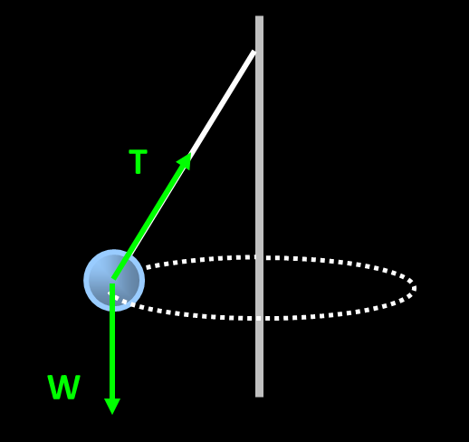
In the game of tetherball, the struck ball whirls around a pole. In what direction does the net force on the ball point?
toward the top of the pole
toward the ground
along the horizontal component of the tension force
along the vertical component of the tension force
tangential to the circle

Slide 15
During a sharp left turn, you find yourself hitting the passenger door. What is the correct description of what is actually happening?
centrifugal force is pushing you into the door
the door is exerting a leftward force on you
both of the above
neither of the above

Slide 16
A rider in a "barrel of fun" is stuck with her back to the wall. Pick the free body diagram.

Slide 17
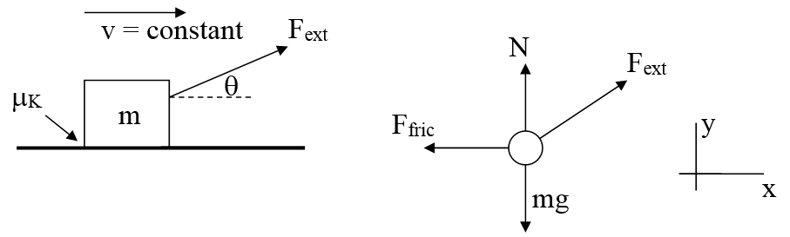
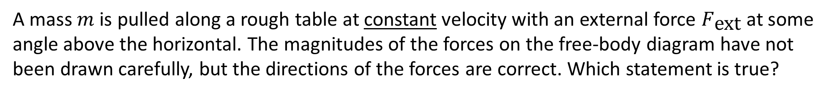
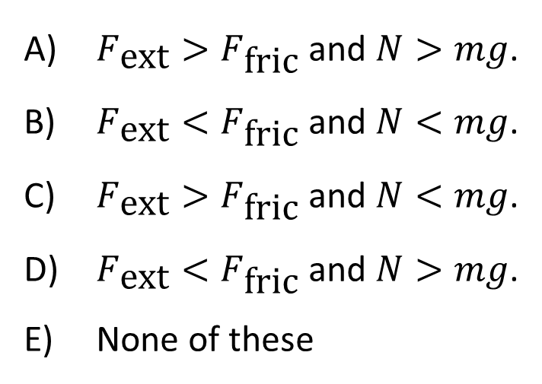
A mass $m$ is pulled along a rough table at constant velocity with an external force $F_{\text{ext}}$ at some angle above the horizontal. The magnitudes of the forces on the free-body diagram have not been drawn carefully, but the directions of the forces are correct. Which statement is true?
$F_{\text{ext}}>F_{\text{fric}}$ and $N>mg$.
$F_{\text{ext}}<F_{\text{fric}}$ and $N<mg$.
$F_{\text{ext}}>F_{\text{fric}}$ and $N<mg$.
$F_{\text{ext}}<F_{\text{fric}}$ and $N>mg$.
None of these

Slide 18
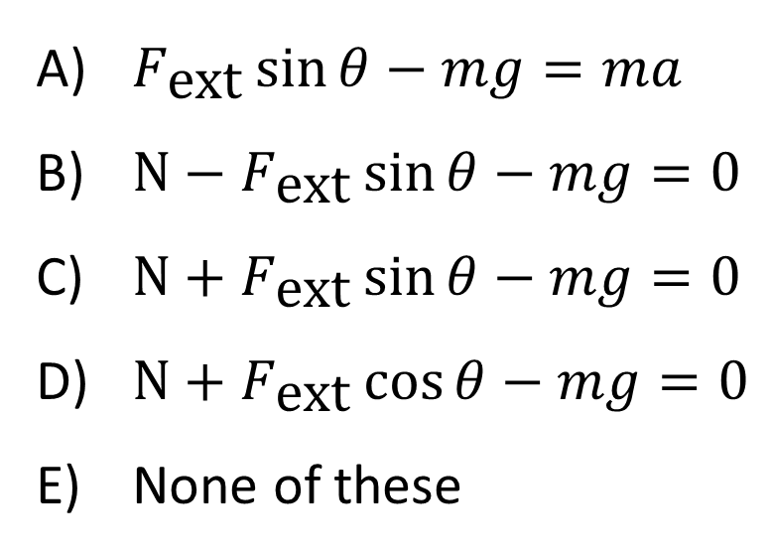
What is the correct $y$-equation?
$F_{\text{ext}}\sin{θ}−mg=ma$
$N−F_{\text{ext}}\sin{θ}−mg=0$
$N+F_{\text{ext}}\sin{θ}−mg=0$
$N+F_{\text{ext}}\cos{θ}−mg=0$
None of these

Slide 19
A block of mass m on a table is pulled along the table by an external horizontal force of magnitude F_{ext}, as shown. The table has a rough surface so there is a frictional force of magnitude F_{fric} on block. The block is moving at constant speed v. How do the magnitudes of the external force F_{ext} and the friction force F_{fric} compare?
v = constant
F_{ext}
F_{ext} = F_{fric}
F_{ext} > F_{fric}
F_{ext} < F_{fric}

Slide 20
A block of mass m on a table is pulled by an external horizontal force of magnitude F_{ext}, but it does not move! The table has a rough surface so there is a static frictional force of magnitude F_{fric} on block. Which formula must be correct for the frictional force?
v = 0
m
F_{ext}
F_{fric} = μ_{s}mg
F_{fric} = F_{ext} + μ_{s}mg
F_{fric} = F_{ext} – μ_{s}mg
F_{fric} = F_{ext}
F_{fric} = 0
Notes:
Phys 1110 Fa 15 SJP Lect # (review day) :

Slide 21
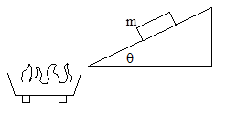
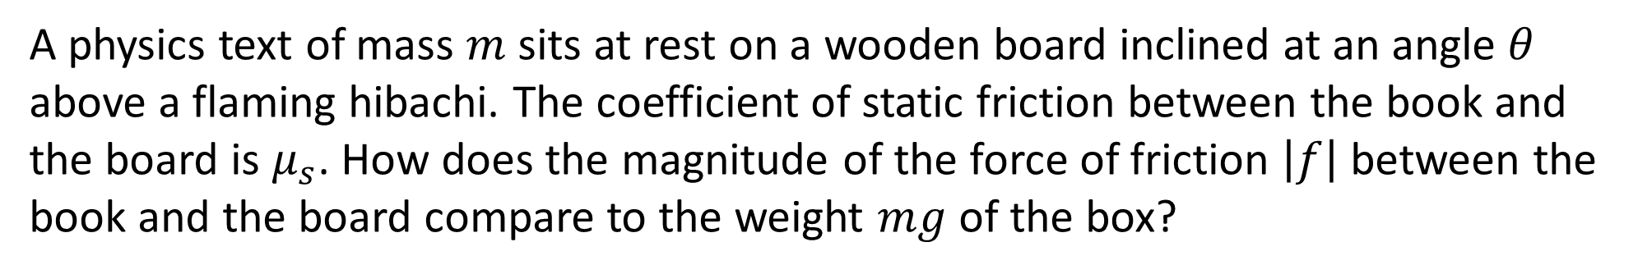
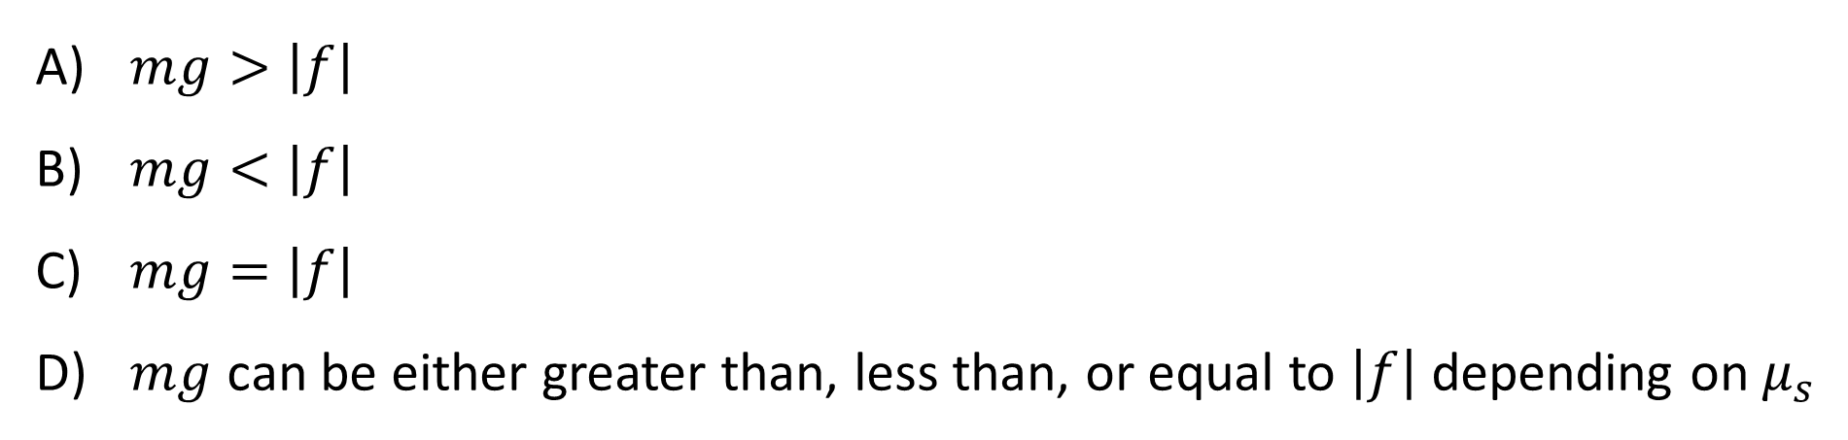
A physics text of mass $m$ sits at rest on a wooden board inclined at an angle $θ$ above a flaming hibachi. The coefficient of static friction between the book and the board is $μ_{s}$. How does the magnitude of the force of friction $\left|f\right|$ between the book and the board compare to the weight $mg$ of the box?
$mg>\left|f\right|$
$mg<\left|f\right|$
$mg=\left|f\right|$
$mg$ can be either greater than, less than, or equal to $\left|f\right|$ depending on $μ_{s}$

Slide 22
A box of mass m is resting stationary on a board which is tilted at an angle θ from the horizontal. The coefficient of static friction between the box and the board is μ_{s}. The angle is rather shallow and the friction is large, so the box is not about to slip. What is the magnitude of the force of friction between the board and the box?
μ_{s}mg
μ_{s}mg /cosθ
μ_{s}mg cosθ
mgsinθ
None of these
θ
Notes:
Phys 1110 Fa 15 SJP Lect # (review day) :

Slide 23
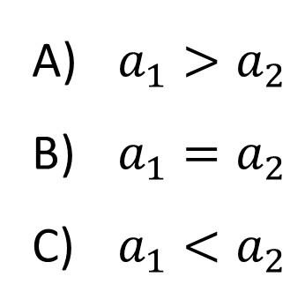
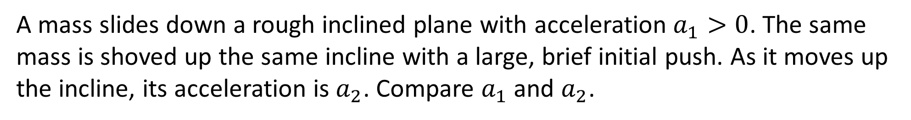
A mass slides down a rough inclined plane with acceleration $a_{1}>0$. The same mass is shoved up the same incline with a large, brief initial push. As it moves up the incline, its acceleration is $a_{2}$. Compare $a_{1}$ and $a_{2}$.
v
v
a₁
a₂
$a_{1}>a_{2}$
$a_{1}=a_{2}$
$a_{1}<a_{2}$

Slide 24
A box sits on a flat board. You lift one end of the board, making an angle with the floor. As you increase the angle, the box will eventually begin to slide down. Why?
component of the gravity force parallel to the plane increased
coefficient of static friction decreased
normal force exerted by the board decreased
both A) and C)
all of A), B), and C)

Slide 25
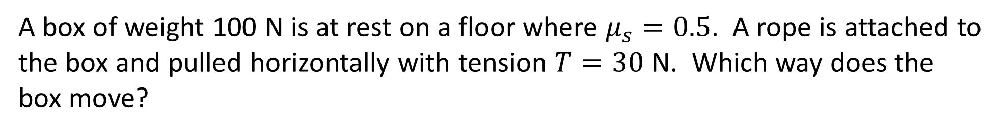
A box of weight 100 N is at rest on a floor where $μ_{s}=0.5$. A rope is attached to the box and pulled horizontally with tension $T=30$ N. Which way does the box move?
Static friction (μ_{s} = 0.5 )
T
m
The box moves to the left.
The box moves to the right.
The box moves up.
The box moves down.
The box does not move.

Slide 26
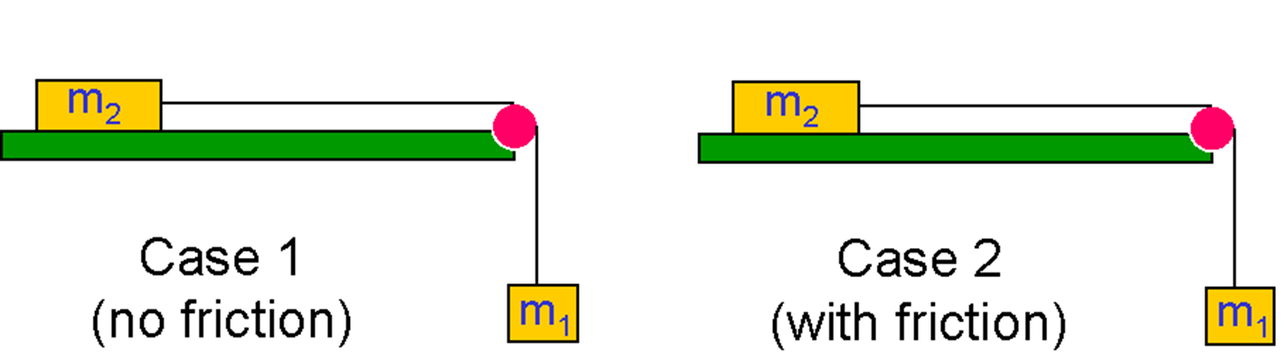
In which case is tension greater?
Case 1
Case 2
Both the same

Slide 27
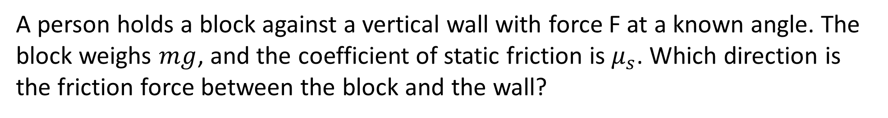
A person holds a block against a vertical wall with force F at a known angle. The block weighs $mg$, and the coefficient of static friction is $μ_{s}$. Which direction is the friction force between the block and the wall?
Up
Down
Zero
It depends…

Slide 28
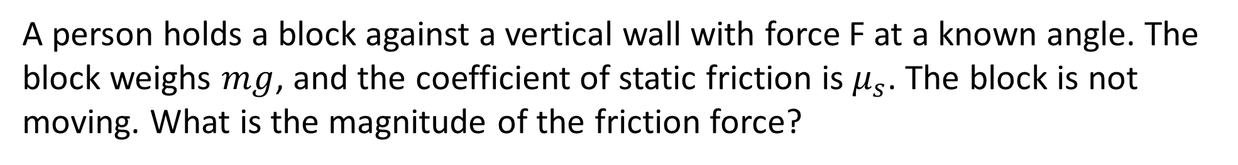
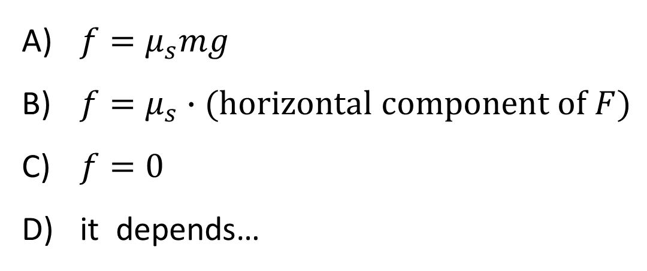
A person holds a block against a vertical wall with force F at a known angle. The block weighs $mg$, and the coefficient of static friction is $μ_{s}$. The block is not moving. What is the magnitude of the friction force?
$f=μ_{s}mg$
$f=μ_{s}∙(\text{horizontal} \text{component} \text{of} F)$
$f=0$
it depends…

Slide 29
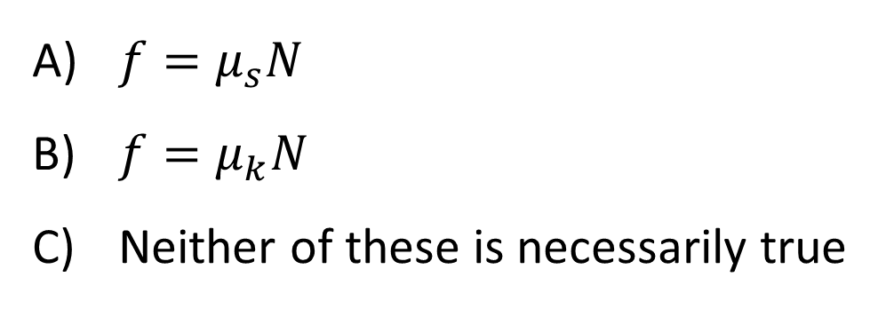
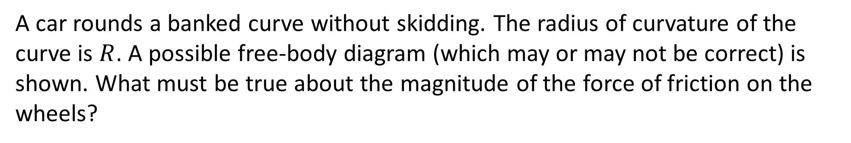



A car rounds a banked curve without skidding. The radius of curvature of the curve is $R$. A possible free-body diagram (which may or may not be correct) is shown. What must be true about the magnitude of the force of friction on the wheels?
“up the banked
surface”
$$v$$
N
“down the banked
surface”
$$R$$
F_{fric}
$$θ$$
mg
car
Rear view
(car moving into the page)
Top view
$f=μ_{s}N$
$f=μ_{k}N$
Neither of these is necessarily true

Slide 30

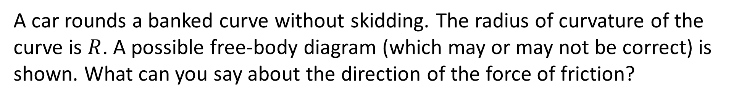


A car rounds a banked curve without skidding. The radius of curvature of the curve is $R$. A possible free-body diagram (which may or may not be correct) is shown. What can you say about the direction of the force of friction?
$$v$$
N
a
$$R$$
F_{fric}
$$θ$$
mg
car
Rear view
Top view
It must be in the direction shown in the FBD.
It must be in the opposite direction to the one shown in the FBD.
It depends on the speed of the car.

Slide 31
The free-body diagram for a car rounding a banked curve is shown. The car is going so fast that it is about to slip. The coordinate system has been chosen as shown. What is the correct y-equation of Newton’s II law?
N sinθ + μ_{s}N cosθ – mg = 0
N – μ_{s}N sinθ – mg cosθ = 0
N – mg cosθ = 0
N cosθ – μ_{s}N sinθ – mg = 0
None of these

