Slide 1
Recall that $\hat{\text{i}}$ and $\hat{\text{j}}$ are unit vectors in the $x$- and $y$-directions. What is $\hat{\text{i}}∙\hat{\text{j}}$ ?
(note: this is pronounced “i-hat dot j-hat”)
+1
0
-1
None of these

Slide 2
Albert Einstein lowers a book of mass $m$ downward a distance $h$ at speed $v$. The work done by the force of gravity is…
positive (+).
negative (-).
zero (0).
We can’t answer without defining a coordinate system!

Slide 3
Albert Einstein lowers a book of mass $m$ downward a distance $h$ at speed $v$. The work done by the force of Albert’s hand is…
positive (+).
negative (-).
zero (0).
We can’t answer without defining a coordinate system!

Slide 4
Albert Einstein lowers a book of mass $m$ downward a distance $h$ at speed $v$. The total work done on the book is…
positive (+).
negative (-).
zero (0).
We can’t answer without defining a coordinate system!

Slide 5
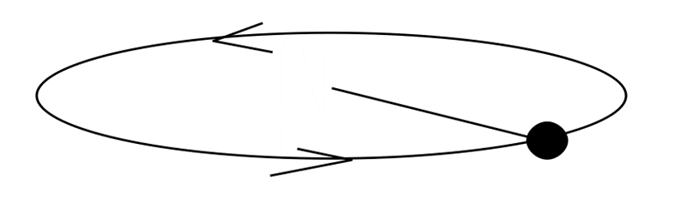
A rock of mass $m$ is twirled on a string in a horizontal plane at constant speed. The work done by the tension in the string on the rock is…
positive (+).
negative (-).
zero (0).

Slide 6


A box is being pulled up a rough incline by a rope connected to a pulley. How many forces are doing non-zero work on the red box?
One force
Two forces
Three forces
Four forces
No forces are doing non-zero work

Slide 7
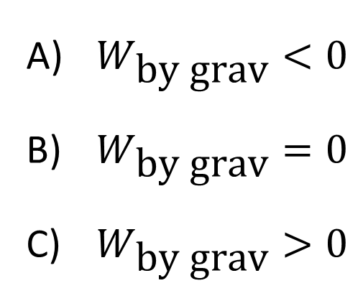
You toss a ball into the air and catch it again. While the object is in the air, what is the total work done by the gravitational force? Take the initial and final positions of the ball to be exactly the same.
$W_{\text{by} \text{grav}}<0$
$W_{\text{by} \text{grav}}=0$
$W_{\text{by} \text{grav}}>0$

Slide 8
A projectile is fired straight up and then it comes back down to its original height. There is non-negligible air resistance as the projectile is moving. During the entire flight of the projectile, the work done by the force of air resistance is…
zero.
positive.
negative.
Notes:
Phys 1110 Fa 15 SJP Lect # (review day) : 24, 6, [[70]], 0 0 At 2pm: 20, 7, [73]], 0
Again, it’s a repeat of an old question. I pointed out from the previous question that you could also use Work-KE theorem (W_friction is everything, and it slows down). But easier just to split the path into “way up” and “way down”, and argue that W_frcition <0 in both.

Slide 9
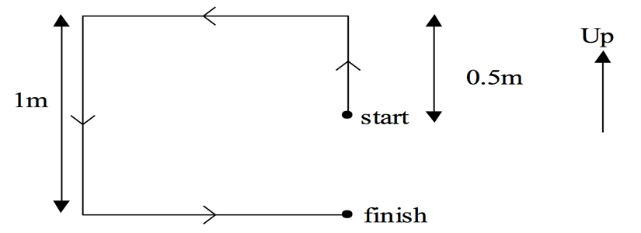
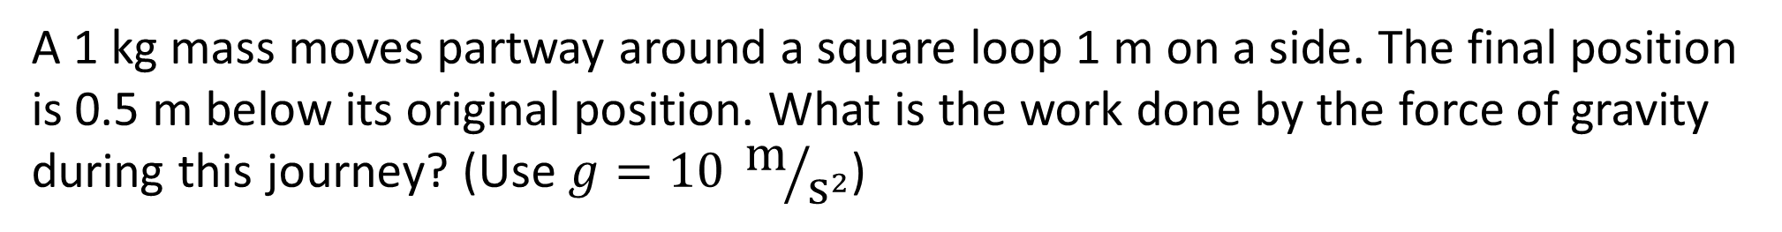
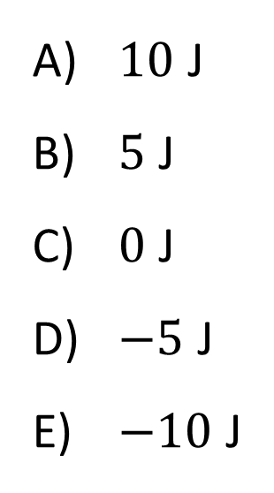
A 1 kg mass moves partway around a square loop 1 m on a side. The final position is 0.5 m below its original position. What is the work done by the force of gravity during this journey? (Use $g=10 {\text{m}}/{{\text{s}}^{2}}$)
$10$ J
$5$ J
$0$ J
$−5$ J
$−10$ J

Slide 10
One end of a spring is fixed in place. I stretch the spring by pulling on the other end. What is the sign of the work done by the force from my hand as I stretch the spring?
positive
negative
zero
depends on the direction in which I pull
depends on my coordinate system choice

Slide 11
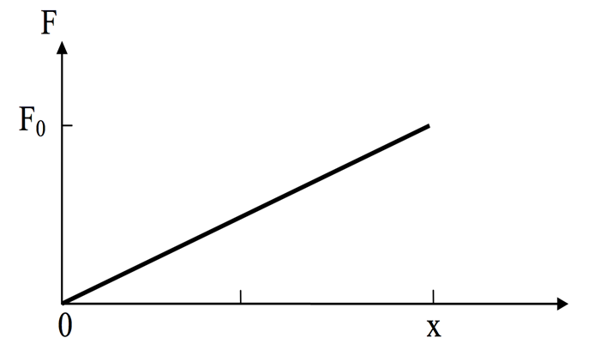
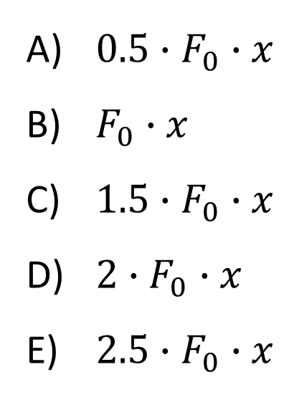
Suppose a force varies with position as shown below. The total work done by the force is…
$0.5∙F_{0}∙x$
$F_{0}∙x$
$1.5∙F_{0}∙x$
$2∙F_{0}∙x$
$2.5∙F_{0}∙x$

Slide 12
How does the work required to stretch a spring 2 cm compare with the work required to stretch it 1 cm?
same amount of work
twice the work
4 times the work
8 times the work

Slide 13
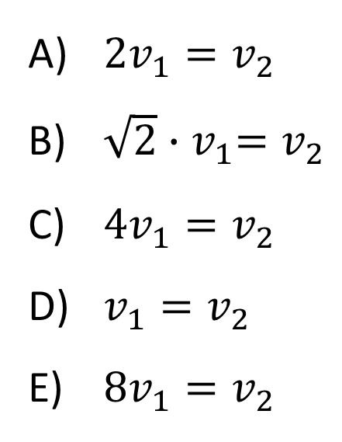
Car 1 has twice the mass of car 2 but they both have the same kinetic energy. How do their speeds compare?
$2v_{1}=v_{2}$
$\sqrt{2}{∙v}_{1}=v_{2}$
$4v_{1}=v_{2}$
$v_{1}=v_{2}$
$8v_{1}=v_{2}$

Slide 14
Two stones, one twice the mass of the other, are dropped from a cliff. Just before hitting the ground, what is the kinetic energy of the heavy stone compared to the light one?
quarter as much
half as much
the same
twice as much
four times as much

Slide 15
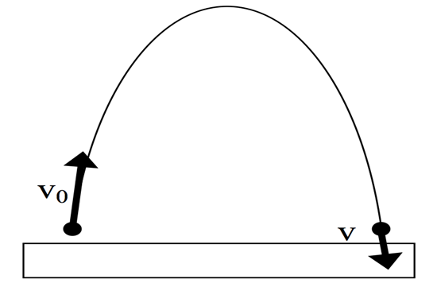
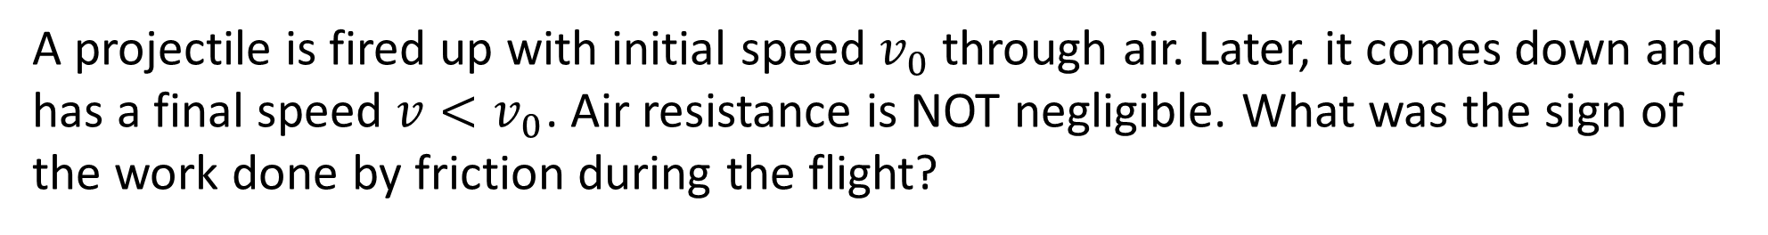
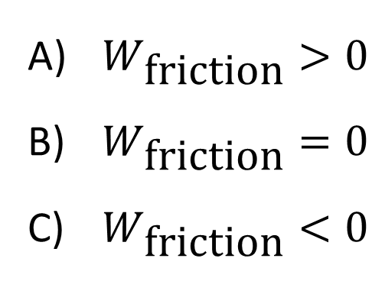
A projectile is fired up with initial speed $v_{0}$ through air. Later, it comes down and has a final speed $v<v_{0}$. Air resistance is NOT negligible. What was the sign of the work done by friction during the flight?
$W_{\text{friction}}>0$
$W_{\text{friction}}=0$
$W_{\text{friction}}<0$

Slide 16
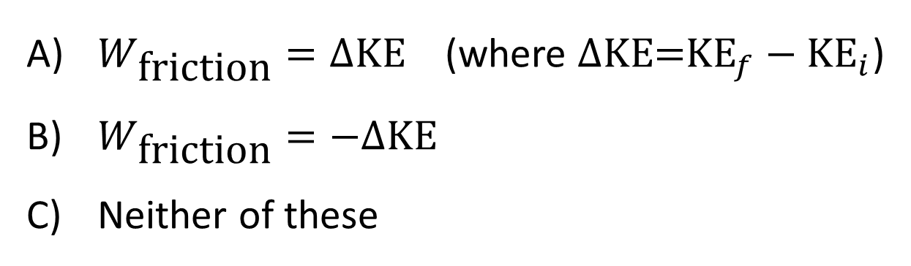
The work done by friction $W_{\text{friction}}$ during the flight is…
$W_{\text{friction}}=∆\text{KE}$ (where $∆\text{KE}\text{=}{\text{KE}}_{f}−{\text{KE}}_{i}$)
$W_{\text{friction}}=−∆\text{KE}$
Neither of these

Slide 17
In a baseball game, a catcher stops a 90-mph pitch. What can you say about the work done by the catcher on the ball?
The catcher has done positive work.
The catcher has done negative work.
The catcher has done no work.

Slide 18
Two stones, one twice the mass of the other, are dropped from a cliff. Just before hitting the ground, what is the kinetic energy of the heavy stone compared to the light one?
quarter as much
half as much
the same
twice as much
four times as much

Slide 19
A hockey puck slides on an ice rink at 1 m/s when it slides onto a carpet. The puck comes to rest after moving 1 m on the carpet. How far along the carpet would the puck go, if instead its initial speed were 2 m/s?
1.5 m
2 m
3 m
4 m
Not enough information

Slide 20
Starting from rest, two identical boxes are pushed through the same distance.
Box 1 experiences a net force F. Box 2 experiences a net force 2F. How do their final speeds compare? [Hint: First compare their kinetic energies, using the work-kinetic energy theorem.]
Speed of box 1 is twice box 2’s
Speed of box 1 is equal to box 2’s
Speed of box 1 is half of box 2’s
None of these

Slide 21
Students A and B push identical crates (there is friction). Both push the same distance x with the same horizontal force F. Student A pushes her crate twice as fast as student B. Who had greater power output?
Student A
Student B
Both had the same power output

Slide 22
Is it possible for the gravitational potential energy of an object to be negative?
Yes
No

Slide 23
Two paths lead to the top of a big hill. One is steep and direct, while the other is twice as long but less steep. How much potential energy would you gain if you take the longer path compared to the shorter path?
The same
Twice as much
Four times as much
Half as much
You gain no PE in either case

Slide 24
You and your friend both solve a problem involving a skier going down a slope, starting from rest. The two of you have chosen different levels for y = 0 in this problem. Which of the following quantities will you and your friend agree on?
Skier’s PE
Skier’s change in PE
Skier’s final PE
Only II
Only III
I, II, and III
Only I and III
Only II and III

Slide 25
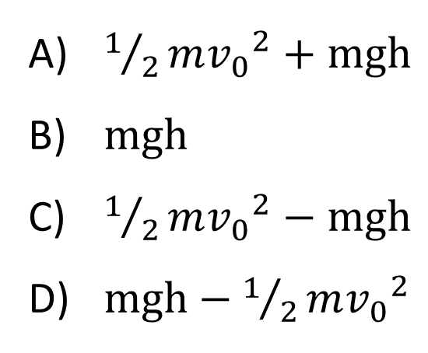
A projectile has initial speed $v_{0}$, angle $θ$. What is its KE when it is on the way down at a height $h$ above the ground? (Assume no air resistance.)
$1/2m{v_{0}}^{2}+mgh$
$mgh$
$1/2m{v_{0}}^{2}−mgh$
$mgh−1/2m{v_{0}}^{2}$

Slide 26
A cart starting from rest rolls down a hill and at the bottom has a speed of 4 m/s. If the cart were given an initial push, so its initial speed at the top of the hill was 3 m/s, what would be its speed at the bottom?
4 m/s
5 m/s
6 m/s
7 m/s
25 m/s

Slide 27
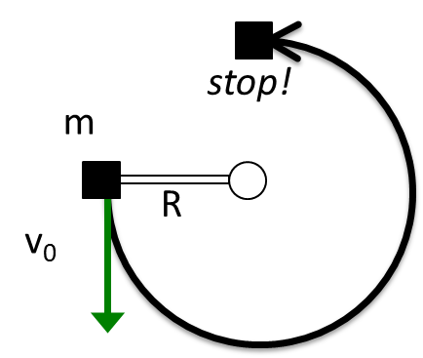
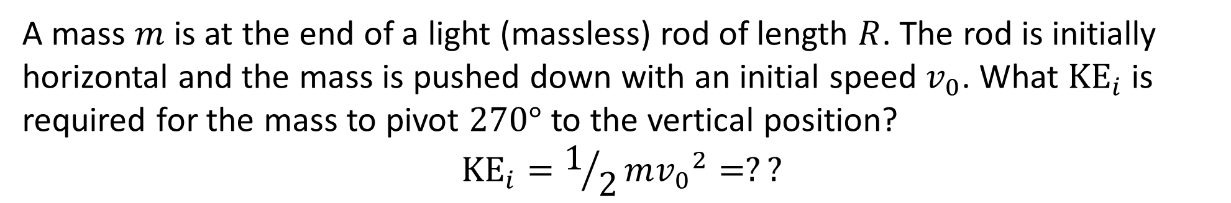
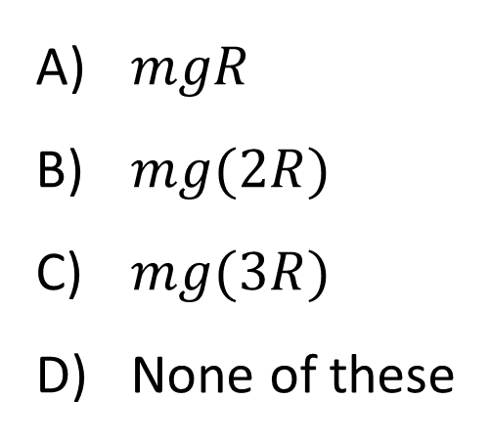
A mass $m$ is at the end of a light (massless) rod of length $R$. The rod is initially horizontal and the mass is pushed down with an initial speed $v_{0}$. What ${\text{KE}}_{i}$ is required for the mass to pivot $270°$ to the vertical position?
$${\text{KE}}_{i}=1/2m{v_{0}}^{2}=??$$
$mgR$
$mg(2R)$
$mg(3R)$
None of these

Slide 28
A mass, starting at rest, slides down a rail with no friction to a loop-de-loop. The loop’s max height matches the initial height of the mass. Note: there is no force holding the ball against the rail, except gravity. Will the ball make it to the top of the loop?
Yes
No
Not enough information to decide

Slide 29
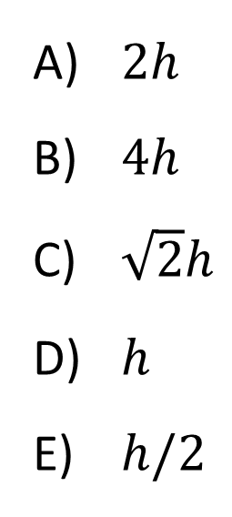
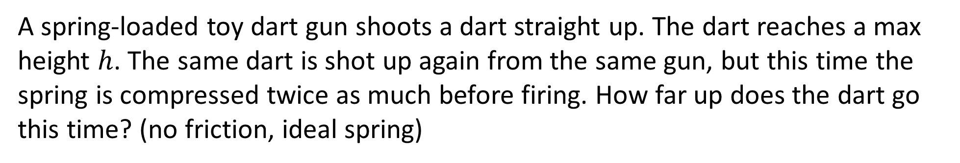
A spring-loaded toy dart gun shoots a dart straight up. The dart reaches a max height $h$. The same dart is shot up again from the same gun, but this time the spring is compressed twice as much before firing. How far up does the dart go this time? (no friction, ideal spring)
$2h$
$4h$
$\sqrt{2}h$
$h$
$h/2$

Slide 30
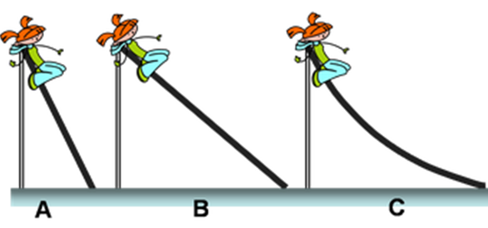
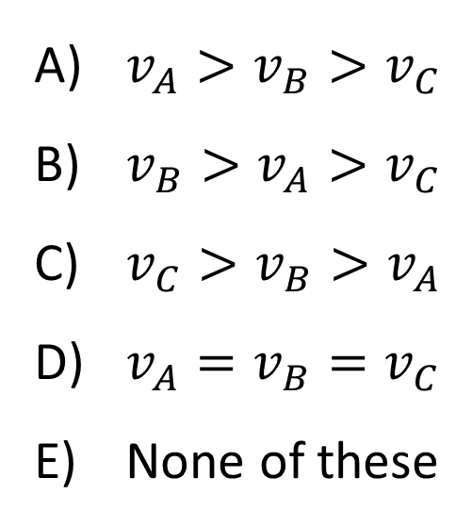
A child can slide down 3 different frictionless ramps with different shapes but same height. How does the speed of the child at the bottom of the ramps compare?
$v_{A}>v_{B}>v_{C}$
$v_{B}>v_{A}>v_{C}$
$v_{C}>v_{B}>v_{A}$
$v_{A}=v_{B}=v_{C}$
None of these

Slide 31
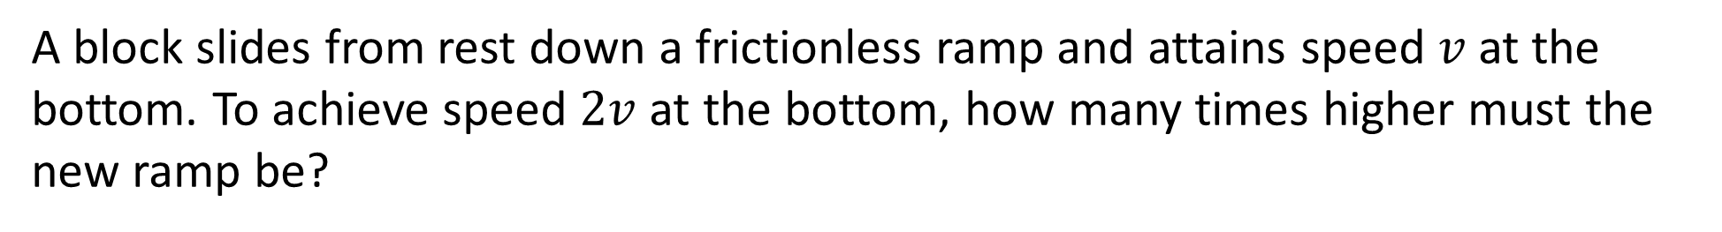
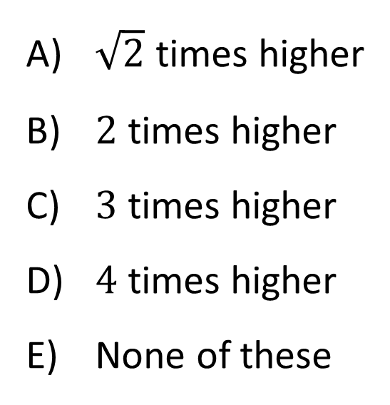
A block slides from rest down a frictionless ramp and attains speed $v$at the bottom. To achieve speed $2v$at the bottom, how many times higher must the new ramp be?
$\sqrt{2}$ times higher
$2$ times higher
$3$ times higher
$4$ times higher
None of these

Slide 32
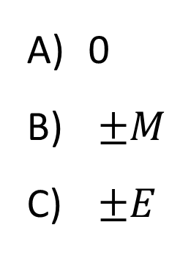
A mass is oscillating back and forth on a spring as shown. Position 0 is the unstretched position of the mass. At which point is the magnitude of the force on the mass maximum?
0
$±M$
$±E$

Slide 33
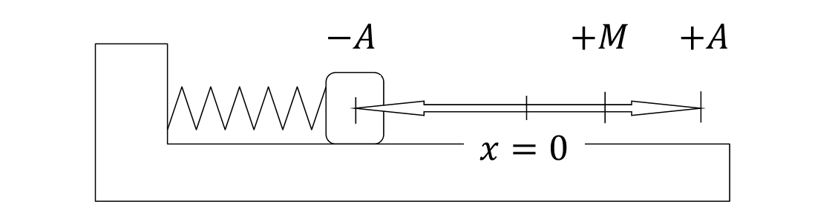
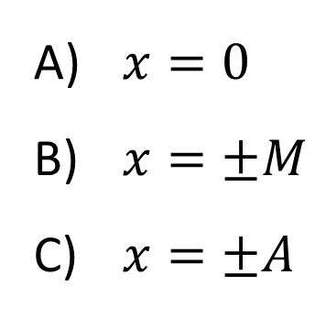
A mass is oscillating back and forth on a spring as shown. Position 0 is the unstretched position of the mass. At which point is the elastic potential energy maximum?
$x=0$
$x=±M$
$x=±A$

Slide 34
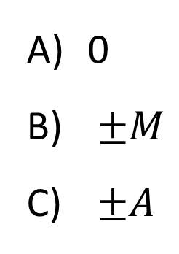
A mass is oscillating back and forth on a spring as shown. Position 0 is the unstretched position of the mass. At which point is the kinetic energy maximum?
0
$±M$
$±A$

Slide 35
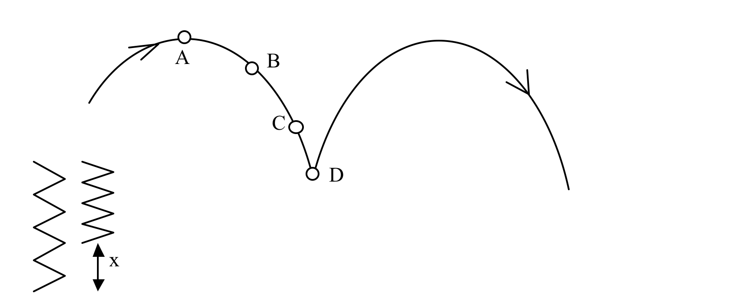
The tip of the nose of a pogo stick rider moves along the path shown. The maximum compression of the pogo stick spring is x. At what point(A, B, C or D) is the elastic potential of the spring energy a maximum?
Notes:
Phys 1110 Fa 15 SJP Lect # (review day) :

Slide 36
The tip of the nose of a pogo stick rider moves along the path shown. The maximum compression of the pogo stick spring is x. At what point is the gravitational potential energy a maximum?
Notes:
Phys 1110 Fa 15 SJP Lect # (review day) :

Slide 37
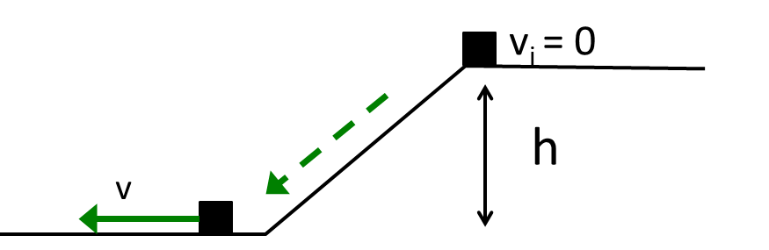
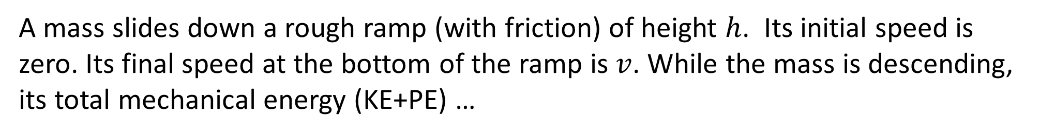
A mass slides down a rough ramp (with friction) of height $h$. Its initial speed is zero. Its final speed at the bottom of the ramp is $v$. While the mass is descending, its total mechanical energy (KE+PE) …
Increases
Decreases
Remains constant

Slide 38
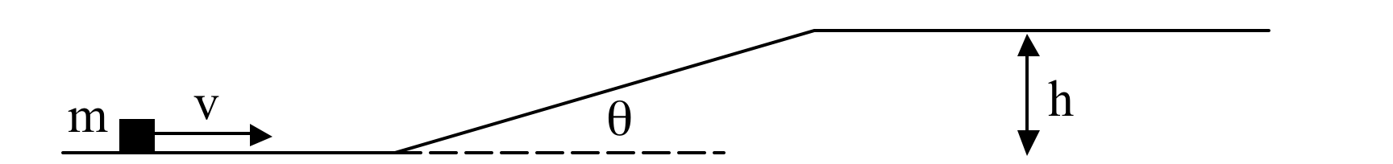
A block of mass m with initial speed v slides up a frictionless ramp of height h inclined at an angle θ as shown. Assume no friction. True or False: Whether the block makes it to the top of the ramp depends on the mass of block.
True
False
Notes:
Phys 1110 Fa 15 SJP Lect # (review day) :

Slide 39
A block of mass m with initial speed v slides up a ramp of height h inclined at an angle θ as shown. Assume there IS friction. True or False: Whether the block makes it to the top of the ramp depends on the angle θ.
True
False
Notes:
Phys 1110 Fa 15 SJP Lect # (review day) :

Slide 40
A mass m is dropped from rest from a height h_{i} above a table top on which sits on a spring with spring constant k. The mass compresses the spring by a maximum amount x and stops for an instant at a height h_{f­}. There is no friction in this problem. Which of the following equations correctly expresses conservation of energy and allows one to solve for the compression x of the spring?
mgh_{i} + ½ mv² = ½ kx²
mgh_{i} = ½ kx² + mgh_{f}
mgh_{i} + ½ kx² = mgh_{f}
mg(h_{F}- h_{i}) = ½ mv² + ½ kx²
None of these
Notes:
Phys 1110 Fa 15 SJP Lect # (review day) : 9, [[70]], 8, 11, 2 At 2PM; 7, [[69]], 8, 12, 3
Classic conservation of energy, not sure why they didn’t score better, but again, perhaps time constraint is killing them.

Slide 41
A pendulum is launched in two different ways. During both launches, the bob is given an initial speed of 3.0 m/s and the same initial angle from the vertical. On launch 1, the speed is upwards, on launch 2, the speed is downwards. Assume no friction. Which launch will cause the pendulum to swing the largest angle from the equilibrium position on the left side?
Launch 1
Launch 2
Both launches give the same maximum displacement.
Notes:
Phys 1110 Fa 15 SJP Lect # (review day) :

Slide 42
A “system” consists of a mass m hanging from a spring (spring constant k) and the Earth as shown. In situation A, the mass is hanging freely, at rest, so the spring is stretched beyond its relaxed length. In situation B, the mass is also stationary, but the spring is now at its relaxed length, because an alien from Planet X has lifted the mass and is holding it up. In which situation is the total energy of the mass/spring/earth system bigger?
A
B
Same in both

Slide 43
A cart rolls on a frictionless track. The total mechanical energy (KE + PE) is 45 kJ. What is ${\text{KE}}_{\text{max}}$ over this stretch of track?
55 kJ
10 kJ
45 kJ
35 kJ
None of these

Slide 44
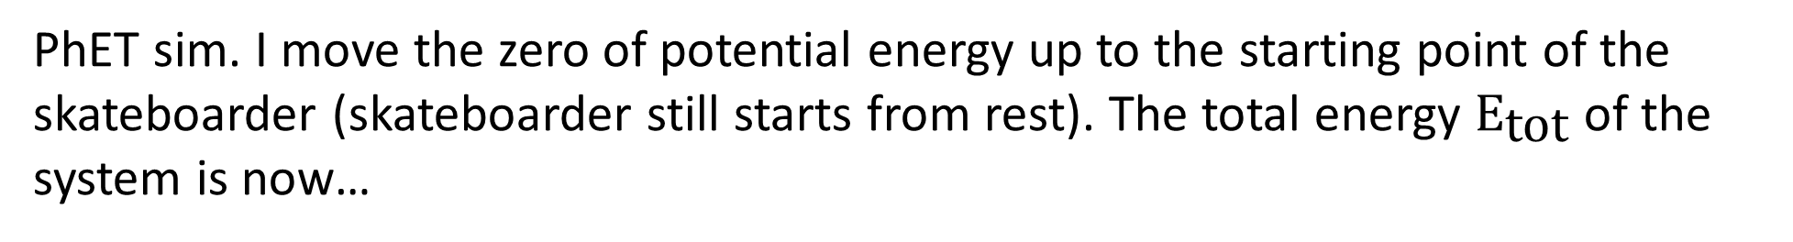
PhET sim. I move the zero of potential energy up to the starting point of the skateboarder (skateboarder still starts from rest). The total energy ${\text{E}}_{\text{tot}}$ of the system is now…
zero.
positive.
negative.
depends on the position of the skateboarder.

Slide 45
A cart rolls on a frictionless track. The total mechanical energy (KE + PE) is 0 kJ. What is ${\text{KE}}_{\text{max}}$ over this stretch of track?
-35 kJ
-15 kJ
15 kJ
35 kJ
None of these

Slide 46
A cart rolls on a frictionless track. The total mechanical energy (KE + PE) is 45 kJ. When the $\text{K}\text{E}$ is minimum (at 35 m), what is the direction of acceleration?
up
down
right
left
acceleration is zero

Slide 47
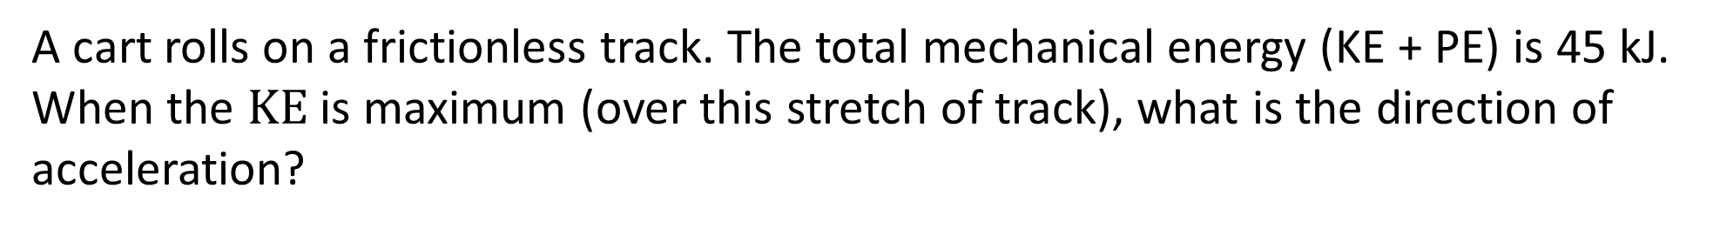
A cart rolls on a frictionless track. The total mechanical energy (KE + PE) is 45 kJ. When the $\text{K}\text{E}$ is maximum (over this stretch of track), what is the direction of acceleration?
up
down
right
left
acceleration is zero

Slide 48
A cart rolls to the right on a frictionless track. If the KE of the cart when it is at $x=20$ m is $20$ kJ, will it make it over the hill?
Yes
No
Not enough information

Slide 49
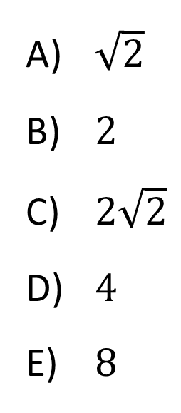
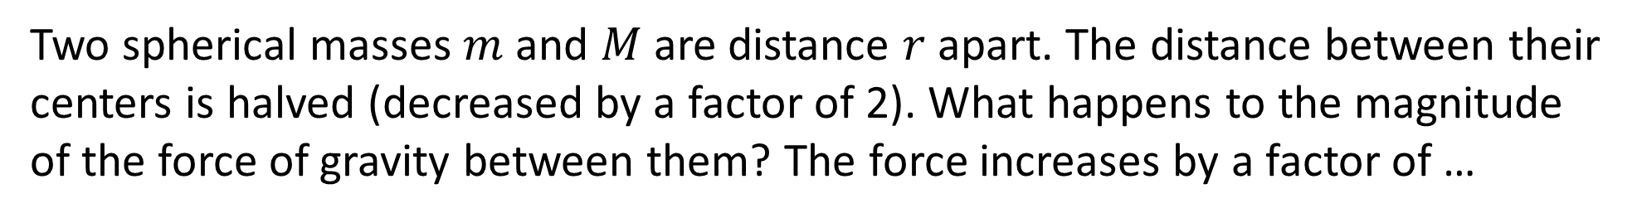
Two spherical masses $m$and $M$are distance $r$apart. The distance between their centers is halved (decreased by a factor of 2). What happens to the magnitude of the force of gravity between them? The force increases by a factor of …
m
r
M
$\sqrt{2}$
$2$
$2\sqrt{2}$
$4$
$8$

Slide 50
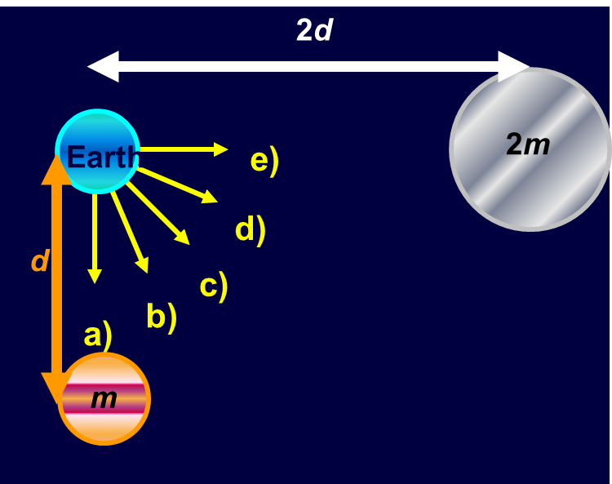
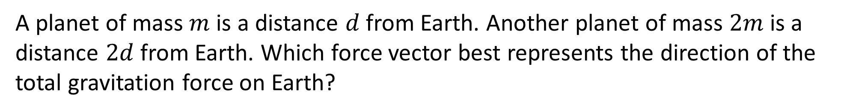
A planet of mass $m$is a distance $d$from Earth. Another planet of mass $2m$is a distance $2d$from Earth. Which force vector best represents the direction of the total gravitation force on Earth?

Slide 51
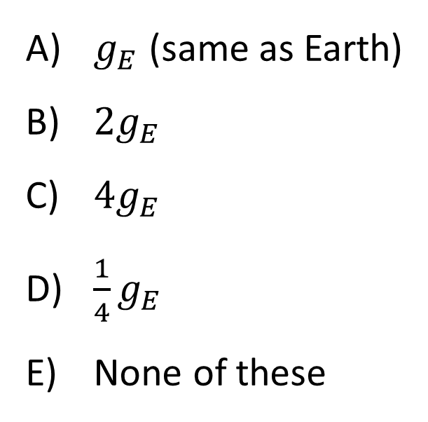
Planet X has the same mass as the Earth, but 1/2 the radius. (So, Planet X is more dense than Earth). What’s the free-fall acceleration due to gravity on Planet X?
$g_{E}$ (same as Earth)
$2g_{E}$
$4g_{E}$
$\frac{1}{4}g_{E}$
None of these

Slide 52
A satellite is in circular orbit at an altitude of 100 miles above the Earth’s surface. The satellite’s pre-launch weight is its weight measured on the ground. The magnitude of the force of gravity on the satellite in orbit is…
slightly greater than its pre-launch weight.
the same as its pre-launch weight.
slightly less than its pre-launch weight.
much less than its pre-launch weight, but not zero.
zero.

Slide 53
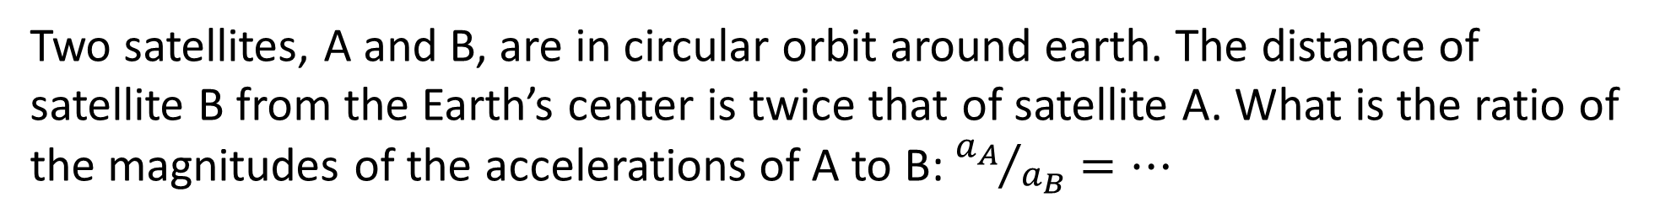
Two satellites, A and B, are in circular orbit around earth. The distance of satellite B from the Earth’s center is twice that of satellite A. What is the ratio of the magnitudes of the accelerations of A to B: ${a_{A}}/{a_{B}}=…$
1
2
4
½
¼

Slide 54
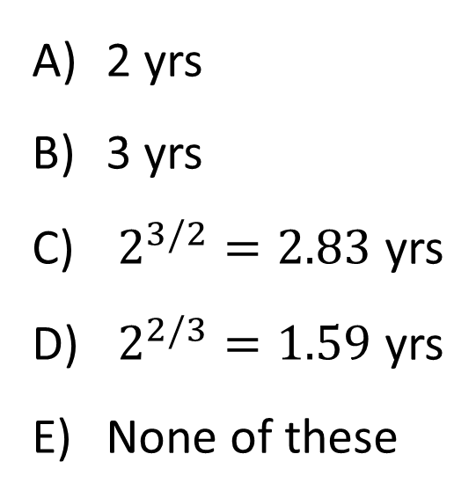
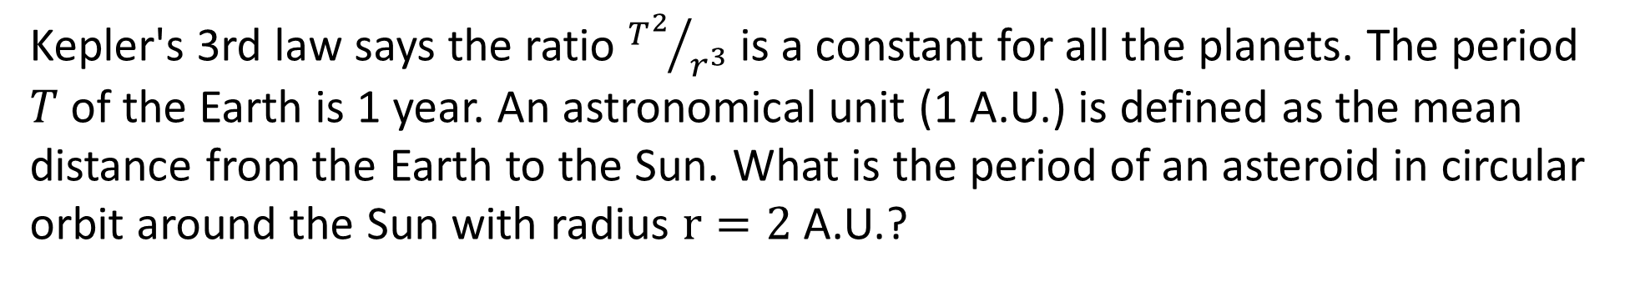
Kepler's 3rd law says the ratio ${T^{2}}/{r^{3}}$ is a constant for all the planets. The period $T$of the Earth is 1 year. An astronomical unit (1 A.U.) is defined as the mean distance from the Earth to the Sun. What is the period of an asteroid in circular orbit around the Sun with radius $r=2$ A.U.?
2 yrs
3 yrs
$2^{3/2}=2.83$ yrs
$2^{2/3}=1.59$ yrs
None of these

Slide 55
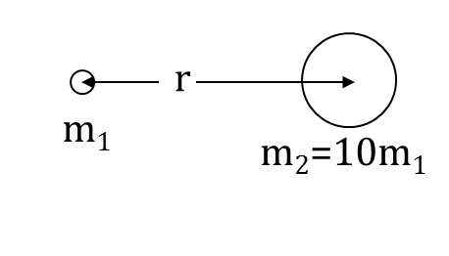
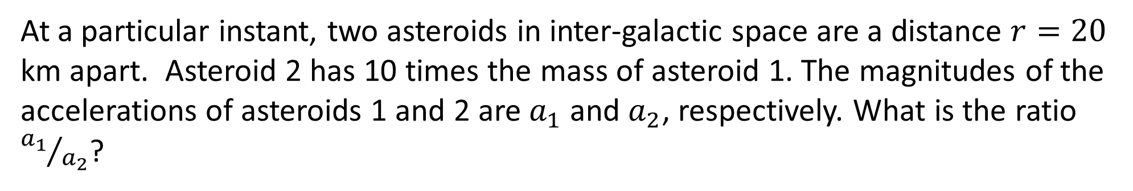
At a particular instant, two asteroids in inter-galactic space are a distance $r=20$ km apart. Asteroid 2 has 10 times the mass of asteroid 1. The magnitudes of the accelerations of asteroids 1 and 2 are $a_{1}$ and $a_{2}$, respectively. What is the ratio ${a_{1}}/{a_{2}}$?
10
1/10
1
Not enough information

Slide 56
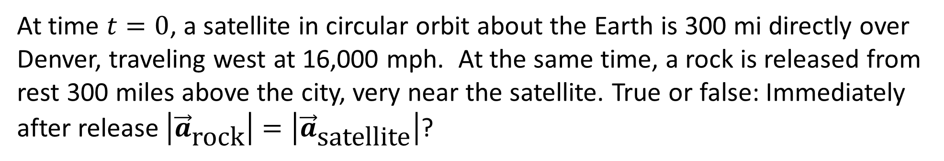
At time $t=0$, a satellite in circular orbit about the Earth is 300 mi directly over Denver, traveling west at 16,000 mph. At the same time, a rock is released from rest 300 miles above the city, very near the satellite. True or false: Immediately after release $\left|{\vec{a}}_{\text{rock}}\right|=\left|{\vec{a}}_{\text{satellite}}\right|$?
True
False

Slide 57
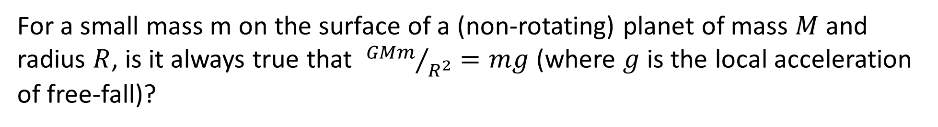
For a small mass m on the surface of a (non-rotating) planet of mass $M$ and radius $R$, is it always true that ${GMm}/{R^{2}}=mg$ (where $g$ is the local acceleration of free-fall)?
Yes, this is always true regardless of whether the mass m is in free-fall or not.
No, this is not always true.
Notes:
Phys 1110 Fa 15 SJP Lect # (review day) :

Slide 58
A planet in elliptical orbit around a star moves from the point in its orbit furthest from the star (A) to the closest point (P). The work done by gravity during this movement is…
zero
positive
negative

Slide 59
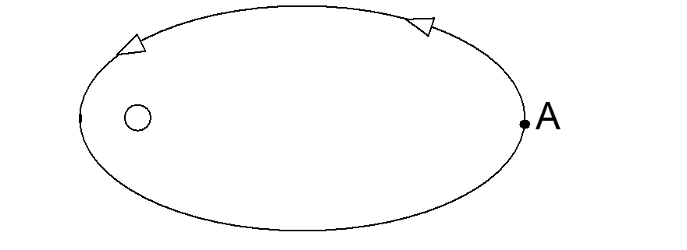
A planet in elliptical orbit around a star executes one complete orbit starting from point A and returning to A. The work done by gravity during this movement is…
zero
positive
negative

Slide 60
A small planet of mass m is in elliptical orbit about a large star of mass M. Which of the following statements is always true as the planet orbits the star?
The direction of the acceleration of the planet is toward the star.
The magnitude of the acceleration of the planet is a = v²/r ,where v is the speed of the planet and r is the distance between the planet and the star.
The magnitude of the force between the planet and the star is constant.
The speed of the planet is constant.
m
A) All are true always.
B) None are true always.
C) Only 1 and 2 are true always.
D) Only 1 is true always.
E) Some other combination.
M
Notes:
Phys 1110 Fa 15 SJP Lect # (review day) : No time, too much reading. (54% correct) At 2 PM I said “Hint, the answer is D” as they left, still only 76%. It was very late…

Slide 61
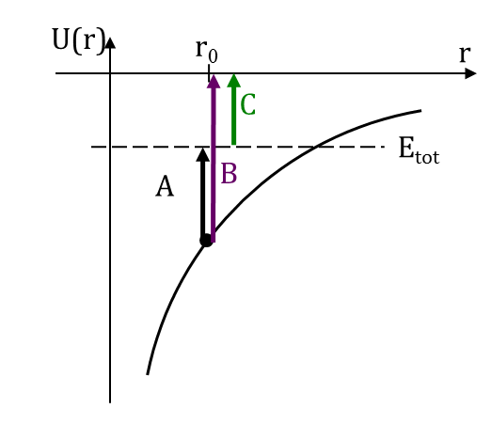
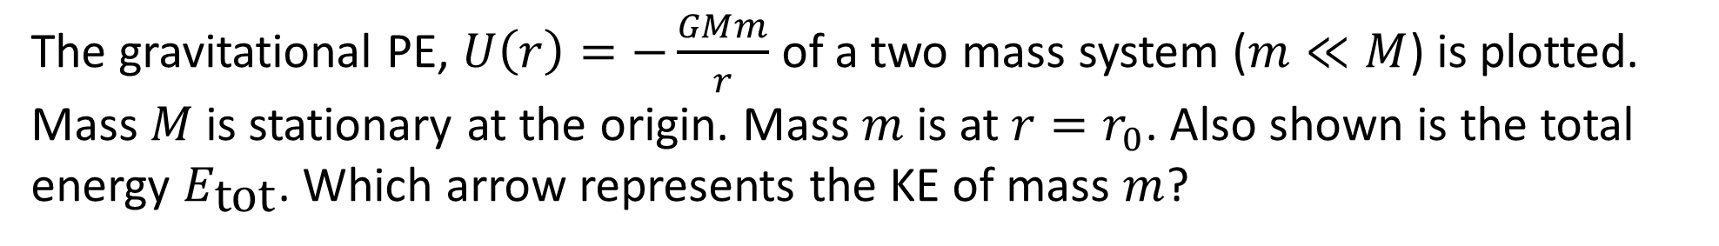
The gravitational PE, $U\left(r\right)=−\frac{GMm}{r}$of a two mass system ($m≪M$) is plotted. Mass $M$is stationary at the origin. Mass $m$is at $r=r_{0}$. Also shown is the total energy $E_{\text{tot}}$. Which arrow represents the KE of mass $m$?
A
B
C
None of these

Slide 62
The gravitational potential energy of a rock near a star is shown in the diagram. When the rock is at the position shown, it has a kinetic energy of 25MJ. Will the rock escape to infinity or is it bound in orbit about the star?
Escape
It is bound in orbit
impossible to tell
Notes:
Phys 1110 Fa 15 SJP Lect # (review day) :

Slide 63
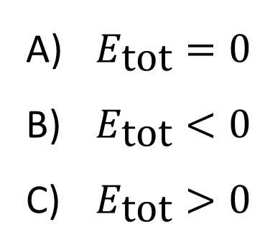
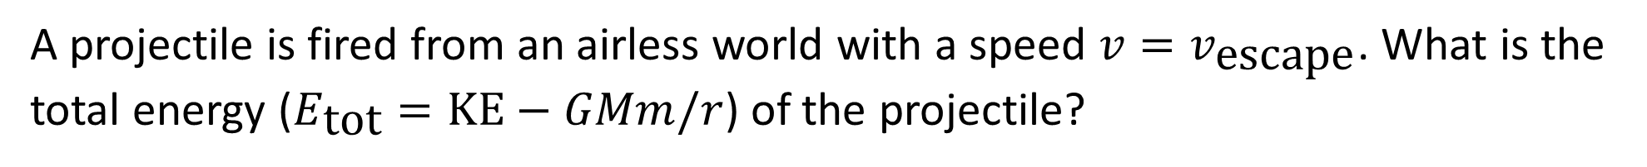
A projectile is fired from an airless world with a speed $v=v_{\text{escape}}$. What is the total energy ($E_{\text{tot}}=\text{KE}−GMm/r$) of the projectile?
$E_{\text{tot}}=0$
$E_{\text{tot}}<0$
$E_{\text{tot}}>0$

Slide 64
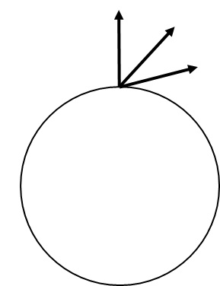
Does escape speed depend on launch angle? That is, if a projectile is given an initial speed $v_{0}$, is it more likely to escape an (airless, non-rotating) planet, if fired straight up than if fired at an angle?
Yes
No

Slide 65


To get $r_{\text{max}}$, what conservation of energy equation should you use?
$\frac{1}{2}m{v_{0}}^{2}−\frac{GMm}{r_{0}}=−\frac{GMm}{r_{\text{max}}}$
$\frac{1}{2}m{v_{0}}^{2}−\frac{GMm}{r_{0}}=\frac{1}{2}m{v_{\text{final}}}^{2}−\frac{GMm}{r_{\text{max}}}$
$\frac{1}{2}m{v_{0}}^{2}=−\frac{GMm}{r_{\text{max}}}$
$\frac{GMm}{r_{0}}=\frac{GMm}{r_{\text{max}}}$
None of these

Slide 66
A projectile is fired straight up from the surface of an airless planet (radius $R$) with the escape velocity $v_{\text{esc}}$ (so, the projectile barely escapes the planet's gravity and it asymptotically approaches ∞ distance and 0 speed.) What is the projectile's speed when it is a distance $4R$from the planet's center ($3R$from the surface)? Ignore the gravity of the Sun and other planets.
$\frac{1}{2}v_{\text{esc}}$
$\frac{1}{4}v_{\text{esc}}$
$\frac{1}{9}v_{\text{esc}}$
$\frac{1}{3}v_{\text{esc}}$
None of these

Slide 67


A projectile is fired straight up from the surface of an airless planet (mass M, radius $R$) with speed $v_{0}$. Derive an expression for the projectile's speed when it is a distance $4R$from the planet's center ($3R$from the surface)?
$v_{0}−\sqrt{\frac{3}{2}\frac{GM}{R}}$
$v_{0}−\sqrt{\frac{GM}{R}}$
$\sqrt{{v_{0}}^{2}−\frac{GM}{R}}$
$\sqrt{{v_{0}}^{2}−\frac{3}{2}\frac{GM}{R}}$

Slide 68



A planet is in elliptical orbit around the Sun. The zero of PE (or “$U$”) is chosen at $r=∞$, so that $U\left(r\right)=−\frac{GMm}{r}$. How does the magnitude of $U$ (note that $\left|U\right|=−U$) compare to KE?
$\left|U\right|>\text{KE}$
$\left|U\right|<\text{KE}$
$\left|U\right|=\text{KE}$

Slide 69


A projectile is fired straight up from the surface of an airless planet (radius $R$) with the escape velocity $v_{\text{esc}}$ (so, the projectile barely escapes the planet's gravity and it asymptotically approaches ∞ distance and 0 speed.) What is the projectile's speed when it is a distance $4R$from the planet's center ($3R$from the surface)? Ignore the gravity of the Sun and other planets.
$\frac{1}{2}v_{\text{esc}}$
$\frac{1}{4}v_{\text{esc}}$
$\frac{1}{9}v_{\text{esc}}$
$\frac{1}{3}v_{\text{esc}}$
None of these

