Slide 1
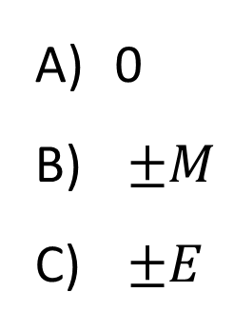
A mass is oscillating back and forth on a spring as shown. Position 0 is the unstretched position of the mass. At which point is the magnitude of the force on the mass maximum?
0
$±M$
$±E$

Slide 2
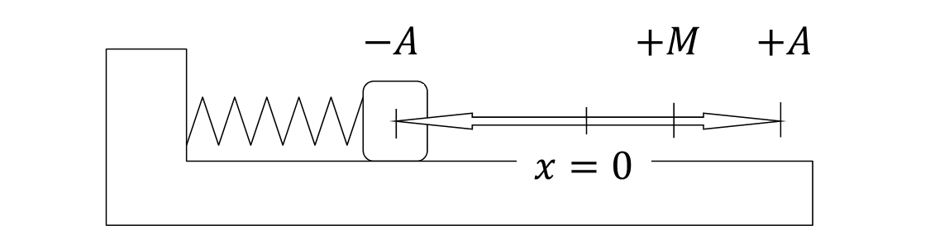
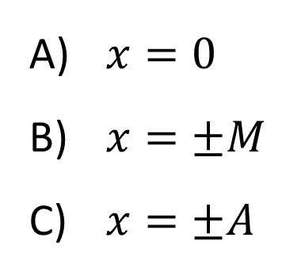
A mass is oscillating back and forth on a spring as shown. Position 0 is the unstretched position of the mass. At which point is the elastic potential energy maximum?
$x=0$
$x=±M$
$x=±A$

Slide 3
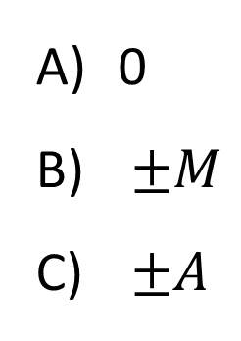
A mass is oscillating back and forth on a spring as shown. Position 0 is the unstretched position of the mass. At which point is the kinetic energy maximum?
0
$±M$
$±A$

Slide 4
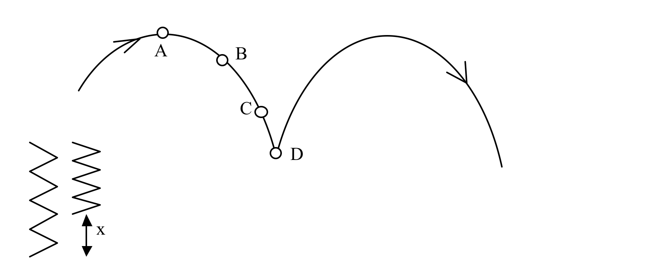
The tip of the nose of a pogo stick rider moves along the path shown. The maximum compression of the pogo stick spring is x. At what point(A, B, C or D) is the elastic potential of the spring energy a maximum?
Notes:
Phys 1110 Fa 15 SJP Lect # (review day) :

Slide 5
The tip of the nose of a pogo stick rider moves along the path shown. The maximum compression of the pogo stick spring is x. At what point is the gravitational potential energy a maximum?
Notes:
Phys 1110 Fa 15 SJP Lect # (review day) :

Slide 6
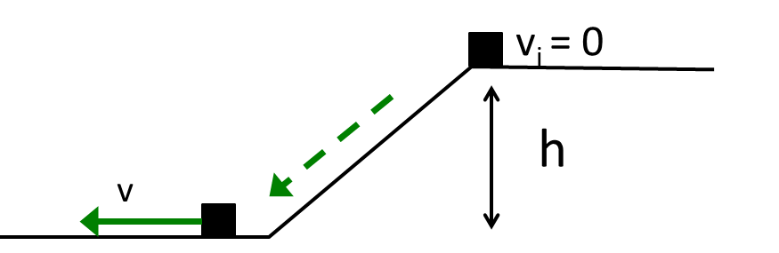
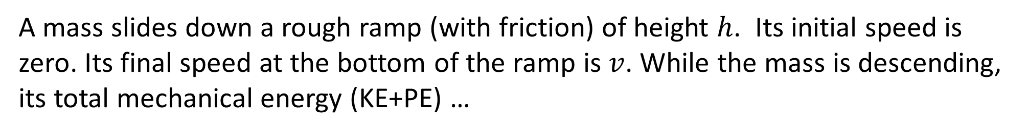
A mass slides down a rough ramp (with friction) of height $h$. Its initial speed is zero. Its final speed at the bottom of the ramp is $v$. While the mass is descending, its total mechanical energy (KE+PE) …
Increases
Decreases
Remains constant

Slide 7
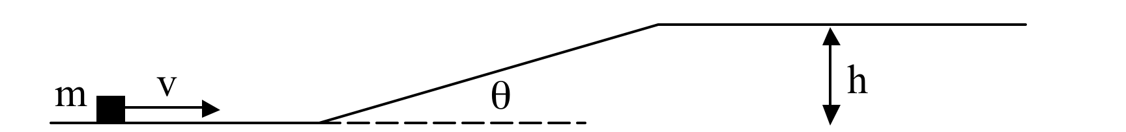
A block of mass m with initial speed v slides up a frictionless ramp of height h inclined at an angle θ as shown. Assume no friction. True or False: Whether the block makes it to the top of the ramp depends on the mass of block.
True
False
Notes:
Phys 1110 Fa 15 SJP Lect # (review day) :

Slide 8
A block of mass m with initial speed v slides up a ramp of height h inclined at an angle θ as shown. Assume there IS friction. True or False: Whether the block makes it to the top of the ramp depends on the angle θ.
True
False
Notes:
Phys 1110 Fa 15 SJP Lect # (review day) :

Slide 9
A mass m is dropped from rest from a height h_{i} above a table top on which sits on a spring with spring constant k. The mass compresses the spring by a maximum amount x and stops for an instant at a height h_{f­}. There is no friction in this problem. Which of the following equations correctly expresses conservation of energy and allows one to solve for the compression x of the spring?
mgh_{i} + ½ mv² = ½ kx²
mgh_{i} = ½ kx² + mgh_{f}
mgh_{i} + ½ kx² = mgh_{f}
mg(h_{F}- h_{i}) = ½ mv² + ½ kx²
None of these
Notes:
Phys 1110 Fa 15 SJP Lect # (review day) : 9, [[70]], 8, 11, 2 At 2PM; 7, [[69]], 8, 12, 3
Classic conservation of energy, not sure why they didn’t score better, but again, perhaps time constraint is killing them.

Slide 10
A pendulum is launched in two different ways. During both launches, the bob is given an initial speed of 3.0 m/s and the same initial angle from the vertical. On launch 1, the speed is upwards, on launch 2, the speed is downwards. Assume no friction. Which launch will cause the pendulum to swing the largest angle from the equilibrium position on the left side?
Launch 1
Launch 2
Both launches give the same maximum displacement.
Notes:
Phys 1110 Fa 15 SJP Lect # (review day) :

Slide 11
A “system” consists of a mass m hanging from a spring (spring constant k) and the Earth as shown. In situation A, the mass is hanging freely, at rest, so the spring is stretched beyond its relaxed length. In situation B, the mass is also stationary, but the spring is now at its relaxed length, because an alien from Planet X has lifted the mass and is holding it up. In which situation is the total energy of the mass/spring/earth system bigger?
A
B
Same in both

Slide 12
A cart rolls on a frictionless track. The total mechanical energy (KE + PE) is 45 kJ. What is ${\text{KE}}_{\text{max}}$ over this stretch of track?
55 kJ
10 kJ
45 kJ
35 kJ
None of these

Slide 13
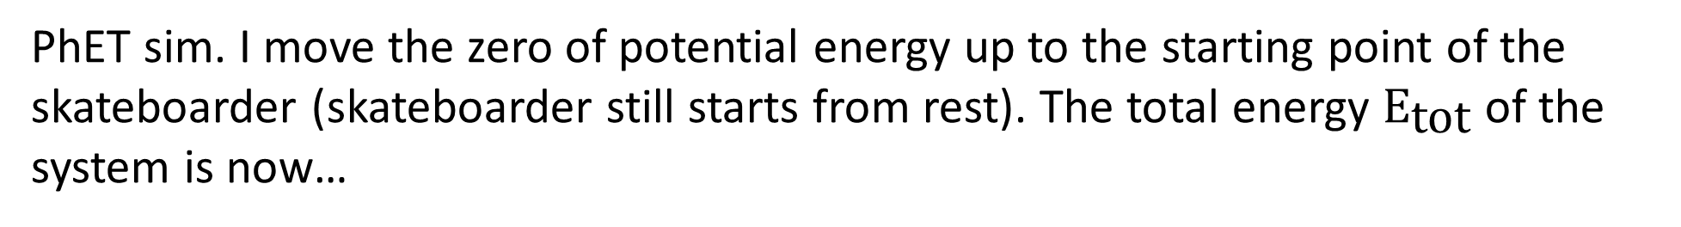
PhET sim. I move the zero of potential energy up to the starting point of the skateboarder (skateboarder still starts from rest). The total energy ${\text{E}}_{\text{tot}}$ of the system is now…
zero.
positive.
negative.
depends on the position of the skateboarder.

Slide 14
A cart rolls on a frictionless track. The total mechanical energy (KE + PE) is 0 kJ. What is ${\text{KE}}_{\text{max}}$ over this stretch of track?
-35 kJ
-15 kJ
15 kJ
35 kJ
None of these

Slide 15
A cart rolls on a frictionless track. The total mechanical energy (KE + PE) is 45 kJ. When the $\text{K}\text{E}$ is minimum (at 35 m), what is the direction of acceleration?
up
down
right
left
acceleration is zero

Slide 16
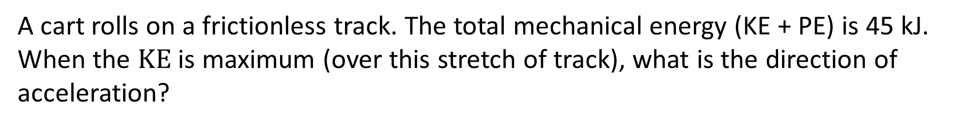
A cart rolls on a frictionless track. The total mechanical energy (KE + PE) is 45 kJ. When the $\text{K}\text{E}$ is maximum (over this stretch of track), what is the direction of acceleration?
up
down
right
left
acceleration is zero

Slide 17
A cart rolls to the right on a frictionless track. If the KE of the cart when it is at $x=20$ m is $20$ kJ, will it make it over the hill?
Yes
No
Not enough information

Slide 18
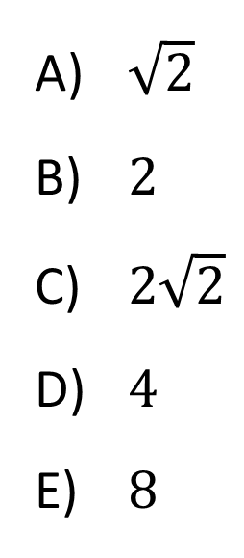
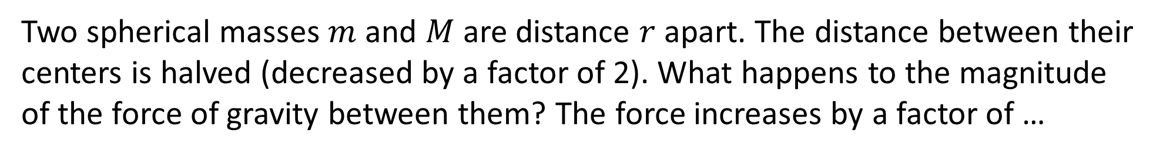
Two spherical masses $m$and $M$are distance $r$apart. The distance between their centers is halved (decreased by a factor of 2). What happens to the magnitude of the force of gravity between them? The force increases by a factor of …
m
r
M
$\sqrt{2}$
$2$
$2\sqrt{2}$
$4$
$8$

Slide 19
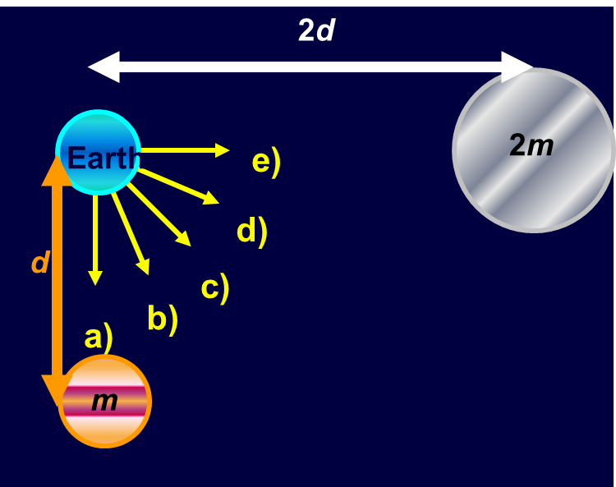
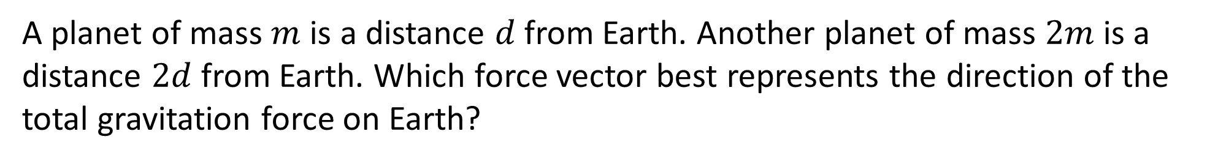
A planet of mass $m$is a distance $d$from Earth. Another planet of mass $2m$is a distance $2d$from Earth. Which force vector best represents the direction of the total gravitation force on Earth?

Slide 20
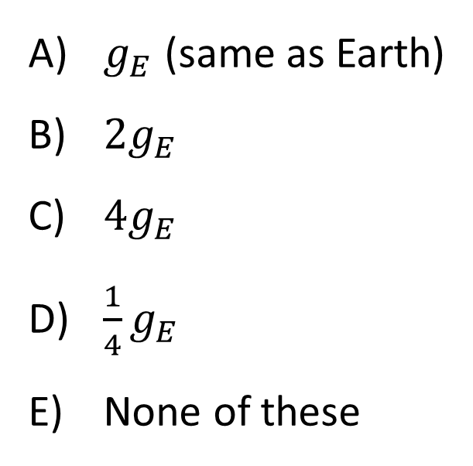
Planet X has the same mass as the Earth, but 1/2 the radius. (So, Planet X is more dense than Earth). What’s the free-fall acceleration due to gravity on Planet X?
$g_{E}$ (same as Earth)
$2g_{E}$
$4g_{E}$
$\frac{1}{4}g_{E}$
None of these

Slide 21
A satellite is in circular orbit at an altitude of 100 miles above the Earth’s surface. The satellite’s pre-launch weight is its weight measured on the ground. The magnitude of the force of gravity on the satellite in orbit is…
slightly greater than its pre-launch weight.
the same as its pre-launch weight.
slightly less than its pre-launch weight.
much less than its pre-launch weight, but not zero.
zero.

Slide 22
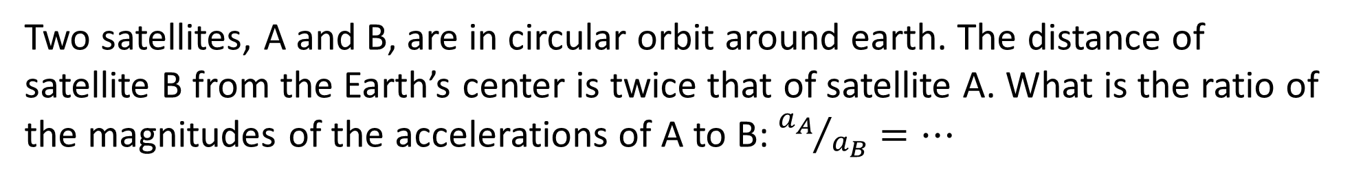
Two satellites, A and B, are in circular orbit around earth. The distance of satellite B from the Earth’s center is twice that of satellite A. What is the ratio of the magnitudes of the accelerations of A to B: ${a_{A}}/{a_{B}}=…$
1
2
4
½
¼

Slide 23
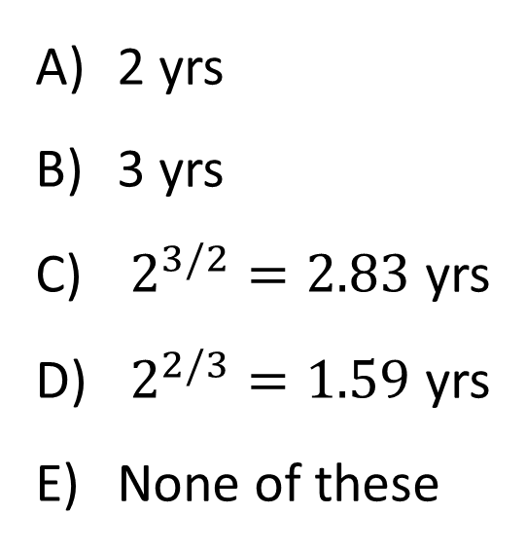
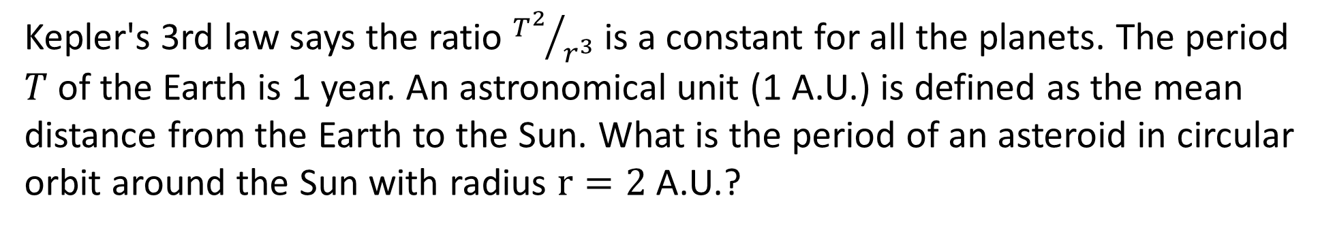
Kepler's 3rd law says the ratio ${T^{2}}/{r^{3}}$ is a constant for all the planets. The period $T$of the Earth is 1 year. An astronomical unit (1 A.U.) is defined as the mean distance from the Earth to the Sun. What is the period of an asteroid in circular orbit around the Sun with radius $r=2$ A.U.?
2 yrs
3 yrs
$2^{3/2}=2.83$ yrs
$2^{2/3}=1.59$ yrs
None of these

Slide 24
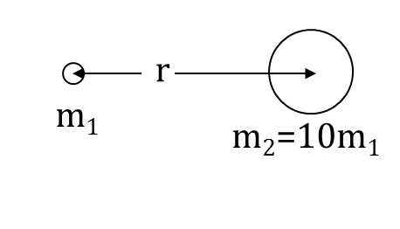
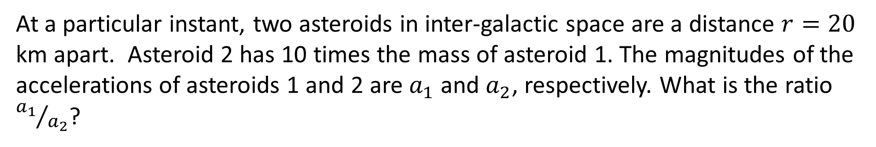
At a particular instant, two asteroids in inter-galactic space are a distance $r=20$ km apart. Asteroid 2 has 10 times the mass of asteroid 1. The magnitudes of the accelerations of asteroids 1 and 2 are $a_{1}$ and $a_{2}$, respectively. What is the ratio ${a_{1}}/{a_{2}}$?
10
1/10
1
Not enough information

Slide 25
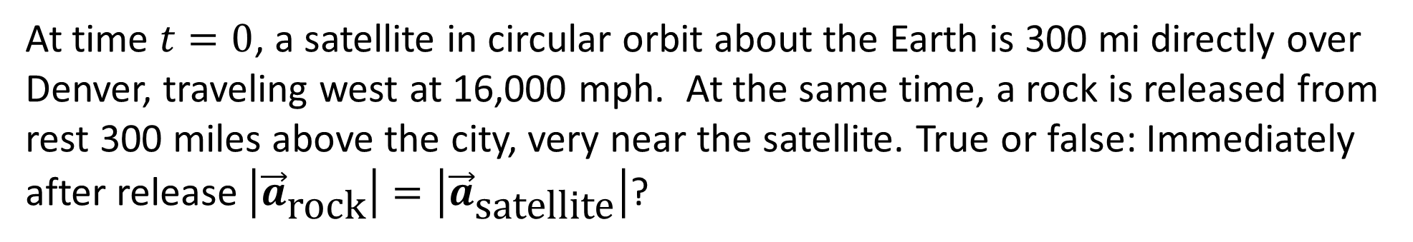
At time $t=0$, a satellite in circular orbit about the Earth is 300 mi directly over Denver, traveling west at 16,000 mph. At the same time, a rock is released from rest 300 miles above the city, very near the satellite. True or false: Immediately after release $\left|{\vec{a}}_{\text{rock}}\right|=\left|{\vec{a}}_{\text{satellite}}\right|$?
True
False

Slide 26
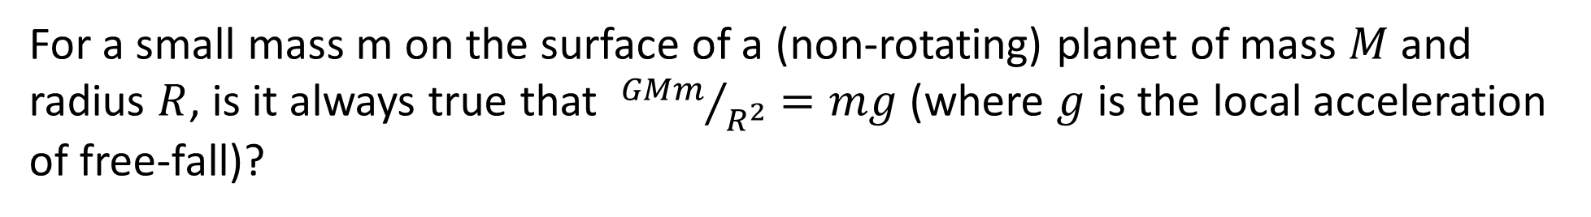
For a small mass m on the surface of a (non-rotating) planet of mass $M$ and radius $R$, is it always true that ${GMm}/{R^{2}}=mg$ (where $g$ is the local acceleration of free-fall)?
Yes, this is always true regardless of whether the mass m is in free-fall or not.
No, this is not always true.
Notes:
Phys 1110 Fa 15 SJP Lect # (review day) :

Slide 27
A planet in elliptical orbit around a star moves from the point in its orbit furthest from the star (A) to the closest point (P). The work done by gravity during this movement is…
zero
positive
negative

Slide 28
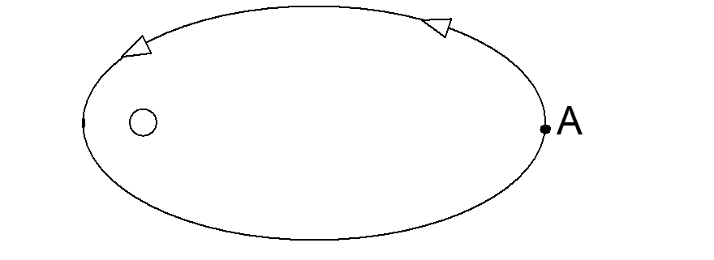
A planet in elliptical orbit around a star executes one complete orbit starting from point A and returning to A. The work done by gravity during this movement is…
zero
positive
negative

Slide 29
A small planet of mass m is in elliptical orbit about a large star of mass M. Which of the following statements is always true as the planet orbits the star?
The direction of the acceleration of the planet is toward the star.
The magnitude of the acceleration of the planet is a = v²/r ,where v is the speed of the planet and r is the distance between the planet and the star.
The magnitude of the force between the planet and the star is constant.
The speed of the planet is constant.
m
A) All are true always.
B) None are true always.
C) Only 1 and 2 are true always.
D) Only 1 is true always.
E) Some other combination.
M
Notes:
Phys 1110 Fa 15 SJP Lect # (review day) : No time, too much reading. (54% correct) At 2 PM I said “Hint, the answer is D” as they left, still only 76%. It was very late…

Slide 30
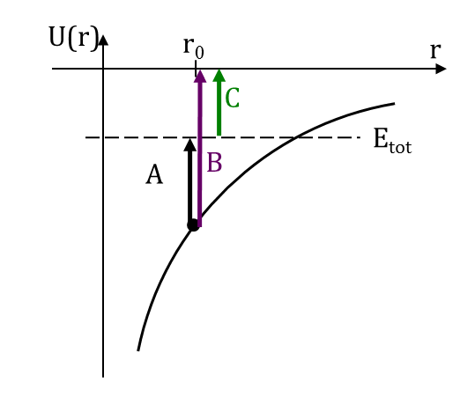
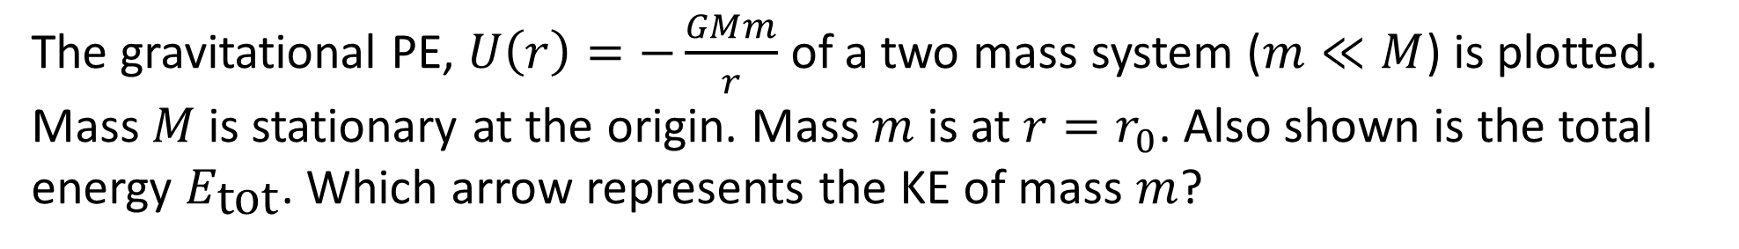
The gravitational PE, $U\left(r\right)=−\frac{GMm}{r}$of a two mass system ($m≪M$) is plotted. Mass $M$is stationary at the origin. Mass $m$is at $r=r_{0}$. Also shown is the total energy $E_{\text{tot}}$. Which arrow represents the KE of mass $m$?
A
B
C
None of these

Slide 31
The gravitational potential energy of a rock near a star is shown in the diagram. When the rock is at the position shown, it has a kinetic energy of 25MJ. Will the rock escape to infinity or is it bound in orbit about the star?
Escape
It is bound in orbit
impossible to tell
Notes:
Phys 1110 Fa 15 SJP Lect # (review day) :

Slide 32
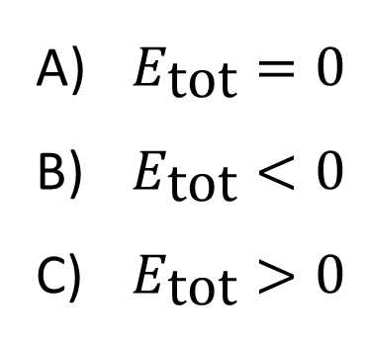
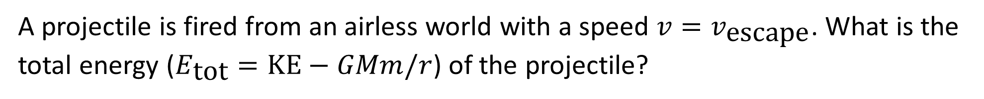
A projectile is fired from an airless world with a speed $v=v_{\text{escape}}$. What is the total energy ($E_{\text{tot}}=\text{KE}−GMm/r$) of the projectile?
$E_{\text{tot}}=0$
$E_{\text{tot}}<0$
$E_{\text{tot}}>0$

Slide 33
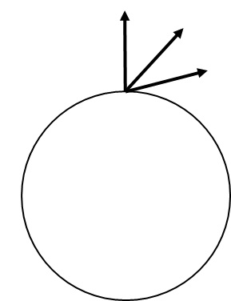
Does escape speed depend on launch angle? That is, if a projectile is given an initial speed $v_{0}$, is it more likely to escape an (airless, non-rotating) planet, if fired straight up than if fired at an angle?
Yes
No

Slide 34
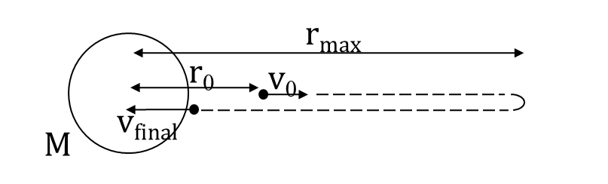
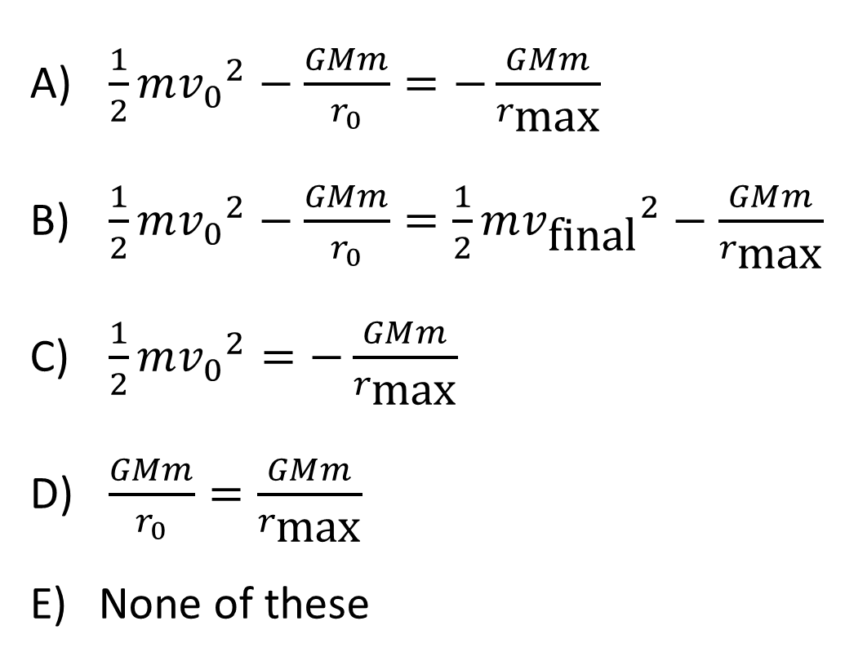
To get $r_{\text{max}}$, what conservation of energy equation should you use?
$\frac{1}{2}m{v_{0}}^{2}−\frac{GMm}{r_{0}}=−\frac{GMm}{r_{\text{max}}}$
$\frac{1}{2}m{v_{0}}^{2}−\frac{GMm}{r_{0}}=\frac{1}{2}m{v_{\text{final}}}^{2}−\frac{GMm}{r_{\text{max}}}$
$\frac{1}{2}m{v_{0}}^{2}=−\frac{GMm}{r_{\text{max}}}$
$\frac{GMm}{r_{0}}=\frac{GMm}{r_{\text{max}}}$
None of these

Slide 35
A projectile is fired straight up from the surface of an airless planet (radius $R$) with the escape velocity $v_{\text{esc}}$ (so, the projectile barely escapes the planet's gravity and it asymptotically approaches ∞ distance and 0 speed.) What is the projectile's speed when it is a distance $4R$from the planet's center ($3R$from the surface)? Ignore the gravity of the Sun and other planets.
$\frac{1}{2}v_{\text{esc}}$
$\frac{1}{4}v_{\text{esc}}$
$\frac{1}{9}v_{\text{esc}}$
$\frac{1}{3}v_{\text{esc}}$
None of these

Slide 36
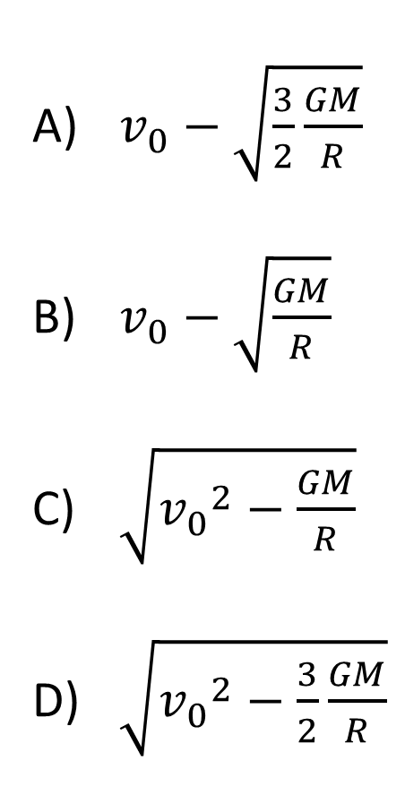
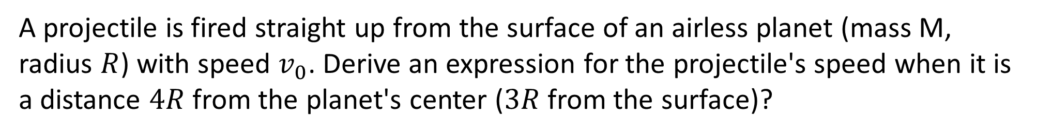
A projectile is fired straight up from the surface of an airless planet (mass M, radius $R$) with speed $v_{0}$. Derive an expression for the projectile's speed when it is a distance $4R$from the planet's center ($3R$from the surface)?
$v_{0}−\sqrt{\frac{3}{2}\frac{GM}{R}}$
$v_{0}−\sqrt{\frac{GM}{R}}$
$\sqrt{{v_{0}}^{2}−\frac{GM}{R}}$
$\sqrt{{v_{0}}^{2}−\frac{3}{2}\frac{GM}{R}}$

Slide 37
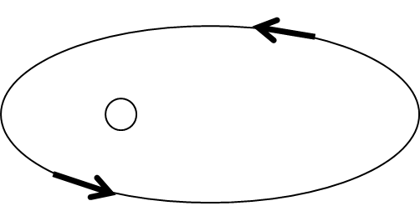
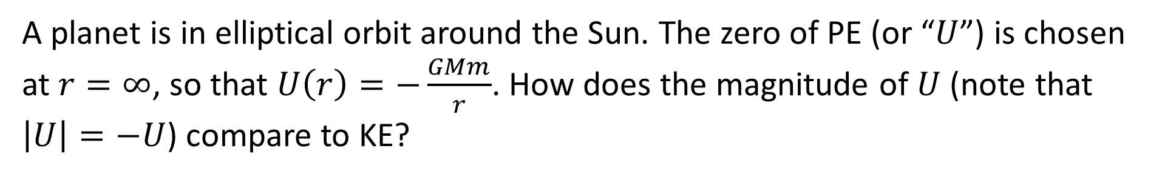
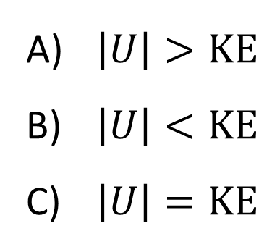
A planet is in elliptical orbit around the Sun. The zero of PE (or “$U$”) is chosen at $r=∞$, so that $U\left(r\right)=−\frac{GMm}{r}$. How does the magnitude of $U$ (note that $\left|U\right|=−U$) compare to KE?
$\left|U\right|>\text{KE}$
$\left|U\right|<\text{KE}$
$\left|U\right|=\text{KE}$

Slide 38
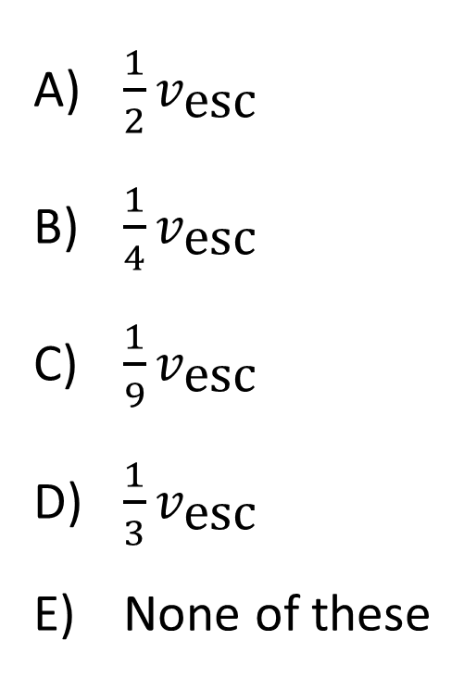
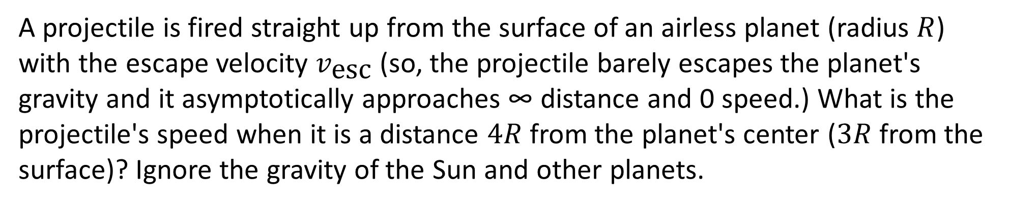
A projectile is fired straight up from the surface of an airless planet (radius $R$) with the escape velocity $v_{\text{esc}}$ (so, the projectile barely escapes the planet's gravity and it asymptotically approaches ∞ distance and 0 speed.) What is the projectile's speed when it is a distance $4R$from the planet's center ($3R$from the surface)? Ignore the gravity of the Sun and other planets.
$\frac{1}{2}v_{\text{esc}}$
$\frac{1}{4}v_{\text{esc}}$
$\frac{1}{9}v_{\text{esc}}$
$\frac{1}{3}v_{\text{esc}}$
None of these

