Slide 1
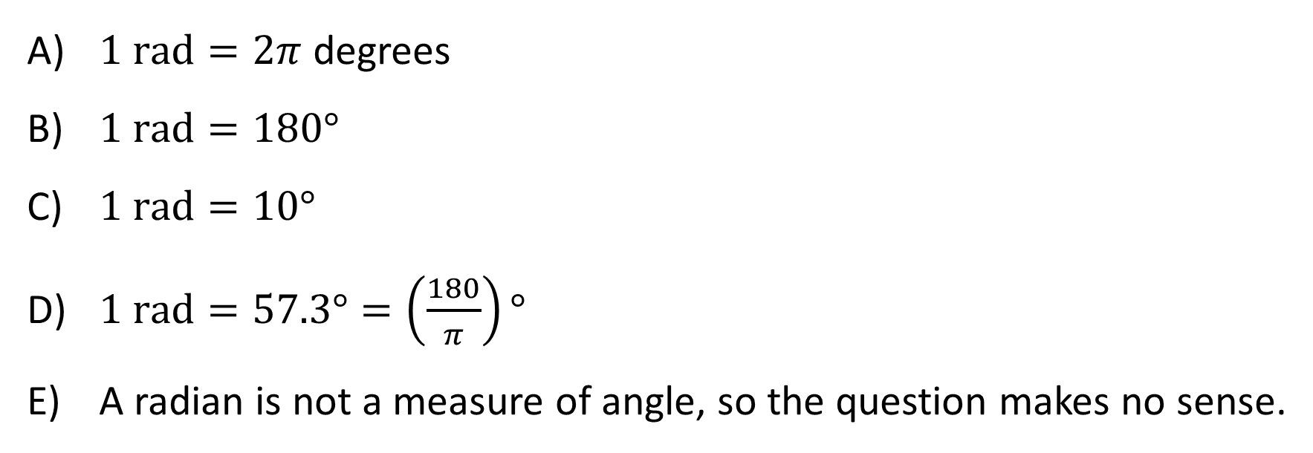
How many degrees in 1 radian?
$1 \text{rad}=2π$ degrees
$1 \text{rad}=180°$
$1 \text{rad}=10°$
$1 \text{rad}=57.3°=\left(\frac{180}{π}\right)°$
A radian is not a measure of angle, so the question makes no sense.

Slide 2
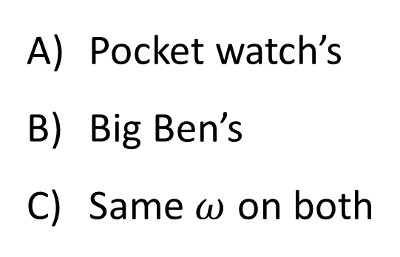
A pocket watch and Big Ben are both keeping perfect time. Which minute hand has the larger magnitude angular velocity $ω$?
Pocket watch’s
Big Ben’s
Same $ω$ on both

Slide 3
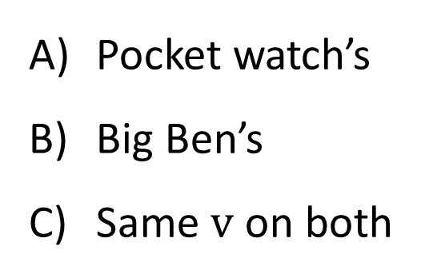
A pocket watch and Big Ben are both keeping perfect time. Which minute hand’s tip has the larger magnitude tangential velocity $v$?
Pocket watch’s
Big Ben’s
Same $v$ on both

Slide 4
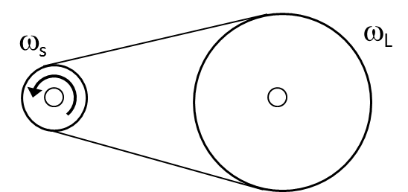
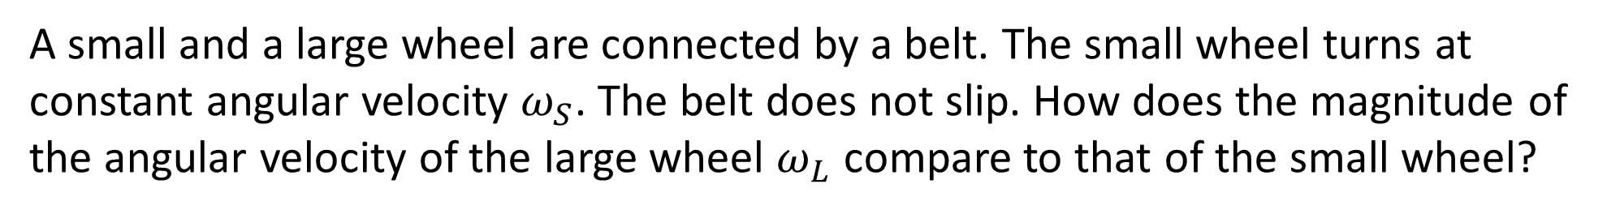
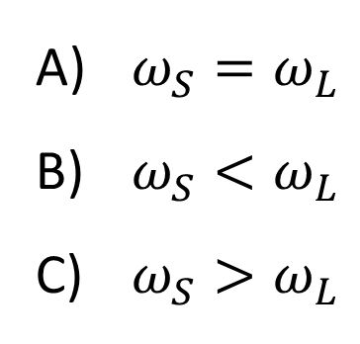
A small and a large wheel are connected by a belt. The small wheel turns at constant angular velocity $ω_{S}$. The belt does not slip. How does the magnitude of the angular velocity of the large wheel $ω_{L}$ compare to that of the small wheel?
$ω_{S}=ω_{L}$
$ω_{S}<ω_{L}$
$ω_{S}>ω_{L}$

Slide 5
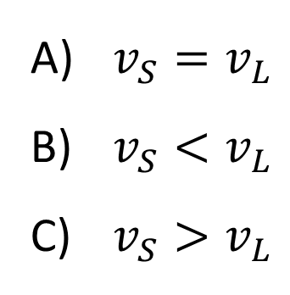
In the previous question, there is a bug S on the rim of the small wheel and another bug L on the rim of the large wheel. How do their speeds compare? Again, the belt does not slip.
$v_{S}=v_{L}$
$v_{S}<v_{L}$
$v_{S}>v_{L}$

Slide 6
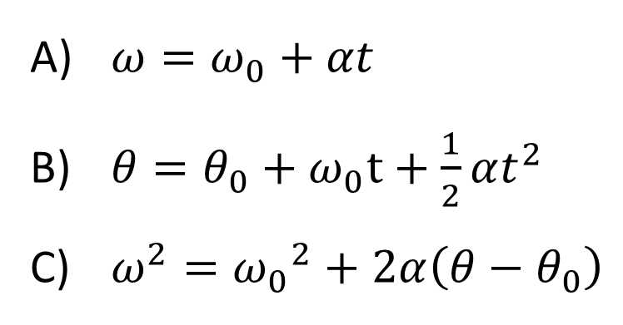
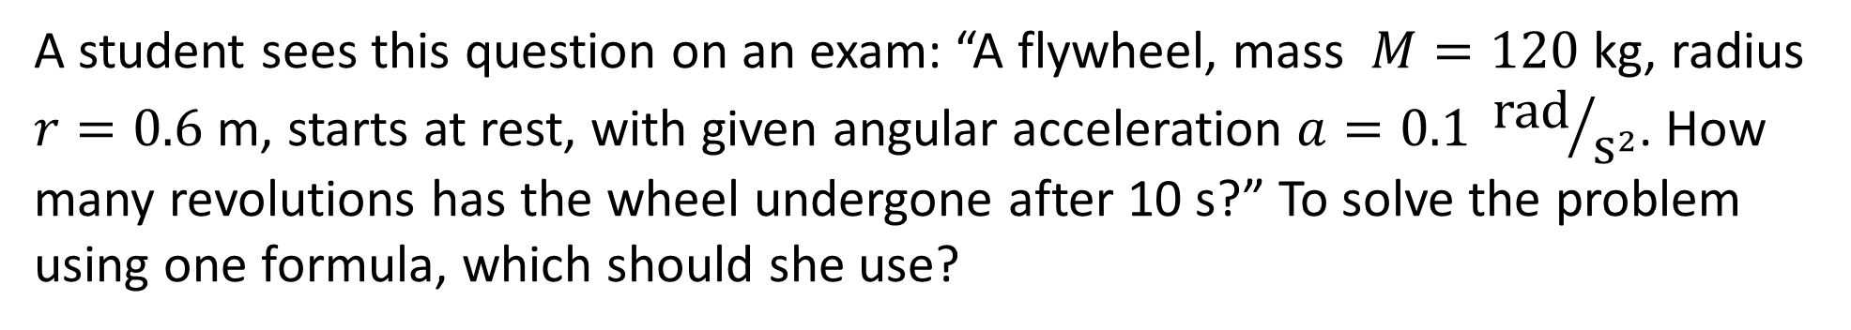
A student sees this question on an exam: “A flywheel, mass $M=120$ kg, radius $r=0.6$ m, starts at rest, with given angular acceleration $a=0.1 {\text{rad}}/{{\text{s}}^{2}}$. How many revolutions has the wheel undergone after 10 s?” To solve the problem using one formula, which should she use?
$ω=ω_{0}+αt$
$θ=θ_{0}+ω_{0}t+\frac{1}{2}αt^{2}$
$ω^{2}={ω_{0}}^{2}+2α\left(θ−θ_{0}\right)$

Slide 7
How many of the following statements about the minute hand of a clock are true?
The tangential acceleration is zero
The centripetal acceleration is zero
The angular acceleration is zero
None are ture
One is true
Two are true
All three are true

Slide 8
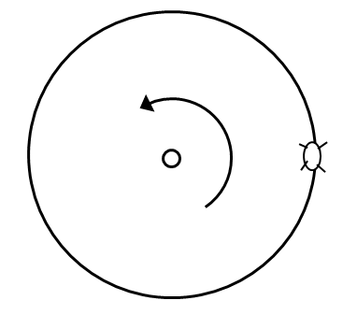
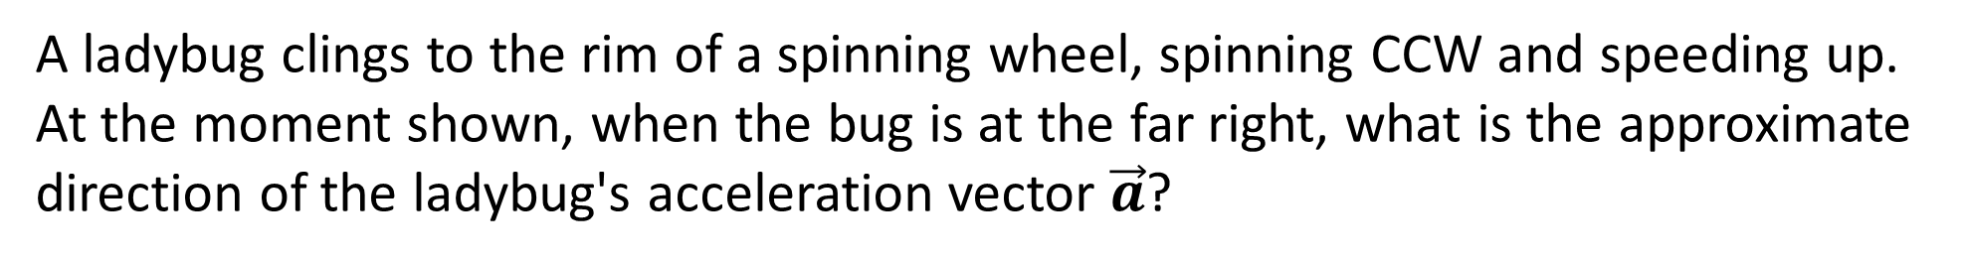
A ladybug clings to the rim of a spinning wheel, spinning CCW and speeding up. At the moment shown, when the bug is at the far right, what is the approximate direction of the ladybug's acceleration vector $\vec{a}$?
↙
↑
→
←
↖

Slide 9
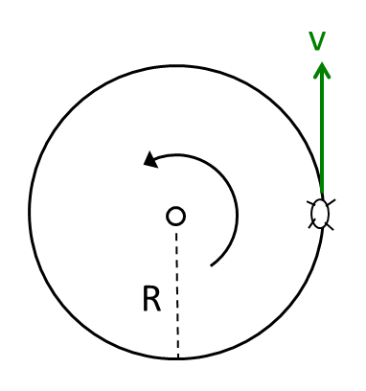
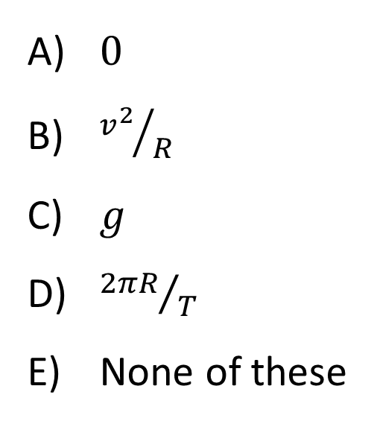
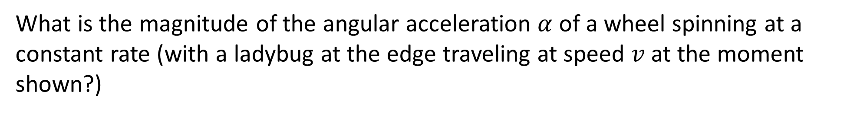
What is the magnitude of the angular acceleration $α$ of a wheel spinning at a constant rate (with a ladybug at the edge traveling at speed $v$at the moment shown?)
$0$
${v^{2}}/R$
$g$
${2πR}/T$
None of these

Slide 10
Three forces (A, B, C) are applied to a rod which pivots on an axis through its center. Which force causes the largest magnitude torque?
[Note: $\cos{45°}=\sin{45°}=\frac{1}{\sqrt{2}}=0.71$]
A
B
C
2 or more tie for the largest torque

Slide 11
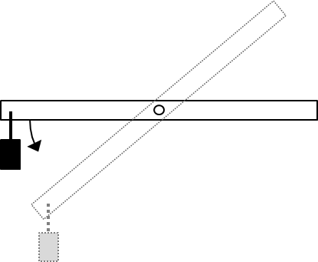
A small mass hangs from the end of a light horizontal bar which pivots about an axis through it center, but is being held stationary. The bar is then released and begins to rotate. As the bar rotates from horizontal to vertical, the magnitude of the torque on the bar…
increases.
decreases.
remains constant.

Slide 12
Three forces are applied to a rod which rotates about the center. What is the net torque about the axis? Use our sign convention.
$RF$
$−RF$
$0$
$3RF$
$−3RF$

Slide 13
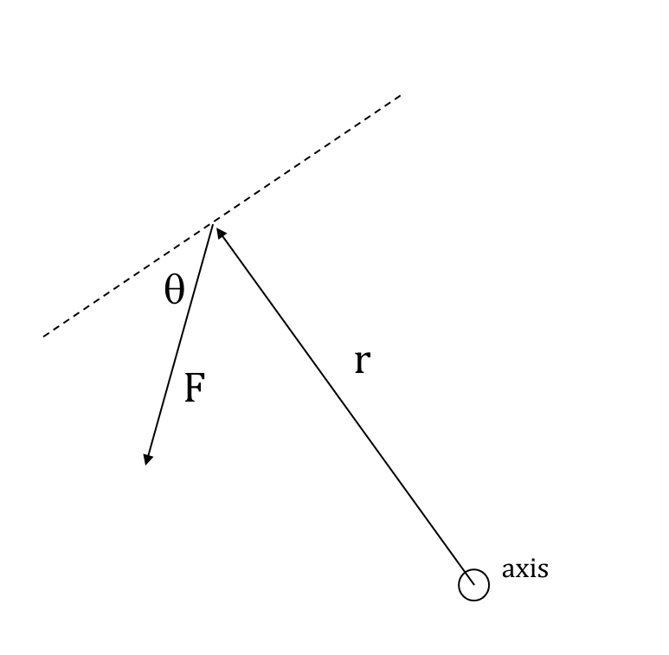
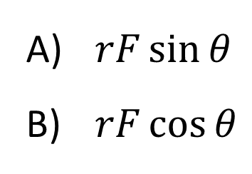
What is the magnitude of the torque about the axis?
$rF\sin{θ}$
$rF\cos{θ}$

Slide 14
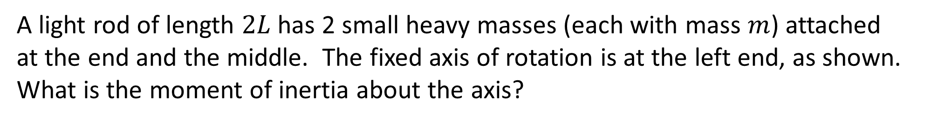
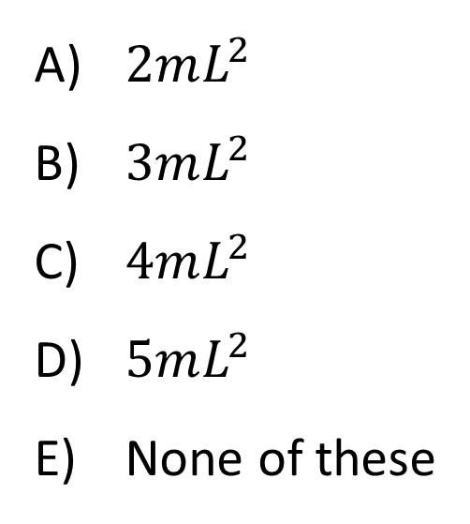
A light rod of length $2L$ has 2 small heavy masses (each with mass $m$) attached at the end and the middle. The fixed axis of rotation is at the left end, as shown. What is the moment of inertia about the axis?
$2mL^{2}$
$3mL^{2}$
$4mL^{2}$
$5mL^{2}$
None of these

Slide 15
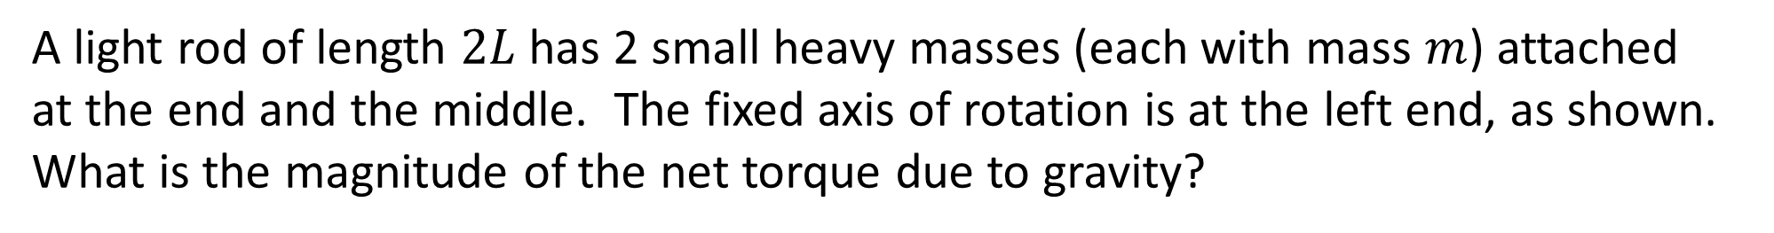
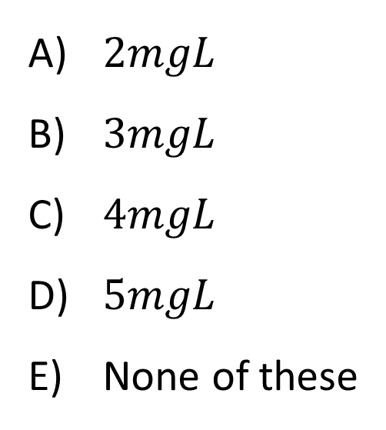
A light rod of length $2L$ has 2 small heavy masses (each with mass $m$) attached at the end and the middle. The fixed axis of rotation is at the left end, as shown. What is the magnitude of the net torque due to gravity?
$2mgL$
$3mgL$
$4mgL$
$5mgL$
None of these

Slide 16
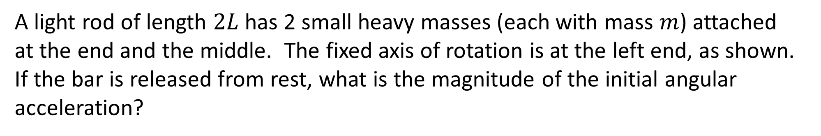
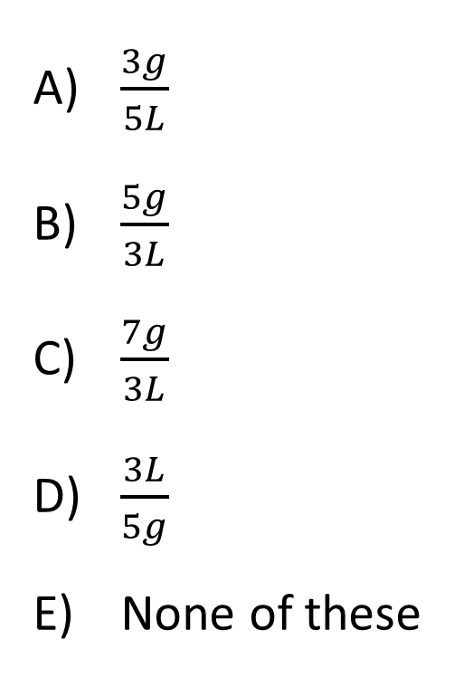
A light rod of length $2L$ has 2 small heavy masses (each with mass $m$) attached at the end and the middle. The fixed axis of rotation is at the left end, as shown. If the bar is released from rest, what is the magnitude of the initial angular acceleration?
$\frac{3g}{5L}$
$\frac{5g}{3L}$
$\frac{7g}{3L}$
$\frac{3L}{5g}$
None of these

Slide 17
The two rulers have the same torque applied (1 weight at end vs. 2 weights in middle). Which will swing faster when released?
The ruler with 1 weight at the end
The ruler with 2 weights in the middle
Both the same

Slide 18
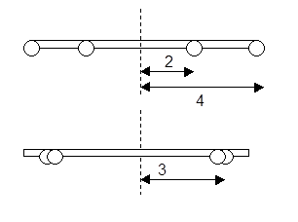
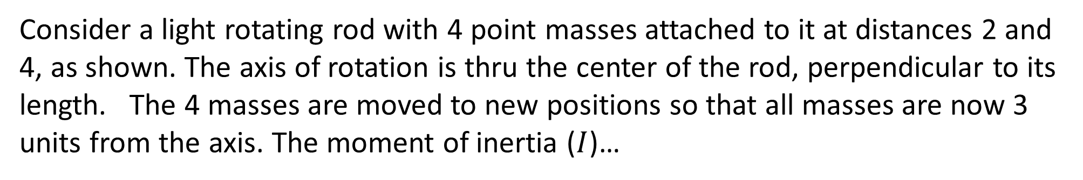
Consider a light rotating rod with 4 point masses attached to it at distances 2 and 4, as shown. The axis of rotation is thru the center of the rod, perpendicular to its length. The 4 masses are moved to new positions so that all masses are now 3 units from the axis. The moment of inertia ($I$)…
increased.
decreased.
remained the same.

Slide 19
A mallet consists of a heavy steel cubical head on a light wooden handle. About which axis of rotation is the moment of inertia $I$ maximum?
E) More than one is tied for max

Slide 20
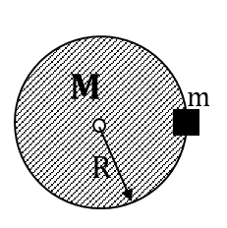
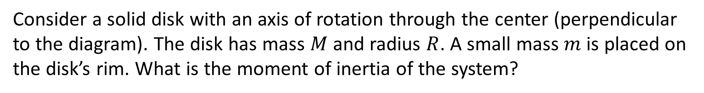
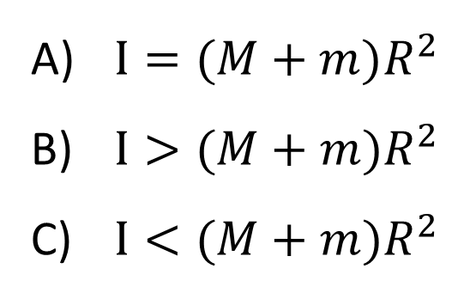
Consider a solid disk with an axis of rotation through the center (perpendicular to the diagram). The disk has mass $M$and radius $R$. A small mass $m$is placed on the disk’s rim. What is the moment of inertia of the system?
$I=(M+m)R^{2}$
$I>(M+m)R^{2}$
$I<(M+m)R^{2}$

Slide 21
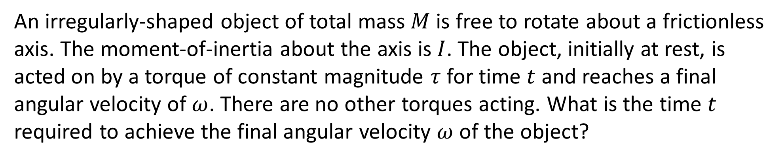
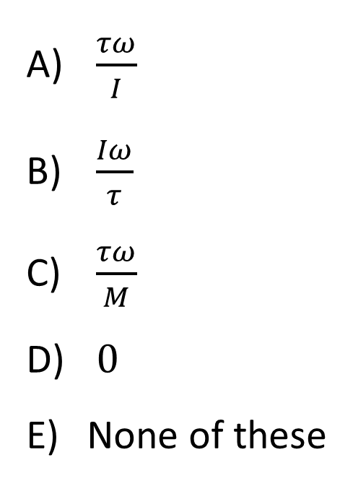
An irregularly-shaped object of total mass $M$is free to rotate about a frictionless axis. The moment-of-inertia about the axis is $I$. The object, initially at rest, is acted on by a torque of constant magnitude $τ$ for time $t$ and reaches a final angular velocity of $ω$. There are no other torques acting. What is the time $t$ required to achieve the final angular velocity $ω$ of the object?
$\frac{τω}{I}$
$\frac{Iω}{τ}$
$\frac{τω}{M}$
$0$
None of these

Slide 22
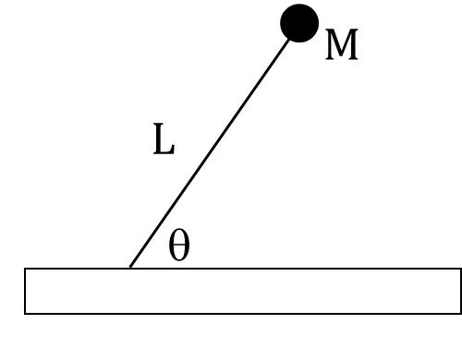
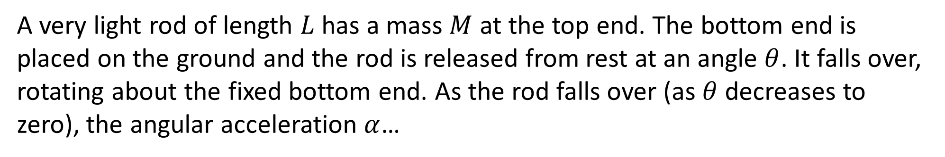
A very light rod of length $L$ has a mass $M$ at the top end. The bottom end is placed on the ground and the rod is released from rest at an angle $θ$. It falls over, rotating about the fixed bottom end. As the rod falls over (as $θ$ decreases to zero), the angular acceleration $α$…
increases.
decreases.
remains constant.

Slide 23
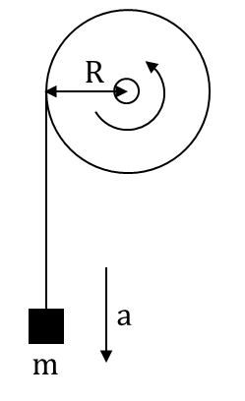
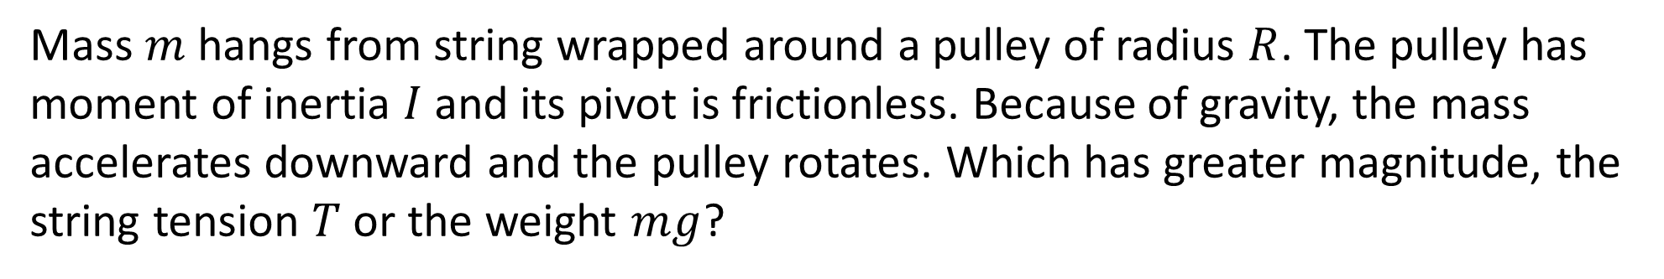
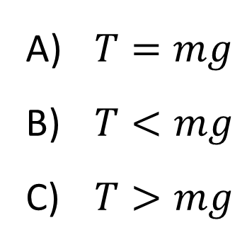
Mass $m$hangs from string wrapped around a pulley of radius $R$. The pulley has moment of inertia $I$and its pivot is frictionless. Because of gravity, the mass
accelerates downward and the pulley rotates. Which has greater magnitude, the string tension $T$ or the weight $mg$?
$T=mg$
$T<mg$
$T>mg$

Slide 24
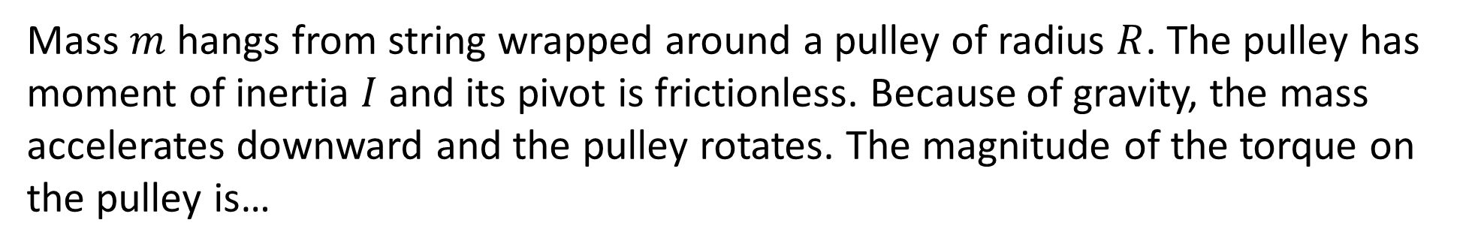
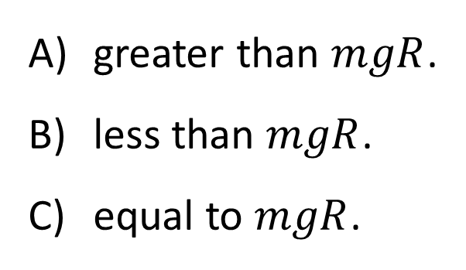
Mass $m$hangs from string wrapped around a pulley of radius $R$. The pulley has moment of inertia $I$and its pivot is frictionless. Because of gravity, the mass
accelerates downward and the pulley rotates. The magnitude of the torque on the pulley is…
greater than $mgR$.
less than $mgR$.
equal to $mgR$.

Slide 25
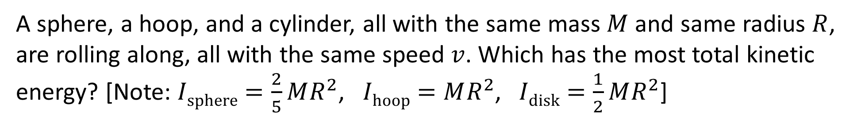
A sphere, a hoop, and a cylinder, all with the same mass $M$and same radius $R$, are rolling along, all with the same speed $v$. Which has the most total kinetic energy? [Note: $Isphere=\frac{2}{5}MR^{2}$, $Ihoop=MR^{2}$, $Idisk=\frac{1}{2}MR^{2}$]
Sphere
Hoop
Disk
All have the same total KE

Slide 26
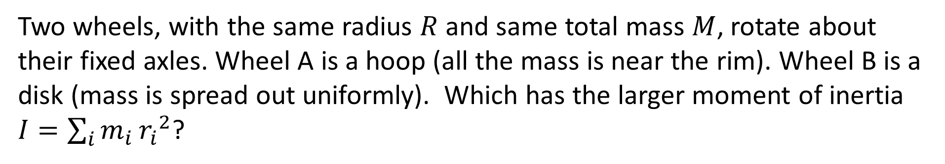
Two wheels, with the same radius $R$and same total mass $M$, rotate about their fixed axles. Wheel A is a hoop (all the mass is near the rim). Wheel B is a disk (mass is spread out uniformly). Which has the larger moment of inertia $I=\sum_{i}{m_{i}}{r_{i}}^{2}$?
The hoop
The disk
They are tied

Slide 27
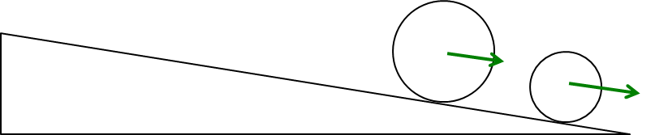
A disk and a hoop both start from rest at the top and roll down an incline. (I am not specifying whether $M$ or $R$ are the same). Which one wins the race?
Disk
Hoop
Tie
Depends on the M’s and R’s!

Slide 28
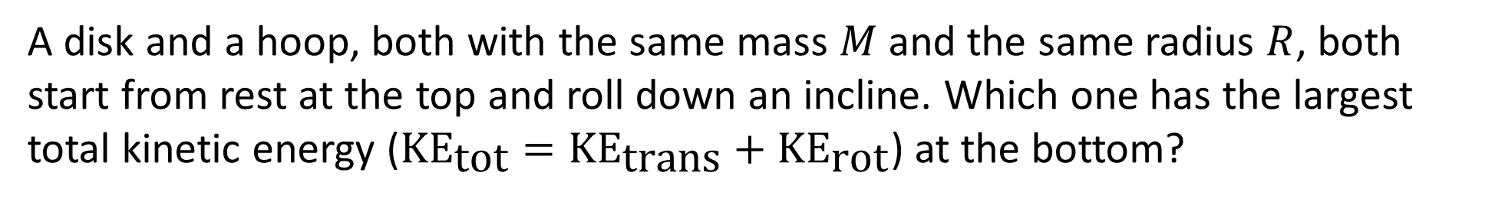
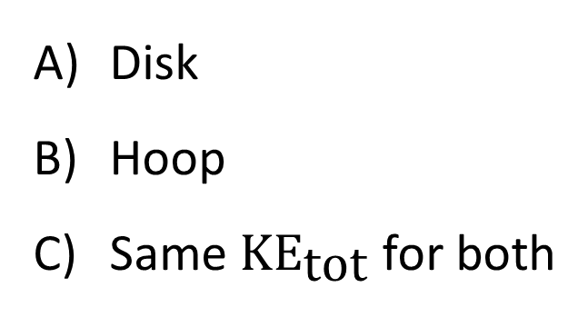
A disk and a hoop, both with the same mass $M$and the same radius $R$, both start from rest at the top and roll down an incline. Which one has the largest total kinetic energy (${\text{KE}}_{\text{tot}}={\text{KE}}_{\text{trans}}+{\text{KE}}_{\text{r}\text{ot}}$) at the bottom?
Disk
Hoop
Same ${\text{KE}}_{\text{t}\text{ot}}$ for both

Slide 29
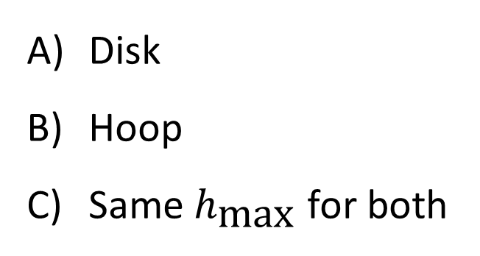
A hoop and a disk, both with the same mass M and the same radius R, both roll without slipping with the same speed v, and are rolling toward an inclined plane, as shown. Which object will roll up to the greatest height on the incline?
Disk
Hoop
Same $h_{\text{max}}$ for both

Slide 30
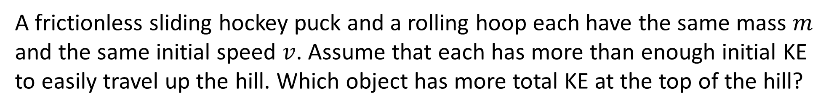
A frictionless sliding hockey puck and a rolling hoop each have the same mass $m$
and the same initial speed $v$. Assume that each has more than enough initial KE to easily travel up the hill. Which object has more total KE at the top of the hill?
Hoop
Puck
Same KE at top

Slide 31
A disk is spinning as shown with angular velocity $ω$. It begins to slow down. While it is slowing, what is the direction of its vector angular acceleration, $α$?
↑
↓
←
→
None of these

