Slide 1
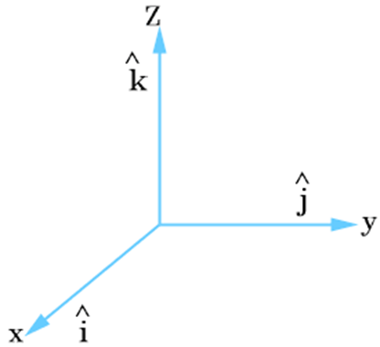
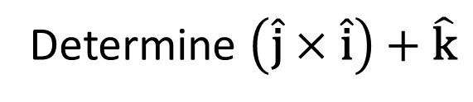
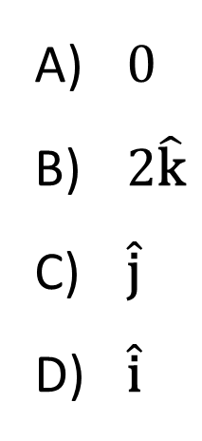
Determine $\left(\hat{\text{j}}×\hat{\text{i}}\right)+\hat{\text{k}}$
$0$
$2\hat{\text{k}}$
$\hat{\text{j}}$
$\hat{\text{i}}$

Slide 2
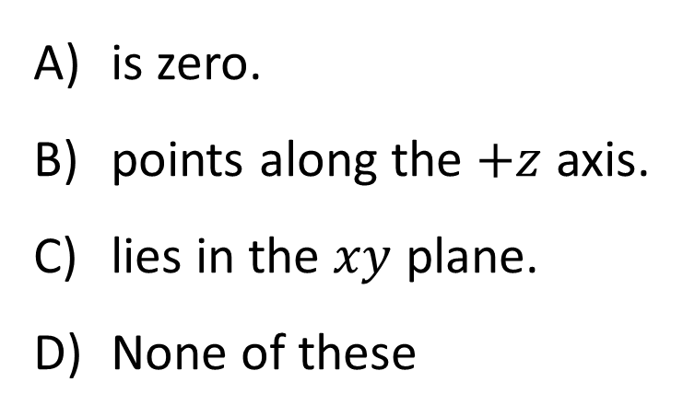
A planet in circular orbit about the Sun is in the position shown. When the origin is located at the Sun, the vector torque on the planet…
planet
S
is zero.
points along the $+z$ axis.
lies in the $xy$ plane.
None of these

Slide 3
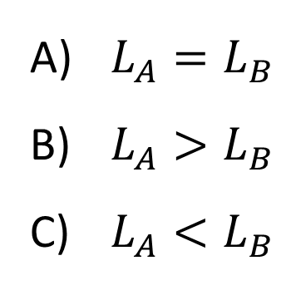
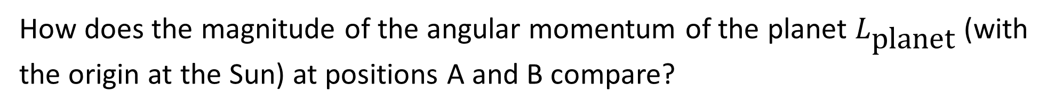
How does the magnitude of the angular momentum of the planet $L_{\text{planet}}$ (with the origin at the Sun) at positions A and B compare?
B
S
A
$L_{A}=L_{B}$
$L_{A}>L_{B}$
$L_{A}<L_{B}$

Slide 4
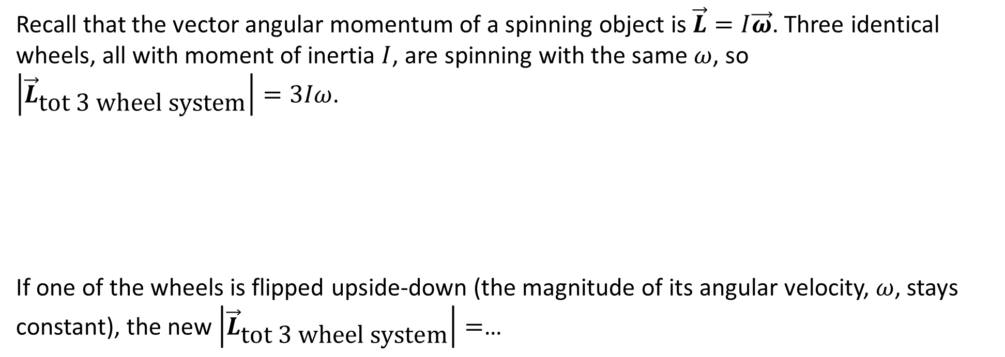
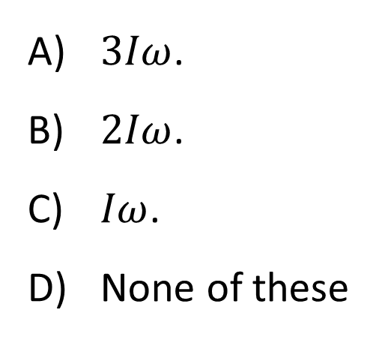
Recall that the vector angular momentum of a spinning object is $\vec{L}=I\vec{ω}$. Three identical wheels, all with moment of inertia $I$, are spinning with the same $ω$, so $\left|{\vec{L}}_{\text{tot}\text{ 3 }\text{wheel} \text{system}}\right|=3Iω$.
If one of the wheels is flipped upside-down (the magnitude of its angular velocity, $ω$, stays constant), the new $\left|{\vec{L}}_{\text{tot}\text{ 3 }\text{wheel} \text{system}}\right|=$…
$3Iω$.
$2Iω$.
$Iω$.
None of these

Slide 5
Two different spinning disks have the same angular momentum, but disk 1 has more kinetic energy than disk 2. Which one has the bigger moment of inertia?
L
L
Disk 1
(more KE)
Disk 2
(less KE)
Disk 1
Disk 2
Not enough info

Slide 6
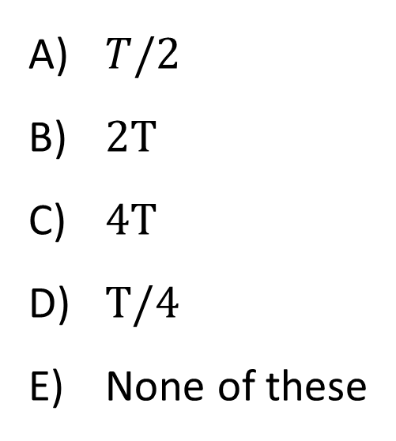
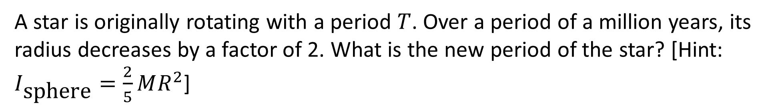
A star is originally rotating with a period $T$. Over a period of a million years, its radius decreases by a factor of 2. What is the new period of the star? [Hint: $I_{\text{sphere}}=\frac{2}{5}MR^{2}$]
$T/2$
$2T$
$4T$
$T/4$
None of these

Slide 7
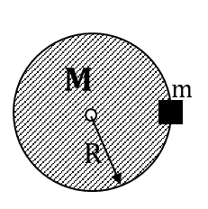
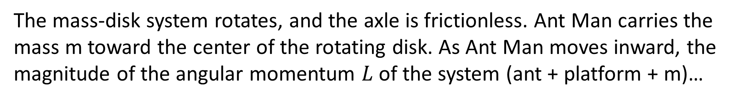
The mass-disk system rotates, and the axle is frictionless. Ant Man carries the mass m toward the center of the rotating disk. As Ant Man moves inward, the magnitude of the angular momentum $L$ of the system (ant + platform + m)…
increases.
decreases.
remains constant.

Slide 8
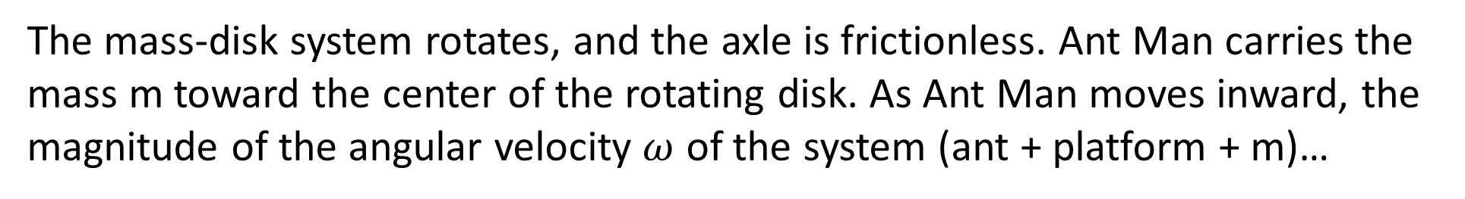
The mass-disk system rotates, and the axle is frictionless. Ant Man carries the mass m toward the center of the rotating disk. As Ant Man moves inward, the magnitude of the angular velocity $ω$ of the system (ant + platform + m)…
increases.
decreases.
remains constant.

Slide 9
The mass-disk system rotates, and the axle is frictionless. Ant Man carries the mass m toward the center of the rotating disk. As Ant Man moves inward, the kinetic energy of the system (ant + platform + m)…
increases.
decreases.
remains constant.

Slide 10
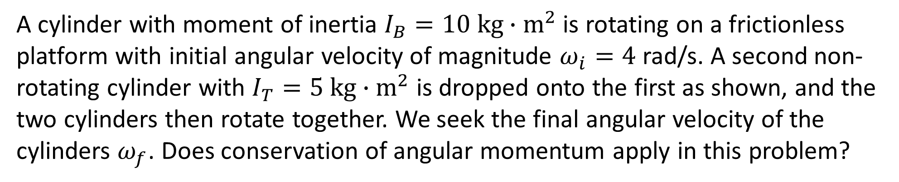
A cylinder with moment of inertia $I_{B}=10 \text{kg}∙{\text{m}}^{2}$ is rotating on a frictionless platform with initial angular velocity of magnitude $ω_{i}=4$ rad/s. A second non-rotating cylinder with $I_{T}=5 \text{kg}∙{\text{m}}^{2}$ is dropped onto the first as shown, and the two cylinders then rotate together. We seek the final angular velocity of the cylinders $ω_{f}$. Does conservation of angular momentum apply in this problem?
Yes
No
Depends on how much friction there is between the cylinders

Slide 11
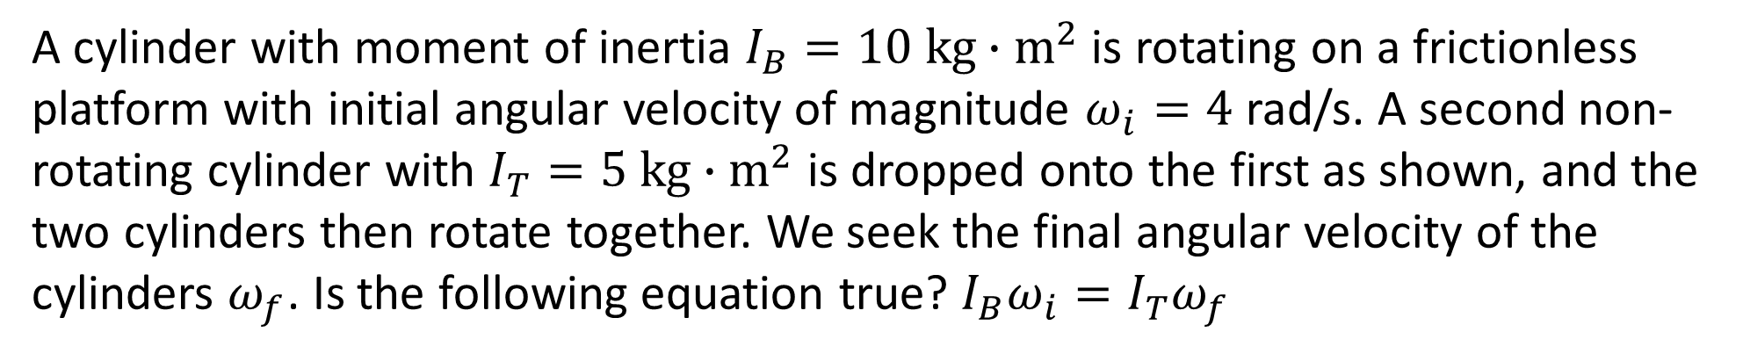
A cylinder with moment of inertia $I_{B}=10 \text{kg}∙{\text{m}}^{2}$ is rotating on a frictionless platform with initial angular velocity of magnitude $ω_{i}=4$ rad/s. A second non-rotating cylinder with $I_{T}=5 \text{kg}∙{\text{m}}^{2}$ is dropped onto the first as shown, and the two cylinders then rotate together. We seek the final angular velocity of the cylinders $ω_{f}$. Is the following equation true? $I_{B}ω_{i}=I_{T}ω_{f}$
Yes
No

Slide 12
A student is sitting at rest on a rotation stool with her feet off the ground. The student is handed a wheel that is not rotating. Now, the student spins the wheel. Which way will the student begin to rotate?
In the same direction as the wheel
In the opposite direction
The student will remain at rest

Slide 13
A student is sitting at rest on a rotation stool with her feet off the ground. The student is handed a wheel that is already rotating. Which way will the student begin to rotate? Hint: the wheel’s axle is frictionless, and it doesn’t speed up or slow down during the handoff.
In the same direction as the wheel was rotating
In the opposite direction
The student will remain at rest

Slide 14
A student is sitting at rest on a rotation stool with her feet off the ground. The student is handed a wheel that is already rotating. Now, the student stops the wheel with her arm. Which way will the student begin to rotate?
In the same direction as the wheel was rotating
In the opposite direction
The student will remain at rest

Slide 15
A student is rotating on a rotation stool hold masses at arm’s length. Now, the student drops the masses. How will the student’s motion change?
She will speed up
She will slow down
Her motion will be unchanged

Slide 16
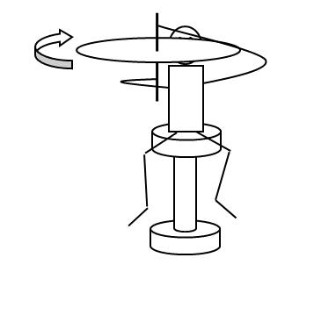
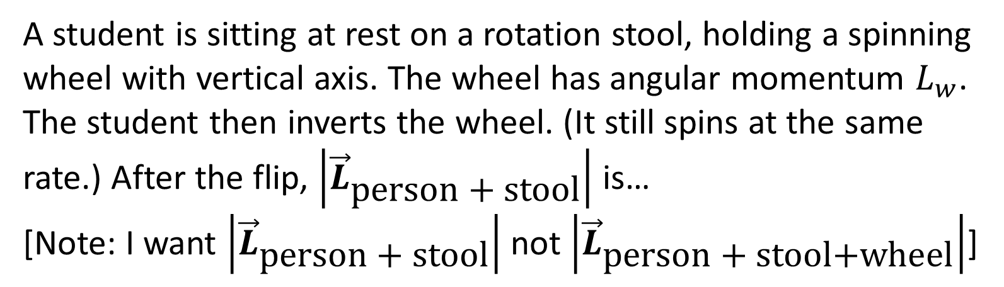
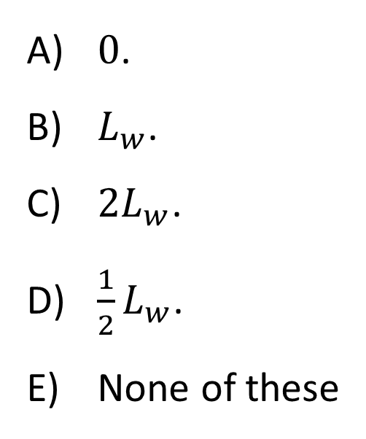
A student is sitting at rest on a rotation stool, holding a spinning wheel with vertical axis. The wheel has angular momentum $L_{w}$. The student then inverts the wheel. (It still spins at the same rate.) After the flip, $\left|{\vec{L}}_{\text{person}\text{ + }\text{stool}}\right|$ is…
[Note: I want $\left|{\vec{L}}_{\text{person}\text{ + }\text{stool}}\right|$ not $\left|{\vec{L}}_{\text{person}\text{ + }\text{stool}\text{+}\text{wheel}}\right|$]
$0$.
$L_{w}$.
$2L_{w}$.
$\frac{1}{2}L_{w}$.
None of these

Slide 17
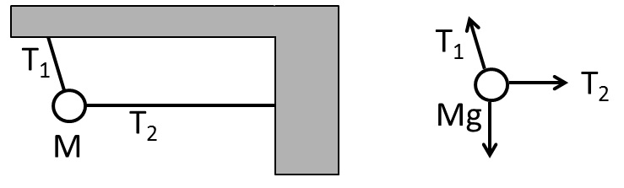
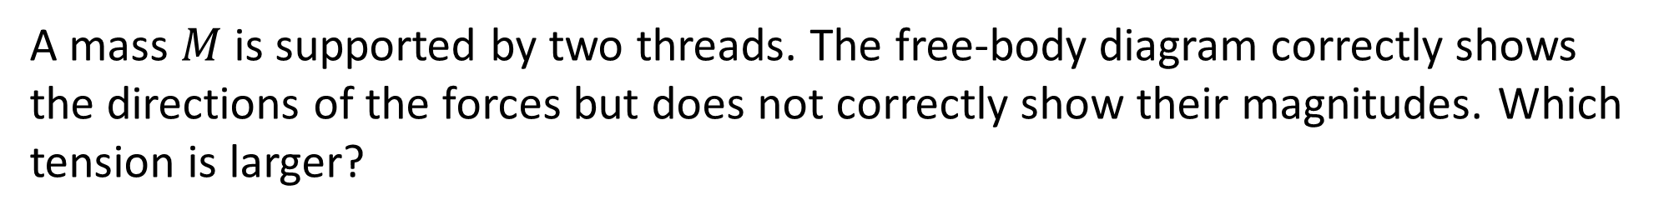
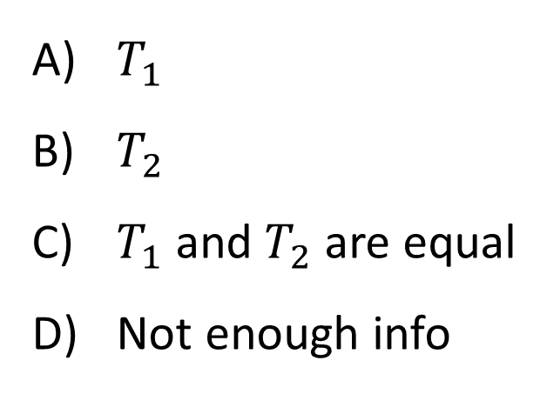
A mass $M$is supported by two threads. The free-body diagram correctly shows the directions of the forces but does not correctly show their magnitudes. Which tension is larger?
$T_{1}$
$T_{2}$
$T_{1}$ and $T_{2}$ are equal
Not enough info

Slide 18
A door is pushed by two forces, a smaller force at the door knob AND a larger force nearer the hinge as shown. The door does not move. The component of the force on the door by the hinge in the xy-plane…
is zero.
points ↑ (along +y)
points ↓ (along –y)
points ↘ (between +x and –y)
points ↗ (between +x and +y)

Slide 19
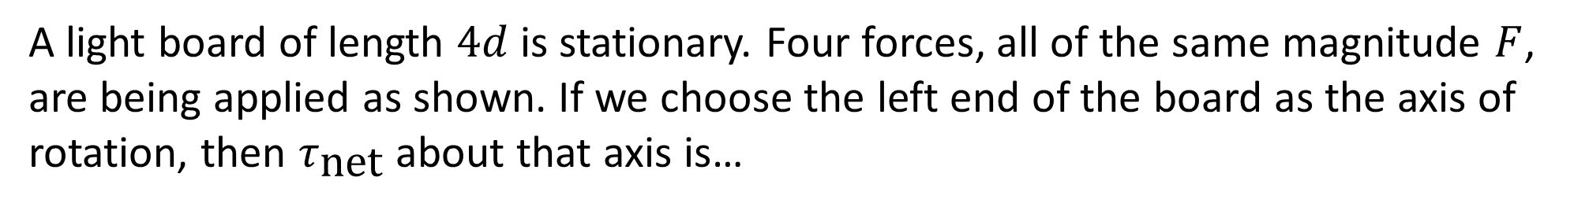
A light board of length $4d$ is stationary. Four forces, all of the same magnitude $F$, are being applied as shown. If we choose the left end of the board as the axis of rotation, then $τ_{\text{net}}$ about that axis is…
axis
zero.
positive (+).
negative (-).

Slide 20
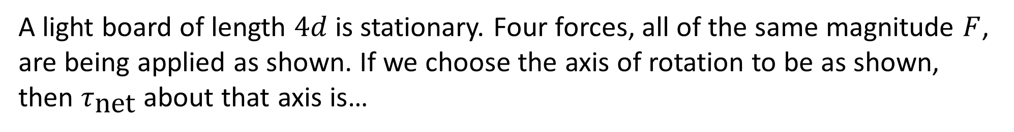
A light board of length $4d$ is stationary. Four forces, all of the same magnitude $F$, are being applied as shown. If we choose the axis of rotation to be as shown, then $τ_{\text{net}}$ about that axis is…
axis
zero.
positive (+).
negative (-).

Slide 21
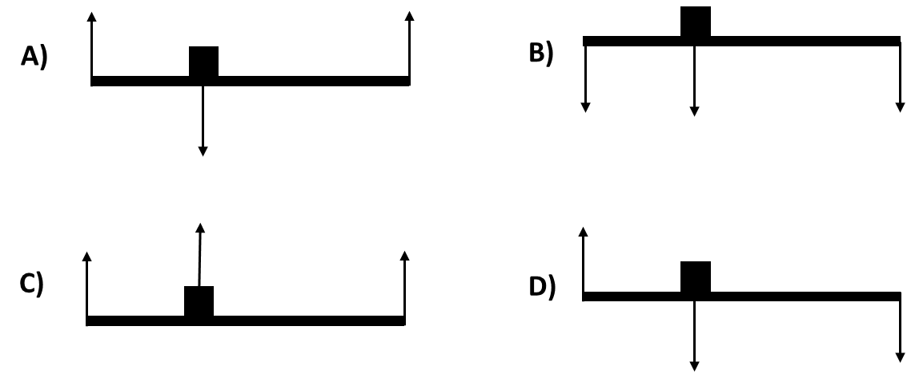
A bridge is supported on both ends. A 20 N car is one third of the way across the bridge. The extended free body diagram looks like… (ignore the weight of the bridge).

Slide 22
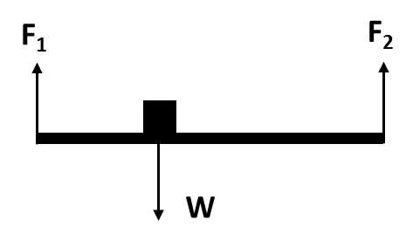
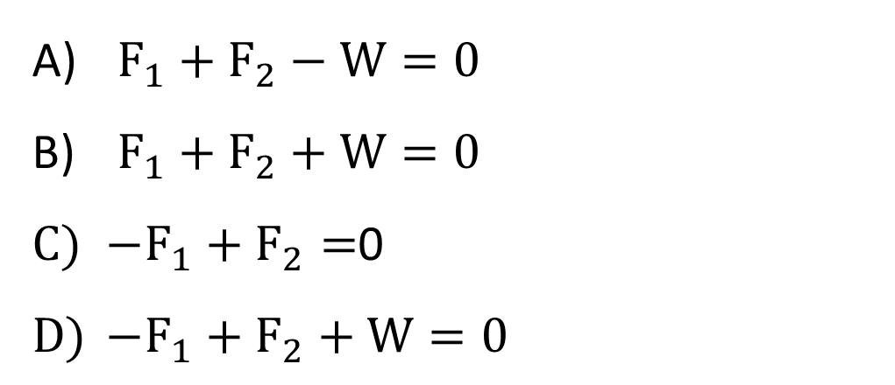
A bridge is supported on both ends. A 20 N car is one third of the way across the bridge. Which is the correct equation for the sum of forces?
$F_{1}+F_{2}−W=0$
$F_{1}+F_{2}+W=0$
$−F_{1}+F_{2}=$0
$−F_{1}+F_{2}+W=0$

Slide 23
A bridge is supported on both ends. A 20 N car is one third of the way across the bridge. To find $F_{1}$ in the quickest way possible, we should choose the axis to be…
the left end.
the right end.
the center.
the car location.

Slide 24

A bridge is supported on both ends. A 20 N car is one third of the way across the bridge. Choosing the right end as the axis, the torque is…
$−L∙F_{1}+\frac{2L}{3}W=0$
$−L∙F_{1}−\frac{2L}{3}W=0$
$−\frac{L}{3}F_{1}+\frac{2L}{3}F_{2}=$0
$\frac{L}{3}F_{1}+\frac{2L}{3}F_{2}=0$

Slide 25

A bridge is supported on both ends. A 20 N car is one third of the way across the bridge. Calculate $F_{1}$.
$20$ N
$\frac{2}{3}∙20 \text{N}=13.3 \text{N}$
$\frac{1}{3}∙20 \text{N}=6.7 \text{N}$

Slide 26
A bridge is supported on both ends. A 20 N car is one third of the way across the bridge. Given that $F_{1}=13.3$ N, calculate $F_{2}$.
33.3 N
20 N
13.3 N
6.6 N

Slide 27
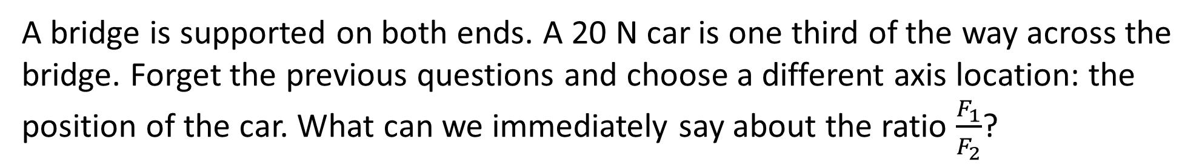
A bridge is supported on both ends. A 20 N car is one third of the way across the bridge. Forget the previous questions and choose a different axis location: the position of the car. What can we immediately say about the ratio $\frac{F_{1}}{F_{2}}$?
2/3
1/3
1/2
2

Slide 28
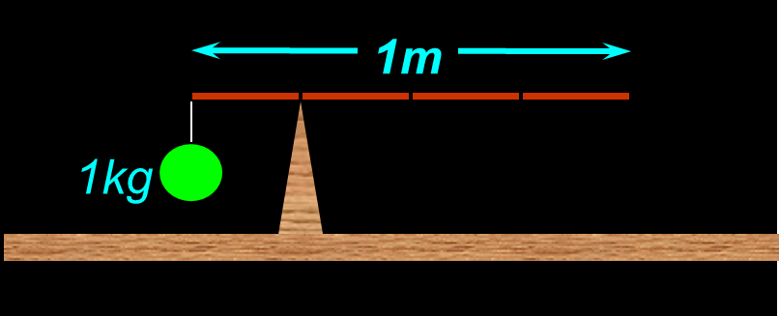
A 1 kg ball is hung at the end of a rod 1 m long. If the system balances at a point on the rod 0.25 m from the end holding the mass, what is the mass of the rod?
¼ kg
½ kg
1 kg
2 kg
4 kg

Slide 29
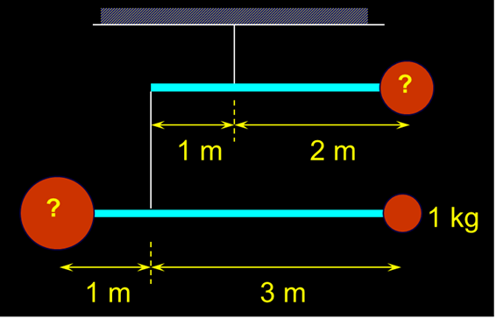
A (static) mobile hangs as shown below. The rods are massless and have lengths as indicated. The mass of the ball at the bottom right is 1 kg. What is the total mass of the mobile?
5 kg
6 kg
7 kg
8 kg
9 kg

Slide 30
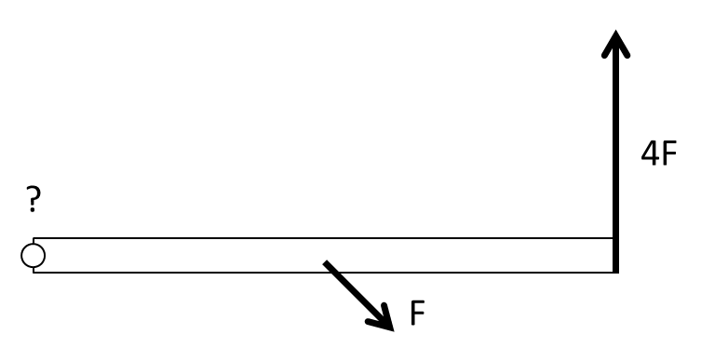
Two forces are applied to a (very thin) bar as shown in the diagram. Force $F$is applied at a $45°$ angle at the center of the bar; force $4F$ is applied at a $90°$ angle at the right end of the bar. Is it possible to maintain the bar in static equilibrium by applying an appropriate third force at the left end of the bar?
Yes, sure
No way

Slide 31
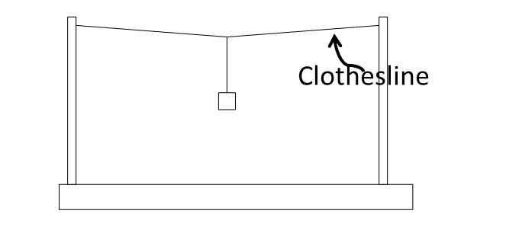
A mass $m$is hung from a clothesline stretched between two poles as shown. As a result, the clothesline sags very slightly as shown. $\left|{\vec{T}}_{\text{clothesline}}\right|=$…
$mg$
$mg/2$
slightly greater than $mg/2$
considerably greater than $mg/2$
considerably less than $mg/2$

Slide 32
You make a desk by attaching a wide shelf (assumed to be massless!) to the top of two legs. When you put a heavy book down on the end of the shelf, the force exerted ON the shelf at the attachment point A is…
↑
↓
→
←
Zero

Slide 33
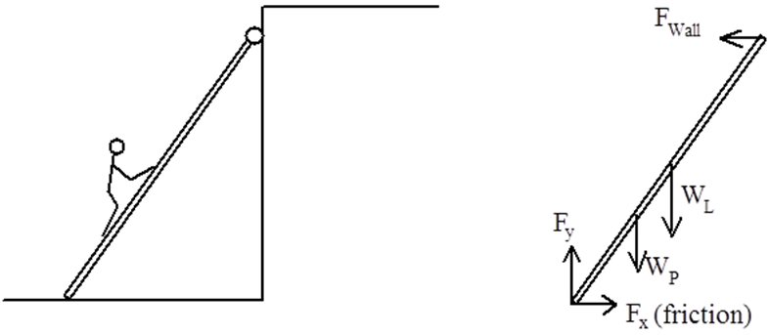
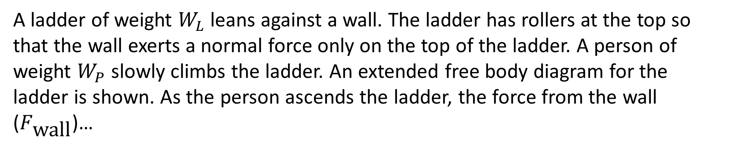
A ladder of weight $W_{L}$ leans against a wall. The ladder has rollers at the top so that the wall exerts a normal force only on the top of the ladder. A person of weight $W_{P}$ slowly climbs the ladder. An extended free body diagram for the ladder is shown. As the person ascends the ladder, the force from the wall ($F_{\text{wall}}$)…
increases.
decreases.
remains the same.

Slide 34
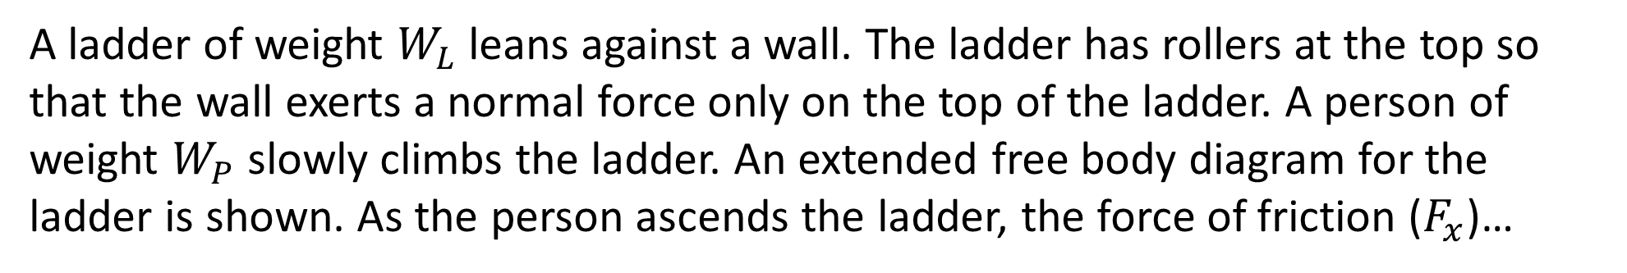
A ladder of weight $W_{L}$ leans against a wall. The ladder has rollers at the top so that the wall exerts a normal force only on the top of the ladder. A person of weight $W_{P}$ slowly climbs the ladder. An extended free body diagram for the ladder is shown. As the person ascends the ladder, the force of friction ($F_{x}$)…
increases.
decreases.
remains the same.

Slide 35
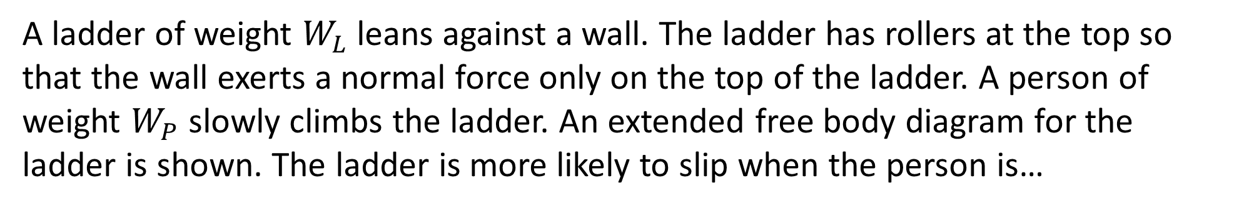
A ladder of weight $W_{L}$ leans against a wall. The ladder has rollers at the top so that the wall exerts a normal force only on the top of the ladder. A person of weight $W_{P}$ slowly climbs the ladder. An extended free body diagram for the ladder is shown. The ladder is more likely to slip when the person is…
lower.
higher.
Doesn’t matter

